Slide 1
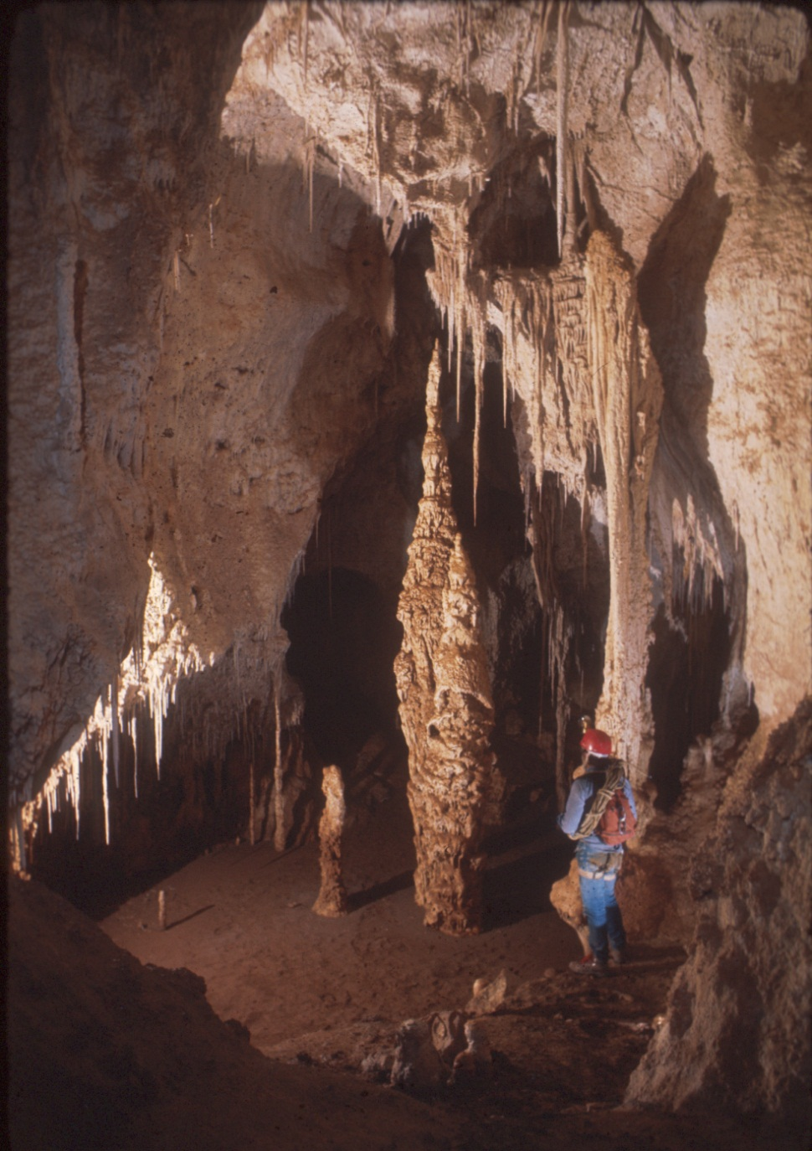
Cave Management Regulations
43 CFR Part 37
and
36 CFR Part 290
James R. Goodbar
Senior Cave/Karst Specialist
Bureau of Land Management
620 E. Green Street, New Mexico 88220
JGoodbar@blm.gov
May 12-16, 2014 Cody, Wyoming

Slide 2
Subpart A: Management
1. Purpose: To provide the basis for identifying and managing Significant caves
2. Policy: Protect and Maintain Significant Caves and Cave Resources (USFS 35 CFR part 290.3/ 290.4)
3. Authority: FCRPA
4. Definitions
5. Collection of Information
Notes:
paoiuegbnpiguABFwpiubwIU OIW0 98ub8b

Slide 3
Definitions
(a) Authorized Officers ;
BLM – local Field Office manager,
FWS – Field Supervisor
NPS – Park Superintendent
USFS – Forest Supervisor
(b) Cave - Any naturally occurring void, cavity, recess, or system of interconnected passages beneath the surface of the earth, including any cave resource therein, large enough to permit a person to enter, entrance may be excavated or naturally formed. Includes natural pits, sinkhole, or other feature that is an extension of a cave entrance or is an integral part of the cave.

Slide 4
Definitions
(a) Cave Resources - Any materials or substances occurring in caves on Federal lands, including, but not limited to, biotic, cultural, mineralogic, paleontologic, geologic, and hydrologic resources
(d) Federal lands – U.S. owned, Administered by Secretary of Agriculture or Interior
(e) Secretary - Secretary of Interior or Agriculture
(f) Significant cave - A cave located on Federal lands that has been determined to meet the Criteria in sec 37.11(c)

Slide 5
Subpart B / 36 CFR 290.3: Nomination, Evaluation, & Designation
Nominations: For subsequent listings will be accepted from governmental agencies and the public.
Evaluations: Carried out in consultation with individuals and organizations interested in cave resources management, within the confidentiality provisions.
Criteria:

Slide 6
Significant Cave Criteria
Biota,
Cultural,
Geologic/Mineralogic/Paleontologic,
Hydrologic,
Recreational,
Educational or Scientific.

Slide 7
Designation
All caves on National Park Service-administered lands are deemed
to fall within the definition of
“significant cave”.
In special management areas
that are designated wholly
or in part due to cave
resources, all caves within
shall be designated as significant.

Slide 8
Confidentiality
No Federal employee shall disclose information that could be used to determine the location of any significant cave or cave resources, unless determined that it will further the purposes of the Act and will not risk cave resources.

Slide 9
Requesting Confidential Information
Name, address, and telephone
A legal description of the area
A statement of the purpose
Written assurances of information confidentiality and protection of the cave and its resources.

Slide 10
Questions

