Slide 1
OTHER APPLICABLE LAWS
AND REGULATIONS
How (does) it all come(s) together.(?)
Aaron Stockton 2011

Slide 2
Context of Law
Process laws: FLPMA, NEPA, ESA, APA
Process Regulations: CEQ regs, 1601 regs, Protests and Appeals
Duty with discretion: Wild and Scenic Rivers, Wilderness Act, National Historic and Scenic Trails, Antiquities Act.
Prescriptive: Don’t do that, or this.
Conditional: Evaluate and come to a conclusion within discretion.

Slide 3
State - Cave Related Laws
Alabama Arkansas Arizona
California Colorado Florida
Georgia Hawaii Idaho
Illinois Indiana Kentucky
Maine Maryland Missouri
Montana Nevada New Mexico
N. Carolina Ohio Oklahoma
Pennsylvania Tennessee Texas
Vermont Virginia W. Virginia
Wisconsin
The definition of cave varies greatly and ranges from
“historic” sites to caverns. (No laws for UT, SD, OR)

Slide 4
FEDERAL LAWS
Federal Land Policy and Management Act 1976 (43 USC 1701)
National Forest Management Act of 1976 (16 USC 1600)
Forest Service Organic Administration Act of 1897
National Park Service Organic Act 1916 (16 USC 1-4, 22, 43)
Federal Land Policy and Management Act 1976 (43 USC 1701)
Freedom of Information Act 1974 (5 USC 552)
National Environmental Policy Act 1969 (42 USC 4371)
Wilderness Act 1964 (16 USC 1131-1136)
Land and Water Conservation Fund 1964 (16 USC 460L-L11)
Toxic Substances Control Act
National Cave and Karst Research Institute Act of 1998
Clean Water Act
Wilderness Act 1964
Administrative Procedures Act as amended (APA)
Annual Appropriations Act (Authority to take action and spend $$)

Slide 5
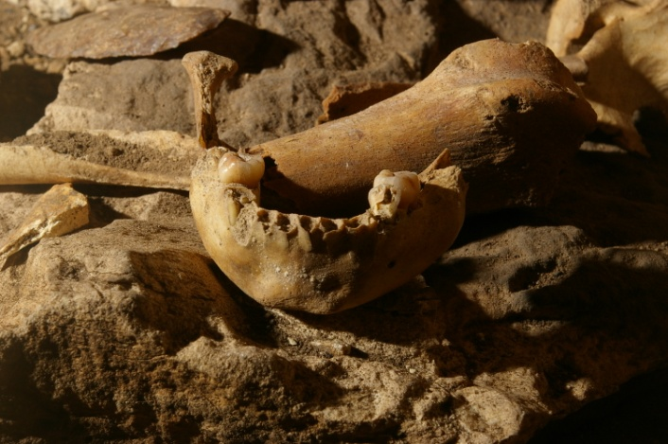
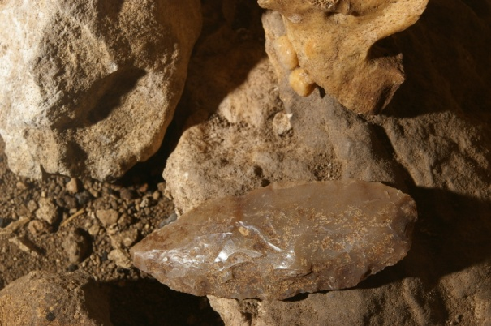
CULTURAL LAWS AND REGULATIONS
Executive Order 11593 1971 Protection of cultural resources.. naming cultural resources as one of BLM’s multiple use responsibilities.
Archaeological Resources Protection Act 1979 (16 USC 1531) boosting the Antiquities Act’s misdemeanor offenses to felonies.
National Historic Preservation Act 1966 (16 USC 470 & 16 USC 469) (Regs. 36 CFR Part 800 "Protection of Historic Properties)
National Native American Grave Protection and Repatriation Act 1990 (25 USC 3001)
Antiquities Act 1906 (16 USC 431) protects cultural resources.
Numerous State Laws relating to cultural and historic resources

Slide 6
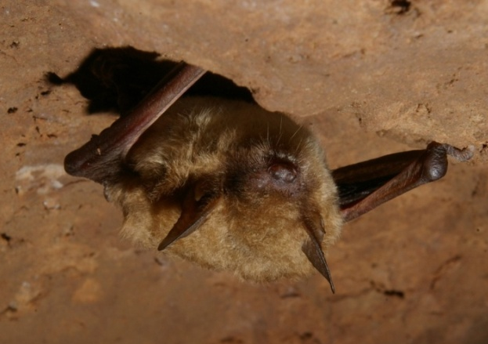
Wildlife Related Laws & Caves
Endangered Species Act 1973
Freedom of Information Act 1974 (5 USC 552)
Sites Act of 1974 promoted federal/state cooperation in managing wildlife habitat
Fish and Wildlife Conservation Act 16 U.S.C. §§ 2901-2911, \ 1980 (“Nongame Act”).
State T&E and Wildlife Protection Laws
State Game Laws.... protecting bats outside of caves

Slide 7
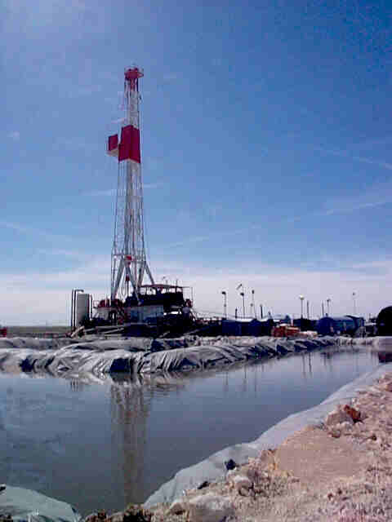
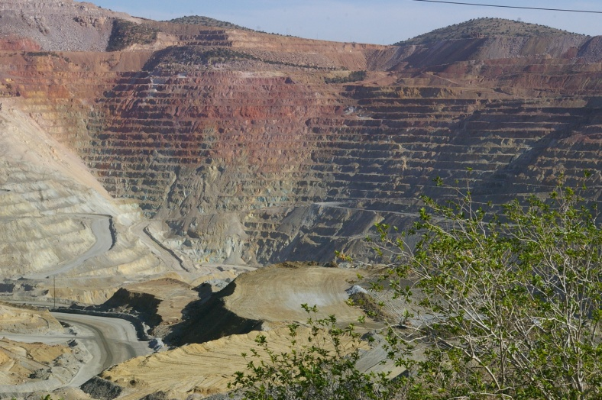
Miscellaneous Laws
Federal Magistrate Act 1979
General Mining Law 1872 (30 USC 22--47)
Mineral Leasing Act of 1920 (30 USC 181- -263)
Surface Mining and Reclamation Act 1977
Classification and Multiple Use Act 1960 (16 USC 528)
The Multiple Surface Use Act 1955 (30 USC 521-531, 541-541i)
Materials Act of 1947 (30 USC 601-604, 611-615)

Slide 8
What’s Important In Law?
Taking action, implementing plans.
Action Law: FLPMA: Manage the public lands and the resources.
More demands in law than time and money, therefore priorities are set through appropriations.
Budget: The ultimate policy maker.

Slide 9
Code of Federal Regulations Forest Service - 36 CFR Part 290
Code of Federal Regulations
43 CFR Part 3 Preservation of Antiquities
43 CFR Part 7 Protection of Archaeological Resources
43 CFR Part10 Native American Grave Protection
43 CFR Part 11 Natural Resource Damage Assessment
43 CFR Part 37 Cave Management
43 CFR Part 2300 Withdrawals
43 CFR Part 6200 Protection and Preservation of Natural Values
43 CFR Part 8200 Natural History Resource Management
43 CFR Park 8300 Recreation Management
43 CFR Part 8341. Conditions of Recreation Use
43 CFR Part 8344 Recreation Permits.
43 CFR Part 8351.2-1 Special Recreation Rules
43 CFR Part 8365. Rules of Conduct
43 CFR Part 8365.1-6 Supplemental Rules
43 CFR Part 8365.1-7 State and local laws shall apply and be enforced on federal lands.
43 CFR Part 8372.0-7. Enforcement, cave permit violations, penalties.
43 CFR Part 8372.1 to 5 Recreation Permits
43 CFR Part 9229 Trespass - Removal of cave minerals

Slide 10
Related Federal Laws - NPS
The Antiquities Act of 1906
The National Park Service Organic Act of 1916
The Wilderness Act of 1964
The National Environmental Policy Act of 1969
The Endangered Species Act of 1973
The Archeological Resources Protection Act of 1979
The National Parks Omnibus Management Act of 1988
The Federal Cave Resources Protection Act of 1988
The Redwood National Park Act of 1988
The Lechuguilla Cave Protection Act of 1993
Code of Federal Regulations - Parks, Forests, and Public Property (CFR 36)
Compendium of Regulations - Carlsbad Caverns National Park - 2004
The National Park Service Management Policies 2006
Paleontological Resources Preservation Act 2009
* The FCRPA is not the only law that exempts cave and karst related info from FOIA – A number of laws exempt locations and the nature of the resource from FOIA requests.

Slide 11
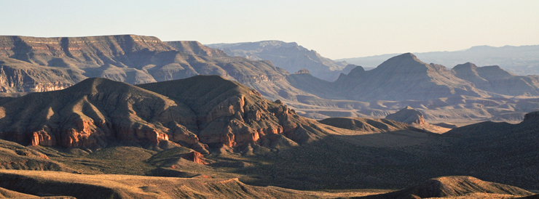
Code of Federal Regulations
National Park Service 36 CFR Parts 1 – 199
Code of Federal Regulations
1.1.5 Closures of Public Use Limits
2.1 Preservation of Natural, Cultural, and Archeological Resources
2.2 Wildlife Preservation
2.5 Research Specimens
2.31 Trespassing, Tampering, and Vandalism
7 Special Regulations, Areas of the National Park Service
80-199 Reserved for Use

