Slide 1
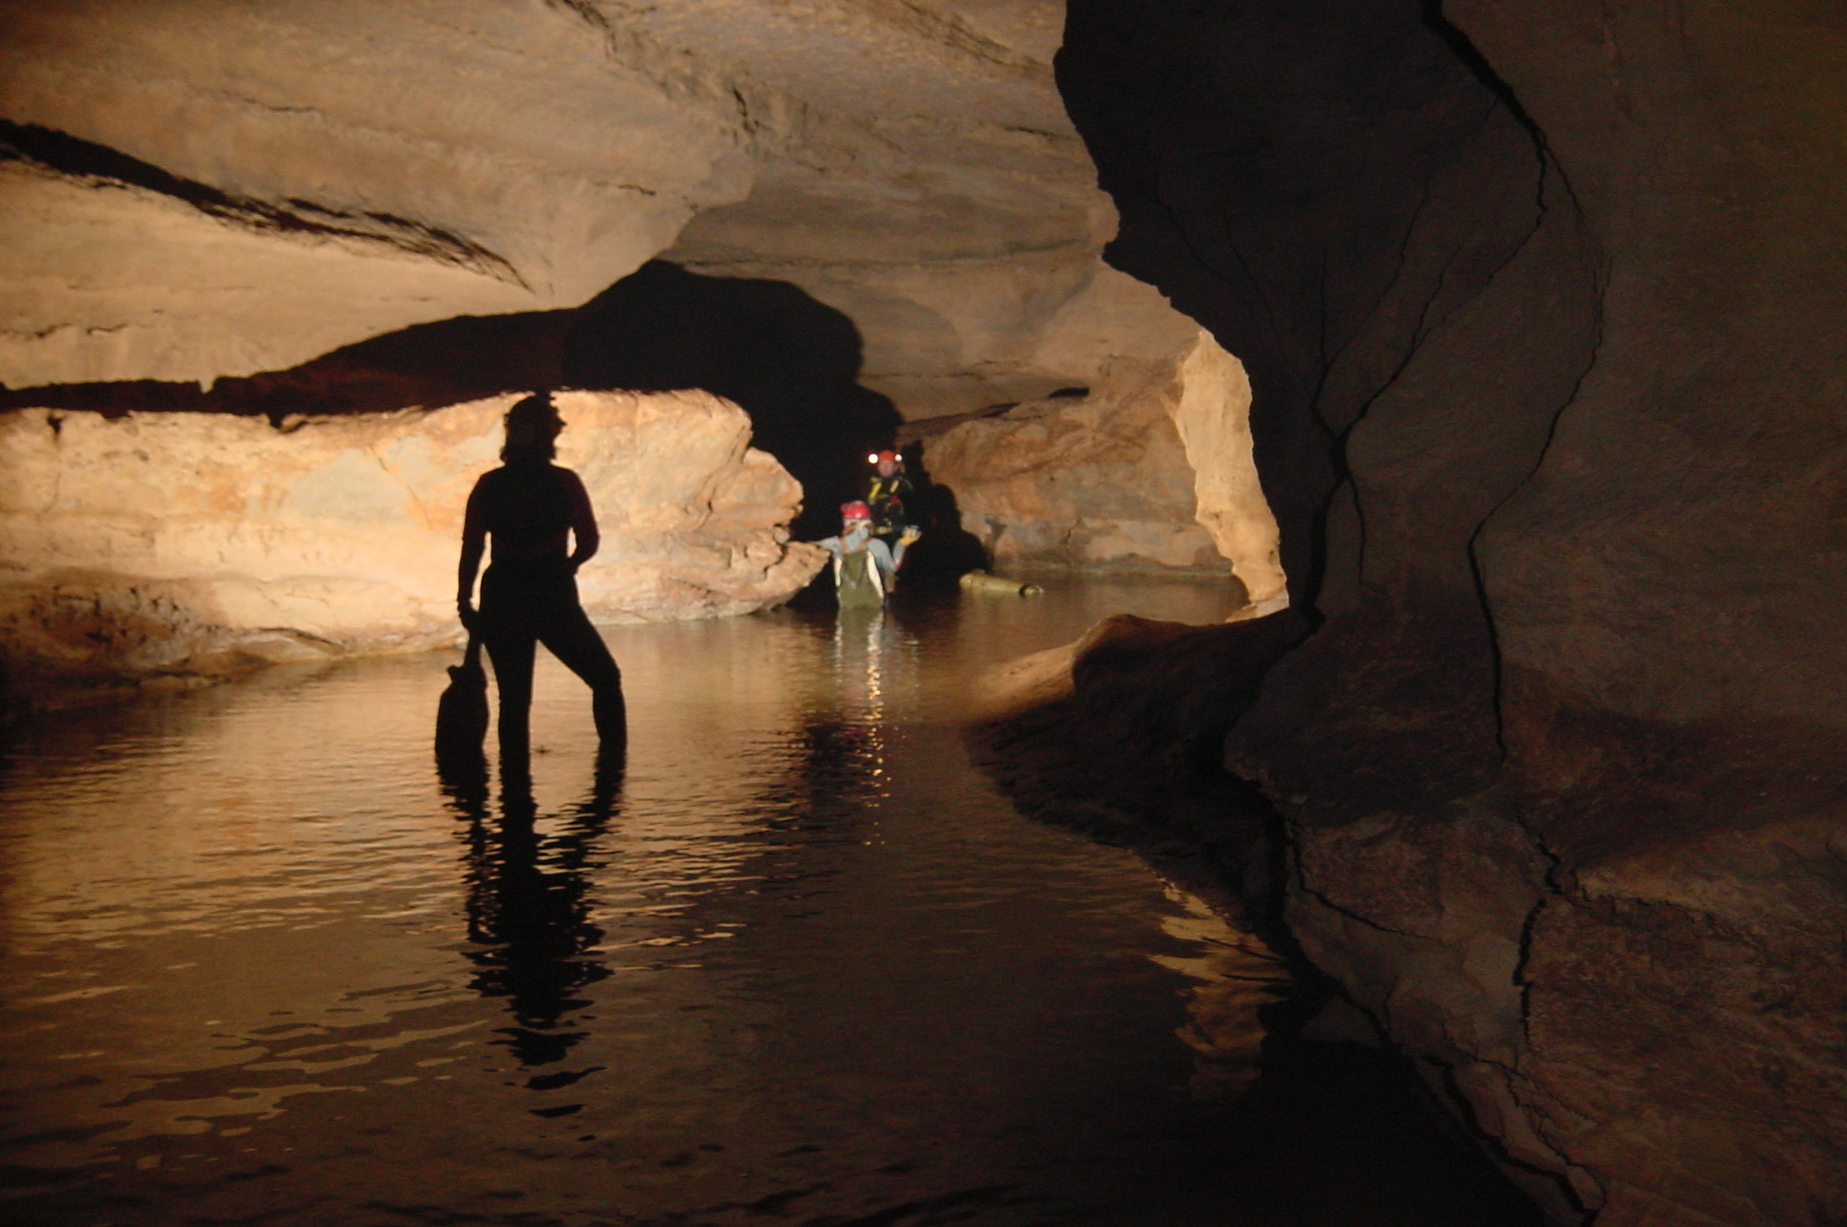
Significant Cave Identification
Cave Types
BLM CAVE & KARST MANAGEMENT TRAINING
Cody, Wyoming
May 12-16, 2014

Slide 2
Major Cave Types
Most often grouped by origin – dissolution, volcanic activity, etc.
Sometimes grouped by rock type – limestone, lava, etc.
Artificial tunnels and mines are not caves, though can contain natural deposits
Cave Systems – refers to a group of interconnected or related caves
Cave Geology by Art Palmer is an excellent learning and reference source

Slide 3
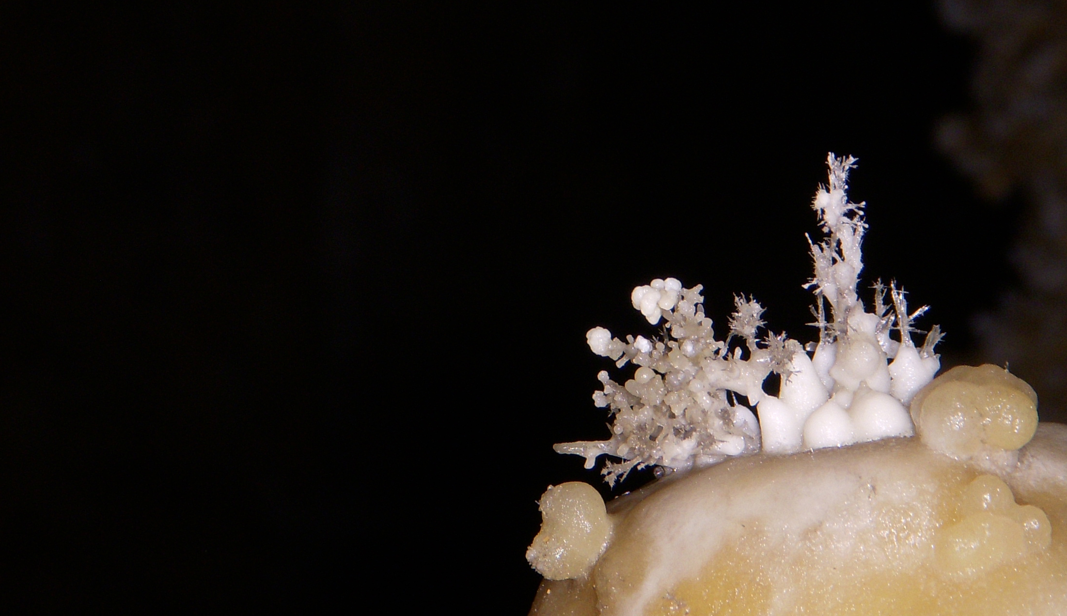
Types of Caves
There are 7 major cave types
Solution
Ice
Volcanic or Lava
Shelter or Sandstone
Sea or Littoral
Talus
Crevice or Fissure
Majority of caves form in soluble
rocks such as limestone, dolomite,
gypsum, and marble,
but caves can form in other
types of rock.
Photo by Dale Pate

Slide 4
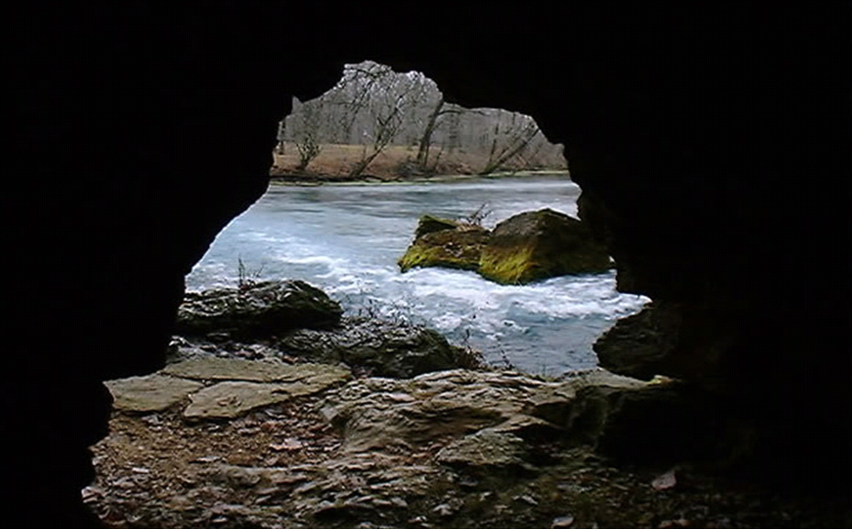
Solution Caves
The most common type of cave.
Formed by the dissolving of the rock along and adjacent to joints (fractures), faults, and layers in the rock.
The processes involved are both chemical (corrosion) and physical (erosion)
Photo by Ronal Kerbo

Slide 5
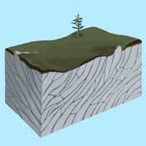
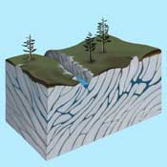
Solution Cave Development-1
Step 1--Rain falling on a limestone terrain reacts with carbon dioxide,
produced by the decay of plant
material in the soil, forming a weak acid.
Step 2--The acidic groundwater accumulates at the surface of the water table and begins to dissolve the limestone forming flooded passages into the limestone bedrock.
(“California Underground” website)

Slide 6
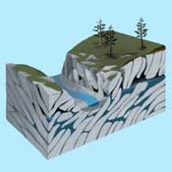
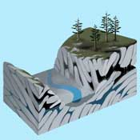
Solution Cave Development-2
Step 3--The deepening river valley
drains away ground water, lowering
the water table and draining the caves. The valley intersects the cave passage, revealing an entrance.
Step 4--Once the cave is opened to the atmosphere, carbon dioxide can escape from the cave. This allows the groundwater seeping into the cave to release carbon dioxide and redeposit the dissolved limestone it carries. This forms calcite stalactites and stalagmites.
(“California Underground” website)

Slide 7
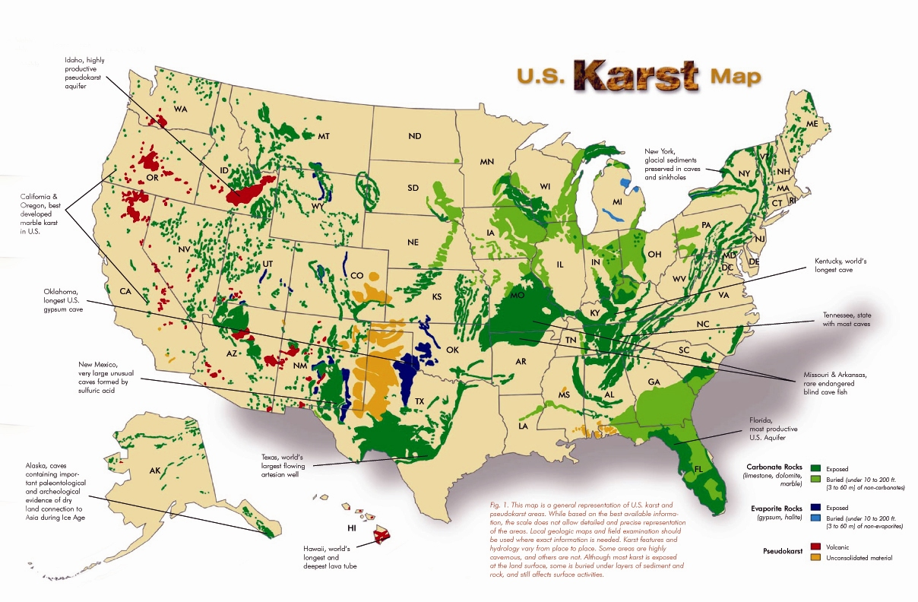
Karst in the United States
(Map from “Living With Karst”, drawn by Dr. George Veni)

Slide 8
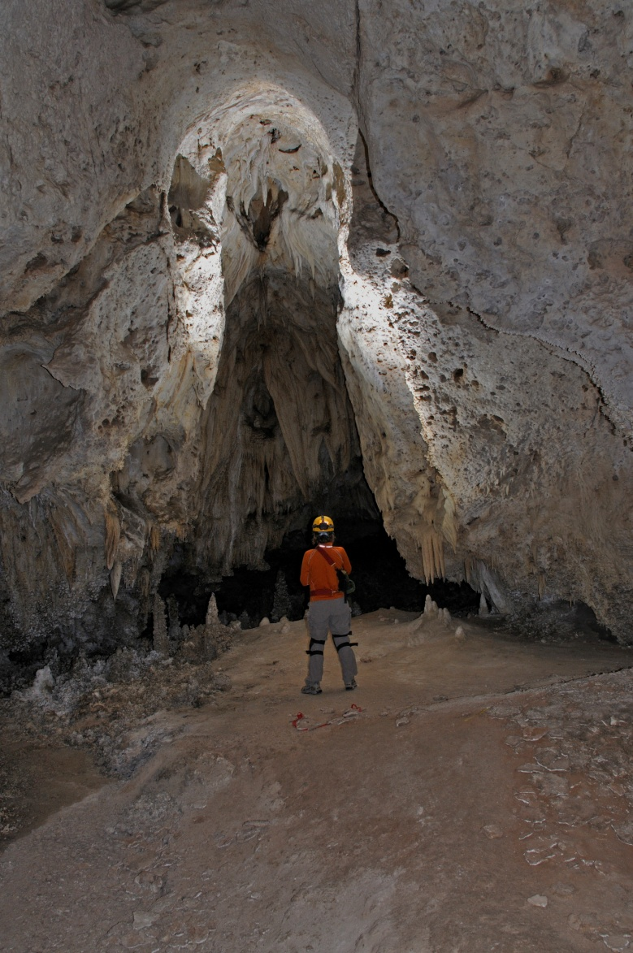
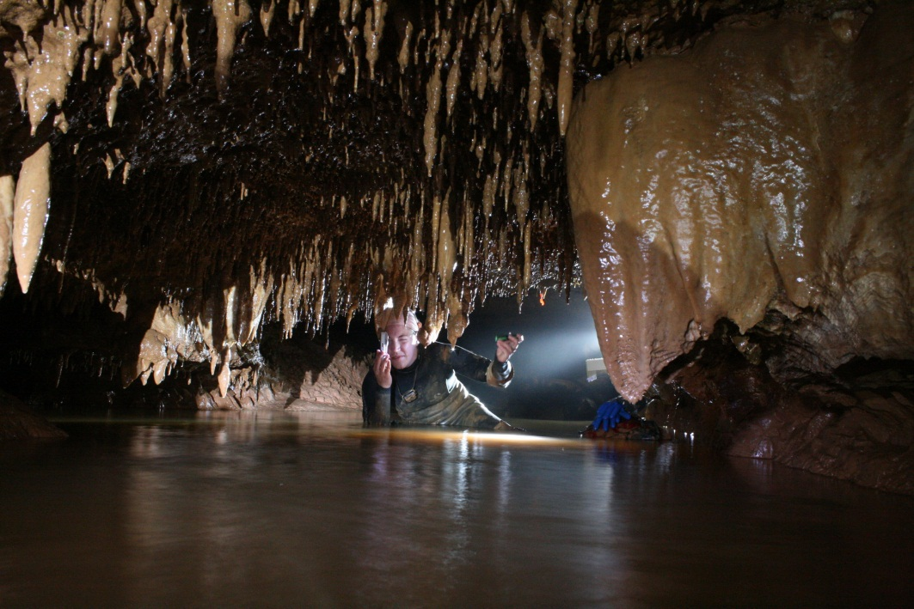
Carbonate Dissolution
There are two main types of carbonate dissolution.
Epigenic
Hypogenic
Epigenic
Photo by Scott House
Hypogenic
Photo by Dale Pate

Slide 9
Epigenic Caves
Epigenic caves form from the action of weak acids derived from the atmosphere, soil and oxidation of sulfides in the vadose zone.
CO₂
H₂O
c
O₂

Slide 10
Comprise ~5% - 10% of all caves. They are formed by acids generated within the earth.
Profile view of
Lechuguilla Cave,
115 mi of passage
Carbon
Dioxide
Methane
Hydrogen
sulfide
Organic acids

Slide 11
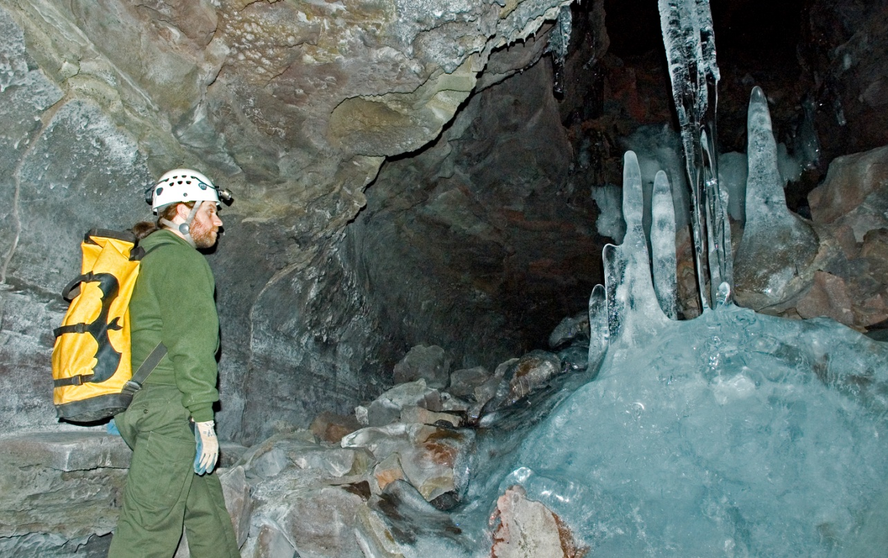
Ice Caves
The term “ice cave” applies to caves that form both in ice and in rock.
Ice caves that form in ice are also called glacier caves. Melt water moving through glaciers can form this type of ice cave.
Caves, formed in rock, that contain ice all year round are also referred to as ice caves. They are also called frozen caves.
These caves may contain very large crystals of ice that form on the floors, walls, and ceilings of the cave.
NPS Photo by Dale Pate

Slide 12
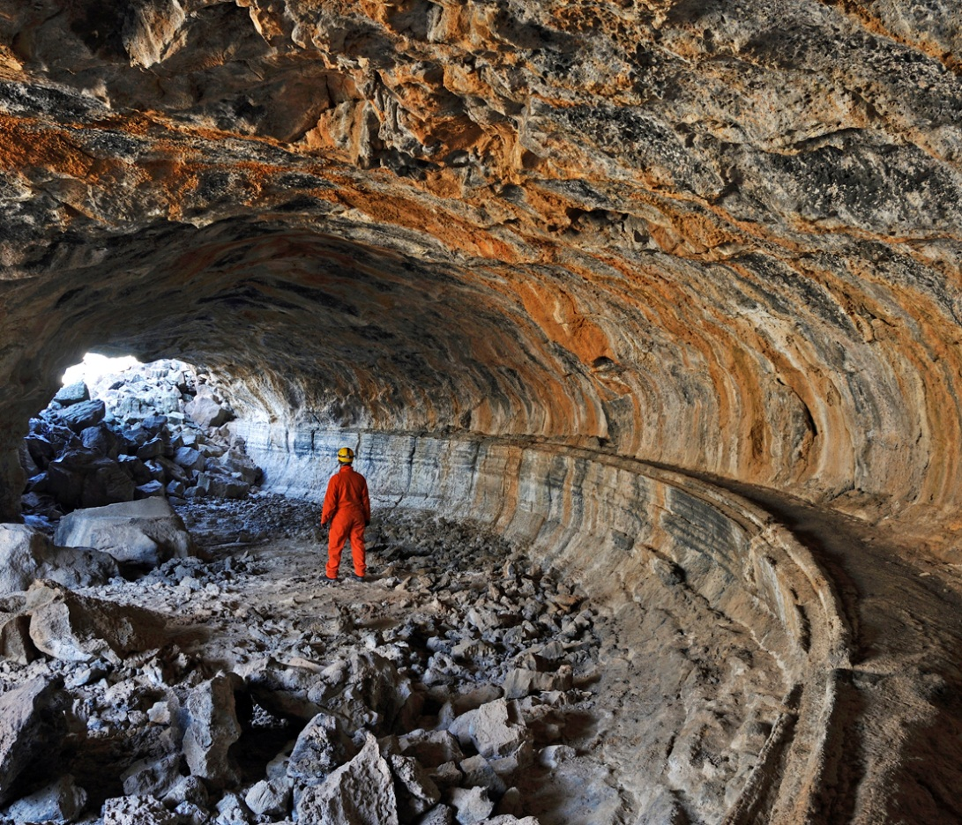
Volcanic or Lava Caves
There are numerous types of caves formed in lava. The most significant tends to be lava tube caves.
When fluid, molten lava flows out of the ground, it works its way downhill. Soon the surface of this lava stream cools and hardens into a crust. Although the outer crust is hard, the lava inside is still molten, and continues to flow downhill. Once the molten lava has passed through, a lava tube, or cave, is all that remains.
NPS Photo by Dale Pate

Slide 13
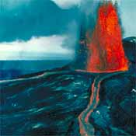
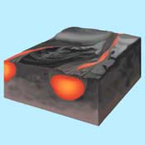
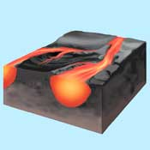
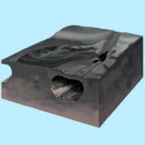
Lava Tube Development
Step 1--Lava erupting from volcanoes flows like a river down the flanks of the volcano.
Step 2--Lava spilling or splattering over the banks of the lava river forms natural levees, further channeling the flow.
Step 4--If the lava breaks through the downstream
blockage, the lava will flow again. When the eruption
slows, or if the flow is diverted elsewhere, the tube drains and a lava-tube cave is born.
Step 3--If the lava meets a downstream blockage, the lava slows, the surface cools and forms a solid crust.
(“California Underground” website)

Slide 14
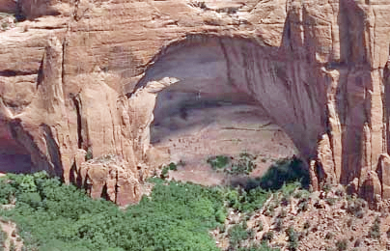
Shelter or Sandstone Caves
These types of caves are abundant in desert areas and were commonly used by native peoples
NPS Photo by Marc Steuben

Slide 15
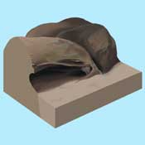
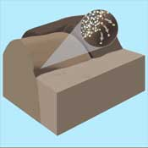
Shelter or Sandstone Caves
Step 1--Moisture persists on the shady side of a sandstone rock. Here it dissolves away the substances that glue together the rock's component sand grains.
Step 2-- Loosened sand grains have blown away, leaving a shallow cave.
(“California Underground” website)

Slide 16
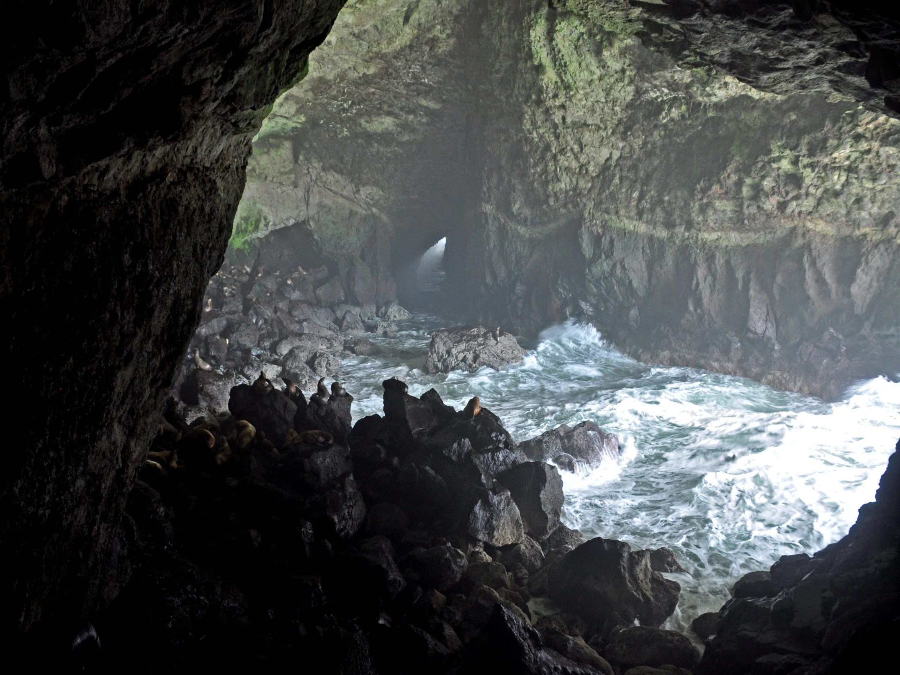
Sea or Littoral Caves
Sea caves are formed by the action of waves pounding against rocks that line the shores of oceans and larger lakes. Sea caves are evidence of the enormous power of waves. Sea caves may be further modified and enlarged by wave-carried sand and gravel.
Photo by Dale Pate

Slide 17
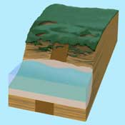
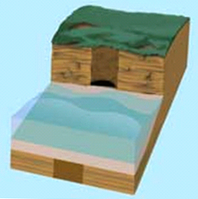
Sea Cave Development-1
Step 1--On rocky shorelines, the
relentless surf erodes weak points
in the cliffs forming sea caves. As
the glaciers melted at the end of
the ice age, the sea level rose.
The eroding surf cut coastal
bluffs as the ocean flooded inland.
Step 2-- Some parts of the
shoreline rock were softer
than surrounding rock. There erosion proceeded faster.
(“California Underground” website)

Slide 18
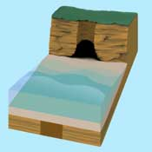
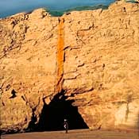
Sea Cave Development-2
Step 3-- A large cave has formed in the weak portion of the rock
Step 4--The bluff will continue to erode inland. Where the cave is today, will, in time, be carved away.
(“California Underground” website)

Slide 19
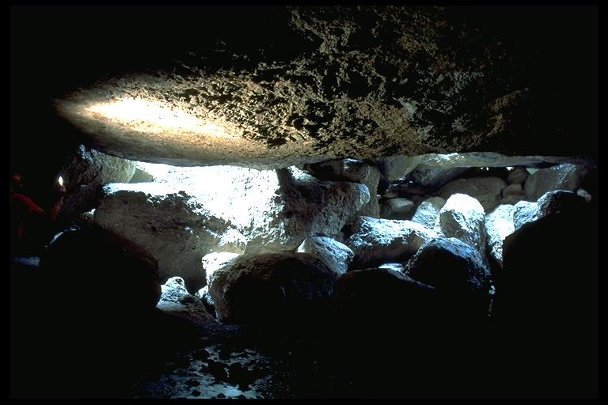
Talus Caves-1
Gravity can move large masses of rock that arch over spaces forming caves. These can be landslides of rock slabs or rubble, or the slow creep of gradually sagging clay beds.
(text-“California Underground” website)

Slide 20
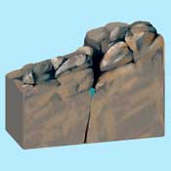
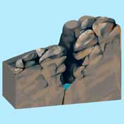
Talus Caves-2
Step 1--A stream winds its way along cracks in a boulder-strewn
landscape.
Step 2--In time the stream cuts a deep slot canyon through the rocks.
(“California Underground” website)

Slide 21
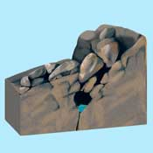
Talus Caves-3
Step 3--Boulders on the canyon rim tumble into the slot canyon, roofing it over.
Step 4--Additional boulders accumulate further roofing over the cave.
(“California Underground” website)

Slide 22
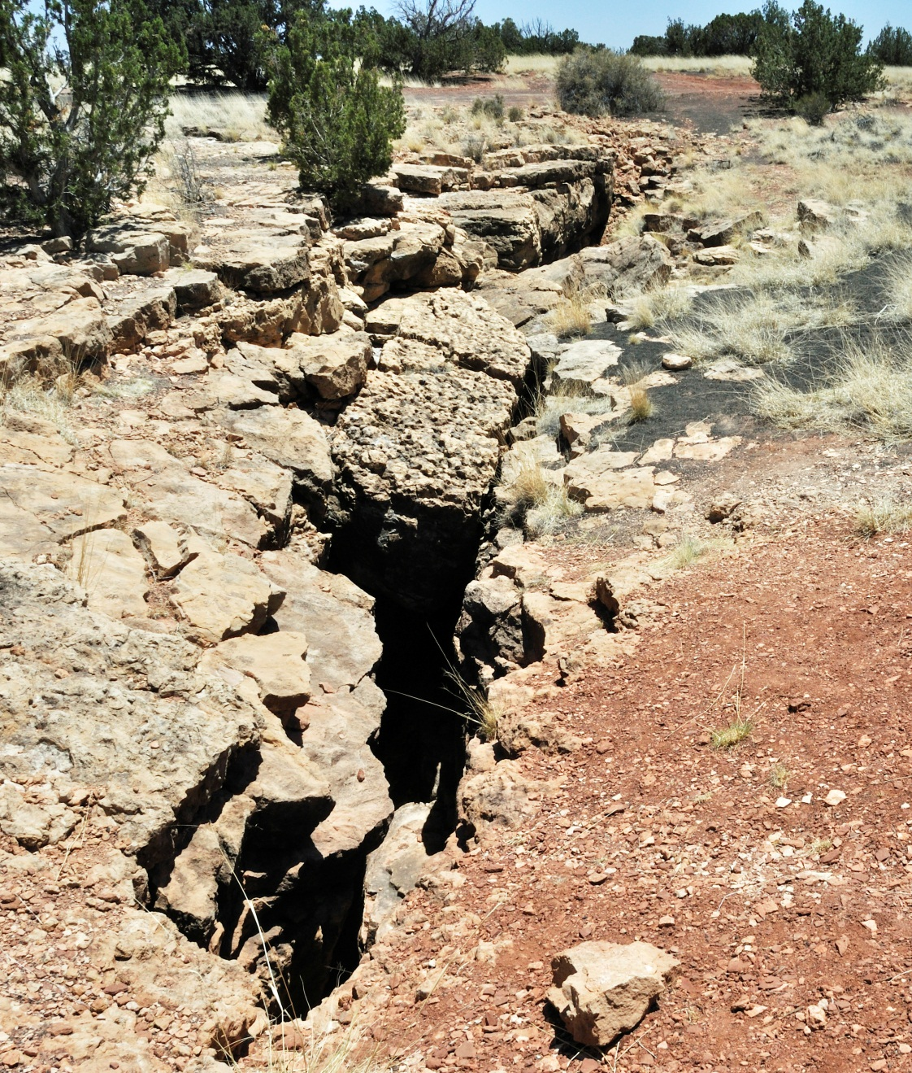
Crevice or Fissure Caves
Crevice or Fissure Caves Form from structural stresses in the Earth or more locally from gravity pulling large rock masses apart in steep terrain
These types of caves can be deep with known vertical drops of up to 600 feet.
NPS Photo by Dale Pate

Slide 23
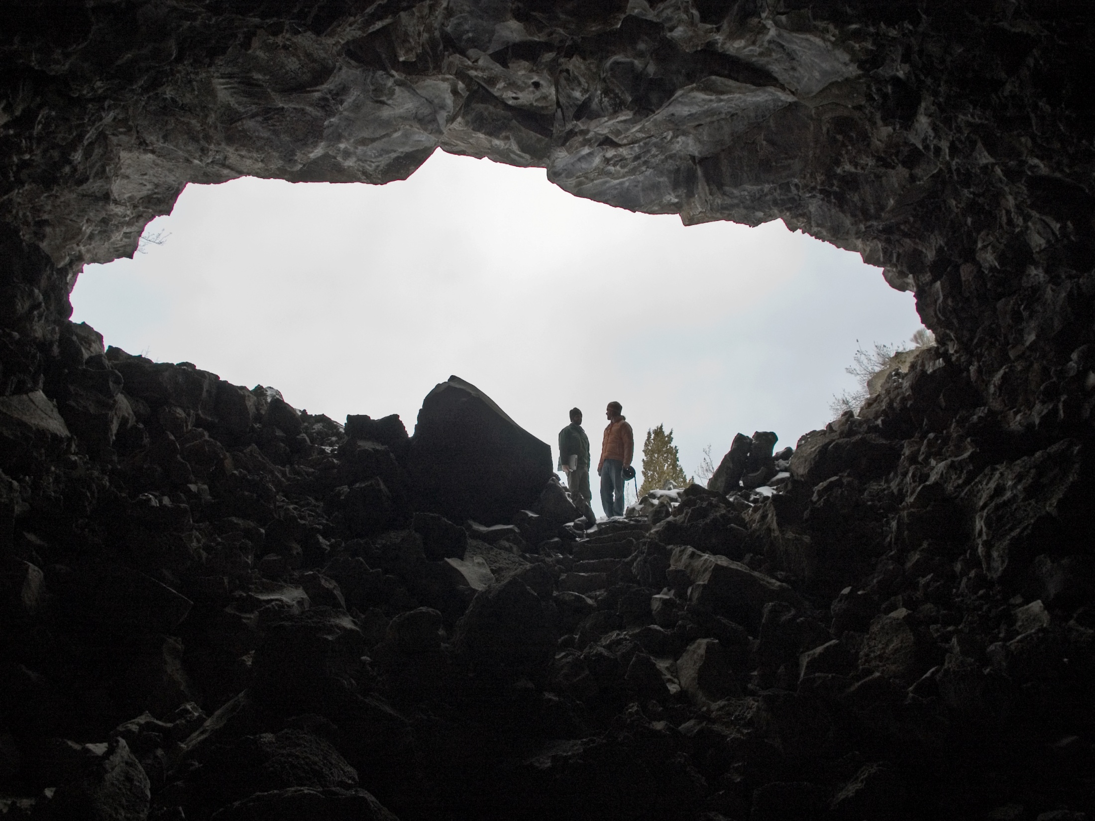
NPS Photo by Dale Pate
Text by: Katie Keller Lynn; Ronal Kerbo and Harvey DuChene
Photos by: Andrew Galewski, Ronal Kerbo, Art Palmer & Dale Pate
Power Point Presentation Modified from Ronal Kerbo 2007 Presentation
(Some graphics and text from “California Underground” website)

