Slide 1
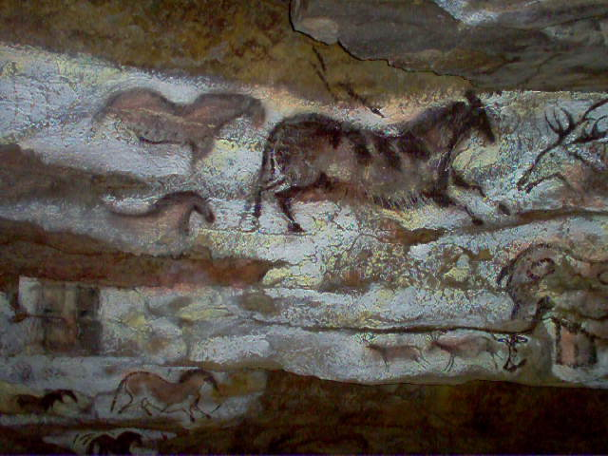
Significant Cave Designation Process
James R. Goodbar
Senior Cave/Karst Specialist
Bureau of Land Management
Jgoodbar@blm.gov
May 12-16, 2014 Cody, Wyoming

Slide 2
Where is it Required ?
Federal Cave Resources Protection Act
Code of Federal Regulations 43 CFR Part 37, 36 CFR Part 290
BLM Instruction Memorandum WO IM 94-125
USFS 2011 Memorandum
BLM Manual (8380) Cave/Karst Management
USFS Manual (2880,2356) Cave Management
BLM Planning Manual H-1601-1 App. C pg 13

Slide 3
Instructions
The Federal Caves Resources Protection Act of 1988 requires a list of significant caves.
Don’t be mislead by the word `significant‘. It is the intent of the Act that significant caves include all caves that have value for scientific, educational, and recreational purposes. That’s a pretty big target.
The term Significant was added to provide screening so Federal agencies are not required to "manage every little hole in the ground" and to screen out cave-like features containing "... no resources of any interest to anyone or any recognizable natural resource value"

Slide 4
Steps
Nomination
Evaluation
  Does it Meet the Definition of a Cave?
  Does it Meet at least One of the Criteria?
Designation

Slide 5
Public Nomination Worksheet
SIGNIFICANT CAVE NOMINATION WORKSHEET
Person or Organization Submitting this Nomination:
Name_______________________________________________________________
Address____________________________/________________/______________ Street City State & zip
Telephone # (____)_______________ Date _______
Person to contact for additional Information:
Name____________________________ Telephone (____)_________________
==============================================================================
Nomination Information:
Cave Name_______________________________
* Location: ______T .____.,R.____., Sec. _____,
State Township Range Section Meridian
OR Longitude __________, Latitude ______________
OR Universal Transverse Mercader _______________, _______________
OR Verbal description ____________________________________________________
_______________________________________________________________________
_______________________________________________________________________
_______________________________________________________________________
* Topographic Map Enclosed yes____ no____
* Cave Map Enclosed yes____ No ____
Administering Federal Agency _____________________________________
Local field office where cave is located _________________________________
* Information marked with an (*) is considered confidential under (section 5, Federal Cave Resources Protection Act, 1988) and is not subject to public disclosure under the Freedom of Information Act (Section 552 of Title 5 U.S. Code).

Slide 6
Nomination Worksheet Continued
SIGNIFICANT CAVE NOMINATION WORKSHEET (Continued)
A cave must meet one or more of the following criteria to be eligible for designation as a significant cave. If you circle "yes" for one or more of these criteria, please explain why in the remarks section. I desired, you may attach additional materials that will support your conclusions.
YES NO Biota: The cave provides seasonal or yearlong habitat for organisms or animals or contains species or subspecies of flora or fauna native to caves, or are sensitive to disruption, or are found on State or Federal sensitive, threatened , or endangered species lists.
Remarks: ______________________________________________________________________________________________________________
YES NO Cultural: The cave contains historic properties or archaeological resources or other features that are included in or eligible for inclusion in the National Register of Historic Places because of its research importance for history or prehistory, its historical associations, or other historical or traditional significance.
Remarks:
___________________________________________________________________________________________________________________
YES NO Geologic/Mineralogic/Paleontologic: The cave possesses one or more of the following features:
(1) Geologic or mineralogic features that are fragile, or that exhibit interesting formation processes, or that are otherwise useful for study.
(2) Deposits of sediments or features useful for evaluating past events.
(3) Paleontological resources with potential to contribute useful educational and scientific information.
Remarks: ______________________________________________________________________________________________________________
YES NO Hydrologic: The cave is a part of a hydrologic system or contains water that is important to humans, biota, or development of cave resources.
Remarks:
___________________________________________________________________________________________________________________
YES NO Recreational: The cave provides or could provide recreational opportunities or scenic values.
Remarks:
Yes NO Educational or Scientific: The cave offers opportunities for educational or scientific use; or, the cave is virtually in a pristine state, lacking evidence of contemporary human disturbance or impact; or, the length, volume, total depth, pit depth, height, or similar measurements are notable.
Remarks
___________________________________________________________________________________________________________________
Additional Comments:________________________________________________________________________________________________

Slide 7
Internal Process
Use existing information in cave files to determine if the cave meets Significance Criteria.
Submit list to Local Manager or Authorized Officer for Designation

Slide 8
Form
U.S. Department of the Interior
Bureau of Land Management
Carlsbad Field Office
****** Confidential Information ******
Subject: Listing of Significant Caves
Authorities: The Federal Caves Resources Protection Act of 1988 (16 U.S.C. 4301-4309) directs the Secretary of the Interior to prepare and maintain a listing of significant caves. The criteria for listing of significant caves is in 43 code of Federal Regulations part 37.11 (c).
Finding/Decision: After careful review of the cave resources in the Carlsbad Resource Area, it has been determined that the following caves meet one or more of the significant cave criteria listed in 43 CFR, Part 37.11(c). These caves are hereby officially listed as significant caves.
Cave Name BLM-NM-520 Cave number Criteria1 Met (B)__ (C) _(G,P) (H) (R) (E,S)
1. Algerita Blossom 078 x x x x
2. Adobe 149 x x x x
3. Banded Pit 111 x x x x x
As prescribed in 43 CFR, Part 37.11 (g) this decision is not subject to further administrative appeal.
__________________________________ _____________
Field Manager Date
____________________
1 See listing of Significants Criteria attached

Slide 9
Confidentiality
All Locations submitted will be confidential
No copies of nomination materials
(It’s the Law)

Slide 10
Reporting in RMIS
Report under No. of Significant Caves

Slide 11
BLM Significant Caves by State 2013
AK Total 6
AZ Total 60
CA Total 16
CO Total 174
ID Total 89
MT Total 5
NM Total 490
NV Total 12
OR Total 195
UT Total 57
WY Total 35
Grand Total 1,050

Slide 12
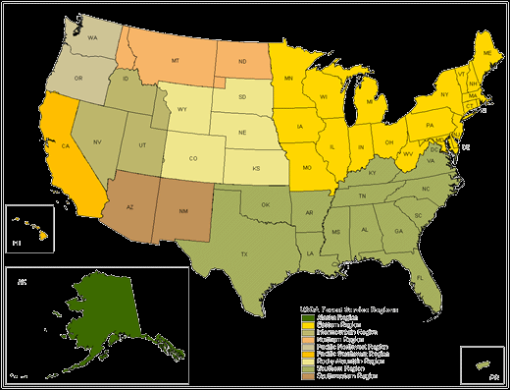
USFS Significant Caves by Region
Region 1 - 130
Region 2 - ~20
Region 3 - 50
Region 4 - 206
Region 5 - 117
Region 6 - 15
Region 8 - 91
Region 9 - ~ 852
Region 10 - ~ 600

Slide 13
Criteria for identifying Significant Caves is
43 CFR 37.11 (c) and 36 CFR part 290.
If a cave meets one of the criteria, it MUST be designated Significant !

Slide 14
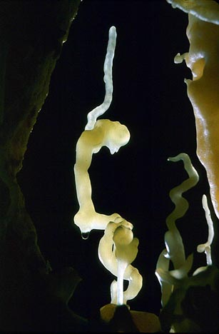
Questions
Is that Upside Down
? ? ? ?
? ? ? ?
? ? ? ? ?
? ? ? ?

