Slide 1
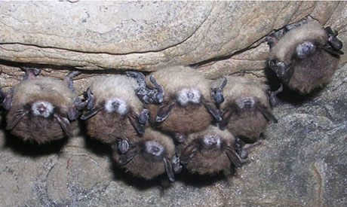
White Nose Syndrome
What We Will
Cover
What is It?
What is the Current Guidance ?
What are Current Containment & Decontamination Procedures?
What are best Monitoring Practices?

Slide 2
WHAT IS WHITE NOSE SYNDROME
A disease that has killed over 6 million bats
The fungus (Pseudogymnoascus destructans)
First detected winter 2006–07 in New York
By Winter 2010 – Spread to 22 states & 5 Canadian Provinces in 11 species of bats
Cold weather-loving fungus
Kills 90 to 100% Mortality Rate

Slide 3
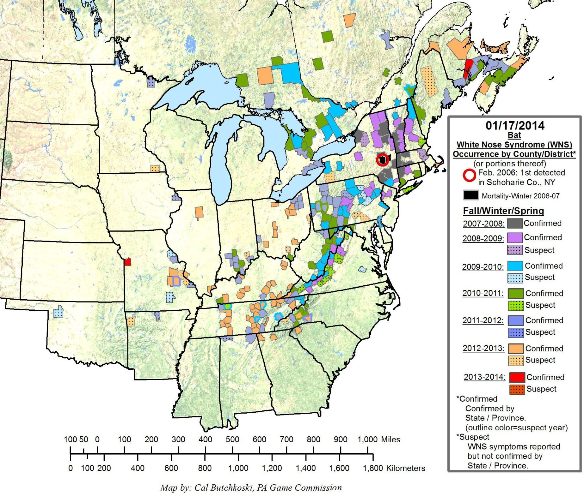
White Nose Syndrome Spread

Slide 4
Damage to Wings

Slide 5
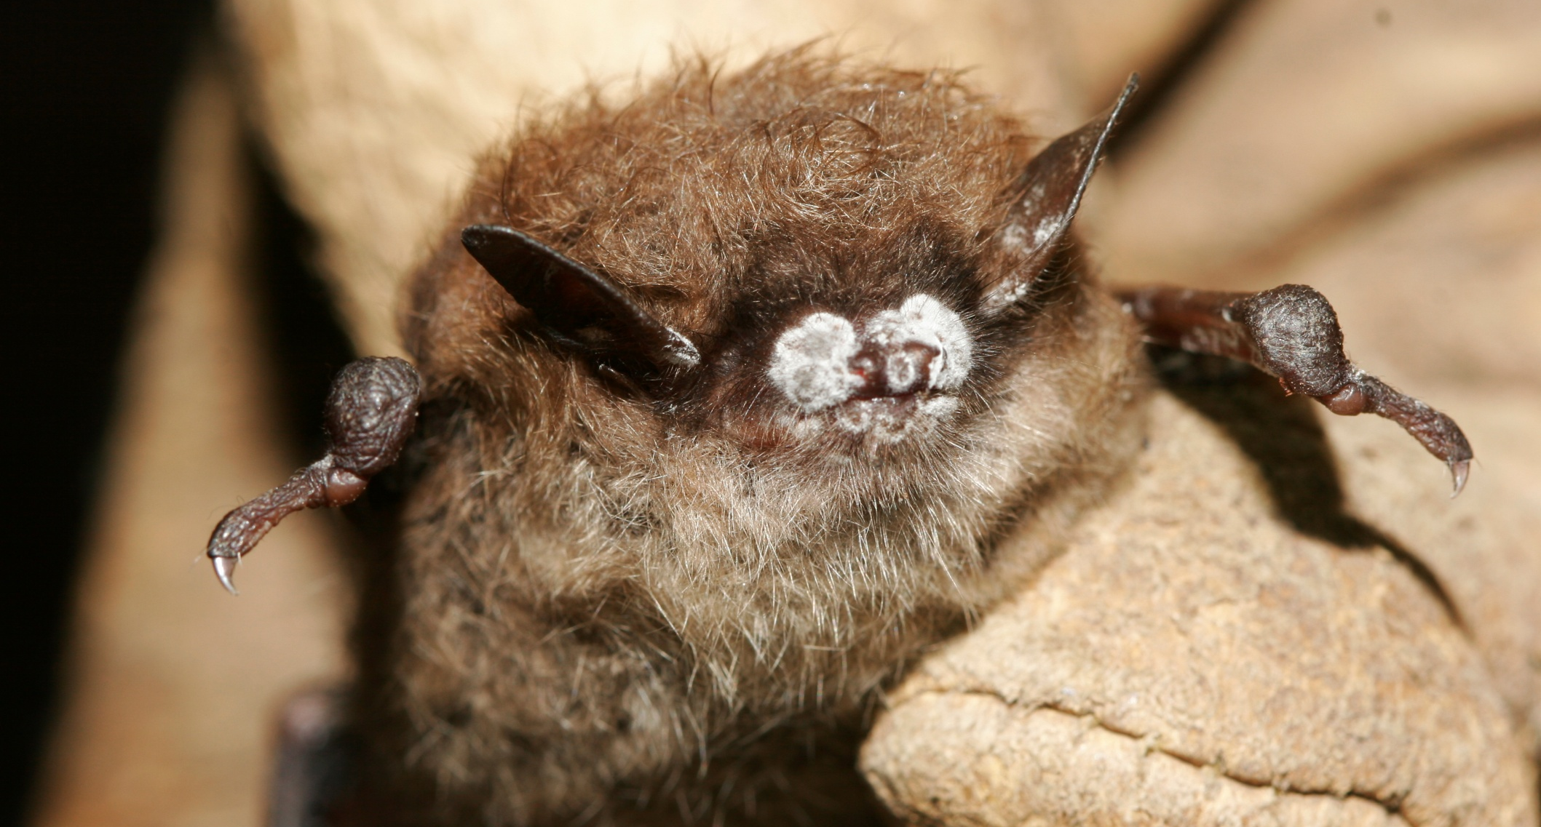
Damage to Muzzle

Slide 6
Current Guidance
National Interagency Response Plan
A. Communications and Outreach
B. Data and Technical Information Mgmt.
C. Diagnostics
D. Disease Management
E. Etiology and Epidemiological Research
F. Disease Surveillance
G. Conservation and Recovery
www.fws.gov/whitenosesyndrome/nationalplan

Slide 7
Current Guidance
Bureau Of Land Management
Instruction Memorandum IM-181-2010 Aug-20-2010
Stakeholder Coordination
2. Identify Sites with Important Bat Resources
3. Emphasize Ongoing Inventory Efforts
4. Site Administrative and Physical Closure
5. Identification of Potential WNS Surveillance Locations
6. Containment and Decontamination
7. Research
8. Outreach

Slide 8
Current Guidance
National Park Service
Update Management Plans to address WNS – If no plan, then develop Interim Guidance
May restrict access to caves/mines to those who hold appropriate permits
Screening not feasible, cave closures recommended
Evaluate reasons for entering bat areas
Encourage decontamination
Closing caves - Inform Kevin Castle, BRMD – He will inform other agencies
More info on NPS policies & guidance
http://www.nature.nps.gov/biology/wns/index.cfm

Slide 9
Current Guidance
US Fish & Wildlife Service
Close ALL Caves and Mines.
Implement Research and Monitoring Protocols in a Nationwide Effort to Slow the Spread of White-Nose-Syndrome (WNS) in bats.

Slide 10
Current Guidance
US Forest Service (Interim Response Plan)
1. Launch Awareness Campaigns
2. ID & Prioritize Bat Caves / Mines & Monitor
3. Apply Decontamination Procedures
4. Evaluate Effectiveness of Closures First
Exempt: SAR – WNS Research/Monitoring –
Unaffected Use
5. Develop Regional WNS Plans Tiered to National Interagency Response Plan

Slide 11
Decontamination & Containment
Submersion in Hot Water: Effective at sustained temperatures ≥50ºC (122ºF) for 20 minutes.
Secondary for non-submersible treatment options (for a minimum of 10 min.) include:
6% Bleach
Lysol IC Quaternary Disinfectant
Lysol Antibacterial All-purpose Cleaner
Formula 409 Antibacterial Cleaner
Lysol Disinfecting Wipes

