Slide 1
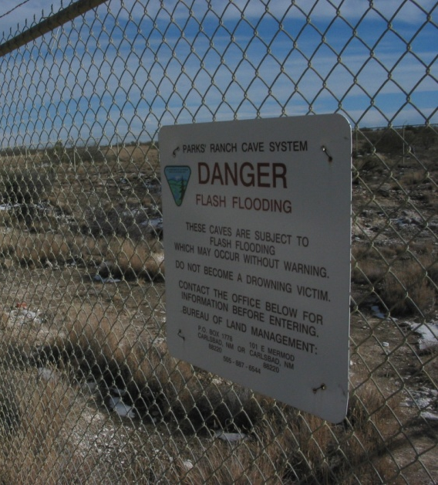
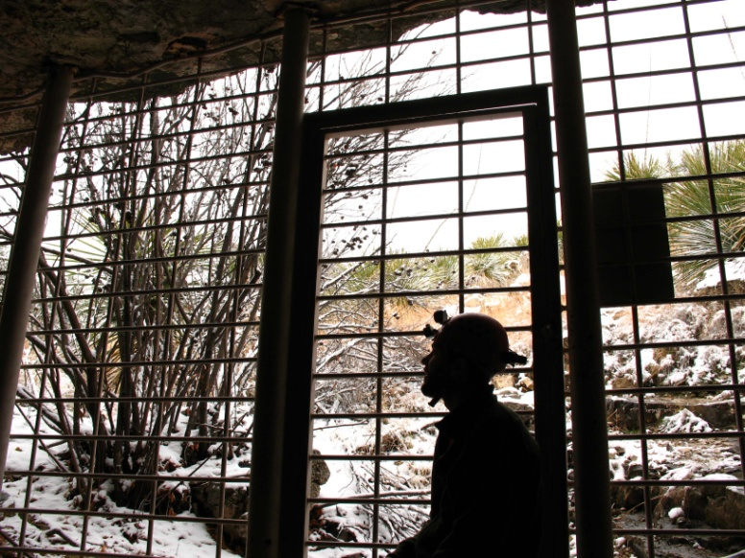
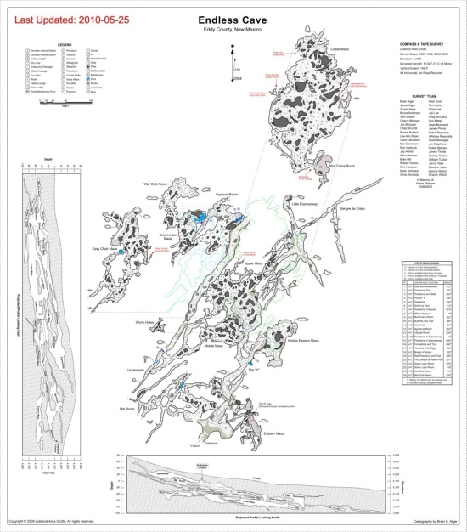
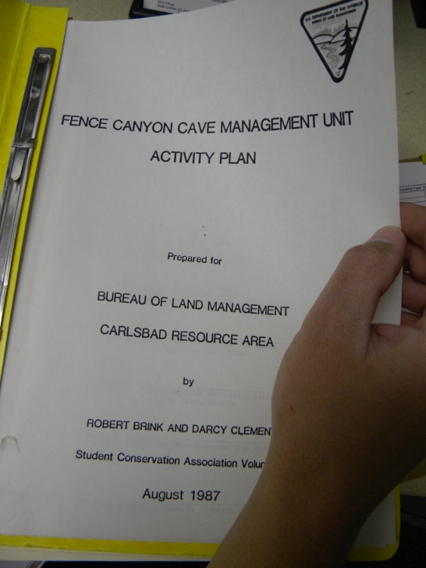
Cave Activity / Management Plans
Aaron Stockton
May 12-16, 2014
Cody, Wyoming

Slide 2
You will Learn
Why having cave activity plans is important
What guides a plan
What goes into a plan

Slide 3
Land Use Planning
Activity Level Planning – What we are going to do….
Project Planning - ….and how we are going to do it.

Slide 4
Why Do You Need Specific Management Plans For Caves?
Identifies cave management issues and solutions
Puts caves on par with other resource programs. Assists in developing an overall cave management policy for your cave resources - programmatic with cave-specific appendices or individual plans
Provides specific guidance as needed to reach goals and objectives beyond that which is found in a RMP

Slide 5
More Reasons…
Insures/provides a multi-disciplinary mgmt. approach
Plans/address potential liability issues
Abide by government laws; cave, T&E, cultural
Planning provides for consistent mgmt.
Sets a range of management options
Provides for public safety and emergencies
Provides a forum for pubic input
Outlines actions, sets goals, needs- priorities -budget

Slide 6
What May Be Included In Your Cave Specific Plan?
Goals and objectives
Monitoring element
Administrative actions closures, withdrawals
Management prescriptions
Permits
Restrictions
Safety/emergency plan
Description of resources
Background info
Location/setting
Identification of issues
Maps
Research - data trends
Photos that document critical planning elements

Slide 7
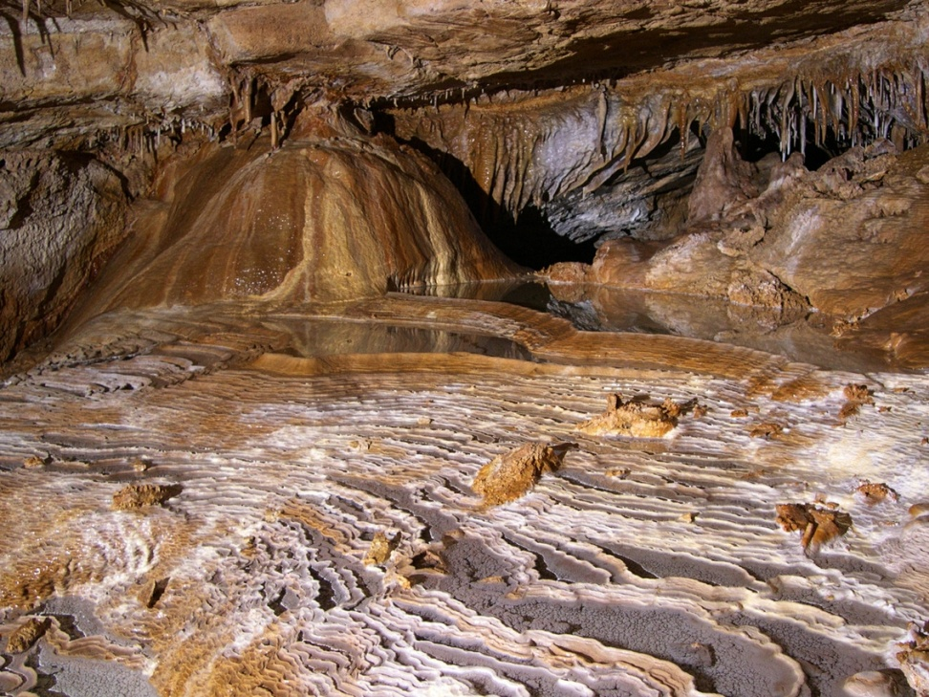
Case Study: McKITTRICK HILL CAVES MANAGEMENT PLAN
INTRODUCTION
A. Management Goal & Objectives
B. Background
C. Visitor Use
D. Geology
E. Biology

Slide 8
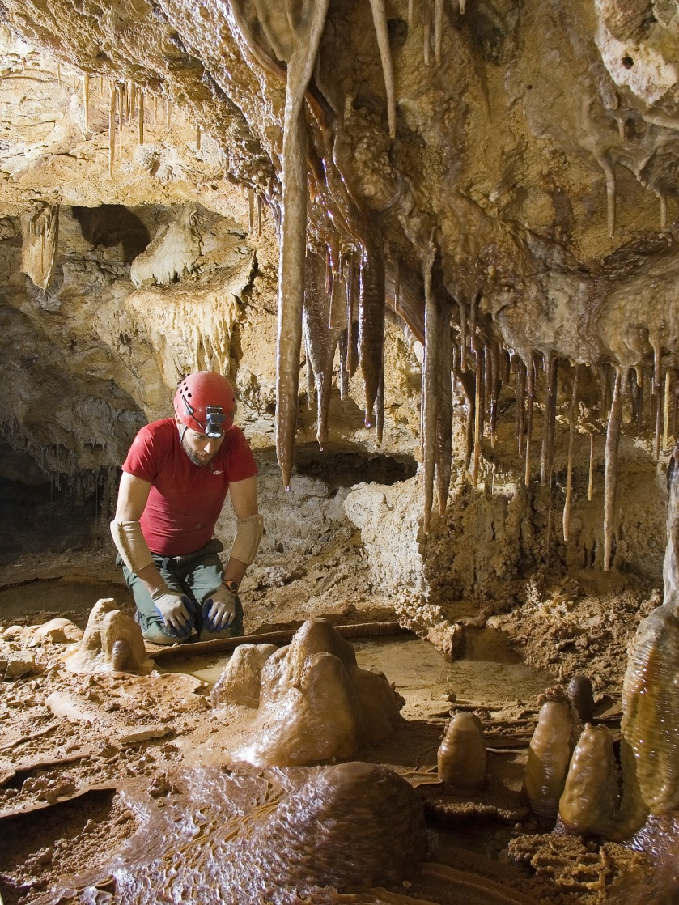
II. GENERAL MANAGEMENT PRACTICES
A. Carlsbad RMP
B. Research
C. Restoration
D. Monitoring
1. Visitor Monitoring
2. Photo Monitoring
3. Law Enforcement Patrol
4. Bat Monitoring
5. Visitor Use Monitoring
E. Continued Exploration

Slide 9
III. Ongoing Management Activities
Issue recreational use permits,
Review & recommend on research & digging proposals,
Change lock combinations at three months intervals,
Maintain cave gates, locks, and signs,
Maintain and direct monitoring program,
Maintain positive caver contacts and relationships,
Maintain a viable volunteer constituency,
Maintain progressive public outreach and environmental education initiative

Slide 10
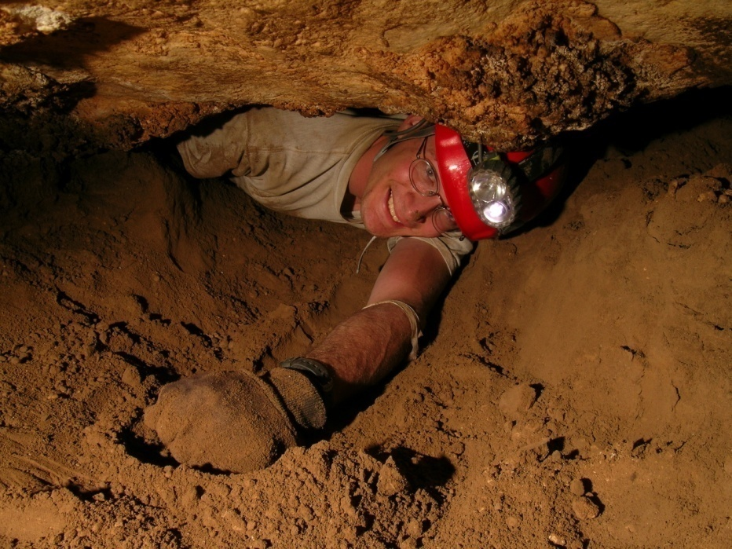
IV. Cave Specific Management Practices
A. Endless Cave
B. Sand Cave
C. McKittrick Cave
D. Little Sand
E. Dry Cave
F. Algerita Blossom Cave (ABC)
G. Phalangid Cave
H. Spider and Little Spider Caves
I. Anticline Crest Cave

Slide 11
A. Endless Cave:
1. Permits limited to one per week. The permit week runs from Monday through Sunday.
2. Registers are placed in the Gypsum Room, War Club Room, and Sangre de Cristo Passage.
3. Photo points are monitored annually. The photo monitoring points are identified on a map of the cave. The photos are maintained in a binder with the map in the CRA cave management program files.
4. West Maze Passage: “Off limits" from April 15 to September 30 to protect Bat. Passages to West Maze are signed & flagged to prevent access. Bat counts conducted each season.
5. The Sangre de Cristo Passage: Gated to protect its pristine character. Permits are limited to one per month. Trips conducted only by BLM authorized trip leaders. A list of leaders is kept in the Endless Cave file. Visitors to Sangre de Cristo will contact trip leaders who will then obtain a permit from the BLM.

Slide 12
V. List of Appendix
The Caves of McKittrick Hill
Guidelines for Cave Research
Guidelines for Cave Digging Projects
Endless Cave Special Stipulations and Hazards, Map

Slide 13
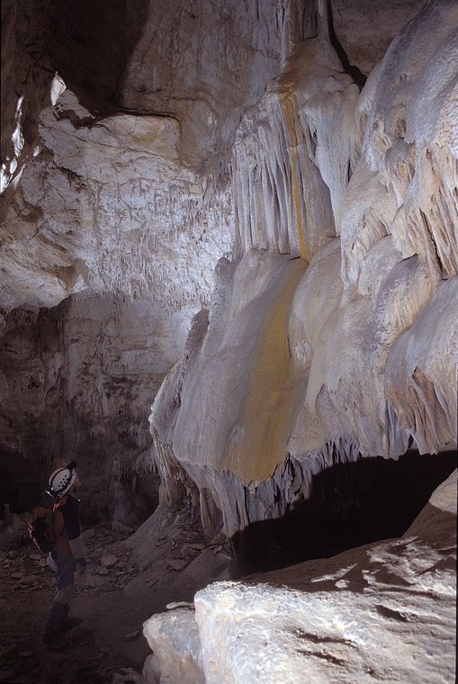
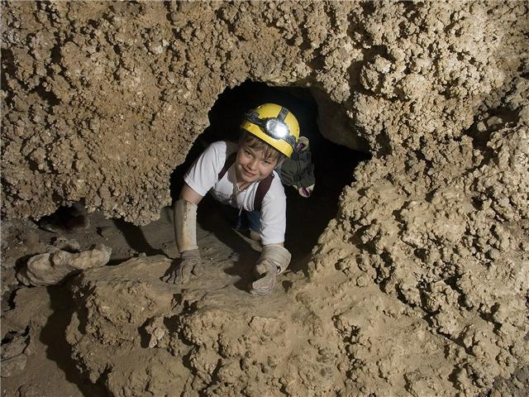
Questions ??
Modified from J. Goodbar 2007 Presentation

