Slide 1
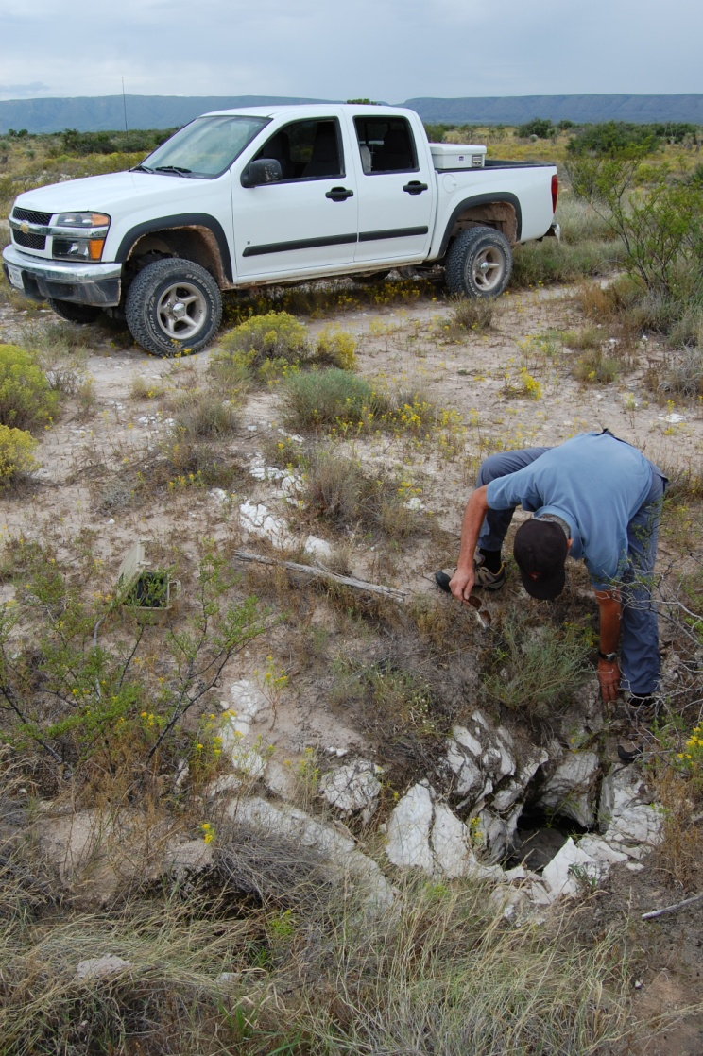
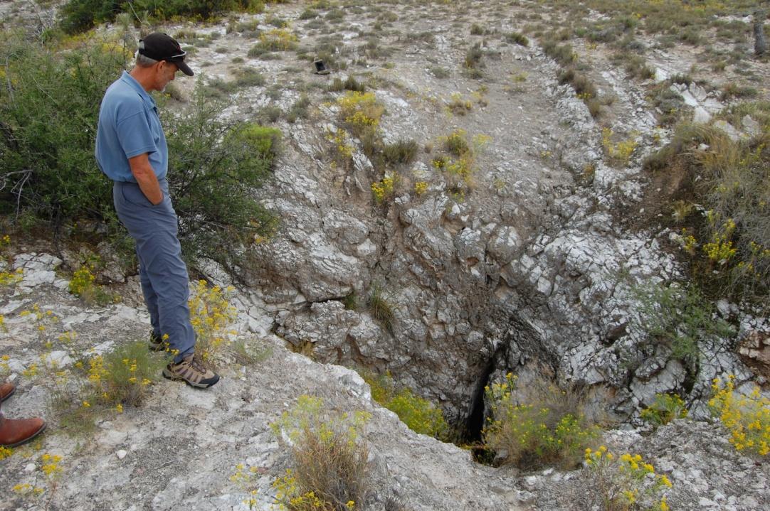
LOCATING CAVE RESOURCES
Aaron Stockton
May 12-16, 2014
Cody, Wyoming

Slide 2
WHY ?
To Protect Resources from Theft, Vandalism, and Careless Damage.
To Eliminate or Reduce Threats from Human Surface Activities.
Reduce Potential Hazards Caves May Present to Visitors and Surface Users.
Gain a Better Understanding of the Natural Environment We are Responsible for Managing.

Slide 3
SEARCH YOUR FILES AND RECORDS
Cultural Records
Range and Timber Files
Recreation Files
Wildlife Records
Minerals Records
Engineering Files
Law Enforcement Files

Slide 4
LOCAL RESEARCH
Ask Ranchers, Loggers, Well Drillers, Hunters, Local Cavers, Hikers, and Riders.
Local SAR, Law Enforcement, Fire Department
Geological, Newspapers, Local History Books, and Articles.
Library
Old Timers
Fly Overs
Google Earth

Slide 5
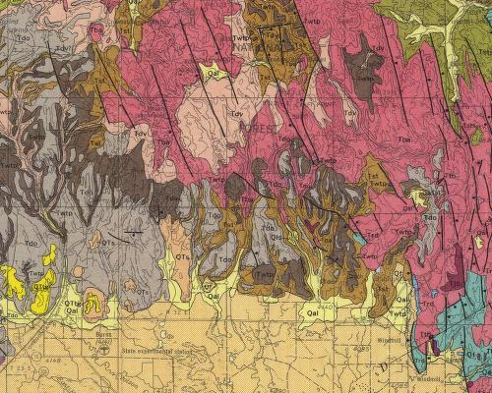
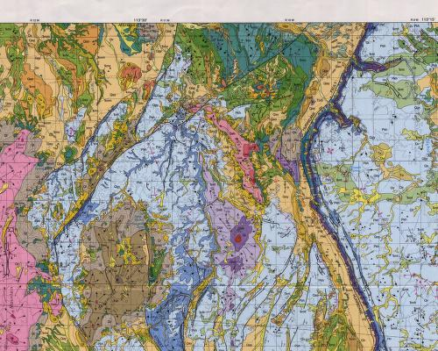
GEOLOGIC MAPS VOLCANIC LIMESTONE

Slide 6
TOPOGRAPHIC MAPS
Search for Features with Cave Names
Sinkholes
Losing/Ephemeral Streams
Springs
Road Anomalies
Vegetation Anomalies

Slide 9
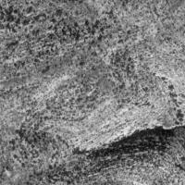
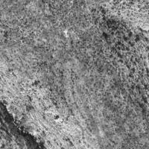
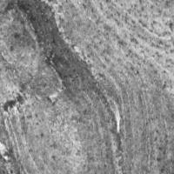
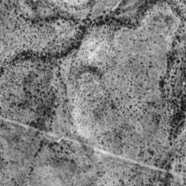

Slide 10
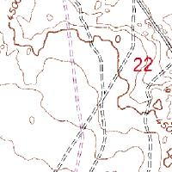
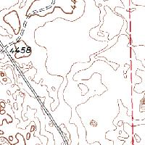
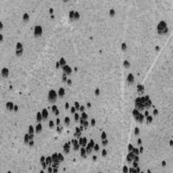
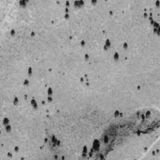
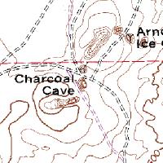
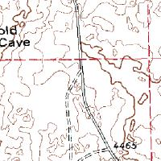
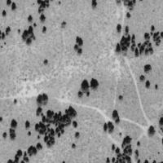
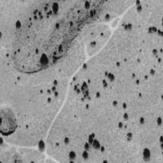
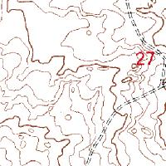
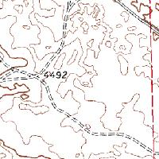
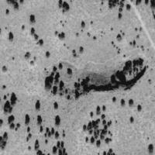
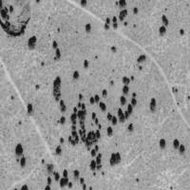
TOPOS and AIR PHOTOS

Slide 11
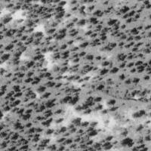
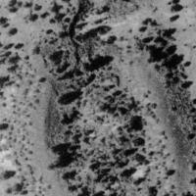
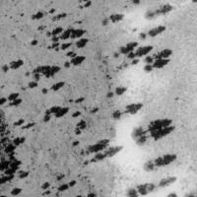
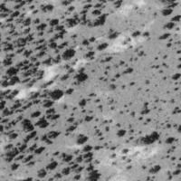
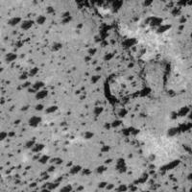
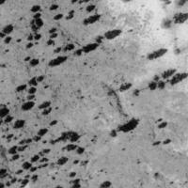
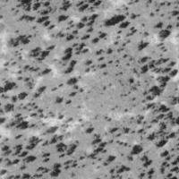
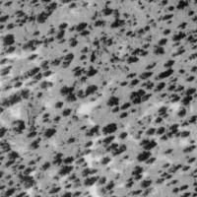
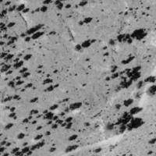
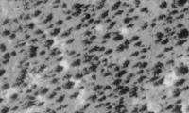
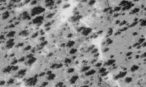
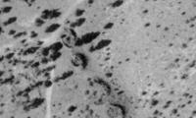

Slide 12
GEOLOGIC SENSING
Ground Penetrating Radar
Seismic Detection
Acoustic Resonance Detection
Resistivity – Electric Current Flow
Magnetometer

Slide 13
FIELD SURVEYS

Slide 14
RESISTIVITY

Slide 15
Digging
Hot button topic
Produced entry into incredible cave systems – Lechuguilla
Can damage valuable information/resources
Not one size fits all….

Slide 16
Questions
?Which way is north?
Modified from 2001 M. Safford, 2004 B. Hummel, 2007 D. Kampwerth, 2011 A. Stockton Presentations
Photos by A. Stockton and BLM files

