Slide 1
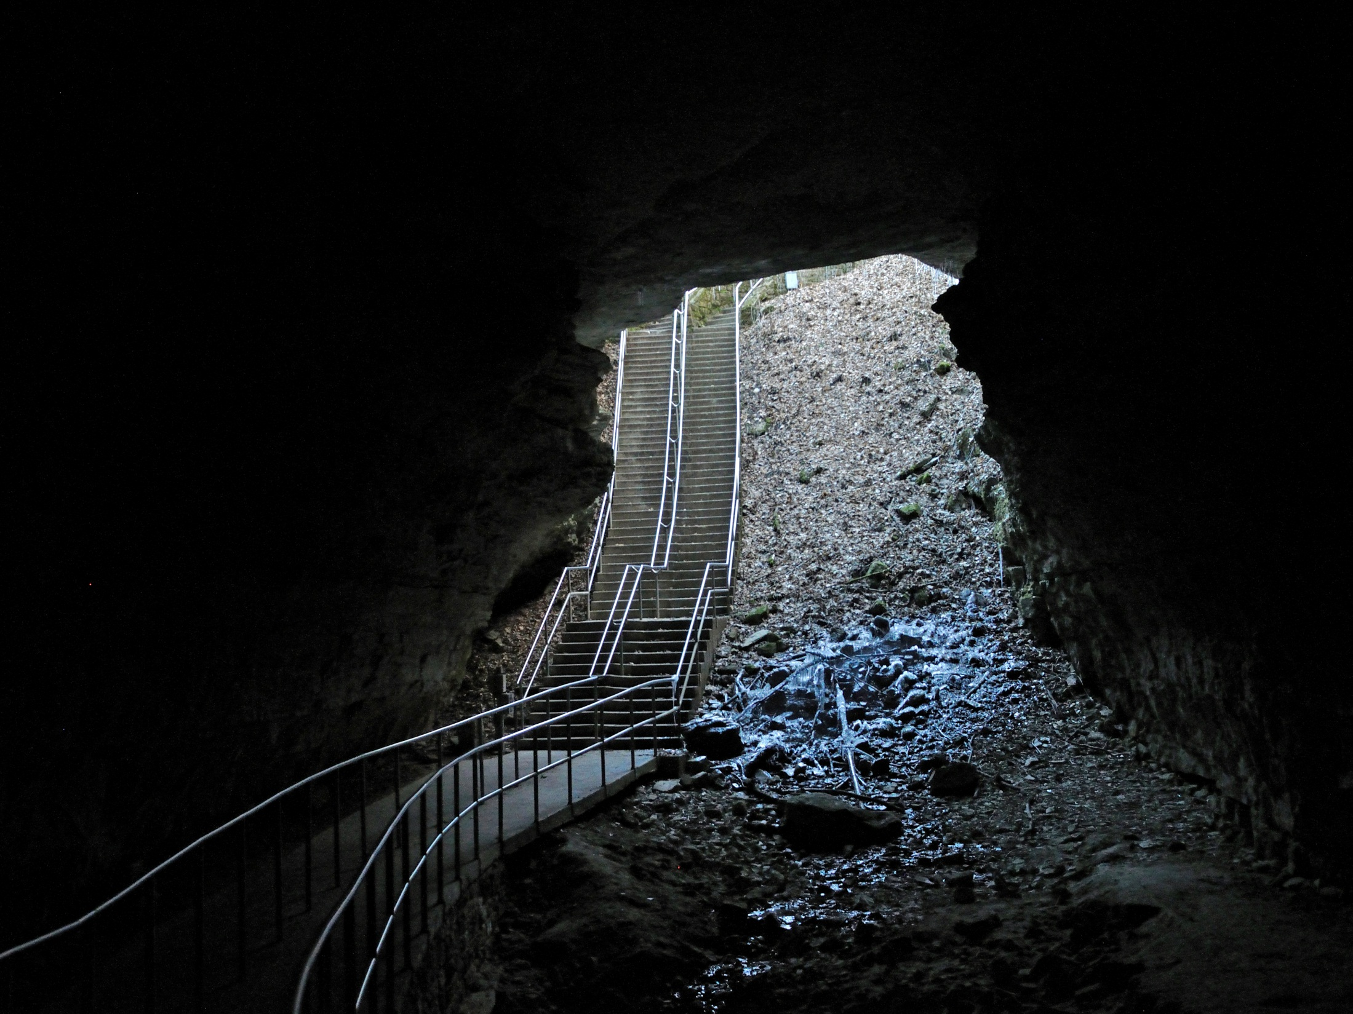
INTERNAL THREATS
TO CAVE AND KARST SYSTEMS
BLM Cave & Karst Training
May 12-16, 2014
Cody, Wyoming
NPS Photo by Dale Pate

Slide 2
Caves and Karst
Most caves have a direct connection to surface processes & the surface has a direct connection to cave and karst processes.
Could this have been prevented?
Photo courtesy the National Corvette Museum

Slide 3
Internal Threats
Not Understanding the Resource
Poor or No Planning
Structures – Above, In, and Near Caves
Bad Practices
NPS Photo by Dale Pate

Slide 4
THREAT Not Understanding the Resource
Lack of knowledge
No surveys
Unaware of problems or potential problems
Out of Sight – Out of Mind
NPS Photo by Ronal Kerbo

Slide 5
Mitigation
Education
Surveys & Inventories
Research
Planning Documents
Guidelines
NPS Photo by Rebecca Port

Slide 6
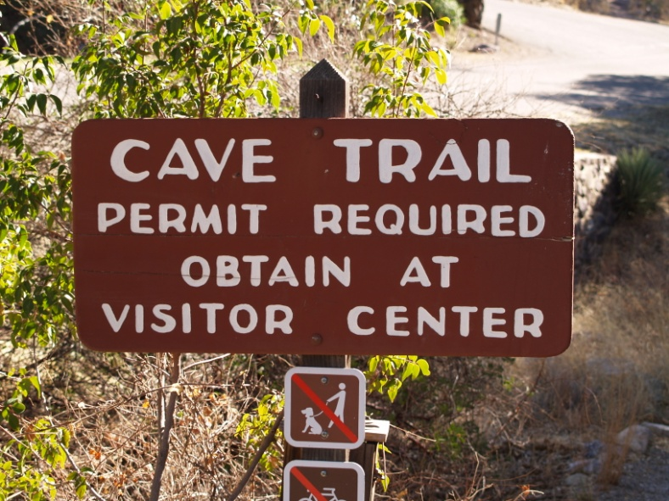
Threat – Poor or No Planning
Development without Resource Considerations
Uncontrolled Access

Slide 7
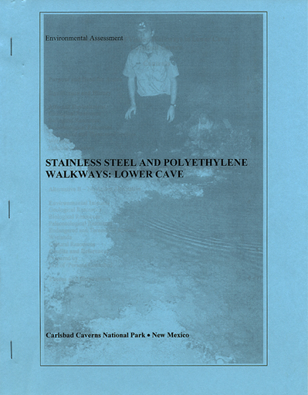
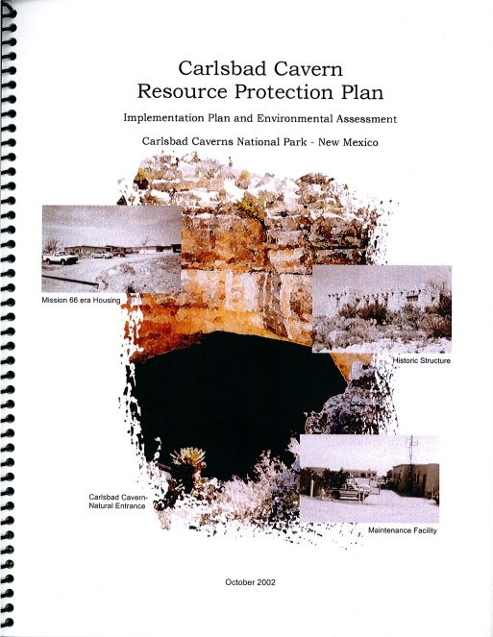
Mitigation
Planning Documents
NEPA Compliance
Public Involvement
Education
Resource Considerations

Slide 8
Threat - Structures
Visitor Use Facilities
Sewer Lines
Living Quarters
Parking Lots
Maintenance Facilities
Buried Gas Tanks
NPS Photo by Dale Pate

Slide 9
Mitigation
Structures Already in Place Over Caves
Identify Most Significant Problems
Remove if possible - Replace with state of the art technology if not possible
Reroute sewer lines
New Structures
Locate away from cave passages, if possible
Double-walled sewer lines
No buried gas tanks
Set Standards
Determine and enforce environmentally friendly guidelines for living and working over cave areas

Slide 10
Threat – Bad Practices
Leaking/Overflowing Sewer Lines
No Parking Lot Runoff Filter System
Poor or No Planning
Uncontrolled Access
No Guidelines for Entering Caves
Releasing Sensitive Information

Slide 11
Mitigation
Good Planning Documents
State of the Art Technology
Remove or Reroute When Possible
Determine Levels of Access
Develop Guidelines for Entering Caves
Establish Sensitive Information Release Guidelines

Slide 12
Carlsbad Caverns – A Case Study
Photo taken before 1991

Slide 13
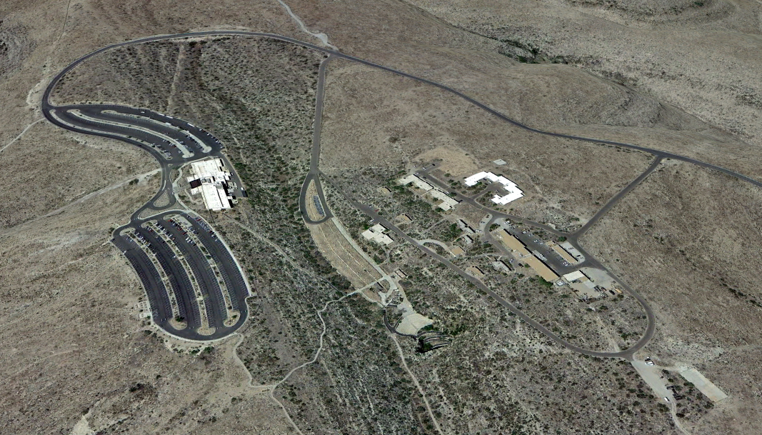
Carlsbad Caverns – A Case Study
Google Earth view from photos taken 4/16/2013

Slide 14
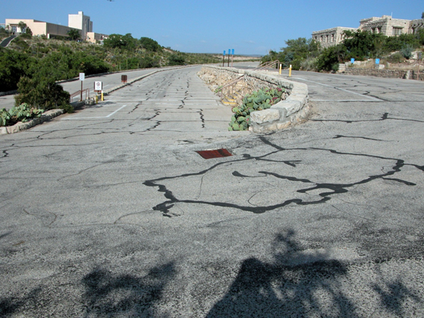
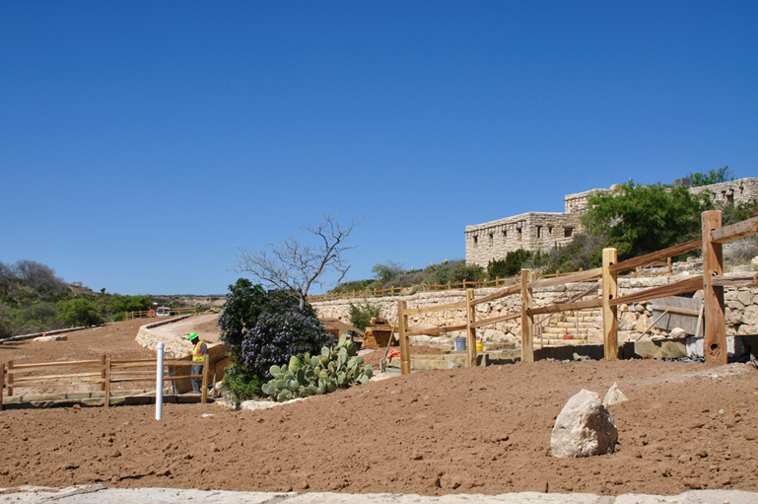
Carlsbad Caverns
A Case Study
BEFORE
DURING

Slide 15
In Conclusion
Know the Resources
Provide Education to Staff & Visitors
Develop Planning Documents
Remove or Mitigate Structure Impacts
Develop & Encourage Practices that Protect the Resources
Text by Dale Pate - Ronal Kerbo
All photos-NPS (except as noted)
NPS Photo by Dale Pate

