Slide 1

External Threats to Cave Systems
Stupidity
Development
Roads
Dumping
Logging
Mining
Oil and Gas

Slide 2
Stupidity
Difficult to overcome but essential for survival
Not to be confused with ignorance, which can be overcome with education
In time the gene pool may cleanse itself

Slide 3
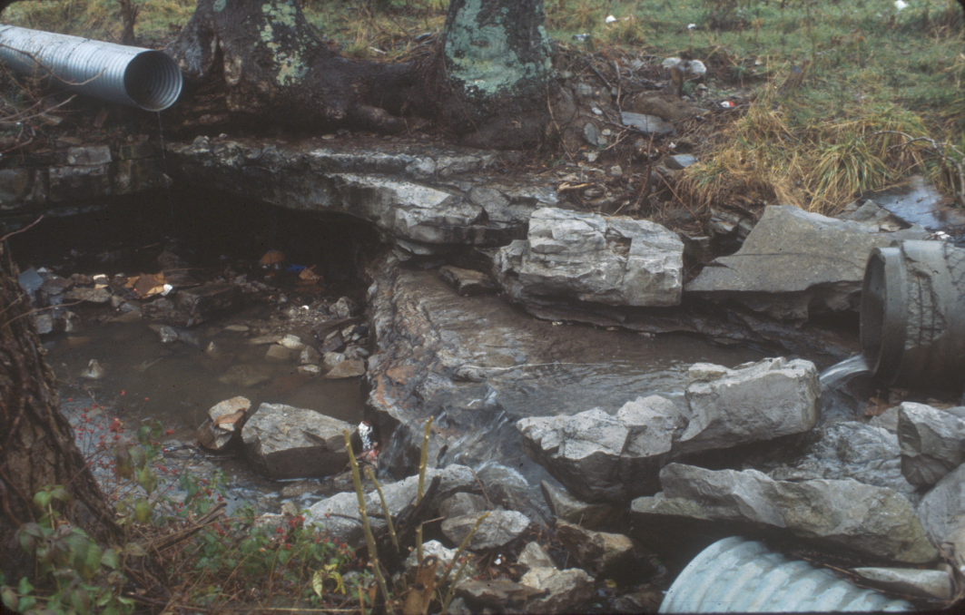
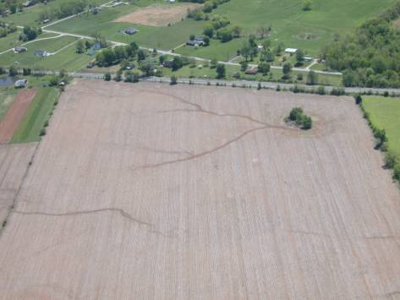
Development
Urban/Industrial
Golf Courses
Agricultural
  Pavement run-off
  Decreased infiltration
  Increased flooding
  Increased Sedimentation
  Increased Contamination

Slide 4
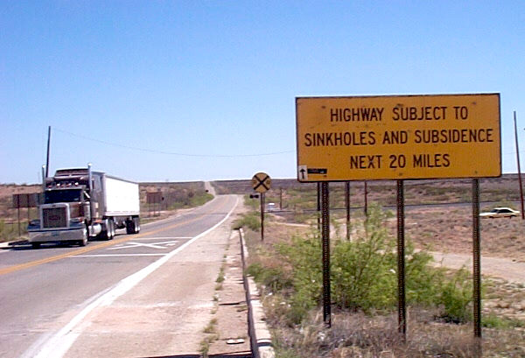
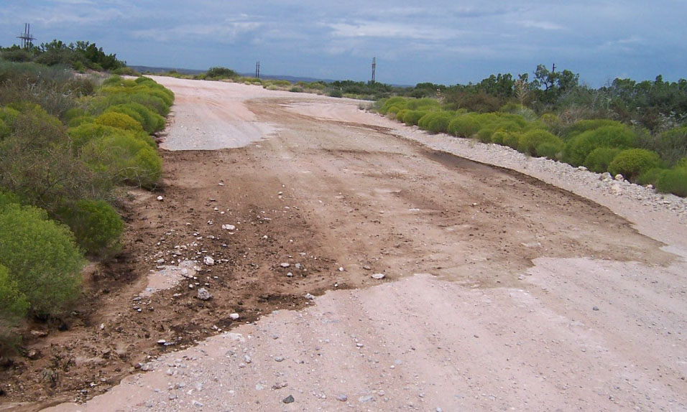
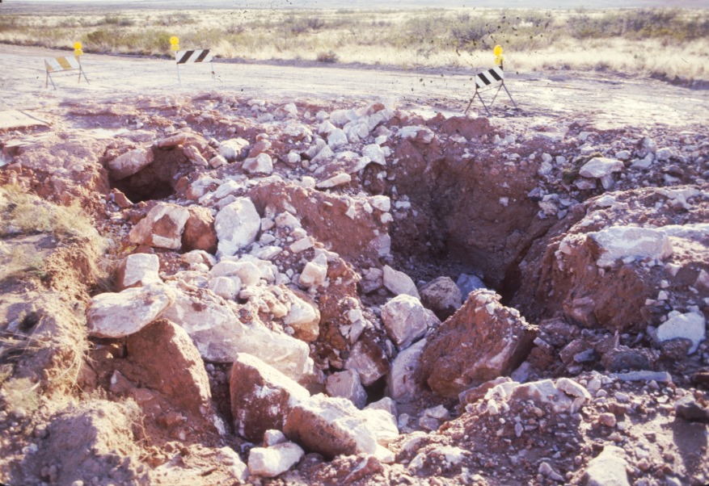
Roads
Collapse
Storm water runoff routed into karst features
Spills Draining into karst features

Slide 5
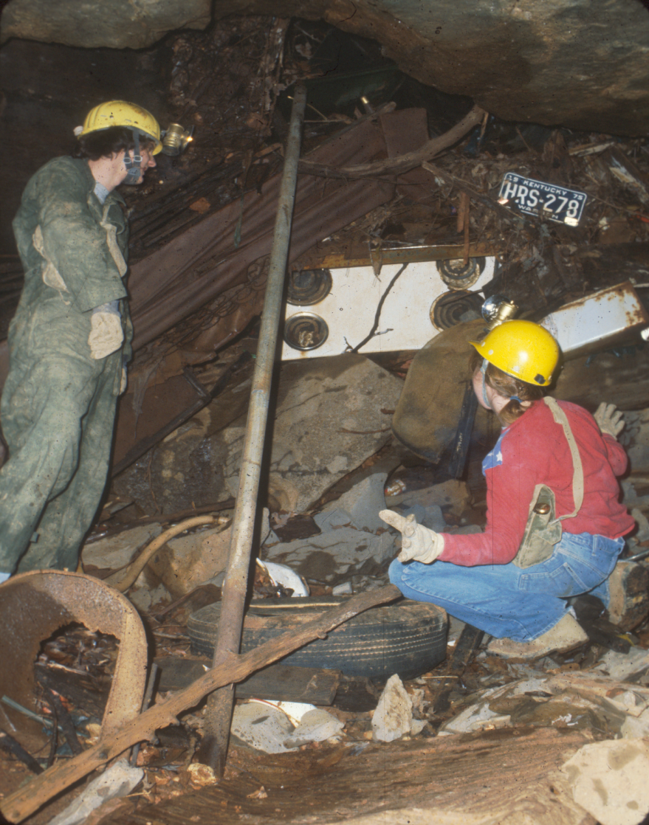
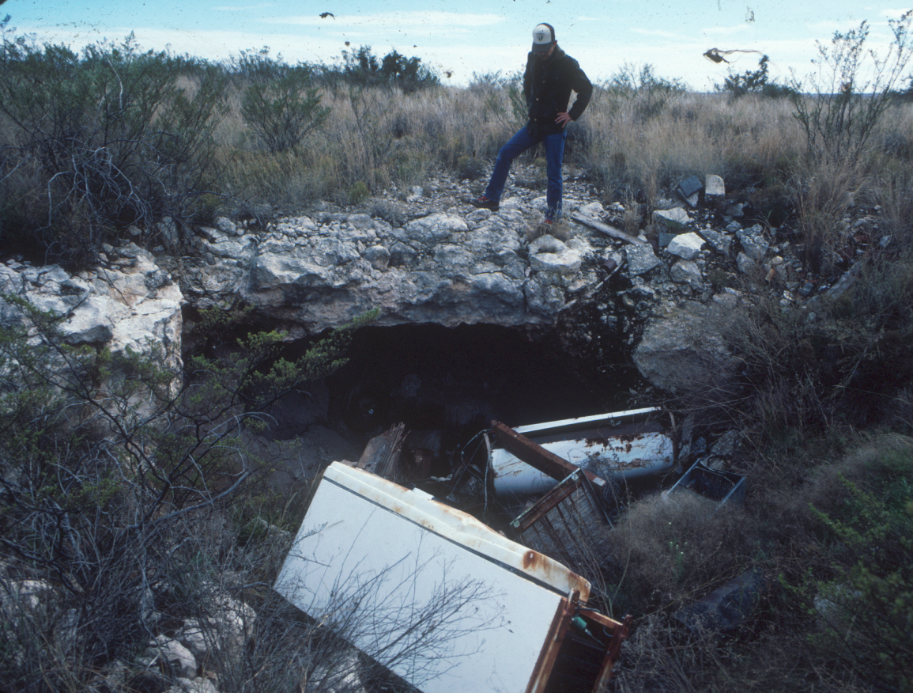
Dumping
Groundwater contamination
Harmful to cave life
Hazardous to visitors

Slide 6
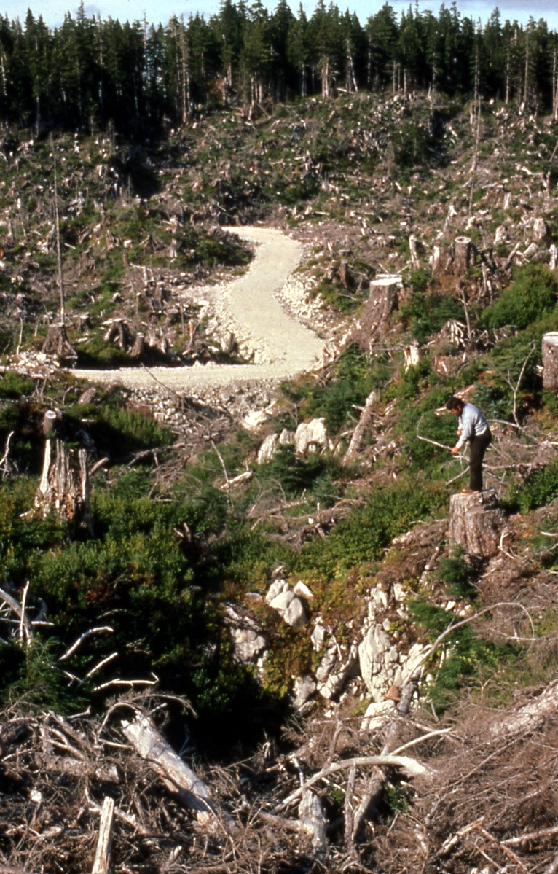
Logging
Increased
Sedimentation
Change in Water
Chemistry
Plugging Entrances
USFS Photo by Jim Baichtal

Slide 7
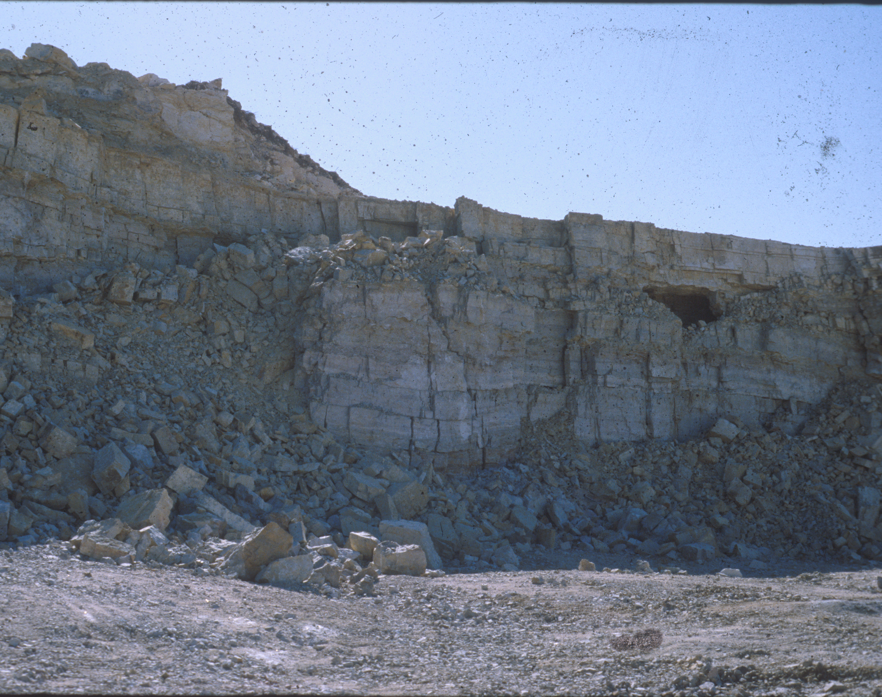
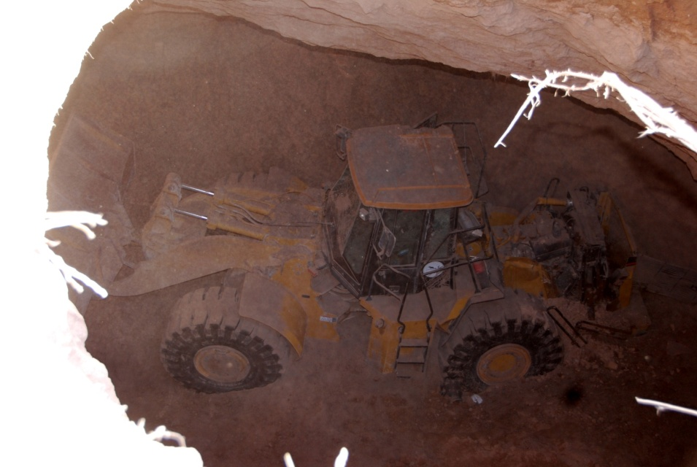
Mining
Removes the
cave
New entrances
may change
air & water flow,
temperature,
and humidity

Slide 8
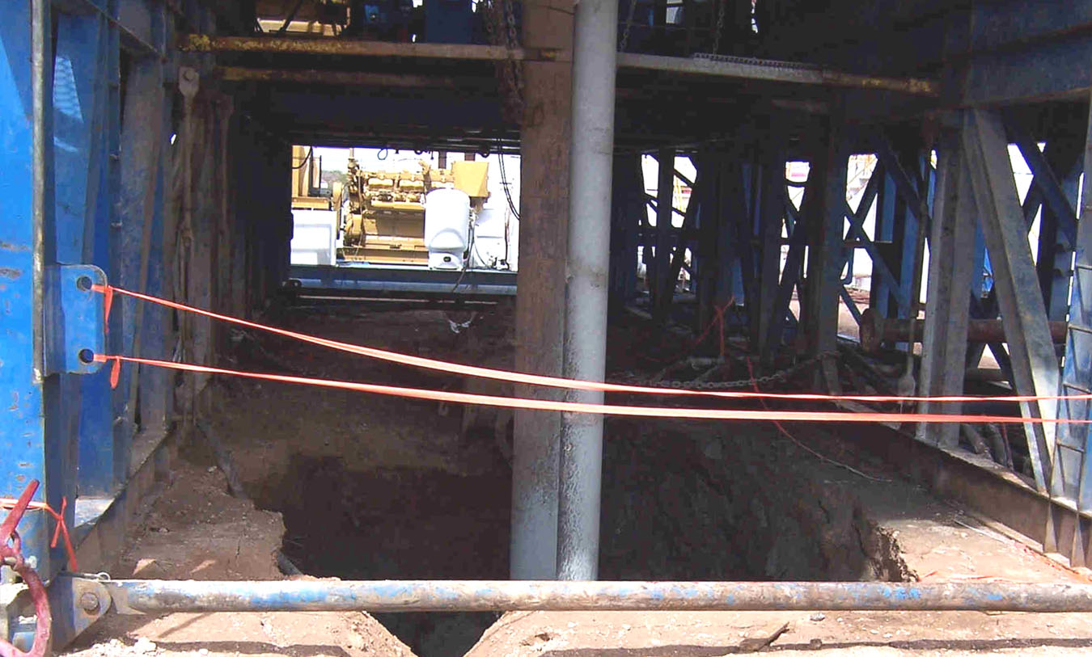
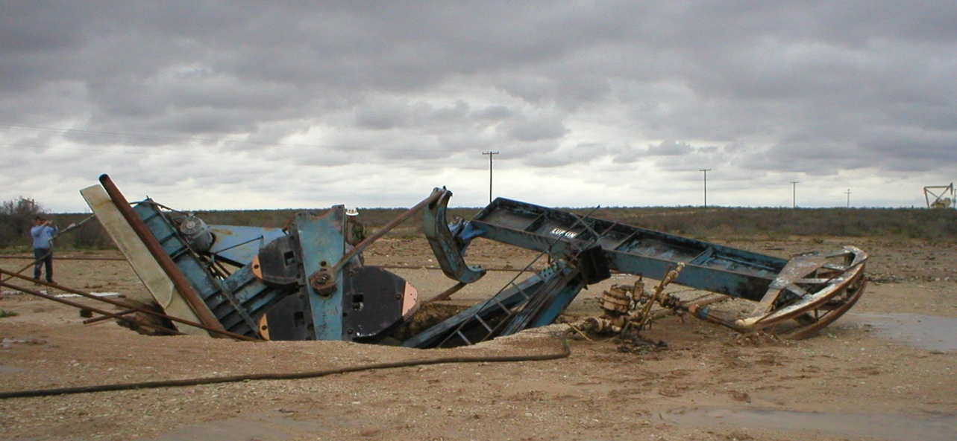
Oil & Gas Drilling
Increased Surface
Disturbance
Drilling fluids in caves
Leaky casing
Leaky tanks, pits, &
pipes
Truck spills =
Groundwater Contamination

Slide 9
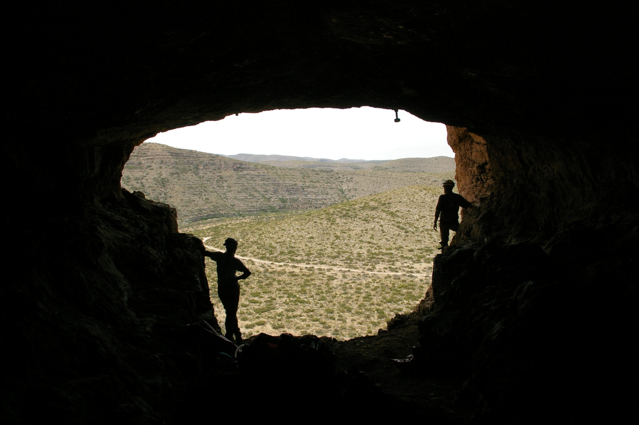
Questions??
Text by: Jim Goodbar
Photos by: Jim Goodbar, Jim Baichtal, Aaron Stockton, BLM
Power Point Modified from J. Goodbar 2007 Presentation

