Slide 1
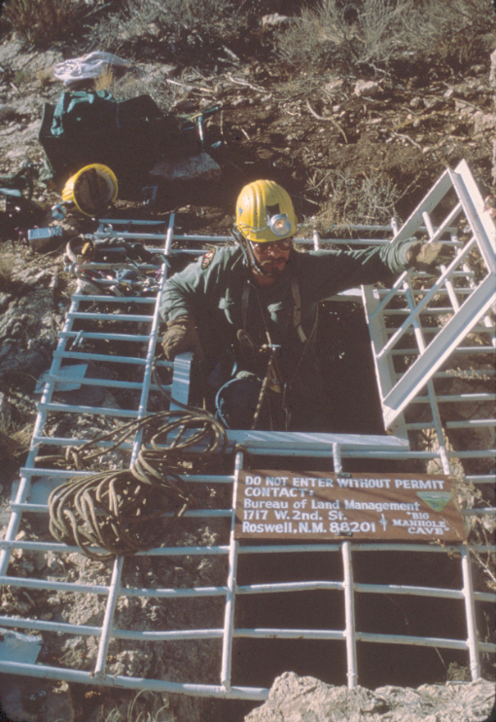
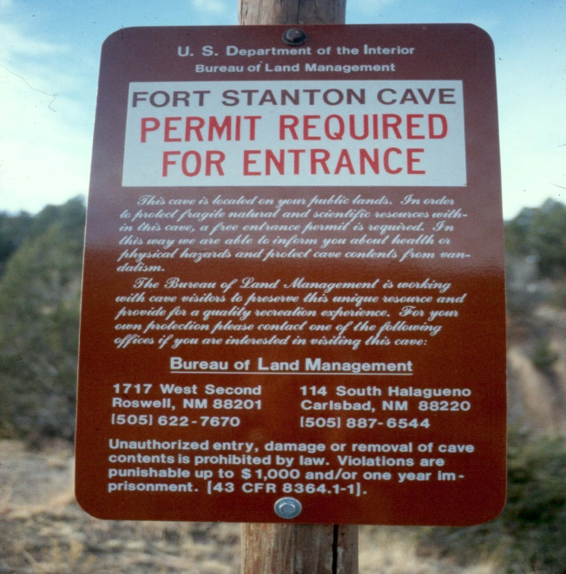
Cave Permits & Permitting Systems
Aaron Stockton 2011

Slide 2
What are they & why should you have them ?
Cave permits are legal documents that approve access into caves
In this session you will learn:
Why & when they might be needed
How to legally “close” caves
Permit contents
Different types of permits
What permitting systems are you currently using?

Slide 3
Why would you need entry permits?
Help control access
Help protect cave resources
Give law enforcement legal grounds
Provide accountability of the visitor
Provide opportunity for visitor contact
Supply visitor use information
Give feedback on cave conditions

Slide 4
When could permits be used?
To prevent uncontrolled visitor use
To protect fragile or sensitive resources
Bats colonies
Formations
Cultural materials
For public safety
Other situations ?

Slide 5
Cave “Closures”
Federal register notices legally “closes”.
BLM solicitor advises it is best to have a physical barrier to enforce “closure”. This means installing a gate.
Signs also inform the visitor that the cave is “closed” and may require a permit for entry.

Slide 6
Federal Register Notice (Example in Notebook)
State authority
State what the lands are being closed from, unauthorized entry
State which caves are being closed (no locations need to be given)
State where permits and additional information may be obtained

Slide 7
Types of Permit Systems
The general permit- The most common type of recreational permit issued.
Trip leader permit- Requires that the trip leader (the person to whom the permit is issued) must have been to the cave a certain number of times to qualify for issuance of a permit or undergone other qualifications as set by the agency.
Guided trips- The agency leads the group to provide the visitor with specific management guidance in caves with highly sensitive resources or on trips where close supervision is necessary ie. restoration trips, mock rescues, collection trips.

Slide 8
Permit Contents (Example in Notebook)
Issuing Office
Caves to be visited, Permit #, Date of Use
Name of Authorized Trip Leader
Who Authorized the Permit
Signature of Visitors
General Laws and Restrictions
Post Trip Comments
Emergency Information
WNS Notice and Decon Procedures

Slide 9
Permit Contents
UNITED STATES DEPARTMENT OF THE INTERIOR
BUREAU OF LAND MANAGEMENT
SPECIAL RECREATION PERMIT - CAVES
Carlsbad Field Office, 620 E. Greene St., Carlsbad, New Mexico 88220, (505) 234-5972
_________________________CAVE (Pmt. No. __________) DATE_____________________
______________________________CAVE (Pmt. No. __________) DATE____________________
______________________________CAVE (Pmt. No. __________) DATE____________________
______________________________CAVE (Pmt. No. __________) DATE____________________
Permission is hereby granted to ________________________________ for a group of _____ people as
reflected by the signatures below to enter the above named cave(s), located on public lands.
Authorized by:_______________________ Date ______________.
<><><><><><><><><><><><><><><><><><><><><><><><><><><><><><><><><><><
The following signatures indicate that permittees have received and understand the information provided by the BLM on hazards which may be found in the cave(s), and agree to comply with the general conditions and special stipulations ________ of this authorization:
1____________________________________(Trip Leader) 6__________________________________________
2_______________________________________________ 7__________________________________________
3_______________________________________________ 8__________________________________________
4_______________________________________________ 9__________________________________________
5_______________________________________________ 10_________________________________________

Slide 10
Special Risks & Stipulations (Example in Notebook)
BLM Solicitor Recommends
Lowers Liability
Informs Visitor of Specific Rules
Informs Visitor of Specific Risks
Puts Combination on Risks Sheets

Slide 11
RISKS AND SPECIAL STIPULATION
ENDLESS CAVE
(Gate Lock_________)
GENERAL RISKS;
All undeveloped caves, by their very nature, contain some risks. Make your trip a safe and enjoyable one by being prepared and careful. General safety hints for exploring undeveloped caves are listed on the reverse side of this page.
Just about all caves contain some risks which are common to the underground environment, such as loose rocks, low ceilings, low tight passages, slippery surfaces, and unstable and uneven floors. Be prepared by wearing the proper cloths and carrying the proper equipment, following safety hints, staying within your groups capabilities, and using common sense.
Specific risks described below are those which are known by BLM, but additional risks due to natural causes could have occurred since the last time the cave was inspected.
SPECIFIC RISKS:
1. Maze cave; passages are especially confusing in the upper maze area.
2. The main trunk (entrance) passage has several ledges which must be traversed. Caution is advised as these ledges are several feet above the floor.
SPECIAL STIPULATIONS:
1. No renewable or nonrenewable resources--either plant, animal or mineral--shall be collected from this cave for personal use, sale, barter, or consumption unless specifically authorized in writing.
2. Avoid contact with bats; DO NOT ANNOY OR DISTURB BATS AT ANY TIME.
3. Maximum group size in this cave is limited to 6 people; special arrangements may be made for larger parties.
DO NOT STRAY OFF TRAILS.

Slide 12
Automated Data Base Permitting
Assigns Permit Numbers
Generates Reports
Attaches Risks and Stipulation
Attaches Combinations

Slide 16
Lock Choices and Delivery Systems
Combination Locks – combinations can be delivered electronically, must be changed regularly to prevent unauthorized entry, weaker locks
Keyed Locks – Stronger, expensive to buy and replace keys, cuts out combination sharing, must be snail mailed or picked up in person, could require deposit

Slide 17
Lock Choices and Delivery Systems
Applications
Requires that an interested party submit a written application for a permit.
Gives the agency a heads up. More paperwork.
Permits can be:
mailed
Emailed
picked up in person
left in a drop box in the field.
Who writes permits?
Specialists knowledgeable of the resource and rules.
Admin staff trained to issue them.
Make sure that rules are clear!

Slide 18
Permit Return
Have a system to ensure permits and keys are returned.
Time limits for returns.
Return location.
Mailed
Drop box
“Punishments” for failure to return.
No issuance of future permits
Loss of deposits

Slide 19
Discussion
What Kind of Permits
Are You Using ????
Modified from 2007 J. Goodbar Presentation

