Slide 1
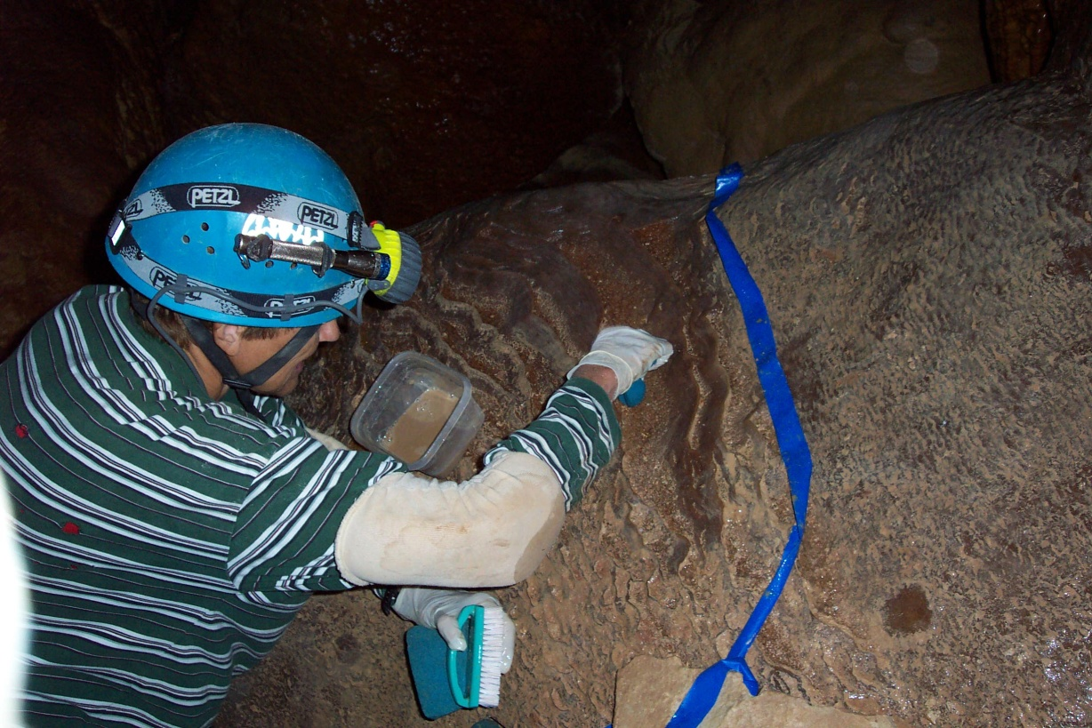
Cave Restoration Techniques
Slow and Steady , Safe and Sure
Aaron Stockton, James Goodbar
May 12-16, 2014
Cody, Wyoming

Slide 2
What You Will Learn
Graffiti Removal
What – When – How
Cleaning Formations
Repairing Broken Formations
Discussion of Success Stories

Slide 3
Graffiti Removal
What Should be Removed ?
Laws 100 years / 50 years
Document Content, Style, Media
When in Doubt - Leave it. It can always be removed later, after determination

Slide 4
Graffiti Removal Tools and Techniques
Sand Blasters
Scrub Brushes
Nylon or Stainless Steel
Avoid Brass, Steel, or Natural Fiber
Rotary Brushes
Scrub Gently

Slide 5
Graffiti Removal Tools and Techniques
Water Sprayers
Hand-Held Spray Bottles
Garden Sprayers
Bladder Bags
Gravity Feed Systems

Slide 6
Graffiti Removal Tools and Techniques
Where to Get the Water ?
Common Sense Approach
Clean Fresh Water - NO Chemicals
Cave Water From Renewable Sources
Collect Water – Filter & Reuse

Slide 7
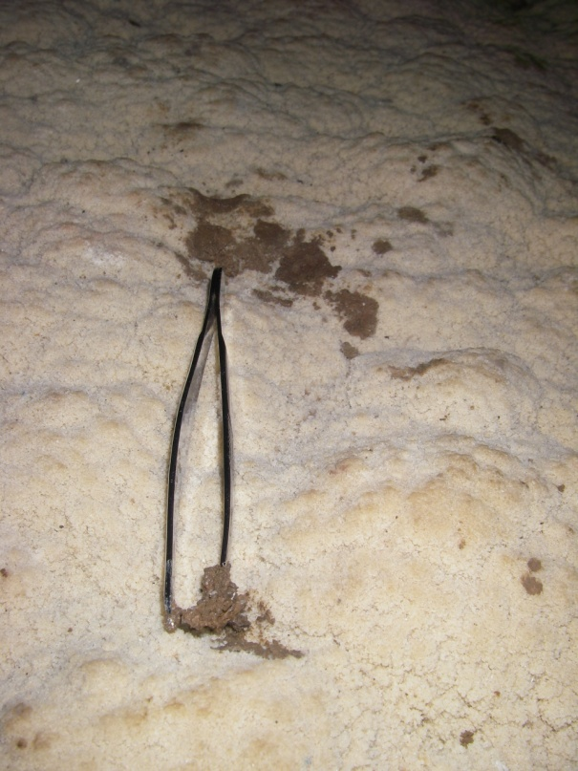
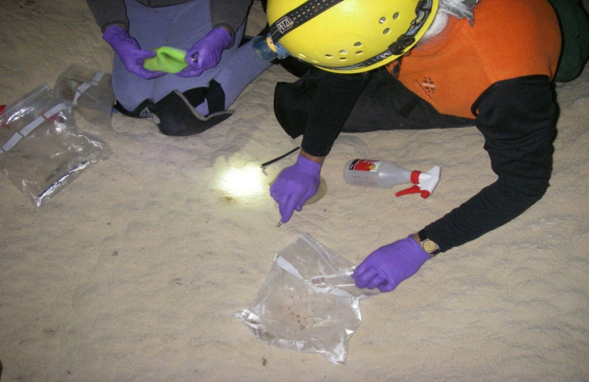
Cleaning Formations
Use Clean Water Sources
Capture and Dispose of Runoff
Watch for Biologic, Mineralogic, and Cultural Resources
Use common Sense around Delicate Formations

Slide 8
Mold Removal
Equipment
Ziplock bags
Antimicrobial Wipes
Disposable Gloves
Surgical Masks
Work Gently to avoid spore dispersal

Slide 9
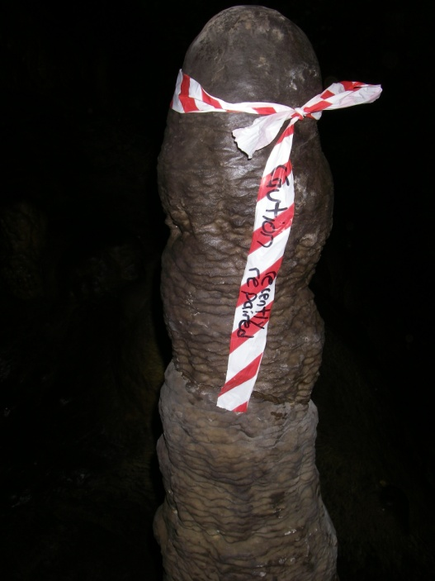
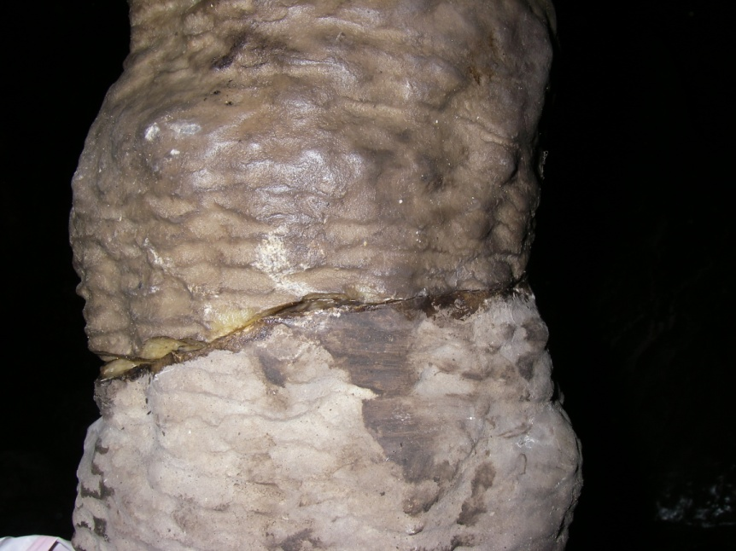
Formation Repair
Ask Questions
Is it a Natural Break?
Do the pieces Fit?
Is it Safe for Workers & other Formations?
Document with Photos and Text
Use Cave-Safe Epoxies
Epon 828 with Versamid
Epi-cure 3234 (TETA)
Use Stainless Steel rods, pins, wire

Slide 10
Buy The Book Go Out and Make It Beautiful

Slide 11
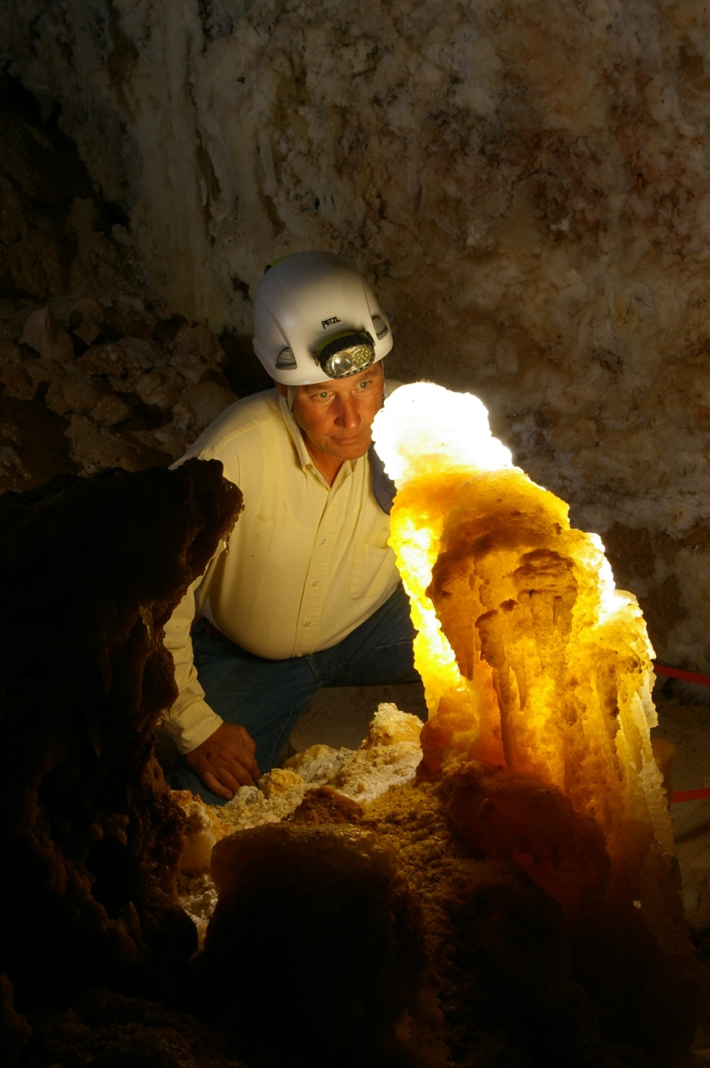
Questions?
Text by J. Goodbar – Photos by A. Stockton
Modified from 2007 J. Goodbar Presentation

