Slide 1
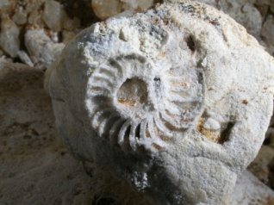
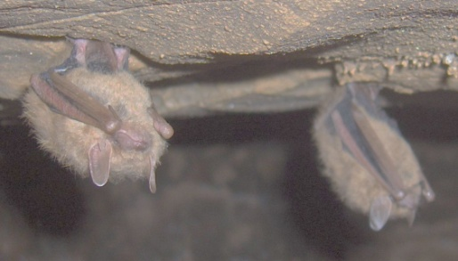
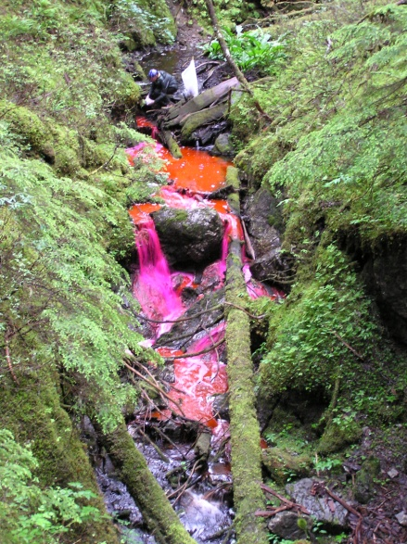
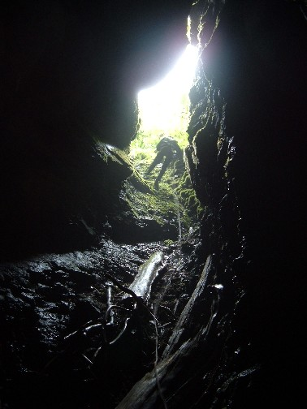
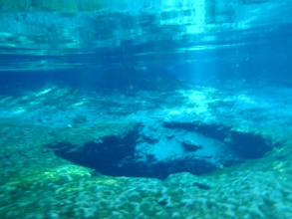
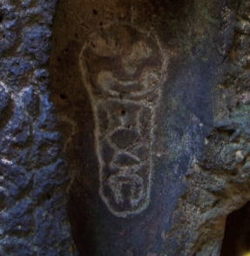
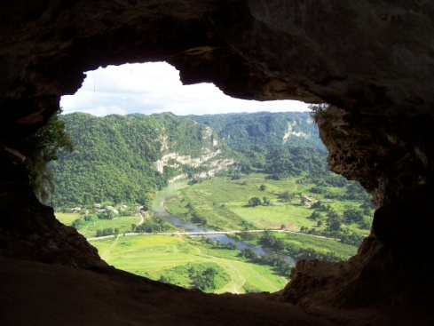
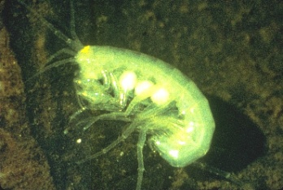
Cave and Karst Resource Inventory and Monitoring
Johanna Kovarik
USDA Forest Service
Minerals and Geology Management

Slide 2
Cave and Karst Resources
Secondary attributes and features both natural and man-made, that reside within the confines of the cave or karst system
Karst resources include epikarst development, springs and spring biota, etc.

Slide 3
Why Inventory?
You’ve got to know what you have and where it is in order to manage:
1. Extent of Karst development (cave systems)
2. Nature of the karst development (# of caves)
3. The resources preserved or endemic within
those environments (attributes) - biota,
cultural artifacts, paleo specimens, etc.
Inventory data provides a BASELINE to which future data can be compared and a valuable collection of data for research

Slide 4
Geographic Data
Resource Inventories
Photo documentation
Maps, databases, and
Geographic Information Systems (GIS)
Scientific Research
Sound Resource Management Decisions
Development of monitoring plan and protocol
Field data collection
Evaluation
Analysis

Slide 5
Don’t Panic!
Cave and Karst managers often have no funding or personnel
Inventory can be time consuming and difficult
The subset of resources within caves often falls beyond the scope of the particular resource a manager is familiar with
BUT
Some data is better than no data
Prioritize
We have an amazing group of stakeholders, and a wide variety of partnership options. Much of this data may already exist for your unit.
Don’t reinvent the wheel - many parks and forests have templates you can adapt!
Notes:
Much of the work described in the slides can be accomplished in some combination with stakeholders and partners. I am going to describe the basic overall process for cave and karst resource inventory – keep in mind that this can be accomplished at varying levels of detail and foci depending on the goals of your program and the extent and type of your cave and karst resources.

Slide 6
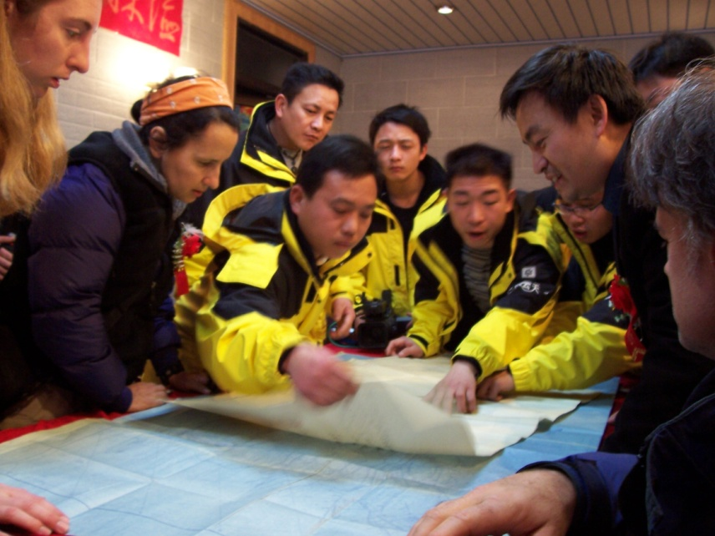
Inventory Background Work
Determine what you already have
State cave surveys, local grottos, hand written accounts
Maps and remote sensing data
Geologic maps
Topographic maps
Aerial photographs
Google Earth
More advanced: LiDar, etc.

Slide 7
Inventory Fieldwork
Plot known information on base map
Collect location information/ inventory new features (GPS)
Type of karst feature or cave
Cave entrance sheet - photos, tags!
Dye Tracing
Cave survey
General cave resource inventory
Detailed inventory

Slide 8
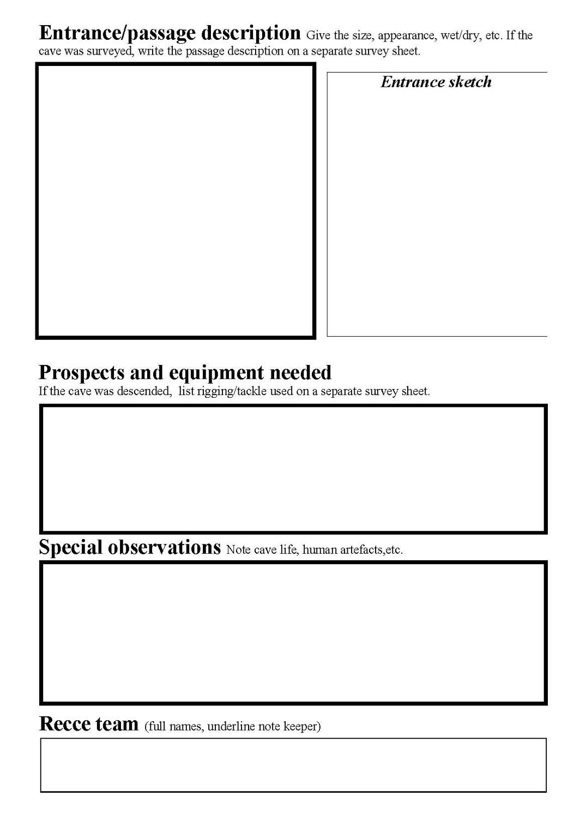
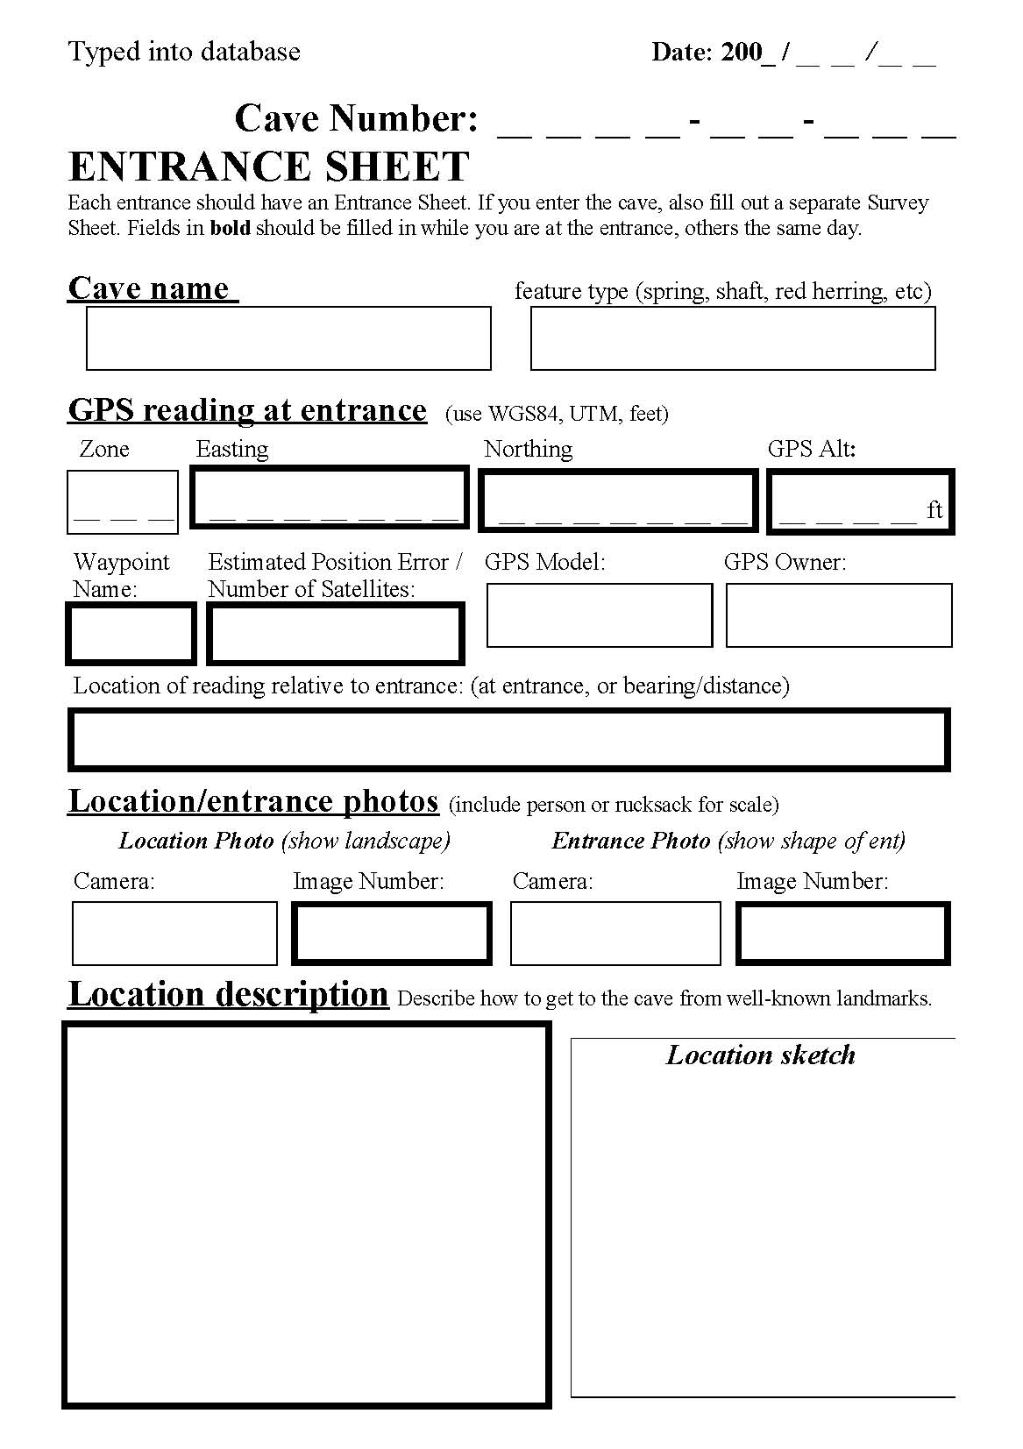

Slide 9
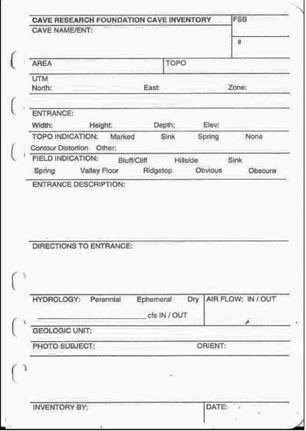
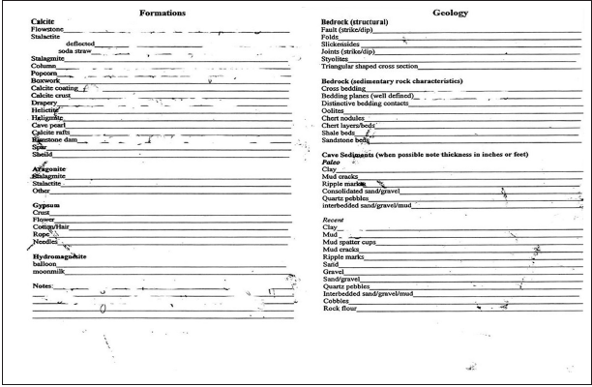
Resource Inventories
Generally conducted during the cave survey
Sketcher or dedicated inventory team member notes geology, biology, cultural, and paleontological resources
Further, detailed resource inventories for professionals in future projects
Notes:
Many parks and forests already implement this – don’t reinvent the wheel!

Slide 10
Record Keeping
Digital as well as hard copy database in safe places (fireproof filing cabinets! Backup hard drives!)
GIS provides easy access and spatial viewing
Consider where your agency keeps files – also consider keeping a digital copy of all files with stakeholders such as cave surveys

Slide 11
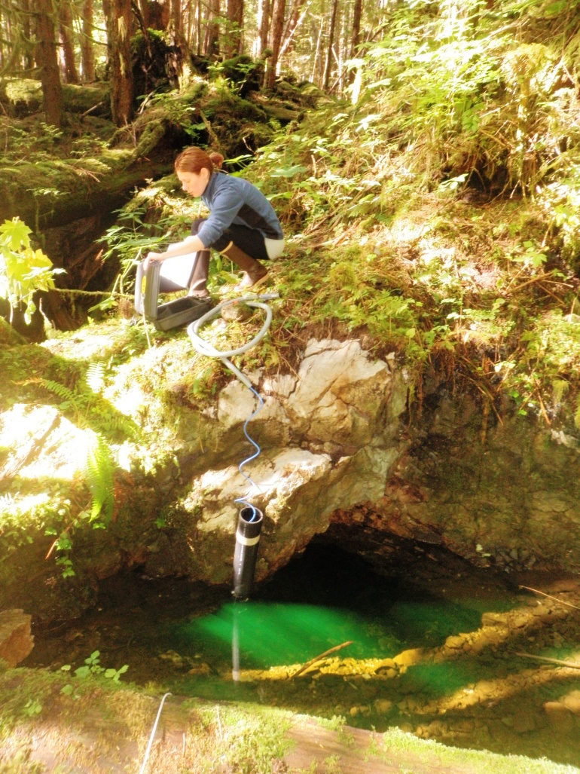
Why Monitor?
Adaptive Management – how much use and impact is too much?
Documenting use
Understanding how management decisions and strategies impact resources

Slide 12
Developing Protocol
Existing Condition
Desired Future Condition
Potential Impacts
Measureable Attributes
Reference condition / baseline
Identify Targets / Goals

Slide 13
NPS List of Monitored Cave Resources
Cave meteorology
Airborne sedimentation
Direct visitor impacts
Permanent or seasonal ice
Cave drip and pool water
Microbiology
Stability-breakdown, rockfall and partings
Mineral growth
Surface expressions and processes
Regional groundwater levels and quantity
Fluvial processes

Slide 14
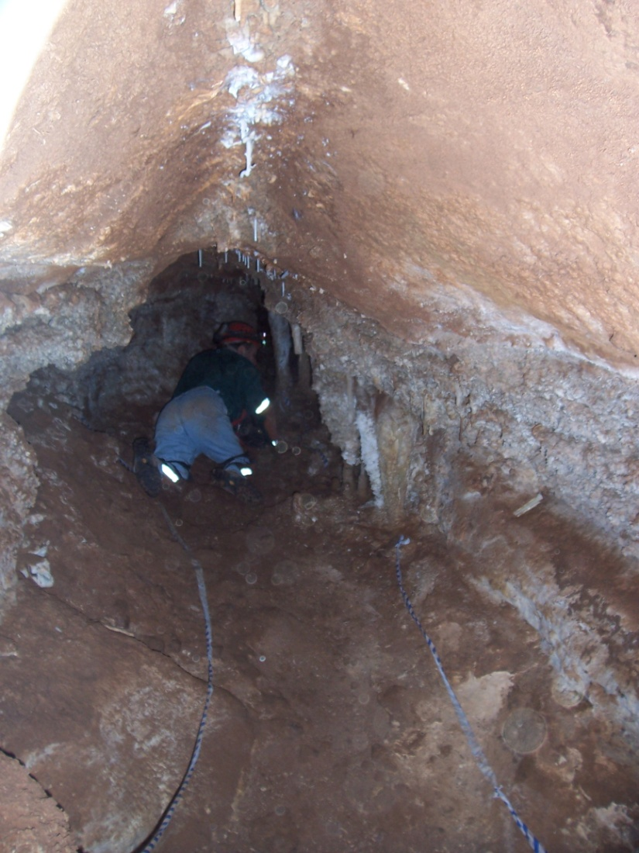
Potential Resource Impacts
Sedimentation / pollutants to karst aquifers
Damage to formations
Loss of habitat for endemic biota
Endless list!

Slide 15
Don’t Panic!
From simple, recreation permit feedback to complex data logger high resolution monitoring, cavers and volunteers are a great resource!
Agencies work together to develop tools – data sheets, monitoring protocol, etc.
Prioritize, and come up with a plan and indicators.

Slide 16
Existing Condition
Document Existing condition - Inventory, as discussed above!
Commission further in-depth studies if resources are present (paleo, cultural, biology, etc.)
Also consider past impacts – past harvest in an area, visitation to caves, etc.

Slide 17
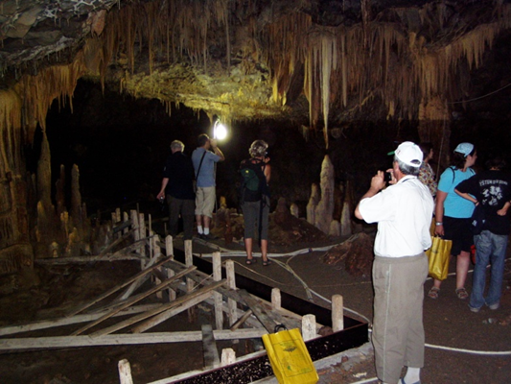
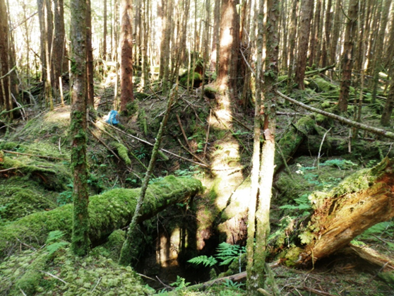
Reference Condition
Baseline / Background values
Can be difficult to achieve in heavily impacted areas
Perhaps develop an index based on similar
Caves in the same area
Springs in the same watershed

Slide 18
Identify Targets/ Future Condition
Again, Rehabilitate – to what values?
Baseline values for a pristine area
Drinking water quality standards
Known prior condition (inventory!)
Maintain
Current values, allow for natural variance and seasonal differences
Plan for impact – what is acceptable?

Slide 19
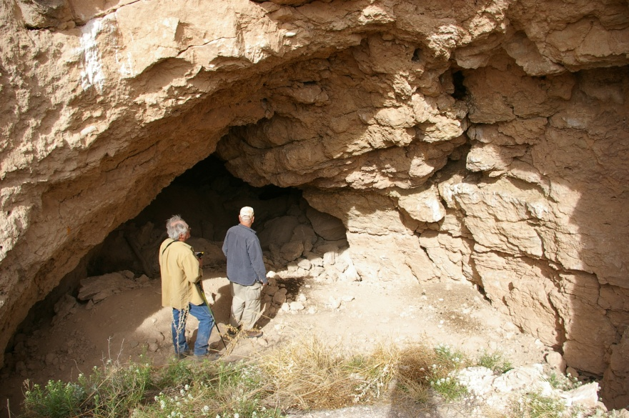
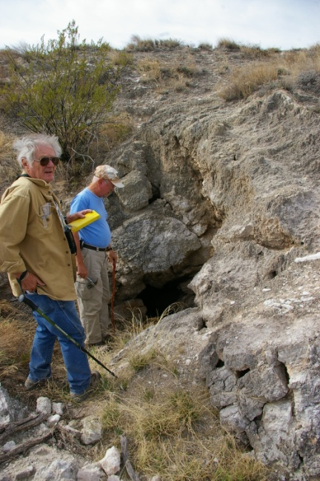
Human visitation/disturbance
Footprints (“brushing” areas clean)
Scheduled monitoring visits (staff or volunteers-stewards)
Data Loggers (light on/off) – place in entrance areas and in remote sections of caves.
Cave Registers
Photo points – recreate the same photograph
Permit issuance
DON’T LET MONITORING BECOME AN UNACCEPTABLE DISTURBANCE!

Slide 20
Photomonitoring “Worth a thousand words”
Provides clear observable comparisons to present and past.
Can document not only negative human caused impact, but also natural change as well.
Can document success stories! Restoration and responsible use.
Can document effectiveness of current management practices.

Slide 21
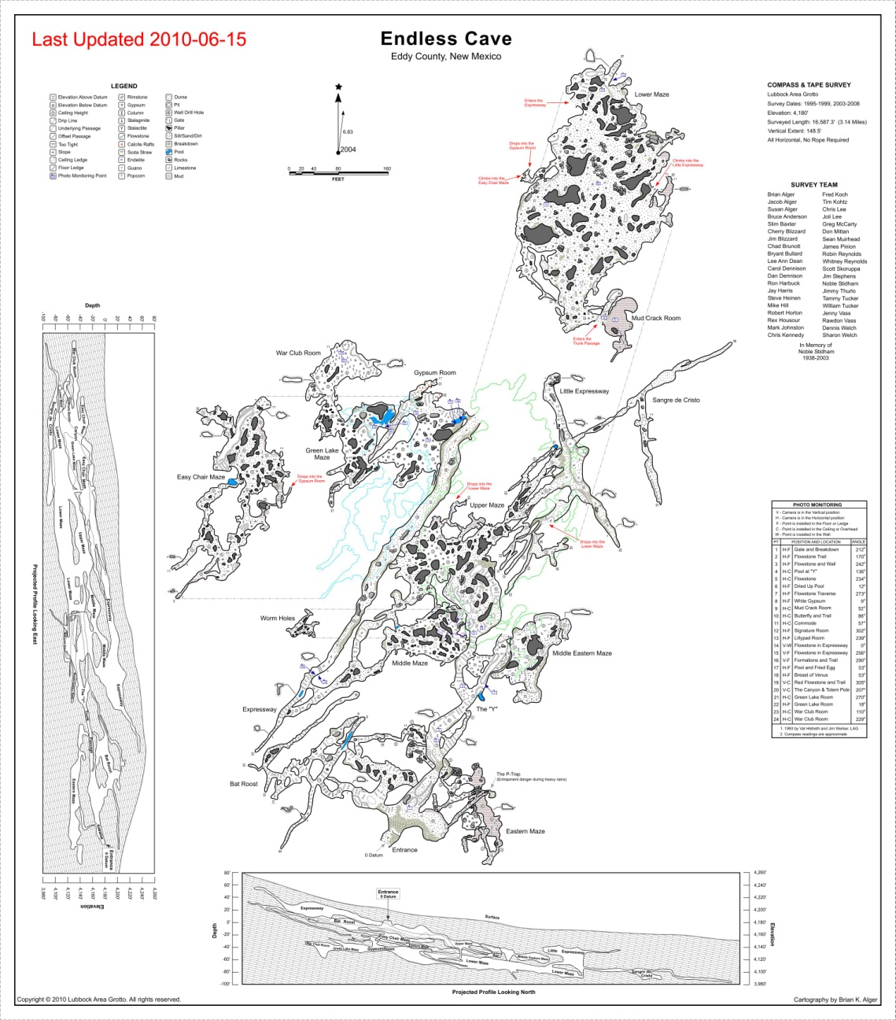

Slide 22
Monitoring Macro Impacts -Development in Karst Areas-
Implementation Monitoring
following NEPA action
were mitigation measures implemented properly?
Site monitoring
Pick an indicator – water quality is often a great one
Sedimentation, debris in sinkholes

Slide 23
What would you monitor in this situation? Indicators?

Slide 24
Limits of acceptable change/visitor experience and resource protection
Developed for Wilderness Areas and Parks
Defines amount of environmental change measured as indicators
Defines limits of acceptable change (LAC)
As change approaches determined limit, management actions are implemented

Slide 25
Visual Impact Evaluation System (VIES)
Easy to use form of LAC
Can be conducted by anyone
Objective – relies on observations
Provides a record of resource monitoring

Slide 26
VIES Steps
Identify indicators
Create impact scales
Determine LAC
Conduct monitoring

Slide 27
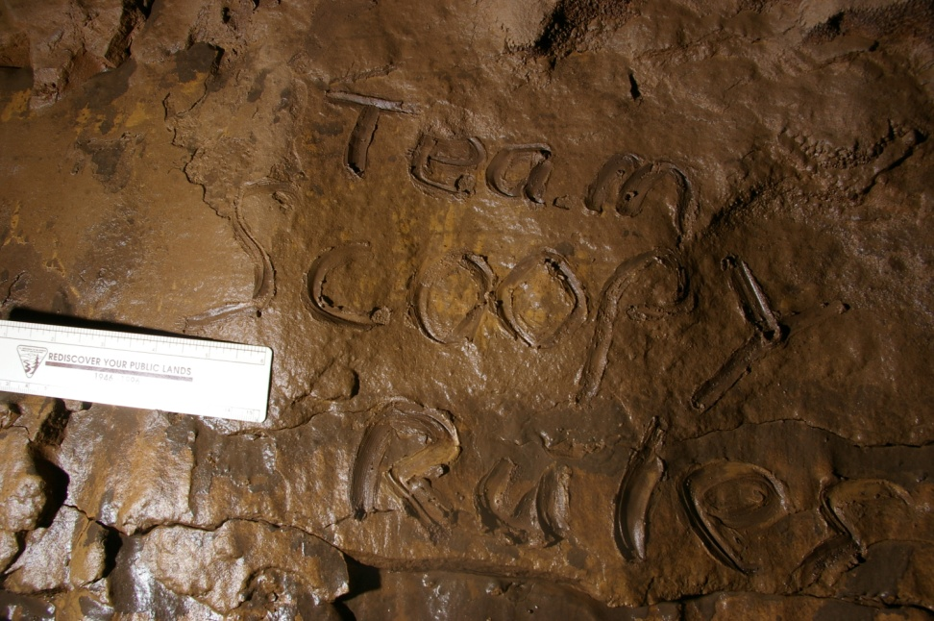
Identify Indicators
Easily observed
Relates to human impact
Examples may include trash, graffiti, impacted formations, critters, altered passages

Slide 28
Impact Scales
Scale indicates how much change the indicator is being impacted or altered
Should be easily understood and observed
Example:
Level 0 – No trash
Level 1 – Limited trash
Level 2 – Trash present
Level 3 – Trash impacts view

Slide 29
Determine LAC
Determine the maximum level of change that is acceptable for each cave “standard”
No change is often the preference and in some cases the only option.

Slide 30
Conduct Monitoring
Use previous monitoring reports for comparison
Establish permanent monitoring points
Document with photos and various methods

Slide 31
VIES Summary

Slide 32
Questions?
Modified from 2011 A. Stockton Presentation

