Slide 1
Cave Safety Standards
James Goodbar
Senior Cave/Karst Specialist
Bureau of Land Management
May 12-16, 2014
Cody, Wyoming

Slide 2
Cave Safety Standards
The Standards consist of:
Cave Safety Guidelines
Search and Rescue (SAR) Pre-Planning
Risk Assessment (DOI), Job Hazard Analysis (DOA)
You Will Learn:
Where and to Whom the Standards Apply,
What the Standards Require,
How they should be implemented
Who is Familiar with them? What is your Experience?

Slide 3
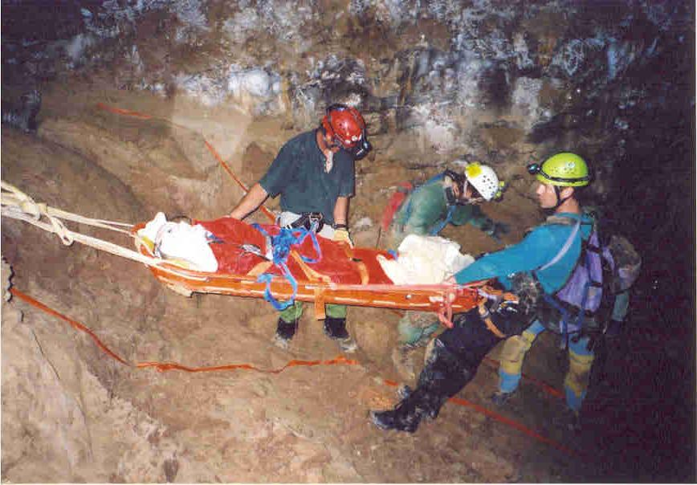
Cave Safety Guidelines
I M No. 2008-105/ FSH 6709
Attachment – JHA / Risk Assessment
Risk Management Worksheet

Slide 4
I M No. 2008-105 (BLM)
Policy/Action: (What is Requires)
Each affected employee becomes familiar with IM.
Affected employees will receive a copy of the Safety Guidelines and Risk Assessment Check List (RA).
Risks in individual caves should be assessed (Low, Medium, High, or Extremely High)
Ensure that cave SAR procedures are in your office Search and Rescue Plan, Cave Management Plans, Emergency Response Plan,
A safety orientation is required for employees or the general public entering caves.

Slide 5
Forest Service Handbook 6709
Very out-of-date
Currently being updated this year – will be a mirror document with the BLM safety guidelines
No official agency-wide JHA, but will be established with the new guidelines. Current examples available.

Slide 6
NPS Cave Safety Guidelines
IT IS EVERYONE’S RESPONSIBILITY TO BE SAFE.
SOME BASIC CAVE SAFETY GUIDELINES
http://inside.nps.gov/waso/custompages.cfm?prg=1107&id=3353&lv=3&pgid=1118
NPS Resource Management #77 – Health & Safety
http://www.nature.nps.gov/rm77/caves/Exhibit3.cfm
Park Cave & Karst Management Plans
Pre-SAR Rescue Plans
Will consider how to address safety at a national level

Slide 7
SAFETY FIRST
1ST Rule of Caving (and Life) – Never Fall

Slide 8
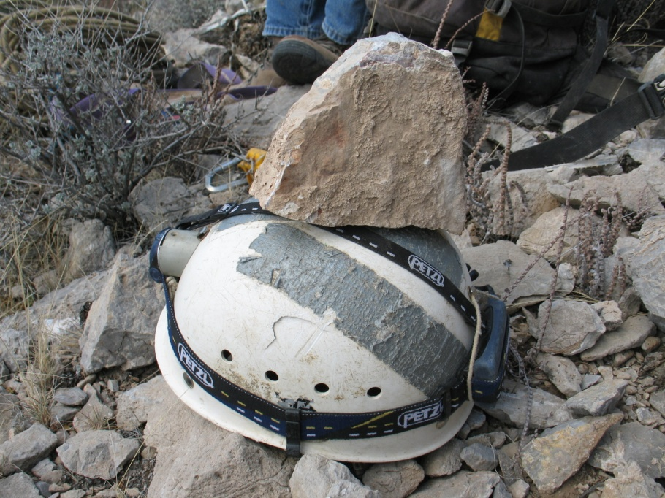
Risk Assessments
Risk Assessment Check List
Employee Name: __________________ Reviewed: (Employee Initial)______
Position Title: ____________________________________ Date: _________
Area or Division: __________________________________
Job element Risk Recommended Protective Measures
Specific Job Element, Unprepared/ Before Your Cave Trip* Obtain a cave
Pre-Trip Preparation/ Equipment Failure map* Know the location of physical
Equipment Check and legal access* Locate information on
risk* Tell someone where you are going
and when you should return* Inspect and
test equipment before using. Be sure all
equipment is adequate for the cave trip
Recommended Protective Equipment:* cave
map* gate keys or combination* pencil*
small tablet* three reliable independent light
sources* extra batteries and bulb* hard hat
with chin strap or preferably a caving or
climbing helmet equipped with a light* ETC.

Slide 9
RISK MANAGEMENT WORKSHEET

Slide 10
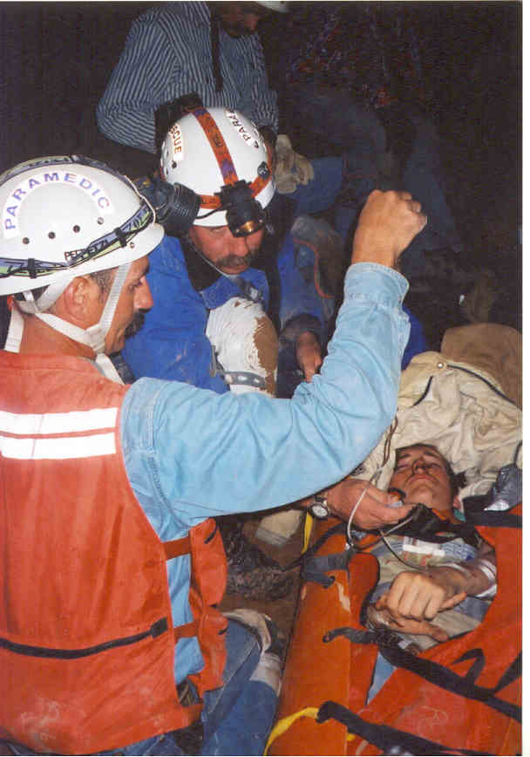
Search & Rescue Pre-Plans
Necessary for frequent use caves (recreation or scientific)
Pre-plans organize personnel &
equipment for urgent incidents
Provide guidance through the
initial response
Determine the sufficiency &
availability of existing cave
SAR programs
Develop partnerships between
agency and responsible authorities

Slide 11
Questions
?

