Slide 1
CAVE & KARST PROJECT MANAGEMENT
Dale L. Pate
NPS - National Cave & Karst Program Coordinator
May 12-16, 2014
Cody, Wyoming

Slide 2
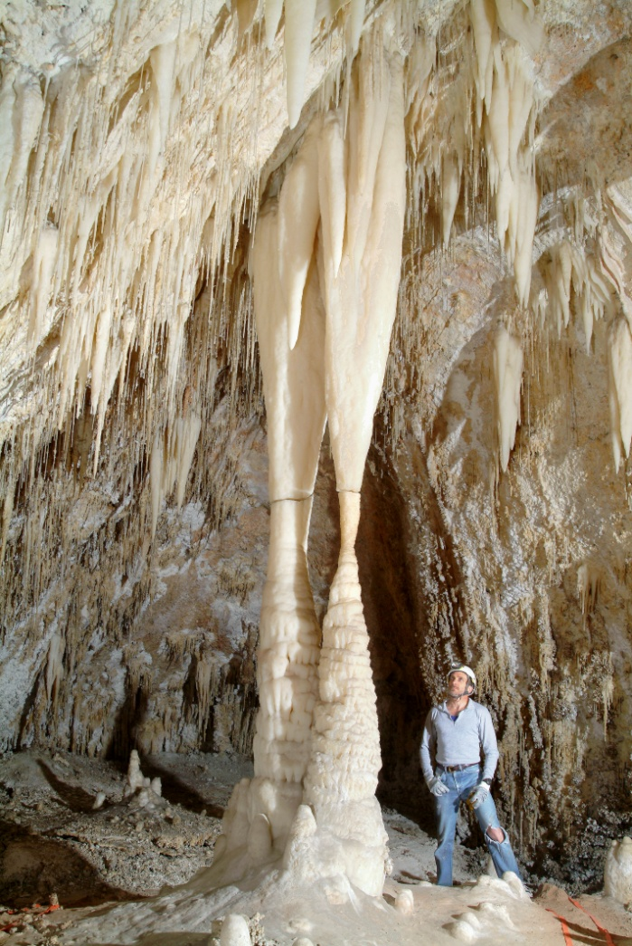
Cave & Karst Project Management
Importance of Understanding
the Resources
Defining the Project
Caves & Cave Systems
Exploration
Survey
Inventory
Data Manipulation & Storage
Karst Areas or Regions
Safety & SAR Activities

Slide 3
Understanding the Resources
Cave & Karst Resources – Out of sight, out of mind
Where does the cave go? Where does water from this spring come from? What are in these caves?
Are there buildings, oil pipelines, parking lots, sewer lines, and other structures built directly above caves and karst aquifers?
Do we know enough to prevent contamination?

Slide 4
Defining the Project?
Determine Needs & Set Clear Objectives
Normally done through the planning process
Develop Standards and Guidelines
Need quality data while minimizing impacts
Final Products
Cave Maps, GPS Locations, Reports, Files on each cave

Slide 5
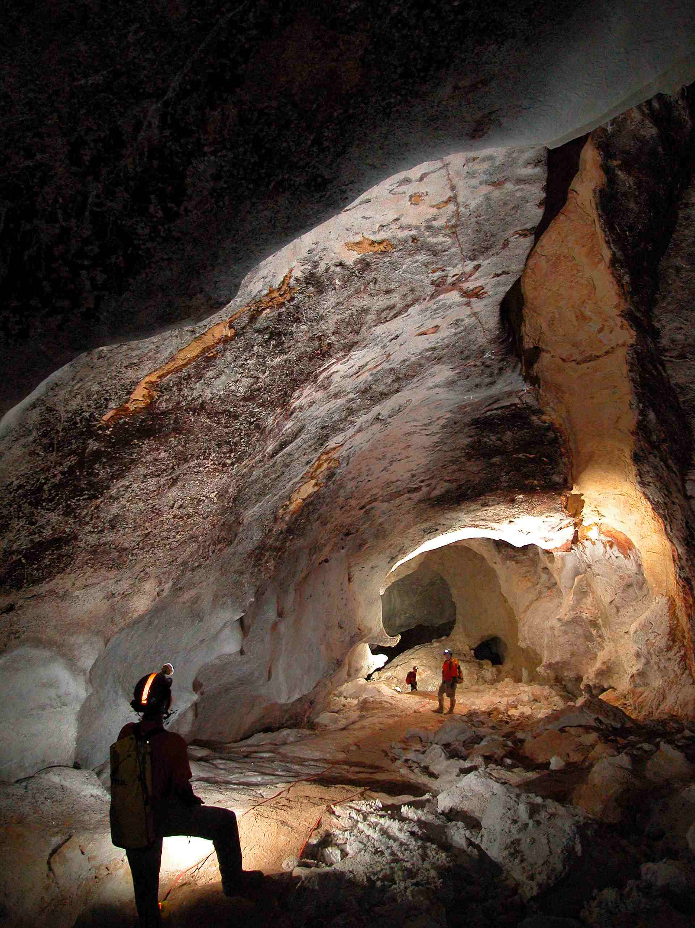
Caves & Cave Systems
EXPLORATION
Traveling through cave
Floors can be very fragile
Define trails to protect resources
Are there activities that need to be considered

Slide 6
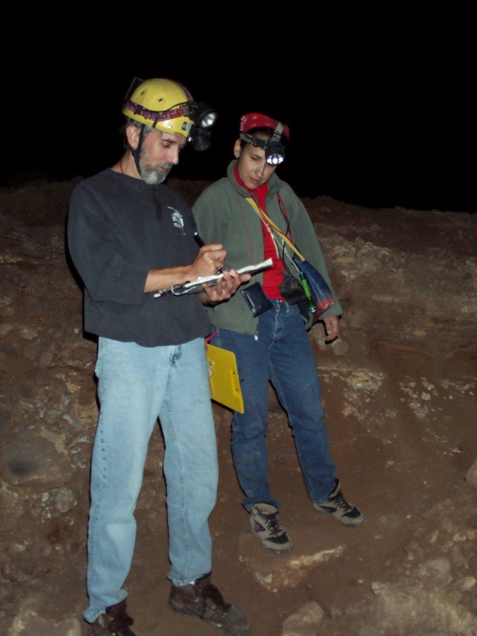
Caves & Cave Systems
SURVEY
Need accurate data
Length
Depth
Location
Shape of passages
Floor detail
Cross-sections
Profiles

Slide 7
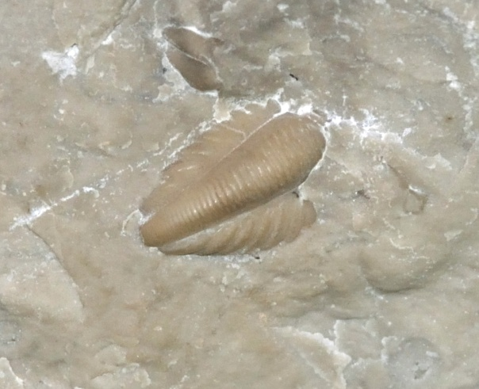
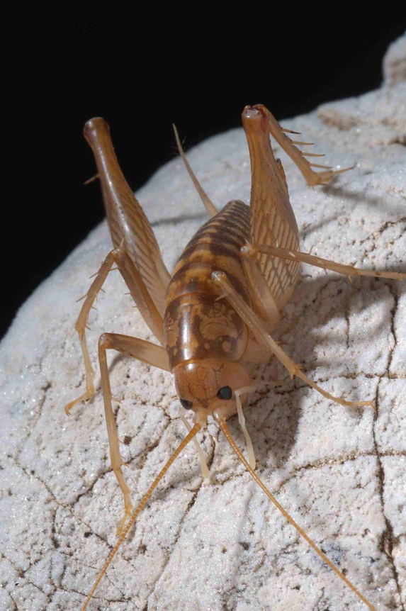
Caves & Cave Systems
Inventory
What is found in the cave and where are they located?
Geologic features
Hydrologic features
Paleontology
Biology
Archeology
Types of Speleothems
A general inventory can set the stage for a more detailed study
Photography is very useful

Slide 8
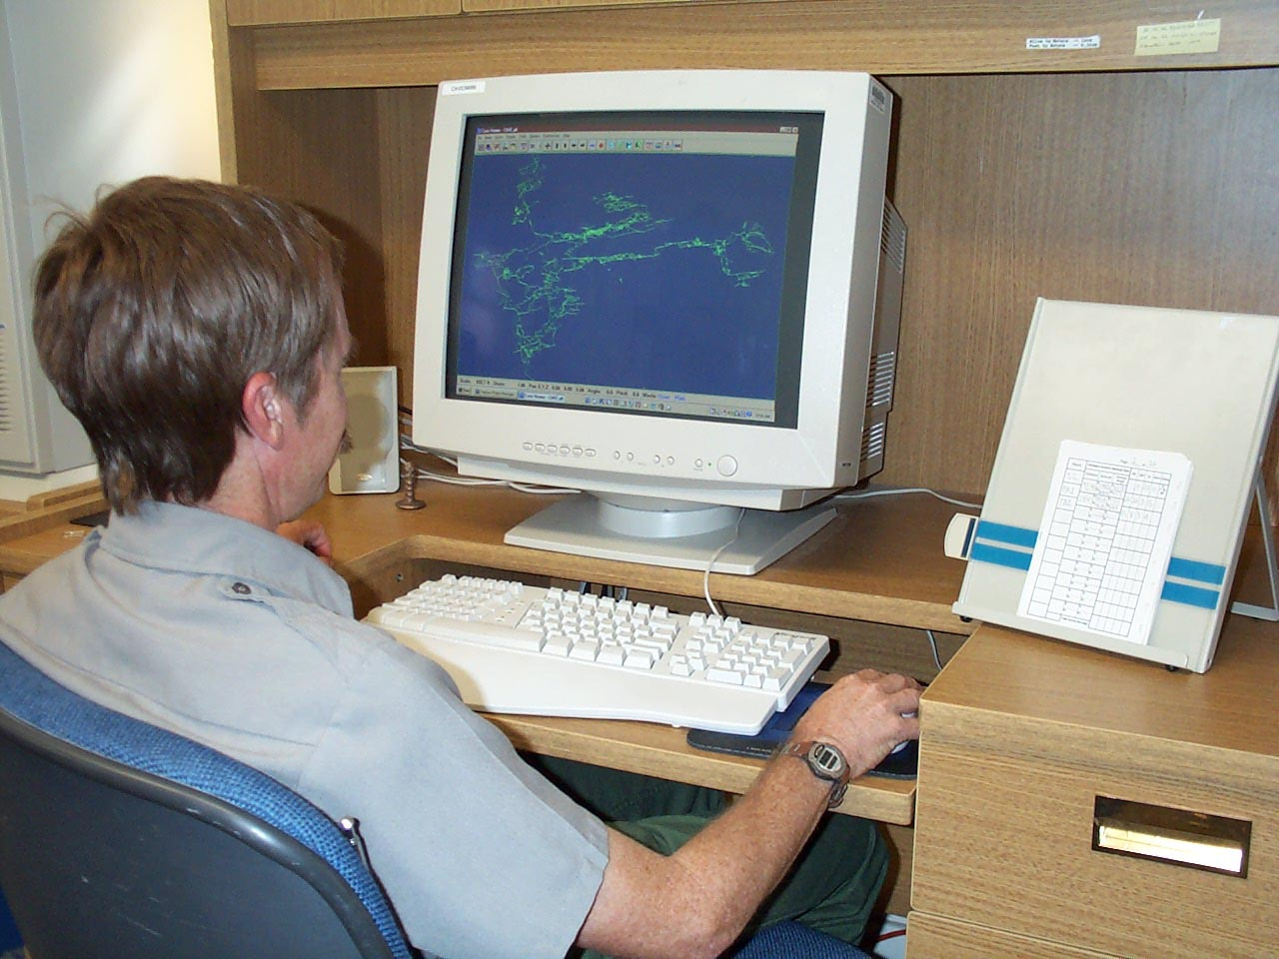
Cave & Cave Systems
Data Manipulation
& Storage
A large project generates a significant amount of information
Cave Mapping Software
Originals or copies of all survey sketches, inventories and notes
Fire-proof cabinets
Stay up-to-date

Slide 9
Karst Areas or Regions
Region-wide Studies can have great value
Large areas can contain a number of caves, springs and entire drainage basins
A regional view can pinpoint potential contamination sites and other problems

Slide 10
Karst Areas or Regions
THE BIGGER PICTURE
Document all caves (Surveys, Inventories, etc)
More In-depth Studies (Dye Traces, water chemistry, geomorphology, biological, etc)
Potential contamination sources both inside and outside study area
Use collected data to help understand & mitigate or prevent problems or issues.

Slide 11
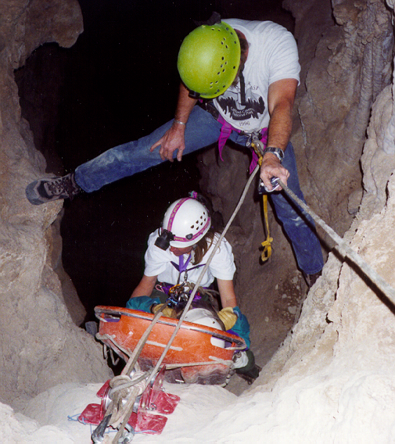
Safety & SAR Activities
SAFETY FIRST
Be safe, take care of the resources, and then get the job done
Accidents cost lives, money, and time
A rescue can impact sensitive cave resources significantly
Develop Pre-Rescue SAR Plans
Be alert & know what you are doing

Slide 12
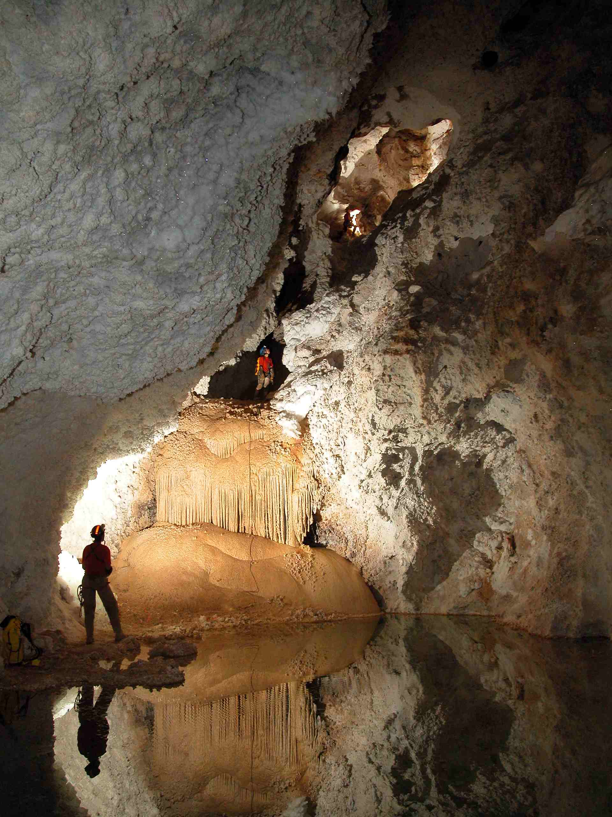
Final Products
WILL IT EVER BE FINISHED
Complete Cave Maps
Locational Information
Studies and Reports
Files – large amounts of information
A More Complete Understanding
Better Management

Slide 13
Thanks to the photographers
Stan Allison Jean Kreja
Google Earth Ron Miller
Peter Jones Dale Pate
Max Wisshak

