Slide 1
Developing and Writing
Effective Documents
Prepared for the
Bureau of Land Management
Prepared by
ICF International

Slide 2
Instructors
Ellen Unsworth, M.S., E.L.S., is a project manager and technical specialist at ICF in Sacramento, where she works on a wide variety of document types, including California Environmental Quality Act (CEQA) documents, scientific studies, monitoring reports, manuals, construction specifications, and interpretative exhibits. As a writer, she works primarily on geology and paleontology sections for National Environmental Policy Act (NEPA) and CEQA documents and on Caltrans-specific documents required for transportation projects affecting paleontological resources. In her 17 years as a technical writer and editor, Ellen has worked for the software industry, academia, and the state of Idaho. Ellen is also certified by the Board of Editors in the Life Sciences and holds a certificate of language proficiency in Danish.
Laura Cooper, B.A., is a managing editor at ICF in Portland, where she leads the PNW Environmental Management Team and edits National Environmental Policy Act (NEPA), California Environmental Quality Act (CEQA), and Washington State Environmental Policy Act (SEPA) documents, as well as wetland, natural resource, restoration, planning, and other documents. In her 25-year editing and writing career, Laura has researched and written about a broad range of environmental topics, provided copywriting and collateral for various nonprofit organizations, and developed training materials for businesses and schools.

Slide 3
Table of Contents
Introduction
Goals for the Class
3-Day Class Outline
Instructors
Class Introductions
Document Layers

Slide 4
Table of Contents
Chapter 1 Prewriting
Determining Document Needs
Identifying Your Audience
Getting Started
Establishing Parallelism
Outlining Your Document
Using Questions as a Writing Tool
Citing Sources

Slide 5
Table of Contents
Chapter 2 Writing
Why Good Writing Matters
Paragraph and Topic Sentences
Passive versus Active
Wordiness and Foggy Writing
Grammar
Punctuation
Style
Commonly Misused Words and Phrases
Numbers

Slide 6
Table of Contents
Chapter 3 Managing Documents
Setting Up Authors for Success
Creating a Writing Template
Writing Impact Statements and Mitigation Measures
Managing the Writing Process
Responding to Comments
Tables

Slide 7
Introduction

Slide 8
Introduction
Goals for the Class
3-Day Class Outline
Instructors
Class Introductions
Document Layers

Slide 9
Goals for the Class
Improve your writing and reviewing process through document planning and drafting
Refine your writing skills by reviewing key grammar, punctuation, and style concepts
Build your confidence and knowledge with individual and group exercises
Develop document management skills

Slide 10
3-Day Class Outline
Day 1―Prewriting (targeting your audience, outlining documents, citing sources)
Day 2―Writing (reviewing key grammar and style concepts important to clear writing)
Day 3―Managing Documents (managing multi-author documents, developing a consistent approach, analyzing impacts)

Slide 11
Instructors
Ellen Unsworth (M.S., E.L.S.; ICF, Sacramento)
Laura Cooper (B.A.; ICF, Portland)

Slide 12
Class Introductions
Name, position, office
Type of writing you do
How you feel about writing
What you hope to get out of this class
Level of skill with Microsoft Word
Something you like to do outside of work

Slide 13
Document Layers
Layer | Pieces | Sequence and Priority
Structure | Goals Outline Headings Order
Paragraphs | Paragraph types Paragraph order Topic sentences
Sentences | Grammar Style Terminology Sentence structure Clear language

Slide 14


Slide 15
Chapter 1–Prewriting

Slide 16
Chapter 1 Prewriting
Determining Document Needs
Identifying Your Audience
Getting Started
Establishing Parallelism
Outlining Your Document
Using Questions as a Writing Tool
Citing Sources

Slide 17
Determining Document Needs
What is the purpose of the document?
  Technical information? Summary? Public information?
  How does the audience affect the tone and content?
Is the document descriptive, persuasive, analytical? A combination?

Slide 18
Determining Document Needs
What do you need to know about document needs in order to get started?
What level of detail is appropriate?
What are common unknowns?
What is the budget and schedule?
What is the likelihood the project will be subject to litigation? Is it a controversial project?

Slide 19
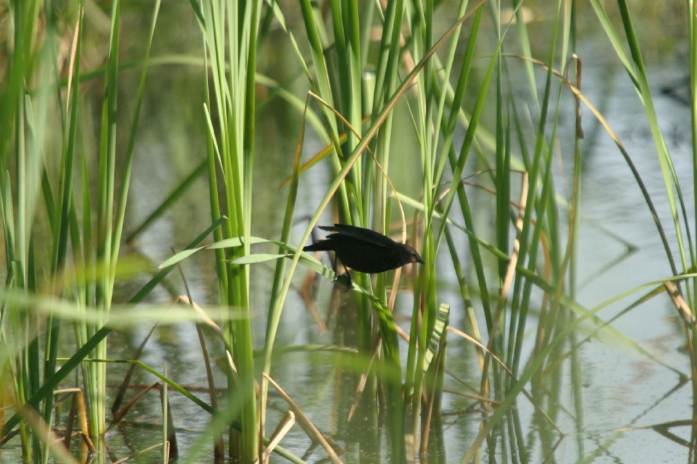

Slide 20
Identifying Your Audience
Write for your audience
Consider your first audience and your final audience
  Reviewers
  Intended audience

Slide 21
Identifying Your Audience
Know Your Reviewers
Why are they reviewing the document?
What do they look for in a document?
What is important to them?
What are their pet peeves?

Slide 22
Identifying Your Audience
Understand Your Intended Audience
How much do they know about the subject?
Are they technical or nontechnical?
Why are they reading your document?
How much background do they need?
What are they concerned about?

Slide 23
Identifying Your Audience
Are there potential controversies?
What can you do to make your document more useful to them?
Do they have document-related preferences?

Slide 24
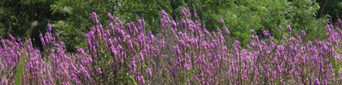

Slide 25
Getting Started
Writing as a Recursive Process (not linear)
  Preparing to write
  Writing
  Revising

Slide 26
Getting Started
Generating ideas and avoiding the “blank page syndrome”
  Reading
  Brainstorming
  Outlining
  Mapping
  Freewriting/focused freewriting
  Writing in pieces

Slide 27


Slide 28
Establishing Parallelism
Parallelism refers to expressing similar ideas in similar ways and showing that these ideas have the same level of importance
Parallel structure—which consists of repeating a pattern in a series of items in a list, consecutive sentences, headings, or ideas—helps your reader see the connections between ideas
Parallel structure should be maintained at all levels of writing: outline, paragraph, sentence, and word

Slide 29
Establishing Parallelism
At the document level, parallel subheadings at the same level have a similar relationship to the major heading and are parallel in grammatical form
  Alternative A—Seven Pond, Raised Levee
    Pond Use and Design
    Pond Operations
  Alternative B—Five Pond, Low Levee
    Pond Use and Design
    Pond Operations
  Alternative C—No Action Alternative
    Pond Use and Design
    Pond Operations

Slide 30
Establishing Parallelism
At the word, phrase, or sentence level, parallel structures use the same grammatical form of items in lists and in the sentence as a whole
  The LID is proposing to replace the Palm and Pine siphon pipelines along the Blue Canal, west of Applewood, California. This canal:
    conveys raw water for irrigation to customers of the LID,
    runs generally east to west, and
    supplies water treatment plants.

Slide 31
Establishing Parallelism
We the people of the United States, in order to form a more perfect union, establish justice, insure domestic tranquility, provide for the common defense, promote the general welfare, and secure the blessings of liberty to ourselves and our posterity, do ordain and establish this Constitution for the United States of America.
Preamble to the U.S. Constitution

Slide 32
Establishing Parallelism
The following Consolidated Resource Management Plan (Consolidated RMP) incorporates decisions: 1) That are RMP level decisions, implementation level decisions, or administrative actions, 2) Found inappropriate sections of the draft or final Smith or Centerville Resource Management Plan or their associated records of Decision, or 3) Will be traced to a valid Management Framework Plan later incorporated into either the Centerville or Smith Resource Management Plan, 4) Decisions found in the amendments described above, 5) Decisions found in the three wilderness EISs 6) designations of cultural resource sites on the National Register of Historic Places and a National Landmark and 7) includes national policy statements for each resource, issue, or program for which policy direction has been provided.

Slide 33
Exercise: Parallelism
Correct these unparallelisms.
African elephants are endangered because poachers kill them and having less and less space to live in.
The term adjacent means bordering, neighboring, or close proximity.
When I go to the market I like to buy fish, cherries, and go to the bakery.

Slide 34
Exercise: Parallelism
Complete Exercise 1, Parallelism.

Slide 35
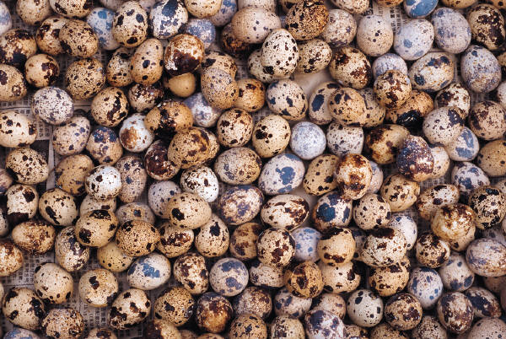

Slide 36
Outlining Your Document
Benefits of Outlining
Eases you into the writing process
Saves you time
Allows you to separate the thinking and writing processes
Saves your reviewers time
Helps you and your reviewers detect duplicated, superfluous, or missing information
Helps you present information in a parallel manner

Slide 37
Outlining Your Document
Develop the main headings
Add second-level headings
Add third-level headings
See examples from an EA on following slides

Slide 38
Outlining Your Document
Example Outline—Affected Environment
Vegetation and Wetlands
  Regulatory Setting
  Environmental Setting
    Land Cover Types
      Riparian Communities
      Nonriparian Woodland Communities
      Wetland Community
      Herbaceous Community
      Developed/Landscaped
    Special-Status Plant Species
    Invasive Plant Species

Slide 39
Outlining Your Document
Example Outline —Impacts
Alternative 1
  Construction
  Operation
  Maintenance
  Restoration

Slide 40
Outlining Your Document
Example Outline—Impacts Option1
Vegetation and Wetlands
  Methods
  Construction
    Land Cover Types
    Special-Status Species
    Invasive Plant Species
  Operation
    Land Cover Types
    Special-Status Species
    Invasive Plant Species

Slide 41
Example Outline—Impacts Option 2
Vegetation and Wetlands
  Methods
  Land Cover Types
    Construction
    Operation
  Special-Status Species
    Construction
    Operation
  Invasive Plant Species
    Construction
    Operation

Slide 42
Outlining Your Document
Outline Example—Affected Environment
Geology
  Geology
    Regional Geologic Setting
    Project Area Geologic Setting
  Geologic Hazards
    Primary Seismic Hazards
      Surface Fault Rupture
      Strong Ground Shaking
    Secondary Seismic Hazards
      Liquefaction
      Slope Failure
    Slope Stability

Slide 43
Outlining Your Document
Recommended EA Format: Guidance from the BLM Handbook, Appendix 9
1. Introduction
2. Proposed Action and Alternatives
3. Affected Environment
4. Environmental Effects
5. Tribes, Individuals, Organizations, or Agencies Consulted
6. List of Preparers

Slide 44
TIP: Word’s Outline and
Navigation Pane Features
The outline and navigation pane features allow you to see your document structure
Open the example Word document
Go to View/Outline
  Good for moving pieces around
Go to View/Navigation Pane
  Good for navigating text and outline simultaneously

Slide 45
Exercise: Outlining
Review and revise the outline of your document or the example document.
  Go to the third-level headings
  Make improvements
  Take about 20 minutes

Slide 46
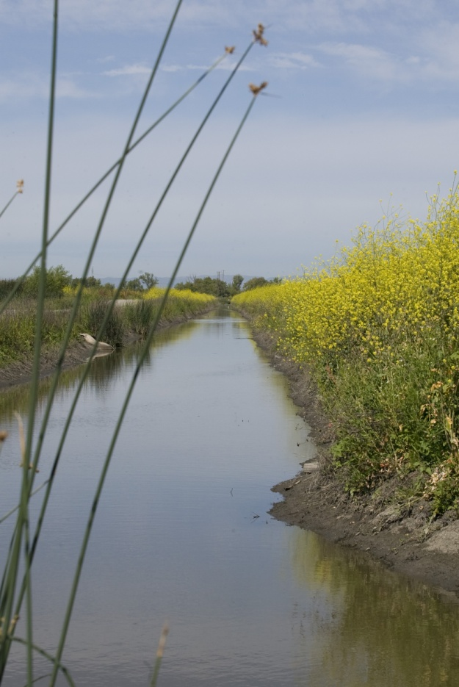

Slide 47
Using Questions as a Writing Tool
Develop questions under each heading
  What information do you need to cover in this section?
Benefits of developing these questions
  You can discuss content with your reviewers
  Questions lead to topic sentences

Slide 48
Using Questions as a Writing Tool
EXAMPLES of QUESTIONS
Geology
  Regional Geologic Setting
    In what geomorphic province is the project site located?
    What are the characteristics of the setting?
      Structure
      Extent
      Elevation
      General geology
  Project Area Geologic Setting
    What geologic units are exposed in the project area?
    What are the characteristics of the units?
      Age
      Description
      Origin
      Other issues
Geologic Hazards
  Primary Seismic Hazards
    Surface Fault Rupture
      What is surface fault rupture?
      What is the Alquist-Priolo Act?
      What is the risk of surface fault rupture in the project area?

Slide 49
Using Questions as a Writing Tool
EXAMPLES of ANSWERS
Regional Geologic Setting
  The 158-acre project site is located in the:
    Sierra Nevada geomorphic province
      is a tilted fault block whose east face is a high, rugged multiple scarp,
      is nearly 400 miles long; and
      ranges in elevation from 300 to 14,495 feet above mean sea level (Smith 2003, 14), and
      contains metamorphic bedrock with gold-bearing veins in the Mother Lode (Jones 2011, 234).
Project Site Geologic Setting
  The geologic unit exposed in the project site is the XYZ Formation (QtlX), and is:
    of Pleistocene age;
    made up of deeply weathered and dissected arkosic gravels,
    derived from plutonic rocks of the Sierra Nevada to the east (Smith 2013, 17), and
    not associated with asbestos, which is a concern in other parts of Apple County (Jones 2000, 55).

Slide 50
Using Questions as a Writing Tool
Another Example: Surface Fault Rupture
Brief definition of surface fault rupture and reference to Alquist-Priolo Earthquake Fault Zoning Act.
The potential for surface fault rupture to affect the project site is low.
  No active faults are at or near the project site (CGS 2010).
  Closest faults to the project site are the Deadman Fault Zone, which is approximately 12 miles east of the project site, and the Willows Fault Zone, which is approximately 12 miles west of the project site. Neither of these faults shows evidence of Quaternary movement (i.e., movement in the last 1.6 million years) (CGS 2010).

Slide 51
Exercise: Using Questions as a Tool
In your own document:
Develop questions under each heading.

Slide 52


Slide 53
Citing Sources
Documenting source materials is important for three reasons:
To complete the administrative record and to produce a legally defensible document
To provide reviewers information about source materials that substantiate your analysis
To avoid the risk of plagiarism

Slide 54
Citing Sources
Correct citation consists of two components
  In-text citation
  Corresponding reference

Slide 55
Citing Sources
Parts of a citation and a reference
  In-text citation: author, date, page number
    Many areas in the Central Valley have experienced subsidence, most notably the San Joaquin Valley and Delta (Faunt 2009:99).
  Reference: author, date, title, publisher or website
    Faunt, C. C. 2009. Groundwater Availability of the Central Valley Aquifer, California: U.S. Geological Survey Professional Paper 1766. Available: http://pubs.usgs.gov/pp/1766/ PP_1766.pdf. Accessed: January 20, 2010.

Slide 56
Citing Sources
What do you NOT need to cite?
Common knowledge
  Facts, proverbs, familiar expressions, and information generally accepted as “common knowledge” in a specific discipline require no citation unless they are taken verbatim from another source
    On April 14, 1865, a few days after Lee’s surrender, Lincoln was assassinated.
  Common knowledge depends on context

Slide 57
Citing Sources
What do you NOT need to cite?
  Material you authored
    If the source material was authored by your agency, no in-text citation is needed (other than for sources embedded in the borrowed text)
    Direct verbatim quotation from someone in your agency is permissible without quotation marks

Slide 58
Citing Sources
What do you NEED to cite?
Direct quotations
The secondary source that reports on, summarizes, or interprets your primary resource
The ideas, concepts, or underlying arguments that support your analysis, whether you summarize, paraphrase, or quote them

Slide 59
Citing Sources
What constitutes plagiarism?
Copying the text, verbatim, of another source without proper citation
Copying the idea, data, or results of another source without proper citation (theft of intellectual property)
Plagiarism is an act of fraud

Slide 60
Citing Sources
Where are we at greatest risk for plagiarism?
Copying text from websites
Copying text from old reports

Slide 61
Exercise: Citing Sources
Review each example and determine whether the text has been correctly cited.
The Elkhorn Pit is 20 acres. Until 1994 approximately 5,000 to 6,000 cubic yards of material were extracted each year. Since 1994, an average of 15,000 cubic yards of gravel has been removed each year.
Monitoring data for Region 4 showed the average daily concentrations of particulate matter during 2001–2006 had been met, and the air quality in 2006 was rated as good for 97.8% of the year (Nevada Bureau of Air Pollution Control 2006).

Slide 62
Exercise: Citing Sources
California lies to the west of the Mississippi River (Atlas 2010).
No cultural resources surveys were conducted. No cultural resources are located within the project area.
The study conducted by Brown demonstrated that fish eggs require sufficient heat to hatch. However, this point was refuted by a later study in which fish eggs hatched at sub-zero temperatures.
Benjamin Franklin argued for a nation based on democratic principles and public education. Nevertheless, his own life embodied a history of bias, abuse, and corruption.

Slide 63
Citing Sources
As You Write Your Document
Track sources from the start of your research
  Developing a source list can help you get a good overview of your approach
  Watching the list grow can reinforce your sense of accomplishment and competency
  Tracking the references from the beginning saves you from the onerous job of assembling the information after you’ve finished writing

Slide 64
Citing Sources
  Provide in-text citations using your agency’s format
    (Smith 2002)
    (Jones 2002 in Brown 2008) (Jones 2002 as cited in Brown 2008)
    (Nelson 2002, Davis 2008) (Nelson 2002; Davis 2008)
    (Bertram pers. comm.)
    (Thom et al. 1990)

Slide 65
Citing Sources
  Develop a template for each item in your bibliography
    book
    monograph or other bound publication in a series
    report (including government reports)
    journal article
    published dissertation
    web page

Slide 66
Citing Sources
Style Manuals
MLA (Modern Language Association; see http://www.mla.org/style and http://owl.english.purdue.edu/owl/resource/557/01/)
APA (American Psychological Association; see http://apastyle.apa.org/ and http://owl.english.purdue.edu/owl/resource/560/01/)
Chicago Manual of Style (see http://www.chicagomanualofstyle.org/tools_citationguide.html)
The OWL at Purdue
  http://owl.english.purdue.edu/owl/resource/696/01/

Slide 67
TIP: Reference Templates
Report:
  [Author(s)]. [Year]. [Report Title in Title Case and Italics] . [Version (draft, final)]. [Internal report number]. [City], [STATE (two-letter abbrev.)]. [Prepared for or prepared by (include city and ST)]"
Book:
  [Author(s)]. [Year]. [Book Title in Title Case and Italics] . [Edition)]. [City], [STATE (two-letter abbrev.)]: [Publisher].
Journal article:
  [Author(s)]. [Year]. [Journal Article Title in Title Case] . [Journal Name in Title Case and Italics] [Volume]([Issue]):[Page from]–[Page to].
Website:
  [Author(s)]. [Year]. [Website Title in Title Case and Italics] . Last revised: [Date posted or last revised)]. Available:[URL, including http://]. Accessed: [Date].
Article in an anthology:
  [Author(s)]. [Year]. [Title in Title Case]. In [Editor(s) Name(s)] (ed(s).), [Publication Title in Title Case and Italics]. [City, ST]: [Publisher].
Personal communication:
  [Last name, first name]. [Job Title]. [Organization/agency name, city, state.]. [Date)]—[Type of personal communication].

Slide 68
TIP: Word’s Reference Ribbon, Quick Parts, and Clipboard
References ribbon lets you insert citations
Clipboard lets you copy multiple items and paste them as you need them
Quick parts lets you build in automation

Slide 69
Exercise: References
Select three documents and write a citation and reference for each one.
Choose different types of references—books, unpublished reports, web sites, personal communications.

Slide 70
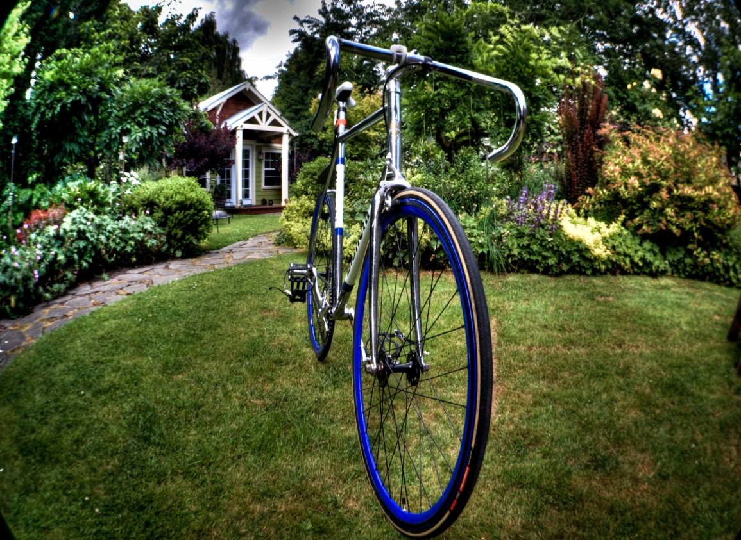

Slide 71
Chapter 1 Prewriting: Review
Determining Document Needs
Identifying Your Audience
Getting Started
Establishing Parallelism
Outlining Your Document
Using Questions as a Writing Tool
Citing Sources
Questions?

Slide 72
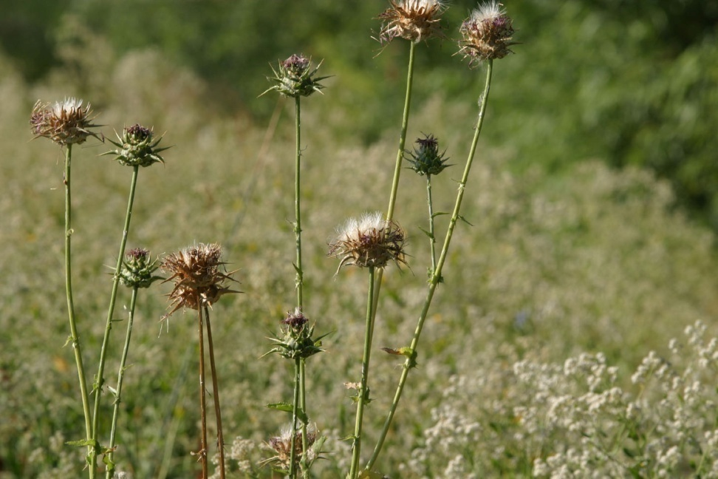
Goodnight!

Slide 73
Chapter 2–Writing

Slide 74
Chapter 2 Writing
Why Good Writing Matters
Paragraph and Topic Sentences
Passive versus Active Voice
Wordiness and Foggy Writing
Grammar
Punctuation
Style
Commonly Misused Words and Phrases
Numbers

Slide 75
Why Good Writing Matters
A few real-life examples:
Predicted resource/use condition given the combination of operators has been provided a clear goal.
The operation of a water well will be impacted if the water column in the well drops sufficiently to not allow the water level in the well to be drawn down enough to induce flow into the well. In general, the larger the drawdown the larger the induced flow that will not be realized.

Slide 76
Why Good Writing Matters
The “Voluntary Incentives Program” project in Puget Sound focused on Moving that debate over whether Voluntary Incentive Programs are useful tools for achieving resource objectives forward by identifying solutions to address key criticisms of these programs, and to build on recognized successes.

Slide 77
Why Good Writing Matters
The California Bay-Delta Authority (Authority) was created by the California State Legislature in 2002 to oversee implementation of CALFED by coordinating the activities of numerous implementing agencies to promote balanced implementation of activities to meet the objectives of CALFED.
. . . in order to not preclude the possibility of a need to accommodate any presently unforeseen needs.

Slide 78


Slide 79
Paragraph and Topic Sentences
Focus on a main point
A paragraph should be unified around a main point. The main point should be clear to the reader, and all sentences in the paragraph must relate to it.

Slide 80
Paragraph and Topic Sentences
Summarize the main point in a topic sentence
Generally, the topic sentence appears first
  It tells the reader where you are going
  It helps the reader remember or refer back to your point
  It enables the skimmer to find information quickly

Slide 81
Paragraph and Topic Sentences
  Topic sentences can also appear later
  Transitional sentences at the beginning of paragraphs
  Topic sentence withheld until the end of the paragraph
  Paragraph is descriptive and does not need a topic sentence
  Topic sentence is not needed if a paragraph continues to develop an idea clearly introduced in a previous paragraph
Most paragraphs need a topic sentence!

Slide 82
Paragraph and Topic Sentences
Laura’s favorite topic sentences:
  Call me Ishmael. (Herman Melville, Moby Dick, 1851)
It was the best of times, it was the worst of times, it was the age of wisdom, it was the age of foolishness, it was the epoch of belief, it was the epoch of incredulity, it was the season of Light, it was the season of Darkness, it was the spring of hope, it was the winter of despair. (Charles Dickens, A Tale of Two Cities, 1859)
  Ellen’s favorite topic sentence:
  Some of the strongest evidence for transgenerational inheritance (…) in humans comes from the survivors of the Dutch Hunger Winter. (Natural History 6/12)

Slide 83
Paragraph and Topic Sentences
Organizing your paragraph
  Examples and illustrations (most common)
  Narration
  Description
  Process (usually describing how to do something)
  Comparison and contrast
  Analogy
  Cause and effect
  Classification and division
  Definition

Slide 84
Paragraph and Topic Sentences
Here is an example of a classification paragraph:
Scientists sort electric fishes into two categories. The first comprises the strongly electric species such as the marine electric rays or the South American electric eel; these deliver a punch strong enough to stun a human. In recent years, biologists have focused on a second category: weakly electric fish in the South American and African rivers that use tiny voltages for communication and navigation. —Anne Rudloe and Jack Rudloe, “Electric Warfare: The Fish That Kill with Thunderbolts”

Slide 85
Paragraph and Topic Sentences
Arranging the information
  Chronological order
  Spatial order
  Dramatic order (building toward a conclusion)
  Order of complexity (from simple to complex)
  Order of familiarity (from most familiar to least familiar)
  Order of audience appeal (from safe ideas to ideas that may challenge the audience’s views)

Slide 86
Paragraph and Topic Sentences
Reasons for beginning a new paragraph
  To shift to a new idea after the preceding one has been fully developed
  To signal the introduction or conclusion
  To highlight a contrast
  To provide readers with a needed pause
  To break up text that looks too dense

Slide 87
Paragraph and Topic Sentences
Reasons for combining paragraphs
  To sustain the reader’s momentum
  To clarify the essay’s organization
  To connect closely related ideas
  To bind together text that looks too choppy

Slide 88
Paragraph and Topic Sentences
BLM Paragraph Example
Reclamation will be completed on areas that are depleted of gravel and are no longer needed for processing or stockpiling. The area will be appropriately contoured, adequate drainage provided, and topsoil put back and seeded to plant species identified by the authorized officer. If needed, seeding shall be repeated until appropriate ground cover is established as determined by the authorized officer. Unwanted material would be buried on site.

Slide 89
Exercise: Paragraphs and Topic Sentences
Select one of the paragraphs from Exercise 2, Paragraph/Topic Sentence.
Read the paragraph closely to determine the topic sentence. Not all the paragraphs will have a topic sentence; if yours doesn’t, devise one.
Reorganize, rearrange, revise as needed.
Make sure the paragraph focuses on a main point.
Take about 20 minutes.

Slide 90
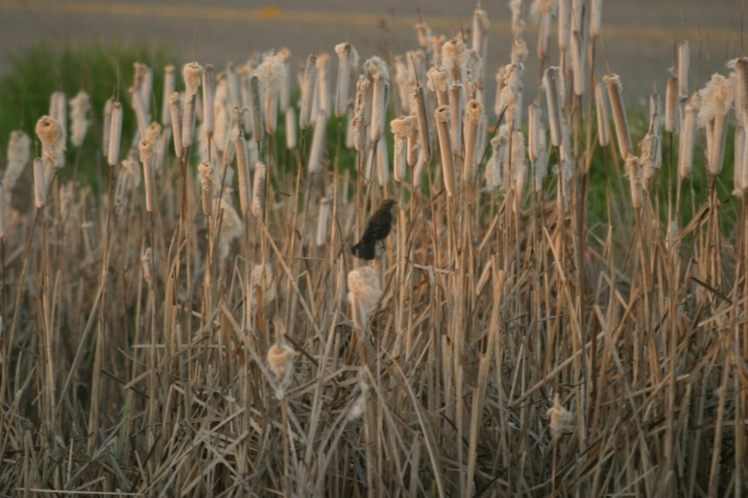

Slide 91
Passive versus Active Voice
The active voice emphasizes the actor while the passive voice emphasizes the action and the thing being acted upon
  The active voice makes writing clear and direct
  The passive voice is acceptable if the action is more important than the actor (as in scientific and technical documents)
  The main problem with passive is that it obscures who is doing the acting (mistakes were made, it was decided), which obscures responsibility for the action

Slide 92
Passive versus Active Voice
Passive or Active Voice in a NEPA Document?
  Purpose and Need
  Proposed Project and Alternatives
  Resource Analysis
    Study Area
    Methods
    Affected Environment
    Impacts
    Mitigation

Slide 93
Exercise: Passive versus Active Voice
  Determine whether active or passive voice is acceptable for each sentence and rephrase as necessary.
  Another unnamed drainage, which originates from irrigation runoff, is crossed by the siphon near the outlet.
  The levee is dominated by nonnative annual grasses.
  No special-status plants were observed in the study area.
  A new process for eliminating nitrogen oxides from diesel engines is presented in this article.

Slide 94
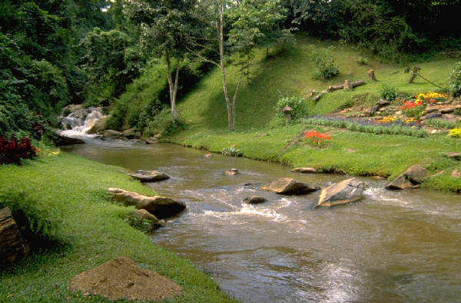


Slide 95
Wordiness and Foggy Writing
Example
Therefore, given that the daily management of water exports to limit entrainment under the existing conditions also would occur under the proposed project, it is concluded that there is no effect of the proposed project in changing this stressor for larval and juvenile fish.

Slide 96
Wordiness and Foggy Writing
Eliminate weak verbs or verbs converted to noun phrases
Example
The BLM cannot make the revisions of the document in time.
Revision
The BLM cannot revise the document in time.
Example
The BLM completed the authorization of the plan last week.
Revision
The BLM authorized the plan last week.

Slide 97
Wordiness and Foggy Writing
Avoid noun strings
Example
The draft water quality standard pollutant inputs are complete.
Revision
The pollutant inputs for the draft version of the water quality standards are complete.

Slide 98
Wordiness and Foggy Writing
Eliminate unnecessary words
A sufficient number of vs. enough
On a monthly basis vs. monthly
In order to vs. to
It is important to note that….
Eliminate unnecessary modifiers
Totally redundant vs. redundant
Really tired vs. tired
Particularly important vs. important
Completely done vs. done

Slide 99
Wordiness and Foggy Writing
Use terms consistently
Example
The greater sandhill crane is a large bird that depends on shallow-water habitat. During the day, the crane forages near shallow water for grain. At night, the GSHC roosts in shallow water to avoid predators such as coyotes.
Revisions
The greater sandhill crane is a large bird that depends on shallow-water habitat. During the day, the crane forages near shallow water for grain. At night, the crane roosts in shallow water to avoid predators such as coyotes.
The greater sandhill crane (GSHC) is a large bird that depends on shallow-water habitat. During the day, the GSHC forages near shallow water for grain. At night, the GSHC roosts in shallow water to avoid predators such as coyotes.

Slide 100
Use terms consistently (continued)
Example
The well site would be leveled and surfaced with mineral material. All areas not needed for production would be reclaimed by removing the caliche, recontouring the area, spreading the stockpiled topsoil over the area, and seeding the area.
Revision
The well site would be leveled and surfaced with mineral material. All areas not needed for production would be reclaimed by removing the mineral material, recontouring the area, spreading the stockpiled topsoil over the area, and seeding the area.

Slide 101
Exercise: Wordiness and Foggy Writing
Revise the sentence below for clarity and brevity.
Therefore, given that the daily management of water exports to limit entrainment under the existing conditions also would occur under the proposed project, it is concluded that there is no effect of the proposed project in changing this stressor for larval and juvenile fish.

Slide 102
Exercise: Wordiness and Foggy Writing
Revision
Because the proposed project would also manage water exports to limit entrainment, the proposed project would not affect this stressor.

Slide 103
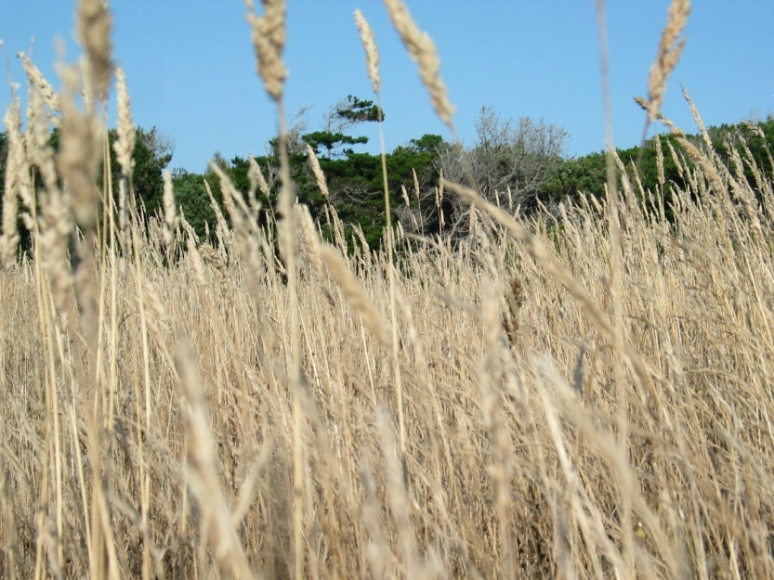

Slide 104
Grammar
Grammar rules address the correct use of parts of speech and their organization into meaningful sentences
Grammar rules can evolve over time
Grammar rules are less flexible than style rules

Slide 105
Grammar
Would, will, shall, should: verbs for environmental documents
Would expresses conditionality or possibility; it is used with impacts because the impacts are conditional based on approval and construction of the project
  The proposed action would have an adverse effect on biological resources.

Slide 106
Grammar
Will expresses futurity; it is used when an outcome is certain, as with mitigation measures.
  Implementing Mitigation Measure BIO-1 will reduce impacts to a less-than-significant level.
Shall is a legalistic expression of will. Do not combine the two.

Slide 107
Grammar
Could or may express possibility; they are used when an outcome is possible or likely but not certain.
  The new dam could affect the streamflow.
Should advises an action that is not mandatory.
  The project proponent should develop an alternate plan.

Slide 108
Grammar
BLM Paragraph Example: look for use of should, would, will, shall
Reclamation will be completed on areas that are depleted of gravel and are no longer needed for processing or stockpiling. The area will be appropriately contoured, adequate drainage provided, and topsoil put back and seeded to plant species identified by the authorized officer. If needed, seeding shall be repeated until appropriate ground cover is established as determined by the authorized officer. Unwanted material would be buried on site.

Slide 109
Grammar
Subject-Verb Agreement
A singular subject requires a singular verb; plural subjects require plural verbs
  Figure out whether your subject is plural or singular (any, either, neither, and none are singular)
    Either of those dogs is a good choice.
    None of those ones are adequate.
    Those criteria do not fit the question.

Slide 110
Grammar
  Determine whether two nouns are a plural subject
    Anna and Sara are going to the prom.
    Anna, as well as Sara, are inciting a riot.
    Anna, in addition to Sara, insists on staying out late.
  Make the verb agree with its subject, not with what comes between the subject and verb
    The disk is round.
    The disk, or at least its enclosure, which was created using a circular template and was fit to scale, is round.
    The disk, which was created using a template, and its enclosure, which was reduced in size to fit, are round.

Slide 111
Exercise: Subject-Verb Agreement
Select the correct verb form.
The results of this report determine/determines the number and types of trees that will require compensation.
High levels of pollution cause/causes damage to the respiratory tract.
Sue’s friend and advisor was/were surprised by her decision.
Each tree, shrub, and vine need/needs to be measured.
This report, as well as a CD, have/has to be turned in tomorrow.
Everyone need/needs to attend the NEPA training.

Slide 112
Grammar
Misplaced Modifiers
A modifier describes another word or phrase.
  The blue house is large.
  My good friend Pat isn’t exactly tidy.
  A circular staircase is substantially risky.
Modifiers should appear as close as possible to the words or phrases they modify.

Slide 113
Exercise: Misplaced Modifiers
Fix the misplaced modifiers in these sentences.
  I spoke to an engineer from the Corps named Bob Willis.
  The thief was described as a 6-foot-tall man with a thick moustache, weighing 170 pounds.
  After he decided to join the Navy, the recruiter shook Joe’s hand.

Slide 114
Grammar
Split infinitives
An infinitive consists of to plus a verb: to think, to sing, to dream. A modifier between to and the verb “splits” the infinitive: to formally launch.
If a split infinitive is obviously awkward, it should be revised.
  He tries to carefully consider his decisions.
  You ought to thoroughly read this EIR.
  The USFWS decided to actually impose the fine.

Slide 115
Grammar
That versus which: restrictive and nonrestrictive clauses
A restrictive clause limits the meaning of the word it modifies and is therefore essential to the meaning of the sentence. It is not set off by commas. Use that only with restrictive clauses.
    For field work, we needed clothes that were durable.
    The red bike that was in the shed was mine.

Slide 116
Grammar
  A nonrestrictive clause describes a noun or pronoun that has already been defined. Because it contains nonessential or parenthetical information, nonrestrictive clauses are set off with commas or parentheses. Use which with nonrestrictive clauses.
    The U.S. Coast Survey, which was established in 1807, was the first scientific agency in this country.
    The red bike, which was in the shed, was mine.
    The clucker hen (which is native to the prairie) nests in hollows.

Slide 117
Exercise: That Versus Which
Fix the that/which clauses in these sentences.
  The project will mitigate environmental impacts that/which are significant.
  The San Joaquin kit fox that/which weighs about 5 pounds is an endangered species.
  The shallow ponds that/which occur in the project area will be replanted with native vegetation.
  Plants native to our area that/which include western redbud and blue oak were installed along the right-of-way.
  The eaglets that/which fledged in the project area were banded.

Slide 118
Grammar
Transitions are bridges between what has been read and what is about to be read; they help readers move from one sentence to another. They also show the connections between ideas at the sentence level or the paragraph level or even between longer blocks of text and thus provide coherence.
  See Handout 1, Transitional Expressions.

Slide 120
Punctuation
Comma
  Separates elements in a series
  The bucket contained rice, beans, and corn.
  Separates an introductory phrase or clause
  To my mother, I am faultless.
  Separates adjectives that modify a noun
    The large, cold, square refrigerator was on the porch.
  Separates long independent clauses
  The order was long and complicated, and we expected a late and insufficient shipment.
  Sets off a quotation
Mary exclaimed, “You’d better get out of here!”

Slide 121
Punctuation
Comma, cont.
Commas are not needed if a coordinating conjunction links closely related clauses.
  The wind was brisk yet nothing toppled.
  The meal was delicious but not nutritious.
  Mary declared amnesty yet remained troubled.
Coordinating conjunctions are the FANBOYS:
  for, and, nor, but, or, yet, so

Slide 122
Exercise: Commas
Place commas in these sentences.
While we were eating a rattlesnake approached our campsite.
Letters were sent to interested parties yet no one responded.
Oak savannas provide nesting sites for raptors and oak grasslands provide foraging habitats for these birds.
We visited the project site but found no suitable habitats.
The riparian community provides escape cover forage and nesting opportunities for wildlife.

Slide 123
Exercise: Commas with Adjectives
Place the commas in these sentences.
The delta green ground beetle is a small beetle with a brilliant green shell.
We hired an experienced efficient CEQA expert.
An old stone wall ran through the center of the study area.
Bill is a generous outgoing person.

Slide 124
Exercise: Unnecessary Commas
Remove any unnecessary commas.
The list included butter, milk, salt, and pepper, and the box was empty.
Betty addressed the forum, and Sam, collected the ballots.
We visited the project site, and conducted a botanical survey.
The client thinks, that we should conduct a wetland delineation, and that a tree survey is necessary.
For example, the project manager, and the lead engineer, are reviewing the technical reports.

Slide 125
Punctuation
Semicolon
  Used between closely related independent clauses that are not joined with coordinating conjunctions (FANBOYS)
    Tomorrow is another day; we will arise with renewed energy.
  Precedes a transitional expressions such as however, hence, this, likewise, therefore
    The project would not affect the environment; therefore, a negative declaration will be prepared.
  Used in series that already contains commas (super comma)
    Waters of the United States comprise navigable waters; interstate waters; wetlands that meet Corps criteria; all other waters where use, degradation, or destruction of the waters could affect interstate commerce or foreign commerce; and tributaries of any of these waters

Slide 126
Punctuation
  Colon
  Follows a complete sentence to introduce a related idea, quotation, or list
    I needed several items for my party: a magician, an outfit, and a secret. But not: I needed: a magician, an outfit, and a secret.
    There is a concept that directly applies to our argument: human rights.
    The Book of Nautical Terms addresses this knot directly: “The Windsor knot is not nautical; it is a naughty necktie knot.”

Slide 127
Punctuation
Hyphenation
Compound words: follow the dictionary
  earthquake, sunflower, moonlight, water-wash,
Prefixes: follow your style guide
  Nonnative, non-native, pre-construction, preconstruction
Modifiers: hyphenate words before the noun to show that the words are operating as a unit
  The project will have a less-than-significant impact (but the impact is less than significant)
  The on-site receptacle will be used (but the waste will be deposited on site)
  He asked an open-ended question (but the question was open ended)

Slide 128
Punctuation
Hyphens and Usage
Use a hyphen when the base element begins with a capital letter or year.
  The election, in mid-May, features a candidate who is pro-French and un-American.
Use a hyphen when the prefix governs two or more words.
  The non-radiation-caused effects are itemized in 3-inch-by-5-inch column.
Do not use a hyphen when the first word ends in ly.
  The federally listed eagle lives near a privately owned highway.
Do not use a space before the hyphen and use a space after the hyphen only if a part of the phrase is missing.
  Streamflow was measured at 5- and 10-minute intervals.

Slide 129
Punctuation
Em dash
The em dash breaks or separates thoughts with emphasis
  After 1 year, CO₂ concentrations were 367 parts per million—a much higher increase than predicted.
  Three raptors—Cooper’s hawk, sharp-shinned hawk, and Swainson’s hawk—were observed in the project area.

Slide 130
Punctuation
En dash
  The en dash signifies a range and is read as X to X. It includes the values at both ends of the range.
    See Chapters 16–19 for documentation.
    The World War II years, 1939–1945, are his area of expertise.
    See pages 119–147 for the revised text.

Slide 131
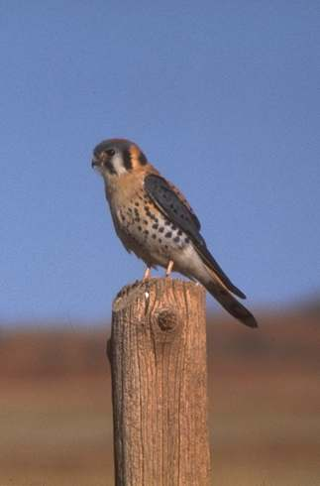

Slide 132
Style
Style conventions are defined by discipline, by publisher, or by publication
Style conventions can evolve over time
Style conventions may be negotiable

Slide 133
Style
A style guide standardizes a document’s approach to usage, terminology, and formatting. It dictates consistency across a document, a project, or an agency. Commonly used style guides include:
  U.S. Government Printing Office Style Manual 2008
  Chicago Manual of Style (16th edition)
  The Elements of Style (Strunk and White)
  Associated Press Style Book (AP)

Slide 134
TIP: Chicago Manual of Style
Writing, editing, and publishing
Style and usage
  Grammar, punctuation, terminology, abbreviations
  Numbers, mathematics
  Foreign languages, dialogue, quotations
Documentation
  Annotations, citations
  Bibliographies
  Indexes

Slide 135
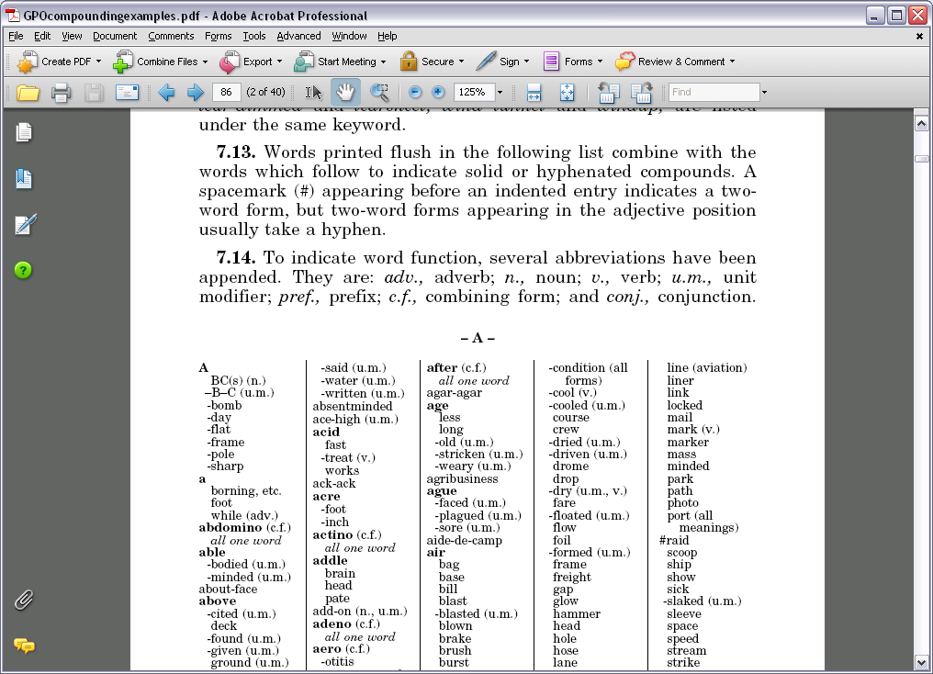
GPO Example

Slide 136
Style
Acronyms and abbreviations
Acronyms and abbreviations are forms of shorthand that facilitate fast, efficient communication. However, too many acronyms can complicate writing and make it inaccessible to a lay reader. Acronyms can sound smart but they can reinforce the exclusiveness of the writer and his or her audience.
¹The scores presented for this change from the PR2P reflect a comparison of the ESO to EBC2, which includes the current MOR flow requirements of the USFWS BiOp (2008). Changes to turbidity as a result of PR2P covered activities are difficult to predict and are likely to vary by ROA and subregion. At this time, no conclusion is made regarding the TMDL as a result of PR2P implementation.

Slide 137
Style
Acronym guidelines
Always define the acronym
  In text in a shorter document, by chapter in longer documents, or in an acronym list
Use an acronym only if the term is used at least three times
Avoid using acronyms when a shorter generic term will do
  The Smith-Dodson Employment Act (SDEA) vs. the act
Define and use an acronym if it has replaced the original term in common usage
  the BLM, NEPA

Slide 138
Style
Capitalization
Capitalization styles change over time
Capitalize proper nouns only
  Job titles: the USFWS Program Manager; the program manager
  Institutions: Arizona University; the university
  Geographic features: the Willamette and Columbia Rivers; the rivers
  Reports: the Boise General Plan; the plan or general plan
  Species names: the Swainson’s hawk; the hawk

Slide 139
Style
Bullet List Punctuation
The most important rule in bullet punctuation is to maintain consistency throughout the document. You can incorporate different styles for different applications, or use one style for all applications. This is a style choice.
Guidelines:
  Use bullets for three items or more; never for one item
  Use an appropriate lead-in sentence (do not start a bullet list directly under a heading)

Slide 140
Style
Bullet List Guidelines:
  Use a numbered list to indicate hierarchy or sequence
  Use bullets for three items or more
  Do not start a bullet list directly under a heading
  Punctuate the lead-in sentence with a period or colon
  Construct the bullets in parallel fashion
  Punctuate the bullets if they are complete sentences or complete the introductory sentence
  Capitalize list items (one or two words, no punctuation)
  Consolidate the articles (a, the, one) at the beginning

Slide 141
Style
Bullet List Examples
  The basket from Granny contained the following items:
    A woolen sweater.
    A bottle of elderflower wine.
    Pressed flowers.
  There were many items in the basket, including:
    a woolen sweater,
    a bottle of elderflower wine, and
    pressed flowers.

Slide 142
Style
Bullet List Punctuation Examples
  There were many items in the basket:
    A woolen sweater
    A bottle of elderflower wine
    Pressed flowers
  Granny was kind enough to send me a basket filled with gifts that express her caring.
    A woolen sweater keeps me warm when the snows fall.
    A bottle of elderflower wine offers consolation for a dark Sunday evening.
    Pressed flowers hearken back to our summer in the meadows.

Slide 143
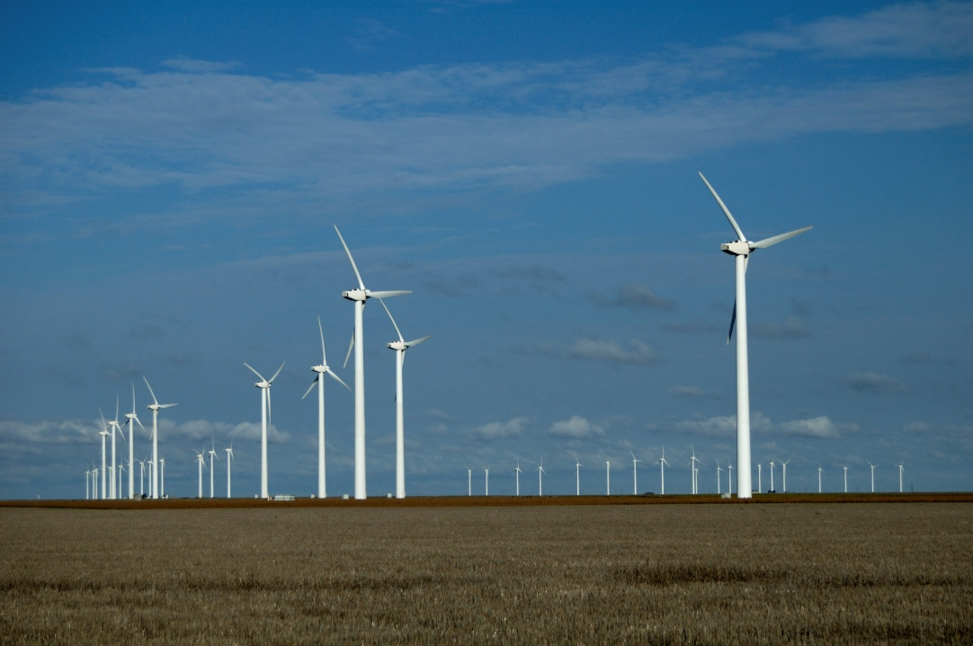

Slide 144
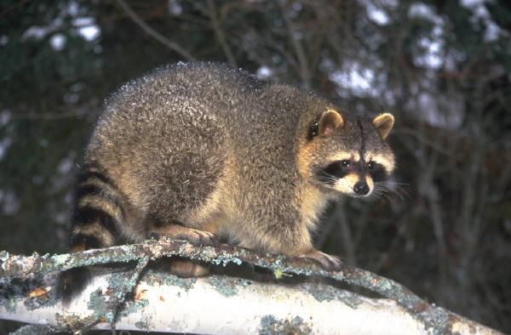
Commonly Misused Words and Phrases
Handout 2, Commonly Misused Words and Phrases

Slide 145
Exercise: Editing
Complete Exercise 4, Editing.

Slide 146
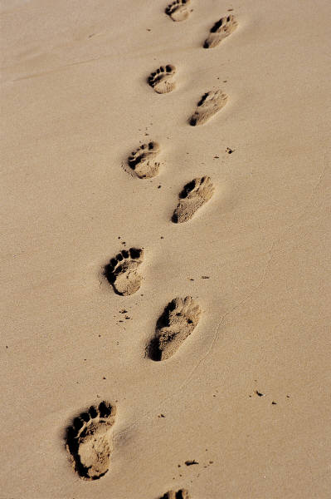
Numbers
Use numerals with units of measure or time
  0.25 acre
  1 month
  3 years
  4 megawatts
  7 years old
  5 hours
  3.6 grams

Slide 147
Numbers
Write out numbers if:
  They are the first element in a sentence
    Thirteen states formed a more perfect union.
  Confusion may result from two numerals being next to each other
    There are fourteen 5-foot terminals.
  They are less than 10 but not a unit of measure
    I saw three ships come sailing in.

Slide 148
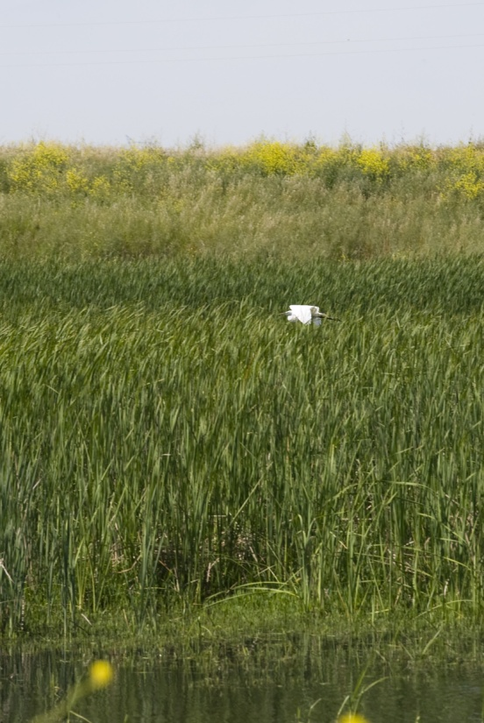
Numbers
Use the additional formats shown below when expressing numerals
  1960s
  20th century
  from 1 to 3 months
  between 5 and 10 acres (does
  not include 5 and 10)
  10-foot-high barrier
  barrier was 10 feet high
  34%

Slide 149
Exercise: Numbers
Correct the enumeration in the sentences below.
The 3-foot high structure is a barrier to fish passage.
Temperatures from 78 to 89°F may be lethal to juvenile fish.
The device was built using recycled wood
and fourteen 3-inch-long screws.
The data are presented in Tables 3 to 19.

Slide 150
Exercise: Numbers
Correct number-related mistakes on Exercise 3, Numbers.

Slide 151
Checklists
When you are done writing, it is a good idea to go over your writing the next day.
Personal checklists and office checklists can be helpful.
  http://www.ccbb.pitt.edu/Faculty/zuckerman/ScienceWritingChecklist.pdf
  http://physics.gac.edu/~huber/misc/wricheck.htm
  http://donstuff.wordpress.com/2008/10/09/rules-for-writing-wicked-good-papers/

Slide 152
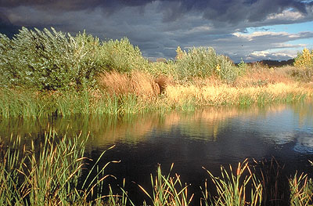

Slide 153
Exercise: Writing Review
Look in your report or the example report and see if there are problems in these areas:
  Lists
Numbers
Tenses (look at several paragraphs on several pages)
Misused words or phrases

Slide 154
Chapter 2 Writing: Review
Why Good Writing Matters
The Paragraph and Topic Sentences
Passive versus Active Voice
Wordiness and Foggy Writing
Grammar
Punctuation
Style
Commonly Misused Words and Phrases
Numbers
Questions?

Slide 155

Goodnight!

Slide 156
Chapter 3―Managing Documents

Slide 157
Chapter 3 Managing Documents
Setting Up Authors for Success
Creating a Writing Template
Writing Impact Statements and Mitigation Measures
Managing the Writing Process
Responding to Comments
Tables

Slide 158
Setting Up Authors for Success
Common problems
  Lack of effective communication
  Lack of resources and information provided to authors
  Inefficient writing approach
  Gaps in logic or information
  Ineffective review of documents
  Audience dissatisfied with documents

Slide 159
Setting Up Authors for Success
Gather information
  Basic information (e.g., project name and objectives)
  Other relevant documents
  Style and usage (e.g. units of measure, acronyms)
  Affected environment versus baseline
  Internal review process
  External deliverables
See Handout 3, Document Development Checklist

Slide 160
Setting Up Authors for Success
BLM NEPA Handbook Guidance
Detailed descriptions of proposed actions usually include six elements:
  Who
  What
  How
  When
  Where
  Why

Slide 161
Setting Up Authors for Success
Project Description
Try to finalize the alternatives description
  A well-written description:
    Facilitates author analysis
    Speeds analysis
    Improves accuracy
    Helps the public and the client

Slide 162
Setting Up Authors for Success
  Be sure to:
  Describe all alternatives in substantial detail
  Identify the agency’s preferred alternative(s)
  Briefly discuss alternatives that were eliminated
  Let authors know about uncertainties
  Anticipate other documents

Slide 163
Managing the Writing Process
Prepare a Style Guide for Your Document
  Project name
  Project terminology
  Project area, project site, proposed project, proposed action, no-action alternative
  Standard terminology
  Grammar, punctuation, usage conventions for your agency
  Standard formatting
  Handout 4, Style Sheet
  Handout 5, ICBEMP Supplemental Draft EIS Editorial Consistency Guidelines (BLM)

Slide 164
Managing the Writing Process
Have a Start-Up Meeting
Provides authors with necessary information
Promotes consistency
Increases efficiency
Provides foundation materials
  Template
  Boilerplate
  Style guide
  Schedule and budget
  Resource materials (GIS, maps, prior documents)

Slide 165
TIP: Numbering Conventions
Number elements of your report that will be cited throughout the report
Environmental commitments or project components
  EC WQ1-Comply with local stormwater regulations
Impacts
  Impact WQ1- Increased storm runoff from impervious surfaces
Mitigation measures
  MM-WQ1-Install storm drains
Tables and figures by section
  See Table 3.4-2

Slide 167
Creating a Writing Template
Provides standardization
Creates a one-voice document
Increases efficiency
Creates parallelism
Handout 6, Basic Writing Template

Slide 168
TIP: Template in Word
Styles and Templates
All files should have a template
All text should have a style
You can use styles and templates provided or make your own

Slide 169
Creating a Writing Template
Example information in an EIS
Affected environment
Regulatory setting (before or after environmental setting, in appendix, or in Regulatory Setting chapter)
Environmental consequences and mitigation measures
Categories for analysis (e.g., construction/operation)

Slide 170
Creating a Writing Template
Arrangement of resource chapters/sections
Chapter Arrangement | Advantages | Disadvantages
Separate chapter for each resource | shorter chapters simple numbering scheme easier production more levels of headings available consistency with other chapters easier to post on the web | more chapters may be unfamiliar to some clients
Affected Environment in Chapter 3 and Environmental Consequences in Chapter 4 | fewer chapters common approach | complicated numbering scheme inconsistency with rest of document fewer available headings

Slide 171
Exercise: Creating a Writing Template
Open your document or the example document in the outline or navigation pane view
    How are the resource sections organized?
    What other ways could you organize these sections?
    Can you locate any boilerplate text?
    What questions are being addressed under each heading?
    Can you identify a topic sentence under each heading?

Slide 172
Creating a Writing Template
Use standardized text (boilerplate)
Keeps the document parallel
Gives it rhythm
Prevents the author from having to create it from scratch
Saves you and the editor time
Sets the tone for the document

Slide 173
Creating a Writing Template
Give direction to authors
Indicate
  Level of detail you would like
  What not to include in the setting section
  Other information that pertains to all resource chapters/sections
  How to organize and phrase impacts
Tips
  Use a different color text for direction
  Decide on your acronym approach
  Use a references tool or develop a template

Slide 174


Slide 175
Writing Impact Statements and Mitigation Measures
Decide how to write and number them
  It is important to have a solid, consistent approach to your analysis
  It is time-consuming to straighten the inconsistent text or numbers out at the end
  Authors will all use a different style unless they are provided consistent language
  Consistency is important for both legal and readability reasons

Slide 176
Writing Impact Statements and Mitigation Measures
Determining Significance Under NEPA
Whether a proposed action significantly affects the quality of the human environment depends on the dual factors of:
  Context
  Intensity

Slide 177
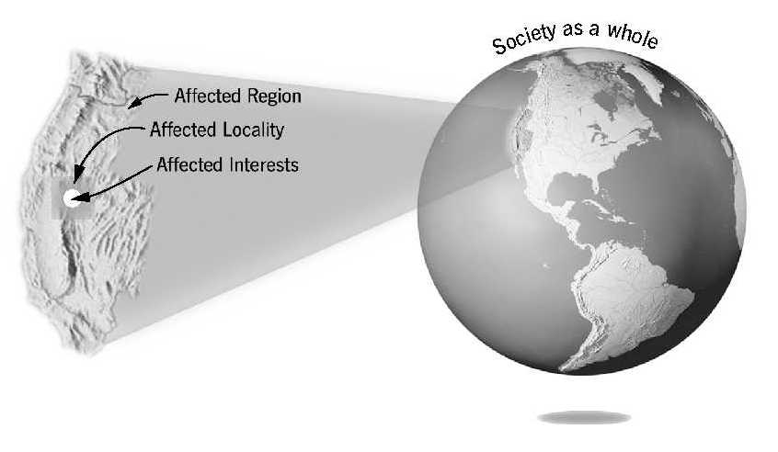
Writing Impact Statements and Mitigation Measures (cont)
Determining the Context of an Action

Slide 178
Writing Impact Statements and Mitigation Measures (cont)
CEQ NEPA Regulations 40 CFR 1508.27
Intensity refers to the severity of the impact. Responsible officials must bear in mind that more than one agency may make decisions about partial aspects of a major action. The following 10 criteria should be considered in evaluating intensity:

Slide 179
Writing Impact Statements and Mitigation Measures (cont)
Determining the Intensity of an Impact
Beneficial actions may have significant effects
Public health effect
Unique characteristics
Degree of controversy
Degree of unique or unknown risk
Cumulative effect
Cultural or historical resources
Special-status species
Violations of federal, state, local environmental law

Slide 180
Managing the Writing Process
Handout 7, Example of BLM Project Initiation

Slide 181
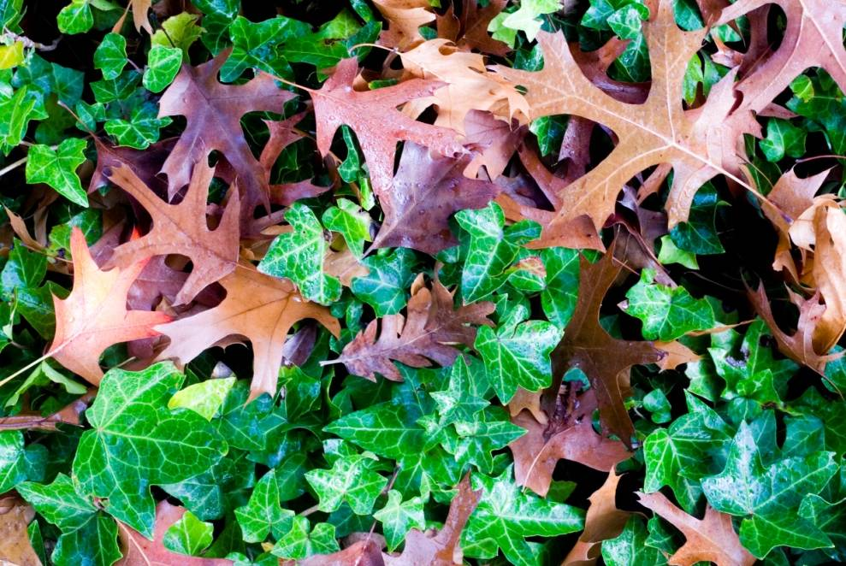

Slide 182
Responding to Comments
Requirements for Responses to Comments
Respond by
  Modifying the proposed action
  Developing and evaluating alternatives not previously given serious consideration by the agency
  Supplementing, improving, or modifying analysis
  Making factual corrections
  Explaining why comments do not warrant further agency response
  BLM NEPA Handbook V.B.4.; 40 CFR 1502.19; 1503.3, 4; 1506.6

Slide 183
Responding to Comments
Plan ahead by gathering background information
Tailor comments to achieve your objectives
Coordinate with other commenters
Organize comments consistent with document structure
Emphasize highest priority comments first
Identify page numbers
Refer to laws and facts
Request specific actions and revisions, rather than ask questions
Be objective, not adversarial or emotional

Slide 184
TIP: Word’s Tracked Changes
Open a Word document and go to the review tab
  Easy to hide track changes
  Easy to select whose changes to view
  Insert comment is useful

Slide 185
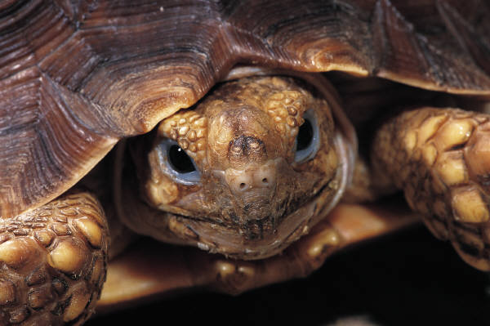

Slide 186
Tables
Using Text in Tables
Make text in tables parallel
Avoid use of articles
Avoid terminal punctuation
Focus information in each column
Add columns or rows if necessary
Use acronyms and define in table notes
Provide source in table notes

Slide 187
Tables
Parts of a Table
  Column heads
  Spanner heads
  Stub heads
  Row titles
  Cells
  Footnotes
Stub Column 1 | Spanner Heading 1 |  |  | Spanner Heading 2
 | Column 2 (subhead) | Column 3 (subhead) |  | Column 5 (subhead) | Column 6 (subhead)
Cut-in heading
Sub item | $100,000 | NA |  | – (en dash) | Table text
Sub item
Sub item | 10,000 | NA |  | – | Table text
Total | $110,000

Slide 188
Tables
Formatting Cell Structure
Before
After
Segment | Bank Length (feet) | Armored Length (feet) |  |  | Natural Bank (%)
 |  | West Bank | East Bank | Riverbed
1 | 1,431 | 448 | 448 | 448 | 33
2 | 4,000 | 305 | 305 | 305 | 44
3A | 2,147 | 695 | 695 | 695 | 32
3B | 3,006 | 1,861 | 2,081 | 1,861 | 12
3C | 1,271 | 1,250 | 1,085 | 1,045 | 45

Slide 189
Exercise: Tables
Revise tables in Exercise 5, Tables.

Slide 190
Chapter 3 Managing Documents: Review
Setting Up Authors for Success
Managing the Writing Process
Creating a Writing Template
Writing Impact Statements and Mitigation Measures
Responding to Comments
Tables
Questions?

Slide 191
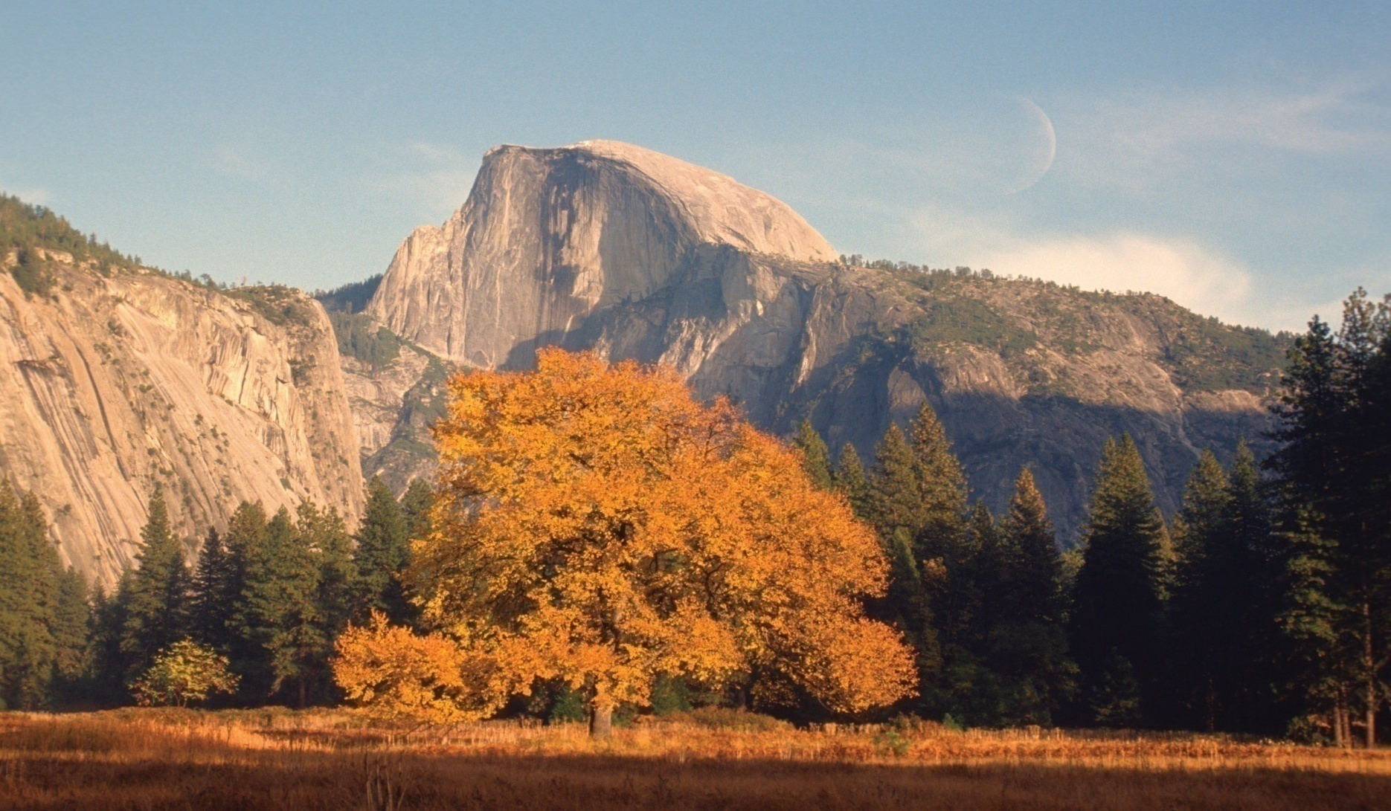
Final Discussion

Slide 192
What will I do differently?

Slide 193
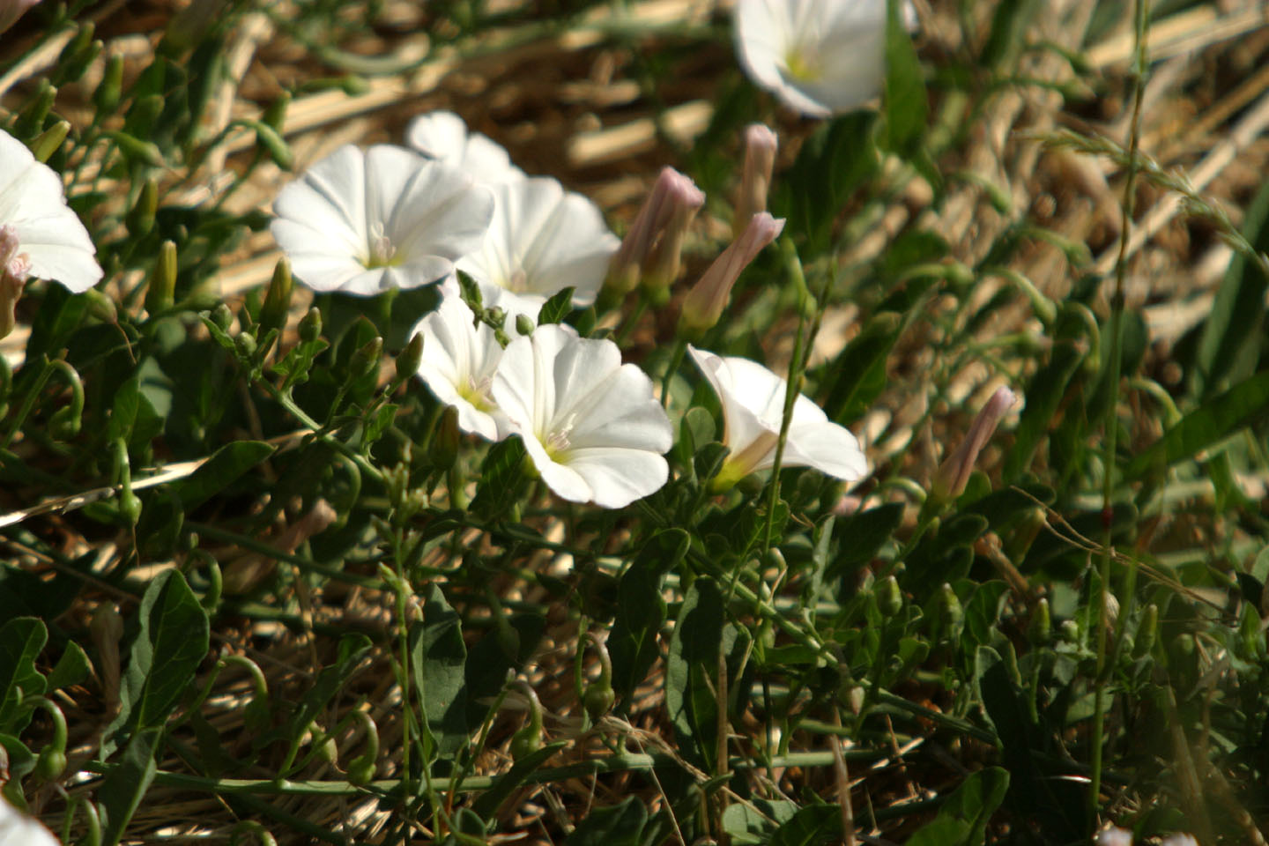
Thank You

