Slide 1
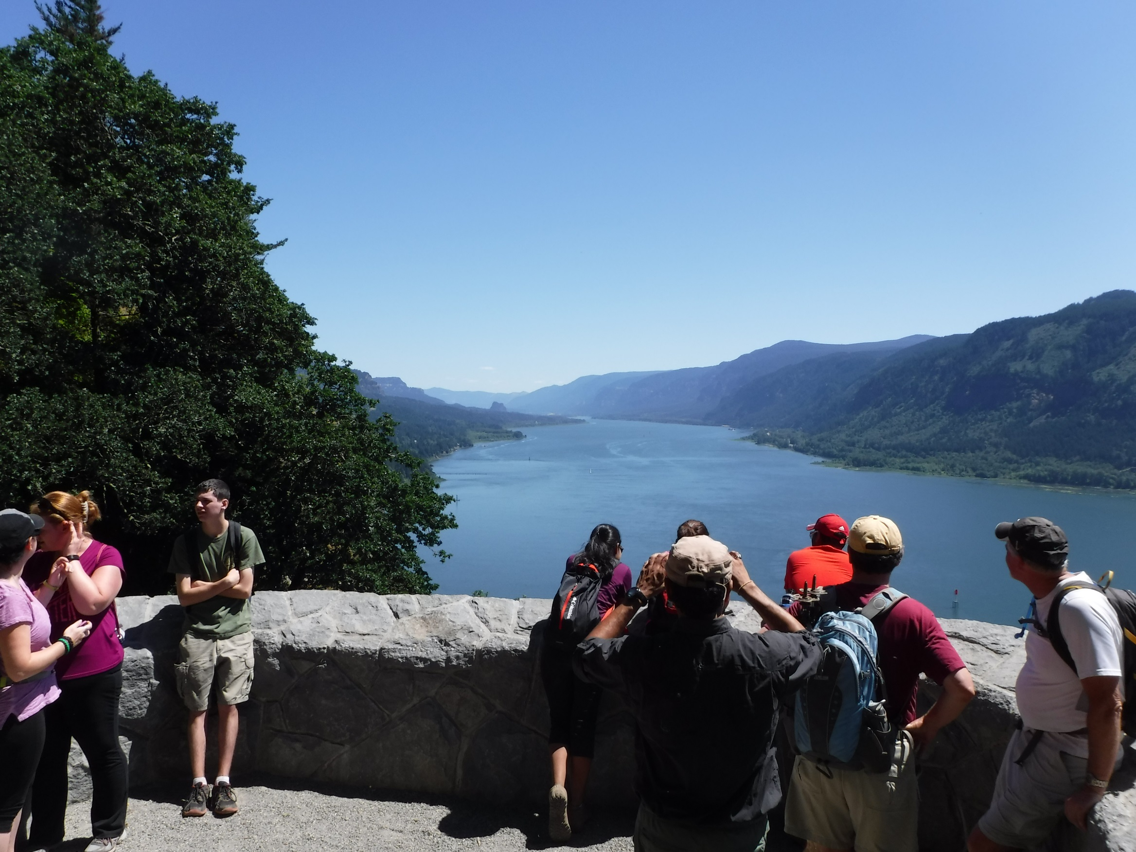

Application of Built Environment Design Principles
Wahkeena Falls
Columbia River Gorge National Scenic Area
Christine Plourde, Landscape Architect

Slide 2
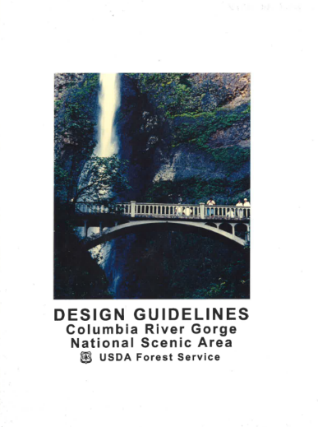
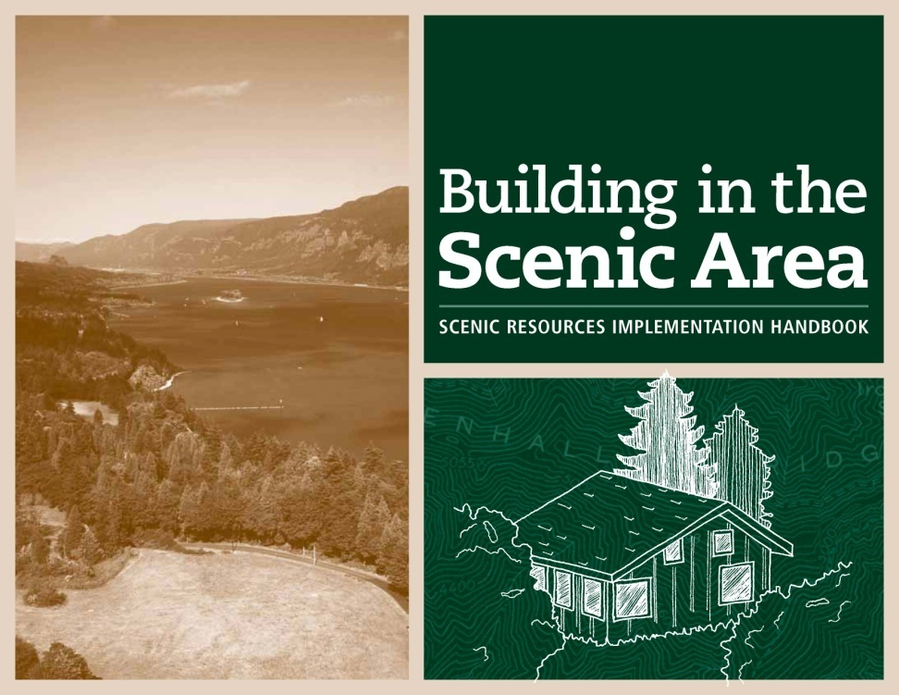
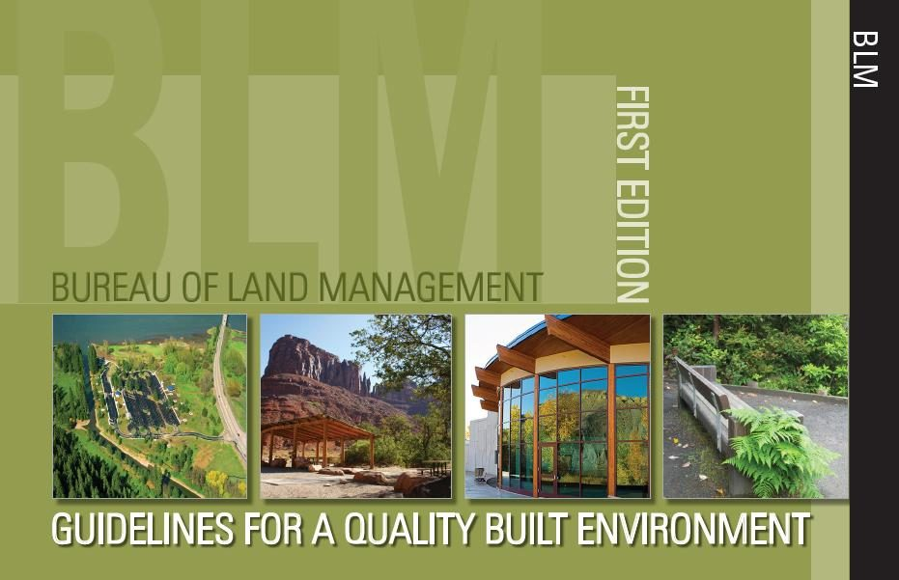
Design Guides

Slide 4
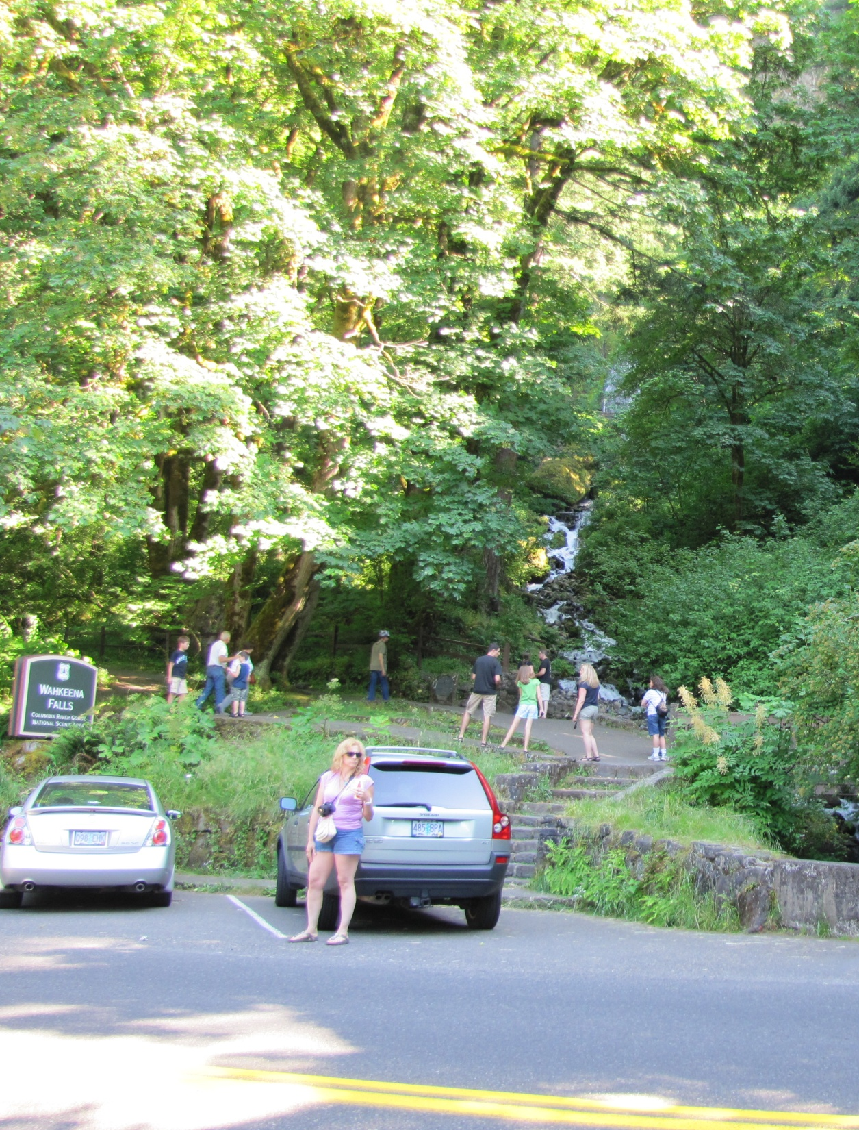

Slide 5
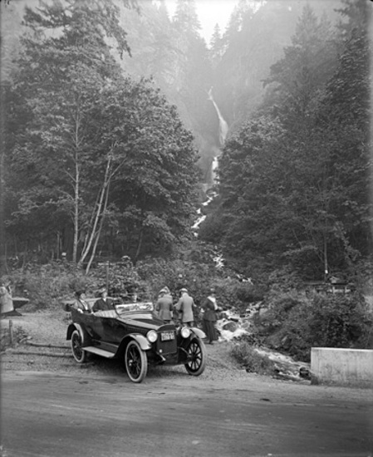

Slide 6
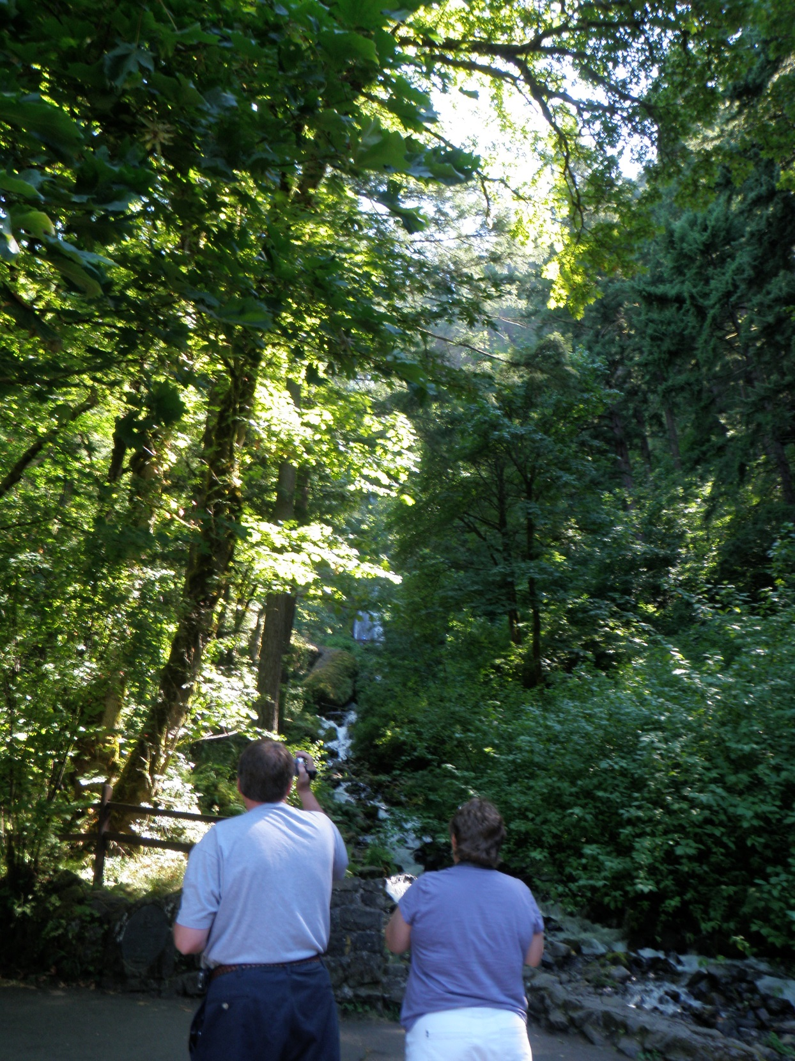

Slide 7
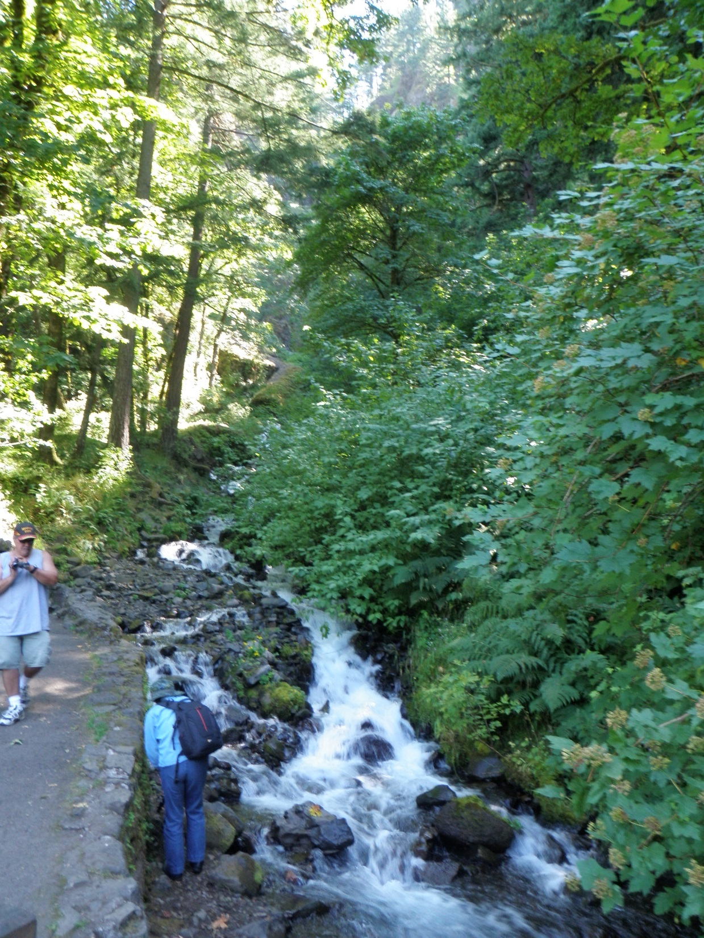

Slide 8
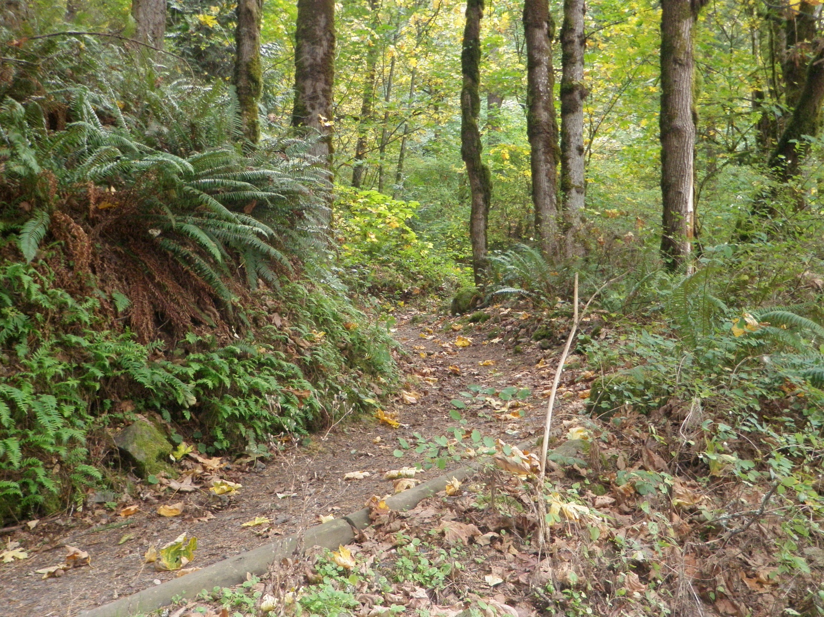

Slide 9
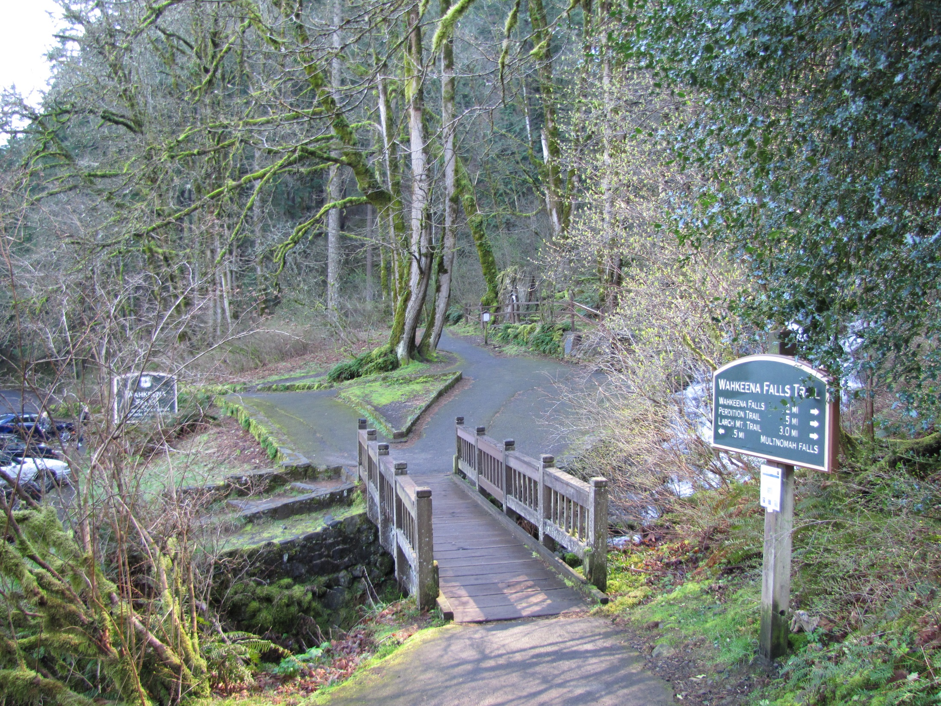

Slide 10
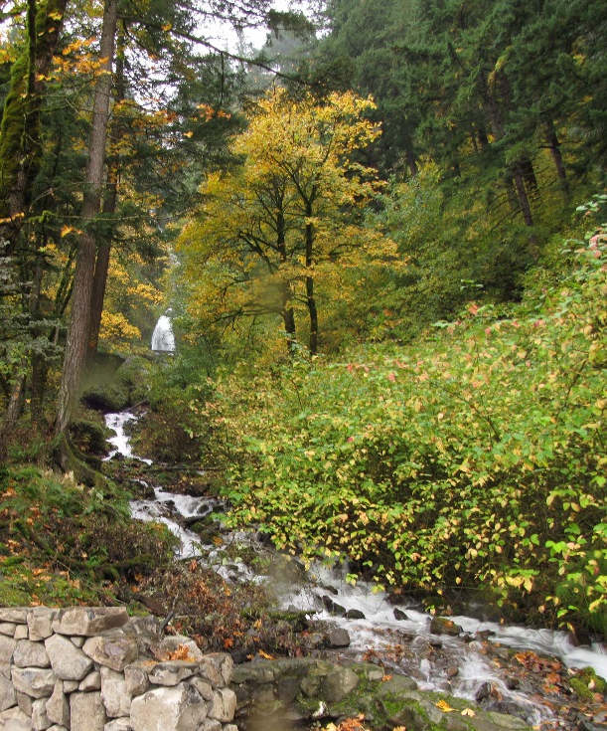
Designated Key Viewshed
  Columbia River Gorge National Scenic Area Act
All American Road
National Historic Landmark District
  Historic Columbia River Highway Advisory Committee
  State Historic Preservation Office

Slide 11
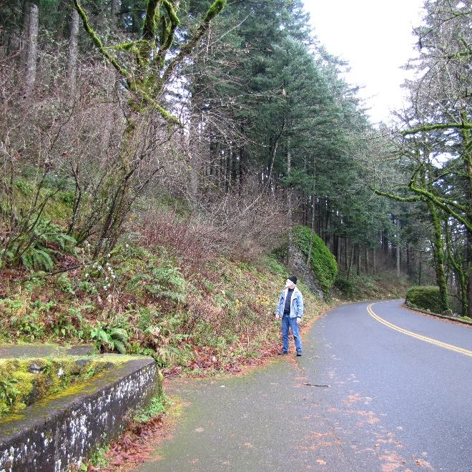
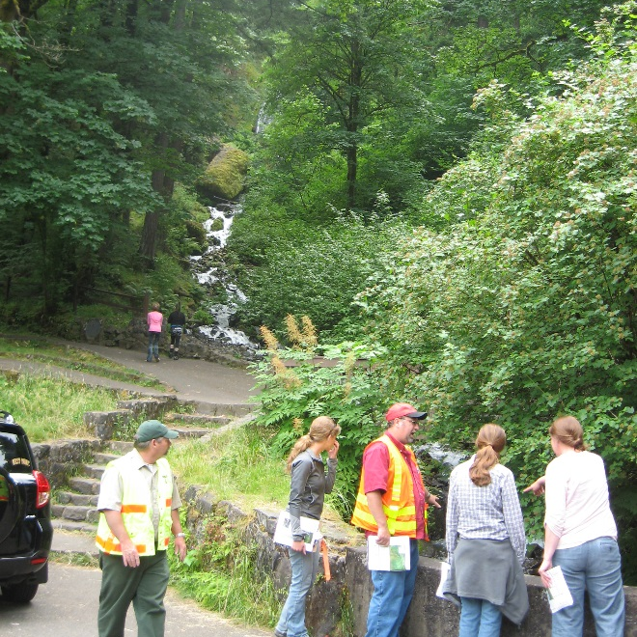
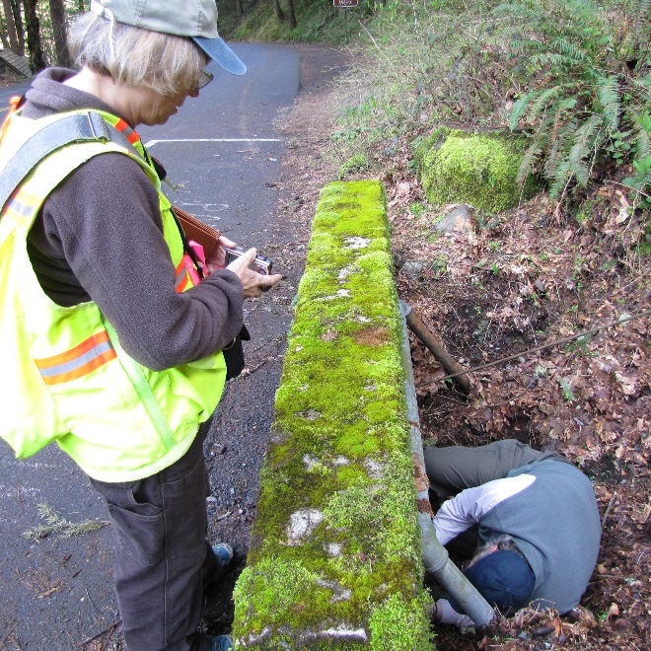

Slide 12
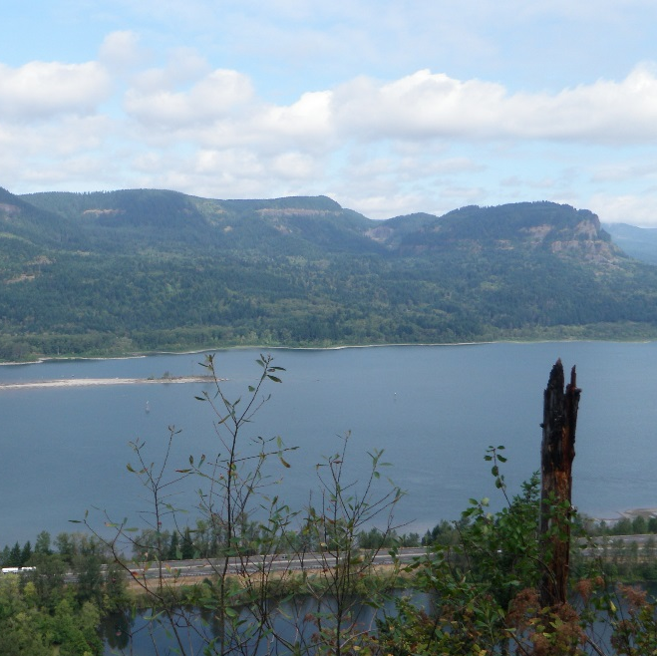
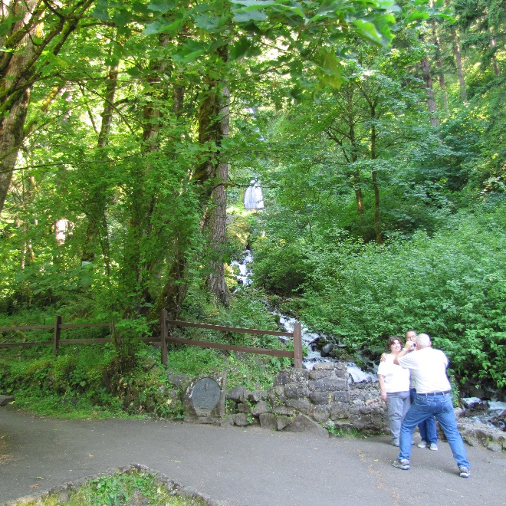
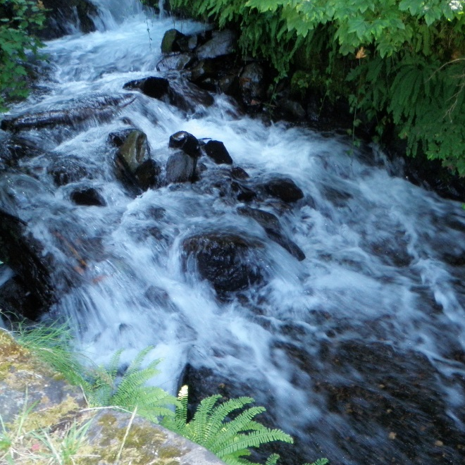
Inventory: Natural Features
Line: Rock Benches
Form: Maple Canopy Frame
Texture: Basalt Cobble

Slide 13
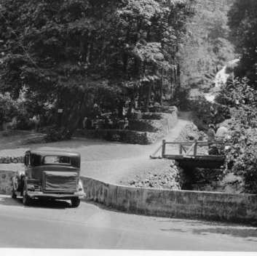
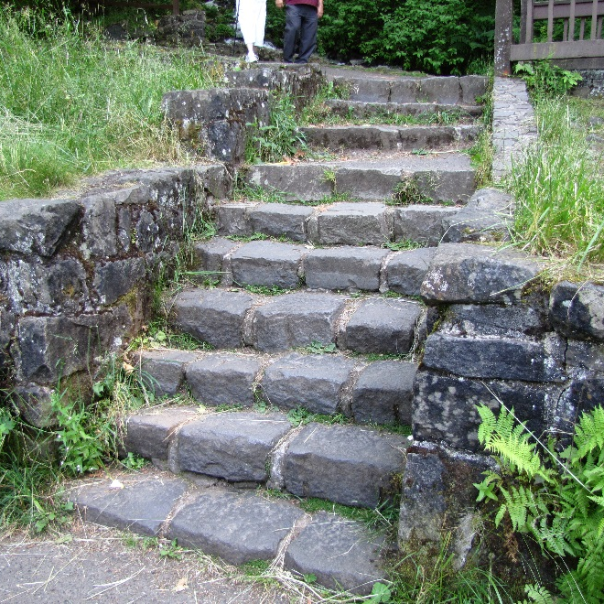
Inventory: Cultural Feature
Line: Rock Benches
Form: Maple Canopy Frame
Texture: Basalt Cobble

Slide 14
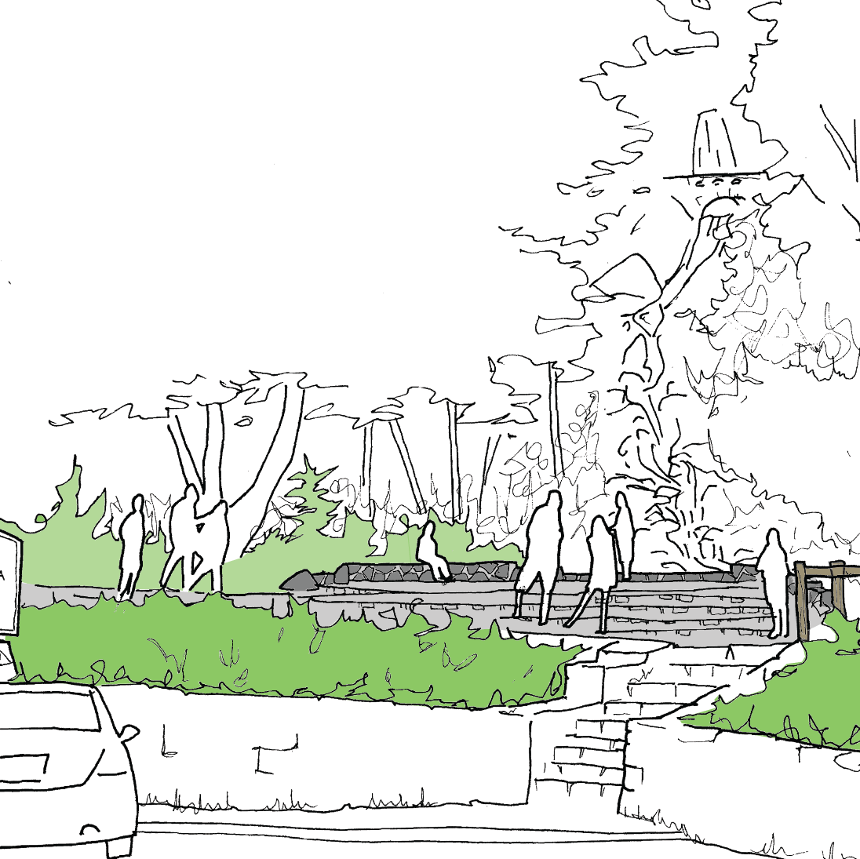
Landscape Character & Design Concept
Line: Horizontal Walls
Form: Framed view of Wahkeena Falls
Texture/ Color: Native Basalt Masonry

Slide 15
Form & Line: Site Layout

Slide 16
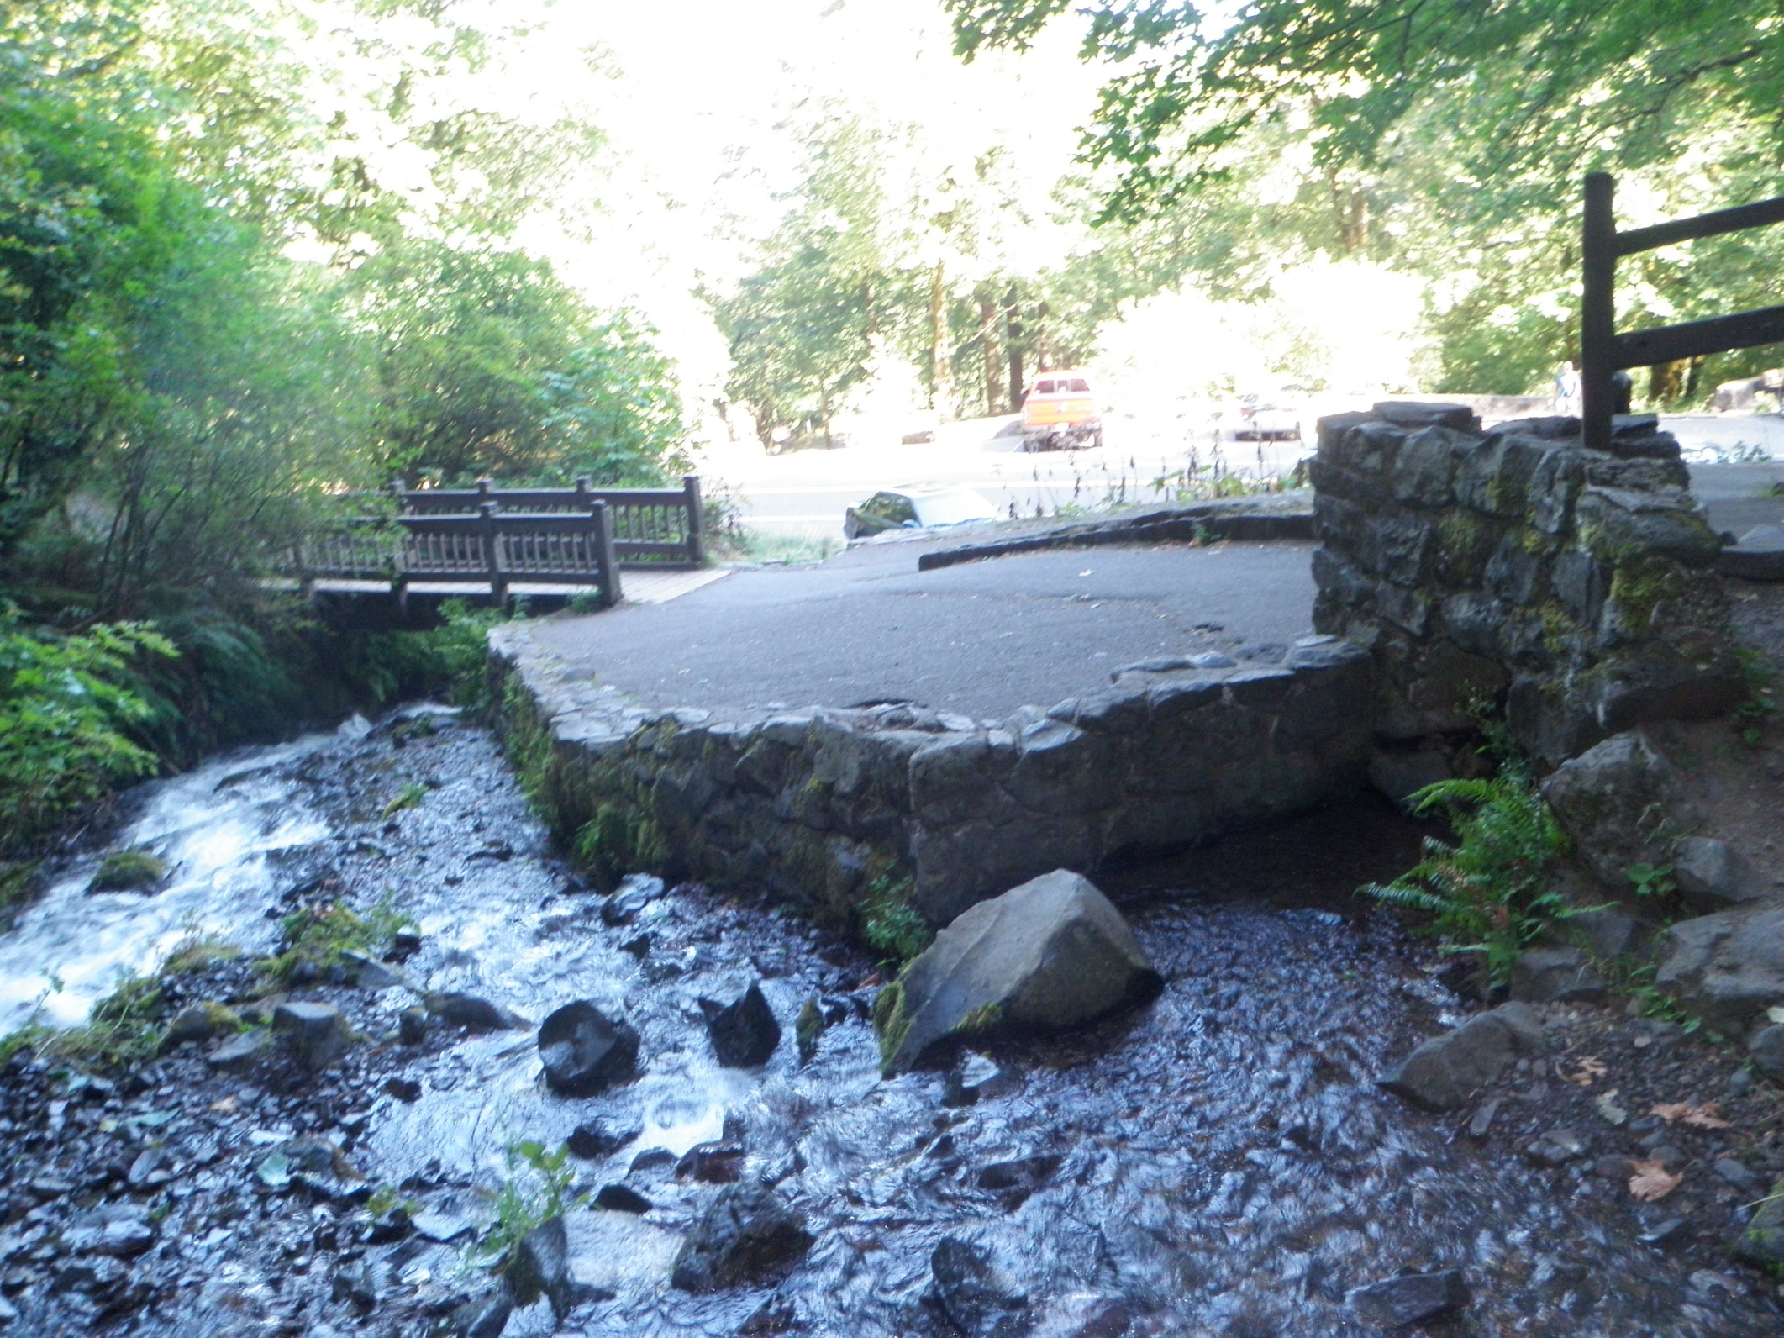
Inventory: Cultural Features

Slide 18
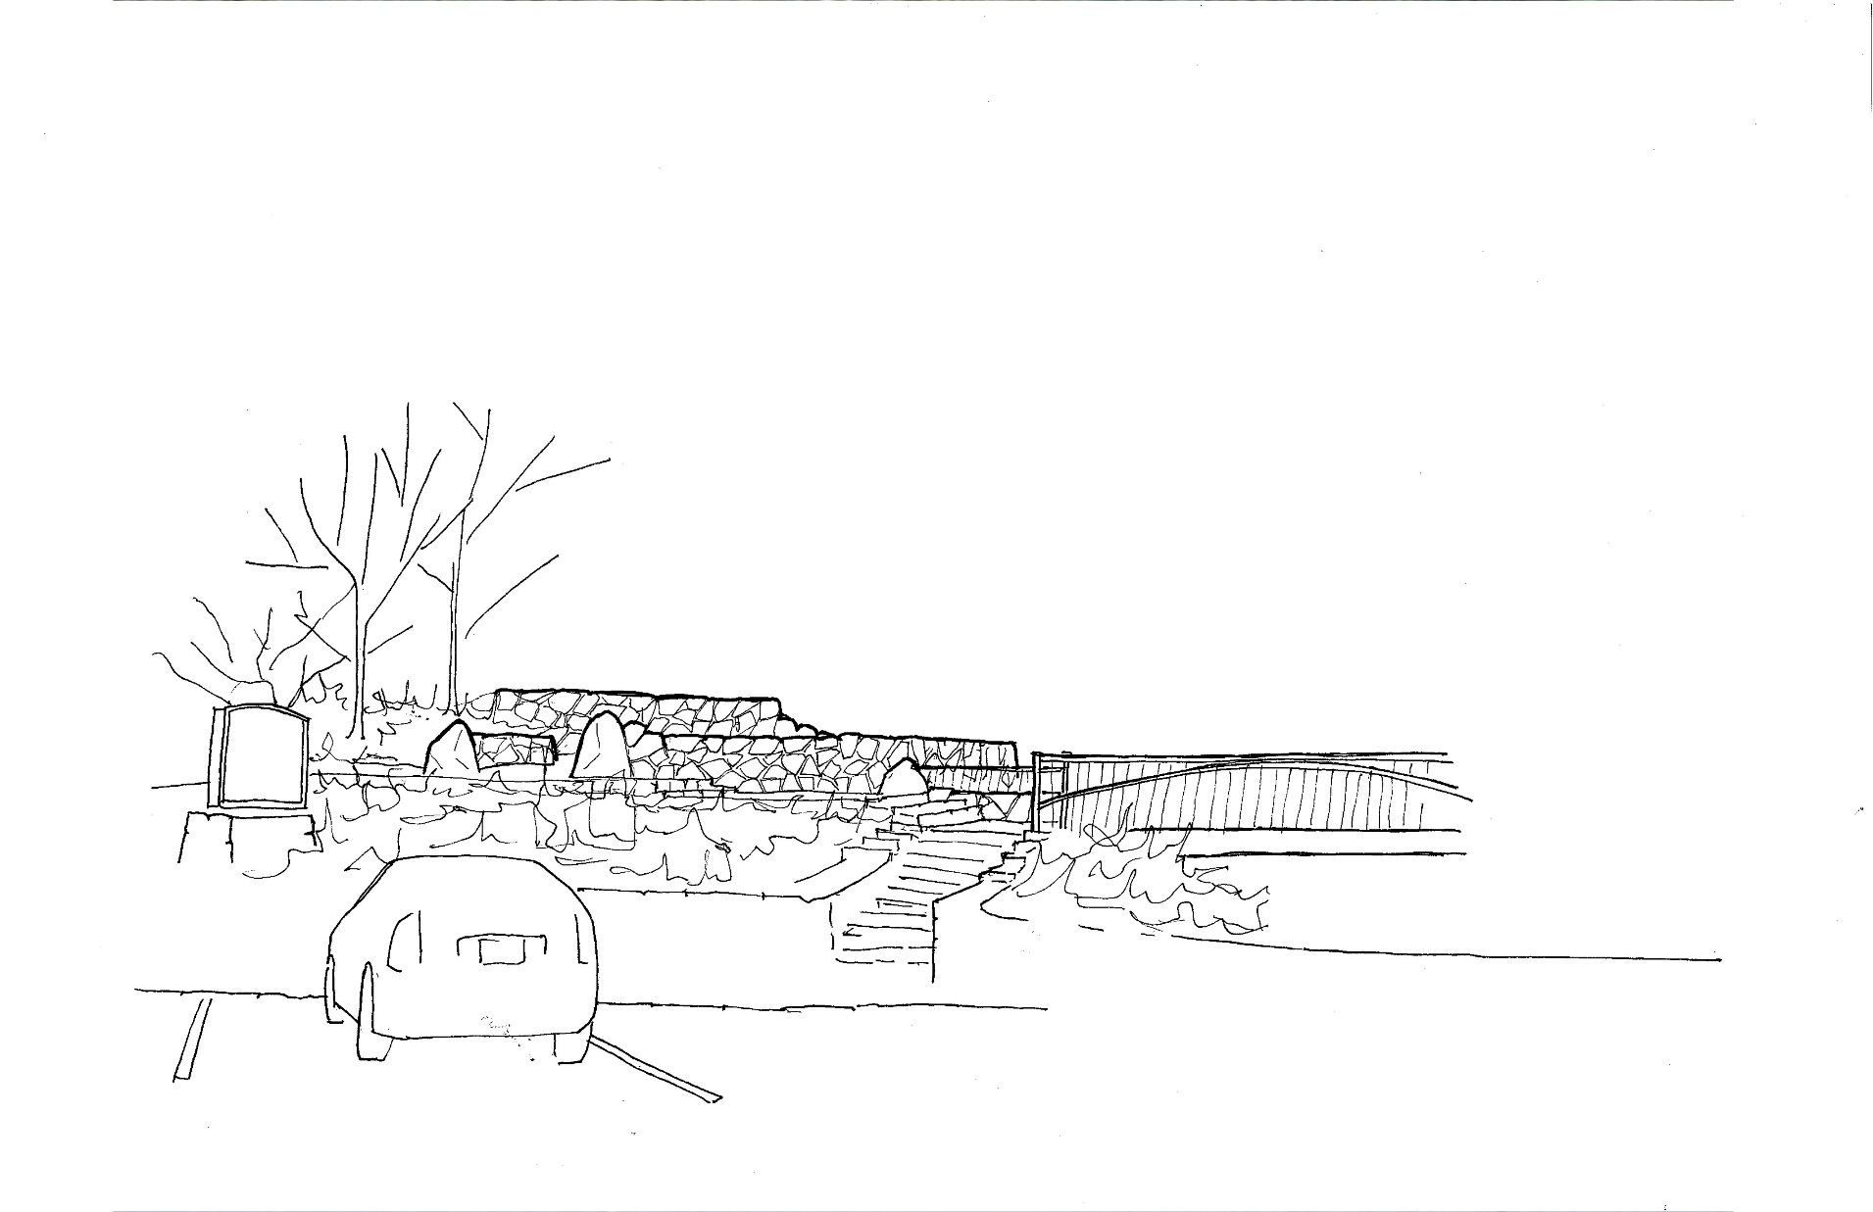

Slide 19
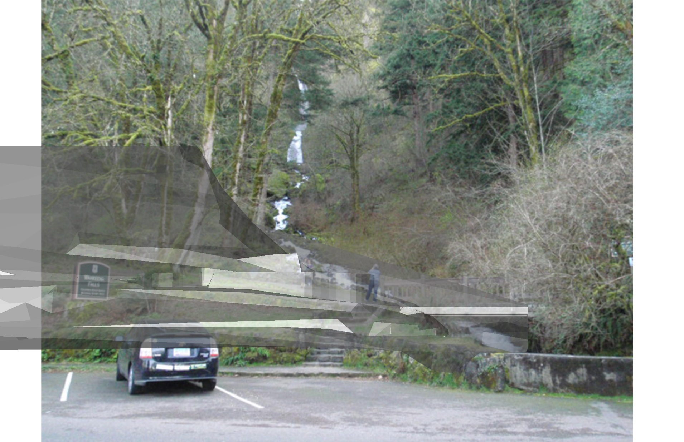

Slide 20
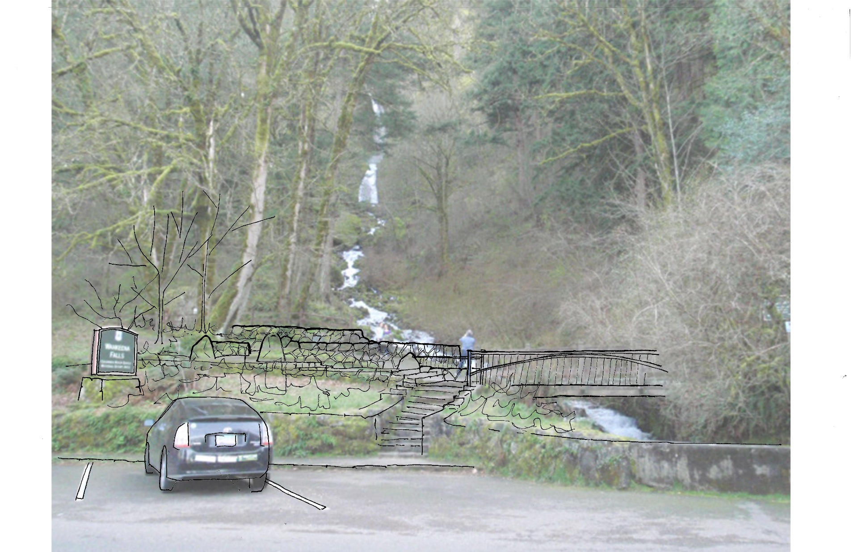

Slide 22
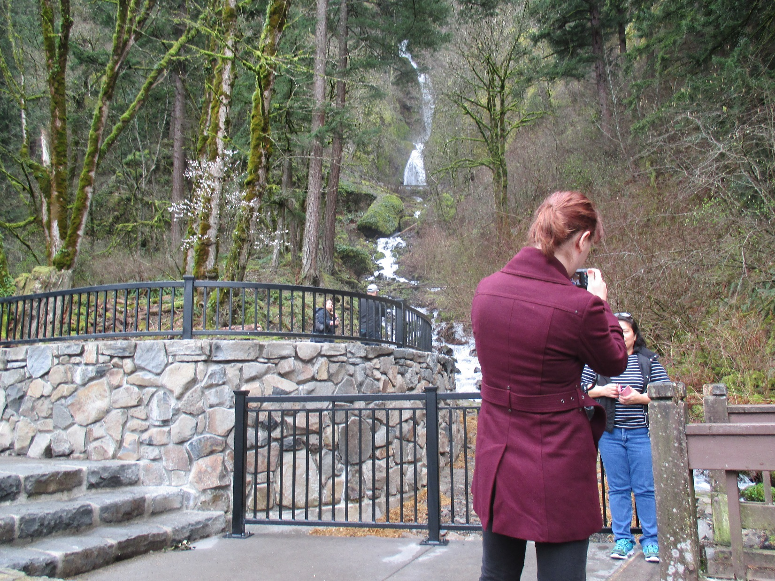

Slide 23
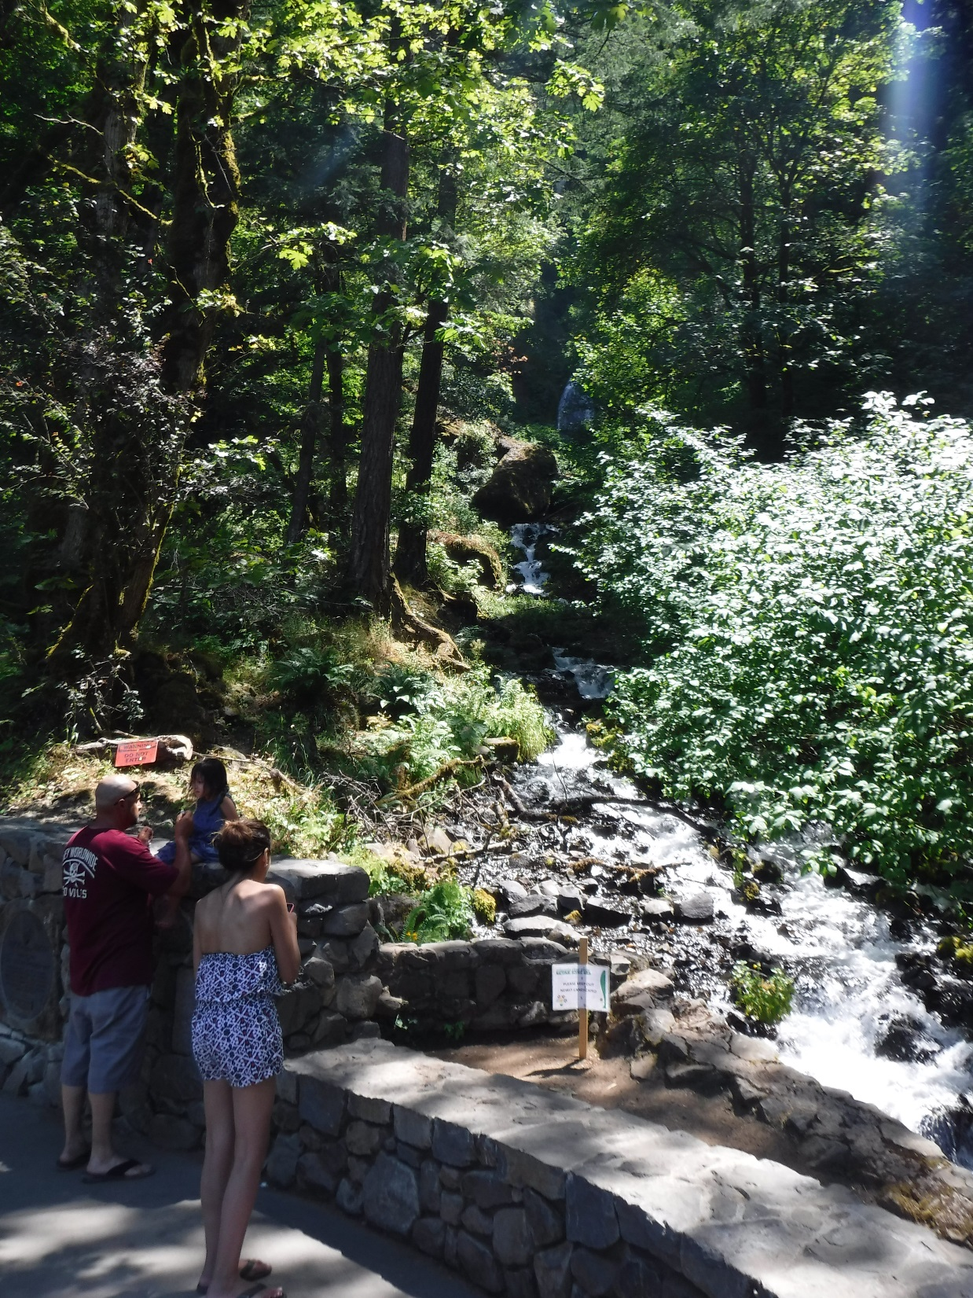

Slide 24
Landscape Character & Design Concept
Line: Horizontal Walls
Form: Framed view of Wahkeena Falls
Texture/ Color: Native Basalt Masonry

Slide 25
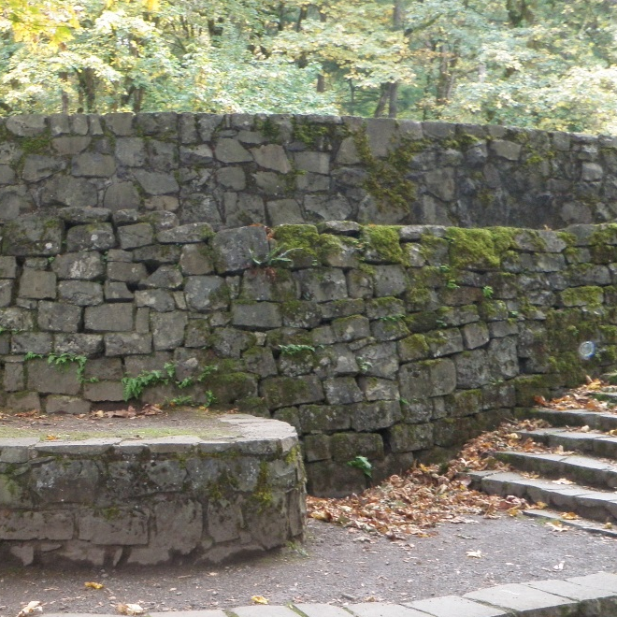
Color & Texture: Design Details

Slide 26
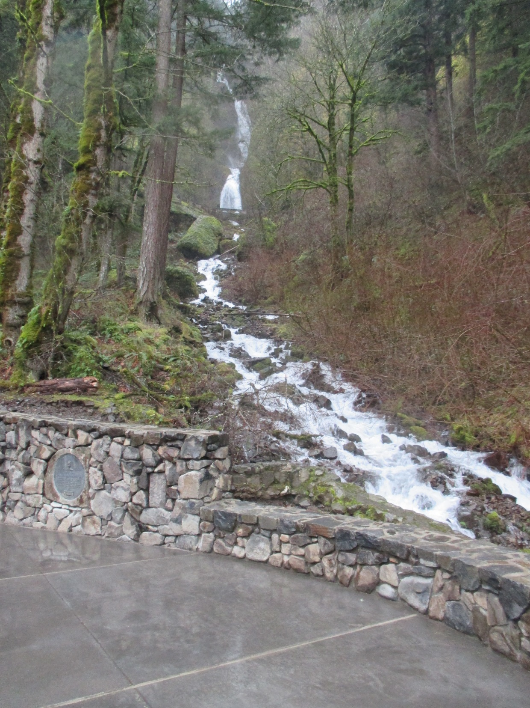

Slide 27
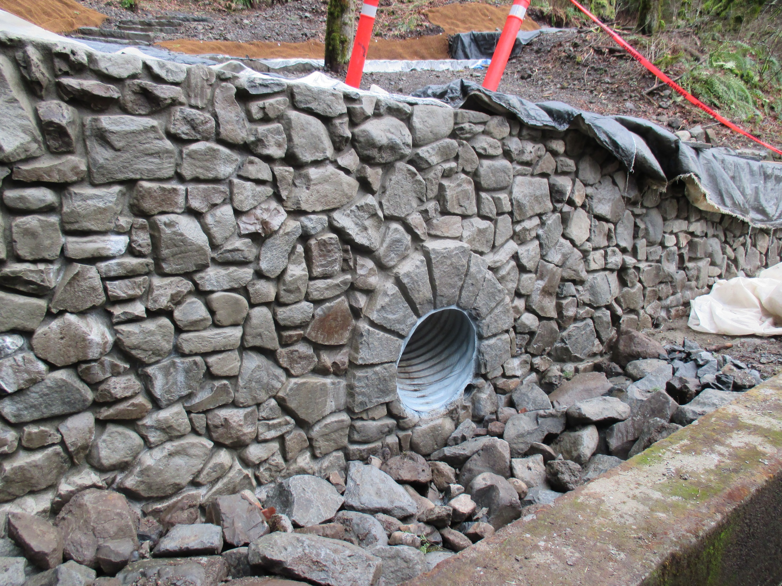

Slide 28
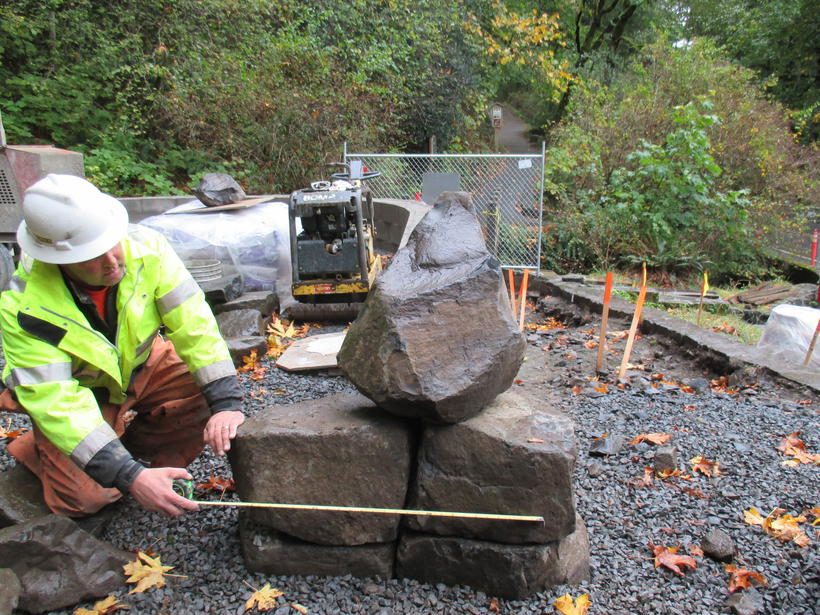

Slide 29
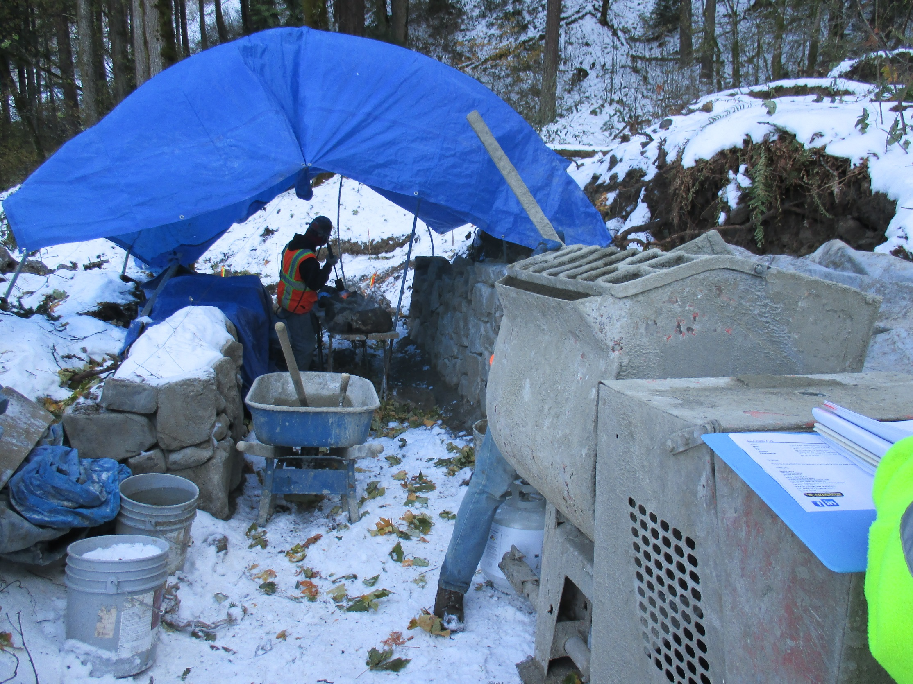

Slide 30
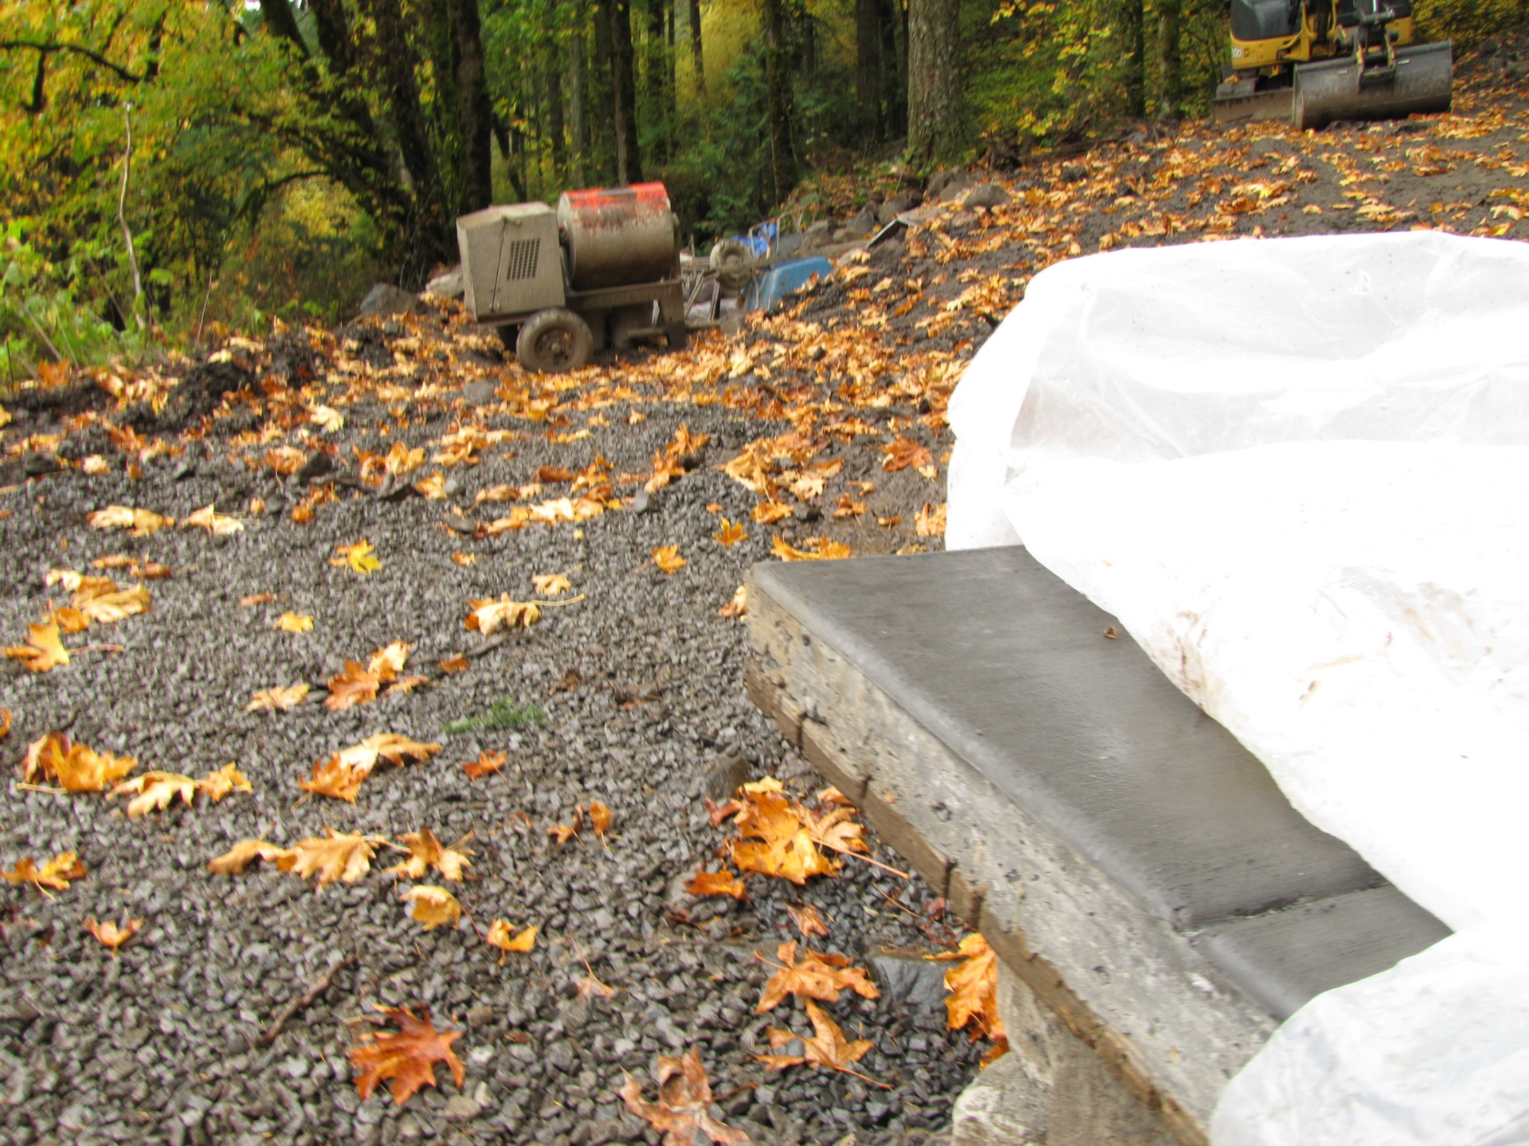

Slide 31
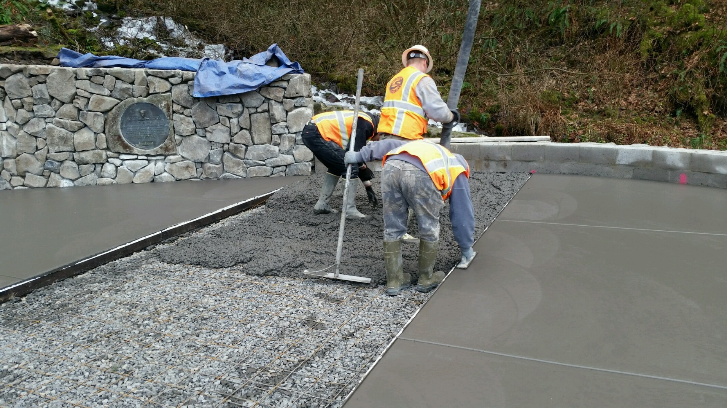

Slide 32
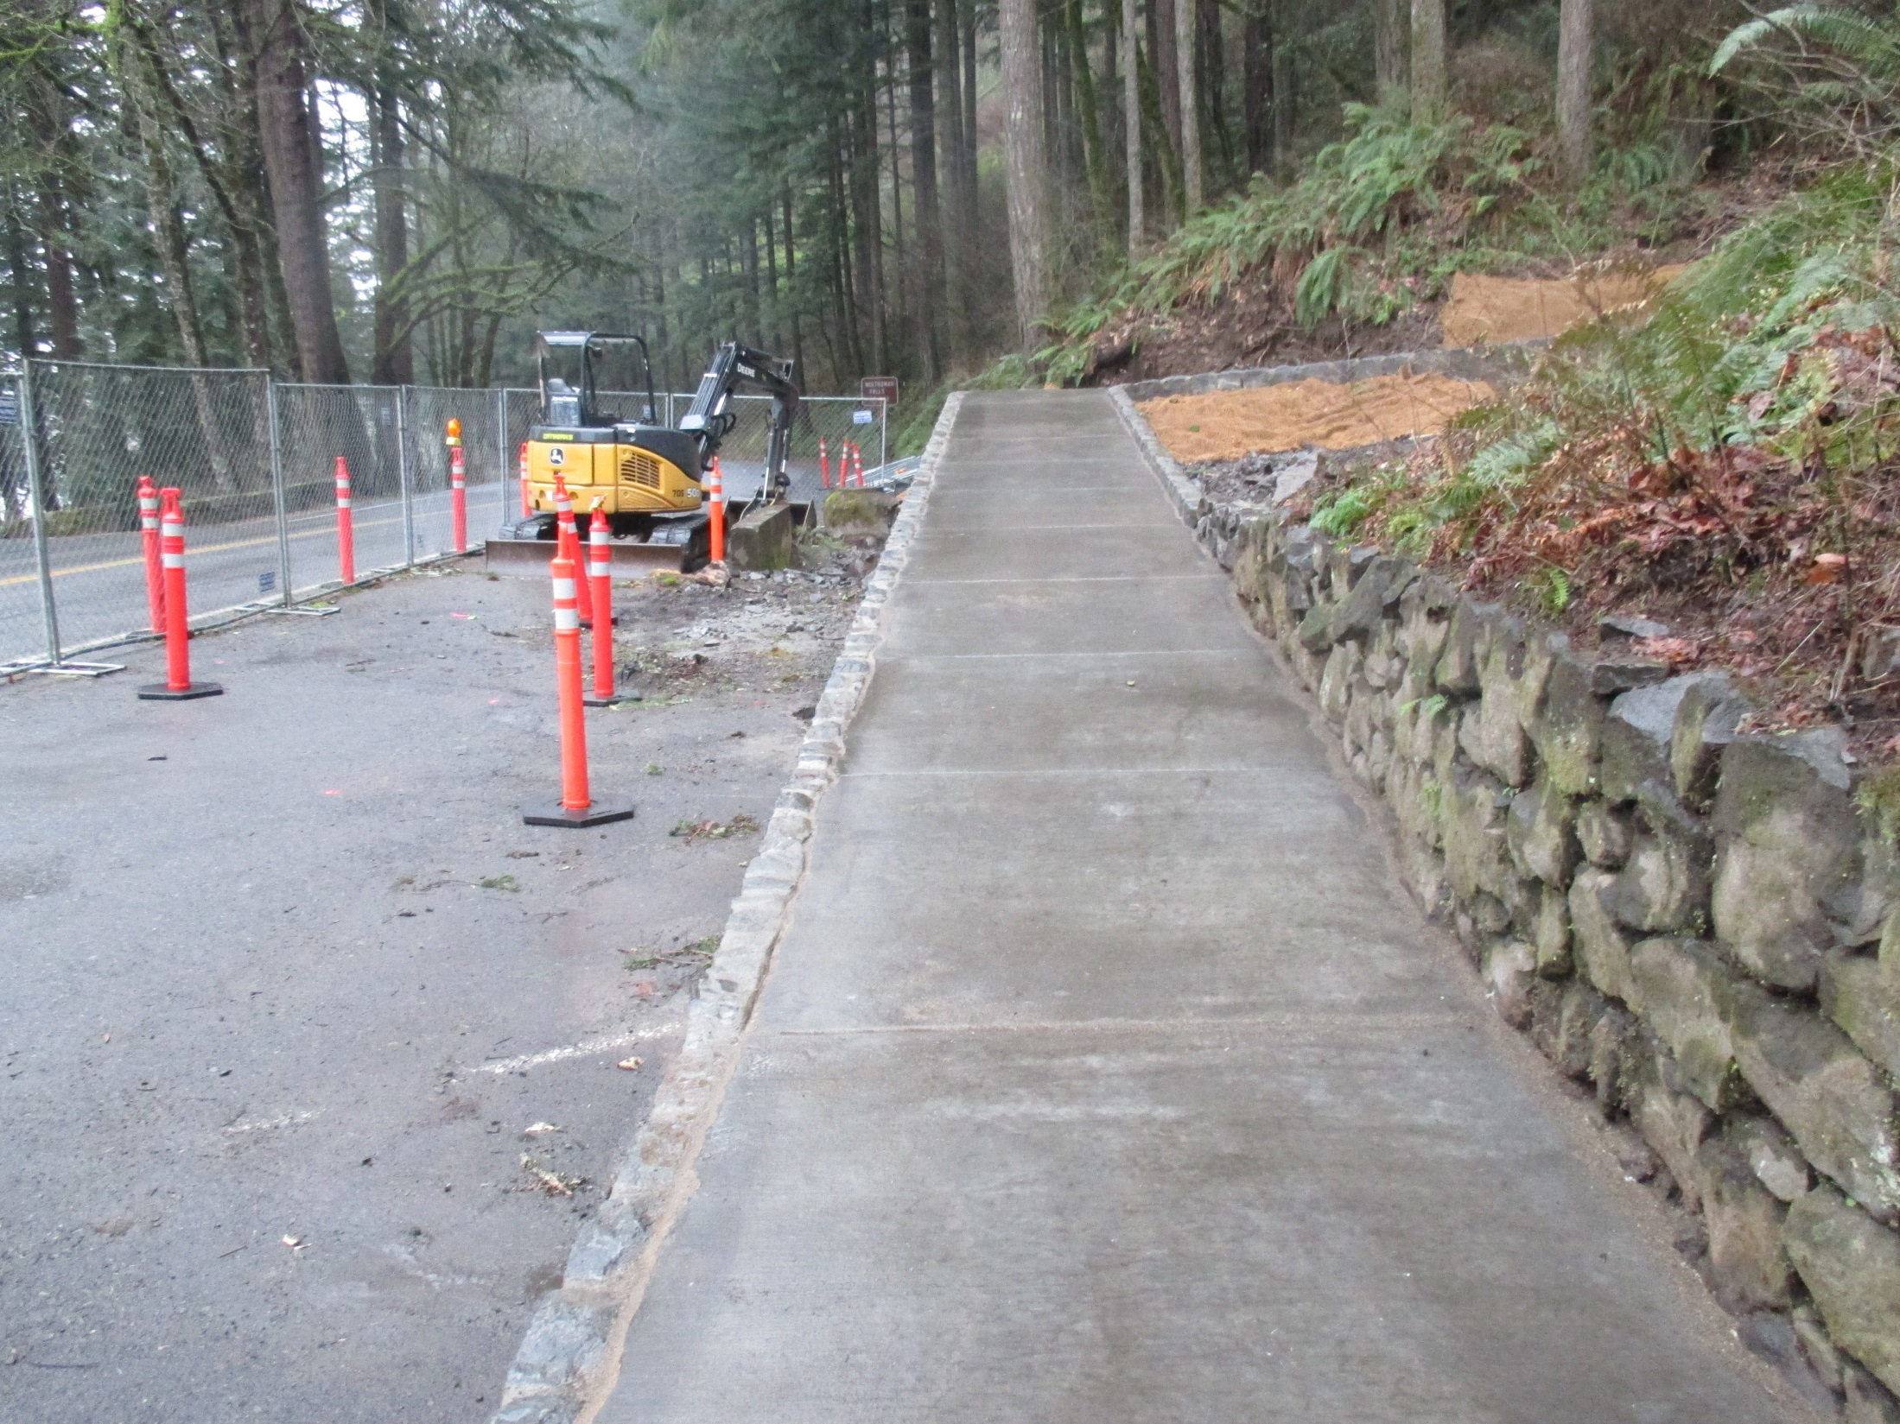

Slide 33
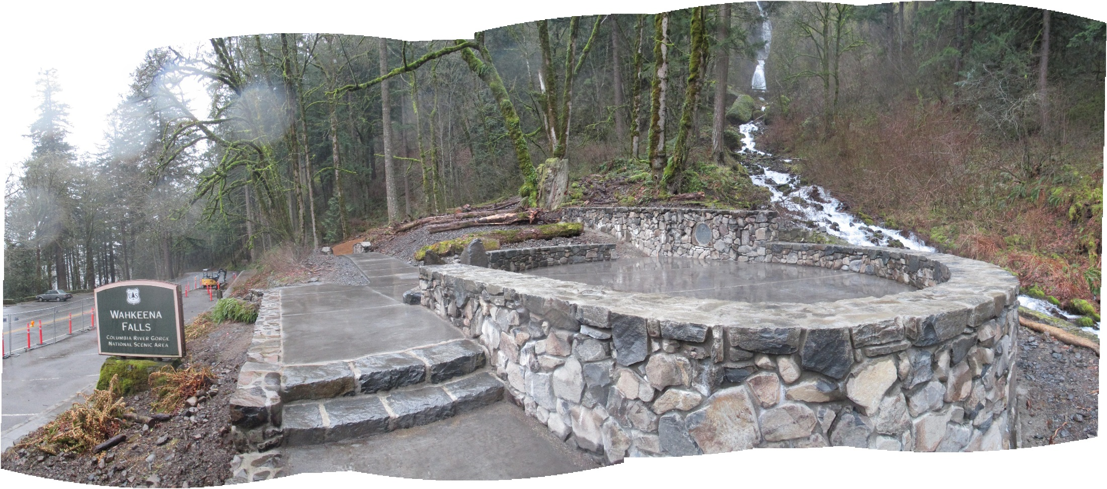

Slide 34
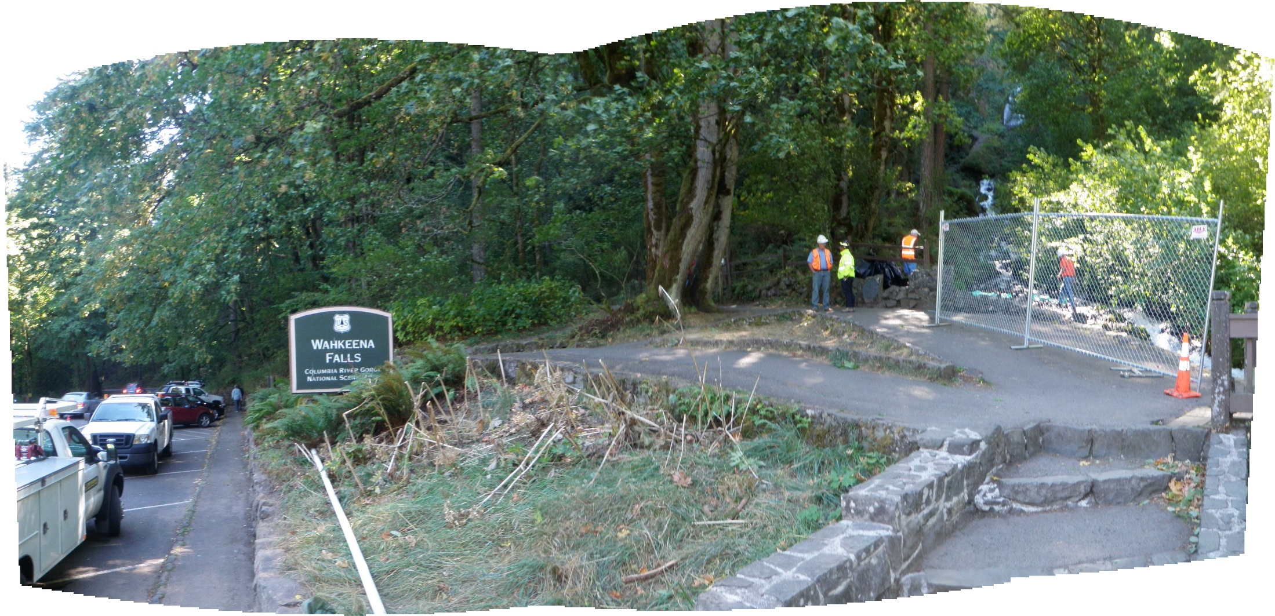
Construction

Slide 35
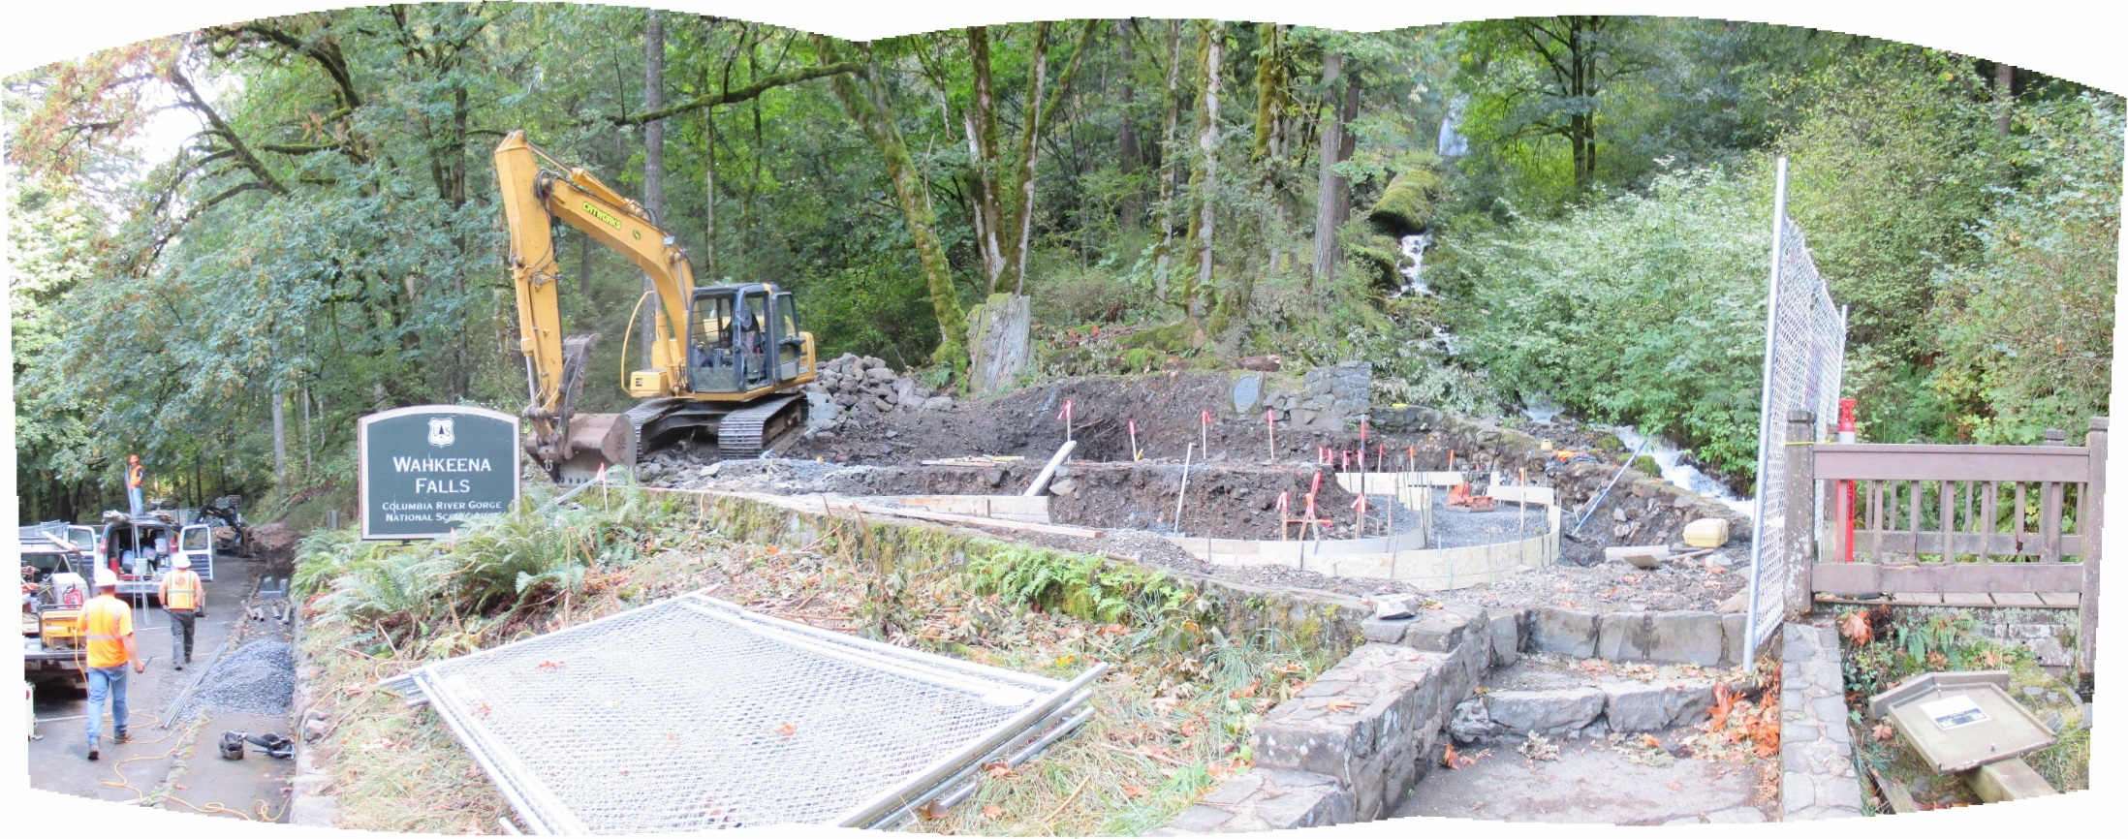

Slide 36
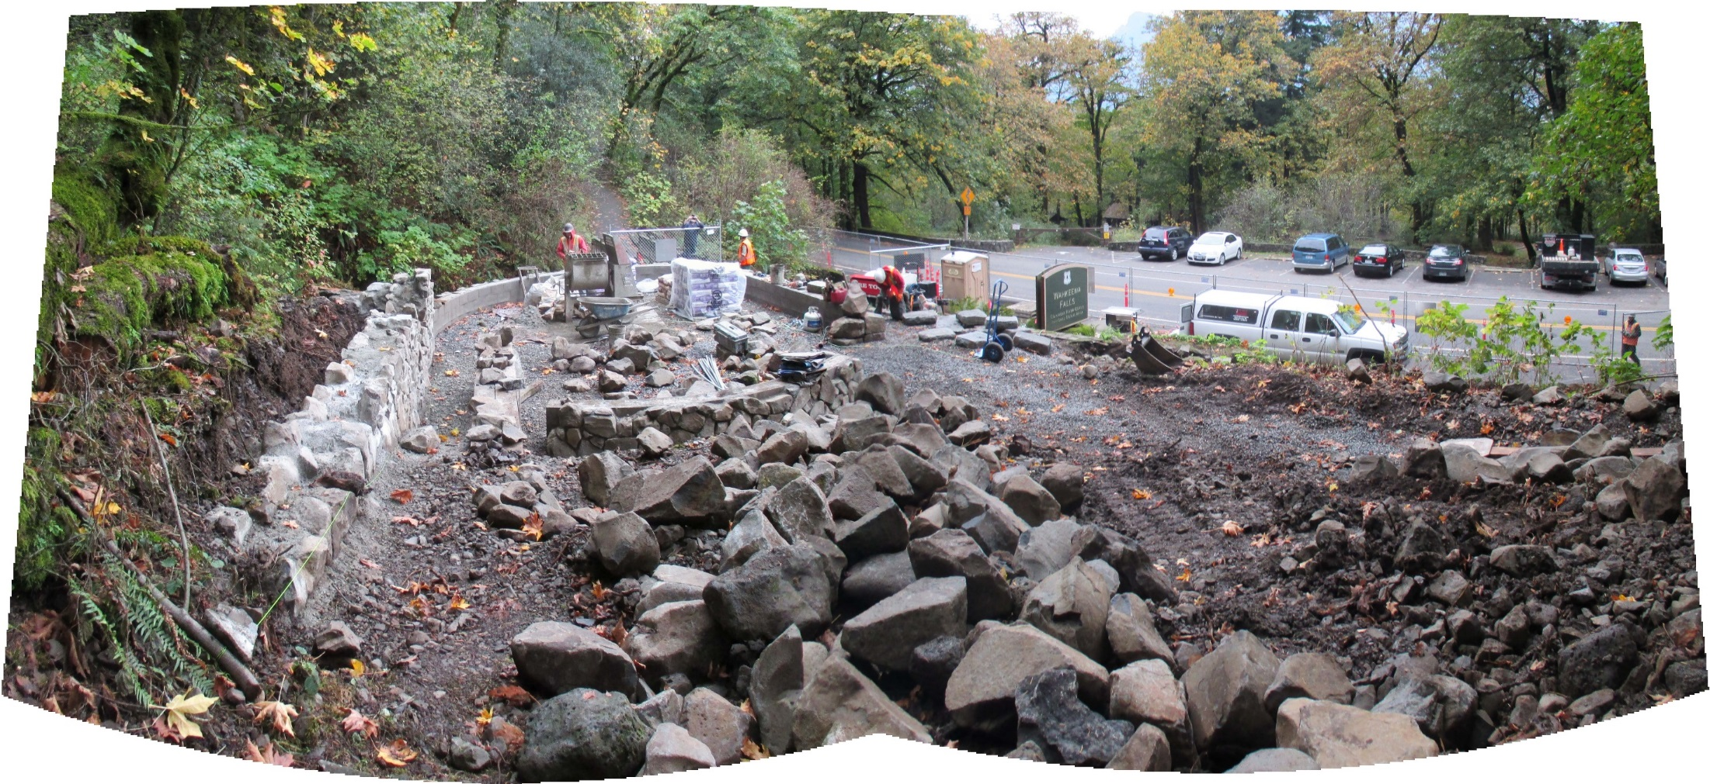

Slide 37
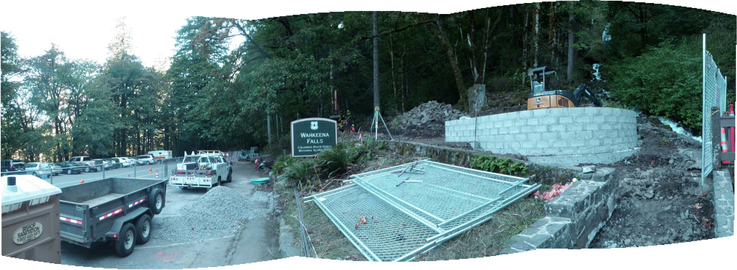

Slide 38
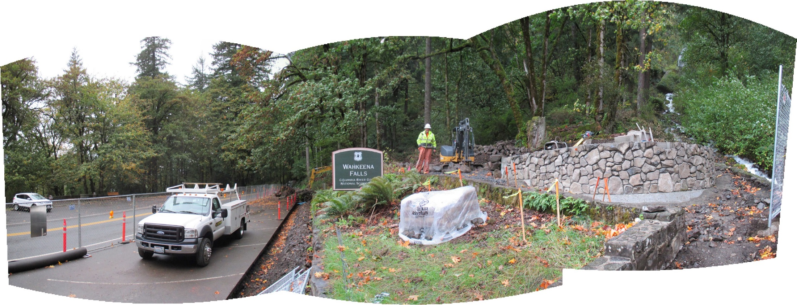

Slide 39
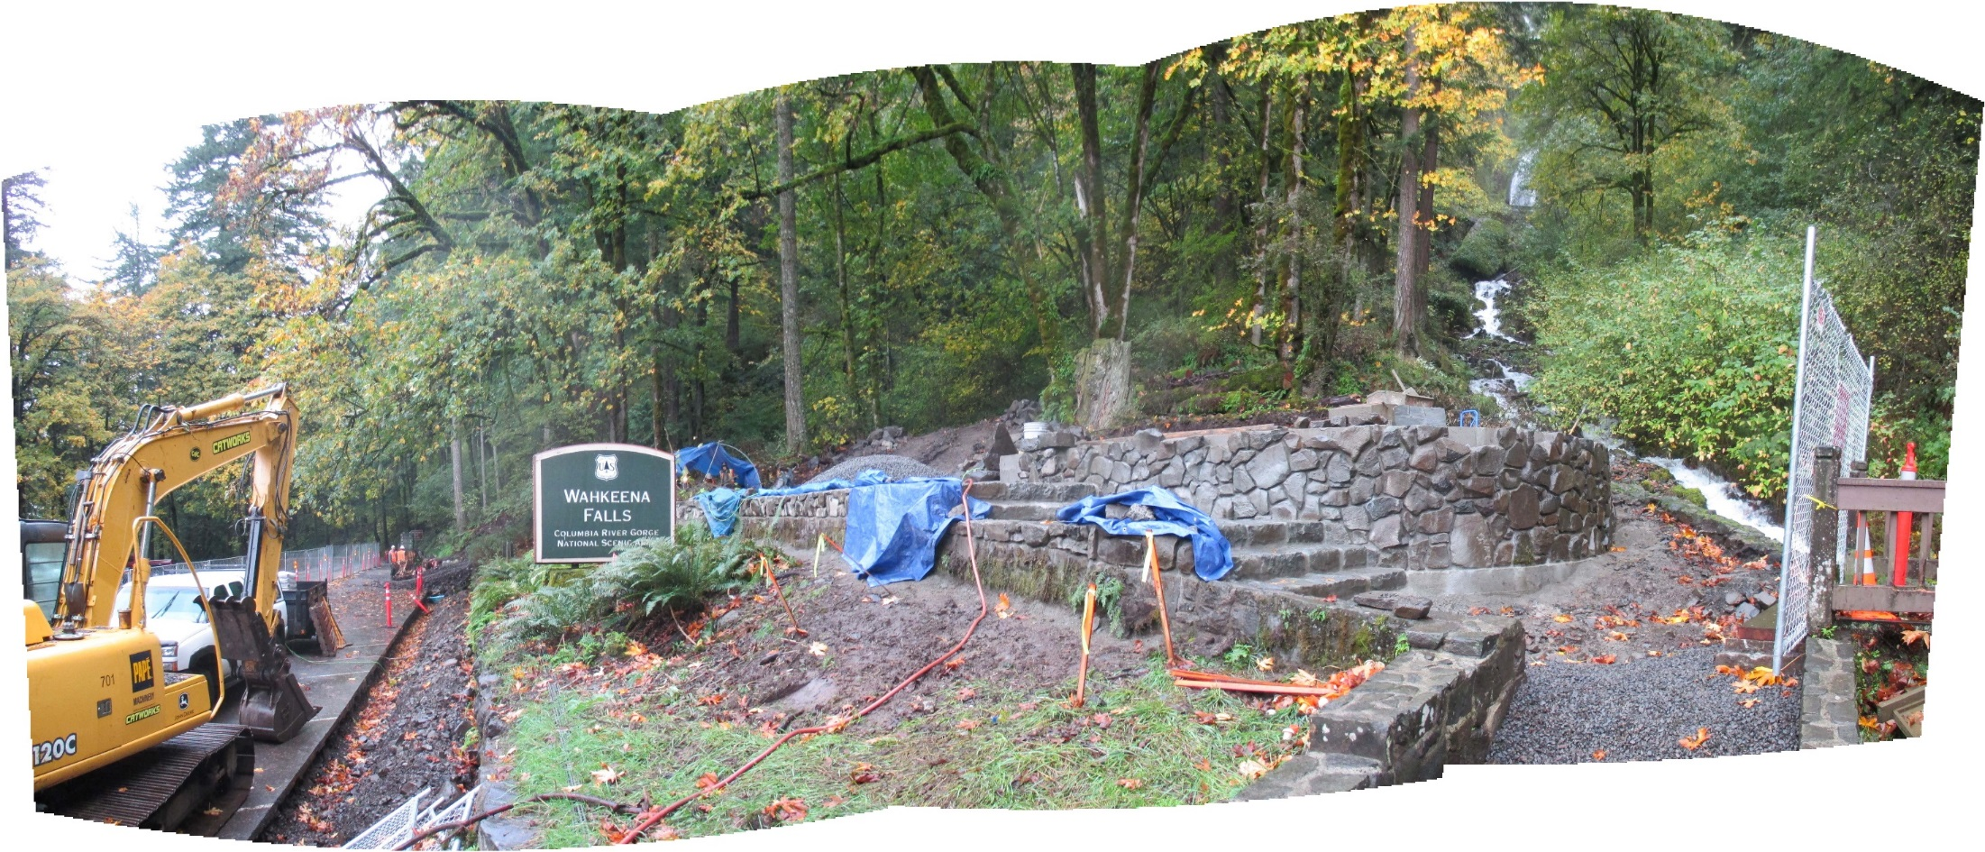

Slide 40
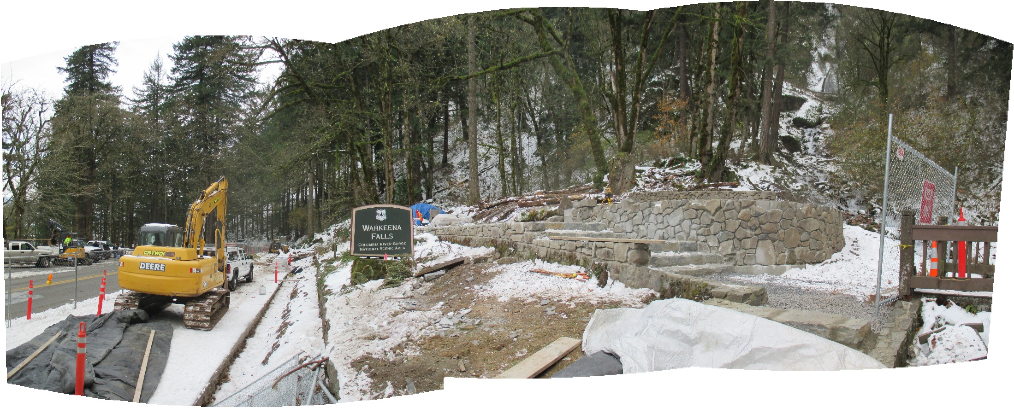

Slide 41
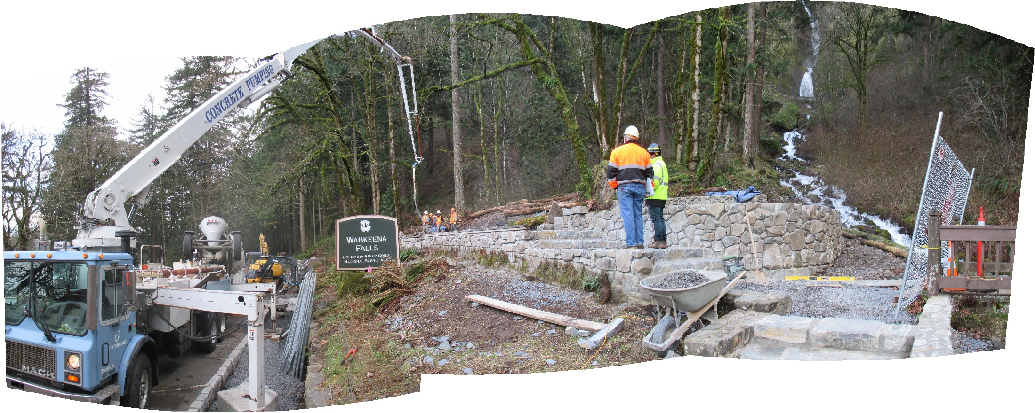

Slide 42
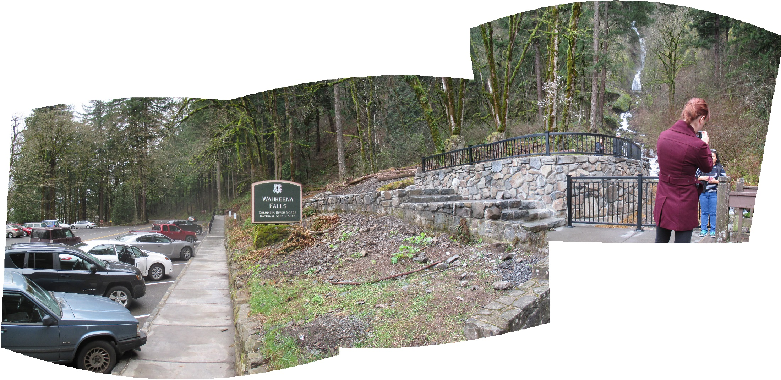

Slide 43
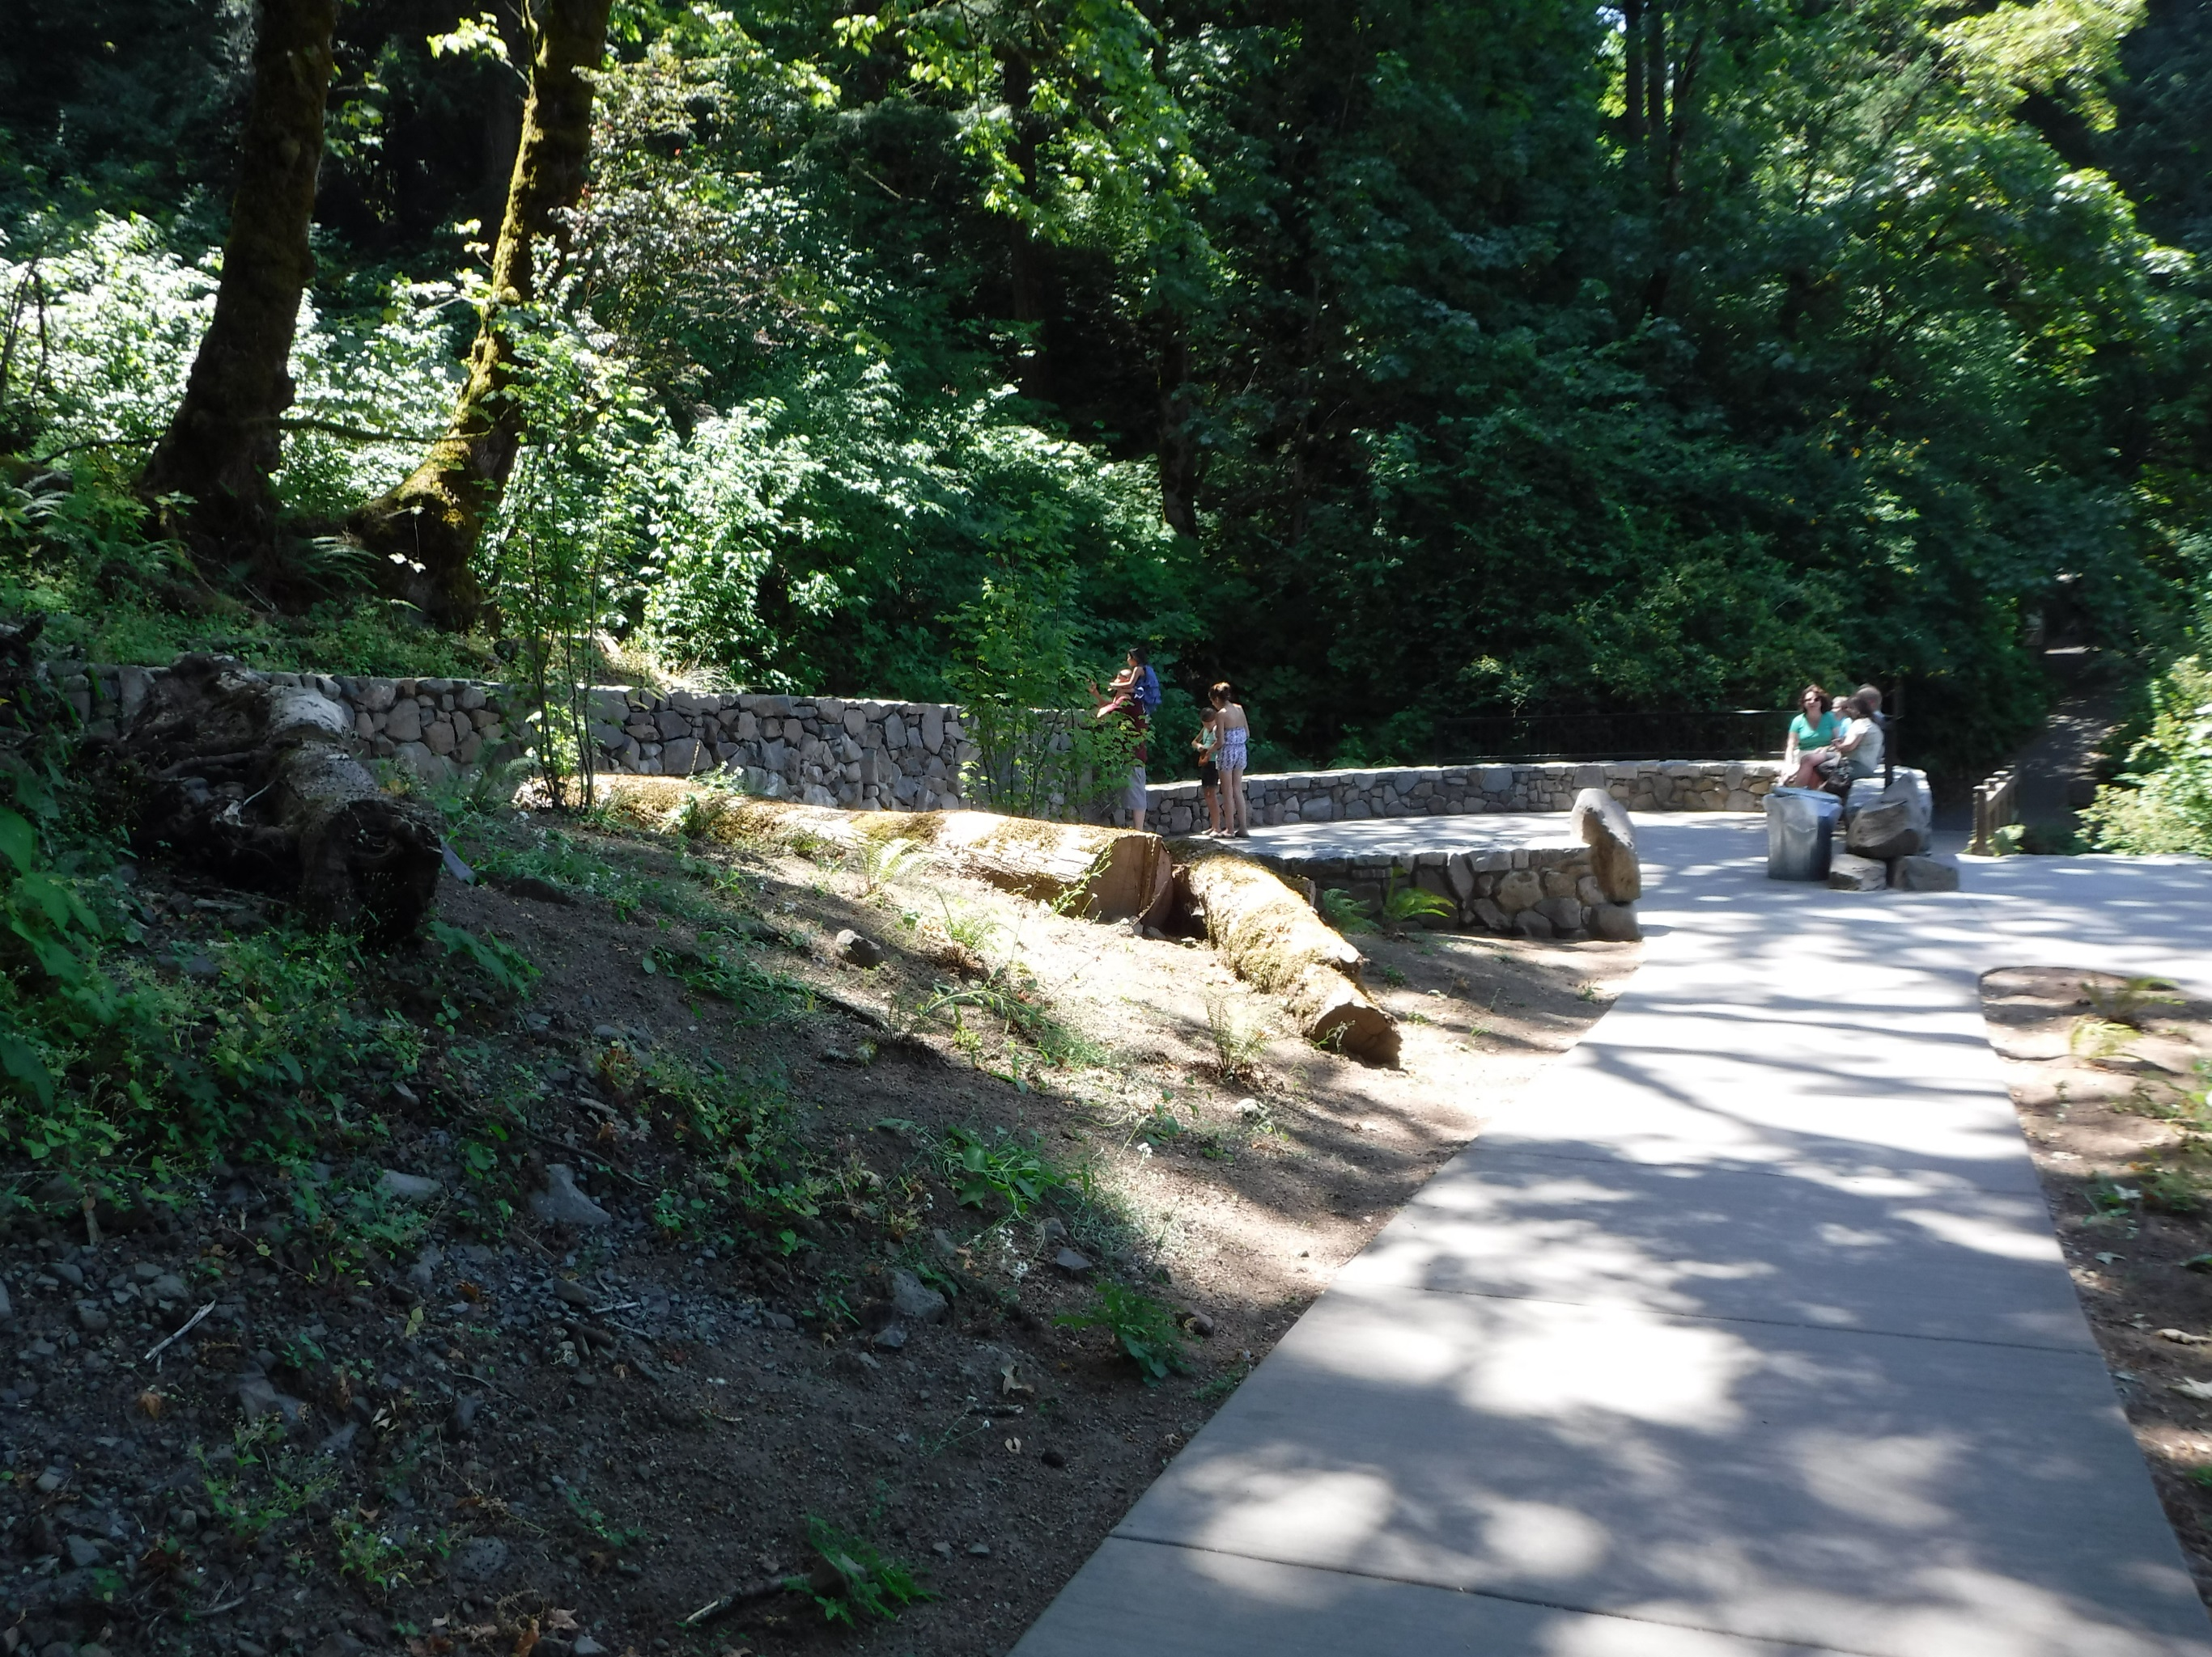

Slide 44
Landscape Character & Design Concept
Line: Horizontal Walls
Form: Framed view of Wahkeena Falls
Texture/ Color: Native Basalt Masonry

Slide 45
