Slide 1
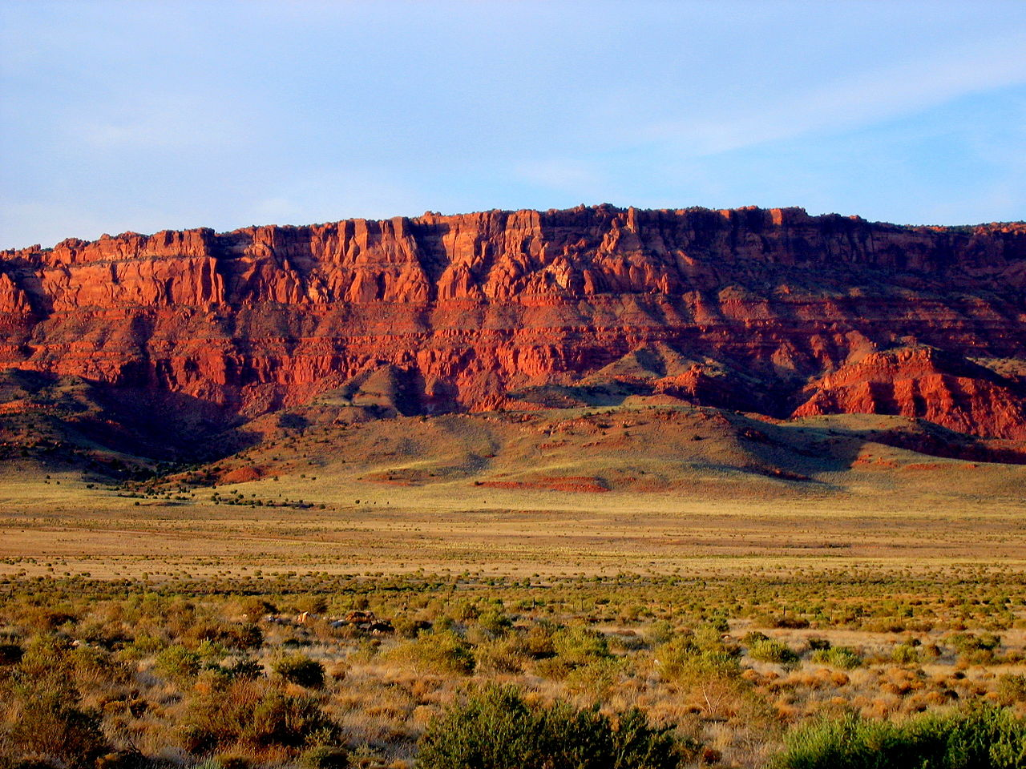
Project Visibility and Contrast
“I think having land and not ruining it is the most beautiful art anybody could want to own.” - Andy Warhol

Slide 2
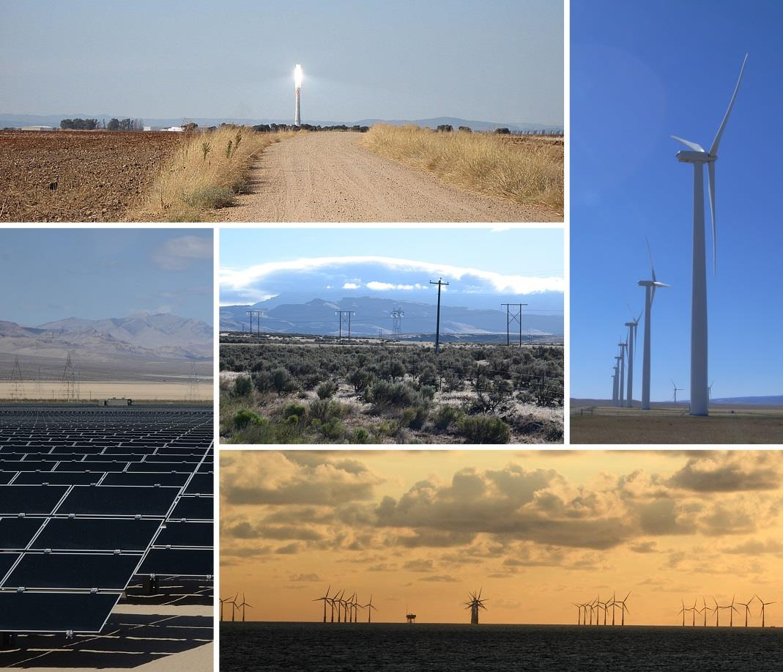
Project Visibility and Contrast
Topics
What makes projects visible?
What are the visual characteristics of large-scale projects, especially energy projects?
Wind Energy
Solar Energy
Electric Transmission
How far can you see them?
What distances matter?

Slide 3
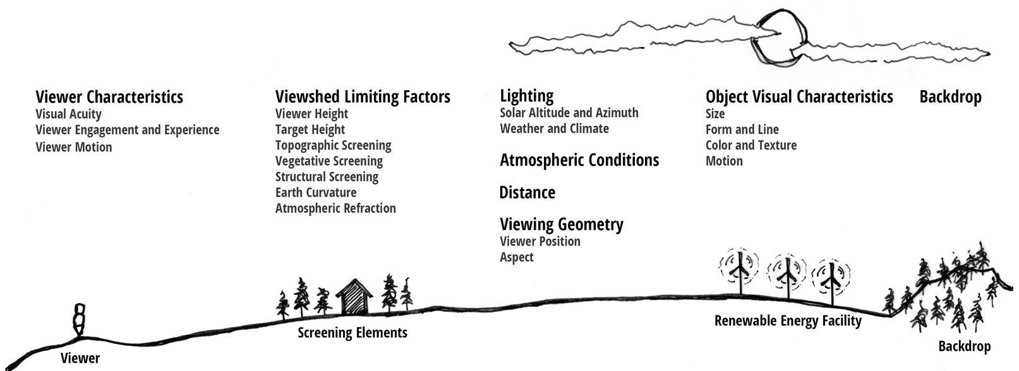
Project Visibility and Contrast
What Makes Projects Visible?
Many variables – called “visibility factors” – affect the visibility of an object in the landscape.
And they all interact…

Slide 4
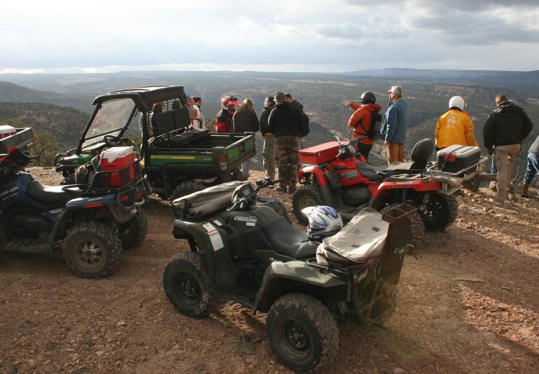
Project Visibility and Contrast
What Makes Projects Visible?
Viewer Characteristics
Visual Acuity
Viewer Engagement and Experience
Viewer Motion

Slide 5
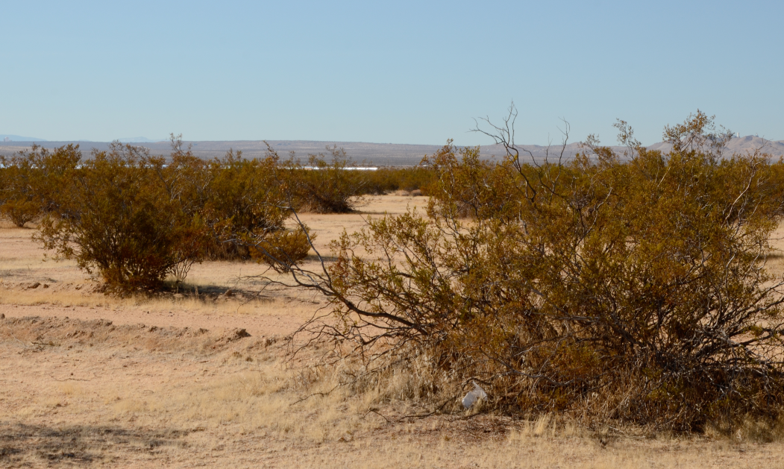
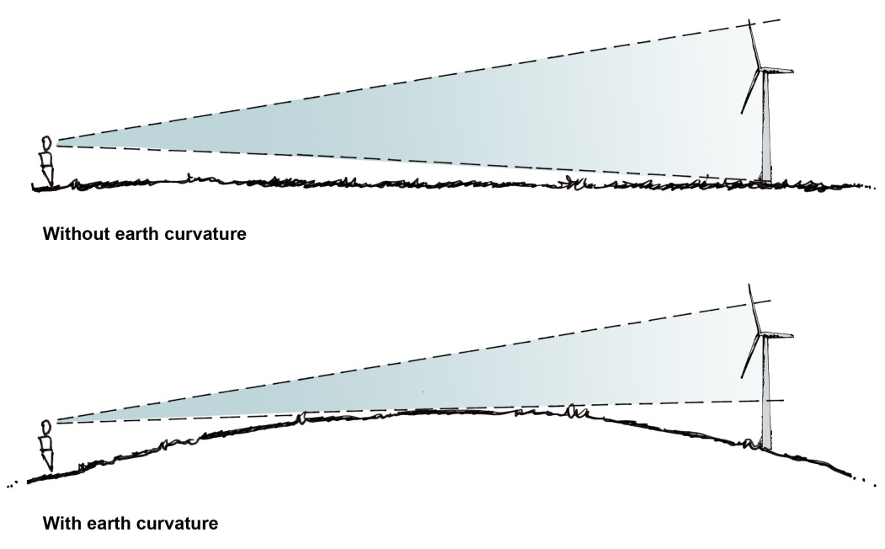
Project Visibility and Contrast
What Makes Projects Visible?
Viewshed Limiting Factors
Topographic Screening
Vegetative Screening
Structural Screening
Viewer Height
Target Height
Earth Curvature
Atmospheric Refraction

Slide 6
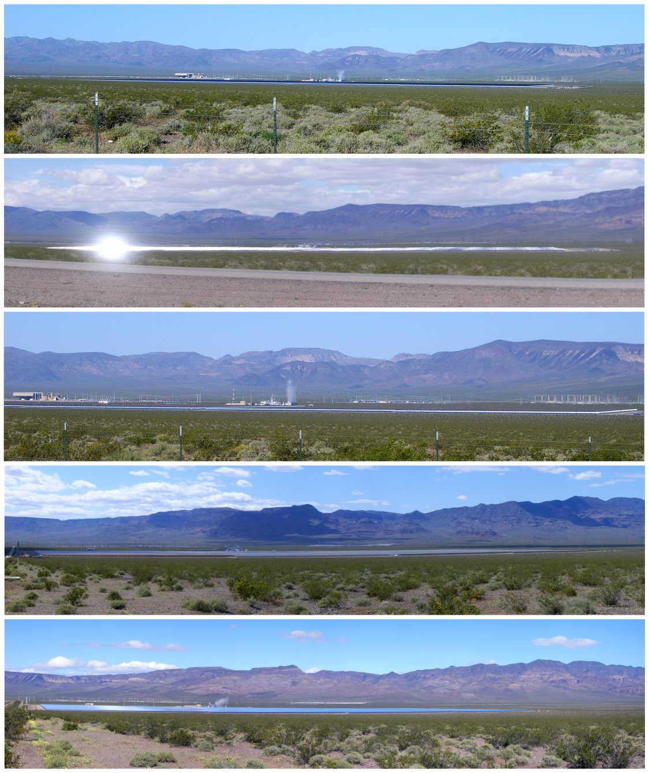
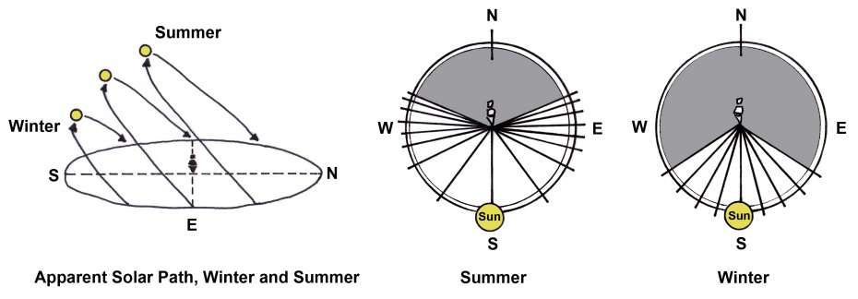
Project Visibility and Contrast
What Makes Projects Visible?
Lighting
Solar Altitude and Azimuth

Slide 7
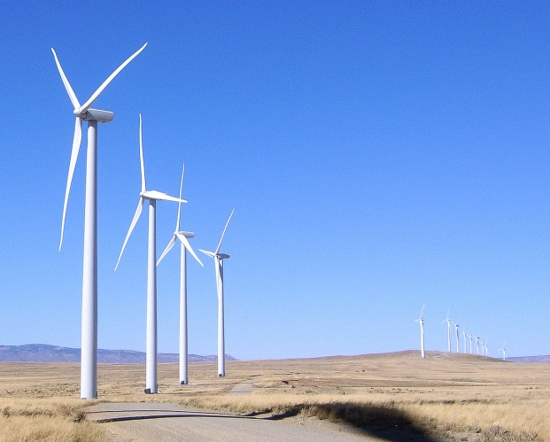
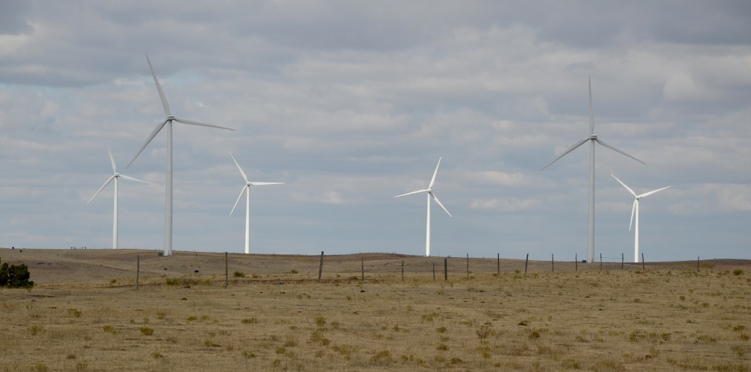
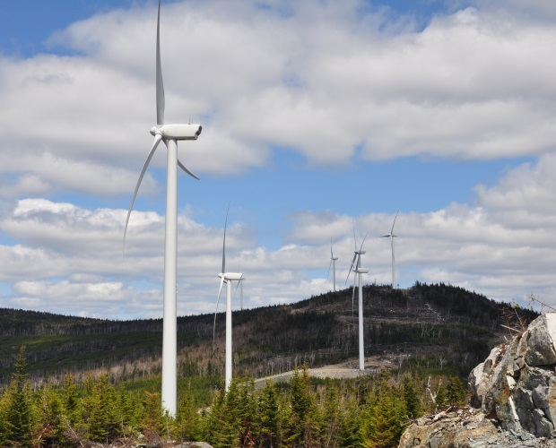
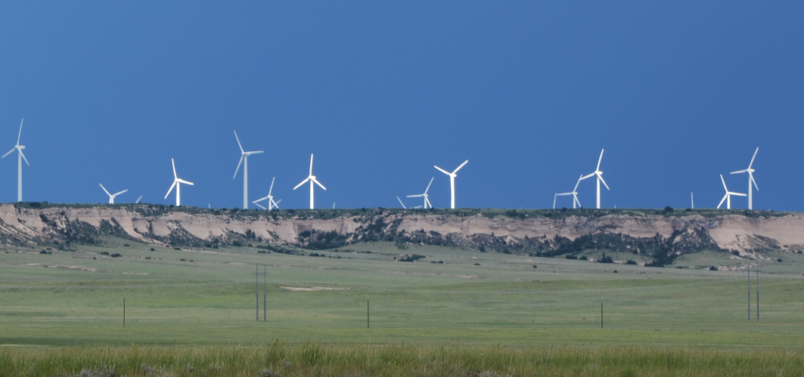
Project Visibility and Contrast
What Makes Projects Visible?
Lighting
Weather and Climate

Slide 8
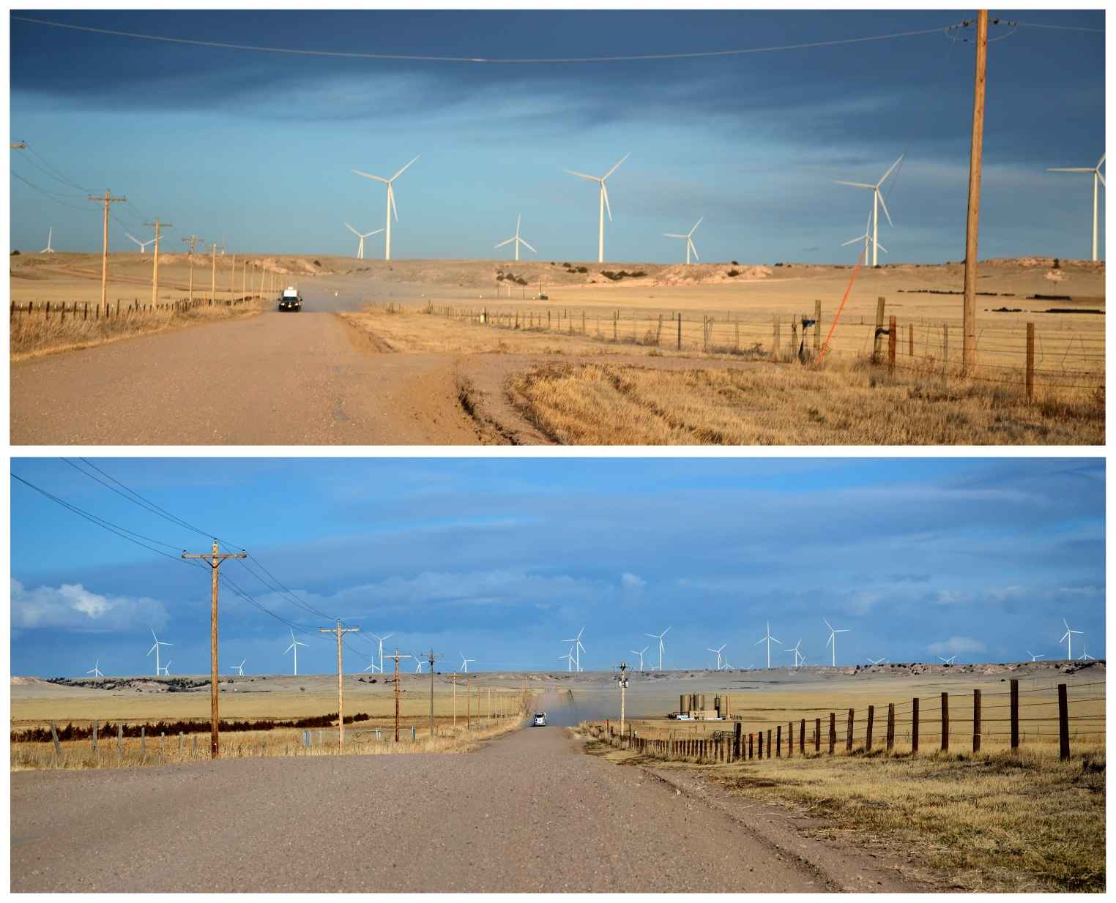
Project Visibility and Contrast
What Makes Projects Visible?
Distance

Slide 9
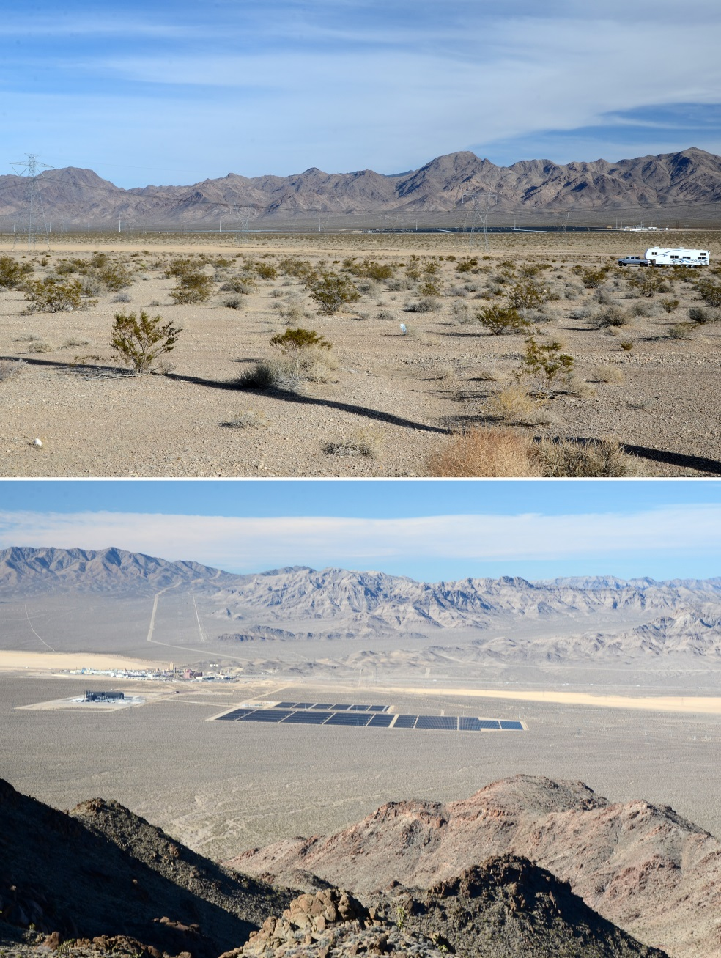
Project Visibility and Contrast
What Makes Projects Visible?
Viewing Geometry
Viewer Position

Slide 10
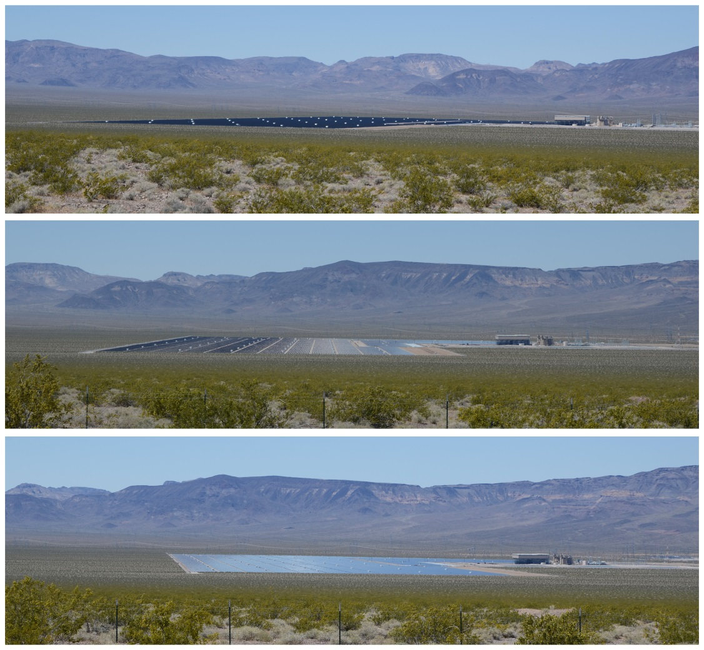
Project Visibility and Contrast
What Makes Projects Visible?
Viewing Geometry
Aspect

Slide 11
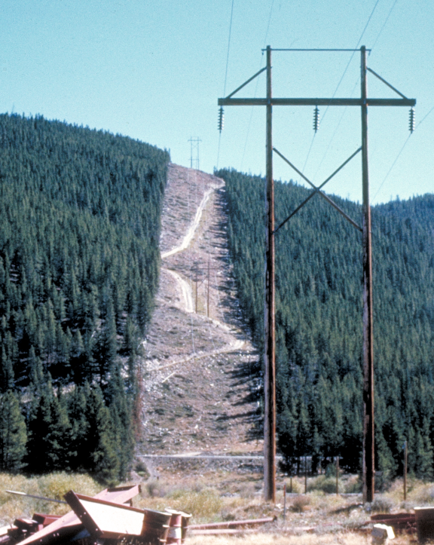
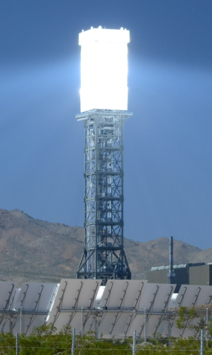
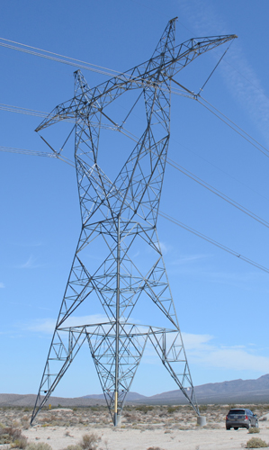
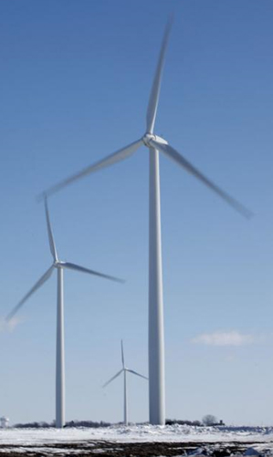
Project Visibility and Contrast
What Makes Projects Visible?
Object Visual Characteristics
Size
Form and Line
Color and Texture
Motion

Slide 12
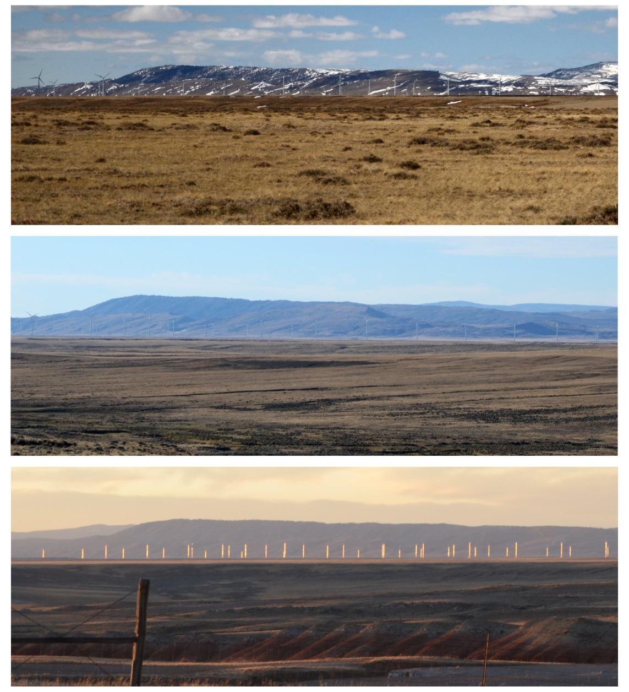
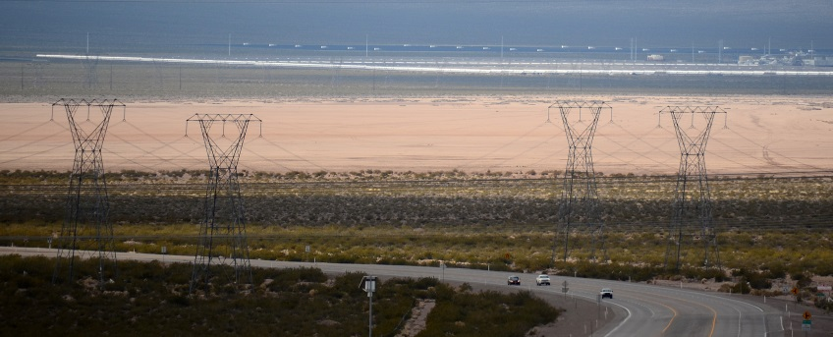
Project Visibility and Contrast
What Makes Projects Visible?
Backdrop

Slide 13
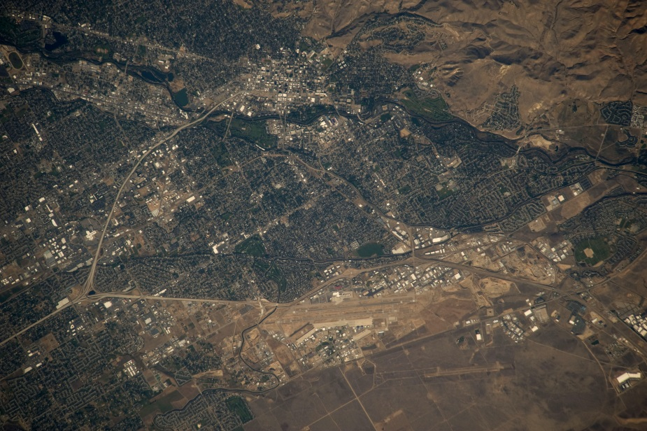
Project Visibility and Contrast
Renewable Energy Facilities
Very Large Facilities
Approved or under construction:
Onshore wind facility of 1,000 turbines on more than 200,000 acres in Wyoming (312 mi²); Boise = 80 mi²
Offshore wind facility up to 50,000 acres in Sweden (78 mi²)
Solar facility up to 8,000 acres in California (12.5 mi²)
Transmission lines hundreds of miles long
Boise from Space
Desert Sunlight Solar Facility - 6.2 mi²

Slide 14
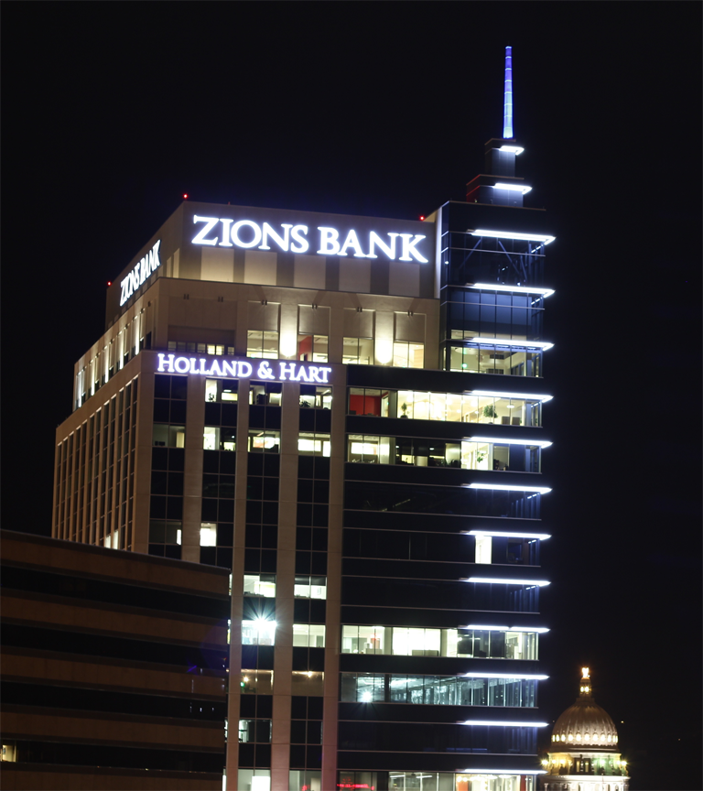
Project Visibility and Contrast
What Makes Projects Visible?
Very Tall Structures
Offshore wind turbines more than 700 ft tall (Vestas V164-8MW)
Onshore wind turbines more than 650 ft tall (Enercon E-126/7.5 MW)
Current solar power tower 640 ft (Crescent Dunes)
Zion’s Bank Building - 323 ft.

Slide 15
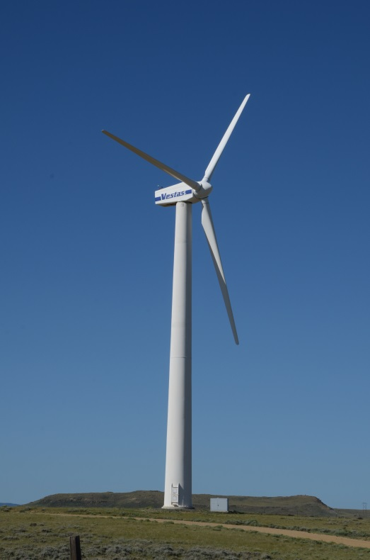
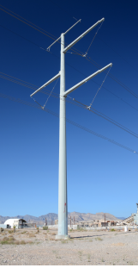
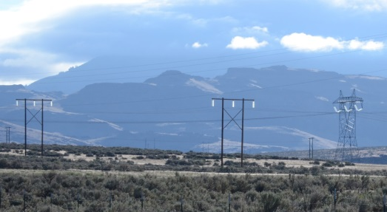
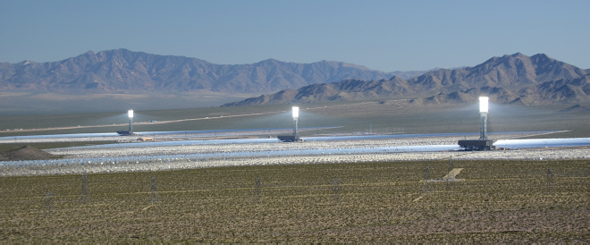
Project Visibility and Contrast
Renewable Energy Facilities
Highly Reflective Surfaces
Wind turbines are white (per FAA requirements).
Solar facilities can cause painfully bright glare at 20 mi.
Transmission lines and insulators can cause glare.

Slide 16
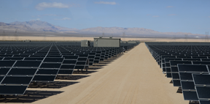
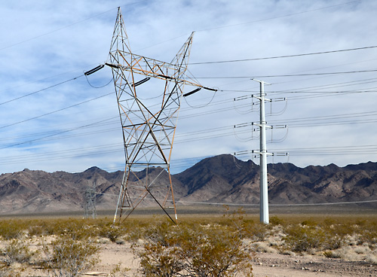
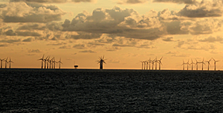
Project Visibility and Contrast
Renewable Energy Facilities
Rectilinear, Ordered Geometry
Many regular polygons
Highly structured and regular spatial arrangement
Perfectly smooth or ordered surface textures
Some introduce strong line contrasts
Don’t blend well with “organic” landscapes

Slide 17
Project Visibility and Contrast
How Far Can You See Them?
Long Distance Visibility
Wind turbines visible beyond 35 miles in western landscapes, strong contrasts beyond 13 mi.
Offshore wind turbines visible beyond 25 mi, strong contrasts beyond 10 mi.
Solar power towers easily visible at 35 mi, strong contrasts beyond 20 mi.
Visible at same distances at night.
Transmission visible beyond 15 mi, strong contrasts to a few miles.

Slide 18
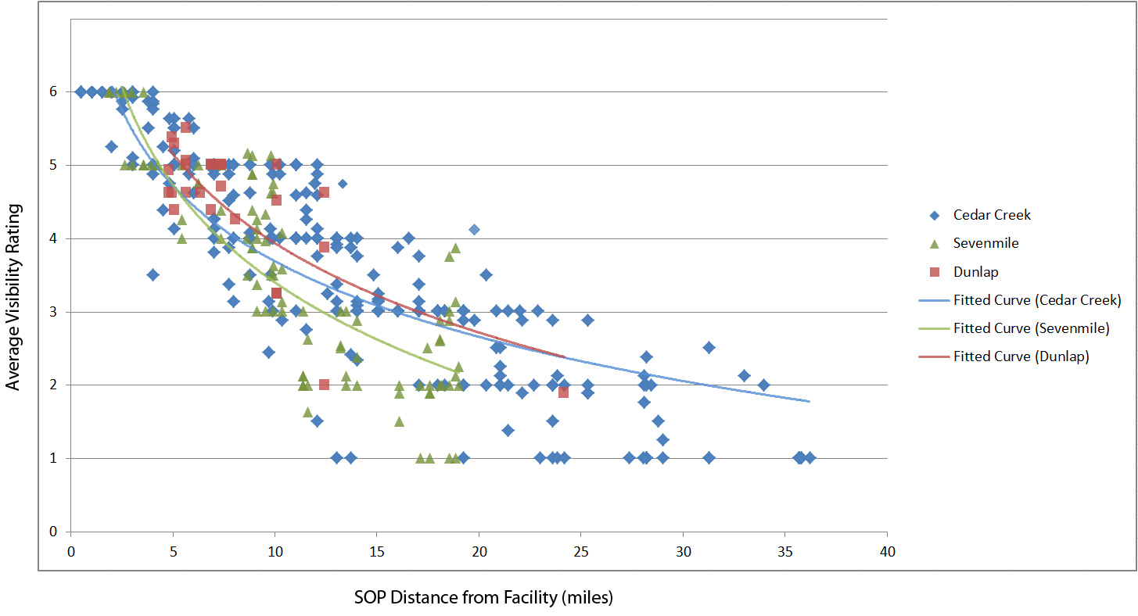
Project Visibility and Contrast
What Distances Matter?
Windfarm Visibility Analysis
For 3 wind farms in Wyoming and Colorado
Average Visibility Rating (AVR)
1-2 = low contrast
3-4 = moderate contrast
5-6 = high contrast, dominates view
Wind facilities often dominated views beyond 10 mi
Easily visible beyond 20 mi
Under optimal conditions, visible beyond 35 mi
Synchronized flashing red lights visible beyond 35 mi at night

Slide 19
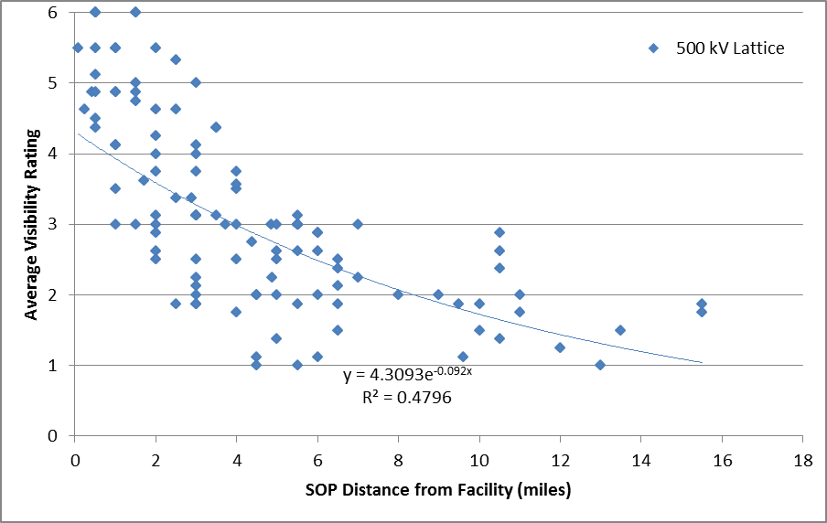
Project Visibility and Contrast
What Distances Matter?
Transmission Visibility Analysis
For three 500 kV lattice tower facilities in Idaho, Nevada, and California
Average Visibility Rating (AVR)
1-2 = low contrast
3-4 = moderate contrast
5-6 = high contrast, dominates view
Facilities sometimes dominated views beyond 2 mi.
Sometimes easily visible beyond 5 mi
Under optimal conditions, visible beyond 15 mi
Very sensitive to backdrop

Slide 20
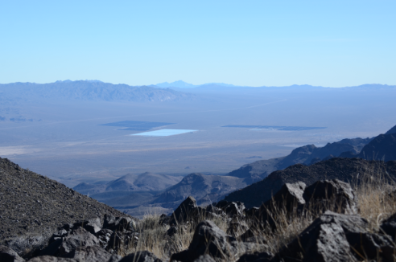
Project Visibility and Contrast
What Distances Matter?
Solar Visibility Analysis
No formal study, but:
Small parabolic trough facility (300 acres) easily visible at 14 mi
Small photovoltaic facility visible beyond 20 mi
Both not recognizable as solar facilities at long distances
Ivanpah Power Tower facility easily visible at 35 mi, likely visible at much greater distance
Parabolic trough and photovoltaic facilities at 10 mi
Ivanpah Solar Power Tower Facility at 35 mi

Slide 21
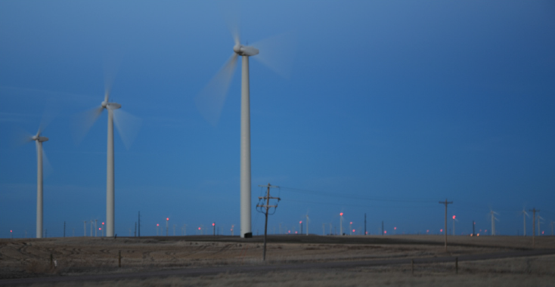
Project Visibility and Contrast
What Distances Matter?
Highly Visible at Night
Synchronized flashing lights on wind turbines
Power block lighting at solar facilities
Transmission substations
Generally visible as far or farther than during the day
Cedar Creek Windfarm, Colorado
Nevada Solar One facility (left) and substation (right), Nevada

Slide 22
Project Visibility and Contrast
What Distances Matter?
Conclusion
Large facilities + large structures + highly reflective surfaces + rectilinear geometry + moving parts + glare + lighting + sited in open landscapes = long-distance visibility.
Ivanpah Solar Power Tower Facility, California

Slide 23
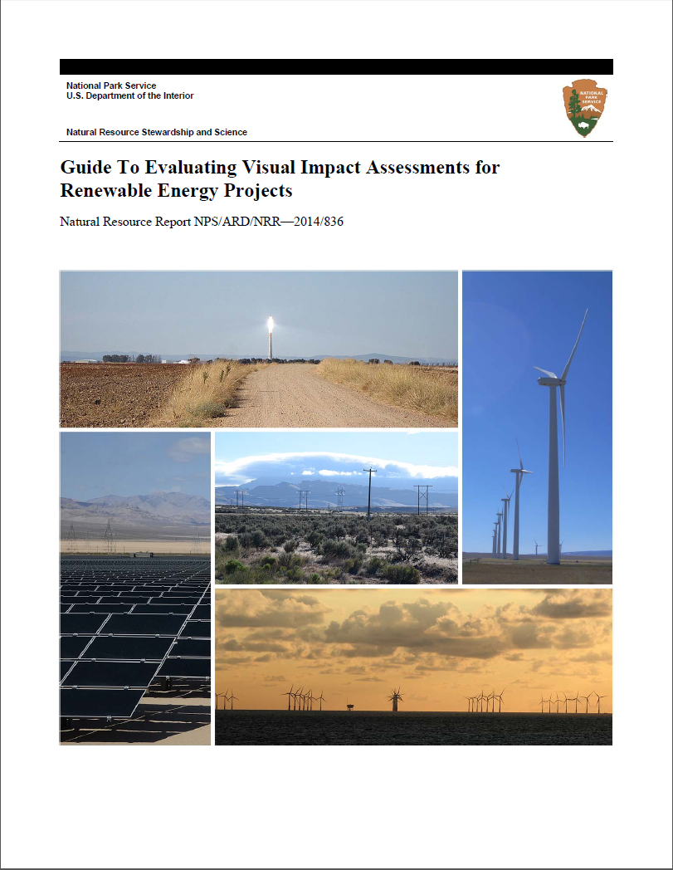
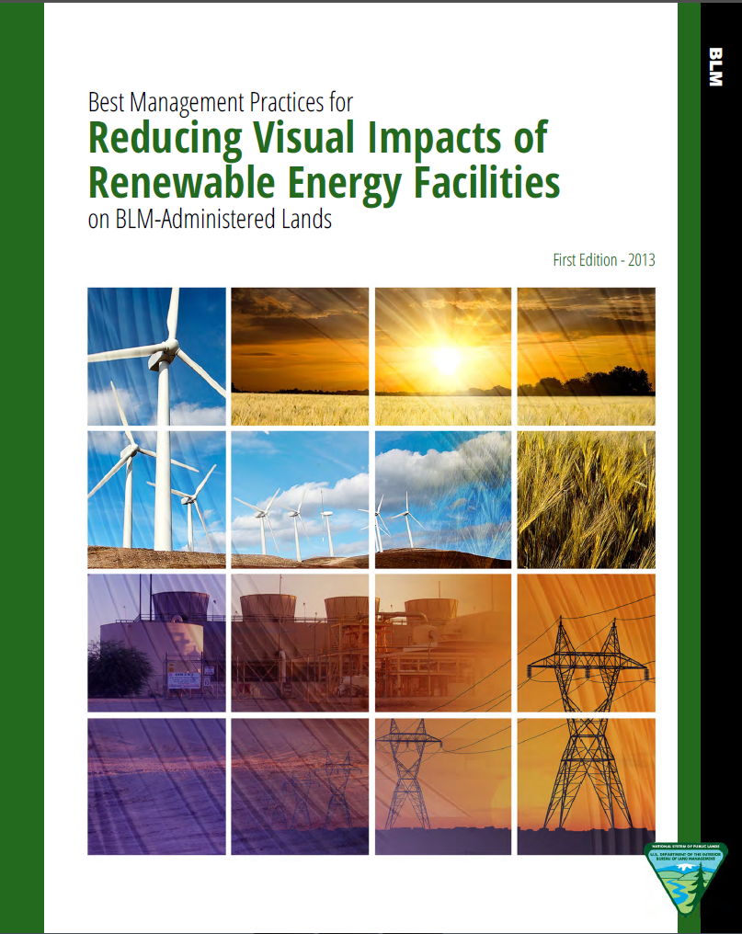
Project Visibility and Contrast
What Distances Matter?
For More Info
sullivan@anl.gov

