Slide 1
Boise, Idaho

Slide 2
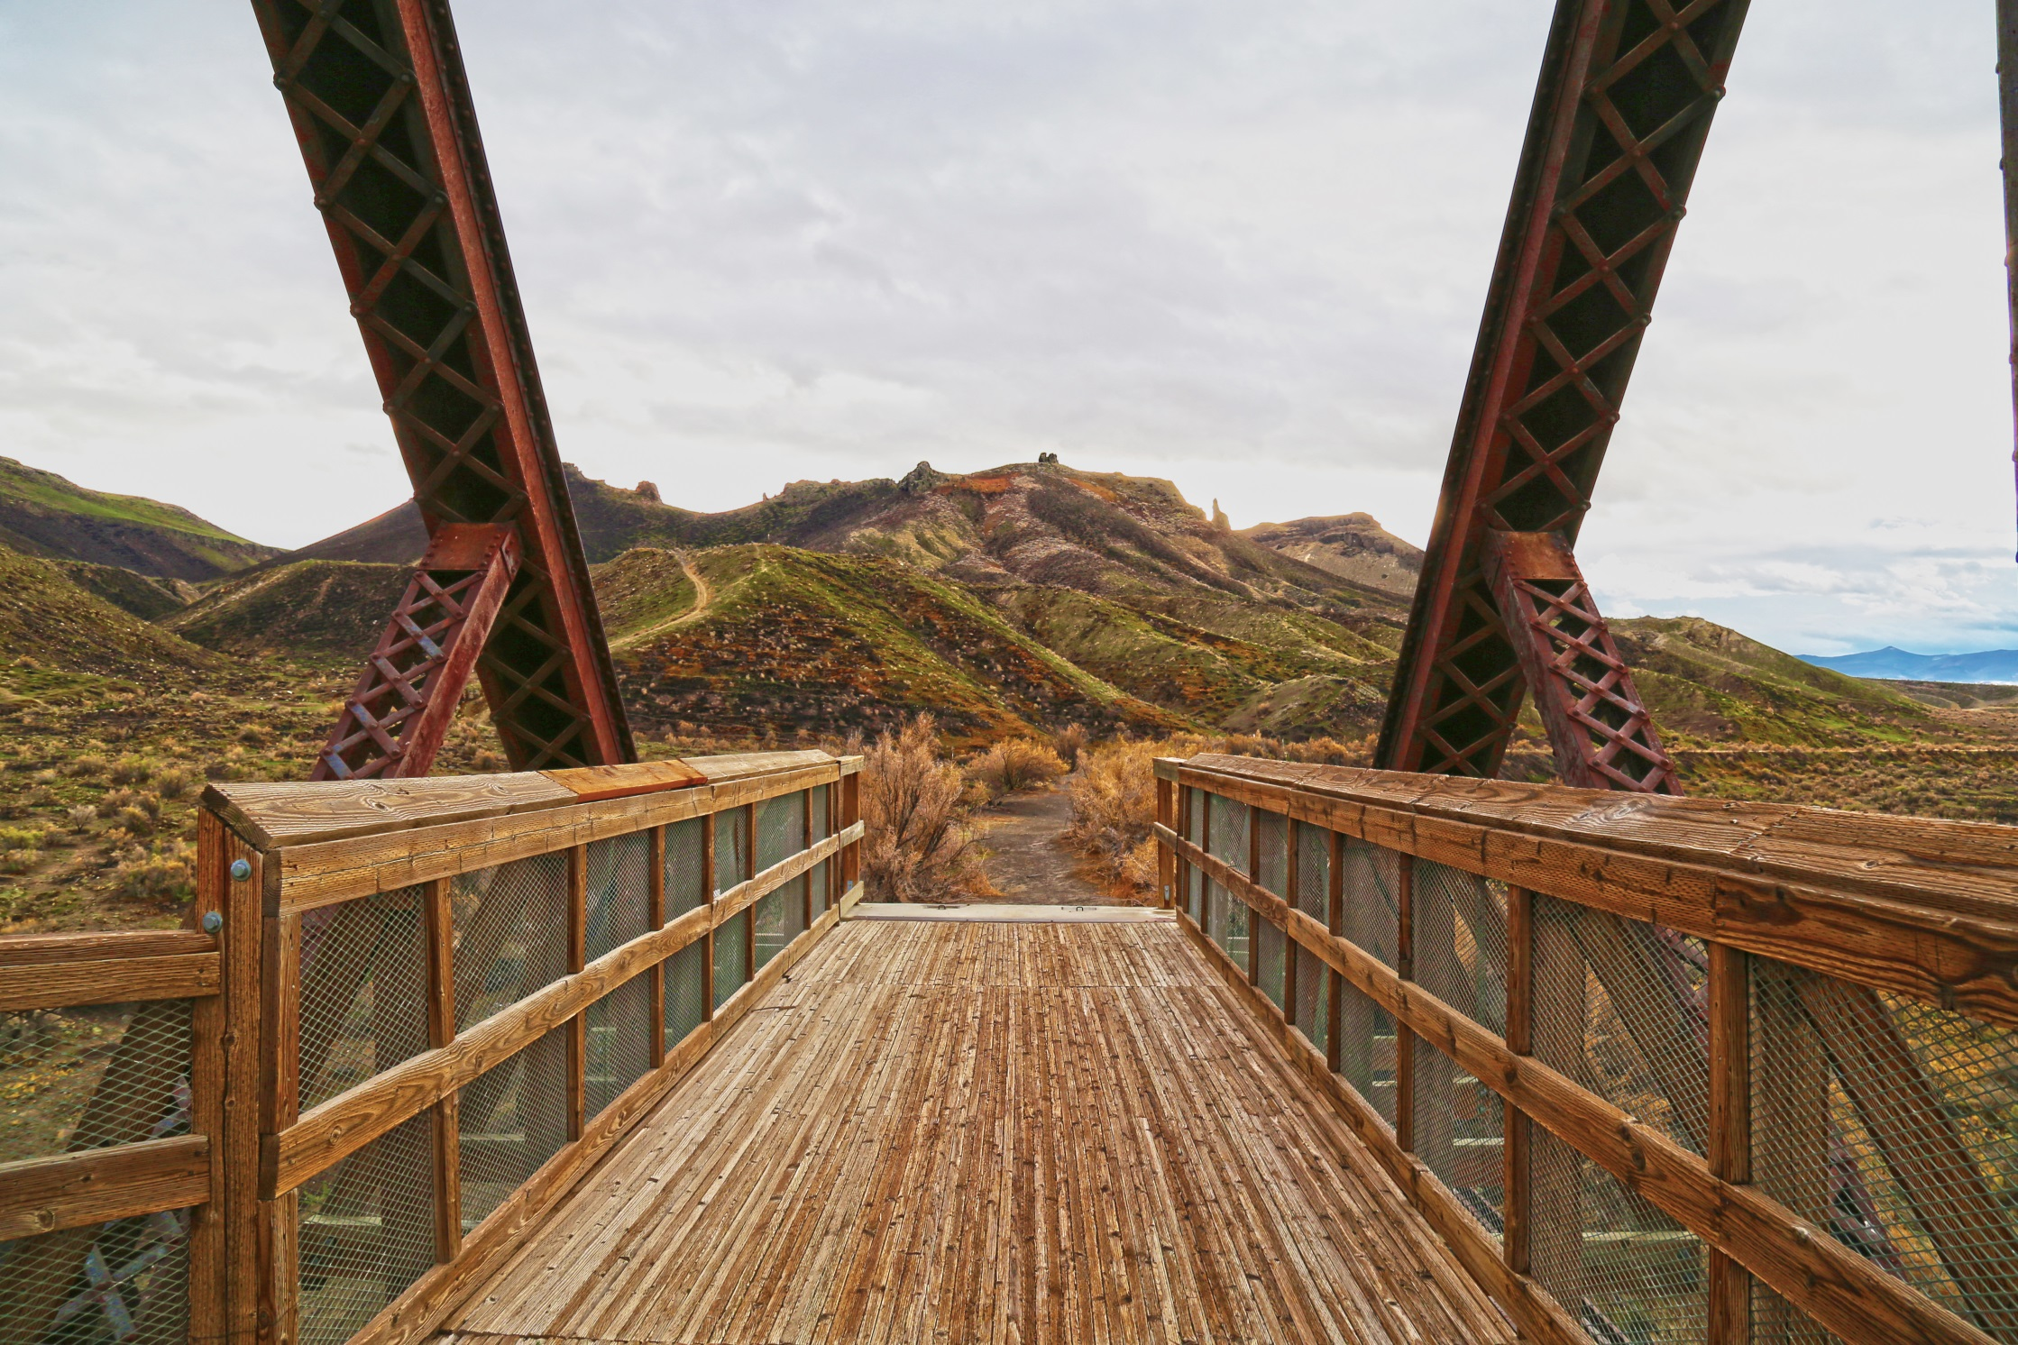
Visual Design Fundamentals

Slide 3
Visual Design Fundamentals
Objectives
Overall Objective
Provide an overview of concepts, methods, and techniques to design projects in a way that minimize adverse effects to visual resources.
Visual Resource / Scenery Management Objective
Manage public lands in a manner which protects their scenic values.
Objective for Projects
Design and construct projects so they are compatible with the natural character of the landscape.

Slide 4
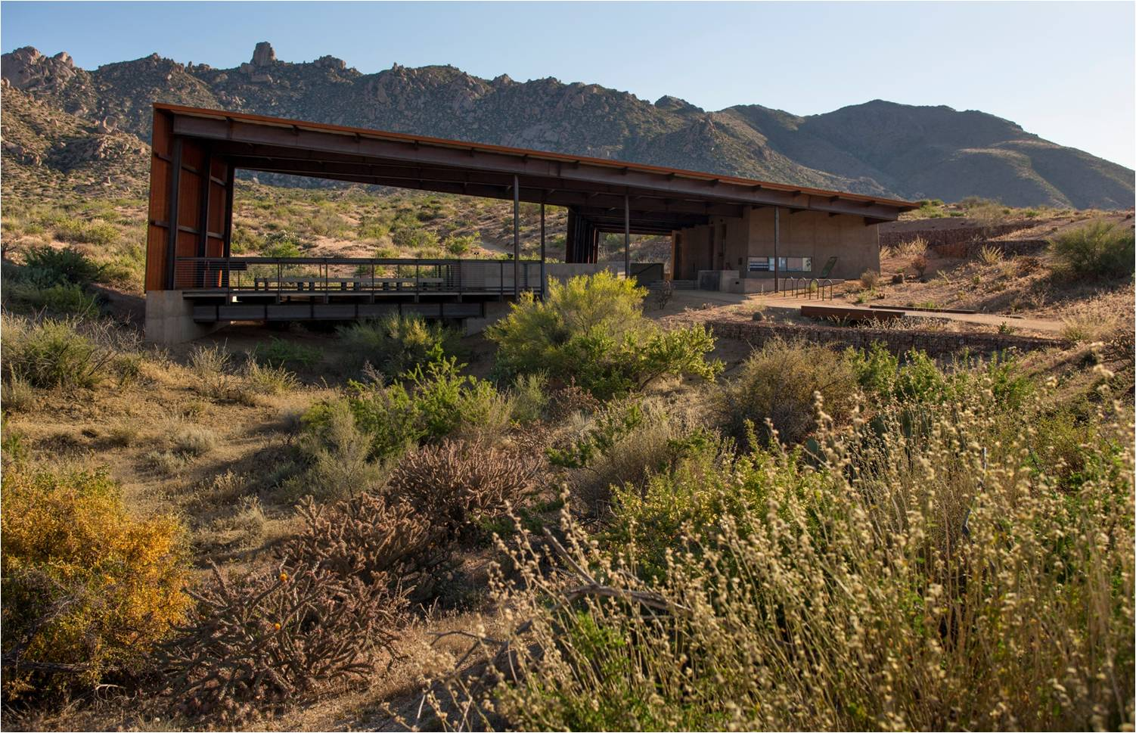
Visual Design Fundamentals
Not Just Design… Good Design.
Objectives
Successful implementation of fundamental visual design principles is critical to protect and maintain the natural scenic integrity of the American public landscape.

Slide 5
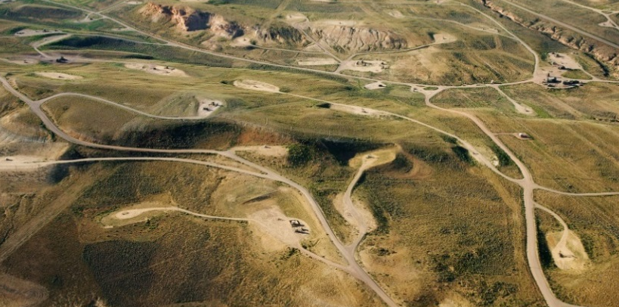
Visual Design Fundamentals
Three Basic Strategies
Proper siting and location
Reduction of unnecessary surface disturbance
Repetition of landscape character elements
1)
2)
3)

Slide 6
Visual Design Fundamentals
Strategy I
Proper siting and location
Reduction of unnecessary surface disturbance
Repetition of landscape character elements
1)
2)
3)

Slide 7
Visual Design Fundamentals
Proper Siting and Location
The Project may be…
Screened by topography.
Screened by vegetation.
Carefully located away from visually sensitive areas.
Located away from dominant landscape features.
Locate the project in a manner that reduces the visibility of both structures and/or associated surface disturbance.

Slide 8
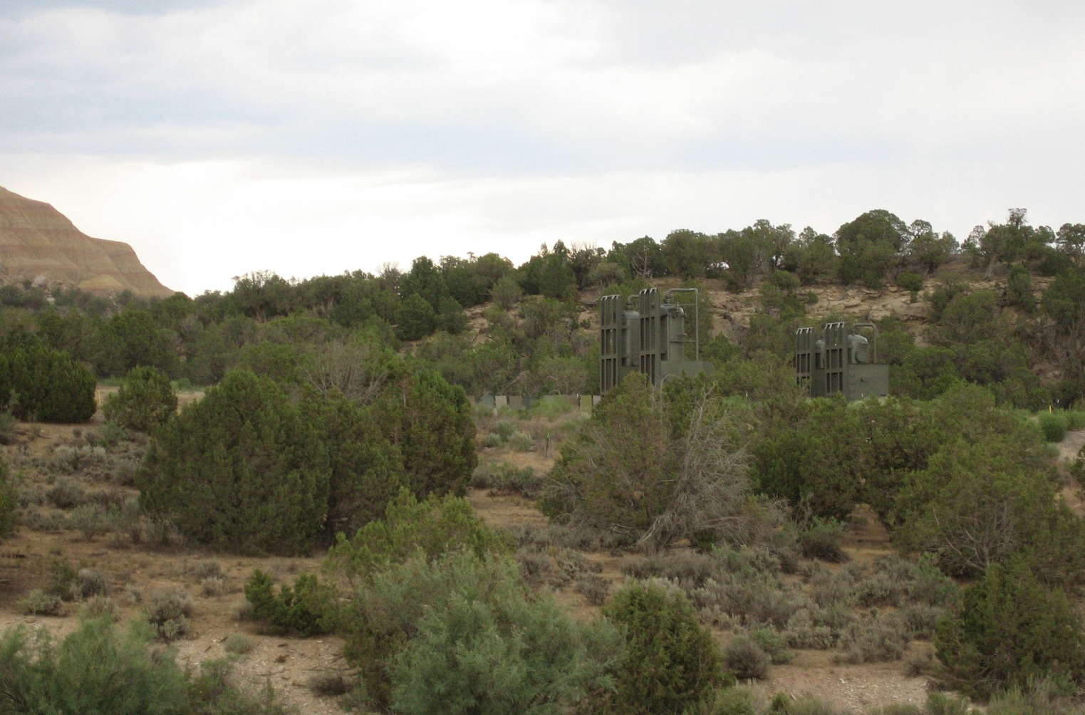
Visual Design Fundamentals
Proper Siting and Location

Slide 9
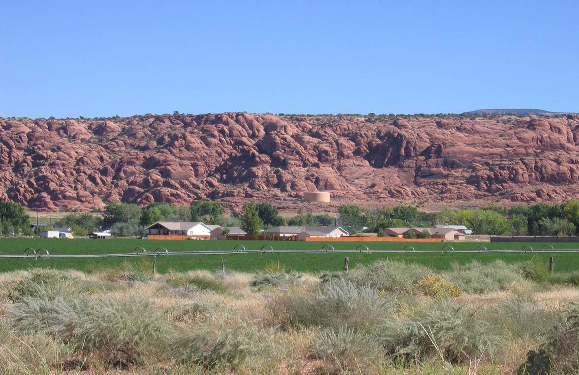
Visual Design Fundamentals
Proper Siting and Location

Slide 10
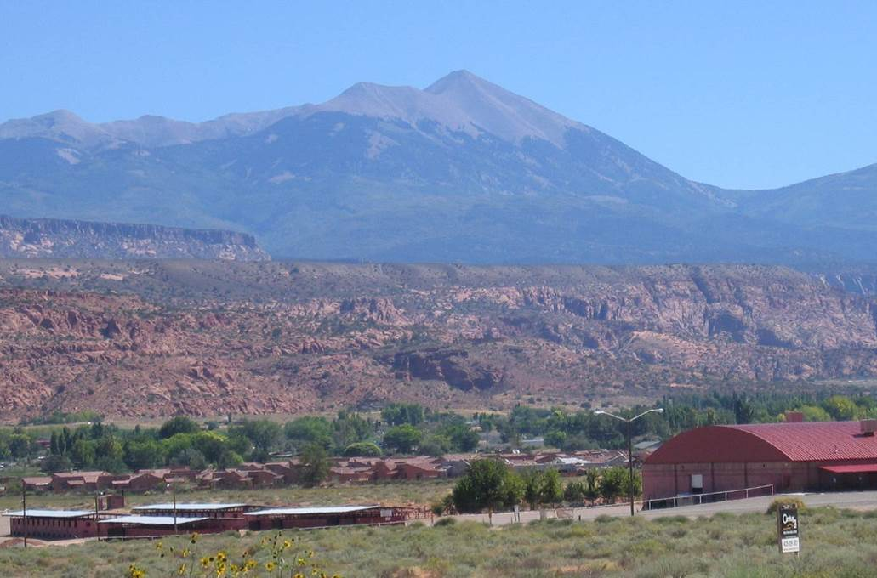
Visual Design Fundamentals
Proper Siting and Location

Slide 11
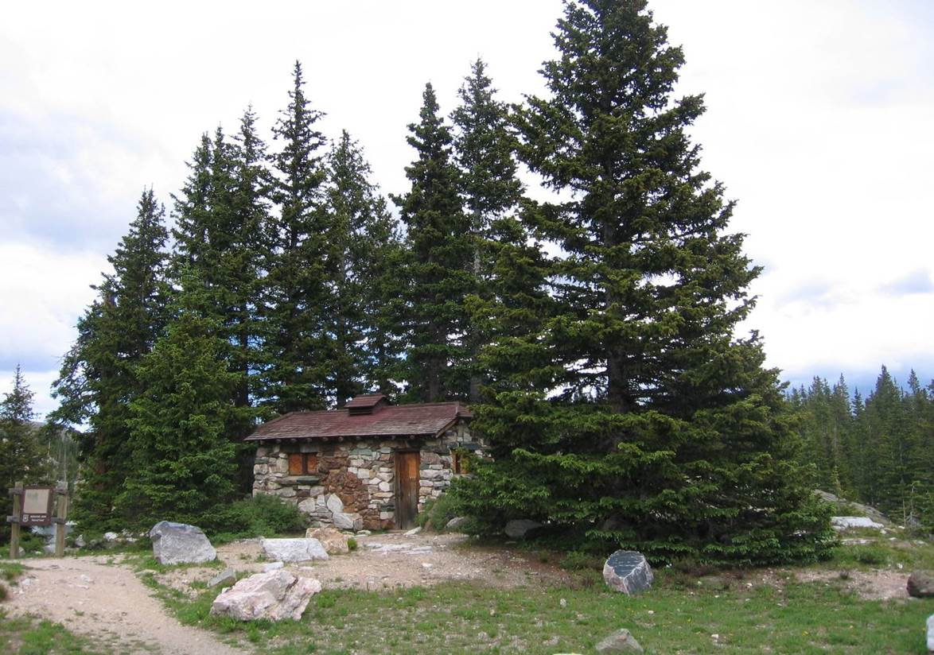
Visual Design Fundamentals
Proper Siting and Location

Slide 12
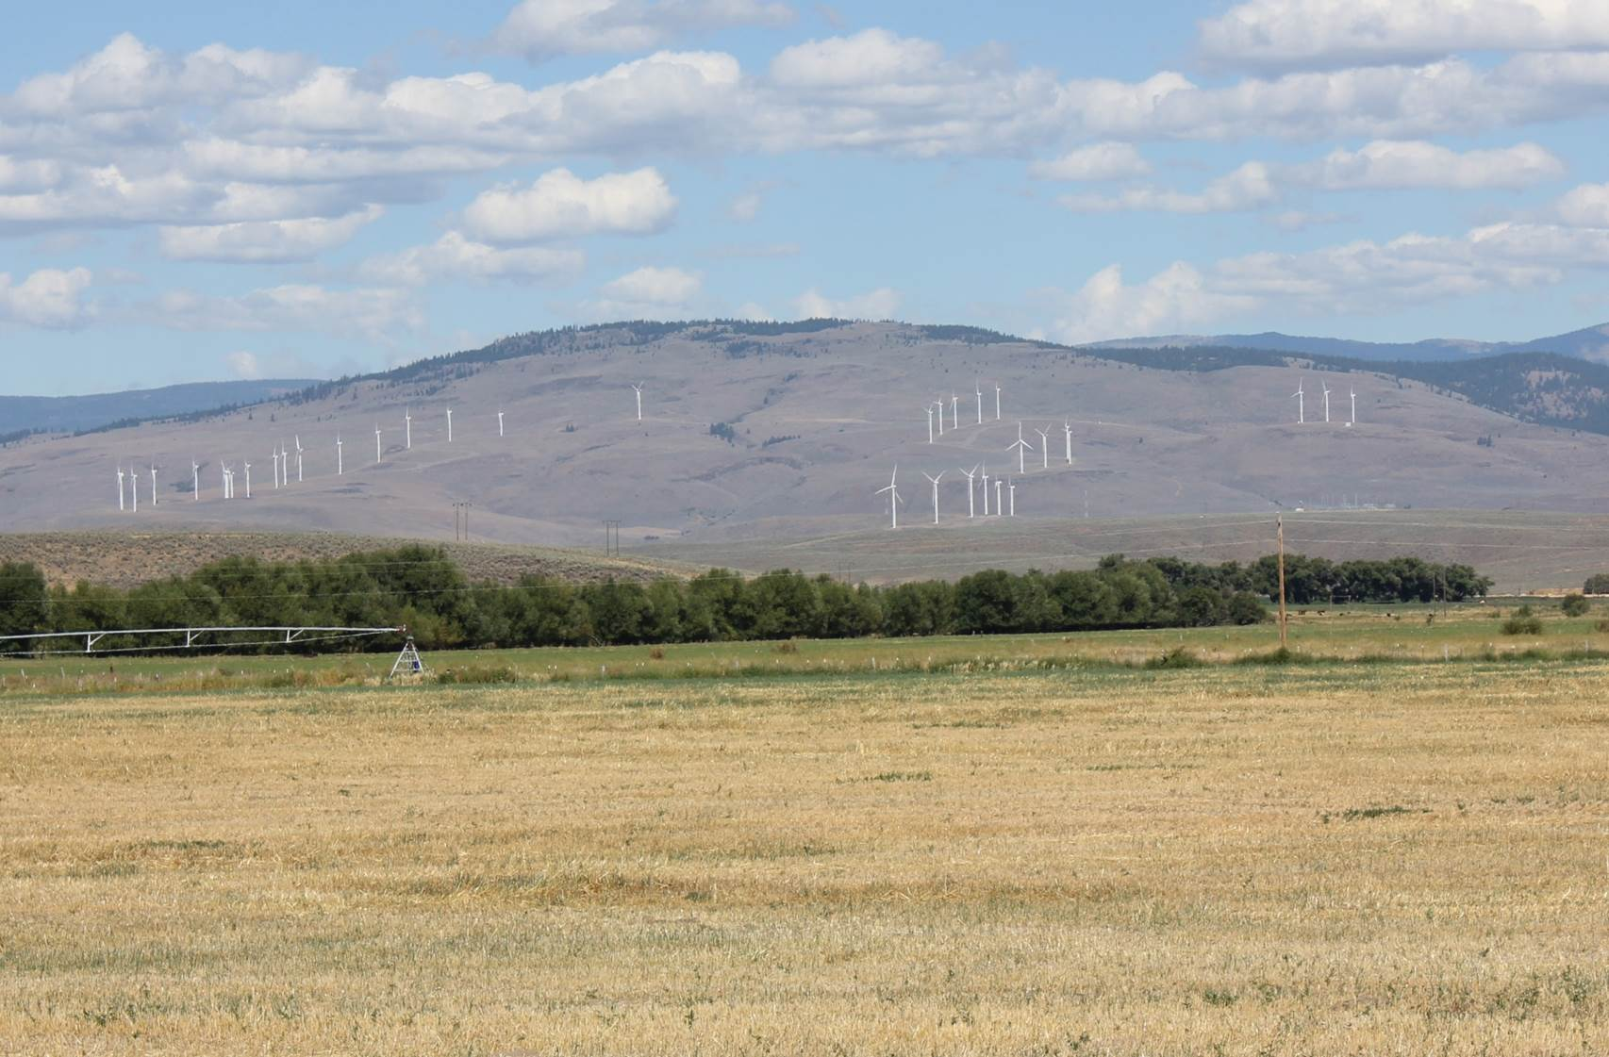
Visual Design Fundamentals
Proper Siting and Location

Slide 13
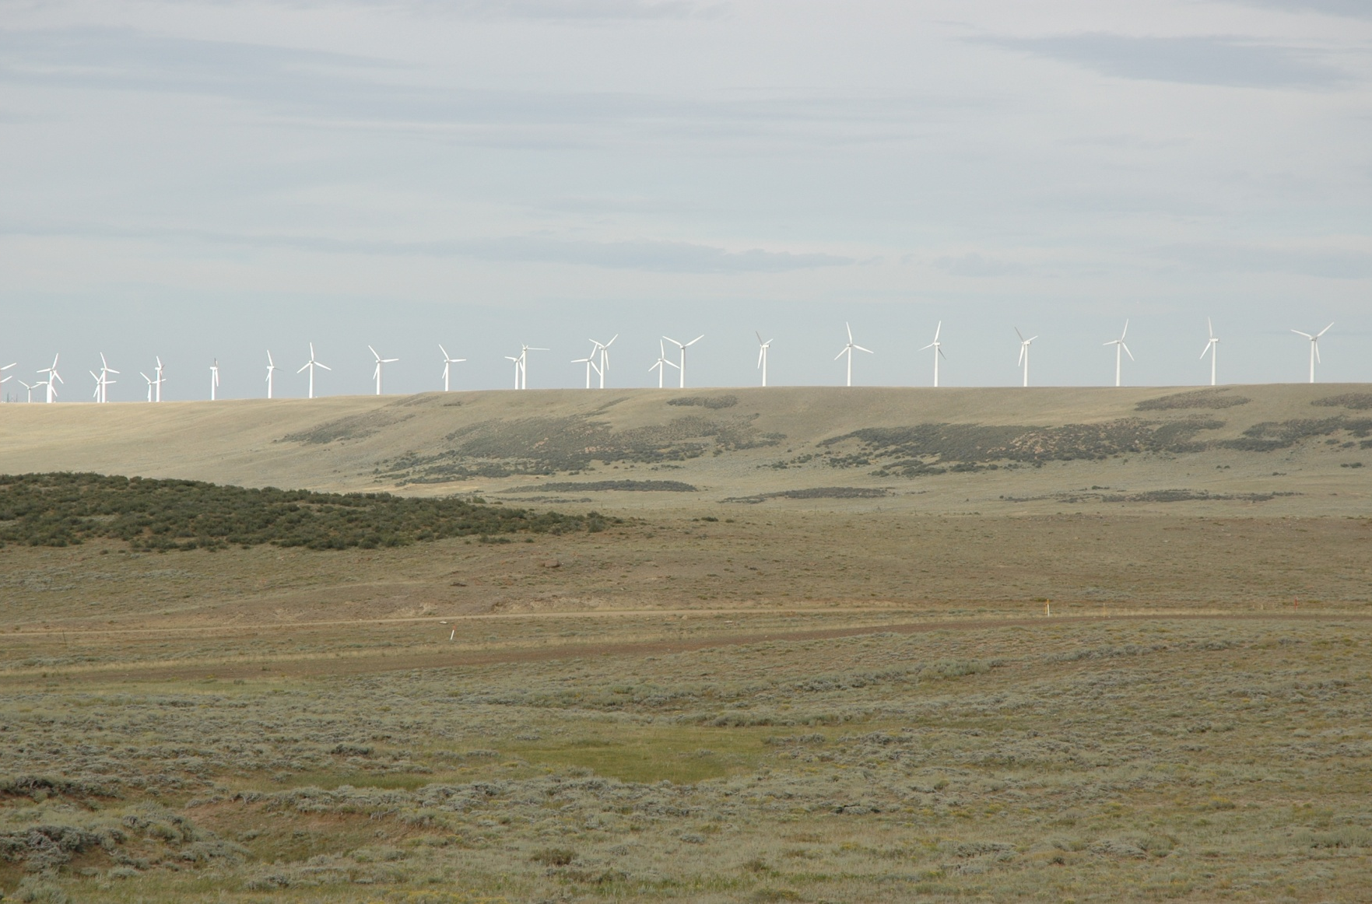
Visual Design Fundamentals
Proper Siting and Location

Slide 14
Visual Design Fundamentals
Strategy II
Proper siting and location
Reduction of unnecessary surface disturbance
Repetition of landscape character elements
1)
2)
3)

Slide 15
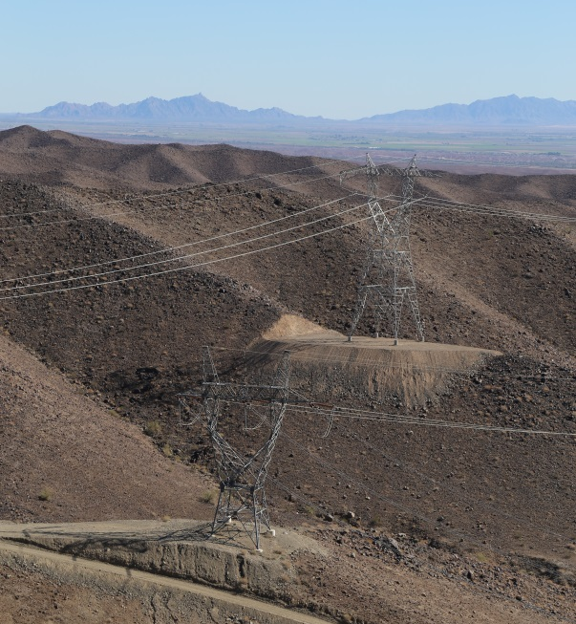
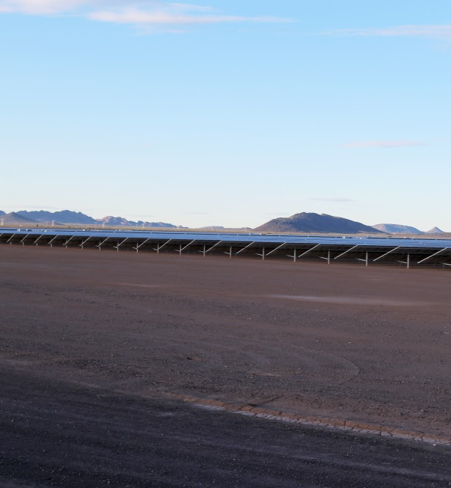
Visual Design Fundamentals
Reduce Unnecessary Disturbance
Fit the project to the landscape
Use smallest area necessary
Minimize cuts and fills
Promote interim reclamation
Complete final reclamation
Post-construction Evaluation

Slide 16
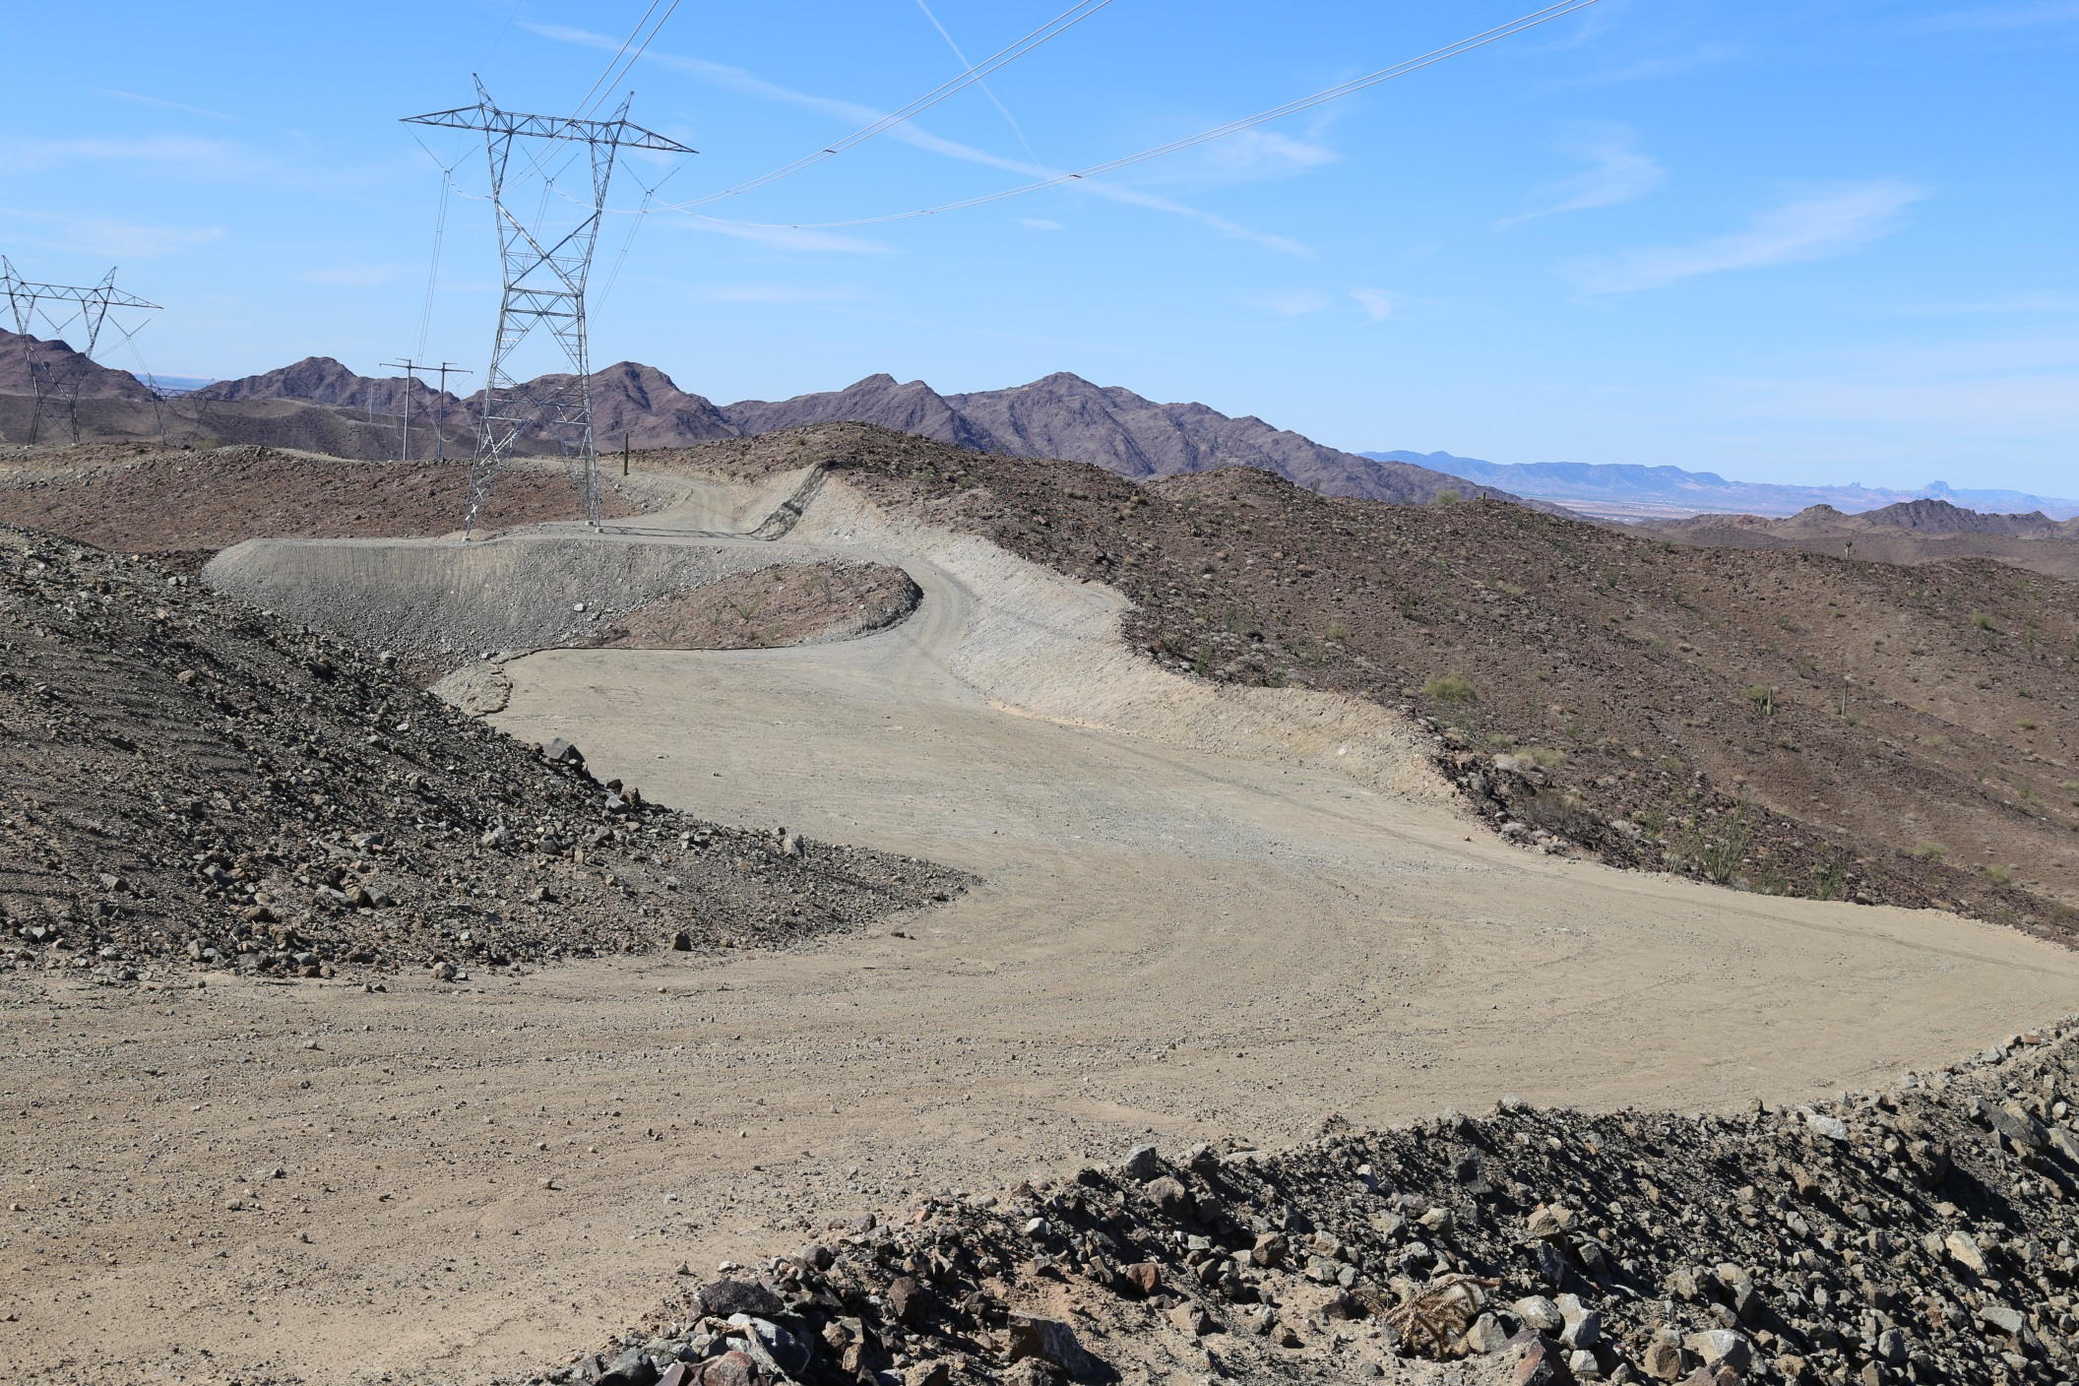
Visual Design Fundamentals
Reduce Unnecessary Disturbance

Slide 17
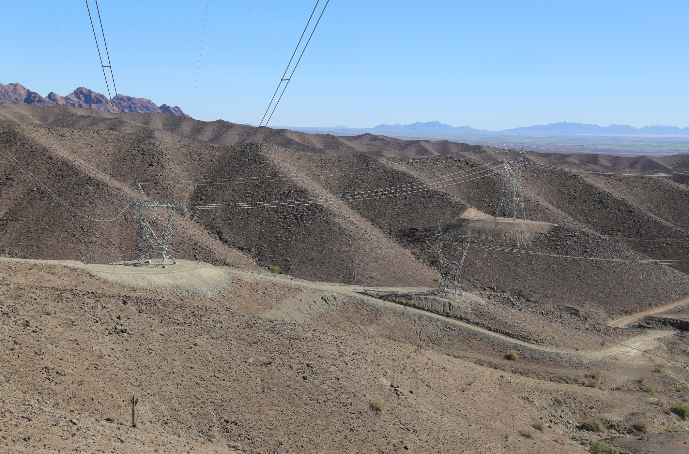
Visual Design Fundamentals
Reduce Unnecessary Disturbance

Slide 18
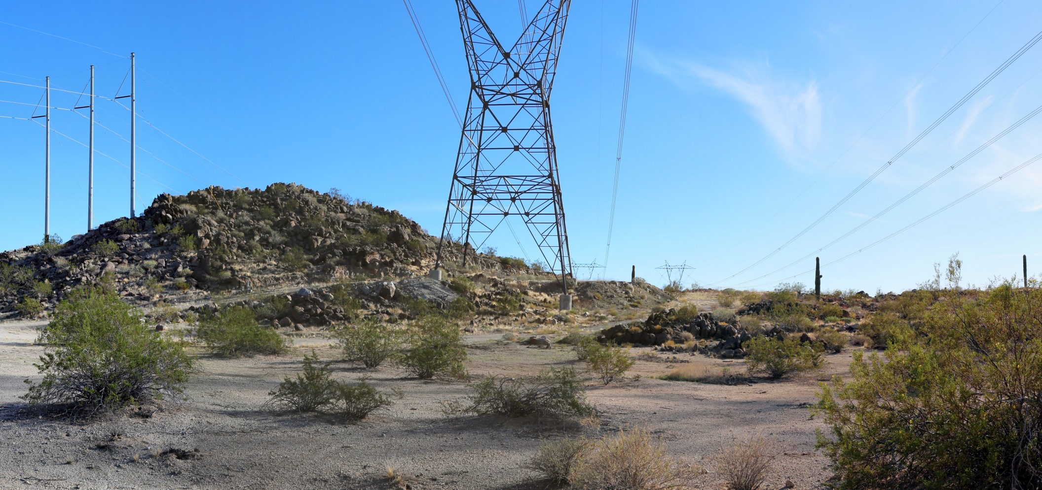
Visual Design Fundamentals
Reduce Unnecessary Disturbance

Slide 19
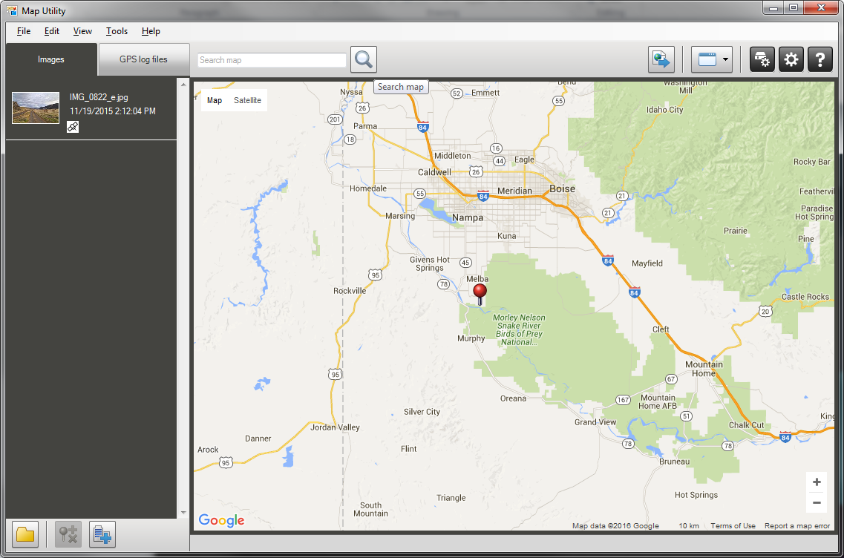
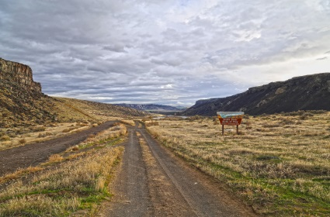
Visual Design Fundamentals
Reducing Unnecessary Disturbance

Slide 20
Visual Design Fundamentals
Reducing Unnecessary Disturbance

Slide 21
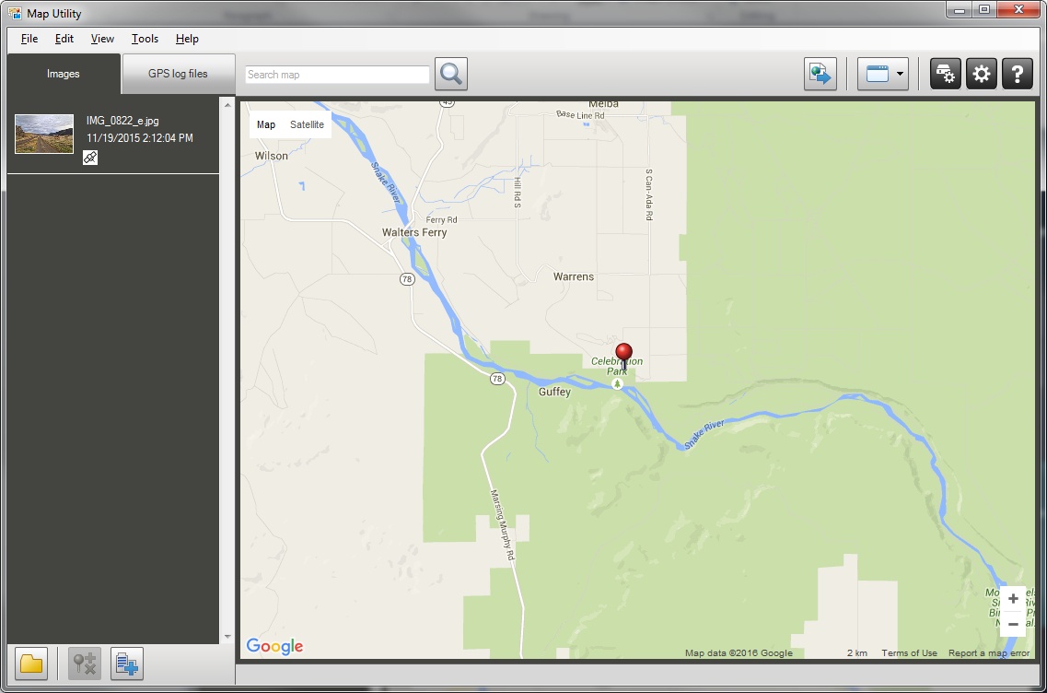
Visual Design Fundamentals
Reducing Unnecessary Disturbance

Slide 22
Visual Design Fundamentals
Reducing Unnecessary Disturbance

Slide 23
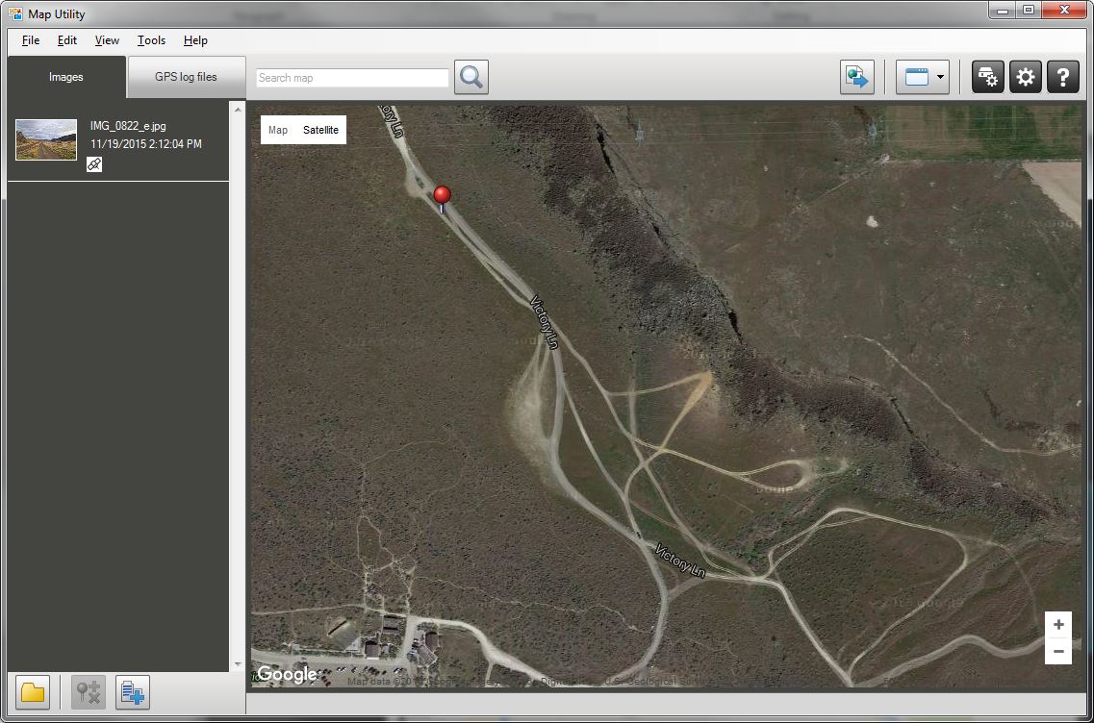
Visual Design Fundamentals
Reducing Unnecessary Disturbance

Slide 24
Visual Design Fundamentals
Reducing Unnecessary Disturbance

Slide 25
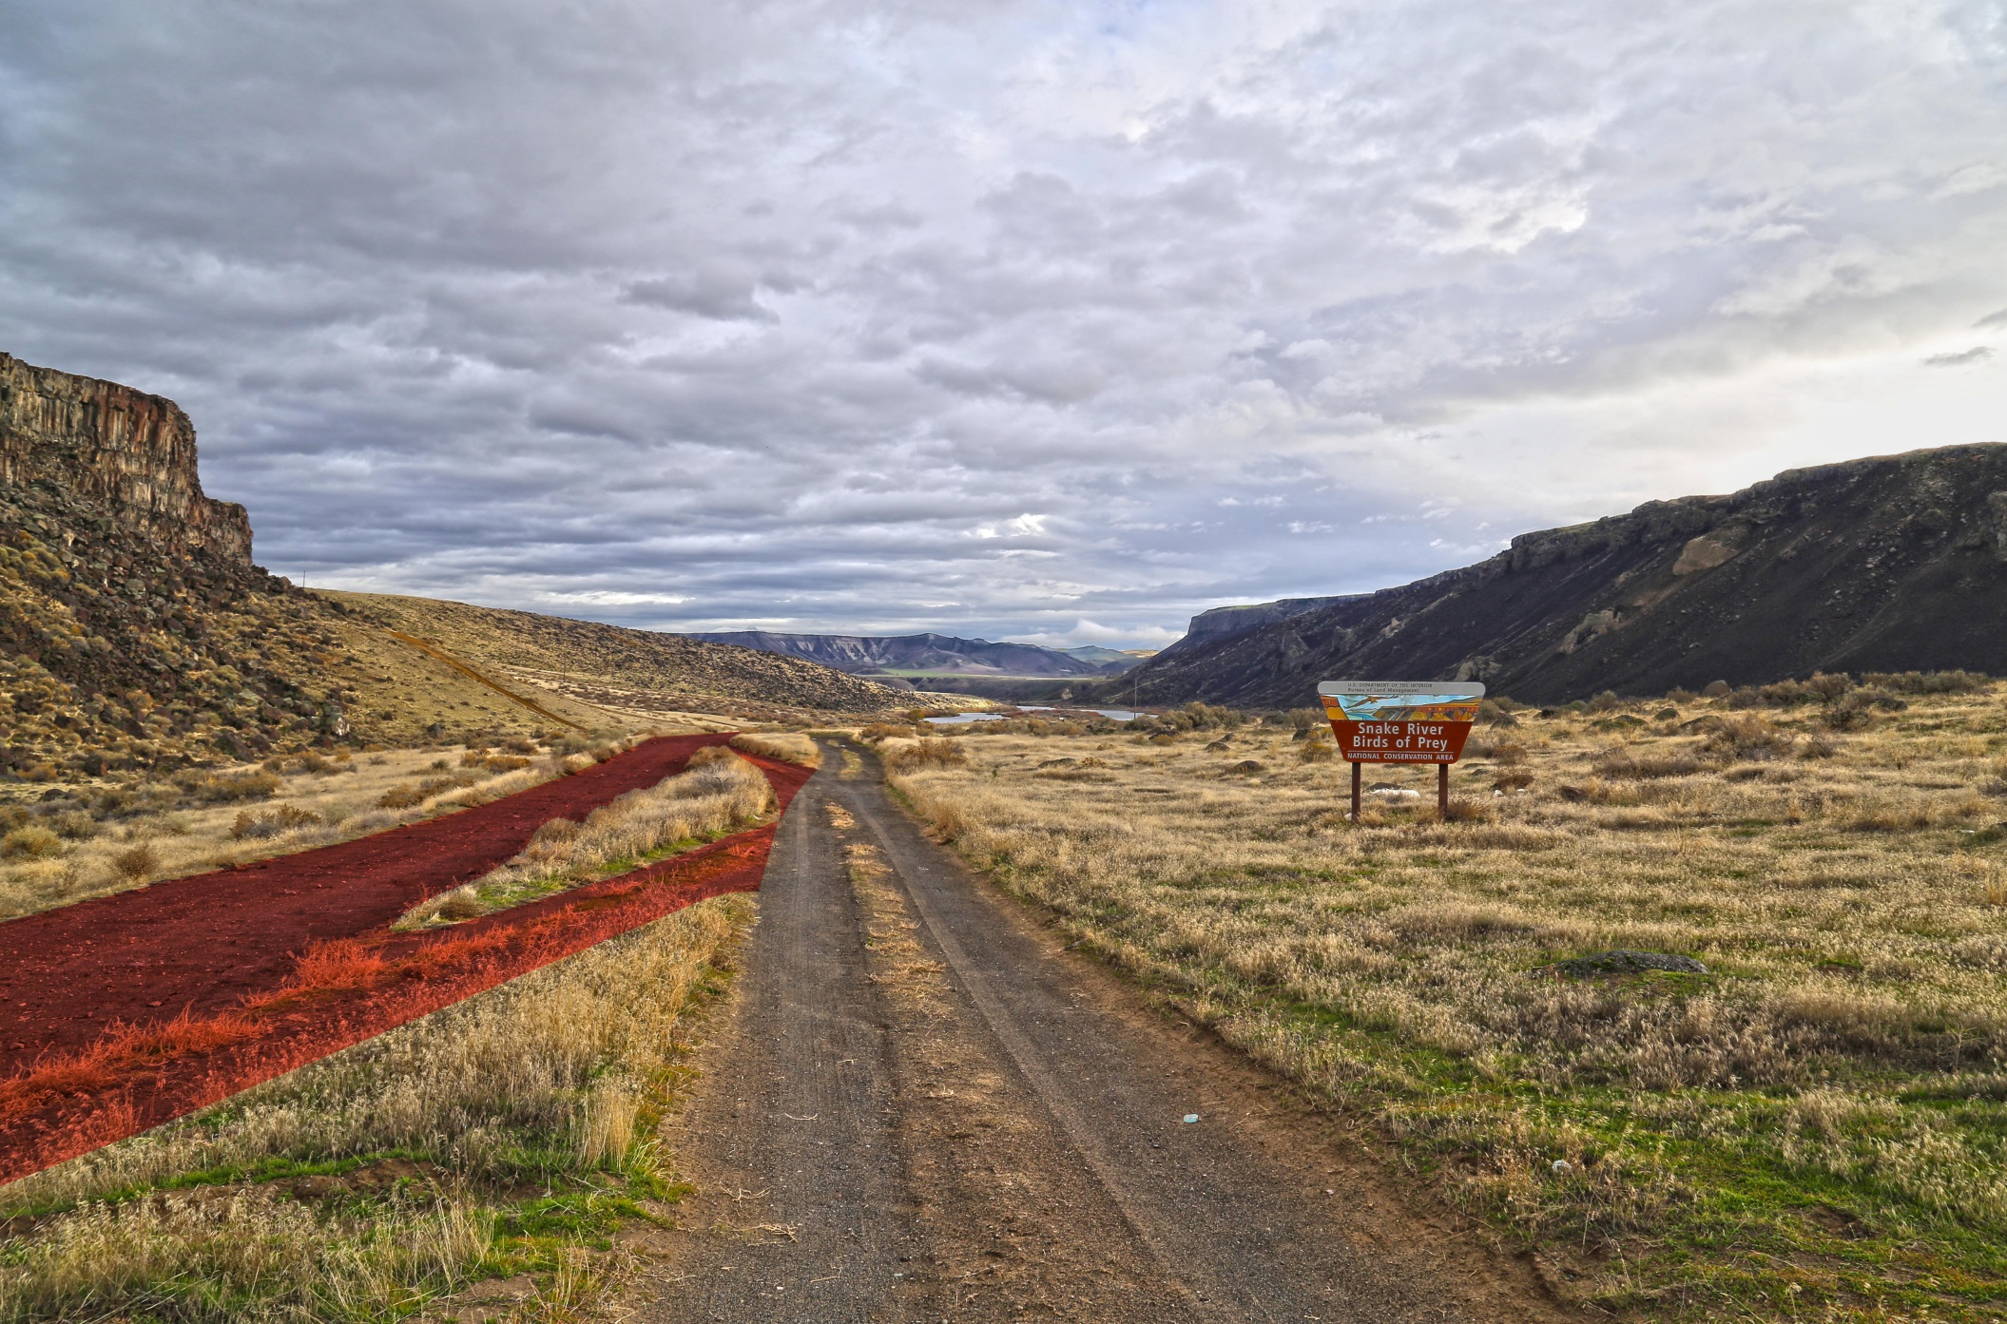
Visual Design Fundamentals
Reducing Unnecessary Disturbance

Slide 26
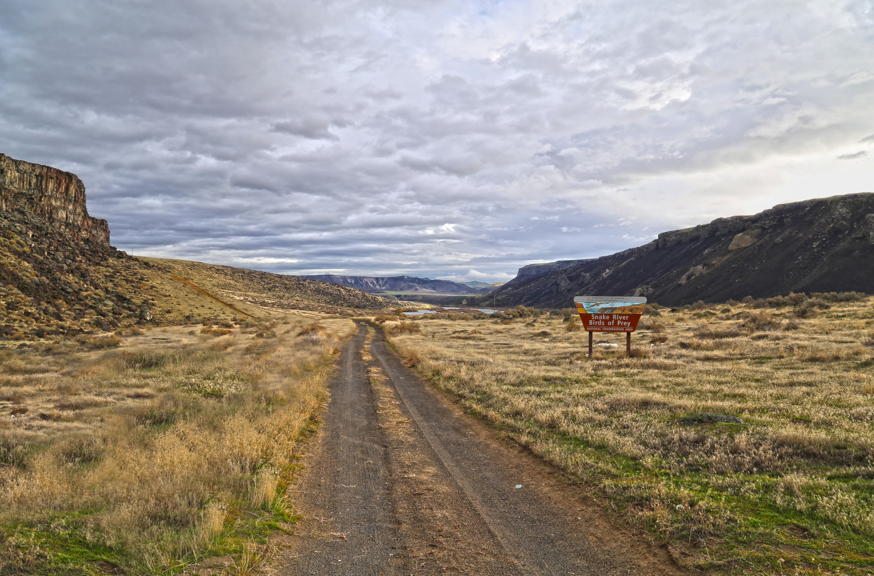
Visual Design Fundamentals
Reducing Unnecessary Disturbance

Slide 27
Visual Design Fundamentals
Strategy III
Proper siting and location
Reduction of unnecessary surface disturbance
Repetition of landscape character elements
1)
2)
3)

Slide 28
Visual Design Fundamentals
Repetition of Landscape Elements
Designing and building a project in a manner that repeats or mimics the natural character elements in the landscape such as:
Modifications repeat the forms in the landscape.
Modifications repeat lines in the landscape.
Modifications repeat colors in the landscape.
Modifications texture is similar to textures in the landscape.

Slide 29
Visual Design Fundamentals
Visual Absorption Capacity
“Visual absorption capacity” is defined as the landscape's ability to absorb physical changes without transformation in its visual character and quality.” S. Amir, E. Gidalizon

Slide 30
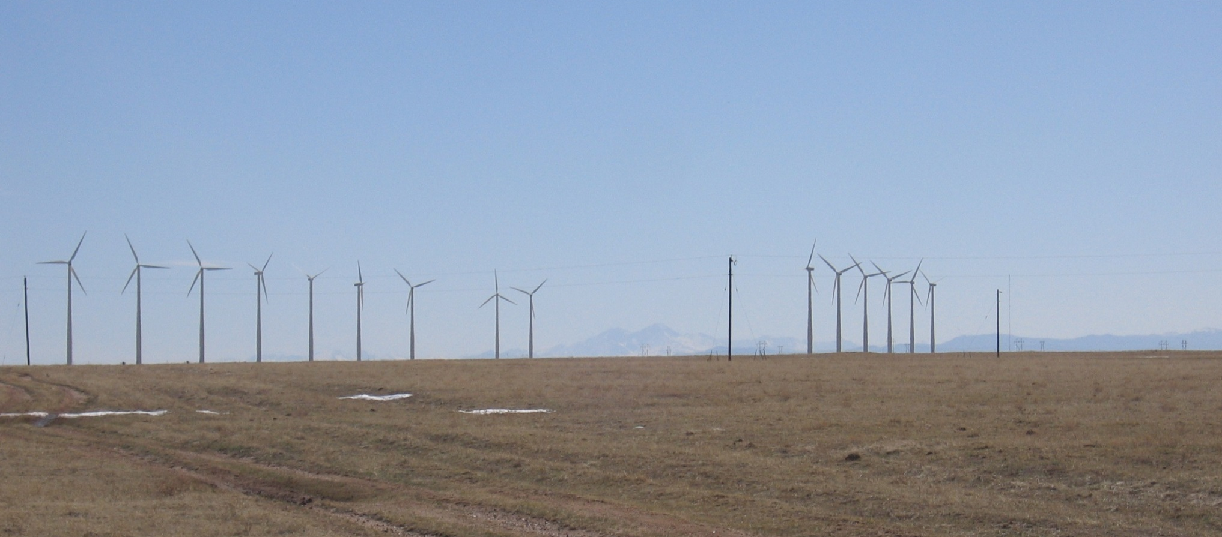
Visual Design Fundamentals
Visual Absorption Capacity
Landscapes with low visual variety have a lower capability to absorb visual impacts.

Slide 31
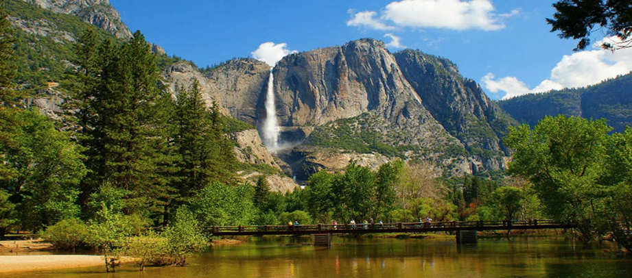
Visual Design Fundamentals
Visual Absorption Capacity
Landscapes with high visual variety have a higher capability to absorb visual impacts.
San Juan National Forest, Colorado

Slide 32
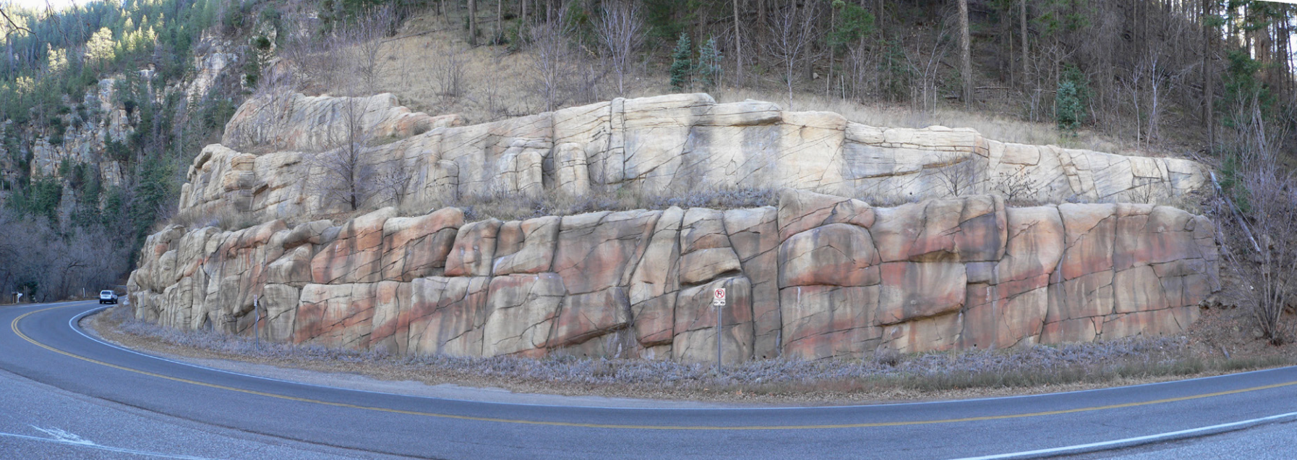
Visual Design Fundamentals
Repetition of Landscape Elements
When proper design responds to site form, line, color, and texture, a successfully design project can strongly repeat the surrounding landscape character.

Slide 33
Visual Design Fundamentals
Repetition of Form

Slide 34
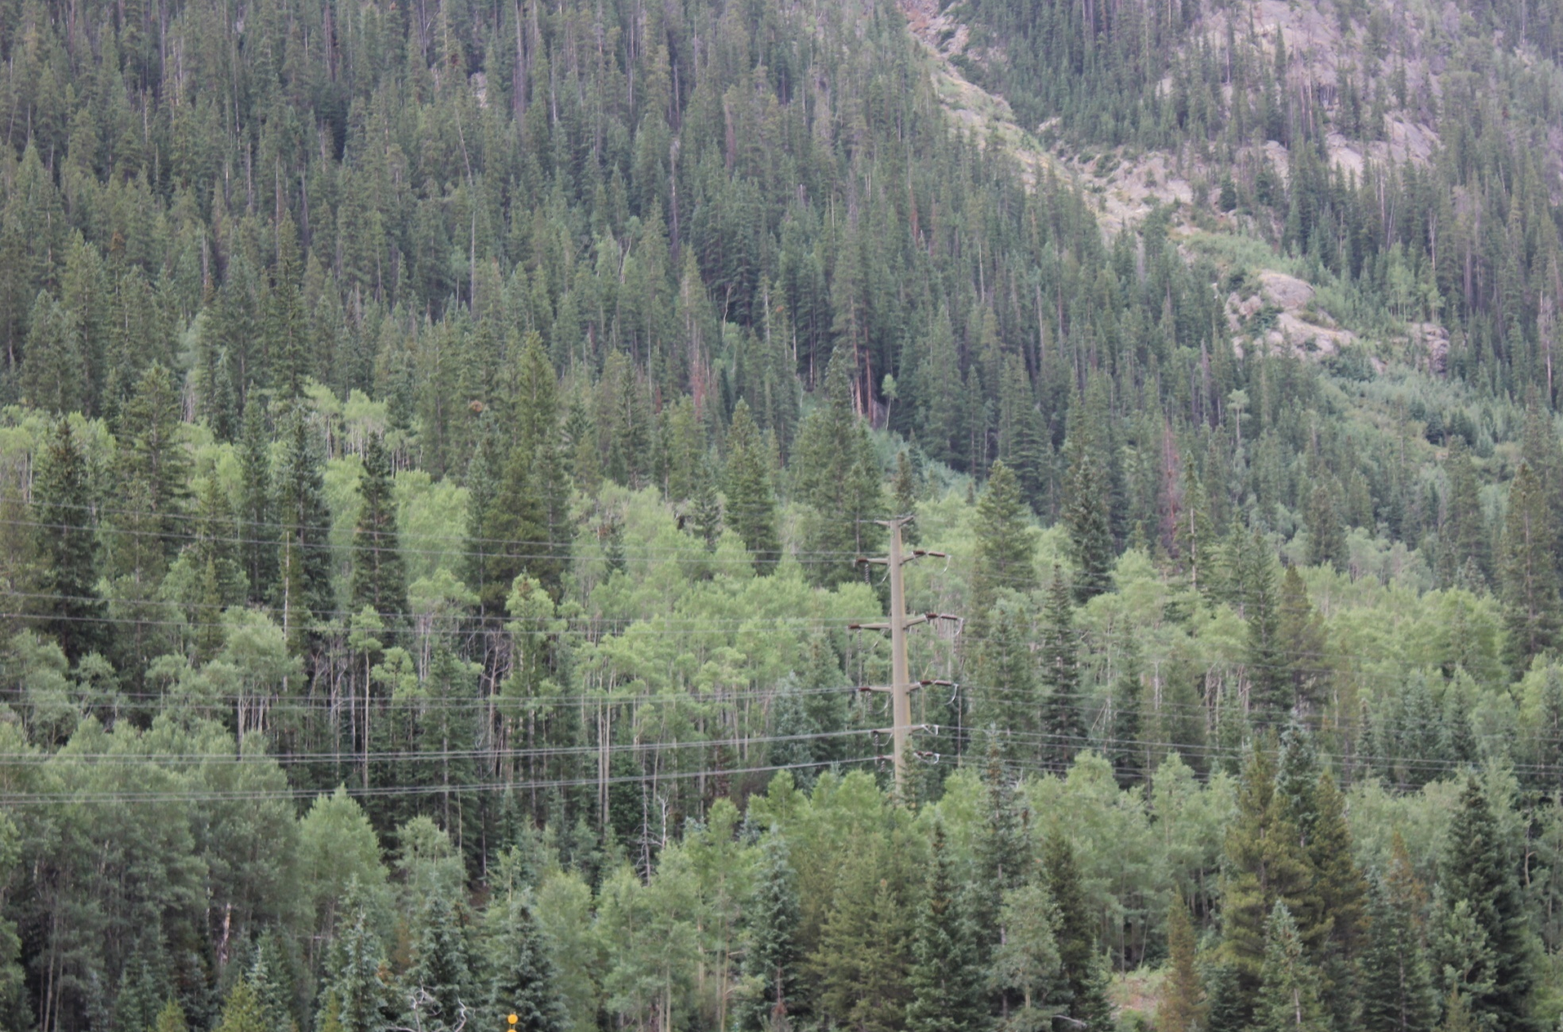
Visual Design Fundamentals
Repetition of Form

Slide 35
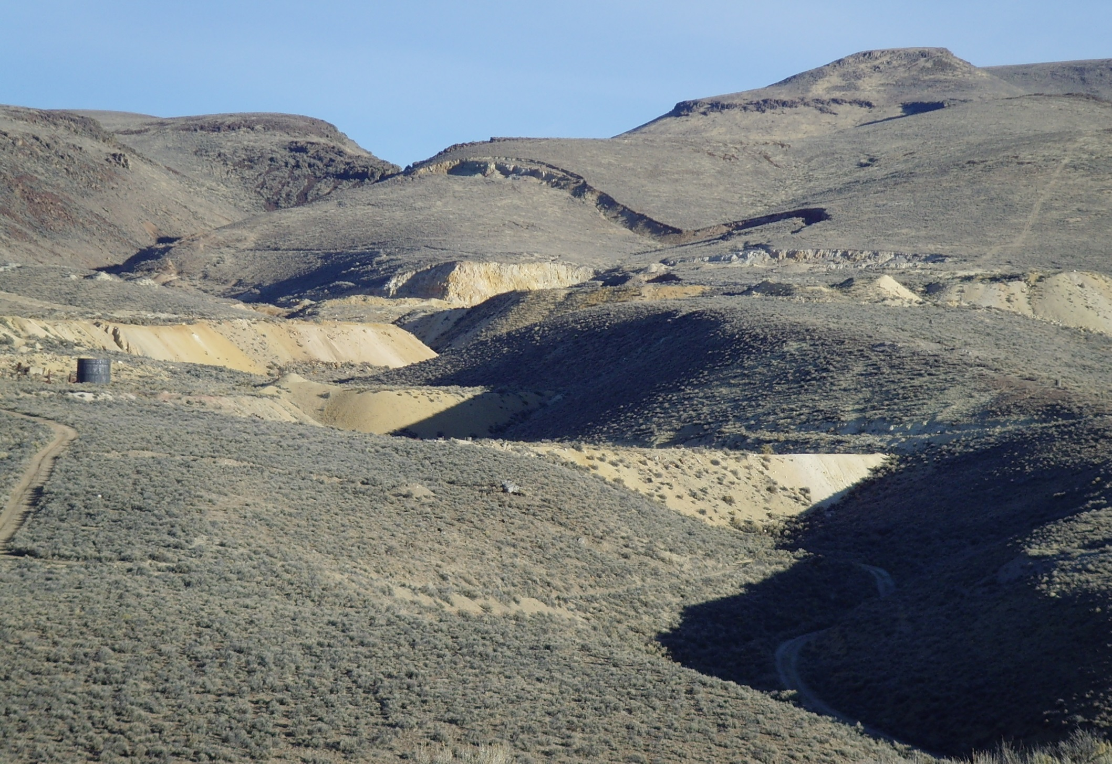
Visual Design Fundamentals
Repetition of Form
RECONTOURING
(Before) Bretz Mine – East Pit in Malheur County, OR

Slide 36
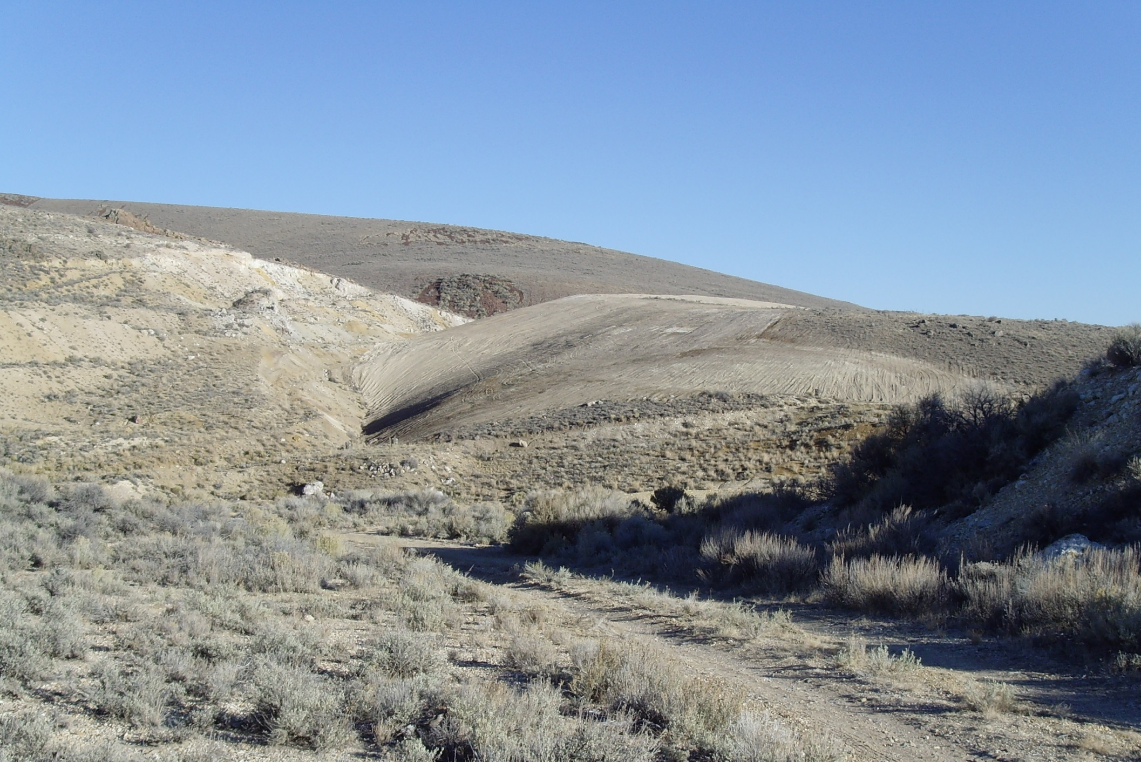
Visual Design Fundamentals
Repetition of Form
RECONTOURING
(After) Bretz Mine – East Pit in Malheur County, OR

Slide 37
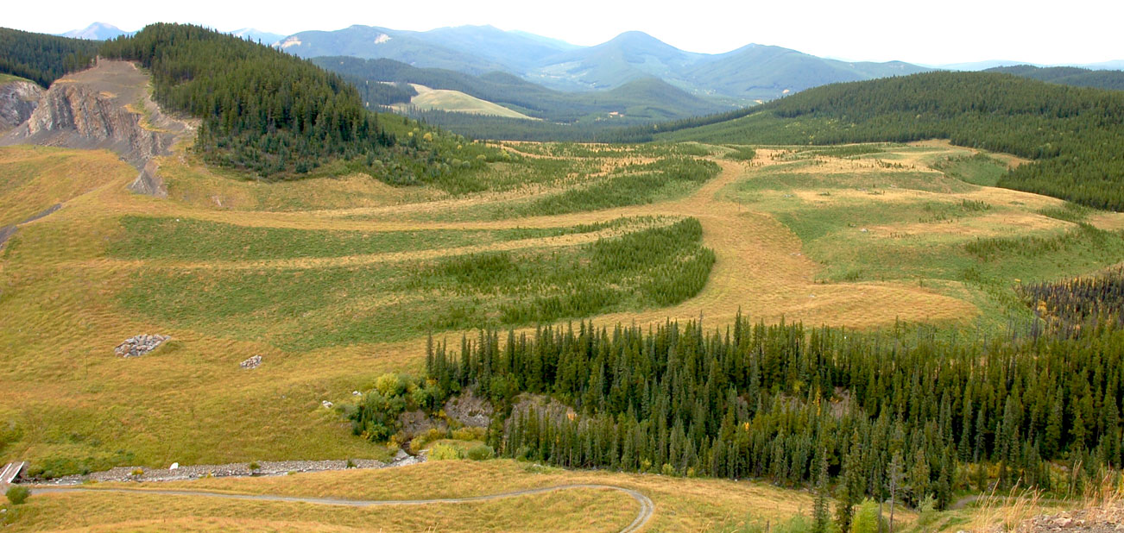
Visual Design Fundamentals
Repetition of Form

Slide 38
Visual Design Fundamentals
Repetition of Line

Slide 39
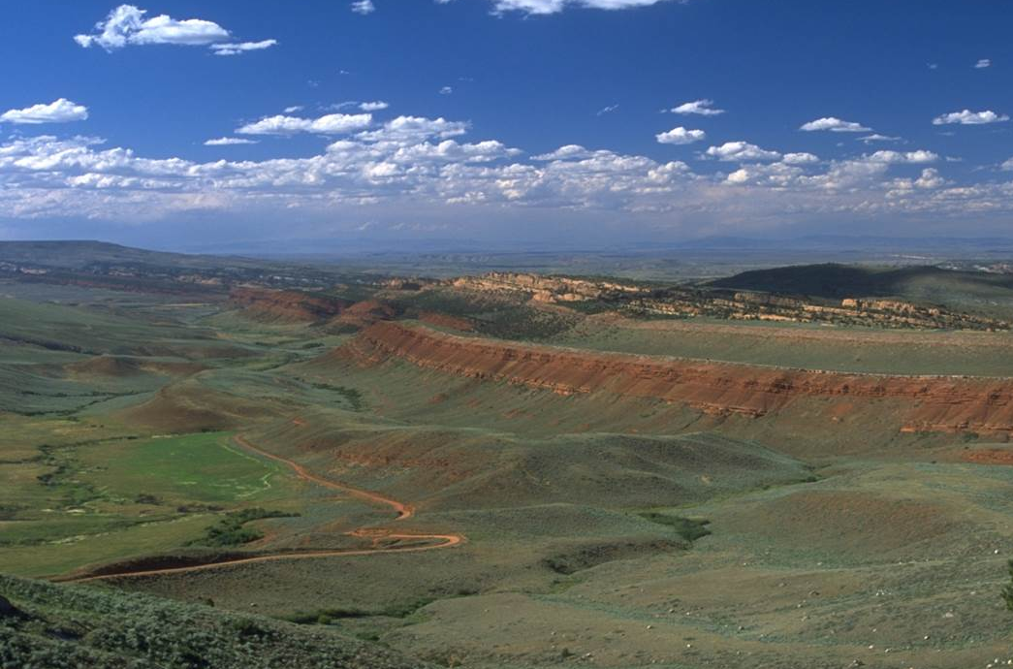
Visual Design Fundamentals
Repetition of Line

Slide 40
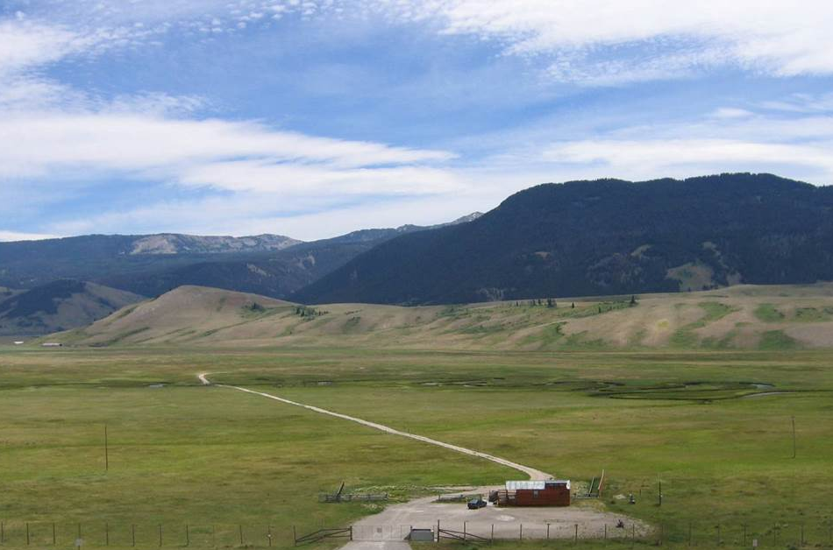
Visual Design Fundamentals
Repetition of Line

Slide 41
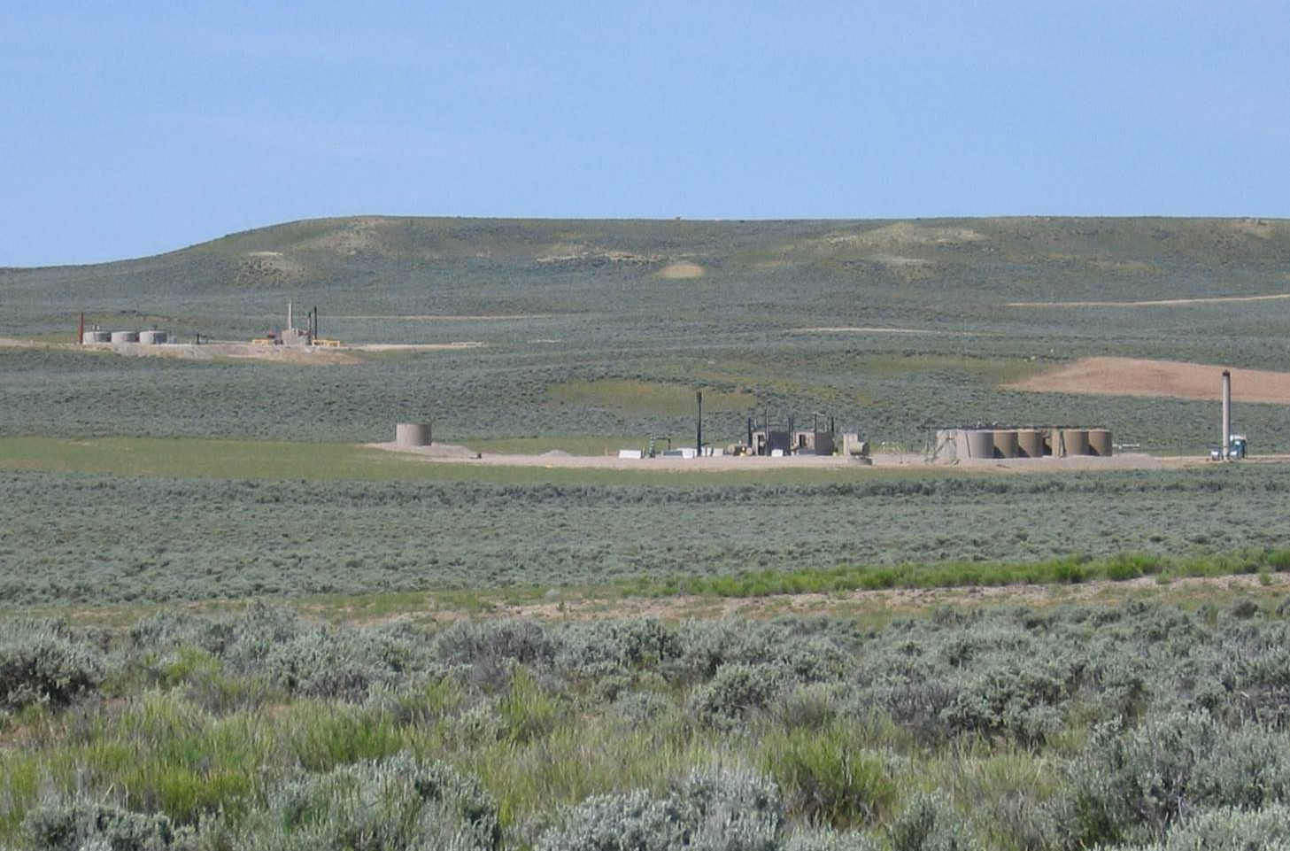
Visual Design Fundamentals
Repetition of Line

Slide 42
Visual Design Fundamentals
Repetition of Color

Slide 43
Visual Design Fundamentals
Repetition of Color
Color is a powerful visual design tool.
Color is increasingly effective in direct proportion to the distance the project is located from where it is viewed.
Color has not been used nearly as effectively as it should have been.
Past experience reveals that colors have often been lighter than they should be.
Note: use desert tan and greens with caution!

Slide 44
Visual Design Fundamentals
Repetition of Color
Light colors are highly visible and draw attention
advance
Dark colors tend to recede into the landscape
recede
[ Image Caption ]

Slide 45
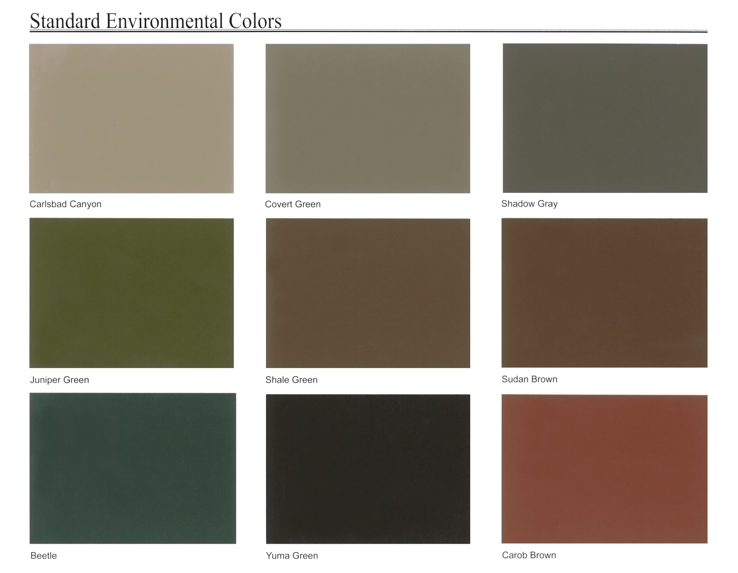
Visual Design Fundamentals
BLM Standard Colors

Slide 46
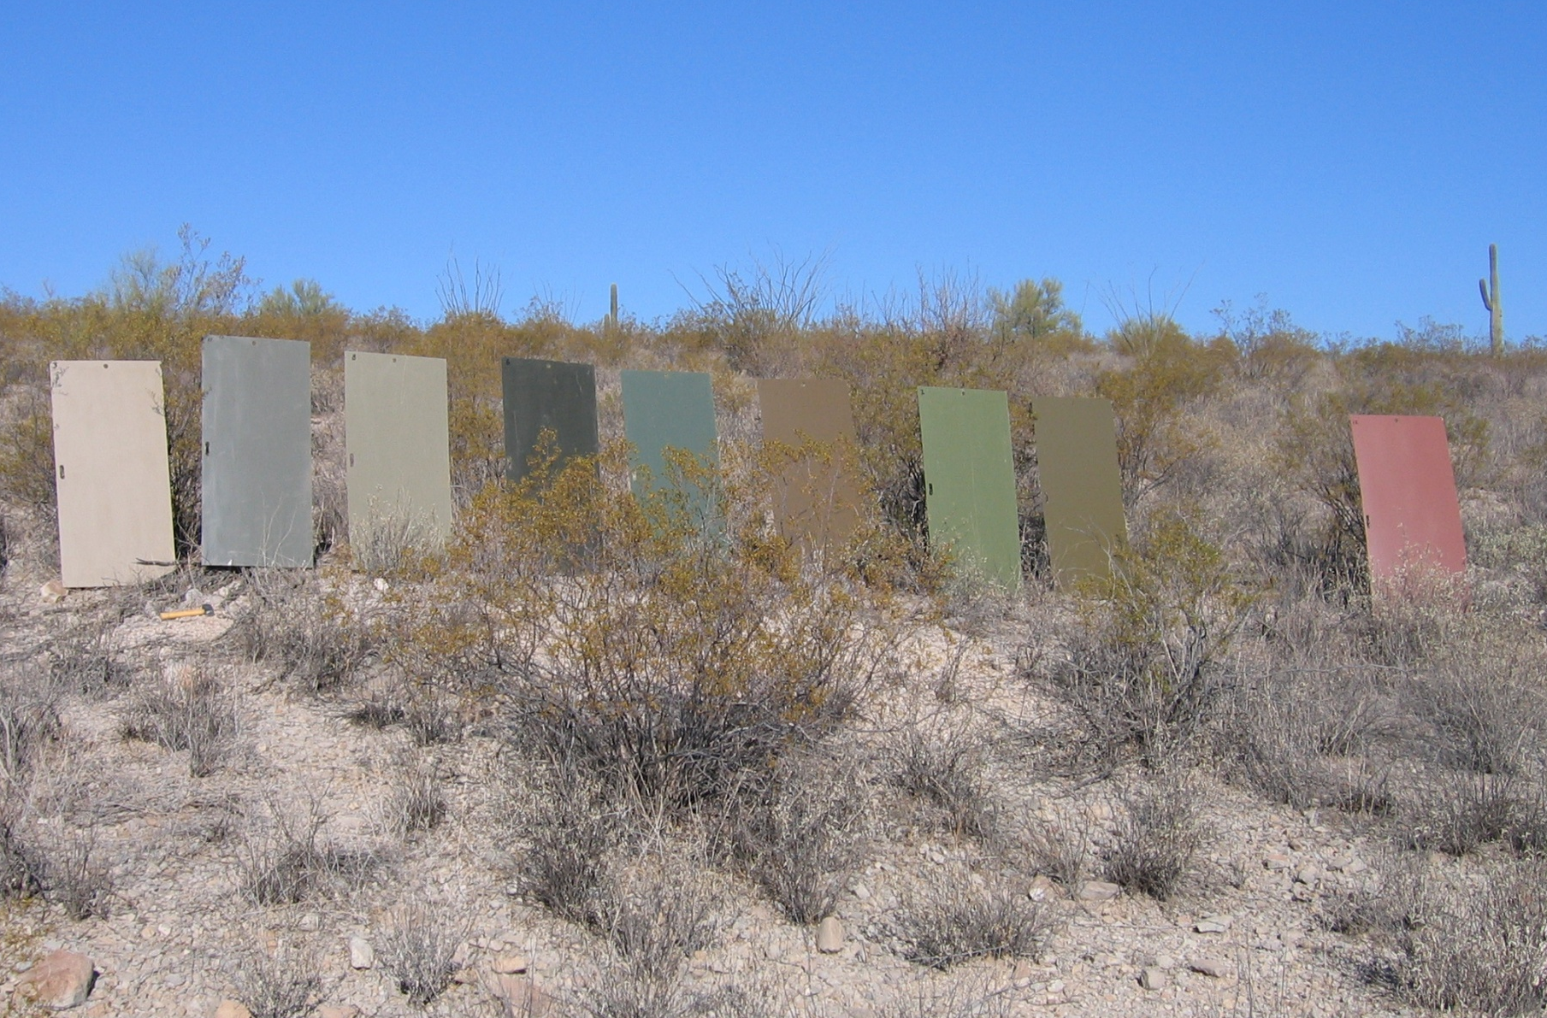
Visual Design Fundamentals
BLM Standard Colors

Slide 47
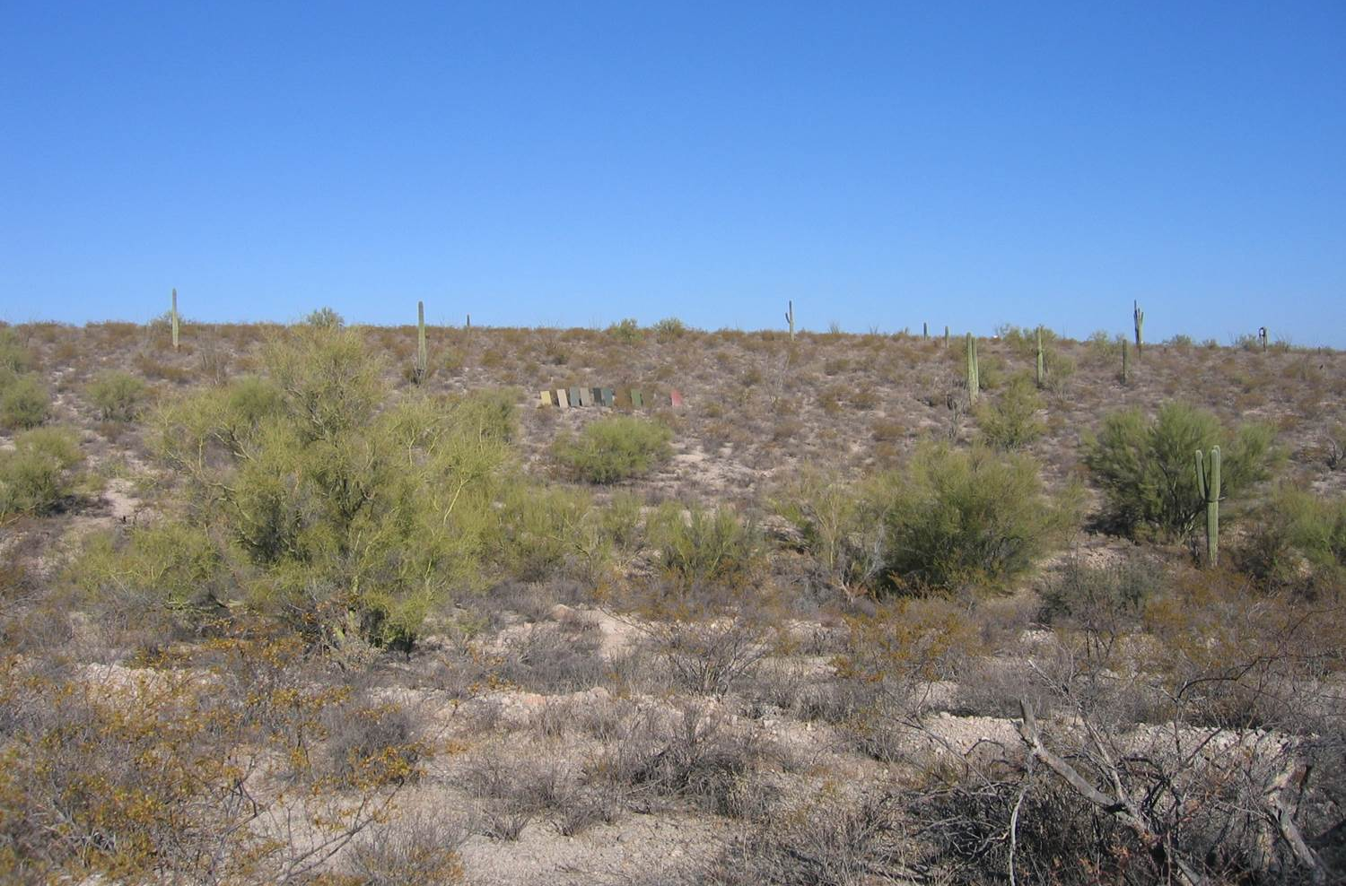
Visual Design Fundamentals
BLM Standard Colors

Slide 48
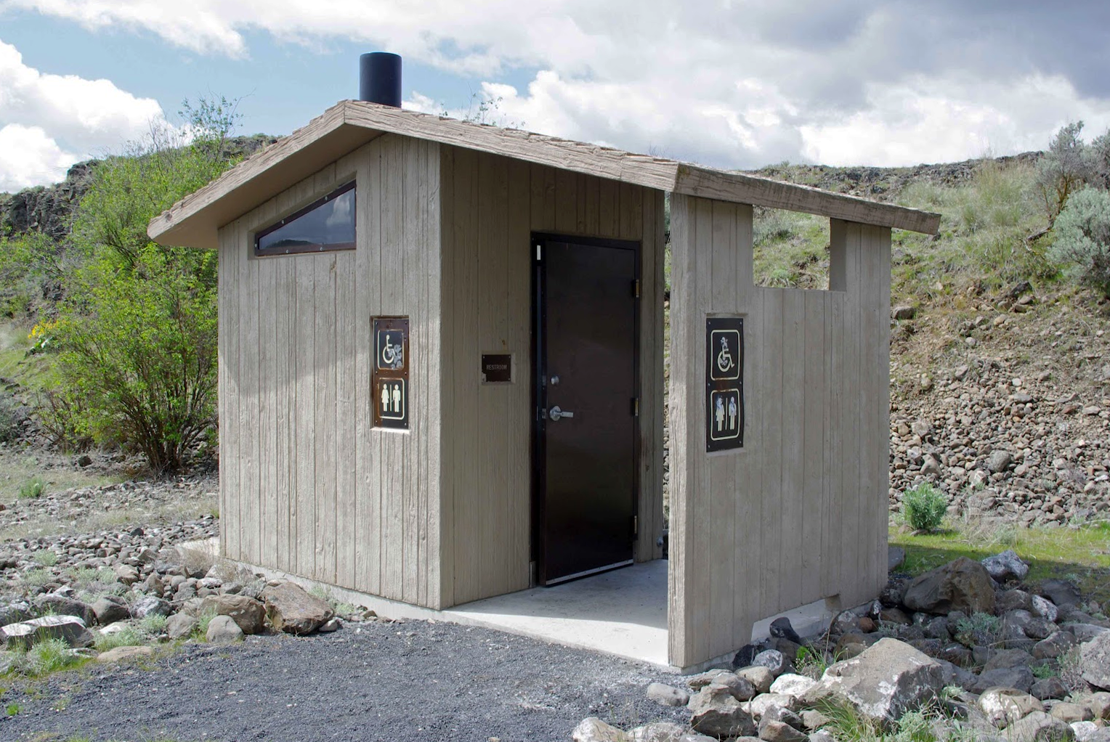
Visual Design Fundamentals
Repetition of Color

Slide 49
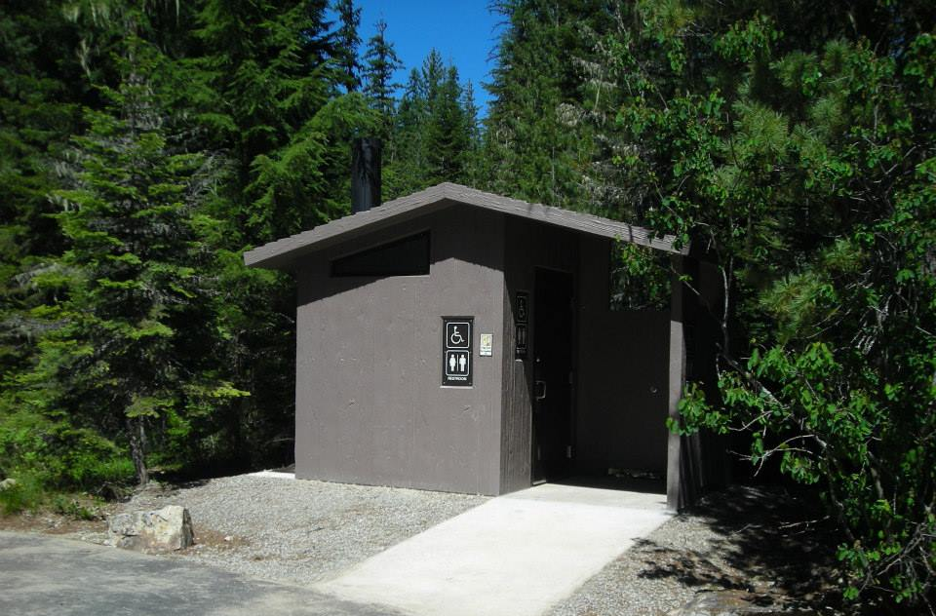
Visual Design Fundamentals
Repetition of Color

Slide 50
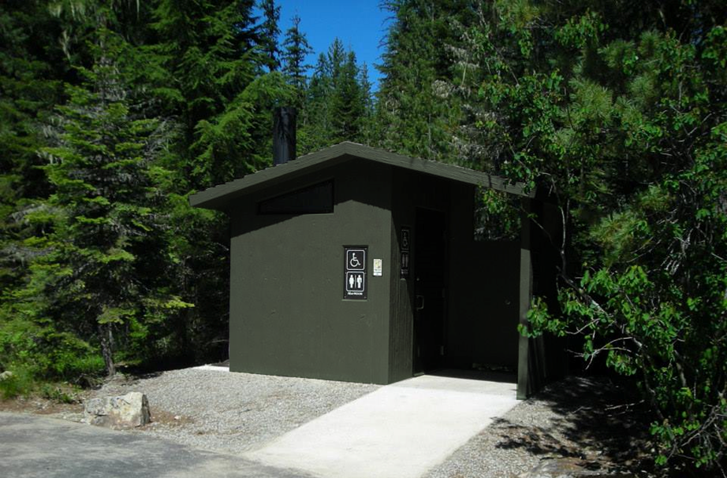
Visual Design Fundamentals
Repetition of Color

Slide 51
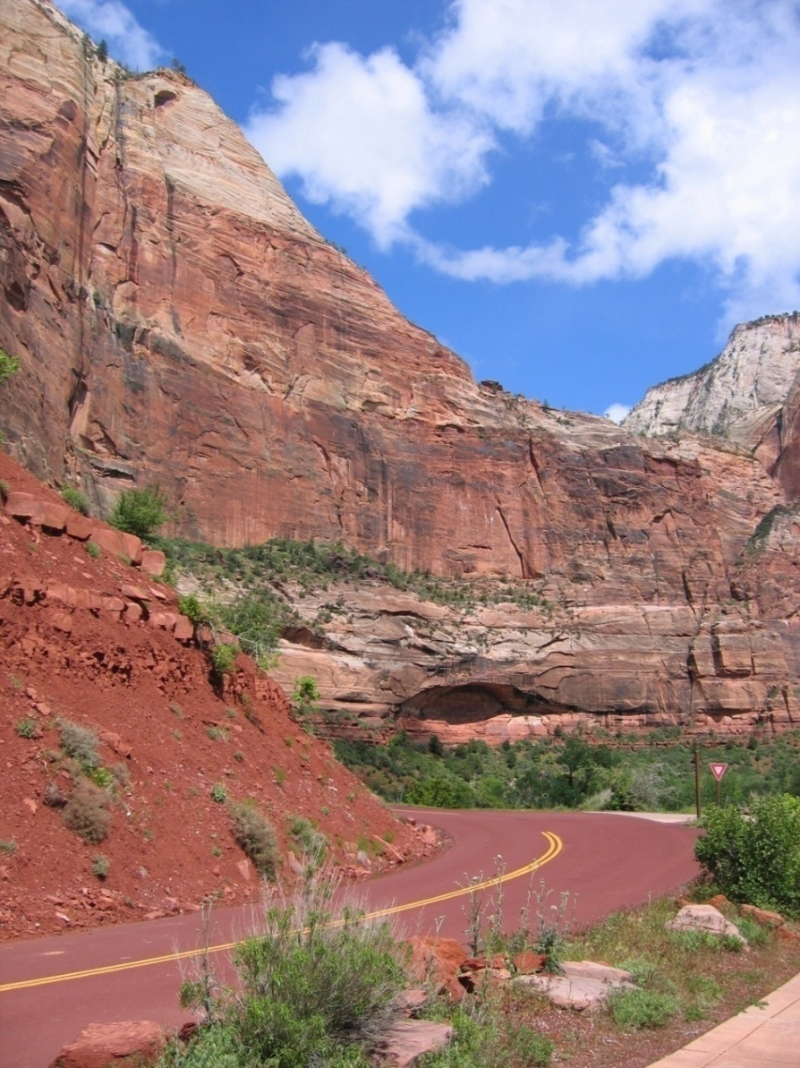
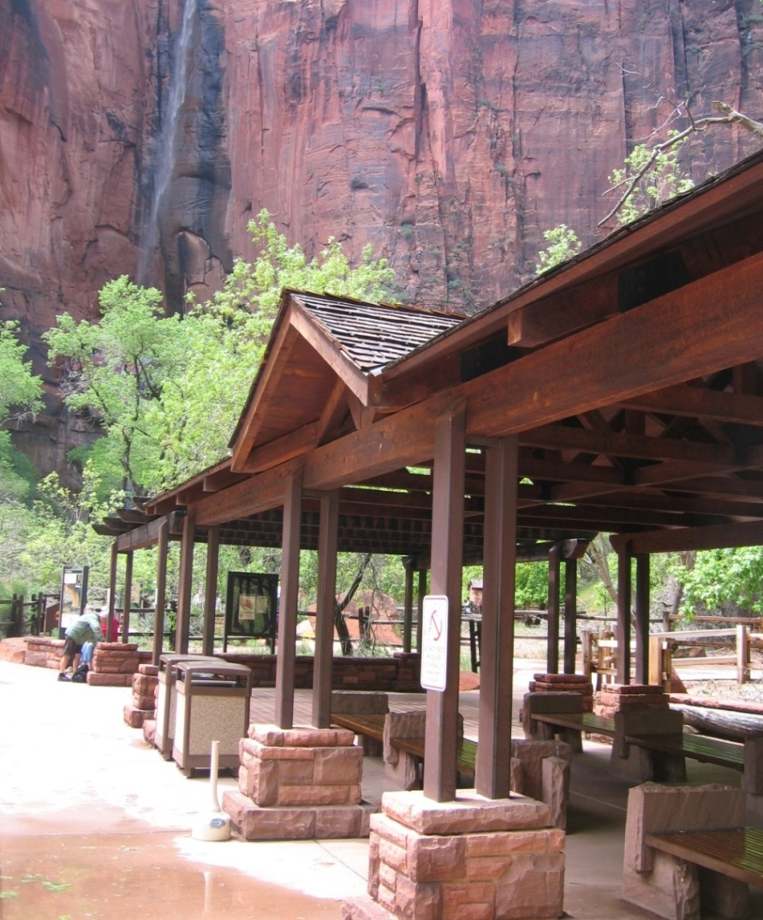
Visual Design Fundamentals
Repetition of Color
Nice examples of repetition in Zion National Park.

Slide 52
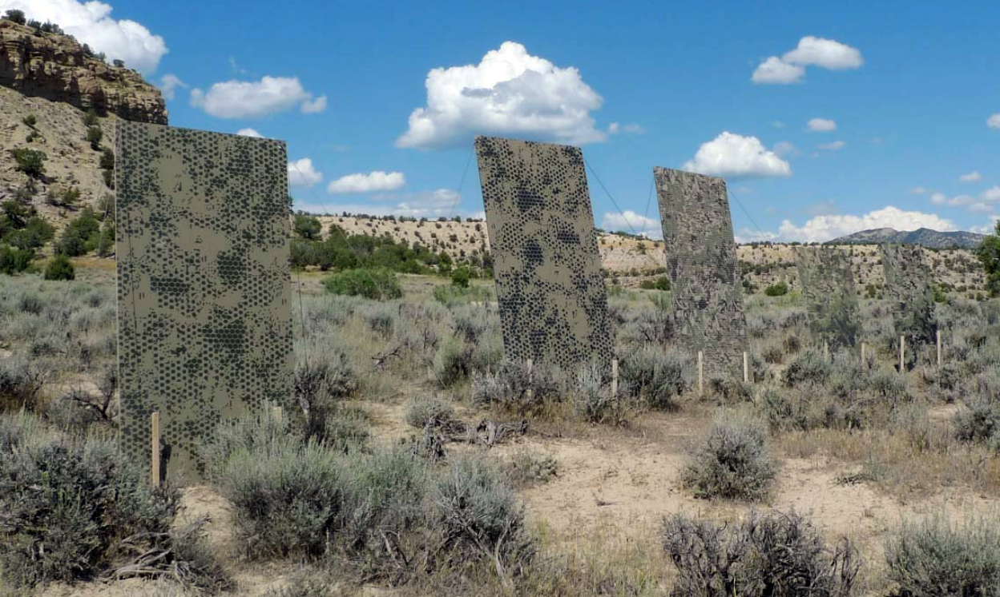
Visual Design Fundamentals
BLM Camouflage Research

Slide 53
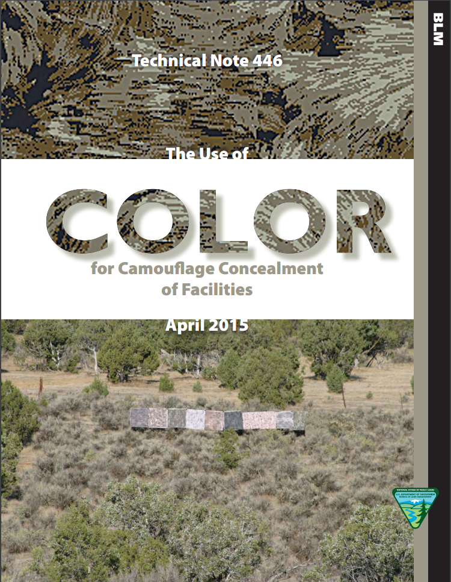
Visual Design Fundamentals
BLM Camouflage Research
Camouflage concealment is also an effective method of minimizing visual impacts.
BLM released Tech Memo 446 in April 2015.
Includes research inspired by decades of military use of camo technology.
NOTE! Very prescriptive and precise methods needed for successful implementation.

Slide 54
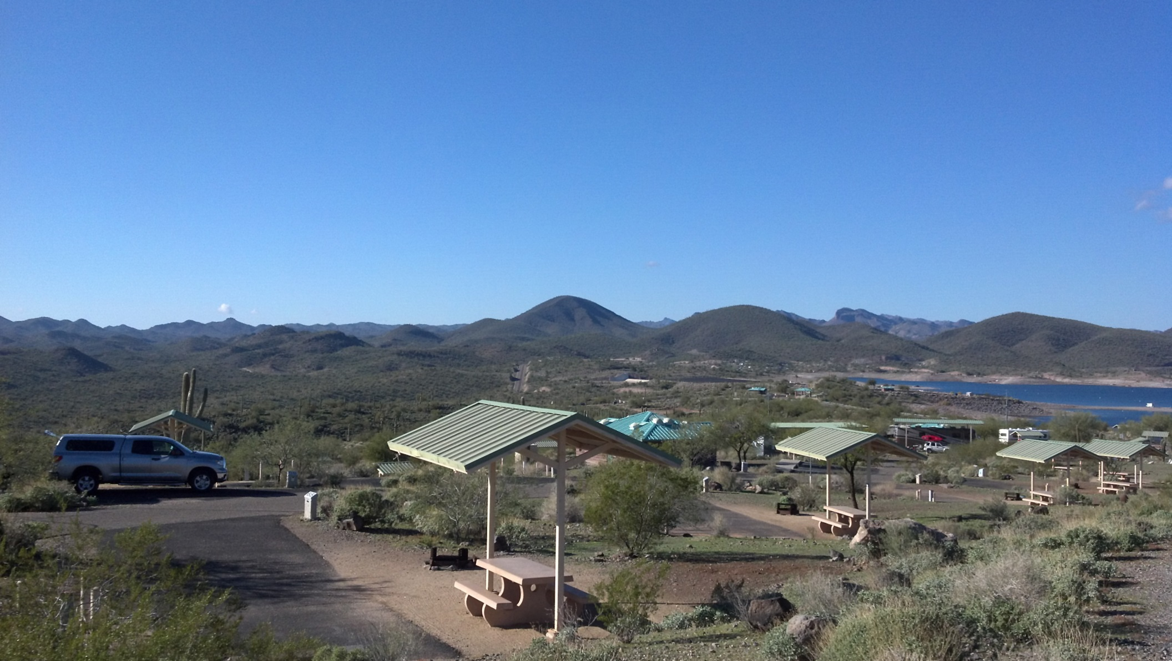
Visual Design Fundamentals
Lake Pleasant Campground, AZ

Slide 55
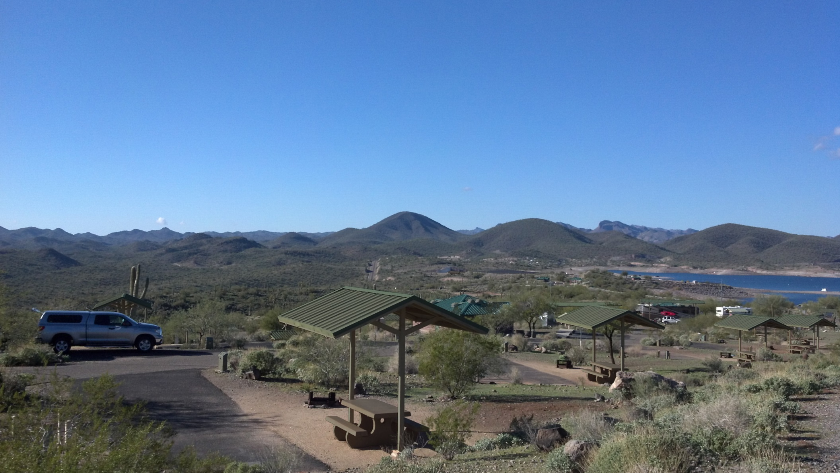
Visual Design Fundamentals
Lake Pleasant Campground, AZ

Slide 56
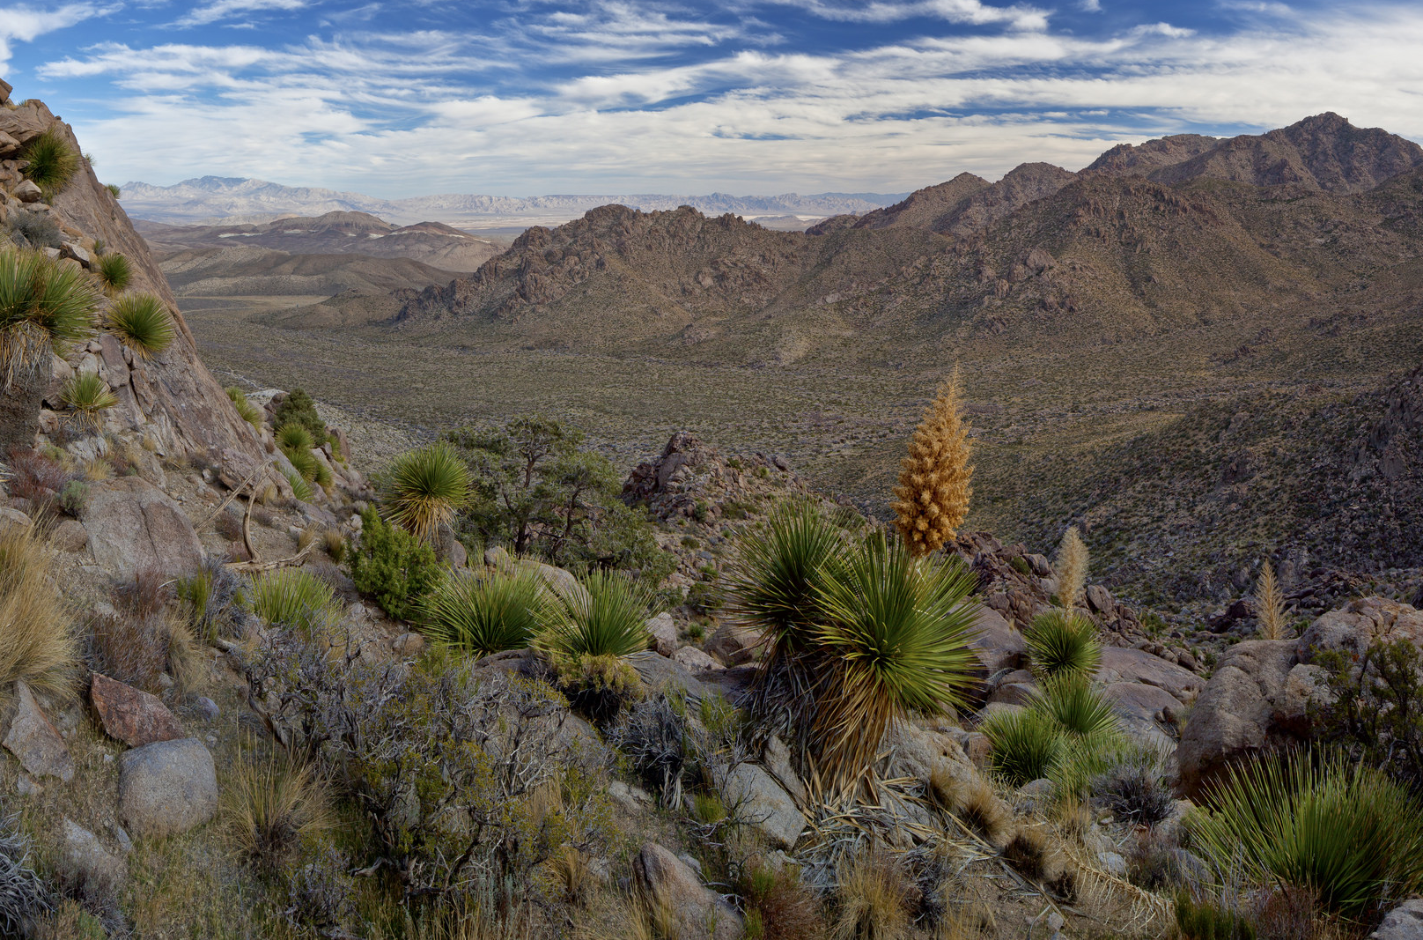
Visual Design Fundamentals
Repetition of Texture

Slide 57
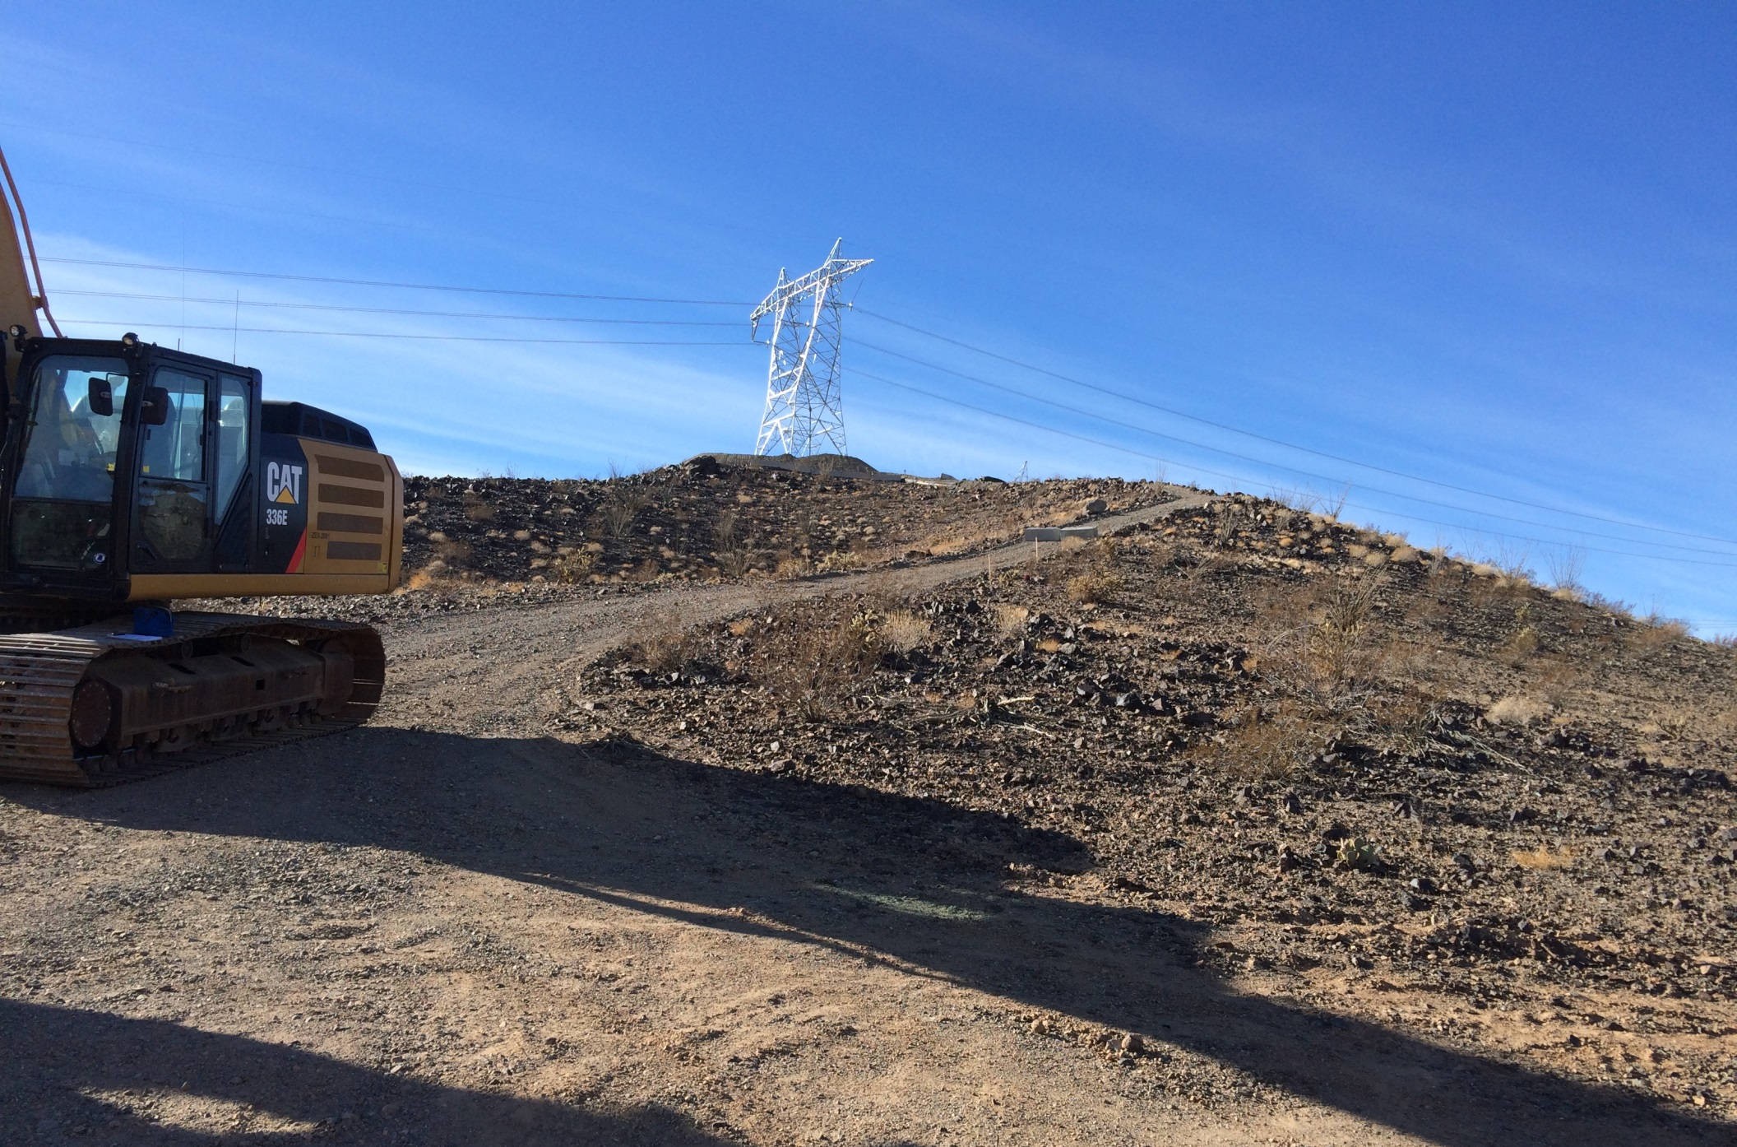
Visual Design Fundamentals
Repetition of Texture

Slide 58
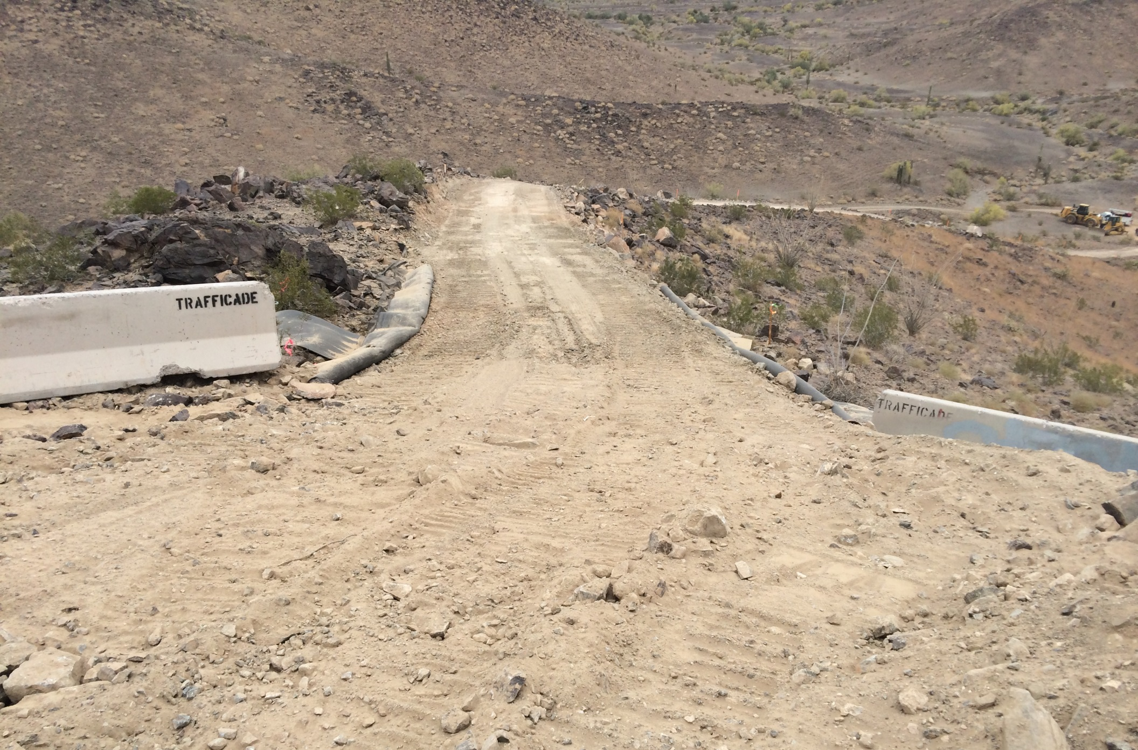
Visual Design Fundamentals
Repetition of Texture

Slide 59
Visual Design Fundamentals
Repetition of Texture

Slide 60
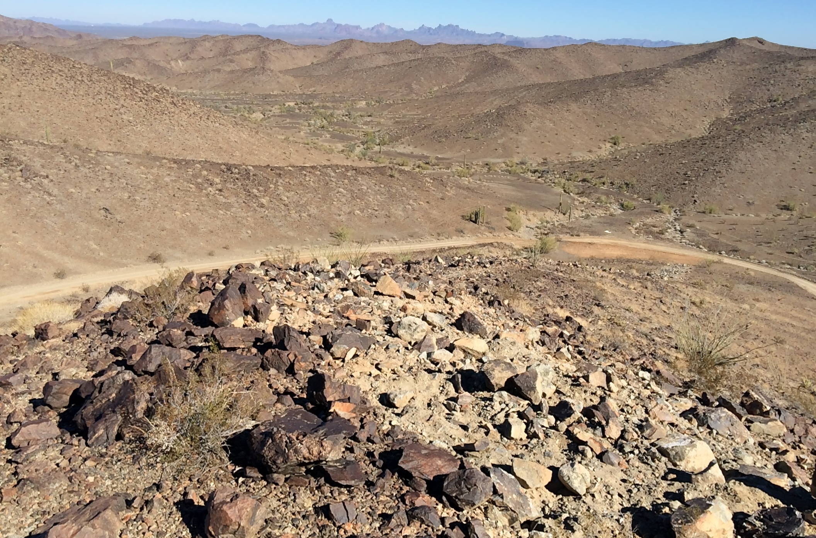
Visual Design Fundamentals
Repetition of Texture

Slide 61
Visual Design Fundamentals
Repetition of Texture

Slide 62
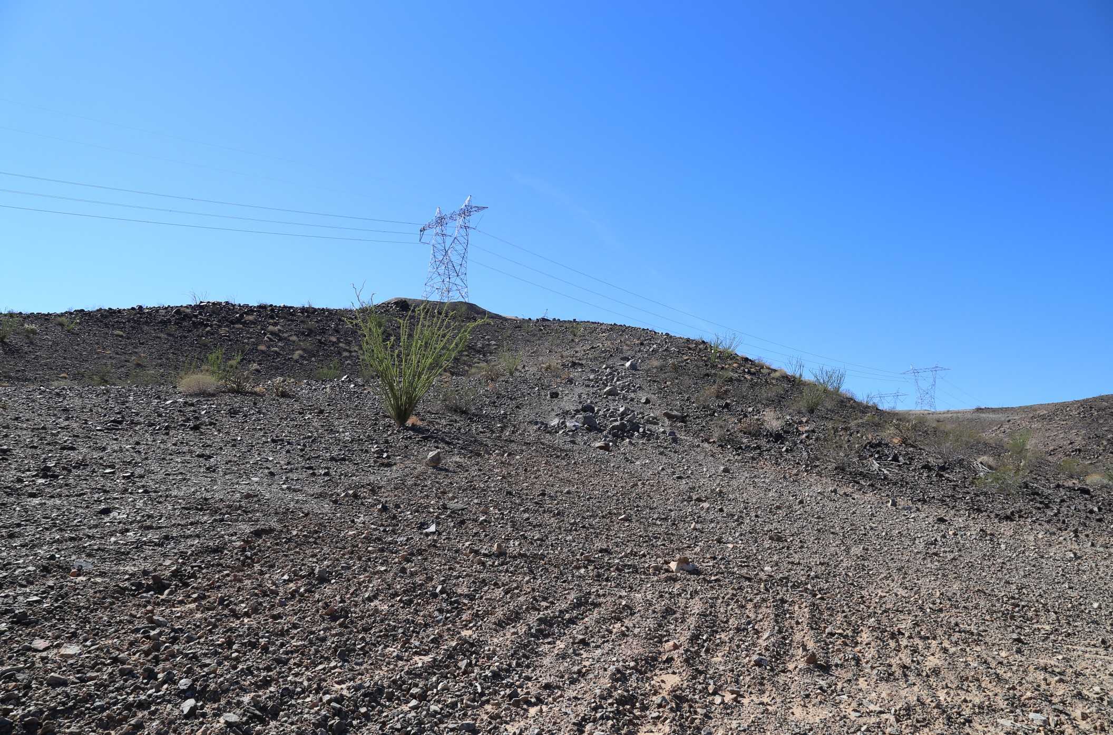
Visual Design Fundamentals
Repetition of Texture

Slide 63
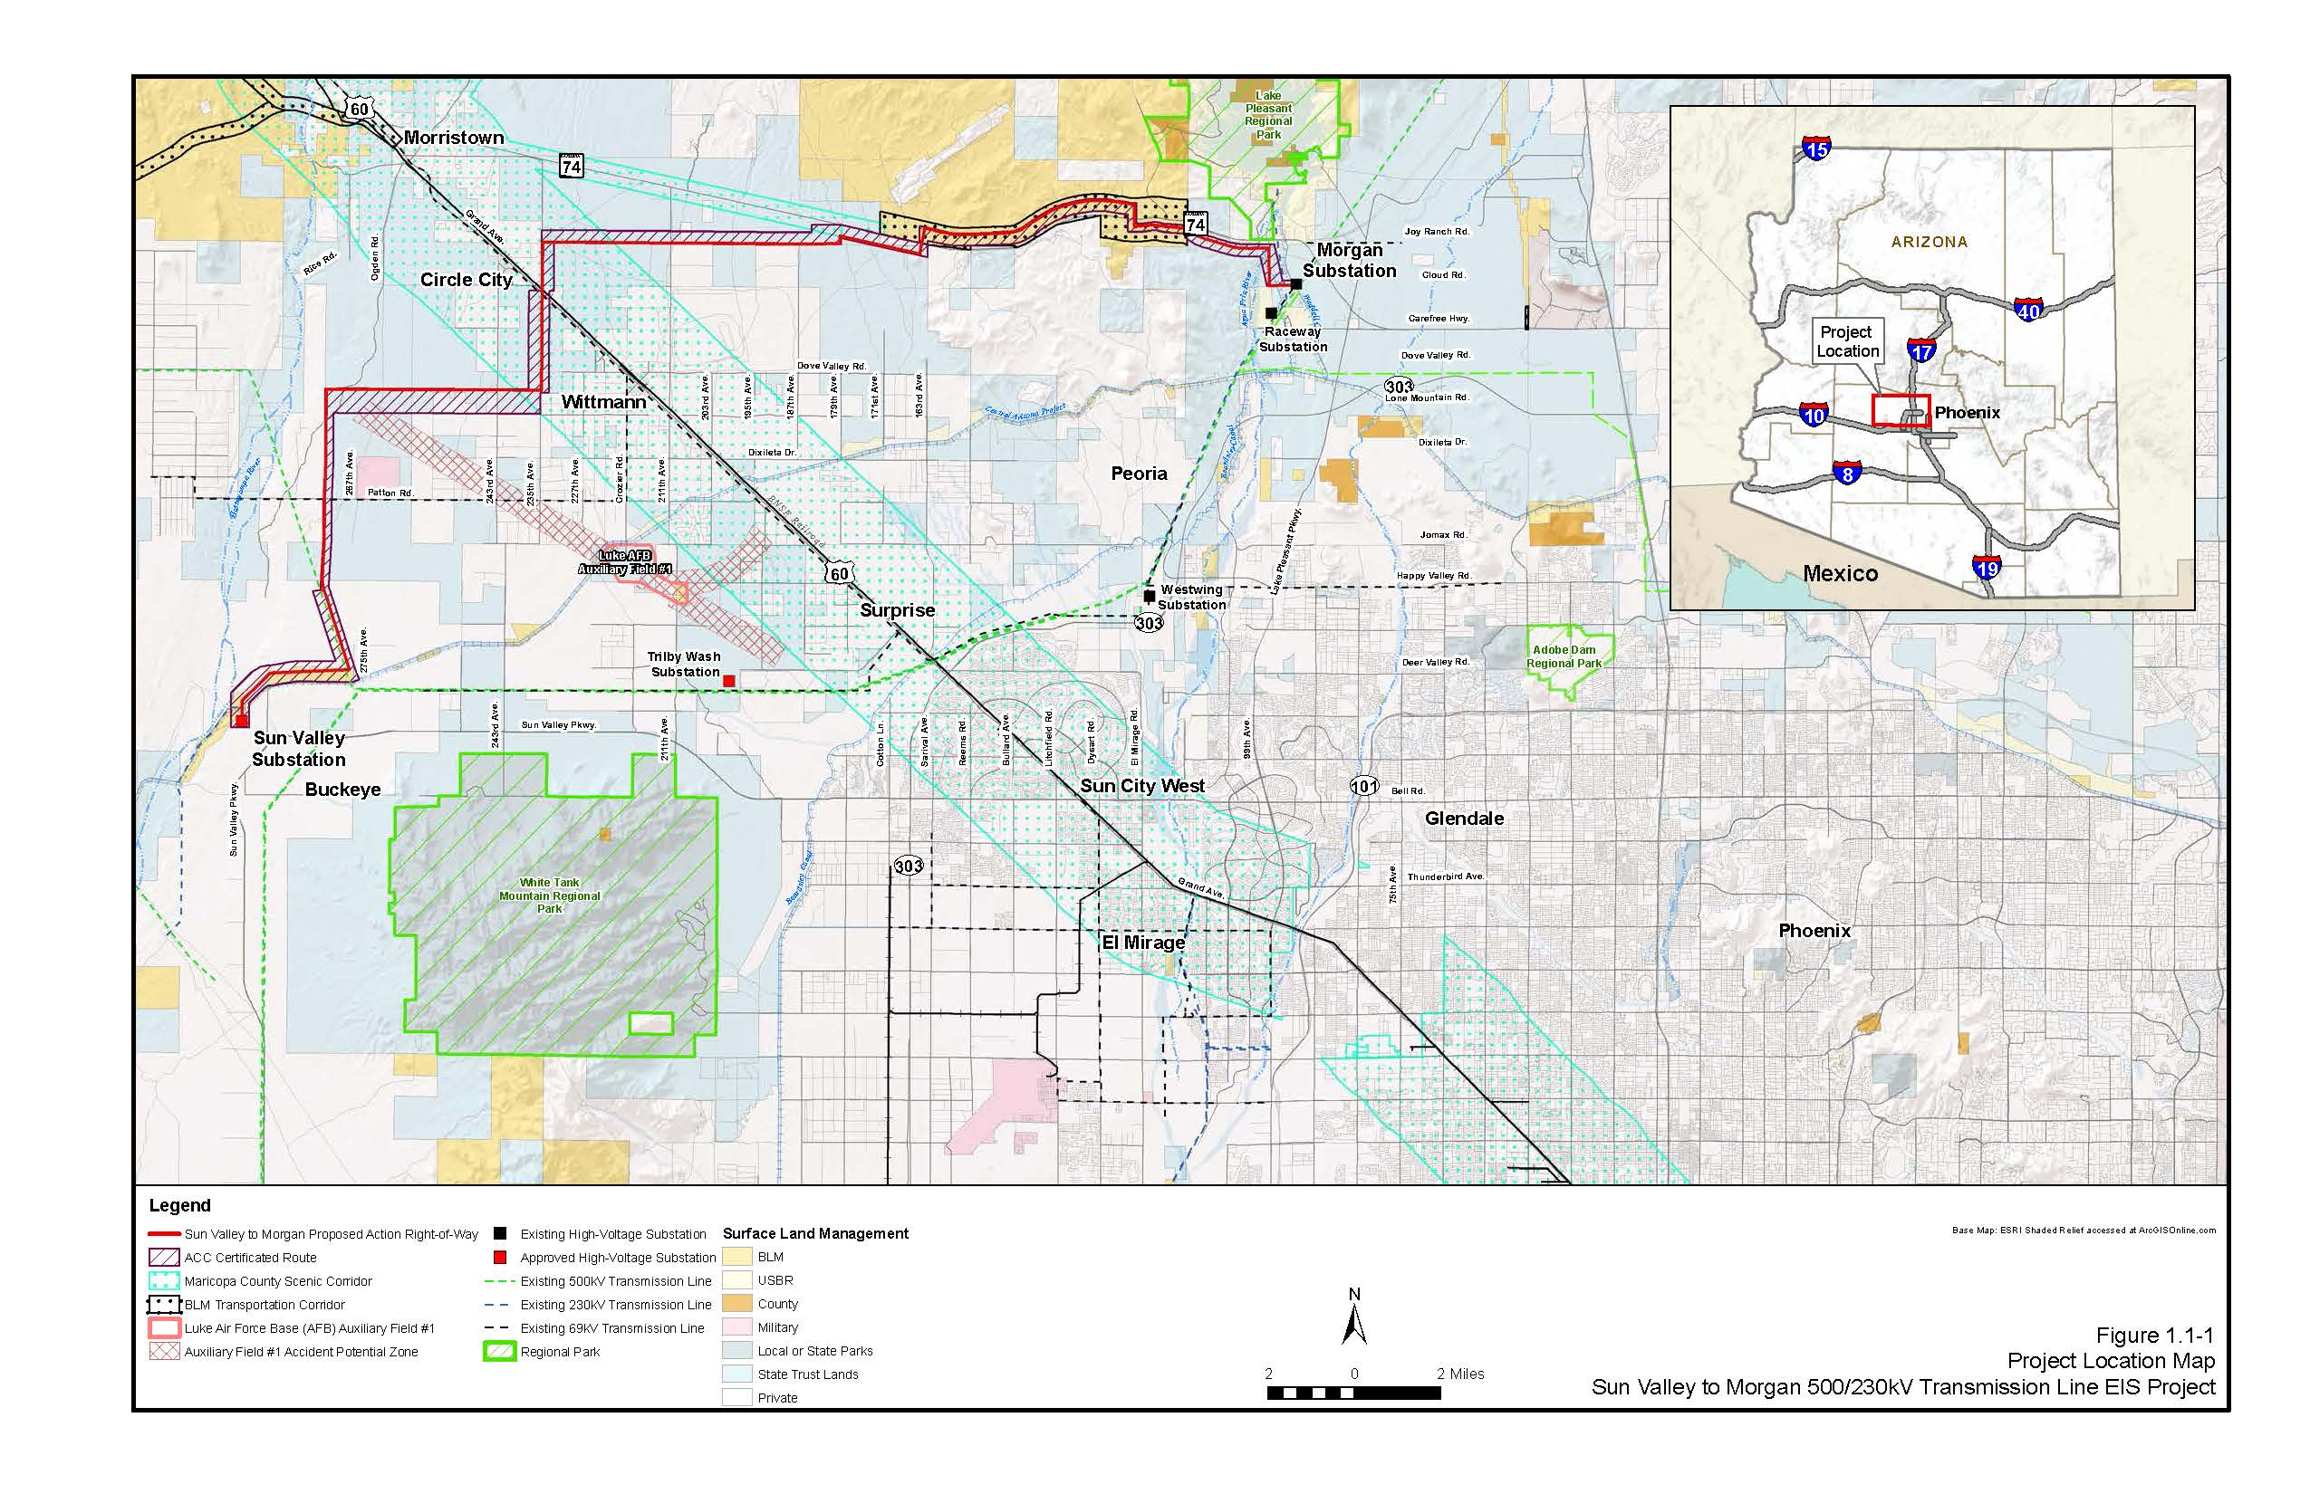
Visual Design Fundamentals
Design in Action – 500 kV Line

Slide 64
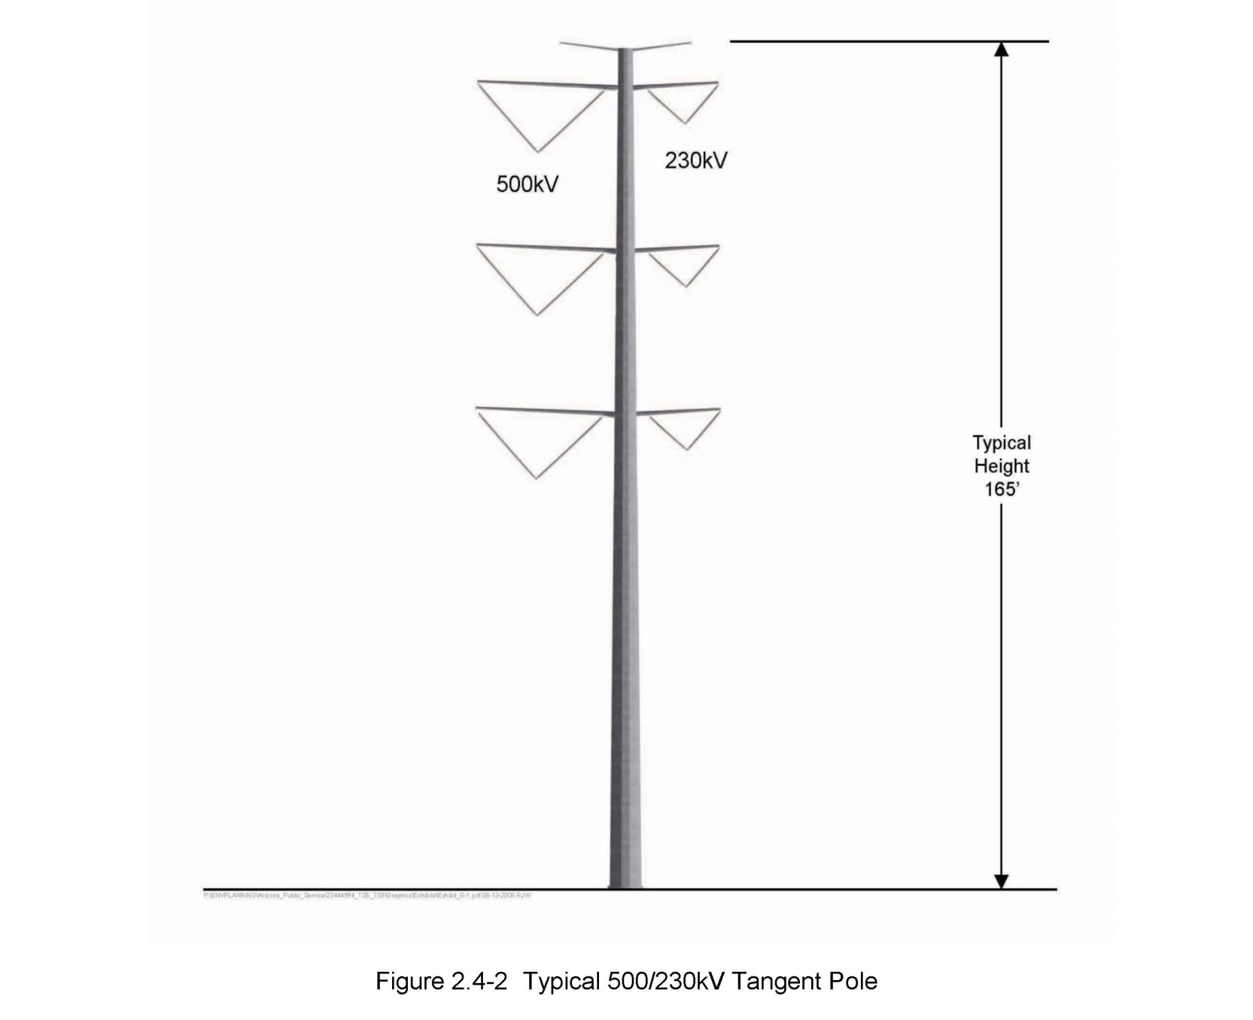
Visual Design Fundamentals
Design in Action – 500 kV Line

Slide 65
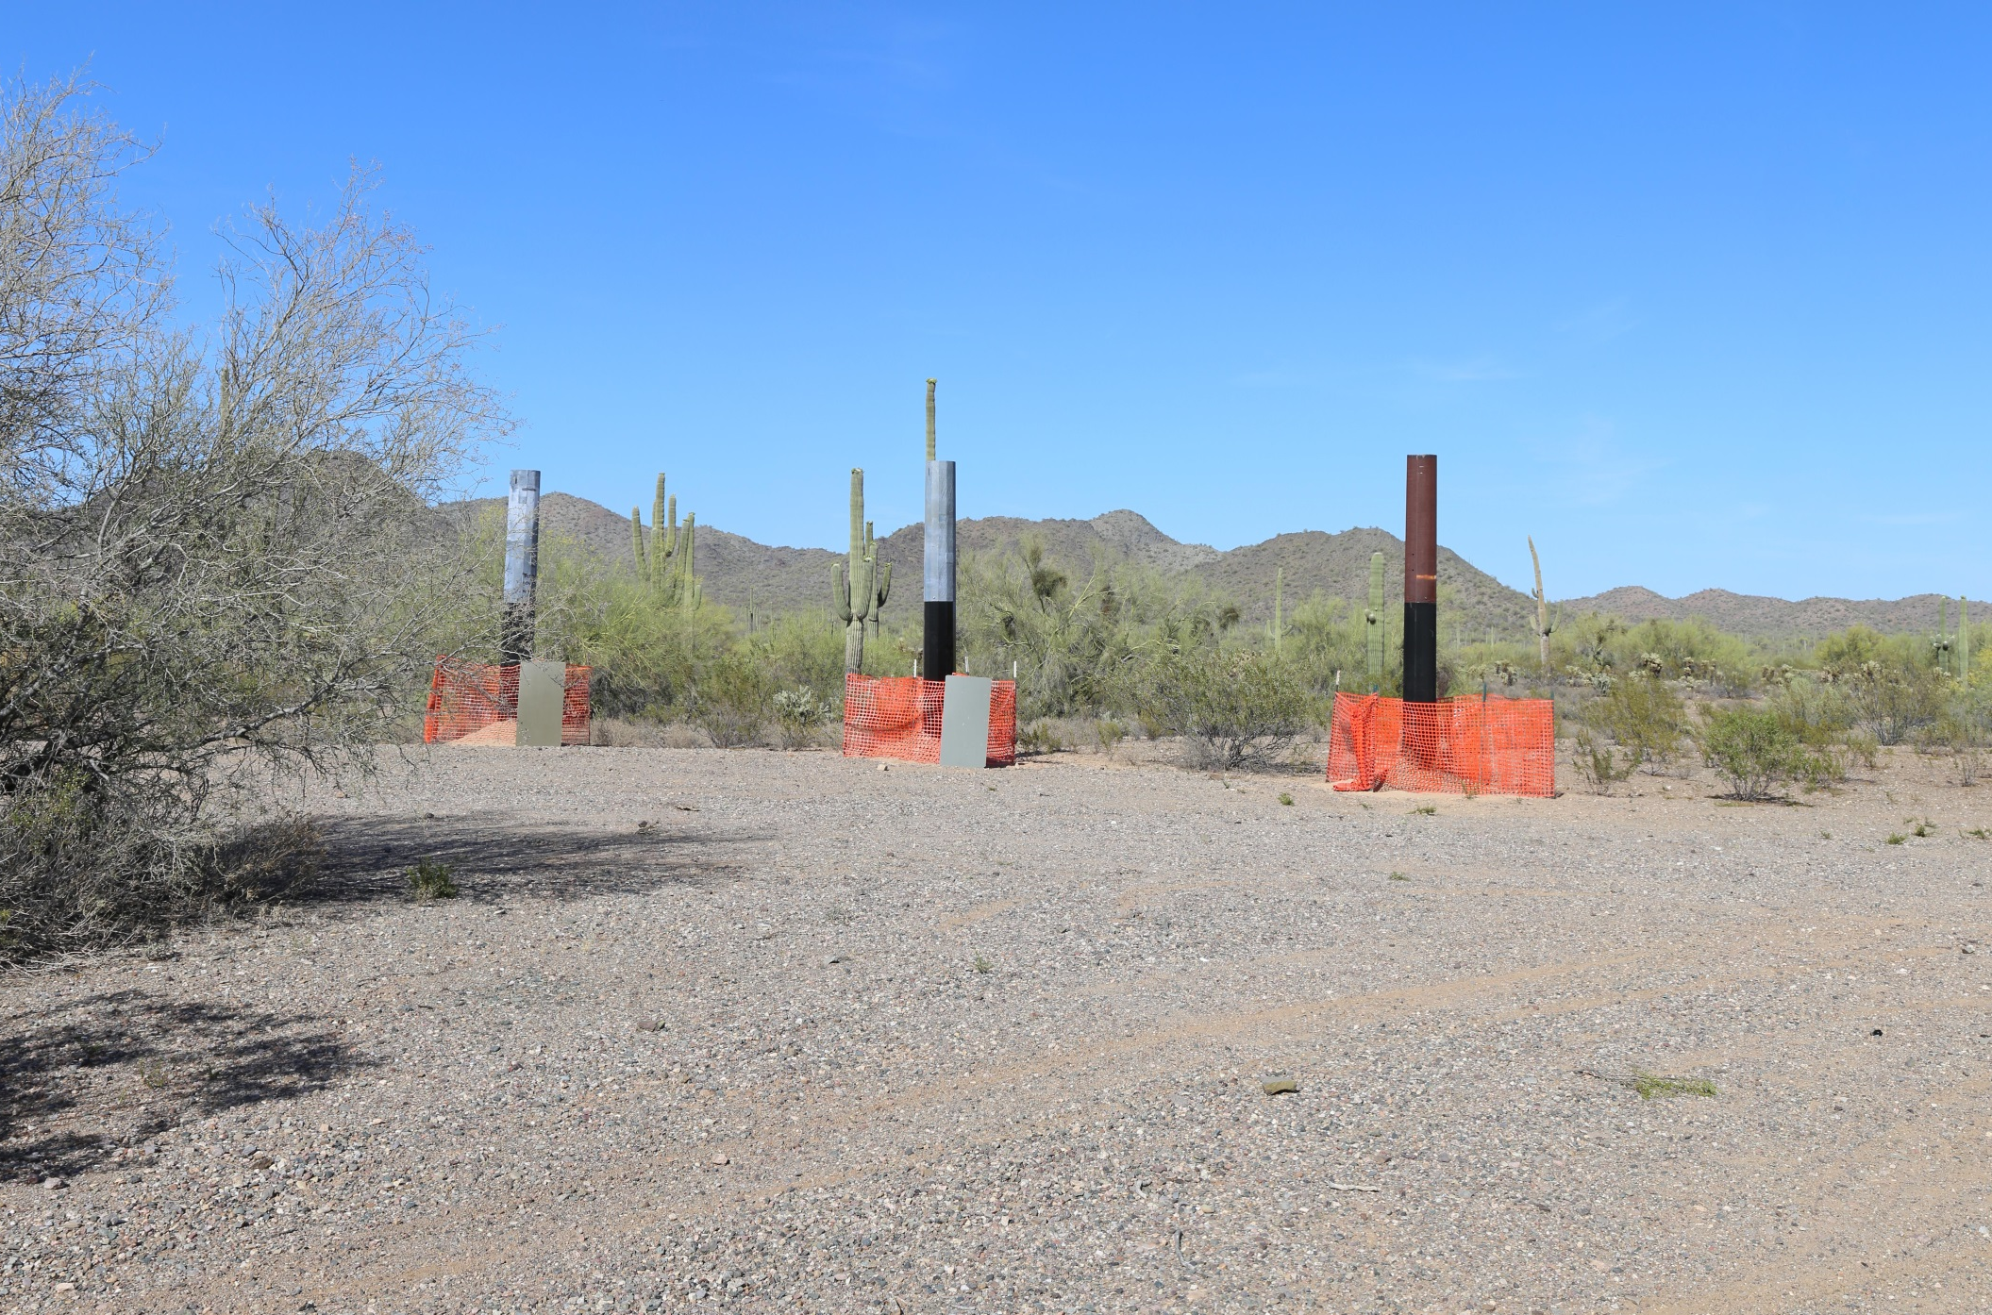
Visual Design Fundamentals
Design in Action – 500 kV Line

Slide 66
Visual Design Fundamentals
Design in Action – 500 kV Line

Slide 67
Visual Design Fundamentals
Design in Action – 500 kV Line

Slide 68
Visual Design Fundamentals
Design in Action – 500 kV Line

Slide 69
Visual Design Fundamentals
Design in Action – 500 kV Line

Slide 70
Visual Design Fundamentals
Design in Action – 500 kV Line

Slide 71
Visual Design Fundamentals
Design in Action – 500 kV Line

Slide 72
Visual Design Fundamentals
Summary
“The greater damage for most of us is not that our aim is too high and we miss it, but that it is too low and we reach it.” (Michelangelo) (1475-1564)

