Slide 1
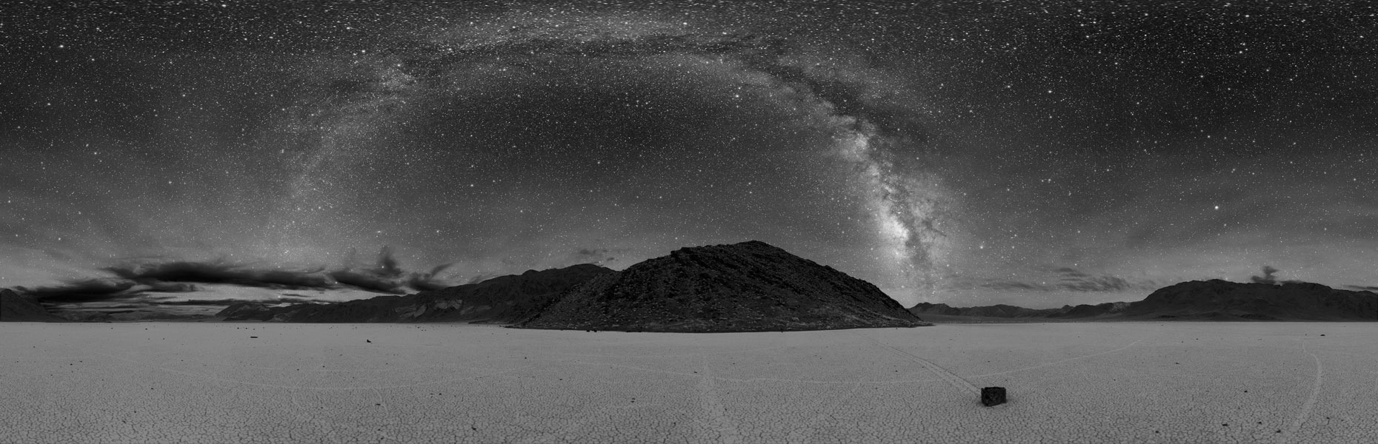
Protecting Night Sky Resources in National Parks
National Park Service
Natural Sounds and Night Skies Division
Methods, Theory, and Practice
NPS Night Sky Training
D Duriscoe April 2011

Slide 2
Main Ideas
Protection of naturally dark environments and night skies is important (wilderness)
Anthropogenic light has impacts
Methods for quantitative measurements of photic conditions are available
Potential impacts from light on natural and cultural resources can be assessed
Mitigation strategies are available

Slide 3
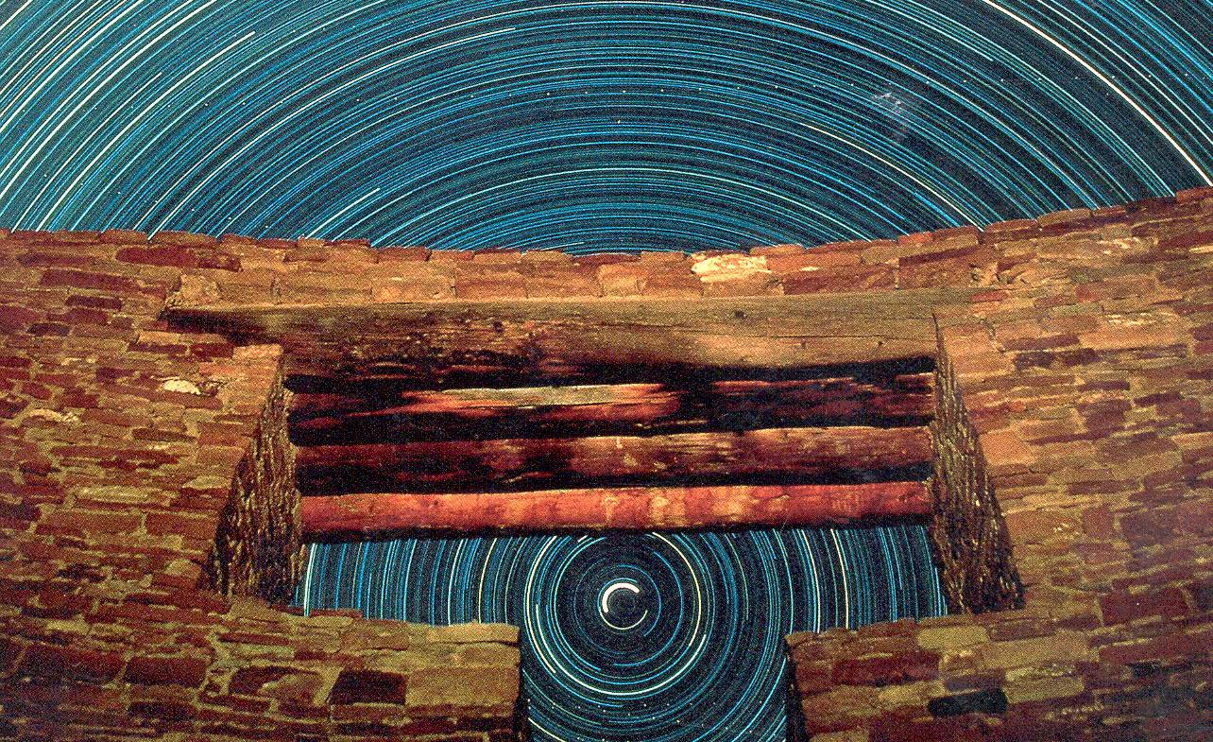


Introduction :
NPS Authorities and Principles

Slide 4
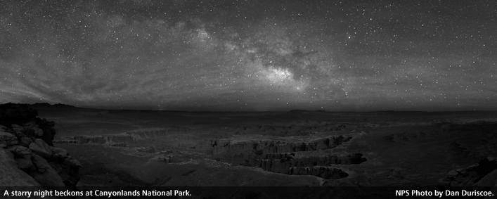
Definitions
Photic environment- The physical amount and character of light at a particular location, irrespective of human perception.
Lightscape - The component of the outdoor photic environment that is perceived and comprehended by humans as a visual scene. They represent the human perception of the nighttime scene, including both the night sky and the faintly illuminated terrain.
Sustainable outdoor lighting (SOL)- An approach to lighting that incorporates ecological and social concerns with economic factors.

Slide 5


NPS Organic Act
"....to conserve the scenery and the natural and historic objects and the wild life therein and to provide for the enjoyment of the same in such manner and by such means as will leave them unimpaired for the enjoyment of future generations."
Redwoods Act

Slide 6
NPS Management Policies
1.4.3 …when there is a conflict between conserving resources and values and providing for enjoyment of them, conservation is to be predominant. This is how courts have consistently interpreted the Organic Act.

Slide 7



Management Policies
    4.10 Lightscape Management
    The Service will preserve, to the greatest extent possible, the natural lightscapes of parks, which are natural resources and values that exist in the absence of human-caused light.
    To prevent the loss of dark conditions and of natural night skies, the Service will minimize light that emanates from park facilities.
    …and also seek the cooperation of park visitors, neighbors, and local government agencies to prevent or minimize the intrusion of artificial light into the night scene of the ecosystems of parks.

Slide 8
Management Policies
4.10 Lightscape Management
The Service will:
Restrict the use of artificial lighting in parks to those areas where security, basic human safety, and specific cultural resource requirements must be met.
Use minimal-impact lighting techniques.
Shield the use of artificial lighting where necessary to prevent the disruption of the night sky, natural cave processes, physiological processes of living organisms, and similar natural processes.

Slide 9
Management Policies
4.10 Lightscape Management
The Service will not use artificial lighting in areas such as sea turtle nesting locations where the presence of the artificial lighting will disrupt a park’s dark-dependent natural resource components.

Slide 10

Directors Order
50C - Public Risk Management
The National Park Service's mission is to conserve park natural and cultural resources and processes unimpaired, and provide opportunities for the public to enjoy them.
Within this context, visitor risk management does not mean eliminating all dangers, nor can the NPS guarantee visitor safety or be responsible for acts and decisions made by visitors that may result in their injury or illness.

Slide 11

Directors Order
50C - Public Risk Management
Park superintendents will seek to identify risks within their jurisdiction and to mitigate these risks within the limits of available resources without compromising the integrity of the environments they are charged to protect.”
Lighting, paving, fences, guardrails, and water purification systems, for example, might be appropriate in some settings while not in backcountry campsites, trails, and similar pristine settings, or even in some urban locations.

Slide 12
Light Pollution 101
D Duriscoe April 2011
Notes:
I’m not a physicist, lighting engineer, or biologist. My background is in policy and resource management . I can handle general questions about the physics of light, but can’t get too far into the weeds before I’m out of my comfort zone.

Slide 13
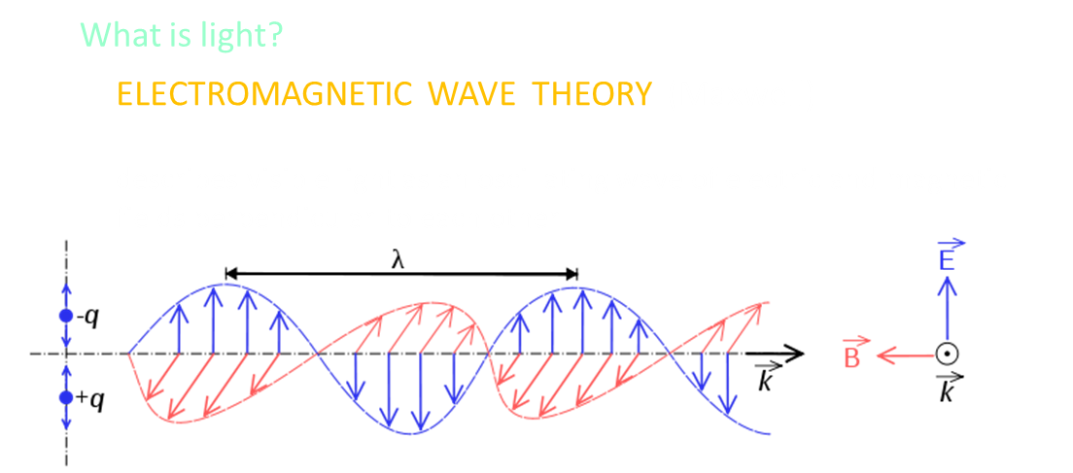
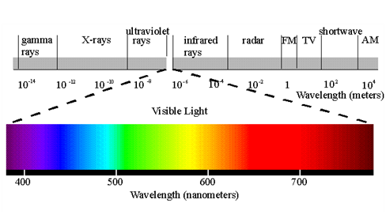
THE ELECTROMAGNETIC SPECTRUM
Includes a range of photon energy levels, from the highest (gamma rays) to the lowest (radio waves)
VISIBLE LIGHT
Includes a narrow band of this spectrum, corresponding to the peak of the sun’s spectral output

Slide 14
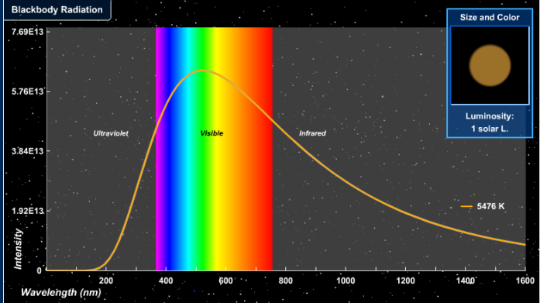
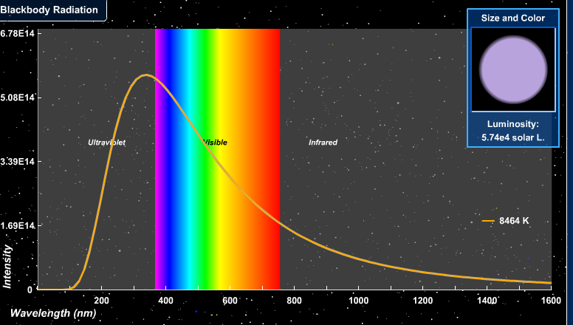
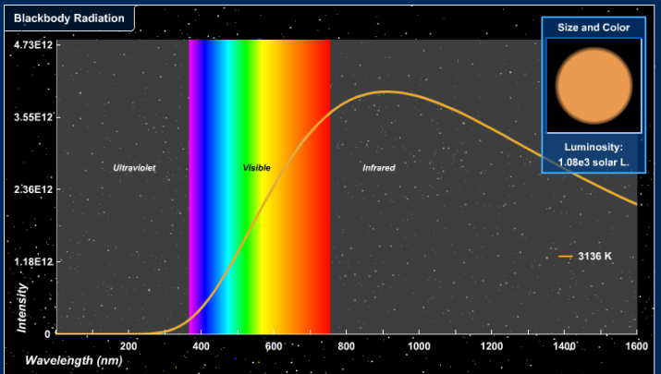
1.1 What is light?
Sun 5300° K
540 nm
THE BLACK BODY CURVE (Wein’s Displacement Law)
Predicts the peak wavelength of a star’s spectrum based upon the star’s surface temperature
The human eye is sensitive to the region of peak intensity in the sun’s spectrum, obviously not by mere chance
WHITE LIGHT
Is a mixture of the colors of the sun’s spectrum as perceived by the human eye
Deneb 8100° K
360 nm
Antares 3100° K
935 nm
D Duriscoe April 2011

Slide 15
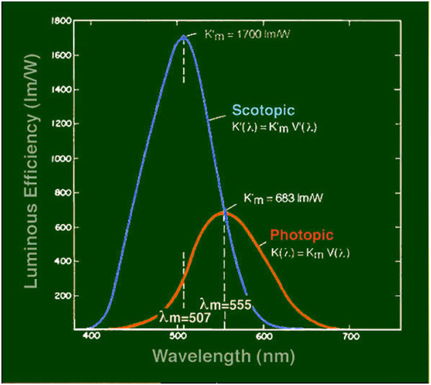
SPECTRAL SENSITIVITY OF THE HUMAN EYE
Varies under different light levels.
The eye is nearly three times as sensitive in scotopic (or so-called “dark adapted”) as it is in photopic (normal) state,
Under scotopic vision the wavelength of peak sensitivity is shifted toward the blue part of the spectrum, from 555 nm to 507 nm.
The transition between the two states is not abrupt, but a continuum, termed mesopic. Mesopic vision is experienced in the natural environment under moonlight or twilight.
D Duriscoe April 2011
Notes:
The eye can tolerate full daylight, but also is able to pick out details in the landscape on moonless nights.

Slide 16
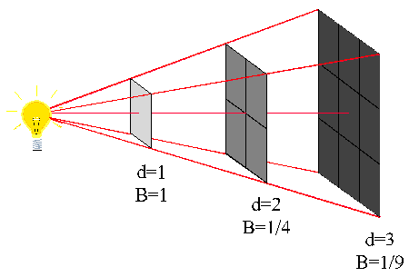
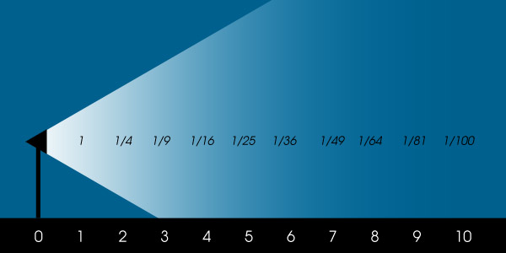
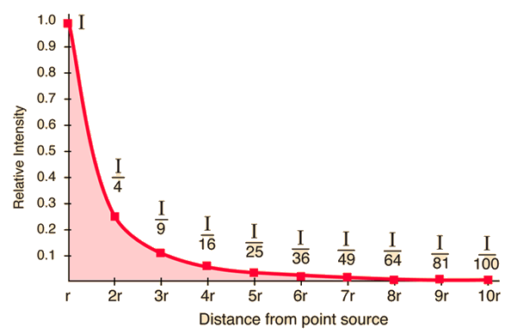
Notes:
The intensity of light diminishes as a function of distance based on the inverse square law. When you double the distance the light is ¼ as bright. When you move closer by half you increase the brightness by a factor of 4.

Slide 17
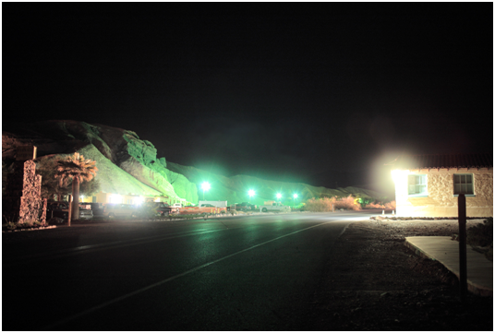
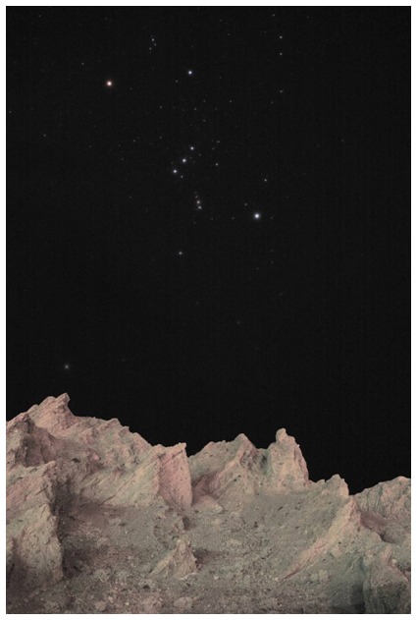
Light Tresspass
LIGHT TRESPASS
Is light directly striking the observer from an anthropogenic source. This type of light pollution illuminates the observer and the landscape unnaturally.
Above: light trespass as seen by an observer on Highway 190 in Death Valley. Right: the desert landscape illuminated by these lights.
Affects environment through Sky Glow and Glare
D Duriscoe April 2011
Notes:
There are two main types of light trespass that can affect natural and cultural resources Sky Glow and Glare

Slide 18
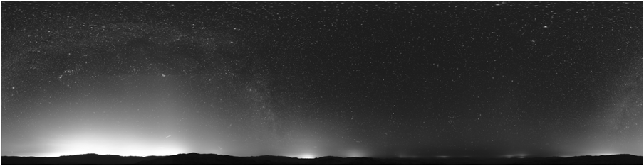
SKY GLOW
Is light scattered and reflected off of air molecules and atmospheric aerosols. The observer sees anthropogenic light originating on the ground in the sky. The sky appears luminous.
This type of light pollution damages the aesthetics of the night sky, and illuminates the observer and the landscape unnaturally.
D Duriscoe April 2011

Slide 19
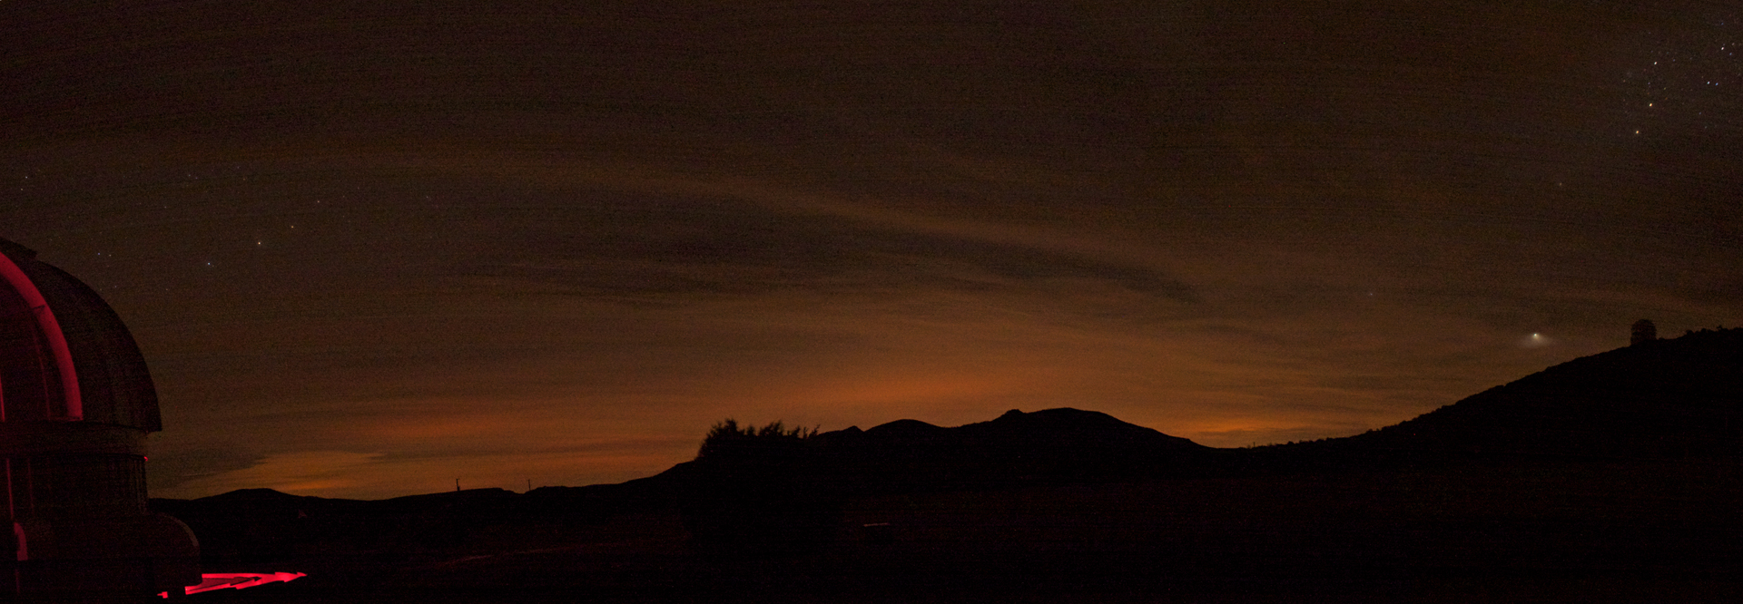
Sky Glow:
Cloudy Night from McDonald Observatory, Texas

Slide 20
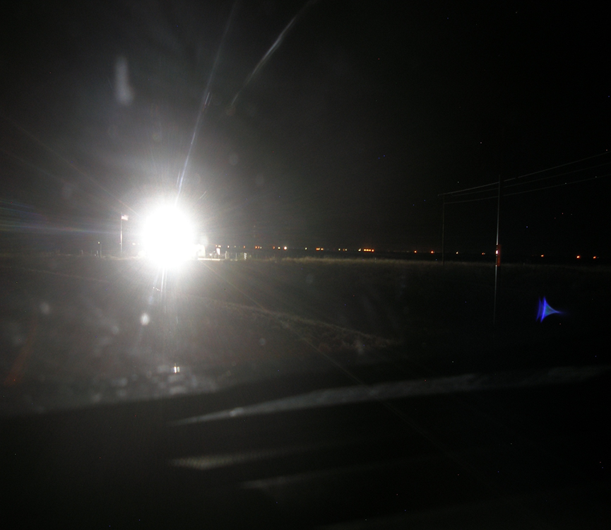
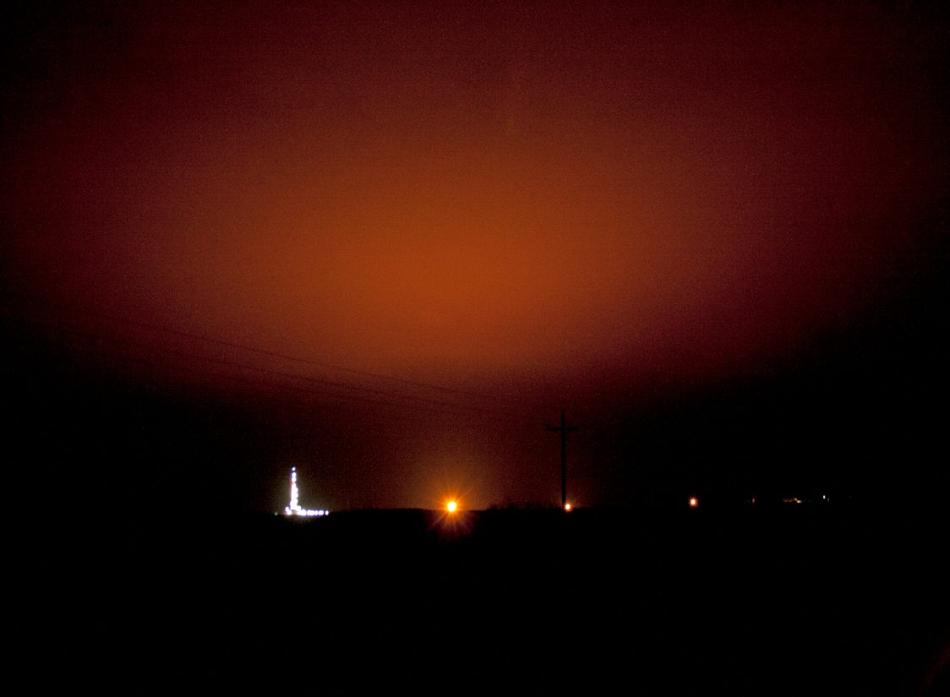
Glare:
Obscures visual information,
Affects dark adaptation

Slide 21
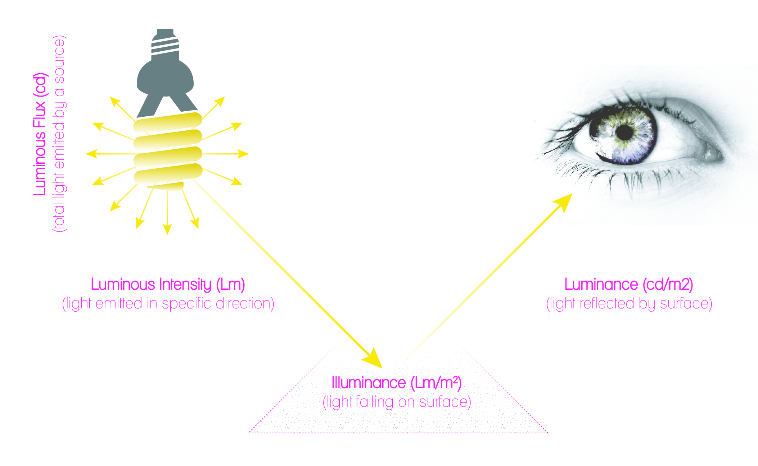
ILLUMINANCE AND LUMINANCE
Are measures of light from the whole field of view of the observer. Both are produced by spilled light from outdoor fixtures, and both can be calibrated to known standards.
D Duriscoe April 2011
Notes:
Illuminance and Luminance are two additional concepts That are important for understanding light.

Slide 22
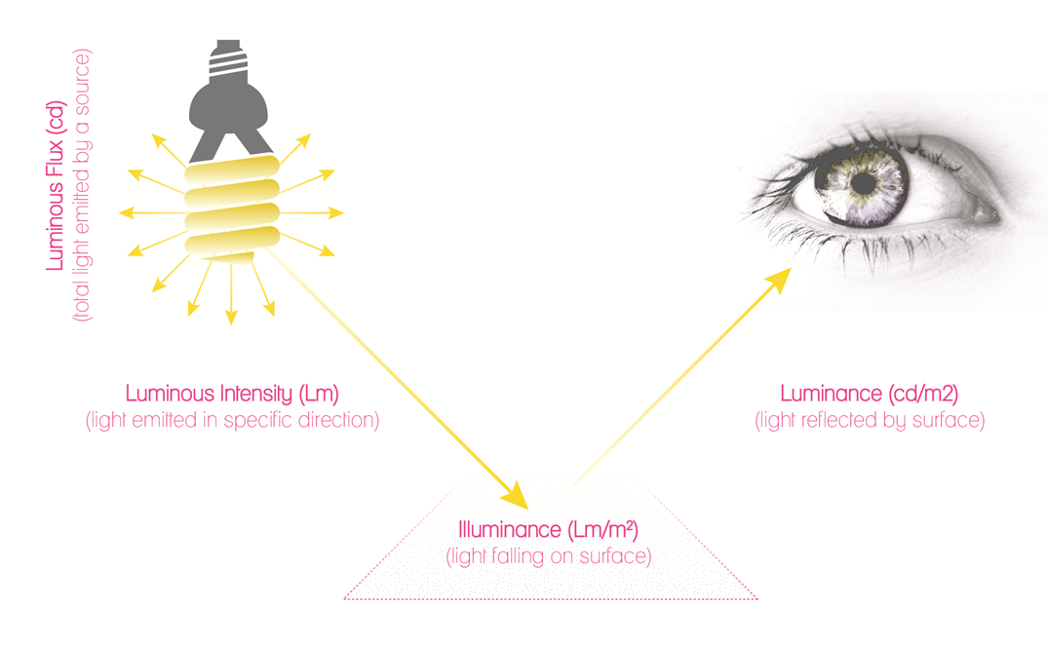
ILLUMINANCE
Is a measure of luminous flux on a surface of a given area, or luminous flux density. It is what matters most when the human eye is trying to examine objects by reflected light. Illuminance is a very useful measure in quantification of anthropogenic light in the natural environment.
Measured in lux
footcandle is the British unit equivalent and equals 0.093 lux or about 1/10 lux.
D Duriscoe April 2011

Slide 23
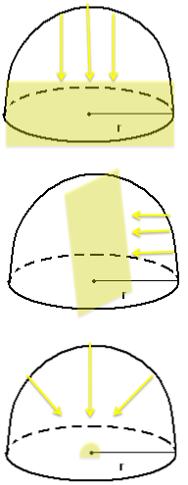
ILLUMINANCE GEOMETRIES
Horizontal illuminance
Vertical illuminance
Hemispheric illuminance
D Duriscoe April 2011
Notes:
Illuminance from the sky or a light source overhead is often measured with the detector in a horizontal plane. We call this measure horizontal illuminance. Horizontal illuminance is a good measure of sky brightness near the zenith or illuminance from a pole mounted outdoor light.
Illuminance from a light source at a distance on the horizon (or from the sky facing a certain direction) may be measured with the detector in a vertical plane, usually normal to the direction of the light source. We call this measure vertical illuminance. Vertical illuminance is an excellent measure of light trespass.
Illuminance from the entire sky striking an imaginary hemispheric surface (like the top of a golf ball on the ground) is an unbiased measure of the light reaching the observer from the entire sky. We call this measure hemispheric illuminance. Hemispheric illuminance is an excellent measure of light pollution from anthropogenic sky glow

Slide 24
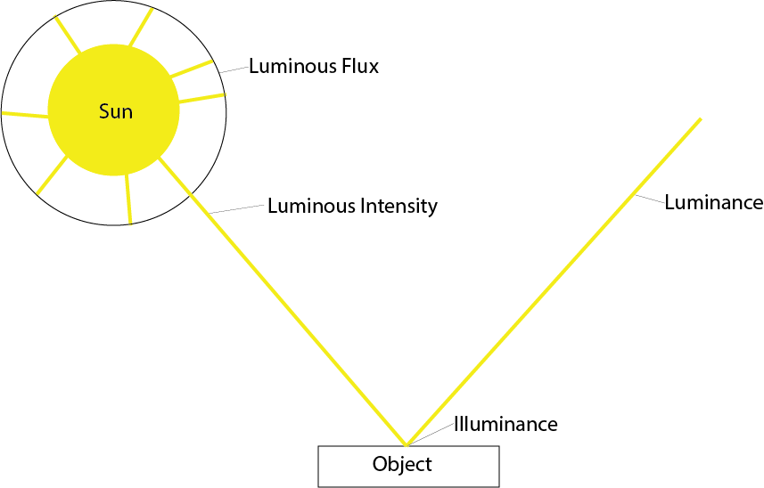
LUMINANCE
Is Luminous Intensity per unit area (candela/m²). It is sometimes called “perceived brightness”, or “surface brightness” of an extended area.
Changing the characteristics of a surface can increase or decrease it’s luminance
Texture
Color
Reflectivity
D Duriscoe April 2011

Slide 25
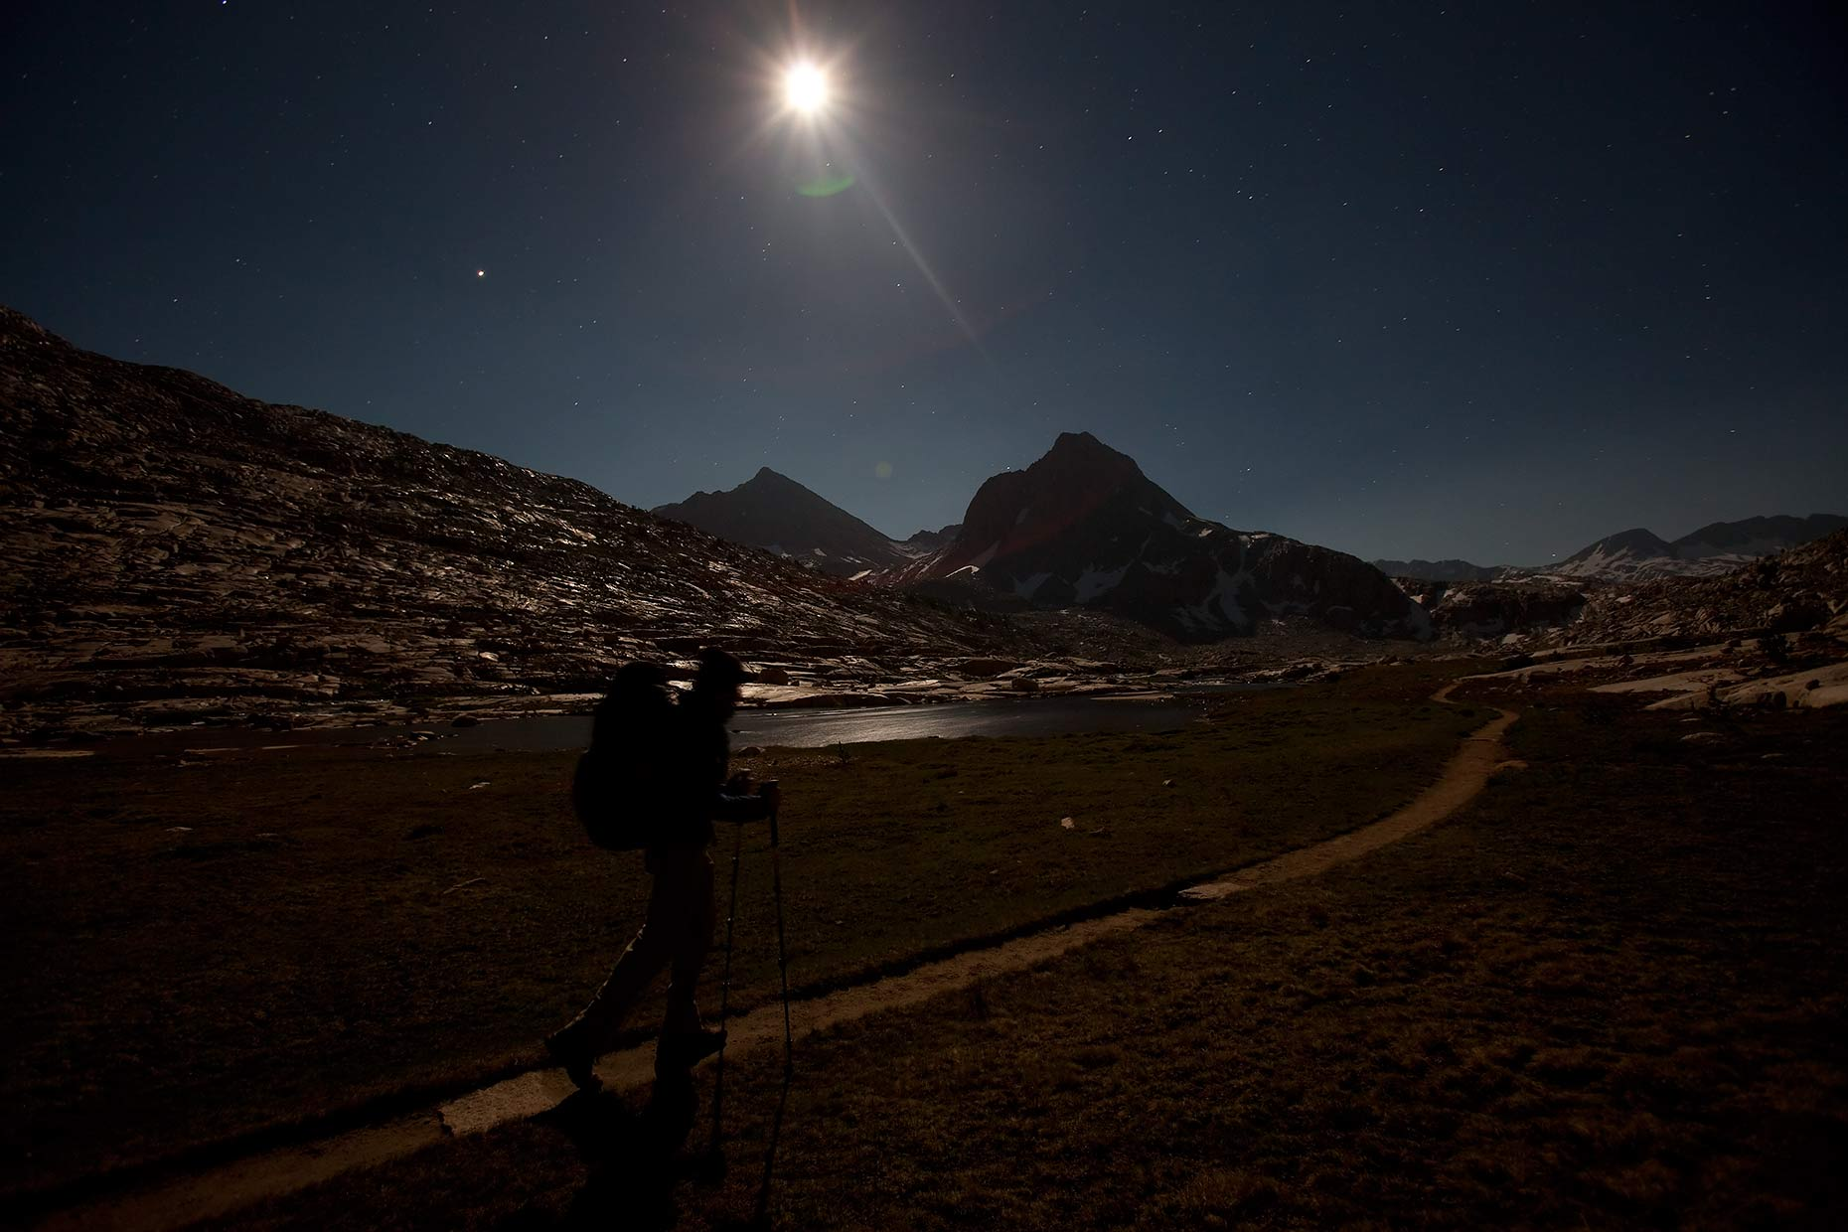
Light in the Natural Night Landscape
Horizontal, Vertical, and Hemispheric Illuminance exists from the night sky, allowing humans to navigate open landscapes. The luminance of the sky background may also be measured in high resolution. The light levels are small, so the units are milli- or 10⁻³ (millicandela/m², millilux).
Full moon
250 mlux
Sky brightness with full moon in sky 20-50 mcd/m²
Landscape by full moonlight
5-10 mcd/m²
D Duriscoe April 2011
Notes:
John Muir Trail Kings Canyon

Slide 26
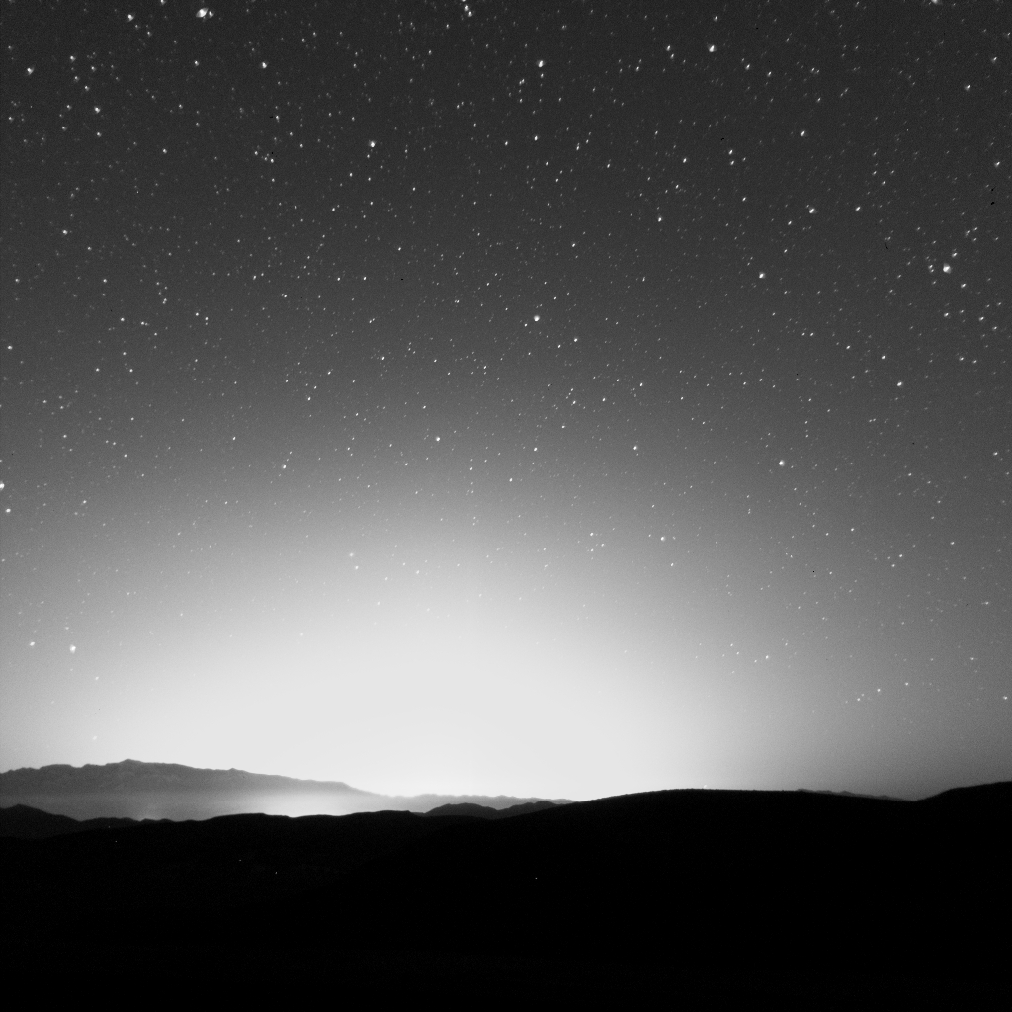
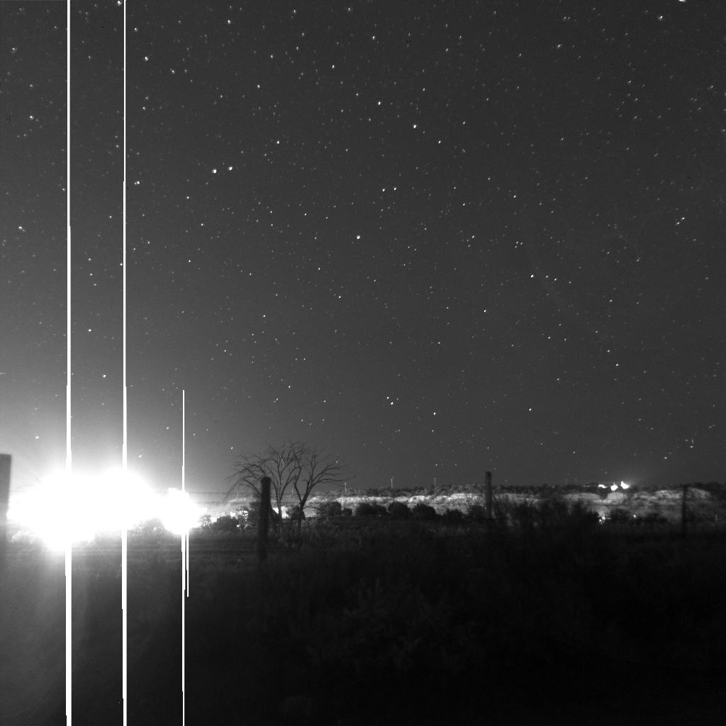
Measurement of Anthropogenic Light in the Landscape
Measuring anthropogenic light involves both illuminance and luminance measures. Often, it is most illustrative to express these values as a ratio to natural conditions. The two most important targets are sky glow and light trespass.
Sky glow (luminance)
Light trespass (illuminance)
Center of bright light dome
Luminance = 10-100 mcd/m²
Unshielded streetlamps
Illuminance = 0.5-50 mlux
D Duriscoe April 2011

Slide 27
Effects of Anthropogenic Light
Aesthetic/Astro-Tourism
Cultural
Ecological
Health
Wilderness

Slide 28
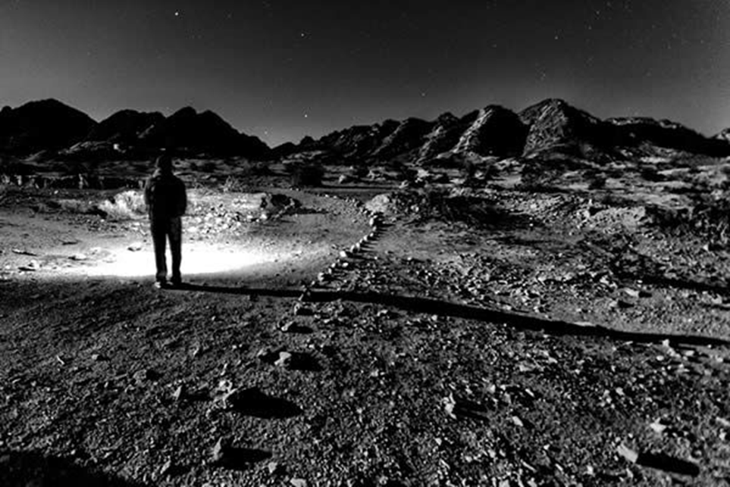
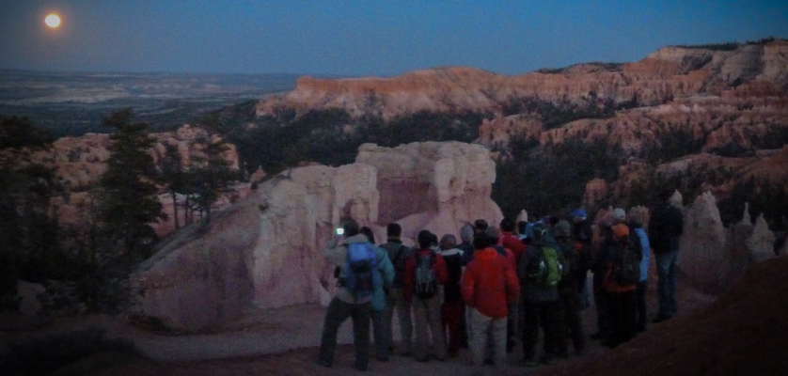
Notes:
As the public loses the view of the night sky in their backyards, they are increasingly seeking it out in parks and protected lands. In many national parks, night time programs such as stargazing and moonlight hikes have become some of the most popular ranger-led activities.

Slide 29
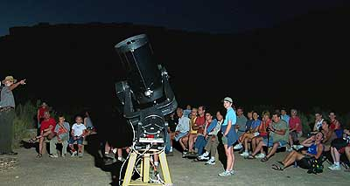
Notes:
As the public loses the view of the night sky in their backyards, they are increasingly seeking it out in parks and protected lands. In many national parks, night time programs such as stargazing and moonlight hikes have become some of the most popular ranger-led activities.

Slide 30
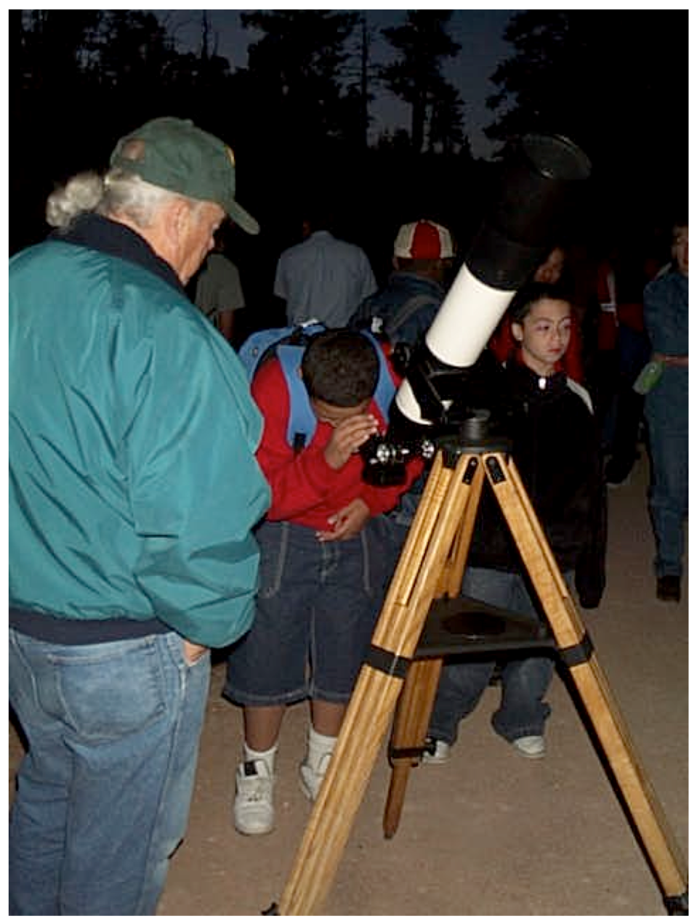
Notes:
As the public loses the view of the night sky in their backyards, they are increasingly seeking it out in parks and protected lands. In many national parks, night time programs such as stargazing and moonlight hikes have become some of the most popular ranger-led activities.

Slide 31
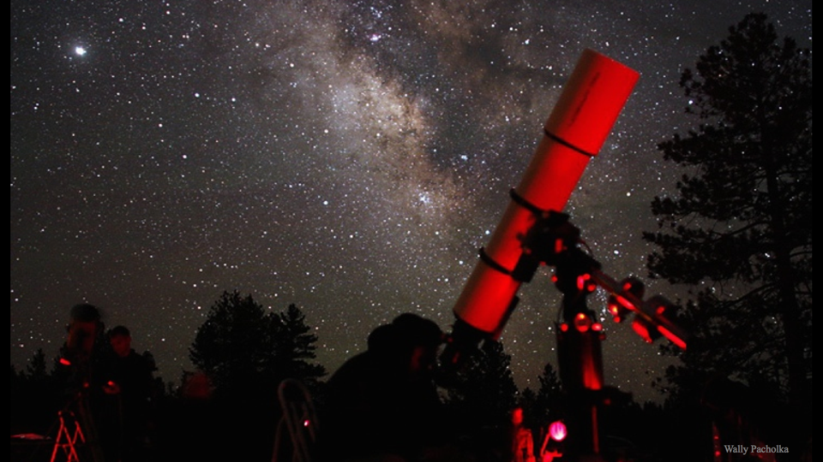
Visitors (Bryce Canyon Astronomy Festival)
Notes:
A visitor survey at two Utah parks revealed that 99% prefer to stargaze in a national park over other locations. 90% believed that there should be places that protect dark skies, 80% thought that the surrounding communities should help support such protection, and only 14% indicated that the quality of night skies were “somewhat unimportant” or “unimportant” to their visit.
Stargazing also has an economic benefit for gateway communities, as attending a stargazing program often turns a drive-thru park visit into additional dinner, breakfast, and lodging revenue for the local economy.

Slide 32
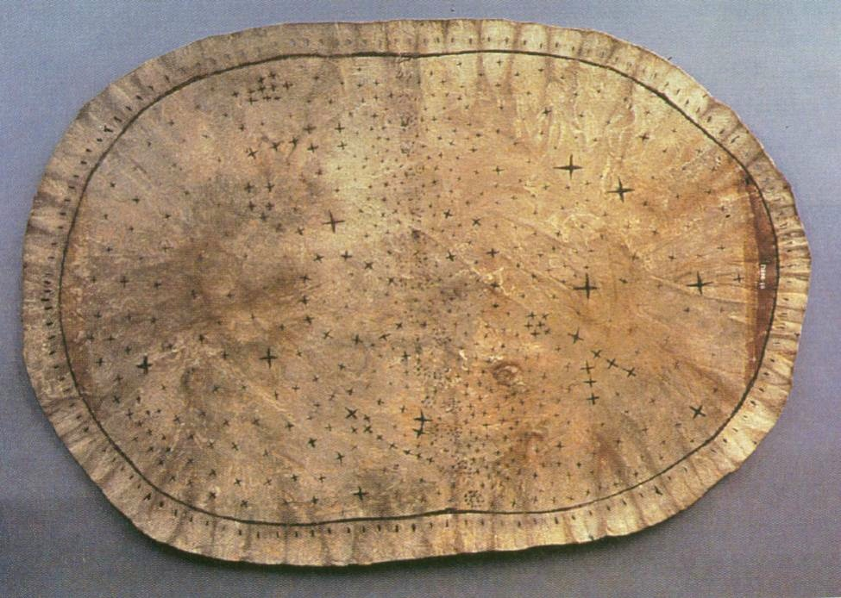
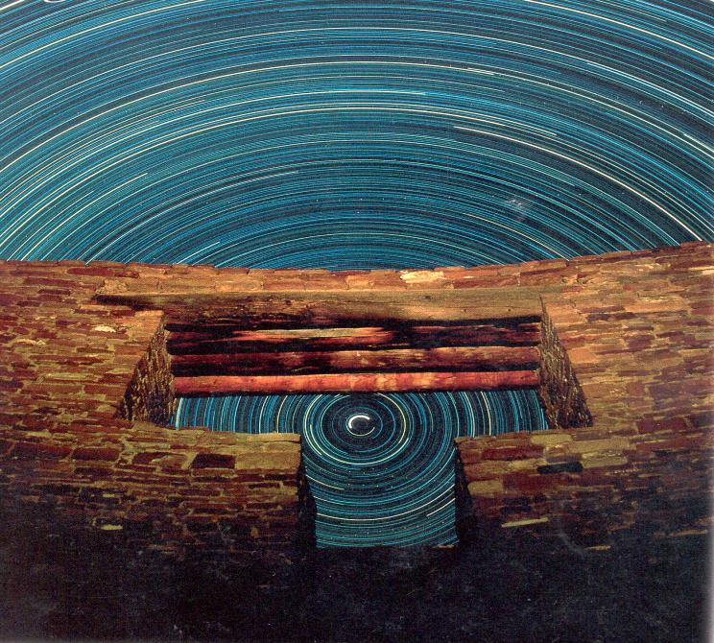
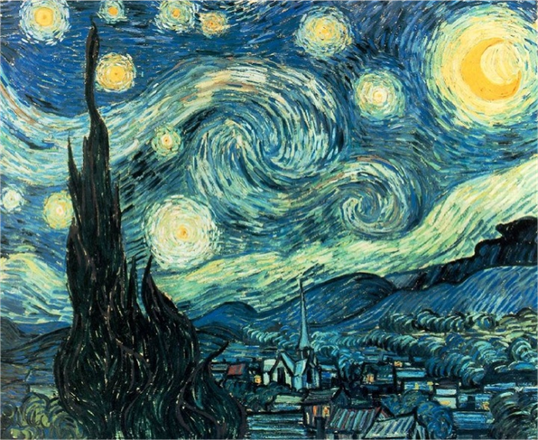
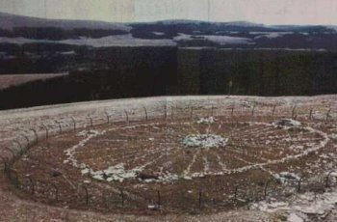
Notes:
Sites such as the pyramids in Egypt, Stone Henge, Angkor Watt, Chichen Itza, and the pueblos of Chaco Canyon are standing testament to our relationship with the stars. We have looked to it for direction and time, studied the motions of the stars and aligned our buildings to it. In this way the night sky connects us with our ancestral past.
The next picture is of a pawnee star chart. Part of the Pawnee creation myth says that Mars, the red morning star warrior, mated with Venus, the female evening star, to produce the first humans. The Pawnee, place cultural and spiritual significance on the Pleiades cluster. The North star was considered to be a chief protecting the stars and the people, which makes sense because the north star is always up and everything else in the sky revolves around it.
Big Horn Medicine Wheel. It has a diameter of 90 feet, with 28 spokes that radiate outward and apparently stand for the number of days in a month. The medicine wheel marks both the rising and setting sun on the summer solstice. Other stones in the arrangement mark the rising of the bright stars Aldebaran, Rigel, and Sirius.
It serves as inspiration for countless works of art, literature, and music.

Slide 33
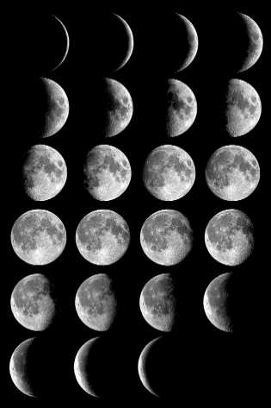
Night Skies: Ecological Consequences
Notes:
And yet, the night sky is more than just a muse for the human race... Since the beginning of life on this planet, there has always been a 28 or 29 day lunar cycle and a 24 hour daily cycle. This natural pattern is ingrained in the DNA of most creatures on Earth. Throughout this time the continents have formed and eroded, the sea level has risen and fallen, even the chemistry of our atmosphere has changed; but we have always had the same light-dark cycle - until the last hundred years.

Slide 34
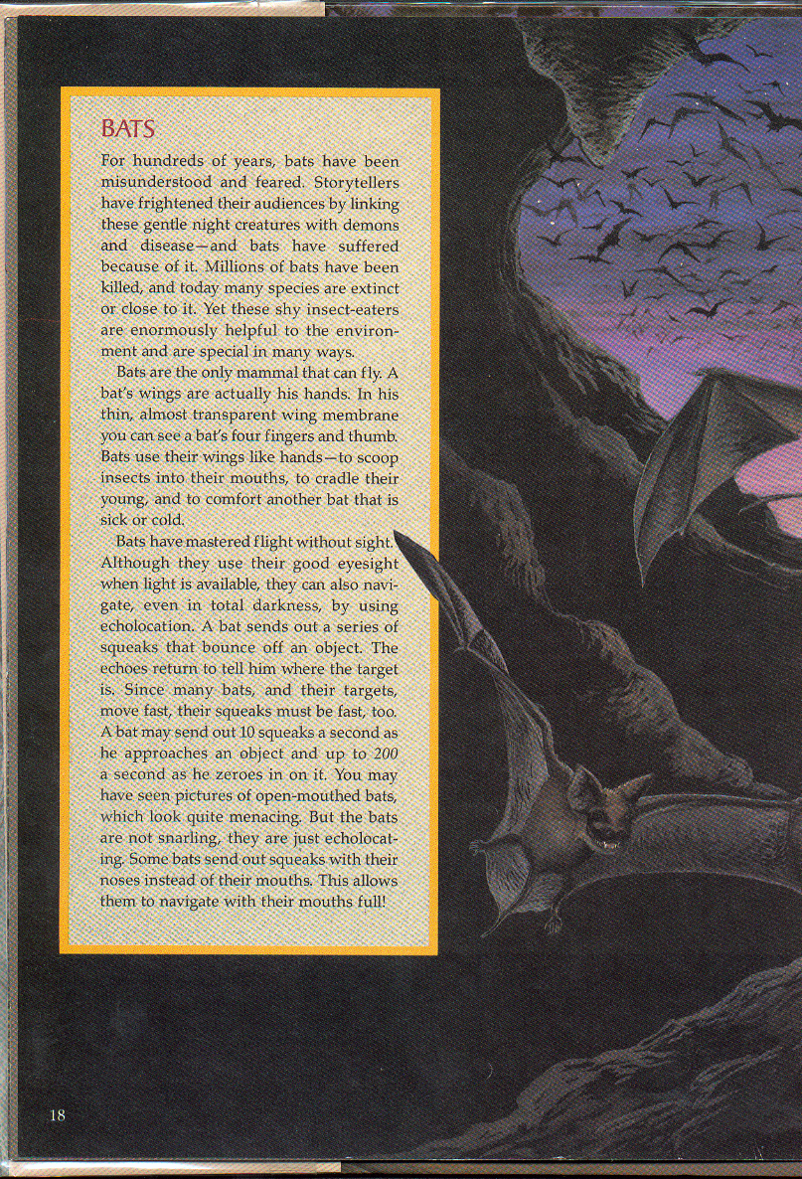
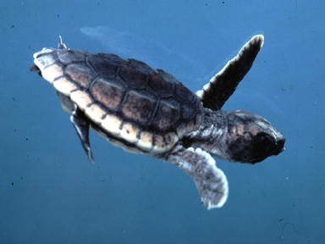
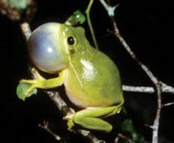
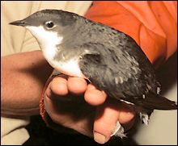
Night Skies: Ecological Consequences
Notes:
Turtle Hatchlings move inland toward lights. Passerine and many small birds migrate at night....
and many amphibians can detect light levels 100x dimmer than what a human can. For many species, we are realizing they in addition to food, shelter, water, and space, they require darkness.

Slide 35
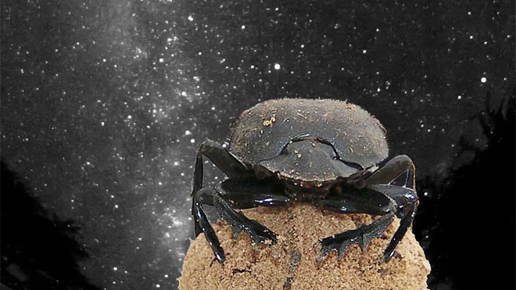
Night Skies: Ecological Consequences
Birds
  Orient using a star as a point source
  Fly relative to that point
  Birds will often circle towers with fixed lights
Insects
  Dung Beatles
  Dance on top of ball of dung
  Difficulty navigating in straight line when views of sky diminished
Notes:
discovered the beetles climb on their dung balls and dance around in circles before taking off. This dance is not one of joy, however; the insects are checking out the sky to get their bearings. Sense the polarization (direction of vibration of light).

Slide 36
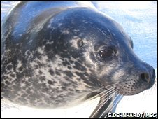
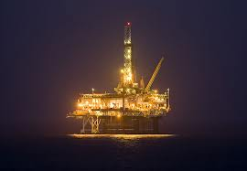
Night Skies: Ecological Consequences
Seals
  “Harbour seals can steer by the stars“, Mauck et al., 2008
  Learn location of feeding grounds relative to stars
Notes:
Sea turtle hatchlings have an inborn tendency to move in the brightest direction. On a natural beach, the brightest direction is most often the open view of the night sky over, and reflected by, the ocean.

Slide 37
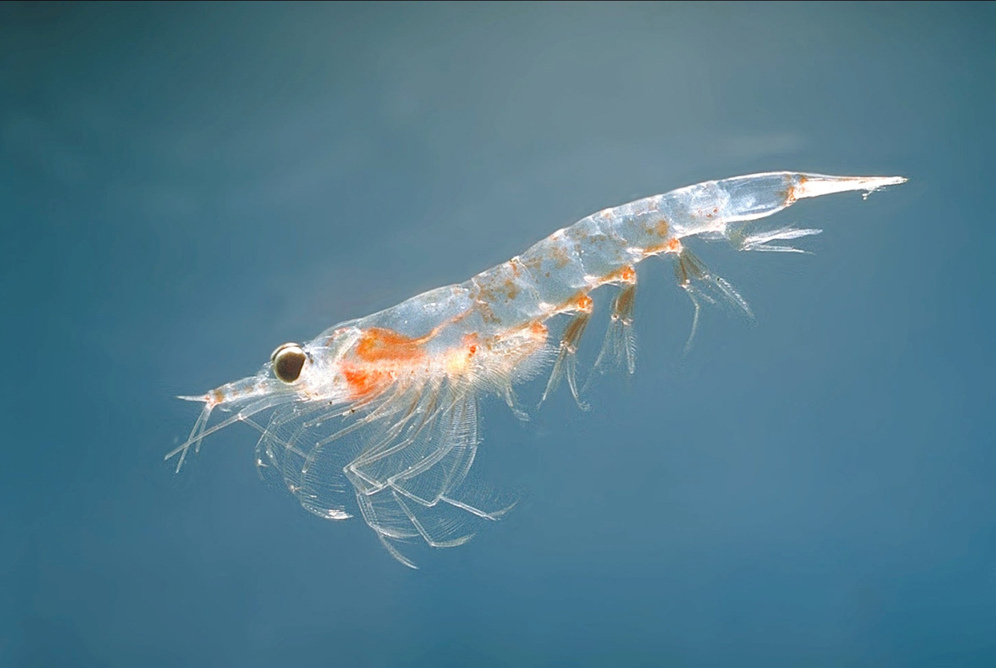
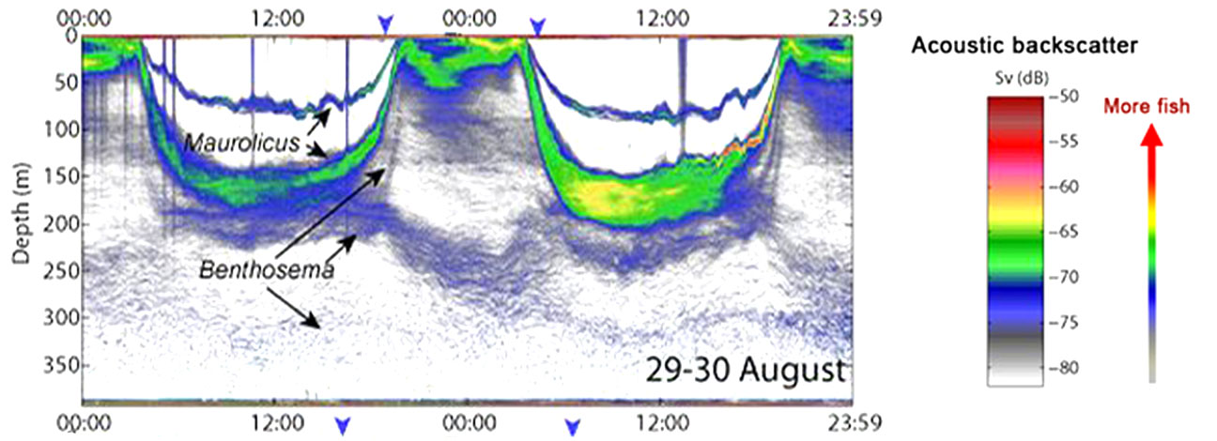
Notes:
The largest migration on earth happens every night.. in the oceans as sea creatures large and small swim upward at dusk and downward at dawn.

Slide 38
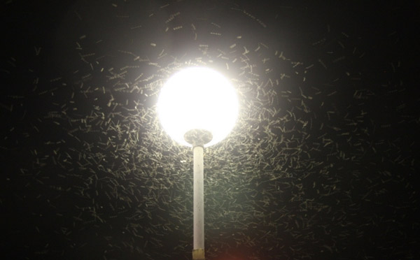
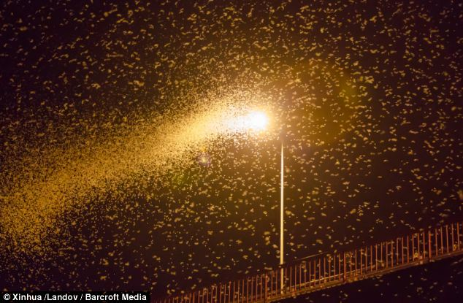
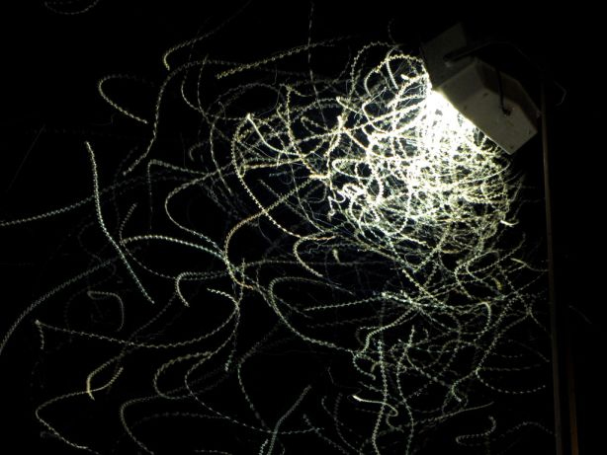
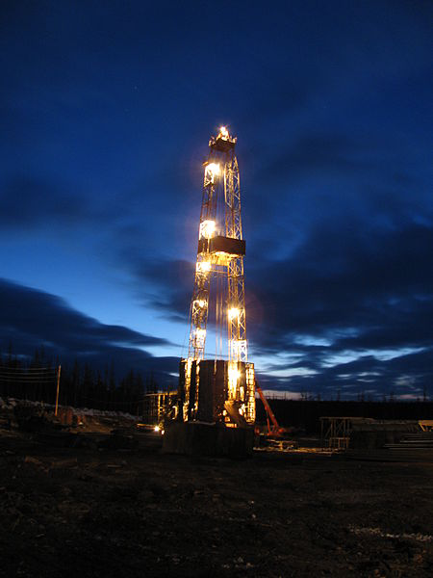
Notes:
There are still many unknowns. For example, the ecological effects of (Explain)light traps on insect populations and distributions are still largely unknown.

Slide 39
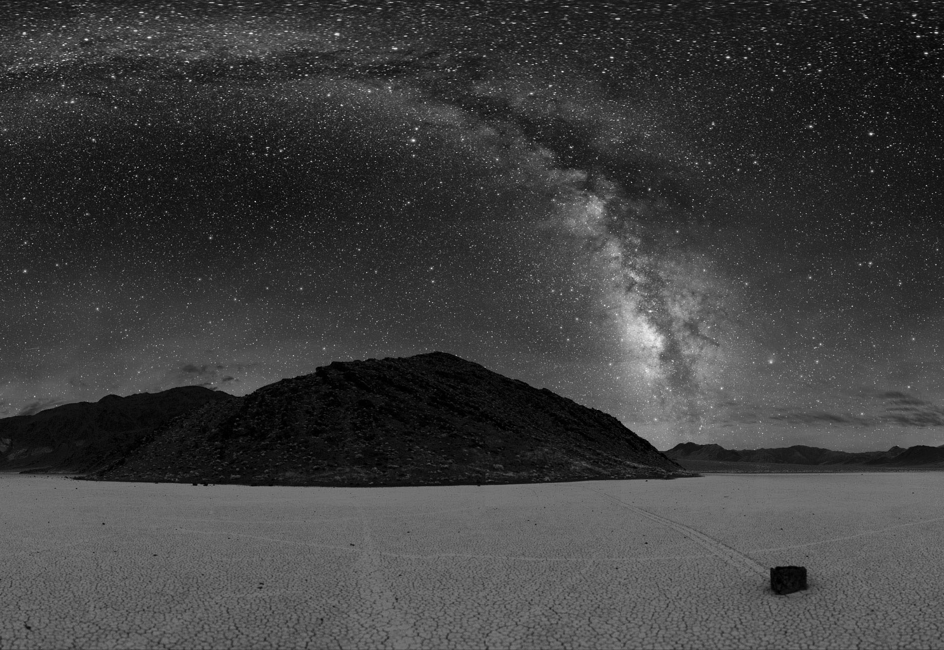
Wilderness
Notes:
Night skies is a key component of wilderness character and values. Wilderness quality can be degraded from light that originates hundreds of miles away. Even a candle at 1 mile would appear about as bright as the stars in the Big Dipper. It is one of the most common human intrusions that a wilderness user is likely to encounter, decreasing their sense of solitude, naturalness. Such vistas are fragile, and any significant artificial light within 20 or 30 miles has the potential to overwhelm the natural features of the night sky and the impression of solitude and grandeur.

Slide 40
Assessing Conditions:
Natural Sources
Anthropogenic Sources
Notes:
In order to effectively protect and manage a resource you need to be able to measure it. Over the years, NPS has pushed the boundaries in developing technology, methodologies, and protocols for measuring the photic environment. Next, I want to discuss how we measure the photic environment including light from both natural and anthropogenic sources.

Slide 41
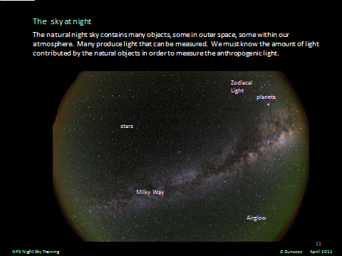
Natural Light in Sky
Starlight
Galactic
Zodiacal
Airglow
NPS Night Sky Training
D Duriscoe April 2011
Notes:
First we’ll discuss light from natural sources. In order to assess the effects of anthropogenic light, we must be able to develop a reference condition by measuring the natural light in the night sky. The natural sources of light include Starlight, Galactic light, Zodiacal light, and Airglow.

Slide 42

Starlight - Astronomical Magnitudes
APPARENT BRIGHTNESS OF SOME ASTRONOMICAL OBJECTS
OBJECT FOOTCANDLES LUX V MAGNITUDE
Venus 0.000014 0.00015 -4.4
Jupiter 3.341 x 10⁻⁶ 3.67 x 10⁻⁵ -2.9
Sirius 9.14 x 10⁻⁷ 9.84 x 10⁻⁶ -1.47
Vega 2.29 x 10⁻⁷ 2.47 x 10⁻⁶ 0.03
Pleiades 6.50 x 10⁻⁸ 7.00 x 10⁻⁷ 1.4
Andromeda Galaxy 1.36 x 10⁻⁸ 1.46 x 10⁻⁷ 3.1
Faintest naked eye stars 3.41 x 10⁻¹⁰ 3.67 x 10⁻⁹ 7.1
Faintest naked eye galaxy 4.10 x 10⁻¹⁰ 4.41 x 10⁻⁹ 6.9
Faintest stars visible in 2.15 x 10⁻¹³ 2.31 x 10⁻¹² 15.1
8” aperture telescope
Faintest objects imaged 9.39 x 10⁻¹⁶ 1.01 x 10⁻¹⁴ 21.0
by CCD in 14” aperture telescope
Faintest objects imaged 1.49 x 10⁻¹⁸ 1.60 x 10⁻¹⁷ 28.0
by ground based observatories
Faintest objects imaged 2.36 x 10⁻¹⁹ 2.54 x 10⁻¹⁸ 30.0
by Hubble Space Telescope
NPS Night Sky Training
D Duriscoe April 2011
Notes:
This chart illustrates the APPARENT BRIGHTNESS OF SOME ASTRONOMICAL OBJECTS . As we can see, starlight is not very bright. Venus, the brightest natural object other than the moon, has a illumination level of 0.00015 lux. Compared to other sources of natural light, starlight contributes little to overall light levels.

Slide 43



Galactic and Zodiacal Light
Notes:
Note MW stretching from 1 o clock to 7 o clock, and Zodiacal Light stretching from 3 to 9 o clock.
The Zodiacal light, sometimes called “false dawn”, is extra-terrestrial in nature, but not very far from earth. It is sunlight reflected off of dust particles in the plane of our solar system, between Mars and Mercury. Near twilight it forms a wedge-shaped band of light at the horizon in the direction of the sun. It is surprisingly bright under dark clear skies.

Slide 44


Airglow
Notes:
Airglow as seen from space, subtle “shell” of light (blue-green from ionized Oxygen)

Slide 45





Model of the 4 major components of the natural sky allows the anthropogenic light at night to be isolated and establish a reference condition
Airglow 48%
Galactic 19%
Zodiacal 28%
Stars 5%
Notes:
Here we have the main components, and the percentage of light that each contributes to the natural night sky. These percentages are averages, all of them vary in brightness.
We can combine these into a model of the natural night sky.

Slide 46

The reference condition – natural darkness
mlx
Horizontal illuminance 0.80
Minimum vertical illuminance 0.38
Average vertical illuminance 0.41
Maximum vertical illuminance 0.43
Scalar illuminance (R = 0) 0.41
Scalar illuminance (R = 0.15) 0.47
Scalar illuminance (R = 0.80) 0.74
Bright planets Venus and Jupiter and of course the moon can increase these values significantly -- we ignore them
Notes:
This model of the natural night sky can be used as a benchmark by which we can assess the condition of any night sky. Later in the webinar we will talk about how we use this model to describe night sky conditions as a ration of the natural condition.

Slide 47

Anthropogenic Sources of Light
Glare Skyglow
Notes:
The next topic is the measurement of anthropogenic sources of light. As we mentioned earlier, the two main sources light trespass are glare and sky glow

Slide 48




DIFFUSER
FILTER
DETECTOR
Measuring Glare
+
Minolta T10 Illuminance Meter
-
Primarily used to measure horizontal illuminance at the task area in outdoor lighting. It may be used to measure large amounts of light trespass if held vertically at the property or lighting zone boundary. It is advertised to read linearly in the range 10 mlux to 299,000 lux
NPS Night Sky Training
D Duriscoe April 2011
Notes:
Less than $1000. Some illumination meters include spectrometers

Slide 49



Measuring Skyglow
Unihedron Sky Quality Meter
Designed to measure night sky brightness near the zenith. Calibrated at the factory to read out in logarithmic (magnitude/arc sec²) luminance units approximating the visual band.
NPS Night Sky Training
D Duriscoe April 2011
Notes:
Under $200 Measures sky brightness near the zenith.

Slide 50



Modern DSLR cameras can be measurement devices
with proper calibration – stars can be used
as well as providing an excellent qualitative record
Notes:
JOTR Coachella Valley Palm Springs. We are working on developing DSLR system, methodologies and protocols

Slide 51



The Charge-Coupled Device (CCD)
Since the 1980s, the charge-coupled device has been the preferred detector for accurate photometry at low light levels.
A CCD Array is essentially a matrix of photodiodes, with associated extra layers of semiconductors to capture, store, and transfer the electrons produced by each pixel’s exposure to light. An array is a digital image, and data from each pixel can be displayed either in grayscale or false color to show pixel-to-pixel variations in light intensity over the full frame of the CCD.
NPS Night Sky Training
D Duriscoe April 2011
Notes:
This is the method that NPS uses to assess night sky quality
By creating a mosaic of 45 images, NPS can assess the entire night sky and show an astonishing level of detail

Slide 52

False Color with Standard Color Ramp
V-magnitudes per square arc-second
Notes:
We can present that data in natural and false color graphics to better demonstrate variations in light levels.

Slide 53

False Color with Standard Color Ramp
V-magnitudes per square arc-second
Notes:
We can present that data in natural and false color graphics to better demonstrate variations in light levels.

Slide 54

Subtraction of Natural Light Sources
Total
Notes:
We measure the total light and subtract the natural sources from the benchmark we developed and that gives us the portion of the light that is from anthropogenic sources.
we can compare the anthropogenic data to our natural sky benchmark to calculate the Anthropogenic Light Ratio

Slide 55

Subtraction of Natural Light Sources
Total
Anthropogenic
Notes:
We measure the total light and subtract the natural sources from the benchmark we developed and that gives us the portion of the light that is from anthropogenic sources.
we can compare the anthropogenic data to our natural sky benchmark to calculate the Anthropogenic Light Ratio

Slide 56






All sky imagery allows calculation of sky quality indicators
Anthropogenic sky luminance (μcd m⁻²)
zenith | average | maximum
Death Valley N.P.
Lake Mead N.R.A
Temple Bar
Bandelier N.M.
6 | 99 | 10,700
54 | 331 | 22,700
108 | 398 | 23,900
Lake Mead N.R.A
Gov’t Wash
Saguaro N.P.
Mt. Hollywood
430 | 1360 | 31,700
853 | 3,170 | 62,800
5370 | 20,100 | 123,000
Notes:
Have measured conditions in 115 units. These figures demonstrate a range of conditions that we have measured. Mt Hollywood near SAMO NRA

Slide 57

Meteor Crater, Arizona
Notes:
We can graphically present the data as the total night levels, the anthropogenic component and the anthropogenic light ratio. This slide shows the measured light levels at Meteor Crater.

Slide 58

Meteor Crater
Arizona
Notes:
Here we have subtracted the natural light to demonstrate the anthropogenic light levels.

Slide 59

Meteor Crater, Arizona
Notes:
Here we have created contours illustrating various levels of the ALR. For example, the brightest areas within the brown contours are 200% brighter than natural conditions. The yellow contours represent the areas that are 60% greater than natural, and areas within the blue contours are 15% brighter than natural conditions.
The median level for the entire sky is 19% above natural.

Slide 60


Other Sites
Mauna Kea, Hawaii, U.S.A.
Notes:
This is data from the summit of Mauna Kea in Hawaii, one of the most pristine night skies in the world.

Slide 61

Mauna Kea, Hawaii, U.S.A.
Notes:
This is the anthropogenic light levels. Obviously there isn’t much anthropogenic light affecting this resource.

Slide 62

Mauna Kea, Hawaii, U.S.A.
Notes:
This image demonstrates the contours. The sky there is nearly pristine and the all-sky median is less than 5%. Exceeds our measurement threshold.

Slide 63

Death Valley National Park, California, U.S.A.
Notes:
It’s important to note that conditions can vary within a park. This is a location in Death Valley called the Harmony Borax Works. That bright spot at 8 oclock is Las Vegas. This site is a little below sea level and there is some terrain shielding. The all sky median is <5% and the brightest area is 771% brighter than natural.

Slide 64

Death Valley National Park, California, U.S.A.
Notes:
This is another point in DEVA called Dante’s View. It’s at a higher elevation less terrain shielding. That’s Las Vegas on Left at 9 o’clock and las Angeles on Right at 5 o’clock.
Here the all sky median is 17% and the brightest areas are 5,300% brighter than natural.

Slide 65

Joshua Tree National Park, California, U.S.A.
BRIGHTEST 1550 %
Notes:
This is Pinto Wells in Joshua Tree with the light domes from Palm springs and LA. The All Sky Median is 12% and the brightest ALR is 1550%

Slide 66

Joshua Tree National Park, California, U.S.A.
BRIGHTEST 6960 %
Notes:
This is from Keye’s view, a popular lookout with sweeping views. It overlooks the Coachella Valley and Palm Springs. As a result, the ASM is 96% above natural and the brightest area is almost 7000% above natural.

Slide 67
Assessing Impacts
Notes:
As the previous slides demonstrate we can accurately measure the condition of the resource and illustrate the data in useful ways. We have also worked on developing methods for measuring and predicting changes in conditions due to actual and proposed changes in lighting conditions.

Slide 68


Notes:
The most straight-forward way to assess changing conditions is to measure before and after the change occurs. This slide shows an increase in light emissions from oil and gas facilities in the Baaken formation from Theodore Roosevelt National Park that occurred from 2010 to 2013. We measured about a 300% increase in overall brightness (all sky). Limited info for “before”.

Slide 69
Modeling Strategy
Direct Glare
• Predicts unidirectional illumination of the landscape
• Affects ability for humans to dark adaptation
• Likely the most significant aspect for wildlife
Skyglow
• Predicts how bright the night sky will appear
• Expressed as a ratio over natural
• Can be translated into functional consequences (# of visible stars, ability to see the Milky Way,
• Both skyglow and glare are important to stargazers / visual quality

Slide 70
Glare Modeling Input
• Geographic locations of light sources
• Key observation point of interest
• Atmospheric conditions
• Lighting (Lumens/Brightness, Direction/Aim)
Simplest of models — uses the Inverse Square Law and spreadsheet to calculate vertical illuminance at a given distance

Slide 71

Skyglow Modeling Input
• Geographic locations of light sources
• Key observation point of interest
• Atmospheric conditions
• Lighting (Lumens/Brightness, Direction/Aim, Color)
Example from BLM Alton Coal Mine, Utah study
Complex modeling — cutting edge science
Notes:
Also mention 5 cities paper

Slide 72

Skyglow Modeling Output
Visual Panorama
Notes:
This is the result of skyglow modeling conducted by Dark Sky Partners completed for Alton Coal Mine EIS. The horizontal axis is the 360 degree horizon; the vertical axis is from the horizon to the zenith. The color ramp illustrates the brightness of the light dome.

Slide 73

Modeling Results
For both glare and skyglow modeling:
• Possible to test different mitigation measures
• Possible to test effects of alternative lighting strategies
• Can be verified by monitoring

Slide 74

A Natural Threshold
• Venus is the brightest natural object in a moonless sky
• Commonly cast shadows in otherwise dark landscape
• Bright enough to reduce dark adaptation
• Peaks at ~0.1 MilliLux after evening twilight
or before morning twilight
← Venus
Notes:
How do you determine whether increased light levels represent an unacceptable impact? One way is to determine an acceptable natural threshold. In the NPS this standard can vary based on the purpose of the park, the existing conditions, sensitive resources in the area, or management objectives. An example of a natural threshold is the natural light level of Venus.

Slide 75
Examples of Thresholds at
Different Distances
Four facilities at 8 km (5 miles) would need to produce less than 0.16 lux at 100 meters in order that the vertical illuminance at observation point ≤ 0.1 millilux
Four facilities at 16 km (10 miles) would need to produce less than 0.64 lux at 100 meters in order that the vertical illuminance at observation point ≤ 0.1 millilux
Four facilities at 32 km (20 miles) would need to produce less than 2.56 lux at 100 meters in order that the vertical illuminance at observation point ≤ 0.1 millilux
Notes:
We can use measurement techniques, mitigations strategies, and our understanding of the effects of light in a management and compliance scenario.

Slide 76
Session 6 - Mitigating Impacts from Anthropogenic Light

Slide 77

Full Sustainability
  • Lighting solutions needs to consider all three realms
  • Informed by science
  • Ecological and visitor enjoyment given similar weight as energy efficiency

Slide 78

Fully Sustainable Lighting
Light only WHERE you need it
Light only WHEN you need it
Direct light downward with SHIELDING
Use an APPROPRIATE SPECTRUM for the task. Use warm-white or amber lighting when possible
Use the MINIMUM BRIGHTNESS necessary
Use the most ENERGY EFFICIENT lamp
Notes:
NPS efforts to determine the effectiveness of different spectra and potential impacts to park resources. Partners

Slide 79


Light only WHERE you need it
Not all areas need to be lit
In some cases overlighting can
make wayfinding less safe by
destroying scotopic vision
Transition zones between
Lit and unlit areas
Encourage use of headlamps
And flashlights when needed
Source: bayphotos.blogspot.com
Notes:
Legacy lighting. Is it necessary?

Slide 80




Light Only WHEN You Need It
Use Lighting Controls Effectively
Motion Sensors
Timers
Dimmers
NPS Night Sky Training
D Duriscoe April 2011
Notes:
This is the method that NPS uses to assess night sky quality
By creating a mosaic of 45 images, NPS can assess the entire night sky and show an astonishing level of detail

Slide 81



Shield light and direct light downward
Notes:
Full cutoff fixtures. Combustion chambers and flare stacks where appropriate. Terrain shielding.

Slide 82
Avoid Blue Tinted Light
Photopic (day vision)
Scotopic (night vision)
Circadian (ganglian)
equal luminous output (lumens)
LPS
HPS
MH
LED
FLED
350 400 450 500 550 600 650 700
Wavelength (nm)
Luginbuhl et al 2013
Notes:
Blue energy in LED doesn’t add much to our vision, buts disturbs circadian rhythm.

Slide 83

Avoid the Blue
Effects of Color on Skyglow
for equal luminous output (lumens)
LED5100K
MH4100K
LED2400K
HPS
LPS/Amber LED
Distance (km)
Notes:
Lights with a lot of energy in the blue end of the spectrum (white LEDs) are scattered more by the atmosphere and cause more skyglow. Also greater adverse effects on humans and wildlife. Color rendition.

Slide 84
Minimum Brightness
Notes:
Minimize the amount of light. Examples of two visitor centers. White façade lighting vs muted fixtures mounted under canopy. Use of low intensity bollards instead of overhead lights on stairs. Painted stairs to increase visibility. Reflective surfaces. Increase contrast. Maintain safety with less light.

Slide 85

Big Bend Lighting Retrofit
Notes:
The results seen from atop Emory Peak in Big Bend speak for themselves.

Slide 86

Notes:
... and in false color showing the significant improvement.

Slide 87
Initial Steps
Alton Coal Mine
RMPs (Vernal, Moab, Farmington, Eastern Colorado)
CHCU

Slide 88

Thank You

