Slide 1
PLANNING FOR RECREATION AND VISITOR SERVICES
Module 1 - Course Overview
WO-250, an introduction!
Manual – Handbook – Strategy
Why benefits?
Planning Cycle
Planning Process and Course Modules
Required Land Use Planning Decisions
Facilitated Breaks

Slide 2
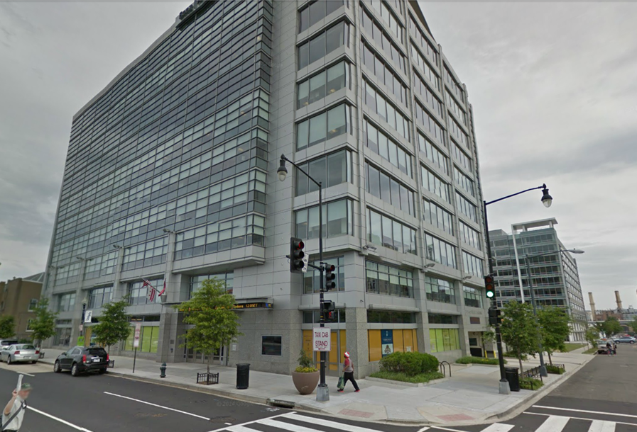
WO-250
Recreation & Visitor Services

Slide 3
Dorothy Morgan
Recreation Planning
LUP review
Legislation
Supplementary Rules
Closure and Restriction Orders

Slide 4
Andy Tenney
Division Chief: WO -250 Recreation and Visitor Services

Slide 5
Scott (Anthony) Feldhausen
Deputy Division Chief

Slide 6
Rob Perrin
Travel and Transportation Management

Slide 7
David Ballenger
National Rec Permit and Fee Program Manager
SRPs, FLREA, Interagency Passes

Slide 8
Dennis Byrd
Rec Data Mgmt
Travel and Transportation Management

Slide 9
John McCarty
Chief Landscape Architect
Visual Resource Management 8400 Manual
Visual Resource mitigation procedures
Use of Color/ Camouflage Concealment of Facilities
Night Skies policy
New activity with Back Country Byways (AZ, WY)

Slide 10
Peggi Brooks
Recreation.gov RUPs Commercial Leases Business Plans

Slide 11
Vacant
Accessibility Coordinator

Slide 12
PLANNING FOR RECREATION AND VISITOR SERVICES
Manual– Handbook – Strategy
How do the all the pieces fit?
?
?
?
?

Slide 13
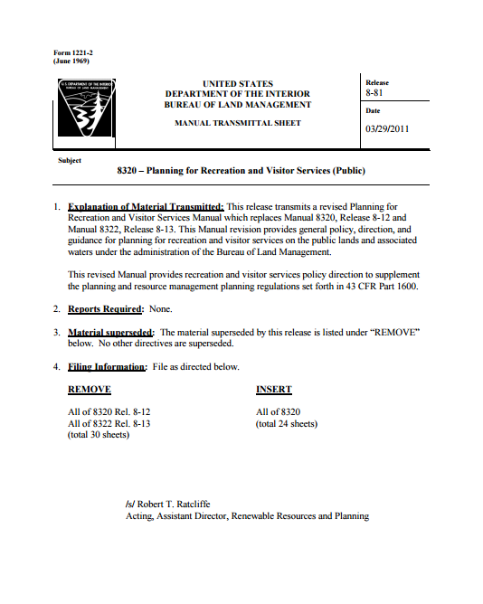
PLANNING FOR RECREATION AND VISITOR SERVICES
Manual - March 2011
(8320 – Planning for Recreation and Visitor Services)
BLM policy
and
program direction.
Notes:
What is the BLM Manual?
The Manual contains BLM policy and program direction.
It provides policy, procedures, and instructions to manage programs.
Each Handbook is controlled by a Manual Section which sets out the basic authority for performing tasks for seeing that these tasks are accomplished.

Slide 14
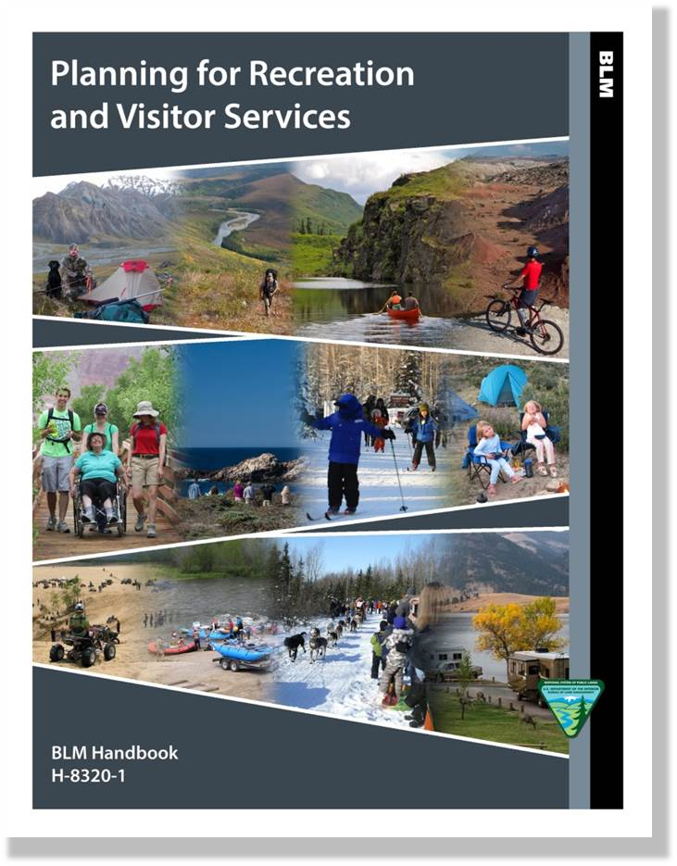
PLANNING FOR RECREATION AND VISITOR SERVICES
Handbook - August 2014
(H-8320-1)
Specific detailed instructions, techniques, procedures, practices,
and processes.
Notes:
What are Handbooks?
Handbooks are considered part of the Manual. They have the same force of authority as the Manual Section.
Source of detailed instructions, techniques, procedures, practices, and processes to carry out policy and direction described in the Manual.
Handbooks do not contain broad objectives, policies, assignment of responsibilities, or delegations needed primarily by line officials and principal staff officials to administer programs.

Slide 15
PLANNING FOR RECREATION AND VISITOR SERVICES
Strategy – May 2014
Repositions…
to focus on producing community
social
and economic
RECREATION BENEFITS!!!
Notes:
The Bureau of Land Management (BLM) has released a national strategy designed to reposition the Recreation and Visitor Services Program to focus on producing community social and economic recreation benefits.

Slide 16
PLANNING FOR RECREATION AND VISITOR SERVICES

Slide 17
PLANNING FOR RECREATION AND VISITOR SERVICES

Slide 18
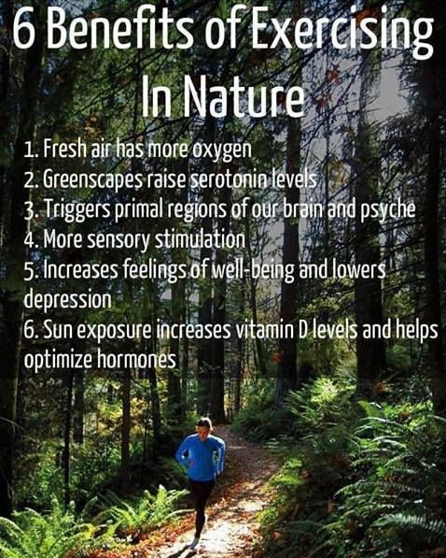
PLANNING FOR RECREATION AND VISITOR SERVICES

Slide 19
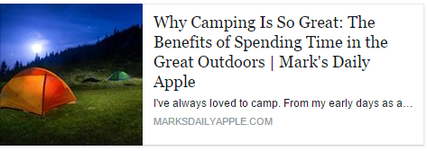
PLANNING FOR RECREATION AND VISITOR SERVICES

Slide 20
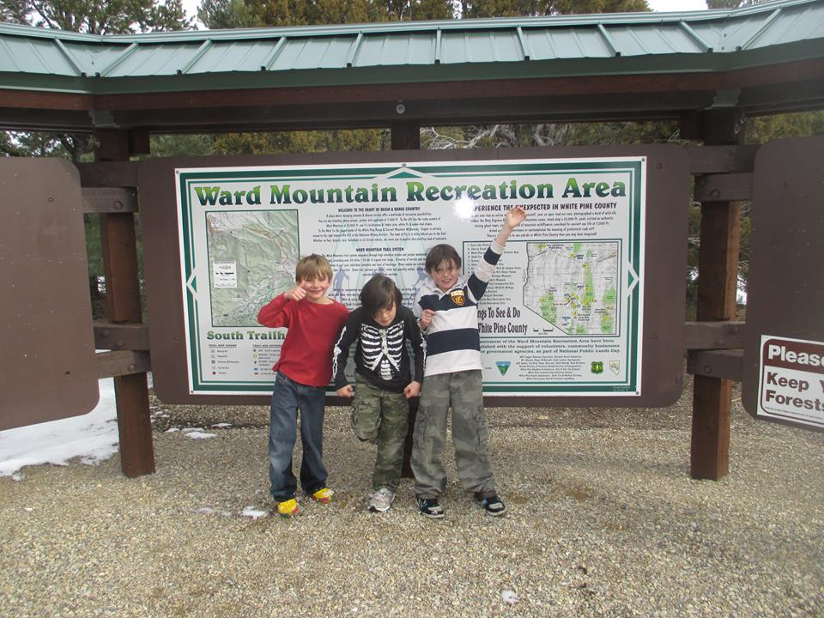
PLANNING FOR RECREATION AND VISITOR SERVICES
Notes:
But why do we as Recreational Professionals spend our time, making sure people can do this? And how do we make sure we’re providing the right opportunities?
It’s an important question to ask. After all, it would be so much easier to tell people to stay home and do this…

Slide 21
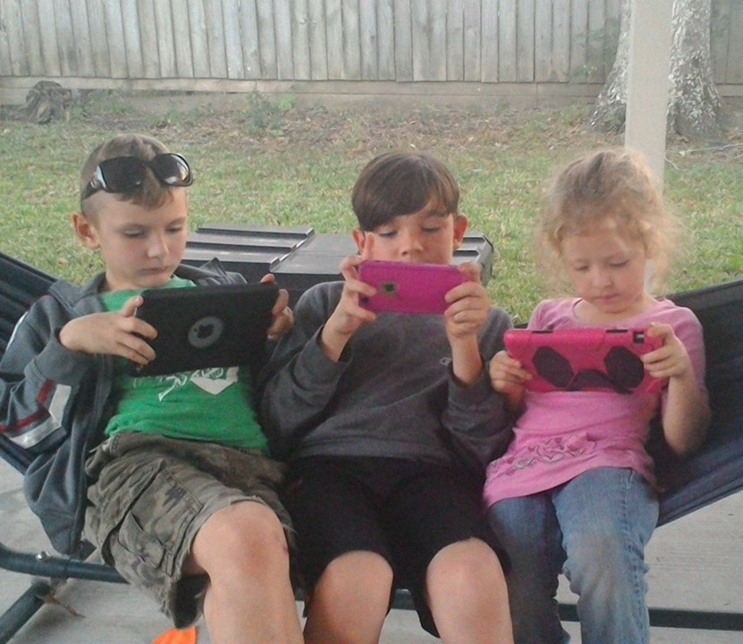
PLANNING FOR RECREATION AND VISITOR SERVICES
Notes:
This course, if nothing else, should challenge you to ask that question. Why? Why do people recreate? What do they want, really want?
What value are we providing to people, to communities and to the environment by providing recreation opportunities?
What do you think the answers are? The public knows!

Slide 22
PLANNING FOR RECREATION AND VISITOR SERVICES
Notes:
The public knows the answer! It’s “activities” right?

Slide 23
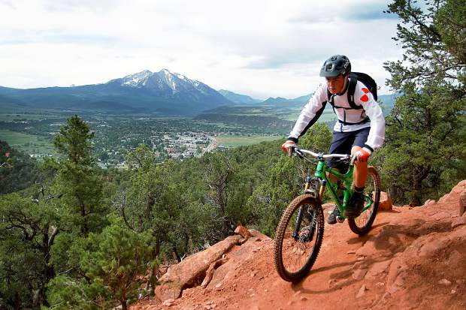
PLANNING FOR RECREATION AND VISITOR SERVICES
Biking
Notes:
But they all give us different answers…

Slide 24
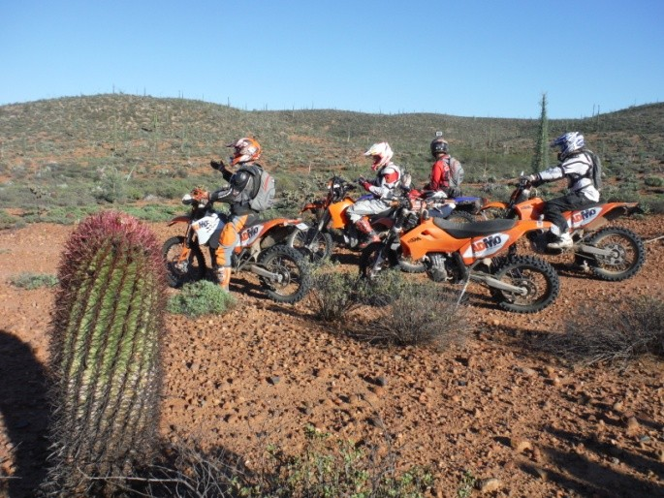
PLANNING FOR RECREATION AND VISITOR SERVICES
Riding

Slide 25
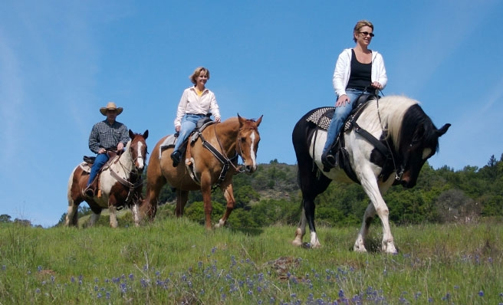
PLANNING FOR RECREATION AND VISITOR SERVICES
Riding

Slide 26
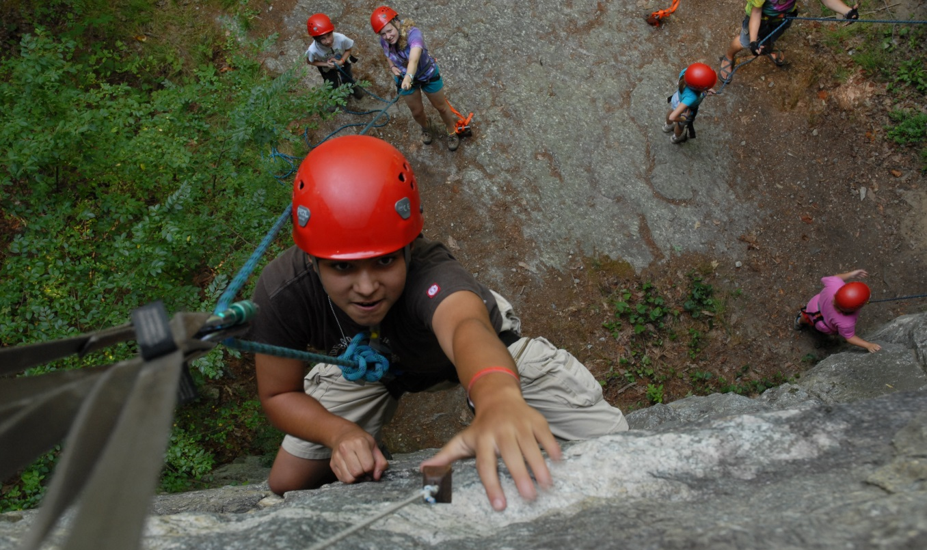
PLANNING FOR RECREATION AND VISITOR SERVICES
Climbing

Slide 27
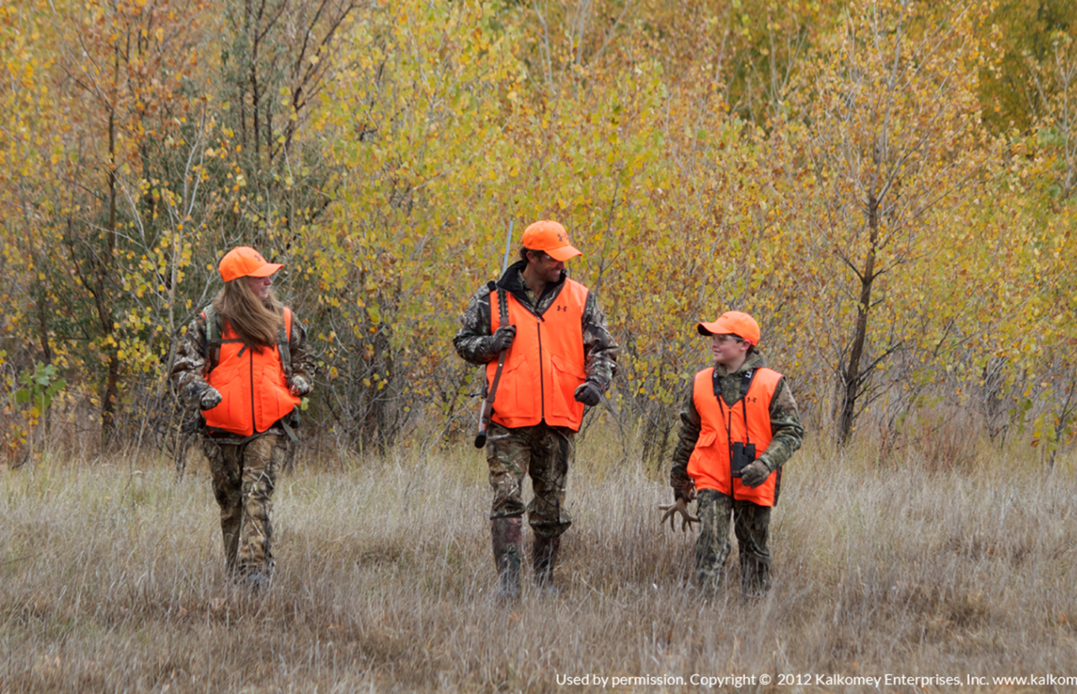
PLANNING FOR RECREATION AND VISITOR SERVICES
Hunting

Slide 28
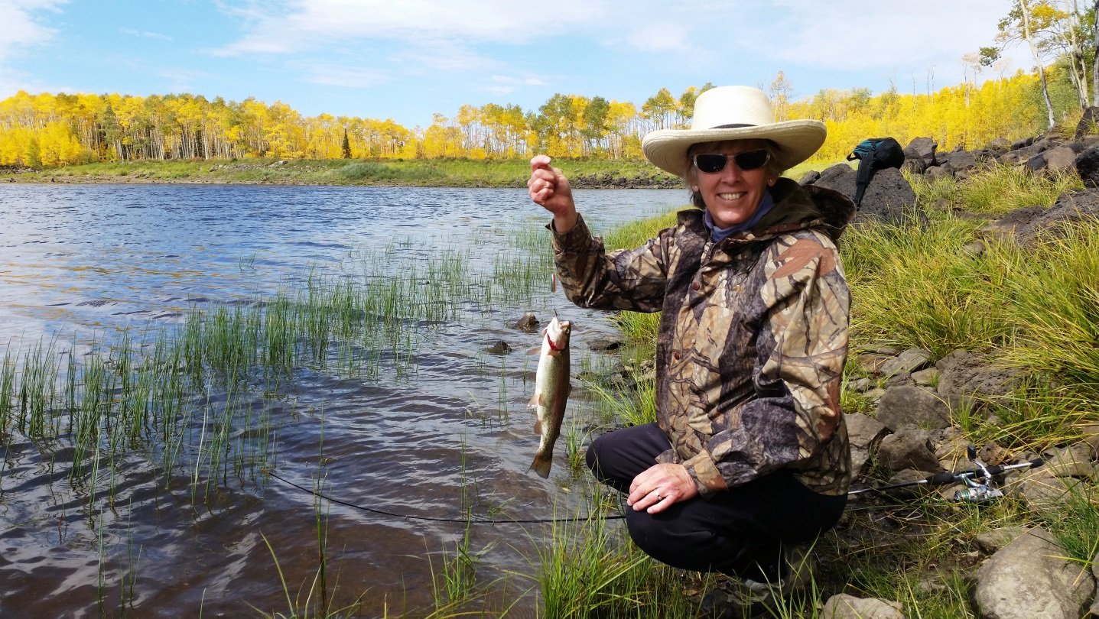
PLANNING FOR RECREATION AND VISITOR SERVICES
Fishing

Slide 29
PLANNING FOR RECREATION AND VISITOR SERVICES
Boating

Slide 30
PLANNING FOR RECREATION AND VISITOR SERVICES
Drinking
Notes:
Or maybe it’s not any of those answers at all…
The public is ready to give you their answers. It’s your job to learn to ask the right questions.
The point is…

Slide 31
PLANNING FOR RECREATION AND VISITOR SERVICES
WE DO!
Notes:
WE care what the question is.
We need to learn to ask the right questions, so we get meaningful answers that help us make informed decisions about how to manage for recreation into the future.
PAUSE

Slide 32
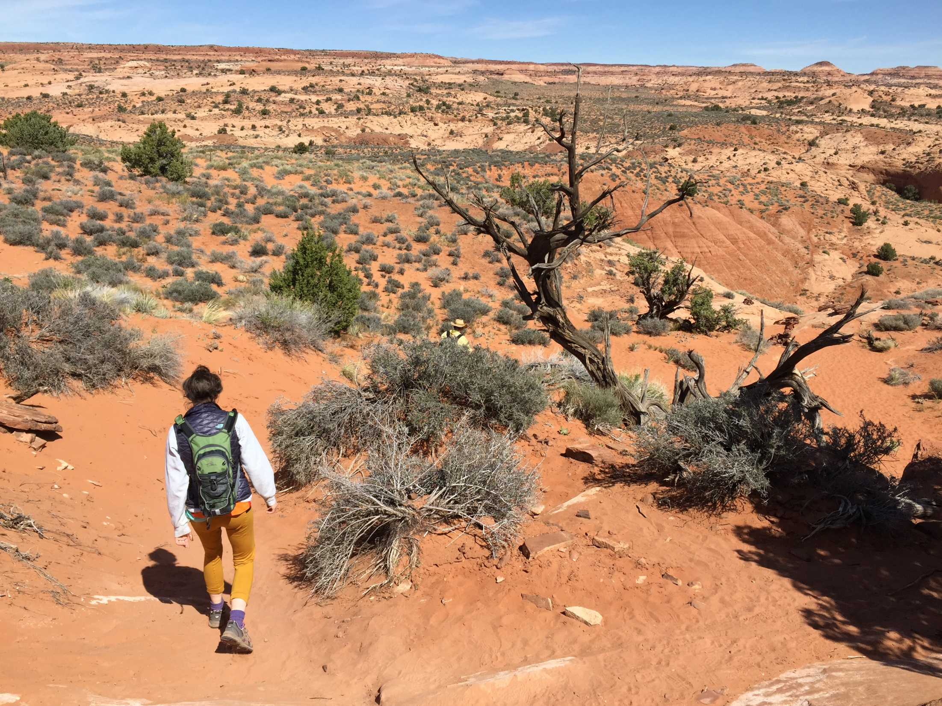
PLANNING FOR RECREATION AND VISITOR SERVICES
Why is course important and relevant to you?
planning background
and experience?
Upcoming Plans?
Notes:
So, let’s talk about the course. Why is it important, and how is it relevant to you?
(Facilitate discussion 5 – 10 min)

Slide 33
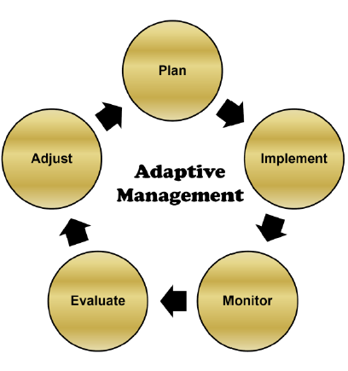
PLANNING FOR RECREATION AND VISITOR SERVICES
The Planning Cycle
.
Committed to achieving the recreation objectives established in the LUP
Flexible in the management approach used to achieve those objectives
Notes:
Recreation planning should be done within an adaptive management framework. This means staying committed to achieving the recreation objectives established in the LUP but being flexible enough in the management approach used to achieve those objectives
The land use planning process is cyclic, allowing for adaptations if monitoring and evaluation indicates that goals and objectives are not being achieved. Adaptations encompass (1) changing recreation implementation actions or practices, (2) revising supporting recreation management actions and allowable use decisions, or (3) fine tuning the desired RSCs. Over the long term, recreation planning within an adaptive management framework means staying committed to achieving the recreation objectives established in the LUP but being flexible enough in the management approach used to achieve those objectives.

Slide 34
PLANNING FOR RECREATION AND VISITOR SERVICES
The Planning Cycle
.
Notes:
We already discussed that we spend most of our time here, in implementation.
But notice this is just one part of the overall cycle.

Slide 35
PLANNING FOR RECREATION AND VISITOR SERVICES
The Planning Cycle
The Focus is on Planning, but also you can also use the procedures in the handbook to monitor, evaluate and adjust throughout the planning cycle.
Notes:
The course content, obviously is going to focus on Planning, but we should also keep in mind, how you can use the procedures in the handbook to monitor, evaluate and adjust throughout your planning cycle.

Slide 36
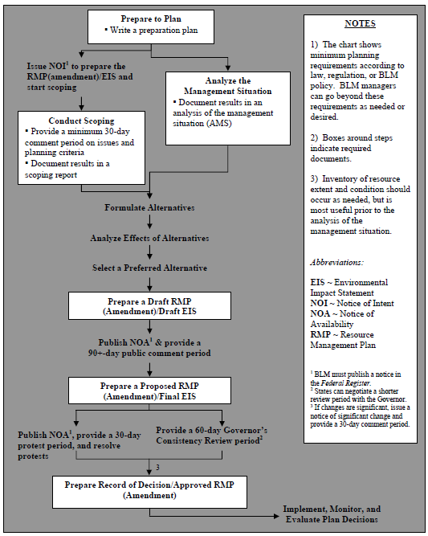
PLANNING FOR RECREATION AND VISITOR SERVICES
LAND USE PLANNING PROCESS
Notes:
Let’s briefly look at the Land Use Planning Process used to develop a Land Use Plan.
This process is also on the wall. It’s important to know where we are in the process as we go though the course, and how the modules (which are sections in the handbook) overlap the planning process.

Slide 37
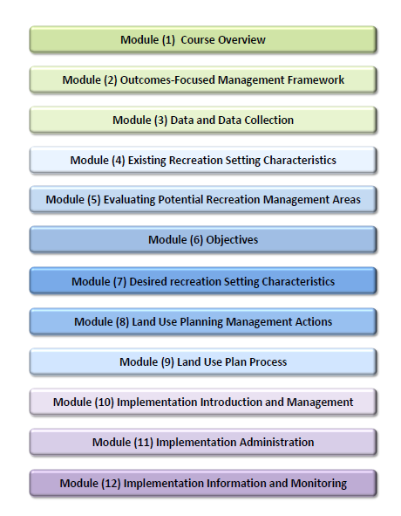
PLANNING FOR RECREATION AND VISITOR SERVICES
Notes:
You’ll notice that your handbook is tabbed by module. We decided early in the course development that we wanted the course to parallel the handbook. We encourage you to make your handbook your own. Make notes, highlight, dog-ear, whatever it takes, so you know where to go when you need more info.

Slide 38
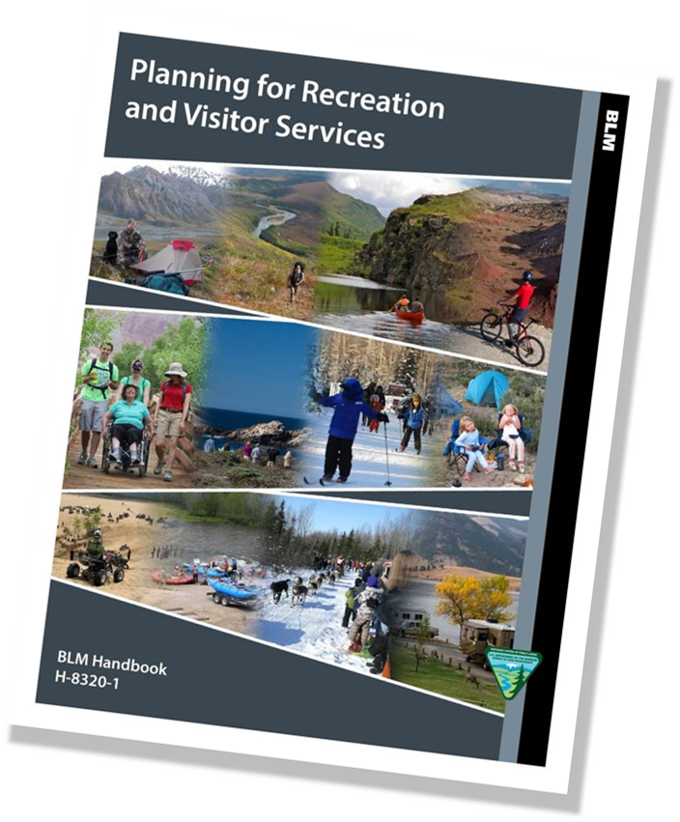
PLANNING FOR RECREATION AND VISITOR SERVICES
Notes:
You can only remember a small percent of the info we cover in this course. My hope is that you learn what you don’t know, and you remember where to go to find it.

Slide 39
PLANNING FOR RECREATION AND VISITOR SERVICES
Required LUP
Decisions
for R&VS
Notes:
There are 3 major LUP requirements for R&VS:
Designate recreation management areas – 2 types, SRMAs, ERMAs
Establish R&VS objectives for each RMA. – There is more to this than you may think, so we’ll be going over this in more detail.
Identify LUP-level management actions and allowable uses for each RMA. - Many decisions related to R&VS are NOT LUP-level decisions, so the trick here will be to separate them from implementation level – but more on that later.

Slide 40
PLANNING FOR RECREATION AND VISITOR SERVICES
Required LUP Decisions
for R&VS:
Designate recreation management areas (RMAs).
Establish R&VS objectives for each RMA.
Identify LUP-level management actions and allowable uses for each RMA.
Notes:
There are 3 major LUP requirements for R&VS:
Designate recreation management areas – 2 types, SRMAs, ERMAs
Establish R&VS objectives for each RMA. – There is more to this than you may think, so we’ll be going over this in more detail.
Identify LUP-level management actions and allowable uses for each RMA. - Many decisions related to R&VS are NOT LUP-level decisions, so the trick here will be to separate them from implementation level – but more on that later.

Slide 41
PLANNING FOR RECREATION AND VISITOR SERVICES
Required LUP Decisions
for R&VS:
Designate Recreation Management Areas (RMAs).
Establish R&VS objectives for each RMA.
Identify LUP-level management actions and allowable uses for each RMA.
Notes:
The first one we’ll talk about is the designation of Recreation Management Areas, or RMAs.

Slide 42
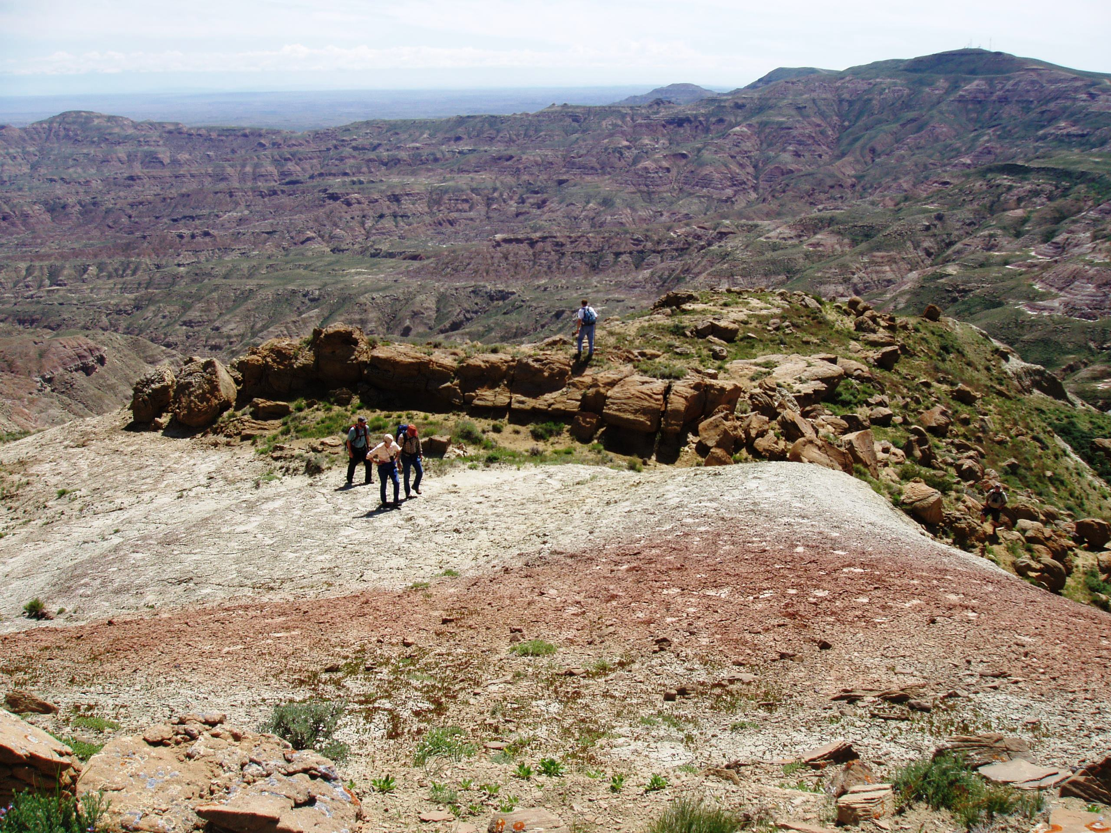
PLANNING FOR RECREATION AND VISITOR SERVICES
The First Required LUP Decision for R&VS:
Designate Recreation Management Areas (RMAs).
Two types:
Special Recreation Management Areas (SRMA)
Extensive Recreation Management Areas (ERMA)
Notes:
RMAs are land units where:
- R&VS objectives are recognized as a primary resource management consideration
- and specific management is required to protect the recreation opportunities.
RMA designation is based on:
recreation demand and issues
recreation setting characteristics
resolving conflicts
compatibility with other resource uses
resource protection needs
There are 2 types. Special Recreation Management Areas (SRMAs) and Extensive Recreation Management Areas (ERMAs)
If you remember the previous recreation policy, it’s important to note that the names are the same, but the definitions have changed!

Slide 43
PLANNING FOR RECREATION AND VISITOR SERVICES
Definitions
ERMAs
Specific management required to address:
Recreation Use
Demand
R&VS investments
SRMAs
Opportunities and recreation Settings are
Unique
Important
Distinctive
Public Lands not Designated
Notes:
SRMAs are administrative designations where the existing or proposed recreation opportunities and recreation setting characteristics (RSCs) are recognized for their unique value, importance and/or distinctiveness, especially as compared to other areas used for recreation.
ERMAs are administrative designations that require specific management consideration in order to address recreation use, demand or R&VS program investments.
One is not better than another. Some FOs won’t have any. Some have many. Do what works for your area.
You also many have lands that do not meet the criteria for RMAs. Those don’t get a designation or a name. We refer to them as undesignated lands or
“Public Lands Not Designated as Recreation Management Areas.”

Slide 44
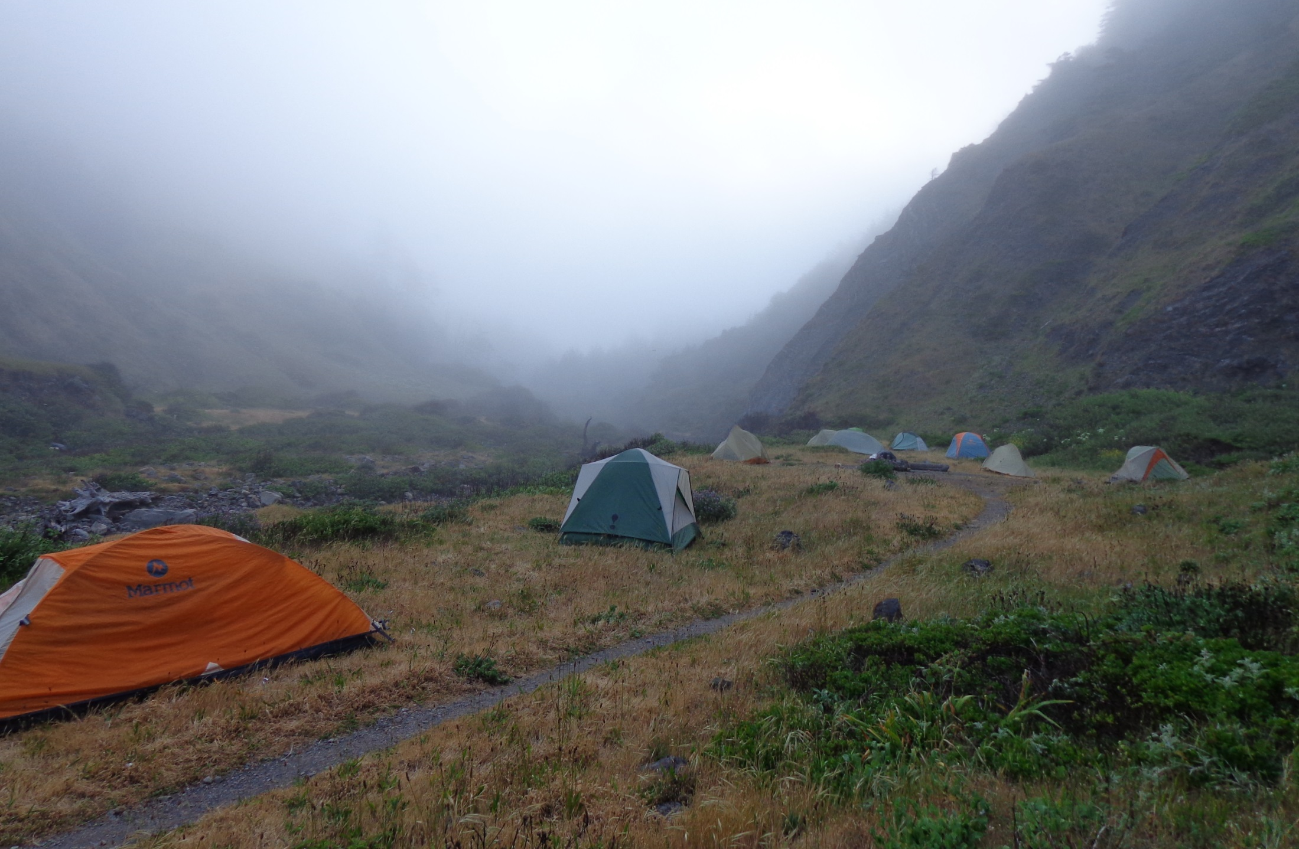
PLANNING FOR RECREATION AND VISITOR SERVICES
Management Focus
SRMAs:
Protect and Enhance:
Activities
Experiences
Benefits
Settings
Keyword: Priority
ERMAs:
Support and Sustain:
Principal Activities
Qualities
Conditions
Keyword: Commensurate
Notes:
Management Focus is different for SRMAs and ERMAs
SRMAs are managed to protect and enhance a
targeted set of activities, experiences, benefits and recreation settings.
R&VS management is recognized as the predominant LUP focus, where specific recreation opportunities and RSCs are managed and protected on a long-term basis.
Recreation may be prioritized among other resources and resources uses.
For example, an SRMA may be closed to leasing ( or subject to NSO stipulations), Closed or limited to motorized use, or be a ROW avoidance area. We’ll look at more examples soon.
ERMAs are different.
They are managed to support and sustain
the principal recreation activities
and the associated qualities and conditions of the ERMA.
Because management of ERMA areas is commensurate with the management of other resources and resource uses, it may not be possible to manage the area in a way that would support and sustain the optimal settings.
What about the undesignated lands? What is the Management Focus there?

Slide 45
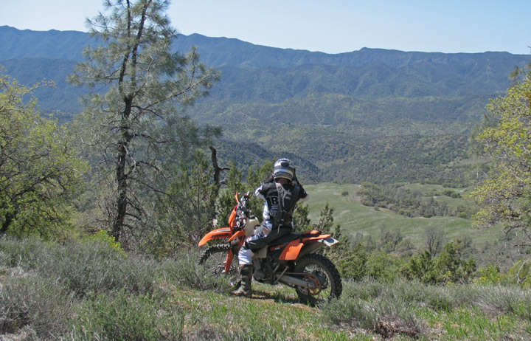
PLANNING FOR RECREATION AND VISITOR SERVICES
Management Focus
Public Lands Not Designated
Address basic R&VS and resource stewardship needs, such as:
(a) Visitor health and safety.
(b) Use and user conflicts.
(c) SRP restrictions
(d) Mitigation of recreation impacts on cultural and natural resources.
Notes:
It’s going to vary, but it’s not Recreation.
On these lands, recreation is not emphasized. They are managed to meet only basic R&VS and resource stewardship needs.
Recreation activities may occur (unless otherwise closed to public use), but managed so that they are not in conflict with the primary uses of these lands.

Slide 46
PLANNING FOR RECREATION AND VISITOR SERVICES
Required LUP Decisions
for R&VS:
Designate recreation management areas (RMAs).
Establish R&VS objectives for each RMA.
Identify LUP-level management actions and allowable uses for each RMA.
Notes:
The second Required LUP Decision for R&VS is to establish Objectives for each RMA.
I’m gong to briefly explain what this means, how they differ for SRMAs and ERMAs and show you some examples.

Slide 47
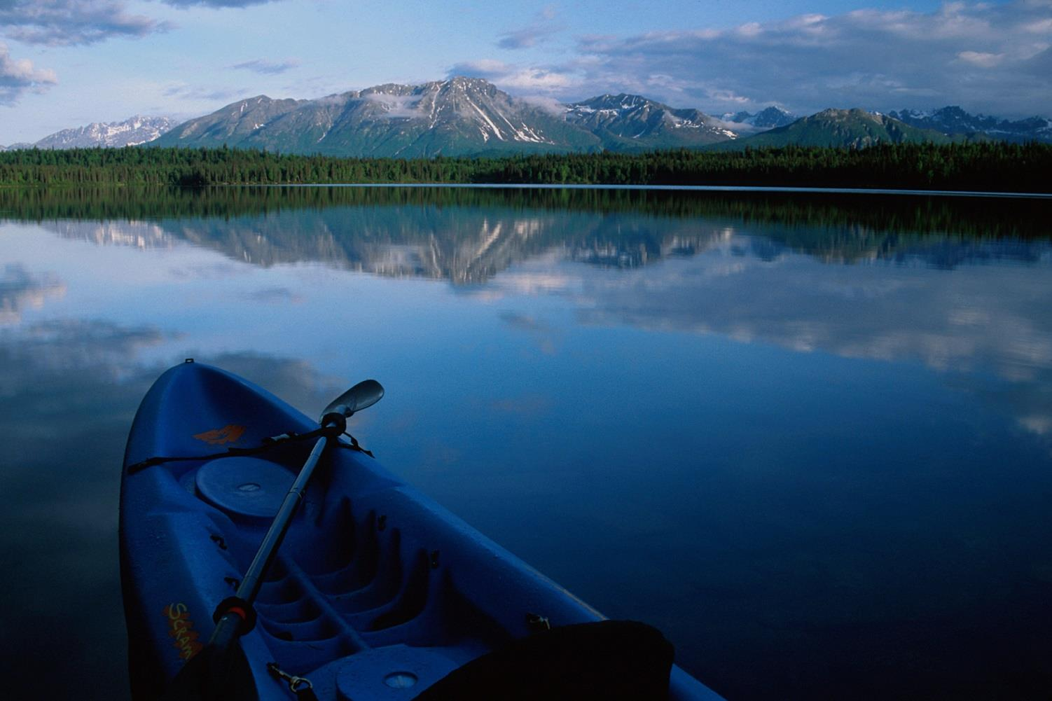
PLANNING FOR RECREATION AND VISITOR SERVICES
Objectives
SRMAs
Measureable Outcome-Focused Objective
which defines:
Activities
Experiences
Benefits
ERMAs
Measurable Objective
Which defines:
Activities
Qualities
Conditions
Notes:
First we’ll look at SRMAs.
SRMAs must have Outcome-focused recreation objectives which identify the
Targeted set of Activities, experiences and benefits.
Linkages between activities, experiences, and benefits should be graphically diagramed to document their relationship. I’ll show you an example in a minute.
ERMA objectives should also be measureable but are not Outcomes Focused.
They do define the recreation activities and associated qualities and conditions
But do not explicitly prescribe outcomes to be targeted
This is because outdoor recreation planners may not be able manage the area's physical, social, and operational components to a degree necessary to facilitate attainment of a targeted set of outcomes. Remember, in ERMAs, recreation is managed commensurately with other resources and resource uses, and recreation opportunities may even be constrained by decisions that benefit other resources.
Before we get to our SRMA example let’s talk about what we mean by outcomes.

Slide 48
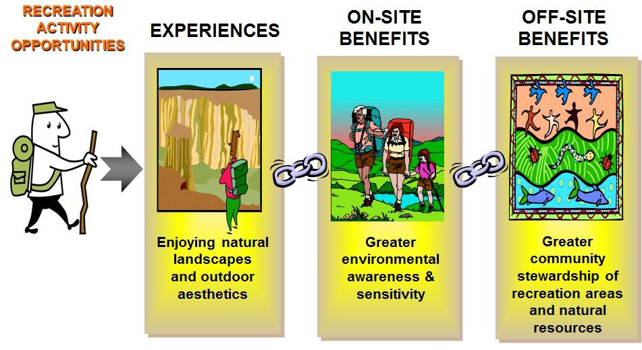
PLANNING FOR RECREATION AND VISITOR SERVICES
Notes:
Onsite and Offsite Benefits of Outcomes-Focused Management.
The fundamental concept of outcomes-focused management is that benefits endure beyond the onsite recreation experience attained by individuals.
Those experiences and onsite benefits stay with the individual when they leave the recreation area and cumulatively lead to offsite beneficial outcomes to communities, economies, and the environment.
This linkage between experiences and outcomes can be viewed as a chain.
For example, the experience of enjoying natural landscapes and outdoor aesthetics can be shown to lead to greater community stewardship of recreation areas and natural resources

Slide 49
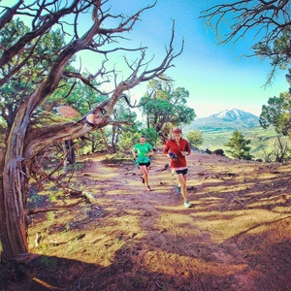
PLANNING FOR RECREATION AND VISITOR SERVICES
SRMA Objectives:
ACTIVITES
EXPERIENCES
and BENEFITS
derived from those experiences!
Notes:
Why are we, as land managers concerned about outcomes?
Recreation is about much more than activities. It’s about human experiences that lead to personal growth, family bonding, better health, environmental stewardship, and much more.
We don’t just manage for activities, but for the experiences and benefits that really make differences in people’s lives.
Appendix 2 of the Handbook has a list of over 100 personal, community, economic and environmental benefits.

Slide 50
PLANNING FOR RECREATION AND VISITOR SERVICES
Required LUP Decisions
for R&VS:
Designate recreation management areas (RMAs).
Establish R&VS objectives for each RMA.
Identify LUP-level management actions and allowable uses for each RMA.
Notes:
Now that we’ve looked at some examples of SRMA and ERMA objectives, we’ll talk about the LUP level
Management Actions and
Allowable Uses for each RMA.

Slide 51
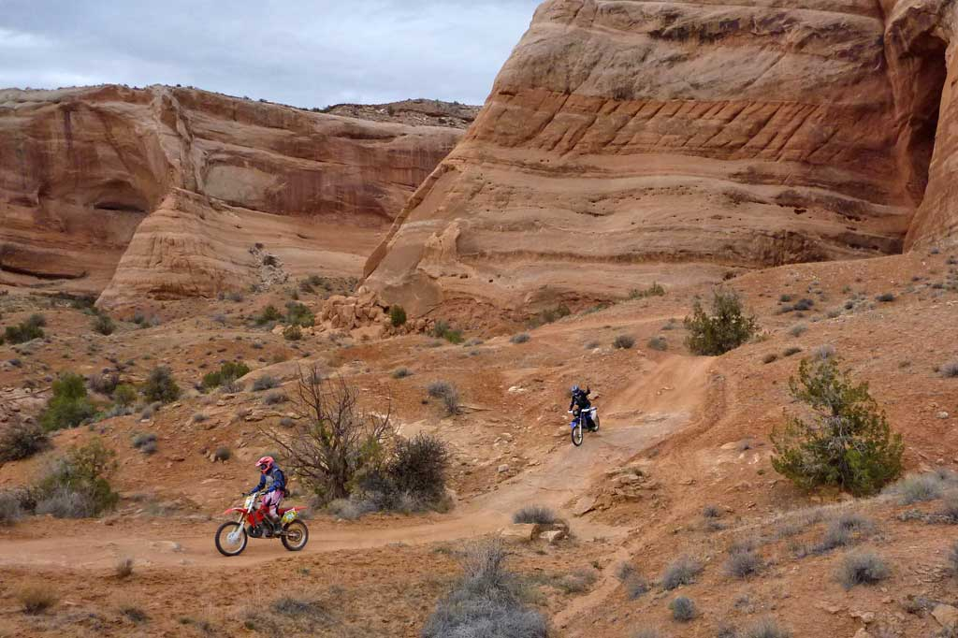
PLANNING FOR RECREATION AND VISITOR SERVICES
LUP Level Decisions
SRMAs and ERMAs
LUP Level:
Management Actions and Allowable Use Decisions
Within R&VS
Within Other Programs
Keyword: LUP Level
Caution!
Avoid making implementation level decisions here!
Notes:
LUP Level decisions are made for both within R&VS and within other programs.
In most cases specific recreational activities not allocated at the LUP level are considered implementation level use decisions (e.g., rope swinging, base jumping, geo-caching, or no dogs).

Slide 52
PLANNING FOR RECREATION AND VISITOR SERVICES
LUP Level Decisions
Within R&VS
• Sustain or enhance recreation objectives.
• Maintain or enhance the desired physical, social, and operational RSCs.
• Constrain uses, including incompatible recreation activities that are detrimental to meeting recreation objectives.
• Address visitor health and safety, resource protection, and use and user conflicts (e.g., areas closed to target shooting, camping limitations).
• Address the type(s), activities, and locations where special recreation permits (SRPs) would or would not be issued.
Notes:
Within the R&VS Program. Within the R&VS program, identify supporting management actions and allowable use decisions to accomplish the following:
• Sustain or enhance recreation objectives.
• Maintain or enhance the desired physical, social, and operational RSCs.
• Constrain uses, including incompatible recreation activities that are detrimental to meeting recreation objectives.
• Address visitor health and safety, resource protection, and use and user conflicts (e.g., areas closed to target shooting, camping limitations).
• Address the type(s), activities, and locations where special recreation permits (SRPs) would or would not be issued.

Slide 53
PLANNING FOR RECREATION AND VISITOR SERVICES
LUP Level Decisions
Within Other Programs
Stipulations on mineral or other development
Designations for all types and modes of travel
Areas available for livestock grazing
Visual resource management classes
Notes:
Within Other Programs. Within other programs, establish terms, conditions, or special considerations necessary to achieve objectives (e.g., stipulations on mineral or other development, designations for all types and modes of travel, areas available for livestock grazing, or visual resource management classes). All actions must conform to applicable program policy, regulations, and valid existing rights.

Slide 54
PLANNING FOR RECREATION AND VISITOR SERVICES
LUP Level Decisions - Undesignated Lands
LUP Decisions to address:
Visitor health and safety.
Use and user conflicts.
The type(s), activities and locations where SRPs would be
issued or not issued.
Mitigation of recreation impacts on cultural and natural
resources.
Caution!
Avoid making implementation level decisions here!
Notes:
Requirements. Management actions and allowable use decisions may still be necessary to address basic R&VS and resource stewardship needs:
Visitor health and safety.
Use and user conflicts.
The type(s), activities and locations where special recreation permits would be issued or not issued.
Mitigation of recreation impacts on cultural and natural resources.

Slide 55
PLANNING FOR RECREATION AND VISITOR SERVICES
implementation decisions
Notes:
The next sections we will discuss is Implementation Decisions.

Slide 56
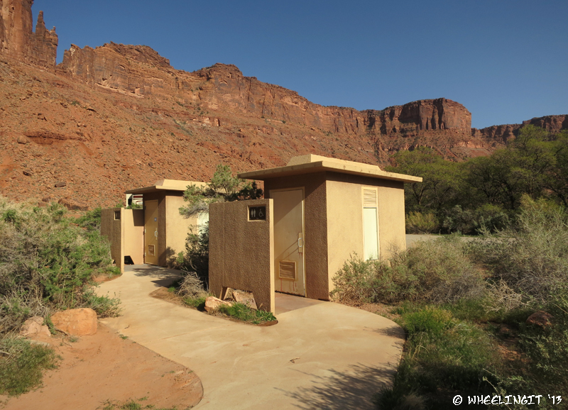
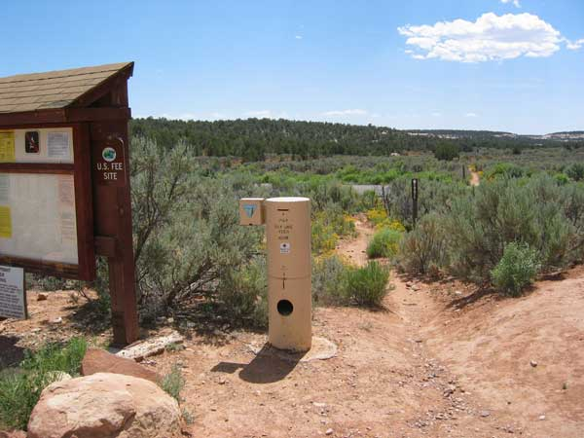
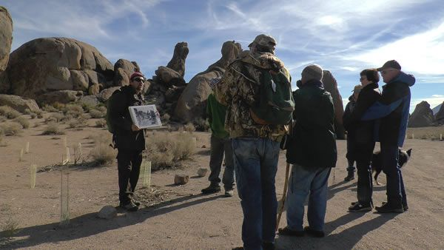
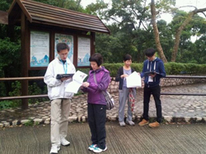
PLANNING FOR RECREATION AND VISITOR SERVICES
Implementation Decisions:
Site specific
Appealable
Management
Administration
Information and Education
Monitoring
Notes:
There are four categories of Implementation Decisions
Management
Administration
Information and Education
Monitoring
Site Specific
2) Appealable to IBLA under 43 CFR 4.410
LUP Decision - protest
The BLM may use a single land use planning/NEPA process to make both land use plan and implementation decisions, provided both types of decisions are adequately addressed with the appropriate level of NEPA analysis.
Where implementation decisions are made as part of the land use planning process, they are still subject to the appeals process or other administrative review as prescribed by the specific resource program regulations after the BLM resolves the protests to land use plan decisions and makes a decision to adopt or amend the RMP.
The proposed plan /final EIS should display land use plan and implementation decisions (and clearly distinguish between the two types of decisions).
Implementation decisions are changed through an interdisciplinary NEPA process in conjunction with the BLM resource program-specific guidance.

Slide 57
PLANNING FOR RECREATION AND VISITOR SERVICES
Implementation Decisions: Management
Commitment of resources
Services
Facilities
Developed sites
Roads and trails
Notes:
Management. Recreation management actions, such as commitment of resources, services to be offered to visitors, and/or the development and provision of facilities (e.g. developed recreation sites, roads and trails).

Slide 58
PLANNING FOR RECREATION AND VISITOR SERVICES
Implementation Decisions: Administration
Regulatory actions including:
Allocation systems
Permits
Fees
Use restrictions
Partnership agreements
Business plans
Fiscal accountability systems
Data management protocols
Notes:
Administration includes regulatory actions including:
Allocation systems
Permits
Fees
Use restrictions
Partnership agreements
Business plans
Fiscal accountability systems
Data management protocols

Slide 59
PLANNING FOR RECREATION AND VISITOR SERVICES
Implementation Decisions: Information and Education
Maps or brochures
Websites
Outreach efforts
Events
Interpretation
Environmental education
Signing
Notes:
Information and Education includes:
Maps or brochures
Websites
Outreach efforts
Events
Interpretation
Environmental education
Signing

Slide 60
PLANNING FOR RECREATION AND VISITOR SERVICES
Implementation Decisions: Monitoring
- Visitor use and use patterns
- Recreation caused resource impacts
- Visitor satisfaction
- Effectiveness or attainment of:
- Outcomes-focused objectives
- Recreation setting characteristics
- Standards and indicators.
Notes:
Monitoring includes:
- Visitor use and use patterns
- Recreation caused resource impacts
- Visitor satisfaction
Monitoring may measure the effectiveness or attainment of:
- Outcomes-focused objectives
- Recreation setting characteristics
- Standards and indicators.

Slide 61
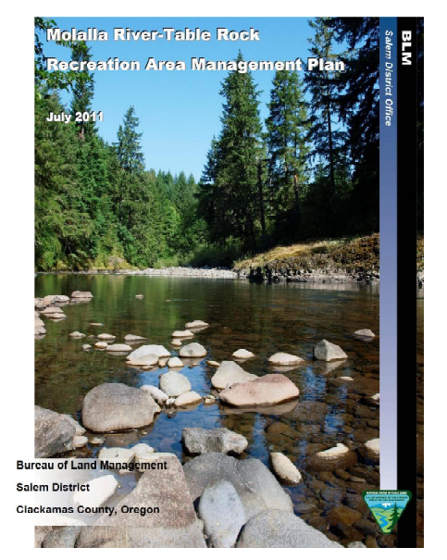
PLANNING FOR RECREATION AND VISITOR SERVICES
Recreation Area Management Plans
Implementation-level:
Management
Administration
Information/Education
Monitoring
Notes:
If Implementation decisions don’t go in the LUP, where do they go?
Recreation management areas with complex implementation issues may require a subsequent plan that addresses implementation-level management, administration, information/education/marketing and monitoring actions.

Slide 62
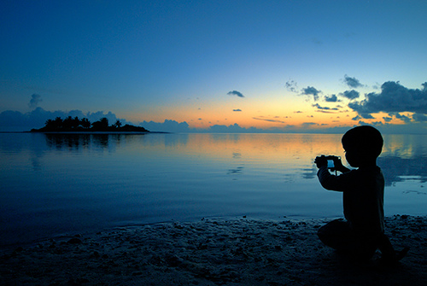
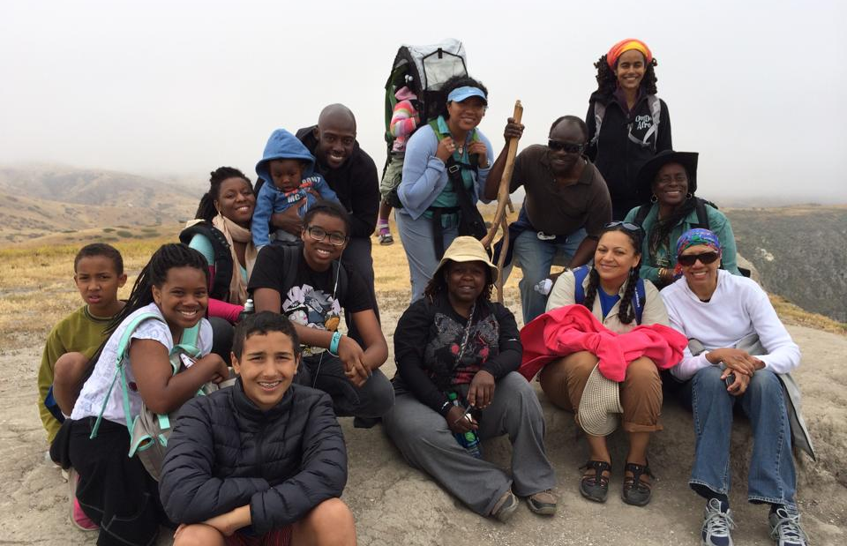
PLANNING FOR RECREATION AND VISITOR SERVICES
Summary and Questions
1. Required LUP decisions for R&VS
2. implementation decisions
Notes:
Summary and other topics not addressed:
Visitor Assessment being submitted for approval by OMB.

Slide 63
PLANNING FOR RECREATION AND VISITOR SERVICES

Slide 64
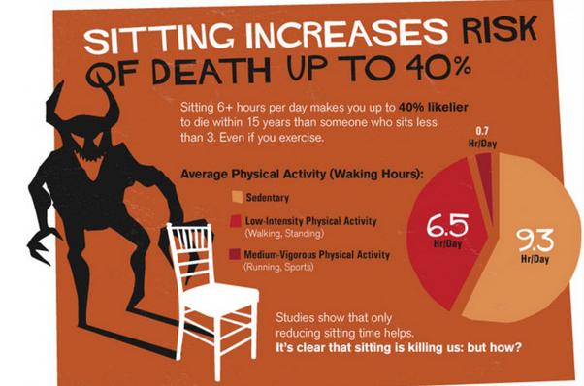
PLANNING FOR RECREATION AND VISITOR SERVICES

Slide 65
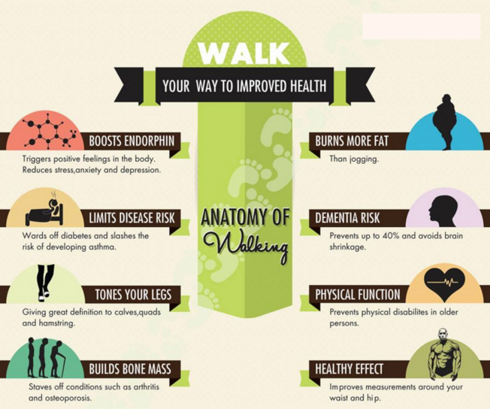
PLANNING FOR RECREATION AND VISITOR SERVICES

Slide 66
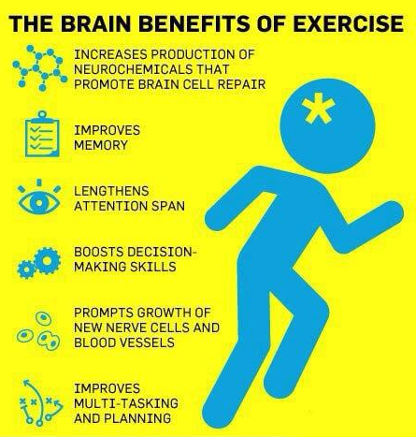
PLANNING FOR RECREATION AND VISITOR SERVICES

Slide 67
PLANNING FOR RECREATION AND VISITOR SERVICES

Slide 68
PLANNING FOR RECREATION AND VISITOR SERVICES
Up to $20 in prizes!!!

Slide 69
PLANNING FOR RECREATION AND VISITOR SERVICES
Facilitated Break Rules
Walk the mapped route.
Find the answer to the question
Do not share your answers! (that’s cheating)
Return to classroom ON TIME with answer.

Slide 70
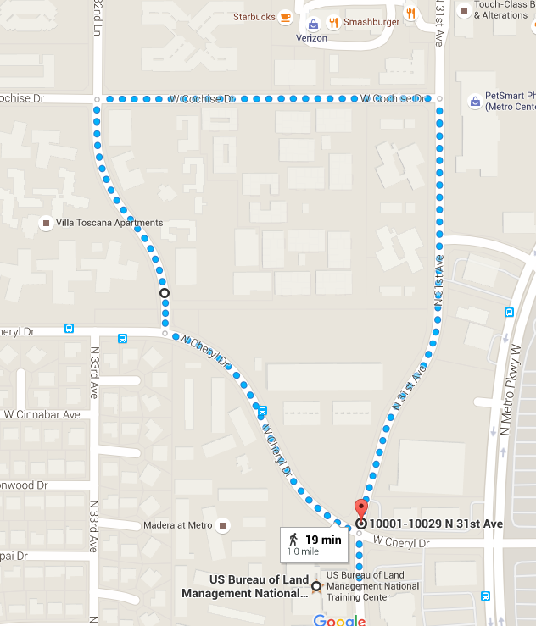
Walk this 1-mile loop.
Answer this question:
What matters?

Slide 71
PLANNING FOR RECREATION AND VISITOR SERVICES
END

Slide 72
PLANNING FOR RECREATION AND VISITOR SERVICES
Movement – natural, functional patterns
Stress – viewing natural scenery, spending time with family, out of busy routine
Sleep – resetting circadian rhythms, natural light, low blue light
Food – cooking, time with friends and family
Sun – Vitamin D and other benefits
Social interactions – benefits of community
Soil – micro biome
Grounding – benefits of contact with ground, walking barefoot

