Slide 1
PLANNING FOR RECREATION AND VISITOR SERVICES
Module 2
MANUALS AND HANDBOOKS
THE PLANNING CYCLE
BLM’S LAND USE PLANNING PROCESS
LUP-LEVEL RECREATION & VISITOR SERVICES (R&VS) DECISIONS
IMPLEMENTATION DECISIONS
Based on
Handbook Section III
and
Appendix 1- Land Use Planning Checklist for R&VS

Slide 2
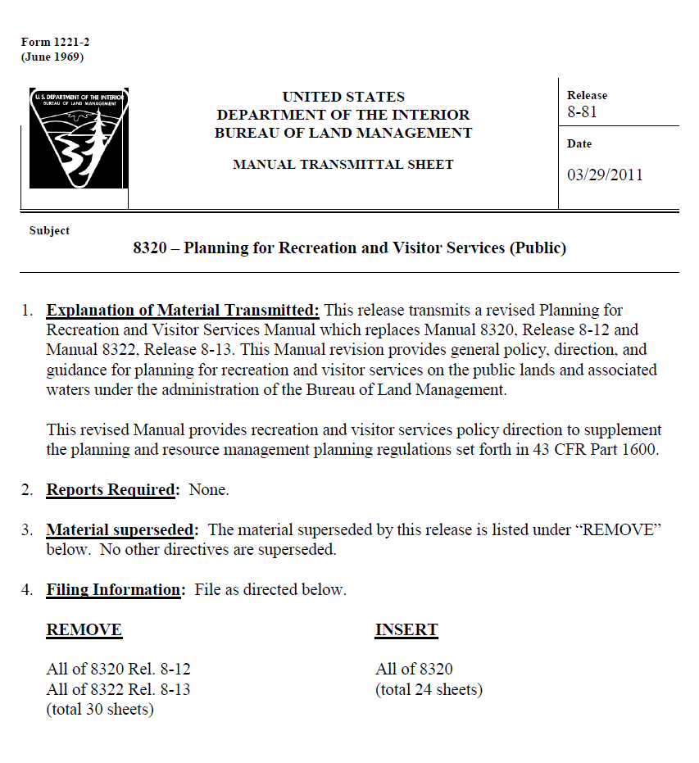
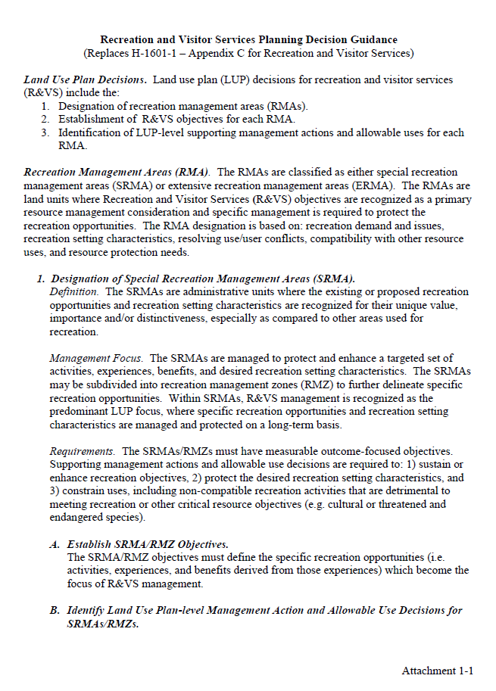
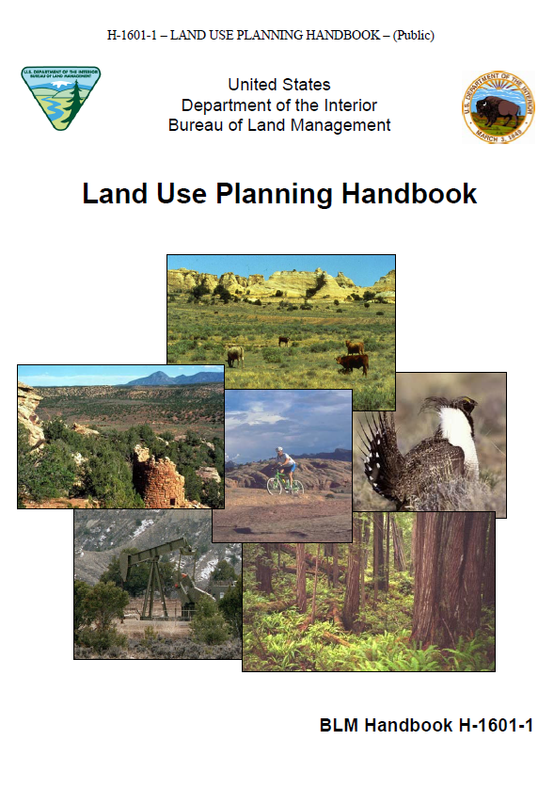
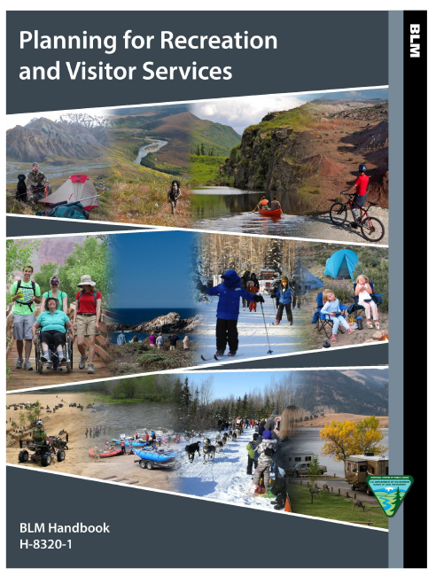
PLANNING FOR RECREATION AND VISITOR SERVICES
Manuals and Handbooks

Slide 3
PLANNING FOR RECREATION AND VISITOR SERVICES
Recreation and Visitor Services Planning Decision Guidance
Replaces the 2005 H-1601-1 – Appendix C for Recreation and Visitor Services

Slide 4
PLANNING FOR RECREATION AND VISITOR SERVICES
Manual 8320 - Planning for Recreation and Visitor Services
Manual provides general policy, direction, and guidance for planning for recreation and visitor services on the public lands and associated waters under the administration of the Bureau of Land Management.
2011 Manual supplements the planning and resource management planning regulations set forth in 43 CFR Part 1600.

Slide 5
PLANNING FOR RECREATION AND VISITOR SERVICES
Handbook 8320– 1 - Planning for Recreation and Visitor Services
Supports policies in BLM Manual 8320 - Planning for Recreation and Visitor Services, and related program guidance in BLM Handbook H-1601-1, “Land Use Planning.”
Provides planning guidance at the land use plan and implementation level.

Slide 6
PLANNING FOR RECREATION AND VISITOR SERVICES
The Planning Cycle

Slide 7
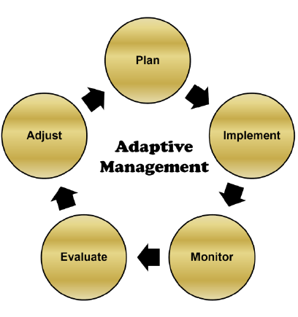
PLANNING FOR RECREATION AND VISITOR SERVICES
The Planning Cycle
.
Notes:
Recreation planning should be done within an adaptive management framework. This means staying committed to achieving the recreation objectives established in the LUP but being flexible enough in the management approach used to achieve those objectives
The land use planning process is cyclic, allowing for adaptations if monitoring and evaluation indicates that goals and objectives are not being achieved. Adaptations encompass (1) changing recreation implementation actions or practices, (2) revising supporting recreation management actions and allowable use decisions, or (3) fine tuning the desired RSCs. Over the long term, recreation planning within an adaptive management framework means staying committed to achieving the recreation objectives established in the LUP but being flexible enough in the management approach used to achieve those objectives.

Slide 8
PLANNING FOR RECREATION AND VISITOR SERVICES
The Planning Cycle
Our focus is on Planning
but also you can also use the R&VS framework in the handbook to
monitor, evaluate and adjust R&VS
Notes:
The course content, obviously is going to focus on Planning, but we should also keep in mind, how you can use the procedures in the handbook to monitor, evaluate and adjust throughout your planning cycle.

Slide 9
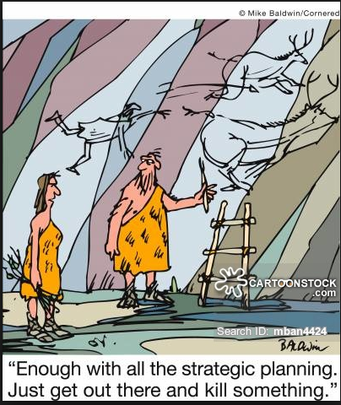
PLANNING FOR RECREATION AND VISITOR SERVICES
BLM’s Land Use Planning Process

Slide 10
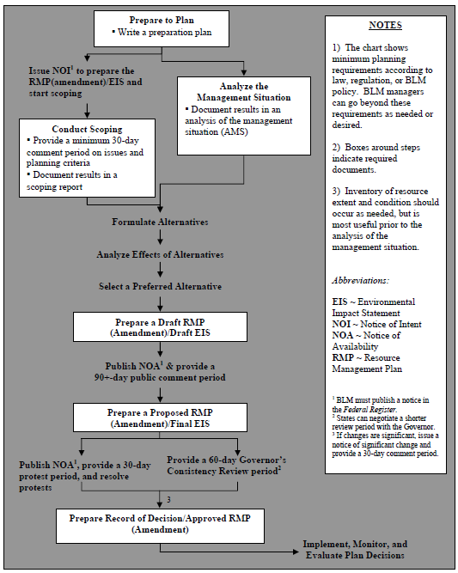
PLANNING FOR RECREATION AND VISITOR SERVICES
Minimum Planning Requirements (Steps)
See
Appendix 1 – Land Use Planning Checklist for Recreation and Visitor Services
Notes:
Let’s briefly look at the Land Use Planning Process used to develop a Land Use Plan.
This process is also on the wall. It’s important to know where we are in the process as we go though the course, and how the modules (which are sections in the handbook) overlap the planning process.

Slide 11
STEP 1 – Pre-Plan (Preparing for a Planning Effort)
Requirements | Tasks
Issues and Concerns | Identify R&VS issues, use/user conflict; visitor health and safety; resource protection; user demand; add, drop, or change RMAs,
Preliminary Planning Criteria | Identify R&VS RMP parameters, constraints, - such as areas or issues that will not be addressed by the plan
Data Needs | Gather existing R&VS data and identify data gaps
Participants in the Process | Identify recreation and tourism stakeholders

Slide 12
STEP 1 continued – – Pre-Plan
Requirements | Tasks
Timeframes for the Planning Schedule | Determine timeframes for collecting recreation data, conduct recreation-related workshops or consult with recreation stakeholders
Budget | Identify labor and operation costs for filling recreation data gaps and obtaining inventory information
Contracting | Let’s make this part easy….. Appendix 1- Land Use Planning Checklist for R&VS provides planners and the contractor the specific requirements for the R&VS program

Slide 13
Pre-Plan Components

Slide 17
STEP 2 – Envisioning?
Planning 2.0 Concept, similar to recreation focus groups

Slide 18
STEP 2 – Analyze the Management Situation (AMS)
Requirements | Tasks
Describe Conditions and Use | Describe existing and potential RMAs including dropping/changing RMAs Describe existing and potential recreation opportunities Describe existing recreation settings Describe recreation opportunities
Describe Recreation Demand | Identify visitors (international, national, resident) and their preferences/demands Identify recreation data sources and information Analyze recreation demand and data to make conclusions on R&VS trends
Unique Landscapes and Areas | Identify types of resource features that should guide land use allocation and management decisions

Slide 19
STEP 2 continued – AMS
Requirements | Tasks
Current Management Direction | Identify R&VS management decisions from all applicable BLM plans Describe R&VS management activities and direction
Potential Management Opportunities | Describe the ability of current management to achieve desired conditions and address R&VS demands Identify areas of social, economic and ecological importance to the R&VS program
Consistency and Coordination with other Plans | Discuss implications to and from other plans (county, city, state lands, tribal, and other federal agency) Identify opportunities for enhancing coordination
Notes:
Ours was 457 pages long.

Slide 20
STEP 3 – Scoping
Requirements | Tasks
Conduct Public Scoping | Work with planning staff to identify R&VS issues that should be addressed during scoping Collect public input regarding the establishment of SRMAs and ERMAs
Scoping Report | Review scoping comments and report Identify and revise the priority recreation issues and concerns that will be addressed by the planning effort
Notes:
This one is 745 pages. All of these reports can be found through e planning.

Slide 21
STEP 4 – Prepare a Draft RMP / Draft EIS
Requirements | Tasks
Affected Environment (EIS Chapter 3) | Provides the basis for impact analysis Discuss existing mgmt, conditions, issues, and trends Be concise -limit the description to what is needed to understand issues, environmental consequences, etc Derived from AMS
Formulate a Range of Alternatives including the “No Action Alternative” (EIS Chapter 2) | A range of alternatives offers different responses to the major issues and the management opportunities May involve cooperating agencies and/or resource advisory councils The no action alternative proposes the continuation of current management
Analyze the Effects of the Alternatives (EIS Chapter 4) | Analyze the degree to which resources / resource uses will be affected by the actions in each alternative. The analysis helps BLM managers and the public understand how a resource will be affected
Select the Preferred Alternative | The BLM determines which alternative best meets the multiple-use and sustained yield principles of FLPMA
Notes:
The no action alternative is usually a viable alternative. However, it may not respond to the purpose and need of the planning process (e.g., new legislation). Regardless, it provides a useful baseline to compare the effects of implementing the “action” alternatives.

Slide 22
STEP 4a – Public Comment on Alternatives?
Another planning 2.0 concept. Not sure if it will stick.
Notes:
The no action alternative is usually a viable alternative. However, it may not respond to the purpose and need of the planning process (e.g., new legislation). Regardless, it provides a useful baseline to compare the effects of implementing the “action” alternatives.

Slide 23
STEP 5 – Publish Notice of Availability (NOA) and Provide a 90 day Comment Period
Requirements | Tasks
Environmental Protection Agency | This public comment period officially starts when the EPA publishes a NOA in the Federal Register
BLM | Also publishes a NOA in the Federal Register to provide information about the project, comment period, contact information, and other supplemental information not contained in the EPA’s NOA
Responding to Comments | ORP evaluates public comments related to the R&VS program The BLM must assess and consider all comments received. BLM required to respond to substantive comments and include responses in the proposed RMP

Slide 24
STEP 6 –Prepare a Proposed RMP / Final EIS
Requirements | Tasks
Proposed RMP / Final EIS | Prepare /update analysis for R&VS portions of Final EIS The proposed LUP/final EIS builds on the Draft LUP/Draft EIS Proposed RMP/Final EIS should clearly display LUP decisions versus implementation decisions The ORP will likely work with the RMP team, cooperating agencies, resource advisory councils, and interested partners

Slide 25
STEP 7 – Publish NOA and Provide a 30 day Protest Period and Resolve Protests
Requirements | Tasks
Environmental Protection Agency | Individuals and entities have 30 days from the publication of the EPA’s NOA of the document to file a protest with the BLM Director
BLM | Also publishes a NOA
Protests and Protest Resolution | ORP may help WO/SO resolve protests A 30-day public protest period is held after the final EIS/proposed RMP is finished to allow for public input before the decisions are finalized in the record of decision. The BLM must resolve any protests on a proposed RMP (or RMP amendment) and final EIS before issuing a record of decision
Notes:
Protests are reviewed by the Director of BLM. Challenges to this decision are made in Federal Court.

Slide 26
STEP 8 – Provide a 60 day Governor's Consistency Review and Resolve Inconsistencies
Requirements | Tasks
Governor's Consistency Review | BLM must also provide a 60-day review period to the Governor to ensure consistency with state and local plans, policies, and programs Protest period and the Governor’s review period usually occur simultaneously in order to save time
Changes to the Proposed RMP | Comments from the Governor could result in modifications to the Proposed RMP If changes are significant, the BLM must announce the intended changes to the public and provide another 30-day comment period

Slide 27
STEP 9 –Prepare a Record of Decision / Approved RMP
Requirements | Tasks
ROD / Approved RMP | Final step in the EIS process Review R&VS planning decisions, GIS data and maps for accuracy Ensure proper identification of LUP-level versus implementation-level R&VS decisions Help document rationale for consideration of RMAs or other recreation program decisions

Slide 28
PLANNING FOR RECREATION AND VISITOR SERVICES
Overview of Required LUP Decisions for R&VS
Notes:
There are 3 major LUP requirements for R&VS:
Designate recreation management areas – 2 types, SRMAs, ERMAs
Establish R&VS objectives for each RMA. – There is more to this than you may think, so we’ll be going over this in more detail.
Identify LUP-level management actions and allowable uses for each RMA. - Many decisions related to R&VS are NOT LUP-level decisions, so the trick here will be to separate them from implementation level – but more on that later.

Slide 29
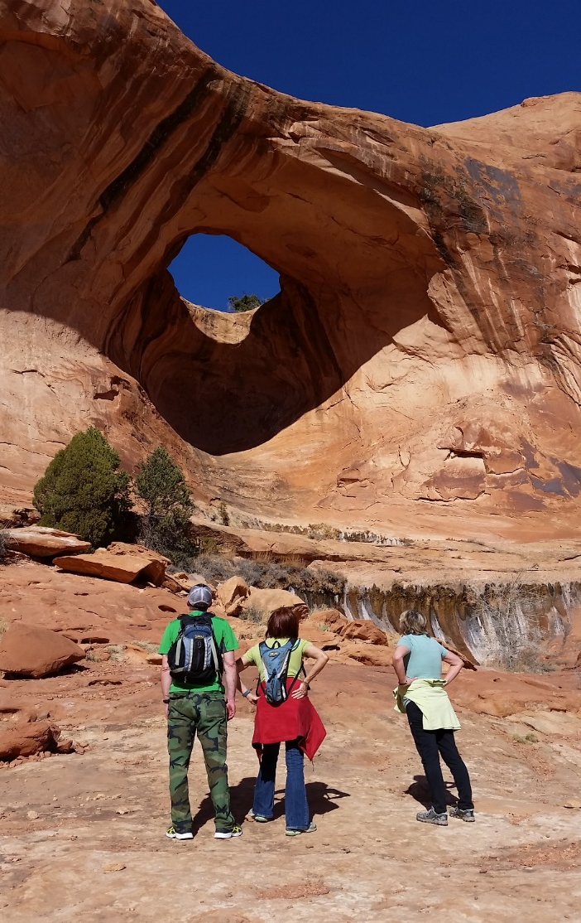
PLANNING FOR RECREATION AND VISITOR SERVICES
Overview of Required LUP Decisions for R&VS
Designate Recreation Management Areas (RMAs)
Establish R&VS Objectives for each RMA
Identify LUP-level Management Actions and Allowable Uses for each RMA
Notes:
There are 3 major LUP requirements for R&VS:
Designate recreation management areas – 2 types, SRMAs, ERMAs
Establish R&VS objectives for each RMA. – There is more to this than you may think, so we’ll be going over this in more detail.
Identify LUP-level management actions and allowable uses for each RMA. - Many decisions related to R&VS are NOT LUP-level decisions, so the trick here will be to separate them from implementation level – but more on that later.

Slide 30
PLANNING FOR RECREATION AND VISITOR SERVICES
1. Designate Recreation Management Areas (RMAs)
SRMA | ERMA
Definition. Recreation opportunities or recreation setting characteristics (RSCs) unique, important or distinctive | Definition. Specific management required to address recreation use, demand or R&VS program investments
Management Focus. Protect/enhance targeted activities, experiences, benefits, and desired RSCs. | Management Focus. Support the principal recreation activities and the associated qualities and conditions
Requirements. Protect or enhance recreation objectives, protect the desired RSCs, & constrain non-compatible uses | Requirements. Facilitate participation in recreation activities & protect the area’s associated qualities and conditions
Keywords. Unique, Important or Distinctive Priority Protect and Enhance | Keywords. Specific R&VS Mgmt Required Commensurate Support and Sustain
Notes:
RMAs are land units where:
- R&VS objectives are recognized as a primary resource management consideration
- and specific management is required to protect the recreation opportunities.
RMA designation is based on:
recreation demand and issues
recreation setting characteristics
resolving conflicts
compatibility with other resource uses
resource protection needs
There are 2 types. Special Recreation Management Areas (SRMAs) and Extensive Recreation Management Areas (ERMAs)
If you remember the previous recreation policy, it’s important to note that the names are the same, but the definitions have changed!

Slide 31
PLANNING FOR RECREATION AND VISITOR SERVICES
1a. Designate Backcountry Conservation Areas?
BCA
Purpose. 1) Protect intact and undeveloped land that contain important wildlife habit and 2) provide for high quality wildlife dependent recreation
Management Focus. Protect/enhance targeted wildlife related opportunities, experiences, benefits, and desired RSCs.
Requirements. Protect or enhance recreation objectives, protect or enhance the desired RSCs, & constrain non-compatible uses
Keywords. Intact and undeveloped, habitat, high quality recreation opportunities
Notes:
RMAs are land units where:
- R&VS objectives are recognized as a primary resource management consideration
- and specific management is required to protect the recreation opportunities.
RMA designation is based on:
recreation demand and issues
recreation setting characteristics
resolving conflicts
compatibility with other resource uses
resource protection needs
There are 2 types. Special Recreation Management Areas (SRMAs) and Extensive Recreation Management Areas (ERMAs)
If you remember the previous recreation policy, it’s important to note that the names are the same, but the definitions have changed!

Slide 32
PLANNING FOR RECREATION AND VISITOR SERVICES
2. Establish R&VS Objectives for each RMA
SRMA | ERMA
Outcome-focused objectives define the specific recreation opportunities: Activities Experiences Benefits (derived from those experiences) which become the focus of R&VS management. | Objectives define the: Activities Associated qualities and conditions of the ERMA which become the focus of R&VS management.
Notes:
RMAs are land units where:
- R&VS objectives are recognized as a primary resource management consideration
- and specific management is required to protect the recreation opportunities.
RMA designation is based on:
recreation demand and issues
recreation setting characteristics
resolving conflicts
compatibility with other resource uses
resource protection needs
There are 2 types. Special Recreation Management Areas (SRMAs) and Extensive Recreation Management Areas (ERMAs)
If you remember the previous recreation policy, it’s important to note that the names are the same, but the definitions have changed!

Slide 33
PLANNING FOR RECREATION AND VISITOR SERVICES
2a. Establish R&VS Objectives for each BCA?
BCA
Outcome-focused objectives define the specific recreation opportunities: Activities Experiences Benefits (derived from those experiences) which become the focus of R&VS and wildlife management.
Notes:
RMAs are land units where:
- R&VS objectives are recognized as a primary resource management consideration
- and specific management is required to protect the recreation opportunities.
RMA designation is based on:
recreation demand and issues
recreation setting characteristics
resolving conflicts
compatibility with other resource uses
resource protection needs
There are 2 types. Special Recreation Management Areas (SRMAs) and Extensive Recreation Management Areas (ERMAs)
If you remember the previous recreation policy, it’s important to note that the names are the same, but the definitions have changed!

Slide 34
PLANNING FOR RECREATION AND VISITOR SERVICES
3. Identify LUP-level Management Actions & Allowable Uses
SRMA | ERMA
Identify R&VS decisions necessary to: Facilitate targeted recreation opportunities Maintain or enhance RSCs | Identify R&VS decisions necessary to: Facilitate participation in identified recreation activities. Maintain particular RSCs.
Address visitor health and safety, resource protection, and use and user conflicts (e.g. areas unavailable to target shooting) Address the type(s), activities and locations where special recreation permits would not be issued Within Other Programs. Establish restrictions for other resource uses necessary to achieve the RMA/RMZ objective(s)
Notes:
RMAs are land units where:
- R&VS objectives are recognized as a primary resource management consideration
- and specific management is required to protect the recreation opportunities.
RMA designation is based on:
recreation demand and issues
recreation setting characteristics
resolving conflicts
compatibility with other resource uses
resource protection needs
There are 2 types. Special Recreation Management Areas (SRMAs) and Extensive Recreation Management Areas (ERMAs)
If you remember the previous recreation policy, it’s important to note that the names are the same, but the definitions have changed!

Slide 35
PLANNING FOR RECREATION AND VISITOR SERVICES
3a. Identify LUP-level Management Actions & Allowable Uses
BCA
Identify R&VS decisions necessary to: Support goals, objectives and designation of the area Identify land tenure decisions Establish resource use determinations; restrictions for other resource uses necessary to achieve the BCA objective(s) and uses that are compatible
Notes:
RMAs are land units where:
- R&VS objectives are recognized as a primary resource management consideration
- and specific management is required to protect the recreation opportunities.
RMA designation is based on:
recreation demand and issues
recreation setting characteristics
resolving conflicts
compatibility with other resource uses
resource protection needs
There are 2 types. Special Recreation Management Areas (SRMAs) and Extensive Recreation Management Areas (ERMAs)
If you remember the previous recreation policy, it’s important to note that the names are the same, but the definitions have changed!

Slide 36
PLANNING FOR RECREATION AND VISITOR SERVICES
3. Identify LUP-level Management Actions & Allowable Uses
PUBLIC LAND NOT DESIGNATED AN RMA
Management Focus. Recreation is not emphasized however recreation activities do occur. Allow recreation uses that are not in conflict with the primary uses. Managed to meet basic R&VS and resource stewardship needs.
Requirements. Identify decisions to address basic R&VS and resource stewardship needs: Visitor health and safety. Use and user conflicts. Address the type(s), activities and locations where special recreation permits would not be issued Mitigation of recreation impacts on cultural and natural resources.
Notes:
RMAs are land units where:
- R&VS objectives are recognized as a primary resource management consideration
- and specific management is required to protect the recreation opportunities.
RMA designation is based on:
recreation demand and issues
recreation setting characteristics
resolving conflicts
compatibility with other resource uses
resource protection needs
There are 2 types. Special Recreation Management Areas (SRMAs) and Extensive Recreation Management Areas (ERMAs)
If you remember the previous recreation policy, it’s important to note that the names are the same, but the definitions have changed!

Slide 37
PLANNING FOR RECREATION AND VISITOR SERVICES
Avoid making implementation level decisions in the LUP !
Notes:
There are 3 major LUP requirements for R&VS:
Designate recreation management areas – 2 types, SRMAs, ERMAs
Establish R&VS objectives for each RMA. – There is more to this than you may think, so we’ll be going over this in more detail.
Identify LUP-level management actions and allowable uses for each RMA. - Many decisions related to R&VS are NOT LUP-level decisions, so the trick here will be to separate them from implementation level – but more on that later.

Slide 38
PLANNING FOR RECREATION AND VISITOR SERVICES
Implementation Decisions for R&VS
Notes:
There are 3 major LUP requirements for R&VS:
Designate recreation management areas – 2 types, SRMAs, ERMAs
Establish R&VS objectives for each RMA. – There is more to this than you may think, so we’ll be going over this in more detail.
Identify LUP-level management actions and allowable uses for each RMA. - Many decisions related to R&VS are NOT LUP-level decisions, so the trick here will be to separate them from implementation level – but more on that later.

Slide 39
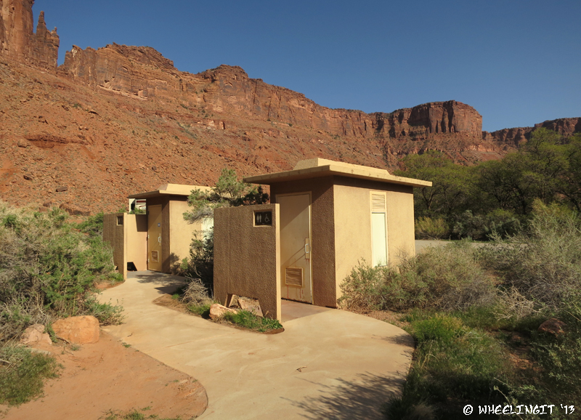
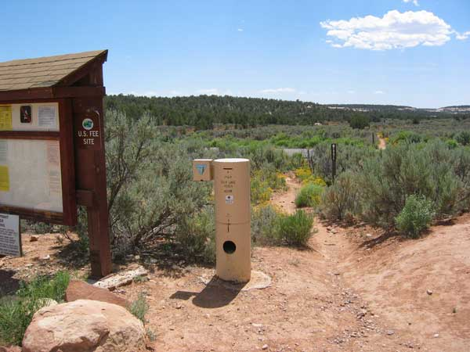
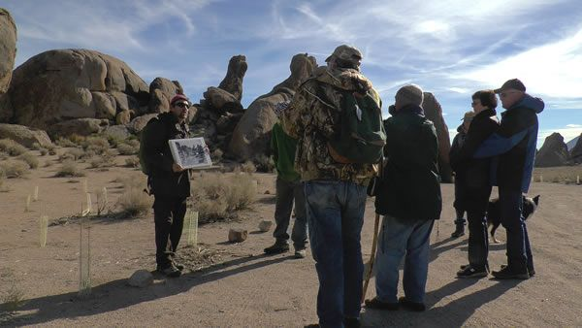
PLANNING FOR RECREATION AND VISITOR SERVICES
Implementation Decisions:
Site specific
Appealable
Management
Administration
Information and Education
Monitoring
Notes:
There are four categories of Implementation Decisions
Management
Administration
Information and Education
Monitoring
Site Specific
2) Appealable to IBLA under 43 CFR 4.410
LUP Decision - protest
The BLM may use a single land use planning/NEPA process to make both land use plan and implementation decisions, provided both types of decisions are adequately addressed with the appropriate level of NEPA analysis.
Where implementation decisions are made as part of the land use planning process, they are still subject to the appeals process or other administrative review as prescribed by the specific resource program regulations after the BLM resolves the protests to land use plan decisions and makes a decision to adopt or amend the RMP.
The proposed plan /final EIS should display land use plan and implementation decisions (and clearly distinguish between the two types of decisions).
Implementation decisions are changed through an interdisciplinary NEPA process in conjunction with the BLM resource program-specific guidance.

Slide 40
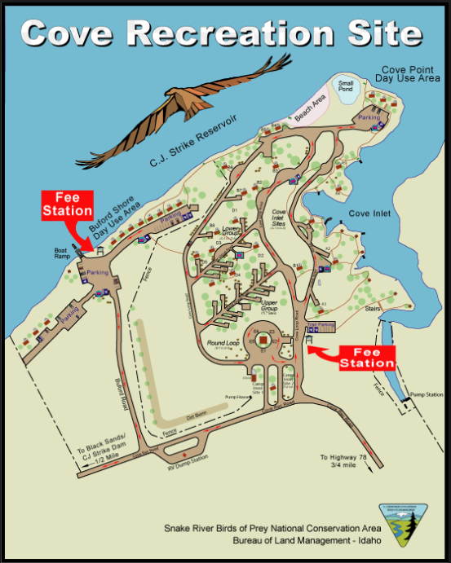
PLANNING FOR RECREATION AND VISITOR SERVICES
Implementation Decisions: Management
Visitor Services
Facilities
Developed Sites
Roads and Trails
Notes:
Information and Education includes:
Maps or brochures
Websites
Outreach efforts
Events
Interpretation
Environmental education
Signing

Slide 41
PLANNING FOR RECREATION AND VISITOR SERVICES
Implementation Decisions: Administration
Allocation Systems
Permits
Fees
Use Restrictions
Partnership Agreements
Business Plans
Fiscal Accountability Systems
Data Management Protocols
Notes:
Information and Education includes:
Maps or brochures
Websites
Outreach efforts
Events
Interpretation
Environmental education
Signing

Slide 42
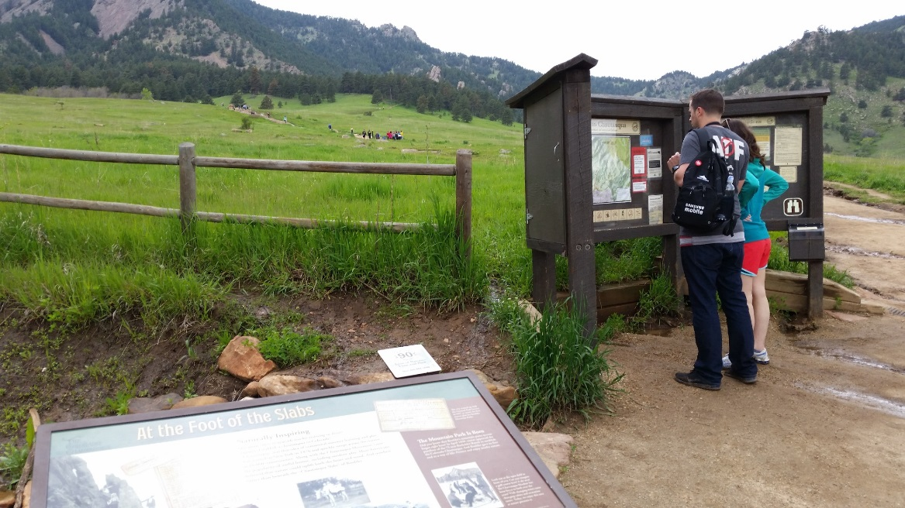
PLANNING FOR RECREATION AND VISITOR SERVICES
Implementation Decisions: Information & Education
Maps or Brochures
Websites
Outreach Efforts
Events
Interpretation
Environmental Education
Signing
Notes:
Information and Education includes:
Maps or brochures
Websites
Outreach efforts
Events
Interpretation
Environmental education
Signing

Slide 43
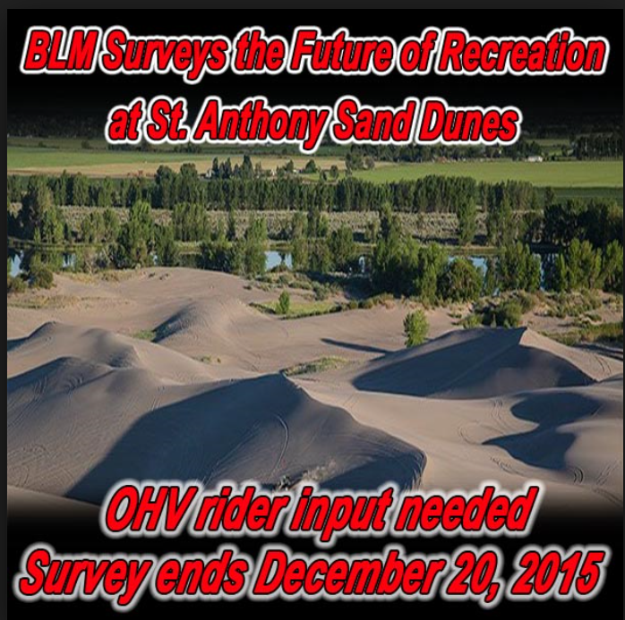
PLANNING FOR RECREATION AND VISITOR SERVICES
Implementation Decisions: Monitoring
Visitor Use and Use Patterns
Recreation Caused Resource Impacts
Visitor Satisfaction
Attainment of Objectives
RSCs
Standards and Indicators
Notes:
Monitoring includes:
- Visitor use and use patterns
- Recreation caused resource impacts
- Visitor satisfaction
Monitoring may measure the effectiveness or attainment of:
- Outcomes-focused objectives
- Recreation setting characteristics
- Standards and indicators.

