Slide 1
Module 3
Data and Data Collection

Slide 2
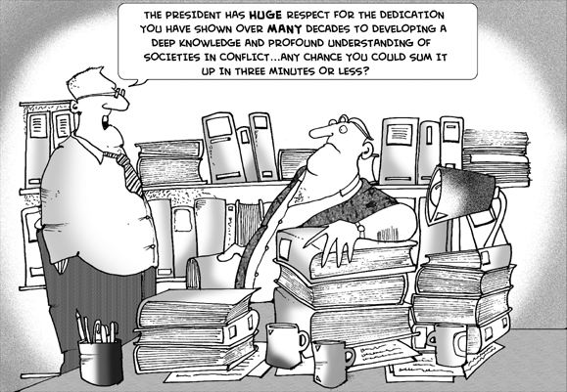
PLANNING FOR
RECREATION AND VISITOR SERVICES
Data and Data Collection
Notes:
How would you answer this question? Many recreation “societies” are in conflict and competing over the same areas for their own experiences. Collecting data will help us understand what they may have in common and provide some insight on how to manage the landscape for a variety of experiences. However it is important to understand that we won’t be all things to all people, management does involve tradeoffs.

Slide 3
Objective
Determine what data is necessary to support Recreation and Visitor Services LUP decisions and how to collect that data.

Slide 4


Informing the Planning Process
High Quality Information
Best Available Science
Notes:
Planning 2.0 approach….. Still valid no matter what planning framework and/or process is followed.
Use high quality information to inform the process, including best available science.
Assessing resource condition and trends.
•Identifying appropriate scales for management.
•Identifying planning issues.
•Developing and analyzing alternatives.
•Monitoring and implementation.

Slide 5
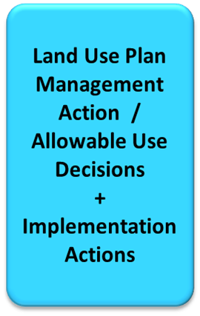
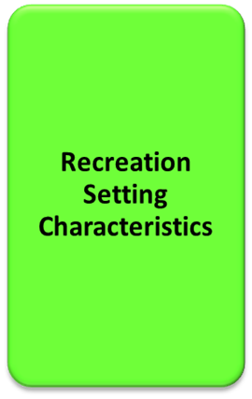
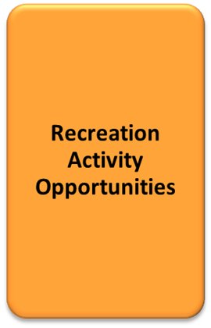
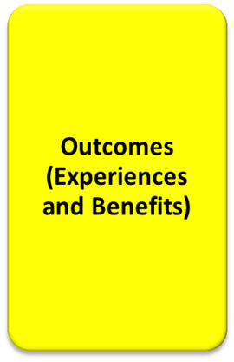
What is Recreation Data?
Supply
Demand

Slide 6
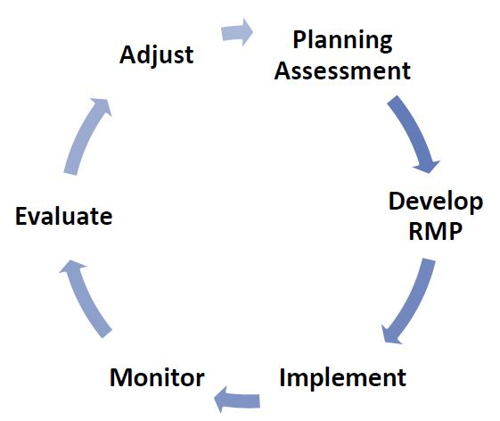
When is Recreation Data Collected?
AMS
Notes:
Pg. I-14 in R&VS Handbook
Analysis of the Management Situation (AMS) RMP data = data collected for 1st time, prior to implementing OFM into a LUP.
Monitoring data = data collected to determine if an (RMA) objective is being met.
Implementation data = usually more site specific data used when monitoring RSCs and their relationship to an SRMA objective, use numbers, specific data collected when monitoring trail widths and braiding, campsite impacts, etc.
This module addresses AMS and Developing RMP data, i.e. Inventory data.

Slide 7
When is Recreation Data Used in a LUP Process?
Preparation Plan,
Analysis of the Management Situation (AMS).
Alternative Formulation,
Impact Analysis.
Notes:
In Appendix A1-1 - R&VS Handbook Appendix A1-3 in the R&VS Handbook.
Each component of the planning process (prep plan, AMS) builds on the previous component. If a poor job is done in one component it makes it more difficult to do a good job on the next components!!
The AMS is a broad assessment of resource, environmental, social and economic conditions in the planning area.
The assessment is a process and the product is a report summarizing findings.
Determine data needs
Data Needs and Management
What issues need to be resolved in the LUP?
What recreation planning tool (LUP Decision) will be used to address the issue?
What data is necessary to help address the issue and support the tool?
Existing data sources (SCORP, regional tourism plans, county and/or city comprehensive plans, etc.)
Data gaps,
Data for LUP plan development,
Recreation Setting Characteristics
Visitor surveys
Partnerships that could assist with data collection.

Slide 8
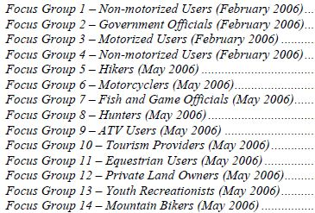
Who do we get recreation data from?
Notes:
Wood River Valley focus groups by category.
Collecting and analyzing data begins the process of allowing managers to create quality recreational opportunities most desired by stakeholders and visitors.
Talk to everyone:
Visitors,
Public land users
Communities,
City and County leaders/planners
Organizations and Clubs
Schools
Other recreation providers.
Permittees
Recreation Districts
Retail Outlets

Slide 9


How is Recreation Data Gathered?
By asking visitors.
Internal scoping
Notes:
More on this in a few minutes.

Slide 10
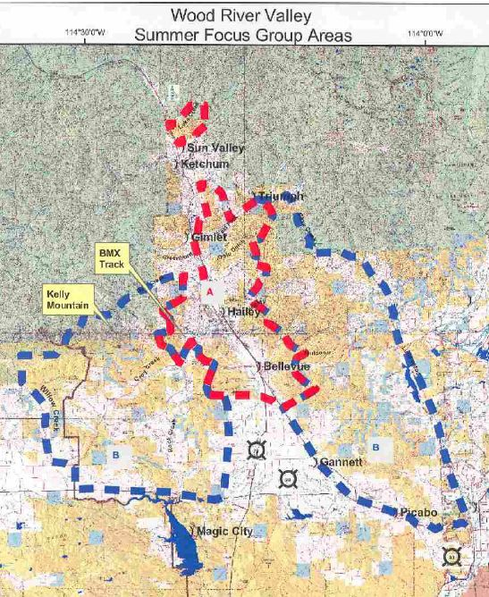
Where does Recreation Data Need to be Collected For?
  Collect site-specific data for areas that are currently designated or have the potential to be designated as RMAs.
Notes:
Handbook pg. 1-15
These data help to establish alternatives and objectives, as well as to analyze and focus implementation actions.

Slide 11
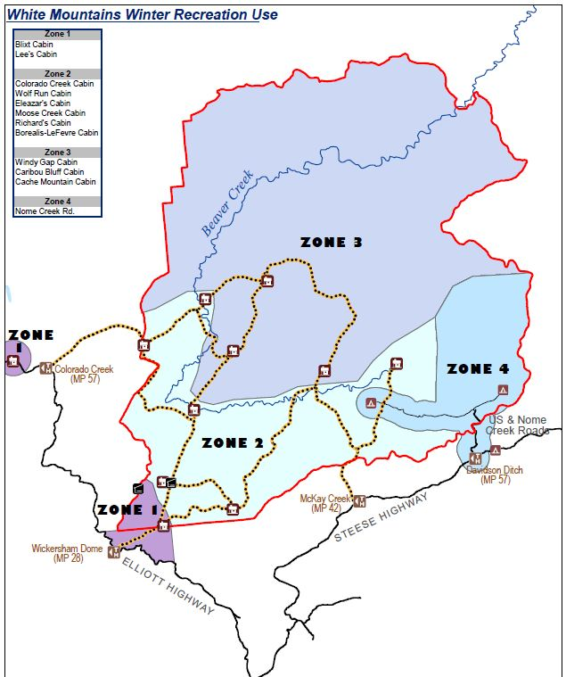
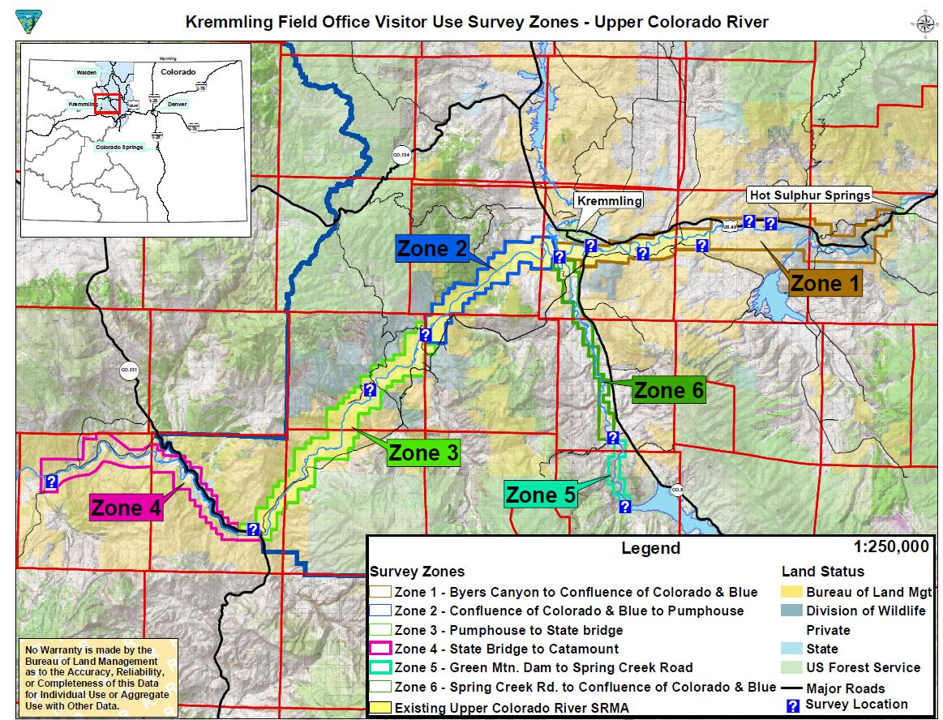
Where does Recreation Data Need to be Collected For?
  Or
  Areas that have high use,
  Where use/user issues (conflicts) exist.
Notes:
Handbook pg. 1-15
These data help to establish alternatives and objectives, as well as to analyze and focus implementation actions.

Slide 12

Data Considerations
Federal Advisory Committee Act (FACA)
Paperwork Reduction Act
Government Performance and Results Act (GPRA) Surveys
Privacy Act
Notes:
FACA: A 1972 law enacted to reduce special interest group influence on decision-makers
Handbook pg. I -15, 2 a. FACA …Talk about what the BLM may and may not do.
Paperwork Reduction Act: OMB approval. Talk about this more in the next slide.
GPRA, BLM Visitor Satisfaction Survey’s
Privacy Act, maintain the privacy of those providing data to the BLM.

Slide 13
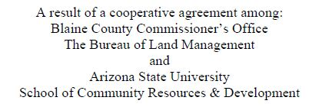
Opportunities for Assistance
Partnerships
Resource Advisory Committees
Cooperating Agencies
Notes:
Handbook pg. 1-17
FACA Chartered Committees (RAC)
Partnerships
BLM OMB approved Survey
Collected using: on and off-site survey’s and focus groups,
Outcome and setting information,
Socio-economic data, and
Inventory survey and monitoring survey methodologies.
Cooperating Agencies
Refer to desk guide referenced in the handbook.

Slide 14

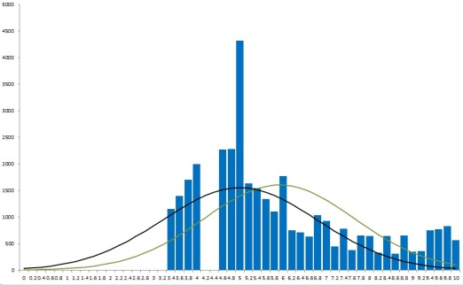
Data is both Quantitative and Qualitative
What is Qualitative data?
  User demand
  Why are people recreating and what do they get out of their experience
What is Quantitative data?
  Surveys
  RMIS
  Numbers of things.
For Outcomes Focused Planning to be successful it must be grounded in Qualitative data!
Notes:
Handbook pg. 1-17
Ask the students, why it is important to ground benefits based planning in qualitative data?.......we will be building on this idea throughout this module.

Slide 15


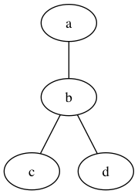
Qualitative Activity, Experience and Benefits Data
Document the experiences and benefits associated with a quality recreation opportunity.
Use the Experience and Benefits Checklist, Appendix 2 in Handbook.
Retain relationship between a particular area and the activities, experiences and benefits.
Notes:
Handbook Pg. I-19 and Figure 6 on pg. 20
Lots of questions need to be asked to acquire this data. This is where the OMB survey will be very helpful. However just get used to the questions so they become a natural part of your dialogue when interacting with the public.
What activities are preferred?
What experiences are realized when participating in these preferred activities?
What individual, social, economic, and/or environmental benefits are attained onsite?
What benefits stay with the individual offsite, and what benefits cumulatively lead to offsite beneficial outcomes to communities, economies, and the environment?
What RSCs support the desired experiences and benefits?

Slide 16


Communication Methodologies
Reframing
Appreciative Inquiry
Facilitation
Informal Discussions
Notes:
Handbook Pg. I-20
People don’t care how much you know until they know how much you care.
Most important skill in collecting data is? Listening! And asking the right questions.
Use Discussion probes in Figure 6 when using any of these communication methodologies.
Side Note:
Treat others the way they want to be treated. Tip 6: BLM dignity and respect campaign.
Four types of people:
Directors
Socializers
Thinkers
Relators
Take home message, brush up on your people/communication skills.

Slide 17
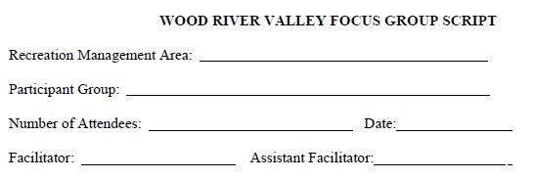
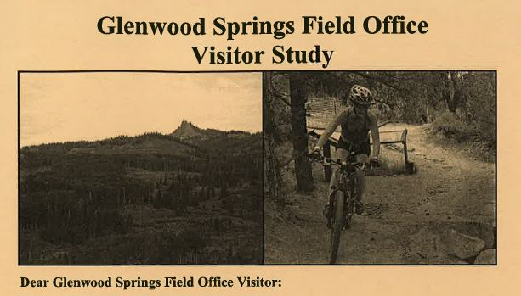
Techniques for Gathering Data
Scoping Meetings
Small Group Discussions (Focus Groups)
Questionnaires and Surveys
Notes:
R&VS Handbook pg. Illustrations IL-2
Small group discussion script
IL-12 Example of Questionnaire

Slide 18
Scoping
Data (Qualitative)
Notes:
Typical results of BLM scoping

Slide 19
Informal Discussions
Data (Qualitative)
Notes:
Discussions that can happen by simple interactions with the public.

Slide 20

Focus Groups
Data
(Qualitative)

Slide 21
Surveys
Data
(Qualitative &
Quantitative)

Slide 22

Data, Linkage and SRMA Objectives
Scoping
Informal Discussions
Professional knowledge,
Working groups,
RACs,
Public Comments on DEIS,
Protest & appeal
Focus Groups
Surveys
Activities ,Experiences and Benefits, RSCs
Data
SRMA Objective

Slide 23
Understand the Relationship
Supply
Demand
Existing
Desired
Notes:
Handbook pg. I – 18.
Understand the relationship between supply and demand.
Supply = What the BLM supplies
Demand = What the public (recreationist) demands, what they get out of (or desire to get out of) their recreation opportunity.
It is important to understand Why people choose to recreate in a particular location.
First we will be talking about Demand. Supply will be talked about later in the module.
Identify trends and related data that are relevant to the demands the field office is experiencing for recreation activities and outcomes.
Has there been a shift in the demand for certain kinds of recreation opportunities within your field office over the last 10 years?

Slide 24

Great News!!!
Notes:
BLM is in the process of obtaining an OMB approved focus group script and survey that will be administered through the University of Alaska – Fairbanks in association with other universities.
You will be taking this survey later in the class.

Slide 25
What do Visitors think about?
Notes:
Want to collect data about “what visitors think about……..”
Lets think through this.
Refer to the SRMA sheet on beneficial outcomes and experiences.

Slide 26
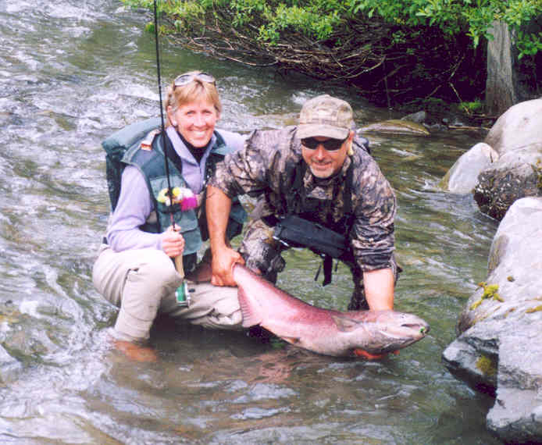
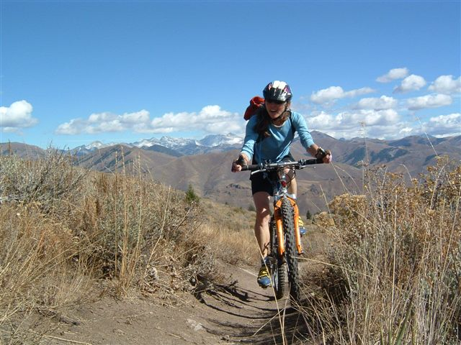
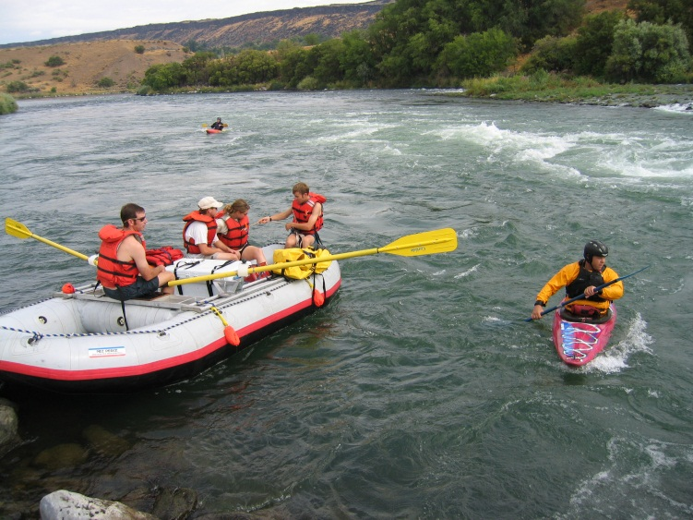
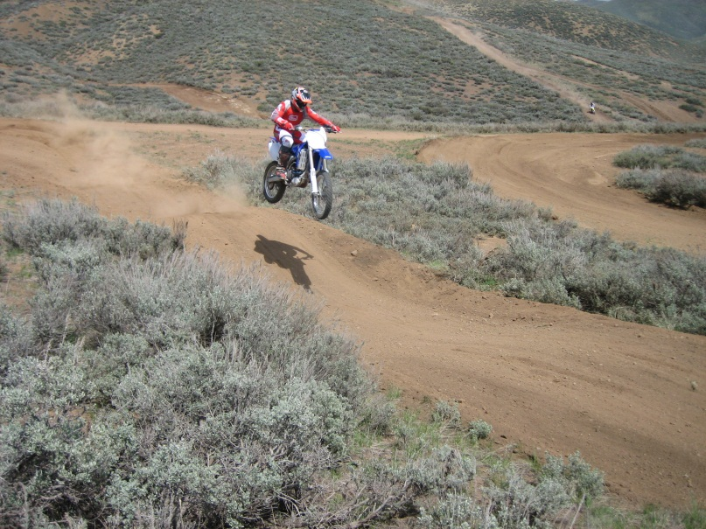
They think about activities

Slide 27
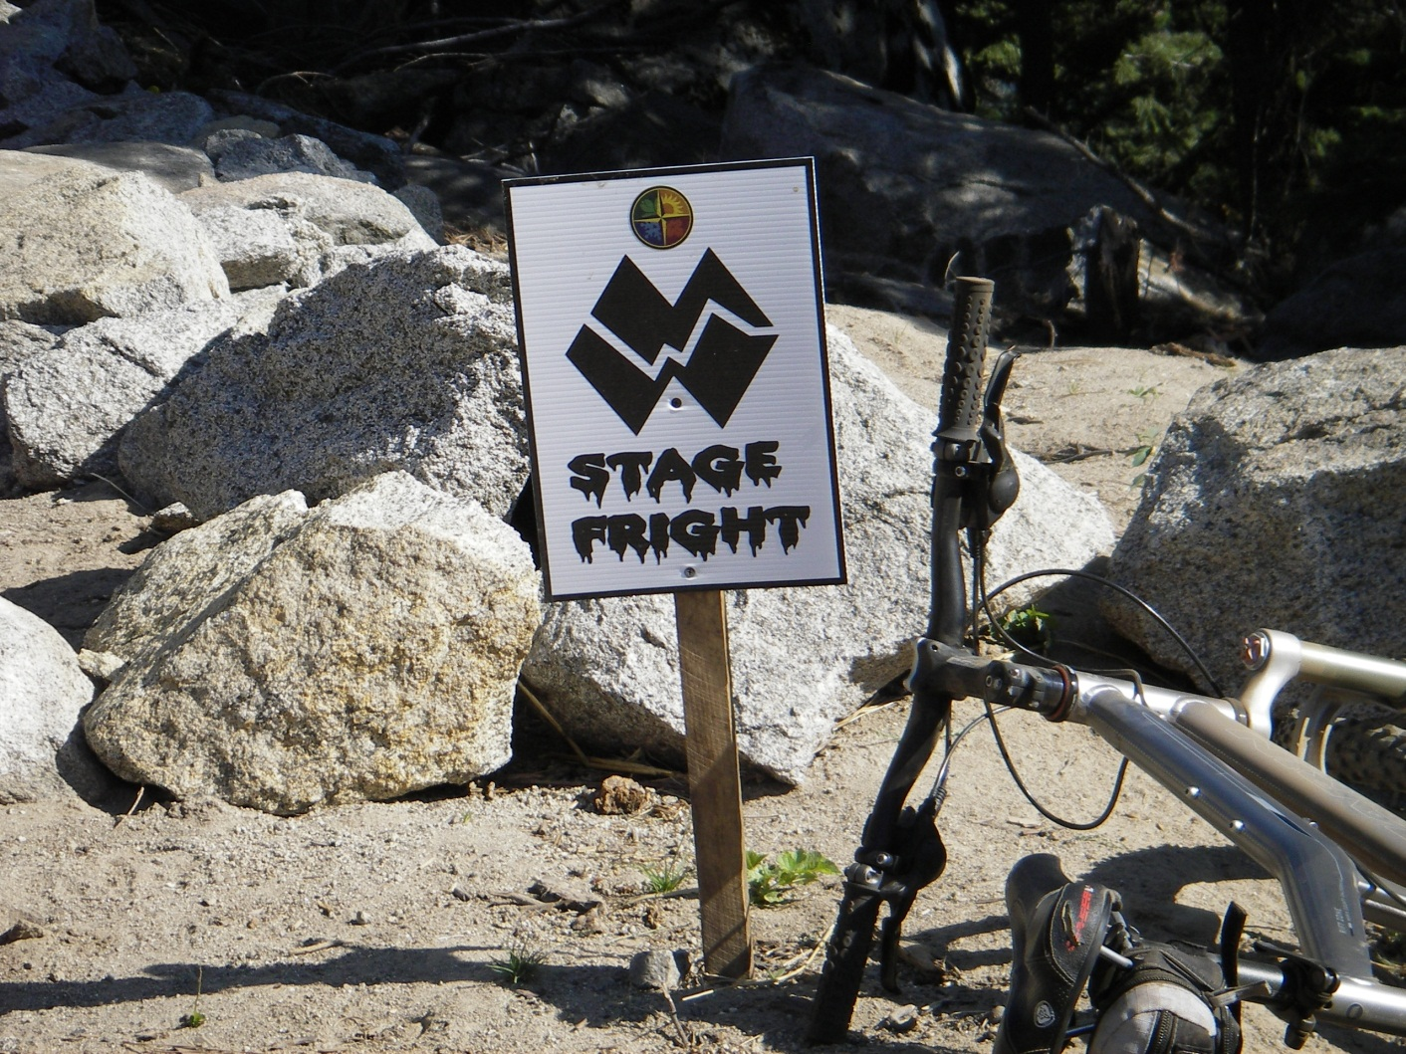
They think about experiences

Slide 28
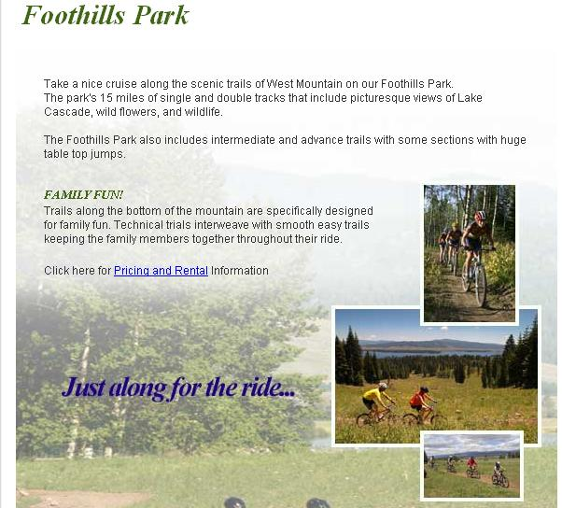
Experiences

Slide 29
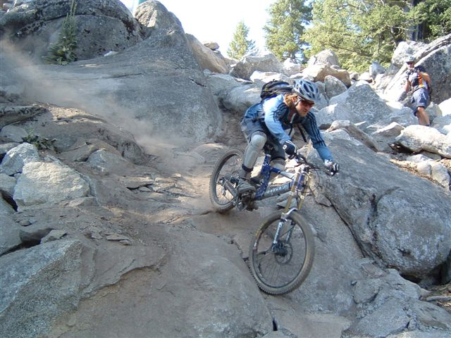
They realize outcomes
Yee ha Bro, you are one skilled rider!

Slide 30
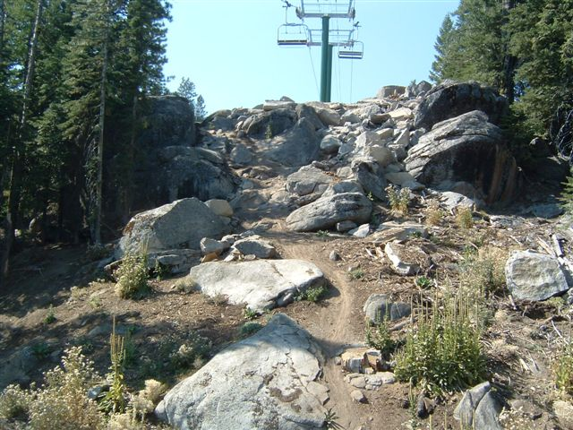
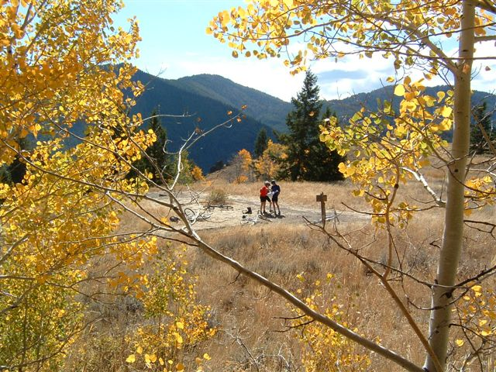
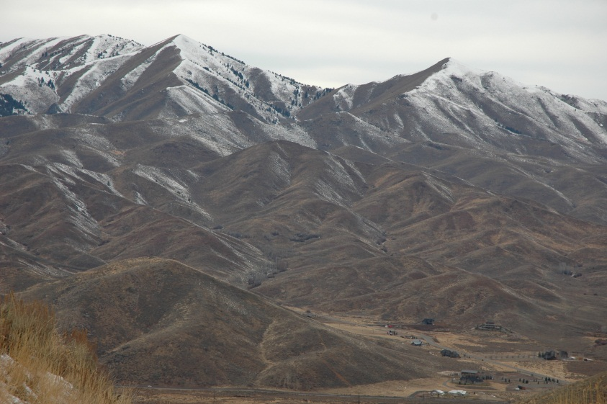
They think about settings

Slide 31

If the activity is mountain biking…
  What kind of Experiences and Benefits are associated with that activity and which ones will be managed for?
What kind of experience do I want to have today?

Slide 32
Is it to experience:
Risk taking
Achievement and Stimulation
OR is it to:
Enjoy nature
Physical exercise
Sense of place
      OR???...We need to ask the question, WHY?
Somebody please ask me, Why I go Mountain Biking?

Slide 33
If the desired
experience is:
  Risk taking
  Achievement and Stimulation
Then the beneficial outcomes may be:
  Improved Skills
  Increased Community Involvement
  Reduced numbers of at-risk youth
  Maintenance of distinctive recreation setting character
Notes:
You don’t know until you ask!

Slide 34
If the desired
experience is:
  Enjoy nature
  Physical exercise
  Sense of place
Then the beneficial
Outcomes may be:
  Restored mind from unwanted stress
  Improved understanding of this communities dependence and impacts on public lands
  Improved local economic stability
  Increased desirability as a place to live or retire
  Increased awareness and protection of natural landscapes
Notes:
You are establishing a Chain of Causality

Slide 35
Data Gathering Review
1. Focus on existing or potential RMAs.
2. Focus on the activities that occur within those areas.
3. Focus on outcomes, experiences and benefits.
4. Identify settings that are needed to achieve the desired outcomes.
Notes:
We will get into the HOW to in the next objective.

Slide 36
Survey exercise instructions:
  Take the survey as if you were recreating in the area, pick the activity your are familiar with and use your imagination along with what you remember from the Steens Mountain Write up.

