Slide 1
Objective
Understand the evolution from ROS to RSC
Generate products used to describe the existing Recreation Setting Characteristics
Understand the process used to produce the existing RSCs

Slide 2
Existing RSCs
Product
Narrative
Matrix
Map
Process

Slide 3
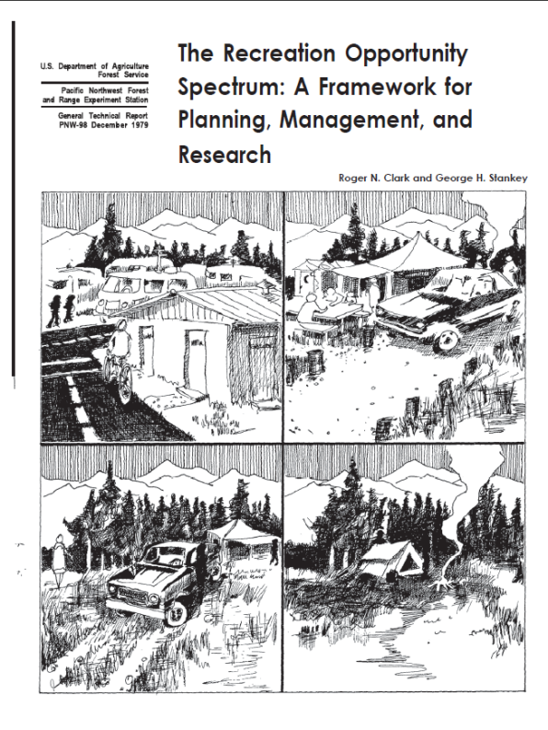
PLANNING FOR RECREATION AND VISITOR SERVICES
Recreation Setting Characteristics
Recreation Opportunity Spectrum (ROS)
1979, Established by the Forest Service to allocate/zone the landscape.
2011, Bureau of Reclamation published Water and Land Recreation Opportunity Spectrum

Slide 4
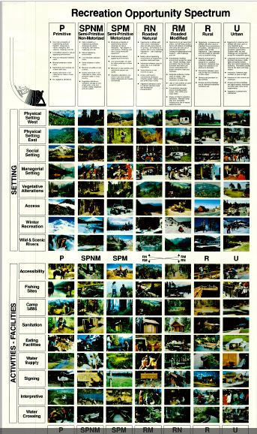
PLANNING FOR RECREATION AND VISITOR SERVICES
Recreation Setting Characteristics

Slide 5
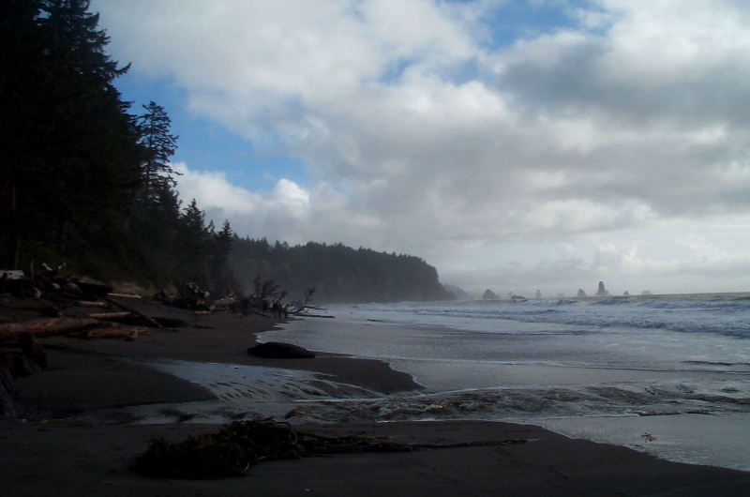
PLANNING FOR RECREATION AND VISITOR SERVICES
Recreation Setting Characteristics
Why are
recreation settings
important?
Notes:
R&VS Handbook pg. 1-23
Ask why are setting important?

Slide 6
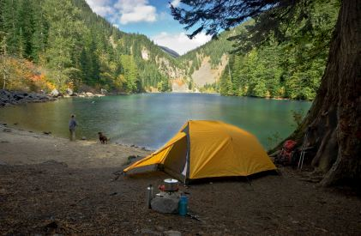
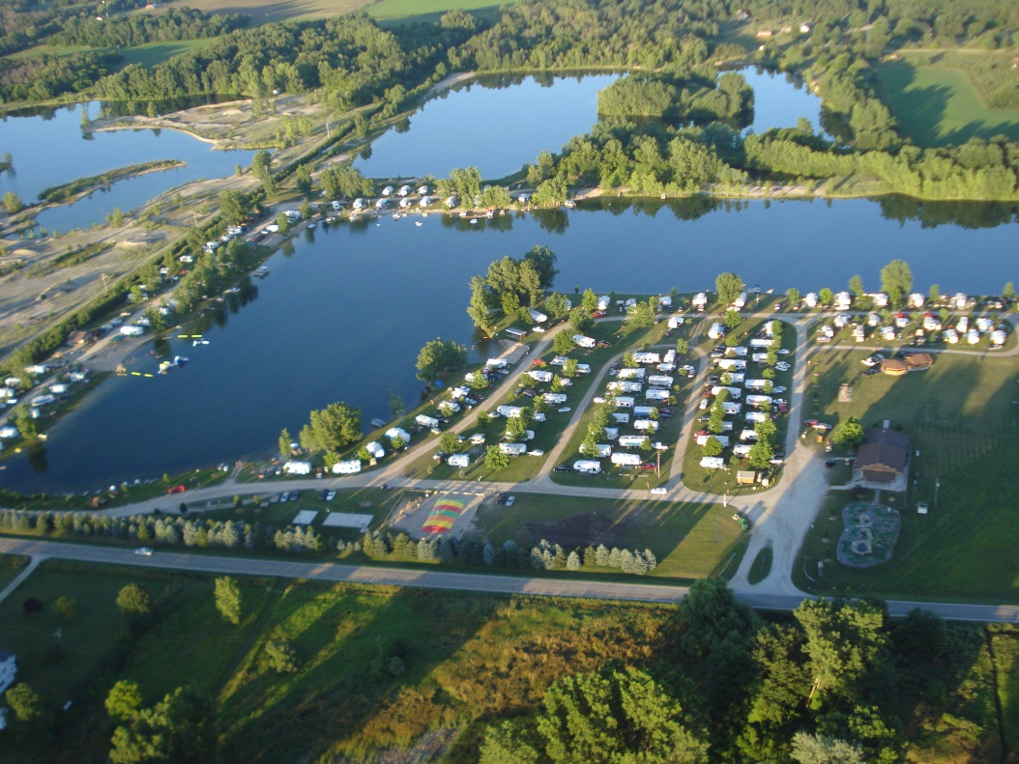
PLANNING FOR RECREATION AND VISITOR SERVICES
Recreation Setting Characteristics
Visitors seek a diverse range of recreation opportunities
Notes:
Visitors seek a diverse range of setting-dependent outdoor recreation opportunities. They choose to recreate in different areas based on the qualities and conditions of the area and because they desire to have distinctive recreation experiences. For example, primitive camping in a backcountry valley by a remote lake offers a different set of outcomes than camping in a highly developed campground adjacent to a manmade reservoir. Engaging in the same activity in different settings can produce different recreation outcomes.

Slide 7
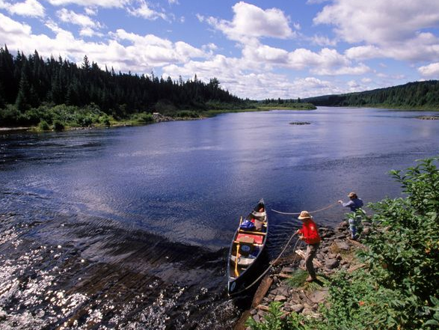
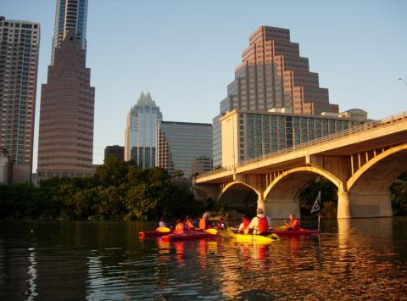
PLANNING FOR RECREATION AND VISITOR SERVICES
Recreation Setting Characteristics
Recreation opportunities are produced by a variety of recreation settings
PRIMITIVE
URBAN
Notes:
Those recreation opportunities are produced by a variety of recreation settings

Slide 8
PLANNING FOR RECREATION AND VISITOR SERVICES
Recreation Setting Characteristics
Recreation settings can be arranged in a continuum divided into a spectrum of classes
PRIMITIVE | SEMI-PRIMITIVE NONMOTORIZED | SEMI-PRIMITIVE MOTORIZED | ROADED NATURAL | RURAL | URBAN
Notes:
R&VS Handbook pg. 1-24
Recreation settings can be arranged in a continuum divided into a spectrum of classes
Typically 6 classes have been used as a basis for land management agencies
The classes are named only to help describe a recreation setting spectrum for recreation management. For example, the “primitive” class is not exclusive to wilderness, wilderness study areas, or lands managed for the protection of wilderness characteristics and may be used elsewhere.

Slide 9
PLANNING FOR RECREATION AND VISITOR SERVICES
Recreation Setting Characteristics
The continuum can be characterized by 3 components
PRIMITIVE | BACK COUNTRY | MIDDLE COUNTRY | FRONT COUNTRY | RURAL | URBAN
PHYSICAL. The physical qualities of nature and the landscape defined by:
SOCIAL. The social qualities associated with use defined by:
OPERATIONAL. The operational conditions to manage recreation use defined by:
Notes:
R&VS Handbook Pg. 1-25
The continuum of classes can be characterized by three components—physical, social, and operational qualities and conditions of the recreation area.

Slide 10
PLANNING FOR RECREATION AND VISITOR SERVICES
Recreation Setting Characteristics
The components can be further defined by characteristics
PRIMITIVE | BACK COUNTRY | MIDDLE COUNTRY | FRONT COUNTRY | RURAL | URBAN
PHYSICAL. The physical qualities of nature and the landscape defined by:
Remoteness
Naturalness
Visitor Facilities
SOCIAL. The social qualities associated with use defined by:
Contacts
Group Size
Evidence of Use
OPERATIONAL. The operational conditions to manage recreation use defined by:
Type of Access
Visitor Services
Management Controls
Notes:
Each component is further defined by characteristics such as remoteness, group size, and management controls. This provides a comprehensive way to describe a geographic location’s recreational qualities and conditions.
The BLM refers to these recreational qualities and conditions as Recreation Setting Characteristics (RSCs).

Slide 11
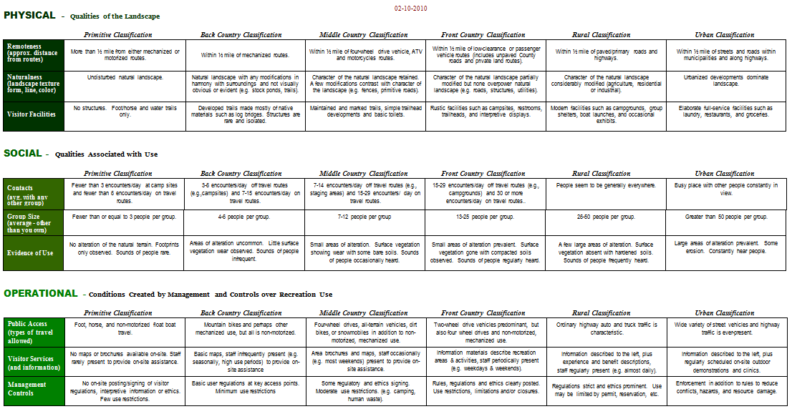
PLANNING FOR RECREATION AND VISITOR SERVICES
Recreation Setting Characteristics
Recreation Setting Characteristics Matrix
Notes:
R&VS Handbook pg. Appendices A3-1.
Here is what it look like displayed in a matrix format

Slide 12
PLANNING FOR RECREATION AND VISITOR SERVICES
Recreation Setting Characteristics
The Concept can be Adaptive
PRIMITIVE | SEMI-PRIMITIVE NONMOTORIZED | SEMI-PRIMITIVE MOTORIZED | ROADED NATURAL | RURAL | URBAN
Classes can be added, split, merged or removed
Characteristics can be added or deleted
Class names can be changed
Class descriptions can be modified
However,
the concept of a continuum or spectrum must remain
Notes:
The Concept can be Adaptive
Classes can be added, split, merged or removed
Characteristics can be added or deleted
Class names can be changed
Class descriptions can be modified
However, the concept of a continuum or spectrum must remain in tact.

Slide 13
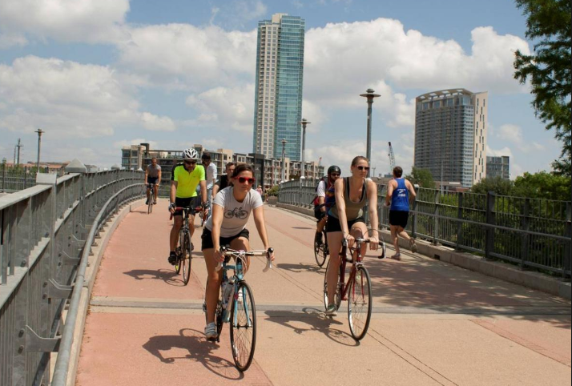
PLANNING FOR RECREATION AND VISITOR SERVICES
Recreation Setting Characteristics
PHYSICAL
PRIMITIVE | BACK COUNTRY | MIDDLE COUNTRY | FRONT COUNTRY | RURAL | URBAN
Notes:
Urban – physical setting class

Slide 14
PLANNING FOR RECREATION AND VISITOR SERVICES
Recreation Setting Characteristics
PHYSICAL
PRIMITIVE | BACK COUNTRY | MIDDLE COUNTRY | FRONT COUNTRY | RURAL | URBAN
Notes:
Front country – physical setting class

Slide 15
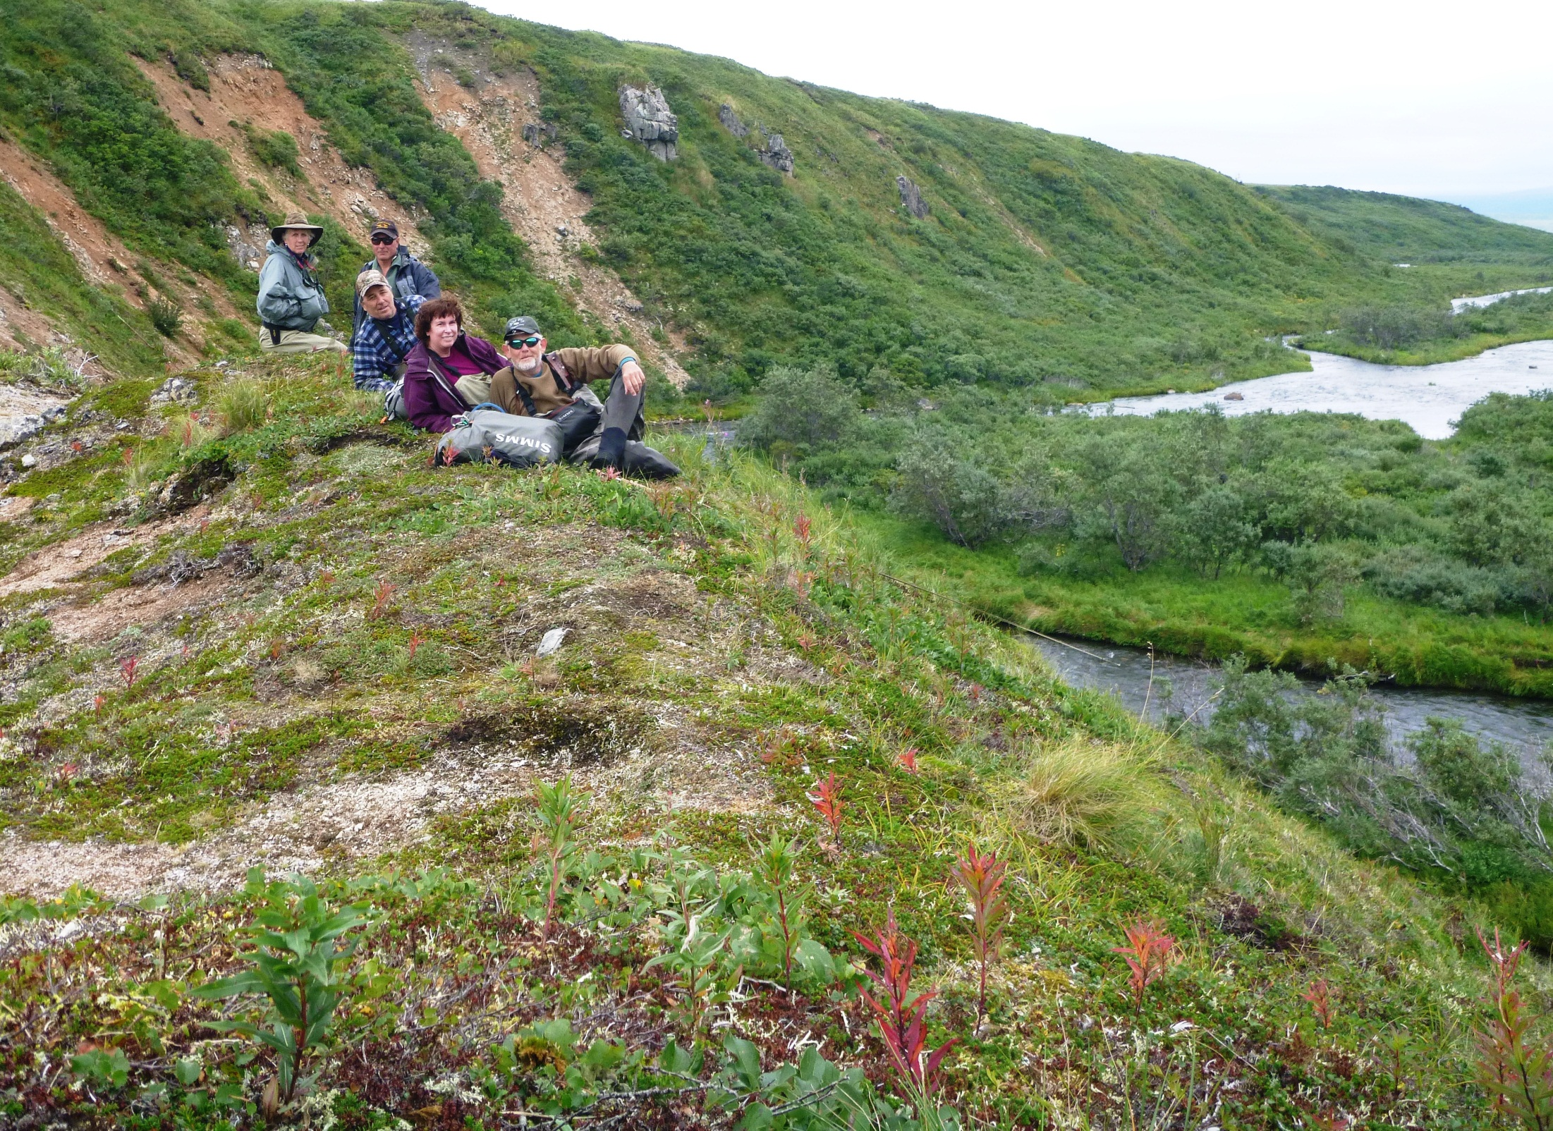
PLANNING FOR RECREATION AND VISITOR SERVICES
Recreation Setting Characteristics
PHYSICAL
PRIMITIVE | BACK COUNTRY | MIDDLE COUNTRY | FRONT COUNTRY | RURAL | URBAN
Notes:
primitive – physical setting class

Slide 16
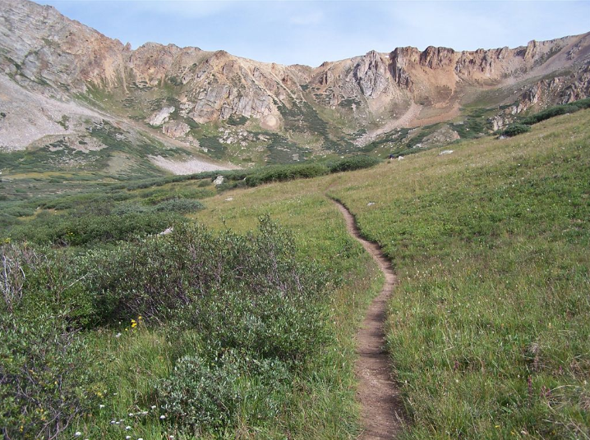
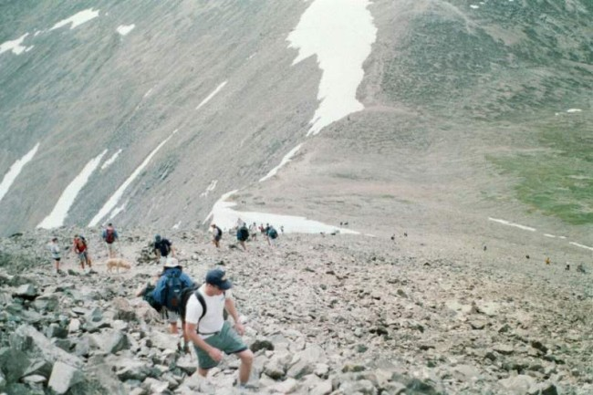
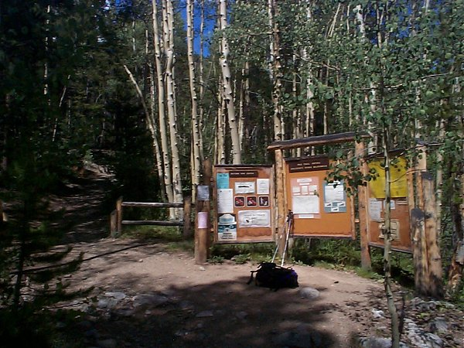
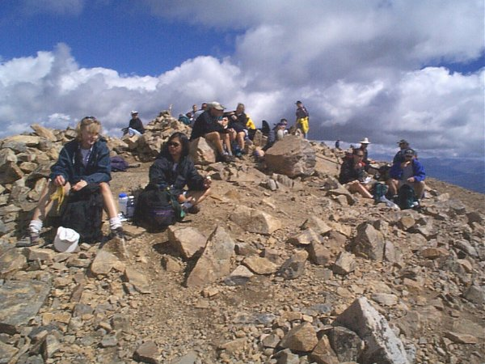
PLANNING FOR RECREATION AND VISITOR SERVICES
Let's put this all together!
EXERCISE:
Climbing a Colorado Fouteener
Notes:
Exercise – Sticky wall
Explain pictures (top left – Physical setting, bottom left – Operational Setting (rules and regulations), top and bottom right – Social Setting).
Have class stick up RSCs on Sticky wall
Explain that ROS resolved inconsistencies between the physical, social, and operational recreation settings by emphasizing the physical setting
Then ask does this really truly portray what is going on in the recreation area of the 14er?

Slide 17
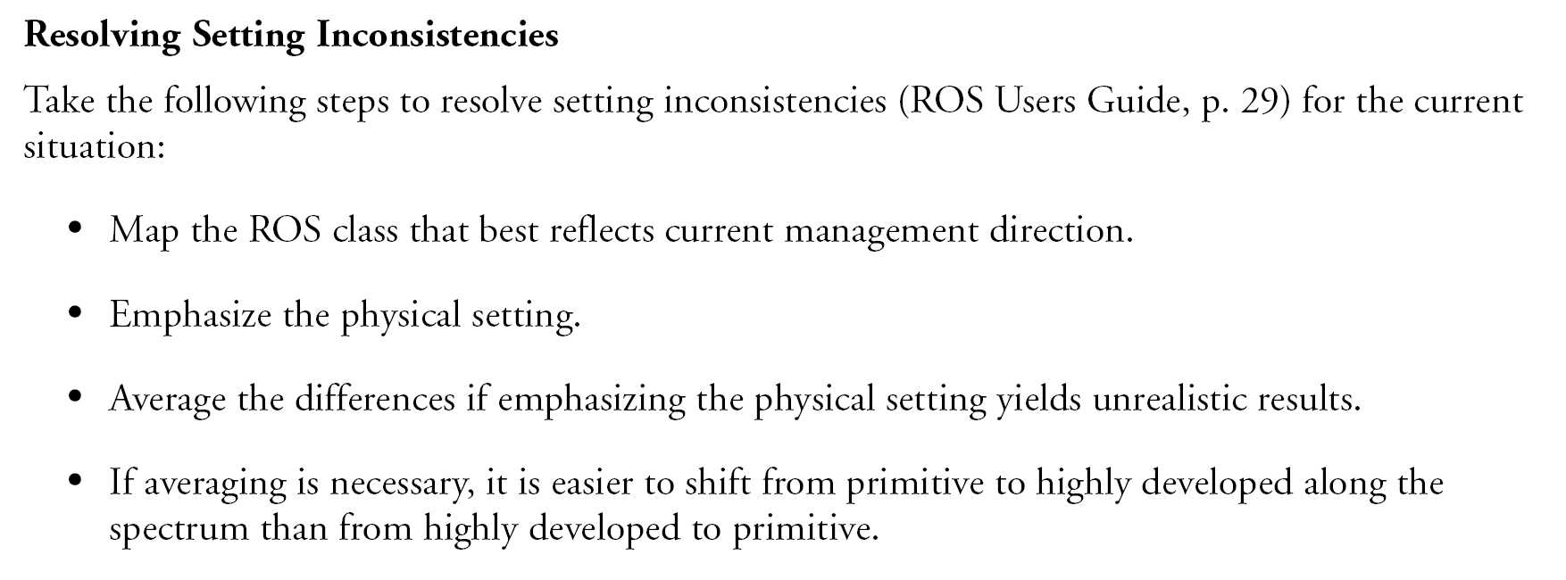
PLANNING FOR RECREATION AND VISITOR SERVICES
Recreation Setting Characteristics
Traditionally, the ROS process mapped the physical, social, and operational setting components separately and then combined all maps into one final composite map.
This often resulted in inconsistencies between the physical, social, and operational recreation settings.
Notes:
Explain - traditionally, the ROS process mapped the physical, social, and operational setting components separately and then combined all maps into one final composite map.
Unfortunately, this often resulted in a misrepresentation of the social and operational qualities of the recreation area, making the ROS difficult to understand and implement.

Slide 18
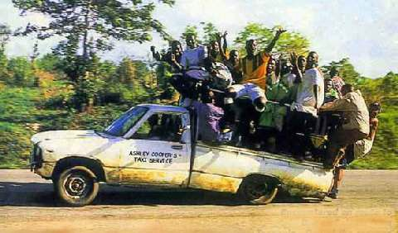
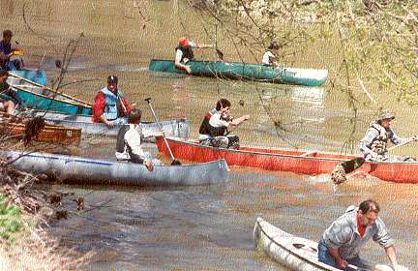
PLANNING FOR RECREATION AND VISITOR SERVICES
Recreation Setting Characteristics
But can you say that…
Contacts
Group size
Evidence of use
have no affect on your recreational experience?
Notes:
Because of this practice the SOCIAL COMPONENT & ATTRIBUTES are often not mapped, however they have a considerable affect on the visitor’s experiences.
Crowding can affect how and when people visit an area (Cordell 1999). Some people do not mind crowds and, in fact, crowds can positively influence their recreation experiences. Many others, however, find that crowding adversely affects their recreation experiences. Consequently, they may avoid visiting areas when they perceive the areas will be more crowded and shift their visits to other areas, other times of the week, or seasons of the year. If people perceive that areas are always crowded, they may simply avoid visiting them altogether (California State Parks 1998, 2002, 2003).

Slide 19
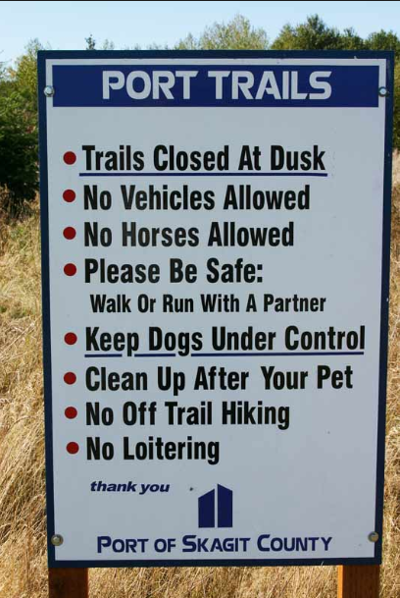
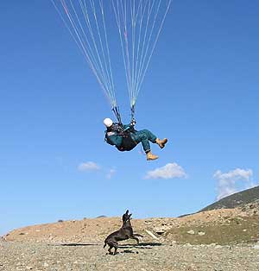
PLANNING FOR RECREATION AND VISITOR SERVICES
Recreation Setting Characteristics
But can you say that…
Type of Access
Visitor Services
Management Controls
Have no affect on your recreational experience?
Notes:
Because of this practice the SOCIAL COMPONENT & ATTRIBUTES are often not mapped, however they have a considerable affect on the visitor’s experiences

Slide 20
Setting Character Conditions | Unmodified natural land-scape. Use is minimal. Mostly free of administrative restrictions and controls. Only facilities for resource protection. No motorized use. | Mostly unmod-ified natural landscape. No roads. Low but evident use. Subtle restrictions and controls. Facilities for resource pro-tection and visitor safety. No motorized use. | Landscape appears natural but has primitive roads. Expect to see motorized and mechanized use, with some restrictions. Facilities for resource pro-tection and to accommodate use. | Resource uses evident, but harmonize with landscape. Improved roads. Rela-tively low use. Rustic facilities for user convenience, some for groups. Use restrictions for user security. | Environment substantially modified. Resource use and development obvious. Large-scale facilities built for and receive high use. Intensive motorized use facilities. | Natural envi-ronment highly modified with hardened sur-faces. Sights and sounds of many users dominate land-scape. Facili-ties accommo-date large numbers. Use restrictions are numerous.
Experience Opportunities | Good isolation, may feel like part of the natural environment, have high degree of challenge and risk, and use outdoor skills. | Some isolation and high inter-action with natural environment. Moderate challenge, risk, and use of outdoor skills. | Less frequent isolation but greater equip-ment testing. More competi-tive skills-building. Associated challenge and risk. | About equal isolation and affiliation with others. Still high interaction with natural world. Except for specialized uses, less risk and challenge. Can still build outdoor skills. | Affiliation and recreation site access are both high. Outdoor risk taking, skills building, and challenge are diminished, except as associated with motorized use. | Opportunities for affiliation with others is dominant. Others nearby who can help if needed. Social and facility-dependent experiences are dominant.
PRIMITIVE | SEMI-PRIMITIVE NONMOTORIZED | SEMI-PRIMITIVE MOTORIZED | ROADED NATURAL | RURAL | URBAN
Class
Setting Characterization
Experience Characterization
Notes:
ROS was also displayed setting character conditions leading to a specific set of experience opportunities.
Ask the question: In which Setting Character Condition can you experience a high degree of challenge and risk? Follow up question, do you think that can be experienced in a different setting such as Semi-Primitive Motorized or Urban?
Although not totally wrong, we now know that not just primitive settings that offer a high degree of challenge and risk and use of outdoor skills.

Slide 21
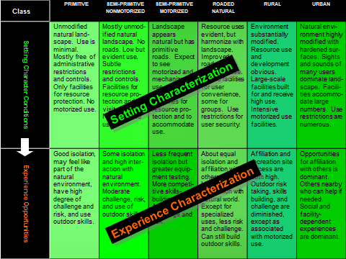
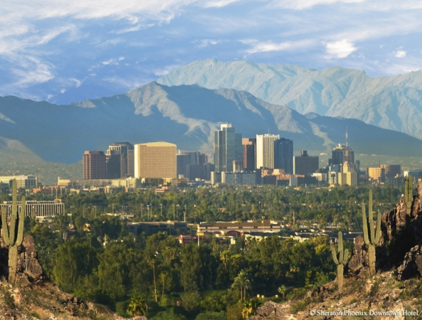
PLANNING FOR RECREATION AND VISITOR SERVICES
Recreation Setting Characteristics
The ROS concept was originally designed for federal agencies managing large land areas, often managerially simple (wilderness areas).
Lands – including BLM lands - in the west are becoming more diverse and complicated to manage, requiring the adaptation of ROS concepts.
Notes:
The ROS concept was originally designed for federal agencies managing large land areas, often managerially simple (wilderness areas).
Lands – including BLM lands - in the west are becoming more diverse and complicated to manage, requiring the adaptation of ROS concepts.

Slide 22
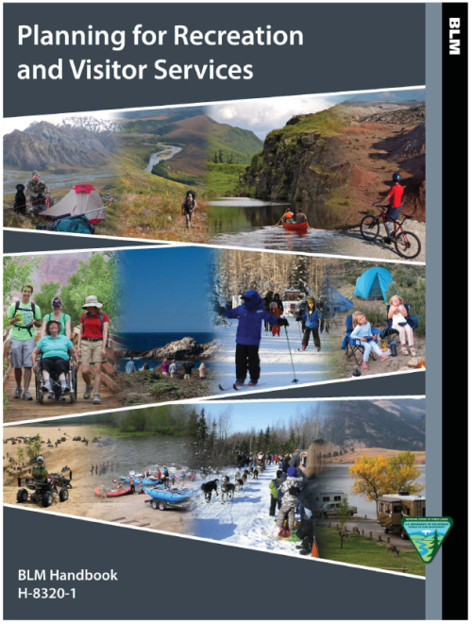
PLANNING FOR RECREATION AND VISITOR SERVICES
Recreation Setting Characteristics
In response, the BLM has modified the application of the ROS by not requiring the integration of the physical, social, and operational RSCs into one final composite map.
Adapting the ROS framework allows the existing and desired recreation setting components and characteristics to be displayed and described separately.
Notes:
Adapting the ROS framework allows the existing and desired recreation setting components and characteristics to be displayed and described separately. Ask the question, What are the benefits from doing this?
R&VS Handbook pg. 1-26.
Considering recreation setting components and characteristics separately:
Eliminates the need to resolve inconsistencies between the physical, social, and operational recreation settings components and characteristics.
Accurately depicts the recreation settings.
Displays the complexity of the recreation setting.
Provides clear implementation direction.
Creates adaptive and useful planning products.

Slide 23
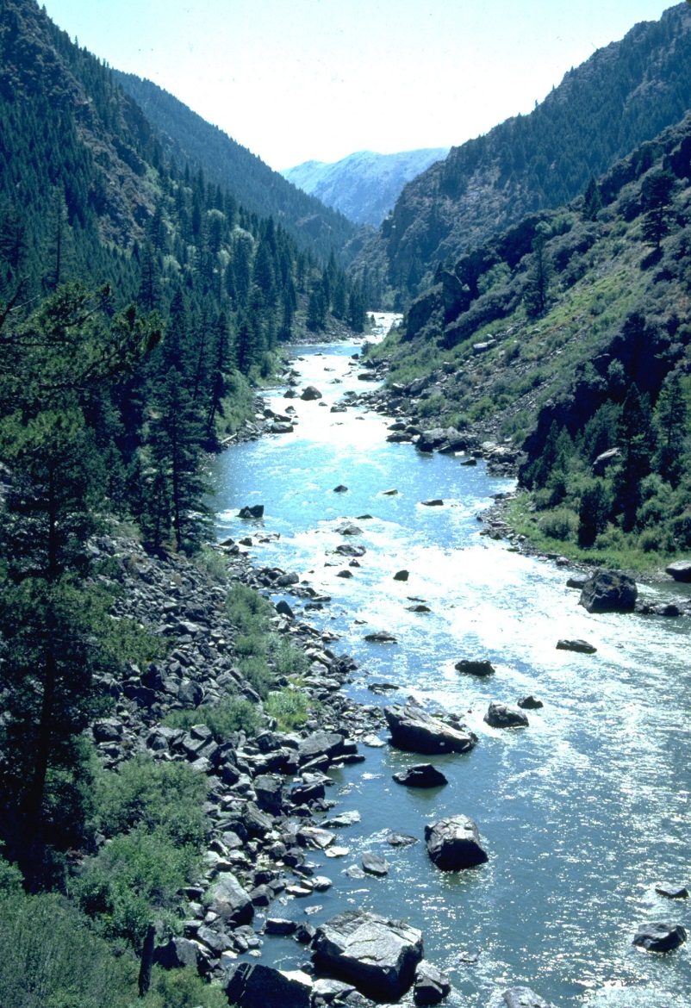
PLANNING FOR RECREATION AND VISITOR SERVICES
Recreation Setting Characteristics
To describe the recreation setting of a particular area, the classes, components, and characteristics can be:
Described through a narrative
Illustrated in matrix form
Illustrated on maps
Notes:
R&VS Handbook pg. 1-26.

Slide 24
PLANNING FOR RECREATION AND VISITOR SERVICES
Recreation Setting Characteristics
How are RSCs useful, what can we do with this tool?
Inventory
Describe
Consider values
Analysis
Set expectations
Notes:
R&VS Handbook pg.1-26 #3.
inventory the supply of recreational resources
describe the recreation setting of a geographic location
provide the basis for considering recreation values in the land use planning process
estimate the consequences of proposed management decisions on recreational opportunities
match settings and experiences recreationists desire with available recreation opportunities

Slide 25
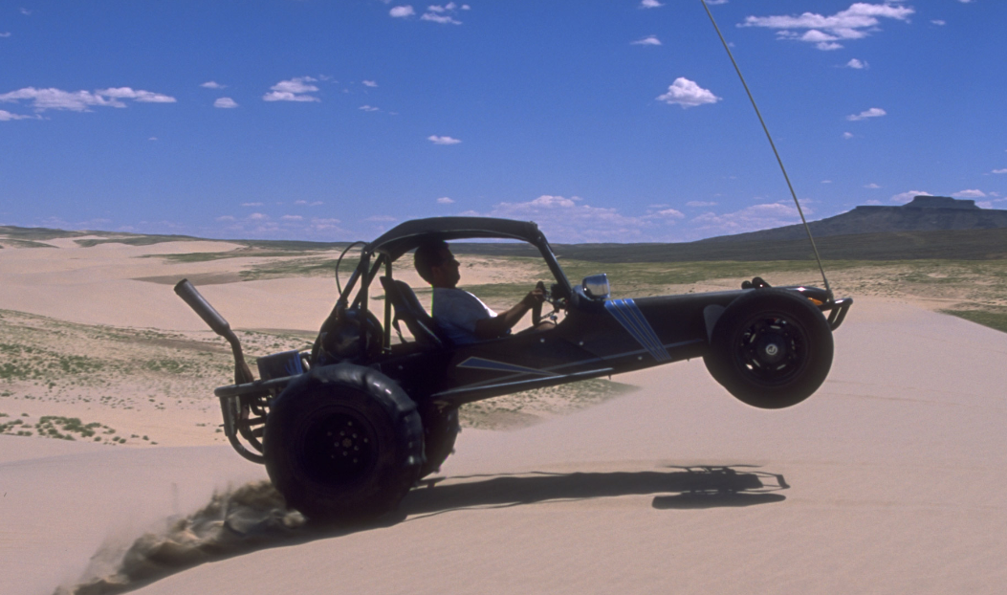
PLANNING FOR RECREATION AND VISITOR SERVICES
Recreation Setting Characteristics
Collecting detailed recreation setting data for a Land Use Plan
Where and,
Why
Notes:
R&VS Handbook pg. 1-26 & 27, #3.
Do you need to collect recreation setting data for the entire planning area?
Where do you need to collect it for and why?
To resolve specific scoping or planning issues
where recreation may be considered a primary resource management consideration, and

Slide 26
PLANNING FOR RECREATION AND VISITOR SERVICES
Describing Existing RSCs
RSCs can be described in 3 formats:
Narrative Format (minimum requirement for LUPs)
Matrix Format
Map Format
At a minimum, the physical, social, and operational RSCs must be described in a narrative format, based on the descriptions in the RSC matrix
Notes:
Each format has different benefits and each are useful when constructing the other formats.

Slide 27
PLANNING FOR RECREATION AND VISITOR SERVICES
Describing Existing RSCs
Narrative Format
Notes:
Pg. 1-27
The narrative format is useful for describing RSCs without engaging in an extensive mapping exercise. If the area is mapped, the number of acres by characteristic can be calculated and therefore provide some quantitative data.
The narrative is based in RSC matrix language but can be more detailed and descriptive
This can be useful in the analysis of the management situation or in planning documents that include many RMA alternatives.
The narratives can describe the RSCs for existing or proposed RMAs.
Data to describe the existing RSCs can be acquired from a variety of sources:
existing land use plans
existing RAMPs
visitor assessments
user group discussions
travel designations
existing GIS information (inc. from other resource programs)
staff observations
monitoring data
professional knowledge and judgment

Slide 28
PLANNING FOR RECREATION AND VISITOR SERVICES
Describing Existing RSCs
Matrix Format
Existing Physical RSCs - Blue Mesa SRMA
Primitive Classification (0 acres) | Back Country Classification (0 acres) | Middle Country Classification (7,300 acres) | Front Country Classification (1,450 acres) | Rural Classification (150 acres) | Urban Classification (140 acres)
Remoteness (approx. distance from routes)
More than ½ mile from either mechanized or motorized trails/routes. | Within ½ mile of mechanized trails/routes. | Within ½ mile of four-wheel drive vehicle, ATV and motorcycles routes. (BLM identified “Primitive Roads” and “Motorized Trails”) | Within ½ mile of low-clearance or passenger vehicle routes (BLM identified “Roads”) (includes unpaved County roads and private land routes). | Within ½ mile of paved/primary roads and highways. | Within ½ mile of streets and roads within municipalities and along highways.
Naturalness (landscape texture form, line, color)
Undisturbed natural landscape. | Natural landscape with modifications in harmony with surroundings and not visually obvious (e.g., stock ponds, habitat treatments, historic structures). | Character of the natural landscape retained. A few modifications contrast with character of the landscape (e.g., fences, ditches). | Character of the natural landscape partially modified but none overpower natural landscape (e.g., structures, utilities). | Character of the natural landscape considerably modified (i.e., agriculture, residential, airstrips or industrial alterations). | Urbanized developments dominate landscape.
Visitor Facilities
No structures. Foot/horse and water trails only. | Developed trails made mostly of native materials such as log bridges. Structures are rare and isolated. | Maintained and marked trails, simple trailhead developments. | Rustic facilities such as campsites, restrooms, trailheads, and interpretive displays. | Modern facilities such as campgrounds, group shelters, boat launches, and occasional exhibits. | Elaborate full-service facilities such as laundry, restaurants, and groceries.
Existing RSCs
Notes:
This is an example of displaying the existing RSCs in a matrix
To accurately know the correct boxes to highlight you need to do some level of mapping.
The benefits of using the matrix format are:
Provides a description of individual RSCs,
Used as a visual tool to display RSCs in documents or for discussions,
The classes of each RSC can be highlighted to visually show the supply of existing recreation settings (Appendix A3-1),
Can be used in lieu of RSCs narratives, or it can be used to complement maps displaying RSCs.
It can concisely display both existing and desired RSCs in the same graphic which will be discussed during Module 7.

Slide 29
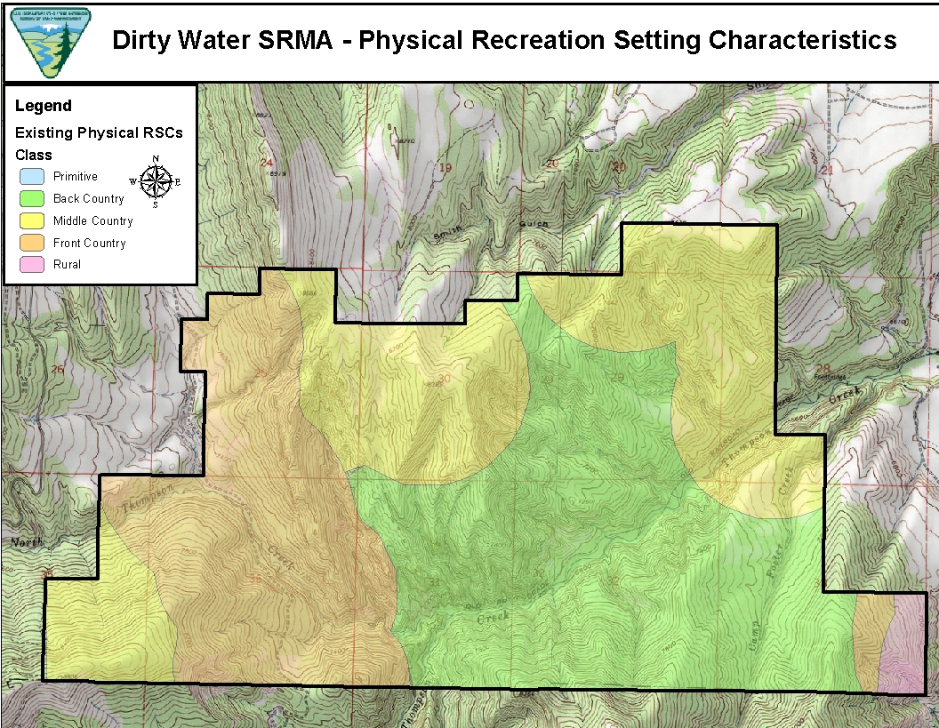
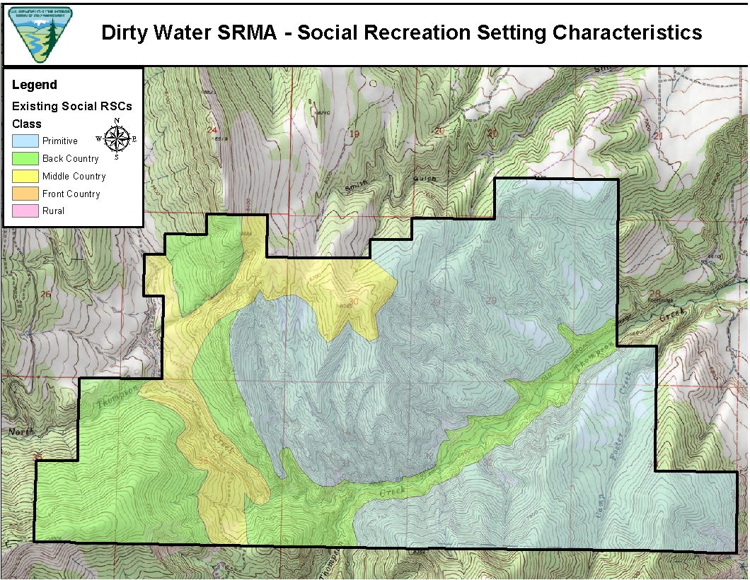
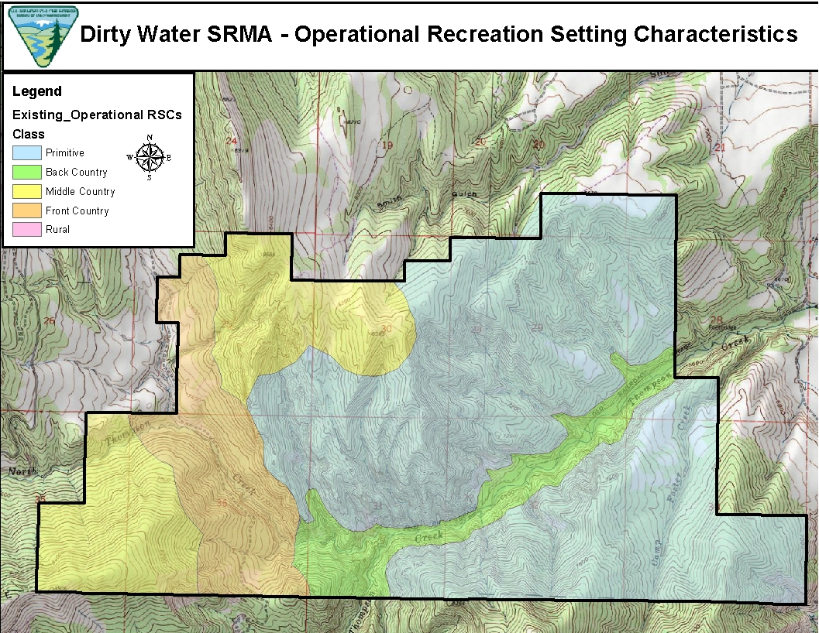
PLANNING FOR RECREATION AND VISITOR SERVICES
Describing Existing RSCs
Map Format
Notes:
Map format is the preferred format for displaying RSCs. The benefits include:
Displays the settings spatially,
Provides data for quantitative analysis,
Easier to do for large geographic areas such as the entire planning area
This will offer useful data to support other LUP decisions.
Use GIS data along with RSC narrative and matrix to help construct maps.

Slide 30
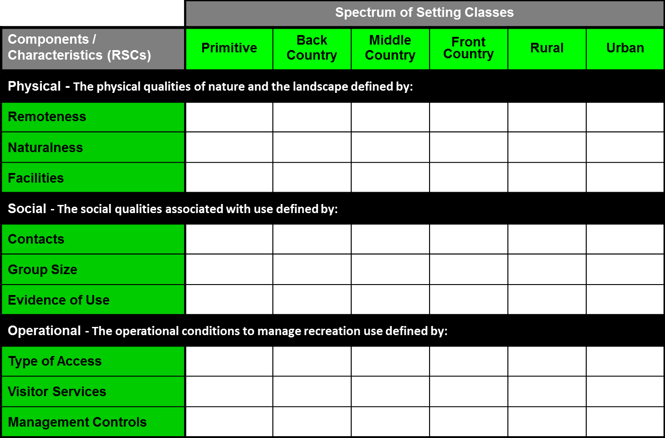
PLANNING FOR RECREATION AND VISITOR SERVICES
Describing Existing RSCs
Mapping Recreation Setting Characteristics
Map measurable and determinative RSCs (having the most influence on the desired recreation opportunities)
The other RSCs can then be used to refine the basemap, if necessary
Notes:
R&VS Handbook pg. 1-31
The following are additional considerations for mapping RSCs:
i. When mapping RSCs, involve other BLM staff, interdisciplinary team members, and the public who have local knowledge of the planning area.
ii. At a minimum, map the RSCs that have been identified as determinative (i.e., having the most influence on the desired recreation opportunities) **This information can be derived from the survey’s or focus groups.
iii. Map the RSCs without regard to land ownership. Mapping all land ownership is critical because RSCs on adjacent federal, state, local government, tribal, and private lands influence settings on public lands. However, only publish the RSCs on BLM lands to avoid conveying any perception that the BLM will be making decisions for lands not under its jurisdiction.
iv. The outdoor recreation planner and the GIS specialist must coordinate when creating maps. The GIS specialist is best able to determine which GIS tools to use. The planner is best able to explain the RSC matrix and to describe which data should be displayed.
v. Document all assumptions in the metadata, and consistently use these assumptions through all phases of planning.
vi. Label maps by listing the incorporated attributes.
vii. If physical, social, or operational characteristics change substantially by season, it may be necessary to make separate maps based on the season of use (e.g., summer, hunting season, and winter).

Slide 31
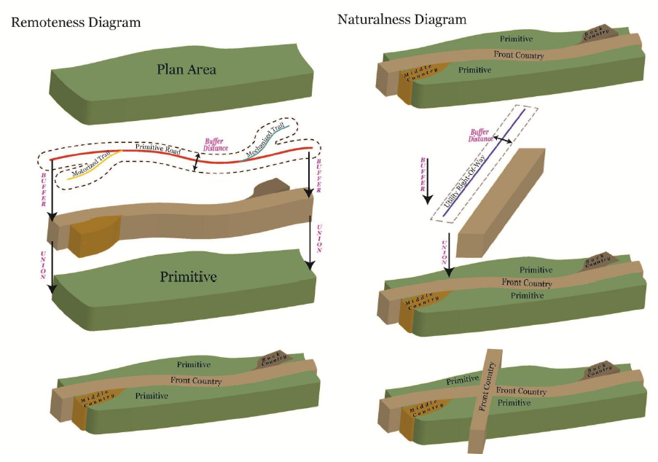
PLANNING FOR RECREATION AND VISITOR SERVICES
Describing Existing RSCs
Notes:
R&VS Handbook pg. 1-32
** Refer to the RSC matrix when going through this exercise. Appendix A3-1.
Mapping the remoteness characteristic (Determinative) displays the remoteness from human modifications associated with routes.
Creating the physical map requires travel management data on trails, primitive roads, roads (e.g., BLM, county, state, federal, and possibly private), and route designations.
Creating the map also involves delineating class boundaries (i.e., primitive to urban) using distance criteria from routes in the RSC matrix (e.g., backcountry - within ½ mile of mechanized routes).
The resulting map is considered the base physical map.
The base map can/should be refined using the Natualness and Visitor Facilities characteristics. Most visitor facilities are located along routes therefore it may not be as useful when refining the physical map. However, the Naturalness characteristic may be necessary if impacts are not associated with a route, see the Naturalness diagram on the slide.

Slide 32
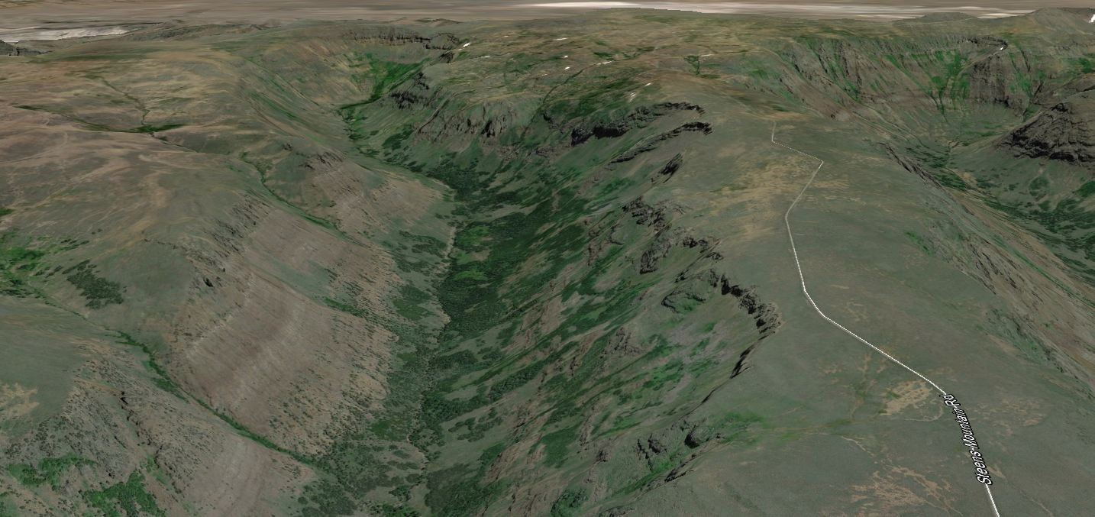
PLANNING FOR RECREATION AND VISITOR SERVICES
Describing Existing RSCs
Mapping Recreation Setting Characteristic
Other Considerations
The distance criteria can be adjusted based on topography or vegetation. For example, if the area is forested or mountainous, the distances can be reduced to better display existing conditions.
This may require manually
digitizing class boundaries
using topographical data or
aerial photos.
Notes:
Any adjustments made should be documented in the GIS attribute table and/or meta data.
Insert image from google earth where there is a road on a canyon rim and then adjust the distance.

Slide 33
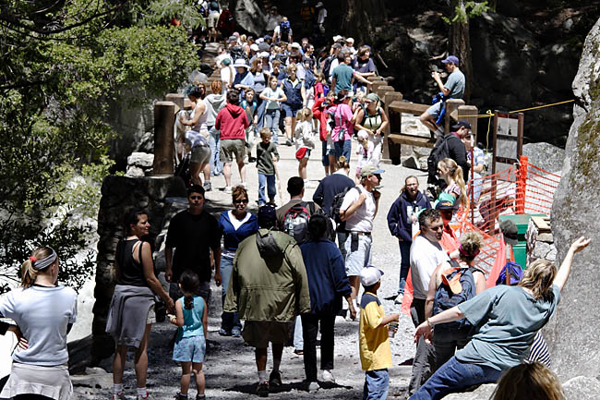
PLANNING FOR RECREATION AND VISITOR SERVICES
Describing Existing RSCs
Social Recreation Setting Component Map
Creating the social RSC map requires knowledge of recreation use and patterns of use by season, area or route
The numbers of contacts are
usually estimated using
professional knowledge
when visitor use data are
not available
However,……….
Notes:
Social Recreation Setting Component Map
Physical and operational are easy to understand and the HB does a good of explaining mapping those components. I just want to say a few things about mapping the social component.
Creating the social RSC map requires knowledge of recreation use and patterns of use by season, area or route
The numbers of contacts (Determinative characteristic for the Social component) are usually estimated using professional knowledge when visitor use data are not available

Slide 34
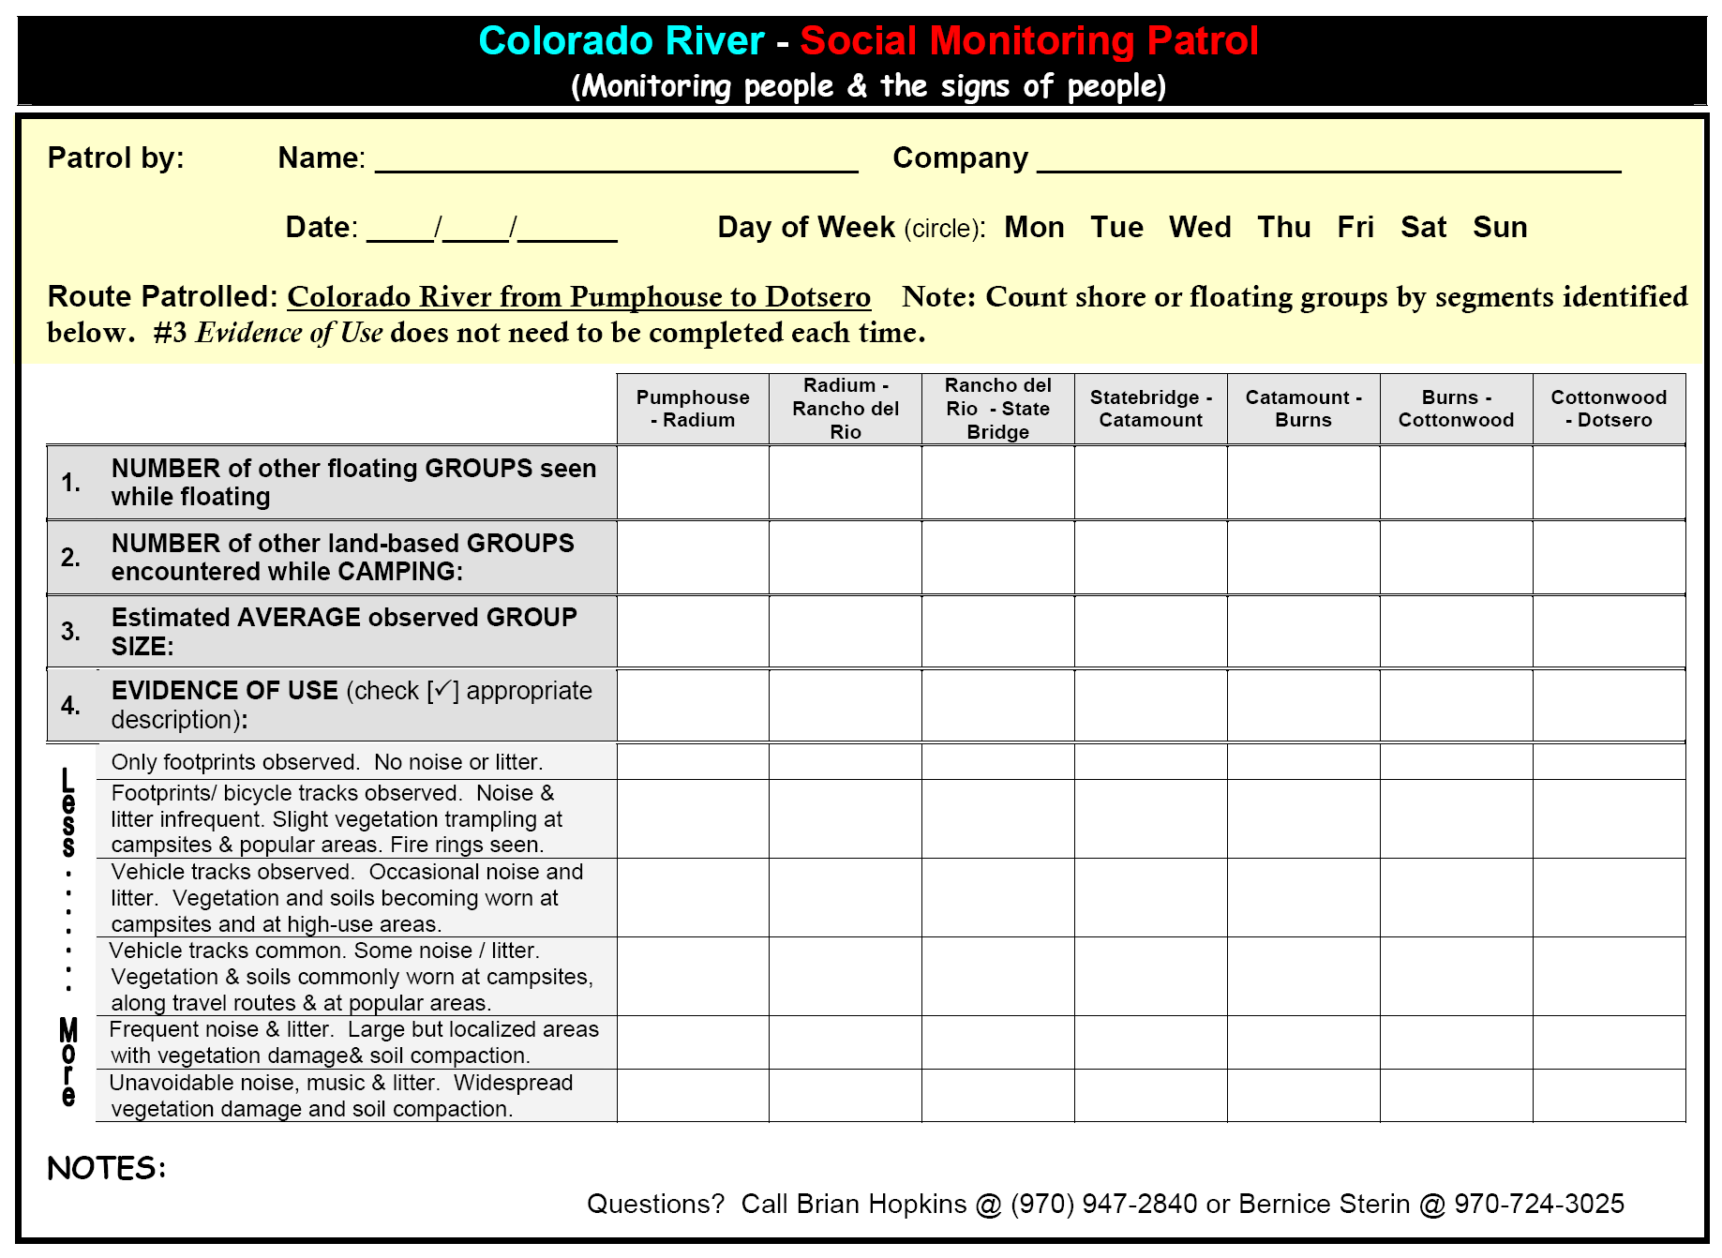
PLANNING FOR RECREATION AND VISITOR SERVICES
Describing Existing RSCs
Notes:
If you can plan ahead you can actually collect pretty good social data.
How?
monitoring forms, sample form for monitoring in a river corridor
staff and/or even partners or outfitters do the monitoring

Slide 35
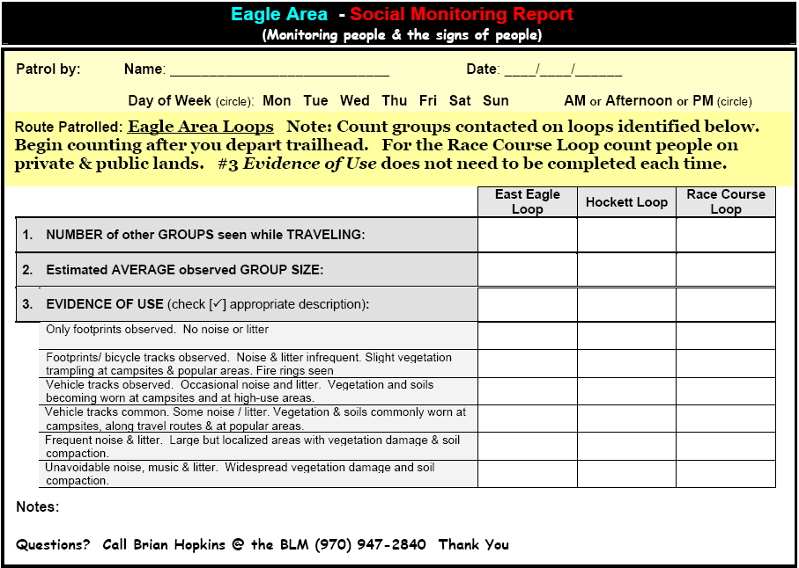
PLANNING FOR RECREATION AND VISITOR SERVICES
Describing Existing RSCs
Front side
Notes:
Front side of Trail-based monitoring form.

Slide 36
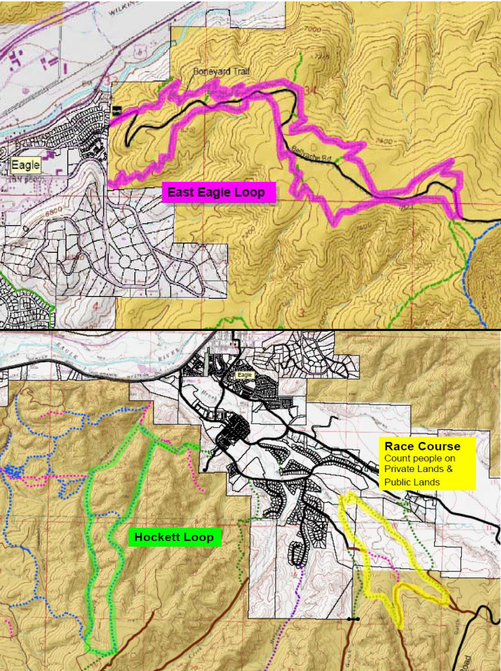
PLANNING FOR RECREATION AND VISITOR SERVICES
Describing Existing RSCs
Back side
Notes:
Back side of Trail-based monitoring form.

Slide 37
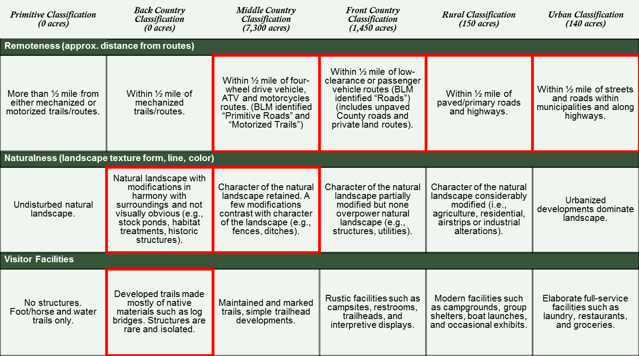
PLANNING FOR RECREATION AND VISITOR SERVICES
Describing Existing RSCs
Mapping Recreation Setting Characteristic
Other Considerations
Relating the
Narrative Format
to the
Matrix Format
to the
Map Format
Notes:
Is there is relationship? If so what is it?

Slide 38
PLANNING FOR RECREATION AND VISITOR SERVICES
Recreation Setting Characteristics
Notes:
Is there is relationship? If so what is it?
The Physical RSC map should display the same classes as the Physical RSC Matrix.

Slide 39
PLANNING FOR RECREATION AND VISITOR SERVICES
Describing Existing RSCs
Mapping Recreation Setting Characteristic
Other Considerations
Notes:
Mapping Recreation Setting Characteristic Other Considerations
Although the premise of mapping RSCs is easy to understand it takes a little time and some practice to functionally use the concept and it is a way to rationally and methodically document the physical, operational and social characteristics that make up the “recreation environment” we manage .
And you will make some professional judgments, just be consistent and document rationale for any adjustments made.
Existing RSC data/information will be used later in the LUP process.

Slide 40
PLANNING FOR RECREATION AND VISITOR SERVICES
Describing Existing RSCs
Handout Steens exercise Physical, Social and Operational setting maps and the Steens base map.
Notes:
Handout Steens exercise Physical, Social and Operational setting maps.
Ask the class for “Questions”?

Slide 41
Steens Fly Over
Notes:
Jared will run this.

