Slide 1

PLANNING FOR
RECREATION AND VISITOR SERVICES
Goals and Objectives

Slide 2

PLANNING FOR
RECREATION AND VISITOR SERVICES
Module 6 - What we will be discussing
Writing Land Use Plan Goals
and Objectives for RMAs and
Undesignated Lands
H-8320-1 – Pages II-1 to II-6
Notes:
Module 6 - What we will be discussing
Writing Land Use Plan Goals
Objectives for RMAs and Undesignated Lands

Slide 3
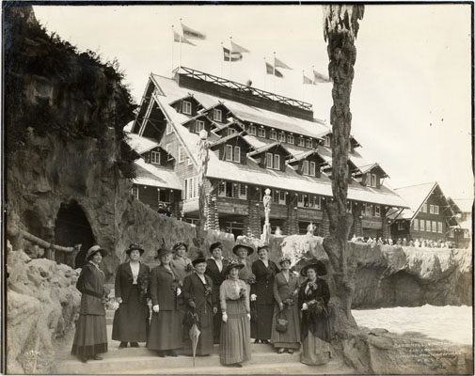
PLANNING FOR
RECREATION AND VISITOR SERVICES
Goals and Objectives
Before we go any farther...
Resource Management Plans have not used
the same "dictionary" when defining:
goals, outcomes, objectives, standards or guidelines
Notes:
Resource Management Plans have not consistently used the same "dictionary" when defining:
goals, outcomes, objectives, standards or guidelines.
But BLM has now defined what is required for R&VS in LUPs.

Slide 4
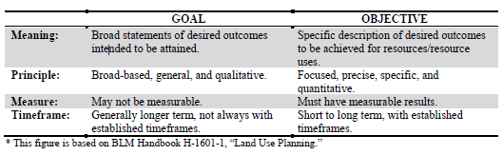
PLANNING FOR
RECREATION AND VISITOR SERVICES
Goals and Objectives
Summary - Comparison of Goals and Objectives
Notes:
Summary - Comparison of Goals and Objectives

Slide 5

PLANNING FOR
RECREATION AND VISITOR SERVICES
Goals and Objectives
Simply put - the difference between
Goals and Objectives
- where you're going
- identifiable steps toward a goal
Notes:
Talk about a road trip to a vacation destination

Slide 6
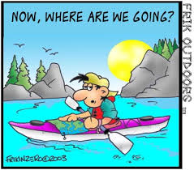
PLANNING FOR
RECREATION AND VISITOR SERVICES
R&VS Goals
Goals
Notes:
Goals

Slide 7
PLANNING FOR
RECREATION AND VISITOR SERVICES
R&VS Goals
Consider:
Think about the future of the planning area
Avoid focusing on management activities of the recreation staff
Goals may be recreation specific or interdisciplinary, depending on the structure of the plan
Sources may include BLM recreation goals, strategic plans, LUP planning themes
Goals should be realistic and attainable
R&VS goals should be consistent with other program goals
Notes:
When developing goals……
Think about the future of the planning area.
Avoid focusing on management activities of the recreation program and staff.
Depending on the structure of the plan, goals may be recreation specific or interdisciplinary
Sources may include departmental recreation goals, strategic plans, LUP planning themes, purpose and need of the planning process.
Goals should be realistic and attainable.
R&VS goals should be consistent with other program goals.

Slide 8
PLANNING FOR
RECREATION AND VISITOR SERVICES
R&VS Goals
To keep the process simple, you goal could be the answer to the answer the following question:
Over the life of the LUP, what will be the general results or accomplishments of the R&VS program?
Notes:
To keep the process simple, write a goal to answer the following question:
Over the life of the LUP, what will be the general results or accomplishments of the recreation program?
Ask the class if they have ever thought about a question like this at their FO?

Slide 9
PLANNING FOR
RECREATION AND VISITOR SERVICES
R&VS Goals
To keep the process simple, you goal could be the answer to the answer the following question:
Over the life of the LUP, what will be the general results or accomplishments of the R&VS program?
An answer to this question might be:
The R&VS program will produce a diversity of quality recreational opportunities that add to the recreation participant’s quality of life, benefit local communities and contribute to regional economies while maintaining public land health
Notes:
To keep the process simple, write a goal to answer the following question:
Over the life of the LUP, what will be the general results or accomplishments of the recreation program?
Ask the class if they have ever thought about a question like this at their FO?

Slide 10
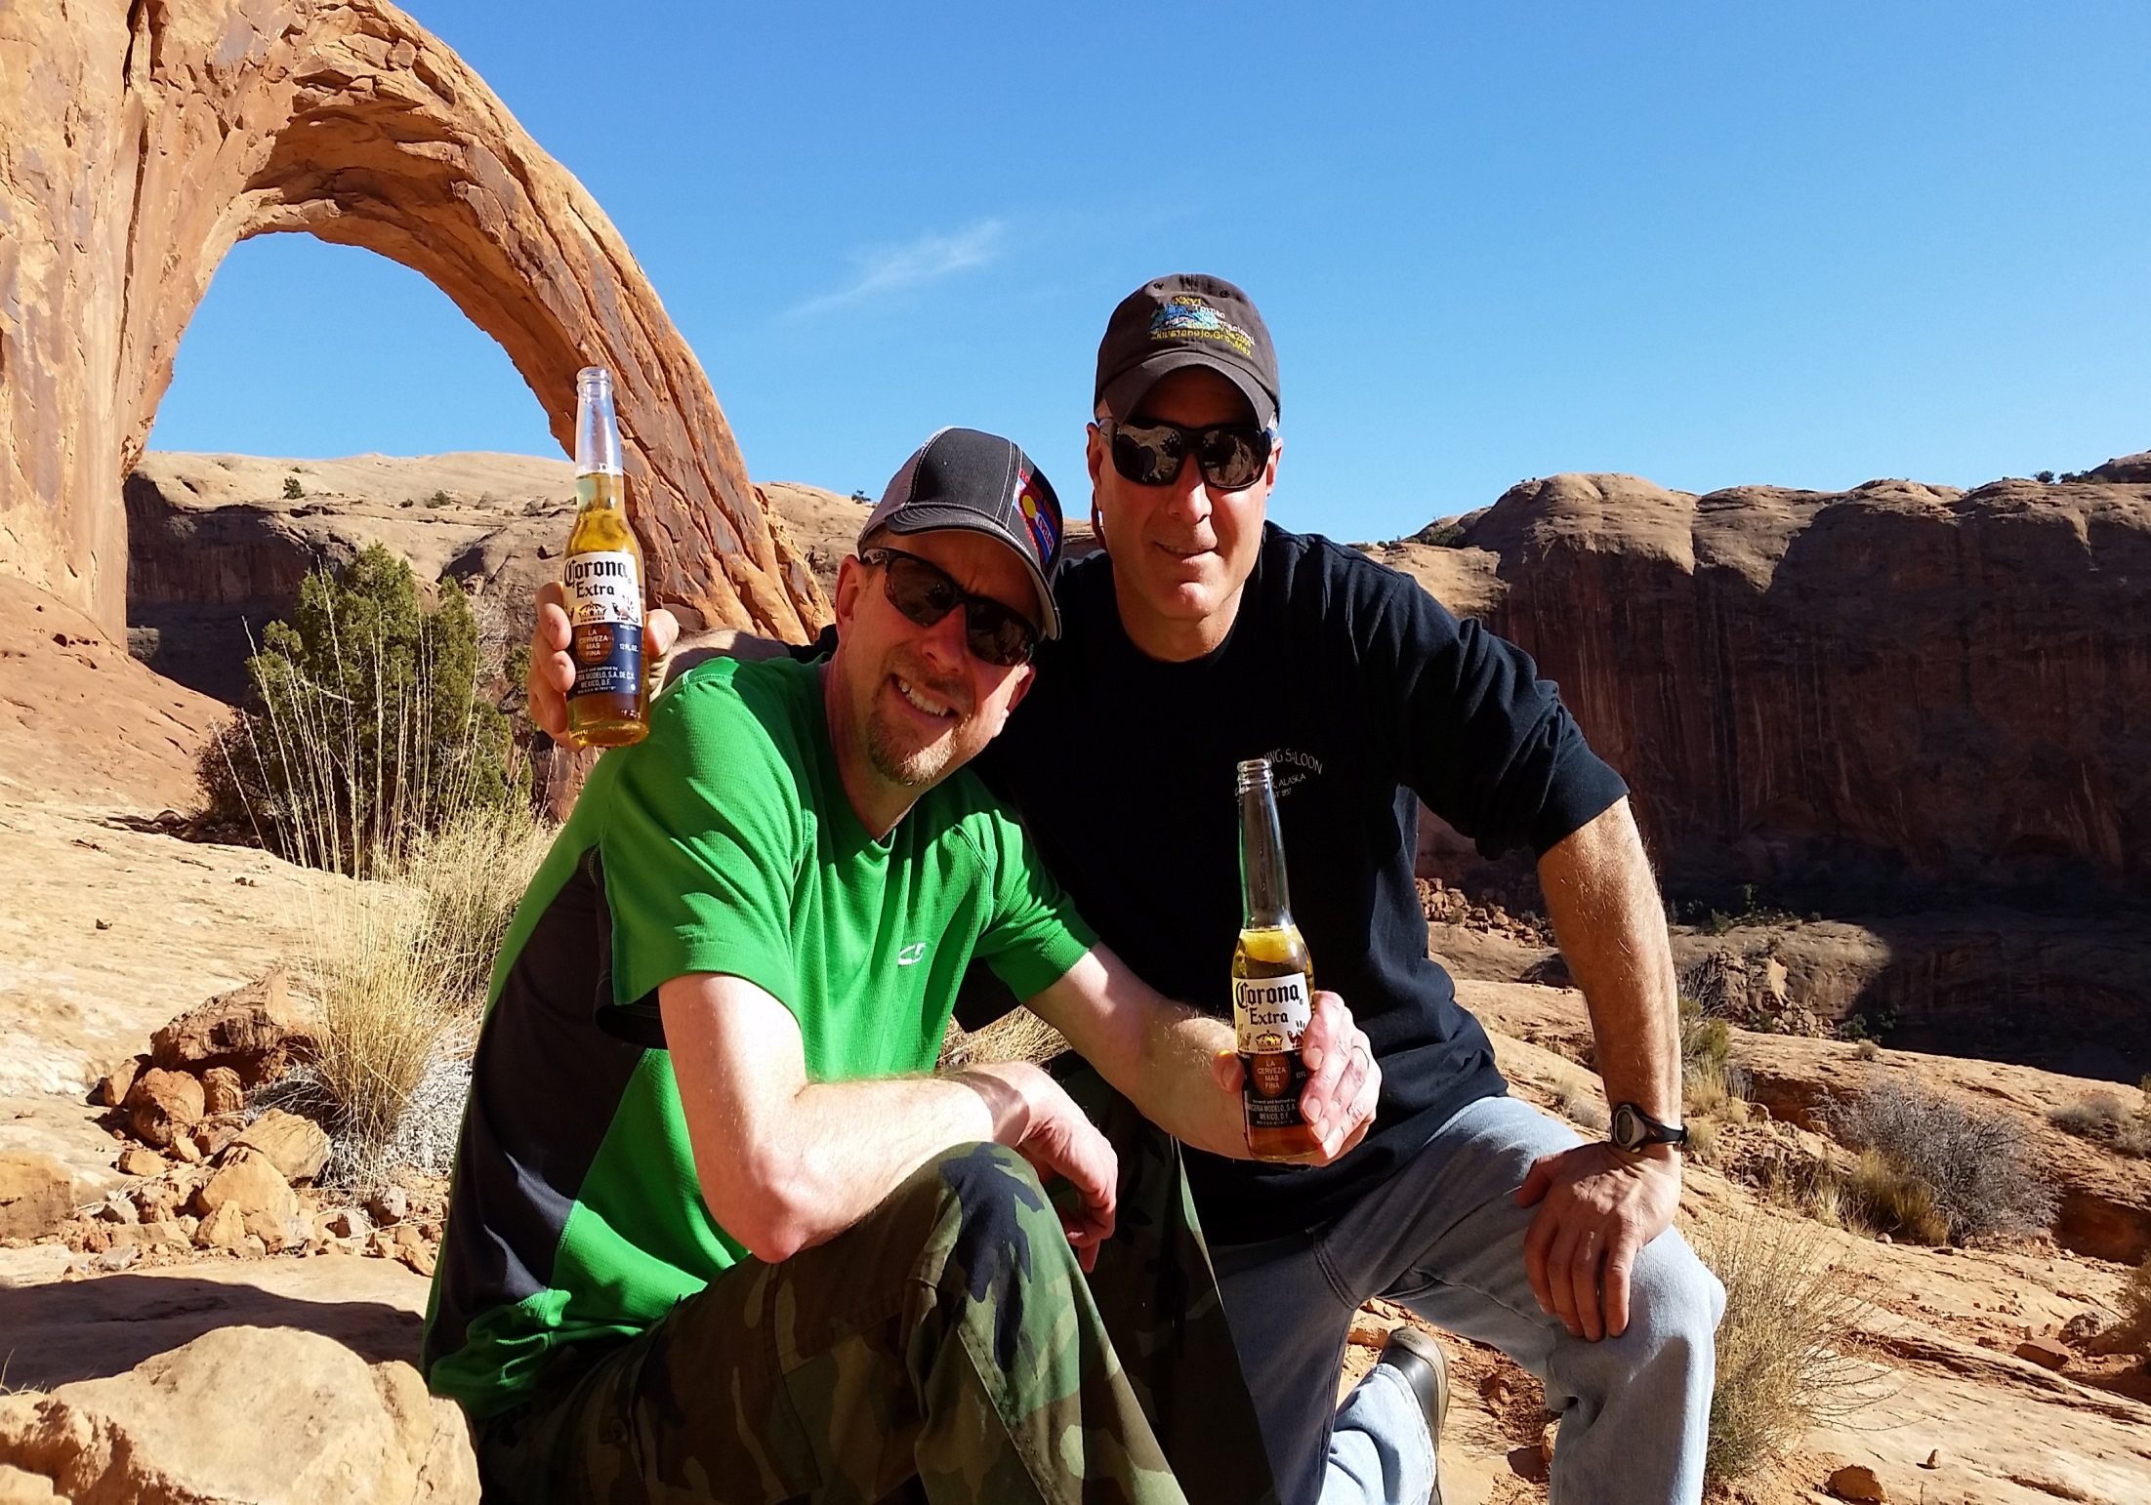
PLANNING FOR
RECREATION AND VISITOR SERVICES
R&VS Objectives
SRMA Objectives

Slide 11
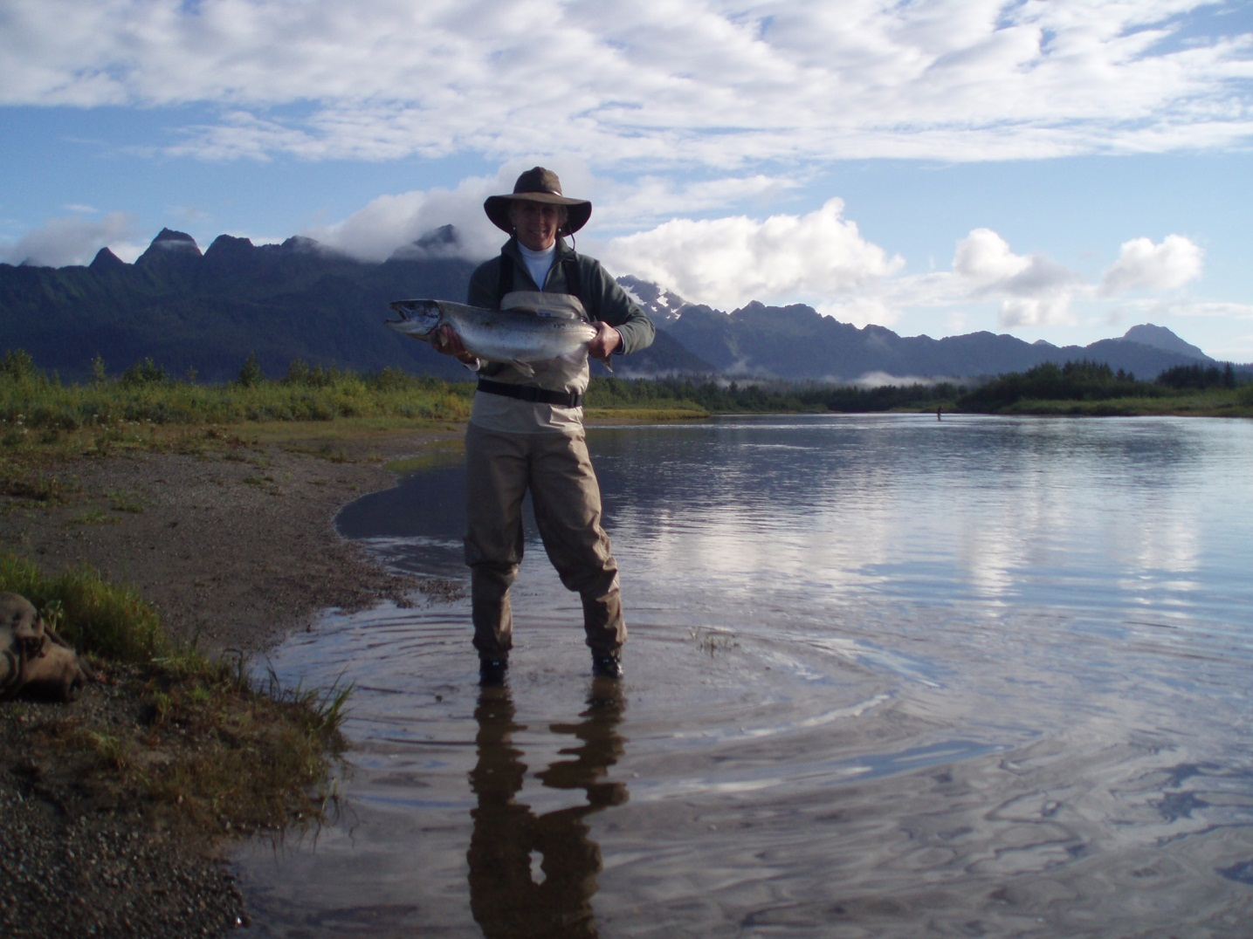
PLANNING FOR
RECREATION AND VISITOR SERVICES
R&VS Objectives
R&VS Objectives describe desired outcomes to be achieved for resources or resource uses
Notes:
Specific desired outcomes for resources. Objectives are usually quantifiable and measurable and may have established timeframes for achievement (as appropriate).
Outcome objectives represent a “direction for recreation area management” and many
stakeholders care a great deal about our management

Slide 12
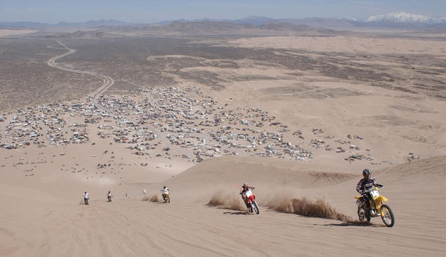
PLANNING FOR
RECREATION AND VISITOR SERVICES
R&VS Objectives
Outcomes-focused recreation objectives for an SRMA or RMZ identify:
the recreation activities to be targeted and
the specific outcomes (experiences and benefits) to be realized
Notes:
Outcome-focused recreation objectives for an SRMA or for RMZs within an SRMA identify:
the specific outcomes (experiences and benefits) to be produced or realized and
(2) the recreation activities to be emphasized

Slide 13
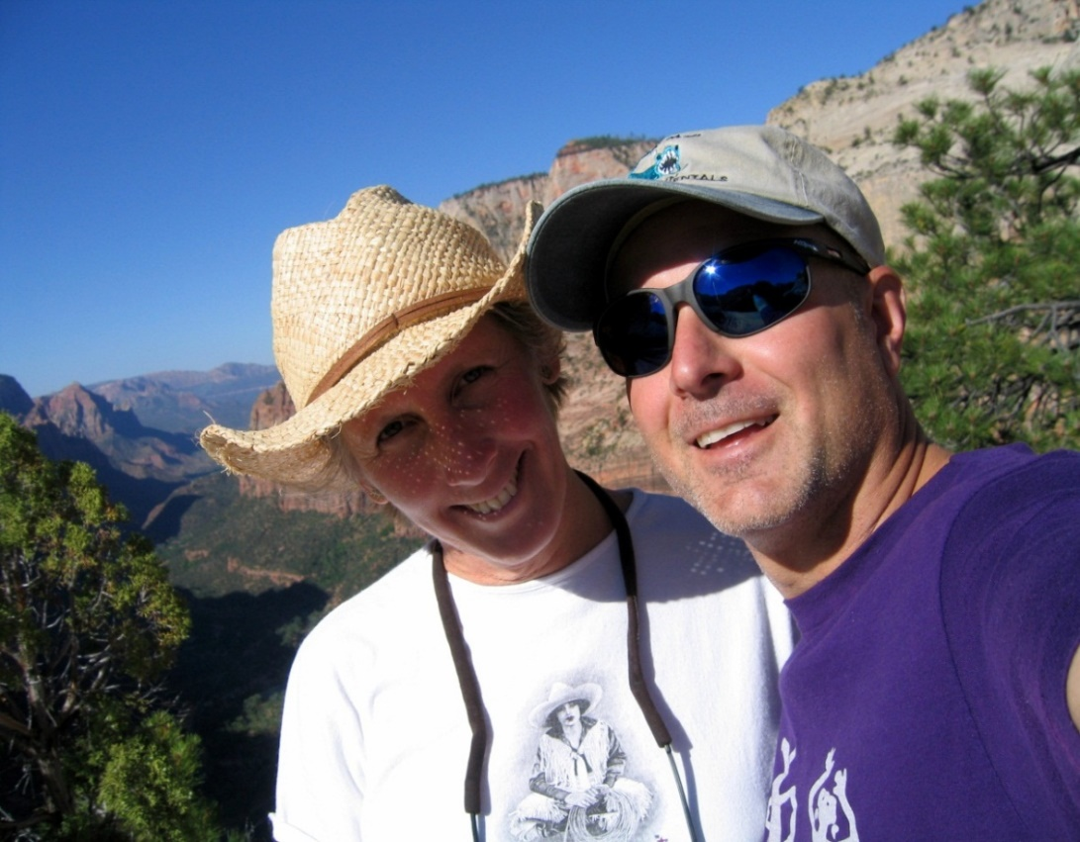
PLANNING FOR
RECREATION AND VISITOR SERVICES
R&VS Objectives
The principal difference between traditional objectives and OFM objectives is that OFM objectives target specific:
activities and desired outcomes
instead of:
recreation development,
implementation, or
resource protection
Notes:
The principal difference between traditional objectives and OFM objectives is that OFM objectives target specific activities, experiences and benefits instead of recreation development, RSCs or resource protection.

Slide 14
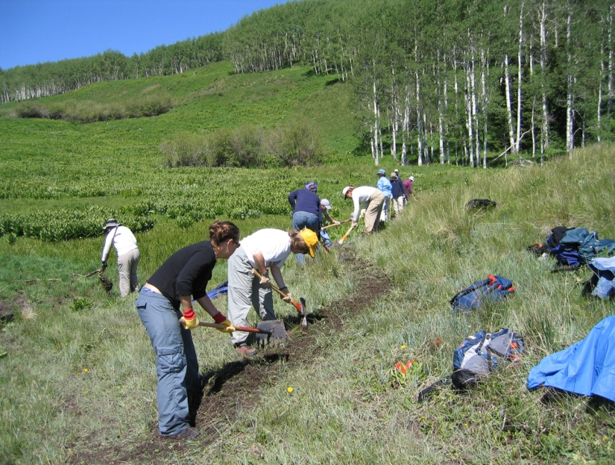
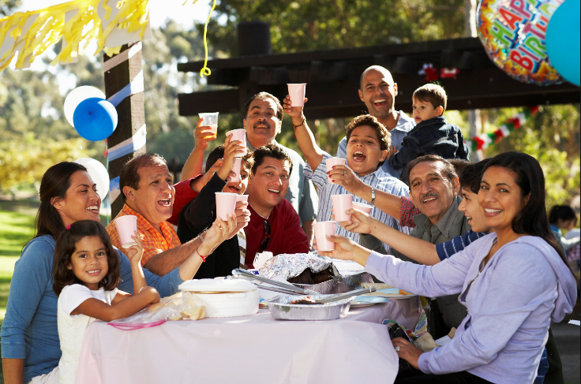
PLANNING FOR
RECREATION AND VISITOR SERVICES
R&VS Objectives
You need to distinguish between objectives that relate to …
"To Do" List
Desired Outcomes
Notes:
You need to distinguish between objectives that relate to …work…. and objectives that relate the ….impact …..of our actions and activities

Slide 15
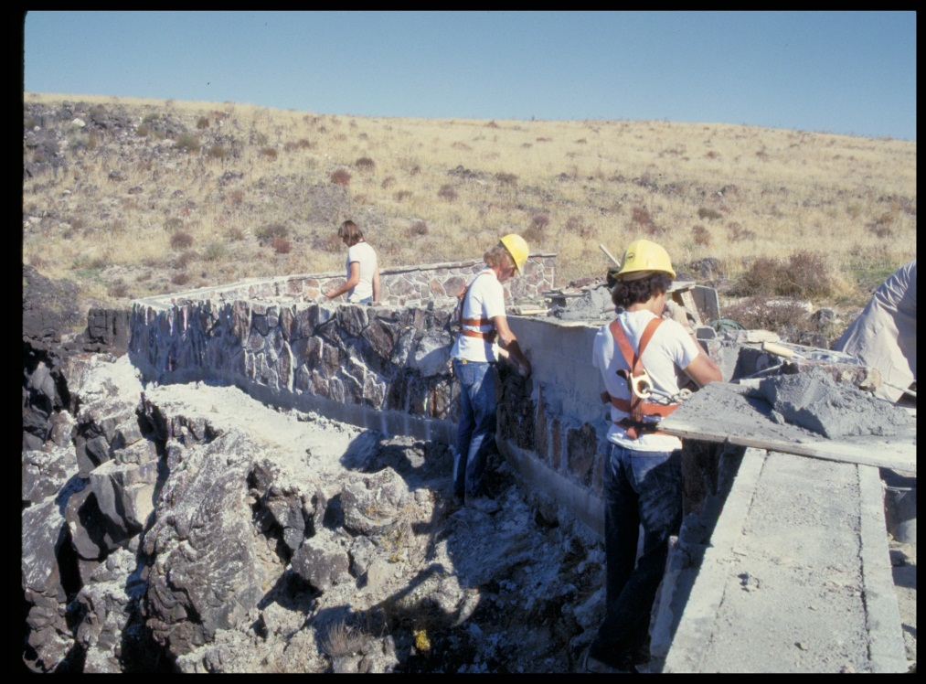
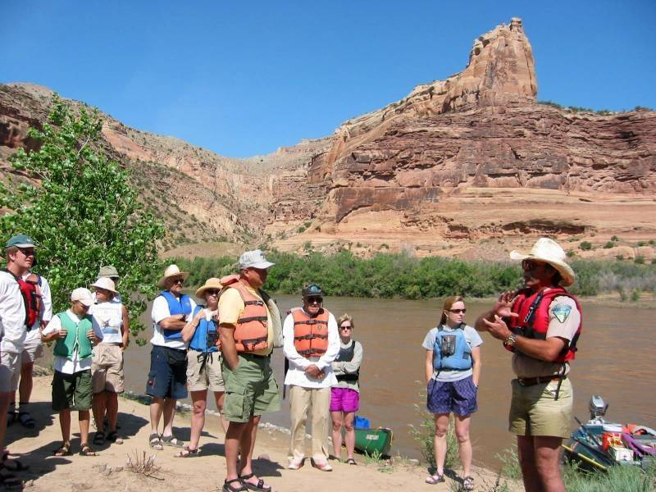
PLANNING FOR
RECREATION AND VISITOR SERVICES
R&VS Objectives
When completed the “To Do” or implementation objectives are indications that you are making progress in carrying out your plan, but do not prove, in & of themselves, that you are making progress toward achieving your goals

Slide 16
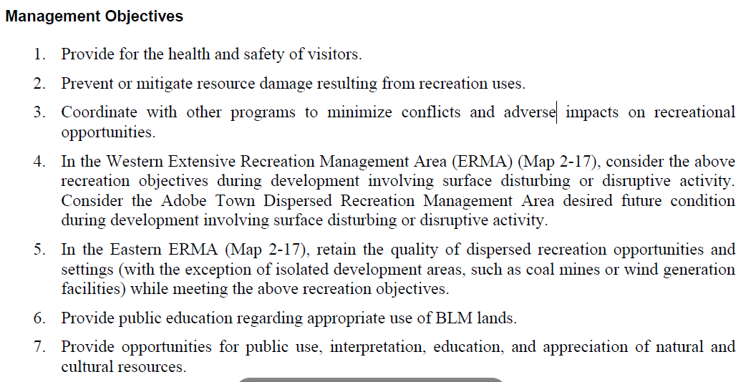
PLANNING FOR
RECREATION AND VISITOR SERVICES
R&VS Objectives
Implementation objectives typically begin with words describing things you will do such as: provide, build, manage, or coordinate…
"To Do" List

Slide 17
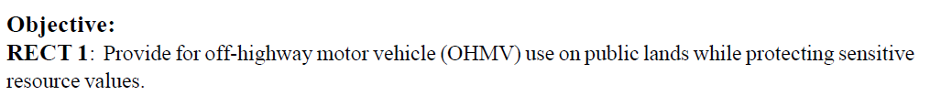
PLANNING FOR
RECREATION AND VISITOR SERVICES
R&VS Objectives
Desired Outcomes
Target specific activities, experiences and benefits
"To Do" List
Recreation development, implementation or resource protection
Notes:
The principal difference between traditional objectives and OFM objectives is that OFM objectives target specific activities, experiences and benefits instead of recreation development, RSCs or resource protection.

Slide 18
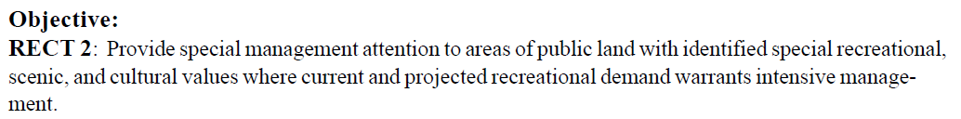
PLANNING FOR
RECREATION AND VISITOR SERVICES
R&VS Objectives
Desired Outcomes
Target specific activities, experiences and benefits
"To Do" List
Recreation development, implementation or resource protection
Notes:
The principal difference between traditional objectives and OFM objectives is that OFM objectives target specific activities, experiences and benefits instead of recreation development, RSCs or resource protection.

Slide 19
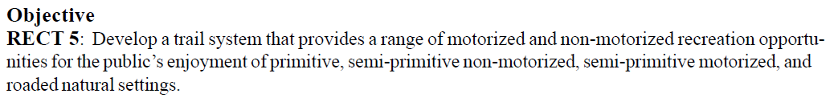
PLANNING FOR
RECREATION AND VISITOR SERVICES
R&VS Objectives
Desired Outcomes
Target specific activities, experiences and benefits
"To Do" List
Recreation development, implementation or resource protection
Notes:
The principal difference between traditional objectives and OFM objectives is that OFM objectives target specific activities, experiences and benefits instead of recreation development, RSCs or resource protection.

Slide 20

PLANNING FOR
RECREATION AND VISITOR SERVICES
R&VS Objectives
Desired Outcomes
Target specific activities, experiences and benefits
"To Do" List
Recreation development, implementation or resource protection
Notes:
The principal difference between traditional objectives and OFM objectives is that OFM objectives target specific activities, experiences and benefits instead of recreation development, RSCs or resource protection.

Slide 21
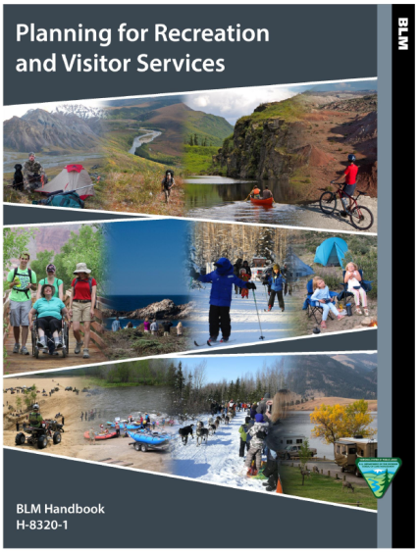

PLANNING FOR
RECREATION AND VISITOR SERVICES
R&VS Objectives
Think about this objective…
“By the end of 2008, there will be recreation planners trained to write outcome-focused
recreation objectives in every FO.”
We may accomplish this action, however…
… can we tell if we are making beneficial differences for visitors, communities, economies or the environment?
Notes:
This is a tricky one. The input objective only says what we are going to do. Discuss that we need an outcome objective to judge whether we are making a difference.

Slide 22
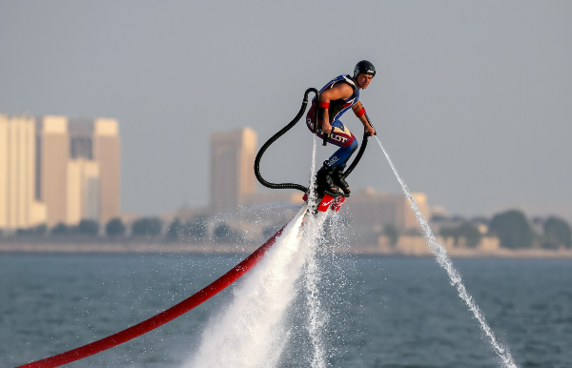
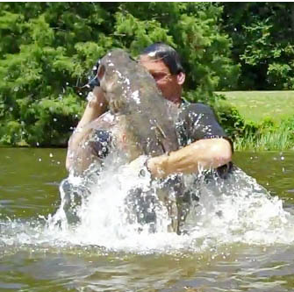
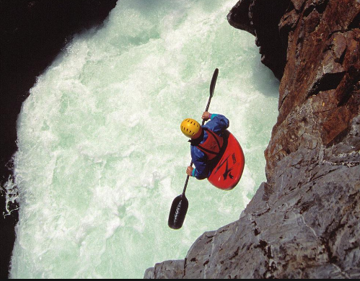
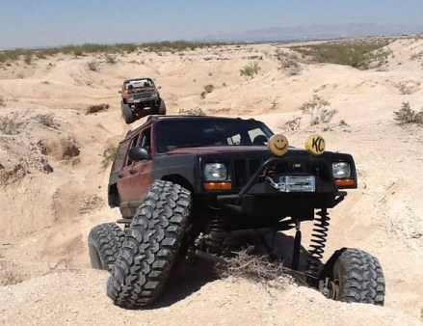
PLANNING FOR
RECREATION AND VISITOR SERVICES
R&VS SRMA Objectives
The challenge is to determine:
the demand for activities and outcomes
as well the stakeholders capacity to offer the activities and facilitate the outcomes
Notes:
The challenge is to determine: the demand for activities and outcomes as well the stakeholders ability to offer the activities and facilitate the outcomes

Slide 23

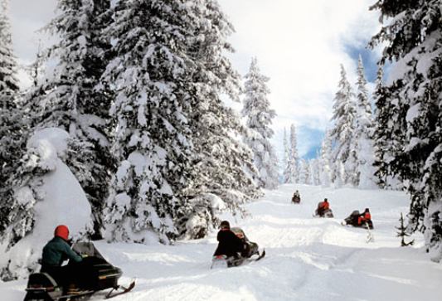
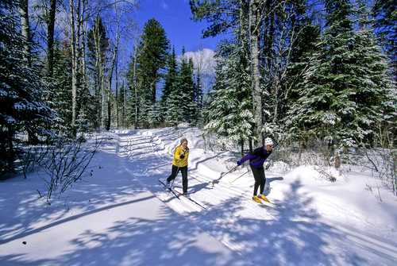
PLANNING FOR
RECREATION AND VISITOR SERVICES
R&VS SRMA Objectives
How would you identify which activities to target?
VS
Notes:
Ask “How would you identify which activities to target?”

Slide 24
PLANNING FOR
RECREATION AND VISITOR SERVICES
R&VS SRMA Objectives
Consider:
visitor demands (recreation assessments)
scoping and public comments
existing uses and user groups
use professional judgment
administrative capability
sustainability over the life of the plan
compatibility with other land uses
Remember - Activities not compatible with the targeted activities may need to be constrained or eliminated

Slide 25
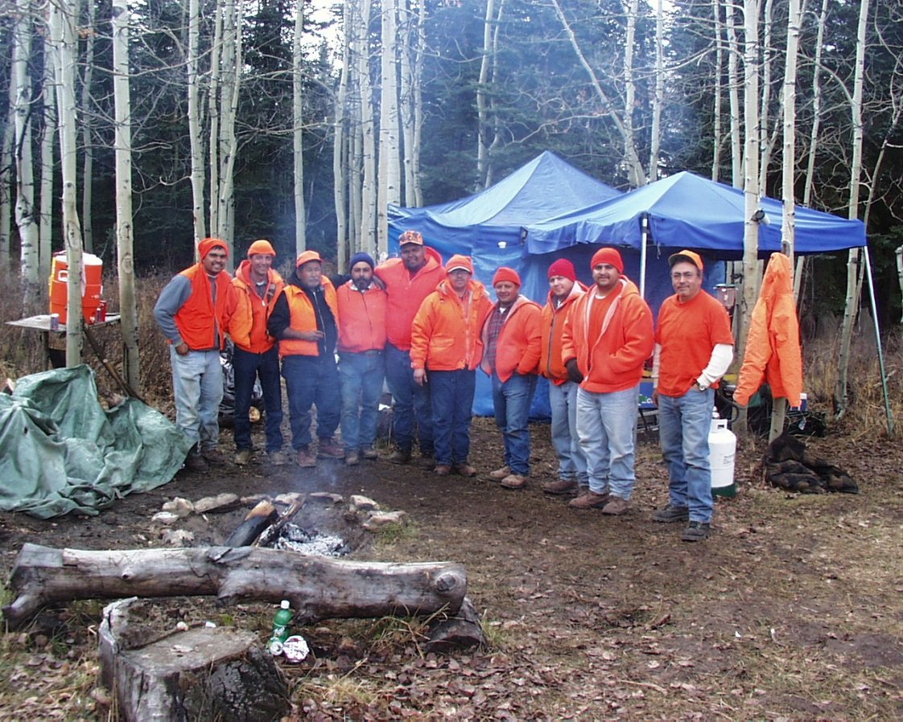
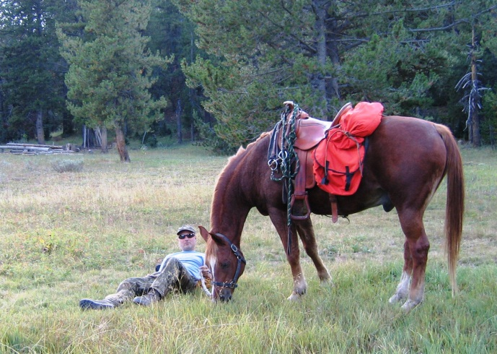
PLANNING FOR
RECREATION AND VISITOR SERVICES
R&VS SRMA Objectives
Be inclusive of the cluster of activities in the SRMA/RMZ necessary to facilitate the outcomes
Hunting, Horseback Riding and Camping

Slide 26
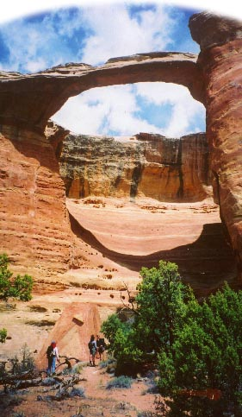


PLANNING FOR
RECREATION AND VISITOR SERVICES
R&VS SRMA Objectives
So what would be the cluster of activities in this RMZ?
Notes:
ASK THE QUESTION…So what would be the cluster of activities in this RMZ?
ANSWER on next slide

Slide 27
PLANNING FOR
RECREATION AND VISITOR SERVICES
R&VS SRMA Objectives
So what would be the cluster of activities in this RMZ?
Four-wheeling,
Hiking and Viewing Arches
GJFO McInnis Canyons NCA Rattlesnake-Mee Canyons Access (Zone 10)
Notes:
Answer appears

Slide 28


PLANNING FOR
RECREATION AND VISITOR SERVICES
R&VS SRMA Objectives
Participation in recreational activities lead to multiple experiences …
Identify...
Enjoying 1) canyon-country aesthetics & 2) a closer relationship with the natural world.

Slide 29

PLANNING FOR
RECREATION AND VISITOR SERVICES
R&VSSRMA Objectives
Participation in recreational activities lead to multiple experiences …
… and experiences lead to multiple personal, social, environmental, and economic benefits – both on-site and off-site
On-site
Off-site
Identify...
Enjoying 1) canyon-country aesthetics & 2) a closer relationship with the natural world.
Greater environmental awareness & sensitivity
Improved stewardship/
preservation

Slide 30
PLANNING FOR
RECREATION AND VISITOR SERVICES
R&VS SRMA Objectives
Consider:
the demand preferences from recreation assessments
planning process – scoping, public input, and work groups
the capacity to facilitate desired outcomes
professional judgment
Notes:
the demand preferences from recreation assessments
planning process – scoping, public input, and work groups
the capacity to produce desired outcomes
professional judgment

Slide 31
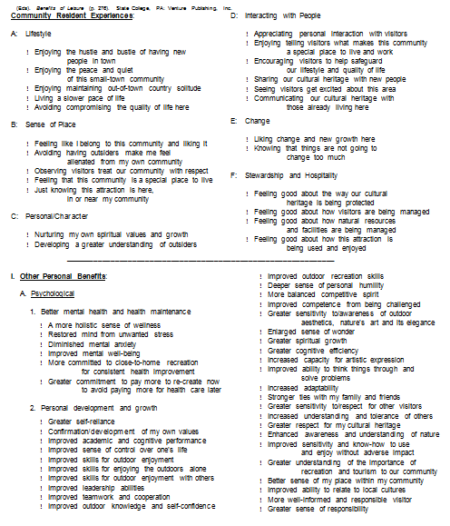
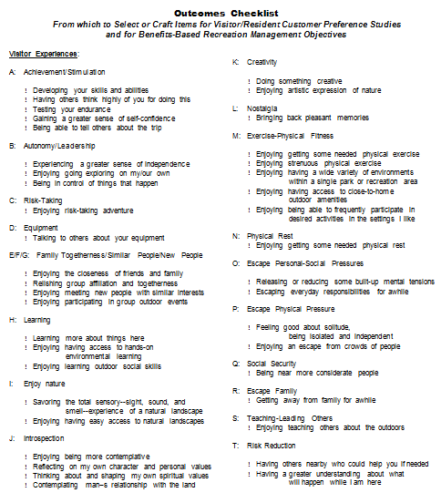
PLANNING FOR
RECREATION AND VISITOR SERVICES
R&VS Objectives
Key Tool - Experience and Benefit Checklist (see Appendix 2) as a guide (but not a shopping list).
Notes:
Key Tool - Experience and Benefit Checklist (Appendix 2) as a guide (but not a shopping list).

Slide 32
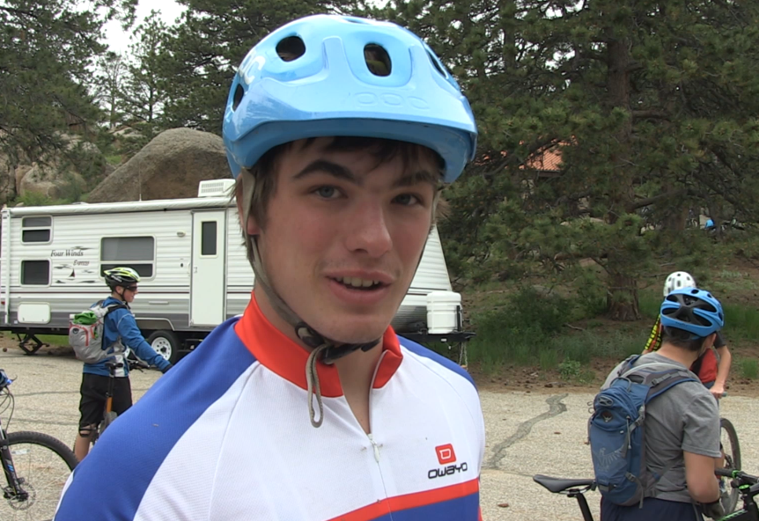
PLANNING FOR
RECREATION AND VISITOR SERVICES
R&VS SRMA Objectives
EXERCISE 1.
Listen to the Wyoming State Parks video. Individually write down outcomes you hear discussed in the video.
Notes:
EXERCISE 1 – Identifying Outcomes
TELL THE CLASS: Listen to the Wyoming State Parks video and individually capture as many outcomes as you can from the video.

Slide 33

PLANNING FOR
RECREATION AND VISITOR SERVICES
R&VS SRMA Objectives
Outcomes in Video:
Enjoying Exercise
Developing Friendships
Reduced Obesity
Reconnecting with Nature
Improving Skills and Abilities
Freedom
Individualism
Healthy Bodies
Happier Mind
Economic Contributions
Learning about Trail Construction
Notes:
EXERCISE 1 – Identifying Outcomes
Listen to the Wyoming State Parks video and individually capture as many outcomes as you can from the video.
Outcomes in Video
Enjoying Exercise
Developing Friendships
Reduced Obesity
Reconnecting with Nature
Improving Skills and Abilities
Freedom
Individualism
Healthy Bodies
Happier Mind
Economic Contributions
Learning about Trail Construction

Slide 34
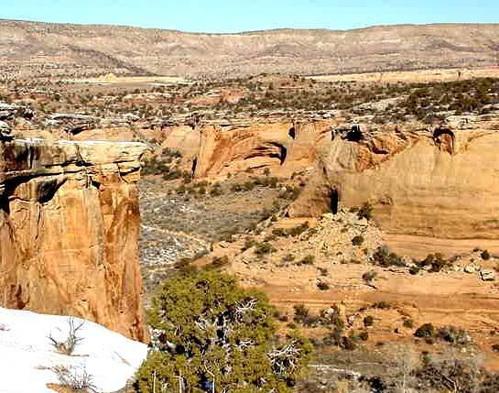
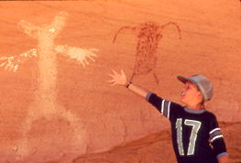
PLANNING FOR
RECREATION AND VISITOR SERVICES
R&VS SRMA Objectives
Let's get alittle help
from
Emma Rieves
Exercise 2.
Read the article. Write down the activities, experiences & benefits associated with McDonald Creek Cultural Mgmt. Area
Notes:
Exercise 2. Read the article. Write down the activities, experiences & benefits associated with McDonald Creek Cultural Management Area

Slide 35
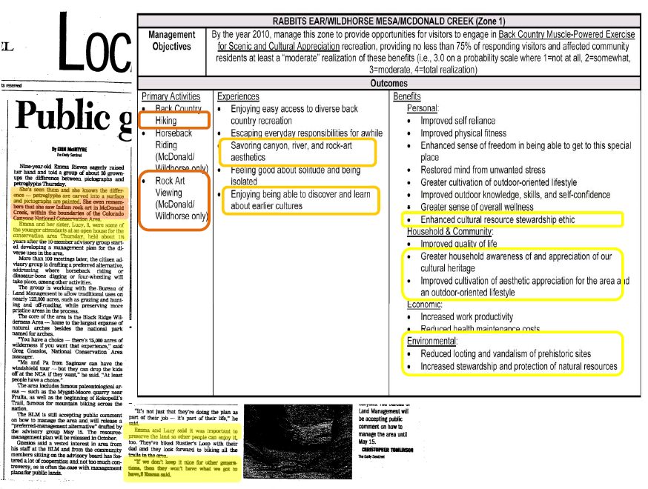
PLANNING FOR
RECREATION AND VISITOR SERVICES
R&VS SRMA Objectives
Notes:
EXERCISE 2– Little Emma
This is another exercise to help you identify outcomes and understand linkages
Outcomes are discussed everywhere…you just need to look and listen
You can see the article captured the recreational opportunities Activities, Experiences and Benefits that eventually ended up in the management plan fpor this RMZ.

Slide 36


PLANNING FOR
RECREATION AND VISITOR SERVICES
R&VS SRMA Objectives
So let’s dig a little deeper on outcomes!
Notes:
Participation in targeted activities leads to multiple experiences.

Slide 37
PLANNING FOR
RECREATION AND VISITOR SERVICES
R&VS SRMA Objectives
Experiences denote the desirability or satisfying nature of the experience (e.g., enjoying, learning, improving)
Notes:
Concept - Experiences denote the desirability or satisfying nature of the experience (e.g., enjoying, learning, improving). The results of a satisfying recreation experience that improve or maintain a desired condition. (e.g., maintain, greater, increased, improved).

Slide 38
PLANNING FOR
RECREATION AND VISITOR SERVICES
R&VS SRMA Objectives
Experiences denote the desirability or satisfying nature of the experience (e.g., enjoying, learning, improving)
Benefits are described by active verbs (e.g., maintained, reduced, improved) which indicate the maintenance or change in a condition
Notes:
Concept - Experiences denote the desirability or satisfying nature of the experience (e.g., enjoying, learning, improving). The results of a satisfying recreation experience that improve or maintain a desired condition. (e.g., maintain, greater, increased, improved).

Slide 39
PLANNING FOR
RECREATION AND VISITOR SERVICES
R&VS SRMA Objectives
Guideline -
Ensure the targeted experiences link to the targeted benefits.
On-site
Off-site
Identify...
Enjoying 1) canyon-country aesthetics & 2) a closer relationship with the natural world.
Greater environmental awareness & sensitivity
Improved stewardship/
preservation

Slide 40
PLANNING FOR
RECREATION AND VISITOR SERVICES
R&VS SRMA Objectives
Guideline - Target only the most essential experiences ( 2 – 4 sufficient ) in each SRMA or RMZ
…it is generally best for an agency to apply BBM (now OFM) incrementally and not try to be too comprehensive the first several times the approach is used. Thus we recommend that at first the focus be on a few outcomes to gain experience with implementing the approach.
Introduction to Outdoor Recreation by Moore and Driver
Identify...
Enjoying 1) canyon-country aesthetics & 2) a closer relationship with the natural world.
Notes:
Guideline - Target only the most essential experiences ( 2 – 4 sufficient ) in each SRMA or RMA…it is generally best for an agency to apply BBM (now OFM) incrementally and not try to be too comprehensive the first several times the approach is used. Thus we recommend that at first the focus be on a few outcomes to gain experience with implementing the approach.

Slide 41
PLANNING FOR
RECREATION AND VISITOR SERVICES
R&VS SRMA Objectives
1+1=3
Notes:
The group of most satisfying / gratifying / beneficial experiences that denote a total synergistic experience greater than the sum of its parts.
A particular group of experiences and benefits are setting dependent…
… although each experience realized separately may not be recreation setting dependent.

Slide 42
PLANNING FOR
RECREATION AND VISITOR SERVICES
R&VS SRMA Objectives
Gestalt - something that is made of many parts and yet is somehow more than the combination of its parts
1+1=3
Notes:
The group of most satisfying / gratifying / beneficial experiences that denote a total synergistic experience greater than the sum of its parts.
A particular group of experiences and benefits are setting dependent…
… although each experience realized separately may not be recreation setting dependent.

Slide 43
PLANNING FOR
RECREATION AND VISITOR SERVICES
R&VS SRMA Objectives
Concept - Experience-Benefit Gestalt
The group (or bundle) of most satisfying / beneficial experiences that denote a total synergistic experience greater than the sum of its parts
On-site
Off-site
Identify...
Enjoying 1) canyon-country aesthetics & 2) a closer relationship with the natural world.
Greater environmental awareness & sensitivity
Improved stewardship/
preservation
Notes:
What does 1 + 1 = 3 mean?

Slide 44
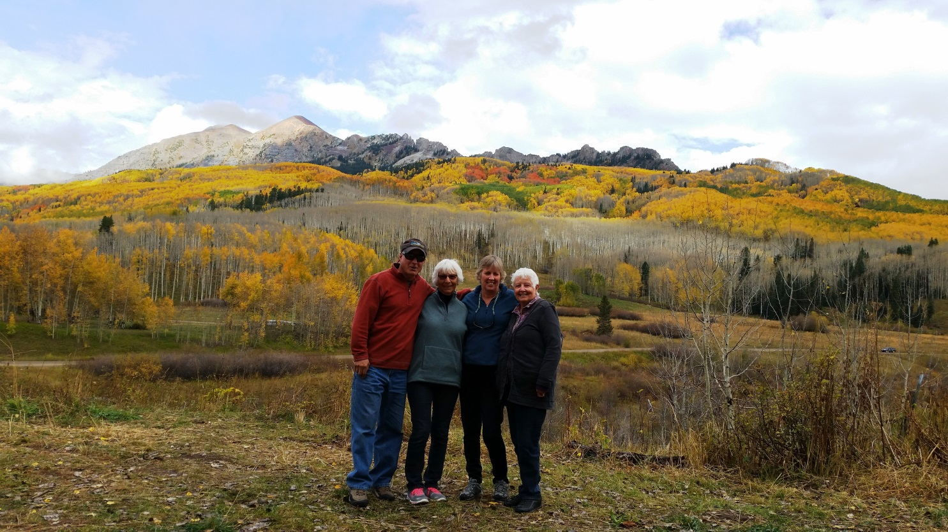
PLANNING FOR
RECREATION AND VISITOR SERVICES
R&VS SRMA Objectives
Recreational outcomes are greater
than the sum of their parts.
Notes:
Recreational outcomes are greater than the sum of their parts. Ask “What does that mean?” Let’s discuss this a bit.

Slide 45
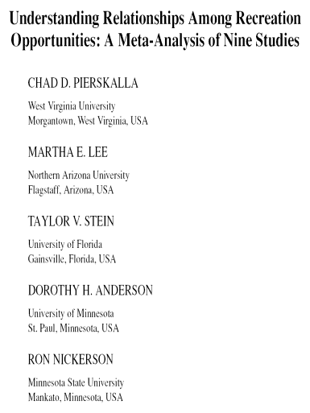
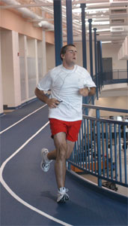

PLANNING FOR
RECREATION AND VISITOR SERVICES
R&VS SRMA Objectives
“Keeping/getting physically fit” was strongly associated with activity type and weakly associated with recreation settings.
The outdoor setting would not matter to the person only desiring to keep physically fit…
…you could run in a gym or on a local trail or in a backcountry area.
Notes:
So you need to think about groupings or clusters of outcomes and not just target individual outcomes

Slide 46
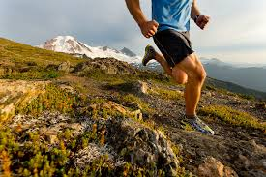

PLANNING FOR
RECREATION AND VISITOR SERVICES
R&VS SRMA Objectives
So why do people want to run in the backcountry to get physically fit?
Notes:
Ask the question “So why do people want to run in the backcountry to get physically fit?” and discuss.
So this is what we mean by the gesault

Slide 47
PLANNING FOR
RECREATION AND VISITOR SERVICES
R&VS SRMA Objectives
Running in a gym …
Experiences Benefits
Improve physical health
Reduced stress
Improve balance of work and play on my life
Keeping physically fit
Releasing or reducing tensions
Notes:
Ask the question “So why do people want to run in the backcountry to get physically fit?” and discuss.
So this is what we mean by the gesault

Slide 48
PLANNING FOR
RECREATION AND VISITOR SERVICES
R&VS SRMA Objectives
Running in a backcountry area …
Experiences Benefits
Improve physical health
Reduced stress
Keeping physically fit
Releasing or reducing tensions
Being where things are natural
Enjoying solitude
Gain a better appreciation of nature
Get away from crowds of people
Escape everyday demands of life
Notes:
Ask the question “So why do people want to run in the backcountry to get physically fit?” and discuss.
So this is what we mean by the gestalt

Slide 49
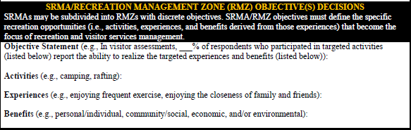
PLANNING FOR
RECREATION AND VISITOR SERVICES
R&VS SRMA Objectives
Activities: Hiking
Experiences: Enjoying canyon-country aesthetics
Enjoying a closer relationship with the natural world
Benefits: Greater environmental awareness and sensitivity
Improved stewardship/preservation
Identify...
Enjoying 1) canyon-country aesthetics & 2) a closer relationship with the natural world.
Greater environmental awareness & sensitivity
Improved stewardship/
preservation
Notes:
Here is what it looks like in the SRMA template however this does not fully explain how and why we came up with our targeted outcomes

Slide 50
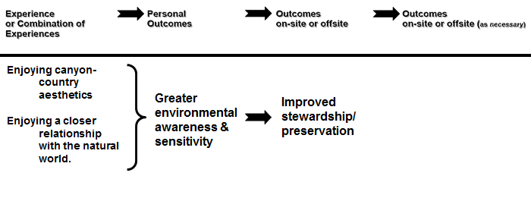
PLANNING FOR
RECREATION AND VISITOR SERVICES
R&VS SRMA Objectives
Identify...
Greater environmental awareness & sensitivity
Improved stewardship/
preservation
Enjoying 1) canyon-country aesthetics & 2) a closer relationship with the natural world.
Notes:
Here is what it looks like in a linkage diagram

Slide 51
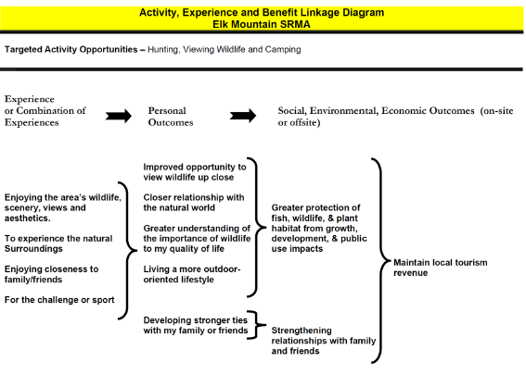
PLANNING FOR
RECREATION AND VISITOR SERVICES
R&VS SRMA Objectives
Linkages between activities, experiences, and benefits should be graphically diagramed to document their relationship
Retain the documentation for the EIS/EA administrative record
Notes:
Linkages between activities, experiences, and benefits should be graphically diagramed to document their relationship
Retain the documentation for the administrative record
What Gets Chained to What?
Outcomes chain from experiences that result from participation in different kinds of activities within different kinds of recreation settings. These chain both singly and in combination to more lasting beneficial outcomes, again both singly and as packages of benefit outcomes. The key is understanding the nature of these experience and benefit gestalts. Mapping these realities can get exceedingly complex. But the utility of doing so is to take the Benefits Chain beyond its philosophic construct to more nearly approach reality

Slide 52
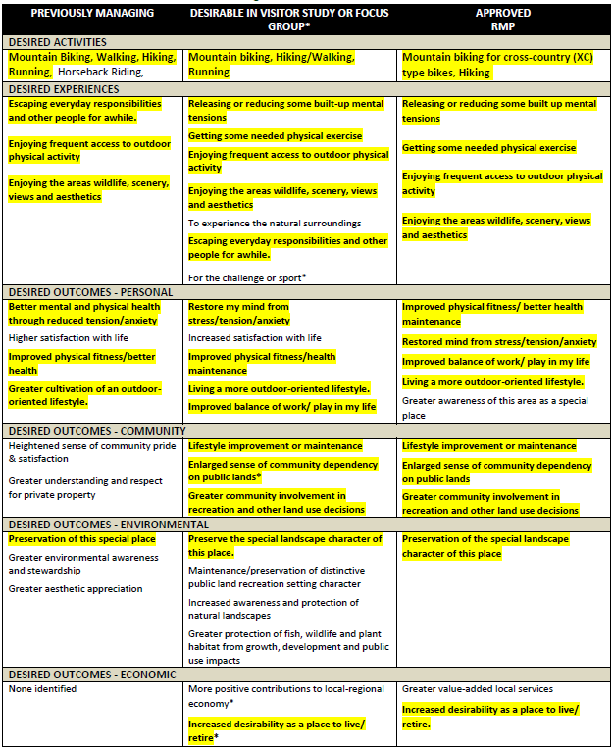
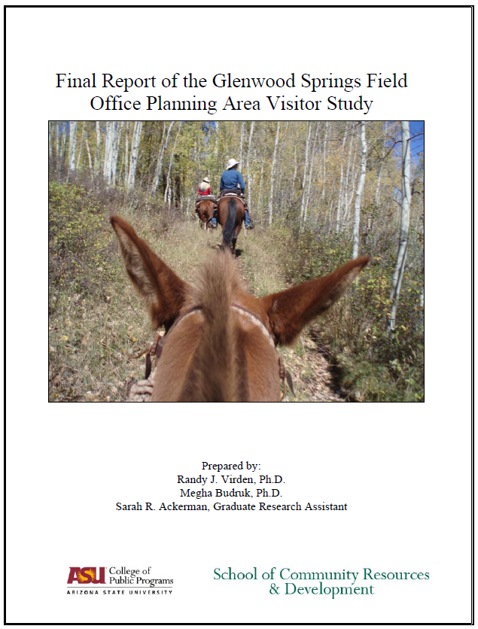
PLANNING FOR
RECREATION AND VISITOR SERVICES
R&VS SRMA Objectives
EXERCISE 3 – PRACTICE DIAGRAMING LINKAGES BETWEEN EXPERIENCES & BENEFITS
Let discuss the “Evolution of Targeted Outcomes in the Red Hill SRMA”
Notes:
EXERCISE 3 – PRACTICE DOCUMENTING LINKAGES BETWEEN EXPERIENCES & BENEFITS
Let discuss the “Evolution of Targeted Outcomes in the Red Hill SRMA”

Slide 53
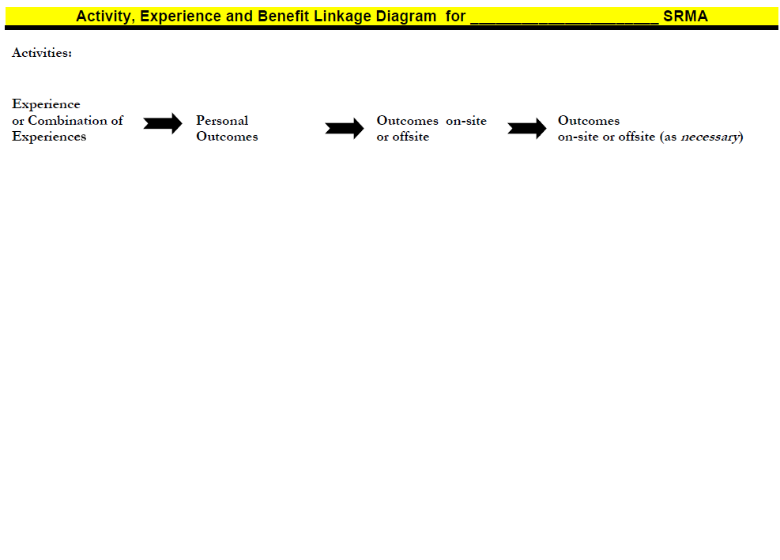
PLANNING FOR
RECREATION AND VISITOR SERVICES
R&VS SRMA Objectives
EXERCISE 3 – PRACTICE DIAGRAMING LINKAGES BETWEEN EXPERIENCES & BENEFITS
Your group is tasked to document the linkages between Experiences & Benefits for the Red Hill SRMA based on the handout (Approved RMP column)
Notes:
EXERCISE 3 – PRACTICE DOCUMENTING LINKAGES BETWEEN EXPERIENCES & BENEFITS
Your group is tasked to documenting the linkages between Experiences & Benefits for the Red Hill SRMA based on the handout

Slide 54
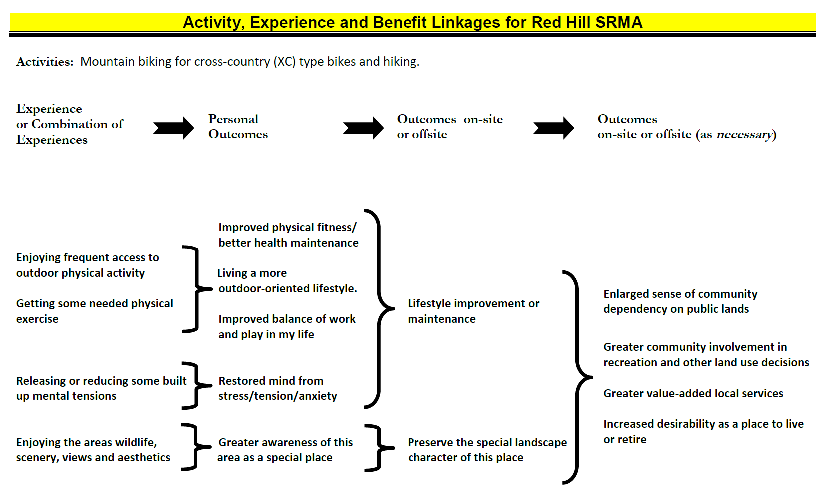
PLANNING FOR
RECREATION AND VISITOR SERVICES
R&VS SRMA Objectives
Documentation of linkages for CRVFO RMP Administrative Record
Notes:
EXERCISE 3 – PRACTICE DOCUMENTING LINKAGES BETWEEN EXPERIENCES & BENEFITS
There is no wrong answer based on the information you have been given
These connections were based on the 1) visitor study and focus group data, 2) professional judgement, and 3) input from users
This is what is in the CRVFO RMP Administrative Record

Slide 55
PLANNING FOR
RECREATION AND VISITOR SERVICES
R&VS SRMA Objectives
So how do we take the targeted activities, experiences and benefits and create an outcome-focused R&VS objective?

Slide 56
PLANNING FOR
RECREATION AND VISITOR SERVICES
R&VS Objectives
“SMART” is an acronym built around the 5 measures of a good objective
pecific
we know exactly what is to be achieved and where
so we know the standard to be achieved or maintained
challenging but reasonable
specify a recreation result / outcome
staff/stakeholders have an under- standing of what is expected and when
easurable
SMART
chievable
esults-oriented
ime-bound
Notes:
All objectives should use SMART objective principles: specific, measurable, achievable, results oriented, and time bound.
SPECIFIC - Area specific
MEASURABLE – measurable indicators specify how much change is expected or standard to be achieved or maintained
ACHIEVABLE – is the change or standard realistic and reasonable
RESULTS-oriented – you can answer the “so what” test
TIME-BOUND – staff and stakeholders have a shared understanding of what is expected and when it may be reasonable to call for an accounting of the results

Slide 57
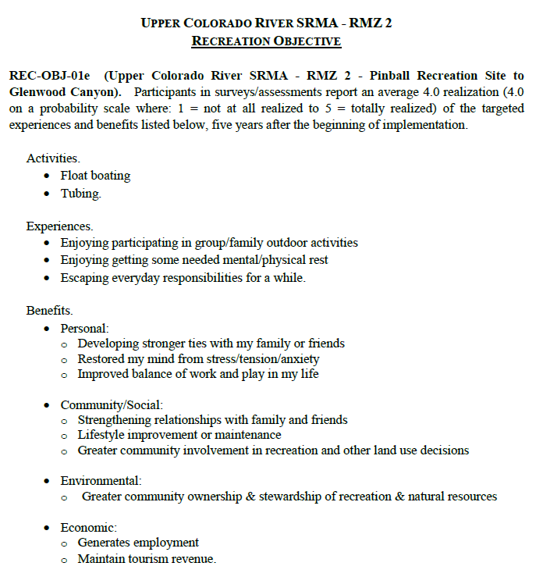

PLANNING FOR
RECREATION AND VISITOR SERVICES
R&VS SRMA Objectives

Slide 58
PLANNING FOR
RECREATION AND VISITOR SERVICES
R&VS SRMA Objectives
Upper Colorado River SRMA Objective
RMZ 2 - Pinball Recreation Site to Glenwood Canyon
Participants in surveys/assessments report an average 4.0 realization (4.0 on a probability scale where: 1 = not at all realized to 5 = totally realized) …
of the targeted experiences and benefits listed below …
five years after the beginning of implementation.
Yes
Notes:
SPECIFIC - Area specific
MEASURABLE – measurable indicators specify how much change is expected or standard to be achieved or maintained
ACHIEVABLE – is the change or standard realistic and reasonable
RESULTS-oriented – you can answer the “so what” test
TIME-BOUND – staff and stakeholders both need a shared understanding of what is expected and when it may be reasonable to call for an accounting of the results

Slide 59


PLANNING FOR
RECREATION AND VISITOR SERVICES
R&VS SRMA Objectives
Do I personally receive any of the targeted benefits from recreating in the area?
Do I believe other individuals probably do so?
Do groups of people (from family members → local communities → society as a whole) receive the types of social or economic benefits listed?
Do natural, cultural or historic resources benefit in any of the ways listed?
Adapted from Introduction to Outdoor Recreation by Roger L. Moore & B.L. Driver
Notes:
If uncertain, verify the links between the identified activities, experiences, and benefits with individual users and stakeholders
Helpful Tips – Ask?.....
Do I personally receive any of the targeted benefits from recreating in the area?
Do I believe other individuals probably do so
Do groups of people (from family members → local communities → society as a whole) receive the types of social or economic benefits listed?
Do natural, cultural or historic resources benefit in any of the ways listed?

Slide 60
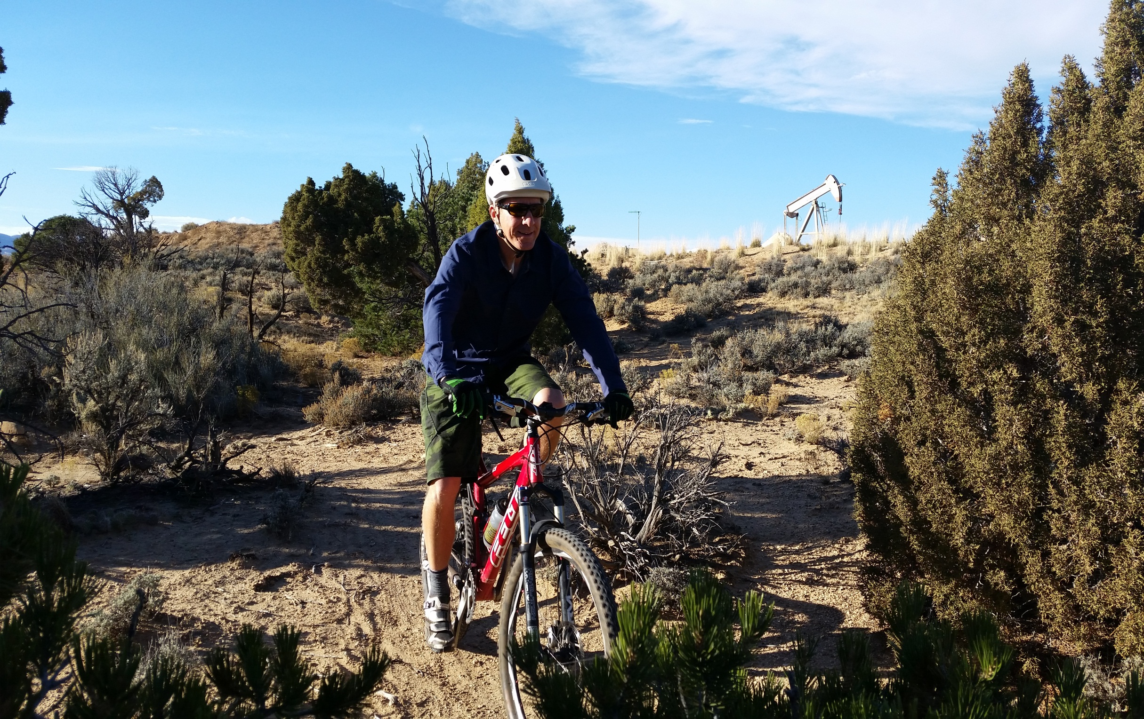
PLANNING FOR
RECREATION AND VISITOR SERVICES
R&VS ERMA Objectives
ERMA Objectives

Slide 61

PLANNING FOR
RECREATION AND VISITOR SERVICES
R&VS ERMA Objectives
Objectives for an ERMA define…
the recreation activities and
associated qualities and conditions
… that will become the management focus for R&VS
Unlike SRMA objectives, ERMA
objectives do not typically
describe a set of outcomes
to be targeted….?
Notes:
Objectives for an ERMA, and for RMZs within an ERMA, define the recreation activities and associated qualities and conditions that will become the management focus for R&VS.
Unlike SRMA objectives, ERMA objectives do not explicitly prescribe outcomes to be targeted.
ANSWER ON NEXT SLIDE: Because they are commensurately managed, R&VS will not likely have sufficient control of the RSCs to produce the outcomes.
Then discuss the responses.

Slide 62
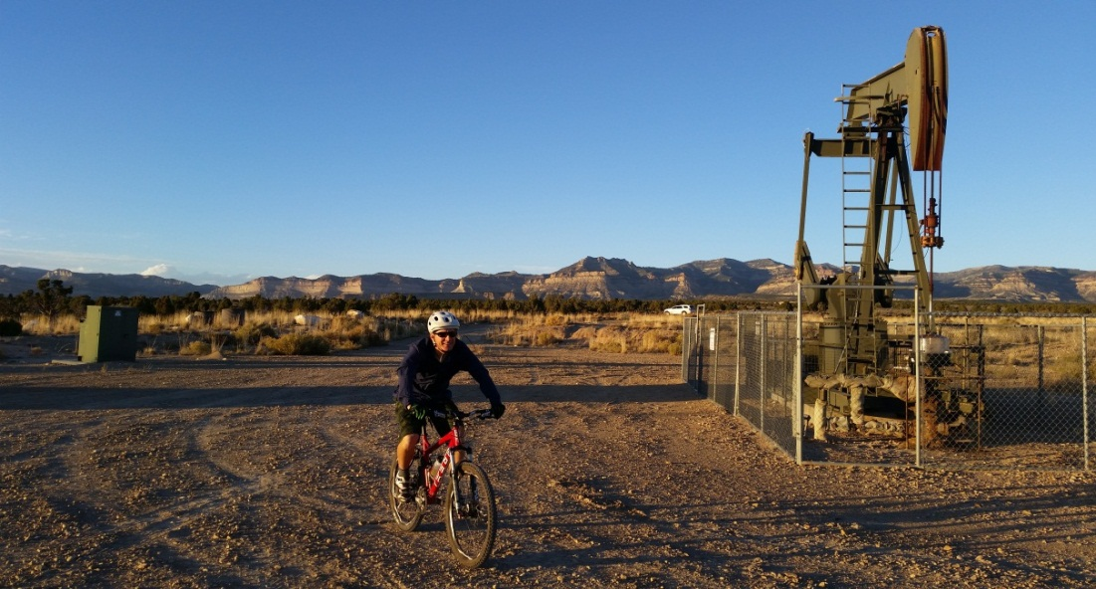

PLANNING FOR
RECREATION AND VISITOR SERVICES
R&VS ERMA Objectives
Recreation managers may not autonomously manage the area's physical, social, and operational components to a degree necessary to facilitate attainment of a targeted set of outcomes …
Notes:
Recreation managers may not autonomously manage the area's physical, social, and operational components to a degree necessary to facilitate attainment of a targeted set of outcomes. This is because, in ERMAs, recreation is managed commensurately with other resources and resource uses, and recreation opportunities may even be constrained by decisions to benefit other resources

Slide 63
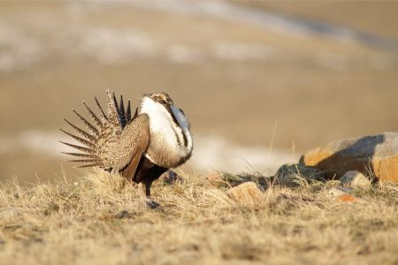
PLANNING FOR
RECREATION AND VISITOR SERVICES
R&VS ERMA Objectives
… and recreation opportunities may be constrained by decisions to benefit other resources
Notes:
Recreation managers may not autonomously manage the area's physical, social, and operational components to a degree necessary to facilitate attainment of a targeted set of outcomes. This is because, in ERMAs, recreation is managed commensurately with other resources and resource uses, and recreation opportunities may even be constrained by decisions to benefit other resources

Slide 64
PLANNING FOR
RECREATION AND VISITOR SERVICES
R&VS ERMA Objectives
Qualities and Conditions
Refer to the interdisciplinary state of the area with regard to …
appearance
administrative /managerial working order
the general environment
… that becomes the focus of recreation and visitor services management
Notes:
Objectives for an ERMA, and for RMZs within an ERMA, define the recreation activities and associated qualities and conditions that will become the management focus for R&VS. Activities are clear but qualities and conditions are less clear to people.
Unlike SRMA objectives, ERMA objectives do not explicitly prescribe outcomes to be targeted.
Then discuss the responses.

Slide 65
PLANNING FOR
RECREATION AND VISITOR SERVICES
R&VS ERMA Objectives
Qualities and Conditions
Examples:
Maintaining particular RSCs
Improved visitor health and safety
Improved resource protection
Reduced use and user conflicts
Future condition of recreation infrastructure
Description of visitor services
Cooperation with community partners
Landscape conditions (e.g. open space)
Notes:
Objectives for an ERMA, and for RMZs within an ERMA, define the recreation activities and associated qualities and conditions that will become the management focus for R&VS. Activities are clear but qualities and conditions are less clear to people.
Unlike SRMA objectives, ERMA objectives do not explicitly prescribe outcomes to be targeted.
Then discuss the responses.

Slide 66
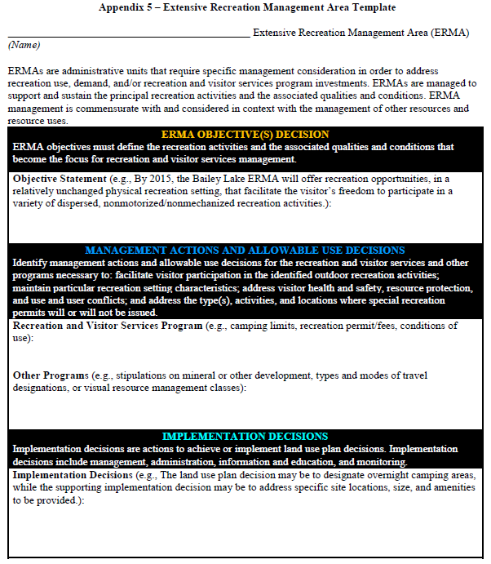
PLANNING FOR
RECREATION AND VISITOR SERVICES
R&VS ERMA Objectives
When developing ERMA objectives, use the ERMA Template in Appendix 5
Base decision on visitor demands from: visitor and community assessments, community interviews, scoping, existing uses
use professional judgment
consider administrative capability

Slide 67
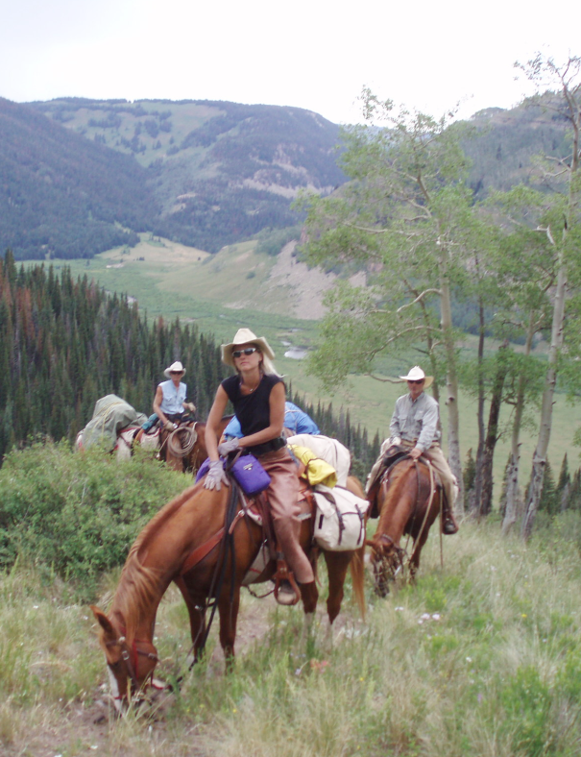
PLANNING FOR
RECREATION AND VISITOR SERVICES
R&VS ERMA Objectives
ERMA Objective Example 1 – Management in the ERMA is commensurate with BLM lands that are managed to protect wilderness characteristics.
Through the life of the RMP in the Thompson Creek ERMA, the R&VS focus maintains the existing naturally-appearing landscape that supports participation in horseback riding and hunting that in turn contributes to local economic stability while commensurately protecting wilderness characteristics and supplemental values.
Notes:
Objective:
Through the life of the RMP in the Thompson Creek ERMA, the R&VS focus maintains the existing naturally-appearing landscape that supports participation in horseback riding and hunting that in turn contributes to local economic stability while commensurately protecting wilderness characteristics and supplemental values.

Slide 68
PLANNING FOR
RECREATION AND VISITOR SERVICES
R&VS ERMA Objectives
ERMA Objective Example 1 – Management in the ERMA is commensurate with BLM lands that are managed to protect wilderness characteristics.
Through the life of the RMP in the Thompson Creek ERMA, the R&VS focus maintains the existing naturally-appearing landscape that supports participation in horseback riding and hunting that in turn contributes to local economic stability while commensurately protecting wilderness characteristics and supplemental values.
Notes:
Objective:
Through the life of the RMP in the Thompson Creek ERMA, the R&VS focus maintains the existing naturally-appearing landscape that supports participation in horseback riding and hunting that in turn contributes to local economic stability while commensurately protecting wilderness characteristics and supplemental values.

Slide 69
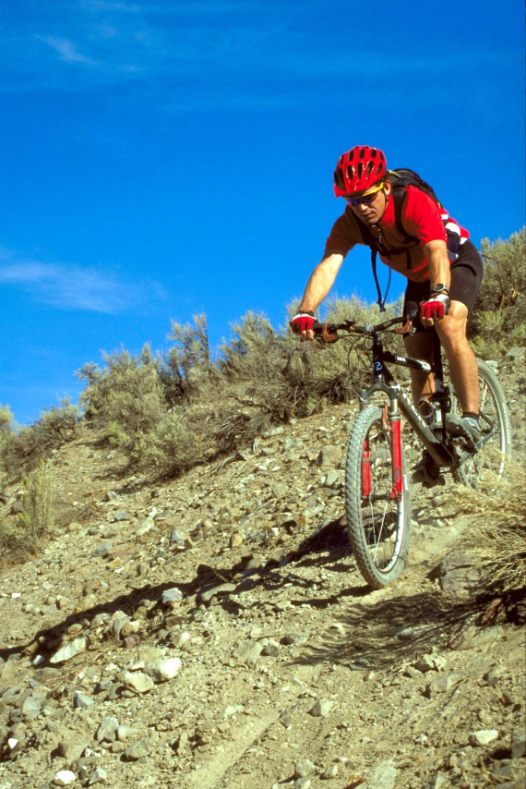
PLANNING FOR
RECREATION AND VISITOR SERVICES
R&VS ERMA Objectives
ERMA Objective Example 2 – Management is commensurate with cultural resources
Five years after RMP implementation, the High Mesa ERMA will maintain similar recreation setting conditions that foster living a more outdoor-oriented lifestyle for motorcycle and mountain bike riders, as well as commensurately reducing adverse affects on cultural resources (habitations & features)

Slide 70
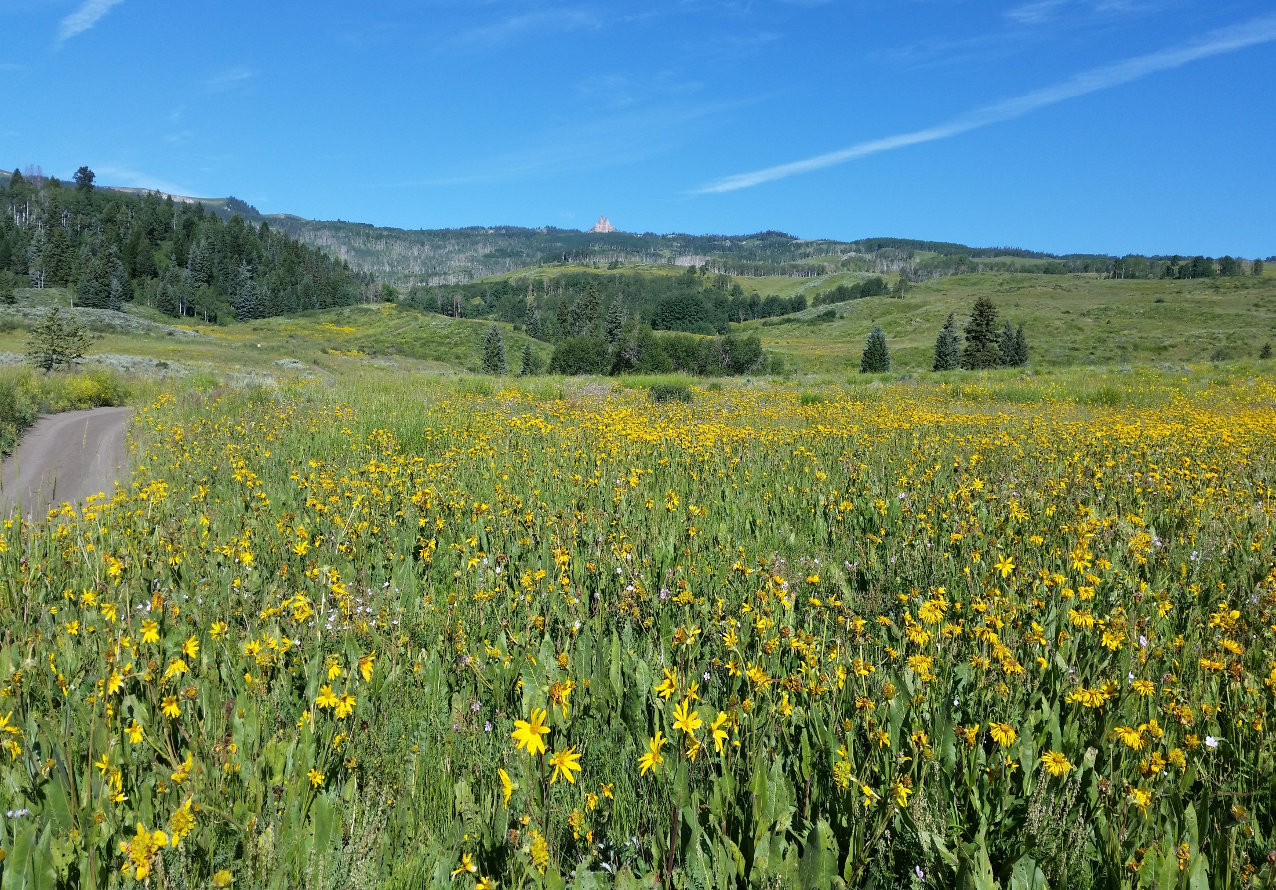
PLANNING FOR
RECREATION AND VISITOR SERVICES
R&VS Objectives for Undesignated Lands
Objectives for Undesignated Lands

Slide 71

PLANNING FOR
RECREATION AND VISITOR SERVICES
R&VS Objectives for Undesignated Lands
R&VS Objectives for Undesignated Lands
Recreation is not emphasized outside RMAs. However, recreation activities occurring outside designated RMAs may require management direction to address basic R&VS and resource stewardship needs
Notes:
Figure 21 for examples of objectives outside RMAs.

Slide 72



PLANNING FOR
RECREATION AND VISITOR SERVICES
R&VS Objectives for Undesignated Lands
R&VS Objectives for Undesignated Lands
On undesignated lands (or all BLM lands), R&VS objectives focus on:
resource protection
human health and safety
use or user conflicts
Notes:
Figure 21 for examples of objectives outside RMAs.
Note: These types of objectives can also be written so they apply to all BLM lands within the planning area.

Slide 73


PLANNING FOR
RECREATION AND VISITOR SERVICES
R&VS Objectives for Undesignated Lands
Objective for Undesignated Lands - Resource Protection
Increase awareness, understanding, and a sense of stewardship in recreation participants so their conduct safeguards cultural and natural resources as defined by Standards for Public Land Health or area-specific LUP objectives (e.g., areas of critical environmental concern, wild and scenic rivers, etc).

Slide 74



PLANNING FOR
RECREATION AND VISITOR SERVICES
R&VS Objectives for Undesignated Lands
Objective for Undesignated Lands - Visitor Health and Safety
Ensure that visitors are not exposed to unhealthy or unsafe human-created conditions defined by a repeat incident in the same year, of the same type, in the same location, due to the same cause.

Slide 75


PLANNING FOR
RECREATION AND VISITOR SERVICES
R&VS Objectives for Undesignated Lands
Objective for Undesignated Lands = Use/User Conflict
Minimize the existing level of conflict between and with visitors to 1) allow other resources/programs to achieve their RMP objectives and 2) curb illegal trespass and property damage; while maintaining a diversity of recreation activity opportunities.

Slide 76


PLANNING FOR
RECREATION AND VISITOR SERVICES
R&VS Objectives
Within an OFM framework, defining outcome objectives is not an exercise for its own sake, but a way to focus implementation actions, management actions, allowable uses and RSCs on producing recreation opportunities and facilitating desirable outcomes
Notes:
When you think of recreation planning within an OFM framework, defining objectives is not an exercise for its own sake, but a way to focus allowable uses and management actions, and implementation actions, and RSCs on producing
recreation opportunities and facilitating desirable outcomes
Outcome objectives set a “direction for recreation area management” and many stakeholders care a great deal about our
management

Slide 77



PLANNING FOR
RECREATION AND VISITOR SERVICES
R&VS Objectives
Steens Mountain Group Exercise
Write an objective for an SRMA (include any supporting info) and an ERMA
Complete a linkage diagram for the SRMA objective
Remember Emma &
the benefits linkage assignment
Note: Don't target too many
experiences in each RMZ!

