Slide 1
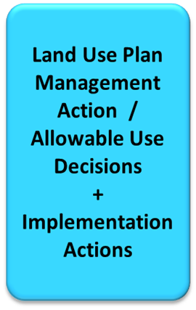
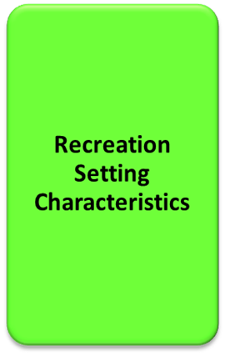
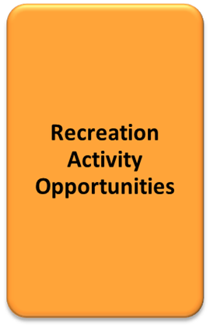
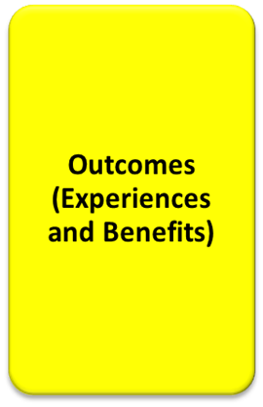
PLANNING FOR RECREATION AND VISITOR SERVICES
Land Use Plan-level Decisions
Learning Objectives, pages II-12 to II-16 in the handbook
Students will be able to:
Identify management actions and allowable uses to support goals and objectives
Distinguish land use plan (LUP) decisions from implementation decisions and from best management practices (BMP).
Distinguish actions for the R&VS program and actions for other programs
Notes:
pages II-12 to II-16 in the handbook
Review the production process
After establishing objectives and identifying desired RSCs in RMAs, we need to identify management actions and allowable uses for each alternative needed to achieve recreation goals and objectives, and desired RSCs. It is very important to distinguish between LUP, implementation, and BMP decisions. Actions applied to the R&VS program could come from other programs (e.g., timing limitations, climbing closure)
Now we need to determine how best to produce recreation opportunities that facilitate outcomes and achieve the desired RSCs by identifying supporting land use plan management actions and allowable uses.

Slide 2
PLANNING FOR RECREATION AND VISITOR SERVICES
Land Use Plan-level Decisions
After establishing objectives and identifying desired RSCs in RMAs, we need to identify management actions and allowable uses to achieve recreation goals and objectives, and desired RSCs.
Management actions and allowable use decisions are generally described as LUP-level decisions needed to achieve program objectives or constrain incompatible activities.
Land use plan-level management actions and allowable use decisions must be made within the R&VS program and also applied to other programs.
Actions from other programs can also restrict recreation.
Notes:
The focal point of the land use planning process is making interdisciplinary LUP level decision and allocations that help achieve RSC’s, produce rec opportunities, and facilitate outcomes.
For this module we will call management actions and allowable uses LUP decisions.
For example, it may be necessary to limit access by and modes of travel that have the potential to impact the targeted recreation opportunities.
Therefore, if the targeted activity is mountain biking and the desired operational RSC is nonmotorized, then the travel designations need to be revised accordingly to create the desired operational RSC.

Slide 3
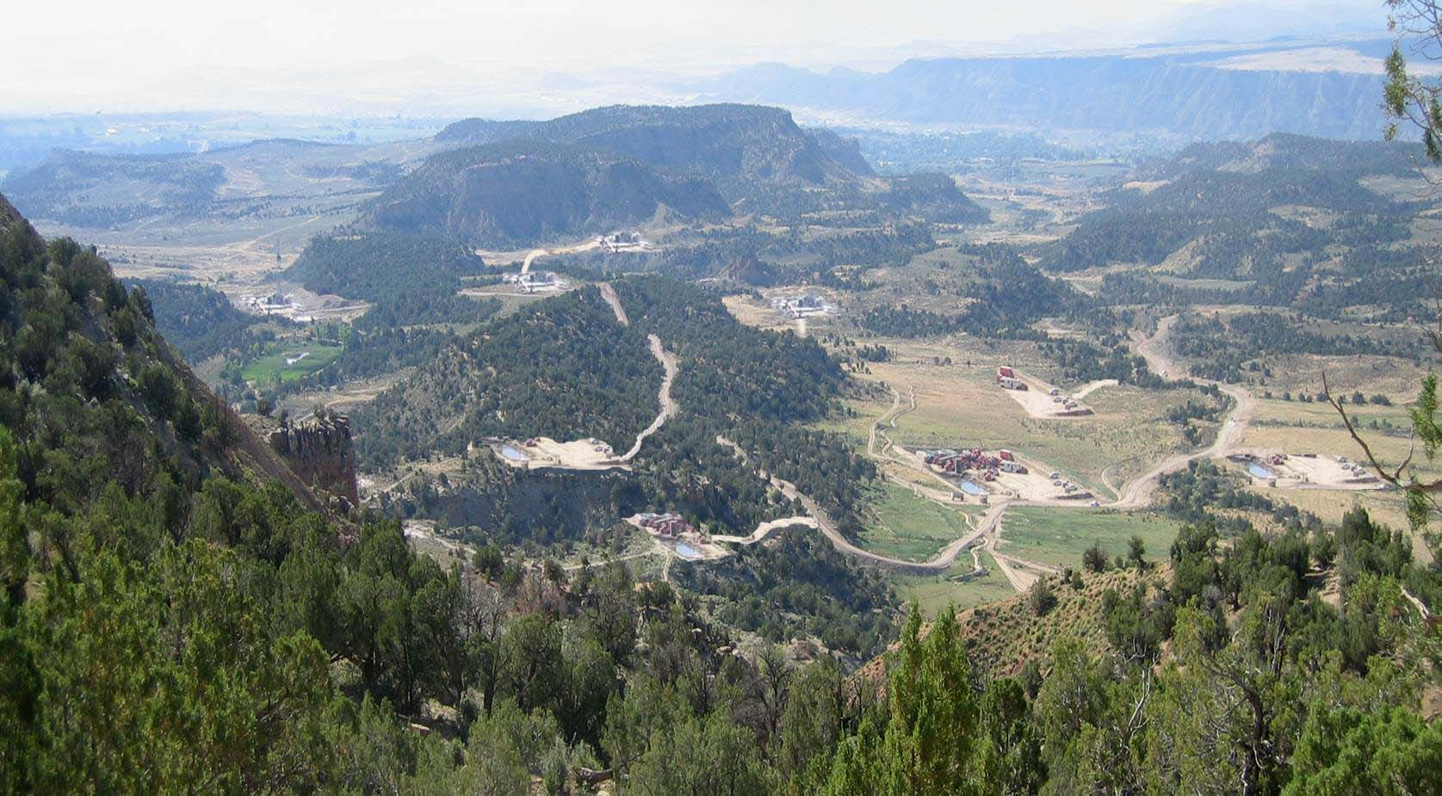
PLANNING FOR RECREATION AND VISITOR SERVICES
Land Use Plan-level Decisions
Example
No management actions
Notes:
Before we get into the details, lets look at an example. This photo represents an area that did not have any LUP decision to protect the setting and these disturbances happened over time. Could these impacts have an impact on settings, rec opportunities or outcomes?

Slide 4
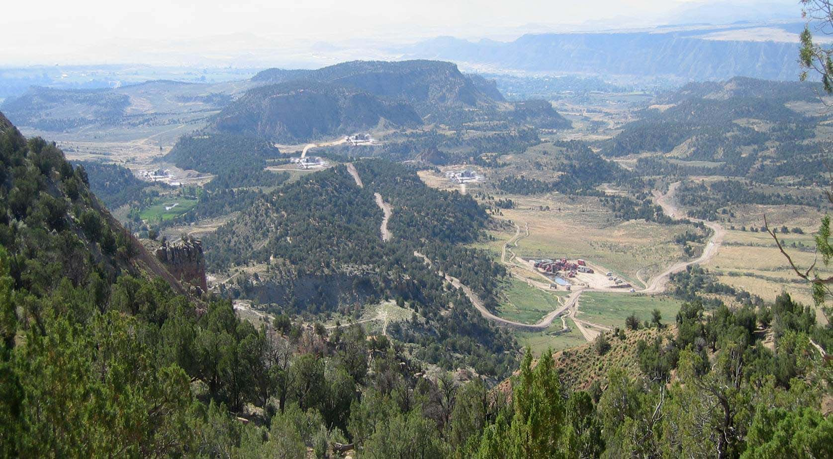
PLANNING FOR RECREATION AND VISITOR SERVICES
Land Use Plan-level Decisions
Example
Apply a CSU to protect some trailheads
Notes:
A CSU stipulation would have allowed the recreation program to move some of the facilities away from the access points

Slide 5
PLANNING FOR RECREATION AND VISITOR SERVICES
Land Use Plan-level Decisions
Example
Apply VRM II to sensitive view sheds
Notes:
If VRM II had been applied in the LUP, the view shed would have been better protected

Slide 6
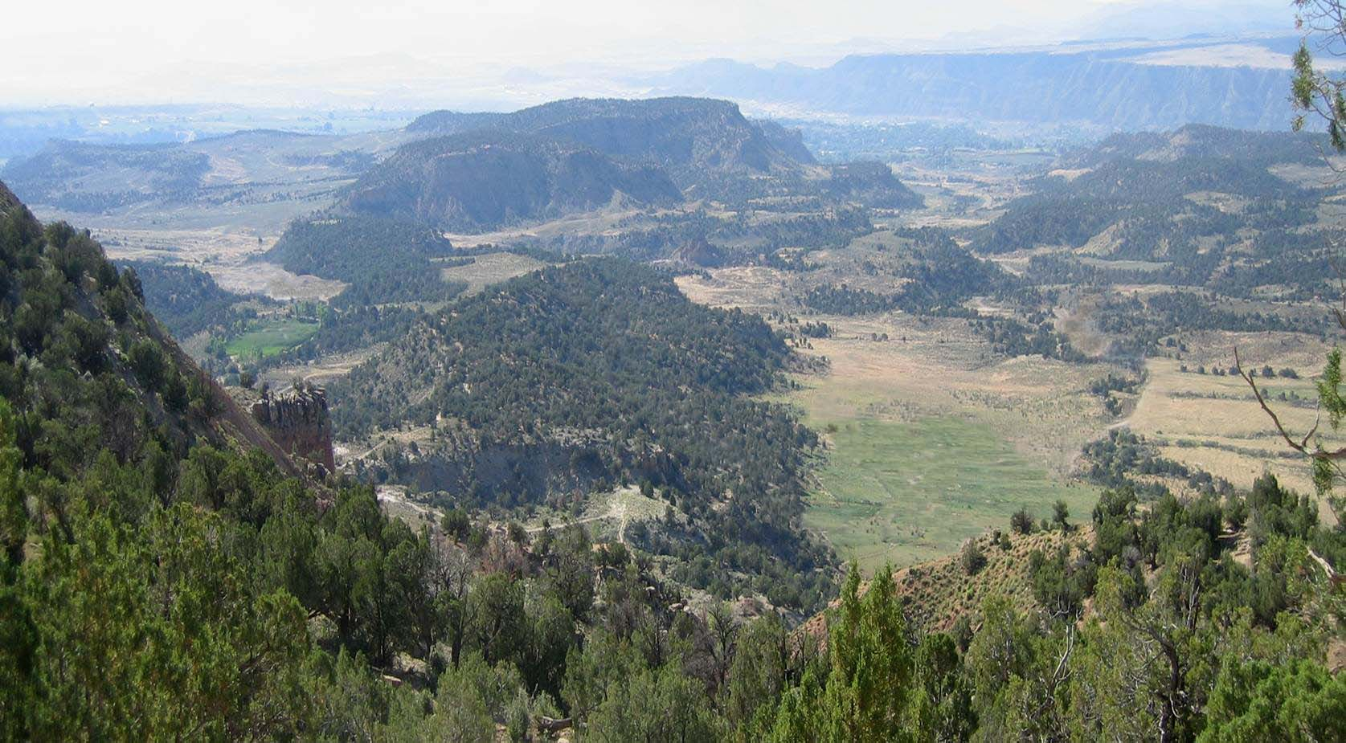
PLANNING FOR RECREATION AND VISITOR SERVICES
Land Use Plan-level Decisions
Example
NSO stipulation for surface disturbing activities
Notes:
An NSO stipulation could have prevented the surface disturbing activities that would have a negative impact on recreation values. Now we can see how selecting appropriate LUP level decisions can protect the setting and help produce the recreation activities and facilitate the desired outcomes.

Slide 7
PLANNING FOR RECREATION AND VISITOR SERVICES
Land Use Plan-level Decisions
Land use plan-level decisions for lands not designated as RMAs
Within public lands that are not designated as RMAs , management actions and allowable use decisions may still be necessary to address basic R&VS and resource stewardship needs for:
Visitor health and safety.
Use and user conflicts (areas closed to target shooting and camping limits).
The type(s), activities and locations where special recreation permits would be issued or not issued.
Mitigation of recreation impacts on cultural and natural resources.
Protect developed recreation sites
Notes:
Let’s start with the undesignated areas since they typically have the least amount of decision made by the R&VS program
Recreation is not emphasized but it does occur.
Allow for recreation uses that don’t conflict with primary use.
Will likely have the most amount of restrictions from other programs
We will want to protect developed rec sites
Address visitor health and safety and use and user conflicts along with SRPs

Slide 8
PLANNING FOR RECREATION AND VISITOR SERVICES
Land Use Plan-level Decisions
Land use plan-level decisions for ERMAs
Within ERMAs, it is necessary to establish a framework of management action and allowable use decisions to:
Facilitate visitor participation in the principal outdoor recreation activities.
Maintain particular RSCs.
Address visitor health and safety, resource protection, and use and user conflicts (areas closed to target shooting and camping limits).
Address the type(s), activities, and locations where SRPs will or will not be issued.
Limit incompatible recreation activities that are detrimental to meeting recreation or other critical resource objectives.
Identify the terms, conditions, or special considerations for other resource programs necessary to achieve ERMA objective(s).
Notes:
Since recreation is managed commensurate with other programs, ERMAs will have generally have more restrictions to other programs than undesignated lands, they may also have a moderate amount of restrictions to recreation from other programs.
Decision must be compatible with other resources
In addition to health and safety and SRPs, we must also support the participation in the principal recreation activities and particular RSCs.
In some cases an ERMA may overlap anther designation or identification.

Slide 9
PLANNING FOR RECREATION AND VISITOR SERVICES
Land Use Plan-level Decisions
Land use plan-level decisions for SRMAs
Within SRMAs, it is necessary to establish a framework of management actions and allowable use decisions to:
Facilitate the targeted recreation opportunities.
Maintain or enhance the desired physical, social, and operational RSCs.
Address visitor health and safety, resource protection, and use and user conflicts (areas closed to target shooting and camping limits).
Address the type(s), activities, and locations where SRPs will or will not be issued.
Limit incompatible recreation activities that are detrimental to meeting recreation or other critical resource objectives.
Identify the terms, conditions, or special considerations for other resource programs necessary to achieve SRMA objective(s)
Any RMA designation without supporting
LUP decisions will be unsuccessful
Notes:
Since recreation is predominant, SRMAs will have the most restrictive LUP decisions for other programs and the fewest from other programs.
Still address health and safety, use and user conflicts, SRPs
Limit incompatible recreation types
Facilitate targeted opportunities
Without supporting LUP decisions any RMA will not be able to managed RSCs to produce an activity or facilitate any outcomes

Slide 10
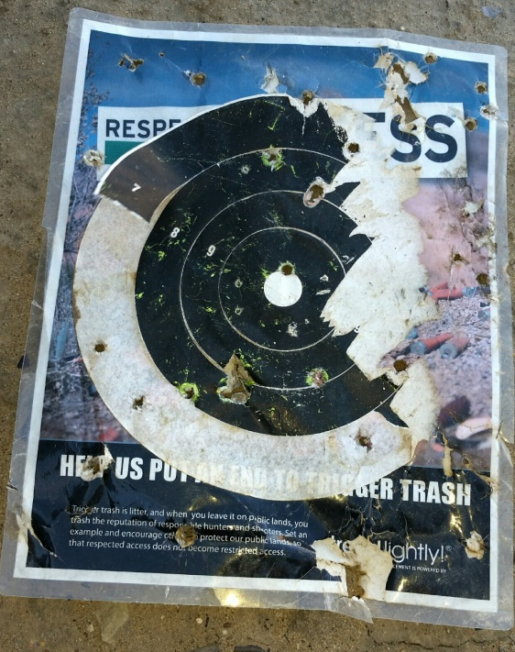
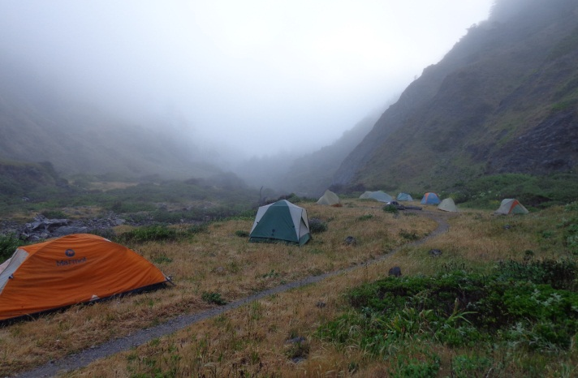
PLANNING FOR RECREATION AND VISITOR SERVICES
Land Use Plan-level Decisions
Recommended R&VS Land use plan-level decisions
Within the R&VS program the primary supporting decisions made as LUP decisions in RMAs and undesignated areas are:
Areas closed to target shooting,
Camping timing restrictions
Types, activities and locations where SRPs would be issued or not issued.
Notes:
Now we can get more specific
In addition to designating RMAs at the LUP level, these actions are required to be made at the LUP level. These decisions can be made in RMAs and in undesignated areas.
Any ideas why these three restrictions are made at the LUP level? Controversial or greater than 100,000 acres
In rare cases there could be other use restrictions included as LUP decisions if they are field office wide. In the case of camping, restricting camping to designated camp sites would be implementation since it is site specific, camping timing restrictions generally are field office wide.
There are so many examples that present grey area of the distinction between a LUP and implementation level decision. It may depend on which solicitor is reviewing your plan. An important question to ask is; “How would the field office benefit if the decision is made at the LUP level?” Also, if you need to change the decision at a later date, would you rather have to do a LUP amendment or would you rather do an EA to change an implementation level decision?

Slide 11
PLANNING FOR RECREATION AND VISITOR SERVICES
Land Use Plan-level Decisions
Land use plan-level decisions for other programs
Within other programs, supporting management actions and allowable use decisions are selected in terms of their ability to help achieve the recreation objectives, maintain or enhance RSCs, or guide recreation implementation. These decisions can be found for other resources in Appendix C of the Land Use Planning Handbook H-1601-1.
Examples from other resources include:
Fuels – restrictions on fuels treatments
Forestry – Close to timber harvest, firewood cutting and special forest products
Lands and Realty – ROW avoidance areas applied to an RMA
VRM – Classify as VRM II
CTTM – Classify as limited to designated routes for mountain bikes
Fluid Mineral Leasing – Apply an NSO stipulation which prohibits surface use, occupancy and surface-disturbing activities.
Notes:
In RMAs it is important to restrict other programs to help achieve recreation objectives.
Examples
Emphasize that the decisions that restrict other resources are found in the Land Use Planning Handbook Appendix C. Take a few minutes to look up a few in Appendix C
Changes require a LUP amendment

Slide 12
PLANNING FOR RECREATION AND VISITOR SERVICES
Land Use Plan-level Decisions
Stipulations
Timing Limitation (TL) Areas identified for application of a TL stipulation are closed to fluid minerals exploration and development and other surface-disturbing activities during identified timeframes.
Controlled Surface Use (CSU) Allows some use and occupancy of surface lands while protecting identified resources or values. A CSU stipulation would allow the BLM to require special operational constraints, including special design or relocating the surface-disturbing activity to protect the specified resource or value.
No Surface Occupancy (NSO) Use or occupancy of the land surface for fluid mineral exploration or development and other surface-disturbing activities is prohibited to protect identified resource values or resource use.
Notes:
NSO – Severe constraint, CSU and TL Moderate constraint, In The CRVFO RMP the CSU allowed us to move an impact up to 200 meters

Slide 13
PLANNING FOR RECREATION AND VISITOR SERVICES
Land Use Plan-level Decisions
Visual Resource Management Classes
VRM Class I –Preserve the existing character of the landscape and to manage for natural ecological changes. The level of change to the characteristic landscape should be very low.
VRM Class II – Retain the existing character of the landscape. The level of change to the characteristic landscape should be low.
VRM Class III – Partially retain the existing character of the landscape. The level of change to the characteristic landscape should be moderate.
VRM Class IV – Provide for management activities which require major modification of the existing character of the landscape. The level of change to the characteristic landscape can be high.
Notes:
VRM classes are an existing designation which can be used in managing settings. They apply to all programs

Slide 14
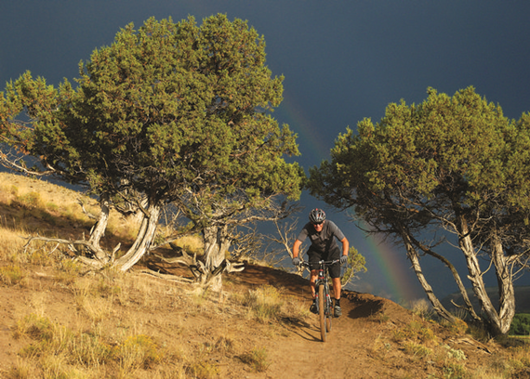
PLANNING FOR RECREATION AND VISITOR SERVICES
Implementation Decisions
Implementation Decisions
Definition: Decisions that take action to implement land use plan decisions; appealable to IBLA under 43 CFR 4.410
Implementation-level decisions are usually made in a more site-specific plan tiered from the LUP.
In some circumstances, it may be advantageous to resolve implementation-level R&VS issues through the land use planning process.
Examples of implementation decisions:
Designation of an existing travel route
Change the dates of a livestock grazing permit
Close climbing areas to protect raptor nests
Notes:
Implementation decisions are site specific and must have site specific NEPA
It is important to be able to distinguish implementation decisions from LUP decisions since they have different administrative remedies. Making implementation decisions part of the land use planning process and analyzing them concurrently with LUP decisions does not change their administrative remedies or the timing of those remedies.
Implementation decisions that are part of the land use planning process should be clearly distinguished as implementation decisions that are not protestable but subject to the appeals process (i.e., appealable to the Interior Board of Land Appeals under 43 CFR 4.410) or other administrative review, as prescribed by the specific resource program regulations
Any changes to implementation decisions may require subsequent NEPA analysis and a new decision.
Grey area that may depend on solicitor and manager
Ask the class for examples of Implementation decisions that would help achieve desired RSCs.

Slide 15
PLANNING FOR RECREATION AND VISITOR SERVICES
Best Management Practices
Best Management Practices
BMPs are state-of-the-art mitigation measures that will guide management, administration, information and education, and monitoring for future implementation level decisions.
BMPs avoid, minimize, reduce, rectify, or compensate for adverse environmental or social impacts of land use activities.
Examples of BMPs for the R&VS program include:
Reroute trails that cause natural or cultural resource damage or trespass on private property
Grant administrative use authorization for motorized travel on a case-by-case basis.
Create an SRMA brochure to address use and user conflicts
Monitor outcomes and preferences through focus group interviews on five year intervals.
Notes:
These are not LUP or Implementation decisions but do guide future management, they are not required as part of a LUP but may be include a BMP appendix. It is important to be able to identify them because they are frequently brought up during the LUP process.
Help to capture partners and cooperators concerns with out making a decision.
Show project proponents examples of commonly used practices to reduce impacts of land use activities on desired RSCs or recreation opportunities.
often included in LUPs, but they are not LUP or implementation decisions
Could be developed once a specific proposal is being evaluated through the environmental analysis process.
Ask the class for examples of BMPs that would help achieve guide future implementation level decisions.

Slide 16
PLANNING FOR RECREATION AND VISITOR SERVICES
Land Use Plan-level Decisions
Land use plan-level decisions (protestable)
Management actions and allowable use decisions are generally described as LUP-level decisions needed to achieve program objectives or constrain incompatible activities.
Example: Prohibited the discharge of firearms for recreational target shooting in the Blue River SRMA
Implementation Decisions (appealable)
Decisions that take site-specific action to achieve land use plan decisions
Example: Require a fire pan in Blue River SRMA
Best Management Practices (not a decision)
Mitigation measures that will guide management, administration, information and education, and monitoring for future implementation level decisions.
Example: Develop brochures and kiosks with Leave No Trace guidelines.
Notes:
This slide reviews the tree types of decisions. We need to be able to distinguish between management actions and allowable uses (LUP Level decisions), implementation level decisions, and BMPs. Also determine if these decisions are in the R&VS program or applied to another program or applied to recreation from another program.

Slide 17
PLANNING FOR RECREATION AND VISITOR SERVICES
Land Use Plan-level Decisions
Exercise
Determine if the following are:
LUP decisions, implementation decisions, or Best Management Practices
Is the action for the R&VS program or for other programs
The Blue Hill SRMA is closed to camping
Implementation level decision for the R&VS program
Notes:
This is site specific

Slide 18
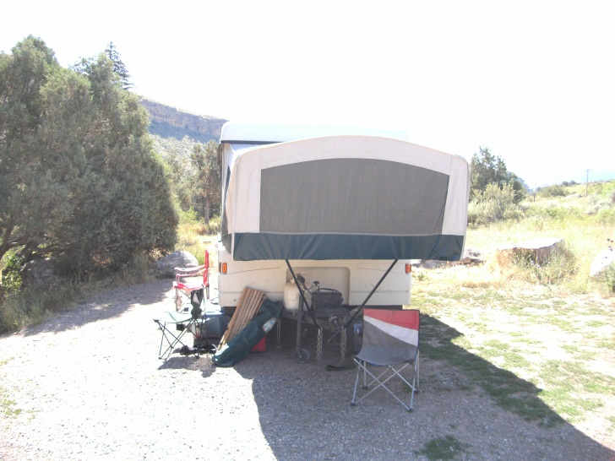
PLANNING FOR RECREATION AND VISITOR SERVICES
Land Use Plan-level Decisions
Exercise
Determine if the following are:
LUP decisions, implementation decisions, or Best Management Practices
Is the action for the R&VS program or for other programs
In areas open to camping and overnight use in the Colorado River Valley Field Office, apply a 7-day camping limit from April 1 to August 31.
LUP level decision for the R&VS program
Notes:
This action applies to an entire field office and is not site-specific.

Slide 19
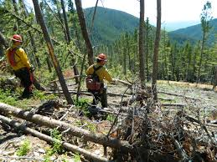
PLANNING FOR RECREATION AND VISITOR SERVICES
Land Use Plan-level Decisions
Exercise
Determine if the following are:
LUP decisions, implementation decisions, or Best Management Practices
Is the action for the R&VS program or for other programs
The Blue Hill SRMA is closed to timber harvest, firewood cutting and special forest product harvest.
LUP level decision for the forestry program

Slide 20
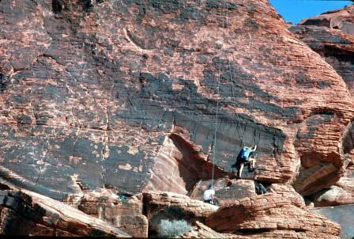
PLANNING FOR RECREATION AND VISITOR SERVICES
Land Use Plan-level Decisions
Exercise
Determine if the following are:
LUP decisions, implementation decisions, or Best Management Practices
Is the action for the R&VS program or for other programs
Close the climbing route Neon Sunset to protect raptor nests
Close the climbing area Wild Iris to protect raptor nests
Close the Blue Hill SRMA to protect raptor nests
Implementation level decision for the R&VS program (from the wildlife program)
Notes:
The scope or scale of an implementation matter does not elevate it to a LUP decision. Also, remember other programs can place restrictions on R&VS program.

Slide 21
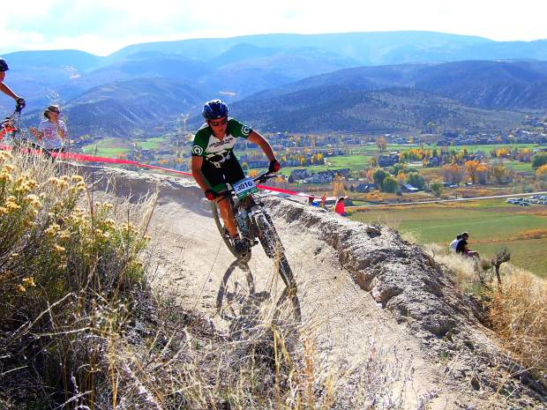
PLANNING FOR RECREATION AND VISITOR SERVICES
Land Use Plan-level Decisions
Exercise
Determine if the following are:
LUP decisions, implementation decisions, or Best Management Practices
Is the action for the R&VS program or for other programs
In the Blue Hill SRMA, no SRPs would be issued
LUP level decision for the R&VS program

Slide 22
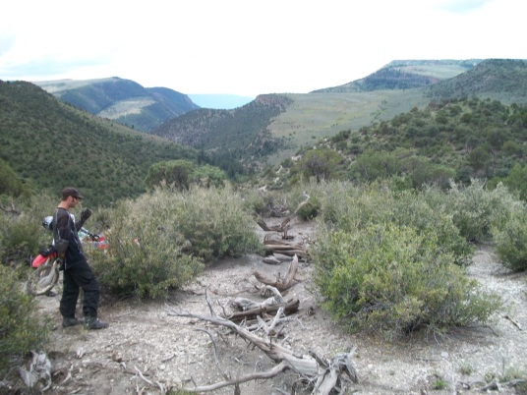
PLANNING FOR RECREATION AND VISITOR SERVICES
Land Use Plan-level Decisions
Exercise
Determine if the following are:
LUP decisions, implementation decisions, or Best Management Practices
Is the action for the R&VS program or for other programs
Reroute any trails in the Capitol Creek ERMA that cause natural resource damage or trespass.
BMP for R&VS program, but could apply to other programs if the route is primarily used by another resource program. (e.g., the range program may need to reroute a road used exclusively by a permittee to access a range improvement)

Slide 23
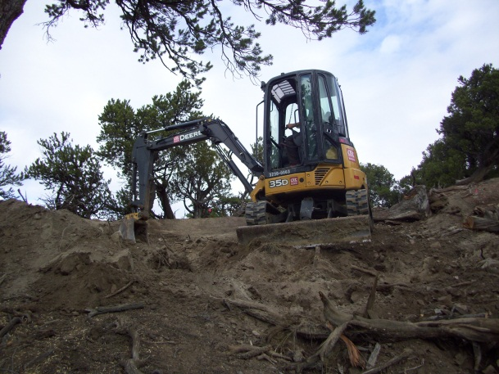
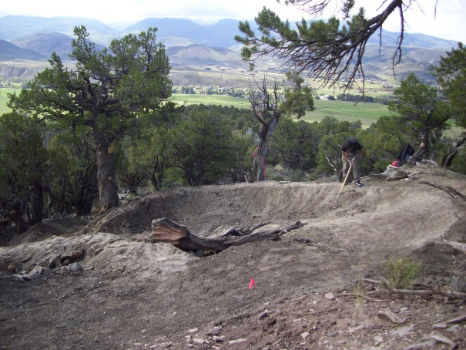
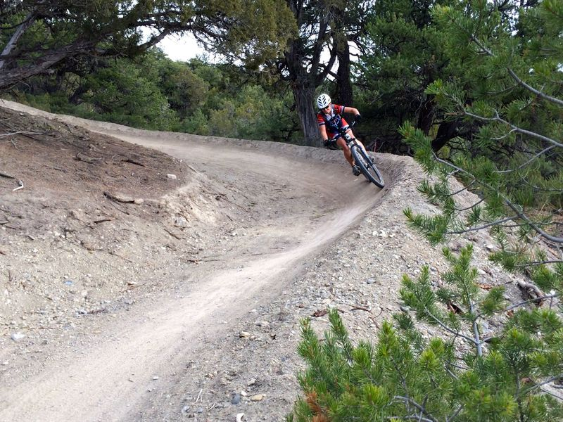
PLANNING FOR RECREATION AND VISITOR SERVICES
Land Use Plan-level Decisions
Exercise
Determine if the following are:
LUP decisions, implementation decisions, or Best Management Practices
Is the action for the R&VS program or for other programs
Reroute the Pool and Ice Trail to eliminate the steep unsustainable sections.
Implementation decision for the R&VS program
Notes:
This is an on-the-ground action which will require site specific analysis through an EA

Slide 24
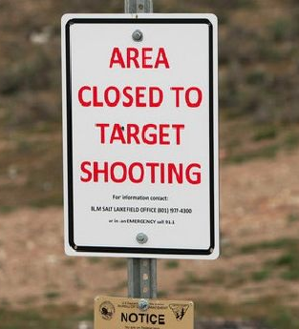
PLANNING FOR RECREATION AND VISITOR SERVICES
Land Use Plan-level Decisions
Exercise
Determine if the following are:
LUP decisions, implementation decisions, or Best Management Practices
Is the action for the R&VS program or for other programs
Close the Blue Hill SRMA to recreational target shooting
LUP decision for the R&VS program
Notes:
Must also consult with the shooting sports round table.

Slide 25
PLANNING FOR RECREATION AND VISITOR SERVICES
Land Use Plan-level Decisions
Exercise
Determine if the following are:
LUP decisions, implementation decisions, or Best Management Practices
Is the action for the R&VS program or for other programs
Facilitate greater well being and economic benefits within communities (from the Recreation Strategy).
BMP for the R&VS program
Notes:
This goal will guide future management decisions.

Slide 26
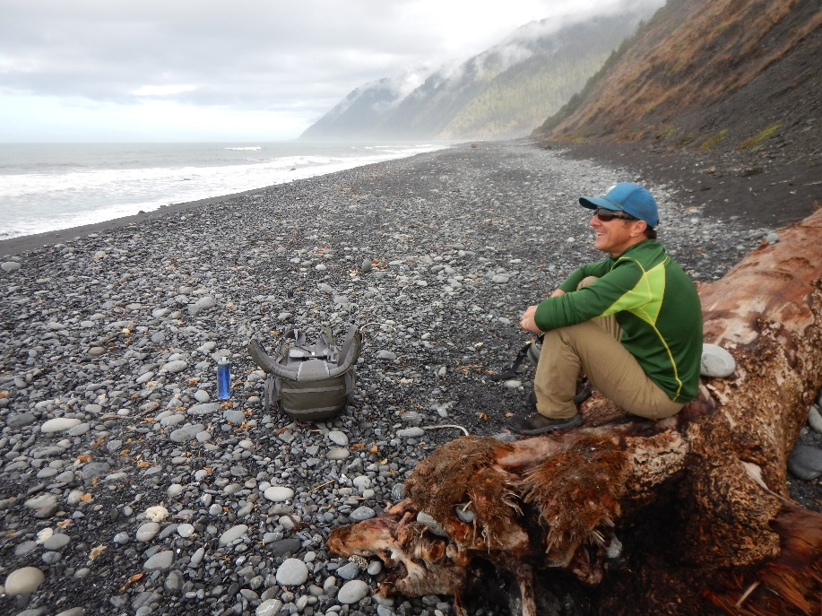
PLANNING FOR RECREATION AND VISITOR SERVICES
Land Use Plan-level Decisions
Steens Mountain Exercise
Work in your team to develop LUP level decisions for your SRMA and ERMA.
Refer to the handout “Common LUP decision” and Illustration 4 on page IL-20 of the handbook.
Also refer to Appendix C of the Land Use Planning Handbook H-1601-1
Notes:
The focal point of the land use planning process is making interdisciplinary LUP decisions. Implementation-level decision are usually made in subsequent site specific NEPA analysis.
Illustration 4 also gives examples of actions that support specific RSCs

