Slide 1
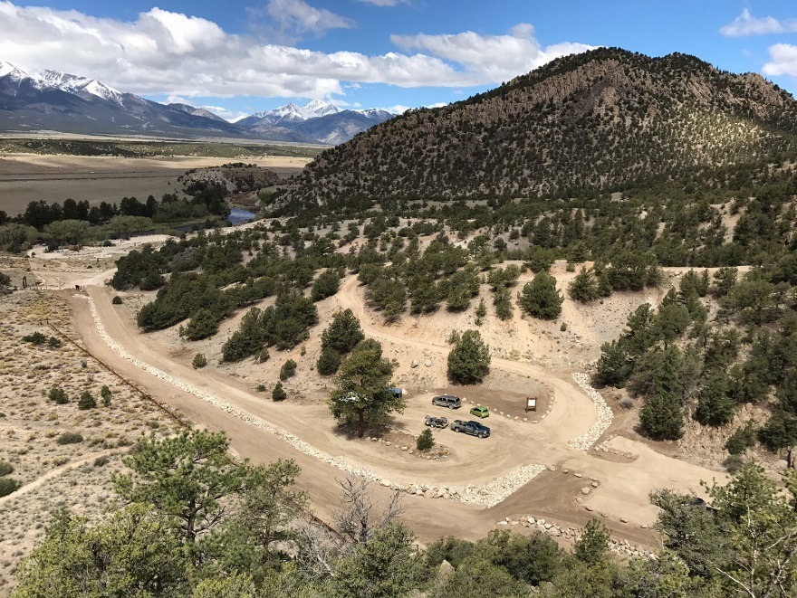
PLANNING FOR RECREATION AND VISITOR SERVICES
the Land Use Planning Process; Part 2
CHAPTER III – LAND USE PLANNING PROCESS
in
H-8320-1– PLANNING FOR RECREATION AND VISITOR SERVICES
Overview of LUP Process
Alternative Development
Affected Environment
Effects Analysis

Slide 2
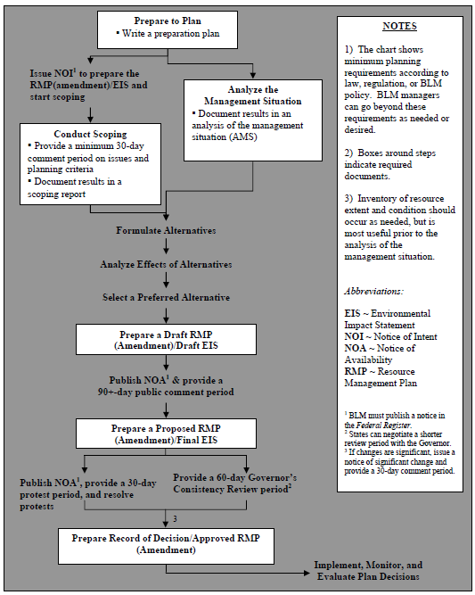
PLANNING FOR RECREATION AND VISITOR SERVICES
1. Overview of the LUP Process
Notes:
Refer to Planning Process Flow chart from Module 1 Planning Overview and Planning Flowchart poster on wall
What is the role of the rec planner throughout the planning process?
Who has gone though a LUP from start to finish?
How long did it take?
What were the greatest challenges?
- Any success stories? Amazing decisions being made as a result of the process?
Open Module 9 Tab in Handbook.
Goal is to show you what you will need to do, not exactly how to do it. Know where to go for help when you need it.

Slide 3
PLANNING FOR RECREATION AND VISITOR SERVICES
1. Overview of the LUP Process
Notes:
Focus on Alternative development.

Slide 4
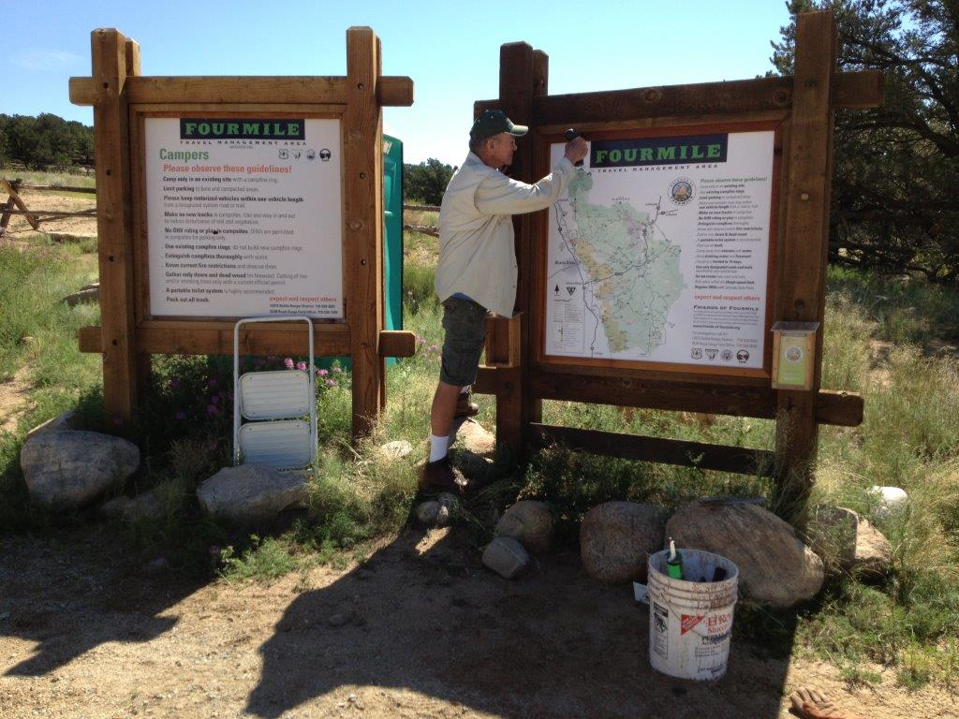
PLANNING FOR RECREATION AND VISITOR SERVICES
1. Overview of the LUP Process
EIS Chapters:
Chapter 1 – Purpose and Need
Chapter 2 – Range of Alternatives
Chapter 3 – Affected Environment
Chapter 4 – Environmental Consequences
Notes:
Chapter 4: III-13 Factors for analysis, summarized.
See checklist in appendix.
Key part of whole section – do not forget to add! Brian will never forgive you if you don’t include this!!!
Appendix 1 LUP Checklist.
Must be in Chapter 4!

Slide 5
PLANNING FOR RECREATION AND VISITOR SERVICES
2. Alternative Development (Chapter 2)
Dictated by the purpose and need.
Different management scenarios to be analyzed.
Involves the collaboration of cooperating agencies.
Considers public scoping
No Action Alternative
Notes:
Offers different responses to
major issues identified in scoping
management opportunities addressed in the analysis of the management situation.
No Action Alternative Narrative:
Describe the existing R&VS direction, which may be taken from the analysis of the management situation.
Other Alternatives:
Describe the proposed R&VS program emphasis under the theme or emphasis of each alternative .

Slide 6
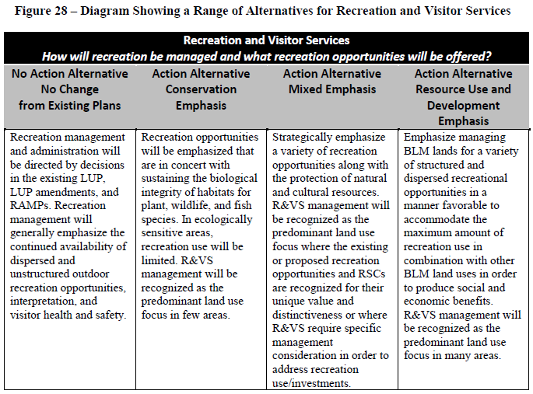
PLANNING FOR RECREATION AND VISITOR SERVICES
2. Alternative Development (Chapter 2)
Notes:
Flip to Figure 28 in the Handbook

Slide 7
PLANNING FOR RECREATION AND VISITOR SERVICES
2. Alternative Development (Chapter 2)
Notes:
- Common range from No action – conservation – balanced/mixed – use & development
A different suite of potential planning decisions:
Desired outcomes
Management actions
Allowable uses
Individual R&VS decisions may be common to multiple or even all alternatives.
All proposed LUP decisions within each alternative must be compatible, but may vary across alternatives.

Slide 8
PLANNING FOR RECREATION AND VISITOR SERVICES
2. Alternative Development (Chapter 2)
Creating a Range of Alternatives
Ideal Recreation scenarios
BCAs
Wildlife
Grazing
Cultural protection
Energy Development
Public Comment
“ Agency Direction”
Etc…

Slide 9
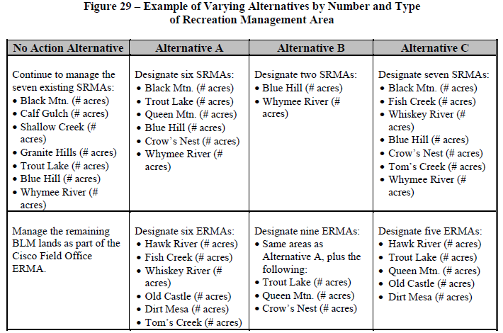
PLANNING FOR RECREATION AND VISITOR SERVICES
2. Alternative Development (Chapter 2)
Varying Alternatives by Number and Type of Recreation Management Area
Notes:
Varying the number, type, size, and management of RMAs has the greatest impact on the range of alternatives.
The same area can be proposed as an SRMA in one alternative, an ERMA in another alternative, and an undesignated area in a third alternative. Alternatives may also vary by changing the RMA objective or changing supporting management actions and allowable uses.
An example of alternatives in which the number and types of RMAs vary can be found in Figure 29 in the Handbook.

Slide 10
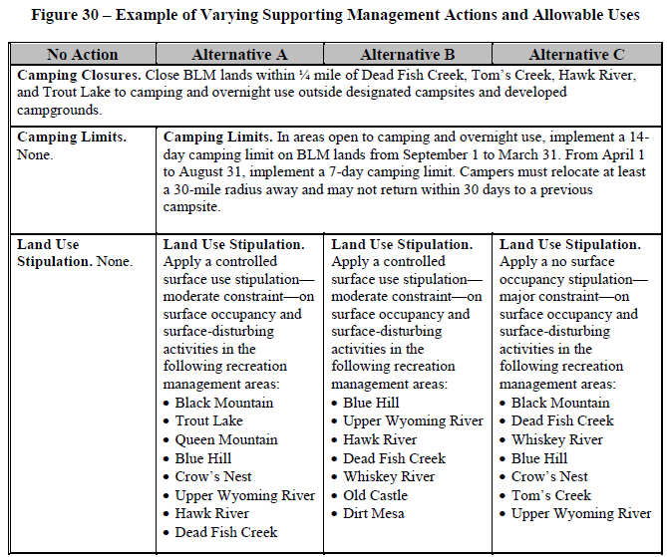
PLANNING FOR RECREATION AND VISITOR SERVICES
2. Alternative Development (Chapter 2)
Notes:
An example of varying supporting management actions and allowable uses can be found in Figure 30.
In this example, the camping closures are common across all four alternatives. Camping limits are common to all action alternatives (Alternatives A, B, and C).
Land use stipulations vary across the alternatives, from no stipulations on surface occupancy and surface-disturbing activities, to a controlled surface use stipulation, to a no surface occupancy stipulation.

Slide 11
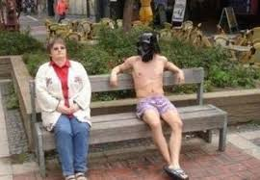
PLANNING FOR RECREATION AND VISITOR SERVICES
2. Alternative Development (Chapter 2)
Notes:
An example of varying supporting management actions and allowable uses can be found in Figure 30.
In this example, the camping closures are common across all four alternatives. Camping limits are common to all action alternatives (Alternatives A, B, and C).
Land use stipulations vary across the alternatives, from no stipulations on surface occupancy and surface-disturbing activities, to a controlled surface use stipulation, to a no surface occupancy stipulation.

Slide 12
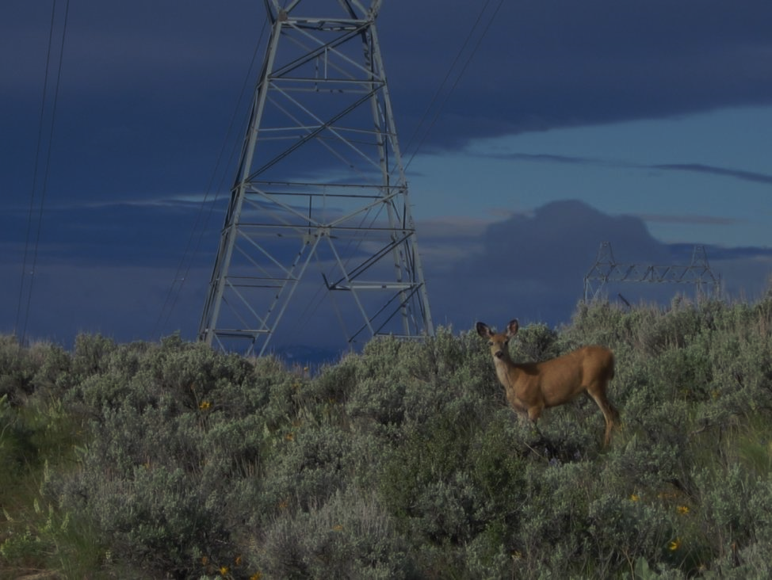
Exercise:
Develop a Range of Alternatives which considers implications from other programs.
Notes:
An instructor will come to your table and share a proposal for a resource use or conflict. Develop a new alternative to accommodate this use.
Discuss after exercise. Any real-world examples?

Slide 13
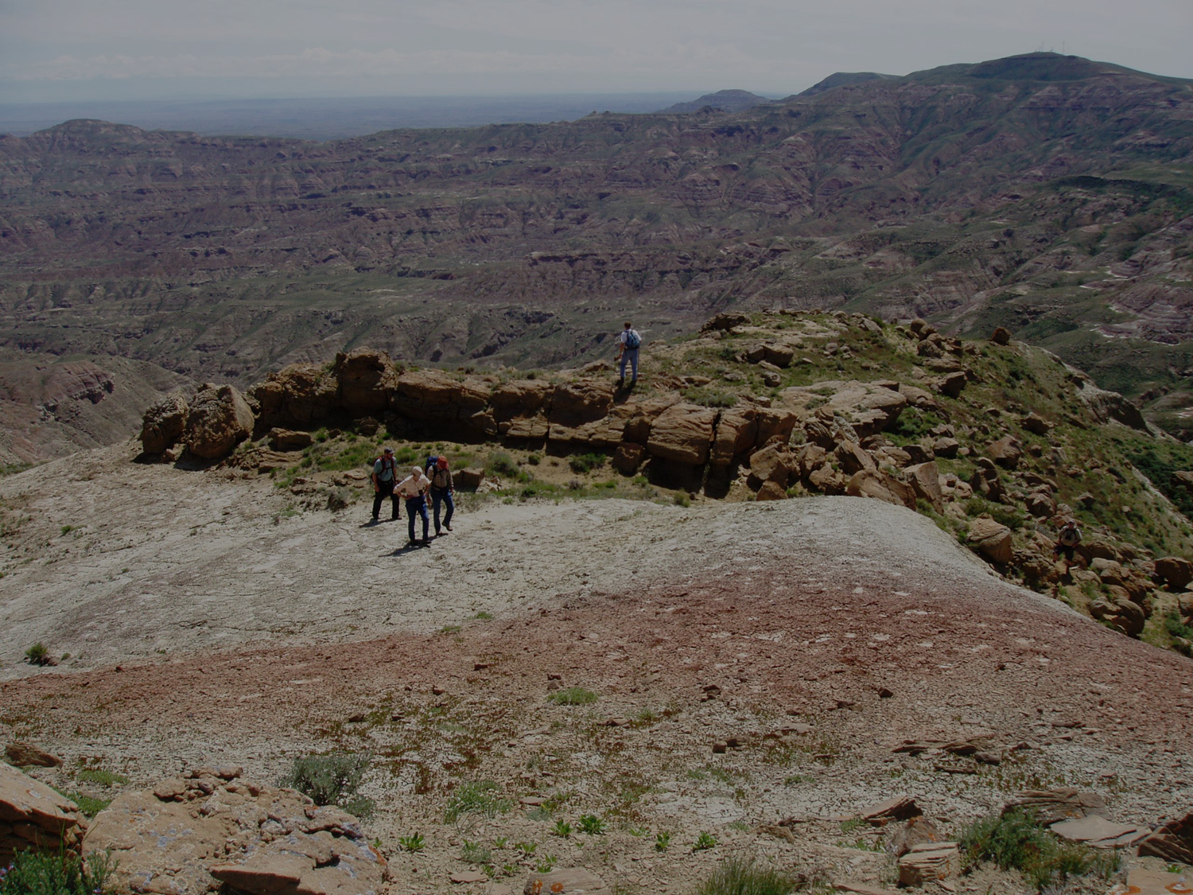
PLANNING FOR RECREATION AND VISITOR SERVICES
3. Affected Environment (Chapter 3)
Affected Environment Description
Built from Analysis of Management Situation (AMS)
Present condition
Supply and demand
Recreational Setting Characteristics (RSCs): Physical, Social, Operational
Pertinent recreation management, administration, information, monitoring
Notes:
Highlight RSCs

Slide 14
PLANNING FOR RECREATION AND VISITOR SERVICES
3. Affected Environment (Chapter 3)
Affected Environment Description
Built from Analysis of Management Situation (AMS)
Present condition
Supply and demand
Recreational Setting Characteristics (RSCs): Physical, Social, Operational
Pertinent recreation management, administration, information, monitoring
Notes:
Highlight RSCs

Slide 15
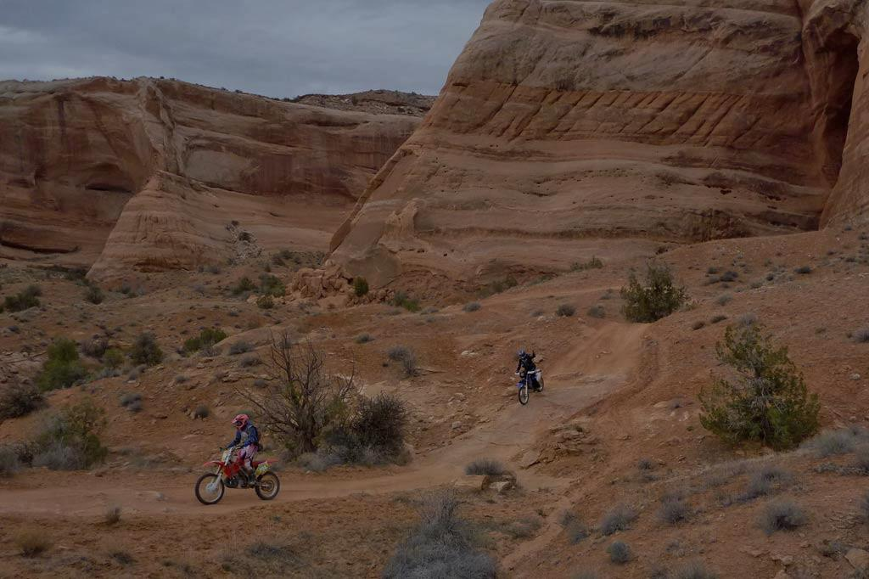
PLANNING FOR RECREATION AND VISITOR SERVICES
4. Effects analysis (Chapter 4)
Effects Analysis
Predicts the degree to which a resource or use will be affected
Demonstrate that the BLM took a “hard look” at the impacts
Commensurate with the importance of the impact
Notes:
Lots of info in Handbook!
The effects analysis predicts the degree to which a resource or resource use will be affected by the proposed actions of each alternative.
A “hard look” is defined as a reasoned analysis containing quantitative or detailed qualitative information.
Data and analyses must be commensurate with the importance of the impact; less important material may be summarized, consolidated, or simply referenced.

Slide 16
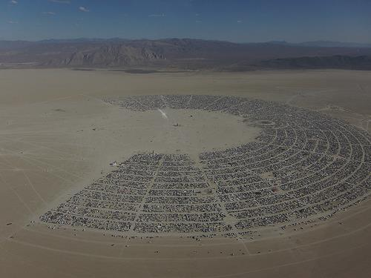
PLANNING FOR RECREATION AND VISITOR SERVICES
4. Effects analysis (Chapter 4)
Defining Environmental Effects
Assumptions
Location and length of time
Baseline for analysis
Reasonably foreseeable future actions
Methodology
Limitations
Rationale
Notes:
Assumptions. The effects analysis should state the analytical assumptions, including the geographic and temporal scope of the analysis (which may vary by issue), the baseline for analysis, as well as the reasonably foreseeable future actions. When information and/or data critical to the analysis are incomplete or unavailable, it must be explained in this section.
Methodology. The effects analysis must describe the analytical methodology sufficiently so that the reader can understand how the analysis was conducted and why the particular methodology was used (40 CFR 1502.24).
This explanation must include a description of any limitations inherent in the methodology. If there is substantial dispute over models, methodology, or data, recognize the opposing viewpoint(s) and explain the rationale for the chosen method of analysis. Discussions of methodology may be placed in the text or in the appendix of the document. To the extent possible, the analysis of impacts should be quantified.

Slide 17
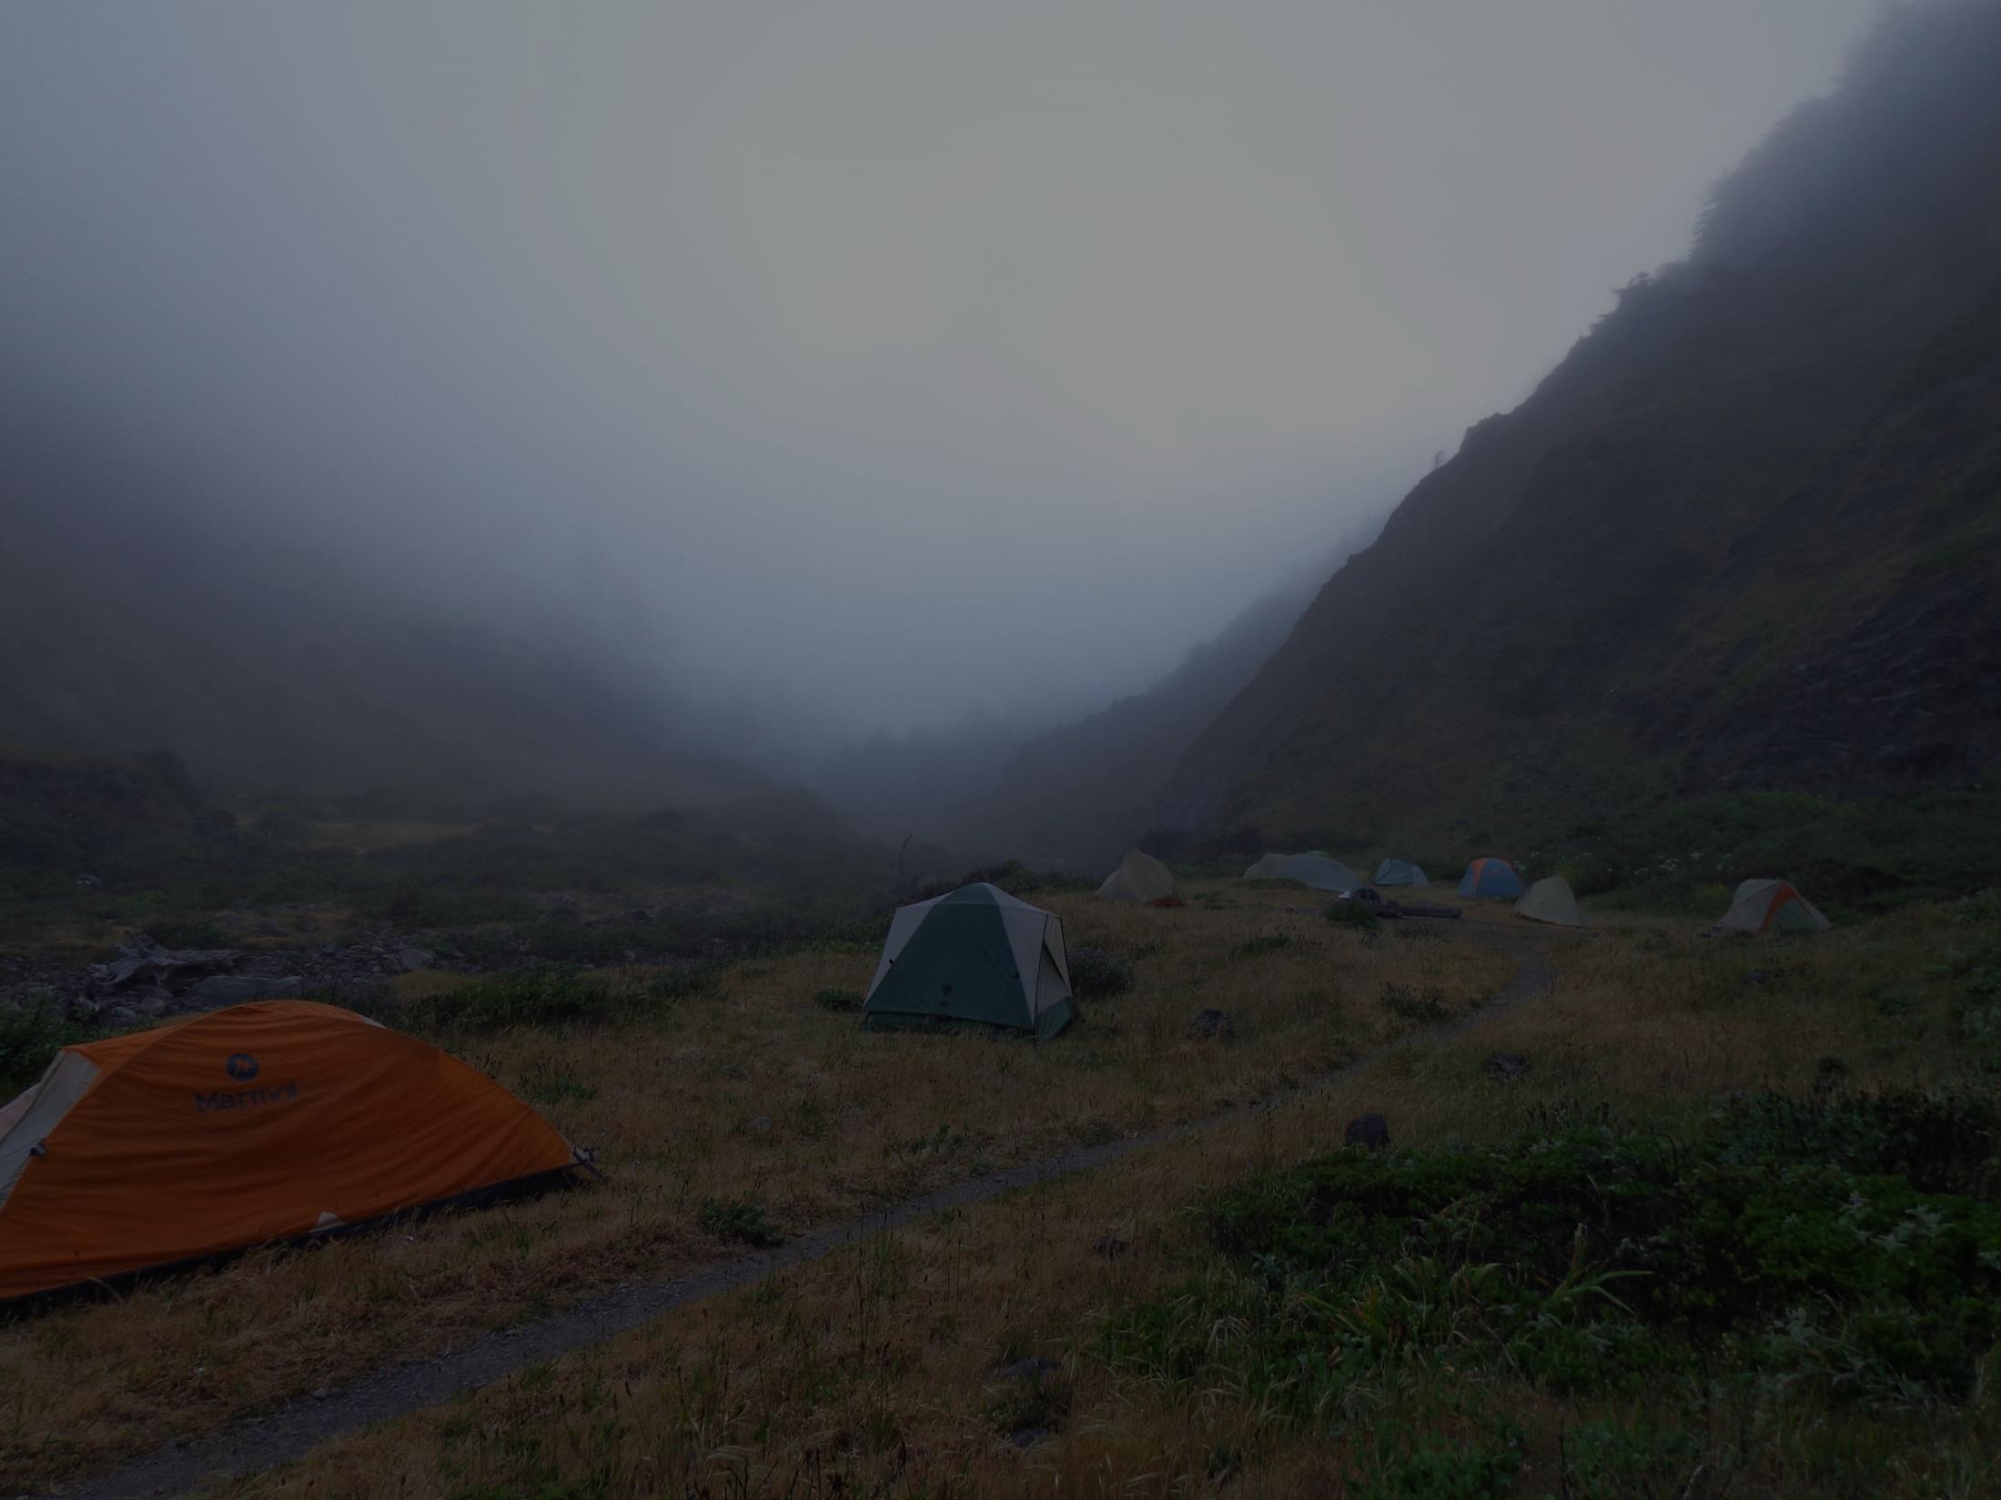
PLANNING FOR RECREATION AND VISITOR SERVICES
4. Effects analysis (Chapter 4)
Analyzing Environmental Effects
Analysis must include both:
Impacts of other proposed resources/resource uses on recreation.
Impacts of the proposed recreation uses on the existing recreation opportunities and other resources or resource uses.
Proposed Recreation
Existing Recreation
Resource Protection
Resource Use
Impacts

Slide 18
PLANNING FOR RECREATION AND VISITOR SERVICES
4. Effects analysis (Chapter 4)
Analyzing Environmental Effects
Provide a real world example of each:
Impacts of resource protection on proposed recreation
Impact of resource use on proposed recreation
Impact of proposed recreation on existing recreation
Impact of proposed recreation on other resource
Impact of proposed recreation on other resource use
Notes:
Ask class for real world examples

Slide 19
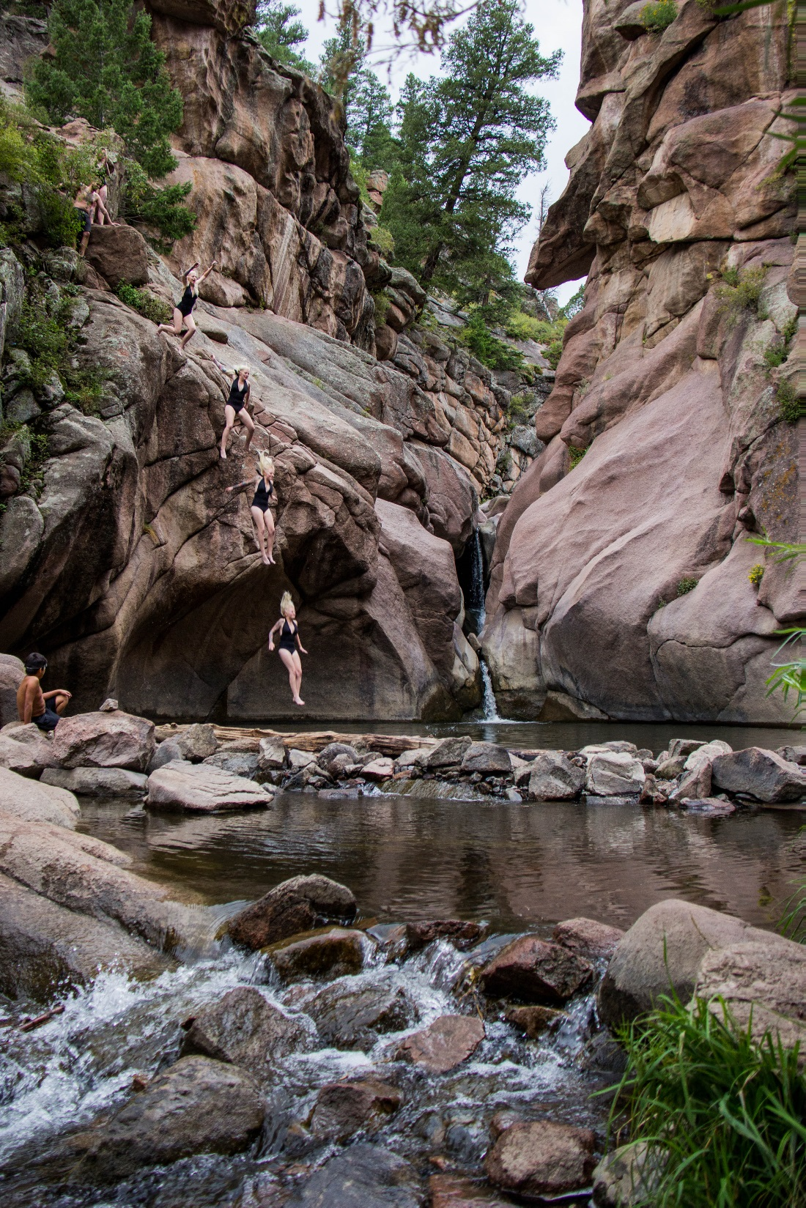
PLANNING FOR RECREATION AND VISITOR SERVICES
4. Effects analysis (Chapter 4)
Analyzing Environmental Effects
Direct
Indirect
Cumulative Effects Analyses
Notes:
Direct, Indirect, and Cumulative Effects Analyses.
Environmental assessments (EAs) and EISs must be used to analyze and describe the direct and indirect effects of the proposed action and the alternatives on the quality of the human environment (40 CFR 1508.8).
The value in requiring analysis of both direct and indirect effects is to make certain that no effects are overlooked. When uncertain which effect is direct and which is indirect, it is helpful to describe the effects together.
Both direct and indirect effects are weighted the same; do not consider an indirect effect less important than a direct effect in the analysis.
The purpose of cumulative effects analysis is to ensure federal decision makers consider the full range of consequences of actions (the proposed action and alternatives, including the no action alternative). Assessing cumulative effects begins early in the NEPA process, during internal and external scoping.

Slide 20
PLANNING FOR RECREATION AND VISITOR SERVICES
4. Effects analysis (Chapter 4)
Analyzing Environmental Effects
Direct :
Occur at the same time and place as the proposed action.
Address impacts in terms of context, intensity, duration, and timing.
Include long term and short term.
Notes:
Direct, Indirect, and Cumulative Effects Analyses. Ask class to provide an example
Environmental assessments (EAs) and EISs must be used to analyze and describe the direct and indirect effects of the proposed action and the alternatives on the quality of the human environment (40 CFR 1508.8).
The value in requiring analysis of both direct and indirect effects is to make certain that no effects are overlooked. When uncertain which effect is direct and which is indirect, it is helpful to describe the effects together.
Both direct and indirect effects are weighted the same; do not consider an indirect effect less important than a direct effect in the analysis.
The purpose of cumulative effects analysis is to ensure federal decision makers consider the full range of consequences of actions (the proposed action and alternatives, including the no action alternative). Assessing cumulative effects begins early in the NEPA process, during internal and external scoping.

Slide 21
PLANNING FOR RECREATION AND VISITOR SERVICES
4. Effects analysis (Chapter 4)
Analyzing Environmental Effects
POP Quiz!
Which RSC would be impacted by the proposed transmission line in the Blue River Valley SRMA?
See example on page III-7 of the handbook.

Slide 22
PLANNING FOR RECREATION AND VISITOR SERVICES
4. Effects analysis (Chapter 4)
Analyzing Environmental Effects
POP Quiz!
Which RSC would be impacted by the proposed transmission line in the Blue River Valley SRMA?
See example on page III-7 of the handbook.
Answer:
The transmission line will impact the physical RSCs of remoteness and naturalness through road construction, placement of power poles, and stringing of transmission lines.

Slide 23
PLANNING FOR RECREATION AND VISITOR SERVICES
4. Effects analysis (Chapter 4)
Analyzing Environmental Effects
Indirect :
Reasonable foreseeable
Occur at different time or place
Using the previous example what are some potential indirect effects?
Notes:
Direct, Indirect, and Cumulative Effects Analyses. Have class provide a real world example
Environmental assessments (EAs) and EISs must be used to analyze and describe the direct and indirect effects of the proposed action and the alternatives on the quality of the human environment (40 CFR 1508.8).
The value in requiring analysis of both direct and indirect effects is to make certain that no effects are overlooked. When uncertain which effect is direct and which is indirect, it is helpful to describe the effects together.
Both direct and indirect effects are weighted the same; do not consider an indirect effect less important than a direct effect in the analysis.
The purpose of cumulative effects analysis is to ensure federal decision makers consider the full range of consequences of actions (the proposed action and alternatives, including the no action alternative). Assessing cumulative effects begins early in the NEPA process, during internal and external scoping.

Slide 24
PLANNING FOR RECREATION AND VISITOR SERVICES
4. Effects analysis (Chapter 4)
Analyzing Environmental Effects
Cumulative Effects
Aggregate impacts resulting from
incremental impact added to:
Past, present, reasonable foreseeable future actions.
Can result from individually minor, but collectively significant, actions occurring over an extended period.
Notes:
Address the cumulative impact of each alternative, and, if feasible, draw a conclusion about each alternative and compare the conclusions against each other.
Do not simply restate the direct and indirect impacts of the alternatives.
If the proposed action and alternatives will have no direct or indirect effects on a resource, cumulative effects on that resource do not need to be analyzed.
Have class provide real world example

Slide 25
PLANNING FOR RECREATION AND VISITOR SERVICES
Environmental Consequences – Chapter 4
Analyzing Environmental Effects
Qualitative and Quantitative Analysis
Qualitatively discuss
Quantitatively estimate
the consequences of proposed decisions on R&VS.
In the absence of quantitative data, use professional judgment to qualitatively analyze the impacts of each alternative.
Notes:
The type and quality of existing data determines if impacts can be analyzed qualitatively and/or quantitatively.
Where possible, quantify both beneficial and detrimental impacts of each alternative to support conclusions.

Slide 26
PLANNING FOR RECREATION AND VISITOR SERVICES
Environmental Consequences – Chapter 4
Analyzing Environmental Effects
Qualitative and Quantitative Analysis
POP QUIZ!!
Look at Figure 31 on page III-10 of the handbook.
How many acres would be converted to a front country physical recreation setting in Alternative B?
Is this Qualitative or Quantitative?
Notes:
Answer: 6,000 acres

Slide 27
PLANNING FOR RECREATION AND VISITOR SERVICES
Environmental Consequences – Chapter 4
Analyzing Environmental Effects
Qualitative and Quantitative Analysis
POP QUIZ!!
Look at Figure 31 on page III-10.
How many acres would be converted to a front country physical recreation setting in Alternative B?
Is this Qualitative or Quantitative?
Answer: 6,000 acres, Quantitative.

Slide 28
PLANNING FOR RECREATION AND VISITOR SERVICES
Environmental Consequences – Chapter 4
Sequential Steps to Analyze Impacts – Page III-11
Summarize the factors/elements that will cause the impact.
b. Describe the impact qualitatively, including appropriate linkages and consequences of the action.
c. Quantify the level of impact (severity) using the appropriate indicator.
d. Describe the context of the impact in relation to the existing condition described in the affected environment, using the appropriate indicator.
e. Compare impacts in the action alternatives to the impacts in the no action alternative and the other action alternatives.
f. Incorporate the big picture. In other words, provide the analytical conclusion
interpreting the results, especially when you are unable to quantify the data.
Notes:
Use these sequential steps to analyze and describe the type and nature of the impacts.
While this process is somewhat repetitive, this method ensures accuracy, uniformity, and consistency in describing the impacts and their causes.

Slide 29
PLANNING FOR RECREATION AND VISITOR SERVICES
1. Overview of the LUP Process
Notes:
Refer to Planning Process Flow chart from Module 1 Planning Overview and Planning Flowchart poster on wall
What is the role of the rec planner throughout the planning process?
Who has gone though a LUP from start to finish?
How long did it take?
What were the greatest challenges?
- Any success stories? Amazing decisions being made as a result of the process?
Open Module 9 Tab in Handbook.
Goal is to show you what you will need to do, not exactly how to do it. Know where to go for help when you need it.

Slide 30
PLANNING FOR RECREATION AND VISITOR SERVICES
1. Overview of the LUP Process
Notes:
Refer to Planning Process Flow chart from Module 1 Planning Overview and Planning Flowchart poster on wall
What is the role of the rec planner throughout the planning process?
Who has gone though a LUP from start to finish?
How long did it take?
What were the greatest challenges?
- Any success stories? Amazing decisions being made as a result of the process?
Open Module 9 Tab in Handbook.
Goal is to show you what you will need to do, not exactly how to do it. Know where to go for help when you need it.

Slide 31
PLANNING FOR RECREATION AND VISITOR SERVICES
1. Overview of the LUP Process
Notes:
Refer to Planning Process Flow chart from Module 1 Planning Overview and Planning Flowchart poster on wall
What is the role of the rec planner throughout the planning process?
Who has gone though a LUP from start to finish?
How long did it take?
What were the greatest challenges?
- Any success stories? Amazing decisions being made as a result of the process?
Open Module 9 Tab in Handbook.
Goal is to show you what you will need to do, not exactly how to do it. Know where to go for help when you need it.

Slide 32
PLANNING FOR RECREATION AND VISITOR SERVICES
1. Overview of the LUP Process
Notes:
Refer to Planning Process Flow chart from Module 1 Planning Overview and Planning Flowchart poster on wall
What is the role of the rec planner throughout the planning process?
Who has gone though a LUP from start to finish?
How long did it take?
What were the greatest challenges?
- Any success stories? Amazing decisions being made as a result of the process?
Open Module 9 Tab in Handbook.
Goal is to show you what you will need to do, not exactly how to do it. Know where to go for help when you need it.

Slide 33
PLANNING FOR RECREATION AND VISITOR SERVICES
1. Overview of the LUP Process
Notes:
Refer to Planning Process Flow chart from Module 1 Planning Overview and Planning Flowchart poster on wall
What is the role of the rec planner throughout the planning process?
Who has gone though a LUP from start to finish?
How long did it take?
What were the greatest challenges?
- Any success stories? Amazing decisions being made as a result of the process?
Open Module 9 Tab in Handbook.
Goal is to show you what you will need to do, not exactly how to do it. Know where to go for help when you need it.

Slide 34
PLANNING FOR RECREATION AND VISITOR SERVICES
1. Overview of the LUP Process
Notes:
Difference between a protest and an appeal?
Protest is a specific process for challenging a Land-Use Plan Decision; goes to director of the BLM. If still not resolved, does not go to Board of Appeals, goes to federal court
Appeal; agency review then an appeal reviewed by IBLA.

Slide 35
PLANNING FOR RECREATION AND VISITOR SERVICES
1. Overview of the LUP Process
Notes:
Refer to Planning Process Flow chart from Module 1 Planning Overview and Planning Flowchart poster on wall
What is the role of the rec planner throughout the planning process?
Who has gone though a LUP from start to finish?
How long did it take?
What were the greatest challenges?
- Any success stories? Amazing decisions being made as a result of the process?
Open Module 9 Tab in Handbook.
Goal is to show you what you will need to do, not exactly how to do it. Know where to go for help when you need it.

Slide 36
PLANNING FOR RECREATION AND VISITOR SERVICES
1. Overview of the LUP Process
Implement, Monitor, and Evaluate!
Notes:
Refer to Planning Process Flow chart from Module 1 Planning Overview and Planning Flowchart poster on wall
What is the role of the rec planner throughout the planning process?
Who has gone though a LUP from start to finish?
How long did it take?
What were the greatest challenges?
- Any success stories? Amazing decisions being made as a result of the process?
Open Module 9 Tab in Handbook.
Goal is to show you what you will need to do, not exactly how to do it. Know where to go for help when you need it.

