Slide 1



Slide 2
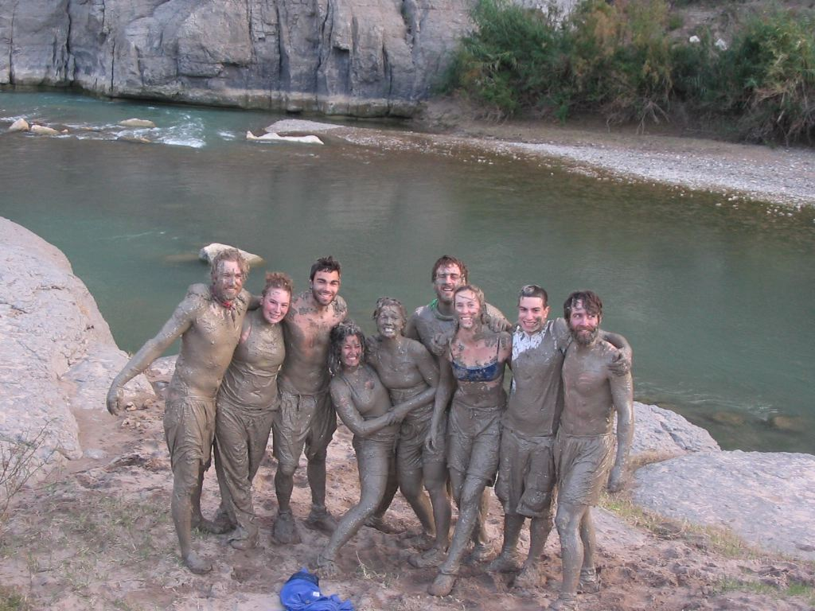
PLANNING FOR
RECREATION AND VISITOR SERVICES
Evaluating Potential RMAs
How would you go about evaluating potential RMAs?
Notes:
Many offices starting an LUP revision will be revising an older plan that had the entire FO covered by either an SRMA or an ERMA. So in your mind I think you need to lift the ERMA off the planning area and really take a look at where recreation opportunities currently are and where you are currently managing recreation. Your existing SRMAs may need to change and you have the opportunity to identify specific areas for ERMAs.

Slide 3
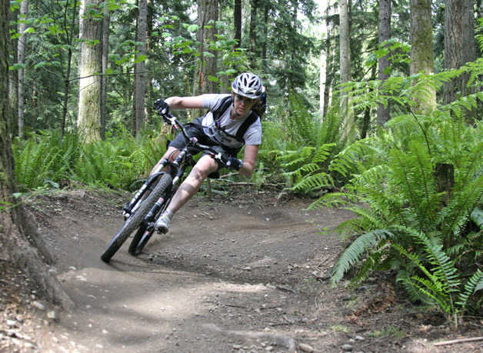
PLANNING FOR
RECREATION AND VISITOR SERVICES
C
Evaluating Potential RMAs
Consider an area’s eligibility and manageability before
discussing it in the analysis of the management situation or
proposing it for designation in the formation of alternatives in the LUP.
Notes:
Page 1-34 in the handbook.
As you are thinking about potential RMAs, there is a process considers specific factors. See Illustration 1 (handhout) for a flow chart that displays the RMA evaluation process. There is both eligibility and manageability – kind of like the WSR eligibility and suitability process

Slide 4
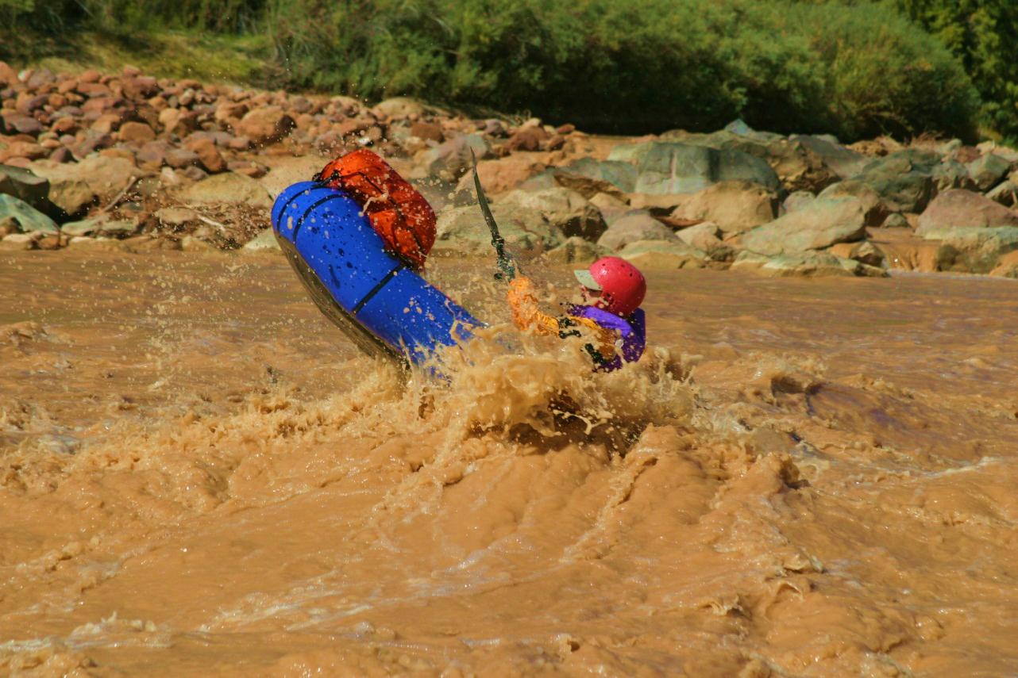
PLANNING FOR
RECREATION AND VISITOR SERVICES
Evaluating Potential RMAs
Step 1 – Consider Eligibility Factors.
The first step assesses the extent the RMA eligibility factors are met in a geographically defined area. If the RMA eligibility factors are not met, the area is not eligible to be designated as an RMA, and further assessment is not required. The following eligibility factors should be considered:
a. Demand for recreation opportunities.
Notes:
Handbook page I-34
Illustration I
What is the demand for recreation opportunities in the area?
Are you getting user created trails (motorized or non-motorized) that might indicate a demand for a certain type of opportunity that isn’t being met?

Slide 5
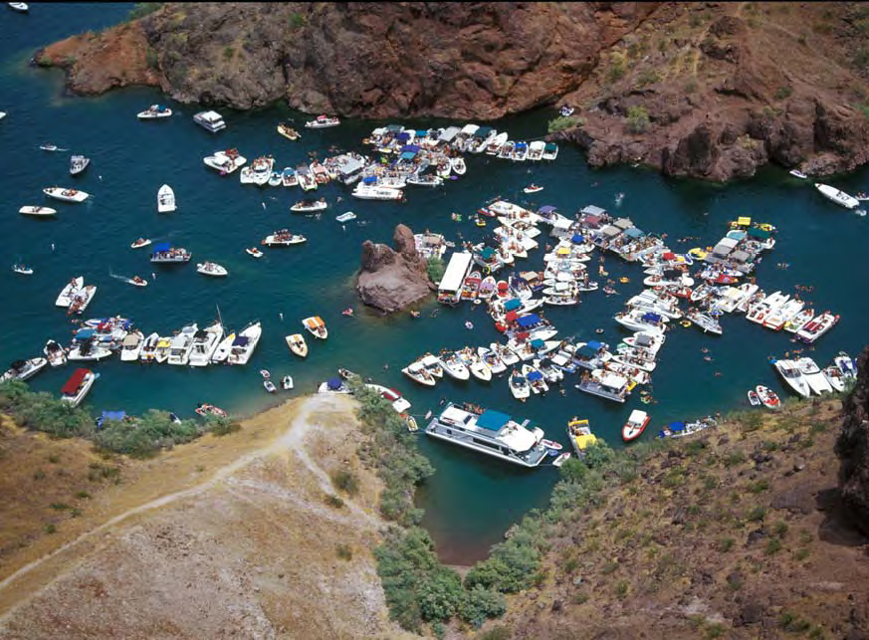
PLANNING FOR
RECREATION AND VISITOR SERVICES
Evaluating Potential RMAs
Step 1 – Consider Eligibility Factors.
The first step assesses the extent the RMA eligibility factors are met in a geographically defined area. If the RMA eligibility factors are not met, the area is not eligible to be designated as an RMA, and further assessment is not required. The following eligibility factors should be considered:
Demand for recreation
opportunities.
b. Existing recreation use.
Notes:
Handbook page I-34
Illustration I
Do you have good data about existing recreation use?
What do your RMIS numbers say? What do your camp hosts say?
What kind of information is being shared online about the area?
How often is the trailhead parking area full or regularly have cars in it.

Slide 6
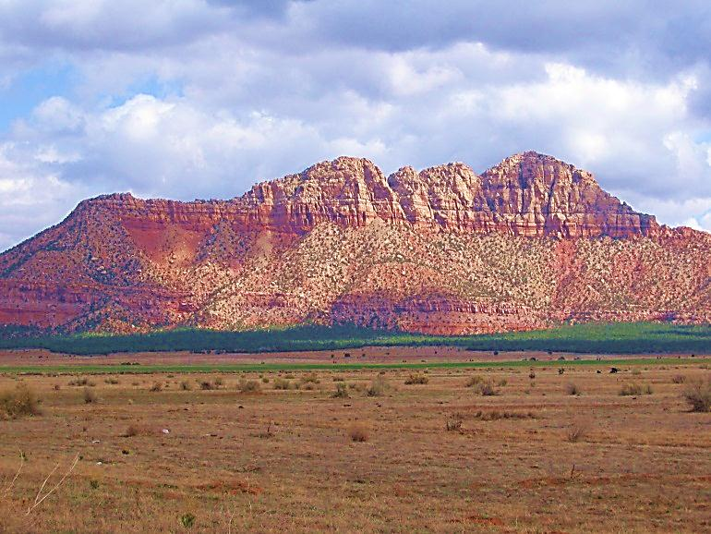

PLANNING FOR
RECREATION AND VISITOR SERVICES
Evaluating Potential RMAs
Step 1 – Consider Eligibility Factors.
The first step assesses the extent the RMA eligibility factors are met in a geographically defined area. If the RMA eligibility factors are not met, the area is not eligible to be designated as an RMA, and further assessment is not required. The following eligibility factors should be considered:
a. Demand for recreation opportunities.
b. Existing recreation use.
c. Supply of RSCs.
Notes:
Handbook page I-34
Illustration I
What is the supply of recreation setting characteristics for the area?
Do you have a narrow or limited supply of settings compared to the full spectrum of settings –

Slide 7
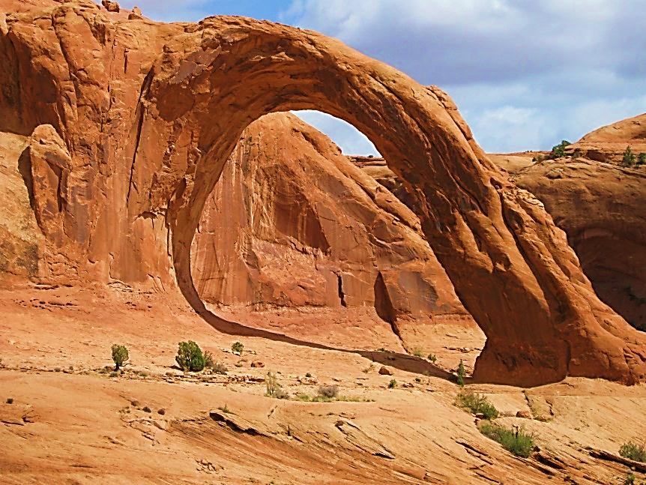
PLANNING FOR
RECREATION AND VISITOR SERVICES
Evaluating Potential RMAs
Step 1 – Consider Eligibility Factors.
The first step assesses the extent the RMA eligibility factors are met in a geographically defined area. If the RMA eligibility factors are not met, the area is not eligible to be designated as an RMA, and further assessment is not required. The following eligibility factors should be considered:
a. Demand for recreation opportunities.
b. Existing recreation use.
c. Supply of RSCs.
d. The unique value, importance, and/or distinctiveness of RSCs, especially compared to other areas used for recreation.
Notes:
Handbook page I-34
Illustration I
Are there unique or distinctive settings that aren’t found in other areas and that draw people to that setting

Slide 8

PLANNING FOR
RECREATION AND VISITOR SERVICES
Evaluating Potential RMAs
Step 1 – Consider Eligibility Factors.
The first step assesses the extent the RMA eligibility factors are met in a geographically defined area. If the RMA eligibility factors are not met, the area is not eligible to be designated as an RMA, and further assessment is not required. The following eligibility factors should be considered:
a. Demand for recreation opportunities.
b. Existing recreation use.
c. Supply of RSCs.
d. The unique value, importance, and/or distinctiveness of RSCs, especially compared to other areas used for recreation.
e. Existing or needed R&VS program investments and infrastructure.
Notes:
Handbook page I-34
Illustration I
Is your existing infrastructure adequate? What infrastructure or other investments may be needed?

Slide 9
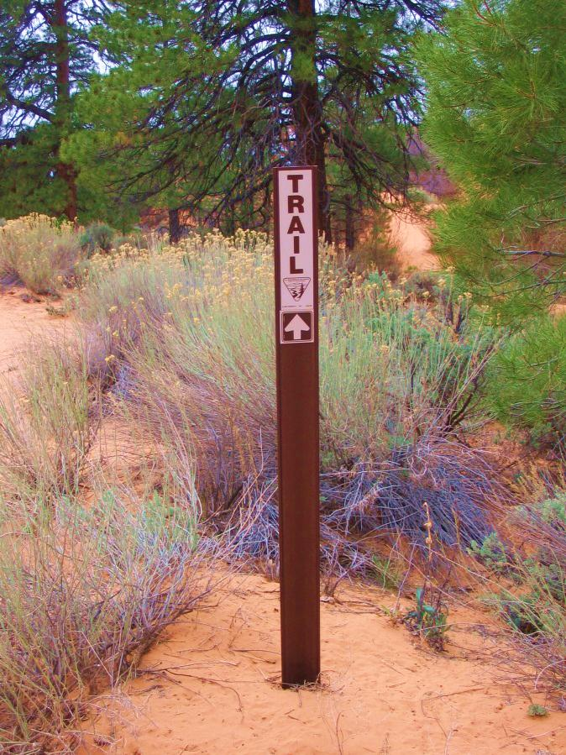
PLANNING FOR
RECREATION AND VISITOR SERVICES
Evaluating Potential RMAs
Step 2 – Evaluate Manageability Considerations.
If RMA eligibility factors are met, the
area is next assessed to determine its manageability as an RMA. Address manageability considerations when formulating proposed RMA alternatives through the planning process. Not all manageability considerations must be met since each RMA proposal is unique. The following manageability considerations should be assessed:
a. Capability to manage recreation resources and uses.
Notes:
What is the capability of the BLM and/or our partners to manage the area for recreation?

Slide 10

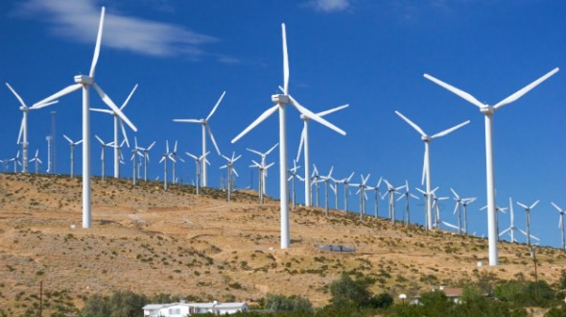
PLANNING FOR
RECREATION AND VISITOR SERVICES
Evaluating Potential RMAs
Step 2 – Evaluate Manageability Considerations.
Capability to manage recreation resources and uses.
b. The amount of certainty that proposed or competing land uses or other resource values do not preclude providing the desired recreation opportunities or protecting the RSCs.
Notes:
Are there other land uses that may make the area unavailable for the desired activities or could significantly change the setting characteristics in the future?

Slide 11

PLANNING FOR
RECREATION AND VISITOR SERVICES
Evaluating Potential RMAs
Step 2 – Evaluate Manageability Considerations.
a. Capability to manage recreation resources and uses.
b. The amount of certainty that proposed or competing land uses or other resource values do not preclude providing the desired recreation opportunities or protecting the RSCs.
c. Ability to establish interdisciplinary management actions and allowable uses to support desired recreation opportunities.
Notes:
Can recreation establish management actions and allowable uses that restrict other BLM programs, to support or protect desired recreation opportunities? Examples: NSO for fluid minerals, ROW avoidance or exclusion area, or remove grazing from a particular area

Slide 12
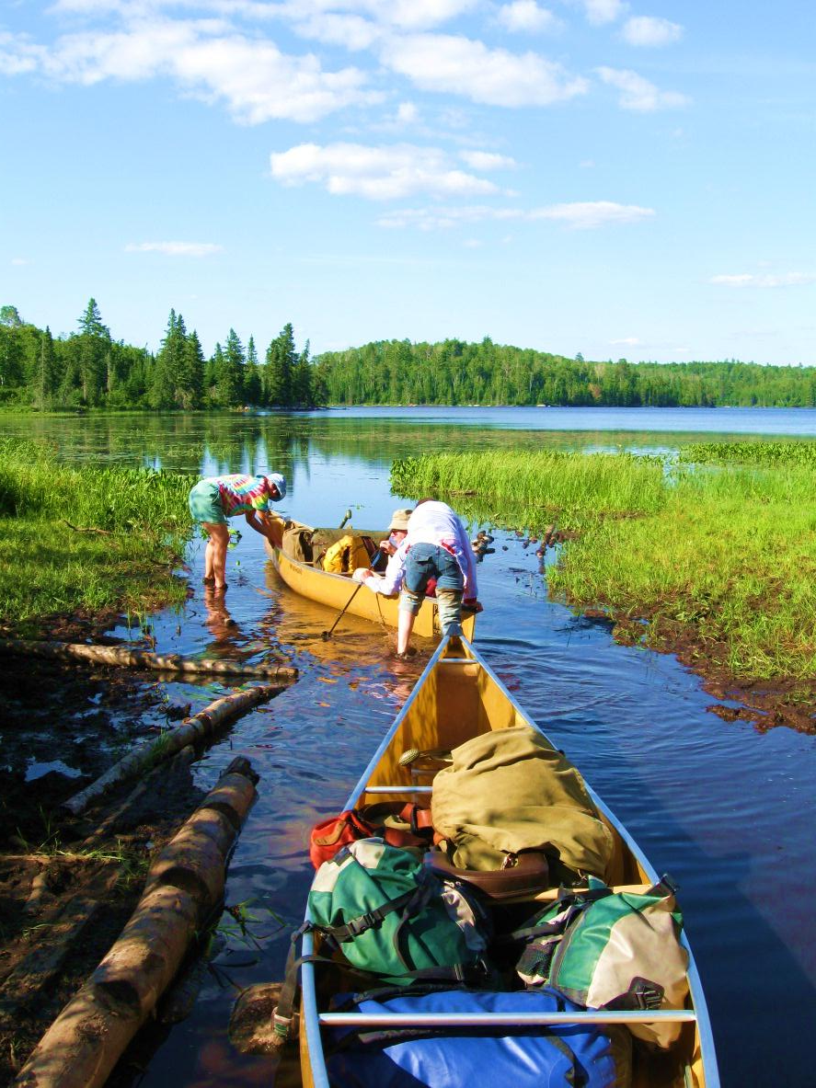
PLANNING FOR
RECREATION AND VISITOR SERVICES
Evaluating Potential RMAs
d. Necessary recreation management actions and allowable uses that will be needed to:
(1) Support and facilitate targeted recreation opportunities.
Notes:
Does your office have the capability to determine the necessary recreation management actions and allowable uses that will be needed to:
(1) Support and facilitate targeted recreation opportunities (ie mountain biking, hiking or single track motorcycle trails.)

Slide 13
PLANNING FOR
RECREATION AND VISITOR SERVICES
Evaluating Potential RMAs
d. Necessary recreation management actions and allowable uses that will be needed to:
(1) Support and facilitate targeted recreation opportunities.
(2) Maintain or enhance RSCs.
Notes:
(2) Maintain or enhance RSCs. (natural landscape, 7-14 encounters/day, rules and regulations clearly posted)

Slide 14
PLANNING FOR
RECREATION AND VISITOR SERVICES
Evaluating Potential RMAs
d. Necessary recreation management actions and allowable uses that will be needed to:
(1) Support and facilitate targeted recreation opportunities.
(2) Maintain or enhance RSCs.
(3) Mitigate recreation impacts to cultural and natural resources.
Notes:
(3) Mitigate recreation impacts to cultural and natural resources.

Slide 15
PLANNING FOR
RECREATION AND VISITOR SERVICES
Evaluating Potential RMAs
d. Necessary recreation management actions and allowable uses that will be needed to:
(1) Support and facilitate targeted recreation opportunities.
(2) Maintain or enhance RSCs.
(3) Mitigate recreation impacts to cultural and natural resources.
(4) Address use and user conflicts.
Notes:
(4) Address use and user conflicts.
.

Slide 16
PLANNING FOR
RECREATION AND VISITOR SERVICES
Evaluating Potential RMAs
d. Necessary recreation management actions and allowable uses that will be needed to:
(1) Support and facilitate targeted recreation opportunities.
(2) Maintain or enhance RSCs.
(3) Mitigate recreation impacts to cultural and natural resources.
(4) Address use and user conflicts.
(5) Gain public support for managing specific recreation opportunities.
Notes:
(5) Gain public support for managing specific recreation opportunities.

Slide 17
PLANNING FOR
RECREATION AND VISITOR SERVICES
Evaluating Potential RMAs
d. Necessary recreation management actions and allowable uses that will be needed to:
(1) Support and facilitate targeted recreation opportunities.
(2) Maintain or enhance RSCs.
(3) Mitigate recreation impacts to cultural and natural resources.
(4) Address use and user conflicts.
(5) Gain public support for managing specific recreation opportunities.
(6) Involve existing and/or potential partners/volunteers to help the BLM manage specific recreation opportunities and RSCs on a sustained long-term basis.
Notes:
(6) Involve existing and/or potential partners/volunteers to help the BLM manage specific recreation opportunities and RSCs on a sustained long-term basis.

Slide 18
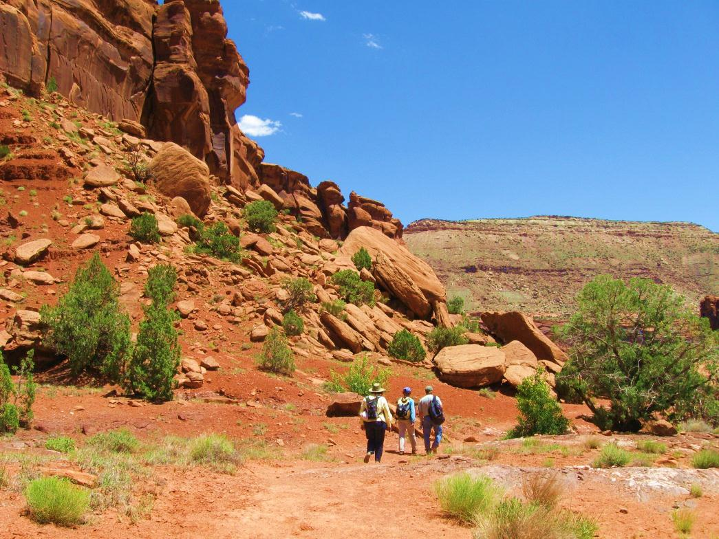
PLANNING FOR
RECREATION AND VISITOR SERVICES
Evaluating Potential RMAs
Step 3 – Determine the Recreation Management Area Type.
These eligibility and manageability factors do not necessarily dictate the RMA type.
There is decision space for managers working with cooperating agencies and community partners to determine the appropriate way to manage recreation resources within the planning area.
SRMA
ERMA
BCA?
Notes:
Step 3 – Determine the Recreation Management Area Type.
These eligibility and
manageability factors do not dictate an absolute determination of RMA type.
There is decision space for managers working with cooperating agencies and community partners to determine the appropriate way to manage recreation resources within the planning area.
See Figure 16 in Handbook. Page 1-36

Slide 19
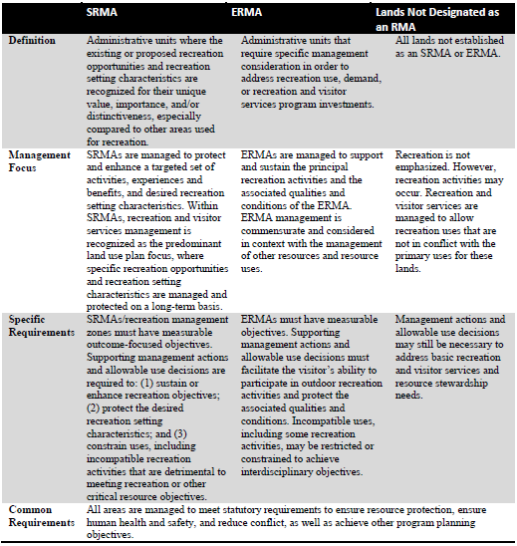
PLANNING FOR
RECREATION AND VISITOR SERVICES
Evaluating Potential RMAs
H-8320-1 Figure 16 – Recreation Management Area Comparison Table
BCA
Use info in BCA IM WO 2107-036
wildlife-dependent recreation
Notes:
H-8320-1 Figure 16 – Recreation Management Area Comparison Table
This table is in your handbook. You may have some areas that are definitely going to be SRMAs (public desire, uniqueness, can be protected) and others that due to other resource decisions can only be ERMA. There may be areas that fit well into the BCA concept. Also you will have areas that could be either an SRMA, an ERMA or a BCA and will be one in one alternative of the LUP and something else in another alternative. The final determination will come through the planning process.
As compared to how BLM planned for recreation in the past, it is likely that offices will have fewer SRMAs, but more ERMAs.

Slide 20
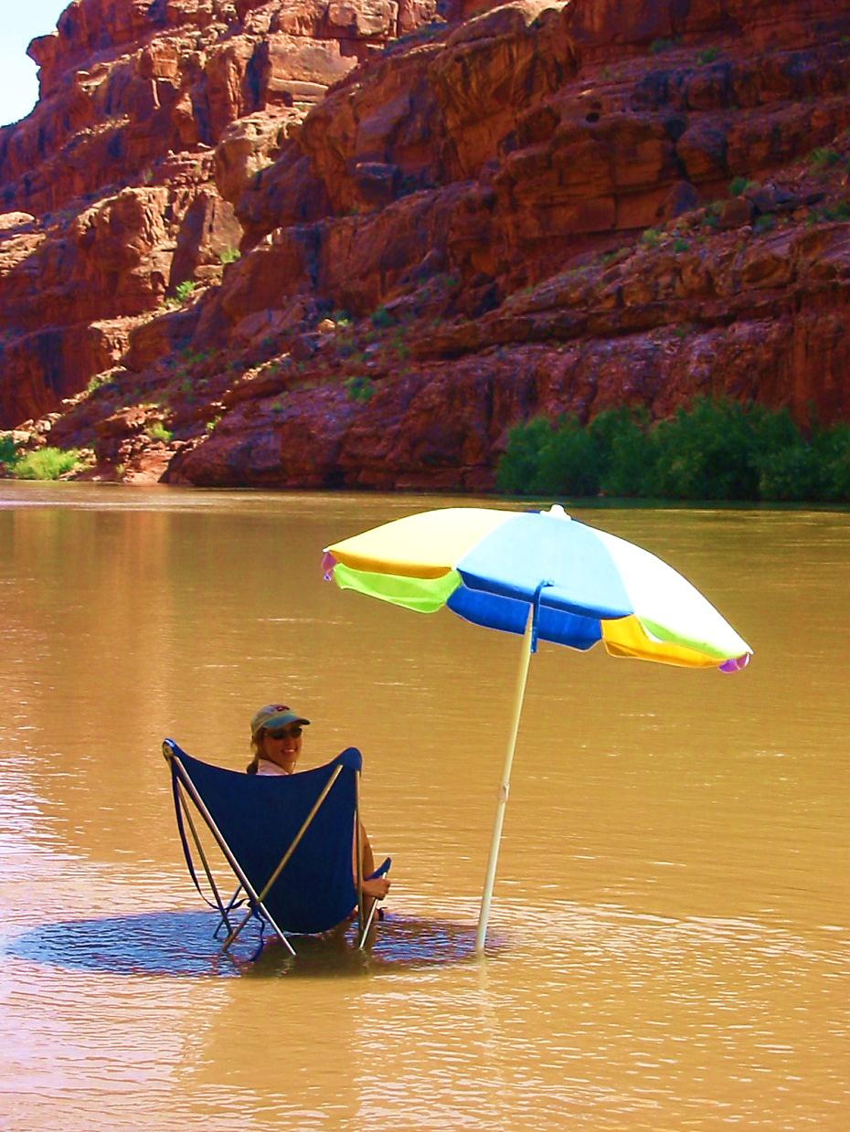
PLANNING FOR
RECREATION AND VISITOR SERVICES
Evaluating Potential RMAs
SRMAs are managed:
For their unique value, importance, and/or distinctiveness, especially as compared to other areas used for recreation.
To protect and enhance a targeted set of activities, experiences, benefits, and desired RSCs.
As the predominant LUP focus within the SMRA.
To protect specific recreation opportunities and RSCs on a long-term basis.
Notes:
For their unique value, importance, and/or distinctiveness, especially as compared to other areas used for recreation.
To protect and enhance a targeted set of activities, experiences, benefits, and desired RSCs.
As the predominant LUP focus within the SMRA.
To protect specific recreation opportunities and RSCs on a long-term basis.

Slide 21
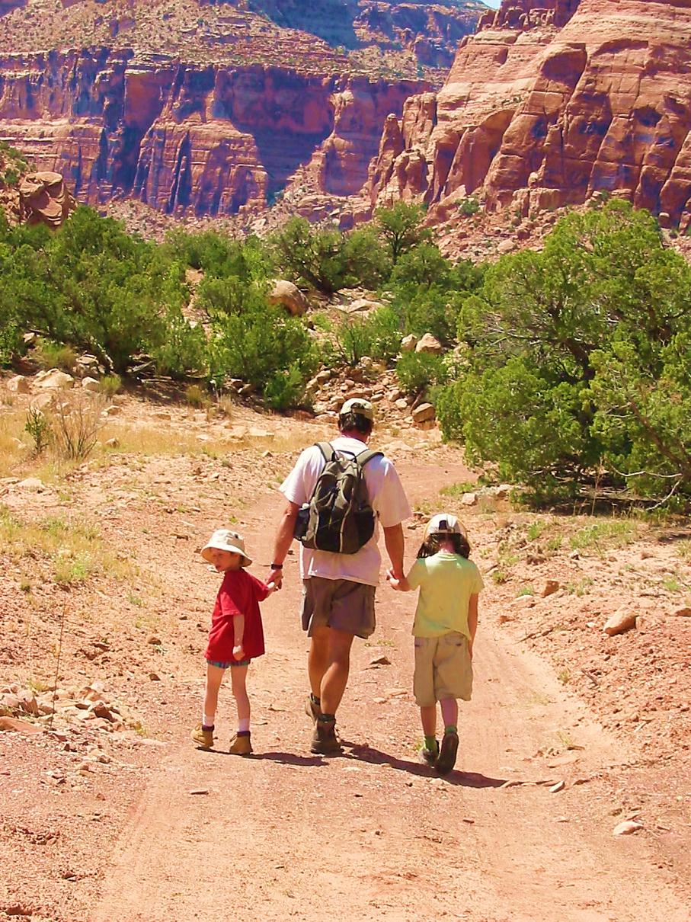
PLANNING FOR
RECREATION AND VISITOR SERVICES
Evaluating Potential RMAs
ERMAs are managed:
To address recreation use, demand, or existing R&VS program investments.
(2) To support and sustain the principal recreation activities and the associated qualities and conditions.
(3) Commensurate with the management of other resources and resource uses in the area.
Notes:
ERMAs are managed:
To address recreation use, demand, or existing R&VS program investments.
(2) To support and sustain the principal recreation activities and the associated qualities and conditions.
(3) Commensurate with the management of other resources and resource uses in the area.

Slide 22

PLANNING FOR
RECREATION AND VISITOR SERVICES
Evaluating Potential RMAs
BCAs are managed:
For high quality wildlife habitat that can be compatibly-managed for wildlife dependent recreation and consistent with the related recreation and fish/wildlife objectives
The objective(s) should focus on protecting and enhancing high-quality wildlife-dependent recreation opportunities.

Slide 23
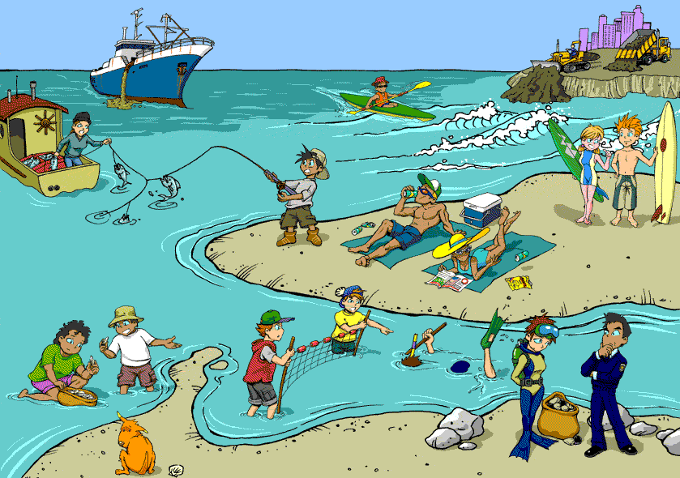
PLANNING FOR
RECREATION AND VISITOR SERVICES
Identifying RMZs
Identifying Recreation Management Zones within SRMAs/ERMAs

Slide 24
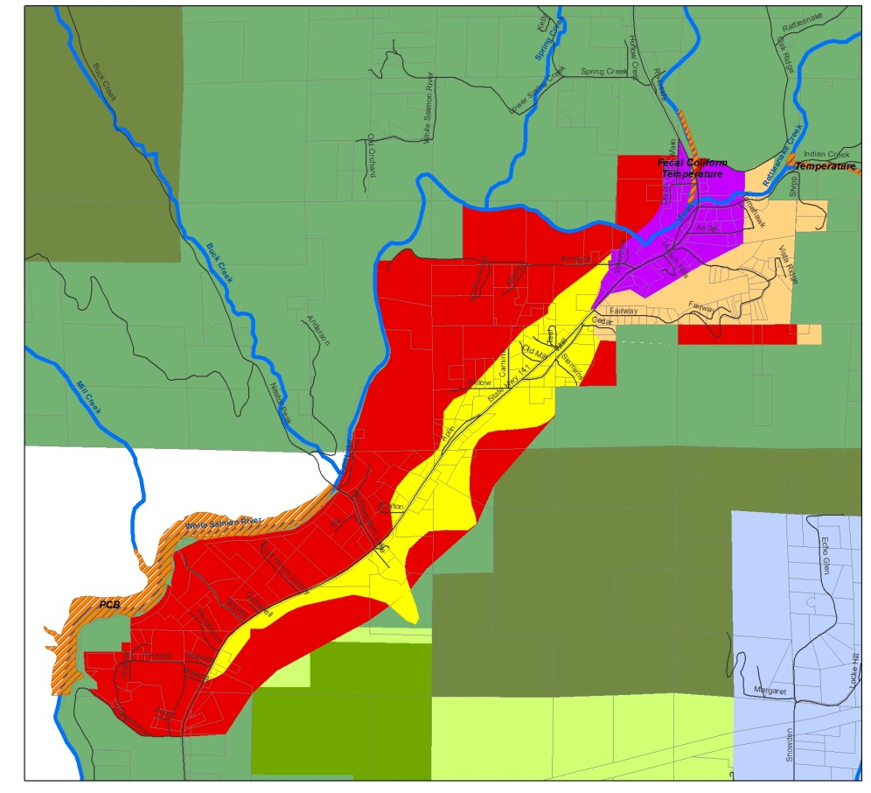
PLANNING FOR
RECREATION AND VISITOR SERVICES
Identifying RMZs
Identifying Recreation Management Zones within SRMAs/ERMAs.
Recreation Management Zone: (RMZs)
A subdivision of a recreation management area that further delineates specific recreation opportunities and recreation setting characteristics.
RMZs provide an optional management tool to manage recreation resources in complex situations where many recreation opportunities are provided.
It is not just about
delineating activities!
Notes:
An SRMA may be subdivided into RMZs to further delineate specific recreation opportunities. RMZs provide an optional management tool to manage recreation resources in complex situations where many recreation opportunities are provided.

Slide 25
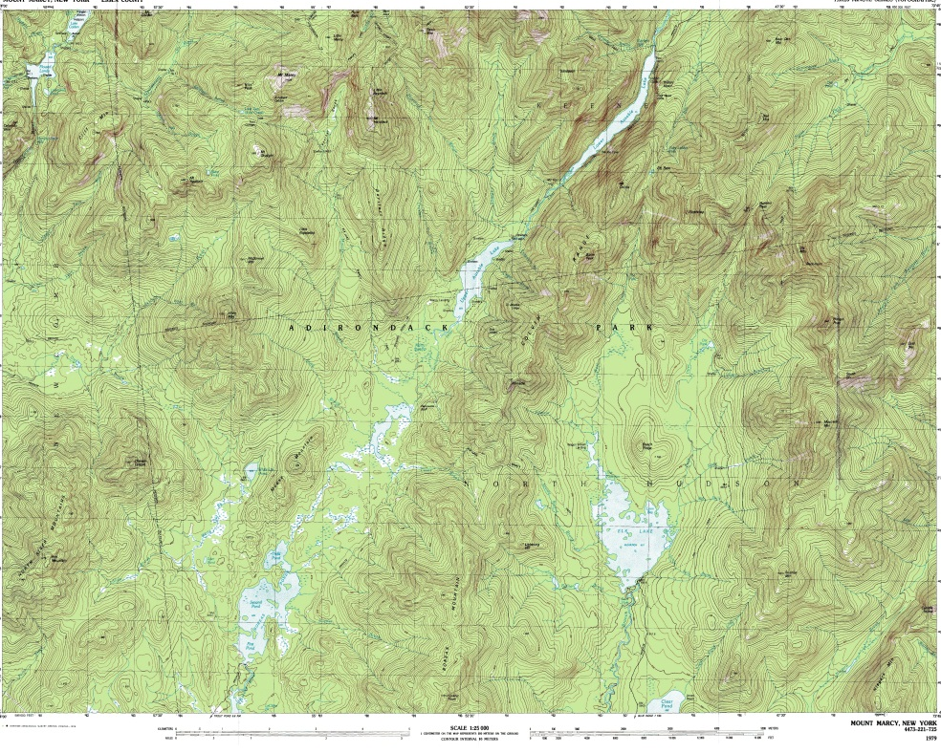


PLANNING FOR
RECREATION AND VISITOR SERVICES
Identifying RMZs
Each RMZ has a discrete objective and provides for specific recreation opportunities.
Establishing RMZs and associated objectives are LUP decisions.
Where RMZs are established, identify the necessary management action and allowable use decisions needed to achieve the RMZ objectives.
While generally unnecessary, ERMAs may be subdivided into RMZs to ensure R&VS are managed commensurate with the management of other resources and resource uses.
Notes:
When this division is made, each RMZ has a discrete objective and provides for specific recreation opportunities (like a mini SRMA)
Establishing RMZs and associated objectives are LUP decisions.
Where RMZs are established, identify the necessary management action and allowable use decisions needed to achieve the RMZ objectives.
While generally unnecessary, ERMAs may be subdivided into RMZs to ensure R&VS are managed commensurate with the management of other resources and resource uses.

Slide 26


PLANNING FOR
RECREATION AND VISITOR SERVICES
Identifying RMZs
Identifying Recreation Management Zones within SRMAs/ERMAs.
For example, an SRMA may offer land-based and water-based recreation activity opportunities, along with a very different set of experiences and outcomes for each.
Therefore, the RMA could be divided into a land-based RMZ objective emphasizing bird watching and the desired beneficial outcomes, and a water-based RMZ emphasizing boating and the corresponding desired beneficial outcomes.

Slide 27
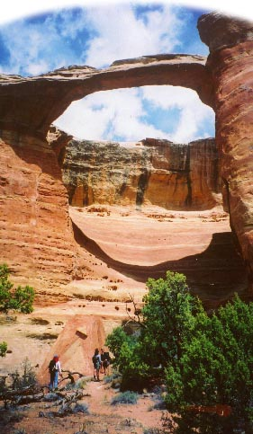


PLANNING FOR
RECREATION AND VISITOR SERVICES
Identifying RMZs
Identifying Recreation Management Zones within SRMAs/ERMAs.
When creating a RMZ
make sure to capture the entire
opportunity
Arch Cyn RMZ
Gateway SRMA
Notes:
Don’t just put the zone around the trailhead and hiking trail if the jeep road that gets you to the trailhead is an important part of the experience in that zone.

Slide 28
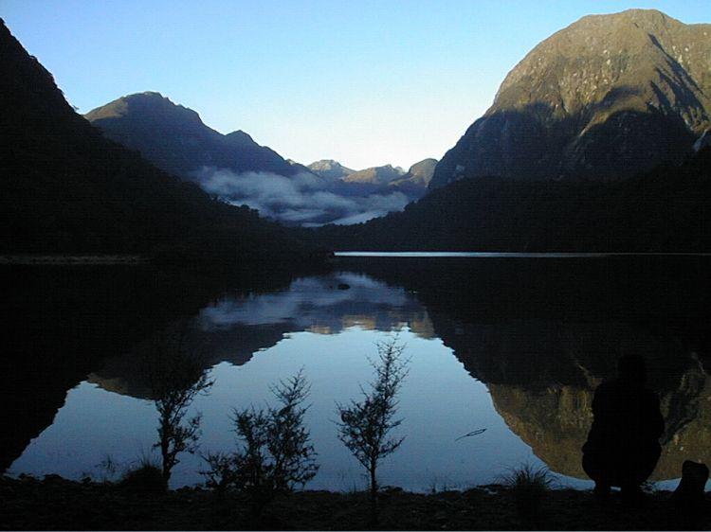

A Methodology for Recreation Management
The department’s aim is to provide for a range of recreation opportunities within the park without compromising the natural and historic values.
To facilitate the provision of the range of opportunities, experiences & benefits being sought by visitors, the park has been split into RMZs.
These RMZs will ‘set the scene’ for the type of activities & effects that are appropriate within a particular RMZs thereby protecting the experience & benefits of those undertaking the activity.
The RMZs are specific to recreation management in the park.
Fiordland National Park
http://www.doc.govt.nz/Explore/001~National-Parks/Fiordland-National-Park/Fiordland-National-Park-Management-Plan-Draft/108~4.3-Recreation-and-Tourism-Management-Visitor-Settings.asp
Notes:
Zoning areas is a common concept. Here is an example.
To facilitate the provision of the range of opportunities, experiences & benefits being sought by visitors, the park has been split into RMZs.
These RMZs will ‘set the scene’ for the type of activities & effects that are appropriate within a particular RMZs thereby protecting the experience & benefits of those undertaking the activity.
The RMZs are specific to recreation management in the park.

Slide 29
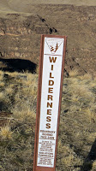
PLANNING FOR
RECREATION AND VISITOR SERVICES
Evaluating Potential RMAs
Overlapping Land Use Plan Designations
Overlapping designations can be problematic when objectives for other special designations (e.g., wilderness, areas of critical environmental concern) are inconsistent with RMA designations, especially at the implementation level.
Notes:
Therefore, LUPs generally should not overlap special designations with RMA designations just to mitigate recreation impacts on cultural and natural resources.
Recreation mitigation should be addressed through plans and prescriptions for those special designations.

Slide 30
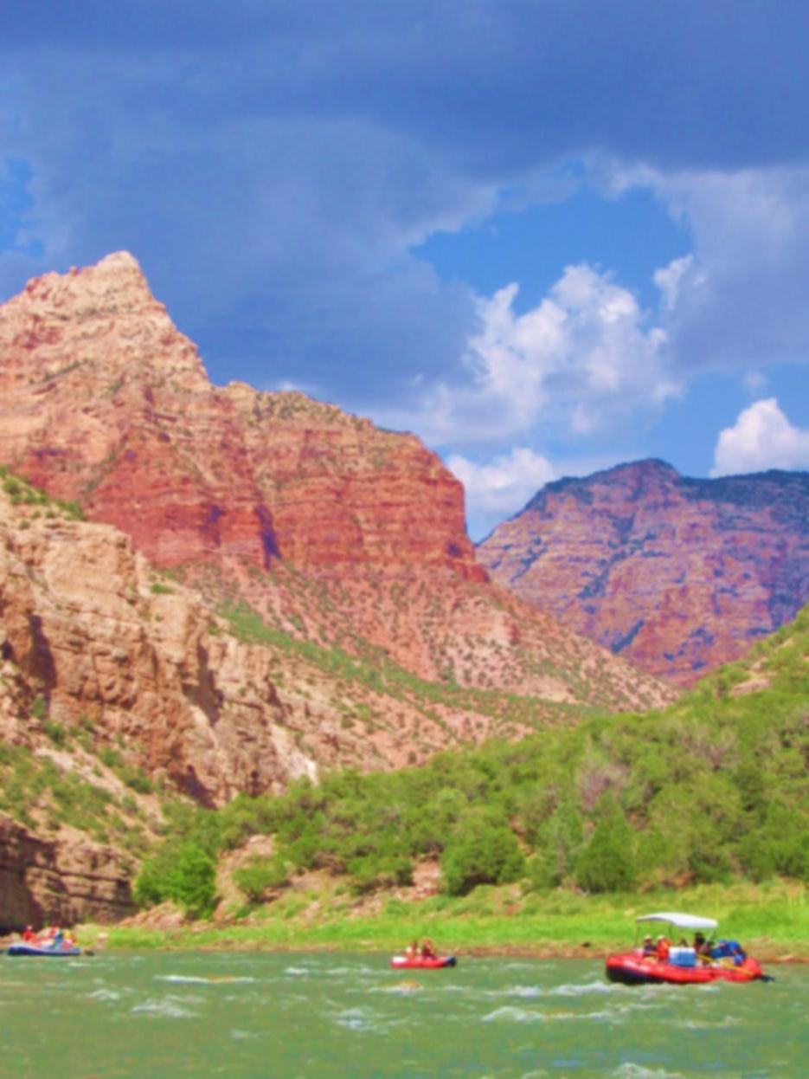
PLANNING FOR
RECREATION AND VISITOR SERVICES
Evaluating Potential RMAs
Overlapping Land Use Plan Designations
Overlapping an RMA designation with other designations may be appropriate if determined necessary to facilitate the visitor’s ability to participate in outdoor recreation activities and protect the associated qualities and conditions of the area.
RMA designations should be applied rationally, thoughtfully, and predictably within the context of the BLM’s interdisciplinary process.
Notes:
Overlapping an RMA designation with other designations may be appropriate if determined necessary to facilitate the visitor’s ability to participate in outdoor recreation activities and protect the associated qualities and conditions of the area.
For example, if a popular river corridor flows through a wilderness area and has management considerations (e.g., recreation facilities upstream and downstream of the wilderness area, hiking trails along the river corridor) it may be appropriate to designate the river corridor as an RMA but not necessarily the entire wilderness area.
RMA designations should be applied rationally, thoughtfully, and predictably within the context of the BLM’s interdisciplinary process.

Slide 31
PLANNING FOR
RECREATION AND VISITOR SERVICES
Evaluating Potential RMAs
EXERCISE
Identifying RMAs and RMZs in the Steens Mtn Planning Area
Notes:
Each group will identify potential SRMAs and/or ERMAs on the maps

