Slide 1
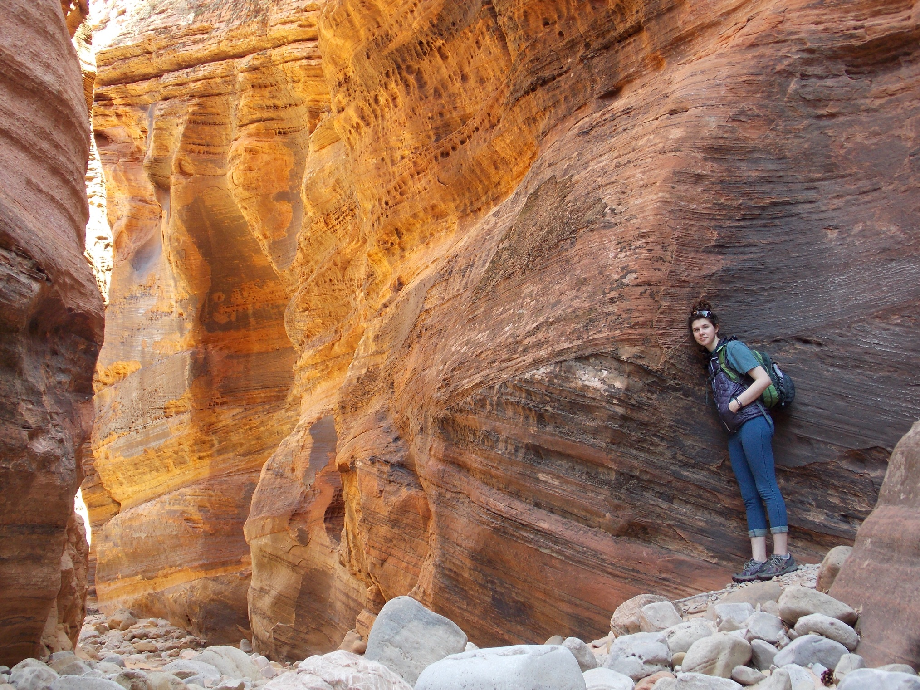
PLANNING FOR
RECREATION AND VISITOR SERVICES
Land Use Plan Implementation
Implementing the Land Use Plan
Chapter IV
    Recreation Management
    Recreation Administration
    Information and Education
    Monitoring
Notes:
Page IV-1

Slide 2
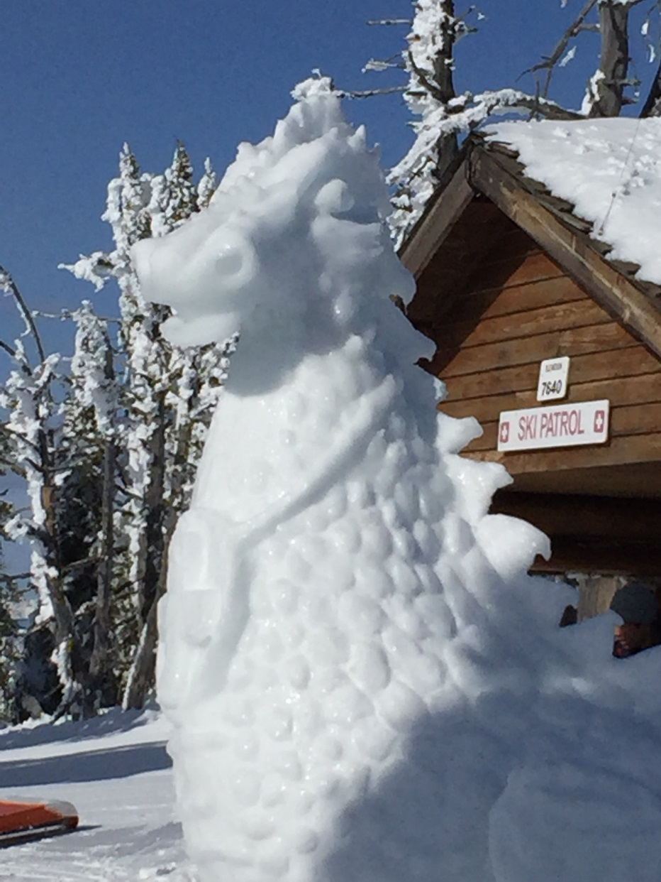
PLANNING FOR
RECREATION AND VISITOR SERVICES
Land Use Plan Implementation
NOW WHAT?
Your Land Use Plan is approved
Notes:
LUP Recreation Objectives will drive your implementation actions.
ASK 4 STUDENTS: Read a single bulleted point, and then explain what it means to them.

Slide 3
PLANNING FOR
RECREATION AND VISITOR SERVICES
Land Use Plan Implementation
NOW WHAT?
Implementation !
Implementation is the foundation of outcomes-focused management because implementation actions interact with recreation settings to produce recreation opportunities and facilitate outcomes
Notes:
LUP Recreation Objectives will drive your implementation actions.
ASK 4 STUDENTS: Read a single bulleted point, and then explain what it means to them.

Slide 4
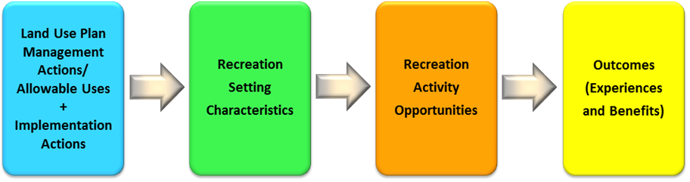
PLANNING FOR
RECREATION AND VISITOR SERVICES
Land Use Plan Implementation
The Production of Recreation Opportunities and Outcomes

Slide 5
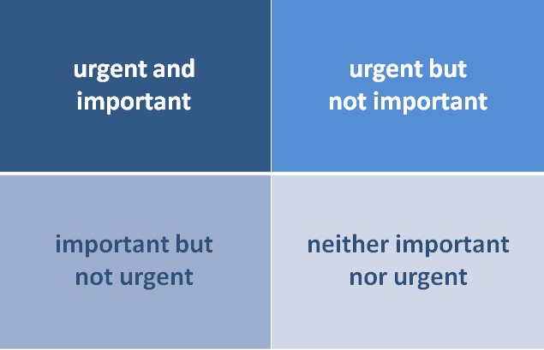
PLANNING FOR
RECREATION AND VISITOR SERVICES
Land Use Plan Implementation
Which box do you get stuck in?
Notes:
Urgent and important
Not urgent and important is for long term strategizing and development
Urgent and not important is the time pressured distractions They aren’t really important but someone wants it now
Not Urgent and not important is for those activities that yield little if any value. These are activitities that are often used for taking a break from time pressured and important activities

Slide 6
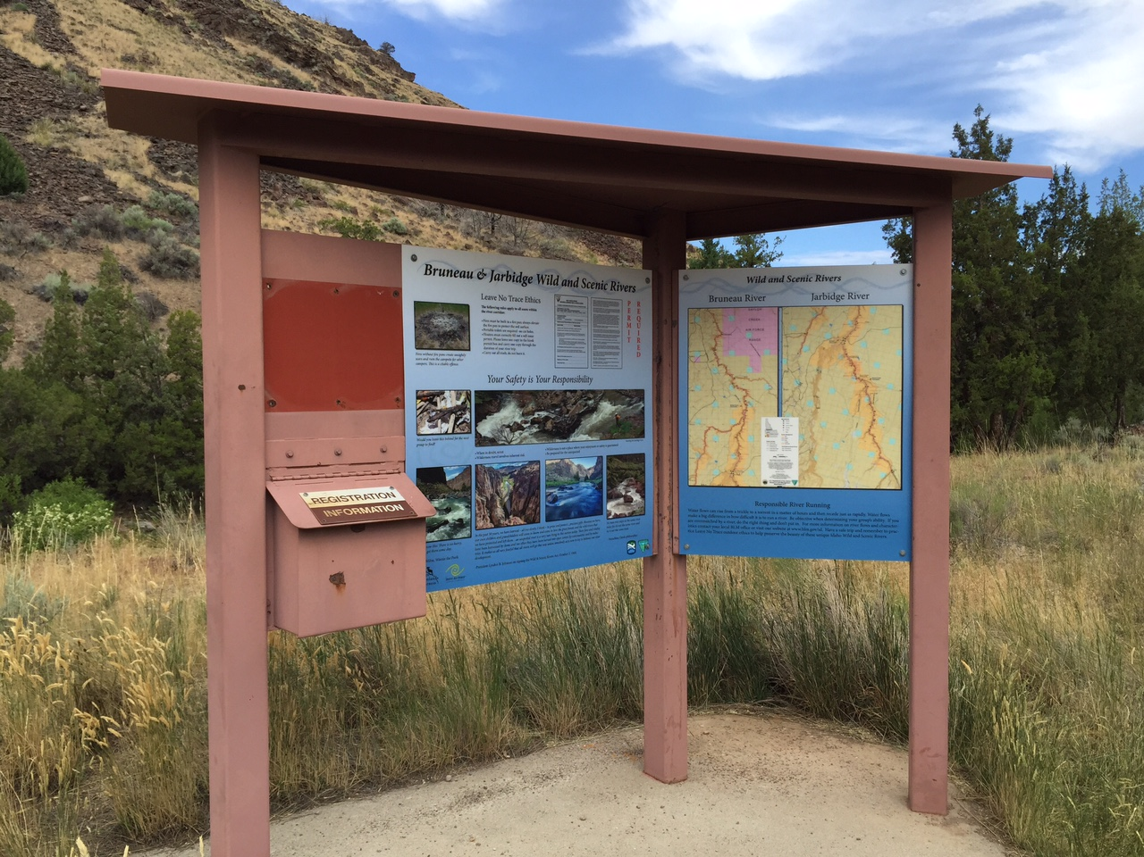
PLANNING FOR
RECREATION AND VISITOR SERVICES
Land Use Plan Implementation
Implementation by Design, Not Default
The need, appropriateness, or relevance
of each implementation action must be evaluated by its ability to:
Support the RMA objective.
Maintain or enhance desired physical, social, or operational RSCs.
Comply with allowable uses and management action decisions identified in the LUP.

Slide 7
PLANNING FOR
RECREATION AND VISITOR SERVICES
Land Use Plan Implementation
Implementation by Design, Not Default
  Mitigate visitor health and safety issues,
  Recreation impacts on natural and cultural resources, or
  Use or user conflicts.

Slide 8
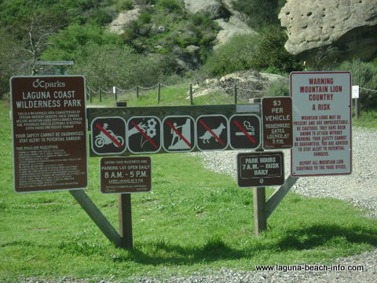
PLANNING FOR
RECREATION AND VISITOR SERVICES
RMP Implementation – Recreation Management
Recreation Management
Recreation management is: On-the-ground management of resources, visitors, and facilities, including the regulation of other resource program actions that impact recreation opportunities and recreation settings.
Recreation management can involve project plans and Recreation Area Management Plans (RAMPs) which allow BLM to implement LUP decisions.
Notes:
ASK STUDENTS – 1) What do we mean by “resources”?
2) Provide examples of “other resource program actions”?

Slide 9

PLANNING FOR
RECREATION AND VISITOR SERVICES
RMP Implementation – Recreation Management
Recreation Management
Recreation management implementation actions fall within certain
categories:
Management
Administration
Information and Education
Monitoring

Slide 10

PLANNING FOR
RECREATION AND VISITOR SERVICES
Land Use Plan Implementation
Recreation Management action
Implementation decisions result in actions
that can be categorized according to
the directness (direct vs indirect) with
which they impact visitor:
  • Behavior
  • Visitor use
  • Recreation participation
  • Desired recreational experiences
Notes:
Ask for examples of a direct and indirect actions

Slide 11
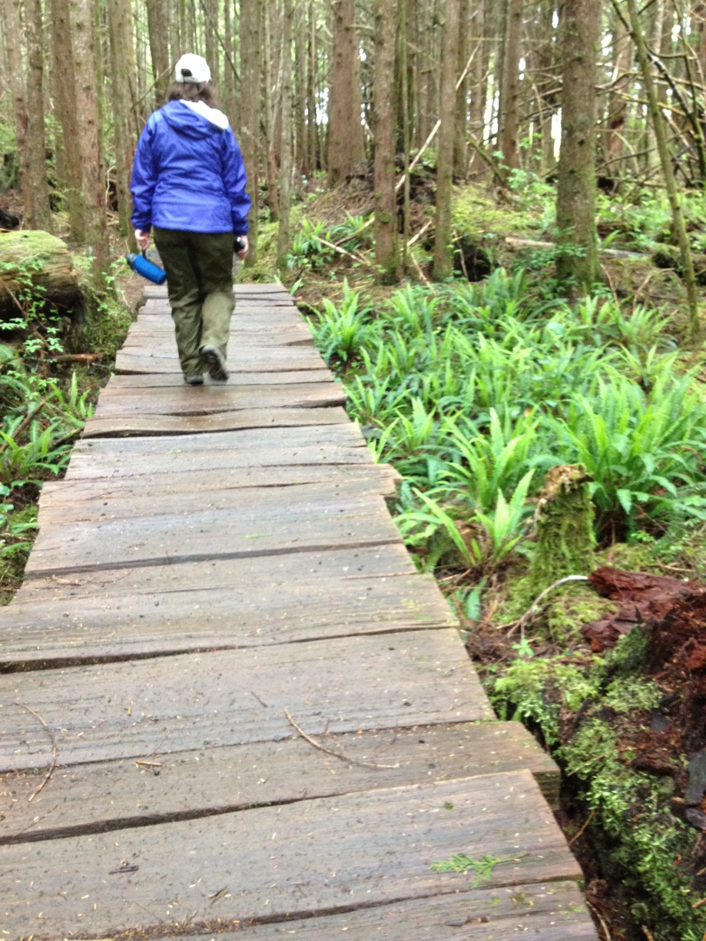
PLANNING FOR
RECREATION AND VISITOR SERVICES
RMP Implementation – Recreation Administration
Recreation Administration
The regulatory actions and the implementation of:
Permits & fees
Allocation systems
Use restrictions
Partnership agreements

Slide 12

PLANNING FOR
RECREATION AND VISITOR SERVICES
RMP Implementation – Recreation Administration
Permits and Fees
The BLM’s recreation permit and fee policy
BLM Manual 2930, “Recreation Permits and Fees,”
BLM Handbook H-2930-1, “Recreation Permit Administration.”
Page IV-8

Slide 13
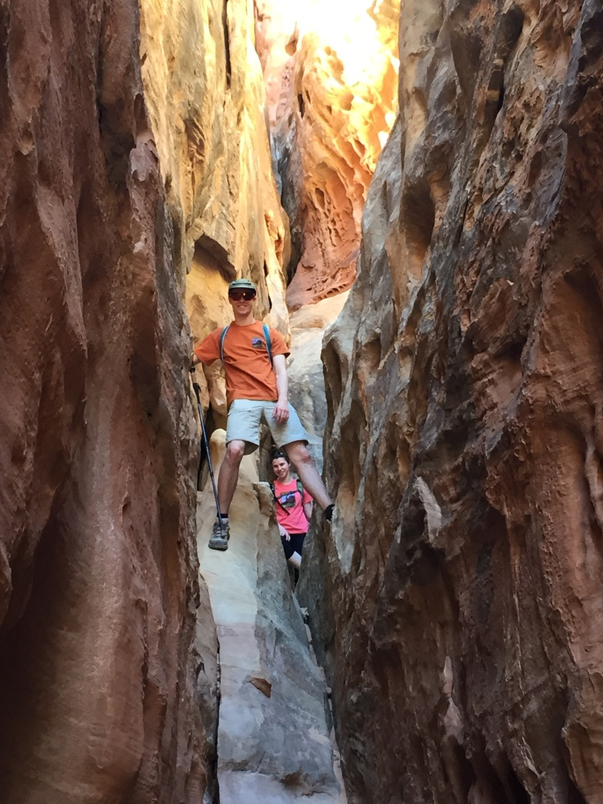
PLANNING FOR
RECREATION AND VISITOR SERVICES
RMP Implementation – Recreation Administration
Permits and Fees
Ensure that recreation permits are specifically addressed in land use planning.
This includes identifying both the types of recreation permits and activities that support the management objectives for each RMA and RMZ, as well as identifying recreational events and activities that will not be permitted.

Slide 14
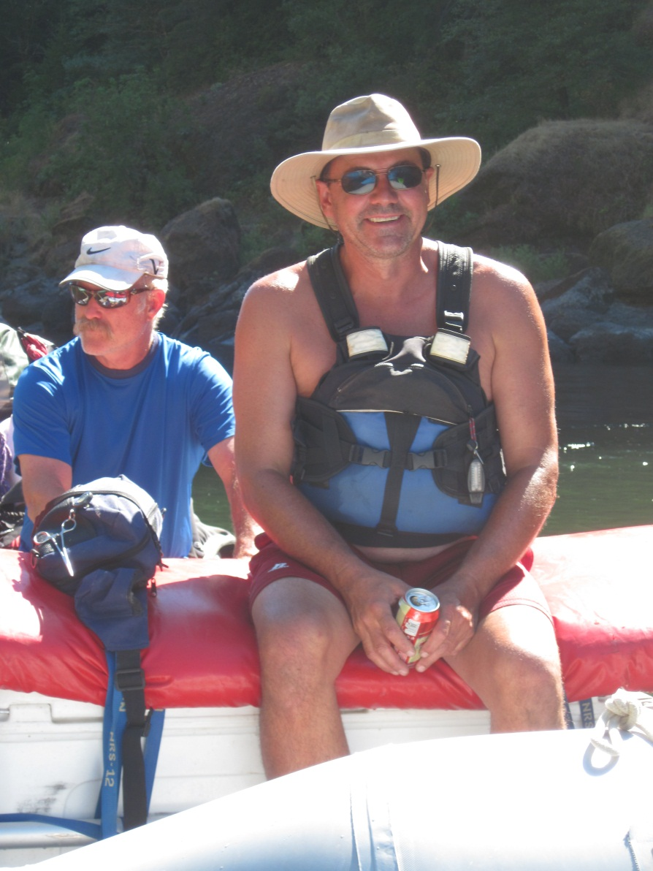
Permits and Fees
Why do we have permits & fees?
Notes:
Ask class why we have permits and fees:

Slide 15
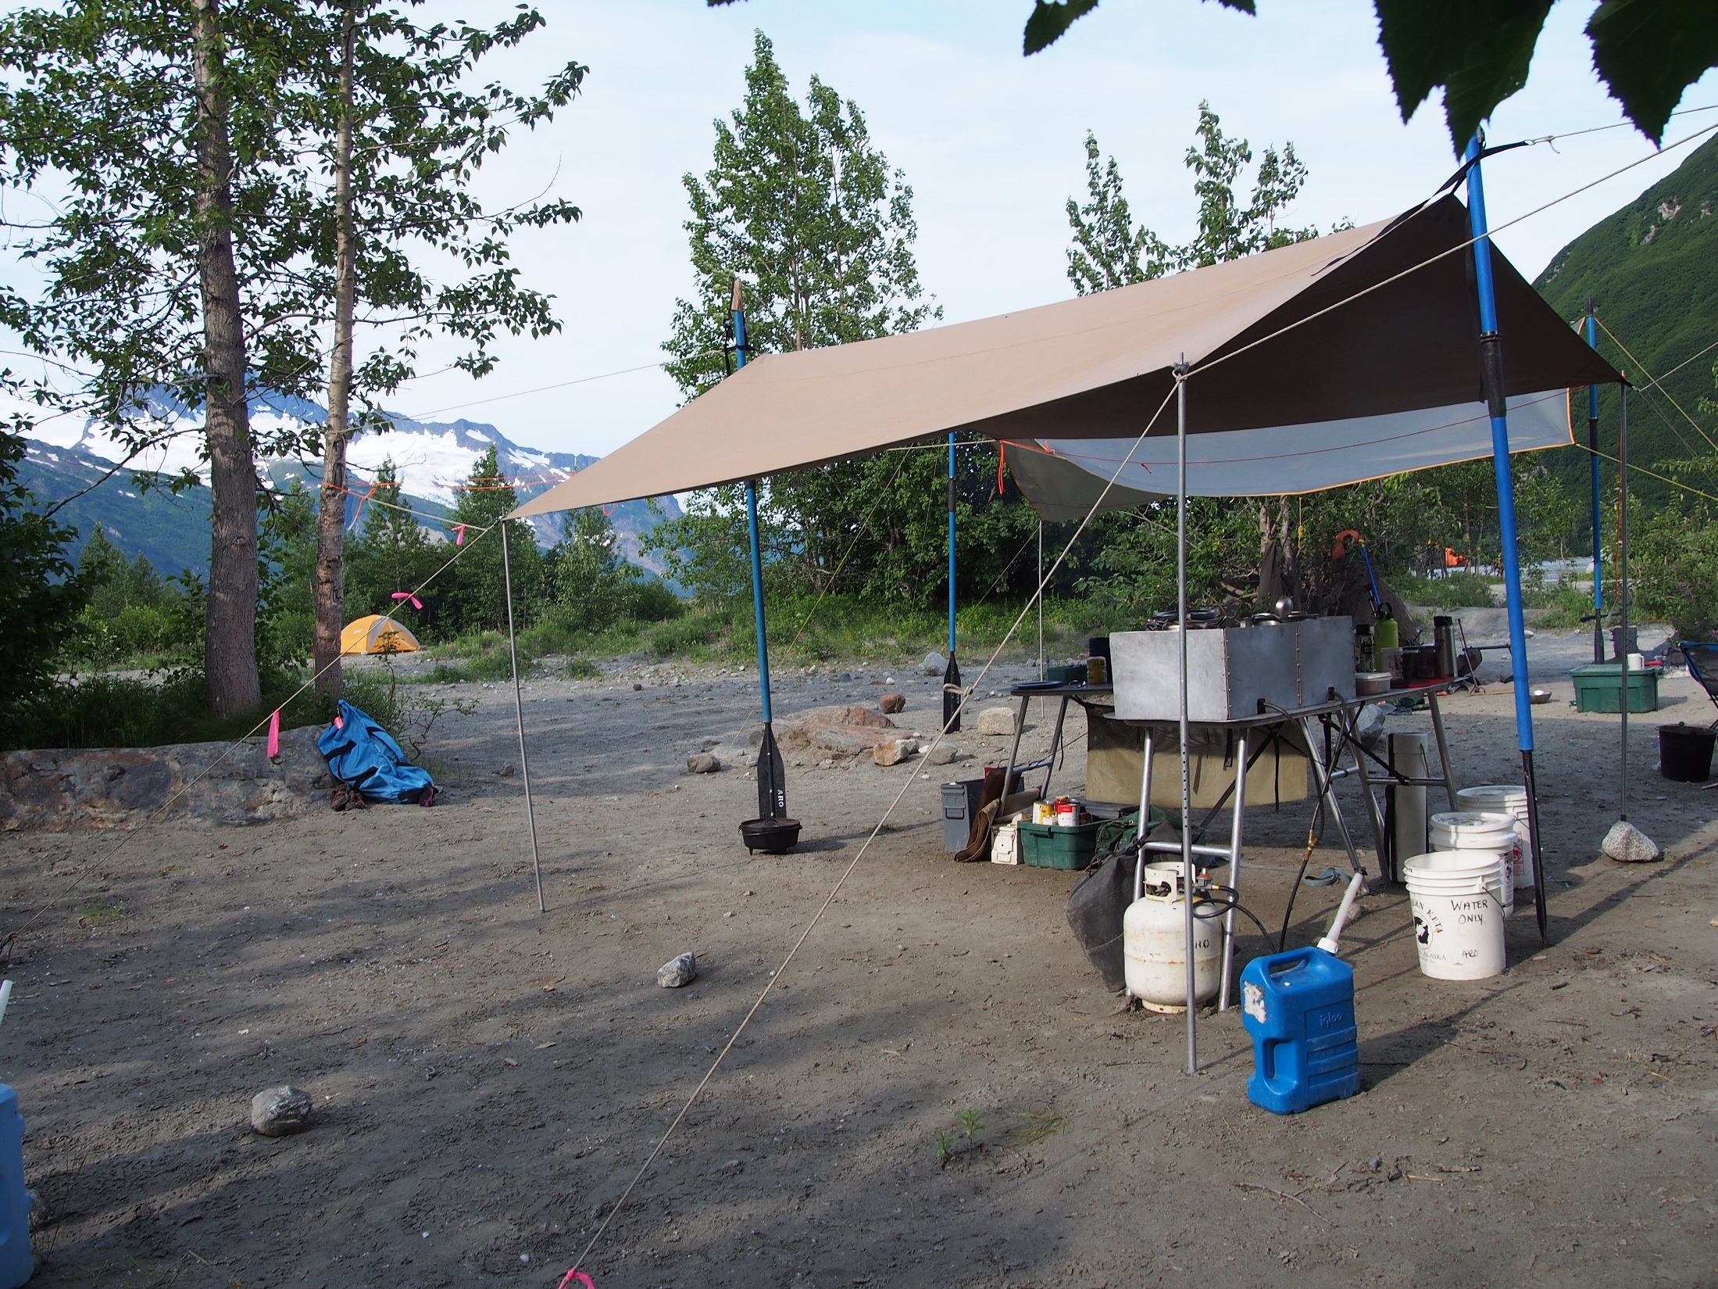
Permits and Fees
BLM permit and fee program provides:
Notes:
Permit and fee program was established to provide?

Slide 16
Permits and Fees
BLM permit and fee program provides:
Needed public services

Slide 17
Permits and Fees
BLM permit and fee program provides:
Needed public services
Satisfies recreation demand within allowable use levels

Slide 18
Permits and Fees
BLM permit and fee program provides:
Needed public services
Satisfies recreation demand within allowable use levels
Minimizes user conflicts

Slide 19
Permits and Fees
BLM permit and fee program provides:
Needed public services
Satisfies recreation demand within allowable use levels
Minimizes user conflicts
Protects and enhances public lands, recreation opportunities, and sustainable and healthy ecosystems.

Slide 20
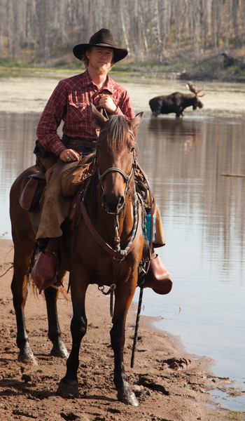
PLANNING FOR
RECREATION AND VISITOR SERVICES
RMP Implementation – Recreation Administration
Permits and Fees
Ensure that the United States is provided a fair return for commercial recreational use of the public lands.

Slide 21
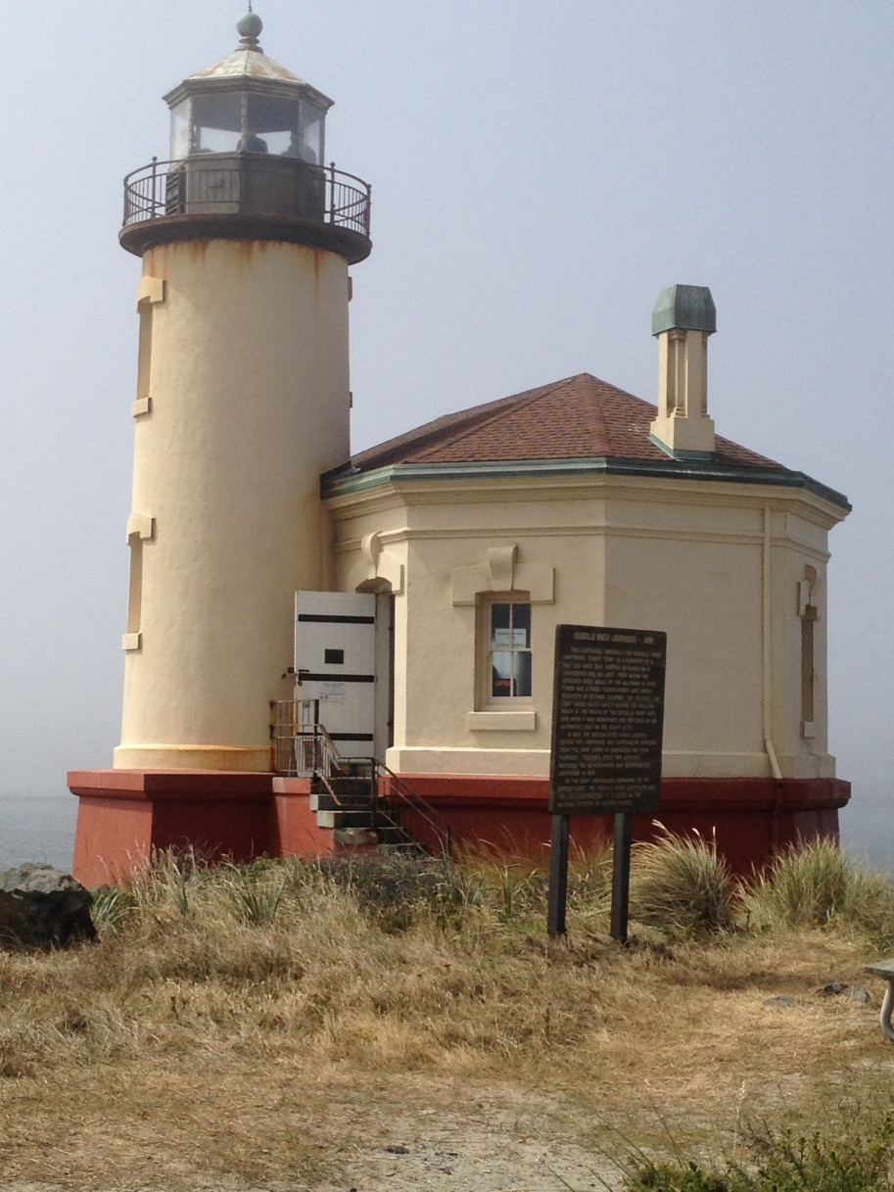
PLANNING FOR
RECREATION AND VISITOR SERVICES
RMP Implementation – Recreation Administration
Permits and Fees
Ensure that recreational users assume an appropriate share of the cost of maintaining recreation programs and facilities by establishing equitable fees

Slide 22
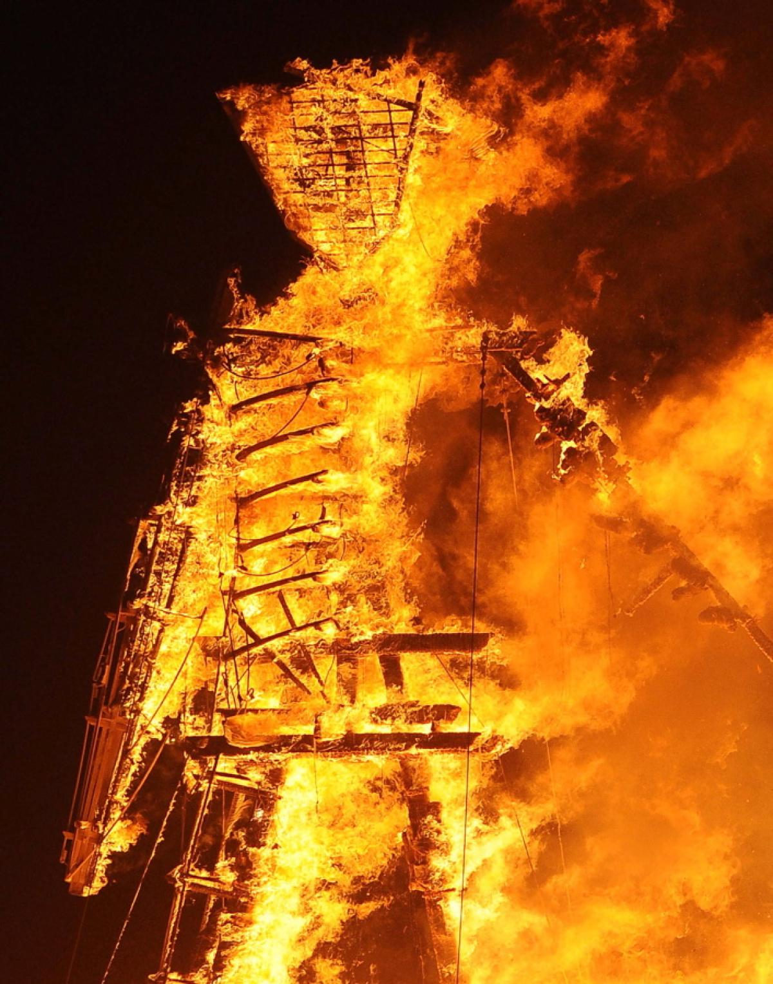
PLANNING FOR
RECREATION AND VISITOR SERVICES
RMP Implementation – Recreation Administration
Permits and Fees
Issue permits for specific recreational uses of the public lands as a means to:
Notes:
Why do we issue permits for specific recreational uses?

Slide 23
PLANNING FOR
RECREATION AND VISITOR SERVICES
RMP Implementation – Recreation Administration
Permits and Fees
Issue recreation for specific recreational uses of the public lands as a means to:
Manage visitor use

Slide 24
PLANNING FOR
RECREATION AND VISITOR SERVICES
RMP Implementation – Recreation Administration
Permits and Fees
Issue recreation for specific recreational uses of the public lands as a means to:
Manage visitor use
Provide for visitor health, safety, and enjoyment;

Slide 25
PLANNING FOR
RECREATION AND VISITOR SERVICES
RMP Implementation – Recreation Administration
Permits and Fees
Issue recreation for specific recreational uses of the public lands as a means to:
Manage visitor use
Provide for visitor health, safety, and enjoyment;
Minimize adverse resource impacts

Slide 26
PLANNING FOR
RECREATION AND VISITOR SERVICES
RMP Implementation – Recreation Administration
Permits and Fees
Issue recreation for specific recreational uses of the public lands as a means to:
Manage visitor use
Provide for visitor health, safety, and enjoyment;
Minimize adverse resource impacts;
Provide for private and commercial recreation use according to BLM established limits or allocations

Slide 27
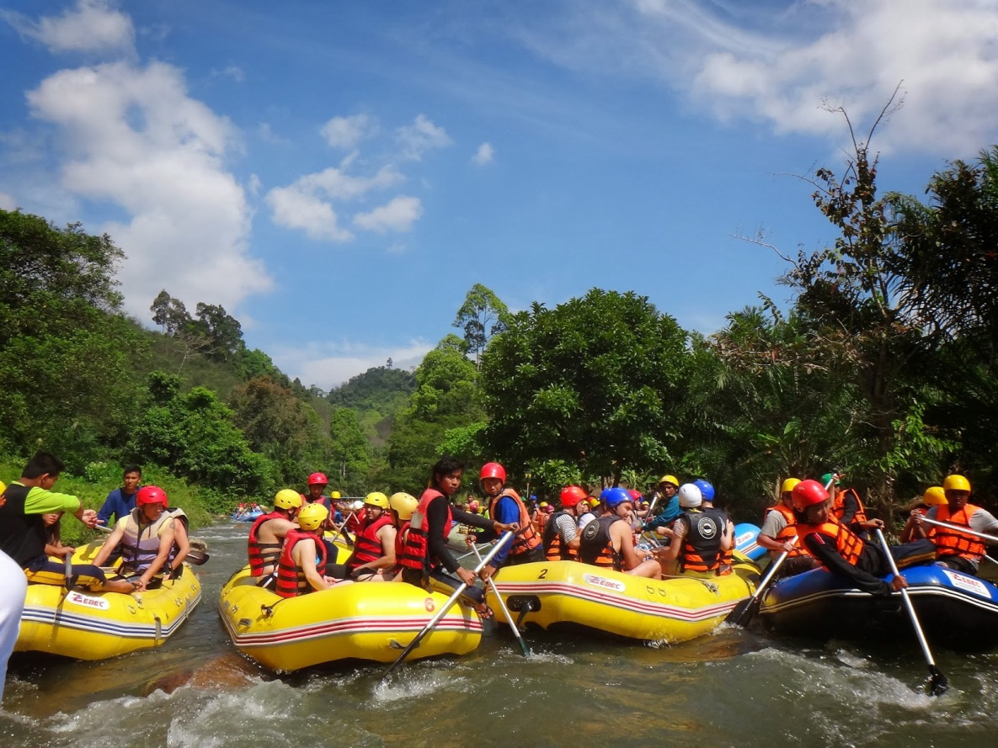
PLANNING FOR
RECREATION AND VISITOR SERVICES
RMP Implementation – Recreation Administration
Allocation Systems
One of the key implementation actions available to recreation
planners to manage recreation settings are the wide variety of recreation use allocation systems. Recreation use allocation is defined as the deliberate distribution of recreation use opportunities.
Notes:
One of the key implementation actions available to recreation
planners to manage recreation settings are the wide variety of recreation use allocation systems. Recreation use allocation is defined as the deliberate distribution of recreation use opportunities.
The BLM’s allocation goals are to maximize opportunities, experiences, and allowable uses within established objectives and to minimize resource impacts and user conflicts.
Approaches for allocation include, but are not limited to, historic use, even split, freedom of choice, temporal and/or spatial zoning, permit lottery, etc.
Decisions on whether to make use of a particular allocation system should be based on whether the allocation system has a direct relationship to the setting objectives identified in either the LUP or specific area management plans.

Slide 28
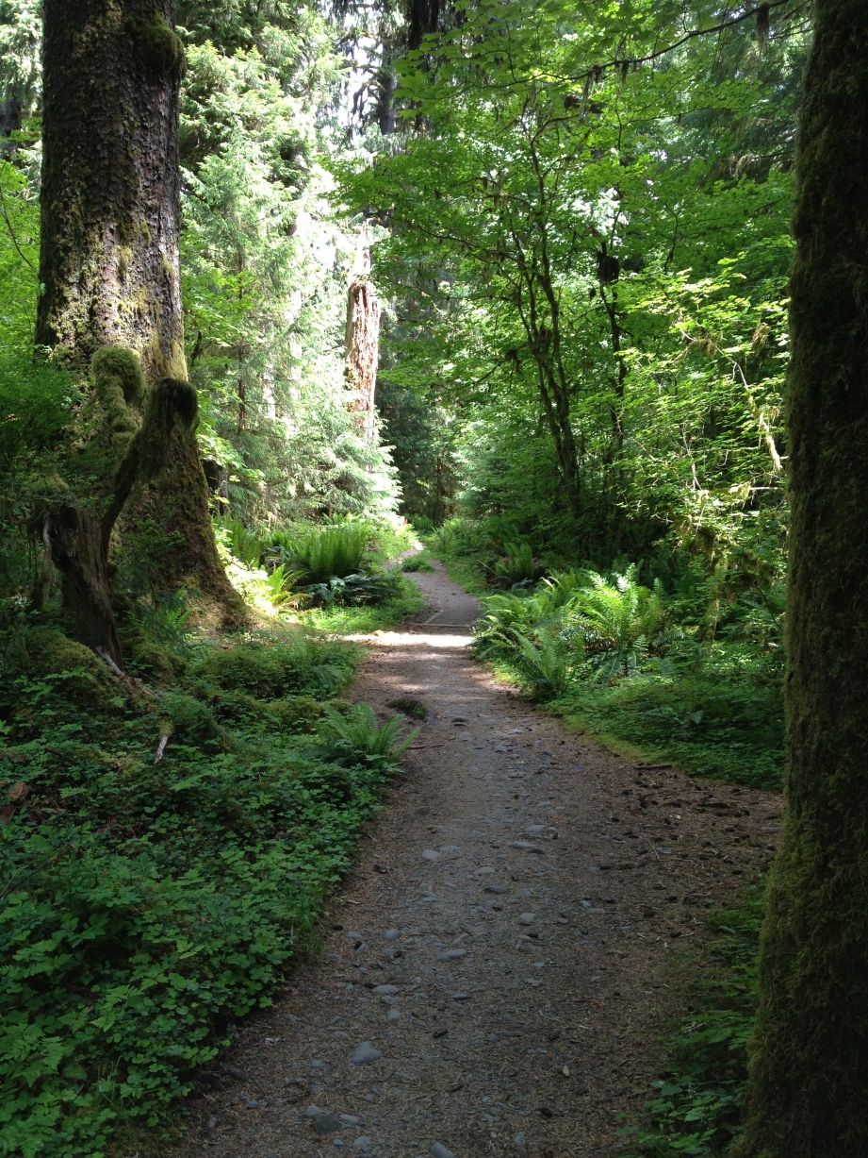
PLANNING FOR
RECREATION AND VISITOR SERVICES
RMP Implementation – Recreation Administration
Allocation Systems
Land managers should be able to show that a particular allocation system will help achieve and maintain the desired recreation setting and opportunities and be able to facilitate targeted outcomes.
Notes:
That is, land managers should be able to show that the implementation of a particular allocation system will help achieve and maintain the desired recreation setting and opportunities and be able to facilitate targeted outcomes. Adaptive management principles should play a key role in any decision to implement an allocation system.
If monitoring shows a particular allocation system is not working as intended, outdoor recreation planners should be responsive and make adjustments in a timely manner.
Allocation systems may be used to manage the identified visitor capacity of national scenic and historic trails and wild and scenic rivers, as required by statute.

Slide 29

PLANNING FOR
RECREATION AND VISITOR SERVICES
RMP Implementation – Recreation Administration
Special Recreation Permits
A key part of recreation use allocation is the issuance of
SRPs. While SRPs are required for all commercial service providers and competitive events operating on public lands and waters, the BLM has the discretionary authority to deny a permit
Notes:
A key part of recreation use allocation is the issuance of
SRPs. While SRPs are required for all commercial service providers and competitive events operating on public lands and waters, the BLM has the discretionary authority to deny a permit for reasons which include if a particular permit would (1) negatively impact the recreation setting or (2) increase conflicts with other SRPs and individual users. The BLM can also deny a permit if (1) the field office does not have the ability to administer and monitor SRPs and visitor use or (2) it can be shown there is little to no public demand for services. Managers should conduct needs assessments to analyze these factors and make determinations regarding the type and level of SRPs needed in particular areas that will help achieve the recreational setting goals and objectives. Managers are encouraged to make use of programmatic EAs, completed in conjunction with outfitter needs assessments, to streamline the decisionmaking process pertaining to the issuance of SRPs and to support the rationale for denying SRPs where appropriate.

Slide 30
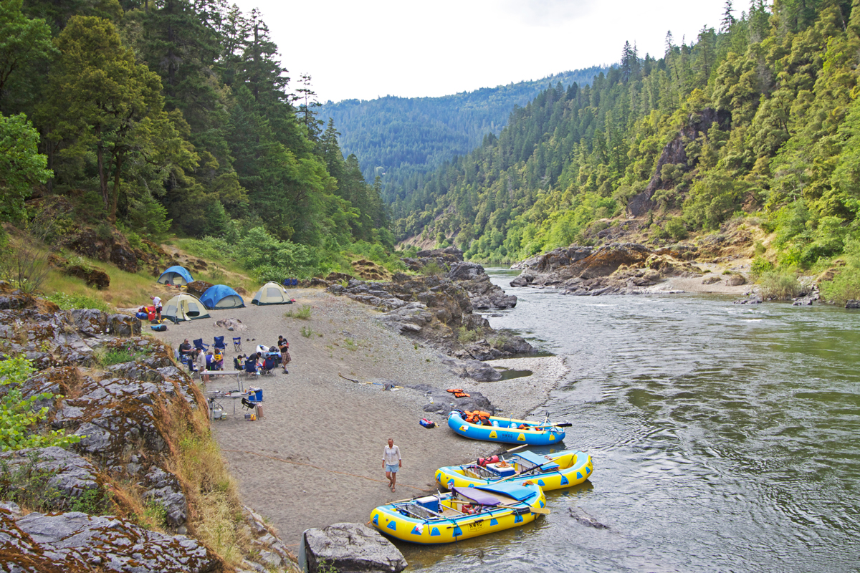
PLANNING FOR
RECREATION AND VISITOR SERVICES
RMP Implementation – Recreation Administration
Allocation systems and permits may be used to manage the identified visitor capacity of national scenic and historic trails and wild and scenic rivers, as required by statute.
Allocation Systems
Notes:
That is, land managers should be able to show that the implementation of a particular allocation system will help achieve and maintain the desired recreation setting and opportunities and be able to facilitate targeted outcomes. Adaptive management principles should play a key role in any decision to implement an allocation system.
If monitoring shows a particular allocation system is not working as intended, outdoor recreation planners should be responsive and make adjustments in a timely manner.
Allocation systems may be used to manage the identified visitor capacity of national scenic and historic trails and wild and scenic rivers, as required by statute.

Slide 31

PLANNING FOR
RECREATION AND VISITOR SERVICES
RMP Implementation – Recreation Administration
Use Restrictions and Supplementary Rules
Use restrictions examples include:
Restricting a trail to a certain type of use
Use hours for a day use site
No alcohol rules
Pallet burning
Limiting camping to designated sites
Notes:
Dorothy would like to add something here on closures/use restrictions and supplemental rules

Slide 32
PLANNING FOR
RECREATION AND VISITOR SERVICES
RMP Implementation – Recreation Administration
Use Restrictions and Supplementary Rules
Supplementary rules may be proposed in circumstances in which existing regulations are not sufficient to manage resource use conflicts or to protect resources.
They may also be needed to implement decisions in RMPs or other planning documents.
Notes:
Dorothy would like to add something here on closures/use restrictions and supplemental rules

Slide 33
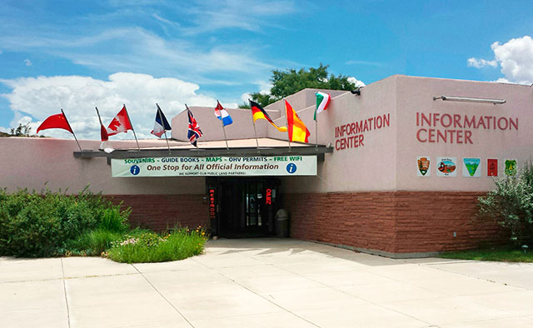
PLANNING FOR
RECREATION AND VISITOR SERVICES
RMP Implementation – Recreation Administration
Partnerships and Collaboration
A partnership is an agreement between two or more entities, created to achieve or to assist in reaching a common goal.
Collaboration is a process in which interested people work together to seek solutions.
See Handbook for authorities for collaboration Page iv-10
Notes:
Collaboration is a process in which interested people work together to seek solutions.
A partnership is an agreement between two or more entities, created to achieve or to assist in reaching a common goal.
Partnerships may involve one organization using another’s unique abilities, equipment, or services, or it may be a sharing of resources (e.g., money, time, knowledge, equipment, etc.) to accomplish short- or long-term objectives for one or all of the participating partners.

Slide 34




Partnerships and Collaboration
Partnerships may involve one organization using another’s unique abilities, equipment, or services, or it may be a sharing of resources (e.g., money, time, knowledge, equipment, etc.) to accomplish short- or long-term objectives for one or all of the participating partners.
Notes:
Lots of information on partnerships and how to accomplish them. There’s more information in your handbook and lots of information on BLM websites.

Slide 35
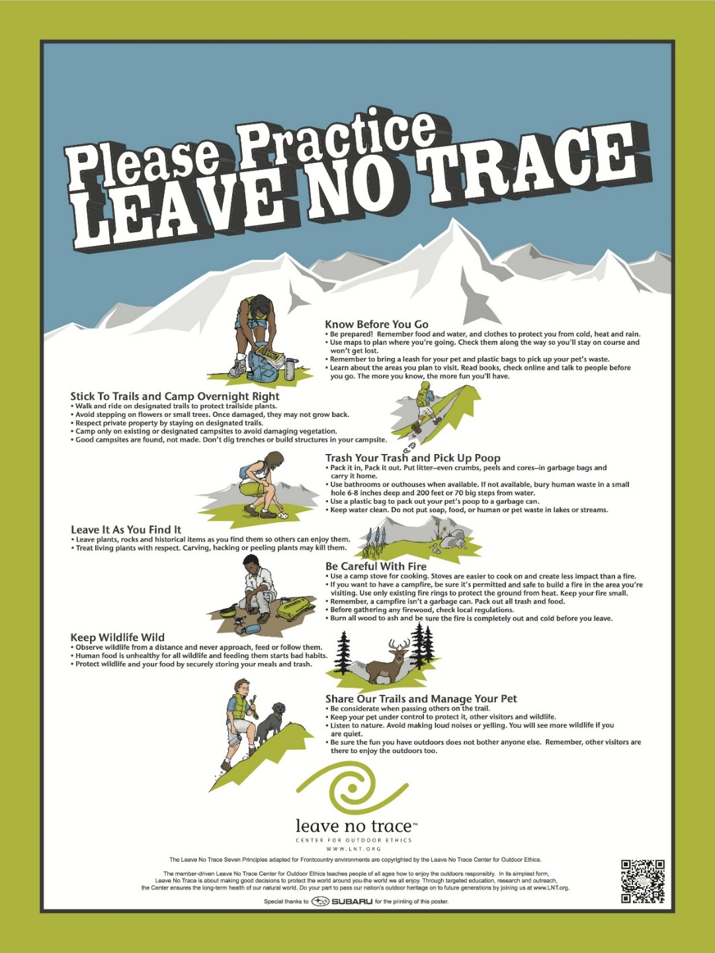
PLANNING FOR
RECREATION AND VISITOR SERVICES
RMP Implementation
Information
Education
Monitoring

Slide 36
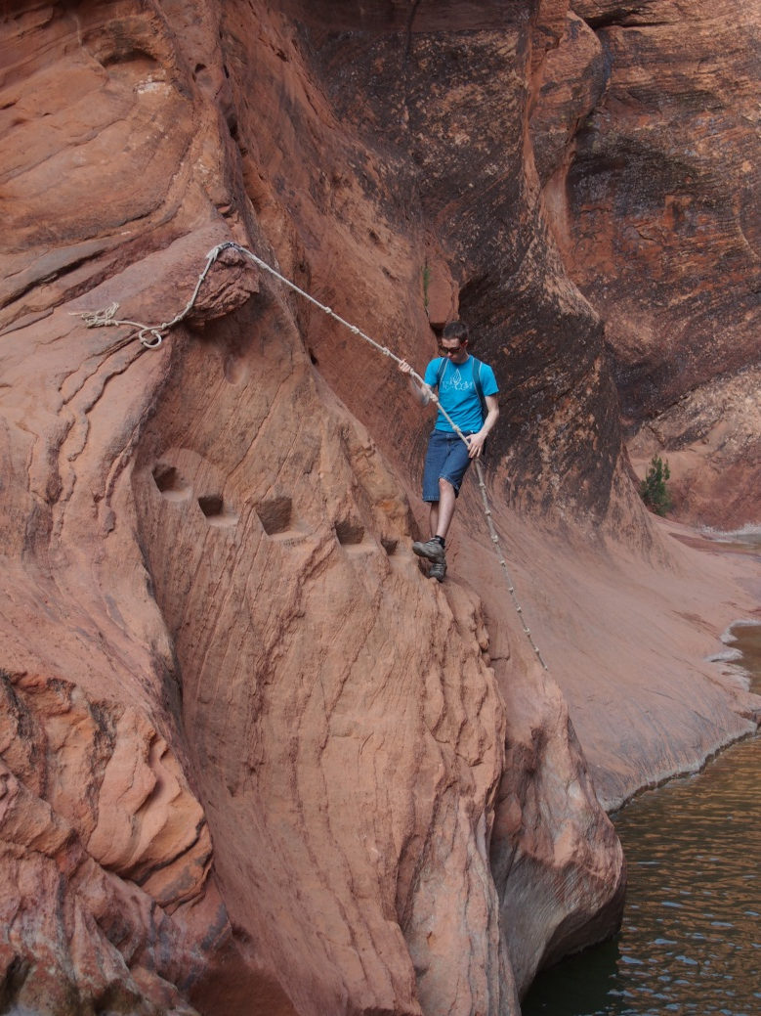
PLANNING FOR
RECREATION AND VISITOR SERVICES
RMP Implementation
Information and education efforts tell the BLM’s customers:
What kinds of recreation opportunities are available,
How to find them, and
How these opportunities can be enjoyed responsibly and sustainably.
Page IV-13

Slide 37
PLANNING FOR
RECREATION AND VISITOR SERVICES
RMP Implementation

Slide 38
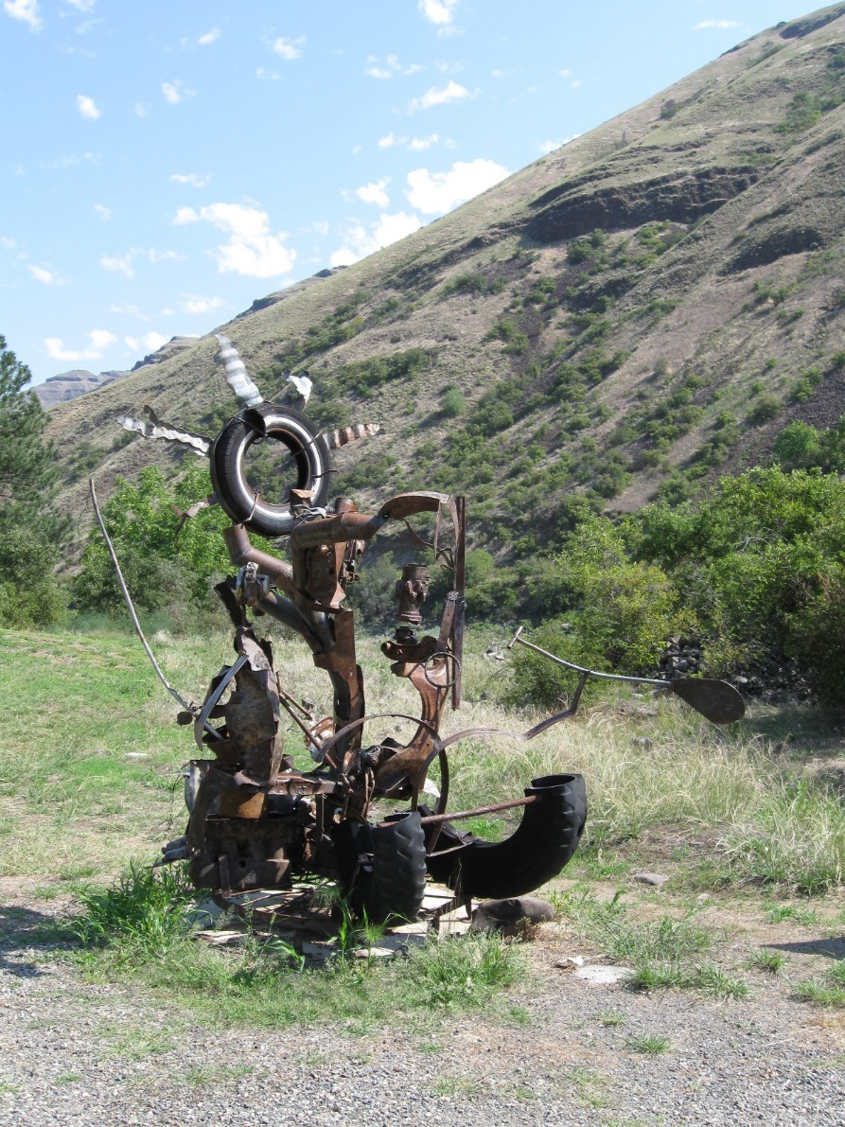
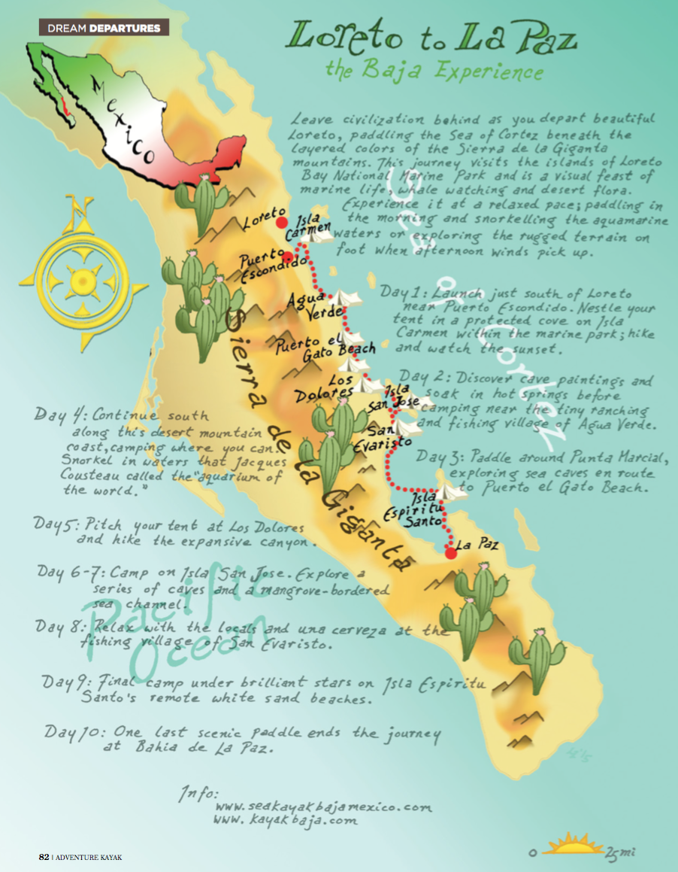
PLANNING FOR
RECREATION AND VISITOR SERVICES
RMP Implementation – Information & Education
Information and Education actions includes:
Outreach efforts,
Promotion,
Interpretation,
Environmental education, and
External visitor service providers.

Slide 39
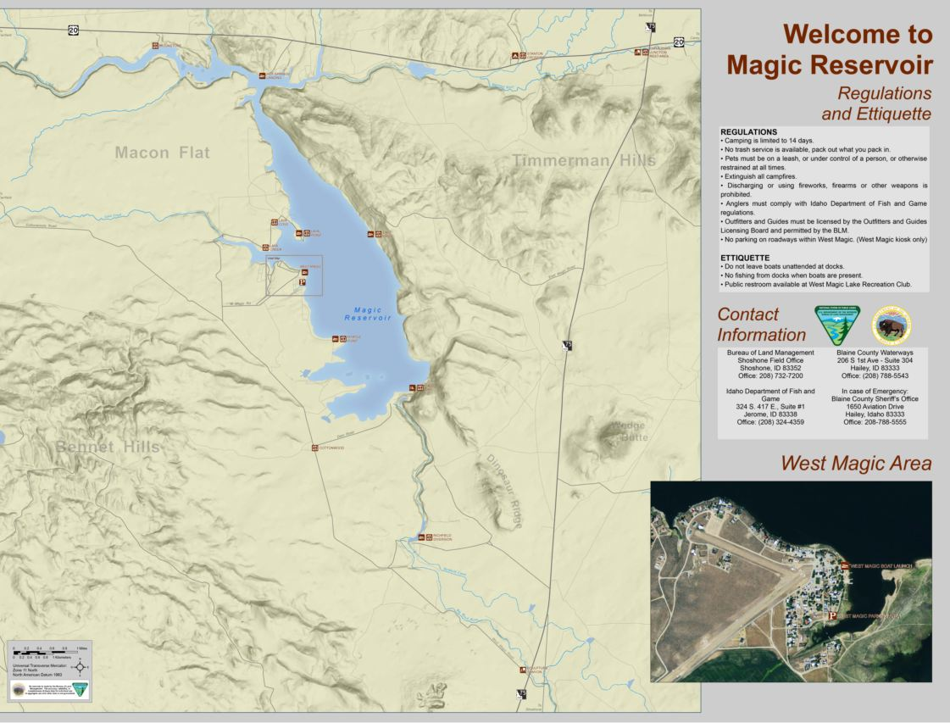
PLANNING FOR
RECREATION AND VISITOR SERVICES
RMP Implementation – Information & Education
Information and Education Products include:
Maps,

Slide 40
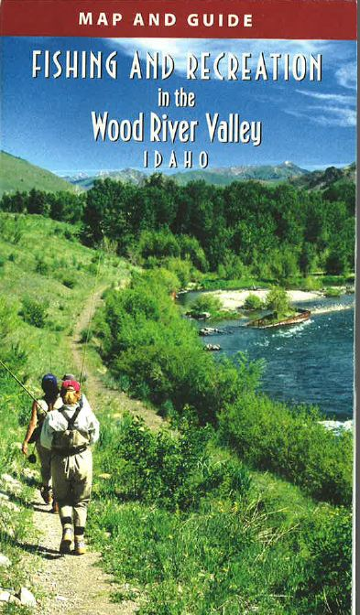
PLANNING FOR
RECREATION AND VISITOR SERVICES
RMP Implementation – Information & Education
Information and Education Products include:
Brochures,

Slide 41
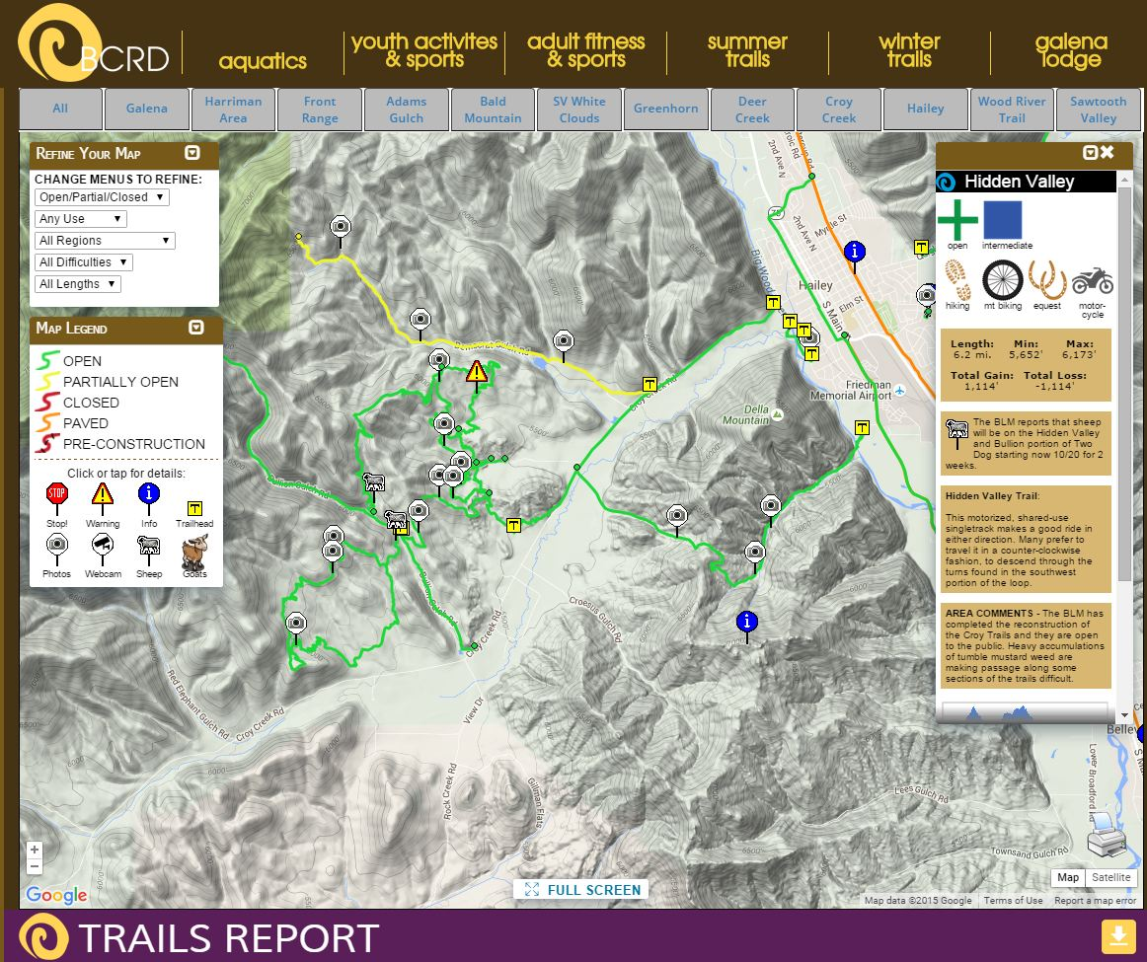
PLANNING FOR
RECREATION AND VISITOR SERVICES
RMP Implementation – Information & Education
Information and Education Products include:
Websites and
Social Media,

Slide 42
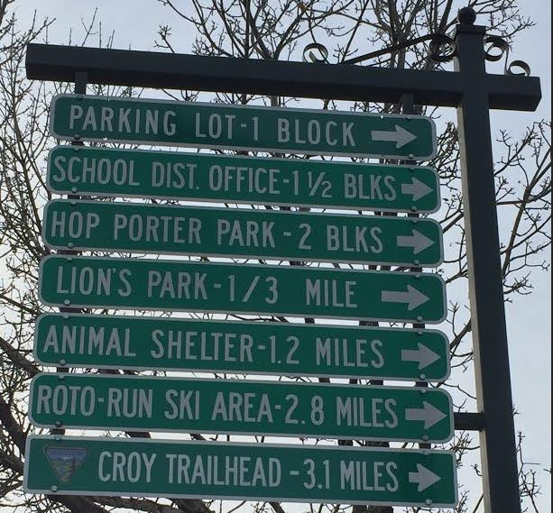
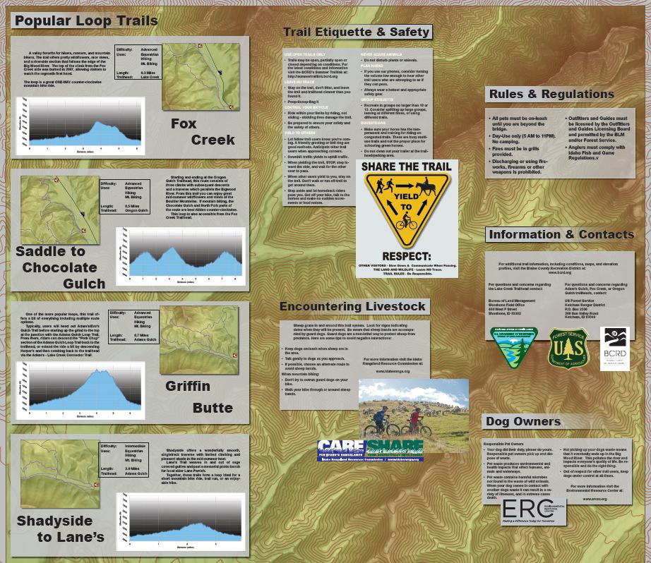
PLANNING FOR
RECREATION AND VISITOR SERVICES
RMP Implementation – Information & Education
Information and Education Products include:
Signs (information ,
and direction)

Slide 43

PLANNING FOR
RECREATION AND VISITOR SERVICES
RMP Implementation – Information & Education
Information and Education Products include:
Information provided by external entities

Slide 44
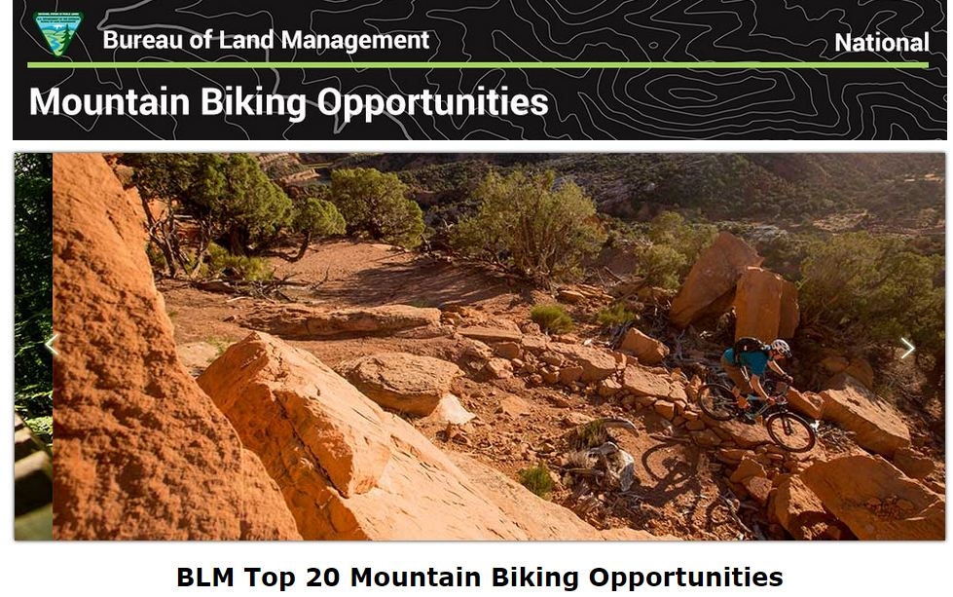
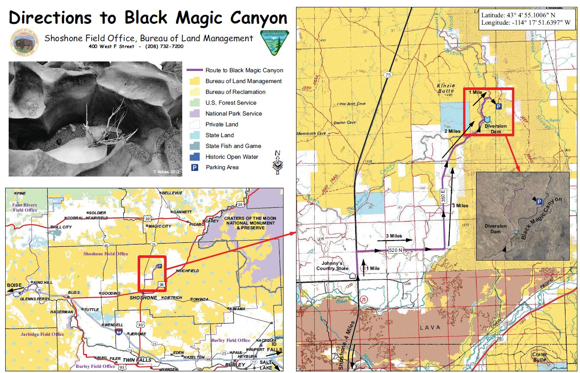
PLANNING FOR
RECREATION AND VISITOR SERVICES
RMP Implementation – Information & Education
Information and Education Questions
Will the RMA be actively promoted or simply identified?
Notes:
The information and education section must support the RMA objective.
The objective will help the outdoor recreation planner design an appropriate information and education strategy that may address such issues as:
Promoted vs Identified

Slide 45
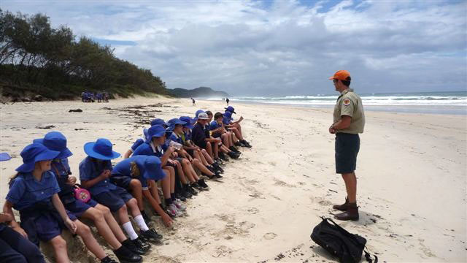

PLANNING FOR
RECREATION AND VISITOR SERVICES
RMP Implementation – Information & Education
Information and Education Questions
Will information or education efforts will occur onsite or offsite?

Slide 46
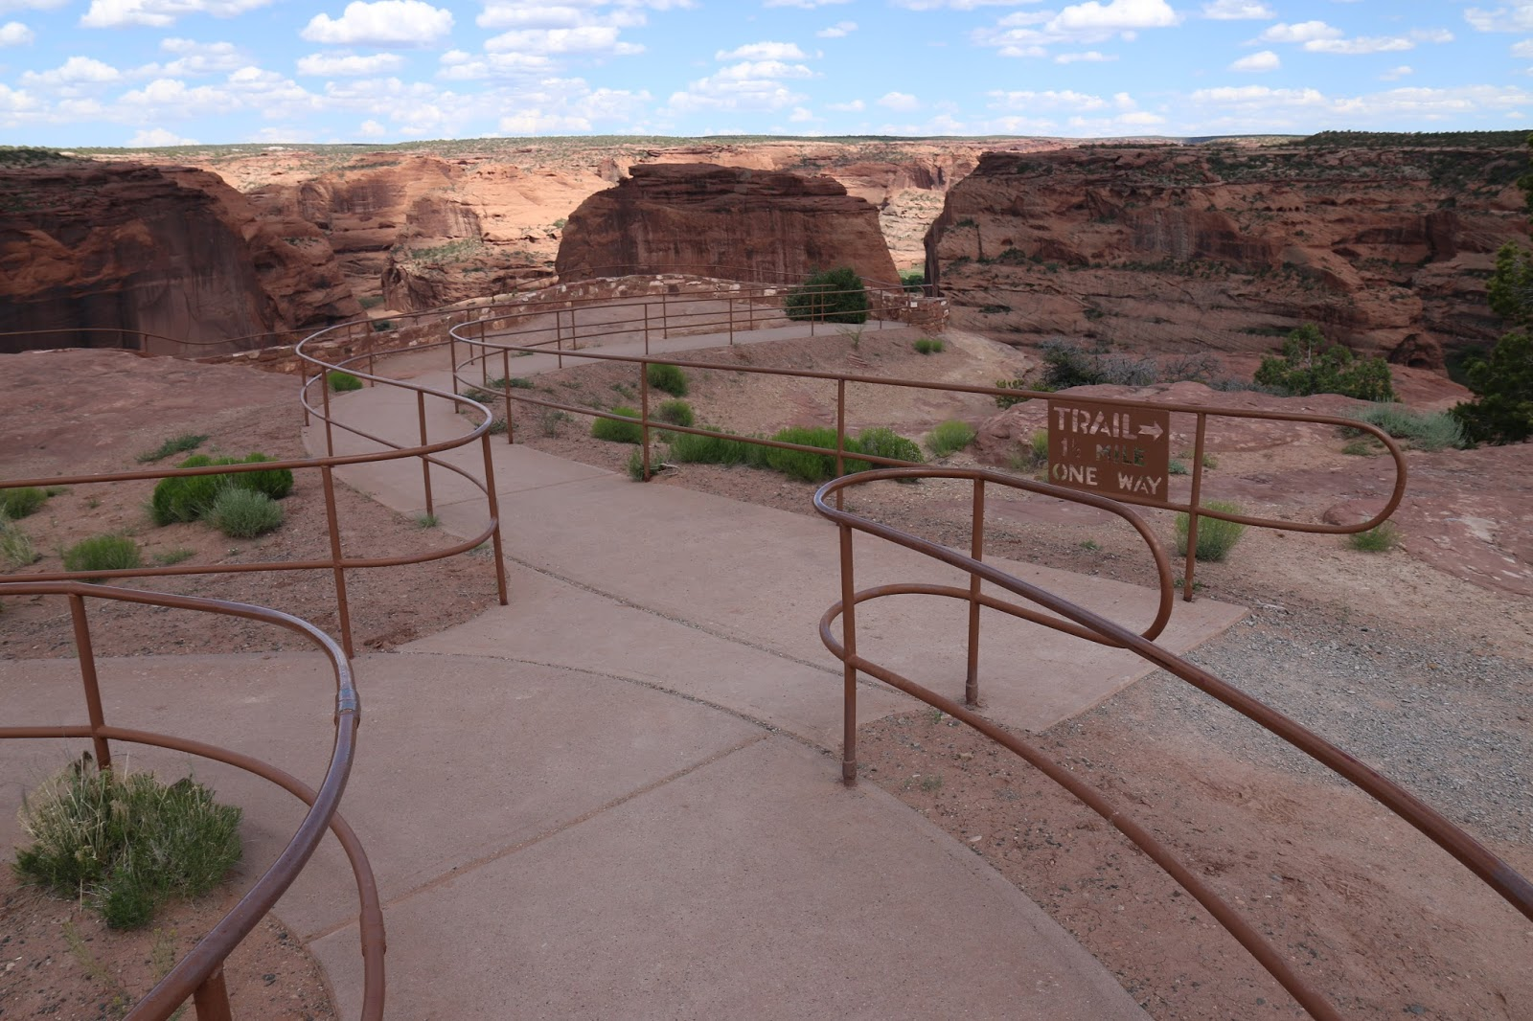
PLANNING FOR
RECREATION AND VISITOR SERVICES
RMP Implementation – Information & Education
Information and Education Questions
Are signs or facilities needed?
Where are they are needed?

Slide 47
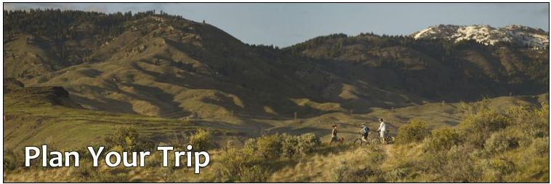
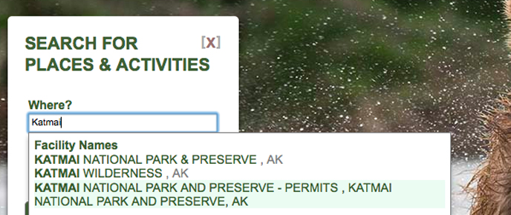

PLANNING FOR
RECREATION AND VISITOR SERVICES
RMP Implementation – Information & Education
Information and Education Questions
Will information provided direct users to specific locations?
Notes:
What will BLM put on our website?

Slide 48
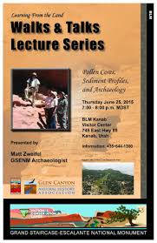
PLANNING FOR
RECREATION AND VISITOR SERVICES
RMP Implementation – Information & Education
Interpretation and Environmental Education
Why and how do information and environmental education programs help BLM?
From a visitor’s perspective, an information and environmental education strategy helps visitors make better recreational choices by matching them with the appropriate areas, allowing realization of the high-quality experiences they seek.
From a field manager’s perspective, effective information and education efforts help sustain the character of the recreation settings and deliver the desired recreation opportunities.
Notes:
The recreation planner must view the material from both the visitor’s and manager’s perspective.

Slide 49



PLANNING FOR
RECREATION AND VISITOR SERVICES
RMP Implementation – Monitoring
Monitoring
Page IV-14
Notes:
R&VS Handbook pg. IV-14.
We will be going over the who, what, when, where, why and how

Slide 50
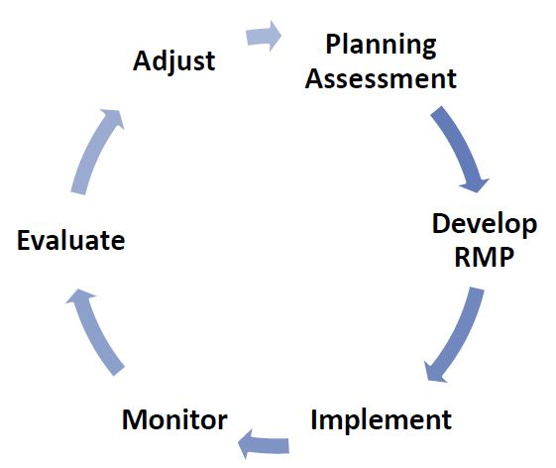
When is Recreation Data Collected?
During Planning, Implementation, Monitoring and Evaluation
Notes:
Pg. I-14 in R&VS Handbook When is Recreation Data used?
Inventory data = data collected for 1st time, prior to implementing OFM into a LUP.
Monitoring data = data collected to determine if an (RMA) objective is being met.
Implementation data = usually more site specific data used when monitoring RSCs and their relationship to an SRMA objective, use numbers, specific data collected when monitoring trail widths and braiding, campsite impacts, etc.

Slide 51

PLANNING FOR
RECREATION AND VISITOR SERVICES
RMP Implementation – Monitoring
Land Use Plan-Level Monitoring
Who,
What,
When,
Where,
Why, and
How
Notes:
Who: RMA customers.
What: RMA objective, RSCs, Management Actions and Allowable Uses, Visitor Health and Safety, Impacts on Natural and Cultural Resources and use/user conflicts. (The evaluation of the monitoring data should make conclusions about the visitor’s ability to realize RMA recreation opportunities.)
When: R&VS objectives should be monitored on a regular schedule.
Where: For each RMA.
Why: Ensures the long-term ability of the BLM to offer quality recreation opportunities.
How: RMA outcomes and objectives should be monitored through periodic visitor assessments (e.g., informal interviews, focus group surveys, and visitor surveys).

Slide 52
PLANNING FOR
RECREATION AND VISITOR SERVICES
RMP Implementation – Monitoring
Land Use Plan-Level Monitoring
SRMA
Activity
Experiences and Benefits
Desired RSCs
Management actions and allowable uses
ERMA
Activity
Qualities and Conditions
Management actions and allowable uses
vs

Slide 53
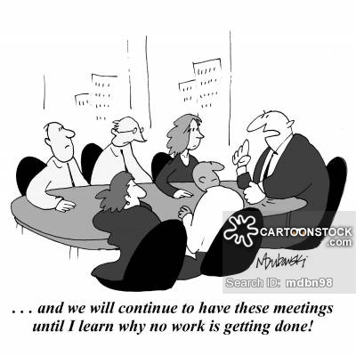
PLANNING FOR
RECREATION AND VISITOR SERVICES
RMP Implementation – Monitoring
Land Use Plan-Level Monitoring
What are some of the reasons an objective may not be met?
What needs to be done if and objective isn’t being met?
Notes:
Achieving the standards set by R&VS objectives may take time based on the extent of change needed to create the desired (SRMA) or particular (ERMA) RSCs and the ability to complete key implementation actions.
2. Monitoring R&VS objectives will not provide viable feedback until there has been substantial progress made through implementation actions to create the desired or particular RSCs.
If monitoring indicates that the participants in the primary activity are not achieving the targeted outcomes due to conflicts with other recreation activities, then activities that are not compatible with the targeted recreation activities may need to be constrained or eliminated.

Slide 54
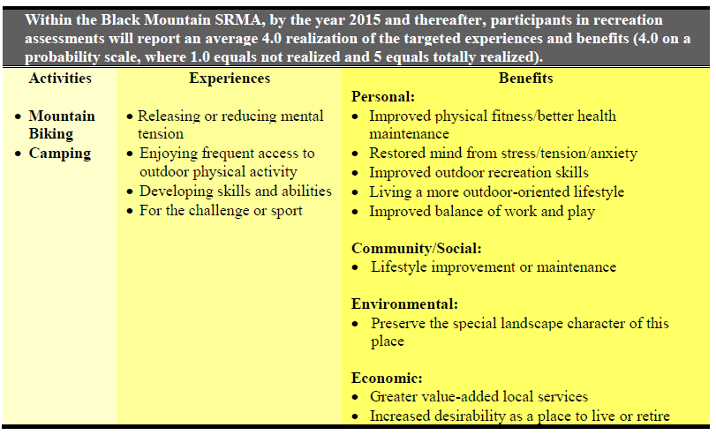
Monitoring SRMAs
Standard
Indicators
Notes:
The benefit of writing objectives in the format identified in Chapter II, Paragraph A2, is that they then encompass the standards and indicators used to monitor the realization of the outcomes.
Indicators = What will be measured (activities, experiences and benefits).
Standards = Measures of achievement or permissible conditions allowed (an average 4.0 realization of the targeted experiences and benefits).

Slide 55
PLANNING FOR
RECREATION AND VISITOR SERVICES
Monitoring
Clear River SRMA – RMZ 2
Value to be maintained | Key Indicators (Experiences) | Management Standard | Implementation Actions if Standards Are not being met | Sampling Method/ Frequency
Realization of Targeted Experiences | Enjoying closeness to family/friends Enjoying the area’s wildlife, scenery, views and aesthetics Escaping everyday responsibilities for a while Developing your skills and abilities | Participants in surveys/assessments report an average 4.0 realization (4.0 on a probability scale where: 1 = not at all realized to 5 = totally realized) of the targeted experiences | 1st - Indirect actions will be implemented if Stds are not being achieved (e.g., limit camping to designated sites, work with tourism agencies and outfitters to spread out use) 2nd – If indirect actions do not succeed by the next survey period then implement a permit system | Survey visitors every 3 years
Notes:
Limits of acceptable change example addressing camping and use .
**Narrative Format, can also have a map format.

Slide 56

PLANNING FOR
RECREATION AND VISITOR SERVICES
RMP Implementation – Monitoring
OMB approved Outcomes Focused (SRMA) Monitoring Survey being developed
Notes:
This survey is similar to the survey you took earlier in the class about experiences, benefits and settings however it is tailored to monitoring the SRMA objective.

Slide 57

SRMA Monitoring
Indicator Questions
Informal Discussions
Focus Groups
Surveys
SRMA Objective (Activities, Experiences & Benefits) & Desired RSCs
Data (4.0 Realization?)

Slide 58
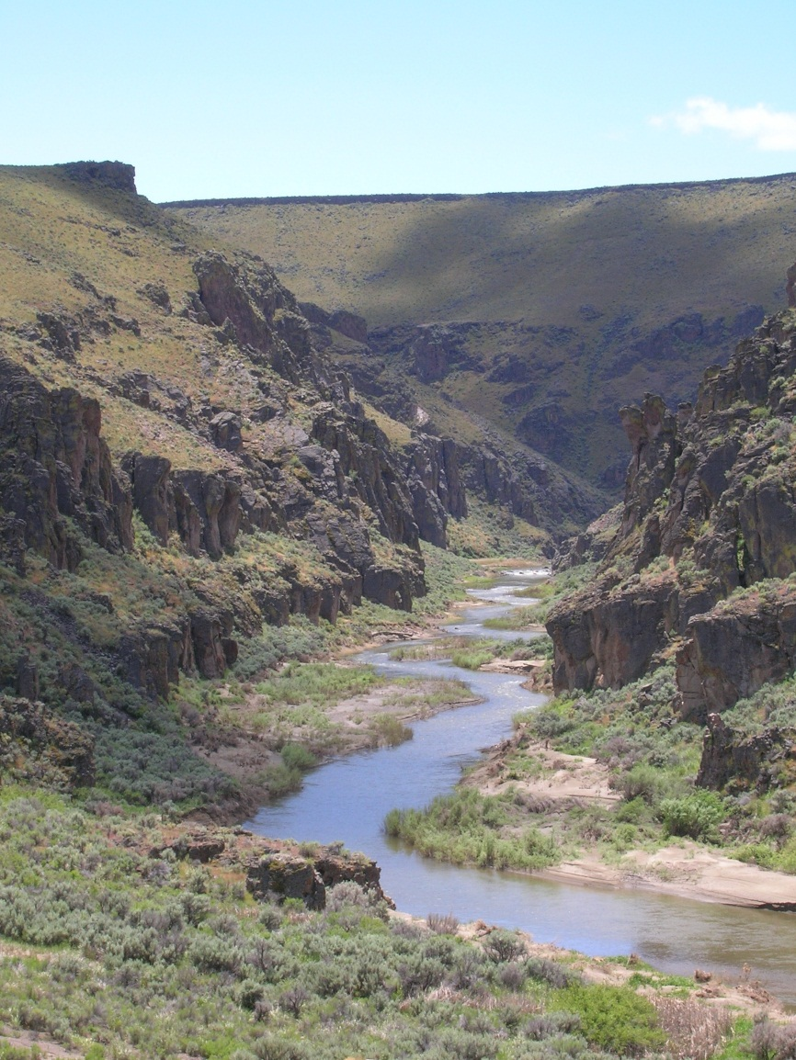
PLANNING FOR
RECREATION AND VISITOR SERVICES
RMP Implementation – Monitoring
Monitoring Recreation Setting Characteristics
Impacts on physical and social RSCs are inevitable consequences of human use of BLM lands. Monitoring ensures the long-term protection of RSCs.
The primary emphasis of monitoring recreation settings should be on achieving or maintaining the desired RSCs.
The desired physical, social, and operational RSCs of SRMAs and the qualities and conditions identified for ERMAs ensure recreation use and other land uses are consistent with RMA management focus and are maintained at acceptable levels.
While visitor capacity and land use limitations may not be initially implemented, a good monitoring strategy (e.g., limits of acceptable change strategy) alerts managers to unacceptable changes/trends over time so managers can enact proactive implementation actions to protect RSCs.
Page IV-16

Slide 59
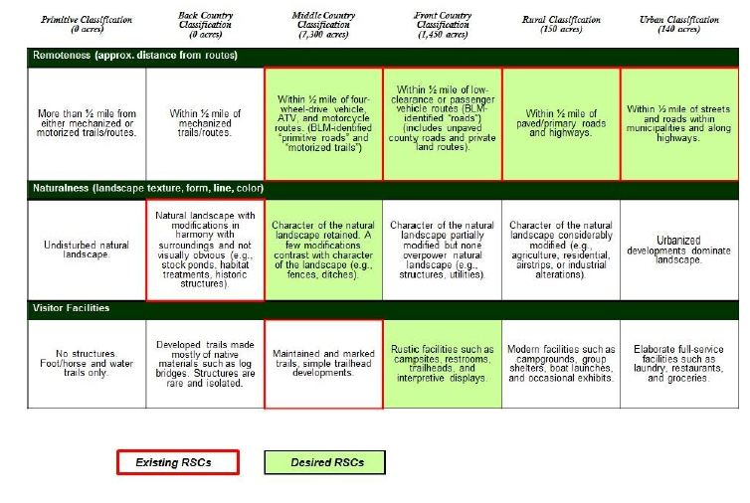
PLANNING FOR
RECREATION AND VISITOR SERVICES
RMP Implementation – Monitoring
Monitoring Recreation Setting Characteristics
Notes:
What is the one thing that results from humans recreating on public lands? **Impacts
How do we determine what level of impacts are acceptable? (Existing and Desired RSCs)
Identify unacceptable changes (Limits of Acceptable Change)
The primary emphasis of monitoring recreation settings should be on achieving or maintaining the desired RSCs.
The desired physical, social, and operational RSCs of SRMAs and the qualities and conditions identified for ERMAs ensure recreation use and other land uses are consistent with RMA management focus and are maintained at acceptable levels.
While visitor capacity and land use limitations may not be initially implemented, a good monitoring strategy (e.g., limits of acceptable change strategy) alerts managers to unacceptable changes/trends over time so managers can enact proactive implementation actions to protect RSCs.

Slide 60
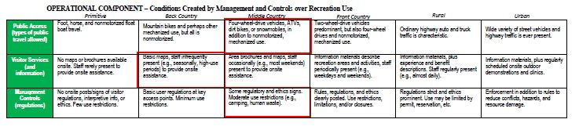
PLANNING FOR
RECREATION AND VISITOR SERVICES
RMP Implementation – Monitoring
Monitoring Recreation Setting Characteristics
Indicator
Standard
Notes:
The monitoring strategy for recreation settings should focus on the specific RSCs (indicators) and their respective RSC descriptions (standards) that serve to define the "limit of acceptable change."
**Matrix Format.

Slide 61
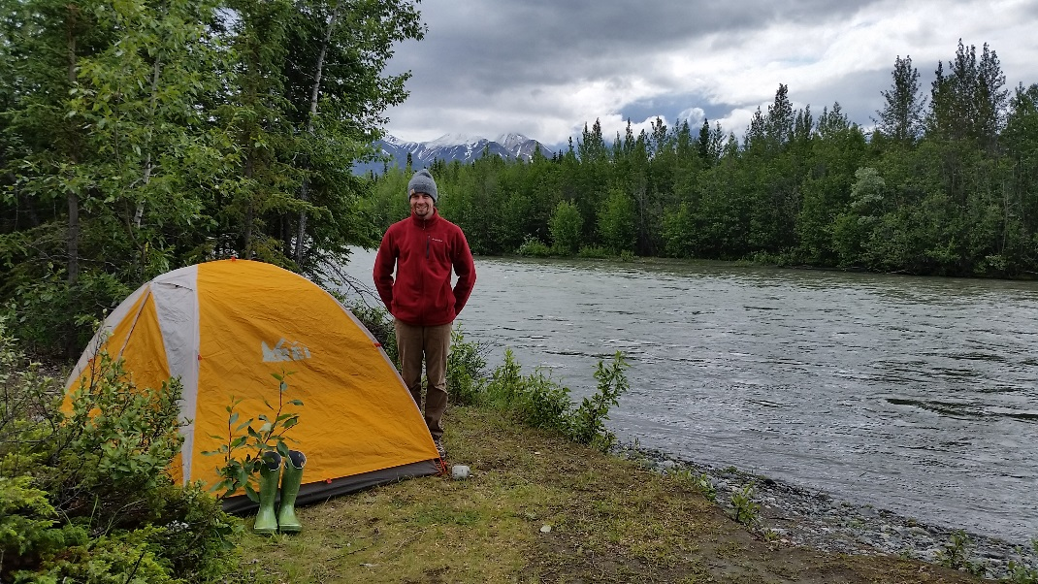
What else to monitor in RMAs?
Supporting management action and allowable use decisions
Camping Restrictions: In areas open to camping and overnight use, apply a 14-day camping limit on BLM lands from September 1 to March 31. From April 1 to August 31, apply a 7-day camping limit. Campers must relocate at least a 30-mile radius away and may not return within 30 days to a previous campsite.
Special Recreation Permits: No special recreation permits for competitive events, vending, group use, special area use, or new commercial special recreation permits would be issued.
Notes:
Important to monitor supporting management actions and allowable uses. These help address the “particular setting characteristics” associated with the RMA. **Take home message, there is a lot to monitor however it is important to pay close attention to new projects/implementation actions that can have the potential to influence/change the existing and/or desired settings. This potential changes needs to be documented in the EA associated with the project.

Slide 62

What else to monitor in RMAs?
Supporting management action and allowable use decisions
Lands and Realty: ROW avoidance areas are applied to developed recreation sites. The ERMA is retained for long-term management.
Stipulations for Fluid Mineral Leasing and Other Surface-Disturbing Activities: Apply stipulation CRVFO-CSU-11 which constrains: surface use, occupancy, and surface disturbing activities in ERMAs.
Notes:
Important to monitor supporting management actions and allowable uses. These help address the “particular setting characteristics” associated with the ERMA.

Slide 63
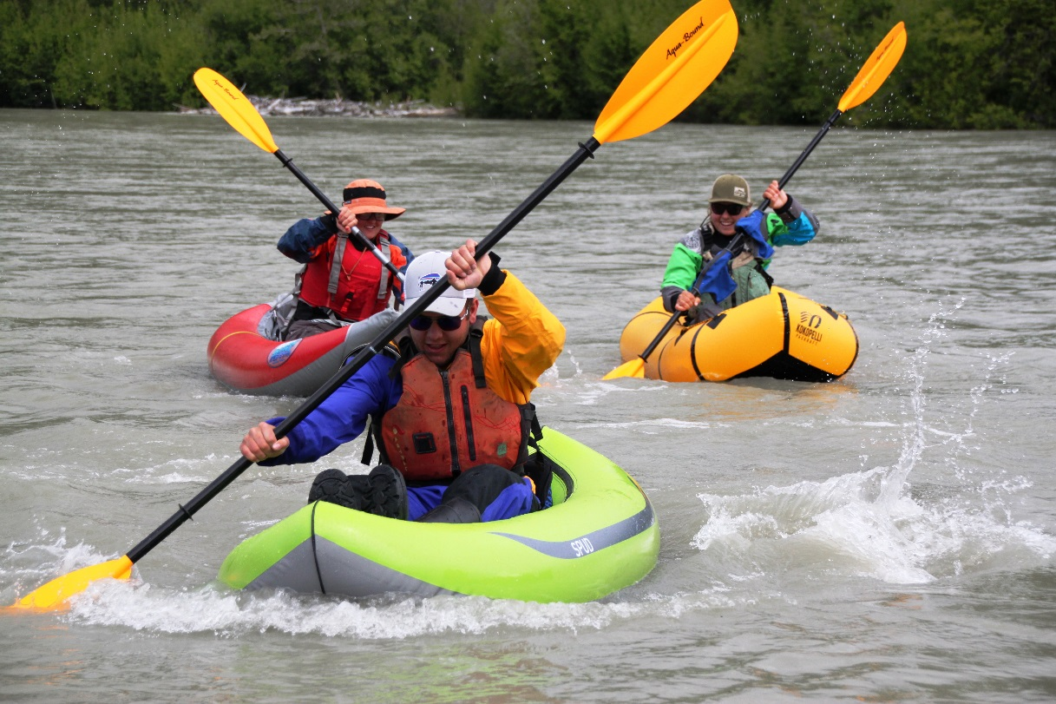
Lands Not Designated
Monitor any LUP objectives written for:
  Visitor Health and Safety
  Use and User Conflicts
  The type(s), activities and locations
  where SRPs would or would not be issued
  Mitigation of recreation impacts on cultural and natural resources.
Notes:
Document these issues and remedies as they occur.

Slide 64
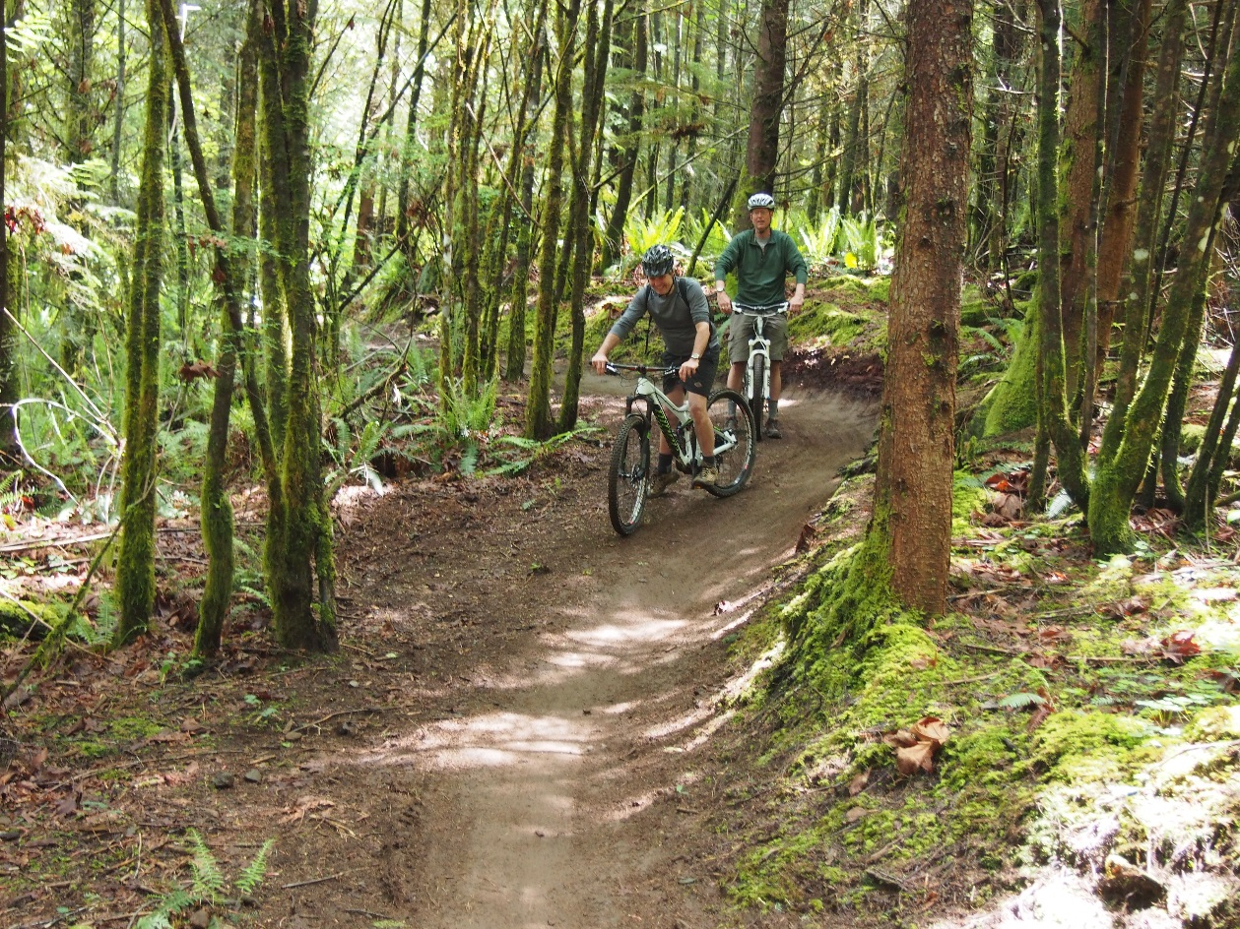
PLANNING FOR
RECREATION AND VISITOR SERVICES
RMP Implementation – Monitoring
Implementation Monitoring
Execution
Effectiveness
Visitor Use Patterns
Notes:
Implementation
Execution: 1. what was done in each RMA that year? Document which R&VS implementation actions were completed and the further actions needed to continue implementing LUP decisions.
Effectiveness: effectiveness of those actions (i.e., did it do what was expected?) are critical in determining if the action is helping achieve the RMA objective and desired RSCs. Make sure all implementation actions are designed and implemented with the intent of maintaining and/or achieving the desired RSCs.
Monitoring visitor use and use patterns involves collecting and evaluating site inventory and condition data to establish a baseline or to identify trends in visitor use and visitor impacts over time. This information is useful in visitor use management and to reduce or mitigate resource impacts of recreation use.

Slide 65
Adaptive Management
Notes:
This is adaptive management. If indicators tell you that standards are not being met then adjustments to the Operational Setting are most likely needed.
Simply put, adaptive recreation management is not possible without effective monitoring because monitoring data show if progress is being made toward achieving LUP objectives.
Since accrued monitoring data and evaluation are used to improve future implementation actions, monitoring is continual and never complete.
The cyclic process generally includes four phases: planning, implementation, monitoring, and evaluation.

Slide 66
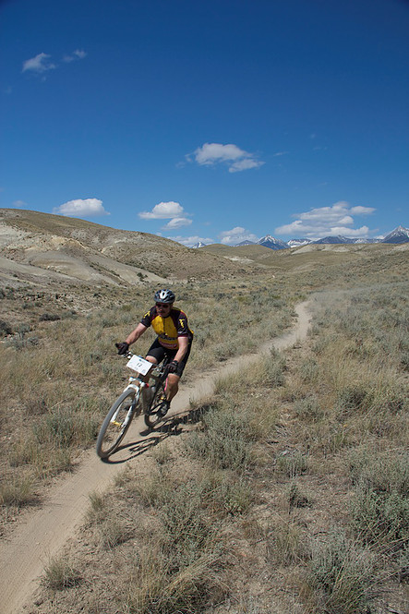
PLANNING FOR
RECREATION AND VISITOR SERVICES
RMP Implementation – Monitoring
Monitoring Plans
A recreation monitoring strategy should be developed that identifies
such items as:
indicators,
standards,
protocols,
frequency,
documentation,
who does the monitoring, and
estimated costs.
Monitoring plans can also outline the implementation actions that will be performed if the standards are not met. Monitoring plans do not need to be complex documents.

Slide 67
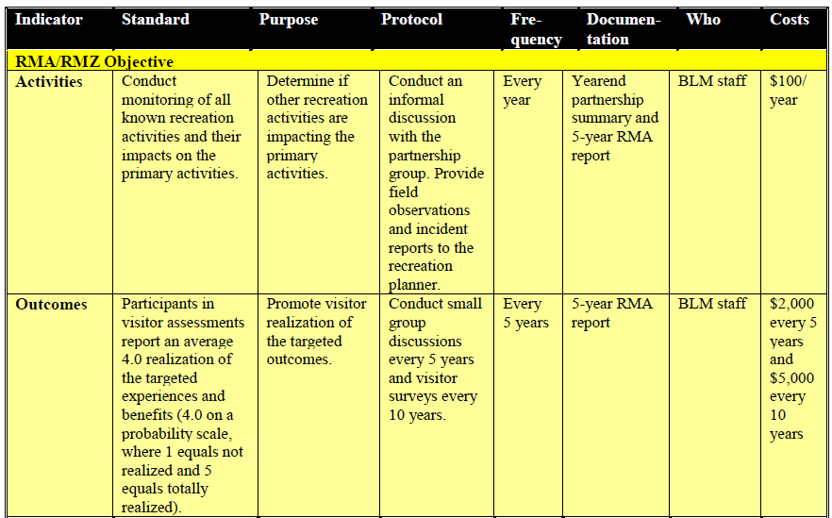
PLANNING FOR
RECREATION AND VISITOR SERVICES
RMP Implementation – Monitoring
Monitoring Plans
Notes:
R&VS Handbook, IL-28 and IL30-provides an example of a monitoring strategy.

Slide 68
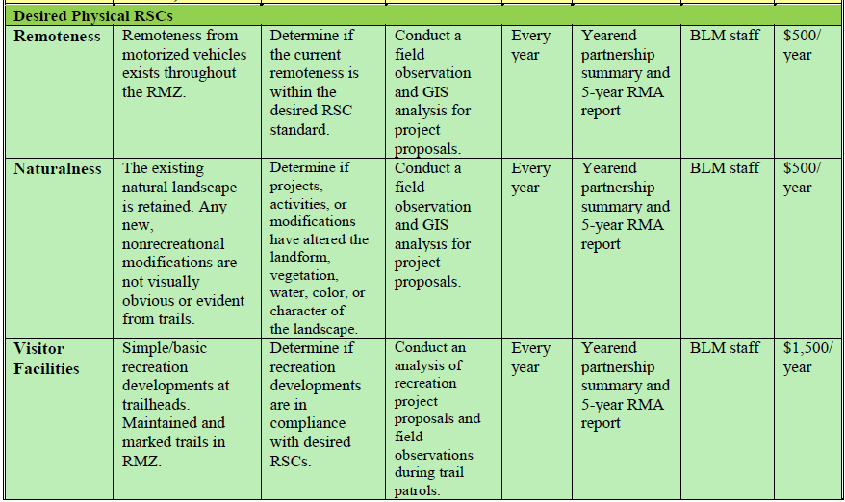
PLANNING FOR
RECREATION AND VISITOR SERVICES
RMP Implementation – Monitoring
Monitoring Plans
Notes:
R&VS Handbook, Illustration 7 provides an example of a monitoring strategy.

Slide 69
