Slide 1
PLANNING FOR RECREATION AND VISITOR SERVICES
RMP Implementation
Module 12
OFM Implementation Planning

Slide 2
Objective:
Integrating OFM data into implantation plans.

Slide 3
Broad LUP Objectives
Alabama Hills Special Recreation Management Area (SRMA)
RMA/Recreation Management Zone (RMZ) Objective(s) Decisions
Objective Statement: The purpose of the Alabama Hills Scenic Area RMZ is to conserve, protect, and enhance for the benefit and enjoyment of present and future generations the nationally significant scenic, cultural, recreational, geological, educational, biological, historical, recreational, cinematographic and scientific resources of the Alabama Hills.
Activities: Recreational uses of the Alabama Hills Scenic RMZ include, but are not limited to, hiking, mountain biking, rock climbing, sightseeing, horseback riding, hunting, fishing, and appropriate authorized vehicle use. Commercial filming and still photography are also common. Tuttle Creek campground is within this RMZ and includes 83 tent/RV sites, toilets, and seasonally-available potable water. Livestock grazing is permitted in existing allotments within this RMZ in accordance with applicable laws, regulations, policies, and land use plan guidance. A number of Special Recreation Permits are issued annually for activities in the RMZ.
Experiences: Visitors to the Alabama Hills Scenic Area RMZ find beautiful scenery, enjoyment of the outdoors with family and friends, a release from routine tensions from modern living, satisfaction in exploring new areas, connection with nature, spiritual renewal and exercise.
Benefits: Visitors benefit from enhanced mental and physical health, ownership in America’s great outdoors, opportunities for solitude and unconfined outdoor recreation. Commercial filming, grazing, rock climbing, rock hounding, hunting, fishing and all the other activities which occur in the Alabama Hills create a positive economic impact, generating significant revenue which helps to sustain the long term economic viability of the community of Lone Pine and Inyo County.
Notes:
What would you do in this case? Discussion by table and then report out to open discussion.
Collect OFM data, Do a RAMP, implement
In the RAMP document the data collection process, focus the implementation portion of the RAMP.
Describe the proposed actions in the RAMP, disclose how will the proposed action impact/support the Desired RSC’s?
Don’t write RAMP objectives that could be confused with the LUP recreation objectives.

Slide 4
Specific/Similar RMAs
Notes:
Very Specific RMA’s or SRMA objective that was written “in-house” without the help/support of OFM data. Table or Open Discussion:
Collect OFM data, then depending on the results, refine and bundle/chain the activities, experiences and benefits.
Focusing implementation decisions., but must be in conformance with the existing/original Recreation LUP Recreation Objective.
Focus the RAMP proposed action based on the data.
Design the proposed action and facilities to support the results of the OFM data.
Again…Do not attempt to write a RAMP objective so it gets confused with the LUP objective.

Slide 5
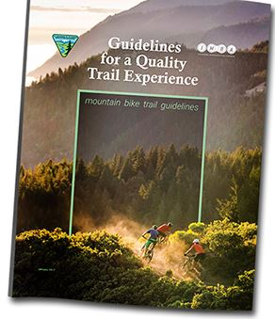
Notes:
Use OFM data to help design facilities.
How does the OFM data relate to the existing and/or desired RSC’s?
Incorporate Guidelines for a Quality Built Environment and/or Guidelines for a Quality Trail Experience.

Slide 6
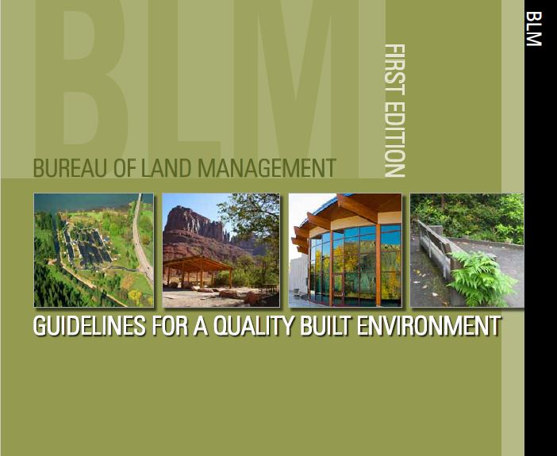
Notes:
Use this tool/guideline to help with project design and ask the question during the design process:
How will the proposed design impact the setting?
Does the proposal support the Outcomes identified for management?

Slide 7
Implementation Action (EA)
Document source, i.e. Wood River Lands Benefits Study, and findings in the Existing Environment,
Include data in the analysis,
FONSI, include as a beneficial impact,
Decision, list as rationale.
Notes:
Collect and use OFM data for the analysis.
Rationale for the decision can site OFM data and outcomes but BLM isn’t managing for long term OFM related objectives that would be part of a LUP.
Still in compliance with the Recreation LUP Objective?
Collect OFM data to help determine the magnitude of the issues. Based on the results and potential threats to the RSCs consider a LUP amendment to support the desired RSCs.

Slide 8
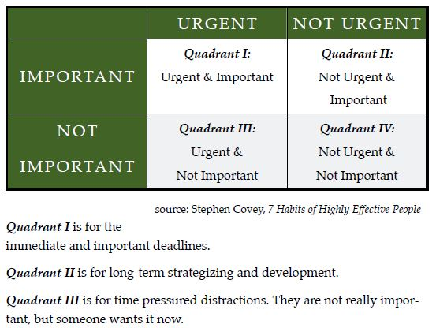
Notes:
Quad 2. Monitoring, Planning…what kind of long-term impacts/legacy do you want to have on public lands within your field office? Must spend time here.
Quad 3: IM, IB, data calls,
Quad 1: required trainings
Quad 4:

Slide 9
Questions/Comments

