Slide 1
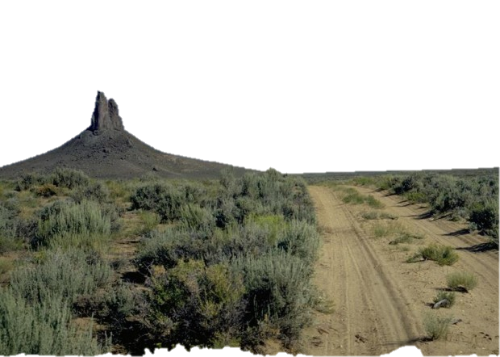
Travel and Transportation Management for Managers
National Training Center Course #8300-26
The Basics
Why, What & How?

Slide 2
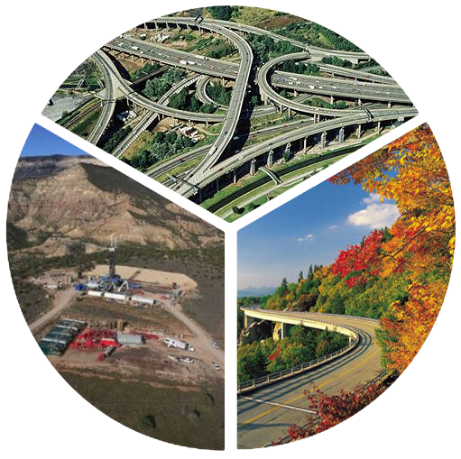
Why are there routes?
Connectivity
Access
Experience

Slide 3
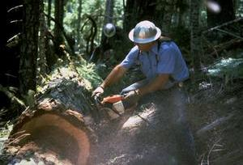
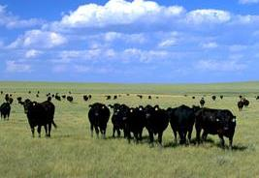
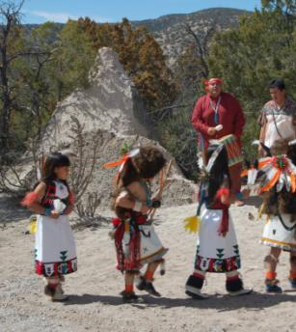
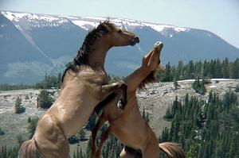
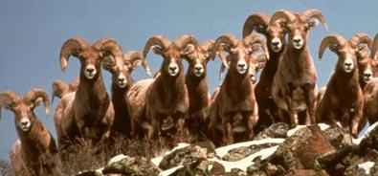
BLM Mission
It is the mission of the Bureau of Land Management to sustain the health, diversity, and productivity of the public lands for the use and enjoyment of present and future generations.

Slide 4
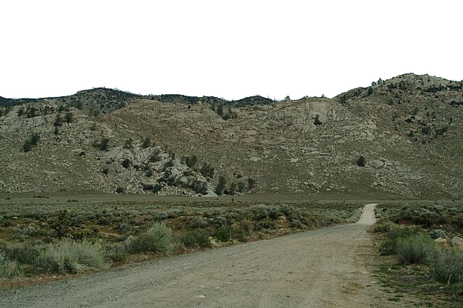
Why Manage Routes?
Provision of Access and Experience
Maintain Connectivity
Increase Efficiency
Reduce Impacts

Slide 5
Authority & Guidance for Travel Management Planning
Executive Order No. 11644, February 8, 1972
Executive Order No. 11989, May 25, 1977
43 Code of Federal Regulations Part 8342
National Management Strategy for Motorized Off-Highway Vehicle Use on Public Lands (BLM 2001)
Travel and Transportation Management Manual (BLM Manual 1626, September 27, 2016)
Travel and Transportation Management Handbook (BLM Handbook H-8342-1, 2012)

Slide 6
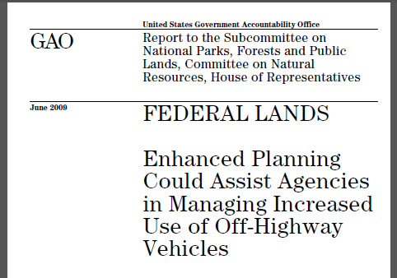
GAO-09-509

Slide 7
Public Lands Travel Network

Slide 8
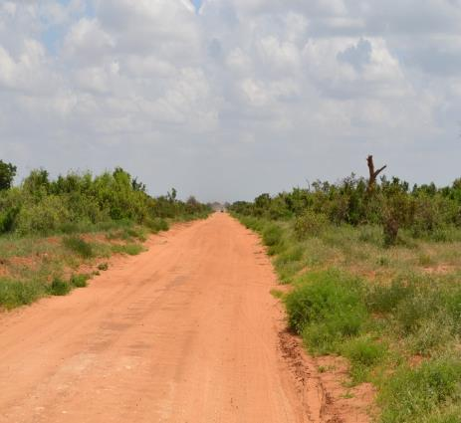
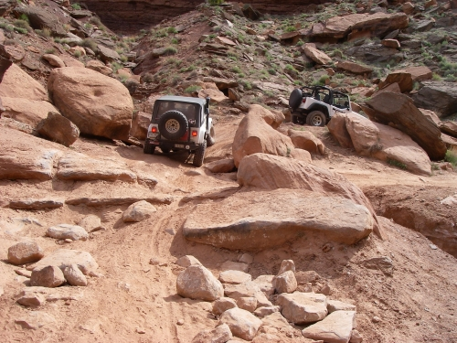
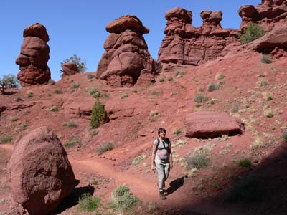
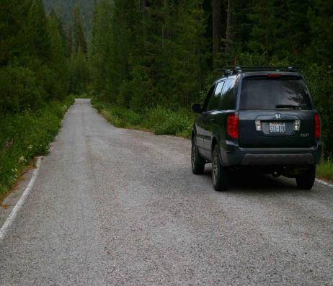
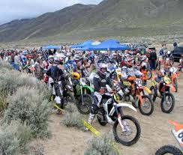
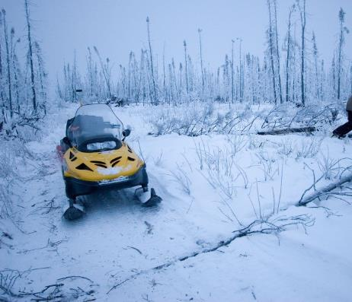
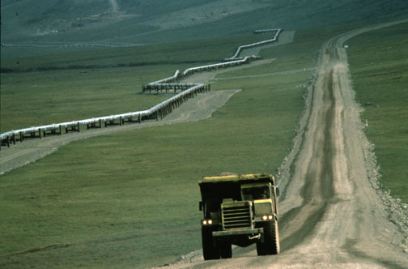
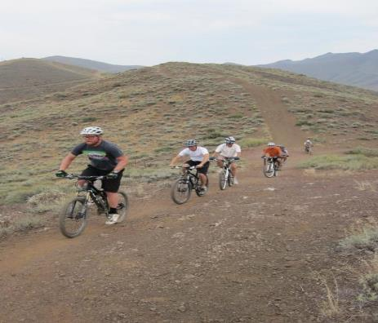
Linear Travel Features - “Routes”

Slide 9
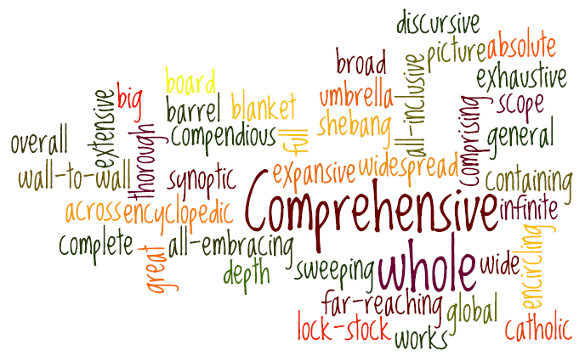
All Users – All Vehicles – All Modes-of-Travel

Slide 10
Off-Highway Vehicles

Slide 11
Definition of OHV
Definitions established in 43 CFR 8340.05
(a) Off-road vehicle [OHV] means any motorized vehicle capable of, or designed for, travel on or immediately over land, water, or other natural terrain, excluding:
(1) Any nonamphibious registered motorboat;
(2) Any military, fire, emergency, or law enforcement vehicle while being used for emergency purposes;
(3) Any vehicle whose use is expressly authorized by the authorized officer, or otherwise officially approved;
(4) Vehicles in official use; and
(5) Any combat or combat support vehicle when used in times of national defense emergencies.

Slide 12
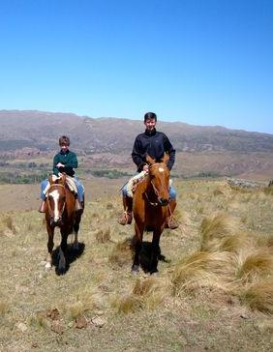
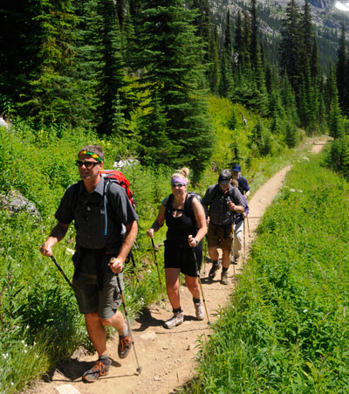
Non-Motorized Modes-of-Transport

Slide 13
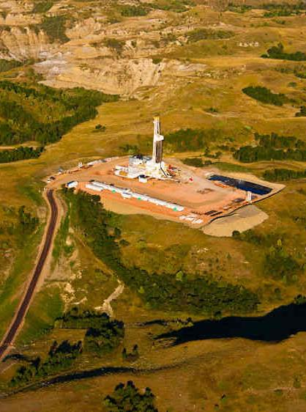
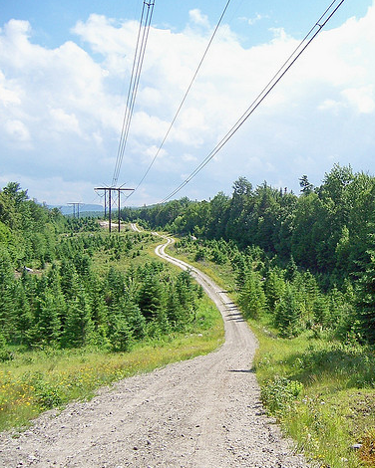
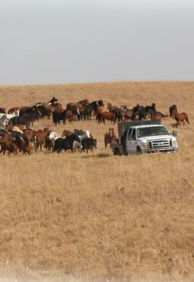
Permitted & Authorized Use

Slide 14
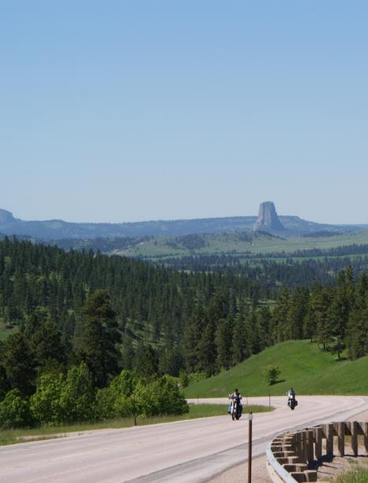
Travel Network & Transportation Systems
Sustainable - Multi-Modal - Comprehensive

Slide 15
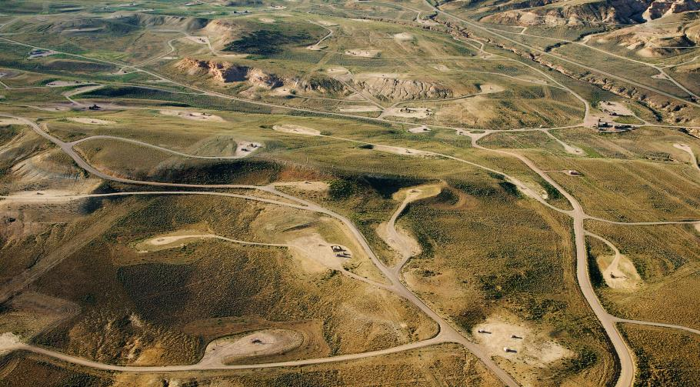
What’s the difference between a Travel Network and Transportation System?

Slide 16
Managing Comprehensively
TTM
Non-Motorized Trail Decisions
Permitted and Authorized Use
OHV Area Designations
OHV Trails Designations
43 CFR 8342 Designation Criteria
43 CFR 8342 Designation Criteria
43 CFR 8364 / 8365
Closures, Restrictions & Rules
Terms & Conditions / Stipulations
Land Use Allocation
Implementation Decision

Slide 17
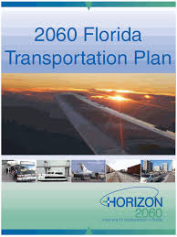
Travel and Transportation Planning
Presents opportunity to review Inventory & Resources
Achieves Site-Specific Impact Analysis
Allows incorporation of Best Management Practices
Results in Defensible Decisions
Aids in Dissemination of Information (User Maps etc.)
Eases Development and Analysis of Future Actions

Slide 18
Travel and Transportation Management for Managers
National Training Center Course #8300-26
Preparing to Make TTM Decisions
Fundamental Planning Processes

Slide 19
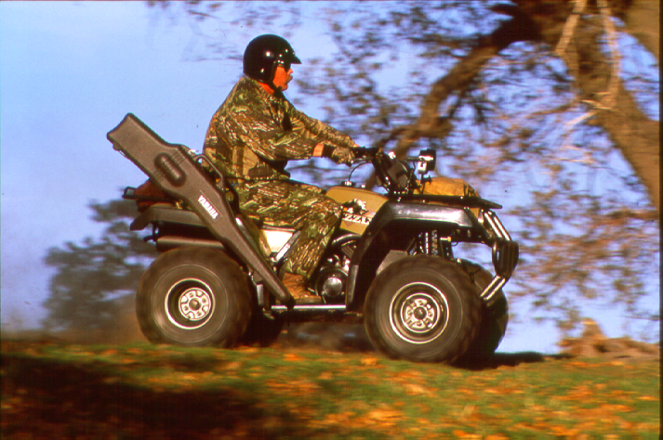
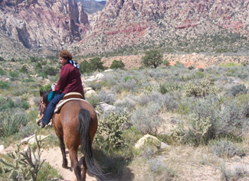
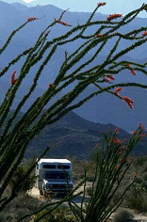
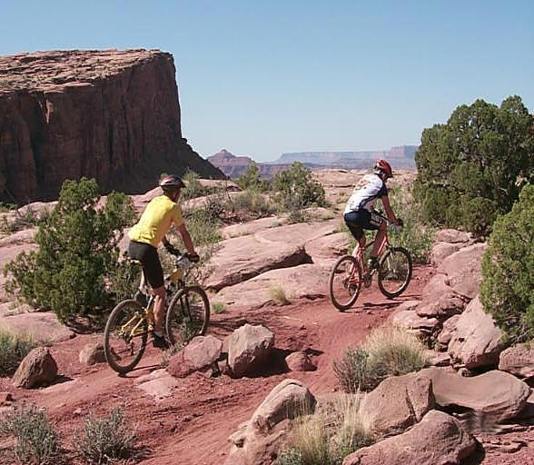
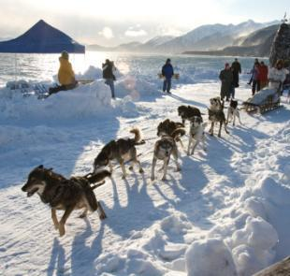
Comprehensive

Slide 20
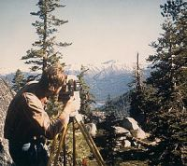
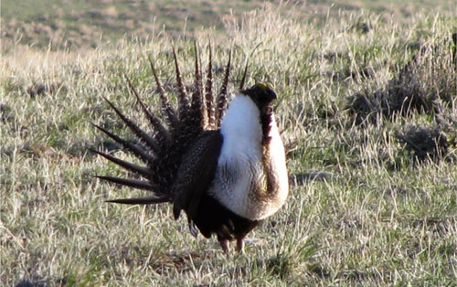
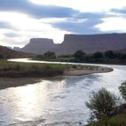
Interdisciplinary

Slide 21
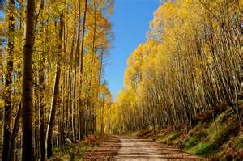
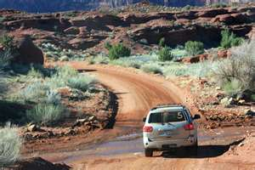
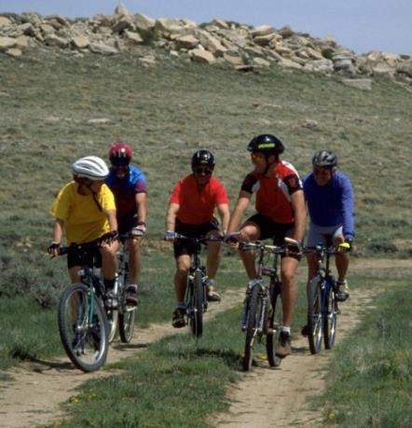
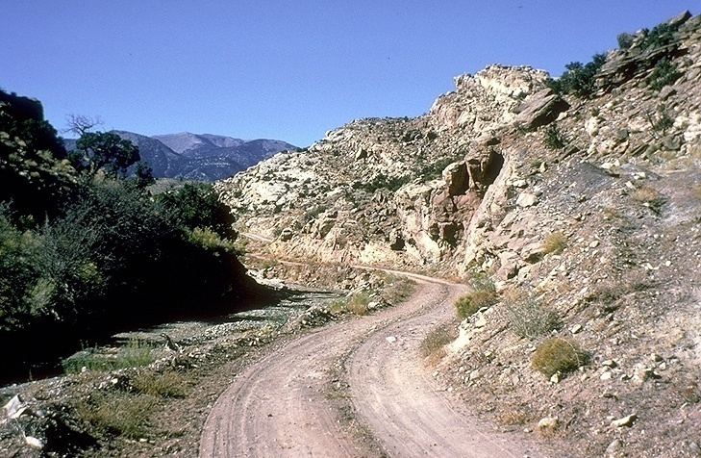
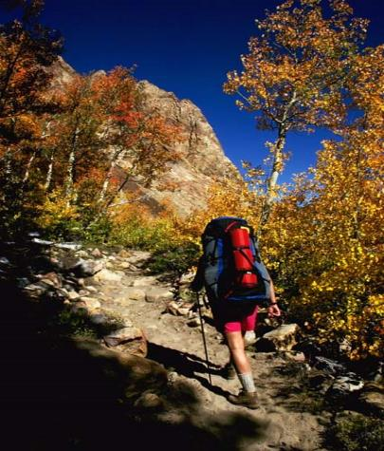
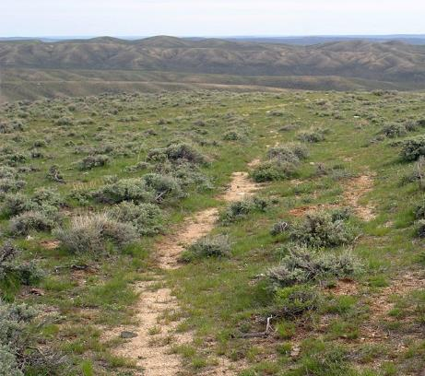
Outcome-Based

Slide 22
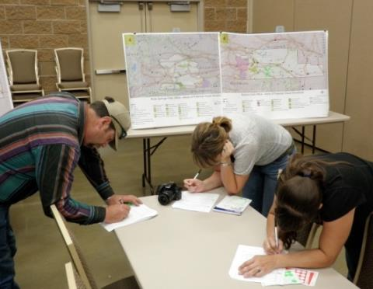
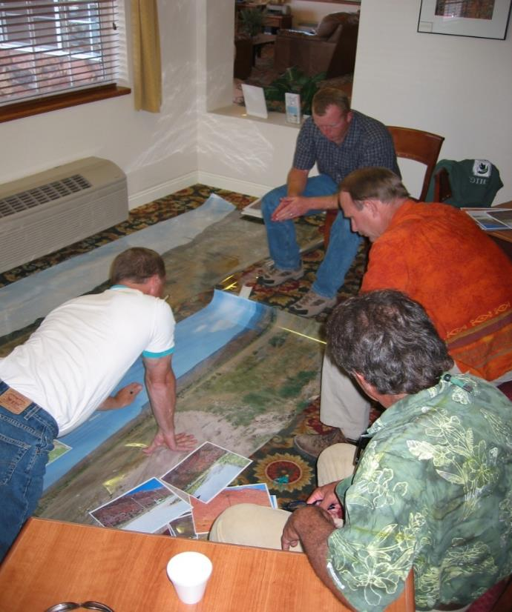
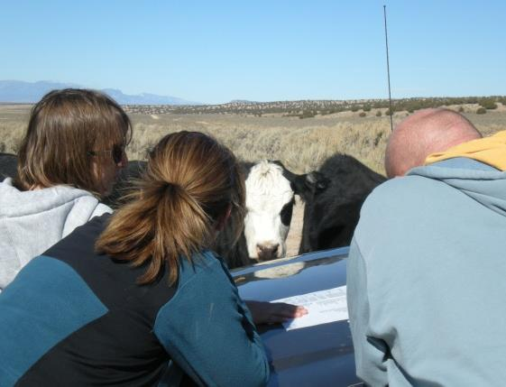
Collaborative

Slide 23
Communication…
“We all have questions! We want someone up there to answer them.”
- Public Meeting, Manti-La Sal National Forest

Slide 24
Pre-Planning
Identify data requirements
Identify the existing available data
Resource Data
Route Inventory
Identify the data gaps
Identify the issues, concerns and opportunities
Document Pre-Planning
Establish Planning Criteria
Involve leadership so they understand the workload, resources, and funding required!

Slide 25
Resource & Program Data
Driven by planning needs!
Addresses the issues, concerns and opportunities
Includes previous route/area authorizations impacting travel e.g., ROWs, APDs, Sundry Notices, Grazing Permits etc.
Examples
Soils, Water / Watersheds, Vegetation, Air Quality, Wilderness Study / Wilderness Characteristics
Wildlife, Habitat, Critical Habitat
Recreational Uses / Settings / Desired Outcomes
Designated Wilderness, Primitive Areas, Natural Areas

Slide 26
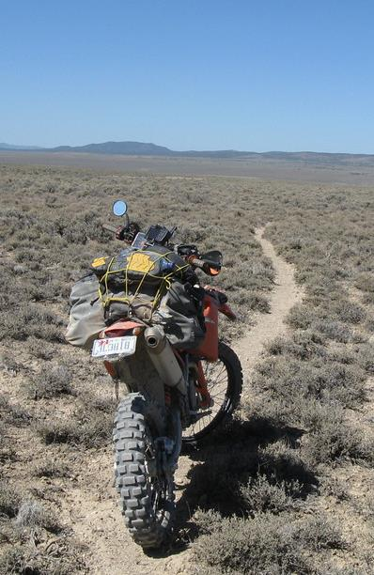
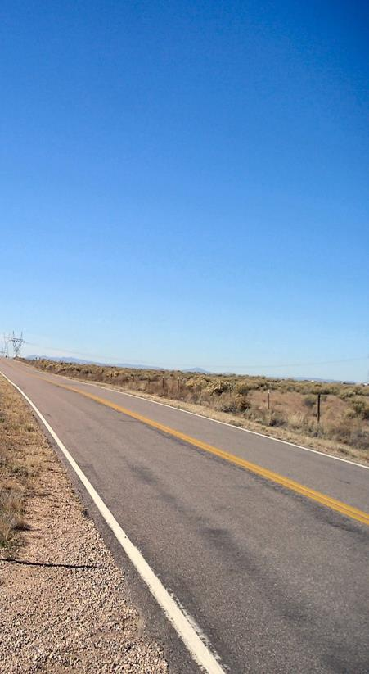
Linear Travel Features ~ “Route” Inventory

Slide 27
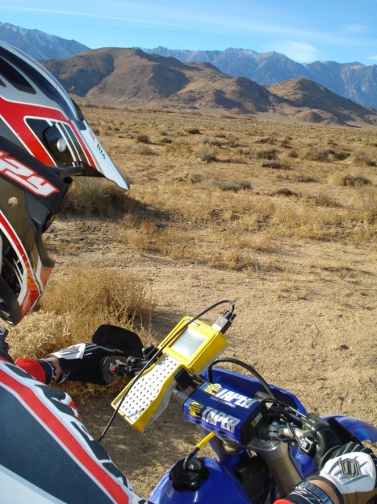
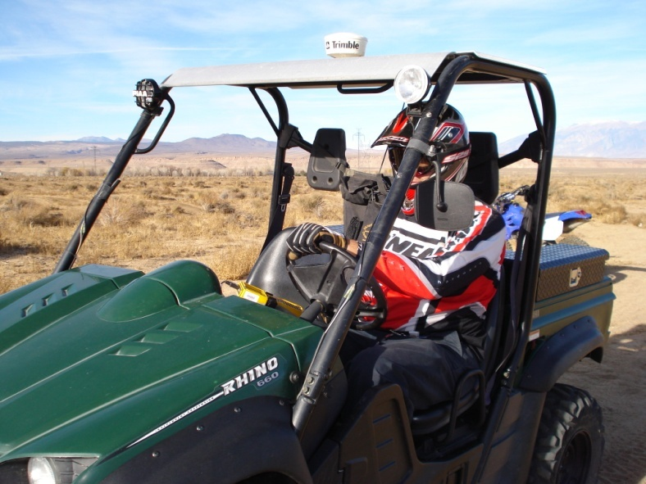
Collecting the Data Manually

Slide 28
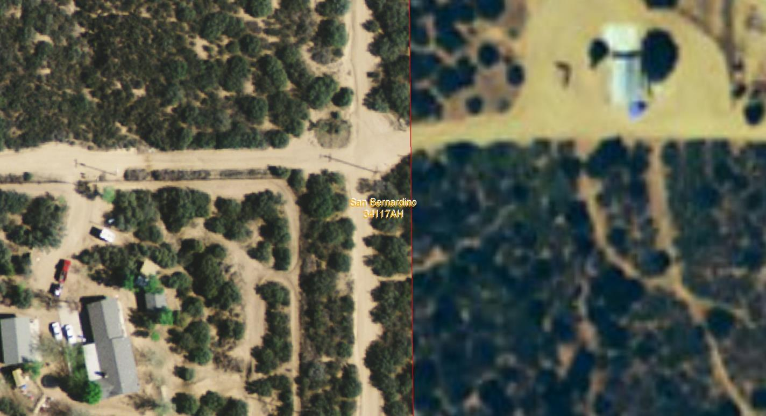
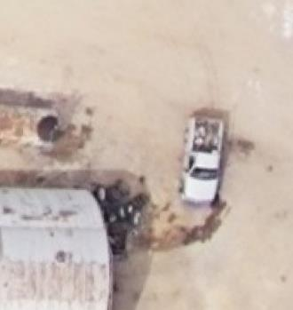
Collecting the Data Digitally

Slide 29
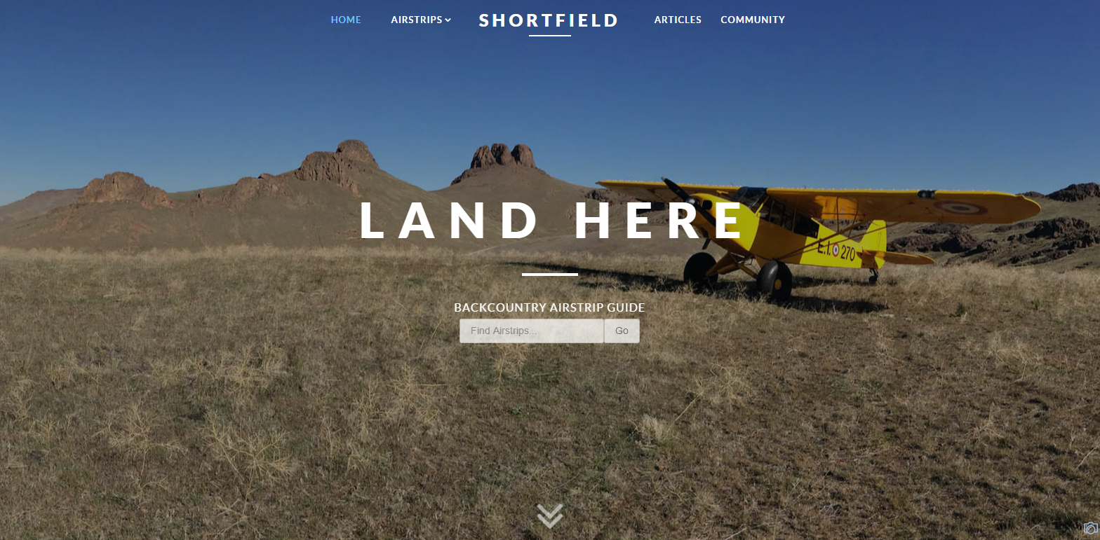
Crowd-sourced Data

Slide 30
Ground Transportation Linear Features
Notes:
Required method of storage, national data standard, field office controlled, universally accessible – unit 7

Slide 31
GTLF “Inventory” Minimums
Route Designation Authority
Observed Mode of Transport
Indicates the general category of transportation observed on the route.
Observed Surface Type
The main surface material of the ground transportation linear feature at the time the observation was made.
Observed Functional Class
This attribute groups routes according to the type of service and amount of traffic they have.
Observed Route Use Class
Describes the observed physical suitability of use of a road in order to aid in safe travel by the public across the BLM road network.
Route Existing Authorization Status
Indicates the existence of an easement, Right-of-Way (ROW), Reciprocal Right-Of-Way (RROW) or similar authorizations.
Route Planning ID

Slide 32
Route Purpose
Access | Connectivity | Experience

Slide 33
Characterizing Route Use
By the numbers…
Vehicle Counters etc.
RMIS
Federal Highways / State DOT
Field Observation
High
Medium
Low

Slide 34
Credible Data?
Is your inventory current?
“How” and “When” was it collected?
What percent has been checked against Aerial Photography?
What percent has been collected by GPS/Ground Truthed?
Is your data stored in a usable format?
GIS data in Ground Transportation Linear Feature (GTLF) layer(s)?
Geo-referenced tables used to store meaningful attributes?
Is the Metadata up-to-date?
Has each route been assigned a unique number?
Has your public process included verification of inventory data?
Has input from the public been verified?

Slide 35
Questions?

Slide 36
Travel and Transportation Management for Managers
National Training Center Course #8300-26
The Big “Decisions”
Land Use Planning for TTM

Slide 37
Decisions, Decisions…
Land Use Planning Level Decisions
Broad-scale [protestable] decisions to direct future management actions and subsequent site-specific implementation decisions.
OHV Area Designations
Open, Closed, Limited – 43 CFR 8342.0-5
BLM Handbook H-8342-1 (Section IV.C – page 11 - 13)
Implementation Decisions
Final [appealable] approval allowing on-the-ground actions to proceed.
Evaluation of Linear Transportation Features (Routes)
Type of Feature (Road, Primitive Road, Trail, Primitive Route or Transportation Linear Disturbances), OHV Trail Designations
Other Limitation/Restrictions e.g., Season of Use, Authorized Users, Type of Vehicle etc.
Implementation Strategy
Sign, Monitoring, Restoration, Outreach, Enforcement Components

Slide 38
TTM & Land Use Planning
LUPs provide the overarching guidance for all resources…
Some Resource/Program goals, objectives and allocations directly relate to TTM e.g., provision of access
Others indirectly relate e.g., reduce impacts on air quality from motorized sources
LUPs also include allocations specific to TTM.
OHV Area Designations

Slide 39
Biological Resource Decisions
Surface-disturbing and disruptive activities would be allowed within 1/2 miles of raptor nest sites with design features which maintain the functionality for the nesting habitat.
Prohibit surface‐disturbing activities within ¼ mile of or within riparian/wetland areas (219,683 acres).
Continue the Bald Ridge Area human presence seasonal closure currently January 1 to April 30 in cooperation with stakeholders.

Slide 40
OHV Area Designations

Slide 41
OHV Area Management
The Land Use Planning level decision required by regulation and policy – 43 CFR 8342 & H1601-1
The authorized officer shall designate all public lands as either open, limited, or closed to off-highway vehicles.
This regulation only applies to off-highway vehicles!

Slide 42
OHV Open, Closed & Limited Areas
Open
Closed
Limited

Slide 43
OHV Area Designation Decisions
Decisions must comply with 43 CFR 8342 – Designation of Areas and Trails
All designations shall be based on the protection of the resources of the public lands, the promotion of the safety of all the users of the public lands, and the minimization of conflicts among various uses of the public lands; and in accordance with the following criteria:
(a) Areas and trails shall be located to minimize damage to soil, watershed, vegetation, air, or other resources of the public lands, and to prevent impairment of wilderness suitability.
(b) Areas and trails shall be located to minimize harassment of wildlife or significant disruption of wildlife habitats. Special attention will be given to protect endangered or threatened species and their habitats.
(c) Areas and trails shall be located to minimize conflicts between off-road vehicle use and other existing or proposed recreational uses of the same or neighboring public lands, and to ensure the compatibility of such uses with existing conditions in populated areas, taking into account noise and other factors.
(d) Areas and trails shall not be located in officially designated wilderness areas or primitive areas. Areas and trails shall be located in natural areas only if the authorized officer determines that off-road vehicle use in such locations will not adversely affect their natural, esthetic, scenic, or other values for which such areas are established.

Slide 44
Travel Management Areas

Slide 45
What is a Travel Management Area?
TMAs are a planning tool to frame transportation issues and help identify travel networks that address specific uses and resource concerns.
A
B
C

Slide 46
TMAP Data
Travel Management Areas
Off-Highway Vehicle Areas

Slide 47
Questions?

Slide 48
Travel and Transportation Management for Managers
National Training Center Course #8300-26
The “Details”
TTM Implementation Decisions

Slide 49
From Linear Travel Features to Travel Network/Transportation Systems

Slide 51
Linear Transportation Features
Road
A linear route declared a road by the owner, managed for use by low-clearance vehicles having four or more wheels, and maintained for regular and continuous use.
BLM Handbook H-8342-1 (Section V.C – page 20)

Slide 52
Linear Transportation Features
Primitive Road
A linear route managed for use by four-wheel drive or high-clearance vehicles. These routes do not normally meet any BLM road design standards.
BLM Handbook H-8342-1 (Section V.C – page 20)

Slide 53
Linear Transportation Features
Trail
A linear route managed for human-powered, stock, or off-highway vehicle forms of transportation or for historical or heritage values. Trails are not generally managed for use by four-wheel drive or high-clearance vehicles.
BLM Handbook H-8342-1 (Section V.C – page 21)

Slide 54
Linear Travel Features
Temporary Route
Short-term roads, primitive roads or trails authorized or acquired for the development, construction or staging of a project or event that has a finite lifespan.
BLM Handbook H-8342-1 (Section V.C – page 21 - 22)

Slide 55
Linear Travel Features
Primitive Route
Any motorized/mechanized linear transportation feature located within Wilderness Study Area (WSA) – remains unclassified until Congressional action occurs on WSA.
BLM Handbook H-8342-1 (Section V.C – page 22)

Slide 56
Linear Travel Features
Transportation Linear Disturbance
Routes (unauthorized) that are not part of the designated transportation network and usually identified for decommissioning and restoration.
BLM Handbook H-8342-1 (Section V.C – page 22)

Slide 57
Route Evaluation Criteria

Slide 58
Route Evaluation Process
Develop route evaluation criteria to…
Identify interfacing resource values
Evaluate route
Develop designation and decision alternatives
Develop minimization options
Identify the route objectives
Document designation process!
Rinse and Repeat… for each route!

Slide 59
OHV Area Designation Decisions
Decisions must comply with 43 CFR 8342 – Designation of Areas and Trails
All designations shall be based on the protection of the resources of the public lands, the promotion of the safety of all the users of the public lands, and the minimization of conflicts among various uses of the public lands; and in accordance with the following criteria:
(a) Areas and trails shall be located to minimize damage to soil, watershed, vegetation, air, or other resources of the public lands, and to prevent impairment of wilderness suitability.
(b) Areas and trails shall be located to minimize harassment of wildlife or significant disruption of wildlife habitats. Special attention will be given to protect endangered or threatened species and their habitats.
(c) Areas and trails shall be located to minimize conflicts between off-road vehicle use and other existing or proposed recreational uses of the same or neighboring public lands, and to ensure the compatibility of such uses with existing conditions in populated areas, taking into account noise and other factors.
(d) Areas and trails shall not be located in officially designated wilderness areas or primitive areas. Areas and trails shall be located in natural areas only if the authorized officer determines that off-road vehicle use in such locations will not adversely affect their natural, esthetic, scenic, or other values for which such areas are established.

Slide 60
What does it mean to “Minimize”…
Minimizing impacts by limiting the degree or magnitude of the action and its implementation.
- CEQ 1508 Section 1508.20

Slide 61
Other Evaluation Criteria
43 CFR 8342 Designation Criteria are the minimum items which must be addressed
Other evaluation criteria can evolve from;
Land Use Plan
Issue Development
Scoping

Slide 62
From RMP to Evaluation Criteria
RMP Management Action:
Implement physical and administrative protection measures to stop, limit, or repair damage and vandalism to significant cultural sites.
Related Designation Criteria:
43 CFR 8342.1(a) – minimize damage to “other resources”
Evaluation Criteria:
Proximity of routes to significant cultural sites.
Potential Decisions:
Surface (Cap) site, re-align route, eliminate access, fence resource, etc.

Slide 63
From RMP to Evaluation Criteria
RMP Management Action:
No net loss will occur in the quality or quantity of X species habitat.
Related Designation Criteria:
43 CFR 8342.1(b) – Minimize significant disruption of wildlife habitats.
Evaluation Criteria:
Routes within X species habitat (polygon)
Potential Decisions:
Eliminate routes, reduce route width, reduce traffic, prohibit new routes etc.

Slide 64
Evaluation Criteria Informs Decision
Designation Criteria 43 CFR 8342 (a): Soil
RMP Goal/Objective: Protect highly erodible soils (K factor >0.4) on slopes over 20% from surface disturbing activities.
Resource Data & Analysis:
Analyze Route Inventory against a topography (20% slopes) and highly erodible soils.
Designation Criteria 43 CFR 8342 (b): Harassment of Wildlife
RMP Goal/Objective: Protect sensitive raptor nesting sites.
Resource Data & Analysis:
Analyze Route Inventory against “buffered” point data for known raptor nesting location.
Other Criteria
RMP Goal/Objective: Support Oil & Gas Development through reduced conflict with recreational use of public lands.
Resource Data & Analysis:
Analyze Route Inventory against high density O&G development.

Slide 65
Interfacing Resource Values
Resource values that are on, near, or potentially impacted by a linear feature…

Slide 66
Route Decision that minimize?
Type of Route
Road, Primitive Road, Trail, Temporary Road, Linear Disturbance
Allowable Mode-of-Travel
Motorized, Non-Motorized, Non-Mechanized, OHV Closed
Allowable Users
Administrative Use Only, Permitted/Authorized Users, Street Legal Vehicles Only etc.
Restrictions
Type of Vehicle, Type of Activity/Event etc.
Limitations
Seasonal / Timing, Presence of T&E Species etc.
Everything Else…
Route Objective, Level of Monitoring, Method of Interpretation, Infrastructure, Reroutes, New Routes etc. etc. etc.

Slide 67
- Decision Point -
What is needed in a travel management decision to manage motorized non-OHVs?
Are routes created by a specific authorization available for use by other public land users?
If so, are these routes available to OHV use as governed by 43 CFR 8342? If not, how will use be restricted?

Slide 68
Supplementary Rules
Allows for enforcement of decisions not covered by items in our regulation.
Must be published in the Federal Register.
Proposed Rules
Final Rules
Examples:
Use of bicycles, including mountain bikes, is prohibited for cross country travel within the Blue Ridge TMA.
All mechanized travel is limited to routes identified and designated for their use.
Bicycles are prohibited from using Ridge Way Road.

Slide 69
Types of Authorization
Rights-of-Way
APDs / Sundries
Mining Notice/ Plan of Operations
Grazing Authorizations
Special Recreation Permits
Other Misc. Land Use Authorizations
Grandfathered Uses
Other (e.g., Research Permits, Native American Access etc.)

Slide 70
Revised Statute 2477
RS 2477 was enacted by the United States Congress in 1866 to encourage the settlement of the Western United States by the development of a system of highways.
Its entire text is one sentence: "the right-of-way for the construction of highways across public lands not otherwise reserved for public purposes is hereby granted.“
RS 2477 was repealed in 1976 under the Federal Land Policy and Management Act (FLPMA). The repeal was subject to "valid existing rights.“
The relevant text (Sec. 701. 43 U.S.C. 1701) reads (a) "Nothing in this Act, or in any amendment made by this Act, shall be construed as terminating any valid lease, permit, patent, right-of-way, or other land use right or authorization existing on the date of approval of this Act".^{[1]}

Slide 71
Administrative Use…

Slide 72
How does a Route Decision look on paper?
Example:-
Classification | Mode-of-Transport Designation | Restriction(s) | OHV Designation (43 CFR 8342.0-5)
Primitive Road | Motorized | None | Open
Road | Motorized | Street Legal Vehicles Only | Limited
Trail | Motorized | Seasonally Available [dates] | Limited
Temporary Route | Motorized | Authorized Use Only | Closed
Trail | Non-Motorized | Mountain Bike Only | Closed
Trail | Non-Mechanized | Pedestrian Only | Closed
TLD | Transportation Linear Disturbance |  | Closed

Slide 73
Alternative Formulation
A range of alternative Transportation Networks must be presented and analyzed in the Travel Management Plan.
Concurrent – Range of Alternatives mimics the alternatives main planning document.
Deferred – Range of Alternatives within the pre-established decisions of the planning area.
Alternatives must include a “No Action” alternative
Alternatives must meet Land Use Plan goals and objectives – or amend them
All “open” and all “closed” alternatives are unacceptable

Slide 74
Documenting the Process
The process should be structured to the skills and abilities of the interdisciplinary team;
May be entirely done in GIS
May be done in GIS and an Access Database
May be done in GIS and Paper Evaluation Forms

Slide 75
GIS Recordation

Slide 76
Access Database

Slide 77
Administrative Record

Slide 78
Administrative Record
Why is the Administrative Record so Important?
When the “court finds that the agency, in view of the administrative record as a whole, has considered the relevant factors and articulated a rational connection between the facts found and the …decision”, the agency win the challenge
Friends of Endangered Species v. Jantzen, 700 F.2d 976, 982 (9th Cir. 1985)

Slide 79
What is an Admin Record?
Includes all documents and records (44 U.S.C. §3301) created before or available to the decision maker at the time the challenged decision was made...
Includes documents that may support, or not, the final decision.
Includes privileged documents and records.
Includes policy documents as well as reference books and articles

Slide 80
Who Keeps the Admin Record?
The agency is responsible for completing the Admin Record…
For each project a Administrative Record Coordinator should be assigned.
If a decision is challenged the Administrative Record Coordinator must certify to the court that the record is complete.

Slide 81
How is an Admin Record Created?
Being the Admin Record as soon as the project begins…
Use an easy to follow filing system – Index
Educate the ID team and Collaborators about the Admin Record...
Avoid embarrassing, imprudent or unnecessary remarks.
Keep paper records, meeting notes/minutes, electronic records (emails), data, charts, graphs etc.

Slide 82
Admin Record for Route Evaluation
Inventory & Other Resource Metadata
Must include route specific evaluation information…
ID Team members participating in the evaluation of each route
Documentation of interfacing evaluation criteria
Including a negative declaration
Database, Spreadsheet or GIS Data not sufficient – include a conclusion statement/document

Slide 83
Decision Components
Route Selection Criteria
Definitions of Designations and Limitations
Route Designations
Map – GIS Data
Guidelines for Managing and Maintaining the System
Monitoring & Enforcement
Decommissioning & Restoration
Outreach, Education & Signing
Provisions for New Routes/Changes in Uses
Needed Easements & ROWs
Process for Maintaining Plan and Data
Classification in Facility Asset Management System
BLM Handbook H-8342-1 (Section V.H – page 29 - 30)

Slide 84
Monitoring

Slide 85
Monitoring
Establish Factors to Monitor
New Ground Disturbance, Route Dimensions, Condition, Usage etc.
Tailor to resources of concern
Ensure it’s “easy” to monitor
Set “Threshold of Acceptable Change”
Trigger Point for action
Must relate to items being monitored
Provide a rationale for the threshold
Describe course of action…

Slide 86
Enforcement

Slide 87
Decommissioning & Restoration

Slide 88
Outreach & Signing

Slide 89
Questions?

