Slide 2
Visual Resource Management
Name
Employer/ Title
Office Location (BLM – Field Office name/ town/state)
What brings you here, your main purpose for registering ?
Your first and second choice for the Thursday team projects
Do you have a:
Computer
Photo Shop, or other photo editing software
Power Point
Digital camera
Project Types: Wind – Solar – Recreation Equestrian – Oil & Gas – Communication Tower
April 2018 - Las Vegas, NV

Slide 3
Course objective
After attending this course, you will be able to:
Describe the basic principles and concepts of the VRM system
Communicate the role of visual resource management in BLM land use planning and project/ activity planning
Build a foundation of basic skills necessary to implement the VRM program policies and procedures

Slide 4
Week’s Agenda
Monday
Unit 1 Intro to VRM
Unit 2 Language of Landscapes
Unit 3 Visual Resource Inventory (VRI)
Field Exercises (Return ~5:30 PM)
Tuesday
Unit 4 Land Use Planning
Unit 5 Project Planning Essentials
Unit 6 Environmental Factors
(11:40 lunch)
Unit 7 Visual Design Fundamentals
Facilities Field Trip
(Return ~6:00PM)
Wednesday
Unit 8 Visual Simulation
Unit 9 Contrast Rating
Unit 10 NEPA & VRM
Unit 11 Monitoring
Field Exercises
(Return ~5:30 PM)

Slide 5
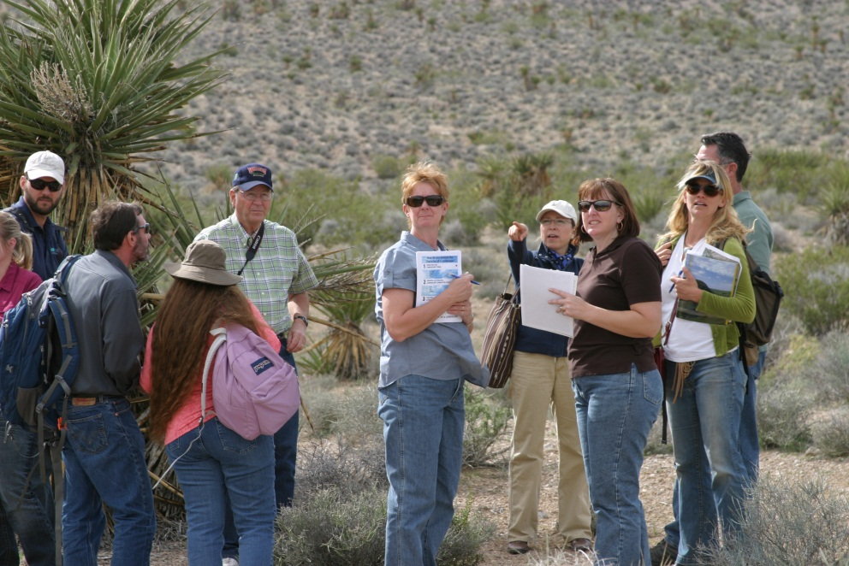
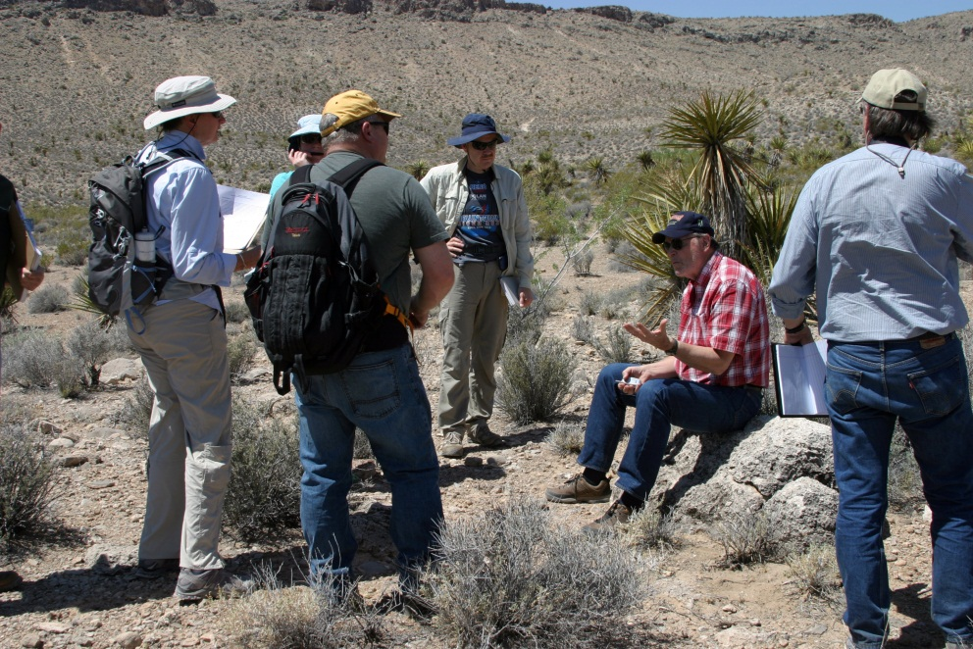
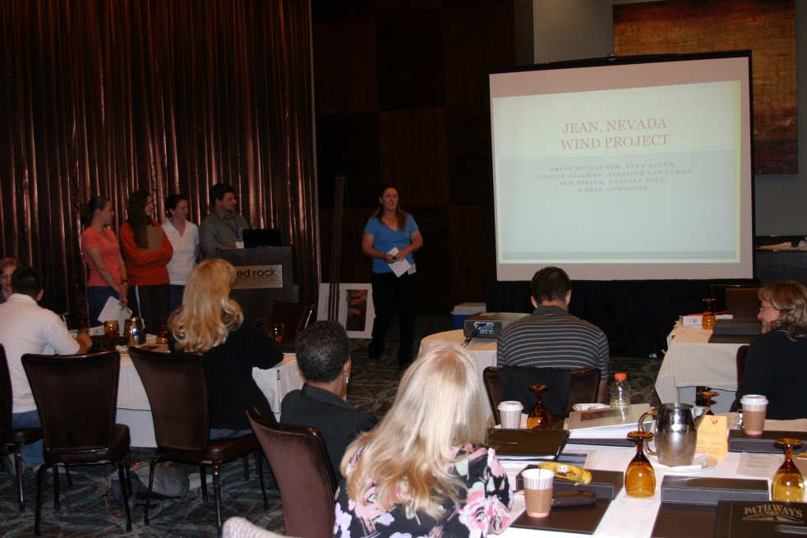
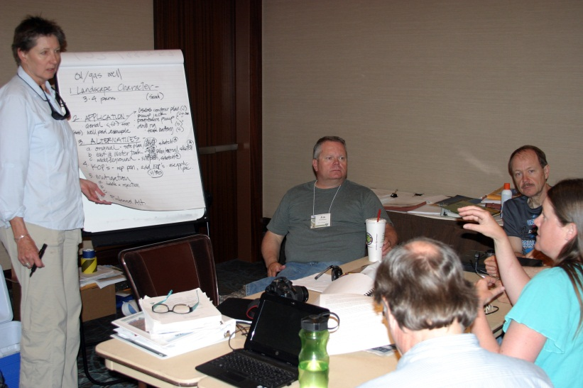
Week’s Agenda
Thursday
Team Exercises – ALL DAY
Friday
Team Project Presentations
Unit 12 - Wrap Up

Slide 6
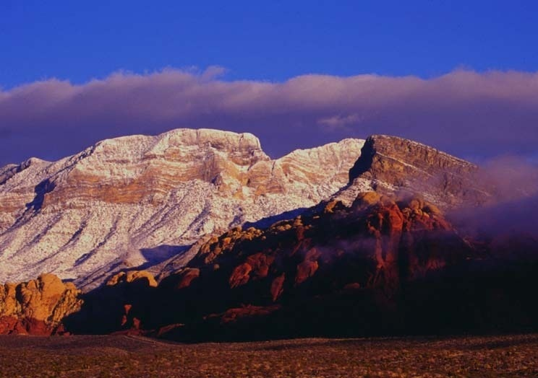
“The beauty of our land is a natural resource. Its preservation is linked to the inner prosperity of the human spirit.”
President Lyndon B. Johnson, 1965 address to Congress

Slide 7
Introductory Unit Objective
To provide a general overview of the Bureau of Land Management’s Visual Resource Management (VRM) program, including:
What is VRM
Why we manage scenery
How we manage scenery

Slide 8
Introductory Unit Objective
Describe the importance of protecting scenic values, and explain in general terms, the process the BLM uses to manage for scenery via the Visual Resource Management (VRM) System.
What is VRM
Why we manage scenery
How we manage scenery

Slide 9
Unit Objective
To provide a general overview of the Bureau of Land Management’s Visual Resource Management (VRM) program, including:
Why we inventory and manage visual resources.
What legal authority drives the BLM VRM program.
The benefits of scenery management.
An overview of the policy and procedures of the VRM Program in place today.

Slide 10
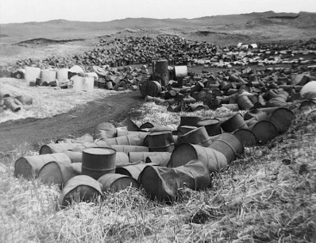
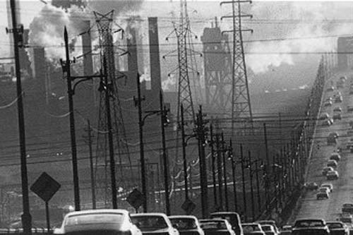
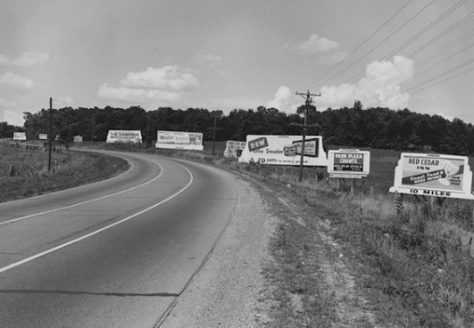
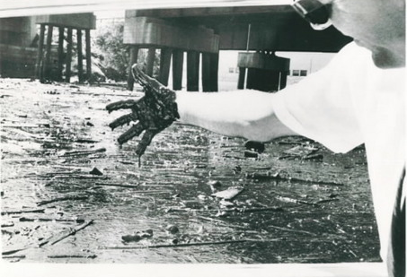
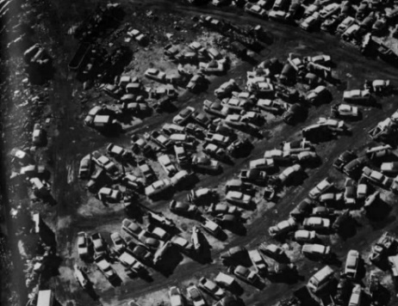
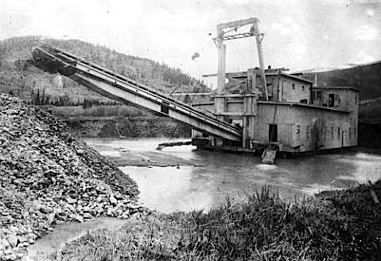
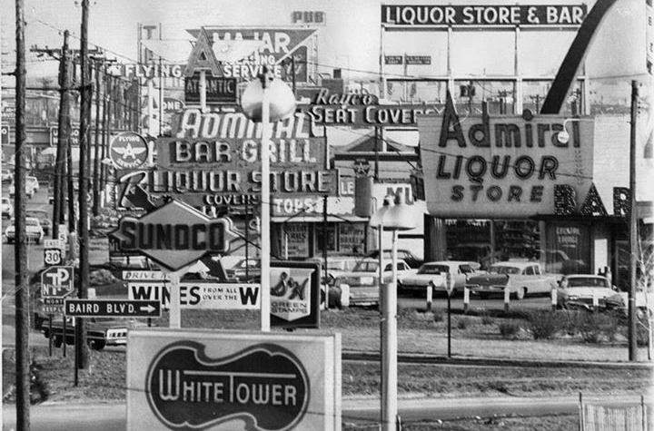
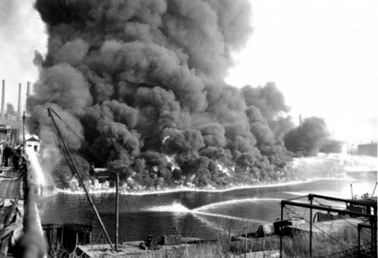
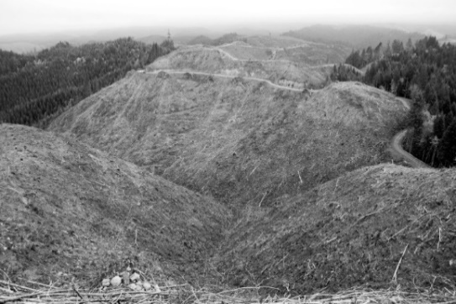
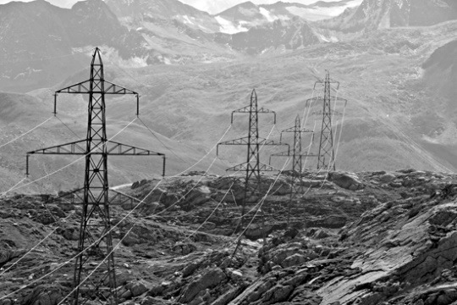
Epidemic Pollution Across U.S.
The condition of the American landscape circa 1965

Slide 11
Epidemic Pollution Across U.S.
The condition of the American landscape
1965 White House Conference on Natural Beauty

Slide 12
Why
On February 8, 1965, President Johnson addressed Congress declaring that “The beauty of our land is a natural resource. Its preservation is linked to the inner prosperity of the human spirit”, and made the commitment to hold a White House Conference on Natural Beauty to meet in mid-May of that year.
Notes:
Consider replacing this series with what I used for Alaska

Slide 13
Why
White House Conference on Natural Beauty, May 24, 1965:
City, rural, and natural landscapes
Pollution: Air, water, litter, junkyards, pesticides
Solid waste management
Sewage waste management
Highway beautification
Electrical transmission lines
Trails
Rivers
Wilderness
Greenhouse gas emissions (Climate Change)

Slide 14
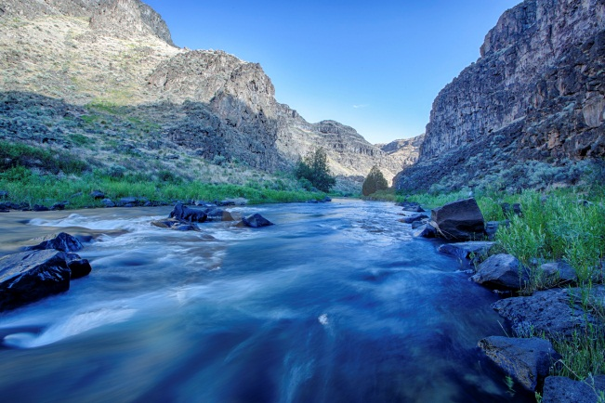
Resulting Legislation
Sampling of Environmental Legislative Acts that followed:
Highway Beautification Act (HBA), 1965
Wild and Scenic Rivers Act, 1968
National Trails System Act, 1968
National Environmental Policy Act, 1969
Clean Air Act, 1970
Clean Water Act, as amended 1972
Resource Conservation and Recovery Act, 1976
Surface Mining Control and Reclamation Act, 1977
National Forest Management Act, 1976
Federal Land Policy and Management Act, 1976

Slide 15
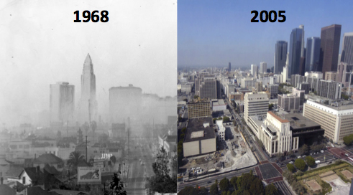
Effects of Legislation

Slide 16
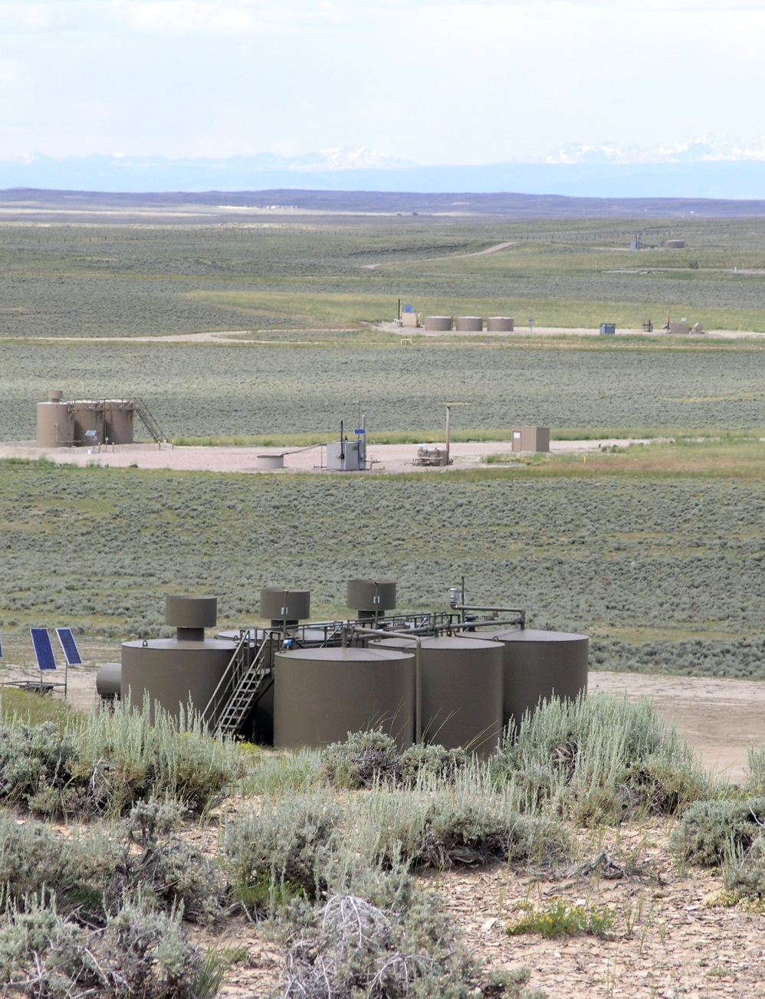
Progress in land use practices

Slide 17
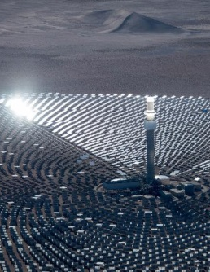
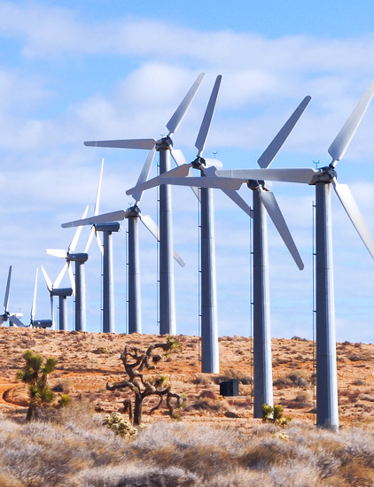
New Challenges

Slide 18
Legal Authority and Obligation
NEPA directs all federal agencies:
Section 101 (b) requires:
Measures to be taken to assure aesthetically pleasing surroundings for all Americans.
Section 102 requires:
Agencies shall use a systematic, interdisciplinary approach to ensure the integrated use of natural and social sciences and the environmental design arts in planning and decision making.

Slide 19
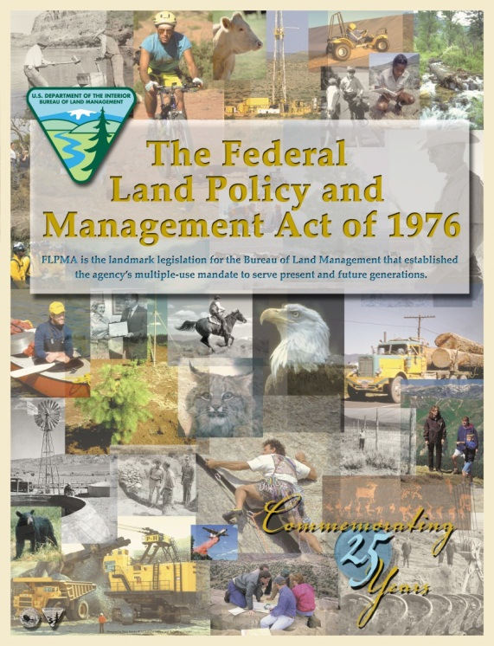
Legal Authority and Obligation
We are legally bound to manage scenery by FLPMA.
FLPMA: “Natural Scenic Values” as a resource to be managed within the multiple use framework
“…a combination of balanced and diverse resource uses that takes into account the long-term needs of future generations for renewable and non-renewable resources, including…natural scenic…values;” (Sec. 103(c))

Slide 20
Legal Authority and Obligation
FLPMA directs BLM to…
Section 201 (a) inventory of all public lands and their resources (including, but not limited to outdoor recreation and scenic values)
maintained on a continuing basis… and use during the land use planning process (Sec. 102(2))
Manage in a manner that will protect the quality of scenic values and provide for outdoor recreation and human occupancy and use (Sec. 102(8))

Slide 21
Policy Guidance for Scenic Resources
FLPMA directs BLM to…
Section 202 (c) Secretary shall – (6) consider the relative scarcity of the values involved
Concerning the management of use, occupancy and development, take any action necessary to prevent unnecessary or undue degradation of the lands (Sec 302(b))
Section 505. (a) Requires that each ROW contains terms and conditions to minimize damage to the scenic and aesthetic values.

Slide 22
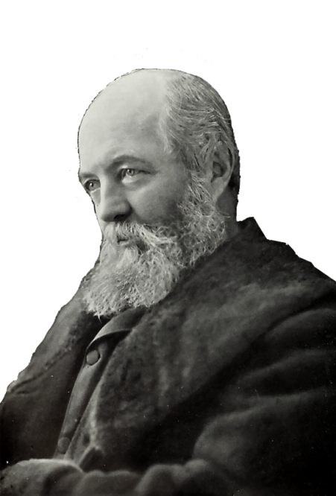
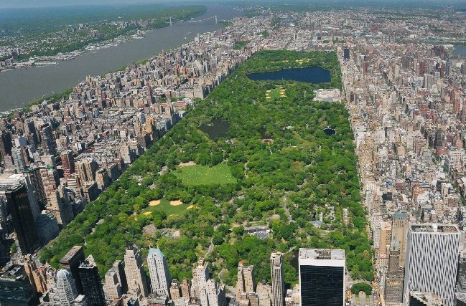
Why Manage Scenery?
“It is a scientific fact that the occasional contemplation of natural scenes … is favorable to the health and vigor of (people) and especially to the health and vigor of their intellect...”
Frederick Law Olmsted, 1865

Slide 23
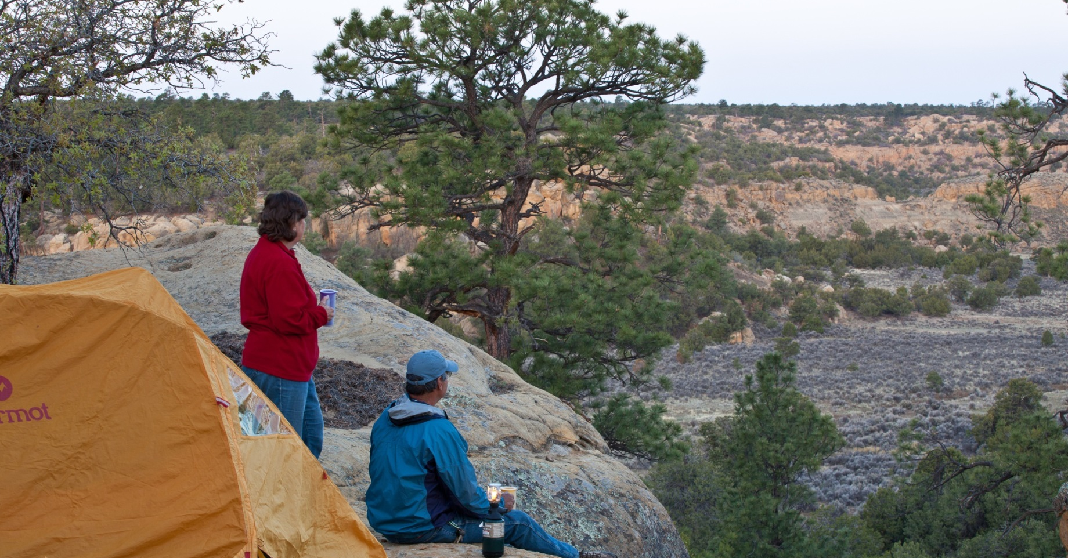
Why Manage Scenery?
Scenic values of public lands are linked with visual settings that provide for a sense of escape, enjoyment of nature, testing of oneself, and reconnecting with others.
Biophilic Design (The integration of nature into the human living space):
5 minutes of “green exercise” can improve health, mood & self‐esteem (Barton & Pretty, 2010).
Decreased depression (Mind, 2007)
Fewer “ruminative thoughts” (Bratman et al., 2015 )
Better memory performance and attention span (Berman, Jonides, & Kaplan, 2008)
Fewer symptoms of ADHD in children (Faber. Taylor & Kuo, 2009) Similar results to ADHD drug methylphenidate (Ritalin)
Courtesy of Naomi Sachs ASLA, EDAC
Notes:
ENTER THE NOTES FROM ASLA PRESENTATION – BIOPHILIA, BIOPHOLIC DESIGN – THE INTERGATION OF NATURAL ELEMENTS INTO HUMAN LIVING SPACES

Slide 24
Why Manage Scenery?
Scenic values of public lands are linked with visual settings that provide for a sense of escape, enjoyment of nature, testing of oneself, and reconnecting with others.
Physiological health markers (evidence-base medical research):
Higher amount of “NK cells” – natural cancer-­fighting cells (Li et al., 2007)
Lowered inflammatory cytokines (Mao et al., 2012)
Lowered blood glucose level (Ohtsuka et al., 2008)
Higher immune function (Kuo, 2015)
Stronger bones (Sato et al., 2003; Turner et al., 2002)
Reduced myopia (Rose et al., 2008)
Reduced stress - Lower amounts of adrenaline & cortisol (Li et al., 2008; Park, 2010).
Drs. Prescribing doses of nature Courtesy of Naomi Sachs
Notes:
ENTER THE NOTES FROM ASLA PRESENTATION – BIOPHILIA, BIOPHOLIC DESIGN – THE INTERGATION OF NATURAL ELEMENTS INTO HUMAN LIVING SPACES

Slide 25
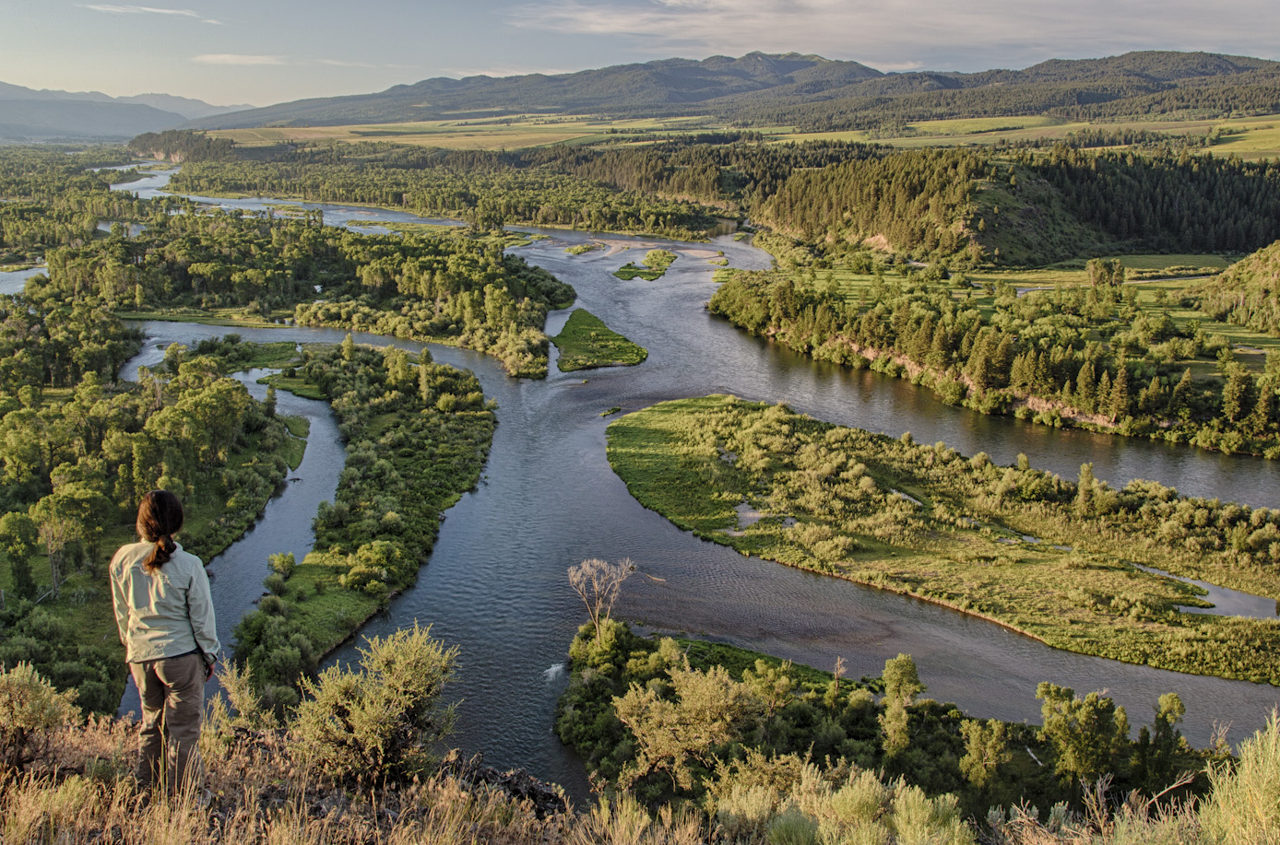
Scenery is a finite public resource…
Photo by Bob Wick

Slide 26
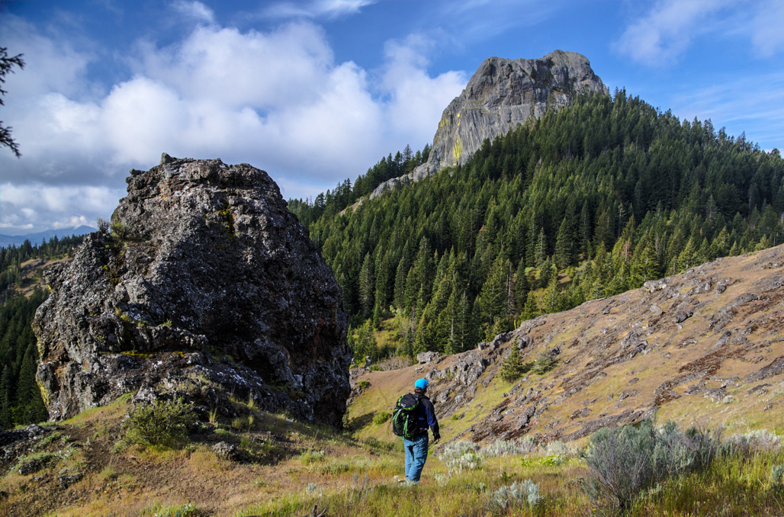
BLM manages lands with scenic value…
Cascade Siskiyou National Monument, OR

Slide 27
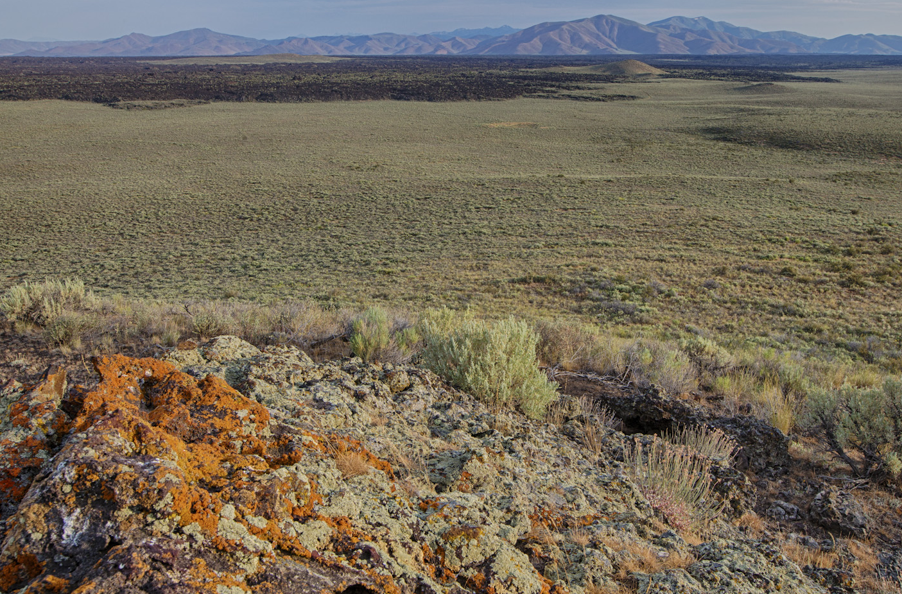
All BLM lands have scenic value…
Photo by Bob Wick
Craters of the Moon National Monument, ID

Slide 28
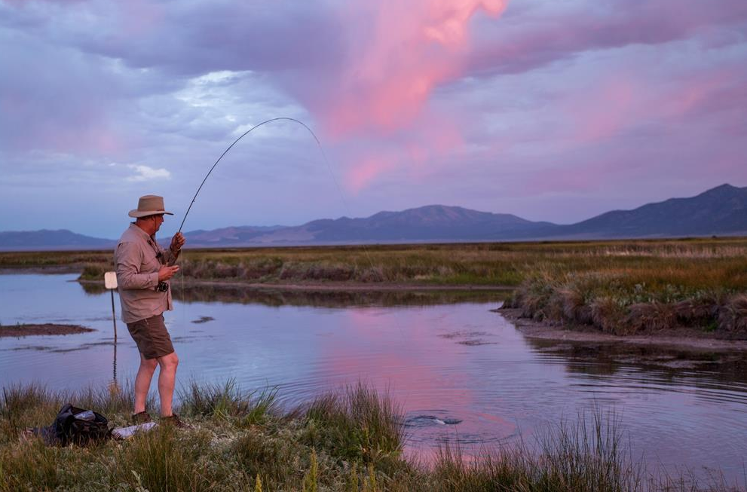
.
BLM land provides scenic escape
Photo by Brady Owen
Pine Forest Range Wilderness Area, NV

Slide 29
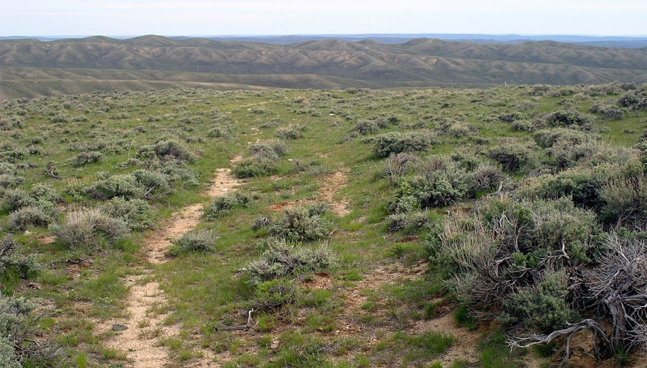
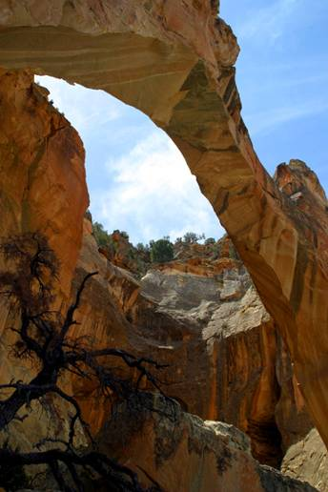
Visual Aspects of Cultural & Historic Sites

Slide 30
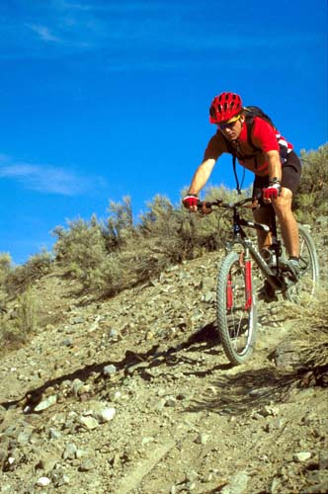
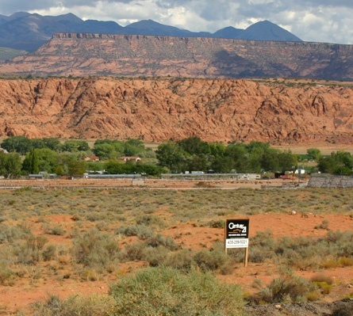
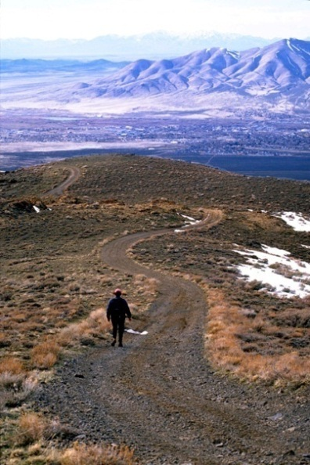
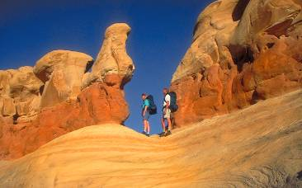
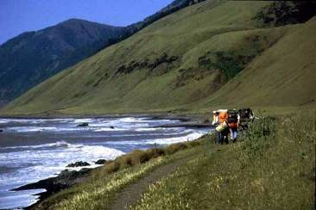
BLM lands are the backyard of many western communities

Slide 31
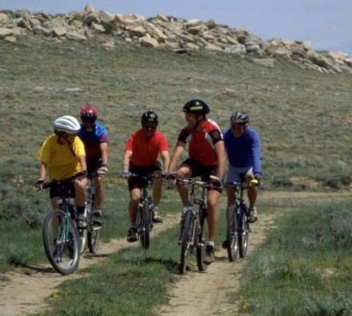
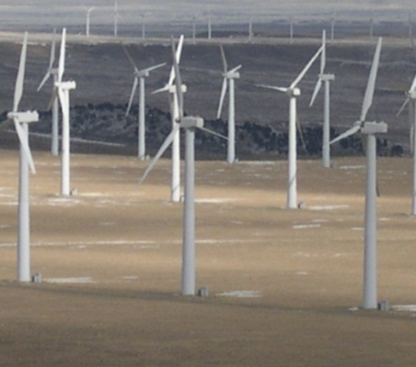
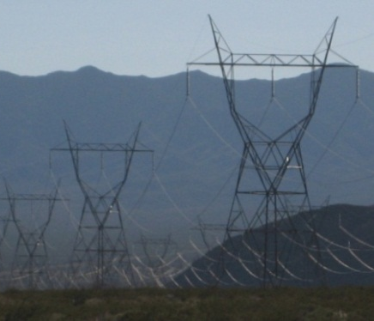
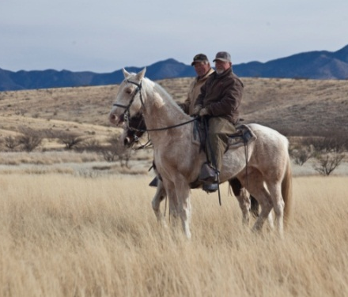
VRM and Multiple Use Management
56 million people live within 30 minutes of BLM administered lands
Recreation activities
Cultural and historic settings
Habitat vegetation treatments
Renewable Energy
Communication systems
Metals/minerals/ aggregates
Timber harvesting
Livestock production
Fire management
Oil and gas
Coal
Uranium

Slide 32
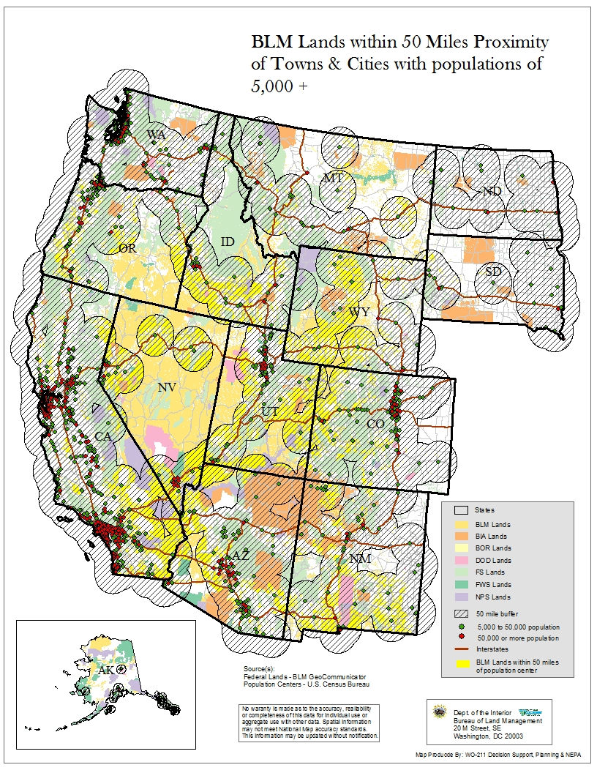
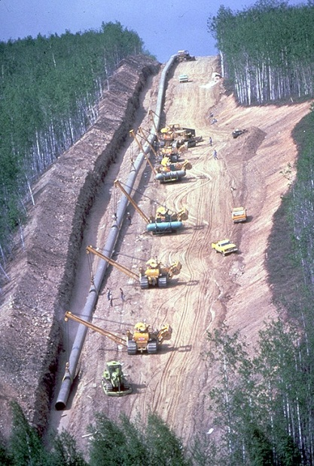
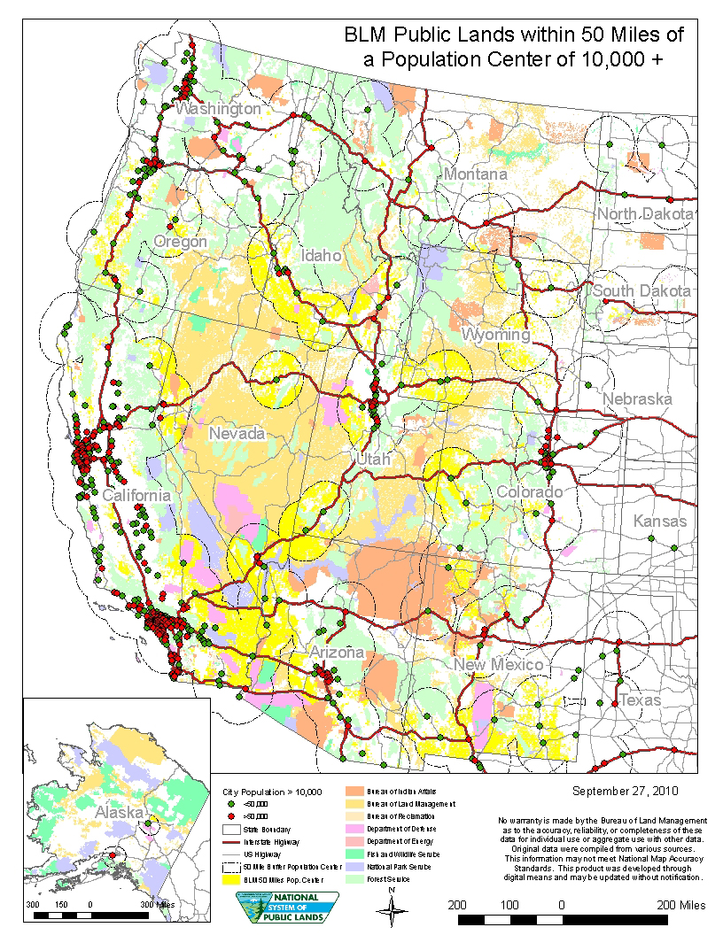
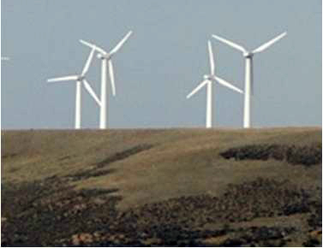
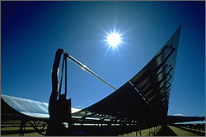
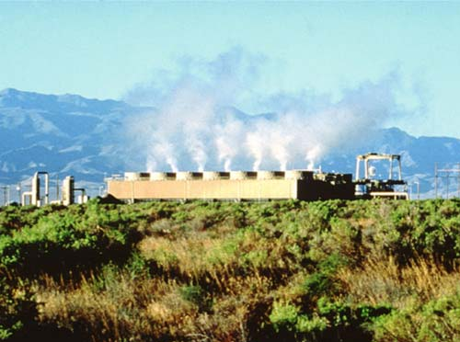
A Developing Landscape
Notes:
Many demands for resource and energy development. Selecting the best site within the mosaic of federally managed lands, communities and treasured landscapes -

Slide 33
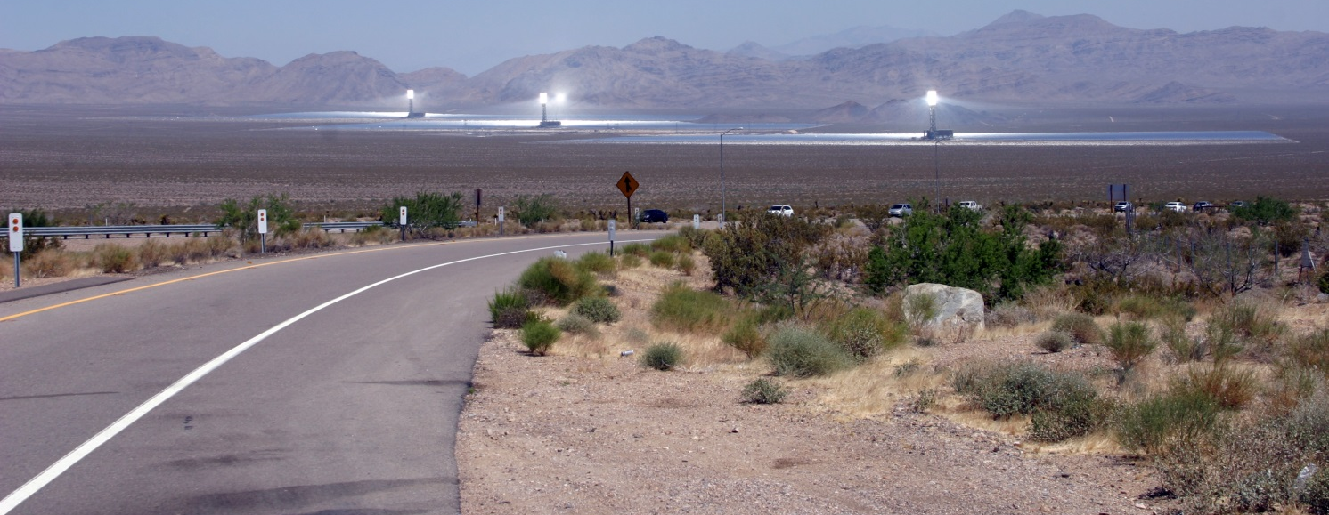
A Developing Landscape
The decisions we make today as public land managers will be judged today and forward into future generations:
87% of experiences through sense of sight
First impressions mold and hold public opinion
Increasing public sensitivity
Visible Stewardship
Legacy for future generations

Slide 34
Overview of VRM Policy
The Visual Resource Management (VRM) System provides an orderly systematic way to observe the public lands and classify existing visual resources. Having this system makes it possible to evaluate effects of change.
Visual Resource Inventory
Establish Management Objectives
Visual Resource Contrast Rating process
Visual Resource Monitoring
Update Visual Resource Inventory
1. Inventory
2. Land Use Plan (LUP) VRM Objectives
3. LUP Implementation
4. Monitoring
5. Inventory Maintenance

Slide 35
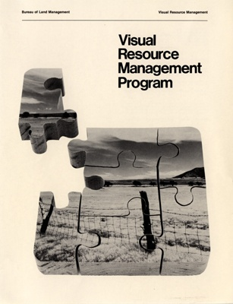
Policy Guidance for Scenic Resources
BLM Policy: Manual Section 8400: Visual Resource Management (1984)
Handbook 8410-1 Visual Resource Inventory
Handbook 8431 Visual Resource Contrast Rating

Slide 36
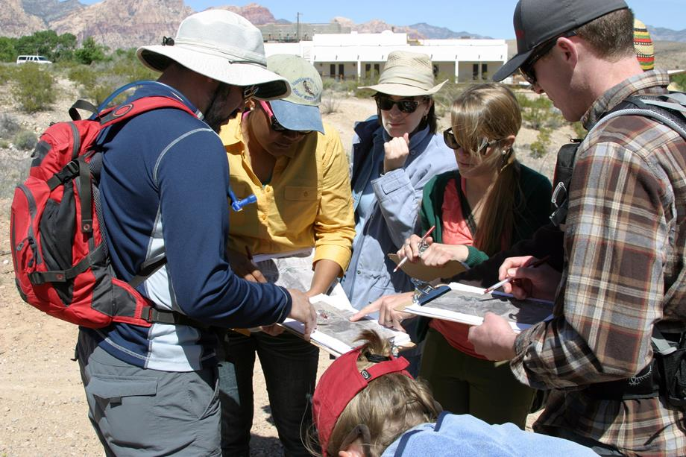
Overview of VRM Policy
VRM is a collaborative process
And all programs have responsibility

Slide 37
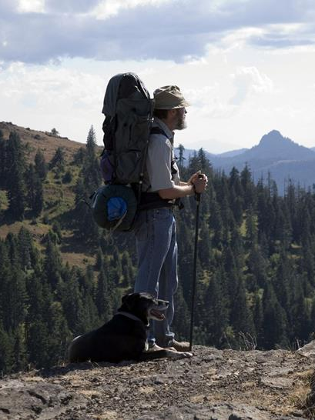
Overview of VRM Policy
Step 1: Visual Resource Inventory
Establishes a quantified record of the value and condition of the visual resources that exist on the public lands:
Scenic Quality (A, B, C)
Public Sensitivity (High, Medium, Low)
Distance Zones (foreground/ middle-ground, background, seldom seen)

Slide 38
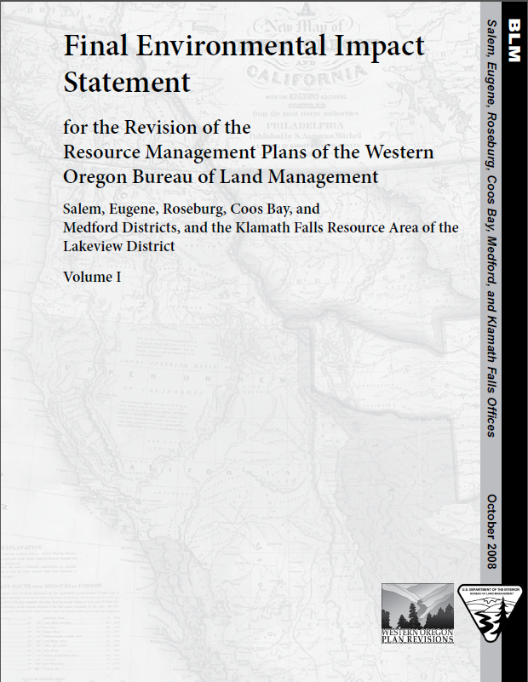
Overview of VRM Policy
Step 2: Planning & Management
Consider the results of the Inventory with other resources and objectives during the RMP process.
Designate visual resource management objectives through the RMP process

Slide 39
Overview of VRM Policy
Step 3: Implementing VRM decisions in the land use plan:
Visual Resource Contrast Rating Process helps guide a proposed action’s early project planning toward RMP/VRM objective conformance.
This process helps identify what does not meet an objective & why.
Provides a basis for identifying alternative design considerations.
Informs analysis of impacts on visual resource inventory values and update the VRI to reflect the new current conditions.

Slide 40
Overview of VRM Policy
Step 4: Monitoring:
Making sure land use authorizations are complying with VRM objectives and the other conditions of approval
Maintaining a pulse on the visual resource condition over time and tracking the trends
Land Use plan adherence to desired outcomes

Slide 41
VRM Policy
Step 5: Update the Visual Resource Inventory
Step 5: VRI Maintenance:
Changes to the VRI factors
Track the trends in the Visual Resource condition
Refresh the Visual Resource Inventory
EcoFlight

Slide 42
Visible Stewardship of a finite resource
If not carefully designed, activities have the potential to:
Significantly alter the visual character of the landscape
Reflect on the BLM’s image
Effects on visitor experience and community quality of life
Cause project delays through protest, appeals
Increase long term costs due to restoration needs

Slide 43
Visible Stewardship of a finite resource
Different viewpoints on what is beautiful

Slide 44
Visible Stewardship of a finite resource
Different approaches to design and many solutions

Slide 45
Visible Stewardship of a finite resource
BLM VRM system is focused on minimizing visual contrast

Slide 46
Visible Stewardship of a finite resource

Slide 47
Visible Stewardship of a finite resource
Notes:
Gipe picture

Slide 48
Benefits if carefully designed...

Slide 49
Benefits if carefully designed...

Slide 50
Benefits if carefully designed...

Slide 51
Benefits if carefully designed...

Slide 52
Interior Board of Land Appeals
BLM has the legal obligation to manage for the protection of Scenic Value:
IBLA Decisions
144IBLA070 - Utah Decision
173IBLA313 - Beaver Rim, Lander FO
174 IBLA 078 - Tom Van Sant, California
IBLA 2016-74 - Big Burrito Mountain Bike Trail Petition for Stay

Slide 53
Someone is watching

Slide 54
And now Language of Landscapes
“For Centuries Americans have drawn strength and inspiration from the beauty of our country. It would be a neglectful generation indeed, indifferent alike to the judgment of history and the command of principle, which failed to preserve and extend such a heritage for its descendants” (Beauty for America 1965)

