Slide 2
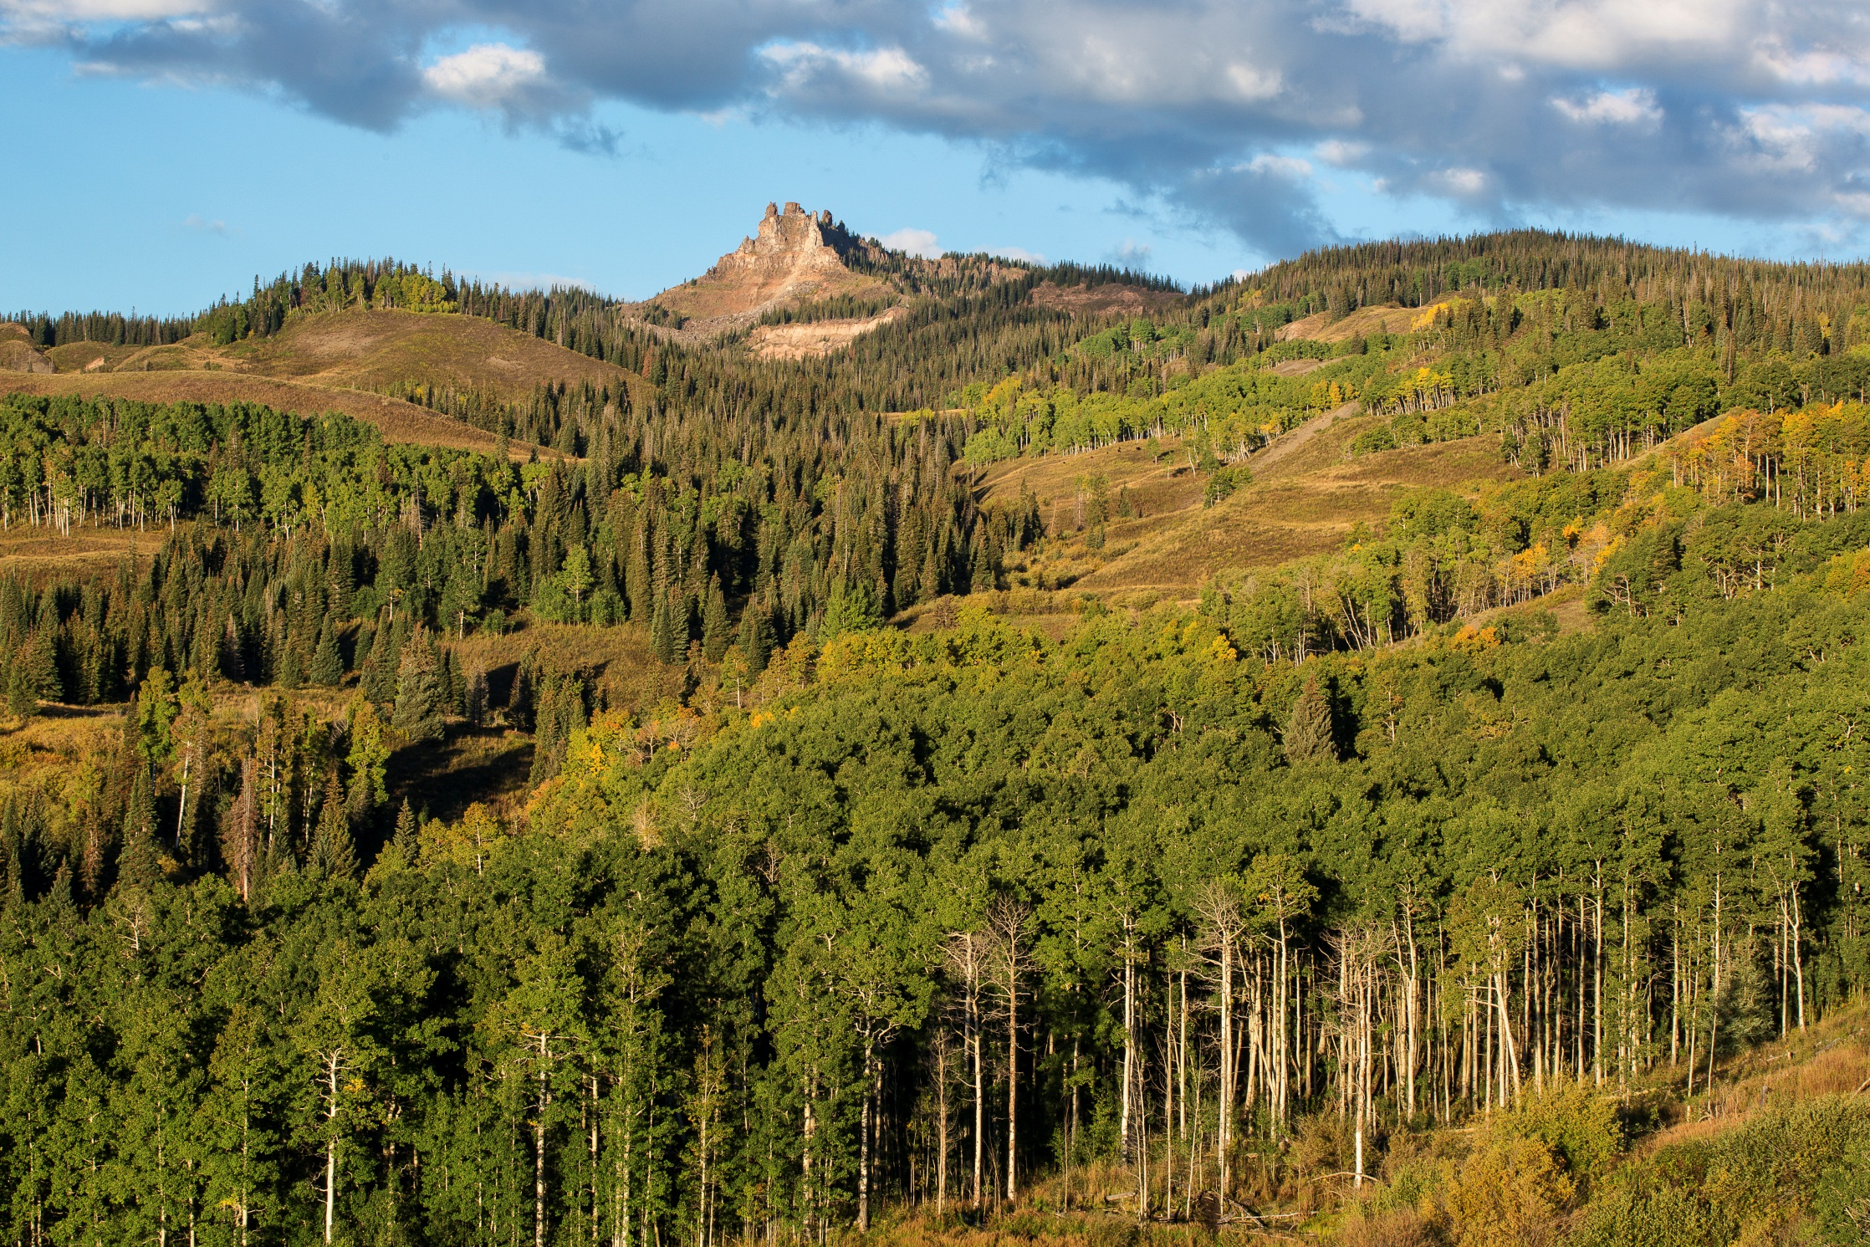

Slide 3
Unit Objective
Provide a foundation from which you can initiate and/or conduct an inventory, or provide oversight to a contracted consultant conducting an inventory

Slide 4
Philosophy & Process
A systematic process that is designed to determine the extent and quality of visual resources in a given area
BLM Handbook 8410-1
Quantitative
Objective
Repeatable
The outcome of the inventory provides the basis for considering visual values in the land use planning process for all BLM-administered lands

Slide 5
Practical value
Provides information about the national interest that is critical to consider during land use planning when setting visual management objectives in an RMP (fulfilling FLPMA)
Inventory data is an appropriate starting point for describing the “existing conditions” from which to evaluate environmental effects on the quality of the human environment (fulfilling NEPA)

Slide 6
Practical value
Inventory leads to VRI classes
VRI = Snapshot of existing condition
Management decisions leads to VRM classes
VRM = Measure of level of change allowable to visual resources

Slide 7
Philosophy & Process
Visual Resource Inventory
Scenic Quality Evaluation
Land Features & Characteristics
What does it look like
VRI Classification
Sensitivity Level Analysis
Scenic Values Held by People expressed as a concern/attitude toward visual change
Importance to the Public
Delineation of Distance Zones
Public Land Visibility
Where people view the landscape and how

Slide 8
Inventory Factors
Inventory Factor | Rating & meaning
Scenic Quality Rating | Measure of visual quality based on classic design elements. A (most variety and quality) B C (least variety and quality)
Sensitivity Level Rating | Basically a measure of willingness to accept visual change to the existing landscape. Low (most willing) Moderate High (least willing )
Distance Zone | Measure of distance where closer a closer exposure is more significant than a farther exposure. Foreground/Middleground (0-5 miles) Background (5-15 miles) Seldom Seen (15+ miles or shielded from view)

Slide 9
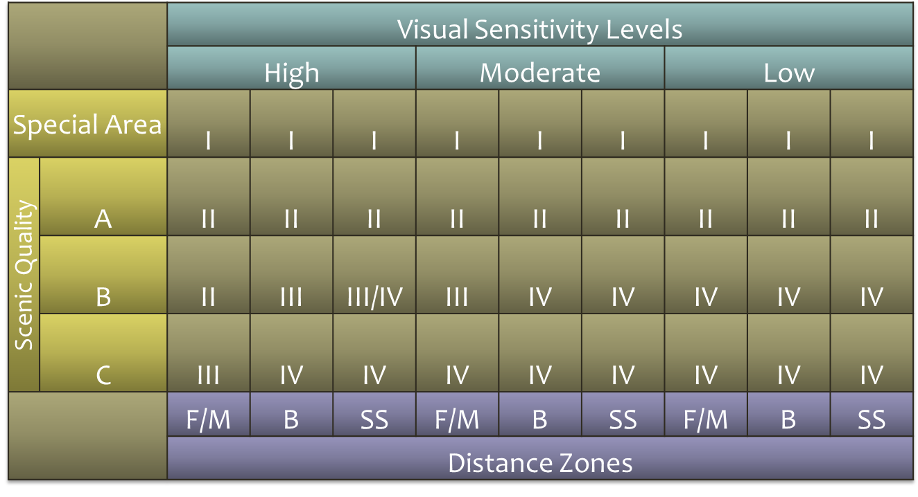
VRI Class Determination Table
How are VRI classes determined?

Slide 10
VRI Class Definitions
The VRI class offers a quick understanding of an area’s overall visual value yet does not replace the need to understand the 3 underlying factors and their ratings.
The VRI class is different than the VRM class
VRI Class 1: NOT BASED ON INVENTORY – Assigned to areas where a decision has been made previously to maintain a natural landscape. These areas reflect a management decision, not based on inventory. (e.g. Wilderness Areas)
VRI Class 2: High overall visual value based on inventory
VRI Class 3: Moderate overall visual value based on inventory
VRI Class 4: Low overall visual value based on inventory

Slide 11
VRI National Data Standard
Geodatabase
A collection of geographic datasets of various types
polygons, polylines, and point spatial data
Format used for editing and data management
Implemented as a series of tables holding information linked to the spatial data
VRI Geodatabase
Supplementary to the Visual Resource Inventory Handbook
H-8410-1
For more information:
http://www.blm.gov/wo/st/en/info/regulations/Instruction_Memos_and_Bulletins/national_instruction/2012/IM_2012-055.html

Slide 12
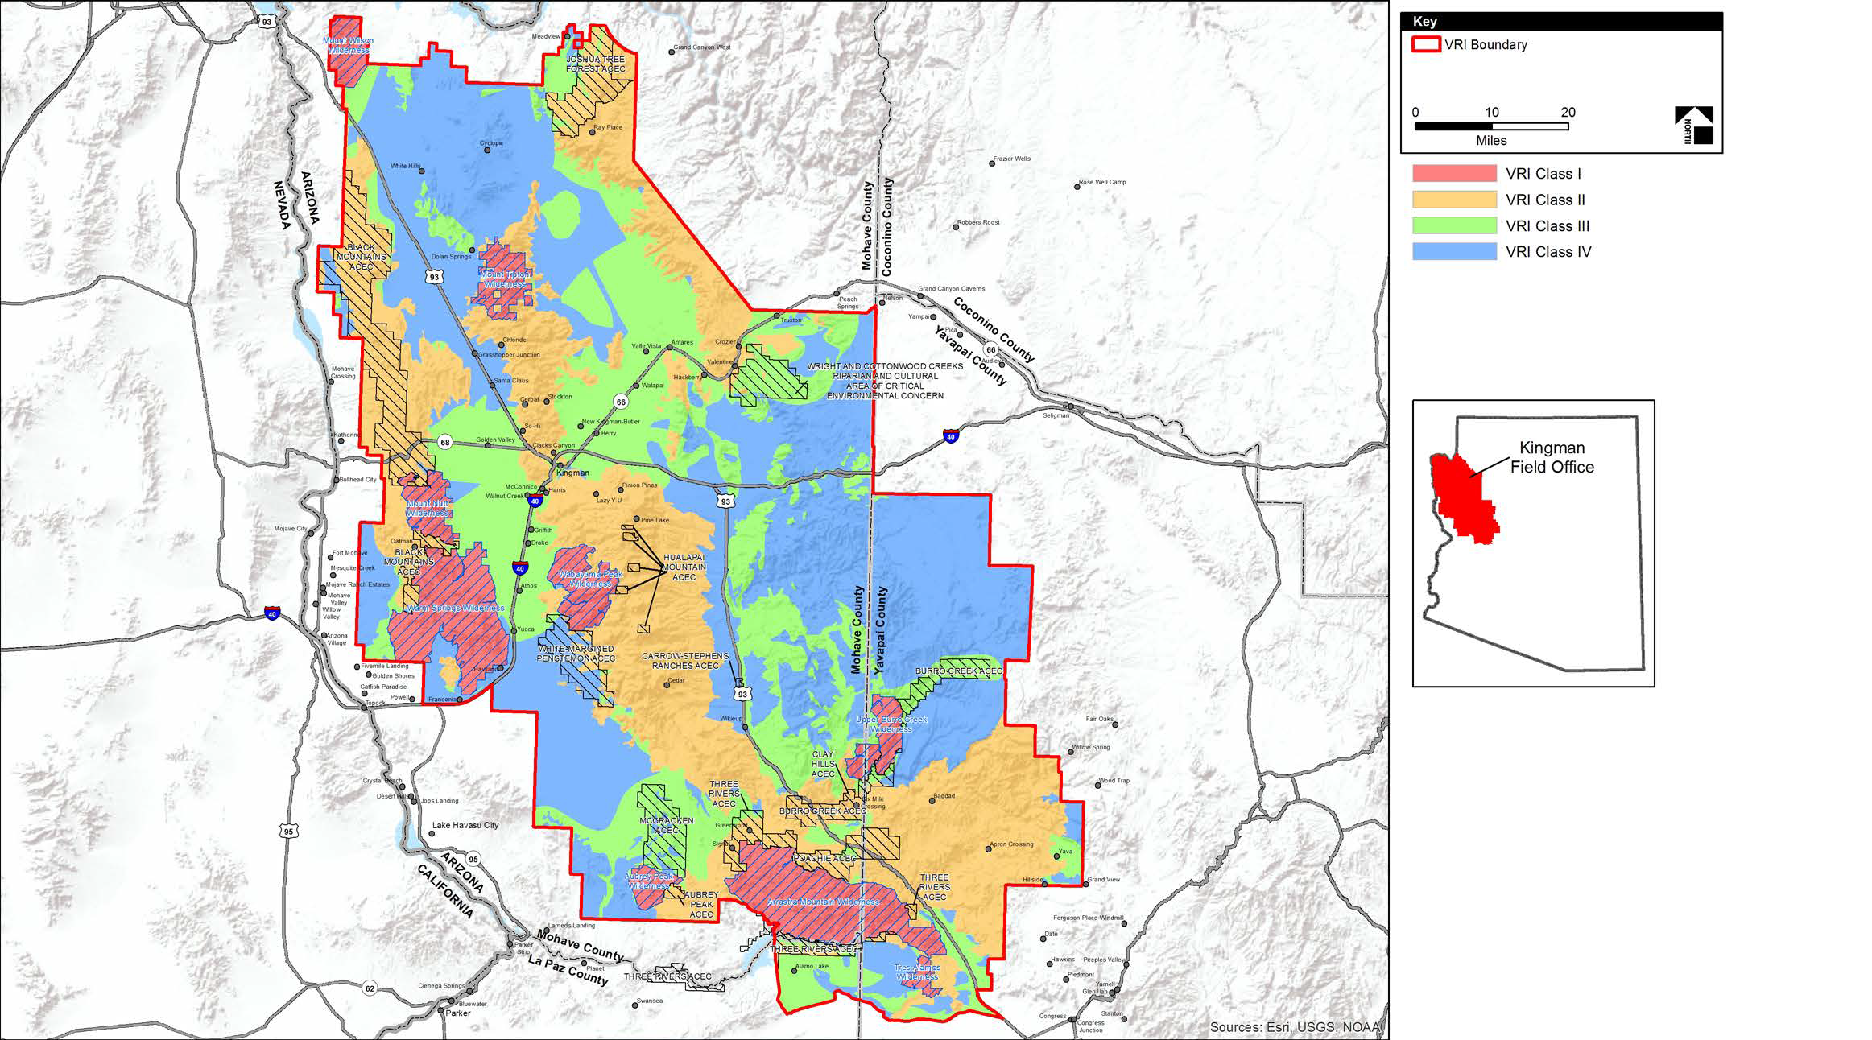
VRI National Data Standard

Slide 13
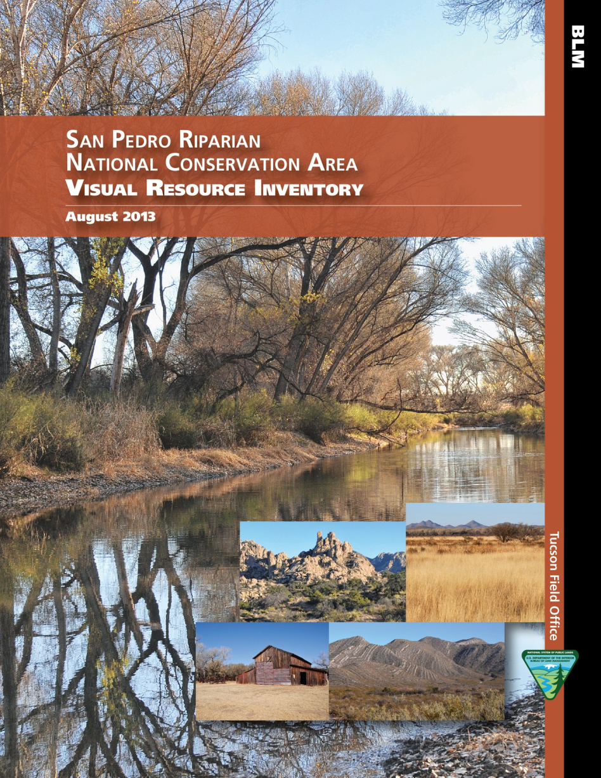
Final Product
Final Product includes:
Report that includes a narrative of the VRI process and justification for the scoring and decisions
GIS data of all layers including all data required for the geodatabase file
CD/flash drive including all information

Slide 14
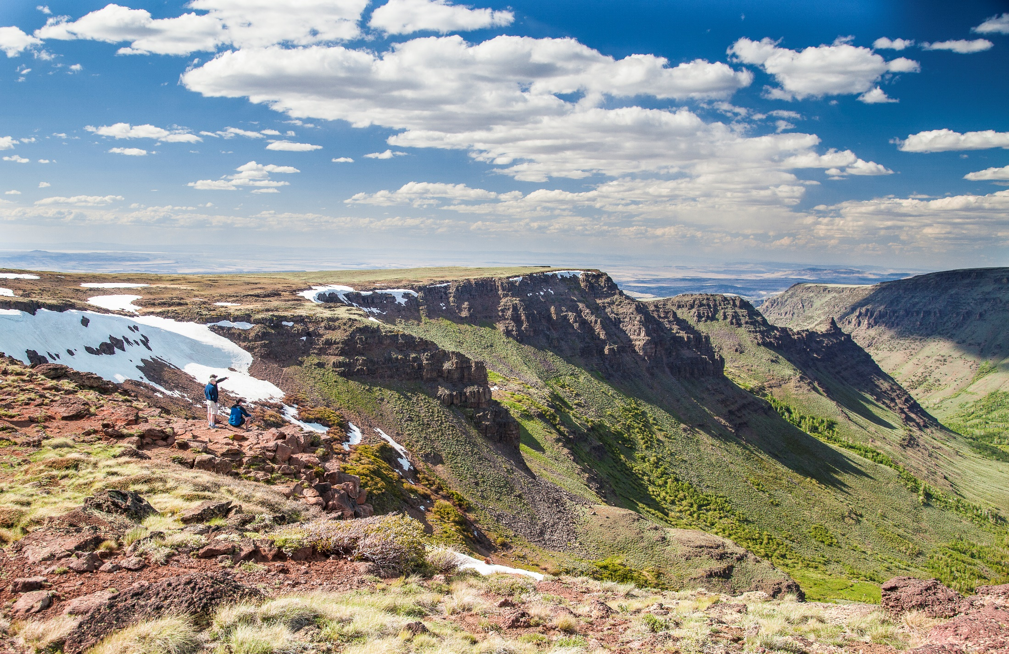
Scenic Quality Analysis

Slide 15
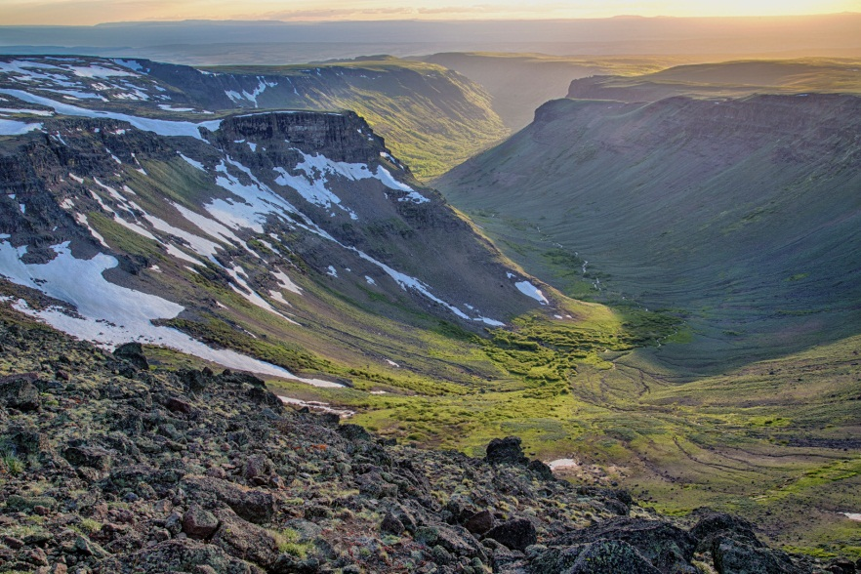
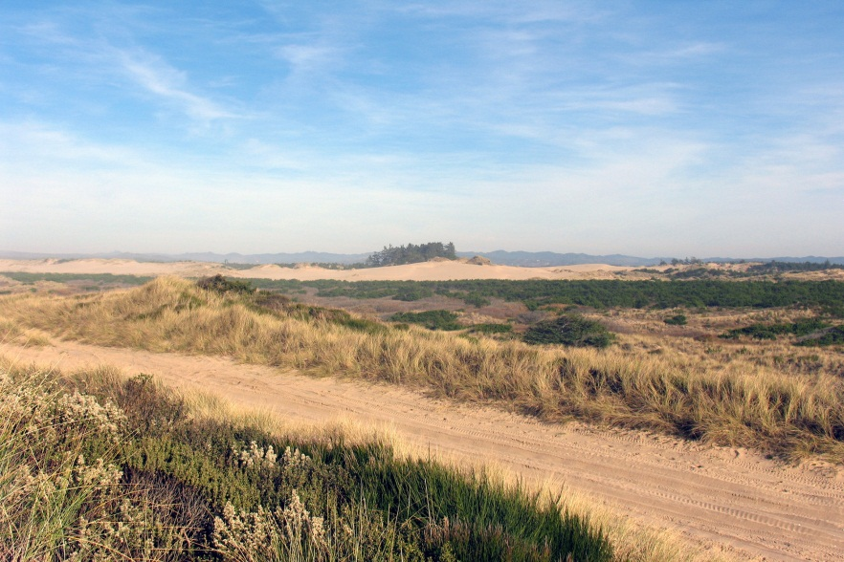
What is Scenic Quality?
Scenery is defined as…
“a view of natural features (such as mountains, hills, valleys, etc.) that is pleasing to look at; the things that can be seen where a person lives, works, etc.”
Quality is defined as…
“peculiar and essential character”
Scenic quality is a description of the landscape features and characteristics that work to define one area as different than another

Slide 16
Scenic Quality Criteria
A measure of the visual appeal of a tract of land
All lands have scenic value but areas with the most variety and the most harmonious composition have the greatest scenic value
Evaluation of scenic quality is done in relationship to the natural landscape on a comparative basis with similar features within the same physiographic province
Lands are given an A, B, C rating based on the apparent scenic quality which is determined by 7 key factors

Slide 17
General Guidelines
Conducted by an interdisciplinary team
Evaluated by observing the area from several locations
Each location becomes an inventory observation point
(IOP) and a photographic record is maintained
Each unit is scored and recorded on the BLM Scenic Quality Rating Form 8400-1
Scores reflect the overall impression of the area

Slide 18
Scenic Quality Evaluation Process
Visual Resource Inventory
Sensitivity Level Analysis
Public Land Visibility
Scenic Values Held by People expressed as a concern/attitude toward visual change
Delineation of Distance Zones
Land Features & Characteristics
Scenic Quality Evaluation
1) Delineate Scenic Quality Rating Units (SQRU)
4) Create Photo Record
3) Make Field Observation Record
5) Evaluate, Score, and Categorize
2) Choose Inventory Observation Points
6) Enter Data into VRI Geodatabase

Slide 19
Step 1 – SQRU Delineation
The planning area is subdivided into scenic quality rating units for rating purposes and are delineated on a basis of:
Similar physiographic characteristics
Similar visual patterns – texture, color, variety etc
Areas that have similar impacts from man-made modifications
Different methods for delineating units include:
Drawing units onto paper topo maps and/or aerial photos
Digitizing directly into GIS
The size of units may vary depending on the homogeneity of the landscape or detail desired and can be fine-tuned in the field by ground trothing

Slide 20
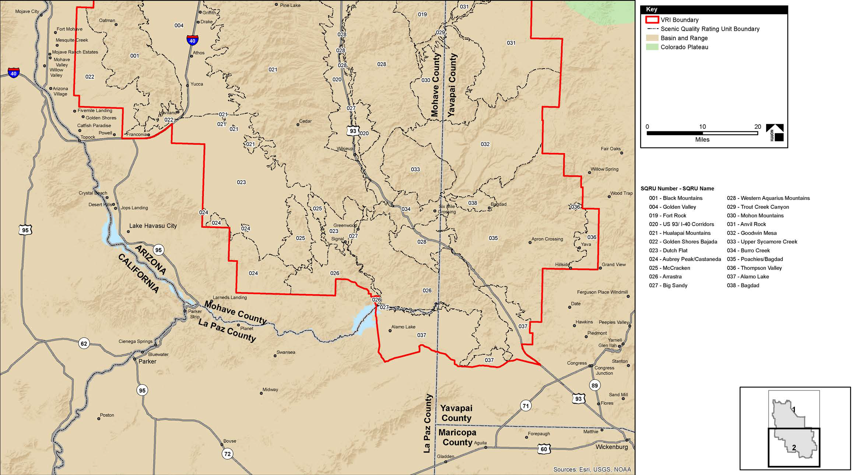
Step 1 – SQRU Delineation

Slide 21
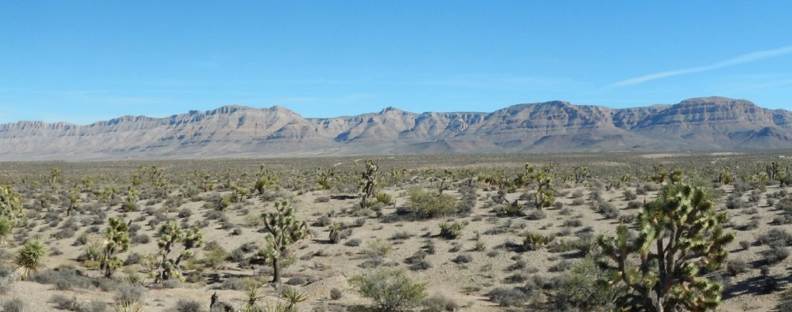
Step 1 – SQRU Delineation
How many SQRU do you see in this image?

Slide 22
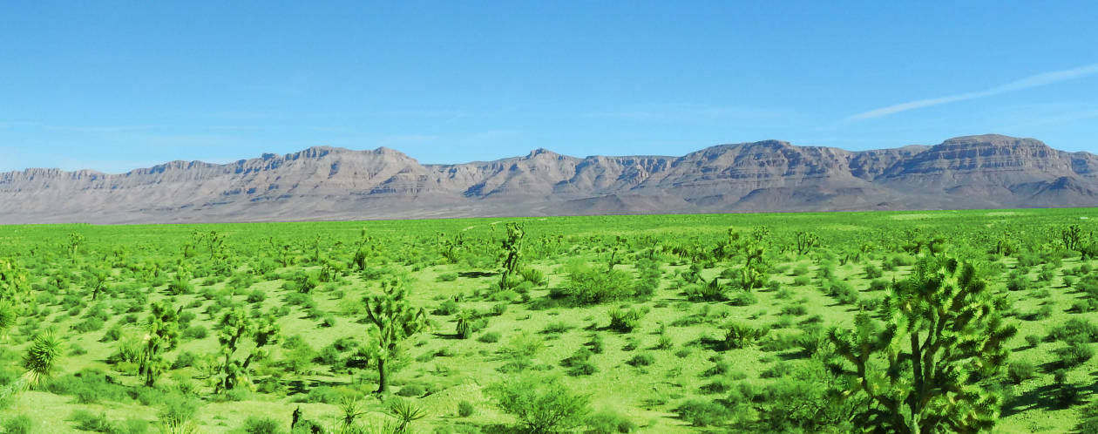
Step 1 – SQRU Delineation
How many SQRU do you see in this image?

Slide 23
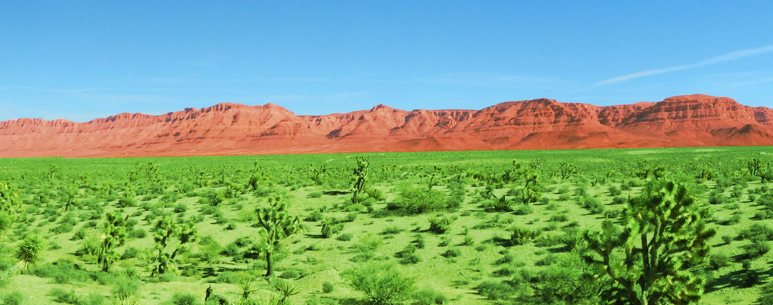
Step 1 – SQRU Delineation
How many SQRU do you see in this image?

Slide 24
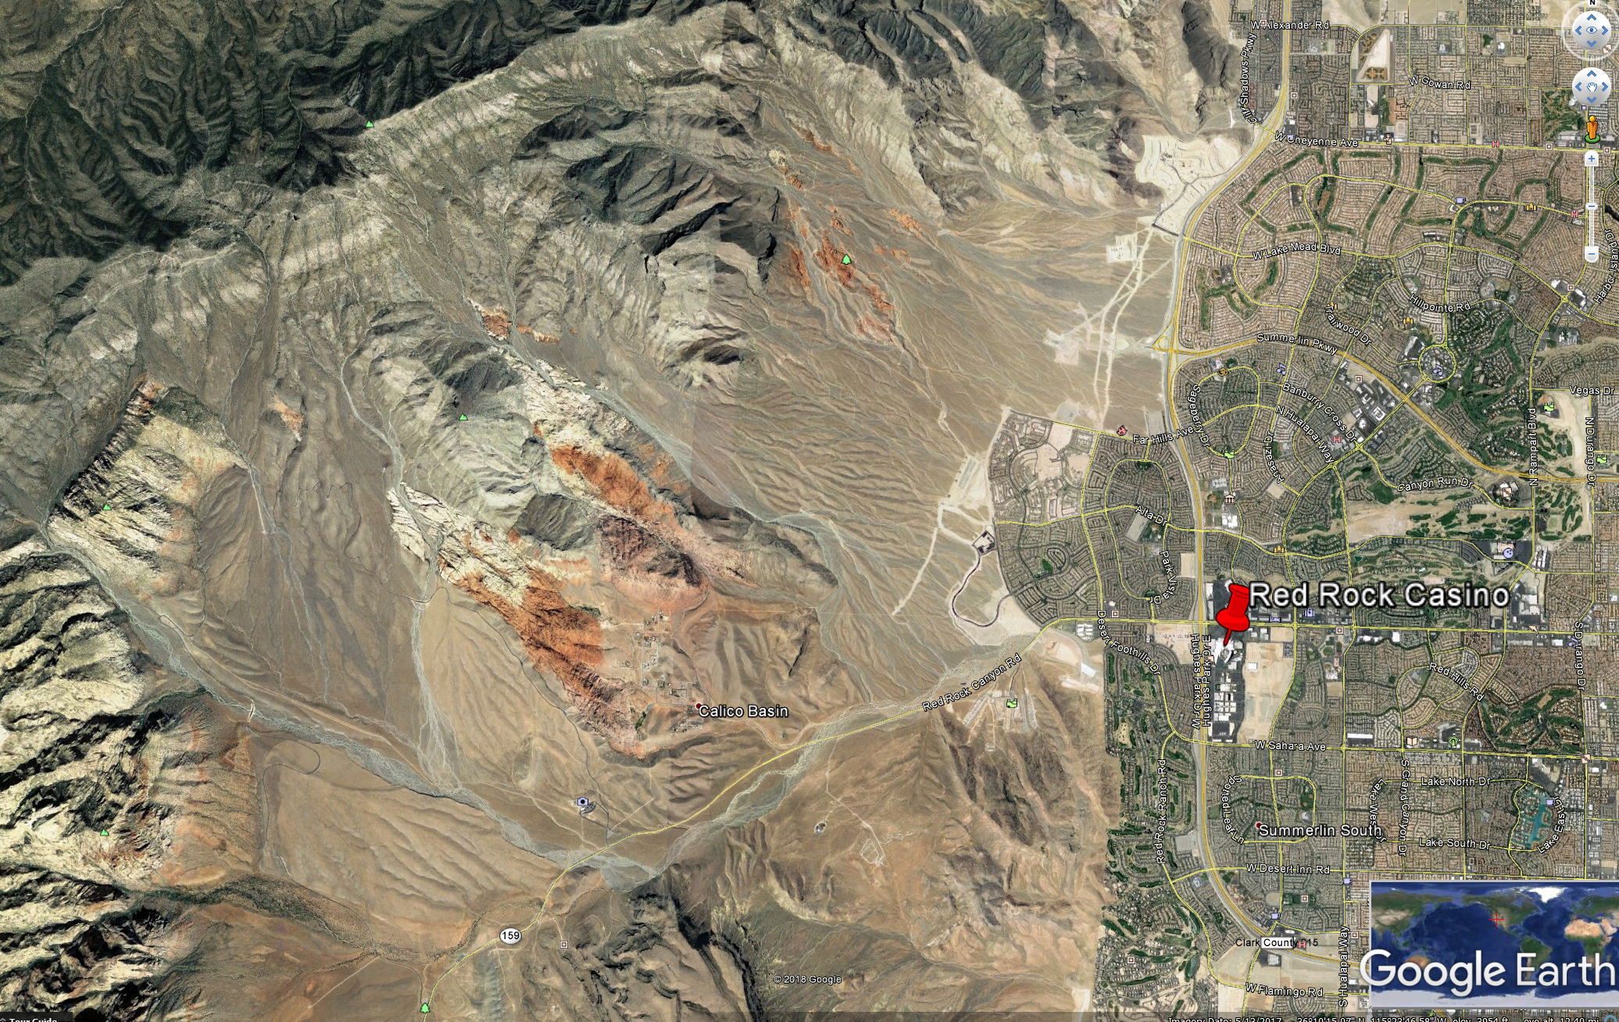
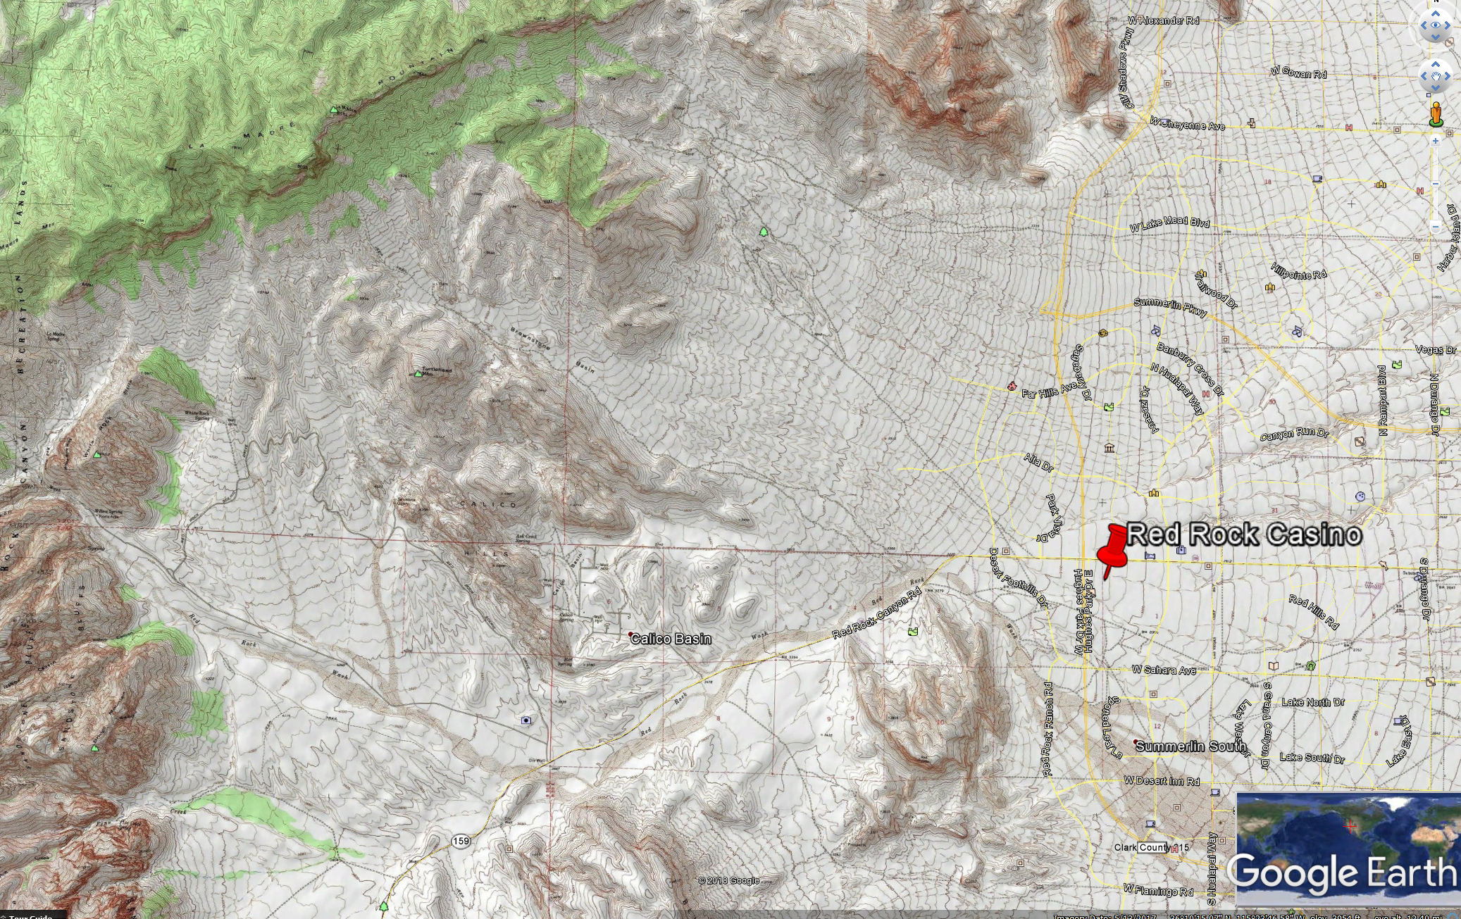
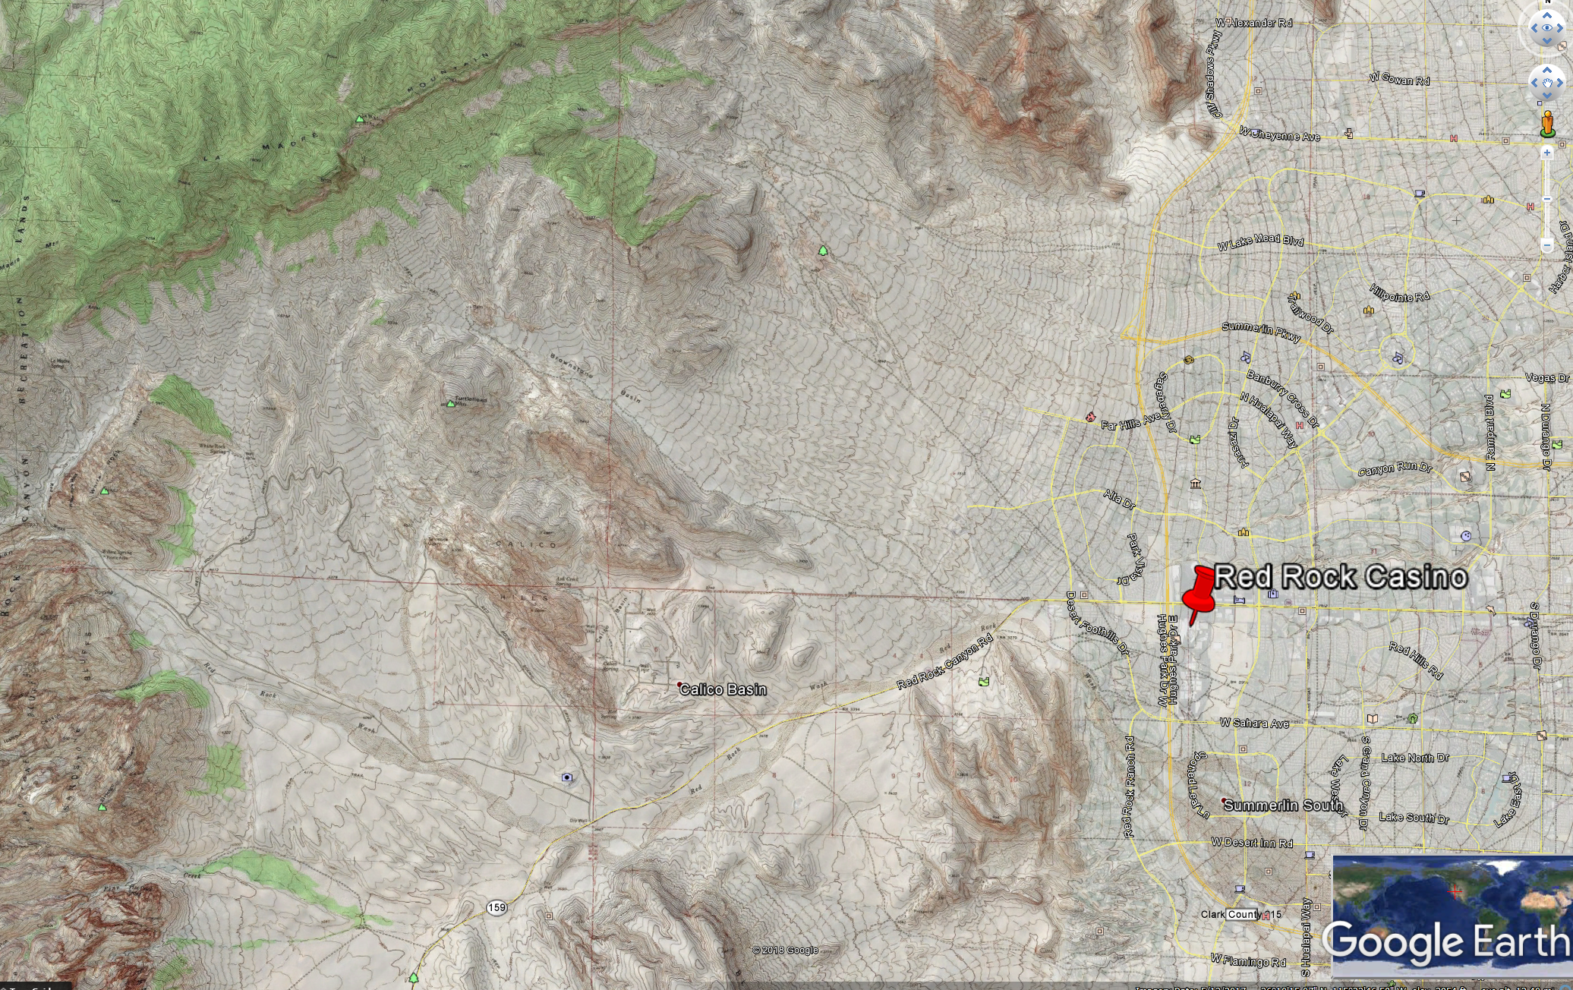
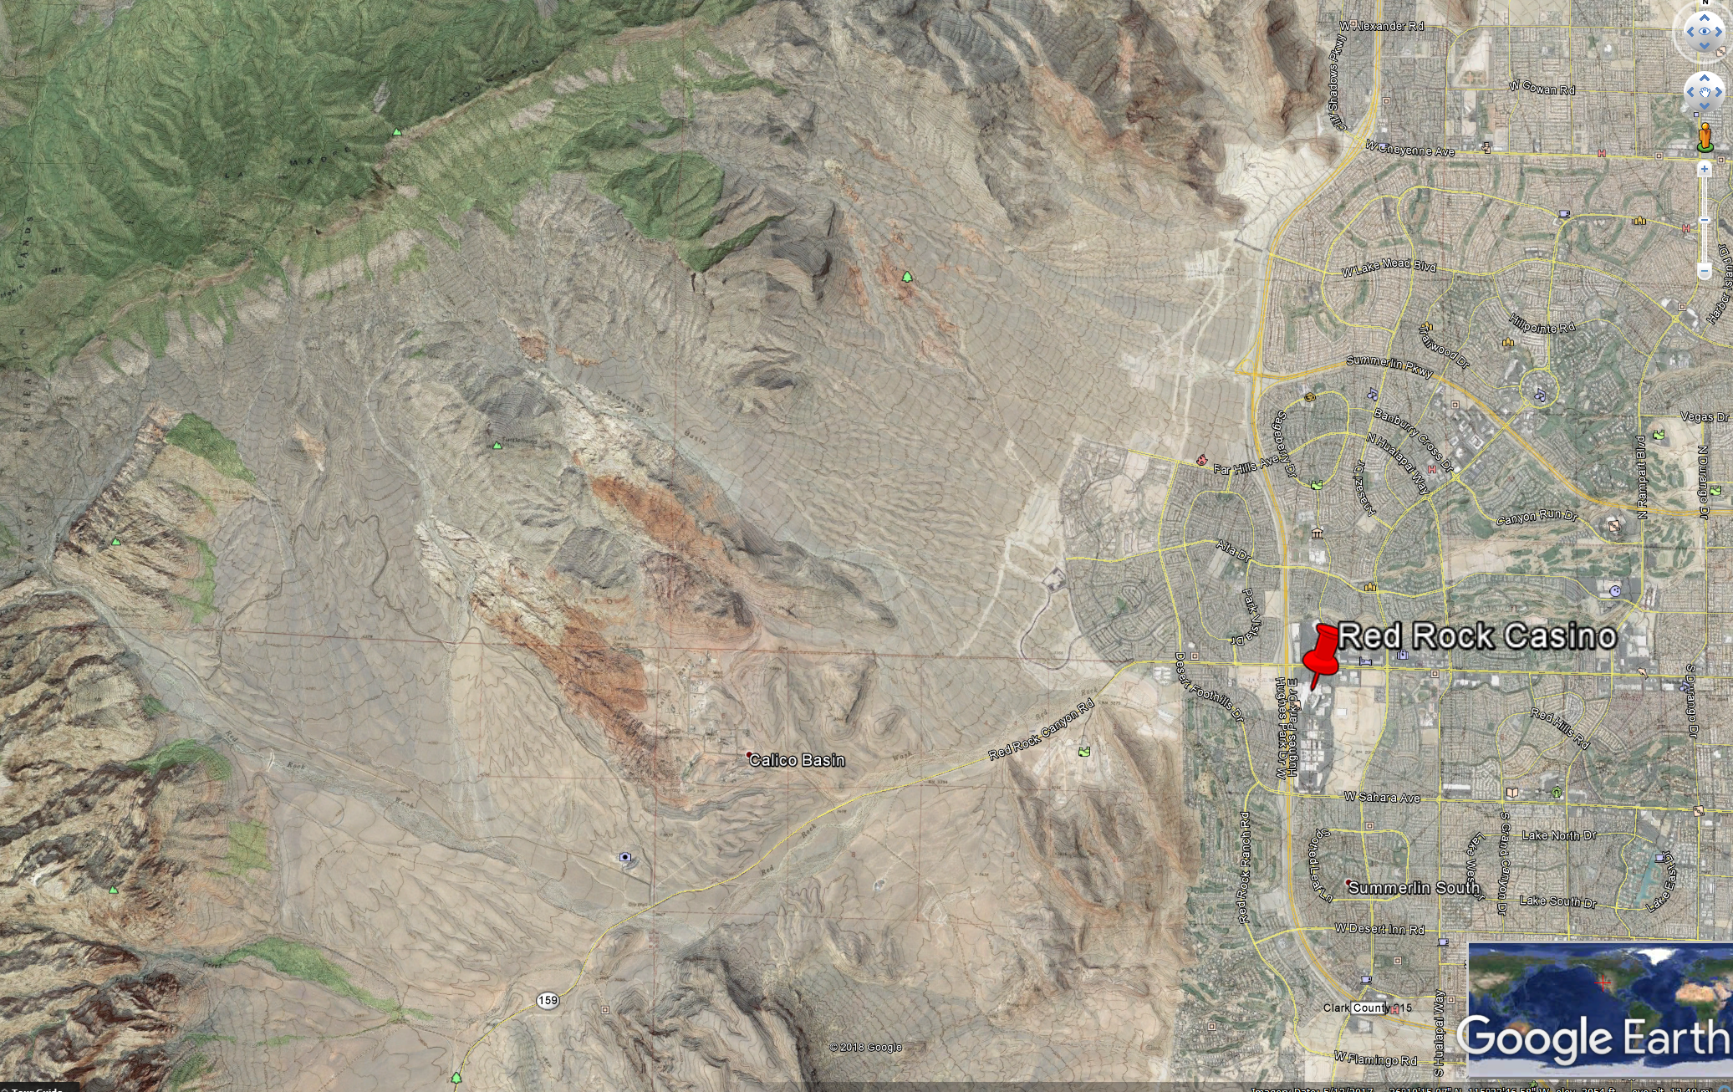
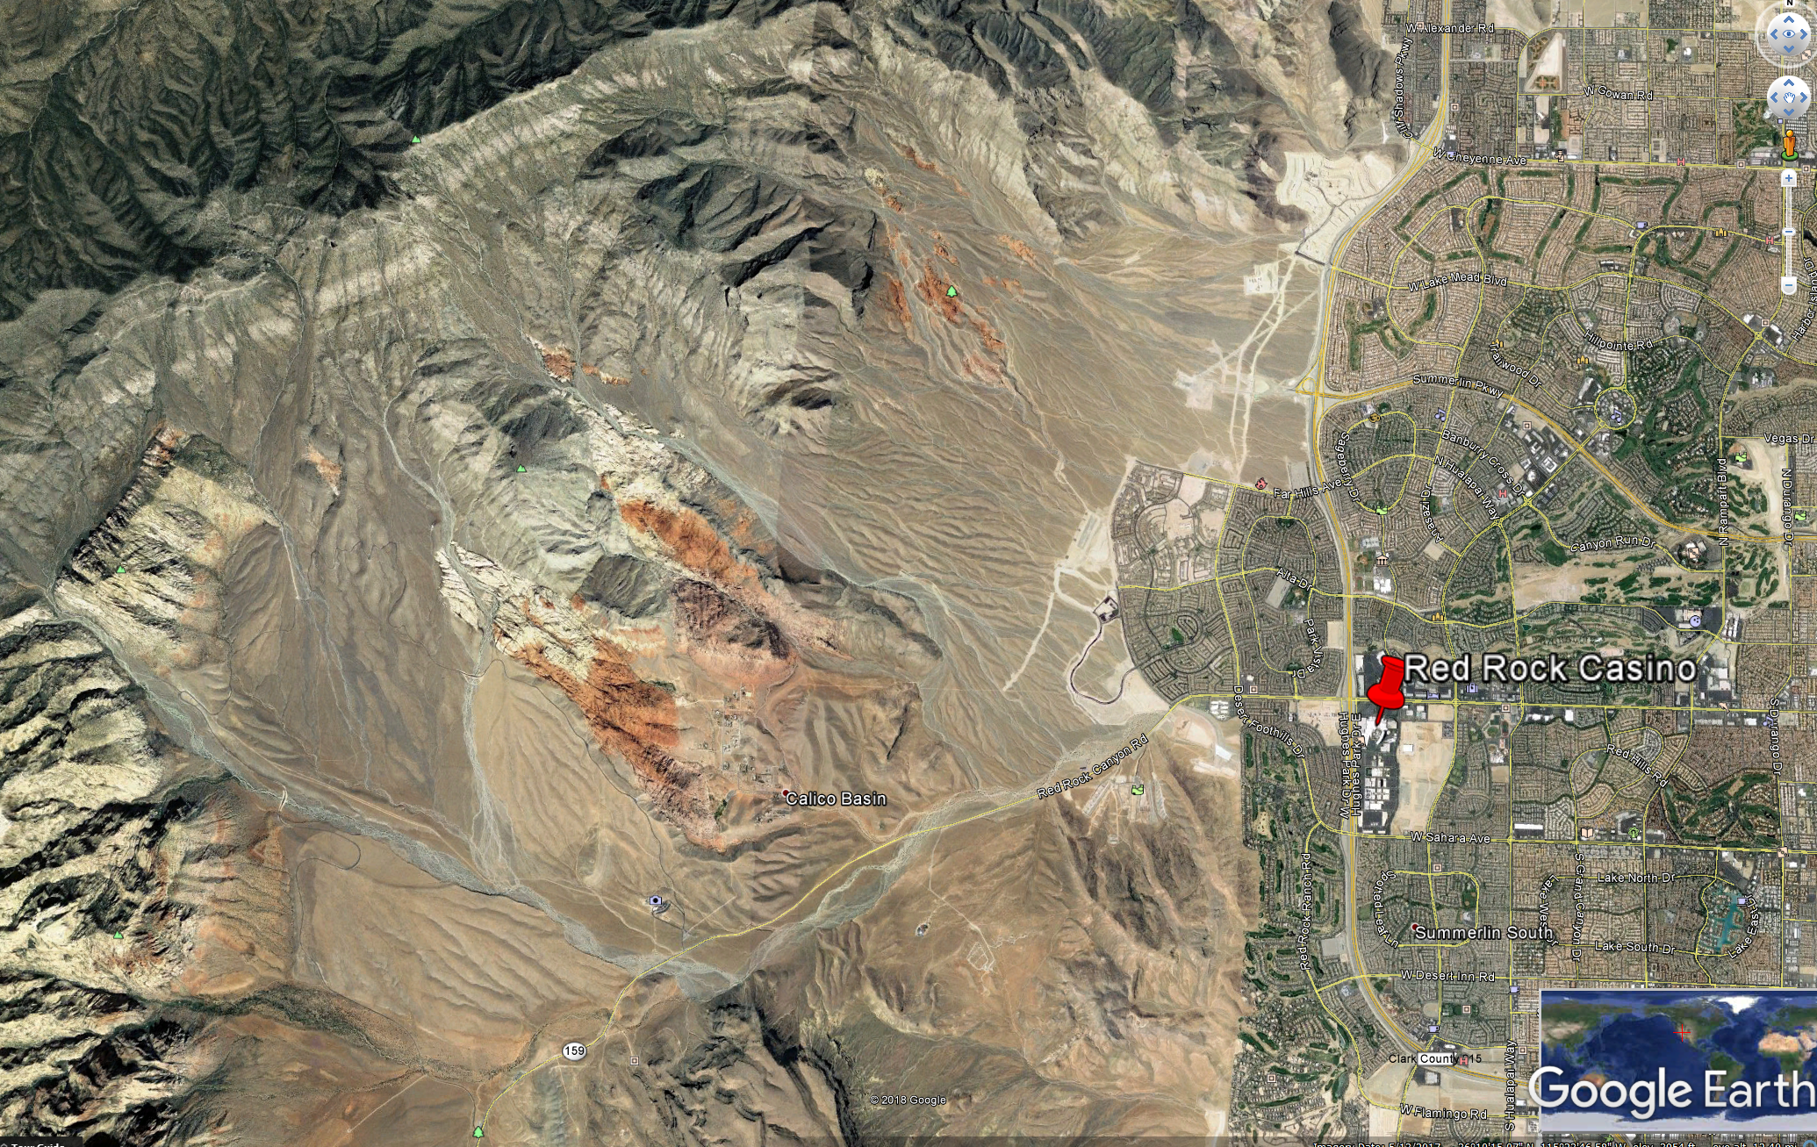
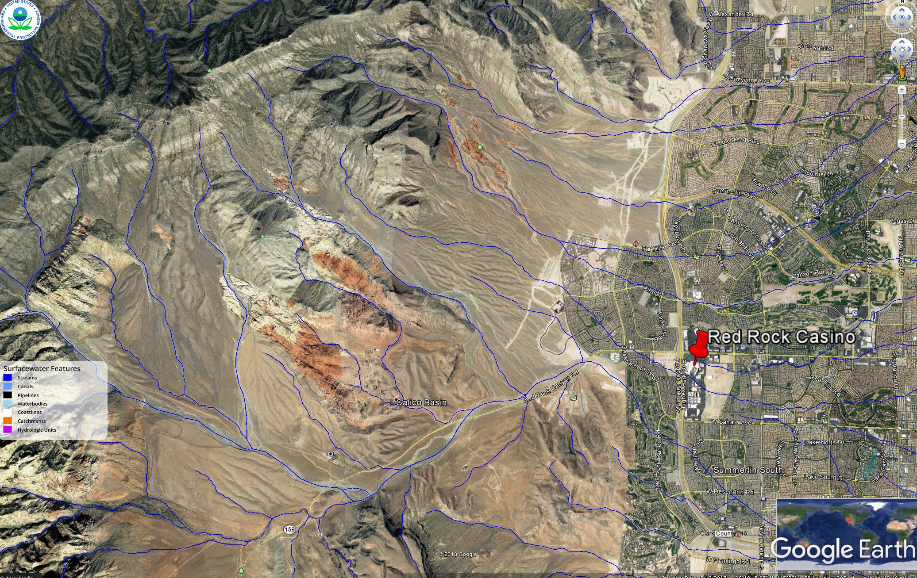
Step 1 – SQRU Delineation
Tools

Slide 25
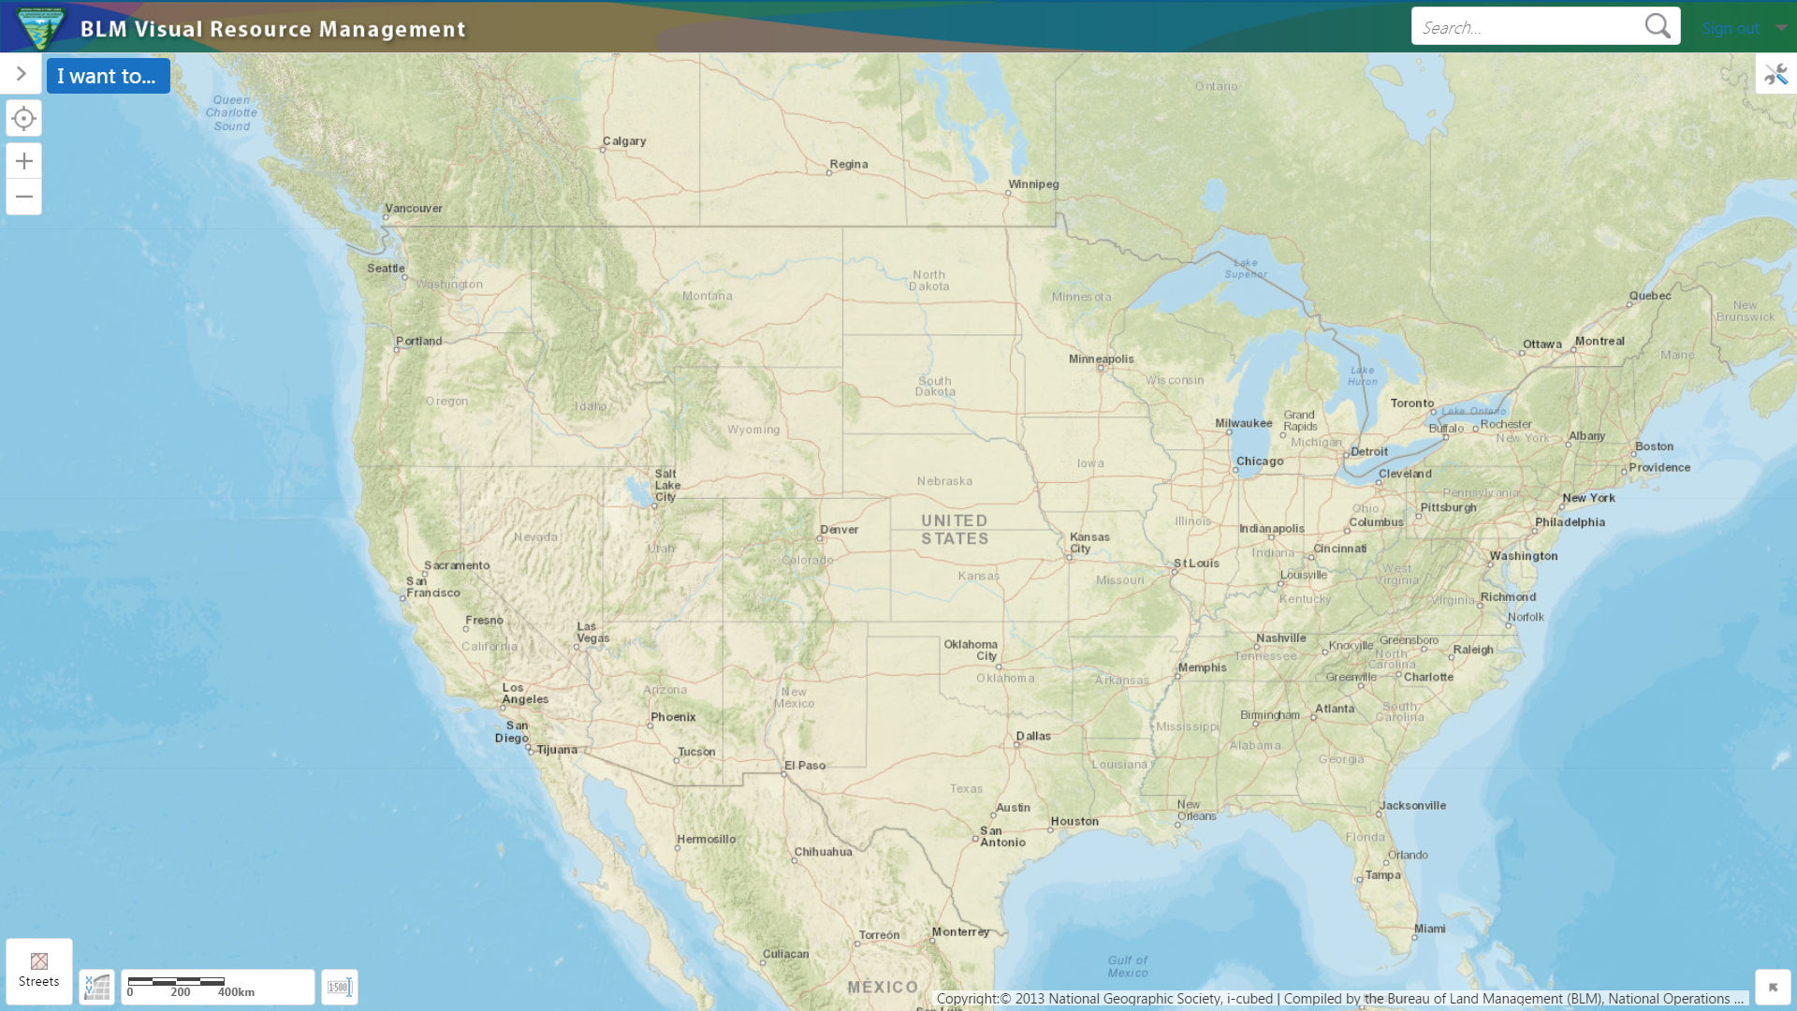
SQRU Class Exercise

Slide 26
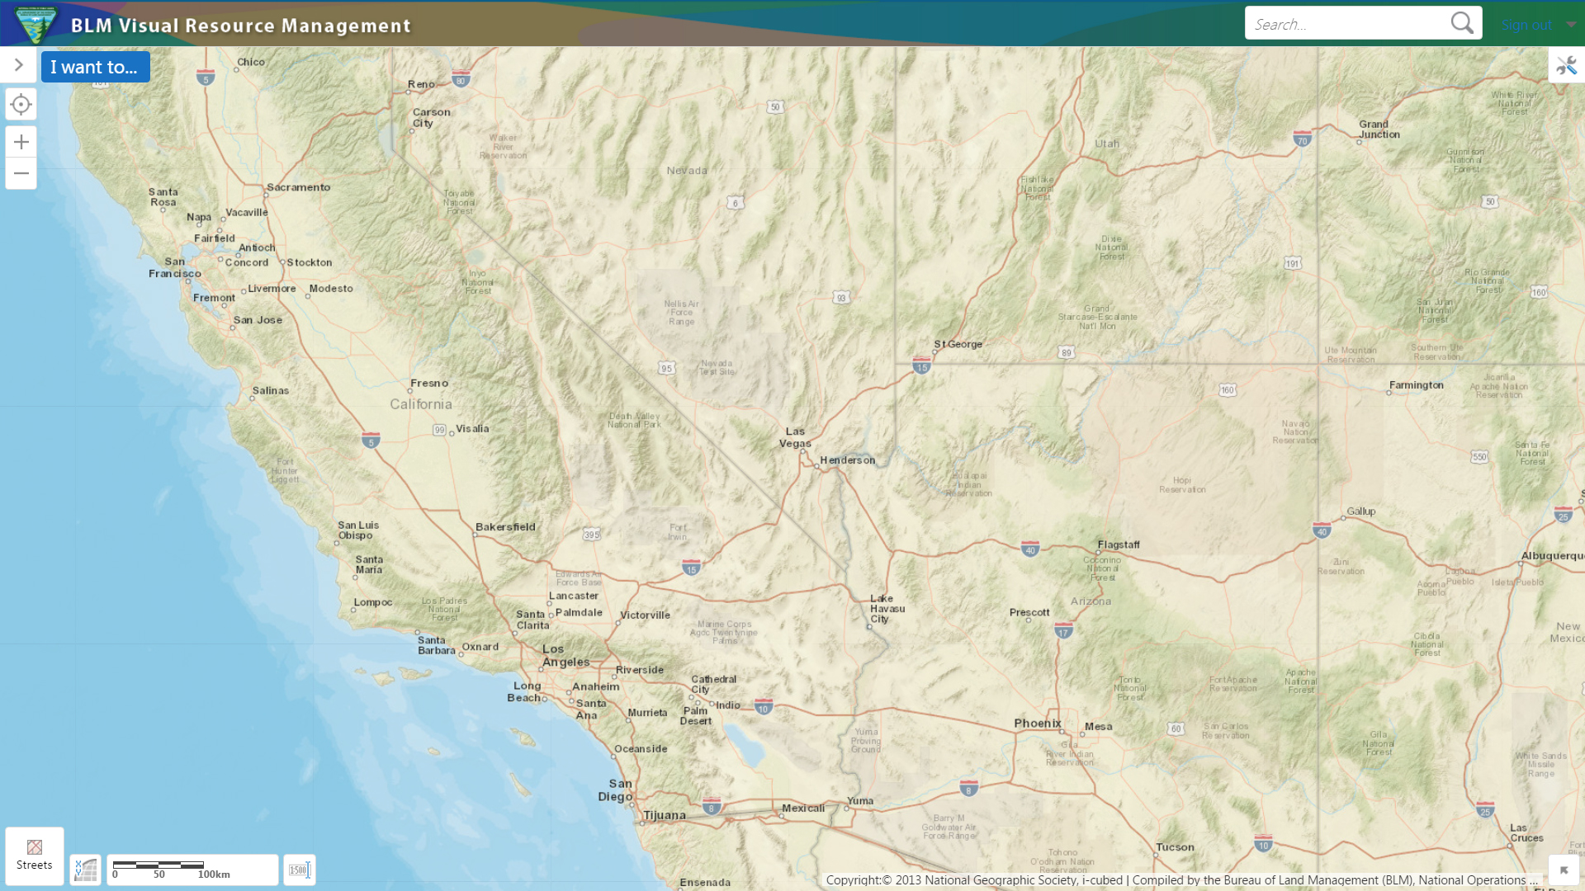
SQRU Class Exercise

Slide 27
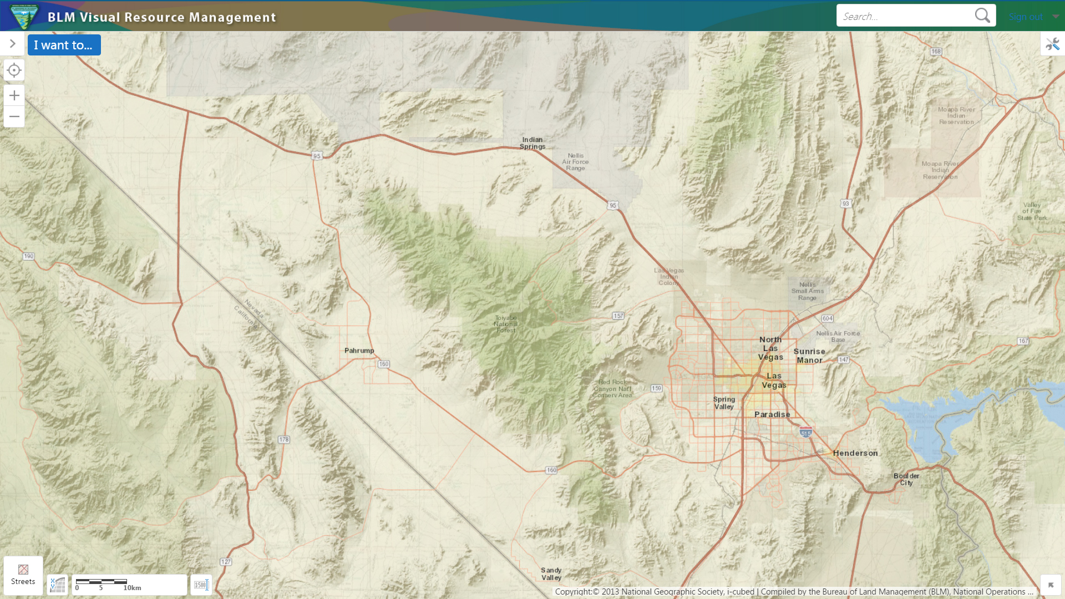
SQRU Class Exercise

Slide 28
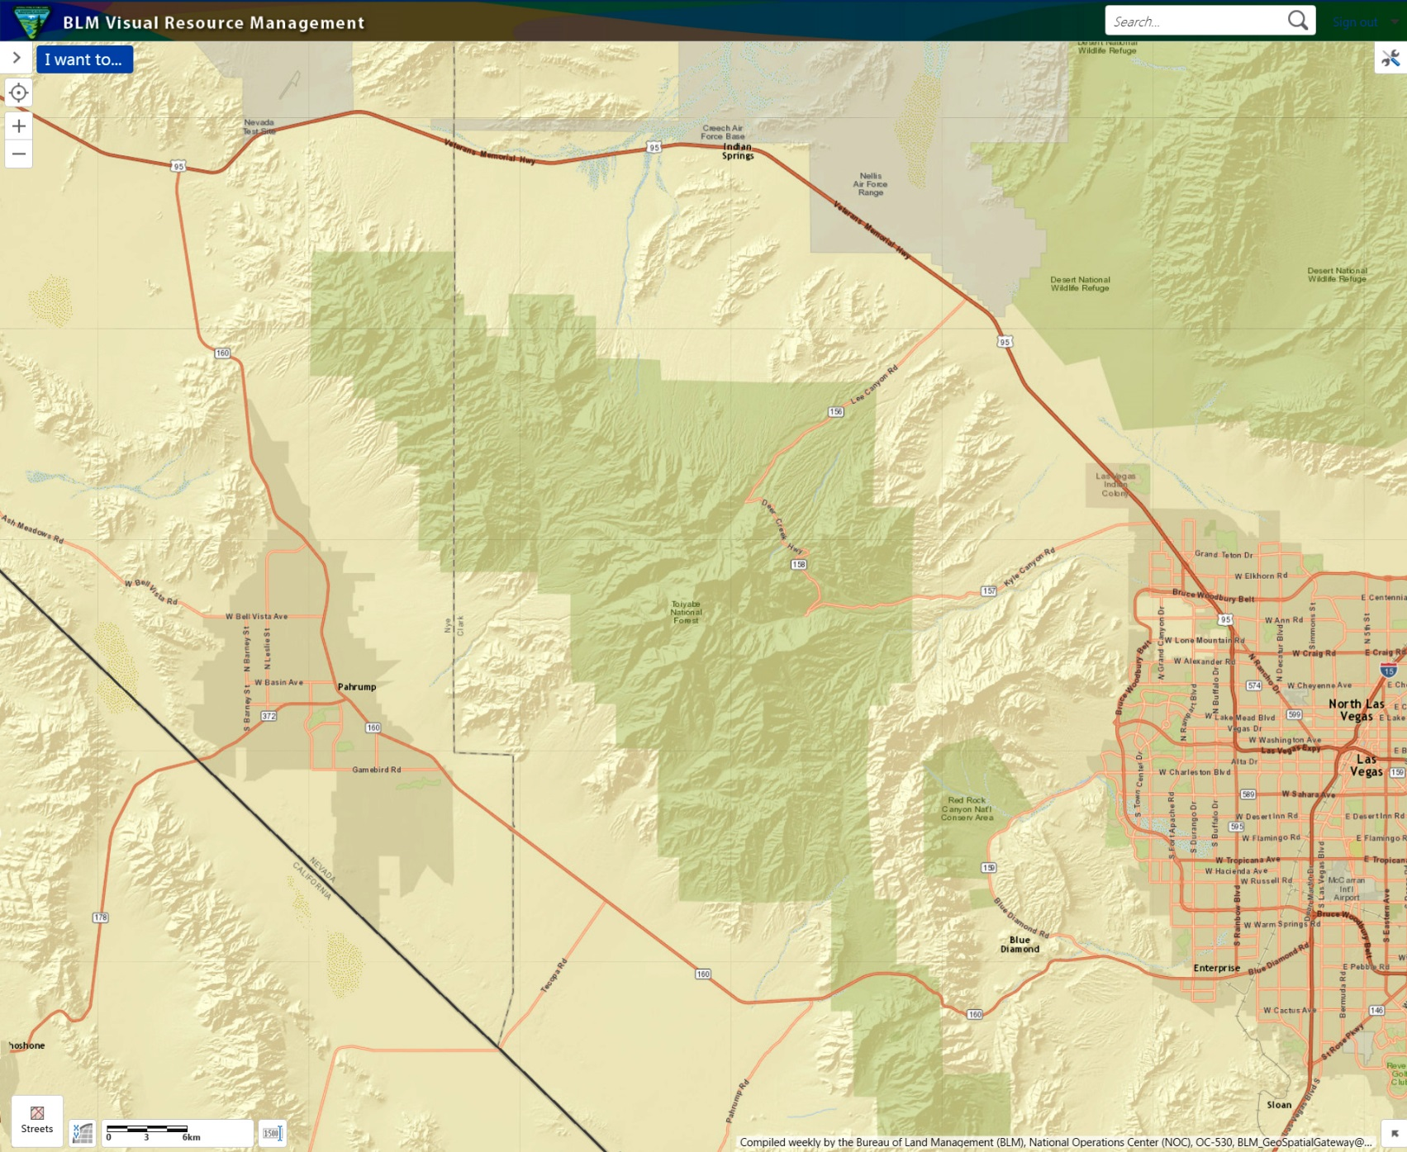
SQRU Class Exercise

Slide 29
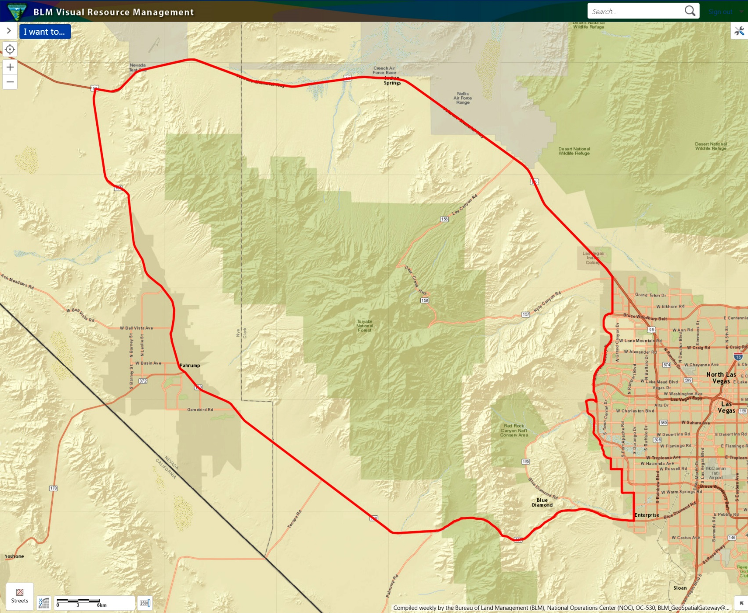
SQRU Class Exercise

Slide 30
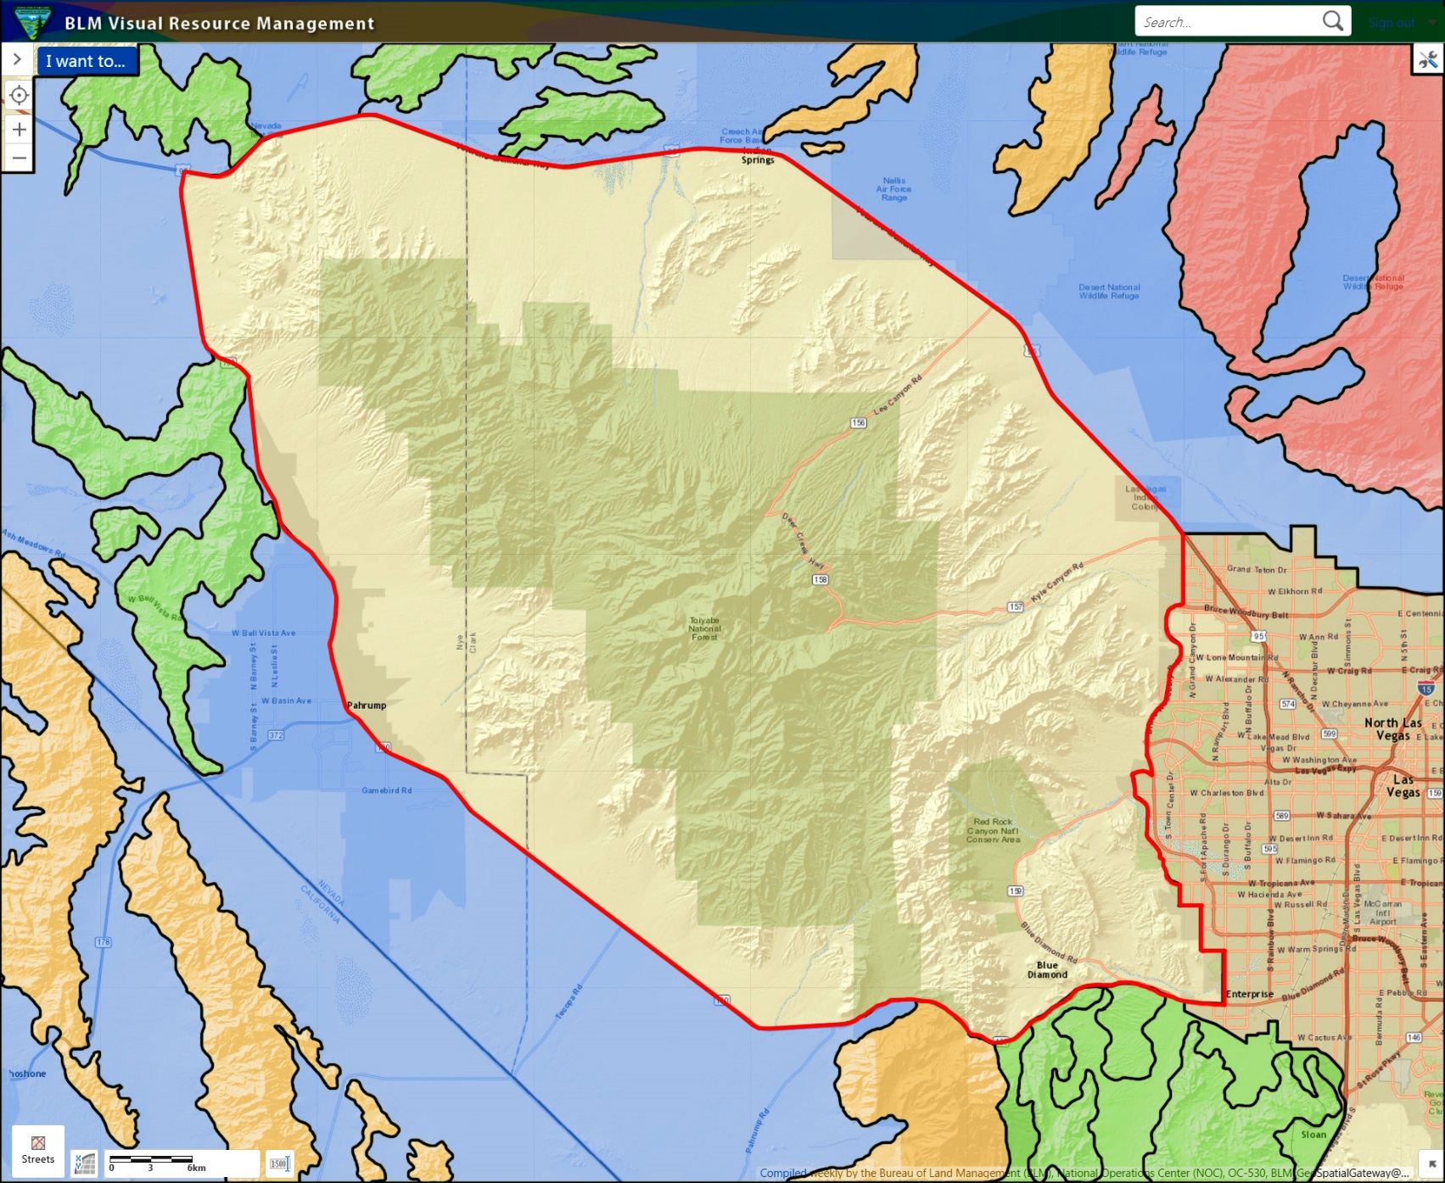
SQRU Class Exercise

Slide 31
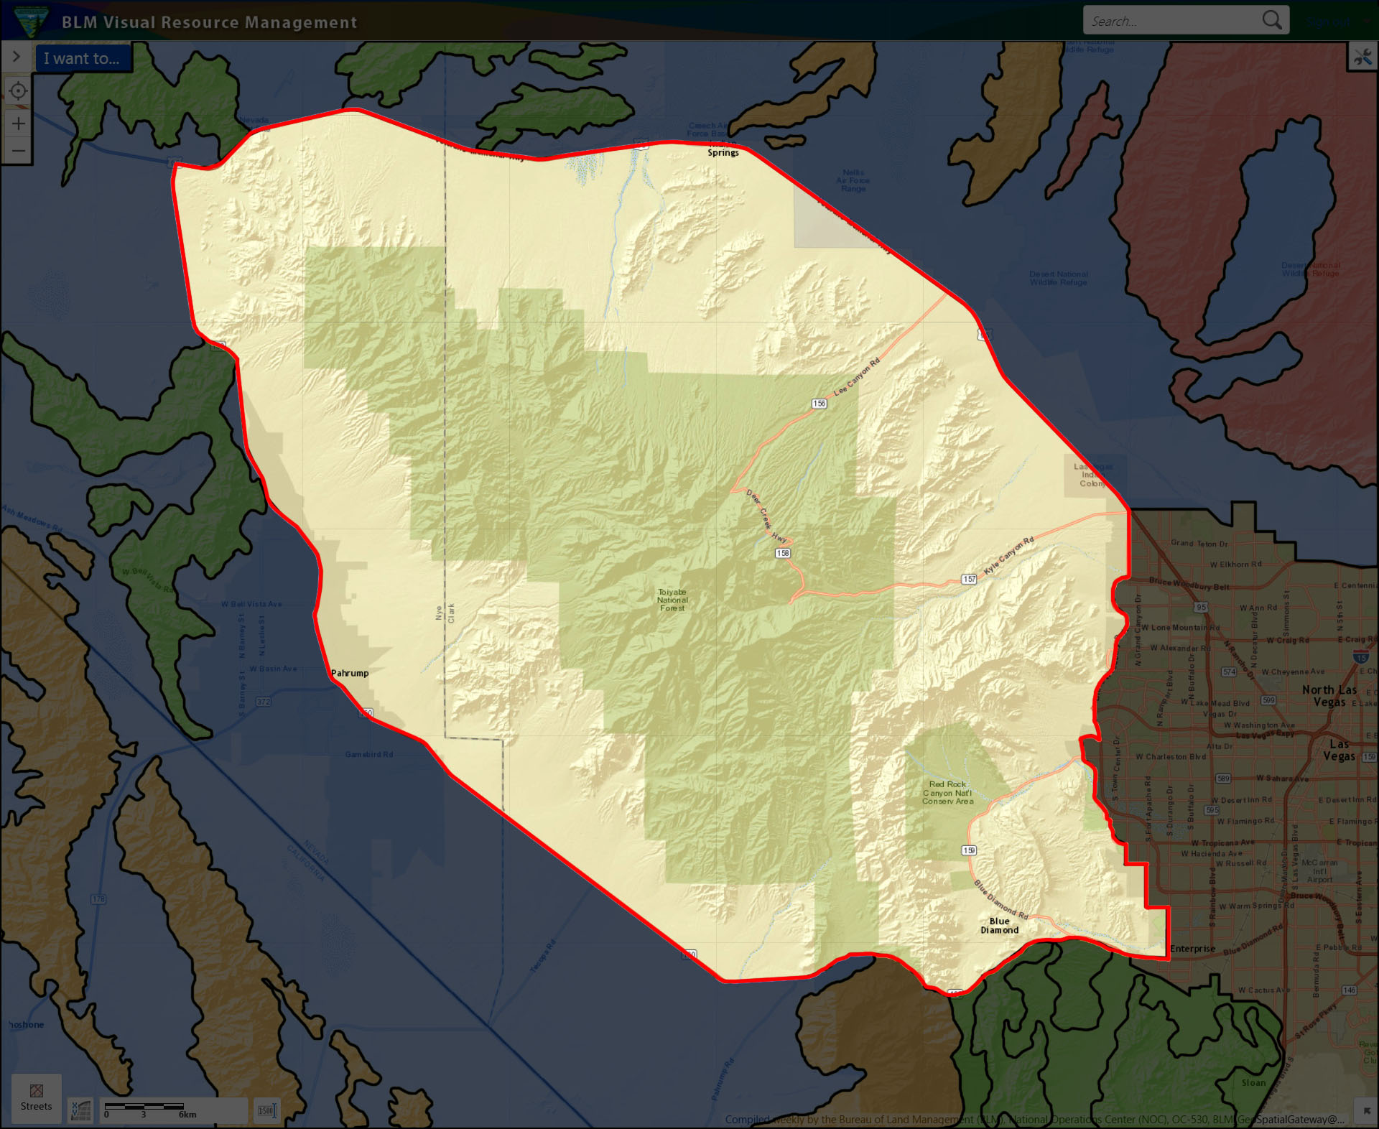
SQRU Class Exercise

Slide 32
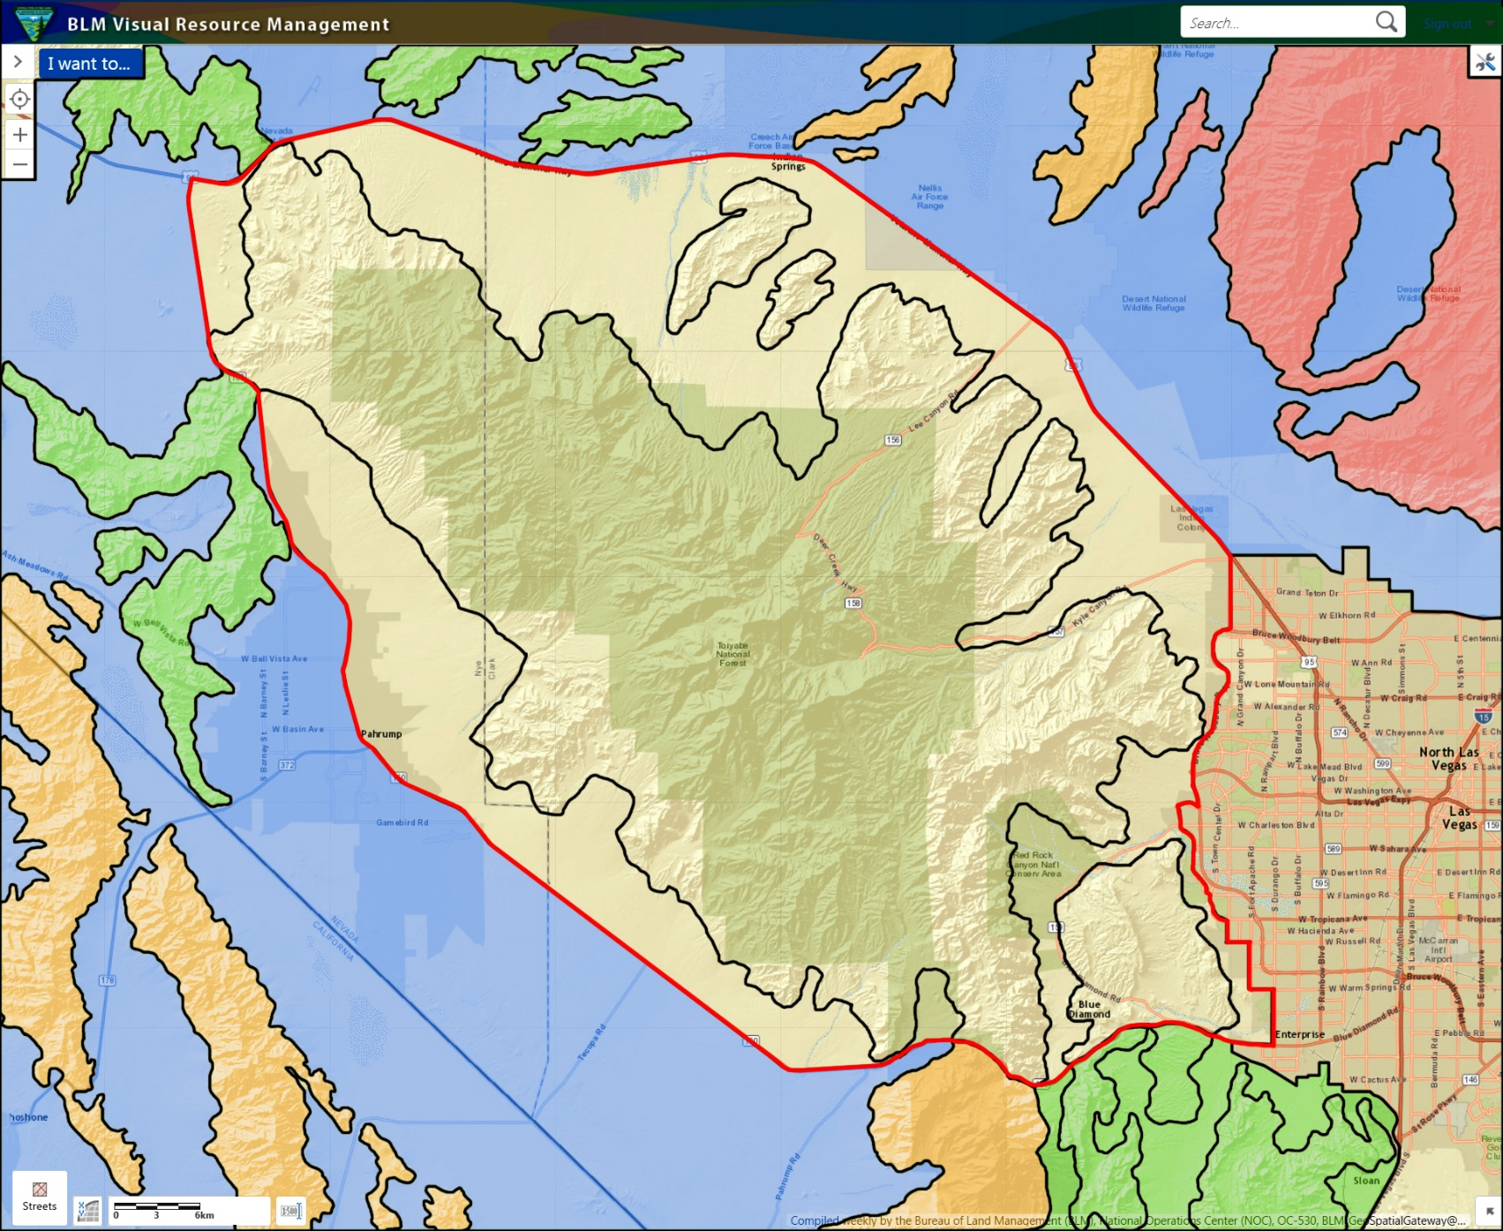
SQRU Class Exercise

Slide 33
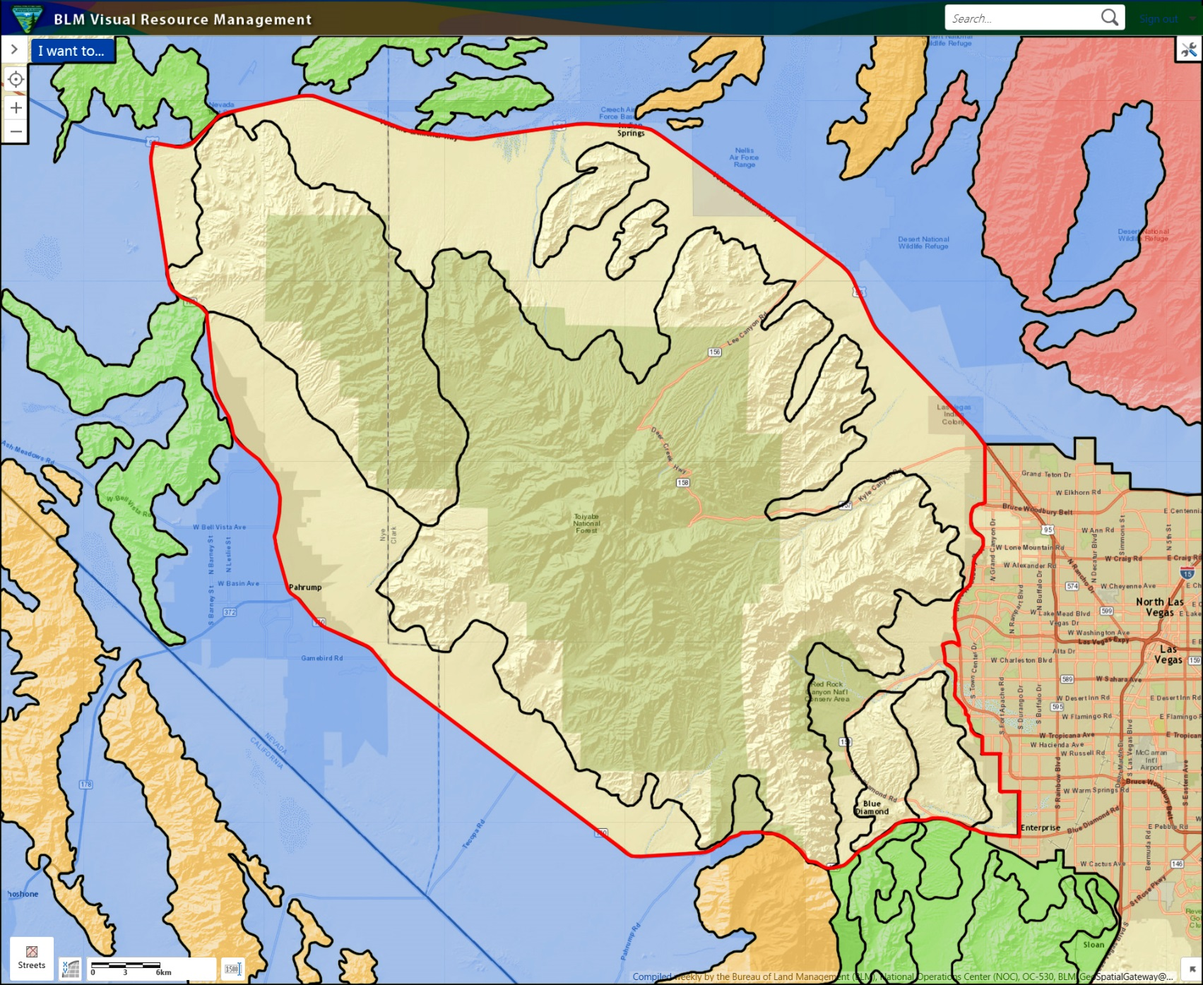
SQRU Class Exercise

Slide 34
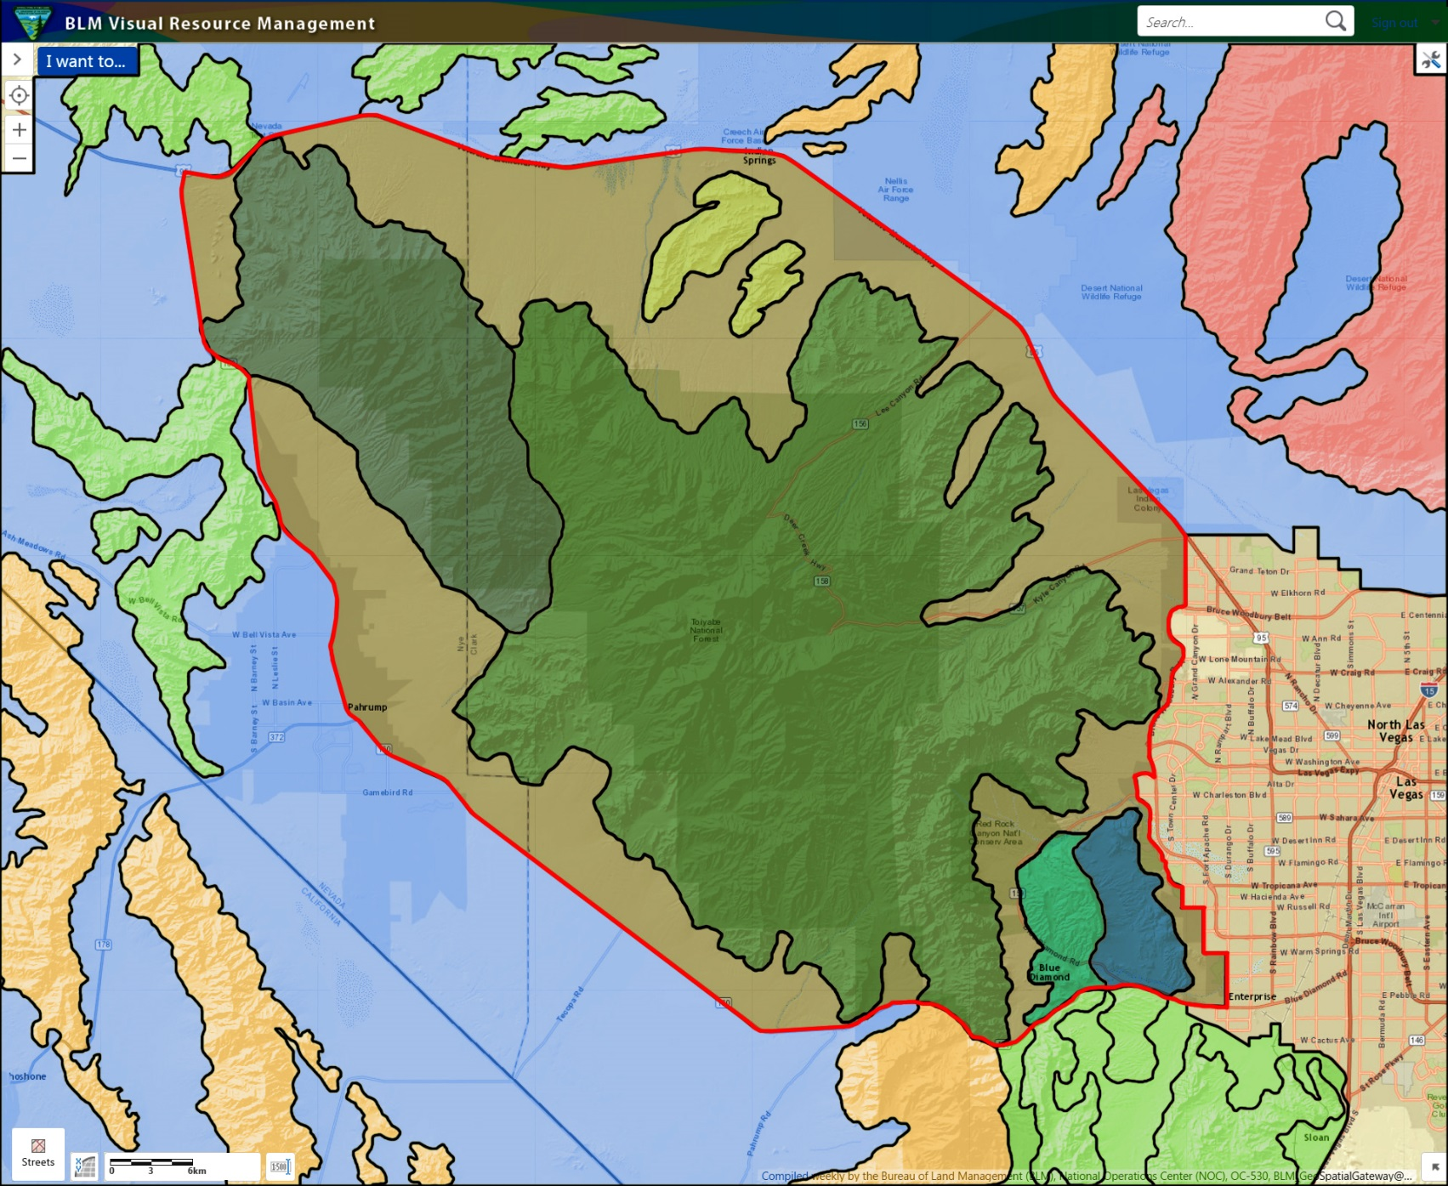
SQRU Class Exercise

Slide 35
Step 2 – Select IOPs
Inventory observation points (IOPs) are used to “observe the area from several important viewpoints”
(H 8410-1, II(B))
Observe each SQRU:
From one or more stopping places inside the SQRU,
While driving through the SQRU and
From a distant vantage point outside of the SQRU
Select IOPs based on the visual vantage. Find locations from where you can assess the overall landscape character of the unit
IOPs are not the same as a KOPs!

Slide 36
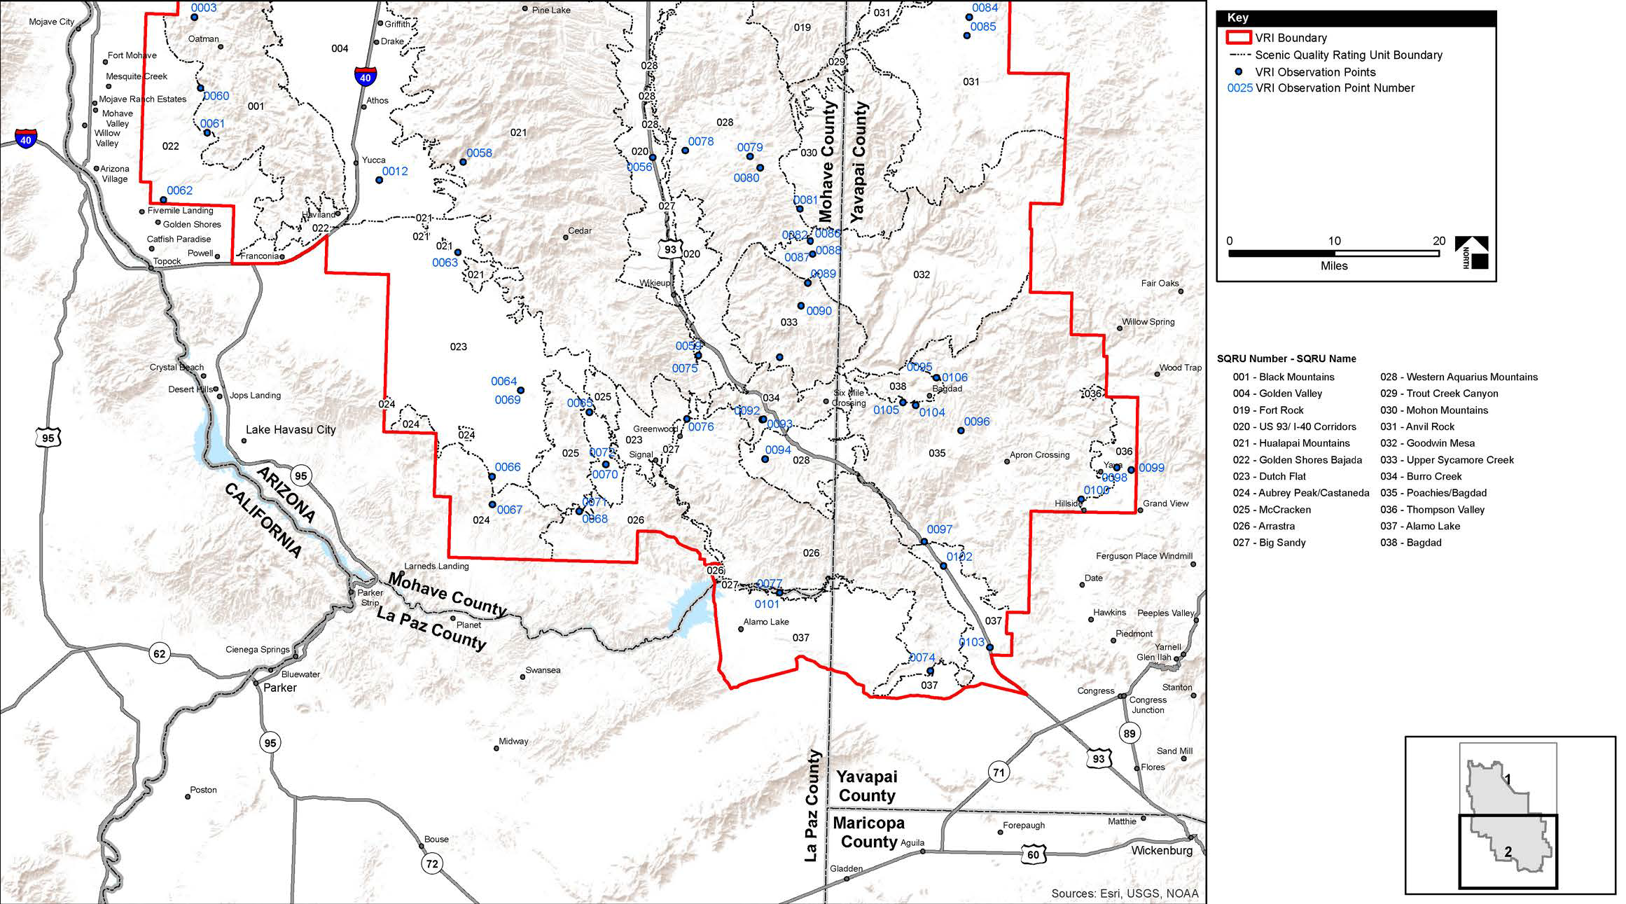
Step 2 – Select IOPs

Slide 37
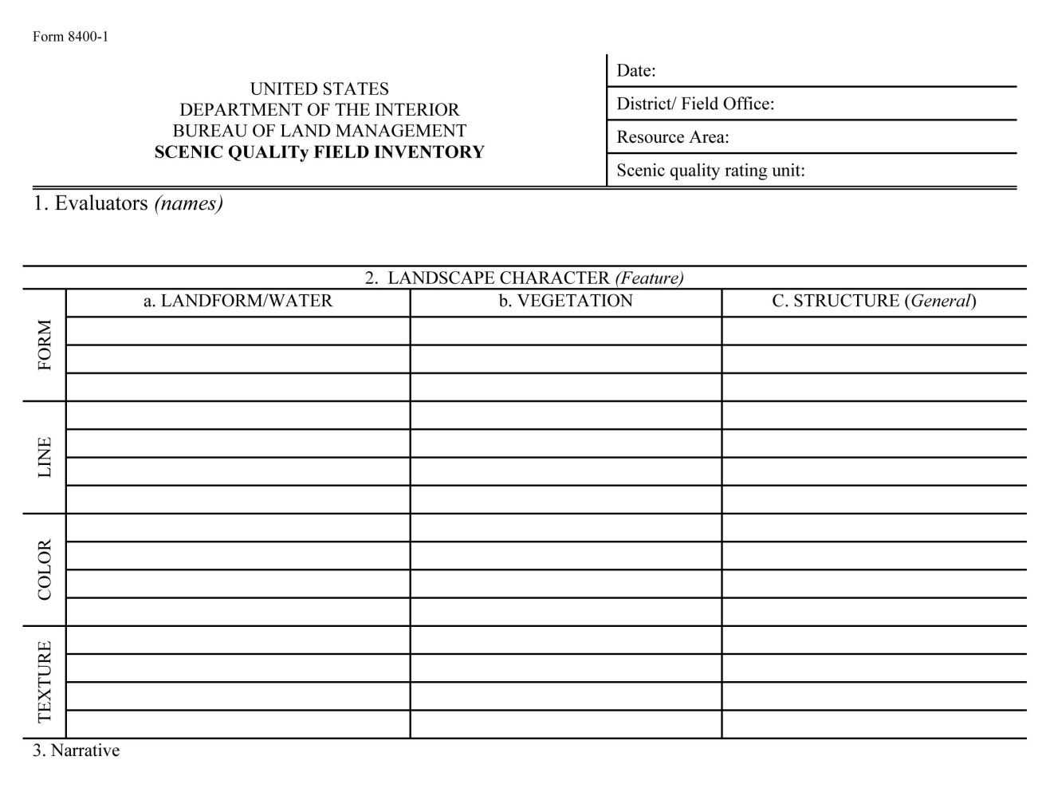
Step 3 – Field Observation Record
Field Inventory
Use the “language of landscapes” for writing descriptions

Slide 38
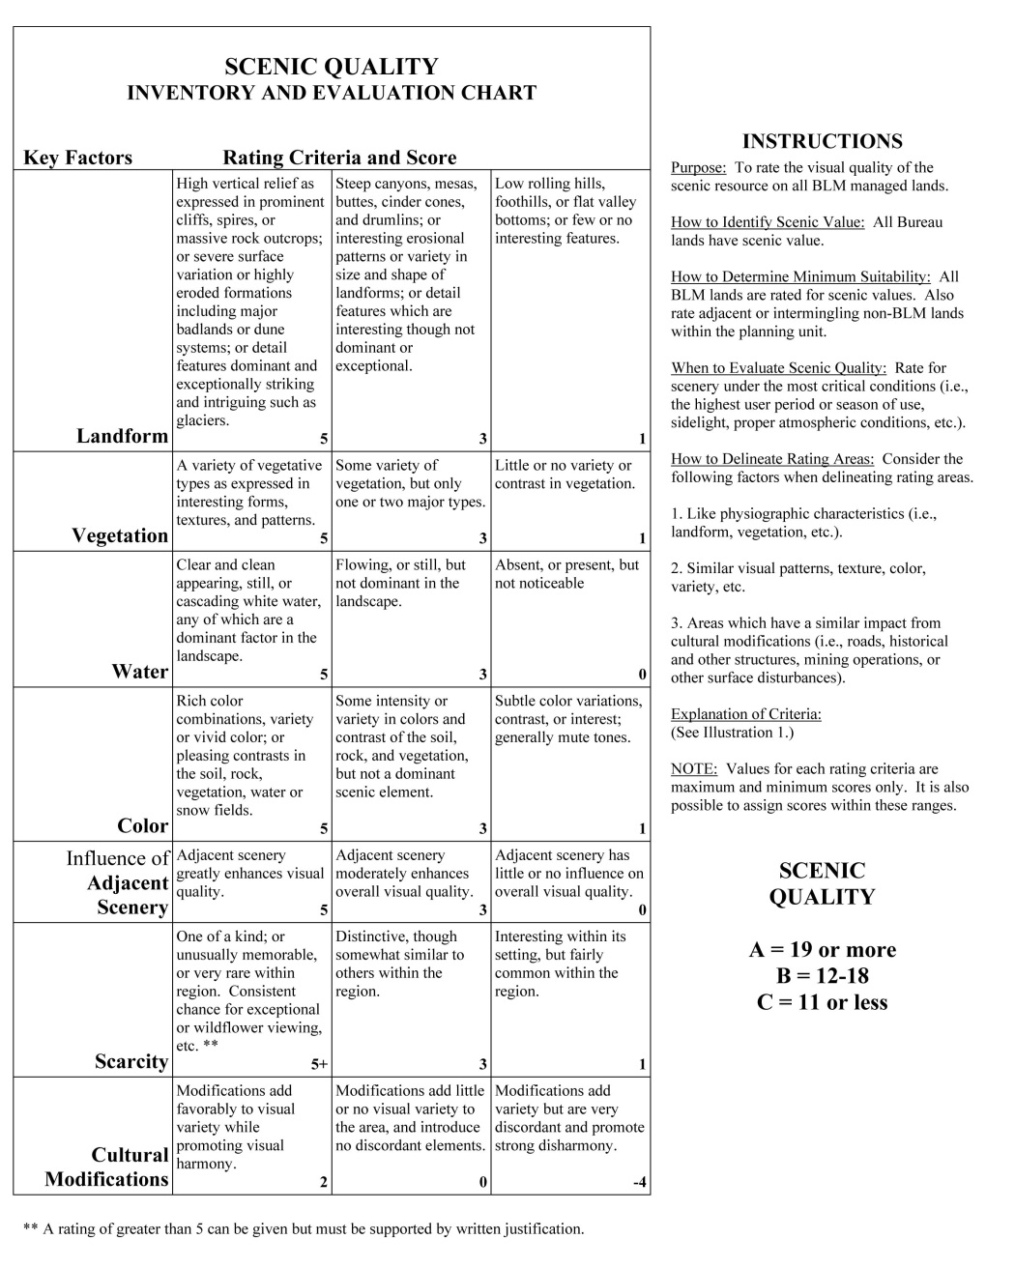
Step 3 – Field Observation Record
Score Determined using 7 key factors
Landform
Vegetation
Water
Color
Adjacent Scenery
Scarcity
Cultural Modifications

Slide 39
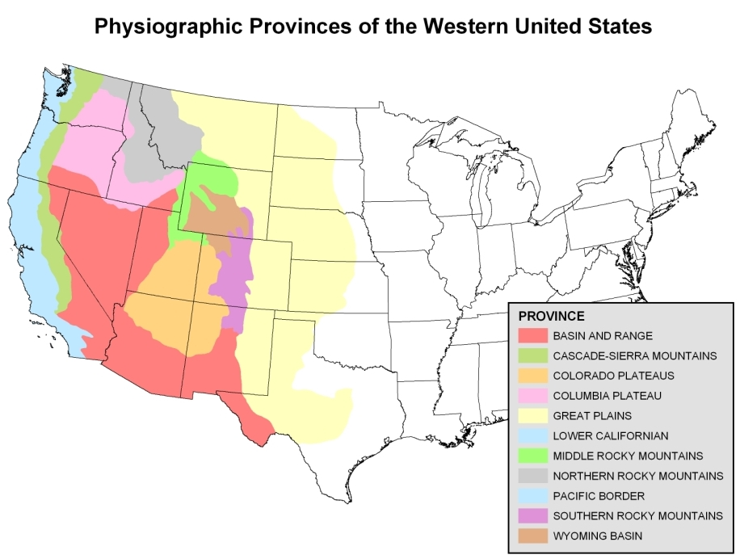
Physiographic Provinces

Slide 40
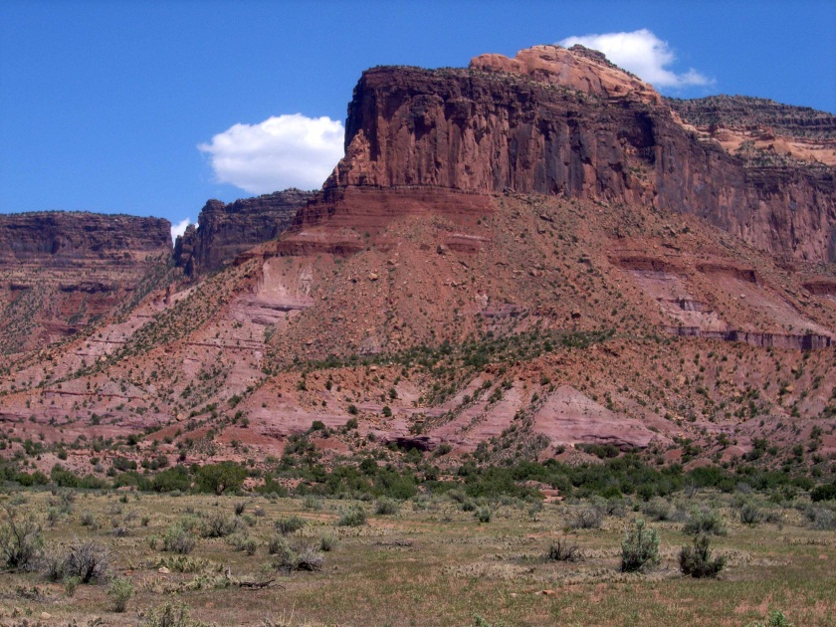
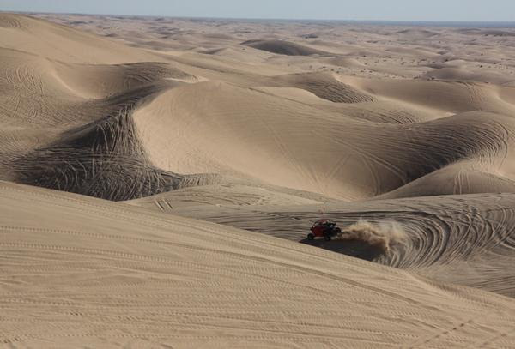
Step 3 – Field Observation Record
Landform
Topography gets more interesting as it gets steeper and more massive, or more severely sculpted
Score of 5 – high vertical relief or dominant detail features
Score of 3 – interesting erosional patterns and variety
Score of 1 – low rolling hills or flat valley bottoms

Slide 41
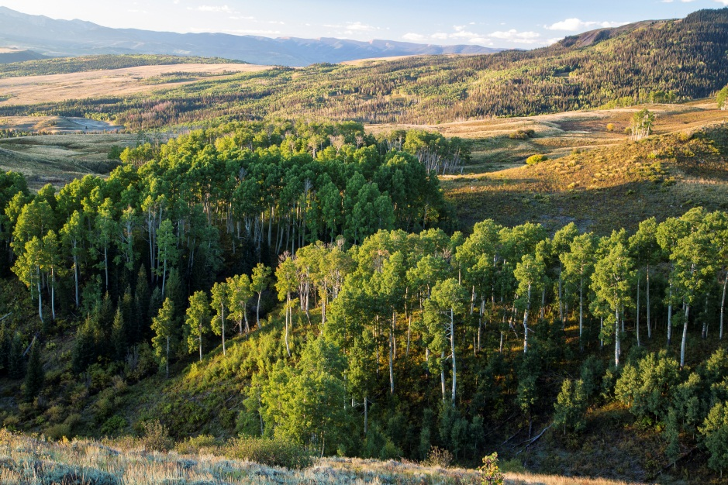
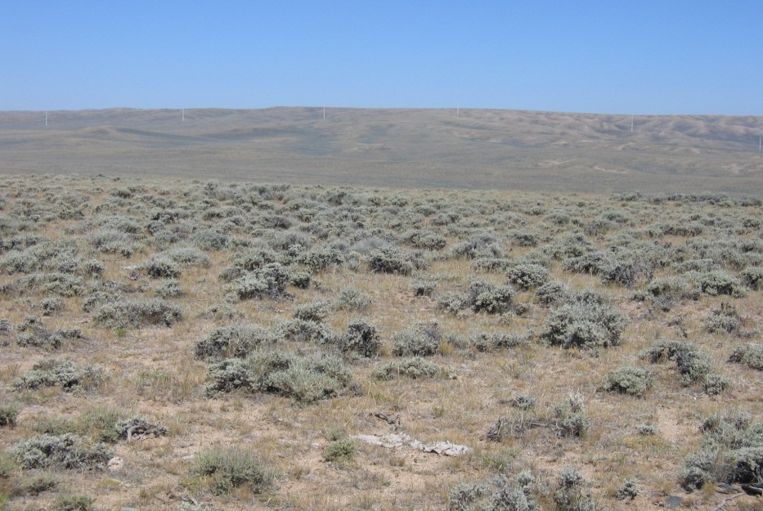
Step 3 – Field Observation Record
Vegetation
Give primary consideration to the variety of patterns, forms, color, and texture created by plant life
Score of 5 – variety of types and interesting patterns
Score of 3 – some variety but only one or two types
Score of 1 – little or no variety or contrast

Slide 42
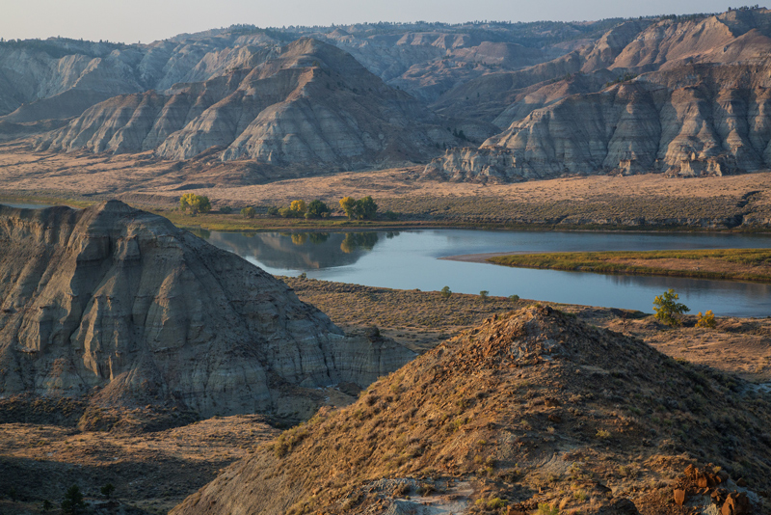
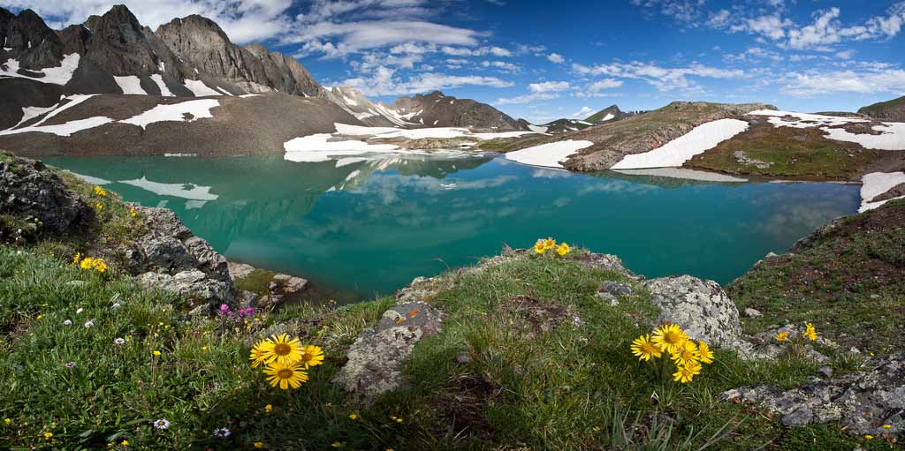
Step 3 – Field Observation Record
Water
Water adds movement and serenity to a scene, the degree to which water dominates the scene affects the rating
Score of 5 – clear, clean, still or cascading and dominant
Score of 3 – flowing or still but not dominant
Score of 1 – absent or present but not noticeable

Slide 43
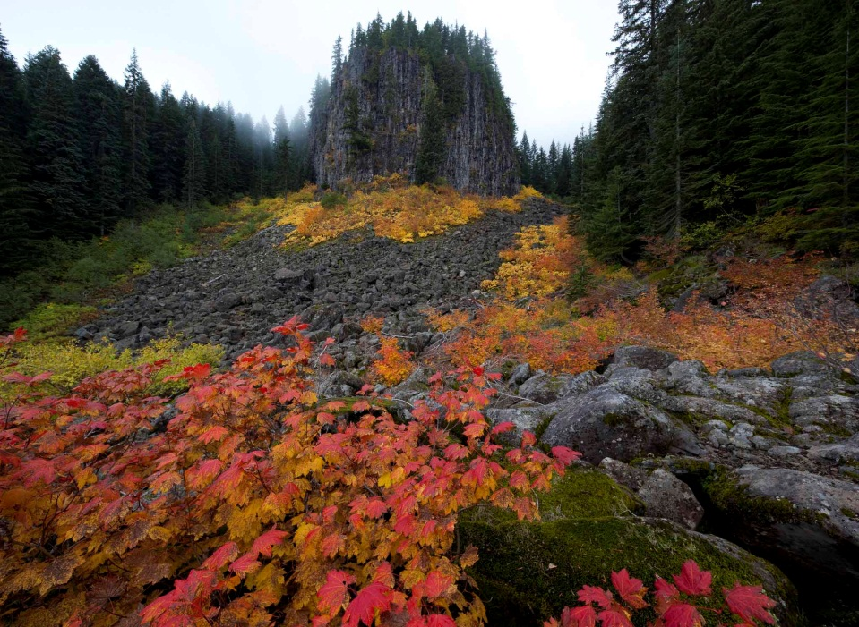
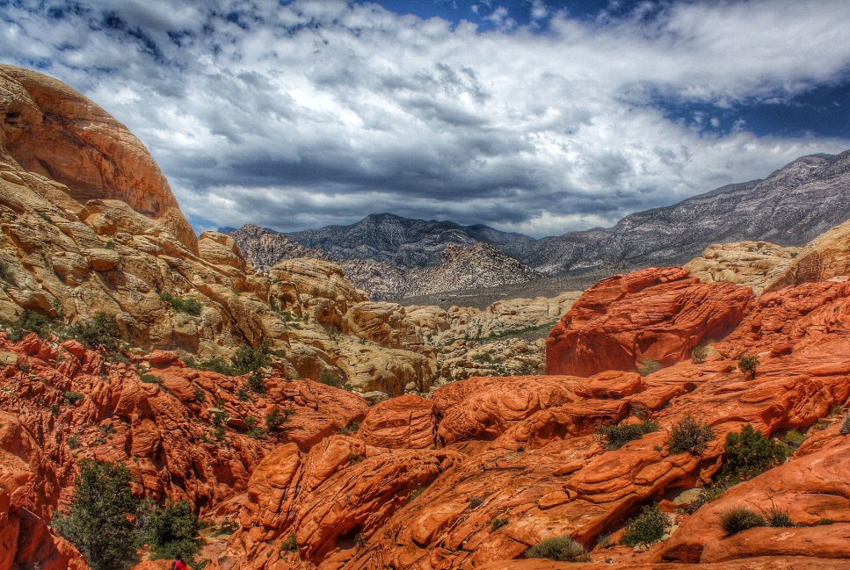
Step 3 – Field Observation Record
Color
Consider the overall color in the landscape, especially focusing on the variety of colors
Score of 5 – rich color combinations, variety and contrast
Score of 3 – some variety but not dominant in the landscape
Score of 1 – subtle color variations, but generally mute tones

Slide 44
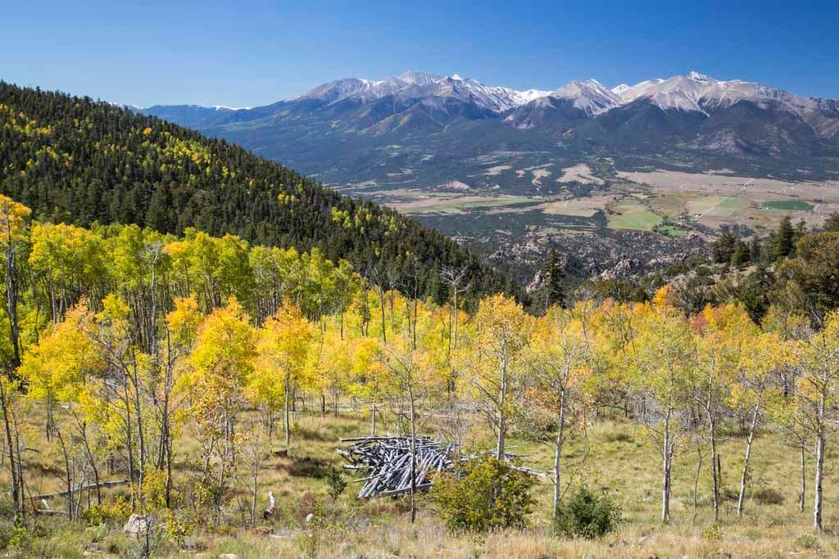
Step 3 – Field Observation Record
Influence of Adjacent Scenery
The degree to which scenery outside the unit being rated enhances the overall impression of scenery within rating unit
Score of 5 – greatly enhances visual quality
Score of 3 – moderately enhances visual quality
Score of 1 – has little or no influence

Slide 45
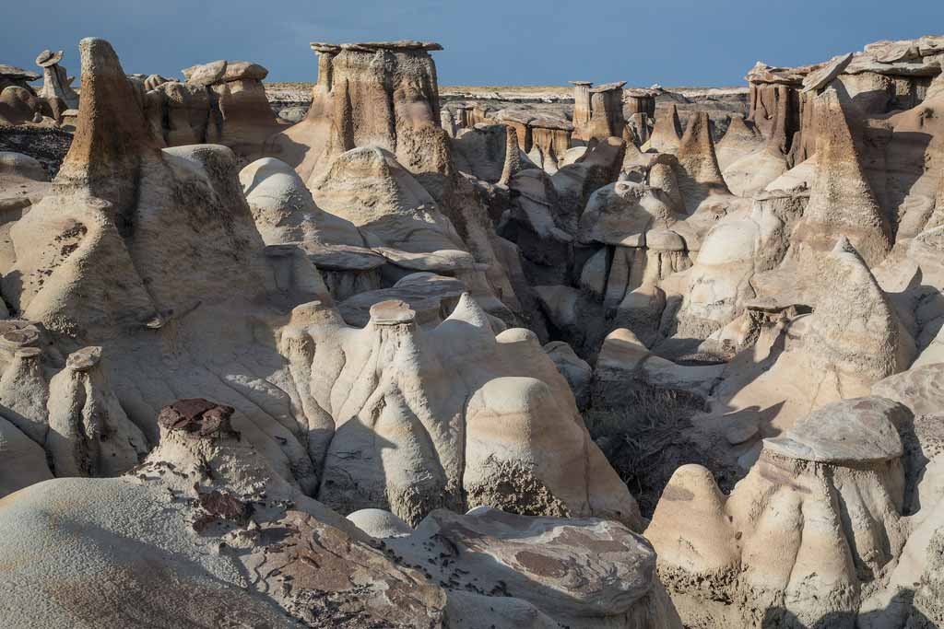
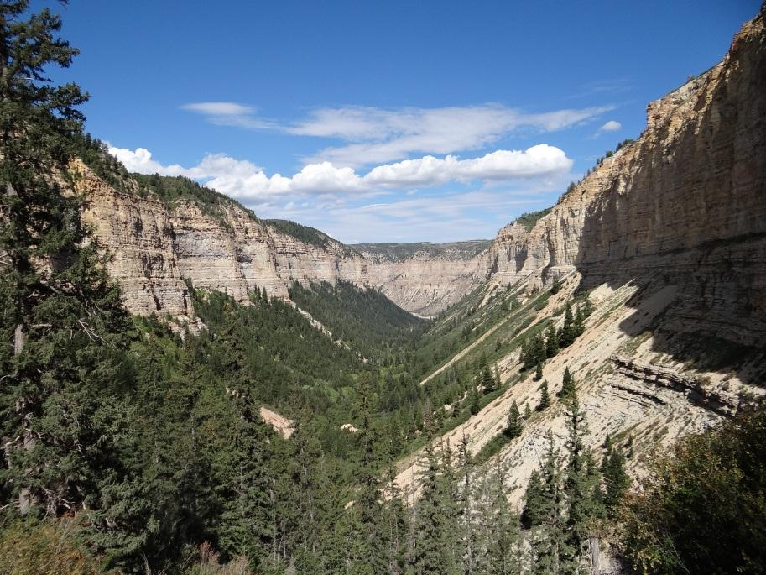
Step 3 – Field Observation Record
Scarcity
Provides an opportunity to give added importance to scenic features that may be unique within physiographic region
Score of *5+ – one of a kind, memorable, or rare
Score of 3 – distinctive, but not unique to region
Score of 1 – fairly common in region

Slide 46
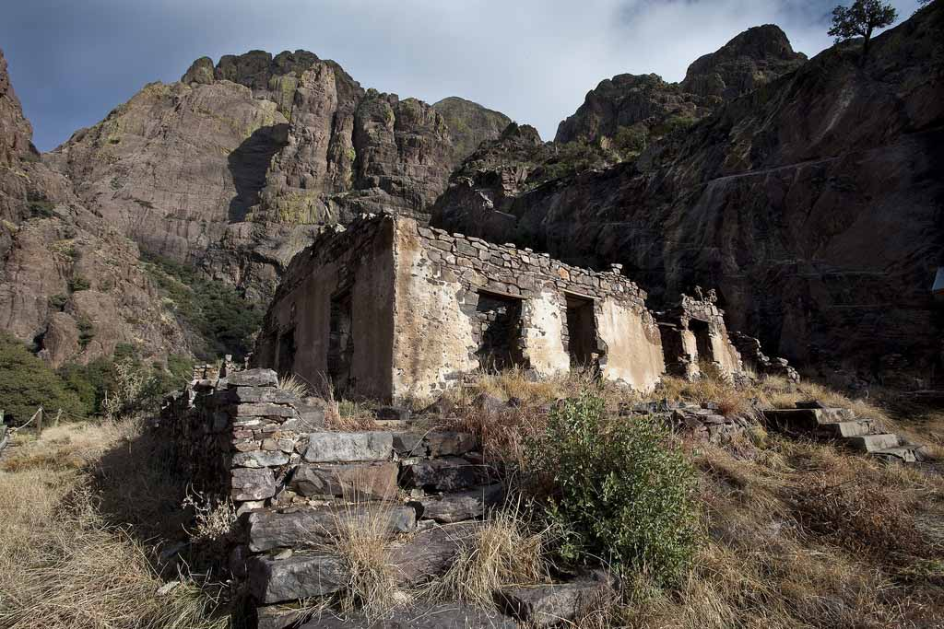
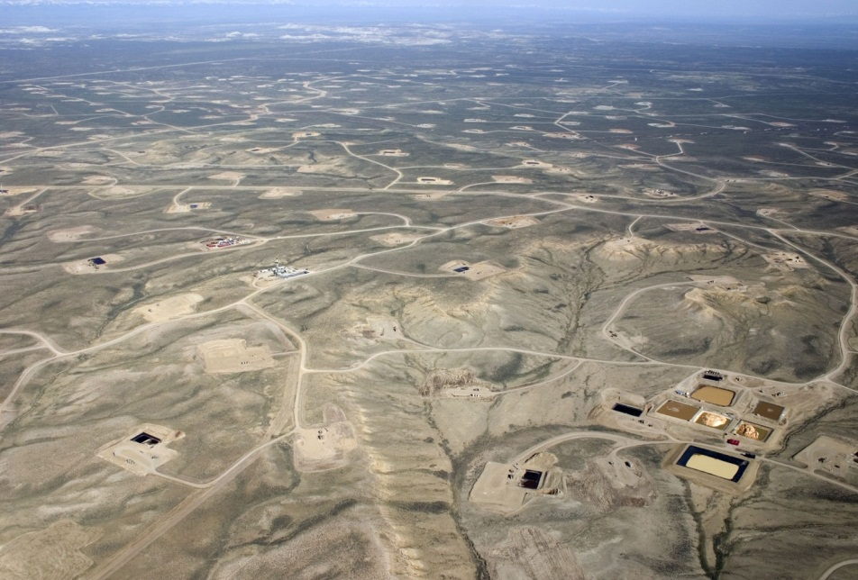
Step 3 – Field Observation Record
Cultural Modifications
Provides an opportunity to give added importance to scenic features that may be unique within physiographic region
Score of 2 – add favorably to visual variety
Score of 0 – add little or no variety and not discordant
Score of -4 – add variety but very discordant

Slide 47
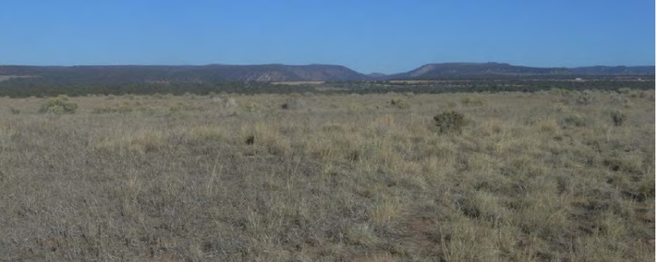
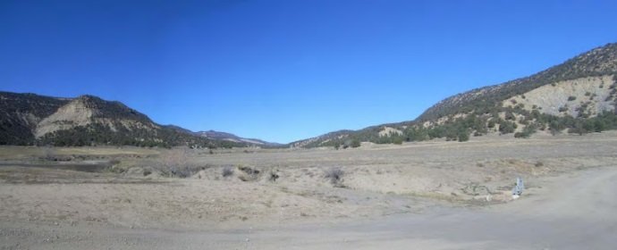
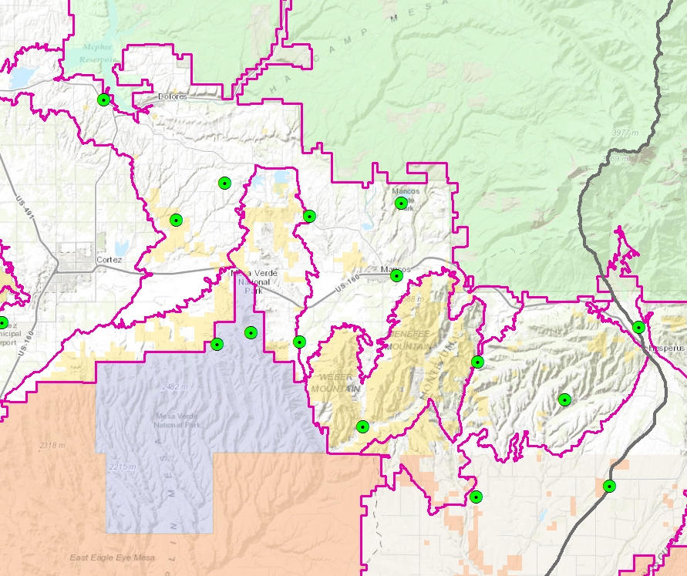
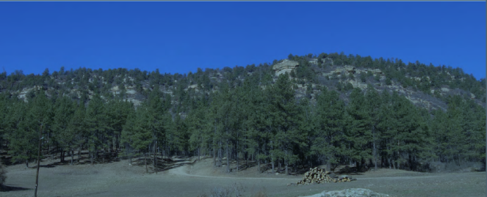
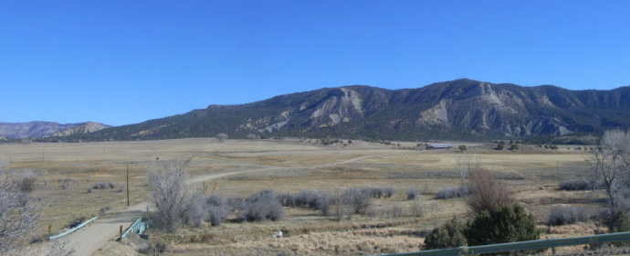
Step 4 – Photo Record (IOPs)
IOP 001
Images from IOPs are recorded with GPS data and are included in an appendix in the VRI report
IOP 002
IOP 003
IOP 004

Slide 48
Step 5 – Evaluate, Score, & Categorize
Scoring - Example
Rich color spectrum with high variety of color
X
Score of 2. Low/Moderate Adjacent Scenery
5
9
2
16

Slide 49
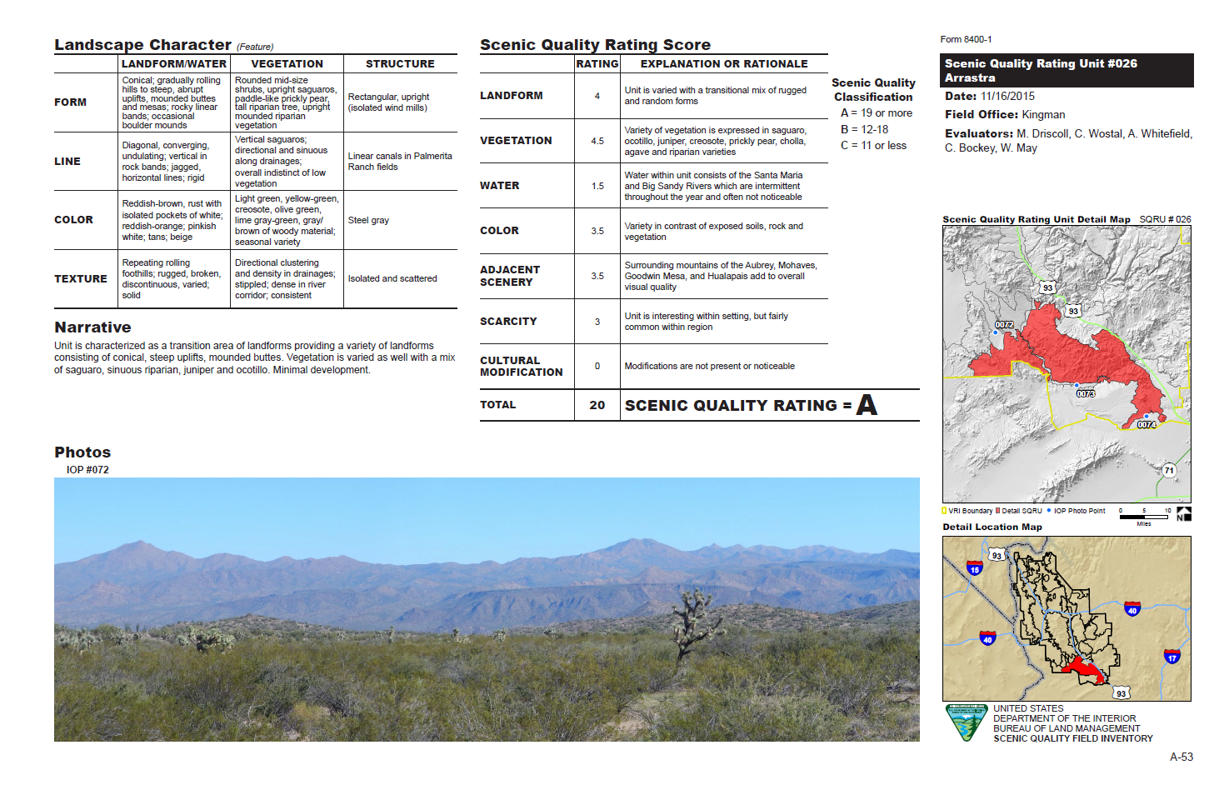
Step 5 – Evaluate, Score, & Categorize
(Draft document)

Slide 50
Step 5 – Evaluate, Score, & Categorize

Slide 51
Example Imagery
Example of Class C Scenery

Slide 52
Example Imagery
Example of Class B Scenery

Slide 53
Example Imagery
Example of Class A Scenery
Example of Class A Scenery

Slide 54
Sensitivity Level Analysis

Slide 55
Overview
Measures the level of public concern for scenic quality
A combination of internal and external data sources are used to inventory visual sensitivity
Input from BLM staff is key because of their experience working with stakeholders, knowledge about areas that are visually sensitive to the public and the reason these areas are visually sensitive to the public
Otherwise, assumptions are made that may not adequately reflect visual sensitivity within a planning area

Slide 56
Why BLM Considers Visual Sensitivity
FLPMA recognizes scenic values and their qualitative value to the public
(Section 102(a)(8) & 103 (c))
BLM responds to FLPMA by including visual sensitivity as an inventory “factor”—an element of scenic value
Scenic values are a quality of the human environment and subject to NEPA
Visual sensitivity determinations are pertinent for land use planning, environmental impact analysis, and for project implementation & design

Slide 57
Definition of Visual Sensitivity
Sensitivity levels are defined as…
(from M-8400r)
Measures (H,M,L) of public concern for the maintenance of scenic quality
SL ratings are based on…
Data regarding who will likely have concern about visual change and the strength of that concern
The inventory of sensitivity indicates the public’s willingness to accept visual change by location

Slide 58
Sensitivity Level Analysis
Public lands are assigned one of three possible sensitivity ratings
High Level of Sensitivity
Indicates publics who generally hold a high CONCERN for retaining existing landscape character, a high INTEREST in potential visual landscape change, and a low RESILIENCE to change
Medium Level of Sensitivity
Indicates publics who hold a moderate CONCERN for retaining existing landscape character, a moderate INTEREST in potential visual landscape change, and a moderate RESILIENCE to change
Low Level of Sensitivity
Indicates publics who hold a low CONCERN for retaining existing landscape character; an accompanying low INTEREST in potential visual landscape change, and a high RESILIENCE to change

Slide 59
Sensitivity Level Analysis
High Sensitivity Examples
National monuments
Wilderness/WSAs/outstanding natural areas
Scenic byways and backways
Major transportation corridors
Backdrops to communities
Historic trail corridors
Special management areas where a pristine setting is important
Low Sensitivity Examples
OHV open areas
Mineral or oil and gas development
L

Slide 60
Sensitivity Analysis Process
Visual Resource Inventory
Sensitivity Level Analysis
Public Land Visibility
Scenic Values Held by People expressed as a concern/attitude toward visual change
Delineation of Distance Zones
Land Features & Characteristics
Scenic Quality Evaluation
1) Information Gathering Effort
4) Evaluate, Score, & Categorize SLRUs
3) Delineate Final Sensitivity Level Rating Units (SLRU)
5) Enter Data into VRI Geodatabase
2) Process and Geo-reference Accounts of Sensitivity

Slide 61
Step 1 – Information Gathering
Factors to consider:
Types of users
Amount of use
Public Interest
Adjacent land uses
Special areas
L
Cripple Creek Scenic Byway Overlook
Undisturbed Float Fishing River Banks
Colliding Rivers, Roseburg, OR
Tehachapi Pass, Mojave, CA

Slide 62
Step 1 – Information Gathering
Types of users
Sensitivity level varies by use
Example: recreational users versus workers who pass through an area on a regular basis
L

Slide 63
Step 1 – Information Gathering
Amount of use
Areas seen by large numbers of people are often more sensitive
Protection of visual values becomes more important as the number of viewers increases
L

Slide 64
Step 1 – Information Gathering
Public interest
Visual quality may be of concern
to local, state, or national groups
Indicators of this concern are
usually expressed in public meetings,
letters, newspaper or magazine
articles, newsletters, land-use plans,
etc.
Public controversy created in
response to proposed activities that
would change the landscape character
should also be considered

Slide 65
Step 1 – Information Gathering
Adjacent land uses
Interrelationships with adjacent land uses can affect visual sensitivity of an area
For example, an area within the viewshed of a residential area may be very sensitive, whereas an area surrounded by commercially developed lands may not be visually sensitive
L

Slide 66
Step 1 – Information Gathering
Special Areas
Management objectives for special areas frequently require special consideration of visual sensitivity
Special areas include: natural areas, wilderness areas or WSA’s, wild and scenic rivers, scenic areas, scenic roads or trails, and ACECs
These areas may not be scenic, but one of the management objectives may be to preserve the natural landscape setting

Slide 67
Step 1 – Information Gathering
Using GIS data
Buffer transportation corridors using viewshed analyses
Use existing polygon resource data to identify other sensitive areas
Other Factors
Consider any other information such as research or studies that include indicators of visual sensitivity
L

Slide 68
Step 2 – Capture and Process Data
Documentation
Sufficiently documenting the sensitivity data is critical to longevity and defensibility of the inventory
Information can be captured in table form, map form, or other means necessary to sufficiently document the information

Slide 69
Step 3 – SLRU Delineation
The planning area is subdivided into sensitivity level rating units.
Boundaries will depend on the factor that is driving the sensitivity consideration
Based on social characteristics and/or physical characteristics.
Can sometimes coincide with Scenic Quality Rating Units, but there does not need to be a direct correlation
Distance zone may also play an important role
GIS can be used exclusively
L

Slide 70
Step 3 – SLRU Delineation

Slide 71
Step 4 – Evaluate & Score
Sensitivity Level Rating Sheet
L
Aug 3, 2015
John Doe
Local, regional, and national populations visit frequently and have a high sensitivity to visual change. Views into and from the unit are highly sensitive due to the multiple trailheads that lead to the Black Ridge Canyons WA.

Slide 72
Step 4 – Evaluate & Score
Explanation and Justification is VITAL!
Remember, this may be reviewed by new BLM staff, project proponents, etc. many years later
Aug 3, 2015
John Doe

Slide 73
Distance Zones

Slide 74
Distance Zone Definitions
H 8410 defines distance zones as follows:
Foreground/Middle-ground
0 – 5 miles
management activities can be viewed in detail
Background
5 – 15 miles
Large vegetation is visible, becoming patterns of light and dark
Seldom Seen
>15 miles or blocked view

Slide 75
Training Objective
Visual Resource Inventory
Sensitivity Level Analysis
Public land visibility
Scenic values held by people expressed as a concern/attitude toward visual change
Delineation of Distance Zones
Land features & characteristics
Scenic Quality Evaluation
1) Select viewing platforms
4) Evaluate, apply H-8410 DZ definitions and classify distance zones.
3) Run a computer-aided viewshed analysis using GIS
5) Enter Data into VRI Geodatabase
2) Document selection details

Slide 76
Step 1 - Select Viewing Platforms
Viewing platforms are popular ‘travel routes’ or ‘observation points’ where the general public are commonly present

Slide 77
Step 1 - Select Viewing Platforms
Viewing platforms are popular ‘travel routes’ or ‘observation points’ where the general public are commonly present

Slide 78
Step 2 – Determine Platforms
Document info:
Info can be gathered via text then transferred to GIS
Data is then represented on hill-shade map with other pertinent information
Field Office
Boundary

Slide 79
Step 3 – Viewshed Analysis
Current practice is to use a GIS viewshed analysis
Rather than to determine in the field by actually traveling along each route and observing the area that can be viewed
Input needed for GIS Visibility Analysis:
Data describing what will limit visibility
Topography/Elevation Model
Vegetation (forest stand heights)
Data describing the viewer location & viewers height
Viewing platforms are popular ‘travel routes’ or ‘observation points’ where the general public are commonly present.

Slide 80
Step 3 – Viewshed Analysis
Common practice is to select viewing platforms with consideration of public access, frequency and purpose
Consider travel routes and observation points such as:
residential developments/ population centers (city/towns),
widely & well used roads,
visitor centers,
campgrounds,
high-use trails,
widely & well used roads,
popular water bodies & floatable river segments,
viewpoints/overlooks, and
scenic railways
Viewing platforms are popular ‘travel routes’ or ‘observation points’ where the general public are commonly present.

Slide 81
Step 4 – Evaluate and Classify
Create 5-mile foreground/ middleground offsets from platforms
H 8410-1, IIV. A(1)

Slide 82
Step 4 – Evaluate and Classify
Create 15-mile background offsets from platforms
H 8410-1, IIV. A(2)

Slide 83
Step 4 – Evaluate and Classify
Colors assigned to Foreground/
Middleground and Background
Field Office
Boundary
Foreground
Background
Seldom
Seen

Slide 84
Step 4 – Viewshed Analysis
Run 15-mile GIS based viewshed analysis from determined platforms to identify visible areas
(shown in magenta)

Slide 85
Step 4 – Evaluate and Classify
Create polygons for ‘unseen’ areas (Blue)
These polygons become the Seldom Seen distance zone
H 8410-1, IIV. A(3)

Slide 86
Distance Zone Application (Example)

Slide 87
Distance Zone Application (Example)

Slide 88
Distance Zone Application (Example)

Slide 89
Distance Zone Application (Example)

Slide 90
Step 4 – Evaluate and Classify
Filtering criteria may be needed if everything comes back as Foreground/Middle ground
Review rationale for selecting viewing platforms and document any further criteria applied to change the selection
For Example:
Highest # of people viewing for the longest time
High public interest
High Scenic Sensitivity (Areas of Special Designation)

Slide 91
Viewshed Analysis
Considering the Distance Zone Information:
Results of this analysis provide insight at the planning-level about where:
lands are most exposed to the viewing public
the BLM’s management actions will be on display & open to the public’s general criticism or praise – more so than other places
to explore alternative siting options, if appropriate, when an activity is proposed

Slide 92
VRI Recap
INVENTORY
is the effort to identify and document information about existing scenic values
EVALUATION
is also done as part of the inventory process
Visual Resource Inventory
Scenic Quality Evaluation
Land Features & Characteristics
What does it look like
VRI Classification
Sensitivity Level Analysis
Scenic Values Held by People expressed as a concern/attitude toward visual change
Importance to the public
Delineation of Distance Zones
Public Land Visibility
Where people view the landscape and how

Slide 93
VRI Class Determination Table
How are VRI classes determined?

Slide 94
Visual Resource Inventory
Closing Remarks
Value of Inventories
Methodology is the same across all BLM field offices
Intent, that the VRI is a living document that can be updated
One inventory serves the planning area and serves as a basis for NEPA analysis for comparing the existing condition to a proposed condition in order to identify how the change would affect scenic quality
Allows analysis to determine scarcity levels of a particular visual value
Provides basis to consider visual values in the land use planning process
Document, document, document!
L

