Slide 2
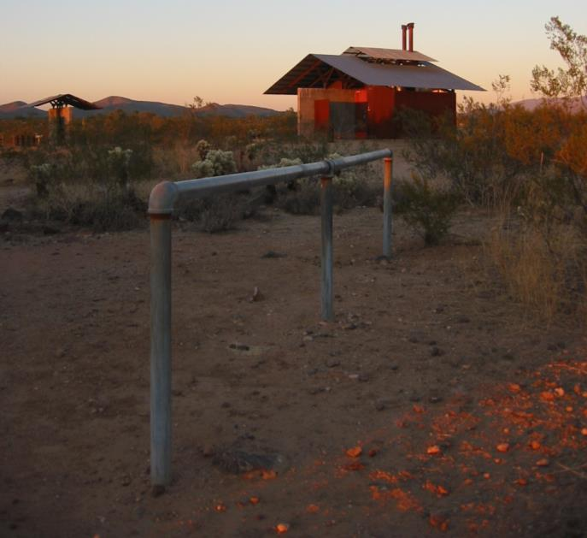
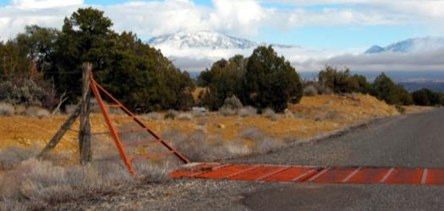
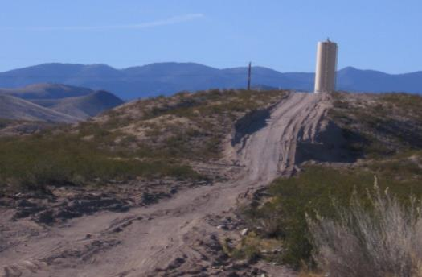
Project Planning Essentials

Slide 3
Project Planning Essentials
Unit Objective
Students will understand the distinctions between Land Use Plan Conformance and NEPA Compliance for project proposals, and will recognize the need to incorporate visual resource concepts and values early and throughout all phases of project planning.

Slide 4
Project Planning Essentials
Project Planning
Plan Conformance vs NEPA Compliance
Plan Conformance: Does the project meet VRM Class Objectives?
NEPA Compliance: What are the effects to visual resources and values (VRI) and how can they be avoided, reduced, or mitigated regionally?
Both analyses use Visual Resource concepts and tools (Units 6-11)

Slide 5
Project Planning Essentials
Project Planning
Key Points to Remember
Understand the proposed project
Consider a “1st impression” of plan conformance
Clear and obvious v Contrast Rating
Coordinate with the project proponent
Incorporate visuals early and throughout the project planning

Slide 6
Project Planning Essentials
Project Planning
Key Points to Remember
Understand existing constraints
A team approach is best
Field review is essential
Consider how types of projects influence planning and design
Don’t jump to design too soon

Slide 7
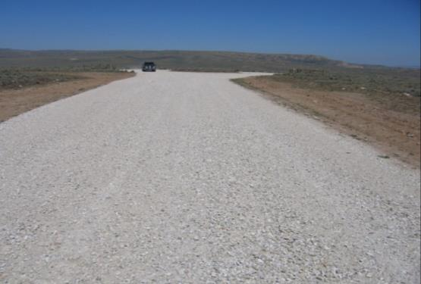
Project Planning Essentials
Incorporation of Visuals in Planning
Better efficiency
Better chance of acceptance
Better projects
Less chance for costly, time delaying court challenges
Avoid/minimize mitigation
Image Caption (if needed)
Image Caption (if needed)

Slide 8
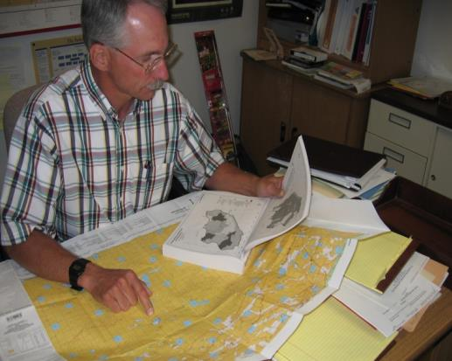
Project Planning Essentials
Understanding Existing Constraints
Law, Mgt. Strategies, Guidance
RMPs, MFPs, City and County Plans
VRM Management Classes
Activity Plans, including
Travel Management Plans,
Transportation Plans,
Master Plans,
Recreation Area Management Plans
Project plan, design guidance/standards
Existing facilities
Image Caption (if needed)

Slide 9
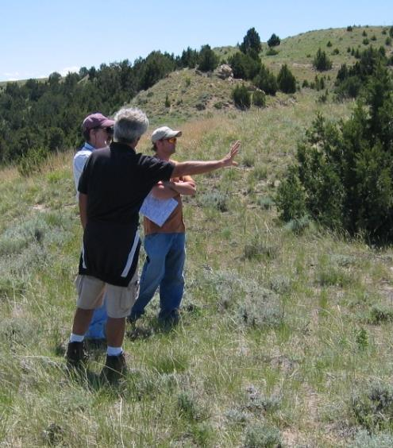
Project Planning Essentials
Team Approach is Best
Minimizing visual impacts is everyone’s job.
Include all of the disciplines that have a significant stake.
Include external stakeholders early on.
Increases the credibility of the recommendations and makes project easier to implement.

Slide 10
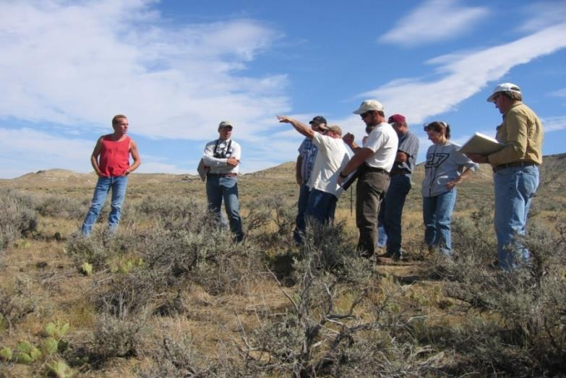
Project Planning Essentials
Field Review is Essential
Proponent and planning team can only meaningfully discuss project on site.
Keeps everyone on the same page.
Misunderstandings can be avoided.
Project parameters can be determined more easily.

Slide 11
Project Planning Essentials
Types of Projects
Linear alignments (roads, bridges, transmission corridors, pipelines)
Energy production (oil and gas, wind, solar, geothermal, hydro)
Mineral extraction (mining, gravel operations )
Vertical development (communication sites, radio, cellular)
Vegetative manipulation (fire and fuels, restoration and rehabilitation, timber)
Wildlife and Range (habitat or range improvement, enclosures, water sources)
Recreation and administrative sites (trails, toilets, campgrounds, visitor centers)

Slide 12
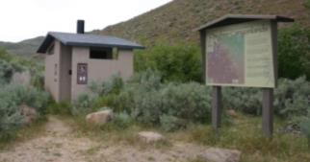
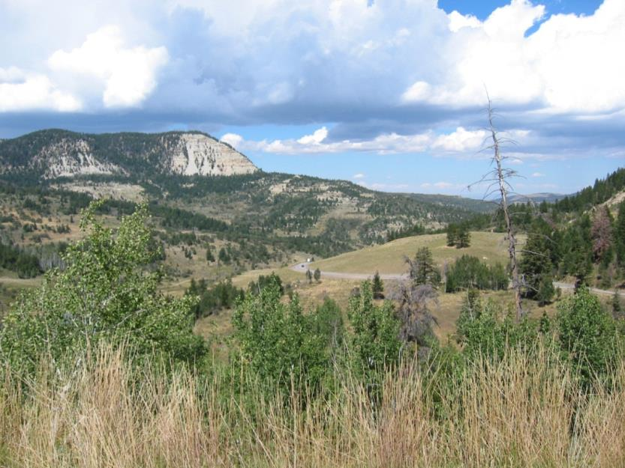
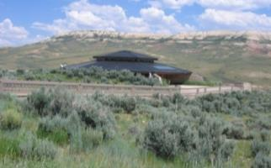
Project Planning Essentials
Don’t Jump to Design Too Soon
Thoughtful and comprehensive planning leads to better design.
Saves time and money if planning leads design.

Slide 13
Project Planning Essentials
Analyzing Impacts using VRI
Integrate VRI (overall values & individual components)
Establish Key Observation Points (KOPs)
Conduct “viewshed analysis” appropriate to the scale of the proposal
Handouts: Analysis of Visual Resources in EAs
and Impact Indicators

Slide 14
Project Planning Essentials
Alternatives to Consider
Formulate alternatives that meet P&N while mitigating visual effects
Ensure conformance of each alternative with the RMP’s VRM Class objectives
Explore ways to further reduce visual effects of otherwise conforming projects

Slide 15
Project Planning Essentials
If the Proposal Cannot Conform
Contemplate RMP Amendment
ONLY as a last resort
Considering the intent/integrity of the original RMP
Follow RMP Amendment procedures (major v minor)
And offset visual losses through regional mitigation

Slide 16
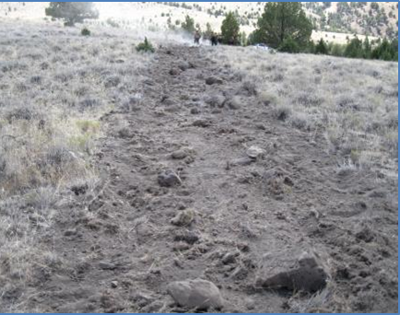
Project Planning Essentials
All Done and Dusted?
Following project design and approval:
Monitor implementation for compliance with design features
Assess over time for effectiveness of design features

Slide 17
Project Planning Essentials
Rigorous Post-unit Academic Analysis
It’s Q Time!
Quiz me!
Questions?

