Slide 2
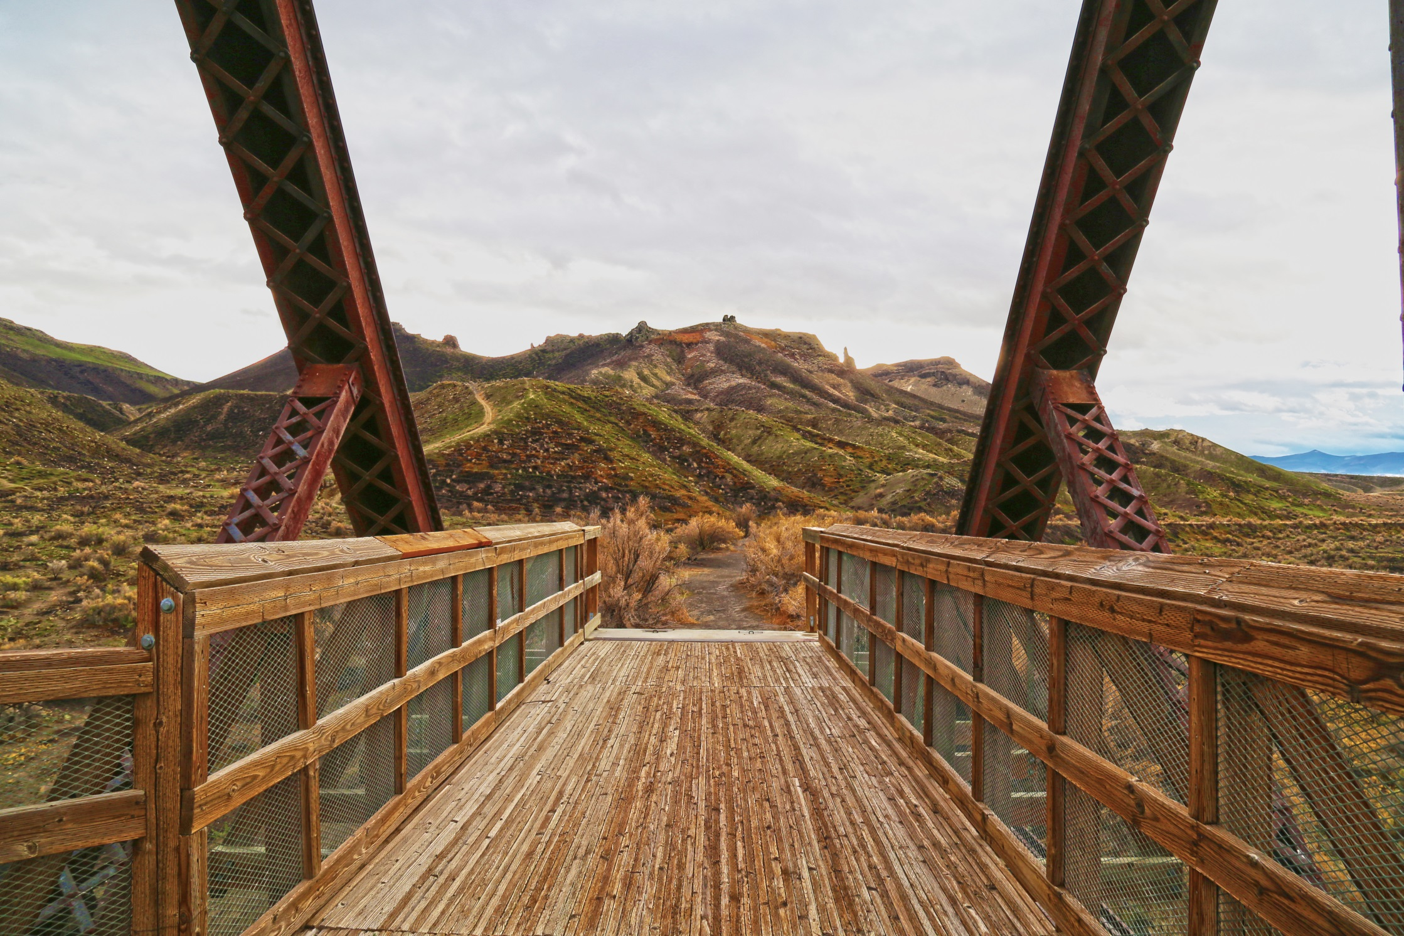

Slide 3
Unit Objectives
Overall Objective
Provide an overview of concepts, methods, and techniques to design projects in a way that minimize adverse effects to visual resources.
Visual Resource Management Objective
Manage public lands in a manner which protects their scenic values.
Objective for Projects
Design and construct projects so they are compatible with the natural character of the landscape.

Slide 4
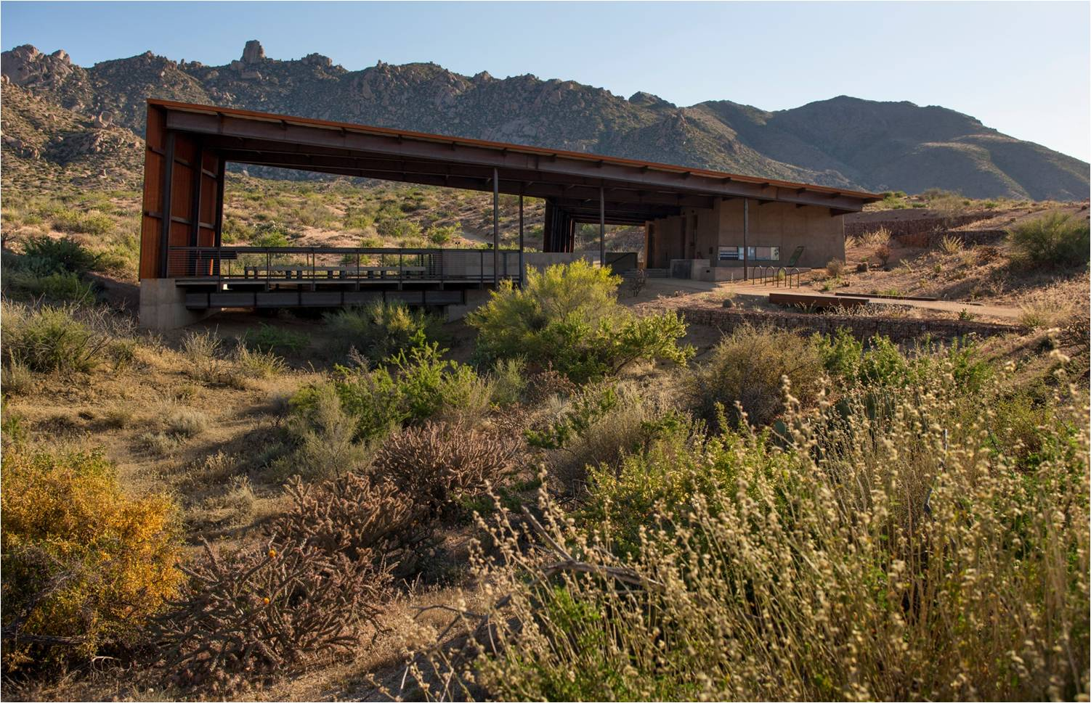
Not Just Design… Good Design.
Successful implementation of fundamental visual design principles is critical to protect and maintain the natural scenic integrity of the American public landscape.

Slide 5
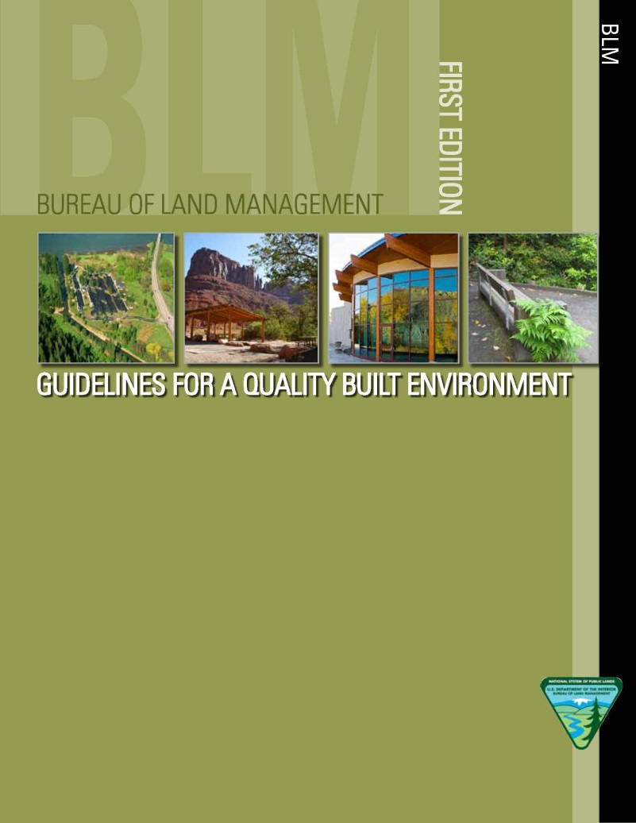
Not Just Design… Good Design.

Slide 6
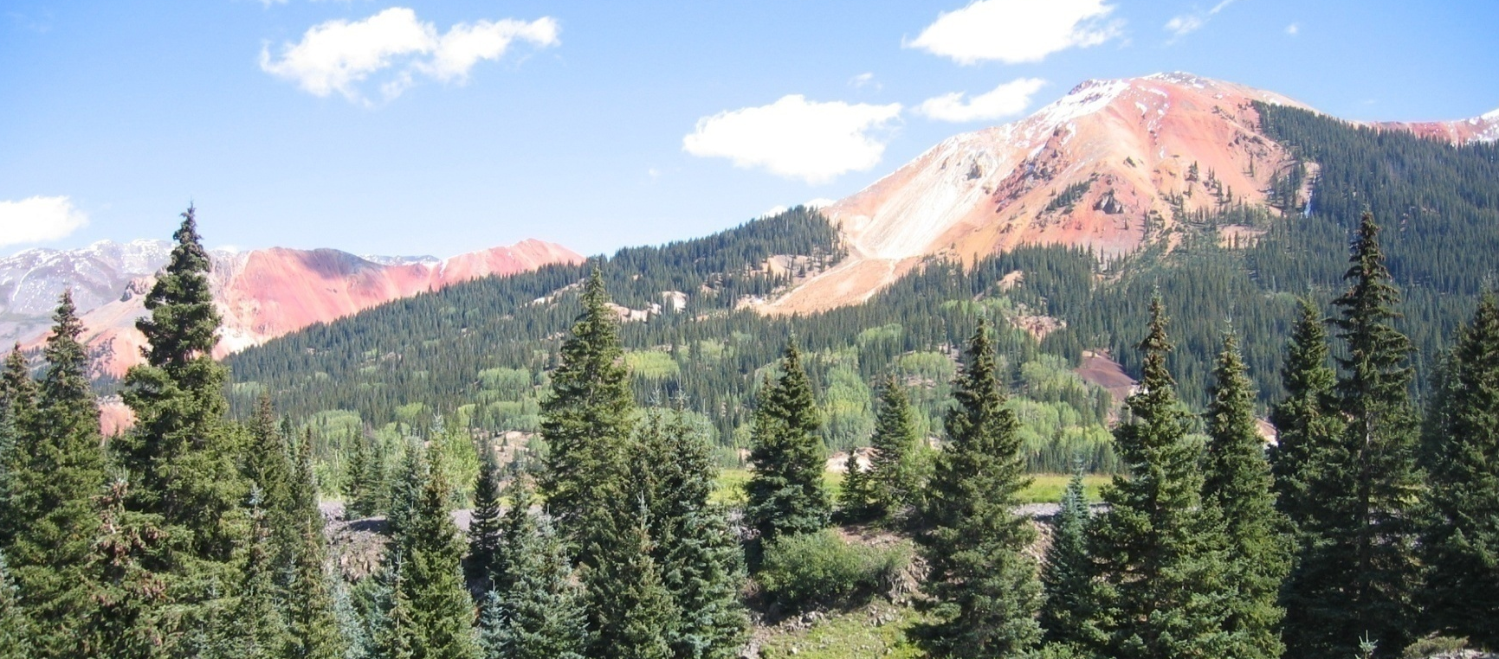
Visual Absorption Capacity
“Visual absorption capacity” is defined as the landscape's ability to absorb physical changes without transformation in its visual character and quality.”

Slide 7
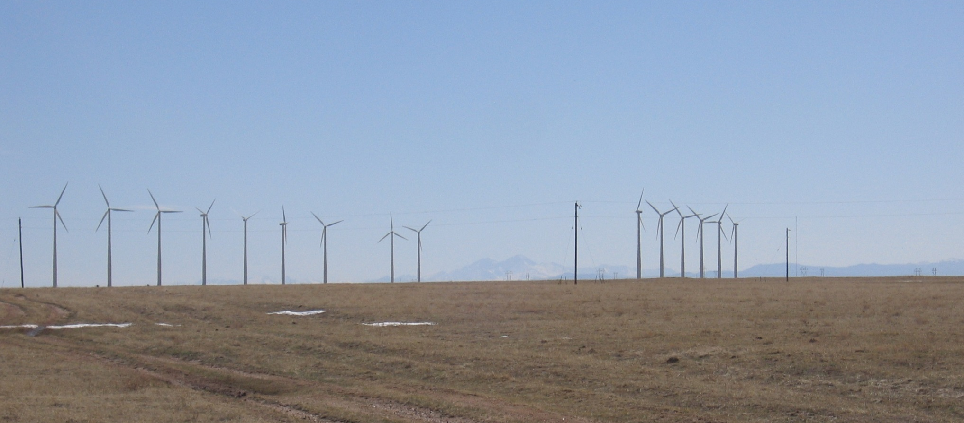
Visual Absorption Capacity
Landscapes with low visual variety have a lower capability to absorb visual impacts.

Slide 8
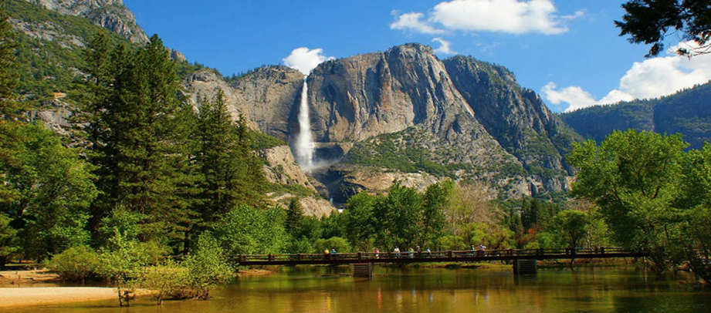
Visual Absorption Capacity
Landscapes with high visual variety have a higher capability to absorb visual impacts.

Slide 9
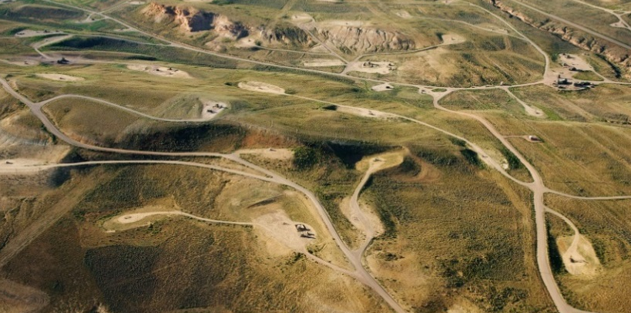
Three Basic Strategies
Proper siting and location
Reduction of unnecessary surface disturbance
Repetition of landscape character elements
1)
2)
3)

Slide 10
Strategy I
Proper siting and location
Reduction of unnecessary surface disturbance
Repetition of landscape character elements
1)
2)
3)

Slide 11
Proper Siting and Location
The Project may be…
Screened by topography.
Screened by vegetation.
Carefully located away from visually sensitive areas.
Located away from dominant landscape features.
Locate the project in a manner that reduces the visibility of both structures and/or associated surface disturbance.

Slide 12
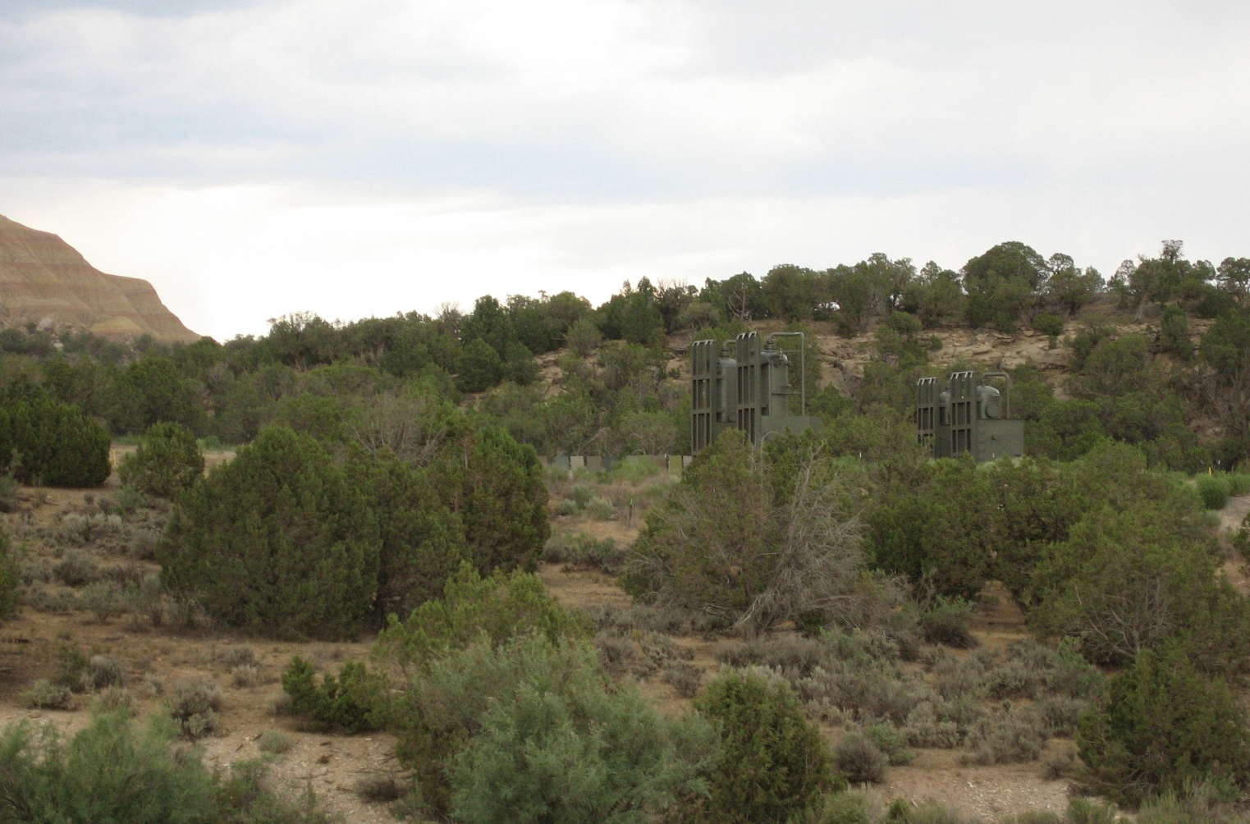
Proper Siting and Location

Slide 13
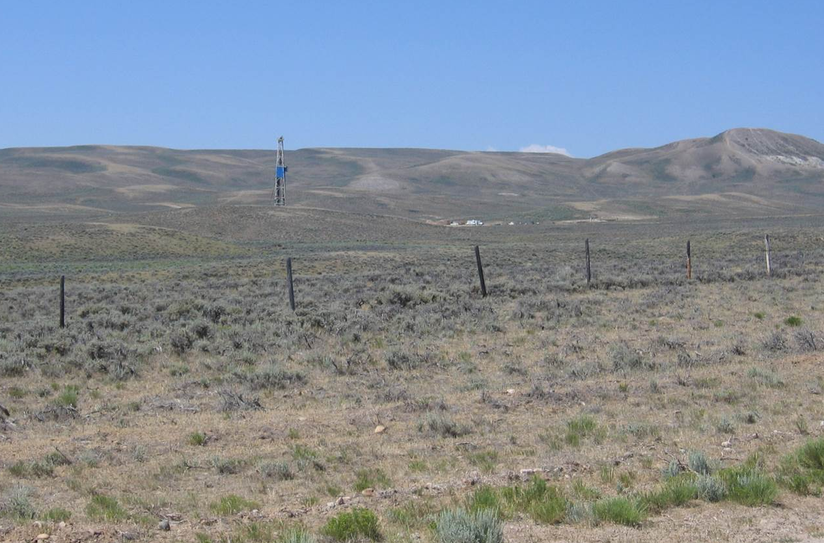
Proper Siting and Location

Slide 14
Proper Siting and Location

Slide 15
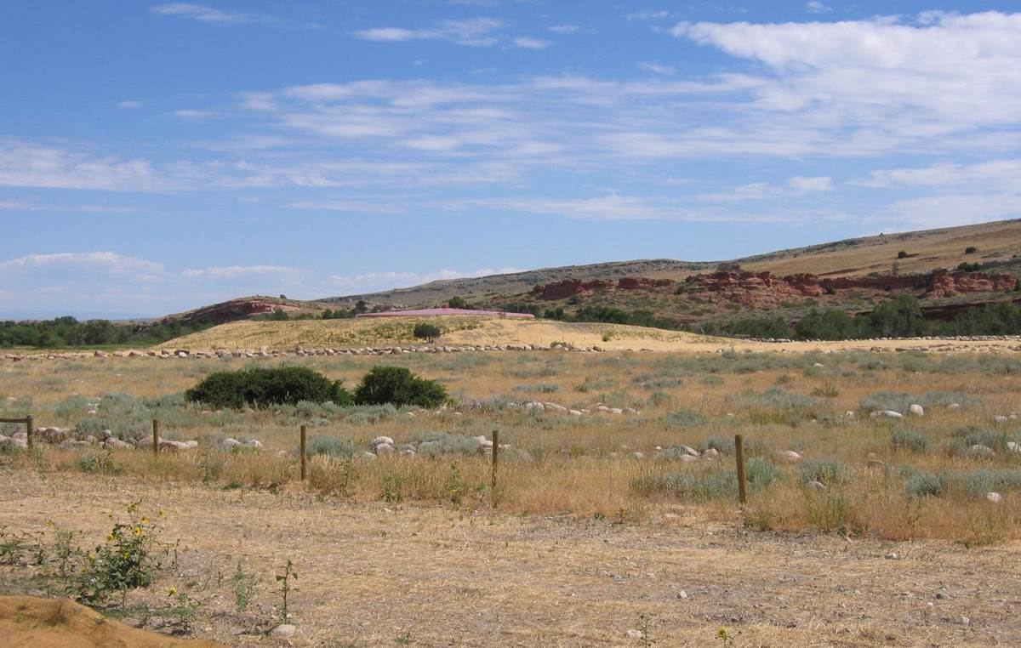
Proper Siting and Location

Slide 16
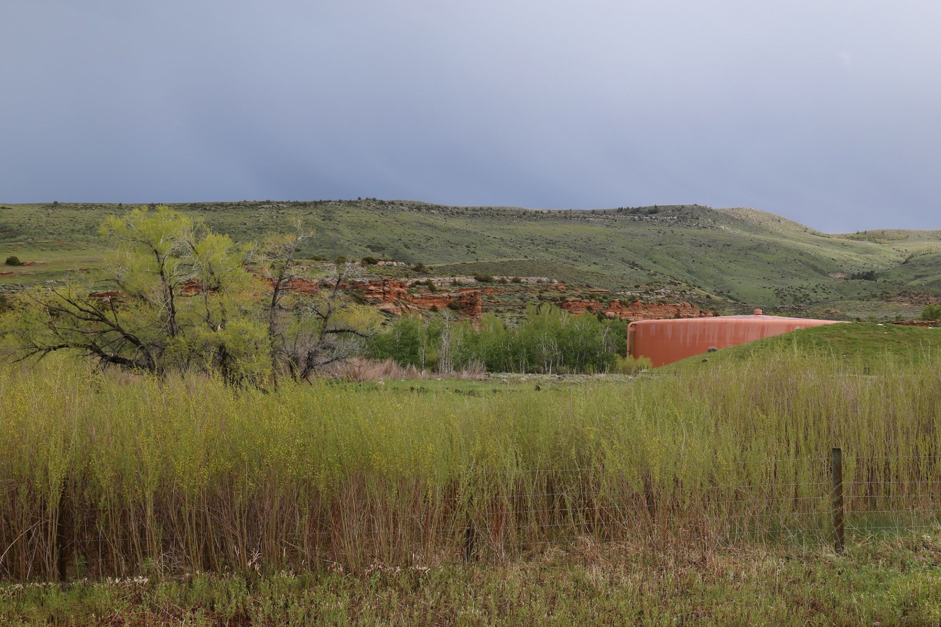
Proper Siting and Location

Slide 17
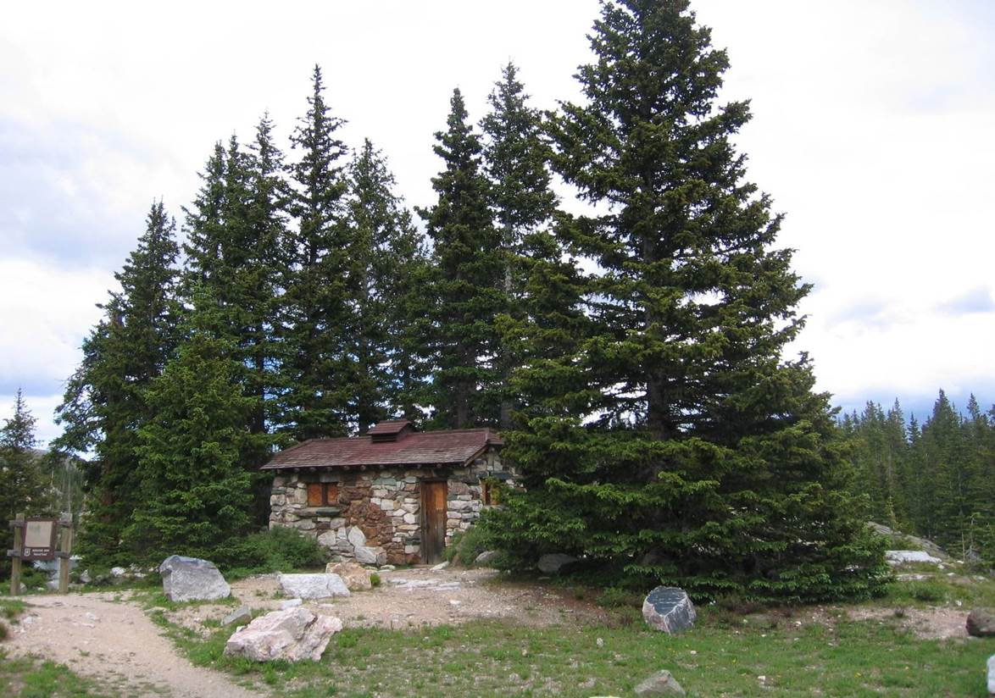
Proper Siting and Location

Slide 18
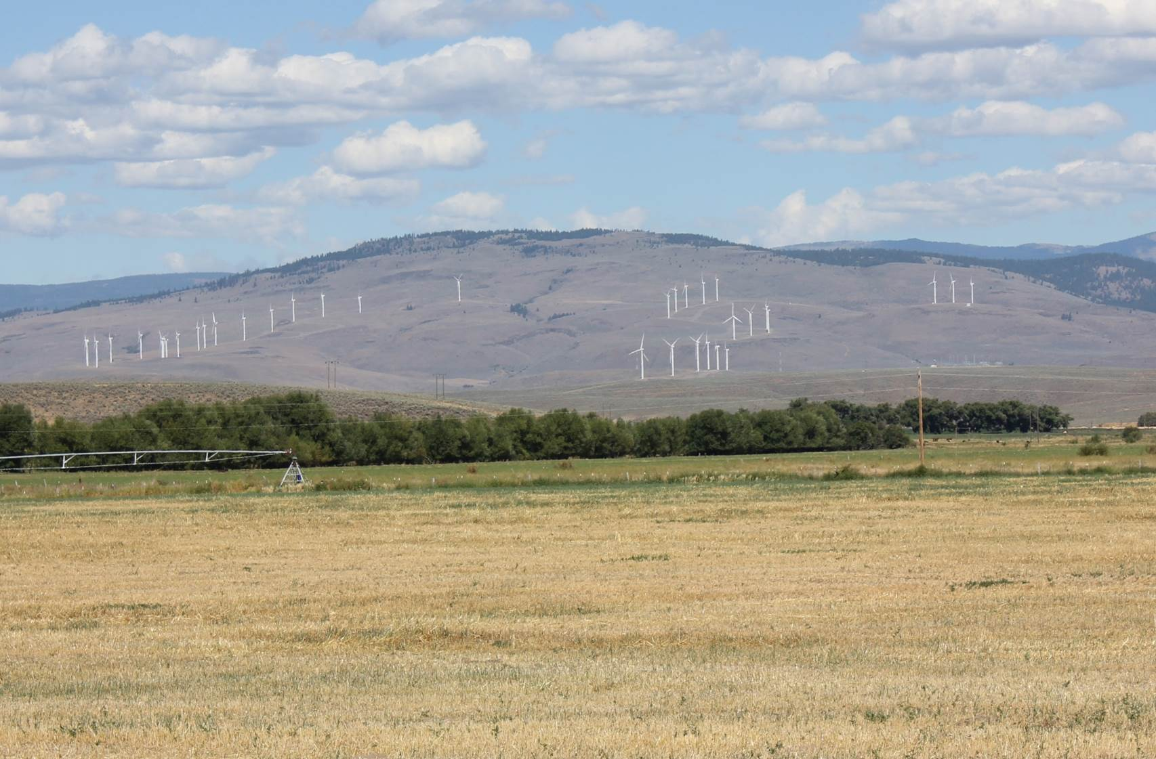
Proper Siting and Location

Slide 19
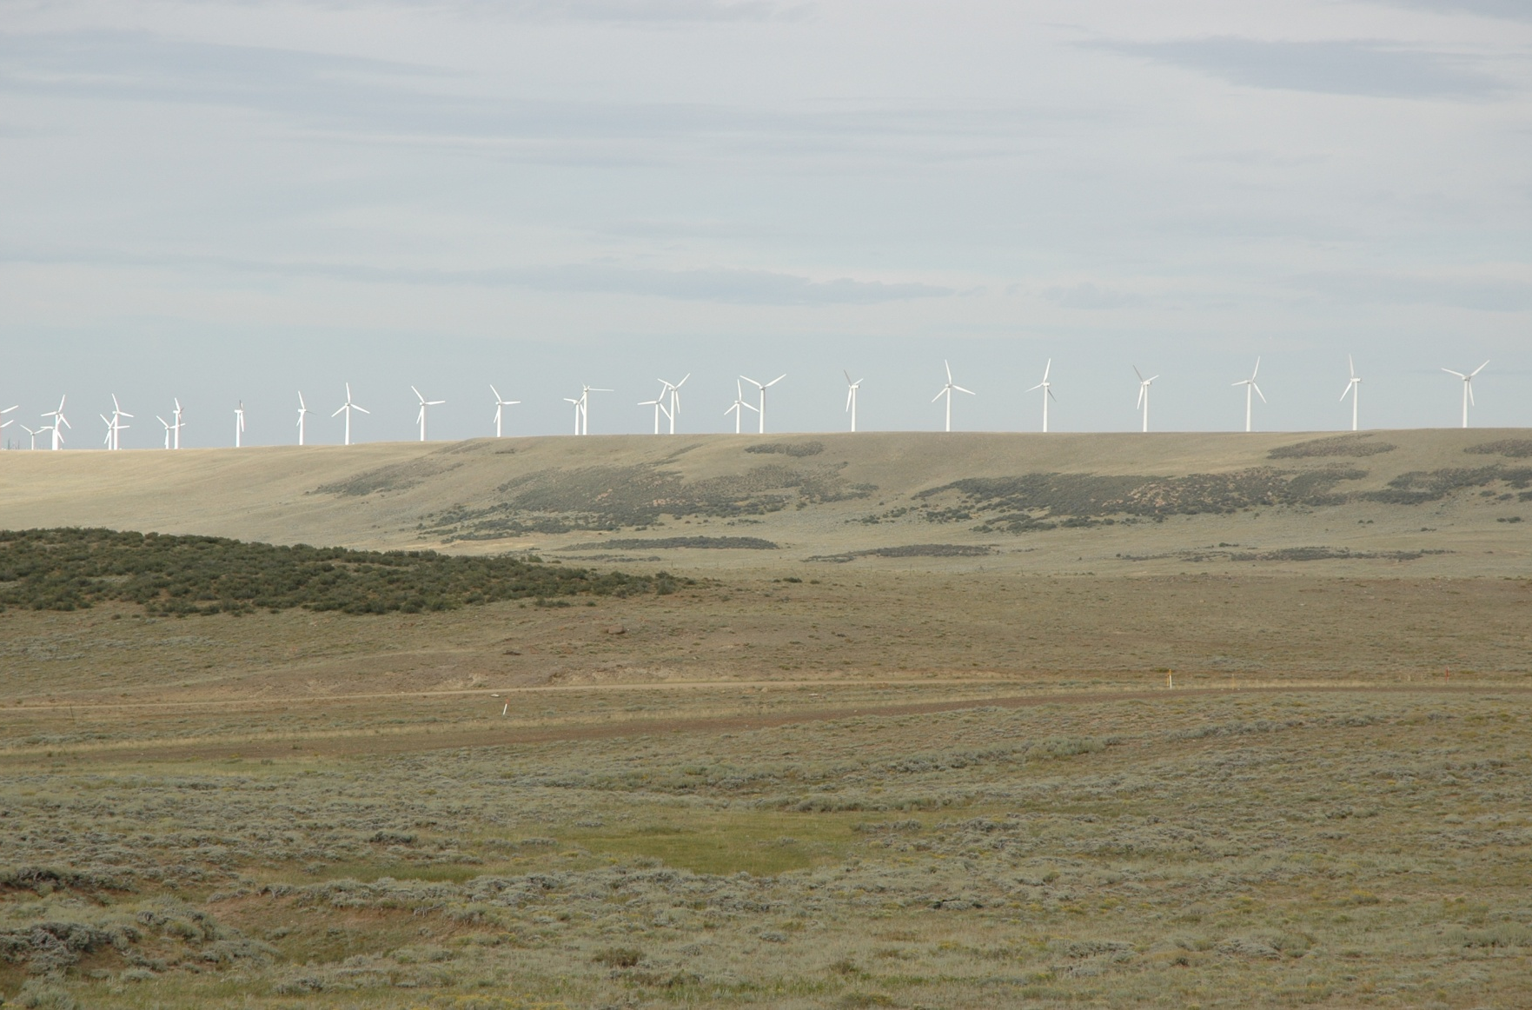
Proper Siting and Location

Slide 20
Siting & Locating Linear Projects
Tips for effective design and construction of linear types of projects:
Fit to the contours of the landscape.
Repeat the landscape character elements.
Don’t over-build.
Co-locate project elements with other facilities.
Choose structures and facilities that minimize visual impact.

Slide 21
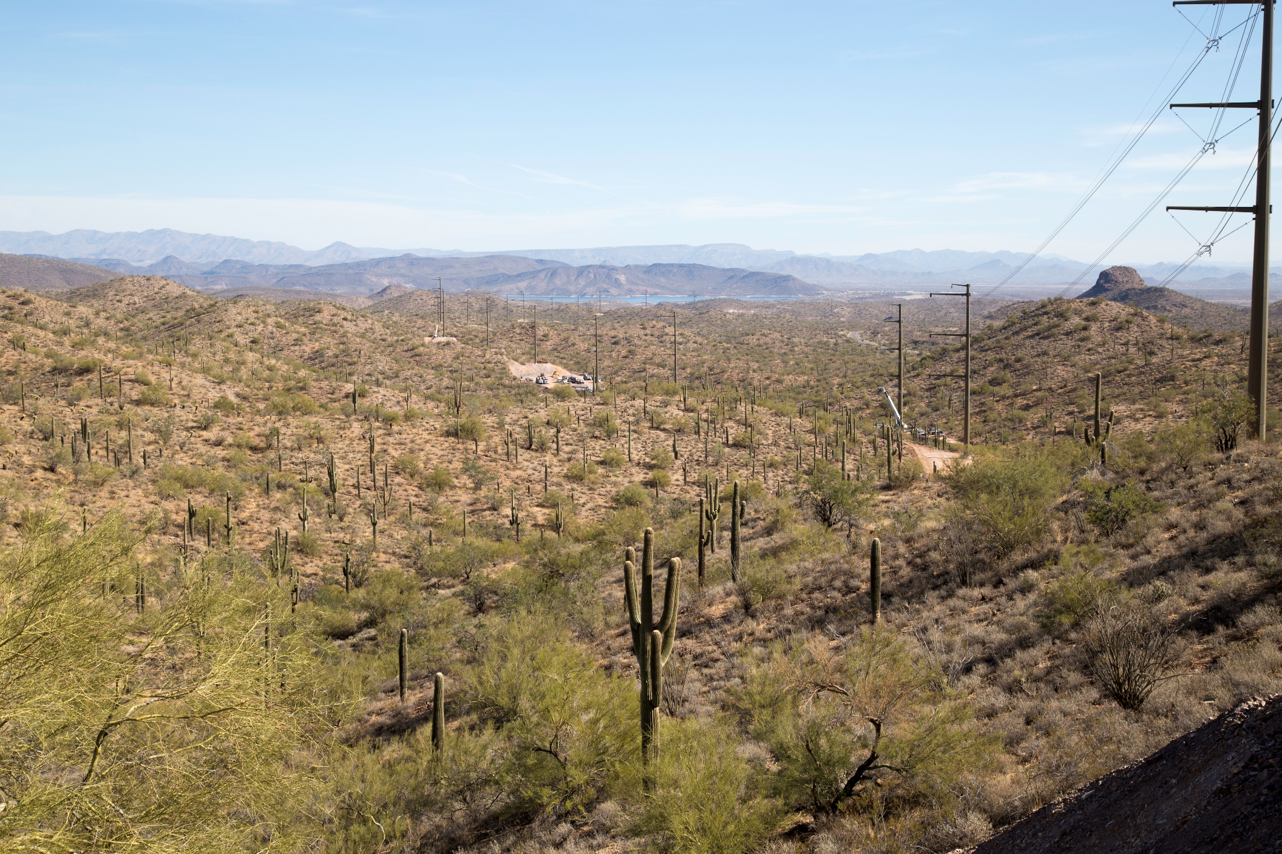
Siting & Locating Linear Projects

Slide 22
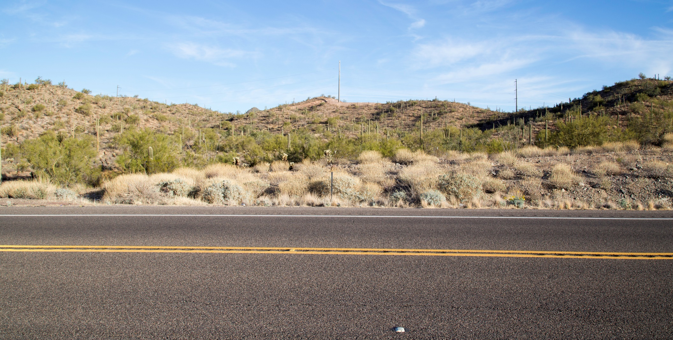
Siting & Locating Linear Projects

Slide 23
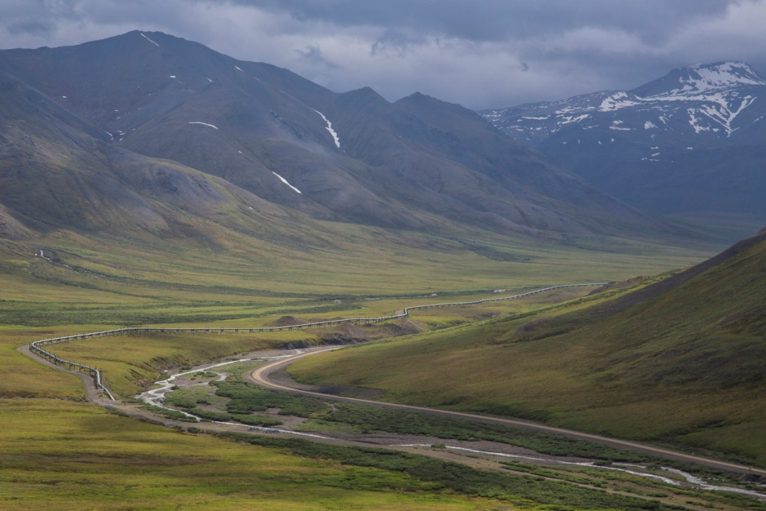
Siting & Locating Linear Projects
Notes:
More contrast between existing landscape and constructed elements (within proximity to a national historic trail)

Slide 24
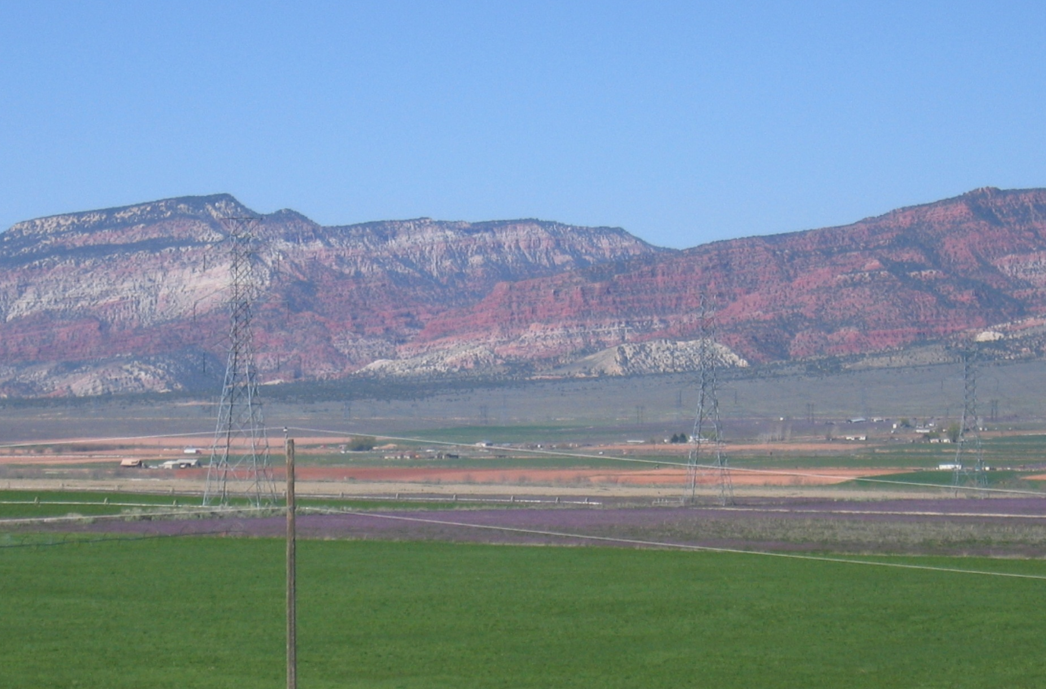
Siting & Locating Linear Projects
Notes:
Better example of elements blending

Slide 25
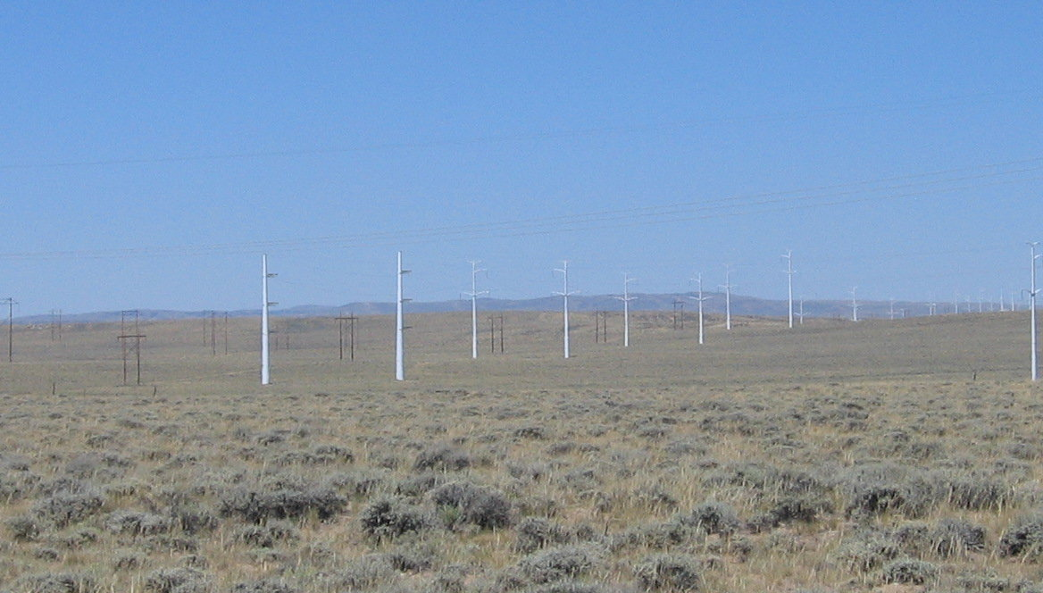
Siting & Locating Linear Projects
Notes:
More contrast between existing landscape and constructed elements (within proximity to a national historic trail)

Slide 26
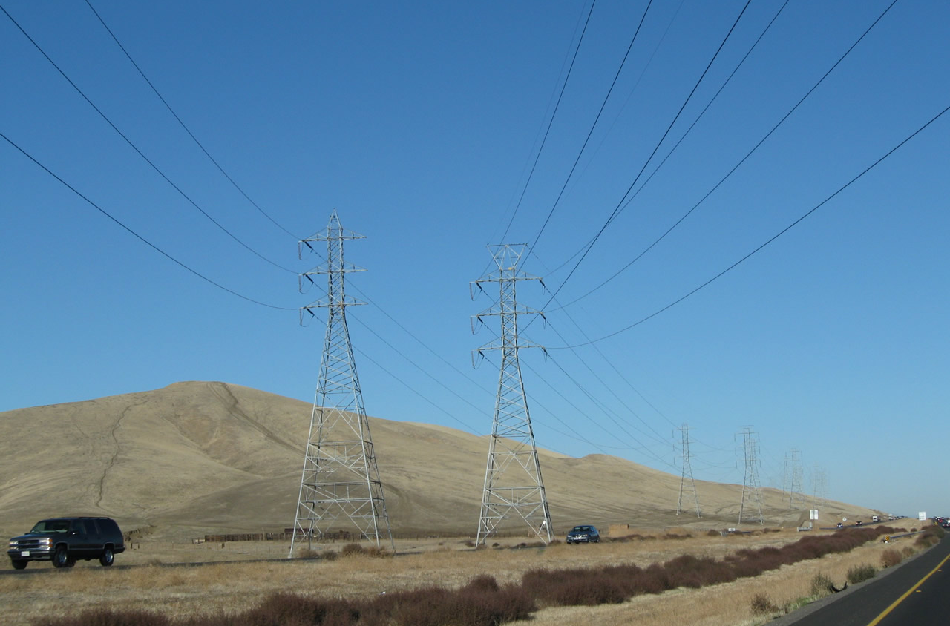
Siting & Locating Linear Projects
Notes:
More contrast between existing landscape and constructed elements (within proximity to a national historic trail)

Slide 27
Class Exercise
Class Exercise #1
Notes:
Improper siting & location
Failure to repeat landscape character elements, or
Failure to minimize unnecessary surface disturbance.

Slide 28
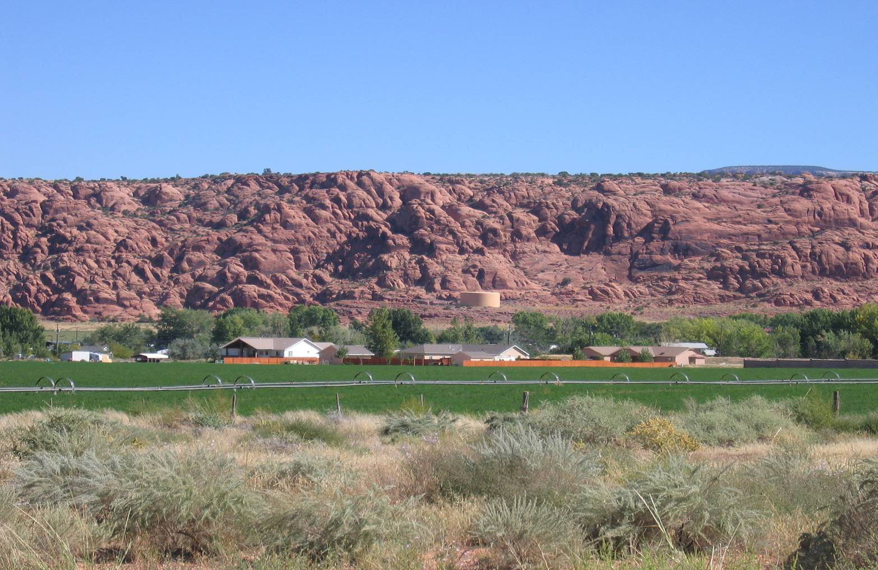
Class Exercise #1
Notes:
Improper siting & location
Failure to repeat landscape character elements, or
Failure to minimize unnecessary surface disturbance.

Slide 29
Strategy II
Proper siting and location
Reduction of unnecessary surface disturbance
Repetition of landscape character elements
1)
2)
3)

Slide 30
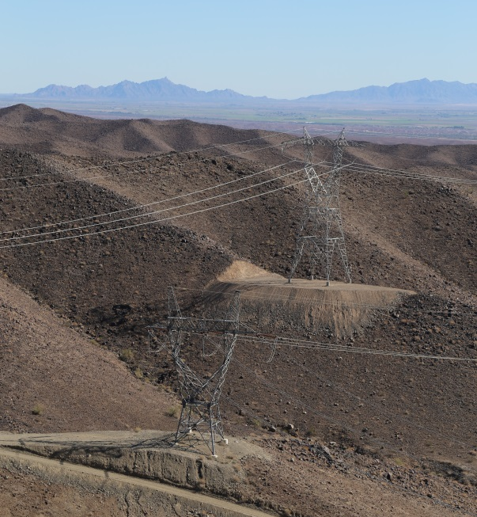
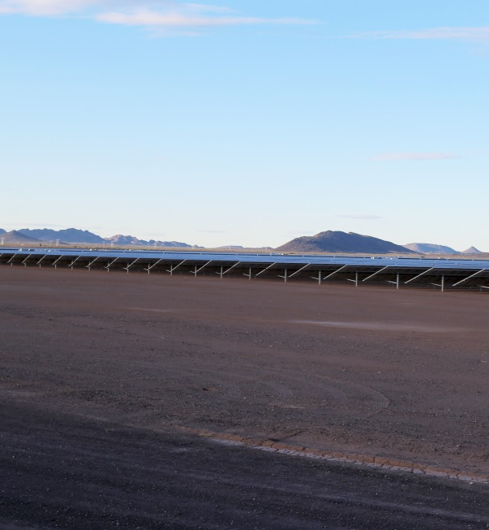
Reducing Unnecessary Disturbance
Fit the project to the landscape
Use smallest area necessary
Minimize cuts and fills
Interim rehabilitation
Final rehabilitation
Post-construction evaluation

Slide 31
Reducing Unnecessary Disturbance
Minimizing impacts of earthwork:
Avoid excessive cuts and fills.
Retain existing:
Rock formations
Vegetation
Drainage
Prohibit sloughing excess earthwork spoils/rock on downhill slopes.
Use retaining walls to reduce the amount and extent of earthwork.
Treat freshly cut rock faces with the use of rock stains.

Slide 32
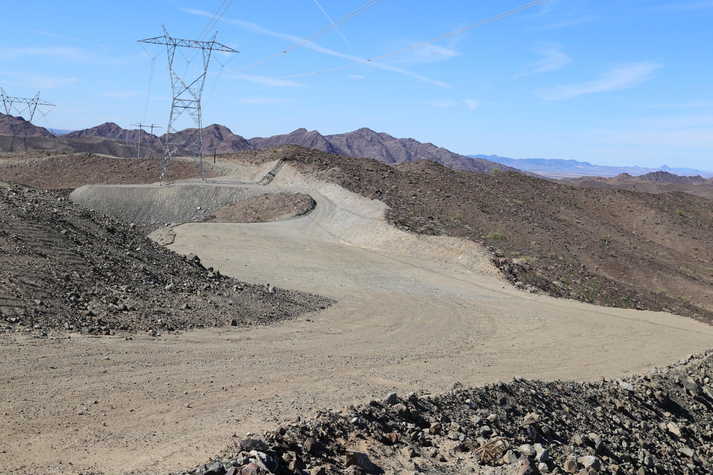
Reducing Unnecessary Disturbance

Slide 33
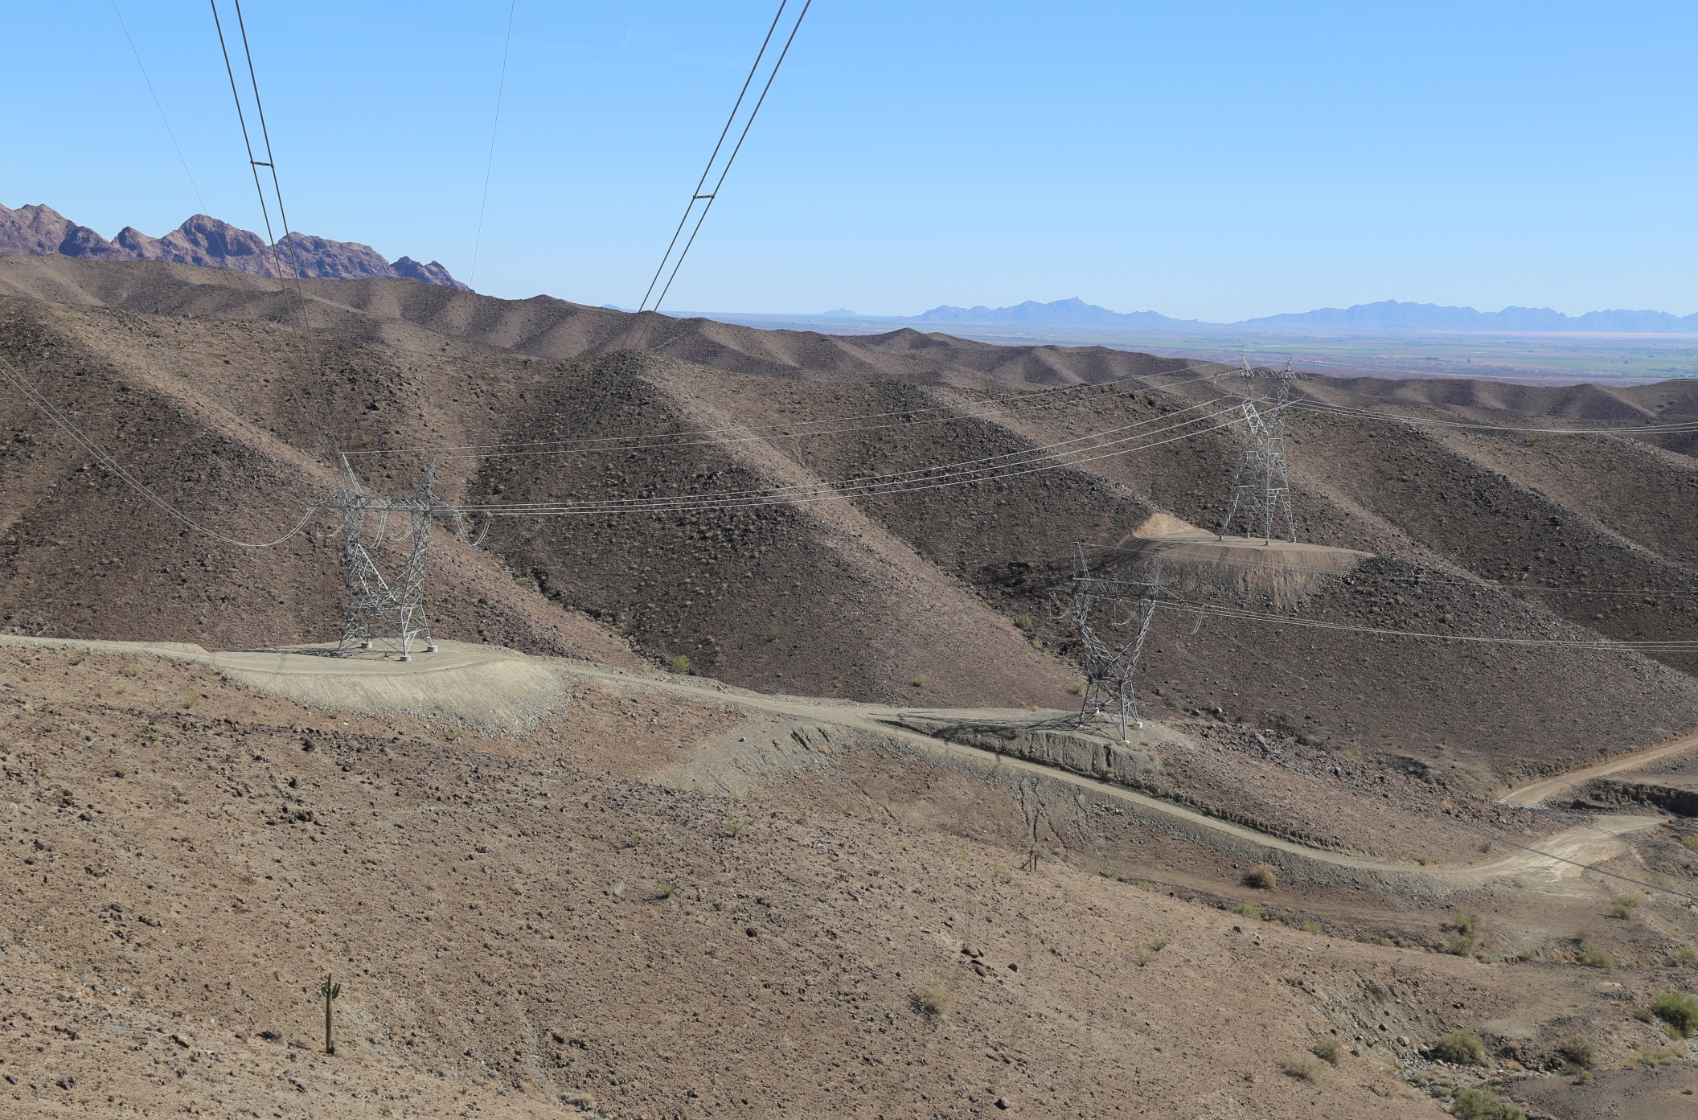
Reducing Unnecessary Disturbance

Slide 34
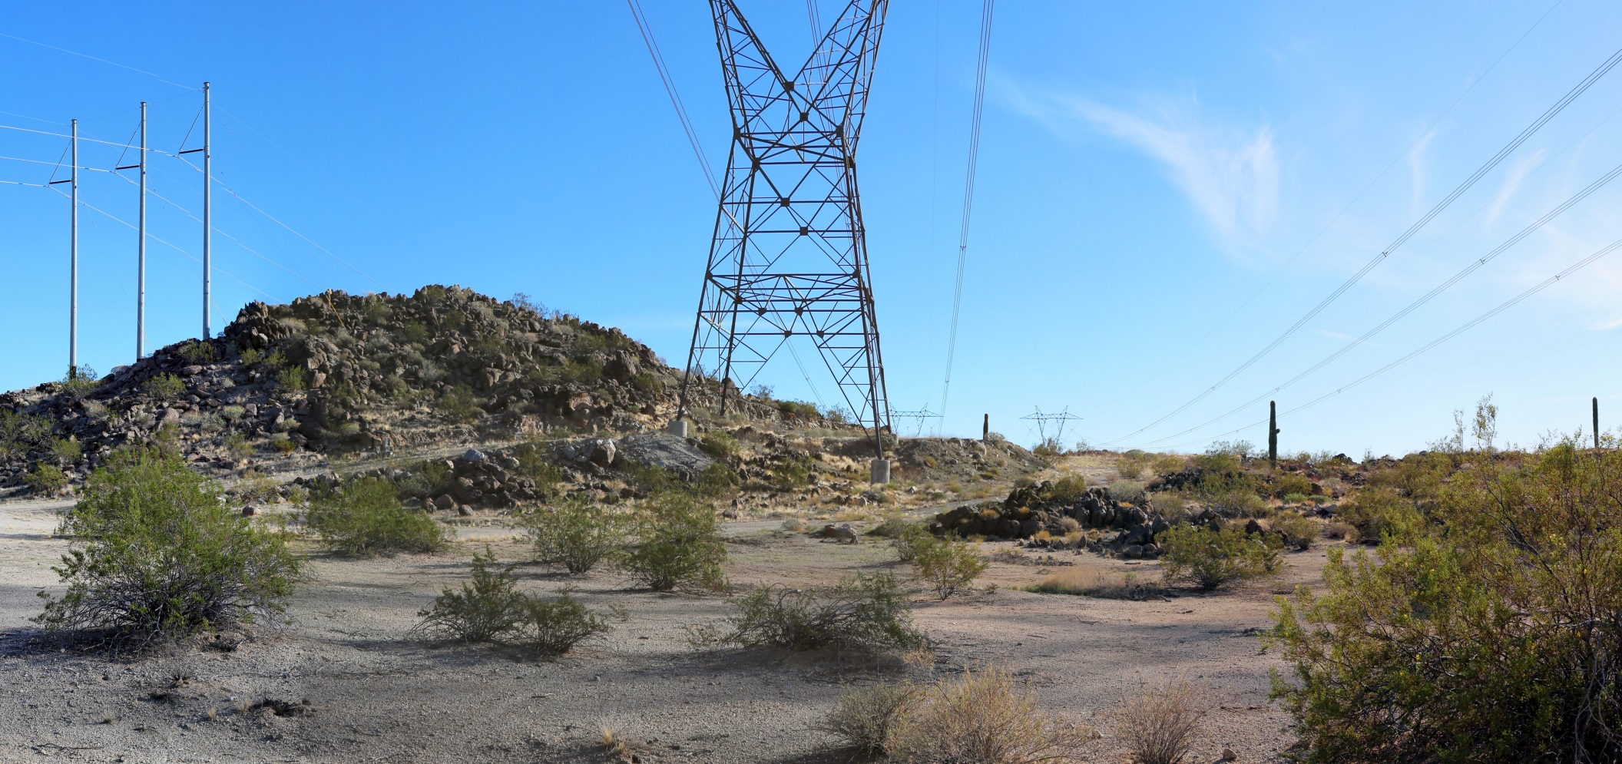
Reducing Unnecessary Disturbance

Slide 35
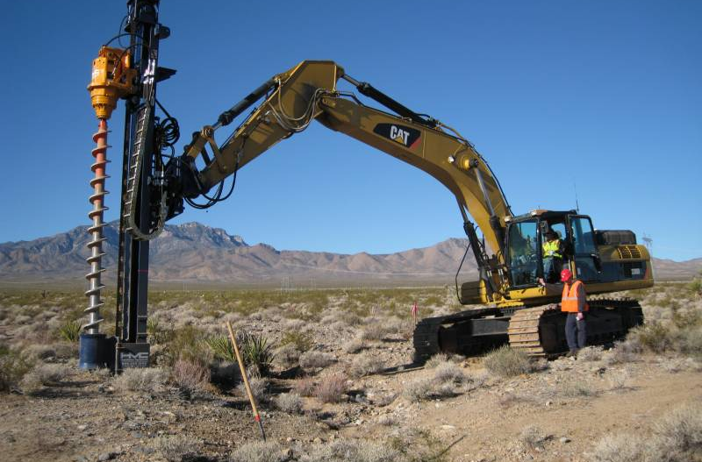
Reducing Unnecessary Disturbance
Notes:
http://hmc-us.com/foundation-drilling-equipment/hmc-model-pgs10.html

Slide 36
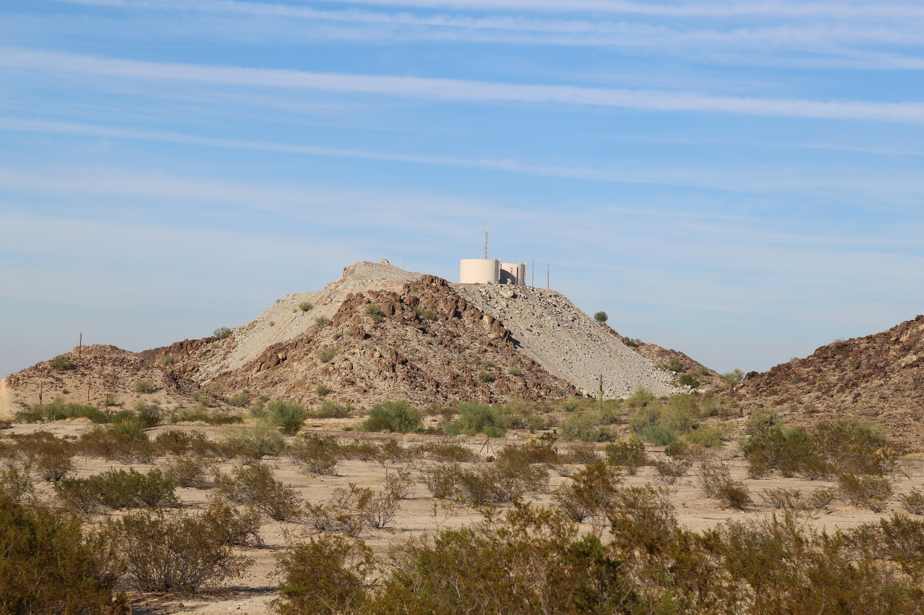
Reducing Unnecessary Disturbance
Notes:
Tanks could have been placed more inland. Also, spoils from the cut could have been better dealt with.
This is state land. It is surrounded by federal land.

Slide 37
Class Exercise
Class Exercise #2
Notes:
Improper siting & location
Failure to repeat landscape character elements, or
Failure to minimize unnecessary surface disturbance.

Slide 38
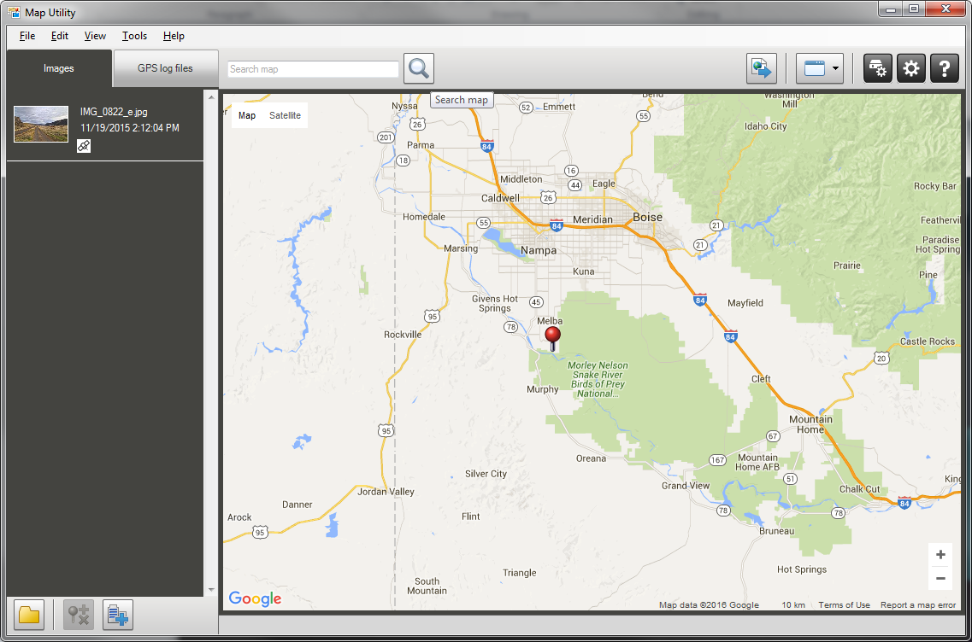
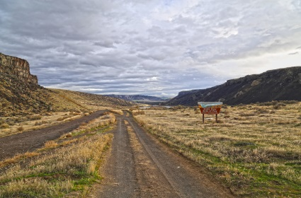
Class Exercise #2

Slide 39
Class Exercise #2

Slide 40
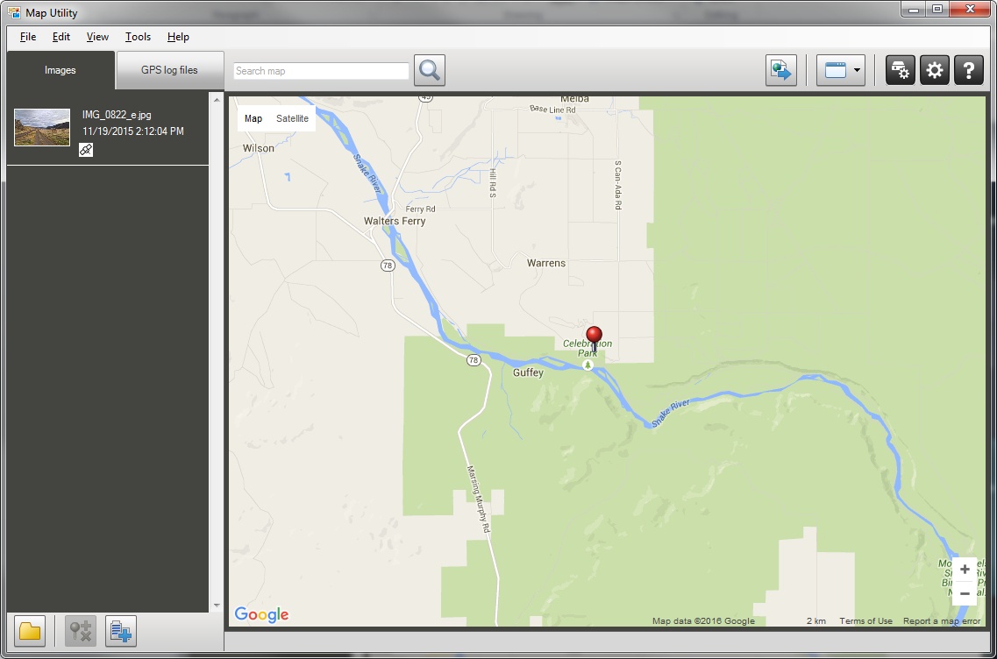
Class Exercise #2

Slide 41
Class Exercise #2

Slide 42
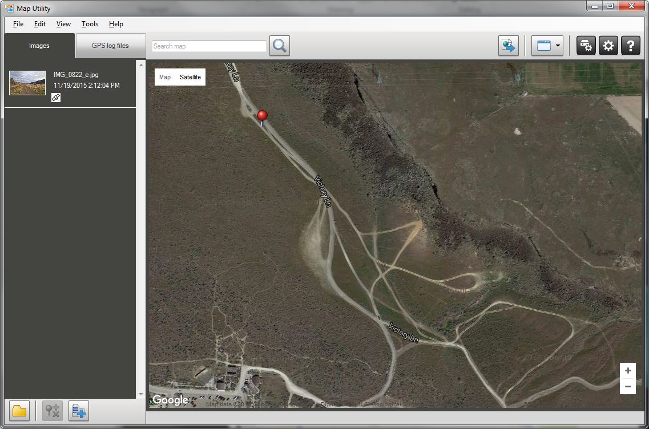
Class Exercise #2

Slide 43
Class Exercise #2

Slide 44
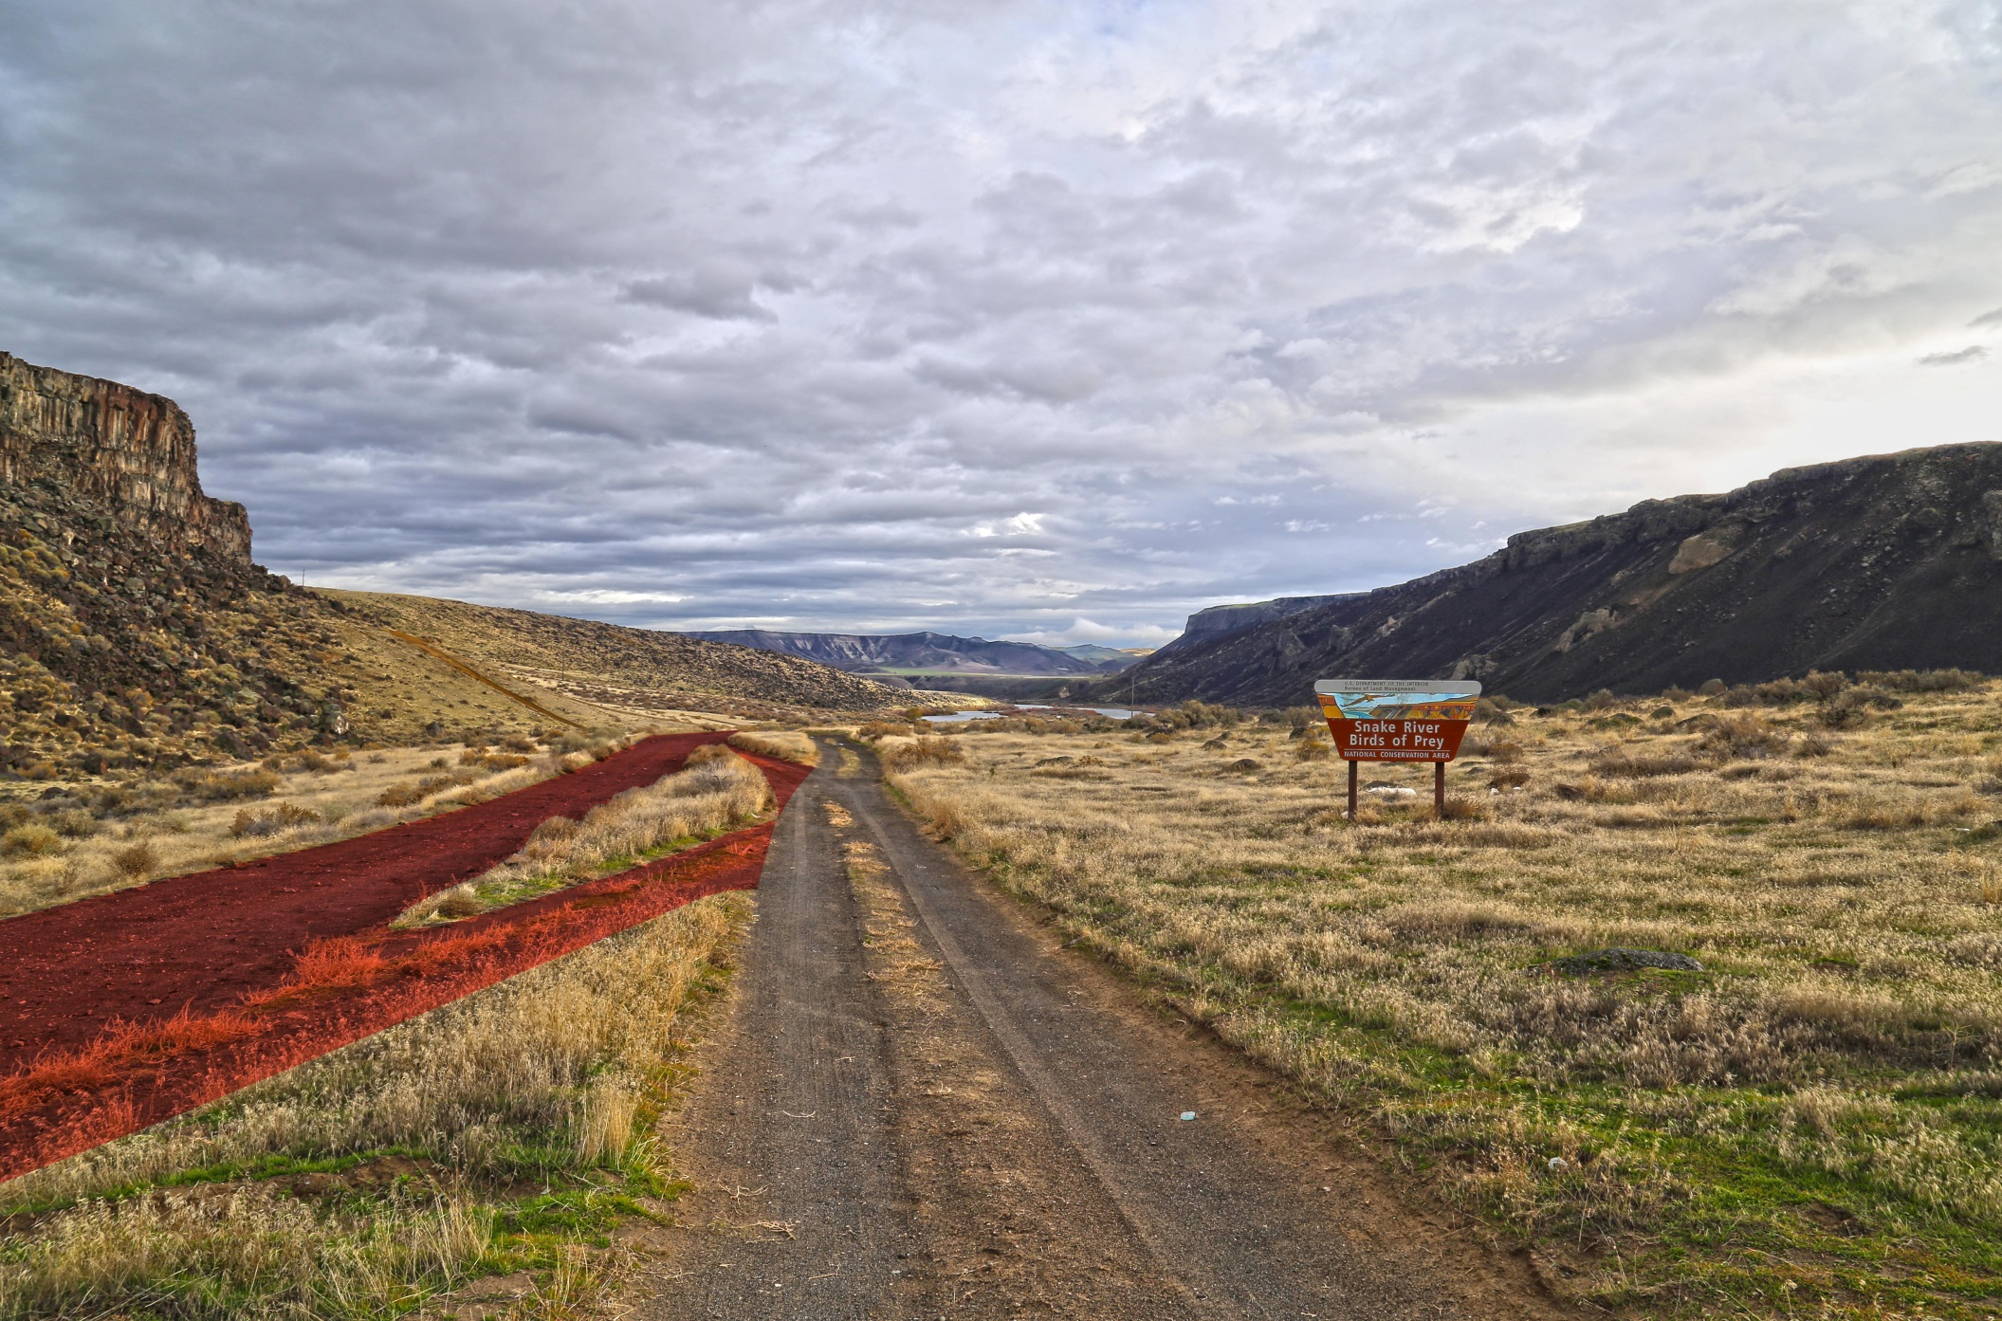
Class Exercise #2

Slide 45
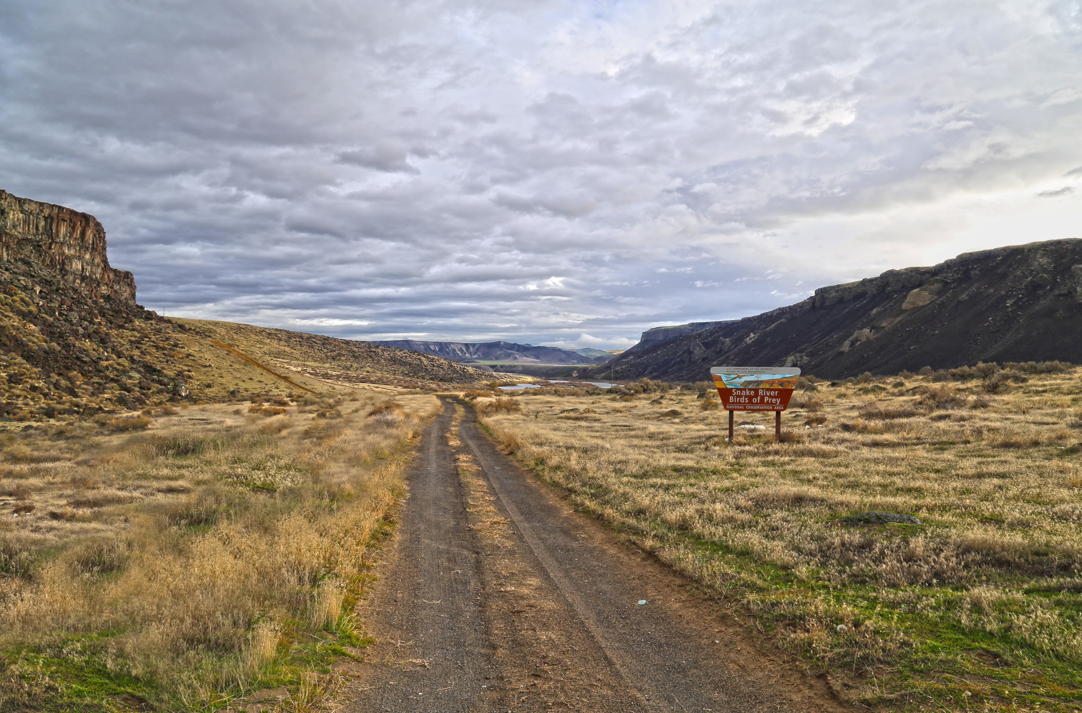
Class Exercise #2

Slide 46
Strategy III
Proper siting and location
Reduction of unnecessary surface disturbance
Repetition of landscape character elements
1)
2)
3)

Slide 47
Repetition of Landscape Elements
Designing and building a project in a manner that repeats or mimics the natural character elements in the landscape such as:
Modifications repeat the forms in the landscape.
Modifications repeat lines in the landscape.
Modifications repeat colors in the landscape.
Modifications texture is similar to textures in the landscape.

Slide 48
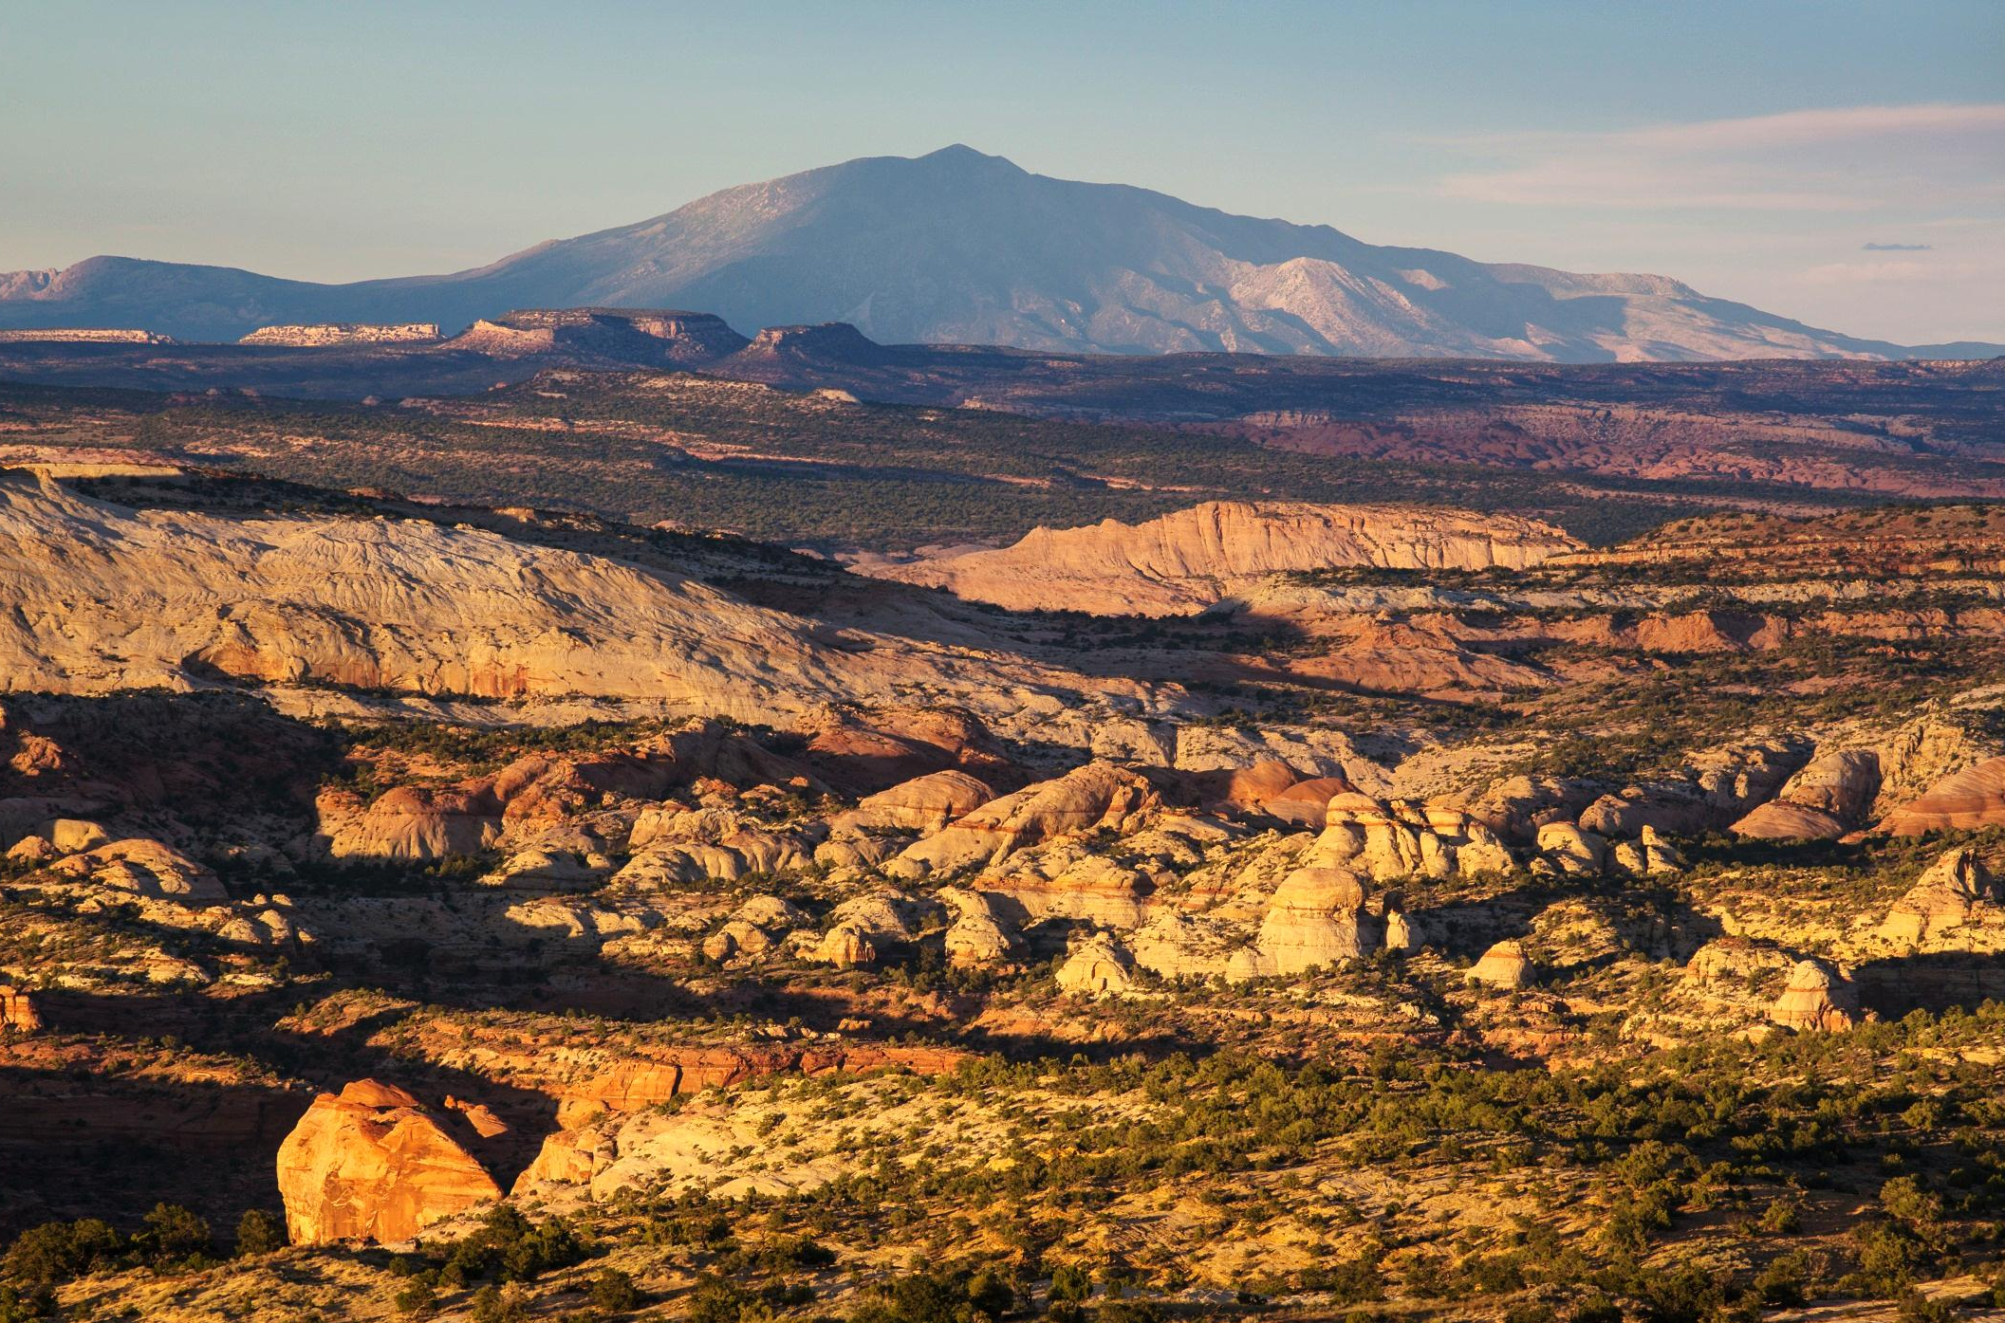
Repetition of Form

Slide 49
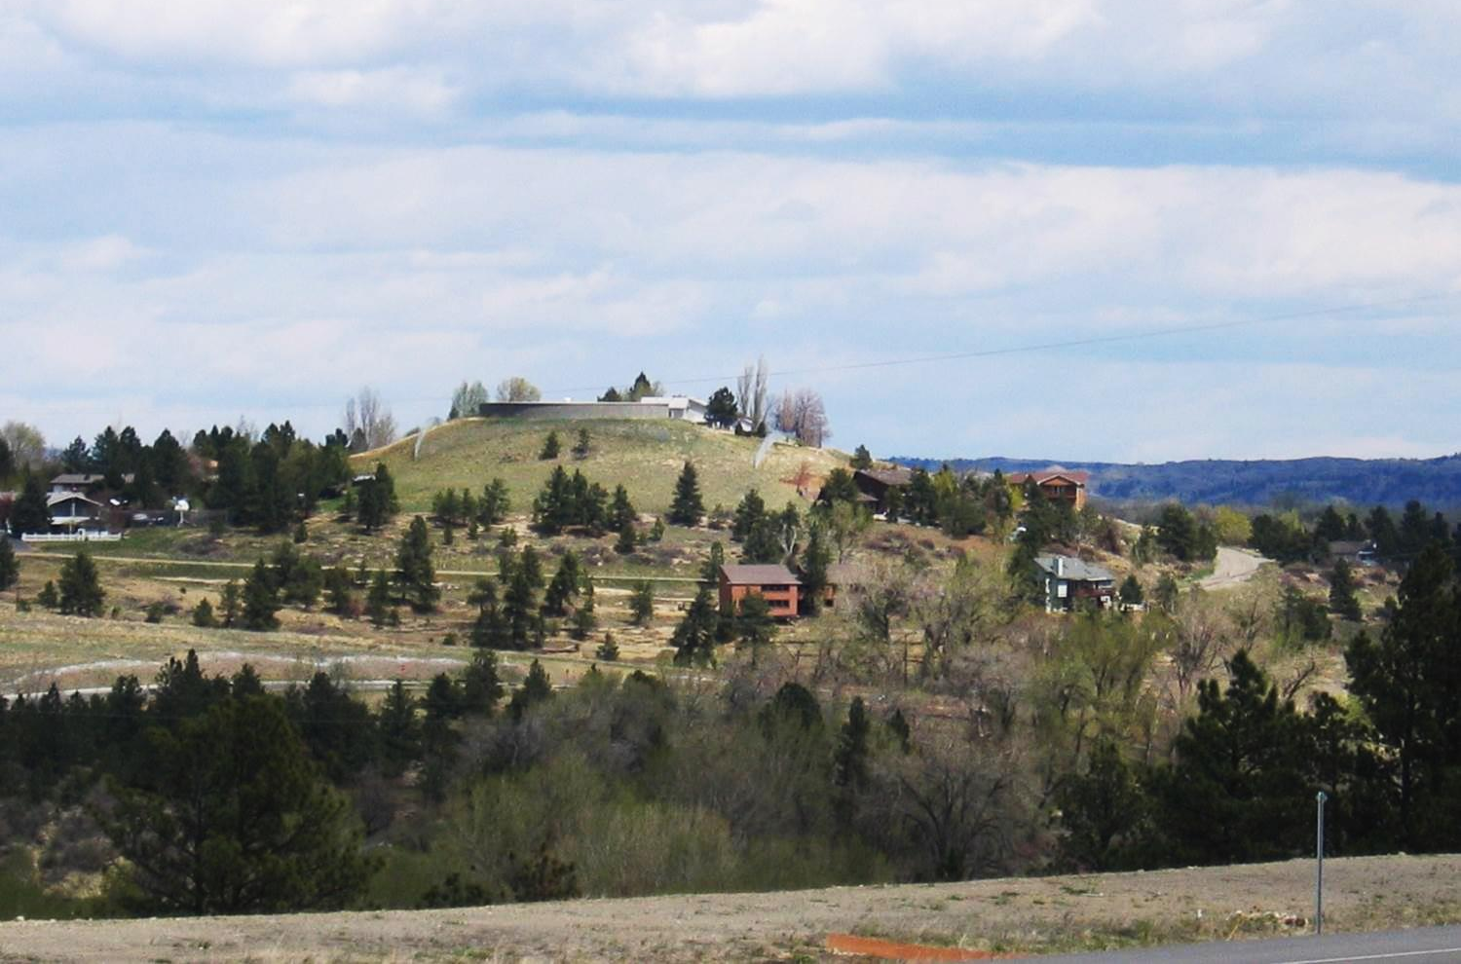
Repetition of Form

Slide 50
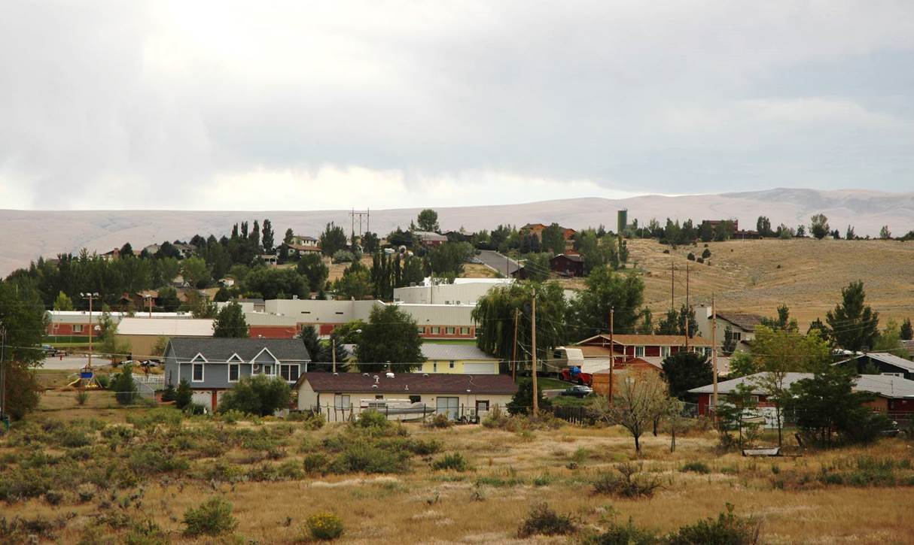
Repetition of Form

Slide 51
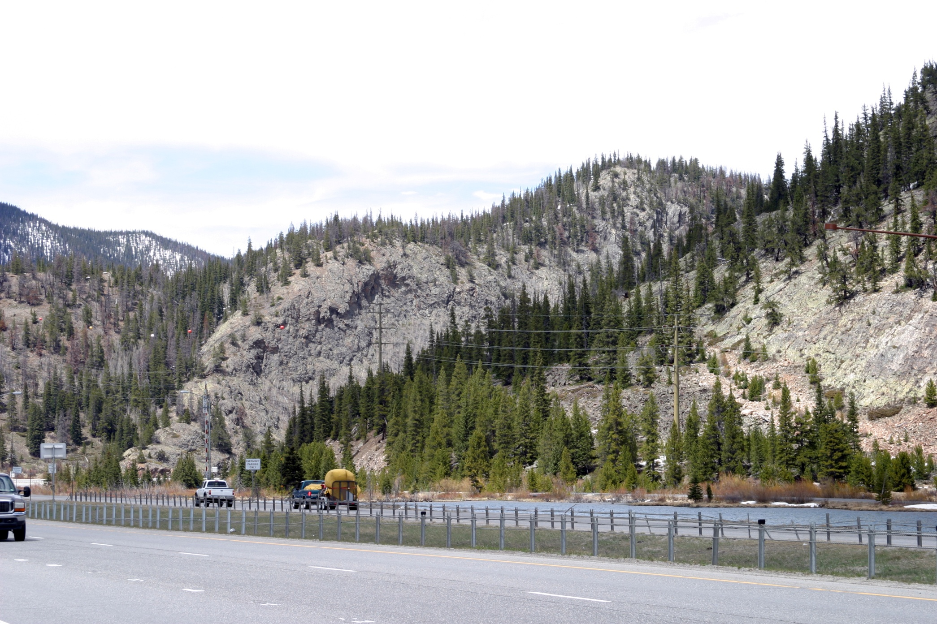
Repetition of Form

Slide 52
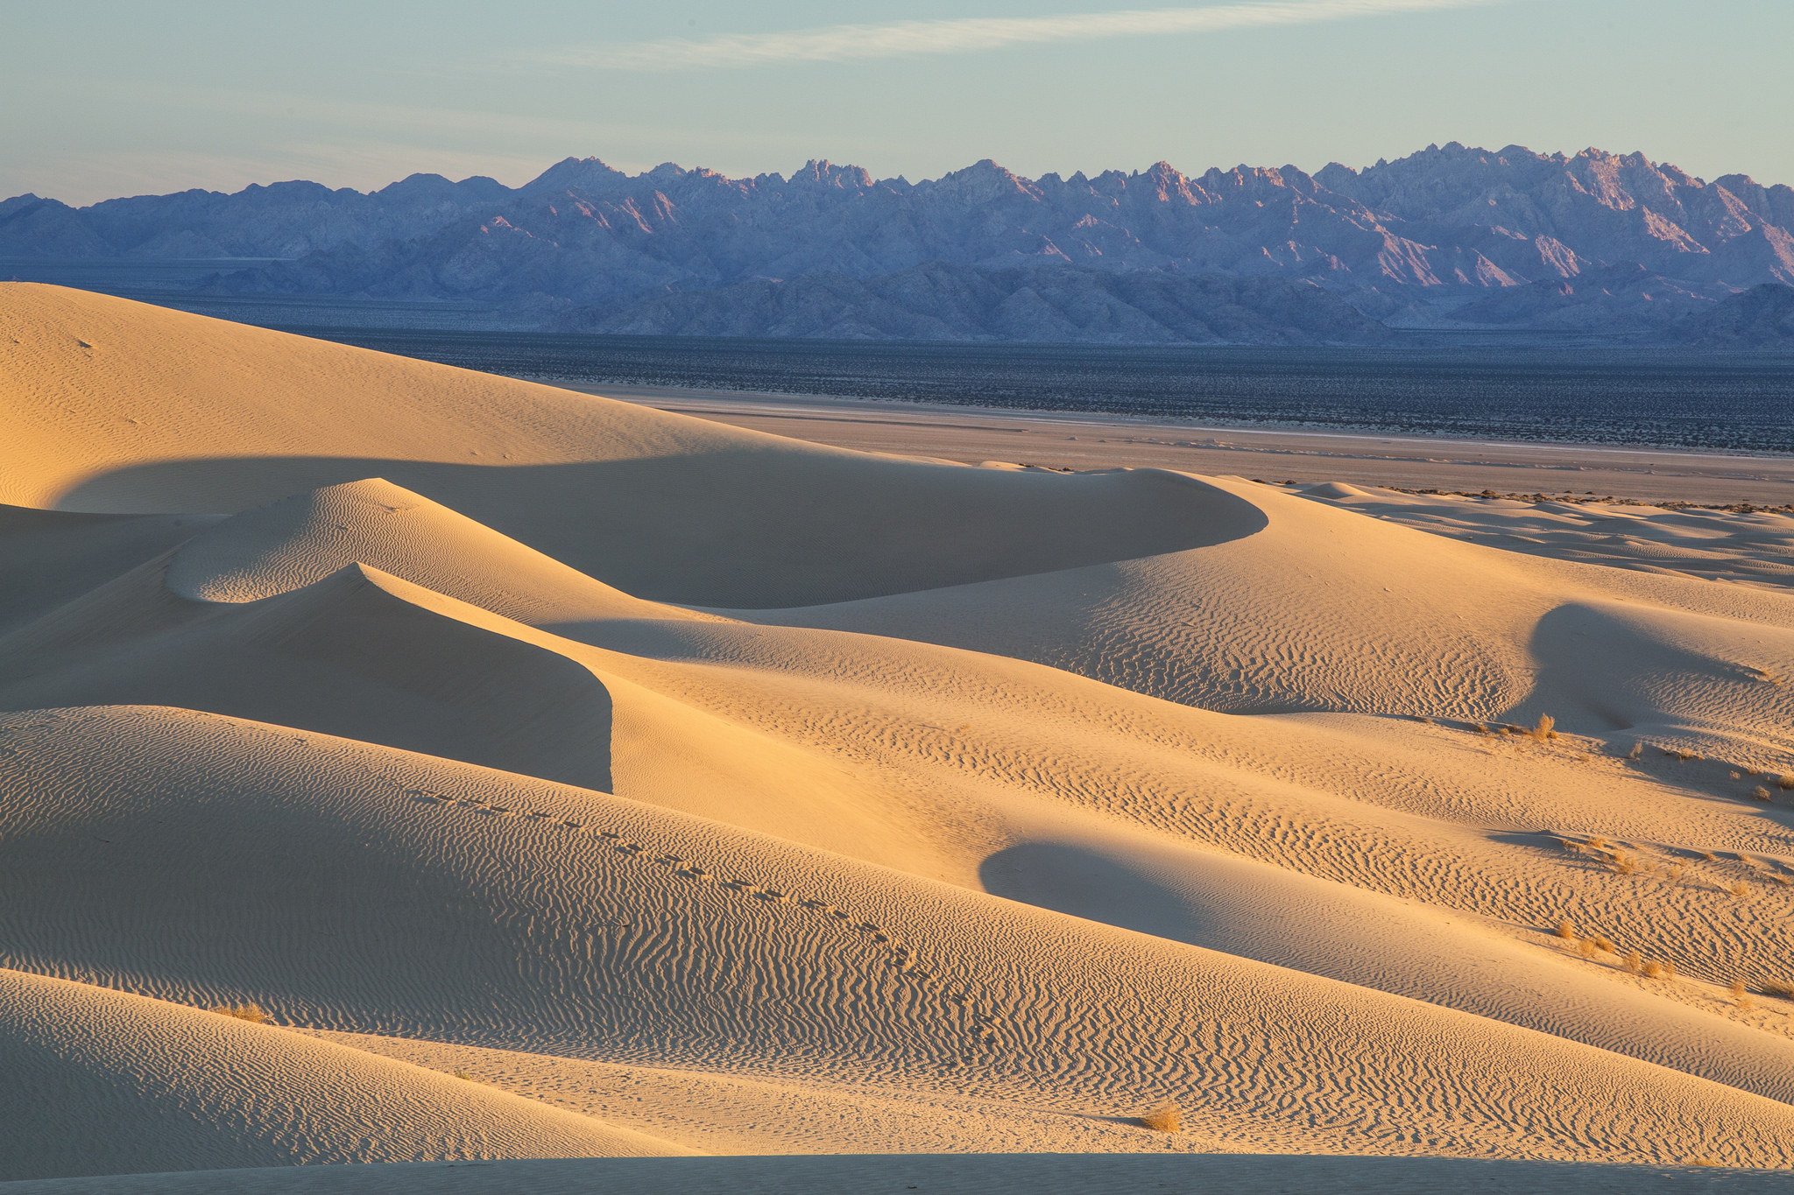
Repetition of Line

Slide 53
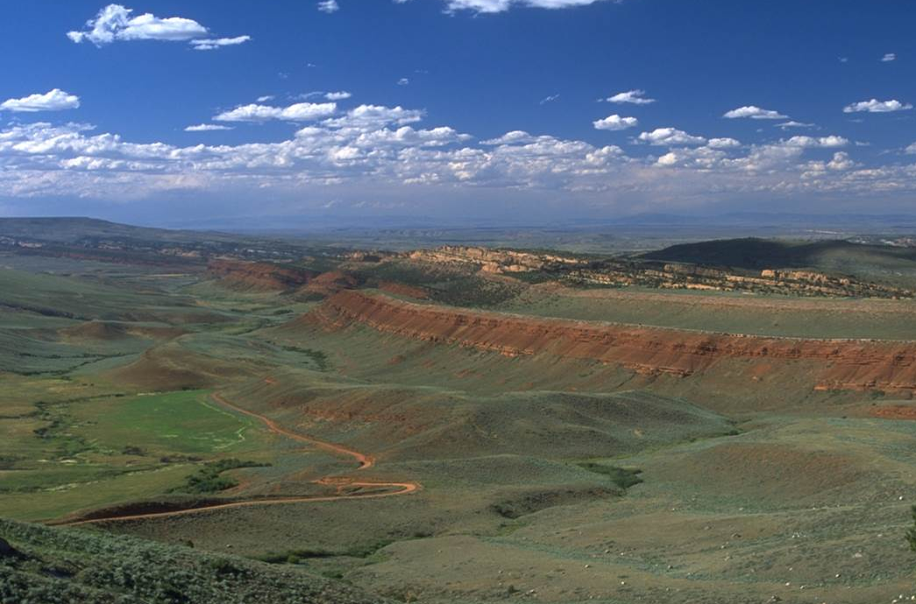
Repetition of Line

Slide 54
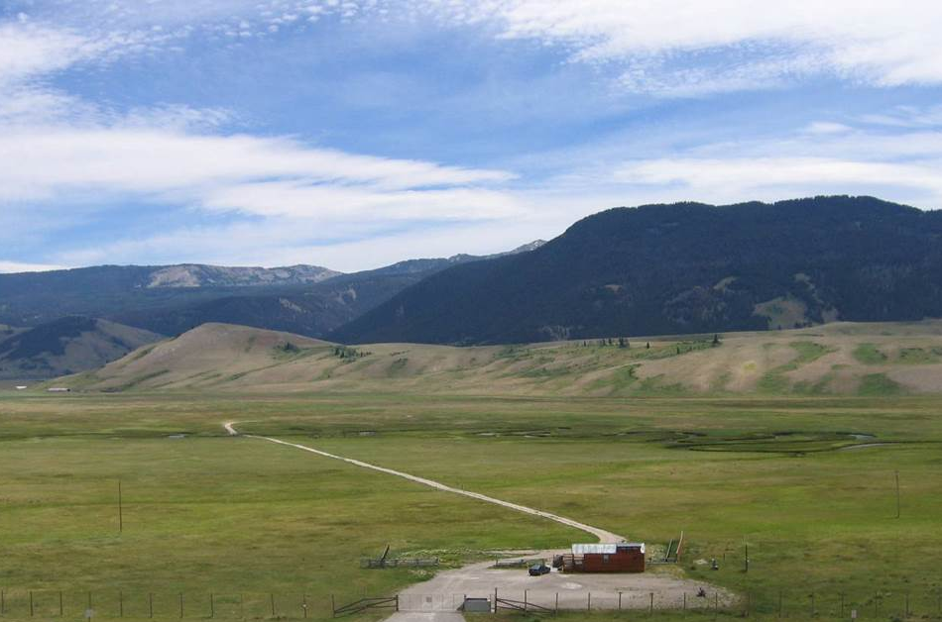
Repetition of Line

Slide 55
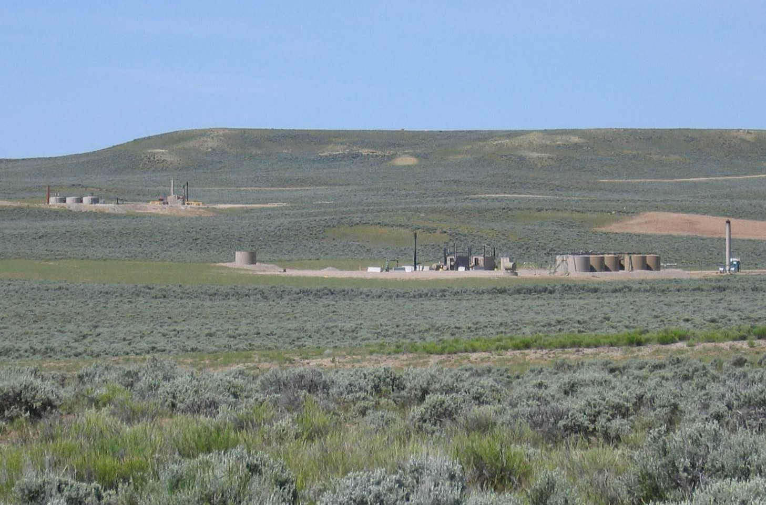
Repetition of Line

Slide 56
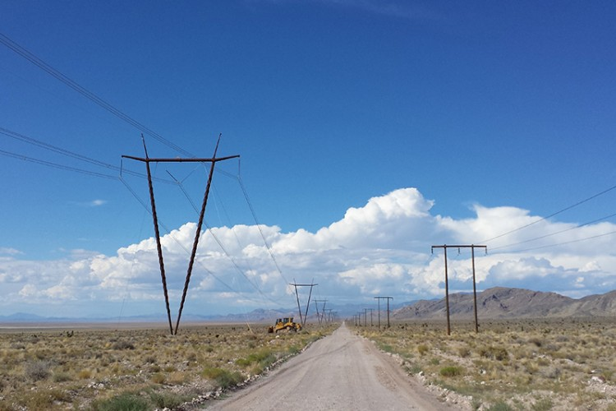
Repetition of Line

Slide 57
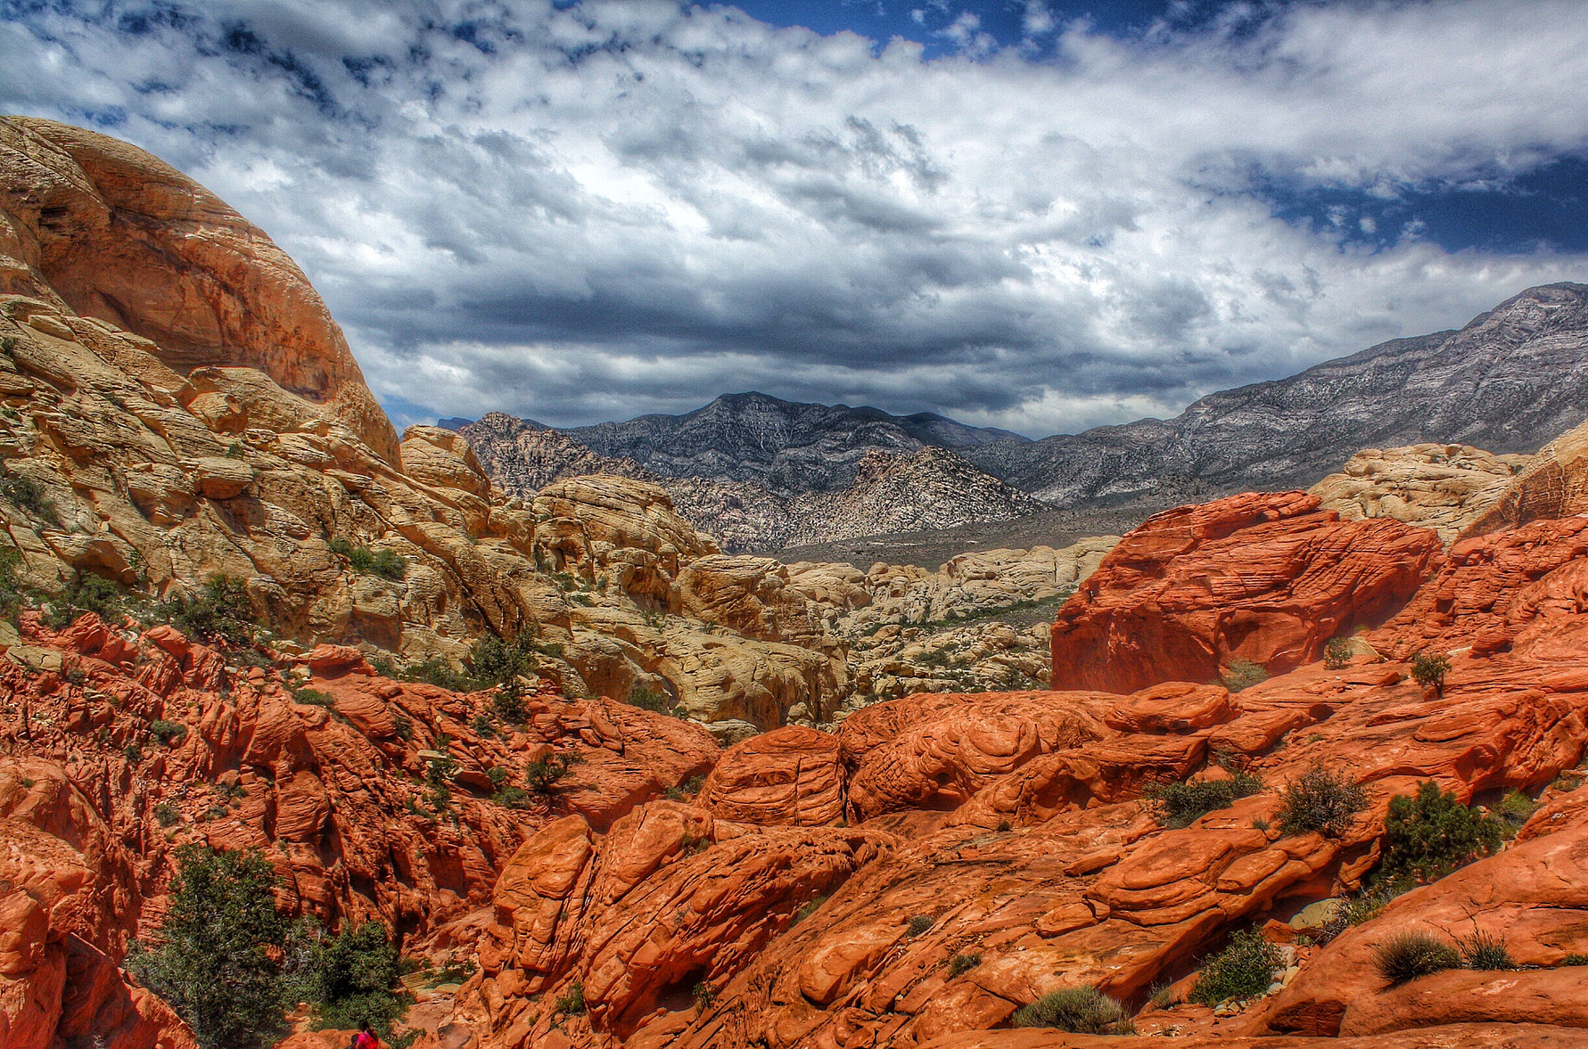
Repetition of Color

Slide 58
Repetition of Color
Color is a powerful visual design tool.
Color is increasingly effective in direct proportion to the distance the project is located from where it is viewed.
Color has not been used nearly as effectively as it should have been.
Past experience reveals that colors have often been lighter than they should be.
Note: use desert tan and greens with caution!

Slide 59
Repetition of Color
Light colors are highly visible and draw attention
advance
Dark colors tend to recede into the landscape
recede

Slide 60
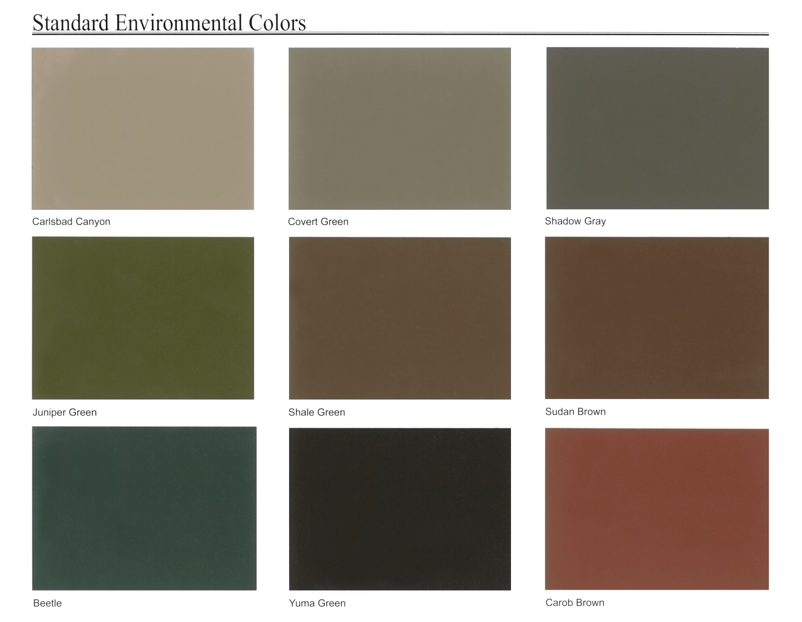
BLM Standard Colors
For reference only
Must use hard copy of color chart

Slide 61
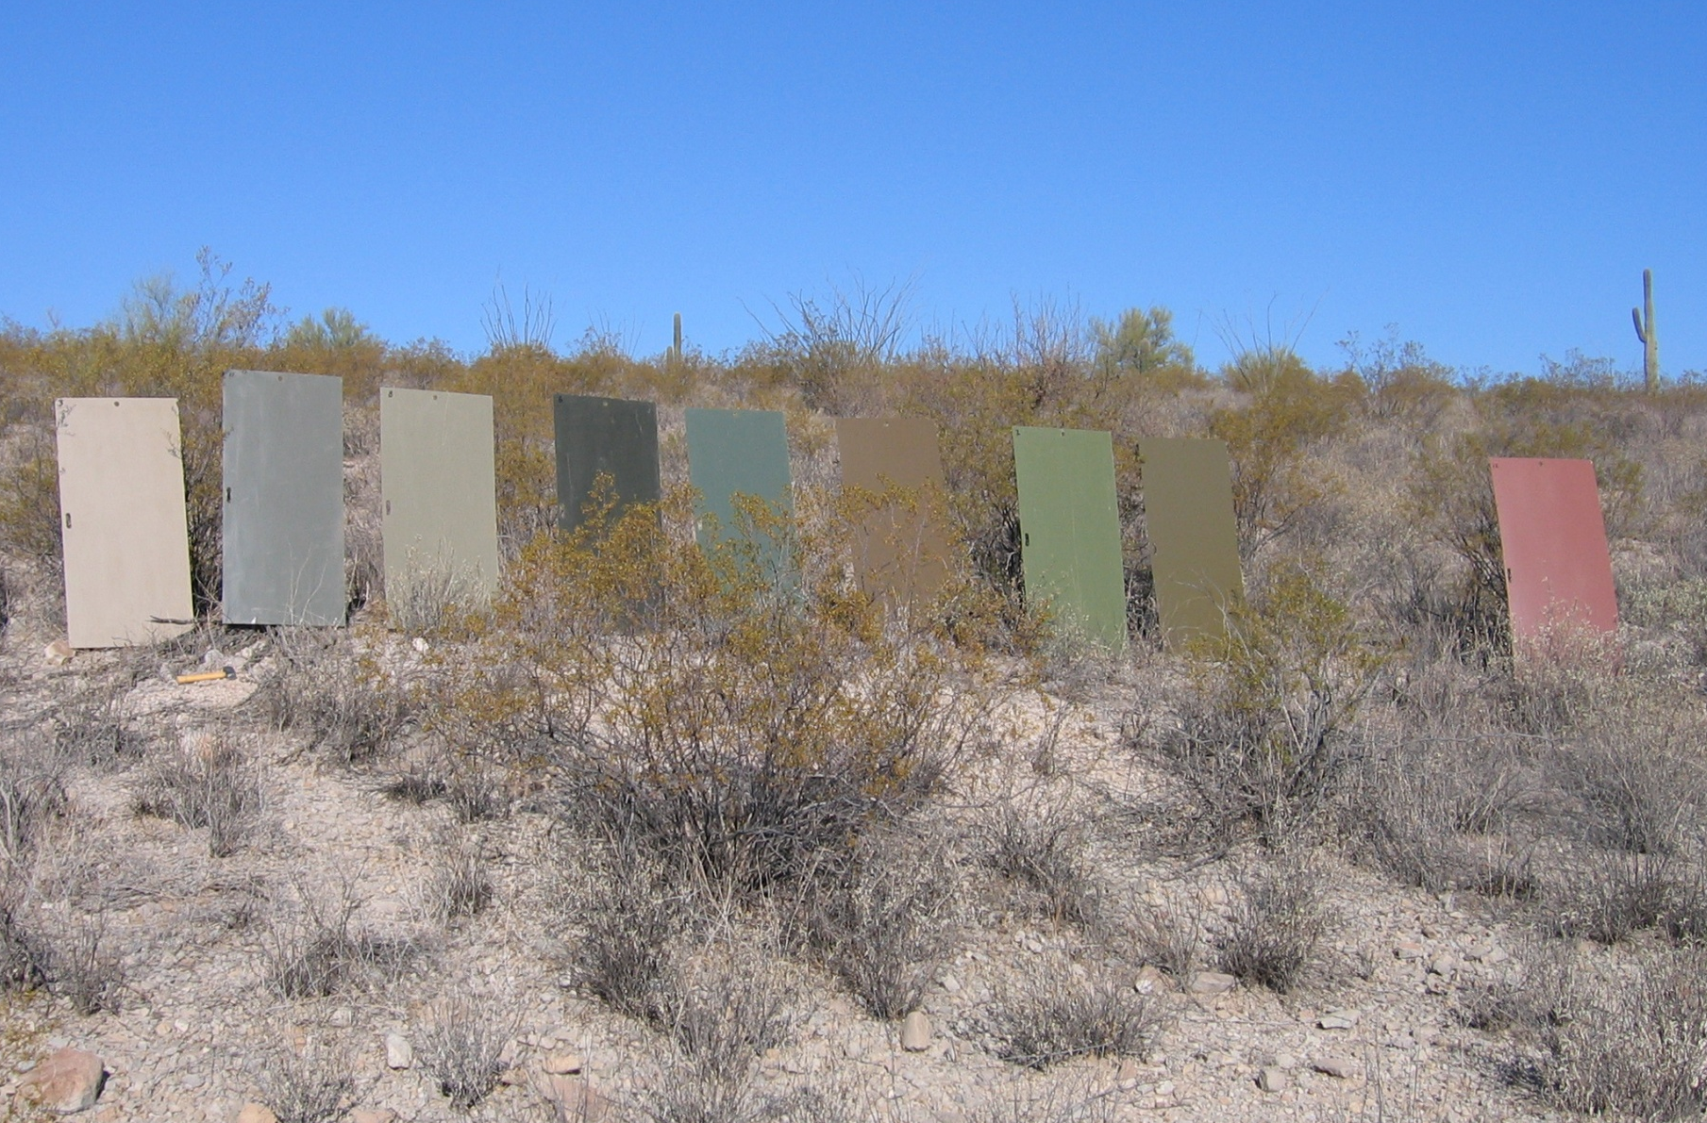
BLM Standard Colors

Slide 62
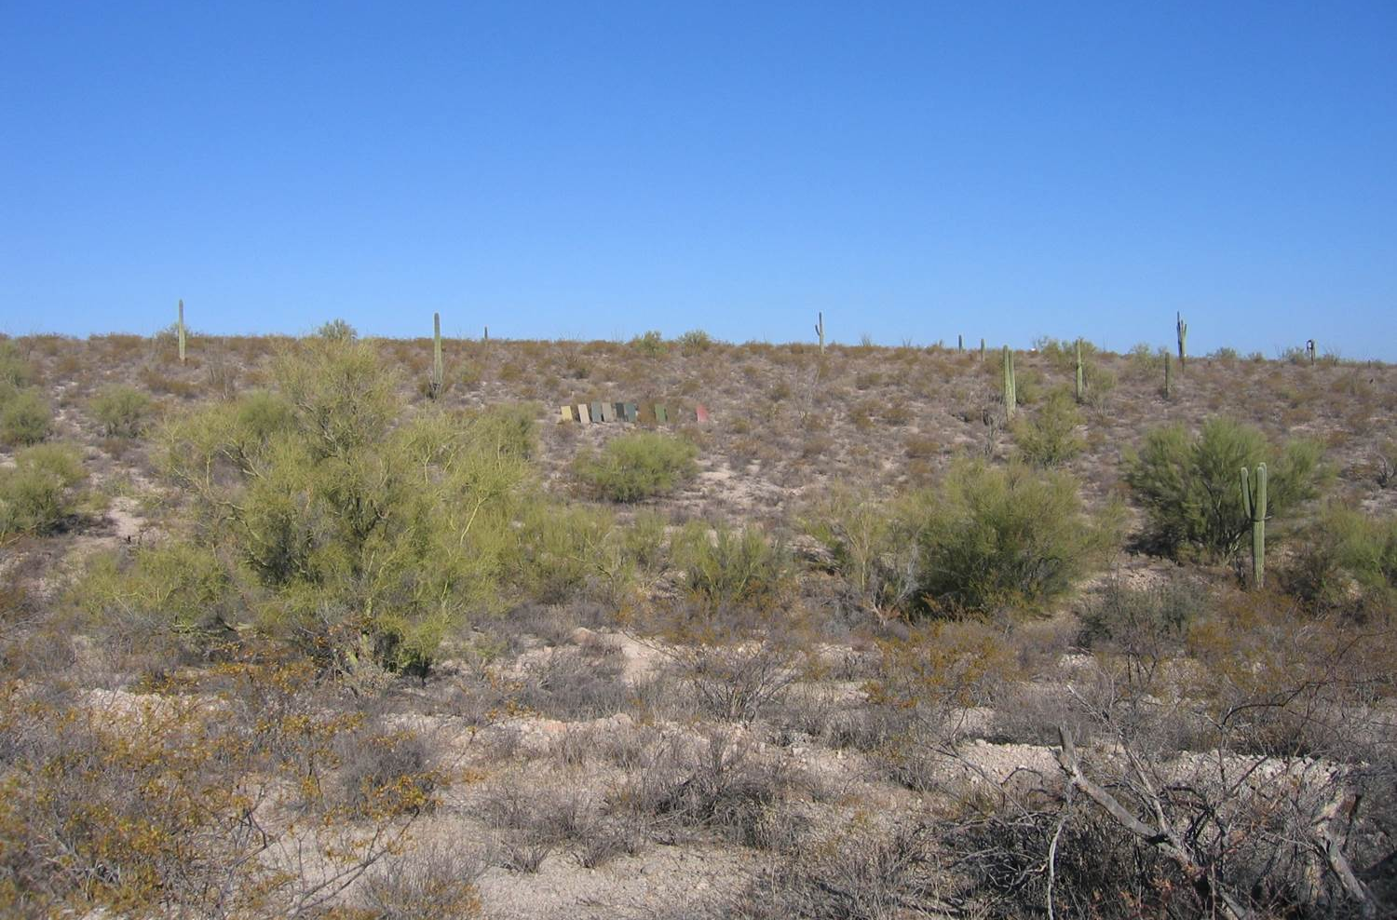
BLM Standard Colors

Slide 63
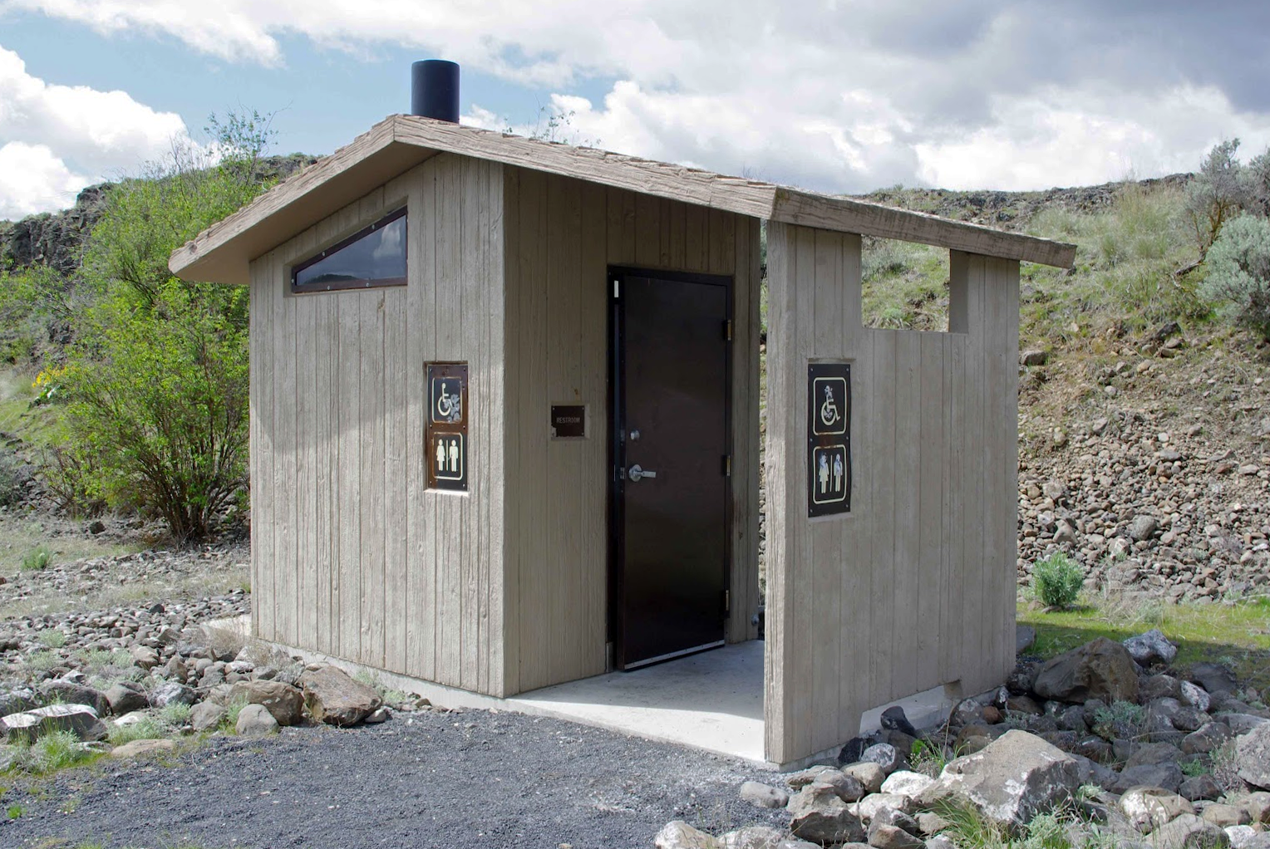
Repetition of Color

Slide 64
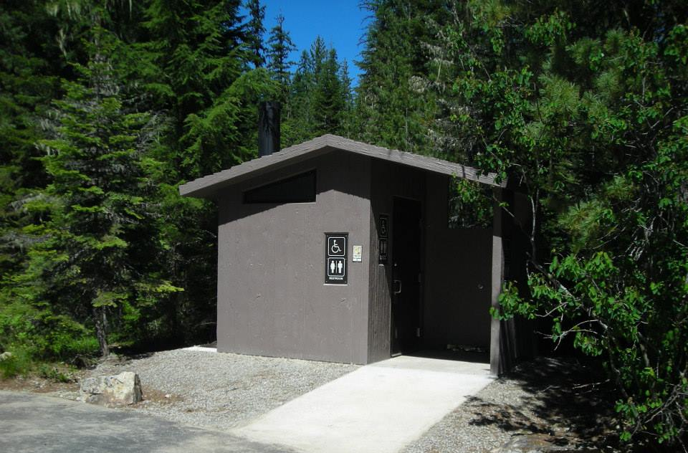
Repetition of Color

Slide 65
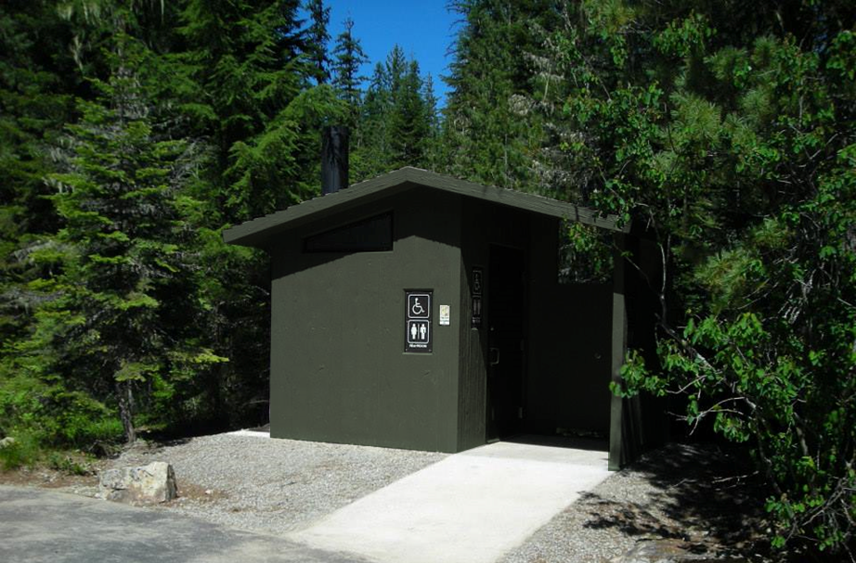
Repetition of Color

Slide 66
Lake Pleasant Campground, AZ

Slide 67
Lake Pleasant Campground, AZ

Slide 68
Repetition of Color
Nice examples of repetition in Zion National Park.

Slide 69
Repetition of Color
Can you find the structures in this picture?

Slide 70
Repetition of Color
Transmission structures can be treated with a variety of colored surfaces:
Power-coating
Electrostatic paint
Liquid paint
Industrial Structures have been painted for decades.
We need to initiate these discussions.

Slide 71
Repetition of Color

Slide 72
Repetition of Color

Slide 73
Repetition of Color
How many lattice towers do you see?
Effective use of color to minimize visual impacts for power line development.

Slide 74
Repetition of Color
COLOR TREATMENT
Transmission tower (one treated and one not)
Notes:
Natinaproducts.com

Slide 75
Repetition of Color
COLOR TREATMENT
Materials can be color treated to reduce visual impacts

Slide 76
Repetition of Color
COLOR TREATMENT
Materials can be color treated to reduce visual impacts

Slide 77
Repetition of Color
Can you find the water tower?
Notes:
Water tower in Casper, Wyoming

Slide 78
BLM Camouflage Research
Camouflage concealment is also an effective method of minimizing visual impacts.
BLM released Tech Memo 446 in April 2015.
Includes research inspired by decades of military use of camo technology.
NOTE! Very prescriptive and precise methods needed for successful implementation.

Slide 79
BLM Camouflage Research
Do you see anything else?
Where’s ‘Camo Waldo’?

Slide 80
BLM Camouflage Research
Do you see anything else?
Where’s ‘Camo Waldo’?

Slide 81
BLM Camouflage Research

Slide 82
BLM Camouflage Research

Slide 83
BLM Camouflage Research

Slide 84
BLM Camouflage Research
Notes:
simulation

Slide 85
BLM Camouflage Research
Notes:
Darker green may have been a better choice (John will send me simulation of this).
Can anyone find the pump jack?
Timothy R. O’Neill

Slide 86
BLM Camouflage Research
Notes:
Darker green may have been a better choice (John will send me simulation of this).
Can anyone find the pump jack?
Timothy R. O’Neill

Slide 87
Repetition of Texture

Slide 88
Repetition of Texture
Vegetation manipulation
Feathering vegetation along edge of right-of-way

Slide 89
Repetition of Texture
Feathering plantings helps to blur edges.

Slide 90
Repetition of Texture

Slide 91
Repetition of Texture

Slide 92
Repetition of Texture
What do you notice in this picture as built elements?
Water tank at Arches National Park.
Is this a good example of repetition of natural conditions?

Slide 93
Repetition of Texture
Water tank at Arches National Park.
The access road emphasizes the site. If the road was restored to its original condition, it would significantly reduce the visual impact on the hillside.

Slide 94
Repetition of Texture

Slide 95
Repetition of Texture

Slide 96
Repetition of Texture

Slide 97
Repetition of Texture

Slide 98
Repetition of Landscape Elements
When proper design responds to site form, line, color, and texture, a successfully design project can strongly repeat the surrounding landscape character.

Slide 99
Class Exercise
Class Exercise #3
Notes:
Improper siting & location
Failure to repeat landscape character elements, or
Failure to minimize unnecessary surface disturbance.

Slide 100
Class Exercise (3)
Based on the following images…
Identify the project that has caused visual impacts to the natural landscape.
Report whether the visual impact is a result of:
Improper siting & location
Failure to repeat landscape character elements, or
Failure to minimize unnecessary surface disturbance.
Propose a solution that minimizes the visual impact.
Notes:
Have tables work together.

Slide 101
Class Exercise #3 - Image (1)
Notes:
Improper siting & location
Failure to repeat landscape character elements, or
Failure to minimize unnecessary surface disturbance.

Slide 102
Class Exercise #3 - Image (2)
Notes:
Improper siting & location
Failure to repeat landscape character elements, or
Failure to minimize unnecessary surface disturbance.

Slide 103
Land Rehabilitation
Visual rehabilitation is…
Restoration of form, line, color, and texture of landforms and vegetation to as much of a native condition as possible.

Slide 104
Land Rehabilitation
Rehabilitation efforts must…
always
have an objective.

Slide 105
Land Rehabilitation
There are three basic methods of site rehabilitation:
Re-contouring
Revegetation
Color treatment
Post Construction Evaluation

Slide 106
Land Rehabilitation
RECONTOURING
(Before) Bretz Mine – East Pit in Malheur County, OR

Slide 107
Land Rehabilitation
RECONTOURING
(After) Bretz Mine – East Pit in Malheur County, OR

Slide 108
Land Rehabilitation
REVEGETATION
Seed mix should match the existing vegetative composition
Notes:
(crested wheatgrass??)

Slide 109
Land Rehabilitation
REVEGETATION
ADOT Gonzales Pass US60 (Images from Logan Simpson)
Notes:
(crested wheatgrass??)

Slide 110
Land Rehabilitation
REVEGETATION
ADOT Gonzales Pass US60 (Images from Logan Simpson)
Notes:
(crested wheatgrass??)

Slide 111
Land Rehabilitation
REVEGETATION
ADOT Gonzales Pass US60 (Images from Logan Simpson)
Notes:
(crested wheatgrass??)

Slide 112
Land Rehabilitation
Notes:
Tanks could have been placed more inland. Also, spoils from the cut could have been better dealt with.
This is state land. It is surrounded by federal land.

Slide 113
Land Rehabilitation
Notes:
Tanks could have been placed more inland. Also, spoils from the cut could have been better dealt with.
This is state land. It is surrounded by federal land.

Slide 114
Land Rehabilitation
Notes:
Tanks could have been placed more inland. Also, spoils from the cut could have been better dealt with.
This is state land. It is surrounded by federal land.

Slide 115
Land Rehabilitation
COLOR TREATMENT
Existing site condition

Slide 116
Land Rehabilitation
COLOR TREATMENT
After site rehabilitation and color treatment

Slide 117
Conclusion
“The greater damage for most of us is not that our aim is too high and we miss it, but that it is too low and we reach it.” (Michelangelo) (1475-1564)

