Slide 2
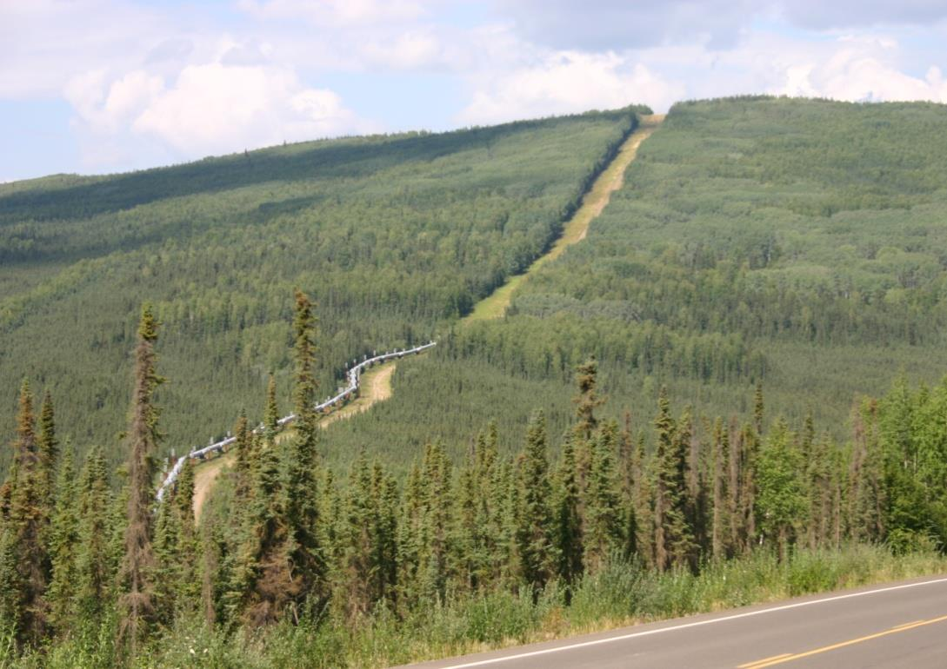
Contrast Rating

Slide 3
Contrast Rating
Unit Objective
Determine the elements of a project that are inconsistent with VRM objectives and recommend measures to improve the visual quality of the project
The VRM System is about minimizing visual contrast.
The Contrast Rating process
First, determines whether a proposal conforms to the current Land Use Plan, and
Second, supports the subsequent impact analysis process

Slide 4
Contrast Rating
Process
A systematic process used to analyze potential visual impacts of proposed projects and activities
BLM Handbook 8431-1
The amount of contrast is measured by separating the landscape into major features
Landform/water, vegetation, and structures
Use “language of landscapes” when describing
Then predicting the magnitude of contrast in each of the basic elements
Form, line, color, and texture

Slide 5
Contrast Rating
Process
Quickly reveals elements and features that cause the greatest visual impact
Intended to assist BLM personnel not formally trained in the design arts to apply basic principles of planning and design to prevent or minimize visual impacts
Every attempt should be made to reduce visual impacts even if a project meets VRM objectives for the area

Slide 6
Contrast Rating
Tips
The contrast rating should be completed in the field from the selected KOP(s) and should be completed by an interdisciplinary team
Do not fill out forms as a “desk exercise,” it is important to get out on the ground to see the context of the proposed project and its location
The contrast rating should be completed during the time of year and time of day when most people will be viewing the area of development

Slide 7
Contrast Rating
Steps
Work with project proponent early in the project planning process, this will help prevent surprises later!
1 – Obtain a complete project description
2 – Identify VRM objectives from land use plan
3 – Select Key Observation Points (KOPs)
4 – Prepare visual simulations (optional)
5 – Complete contrast rating

Slide 8
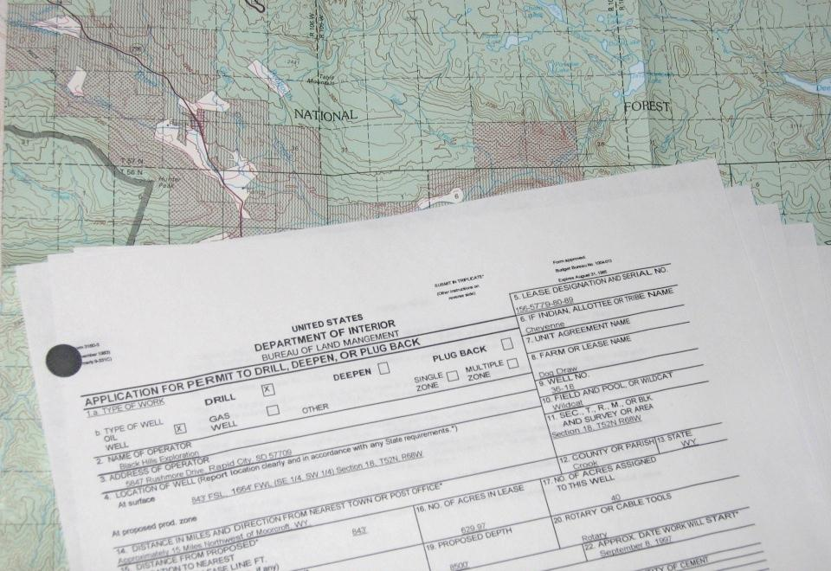
Contrast Rating
Step 1
Obtain a complete project description
Emphasize early contact with project proponent
Coach proponent on project design
Project proposal must be comprehensive

Slide 9
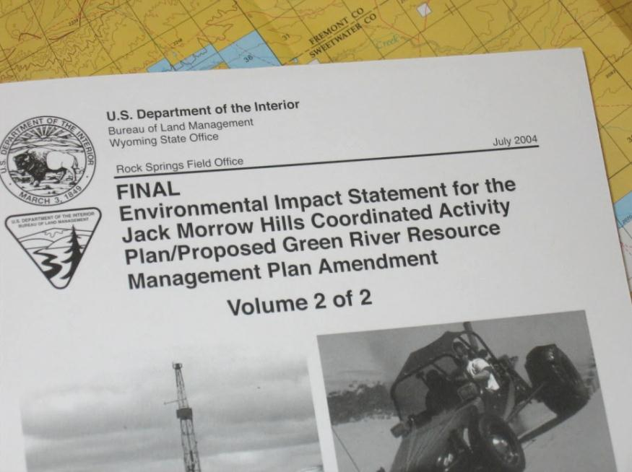
Contrast Rating
Step 2
Identify VRM objectives from the land use plan
Familiarize yourself with your land use plan
Identify VRM objective
What is the existing management class for the project location, and why?
Involve interdisciplinary team
Understand other resource issues

Slide 10
Contrast Rating
VRM Class Objectives
Class I
Preserve the existing character of the landscape
Manage for natural ecological changes
Change allowed: very low
Activities should not be visible and must not attract attention
Class II
Retain the existing character of the landscape
Change allowed: low
Activities may be visible, but should not attract attention

Slide 11
Contrast Rating
VRM Class Objectives
Class III
Partially retain the existing character of the landscape
Change allowed: moderate
Activities may attract attention but should not dominate the view
Class IV
Provide for management activities which require major modification of the existing character of the landscape
Change allowed: high
Activities may attract attention, may dominate the view, but are still mitigated

Slide 12
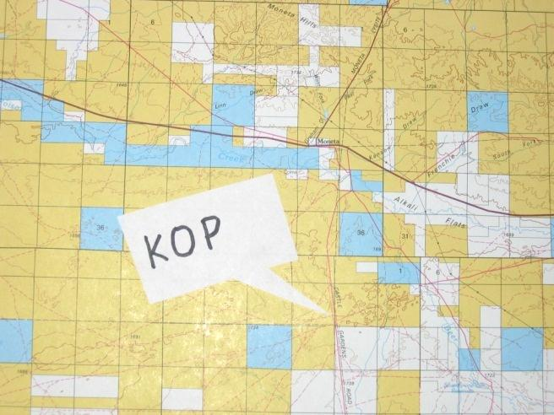
Contrast Rating
Step 3
Select Key Observation Points (KOPs)
What is a KOP?
A critical viewpoint or place from
which we analyze the visual impact
of a proposed project
Types of KOPs
KOPs should be places from which a proposed project is seen by large numbers of viewers or critical viewers
Where view of proposed project is most revealing
Single Points – trailheads, campgrounds, scenic overlooks, parking lots, subdivisions, and towns
Linear – roads, trails, and rivers

Slide 13
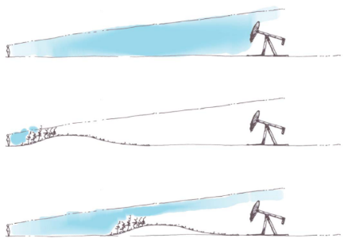
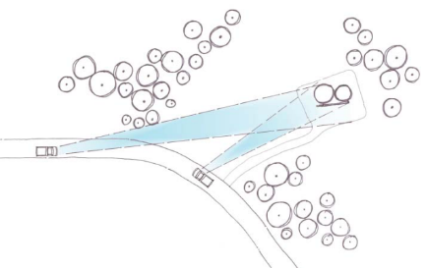
Contrast Rating
Step 3
Factors in KOP selection
(Remember the Environmental Factors!)
Angle of observation
Number of viewers
Length of time the project is in view
Relative project size
Season of use
Light Conditions
How many KOPs are needed?
Linear projects should have more than one
Dependent on the size of the project, land use plan direction, locations from where it can be seen

Slide 14
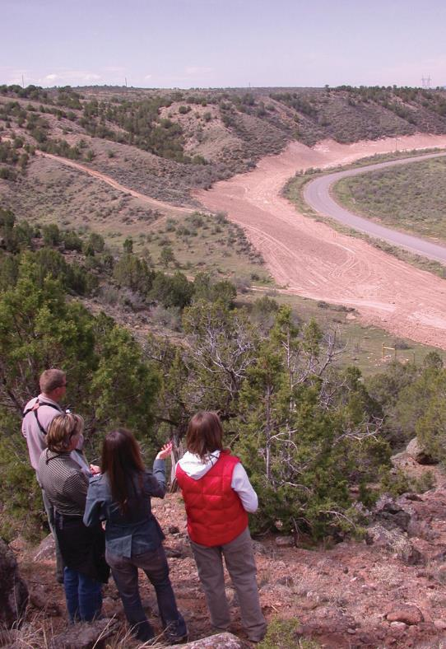
Contrast Rating
Step 3
When are KOPs selected?
Early in the project planning
process
Who selects them?
Interdisciplinary team
Input from proponent
Coordination with other agencies
Examples - NPS and USFS
Accuracy is important!
Location can sway results

Slide 15
Contrast Rating
Step 4
Prepare visual simulations (optional)
Complex projects may benefit from visual simulations
Provides visual representation of a project before and after
Highlights impacts and potential mitigation measures
Good way to illustrate impacts in NEPA analysis
Seeing an image of a project is much more powerful than trying to imagine it
Helps eliminate bias
Allows all team members to see the project the same
Helps the proponent, public, and the BLM

Slide 16
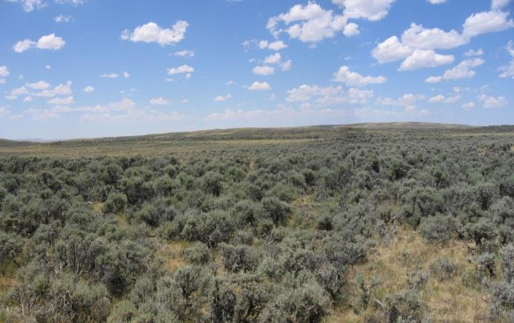
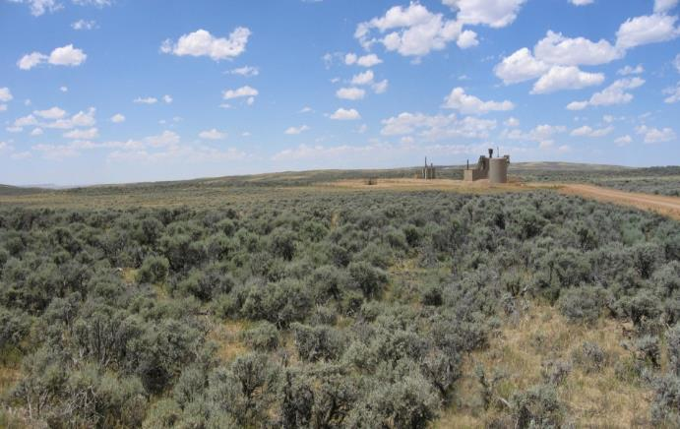
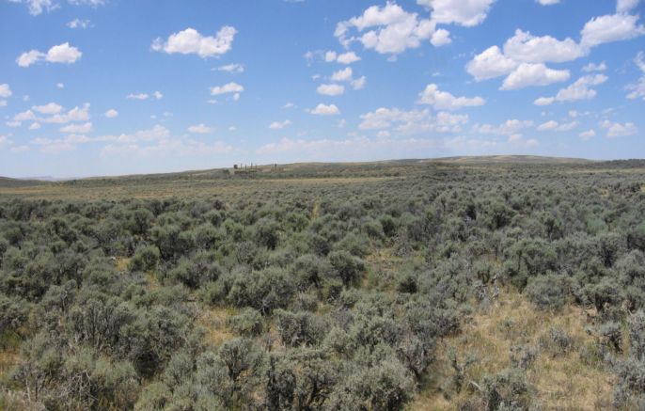
Contrast Rating
Step 4 – Visual Simulations Example
Before – Existing Conditions
“After” Simulation
Mitigated Simulation

Slide 17
Contrast Rating
Step 5
Complete Contrast Rating
Visual Contrast Rating Worksheet – BLM Form 8400-4
See BLM Handbook H-8431-1
Validates Land Use Plan Conformance
Provides documentation for NEPA
Provides a record for future action
Helps defend against appeals
Notes:
Validates plan conformance … or pinpoints where to focus design alterations to meet plan objectives and further minimize impacts.

Slide 18
Contrast Rating
Worksheet

Slide 19
Contrast Rating
Worksheet
Section A
Locates the project and identifies the VRM class
A simple illustration or map identifies the project location and KOP

Slide 20
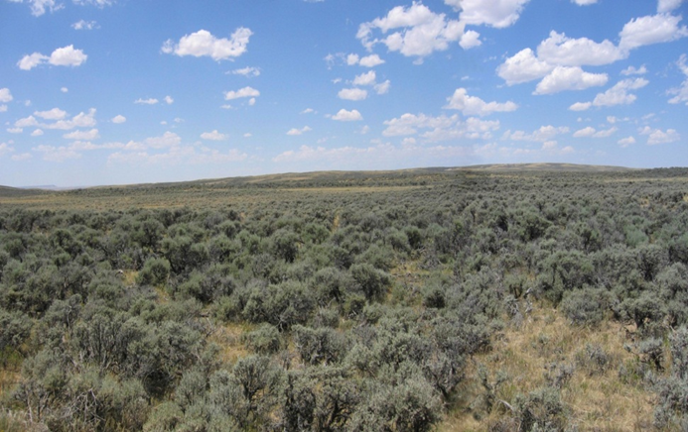
Contrast Rating
Worksheet
Section B
Where the existing characteristic landscape of the project area is described (use “language of landscapes”)
Focus on the area being affected by the project

Slide 21
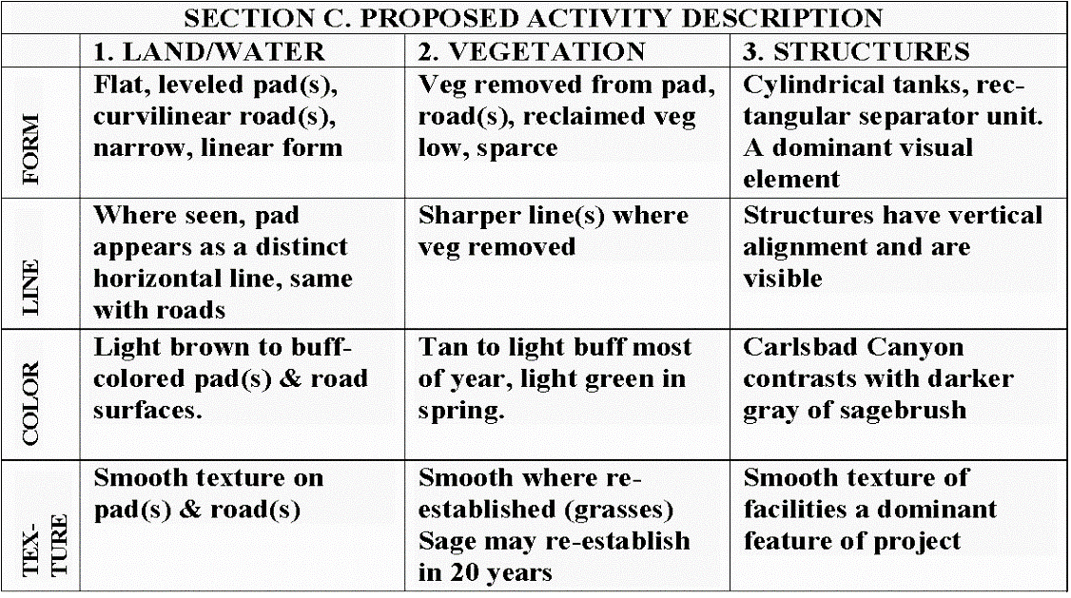
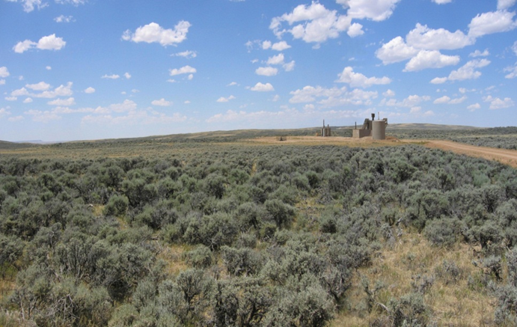
Contrast Rating
Worksheet
Section C
Where the proposed activity’s effects on the characteristic landscape are described

Slide 22
Contrast Rating
Worksheet
Section D
Organized into features (land/water, vegetation, and structures) and elements (form, line, color, and texture)
The terms strong, moderate, weak, and none conform to VRM Classes IV, III, II, and I, respectively
For example – if the project creates strong contrast (impacts), it would conform to the class IV objective but not to the class I – III objectives
If a project only causes weak contrast (impacts), it would meet the Class II VRM objective

Slide 23
Contrast Rating
Worksheet
Section D
In this example, the project would meet the VRM Class III objective for form, but only a VRM Class IV objective for line, color, and texture

Slide 24
Contrast Rating
Worksheet
Section D
This tells you where to focus mitigation efforts in order to reduce the degree of impact, and thus meet the VRM objective

Slide 25
Contrast Rating
Worksheet – Degree of Contrast Criteria
None
Contrast not visible or perceived
Corresponds to VRM Class I
Weak
Contrast seen but does not attract attention
Corresponds to Class II
Moderate
Contrast attracts attention but does not dominate view
Corresponds to Class III
Strong
Contrast demands attention and is dominant
Corresponds to Class IV

Slide 26
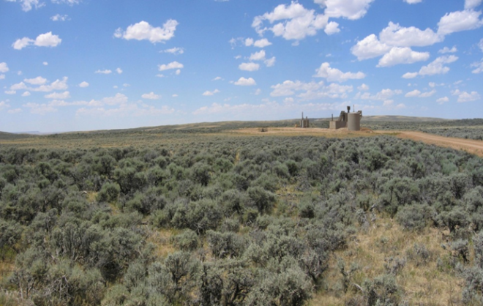
Contrast Rating
Worksheet
Section D (Continued)
Where you can provide further explanation of why a project does or does not meet VRM objectives
As in this example, changes to Land and Vegetation would cause a moderate degree of contrast to the element line, with strong contrast from Structures
The element line is a focus of mitigation efforts for this project

Slide 27
Contrast Rating
Worksheet
Section D (Continued)
Where you can provide recommended mitigation measures
Proposed
Mitigated

Slide 28
Contrast Rating
Process (Continued)
Document! Document! Document!
Take pictures
Complete the form
Write short narratives
Prepare visual simulations (optional)
Do whatever you need to do to describe your thought process and final recommendations
Documentation is the only way you or your manager will accurately remember what took place during your analysis
And if challenged, no documentation = didn’t happen

Slide 29
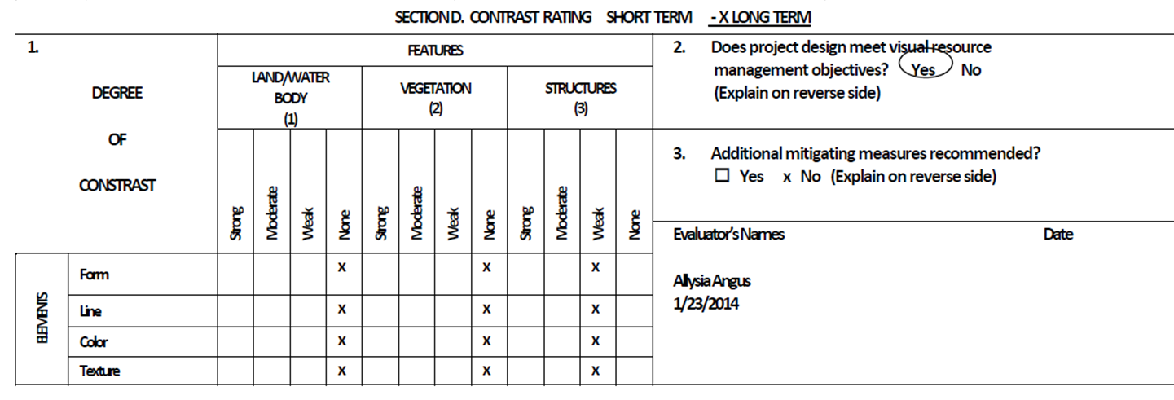
Contrast Rating
Conformance with VRM Objectives
Does project meet VRM Objectives?
YES, if: None = Class I
Weak = Class II
Moderate = Class III
Strong = Class IV

Slide 30
Contrast Rating
Conformance with VRM Objectives
Does project meet VRM Objectives?
NO, what to do?
Redesign project to meet VRM Objectives
Internally initiated – Drop project
Externally initiated – Deny application for project
Amend RMP only as a last resort
Address reasons for the current VRM Class designation
Assess Compensatory Mitigation

Slide 31
Contrast Rating
Process (Continued)
Input information into NEPA document
Enter your findings, along with necessary documentation
Write any necessary stipulations
Be sure all resource stipulations are coordinated and in agreement
Continue to work with the project proponent through all phases of the project (pre-construction, construction, and reclamation) to ensure project is completed as planned and stipulations are being followed!
Patience! It may take years before you see the outcome of all your efforts

Slide 32
Contrast Rating
Example – Habitat Enhancement
1 – Obtain a complete project description
Habitat enhancement project for bighorn sheep
Site was selected for its potential to allow sheep to access suitable habitat
Habitat treatment would include a combination of clear cutting, heavy thinning, and group thinning
Treatment area would be approximately 300 yards wide and would encompass approximately 200 acres
Project design features will be used to minimize the visual impact of the project, including clumping and feathering of the treatment edges to prevent distinct lines, and pruning the lower limbs of the leave trees to maintain portions of intact canopy while still providing sightlines for sheep

Slide 33
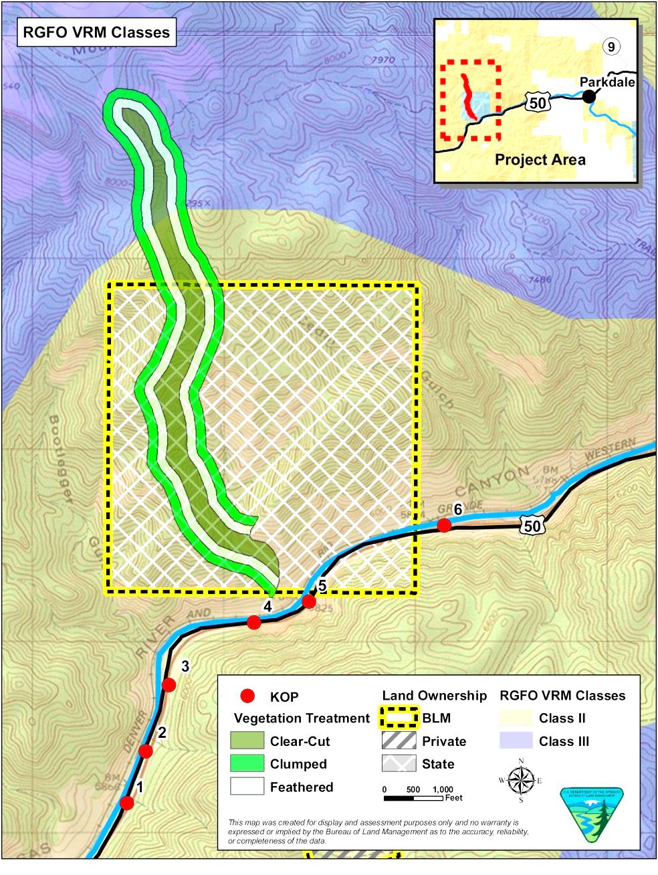
Contrast Rating
Example – Habitat Enhancement
2 – Identify VRM objectives
from land use plan
Class II
Retain landscape character
Change allowed: low
Visible but should not attract
attention
Class III
Partially retain landscape
character
Change allowed: moderate
Can attract attention but
should not dominate view

Slide 34
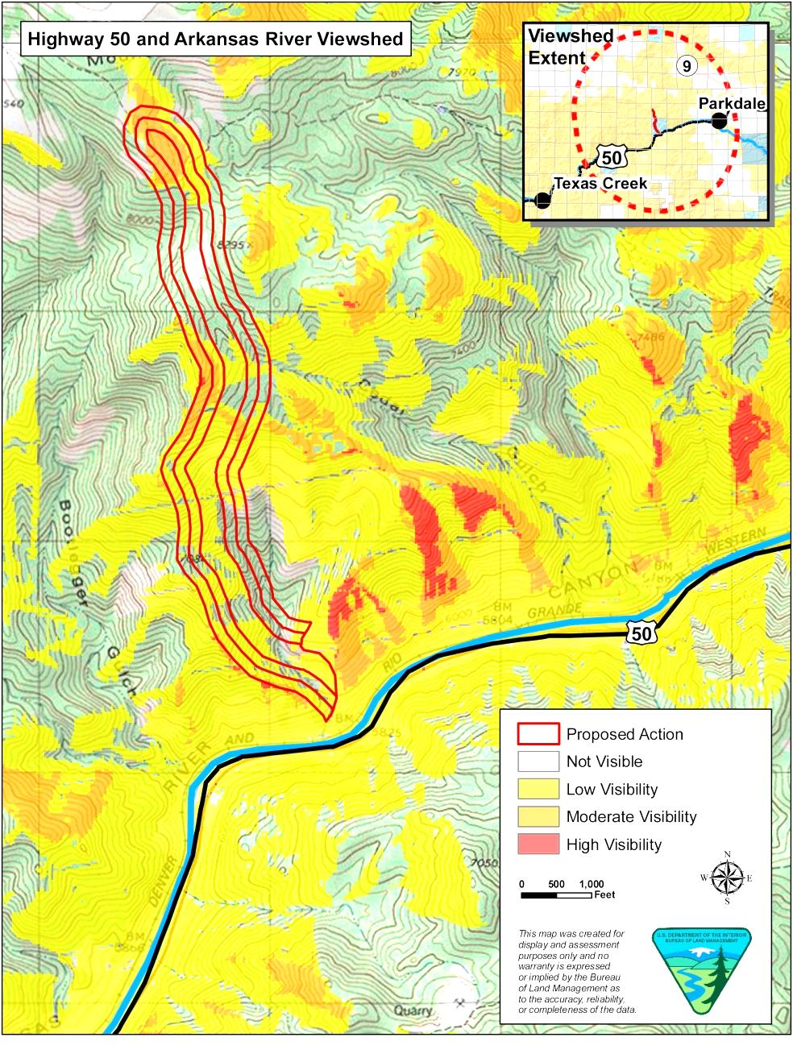
Contrast Rating
Example – Habitat Enhancement
3 – Select Key Observation
Points (KOPs)
Linear feature – State
Highway 50
6 KOPs were selected based
on viewshed analysis and
from environmental factors
(e.g. angle of view, season
of use, duration in view)

Slide 35
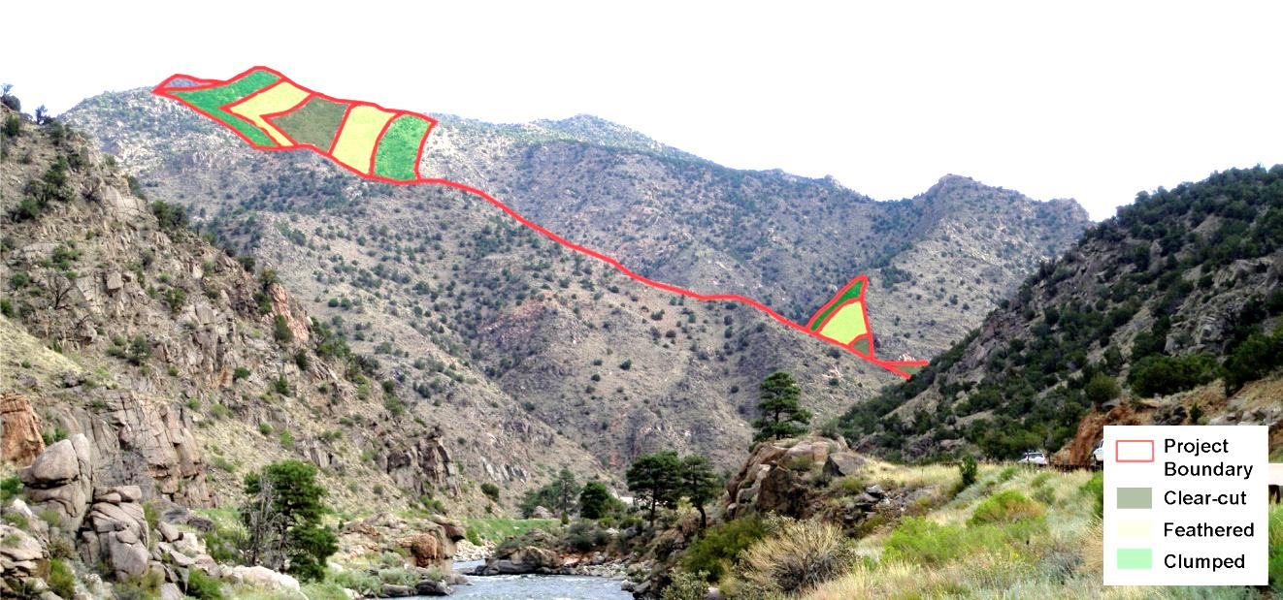
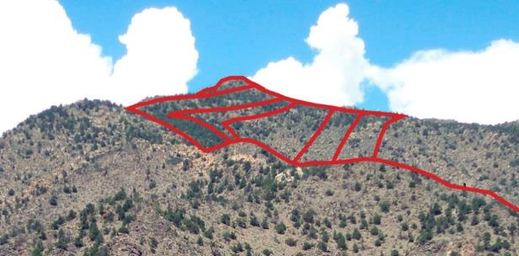
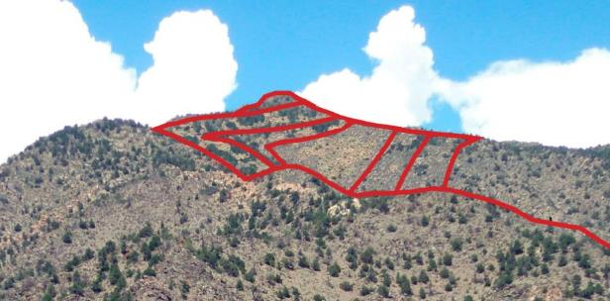
Contrast Rating
Example – Habitat Enhancement
4 – Prepare visual simulations (optional)
KOP 1
Before – Existing Conditions
After Simulation

Slide 36
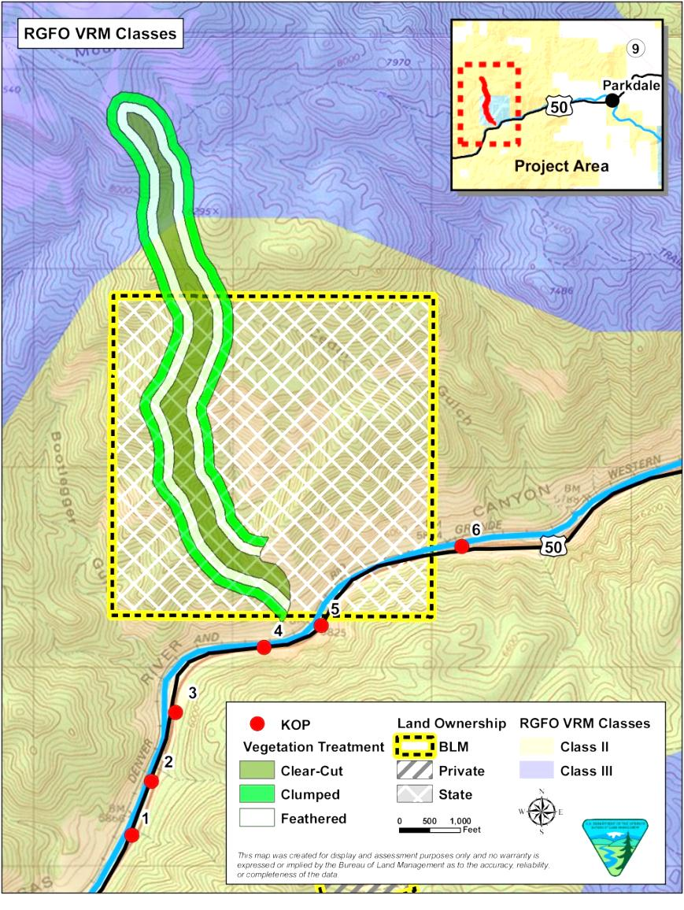
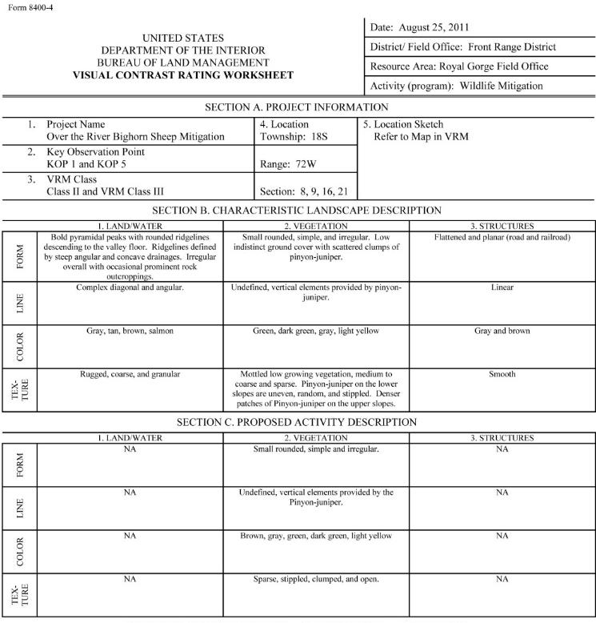
Contrast Rating
Example – Habitat Enhancement
5 – Complete contrast rating

Slide 37
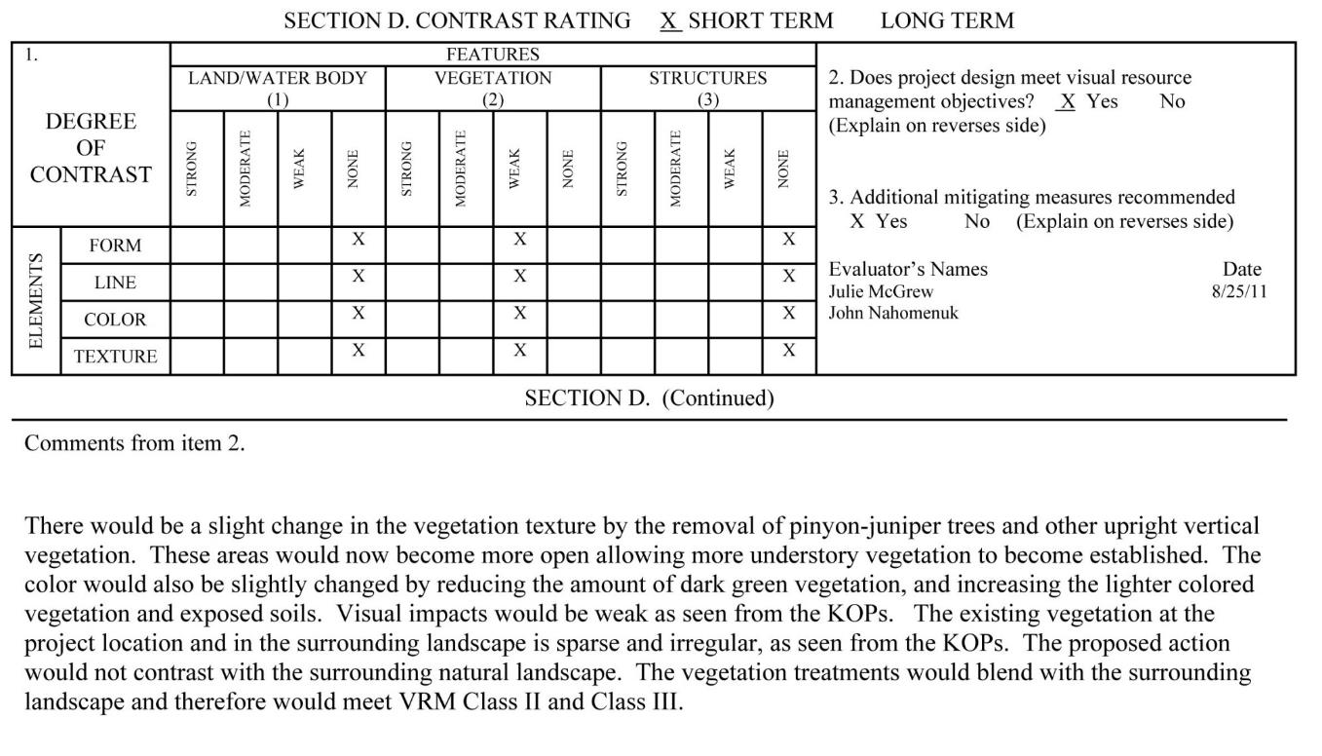
Contrast Rating
Example – Habitat Enhancement
5 – Complete contrast rating

Slide 38
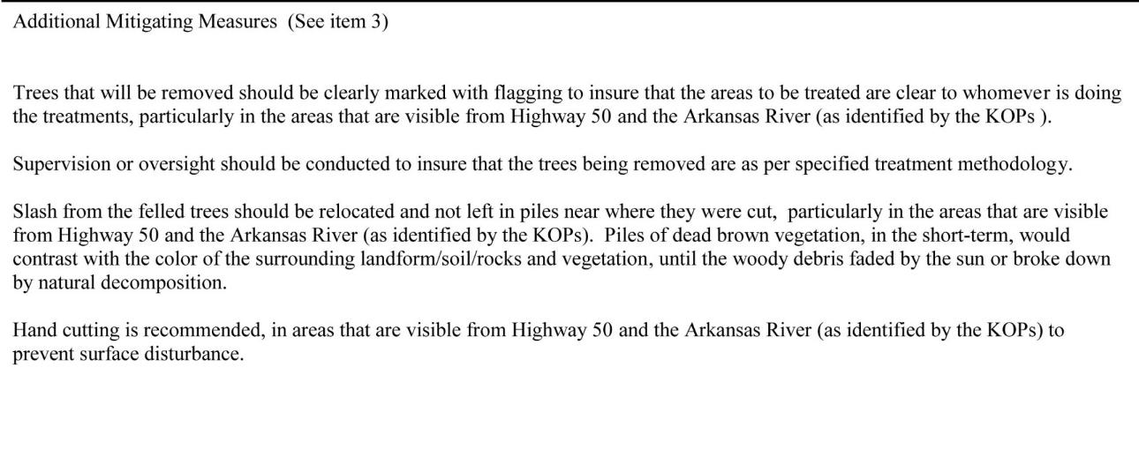
Contrast Rating
Example – Habitat Enhancement
5 – Complete contrast rating

Slide 39
Contrast Rating
Example – New Natural Gas Well Pad
1 – Obtain a complete project description
Proposal to drill 8 new federal wells from a new well pad with new access road on land administered by the BLM
Well pad would have a maximum cut slope of 33.1 feet at the southwest corner and a maximum fill slope of 25.2 feet at the northwestern corner
The road would be approximate 0.4 mile in length and 20-feet in width
The road grade would vary from 5% to 10%
Installation of a temporary pipeline
Construction would involve approximately 7.9 acres of new surface disturbance, which would be reduced to approximately 2.5 acres after interim reclamation

Slide 40
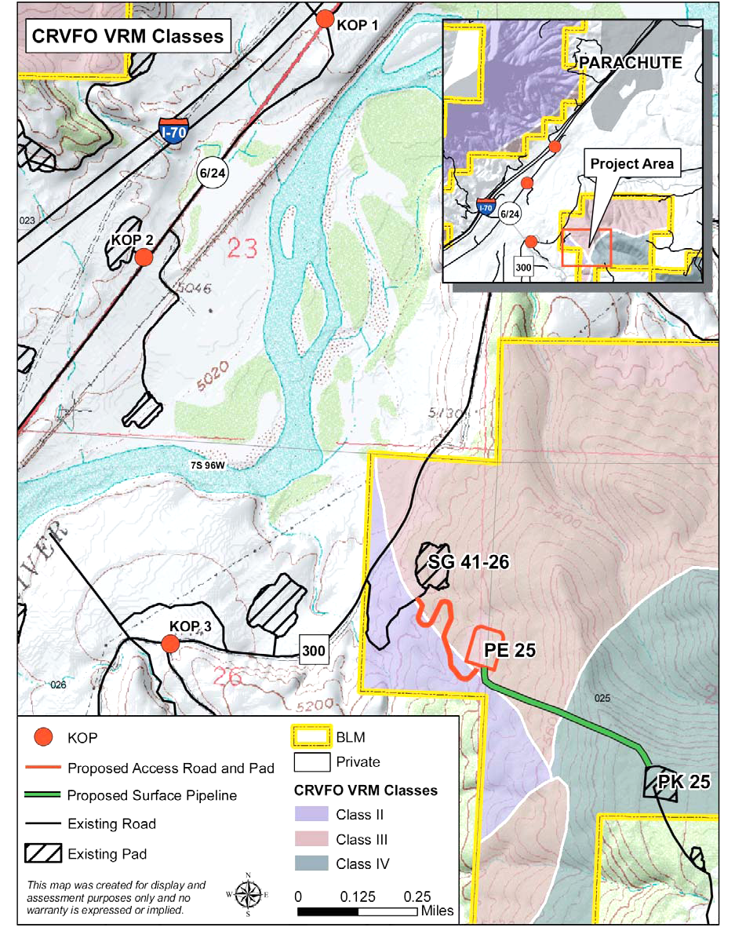
Contrast Rating
Example – New Natural Gas Well Pad
2 – Identify VRM objectives
from land use plan
Class II
Retain landscape character
Change allowed: low
Visible but should not attract
attention
Class III
Partially retain landscape
character
Change allowed: moderate
Can attract attention but
should not dominate view

Slide 41
Contrast Rating
Example – New Natural Gas Well Pad
2 – Identify VRM objectives
from land use plan
Class IV
Provide for management
activities which require
major modification to the
character of the landscape
Change allowed: high
Activities may attract
attention, may dominate the
view, but is still mitigated

Slide 42
Contrast Rating
Example – New Natural Gas Well Pad
3 – Select Key Observation
Points (KOPs)
Linear features – State
Highway 6 and County Road
300
3 KOPs were selected based
on field analysis and
from environmental factors
(e.g. angle of view, season
of use, duration in view)

Slide 43
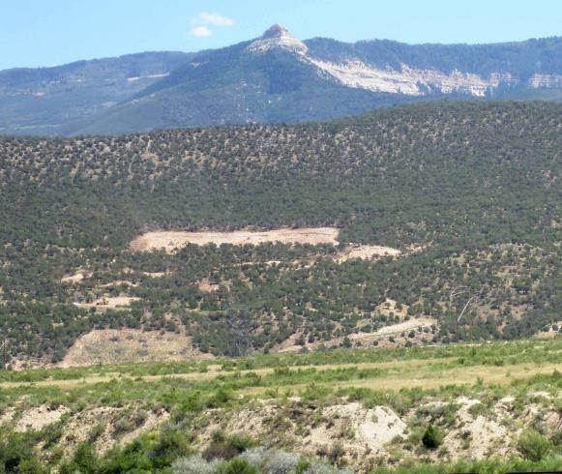
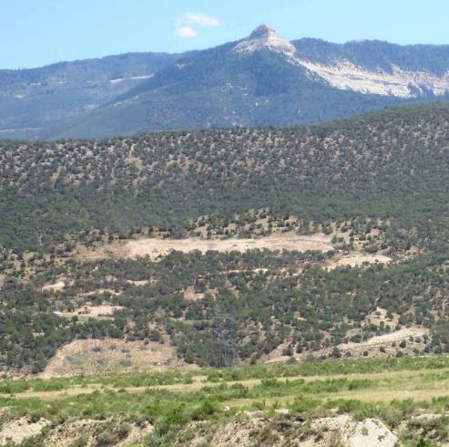
Contrast Rating
Example – New Natural Gas Well Pad
4 – Prepare visual simulations (optional)
KOP 2
Before
Before – Existing Conditions
After
During Construction
Simulation - Mitigated
Notes:
“Interim” mitigation v longer-term restoration (later)

Slide 44
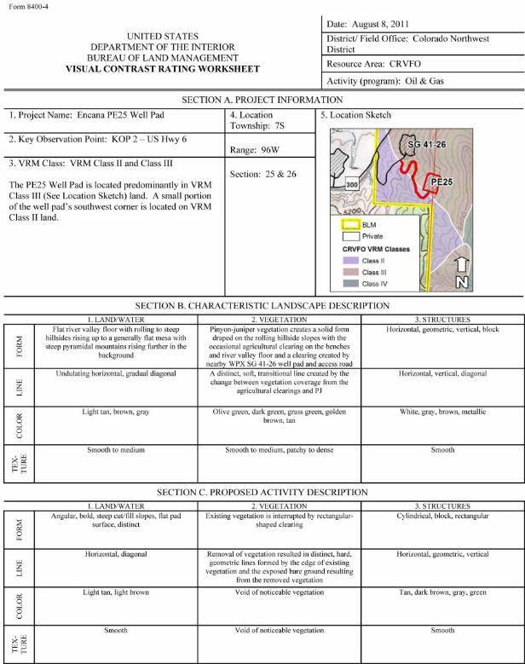
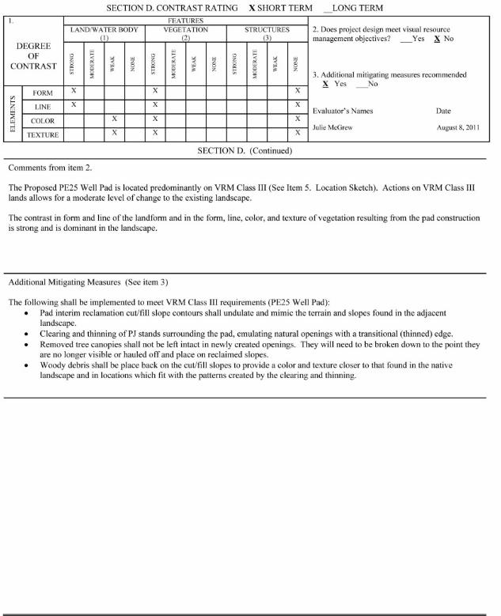
Contrast Rating
Example – New Natural Gas Well Pad
5 – Complete contrast rating

Slide 45
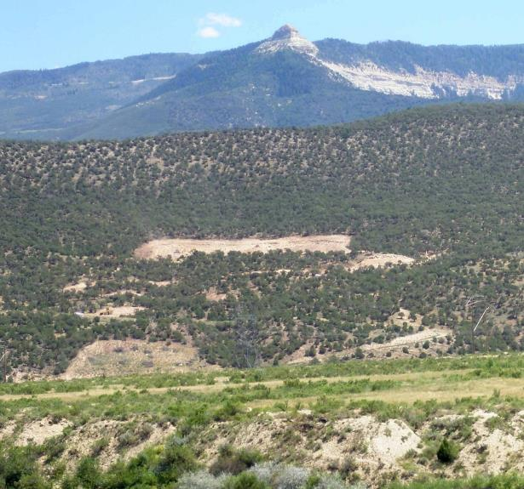
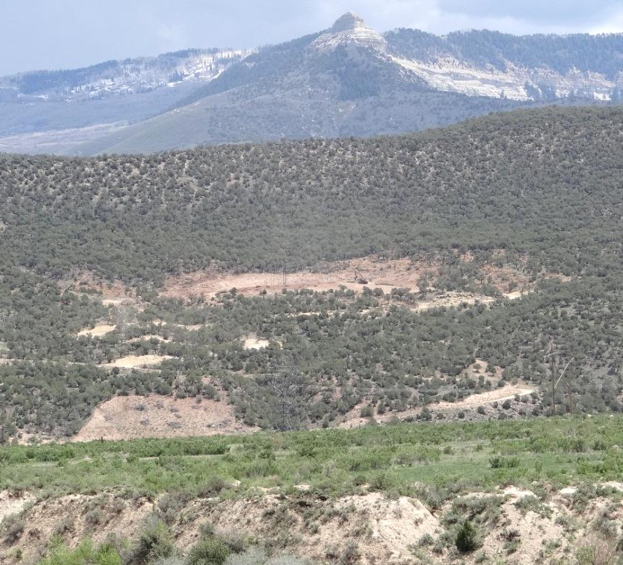
Contrast Rating
Example – New Natural Gas Well Pad
Patience........................
During Construction
Post mitigation
Notes:
It can take years to see the outcome of all the effort, particularly relating to reclamation that meets BLM standards.

Slide 46
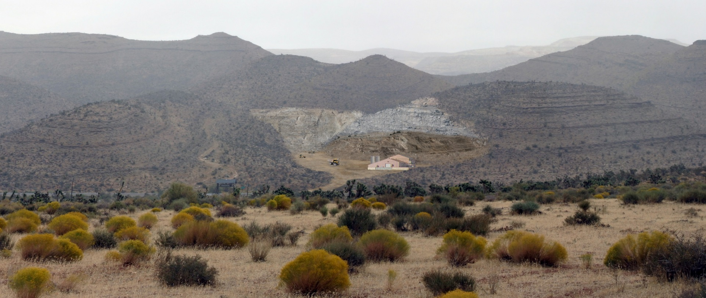
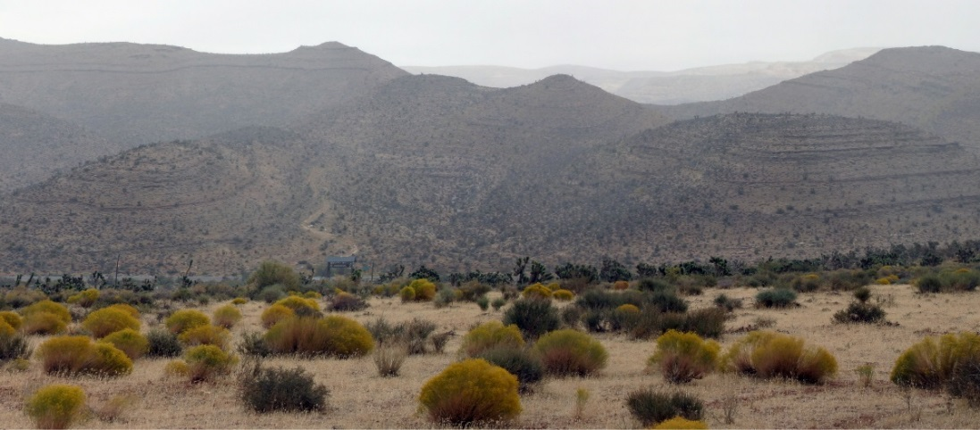
Contrast Rating
Classroom Exercise – Red Rock View Mine
Notes:
Visual Contrast Rating Assignment: Red Rock View Mine
Project Background
After recently attending VRM training, your group has been asked to conduct a contrast rating for a mining operation proposed along the southeast side of Red Rock Canyon National Conservation Area by Red Rock Estates Minery & Casino, LLC. Controversy over this project is escalating as local communities raise concern with the amount of mining that has continued adjacent to the National Conservation Area. There are also concerns about this project being in direct view of a segment of the Old Spanish Trail. Additionally, a national scenery advocacy group, in response to a proposed luxury residential development just to the north near the Red Rock Canyon Visitor Center, has just announced on their website that the Red Rock Canyon State Scenic Byway (State Route 159) has one of the ten most endangered vistas in the country.
Project Overview
The first phase of the mining operation would develop a 15-acre open pit mine. This would be in operation for an anticipated duration of approximately 2 years. The second phase would expand the open pit mine to 40 acres (as shown in the visual simulation). The life-cycle of the mine is anticipated to run for approximately 10 years.
In addition to the open pit mine, there would be an administrative structure built, measuring approximately 150’ x 100’. There would also be frequent truck traffic entering the mine from SR 159. Heavy equipment would also be actively used in conjunction with routine mine operations. It is anticipated that operations would occur 16 hours per day to maximize productivity of the mine. Lighting would be used during dark hours.
At the end of the 10-year operation period, the mine would be decommissioned. Erosion control measures would be taken to ensure no offsite contamination occurs. Minimal recontouring and revegetation would be done.
VRM Information
The Red Rock Canyon NCA RMP designates this area, on the opposite side of SR 159 from the Red Rock escarpment, as VRM III due to its proximity to the NCA.
Assignment
Your field manager asked your group to determine whether the project, as proposed, would meet the VRM Class III objectives and, if not, what mitigation measures might bring it into conformance with VRM Class III objectives.

