Slide 1
March 2018
Las Vegas, NV

Slide 2
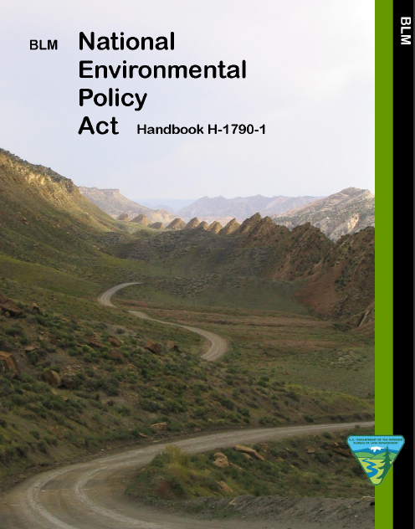
Unit 10 – NEPA & VRM
National Environmental Policy Act
  signed into law on January 1, 1970
  landmark environmental policy
  encourages environmental protection and informed decision-making

Slide 3
Unit 10 – NEPA & VRM
Types of NEPA Efforts - VRM
Determination of NEPA Adequacy (DNA)
  Proposed Action is adequately analyzed in existing NEPA document(s)
Categorical Exclusion (CX)
  Proposed Action predetermined to NOT have significant effect on the quality of the human environment (individually or cumulatively)
  Statutory, Departmental, or BLM categorically excluded
  Lacks extraordinary circumstances (ex. T&E, WA/WSA, wetlands, etc.)
Environmental Assessment (EA)
  Used to determine IF Proposed Action would have significant effects
Environmental Impact Statement (EIS)
  Proposed Action WOULD result in significant effects

Slide 4
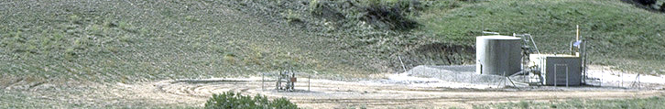
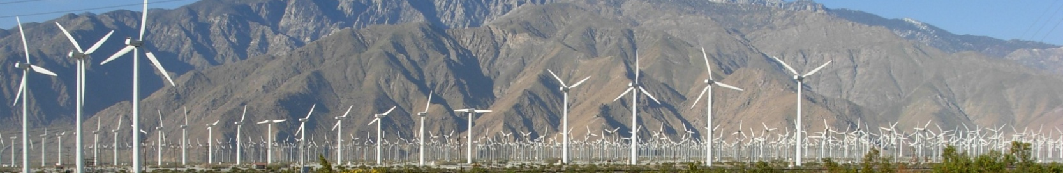
Unit 10 – NEPA & VRM
Types of NEPA Efforts - VRM
Prepared by BLM specialists:
  Internal – rec site, range improvement, fuels reduction
  External – single pad oil & gas well, communication site
Prepared by others but reviewed by BLM specialists:
  Land Use Plan revisions
  ROW for utility-scale renewable energy development
  ROW for transmission line / natural gas line

Slide 5
Unit 10 – NEPA & VRM
NEPA Document Chapters
1 - Purpose and Need
  Land Use Plan Conformance
  Issue Identification
2 - Proposed Action & Alternatives
  VRM Conforming Alternative
  Include VRM Design Features
3 - Affected Environment
  Landscape Character (VRI) / VRM Objectives
4 - Environmental Effects
  Need to be quantified / qualified
  Determine conformance with VRM objectives
5 - Consultation & Coordination

Slide 6
Unit 10 – NEPA & VRM
Sources for Visual Documentation
Project Proponent
Resource Management Plan
Knowledge from Resource Specialists
Visual Resource Inventory
Field Review of Project Proposal
Completed Contrast Rating Form
Input from Affected Landowners
Associated Consulting Firms
Input From the General Public
Similar Projects (including images) / Visualizations

Slide 7
Unit 10 – NEPA & VRM
Ch 1 – RMP Conformance
What is the VRM Management Class where project is proposed?
Is project allowable per RMP guidance? Can it meet VRM objectives?

Slide 8
Unit 10 – NEPA & VRM
Ch 1 – Issue Identification
  Internally-generated (IDT Checklist)
  Externally-generated (public scoping)
  What are visual concerns related to proposed project?
  Entire resources are NOT issues
  Issues drive design features and alternative development
EXAMPLE LANGUAGE:
  Will the proposed site developments create visually contrasting impacts that alter the landscape character?

Slide 9
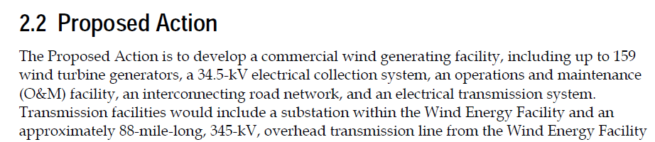
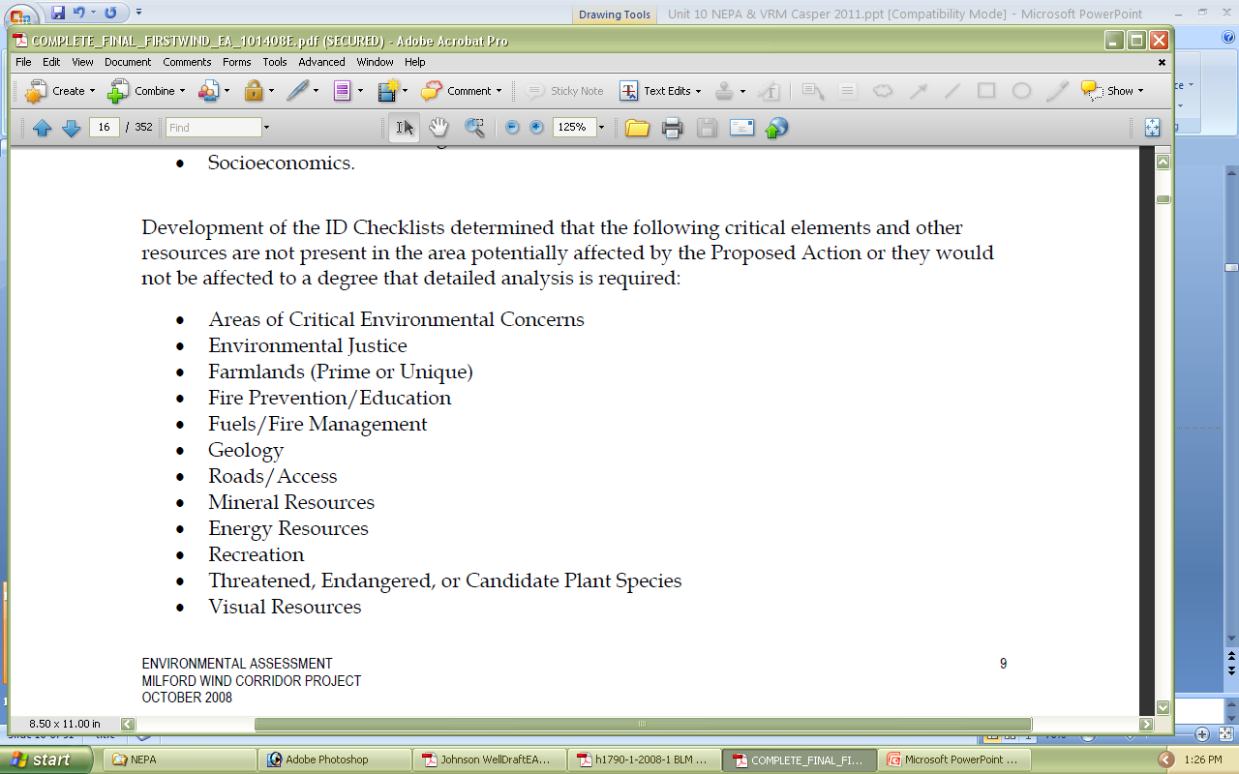
Unit 10 – NEPA & VRM
Ch 1 – Issue Identification
  Example: How would constructing, operating and maintaining a 159 turbine wind energy generating facility alter the landscape character?
  OR

Slide 10
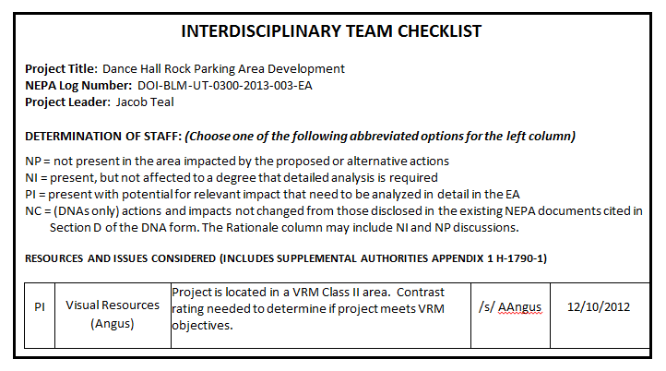
Unit 10 – NEPA & VRM
Ch 1 – Issue Identification
Interdisciplinary Team Checklist

Slide 11
Unit 10 – NEPA & VRM
Ch 2 – Alternatives Development
  Develop alternatives that meet VRM objectives
  What would it take for project to conform?
  Forces early consideration of visual design solutions when preparing alternatives
  Establishes a range of design features and/or mitigation measures
  Allows for better evaluation of trade-offs and benefits
  Allows for informed decision making

Slide 12
Unit 10 – NEPA & VRM
Ch 2 – Alternatives Content
  Complete project descriptions for each alternative
  Who, what, when, where, and how
  Photos of similar projects or visualizations can be very helpful

Slide 13
Unit 10 – NEPA & VRM
Ch 2–Alternatives (Proposed Action) Example
Alternative B: BLM would develop a parking area adjacent to Dance Hall Rock Historic Site on the east side of the Hole in the Rock Road. Development would occur in a previously undisturbed area and include the following:
constructing parking for approximately 12 vehicles including two oversize ones
installing a vault toilet
constructing a 500-foot entrance road for ingress and egress to the parking area
installing interpretive panels
installing site signage
constructing a 500-foot trail from the parking area to the edge of Dance Hall Rock
Improvements would include hardening the parking area and road surface with road base. Equipment that would be used to develop this project would likely include hand tools, dump trucks, front end loaders, road graders and a tractor trailer with crane to install the vault toilet. The earliest the project would be implemented is Fall 2014. Implementation and completion of the project is estimated to be one month from when construction starts.
Design criteria to meet built environment image guidelines and other guidance would include the following:
Natural or natural-appearing materials would be used. These could include concrete, natural stone, gravels or fines, rusted or painted metal, and/or wood. No shiny, reflective materials would be used.
Natural palette colors would include grays, reds, salmons, rusts, browns, and buffs. No bright colors such as whites or yellows would be used.

Slide 14
Unit 10 – NEPA & VRM
Ch 3 – Affected Environment Content
  Describe Characteristic Landscape
    Use Visual Resource Inventory
    Use Section B of the Contrast Rating Form(s)
  Describe the casual observer(s)
  Explain VRM Class Objectives
SECTION B. CHARACTERISTIC LANDSCAPE DESCRIPTION
1. LAND/WATER |  | 2. VEGETATION | 3. STRUCTURES
FORM | Rounded, humpback sandstone forms rising above a flat to gently rolling plain. Massive vertical cliffs to west in background. Rolling sandstone in background to south and east. | Blanket of low shrubs and grasses. Predominantly blackbrush. Random, isolated pinyon /juniper trees. | HITR Road – swath of vegetation removed to create a band.
LINE | Horizontal and rounded. | Indistinct to stippled. | Curving band.
COLOR | Reds, pinks, salmons, tans, buffs, grays. | Dark gray/greens with accents of other greens and golds depending on seasonal vegetation changes. | Salmon.
TEX- TURE | Smooth in flat plain areas, coarse in areas with sandstone uplifting features, and medium in transitional areas in between. | Fine. | Smooth.

Slide 15
Unit 10 – NEPA & VRM
Ch 3 – Affected Environment Example
Characteristic Landscape
The proposed project area is located just off Hole in the Rock Road, adjacent to the locally well-known landmark – Dance Hall Rock – a massive sandstone feature that emerges from the rolling desert floor to create a large natural amphitheater on its western edge and an exposed expanse of uplifted sandstone riddled with huge potholes and depressions toward its eastern backside. It is sited within Visual Resource Inventory Class II (Unit 027), Scenic Quality B (SQRU 056), High Sensitivity (SLRU 039) and within the Foreground/ Middle-ground Distance Zone.
The project area is east of the Straight Cliffs and west of the Escalante Canyons in a landscape comprised of long, rolling desert benches that extend from the base of the Straight Cliffs until they drop away into the Escalante Canyons. The dominant vegetation is blackbrush and other desert shrubs and grasses, with a few random pinyon/juniper in isolated locations. The vegetation is mostly dark greenish gray and ranges from medium to coarse in texture. There are few built elements in this landscape – the road, an interpretive panel, a small monitoring station, and a few signs. The road is the only of these that is prominent enough to draw attention.
The project area is within an enclosed landscape created by the cliffs, uplifted sandstone features, and counterbalancing washes, drainages, and depressions in the landform. The predominant lines are rounded and horizontal created by landform edges. The road adds a distinct band across the landscape that is created by the removal of vegetation which creates a contrast in color and texture to the existing
Visual Resource Inventory
Contrast Rating
Form

Slide 16
Unit 10 – NEPA & VRM
Ch 3 – Affected Environment Example
Characteristic Landscape
The proposed project area is located just off Hole in the Rock Road, adjacent to the locally well-known landmark – Dance Hall Rock – a massive sandstone feature that emerges from the rolling desert floor to create a large natural amphitheater on its western edge and an exposed expanse of uplifted sandstone riddled with huge potholes and depressions toward its eastern backside. It is sited within Visual Resource Inventory Class II (Unit 027), Scenic Quality B (SQRU 056), High Sensitivity (SLRU 039) and within the Foreground/ Middle-ground Distance Zone.
The project area is east of the Straight Cliffs and west of the Escalante Canyons in a landscape comprised of long, rolling desert benches that extend from the base of the Straight Cliffs until they drop away into the Escalante Canyons. The dominant vegetation is blackbrush and other desert shrubs and grasses, with a few random pinyon/juniper in isolated locations. The vegetation is mostly dark greenish gray and ranges from medium to coarse in texture. There are few built elements in this landscape – the road, an interpretive panel, a small monitoring station, and a few signs. The road is the only of these that is prominent enough to draw attention.
The project area is within an enclosed landscape created by the cliffs, uplifted sandstone features, and counterbalancing washes, drainages, and depressions in the landform. The predominant lines are rounded and horizontal created by landform edges. The road adds a distinct band across the landscape that is created by the removal of vegetation which creates a contrast in color and texture to the existing

Slide 17
Unit 10 – NEPA & VRM
Ch 3 – Affected Environment Example
scene and that directs the eye along its alignment. The predominant colors of this landscape are reds and grays due to the landform and vegetation. The texture of the landscape varies from fine due to the consistent swaths of shrubs in the mid- and background, to coarse due to the sandstone outcrops and washes.
This project is proposed in a classic Southern Utah, canyon country landscape with exposed red sandstone, sand dunes, and desert vegetation similar to other areas within the Colorado Plateau.
This lower segment of Hole in the Rock Road where Dance Hall Rock is located is used primarily by recreationists and cattle permittees. Those using the area for recreation are typically engaged in scenic and heritage touring, hiking and backpacking, OHV activities, and photography. This range of individuals defines the casual observer.
Visual Resource Inventory and Management Classes
The proposed Dance Hall Rock Parking Improvements project area is located in Visual Resource Management (VRM) Class II. The objective for VRM Class II is to retain the existing character of the landscape. The level of change to the characteristic landscape should be low. Management activities may be seen, but should not attract the attention of the casual observer. Any changes must repeat the basic elements found in the predominant natural features of the characteristic landscape.
Casual Observer
Management Objectives

Slide 18
Unit 10 – NEPA & VRM
Ch 3 – Affected Environment Example
scene and that directs the eye along its alignment. The predominant colors of this landscape are reds and grays due to the landform and vegetation. The texture of the landscape varies from fine due to the consistent swaths of shrubs in the mid- and background, to coarse due to the sandstone outcrops and washes.
This project is proposed in a classic Southern Utah, canyon country landscape with exposed red sandstone, sand dunes, and desert vegetation similar to other areas within the Colorado Plateau.
This lower segment of Hole in the Rock Road where Dance Hall Rock is located is used primarily by recreationists and cattle permittees. Those using the area for recreation are typically engaged in scenic and heritage touring, hiking and backpacking, OHV activities, and photography. This range of individuals defines the casual observer.
Visual Resource Inventory and Management Classes
The proposed Dance Hall Rock Parking Improvements project area is located in Visual Resource Management (VRM) Class II. The objective for VRM Class II is to retain the existing character of the landscape. The level of change to the characteristic landscape should be low. Management activities may be seen, but should not attract the attention of the casual observer. Any changes must repeat the basic elements found in the predominant natural features of the characteristic landscape.

Slide 19
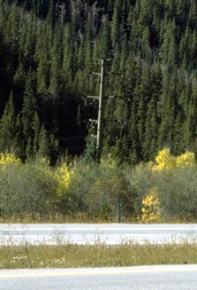
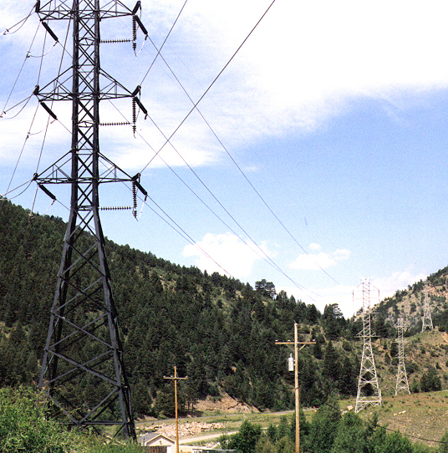
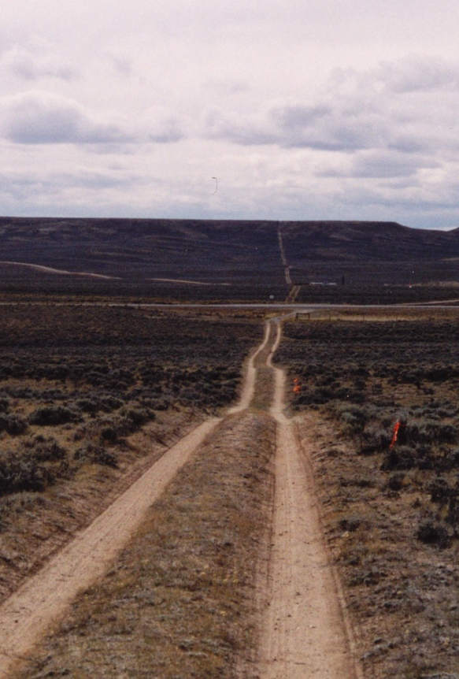
Unit 10 – NEPA & VRM
Ch 4 – Environmental Effects
  A statement like:
  “The project would (or would not) impact visual resources” is NOT sufficient.

Slide 20
Unit 10 – NEPA & VRM
Ch 4 – Environmental Effects
  The Environmental Impact is the amount of contrast the project causes to the existing landscape.
  Identify the KOP(s) and why selected.
  Explain influence of any Environmental Factors.
  Refer to Sections C and D on the Contrast Rating Form.
  Describe the nature of the impact - use terms WEAK, MODERATE, STRONG - and include language from narrative on back of Contrast Rating Form.

Slide 21
Unit 10 – NEPA & VRM
Ch 4 – Environmental Effects
SECTION C. PROPOSED ACTIVITY DESCRIPTION
 | 1. LAND/WATER | 2. VEGETATION | 3. STRUCTURES
FORM | Same . | Same. | Boxy forms associated with toilet and automobiles. Curving swatch of new entrance road and irregular horizontal form parking area.
LINE | Same. | Same. | Horizontal, vertical, curving band.
COLOR | Same. | Same. | Reds and salmons, grays, browns and tans, earth-tones – multi-color intermittently when autos are parked on site.
TEX- TURE | Same. | Same. | Smooth to medium.

Slide 22
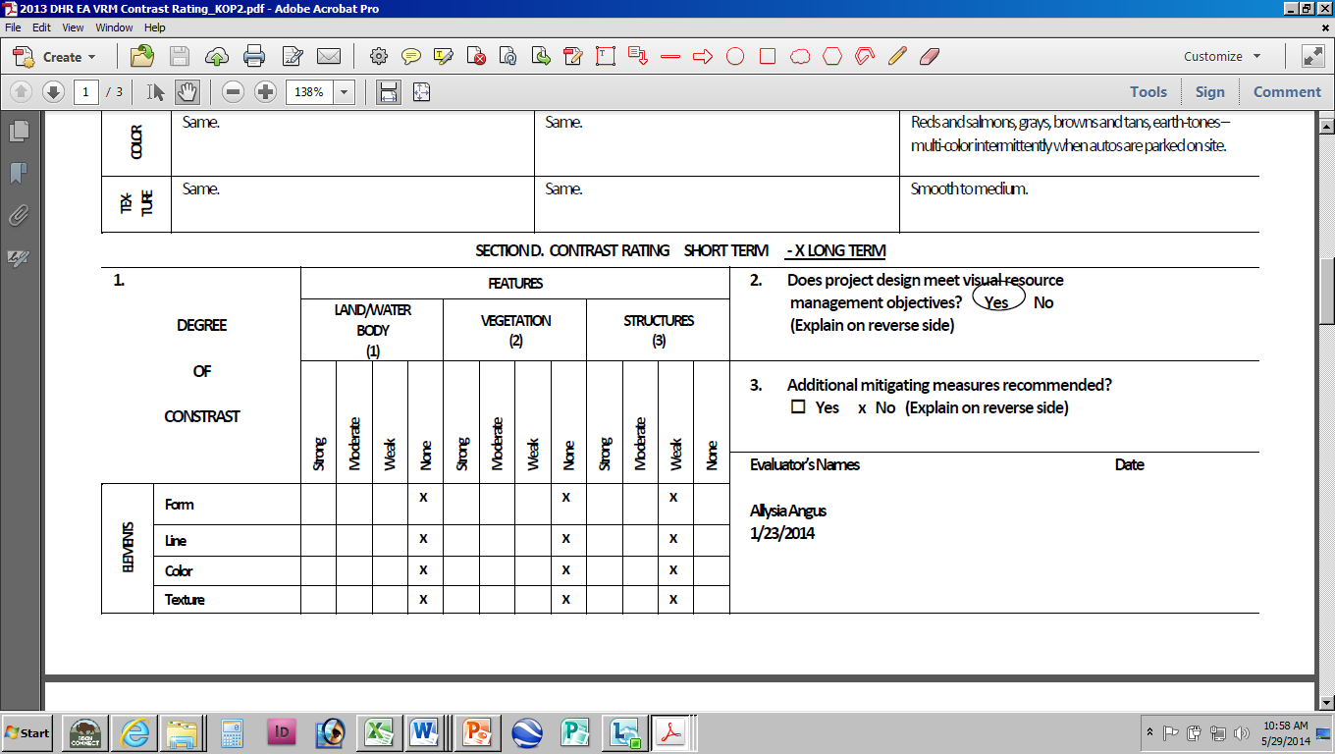
Unit 10 – NEPA & VRM
Ch 4 – Environmental Effects
Section D, continued (from back of Contrast Rating Form)
For Alternative B as viewed from KOP 2 has the development located in a depression where the landform rolls away and down from this viewing angle, thus partially screening the features associated with it. The casual observer would see the upper portions of the vault toilet, portions of the intermittently-parked vehicles and possibly some portions of the other site features. The toilet and other features would be of colors and textures to blend with the natural landscape character. The automobiles of all colors would be the most noticeable items but would be parked intermittently.

Slide 23
Unit 10 – NEPA & VRM
Ch 4 – Environmental Effects Example
BLM’s Visual Resource Management program includes a standardized system to review lands actions for resource management plan conformance. Visual contrast rating worksheets are completed to determine if a project conforms to the resource management plan. In order to evaluate the environmental consequences of the alternatives for this proposed project, three key observations points (KOPs) were established as part of completing the contrast rating analysis.
KOP #1 was along Hole in the Rock Road looking south toward the sites; KOP#2 was also along Hole in the Rock Road but looking north toward the sites; and KOP#3 was on the floor of Dance Hall Rock looking outward across the landscape. The visibility of the alternatives from these KOPs is detailed in the table below.
Comparison of Visibility by Alternative from Key Observation Points
Hole in the Rock Road closely follows the path of the Mormon San Juan Mission expedition route, is a State Scenic Backway, and provides access to many popular recreation destinations in GSENM and Glen Canyon National Recreation Area for thousands of visitors annually, hence the justification for selecting two KOPs along it from both travel directions. The third KOP, on the Dance Hall Rock amphitheater floor looking outward, was selected per feedback from public scoping from those concerned about the preservation of the views from inside the historic site outward.
Key Observation Points
 | KOP#1 | KOP#2 | KOP#3
Alt A: No Action | Not Visible | Minimally Visible | Fully Visible
Alt B: Existing Disturbance Area | Not Visible | Partially Visible | Fully Visible
Alt C: New Disturbance Area | Partially Visible | Fully Visible | Not Visible

Slide 24
Unit 10 – NEPA & VRM
Ch 4 – Environmental Effects Example
BLM’s Visual Resource Management program includes a standardized system to review lands actions for resource management plan conformance. Visual contrast rating worksheets are completed to determine if a project conforms to the resource management plan. In order to evaluate the environmental consequences of the alternatives for this proposed project, three key observations points (KOPs) were established as part of completing the contrast rating analysis.
KOP #1 was along Hole in the Rock Road looking south toward the sites; KOP#2 was also along Hole in the Rock Road but looking north toward the sites; and KOP#3 was on the floor of Dance Hall Rock looking outward across the landscape. The visibility of the alternatives from these KOPs is detailed in the table below.
Comparison of Visibility by Alternative from Key Observation Points
Hole in the Rock Road closely follows the path of the Mormon San Juan Mission expedition route, is a State Scenic Backway, and provides access to many popular recreation destinations in GSENM and Glen Canyon National Recreation Area for thousands of visitors annually, hence the justification for selecting two KOPs along it from both travel directions. The third KOP, on the Dance Hall Rock amphitheater floor looking outward, was selected per feedback from public scoping from those concerned about the preservation of the views from inside the historic site outward.
 | KOP#1 | KOP#2 | KOP#3
Alt A: No Action | Not Visible | Minimally Visible | Fully Visible
Alt B: Existing Disturbance Area | Not Visible | Partially Visible | Fully Visible
Alt C: New Disturbance Area | Partially Visible | Fully Visible | Not Visible

Slide 25
Unit 10 – NEPA & VRM
Ch 4 – Environmental Effects Example
The potential project locations are within close proximity to Hole in the Rock Road, contributing to their visibility. Visitors travel in this area year round though peak visitation is in the spring and fall months. For those travelling the road in either direction, the length of time the sites would be in view is less than a minute, but for those spending time at the site, Alternative B would be visible as long as their visit lasts. The massiveness of Dance Hall Rock would dwarf the site improvements in terms of scale.
Alternative B
During construction, temporary visual impacts would result from the visibility of construction equipment and site work. Post-construction, the contrast created by the site improvements would be negligible in regards to the changes in vegetation. Weak landform contrast would be created in line and form by the delineation of the parking area and the structures (i.e. toilet, signs, etc.) due to adding blocky, randomly-spaced elements with vertical, horizontal, and diagonal lines into the landscape. Additionally, the vehicles that park to use the area would be visible and would create minor visual contrast, though they would be transitory.
In order to minimize the visibility of the site development for those travelling along Hole in the Rock Road, it would be sited in a depression surrounded by landforms. The toilet and other fixtures would be constructed of materials that blend with the natural environment minimizing the color and textural contrast they would create.
Environmental Factors
Contrast Analysis
Conformance to VRM Objectives

Slide 26
Unit 10 – NEPA & VRM
Ch 4 – Environmental Effects Example
The potential project locations are within close proximity to Hole in the Rock Road, contributing to their visibility. Visitors travel in this area year round though peak visitation is in the spring and fall months. For those travelling the road in either direction, the length of time the sites would be in view is less than a minute, but for those spending time at the site, Alternative B would be visible as long as their visit lasts. The massiveness of Dance Hall Rock would dwarf the site improvements in terms of scale.
Alternative B
During construction, temporary visual impacts would result from the visibility of construction equipment and site work. Post-construction, the contrast created by the site improvements would be negligible in regards to the changes in vegetation. Weak landform contrast would be created in line and form by the delineation of the parking area and the structures (i.e. toilet, signs, etc.) due to adding blocky, randomly-spaced elements with vertical, horizontal, and diagonal lines into the landscape. Additionally, the vehicles that park to use the area would be visible and would create minor visual contrast, though they would be transitory.
In order to minimize the visibility of the site development for those travelling along Hole in the Rock Road, it would be sited in a depression surrounded by landforms. The toilet and other fixtures would be constructed of materials that blend with the natural environment minimizing the color and textural contrast they would create.

Slide 27
Unit 10 – NEPA & VRM
Ch 4 – Environmental Effects - Cumulative
  Cumulative Effects
  Impact on the environment which results from incremental effect of past, present, and reasonably foreseeable future actions (no matter who undertakes them).
  Determine Cumulative Impact Area
  Assess quantitatively if possible

Slide 28
Unit 10 – NEPA & VRM
Ch 4 – Environmental Effects - Cumulative
Cumulative Impact Area (CIA)
Visual Resources - The cumulative impact area of analysis for Visual Resources is the viewshed along Hole in the Rock Road.
Cumulative Impact Analysis
The cumulative impacts to visual resources from past, present, and reasonably foreseeable actions include establishment of livestock grazing management facilities (corrals, fences, water developments, storage buildings, etc.), recreational facilities (trailheads, day use areas, etc.), general recreational use, and road construction and maintenance activities. The action alternatives would not contribute to a measureable increase in impacts to visual resources as they would be constructed to blend with the landscape, be screened from view to the extent practicable, and the Dance Hall Rock location is already an attraction visited by the general public on a regular basis. Additionally, the Hole in the Rock Road runs for more than 60 miles from north to south through a viewshed that encompasses a landscape of 100,000s of acres. This development would be visible only when in near proximity to the site and is small in scale within this grand scale landscape.
Cumulative Impact Area
Cumulative Impact Analysis

Slide 29
Unit 10 – NEPA & VRM
Ch 4 – Environmental Effects - Cumulative
Cumulative Impact Area (CIA)
Visual Resources - The cumulative impact area of analysis for Visual Resources is the viewshed along Hole in the Rock Road.
Cumulative Impact Analysis
The cumulative impacts to visual resources from past, present, and reasonably foreseeable actions include establishment of livestock grazing management facilities (corrals, fences, water developments, storage buildings, etc.), recreational facilities (trailheads, day use areas, etc.), general recreational use, and road construction and maintenance activities. The action alternatives would not contribute to a measureable increase in impacts to visual resources as they would be constructed to blend with the landscape, be screened from view to the extent practicable, and the Dance Hall Rock location is already an attraction visited by the general public on a regular basis. Additionally, the Hole in the Rock Road runs for more than 60 miles from north to south through a viewshed that encompasses a landscape of 100,000s of acres. This development would be visible only when in near proximity to the site and is small in scale within this grand scale landscape.

Slide 30
Unit 10 – NEPA & VRM
Conformance with VRM Objectives
  Do alternatives conform to RMP (VRM Objectives)?
  YES, if:
  None = Class I
  Weak = Class II
  Moderate = Class III
  Strong = Class IV

Slide 31
Unit 10 – NEPA & VRM
Conformance with VRM Objectives
  Does project meet VRM Objectives?
  YES, if:
  None = Class I
  Weak = Class II
  Moderate = Class III
  Strong = Class IV

Slide 32
Unit 10 – NEPA & VRM
4 – Environmental Effects
Alternative B
By constructing the project according to the outlined design criteria and implementation measures, the minor changes to the existing character of the landscape would be appropriate to meet the visual resource management objectives of the area.
Conformance to VRM Objectives

Slide 33
Unit 10 – NEPA & VRM
4 – Environmental Effects
Alternative B
By constructing the project according to the outlined design criteria and implementation measures, the minor changes to the existing character of the landscape would be appropriate to meet the visual resource management objectives of the area.

Slide 34
Unit 10 – NEPA & VRM
Conformance with VRM Objectives
  Does project meet VRM Objectives?
  NO, what to do?
  Redesign project to meet VRM Objectives
  Internal – Drop project
  External - Deny application for project
  Amend RMP

Slide 35
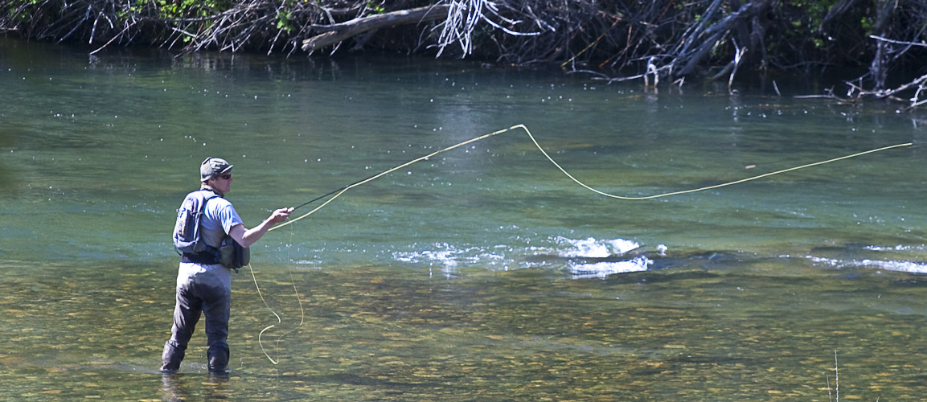
Unit 10 – NEPA & VRM
  Are we done once NEPA is completed?
  Is it time to go fishing?

Slide 36
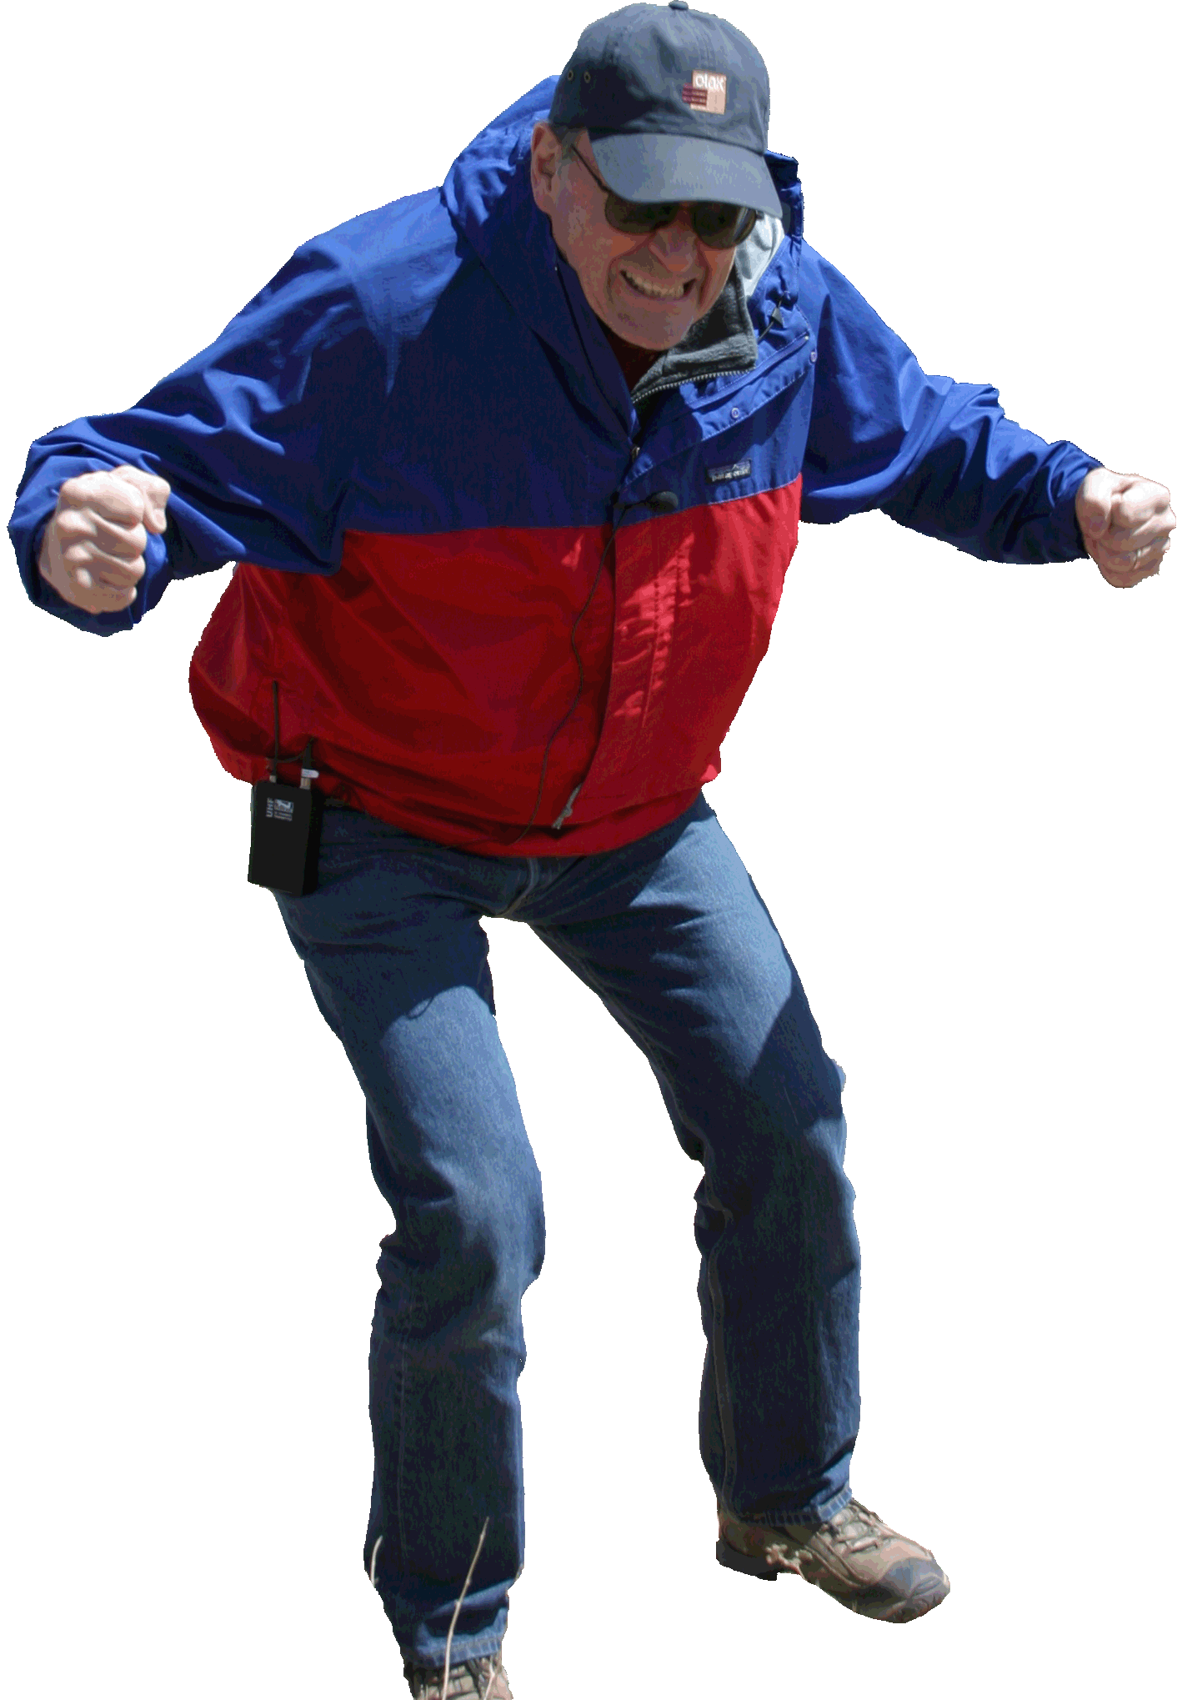
Unit 10 – NEPA & VRM
  NO?!!
  Sooooo, What’s next?

Slide 37
Unit 10 – NEPA & VRM
  Build it and check to see if you did okay …..
  AKA - MONITORING

Slide 38
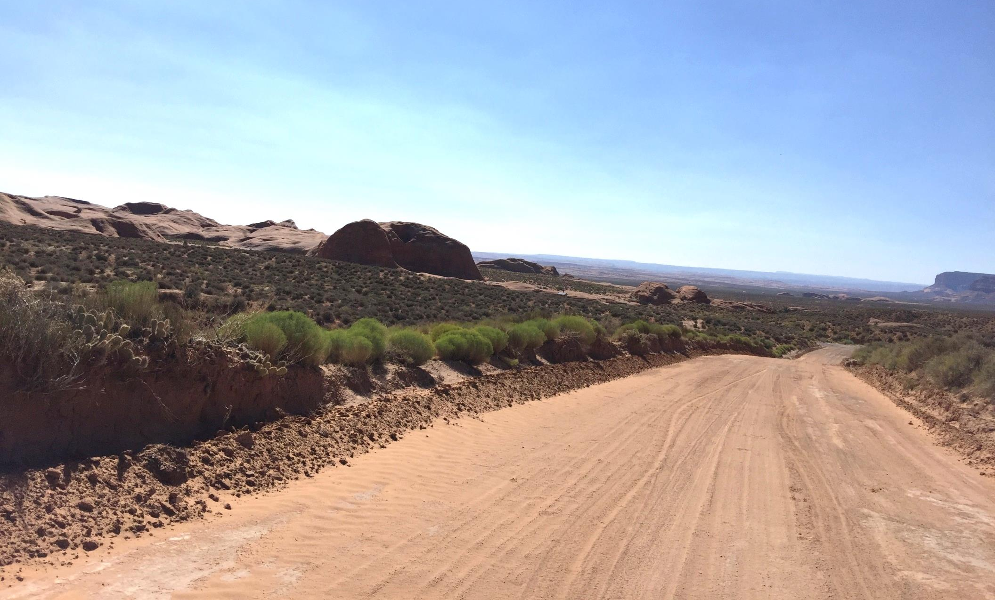
Unit 10 – NEPA & VRM
Dance Hall Rock – KOP #1

Slide 39
Unit 10 – NEPA & VRM
Dance Hall Rock – KOP #1

Slide 40
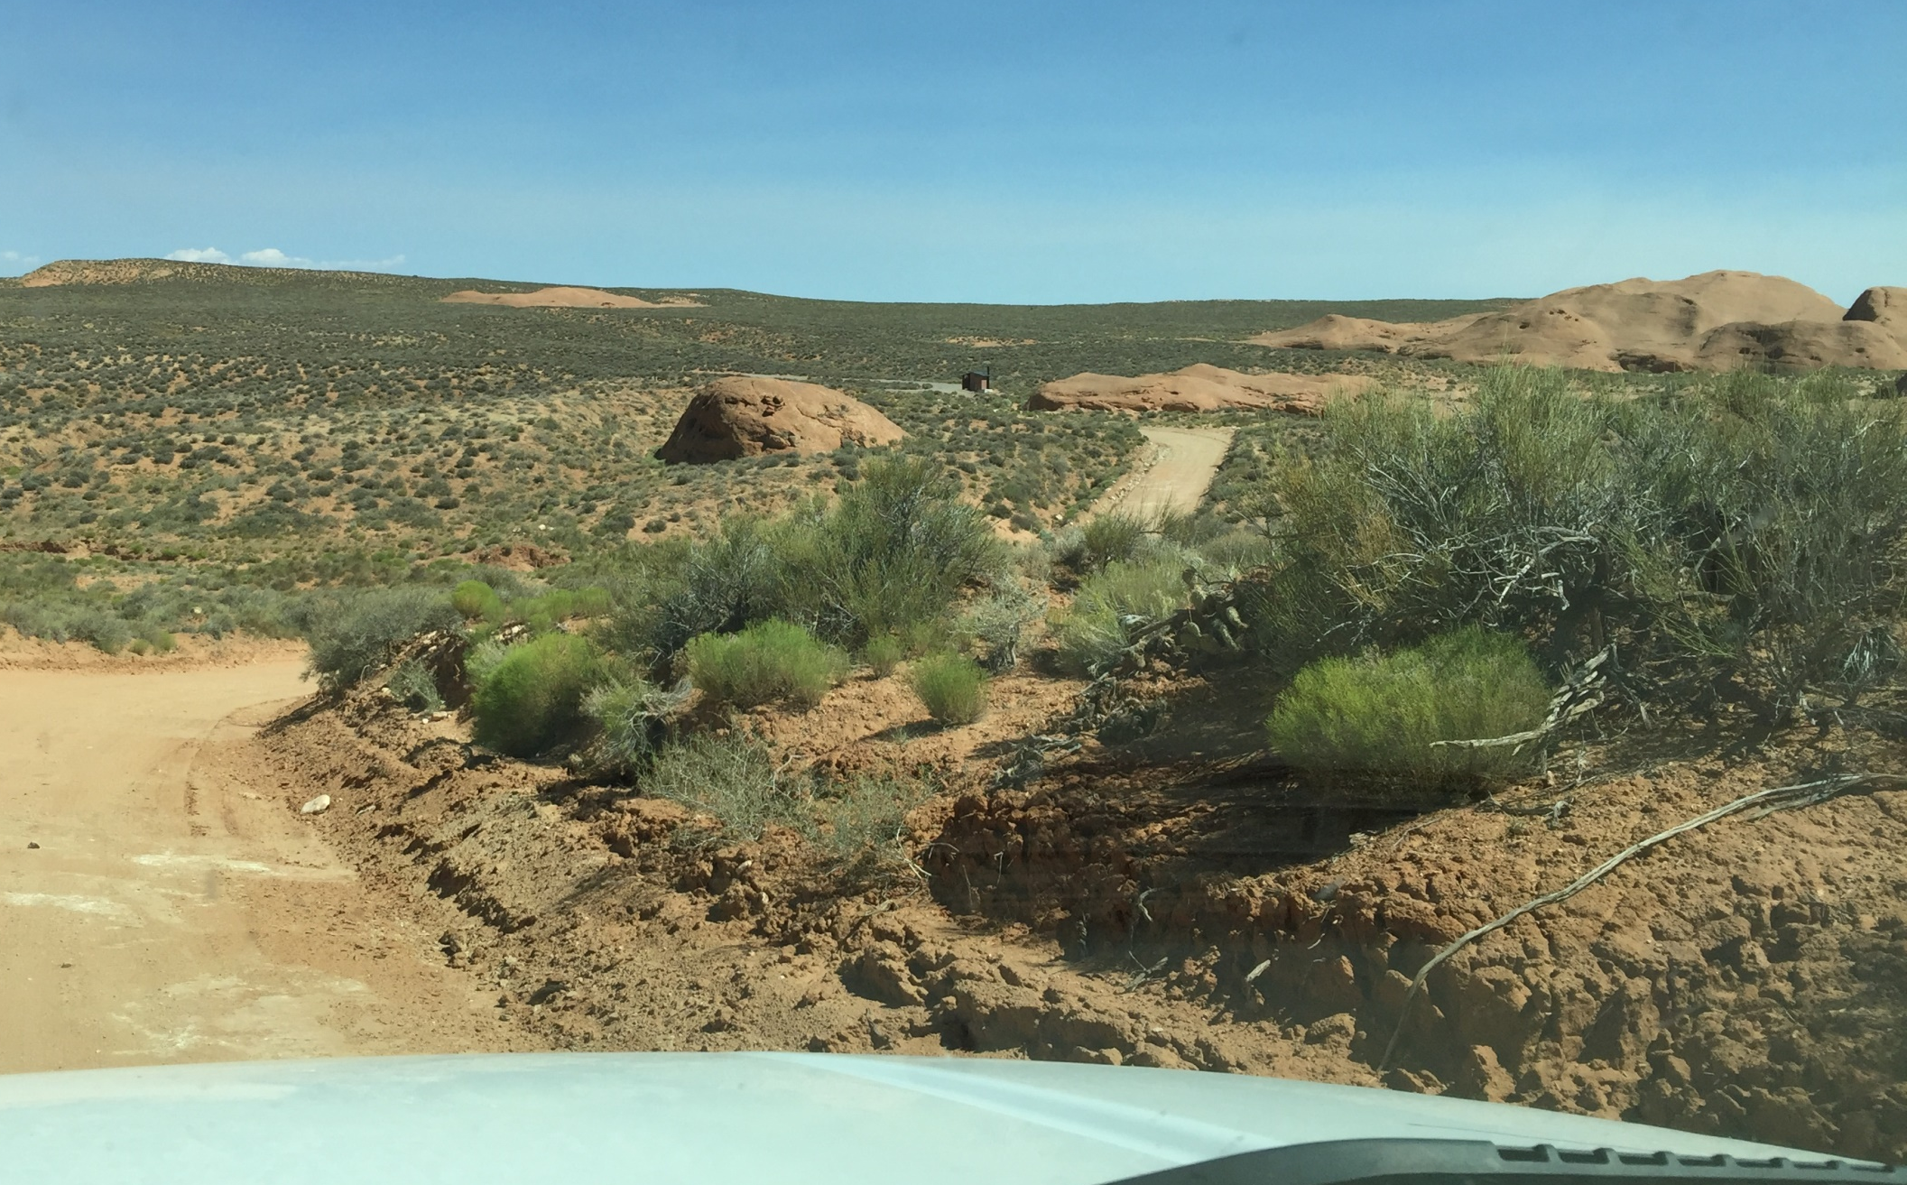
Unit 10 – NEPA & VRM
Dance Hall Rock – KOP #2

Slide 41
Unit 10 – NEPA & VRM
Dance Hall Rock – KOP #2

Slide 42
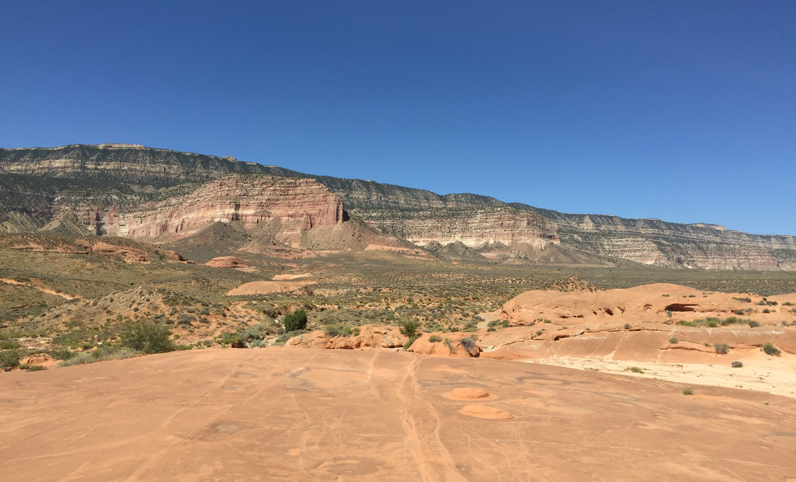
Unit 10 – NEPA & VRM
Dance Hall Rock – KOP #3

Slide 43
Unit 10 – NEPA & VRM
Dance Hall Rock – KOP #3

Slide 44
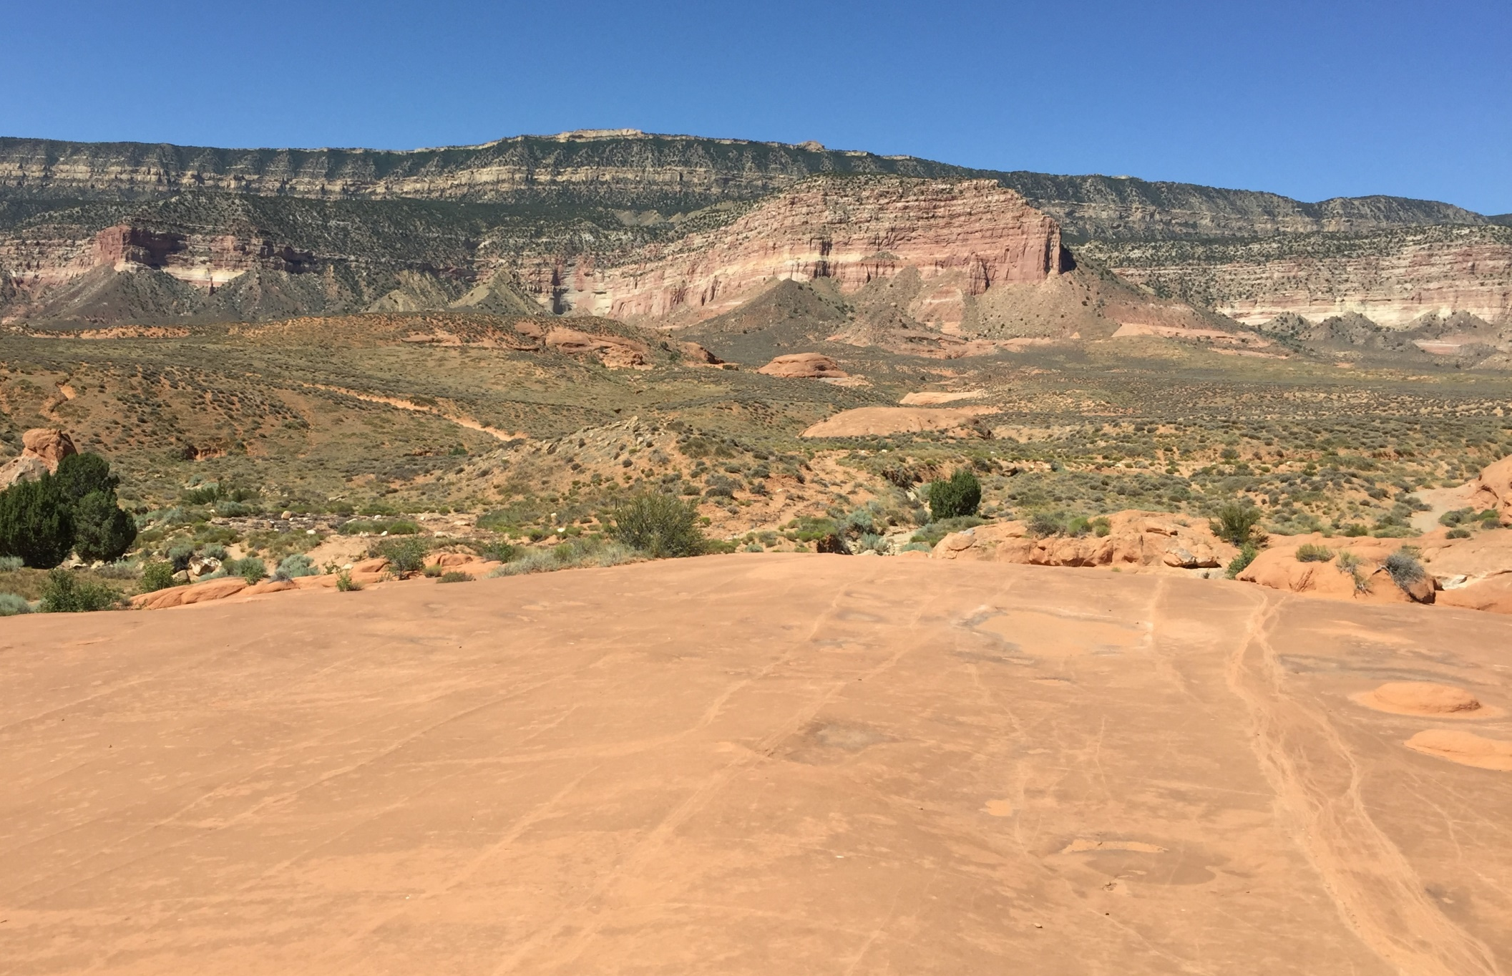
Unit 10 – NEPA & VRM
Dance Hall Rock –Parking Area Reclamation

Slide 45
Unit 10 – NEPA & VRM
Dance Hall Rock –Parking Area Reclamation

