Slide 2
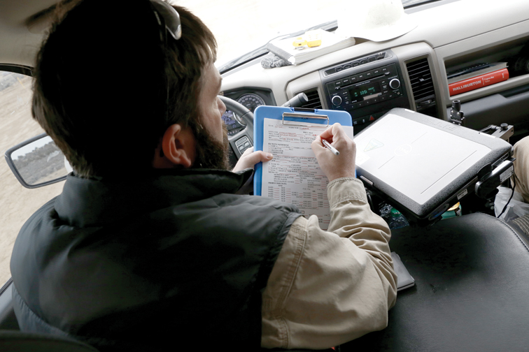

Slide 3
Unit Objective
Contrast ratings are required for proposed projects in highly sensitive areas or high impact projects, but may also be used for other projects where it would appear to be the most effective design or assessment tool.
Learn:
the purpose and importance for monitoring,
elements of a monitoring plan,
what should be monitored, and
methods to consider when developing a monitoring strategy,
Possible actions for non-compliance.

Slide 4
Monitoring
References
Regulatory & policy requirements:
Visual Resource Management MS 8400: 8400.06.A.7 Policy
H-1790-1 BLM NEPA Handbook: Chapter 10.1 Purposes of and Requirements for Monitoring
Council on Environmental Quality (CEQ) 01/14/2011 Memorandum: Appropriate Use of Mitigation And Monitoring and Clarifying the Appropriate Use of Mitigated Findings of No Significant Impact

Slide 5
Purpose
To remain mindful of and effectively manage the visual resource values and condition within the planning area, as well as in context of the regional landscape.
Make measured decisions that factor in the mitigation hierarchy:
avoidance,
minimization,
rectification,
reduction or elimination over time, and
compensate for residual impacts
to resources, values, and functions (40 CFR 1508.20).

Slide 6
Authority and Policy
40 CFR 1505.2(c)
“A monitoring and enforcement program shall be adopted and summarized where applicable for any mitigation.”
H-1790-1 NEPA Handbook, Chapter 10.1
“Record of Decision/ Decision Record must delineate the monitoring measures in sufficient detail to constitute an enforceable commitment, or incorporate by reference the portions of the EIS that do so.”
Visual Resource Management Manual Section 8400.06.A.7
“Ensure that project monitoring efforts include timely and thorough compliance evaluations, especially during the construction phase, to ensure that visual management provisions are effectively carried out.”

Slide 7
Why we monitor
To confirm:
Compliance – comply with the terms, conditions and mitigation requirements identified in the land use plan and project NEPA decisions. Are we meeting our commitments to the public?
Effectiveness – Are the decisions achieving the intended environmental objectives, and are the predicted environmental effects accurate? Validating that the outcome is as anticipated.
Adaptive management – If decisions are not meeting the purpose and need, nor achieving desired outcomes, then monitoring is used to identify necessary changes.

Slide 8
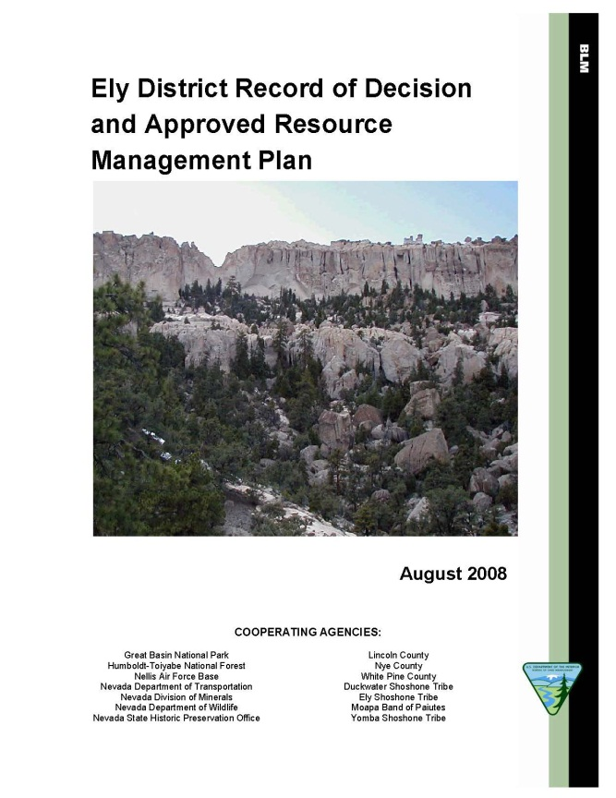
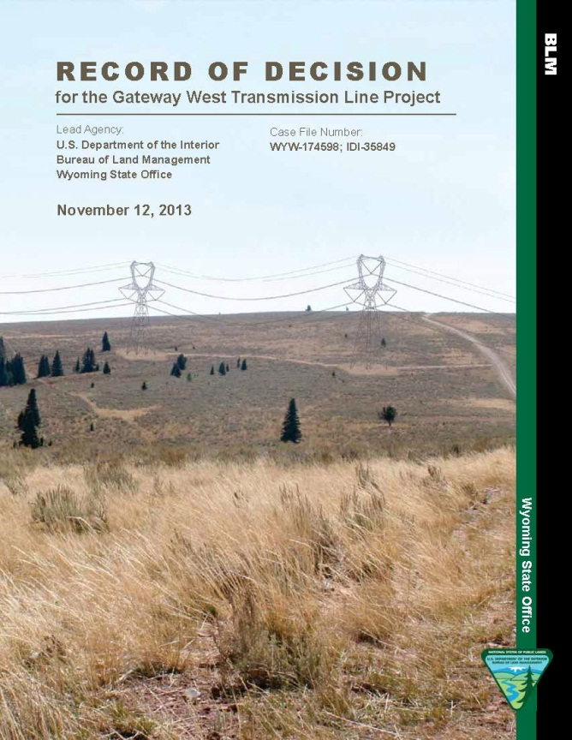
When to Monitor
When does monitoring come into play:
In the implementation of land use plan (LUP) decisions
Oversight of project level land use authorizations
Changes to the Visual Resource Inventory factor values

Slide 9
Project Level
Compliance, effectiveness, and adaptive management of the project design features and mitigation:
while under construction,
while in operation, and
when decommissioned.
Need to have a Monitoring Plan in place:
work with the project manager to make sure the VRM monitoring is addressed in the project’s monitoring plan.

Slide 10
Project Level Monitoring
The VRM Monitoring Plan should:
Set conditions and terms for monitoring, and how and when monitoring occurs.
Clarify measureable performance standards for the applicant and their operators.
Identify how compliance and effectiveness will be quantified and measured.
Outline process for determining and implementing corrective actions when a site is out of compliance or results are ineffective.
Establish a clear understanding of expectations and a road map to successful outcomes.

Slide 11
Project Level
Ensure conformance to the VRM objective:
represents the desired future condition under the management of the plan.
If not met, then consideration of compensatory mitigation may come into play. What other issues might be at play?
Change orders when under construction that change the nature of the project.
Need for re-analysis and adjustment of design features and mitigation to meet desired outcome of the project.
What if we find that the project outcome has drifted out of conformance with the VRM Class objective?
Notes:
Part of Monitoring is to also make sure that the Contrast Rating Analysis was correct in that the VRM Objective will be met.

Slide 12
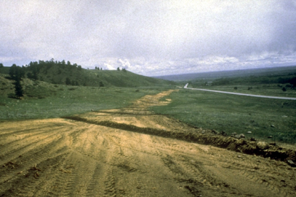
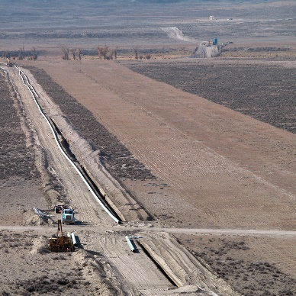
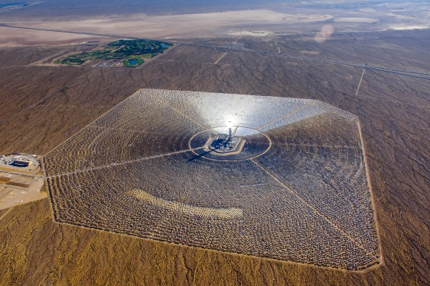
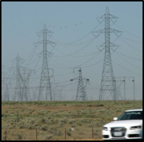
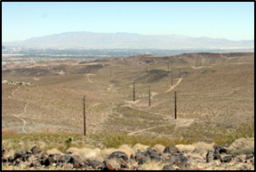
Project Level
Complexity:
Keep the monitoring plan in scale with:
Size of development
Magnitude of impact
Visual sensitivity level
Keep it simple, yet effective.
Small scale
Large scale
Spatial relationship
Large impact
Smaller impact

Slide 13
Project Level
Frequency – Think in terms of project phasing and sequencing:
Document the pre-construction site conditions
After site improvement is staked and limits delineated
Incrementally during construction phases
Construction and installation of VRM:
design features, and
mitigation requirements
Post-construction monitoring of interim design feature/ mitigation results
Final reclamation construction
After monitoring of final reclamation

Slide 14
Project Level Monitoring
What are some of the methods or tools that can be used?
Develop a photo documentation protocol & maintain a record
Establish monitoring photo points
Compare Visual Impact Analysis simulations to project’s results
Contrast Rating evaluation comparisons
Construction plans compared to as-built results
Assess the magnitude of affected viewshed as being built and after completion
Are there unanticipated impacts? Is there a need to mitigate the unanticipated residual impacts?
Notes:
Establish monitoring photo points
Convenient locations to record progress;
From selected KOPs

Slide 15
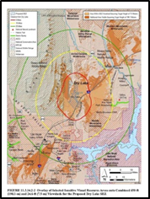
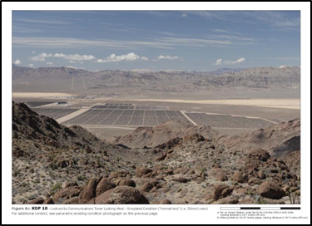
Project Level Monitoring

Slide 16
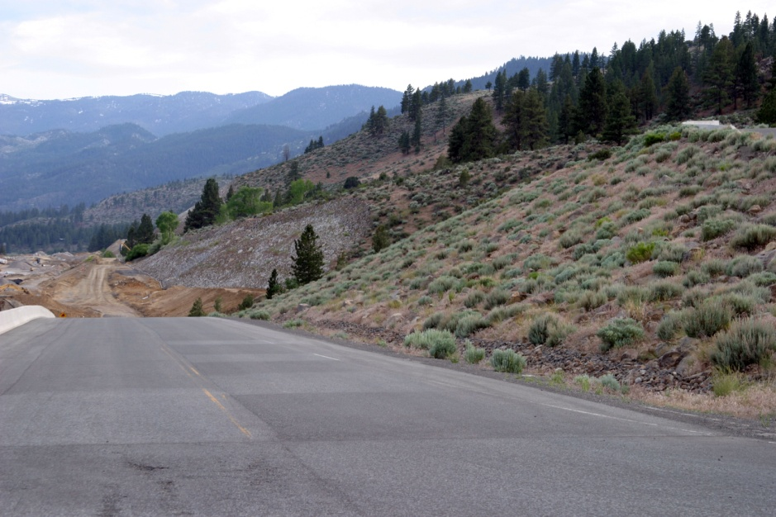
Project Level
Other tools to use?
Construction plans and specifications
Grading plans
Surface preparation
Topsoil specification and testing
Seed mix and germination test
Seeding methods
Mulching

Slide 17
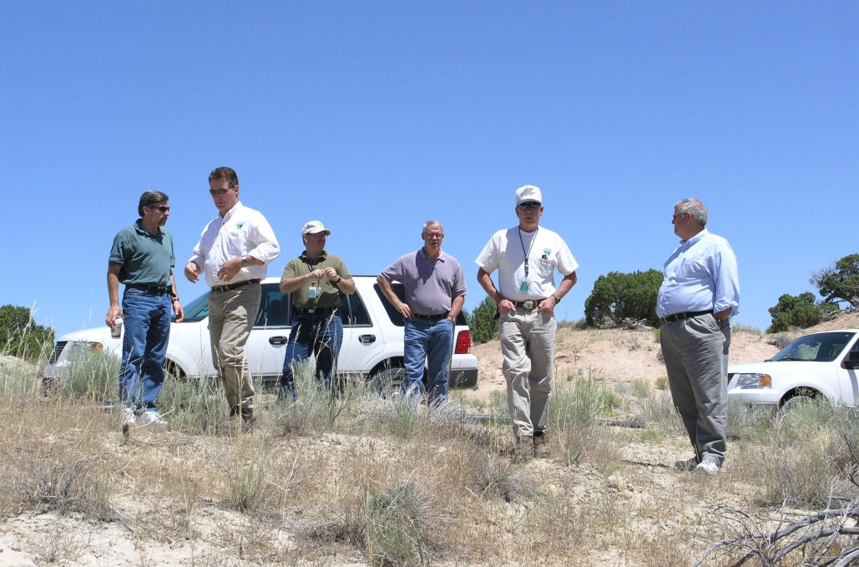
Project Level
Getting it done – You are a member of a community of specialists to consult with in your office that has monitoring responsibility and experience:
Natural resource specialist
Landscape architect
Recreation planner
Engineer
Range conservationist
Wildlife biologist
Botanist
Lands and realty staff
Hydrologist
Foresters

Slide 18
Land Use Plan (LUP) Implementation
Develop a LUP monitoring plan that would answer the following questions as the LUP is implemented:
Are the visual management decisions being implemented?
Is the condition of the visual environment being maintained in accordance with the desired future conditions defined within the LUP?
Monitoring changes and trend in the condition of the visual resource, as described in the inventory (Scenic Quality, Sensitivity, Distance Zone and VRI Classes)

Slide 19
Land Use Plan (LUP) Implementation
Is the condition trending toward a decline? Stability? Or improving?
Are more lands being visually altered?
Are the natural scenic qualities of the landscape character:
Being lost?
In balance?
Or are scenic qualities being recovered through enhancement/ restoration?
Is this measureable?

Slide 20
Land Use Plan (LUP) Implementation
Remember – all programs have a responsibility to the visual environment whether the program alters the landscape through enhancements or new land development - all are participants in the Visual Resource Program.
Tracking the balance between new development and reclamation of decommissioned and/ or inactive land use authorizations.
New authorizations under the lands and realty program
Fluid mineral leasing and development
Healthy Lands – with restored environments
Sage grouse habitat improvements
Abandoned Mine Program - reclamation of inactive mine sites.

Slide 21
Non-conforming action/ LUP Amendment
Contemplating a land use plan amendment: Also carefully consider and evaluate before making the final decision to amend the VRM class objectives:
Existing land use plan’s rationale for the current VRM class objective.
If the public benefits associated with the proposed action’s purpose and need outweigh the public benefits associated with the purpose and protection level of the current VRM class objective.
Effects on other resource values and land use plan decisions that may result from modifying the level of visual resource protection.
The need to compensate for any loss of or reduction to visual resource value
Notes:
Back to the question of: What if we find that a project gravitated into a non-conforming situation, or that we find that a new proposed action will take us over the threshold due to cumulative affects.

Slide 22
Non-conforming action/ LUP Amendment
Contemplating a land use plan amendment: Also carefully consider and evaluate before making the final decision to amend the VRM class objectives:
The BLM shall disclose the impacts to visual resources and explain the tradeoffs and benefits of amending the land use plan.
In circumstances in which a land use plan amendment allows a proposed action to move forward, conditions of approval shall include mitigation of adverse visual resource impact and evaluation of the opportunities for compensatory mitigation for recovering lost or reduced value to the VRI factors.

Slide 23
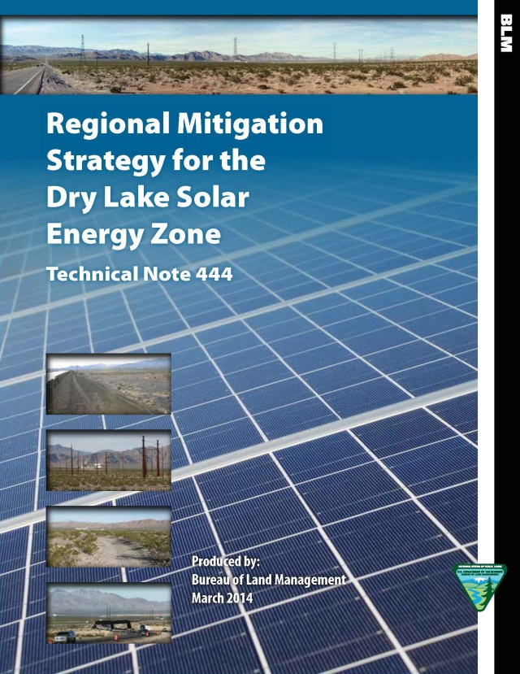
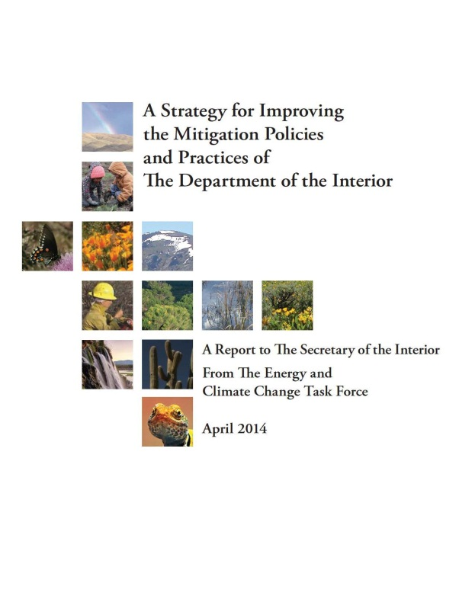
Compensatory Mitigation
Evolution of VRM procedures:
Dry Lake Solar Energy Zone Regional Mitigation Strategy
Colorado/ Arizona/ New Mexico Solar Energy Zone Mitigation Strategy
Strategy for Improving the Mitigation Policies & Practices Report – Task 15: Shared Viewsheds and Visual Resources

Slide 24
Compensatory Mitigation
Notes:
We often view VIA as something being added to the landscape – but with that addition comes a possible subtraction of the scenic quality value.

Slide 25
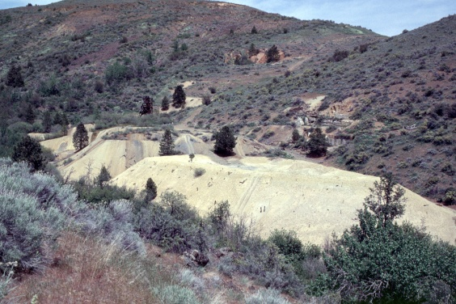
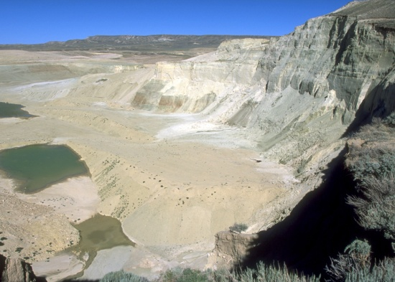
Compensatory Mitigation
Mitigation Actions
Identify candidate sites (visual restoration sites listed in RMP)
Select suitable and resilient sites for mitigating residual visual impacts Corrective actions
Opinion on cost for corrective action
Other resource benefits

Slide 26
Compensatory Mitigation
Determining Warrant for Visual Resource Compensatory Mitigation:
Scenic quality value and scarcity
Visual resource condition
Trends in visual resource management
Land Use Plan’s decision on level of protective management (importance).

Slide 27
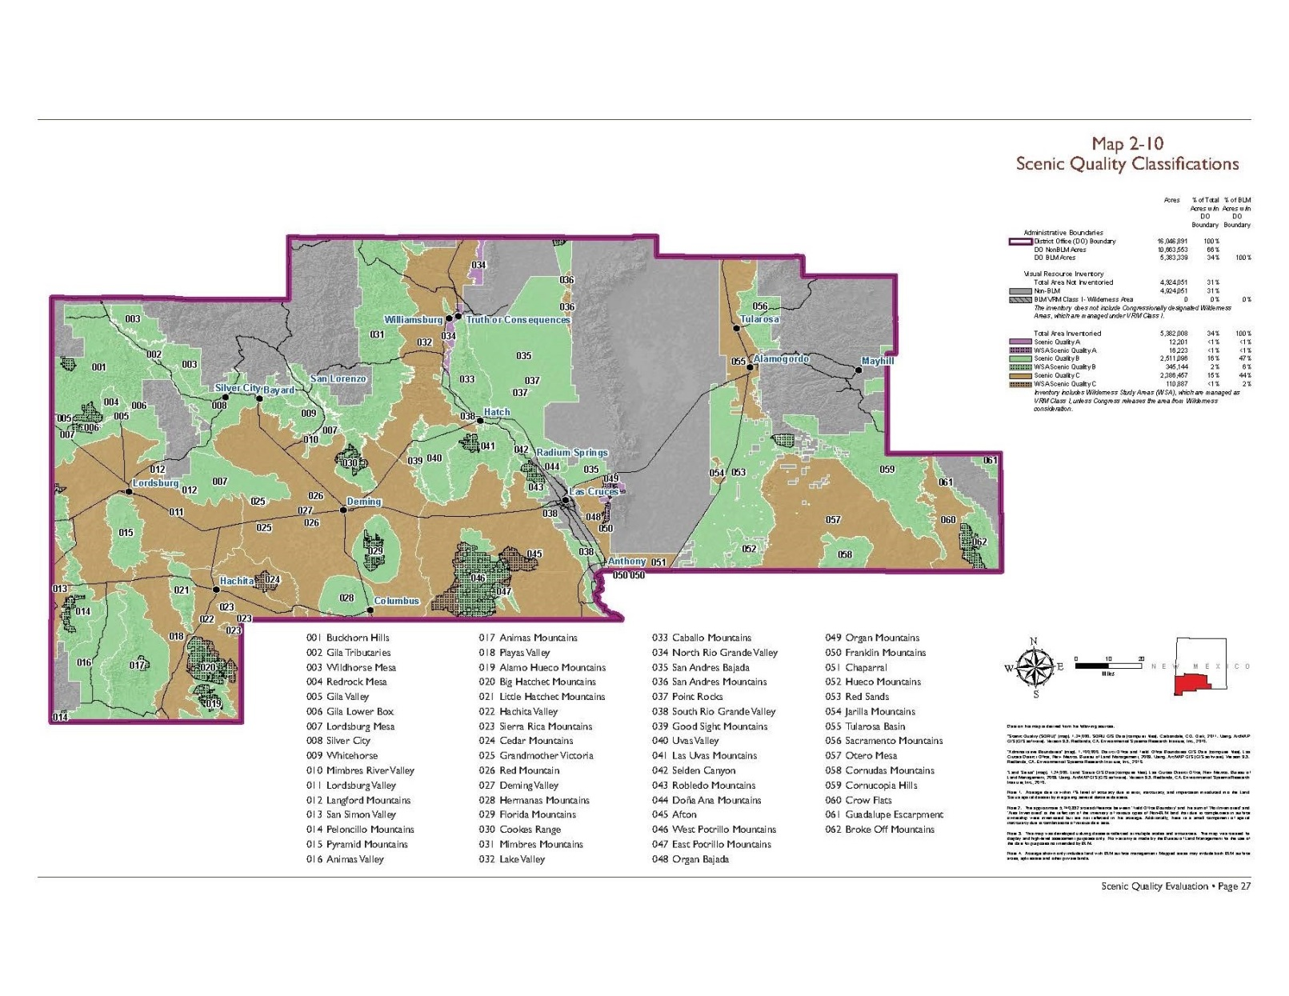
Compensatory Mitigation
Notes:
SQ A is less that 1% of SNDO

Slide 28
Compensatory Mitigation
Determining Warrant for Visual Resource Compensatory Mitigation:
Scenic quality value and scarcity
Visual resource condition
Trends in visual resource management
Land Use Plan’s decision on level of protective management (importance).

Slide 29
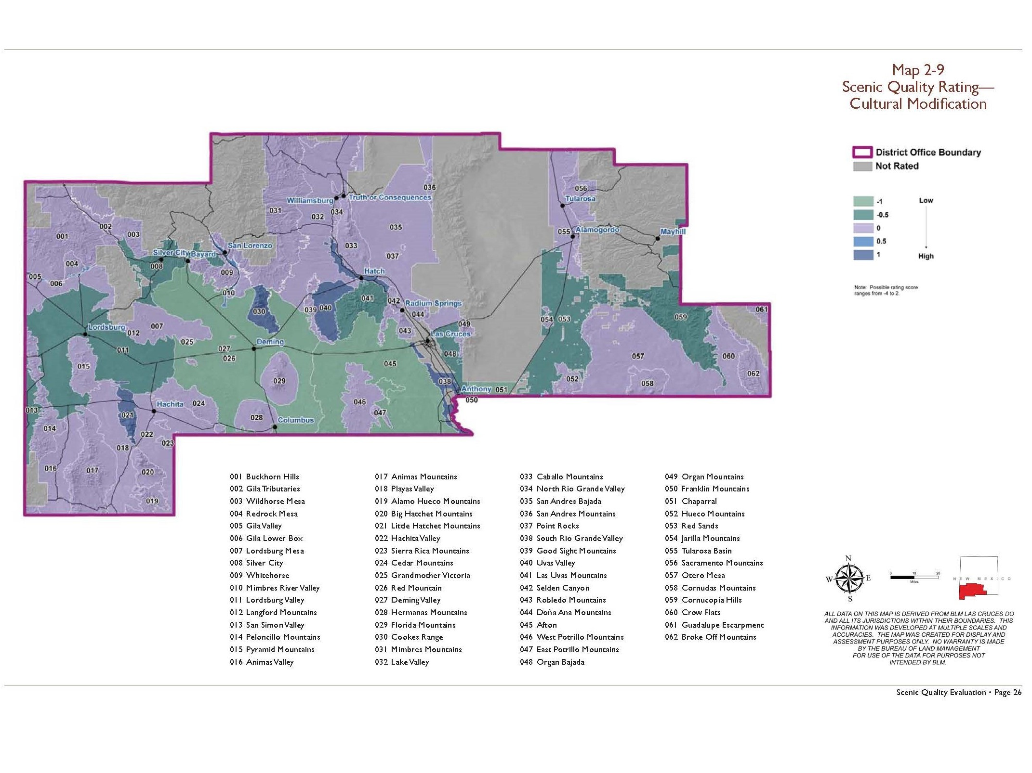
Notes:
SQ Cult Mod rating

Slide 30
Compensatory Mitigation
Determining Warrant for Visual Resource Compensatory Mitigation:
Scenic quality value and scarcity
Visual resource condition
Trends in visual resource management
Land Use Plan’s decision on level of protective management (importance).
VRM
Notes:
Trends – reasonably foreseeable development and acreage the RMP allows to change at a moderate level and a major level contrasted by activities being decommission and land restored. …cumulative impacts

Slide 31
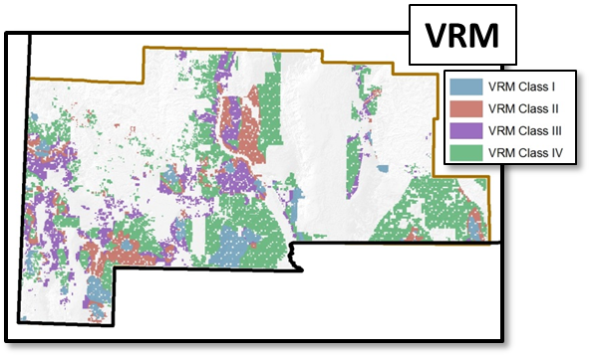
Compensatory Mitigation
Determining Warrant for Visual Resource Compensatory Mitigation:
Scenic quality value and scarcity
Visual resource condition
Trends in visual resource management
Land Use Plan’s decision on level of protective management (importance).

Slide 32
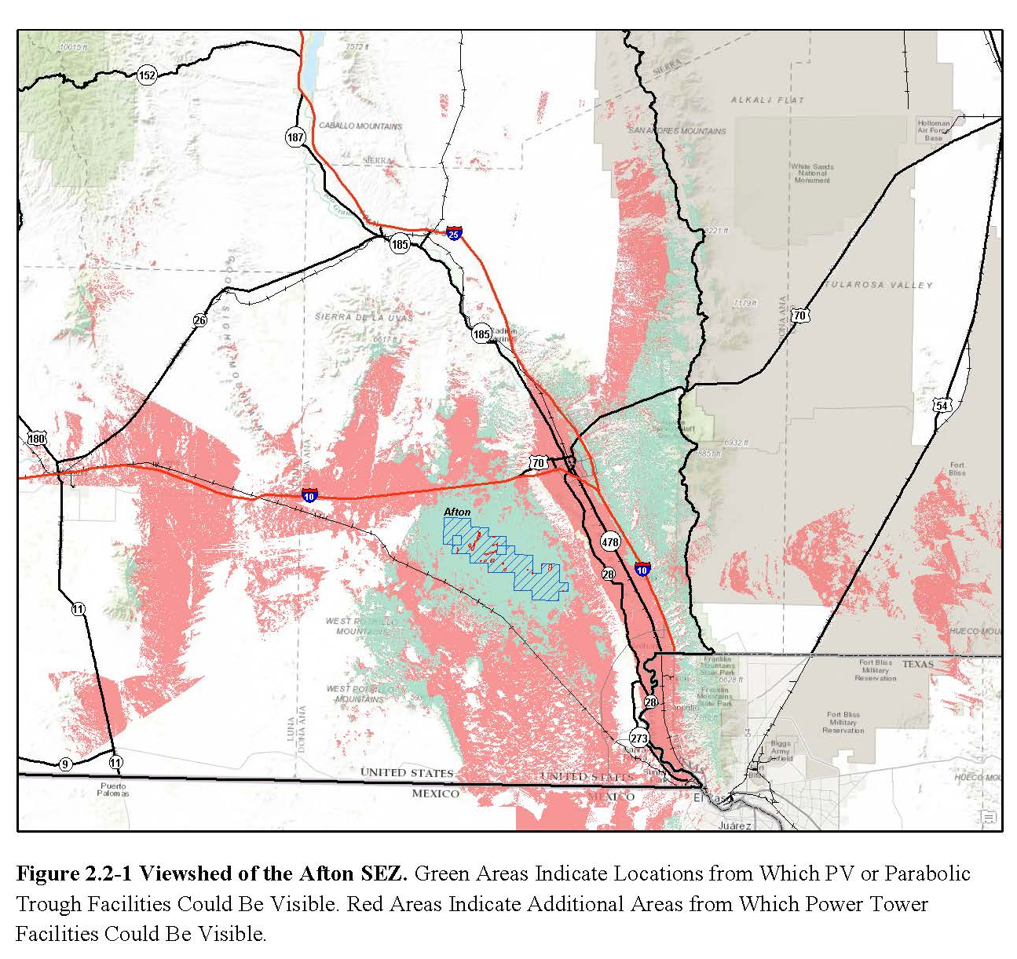
Compensatory Mitigation
Determine affected view-sheds and impacted stakeholders
Homeowners
Travelers
Communities
Outdoor recreationists
Other land management jurisdictions
Assess impact using the Contrast Rating Process

Slide 33
At the Regional Landscape Scale
Need:
A list of candidate sites
Documentation warranting the need for compensatory mitigation
Identify co-benefits and outcomes with other resources
Actions required [selected site(s) and action measures] to satisfy the compensatory requirement
Approximate cost to implement restorative measures
A mechanism to fund and cost share at a proportionate rate to accomplish the work.
New Mexico’s activities and added value
Notes:
Brandon’s additions. Future of Visual Resource Compensatory Mitigation

Slide 34
Project Level
Getting it done – You are a member of a community of specialists to consult with in your office that has monitoring responsibility and experience:
Natural resource specialist
Landscape architect
Recreation planner
Engineer
Range conservationist
Wildlife biologist
Botanist
Lands and realty staff
Hydrologist
Foresters

Slide 35
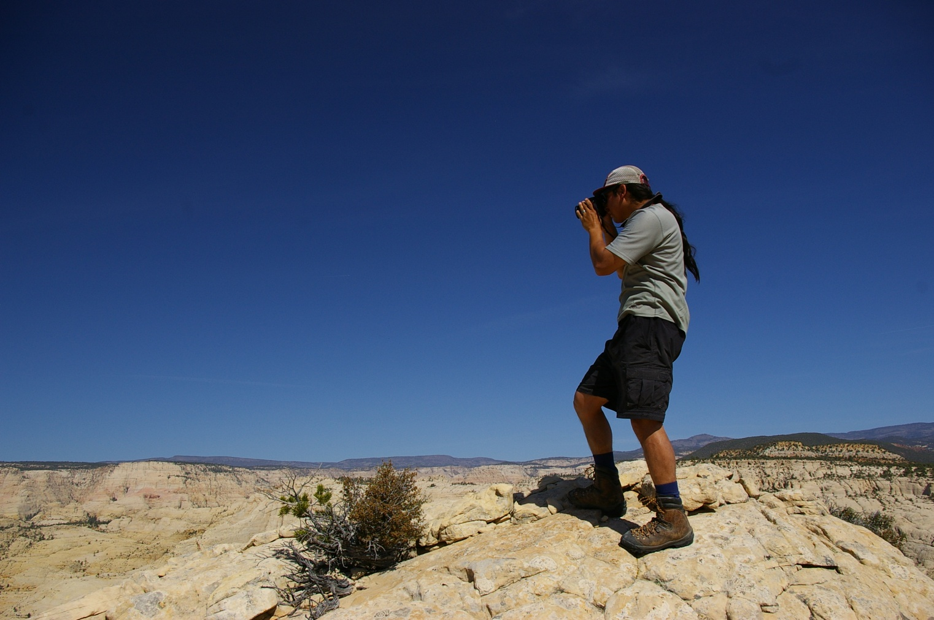
Summary
What’s the overarching purpose for monitoring? Specifically for visual resources?
When does monitoring comes into play?
What are the three things we’re monitoring on the project?
What are some tools that may play a role in monitoring?
Notes:
1. Assure that mitigation commitments are met.
To remain mindful of the visual resource values and condition within the planning area, as well as in context of the regional landscape.
2. Project level and RMP monitoring
3. Compliance, effectiveness, adaptive management
Trends in change to scenic quality and how this also affects sensitivity and

