Slide 2
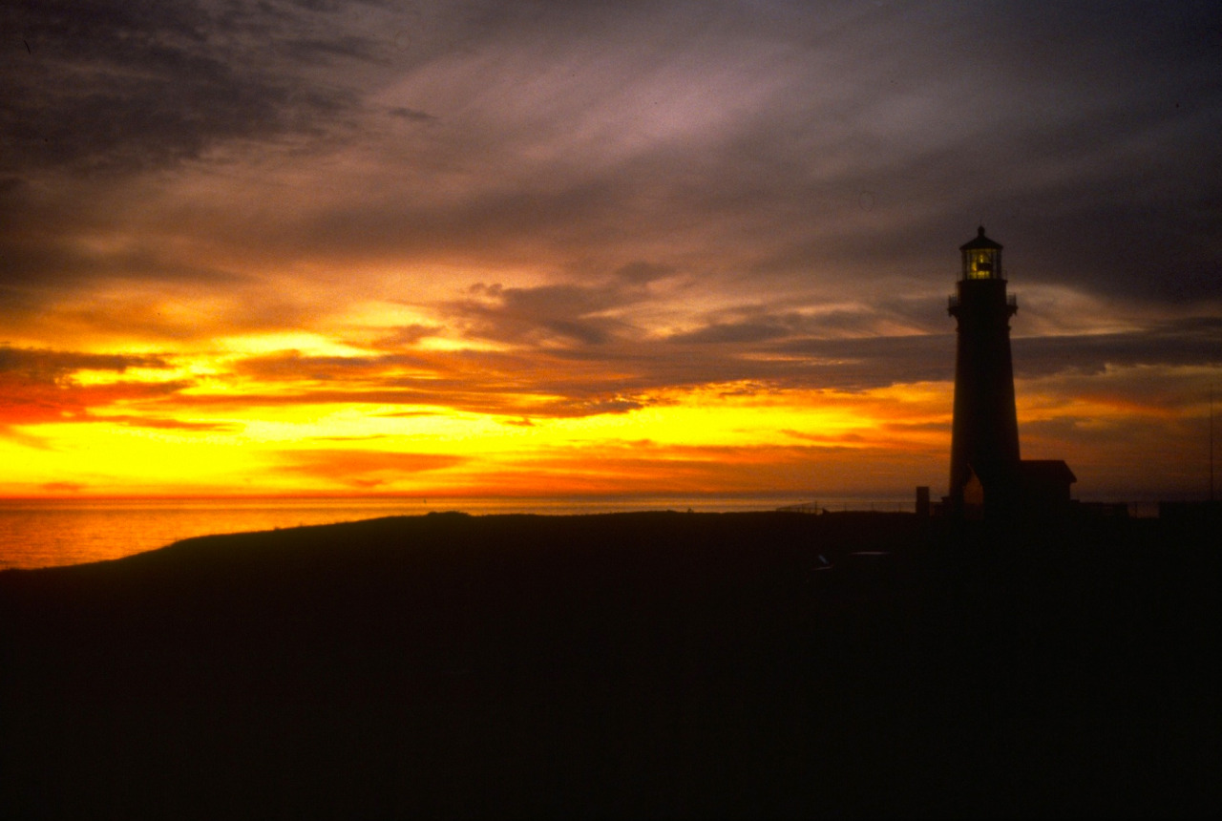

Slide 3
Unit Objective
Review the key learning points of the week
Reflect back on the week’s activities
Answer any remaining questions
And hopefully a chuckle or two

Slide 4
Overall Course Objective
Having participated in the course, you
should be able to:
Describe the basic principles and concepts of VRM
Communicate the role of VRM in land use planning and activity planning within the Bureau.
That you have the foundation to begin hone the skills to:
inventory visual resources,
analyze landscape,
develop mitigations for minimizing contrast.
Notes:
HOPEFULLY COMMUNICATE: Objective process with moments that require PROFESSIONAL JUDGEMENT

Slide 5
Overall Course Objective
Basic Principles
Scenic resources are public resources, which are finite in supply.
BLM has a legal obligation to manage for scenery.
Visual Resource Management (VRM) is our system for scenery management.
VRM is not about stopping projects, but to make projects better integrated into their setting.

Slide 6
Overall Course Objective
VRM Program Objectives
Manage for protection
Minimize adverse visual impact.
Establish consistency in managing visual resources
Establish an inclusive framework for interaction between VRM and other resource programs.
Encourage balanced management of visual values with other resources for now and into the future.
Ensure management of visual resources in accordance with applicable laws and regulations.
Provide adequate information for informed visual resource land use planning, project design, and landscape monitoring.

Slide 7
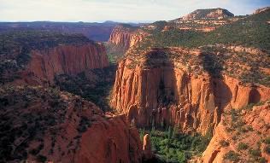
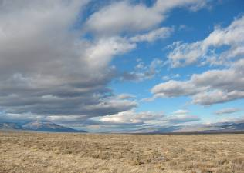
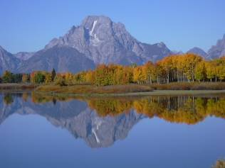
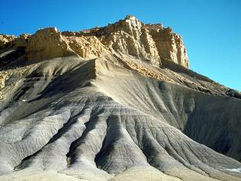
Overall Course Objective
BLM has legal obligation
IBLA Decisions
144IBLA070 - Utah Decision
173IBLA313 - Beaver Rim_Lander FO
174 IBLA 078 -Tom Van Sant - California
VRM system
Inventory for visual values
Establish Mgt. Classes
Evaluate/design activities to meet classes
IM 2009 - 167
VRM is the “Language for Landscapes”
Types of Landscapes
Elements of Landscape Character
Analysis Factors

Slide 8
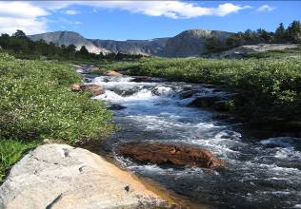
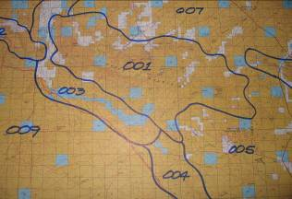
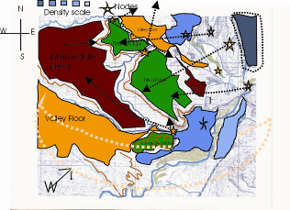
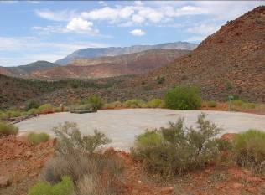
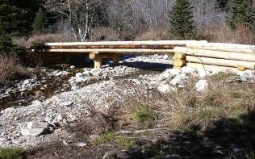
Overall Course Objective
Land Use Planning and VRM
Visual Resource Inventory
Scenic Quality
Sensitivity Levels
Distance Zones
VRI Classes
VRM Management Classes I-IV
Going beyond VRM Classes
Amending Land Use Plans
Interim VRM Classes
Other Allocations

Slide 9
Overall Course Objective
Project Level Planning Essentials
Project Site Planning Considerations
Human and Environmental Factors
Observation
Design Fundamentals
Form, Line, Color, Texture AND Scale
Site Selection (10 Environmental Factors)
Adverse Visual Contrast Reduction

Slide 10
Overall Course Objective
Project Analysis and Evaluation
Visual Contrast Rating System
Project Description
Affected viewshed determination
Identify VRM Objectives
Key Observation Points (KOP)
Visual Simulations
Contrast Rating Form
Design modification
Reevaluation
Visualization/ Simulation

Slide 11
Overall Course Objective
NEPA & VRM
Proposed Action
Alternative
Affected Environment
Environmental Consequences (setting & values)
Mitigation
Monitoring
Compliance
Effectiveness
Adaptive Management
Land Use Plan
Regional Landscape Scale Planning & Mitigation Strategy

Slide 12
Summary Questions:
Are Visual Inventory Classes & VRM Management Classes the same thing?
Is VRM
discretionary, a “soft” decision?
do we manage project beauty?
allows visually unmitigated activity within VRM Class IV?
a way to preclude or exclude projects from happening?
Does VRM applies to existing valid mineral rights?
VRM Management Class IV means the area has low visual value?
Are Contrast Rating Evaluations required for all projects?
Who is responsible for VRM?
Is the VRM Class in question the one from the KOP or from where the project is located, if the two different VRM classes are in play?

Slide 13
Final Comments
VRM is a Collaborative Process – internally and externally.
Is your Visual Resource Inventory up to date?
Take the time to do comprehensive planning – carefully study VRM/VRI/Allocations compatibility – knowing the industry’s challenges, but capabilities, too.
VRM Class IV should be given as much consideration as VRM II and III.
Plan amendment should be the exception to the rule and not viewed as the easy out.

Slide 14
In closing . . .
Members of the VRM Elite - please be assertive stewards of our BLM settings in protecting BLM’s Visual values
Share your challenges and successes with us and your fellow students
Encourage customers to use qualified contractors the conduct VRM analysis.
Call upon the instructors, if you need assistance
Notes:
Diplomacy versus heavy handedness, KNOW YOUR PROPONENT’S BUSINESS IN ORDER TO MAKE SOUND AND REASONABLE RECOMMENDATIONS
ALSO TO KNOW WHEN YOU’RE BEING BLUFFED.

Slide 15
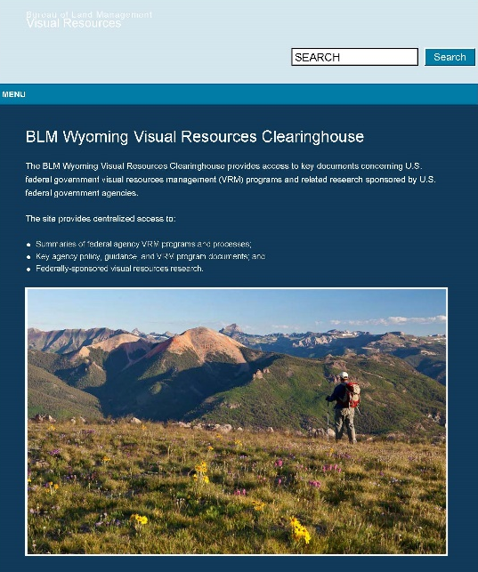
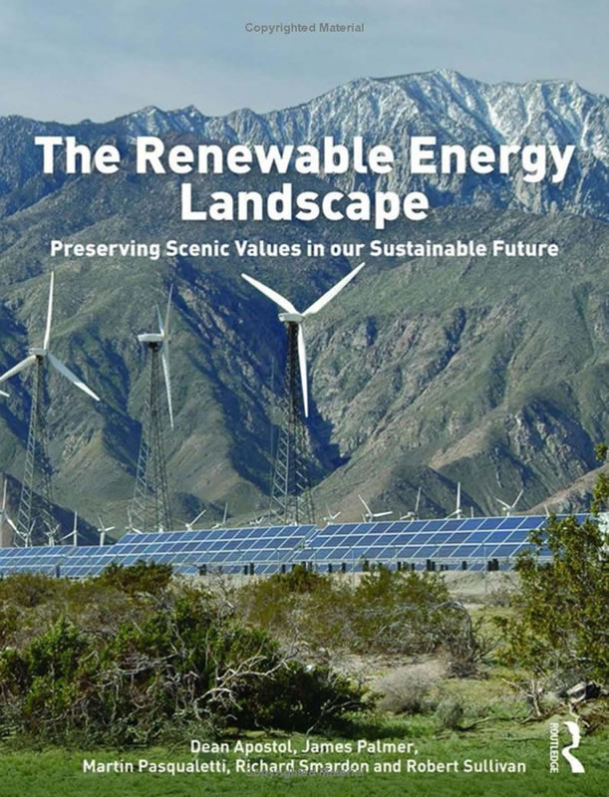
Wrap Up
Other reading
Additional Resources
blmwyomingvisual.anl.gov

Slide 16
Wrap Up
Southern Nevada District & Field Offices
Thanks to:
Tim Smith
Greg Helseth
Katharine August
Kerri-Anne Thorpe
Susan Farkas
Stephen Leslie

Slide 17
Course Sponsors
Phil Cooley, National Training Center
pcooley@blm.gov
Andy Tenney, WO250 Division Chief, Recreation and Visitor Services
atenney@blm.gov

Slide 18
Stay in Touch
John McCarty
Washington Office
jhmccart@blm.gov
202.912.7284

