Slide 2
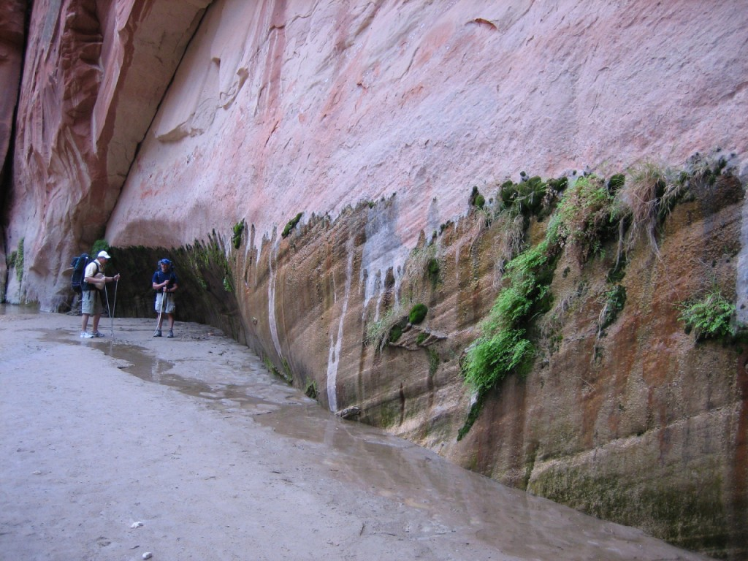

Slide 3
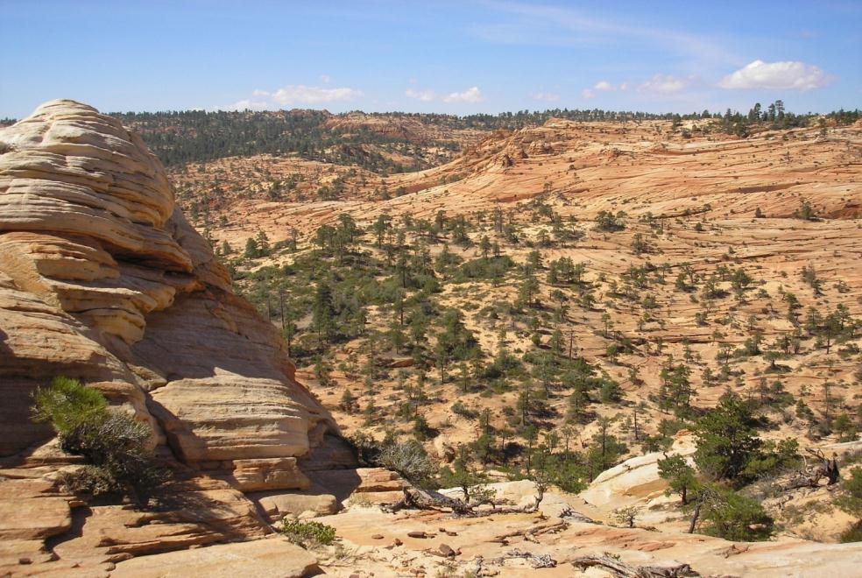
Unit Objective
Understand how to incorporate Visual Resource Inventory information into land use planning decisions.
Notes:
Go through land use planning process for the Resource Management Plan Preparation plan to Rod
Amending the land use plan
Interim classes
Programmatic EIS’s that affect RMP decisions

Slide 4
Unit Objective
Understand how to incorporate Visual Resource Inventory information into land use planning decisions.

Slide 5
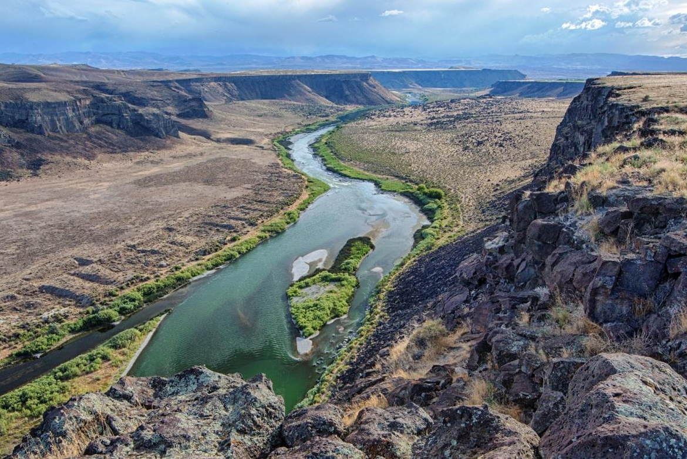
Managing Scenic Values and Viewsheds
Making decisions on managing scenic value . . .

Slide 6
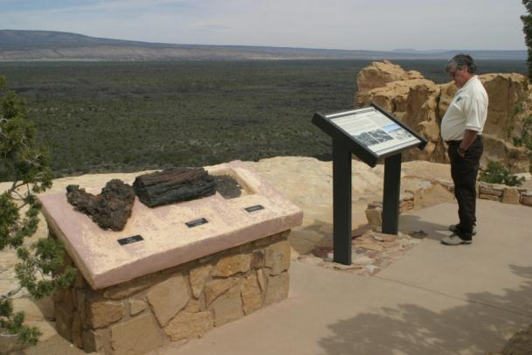
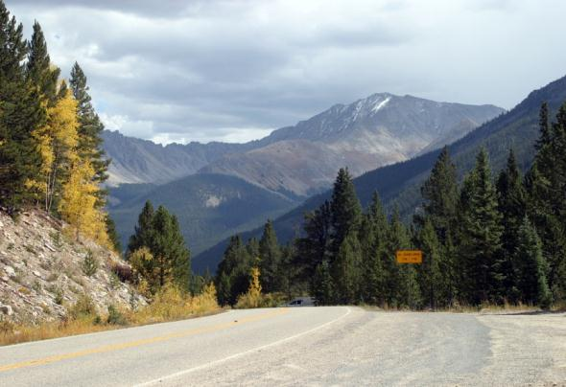
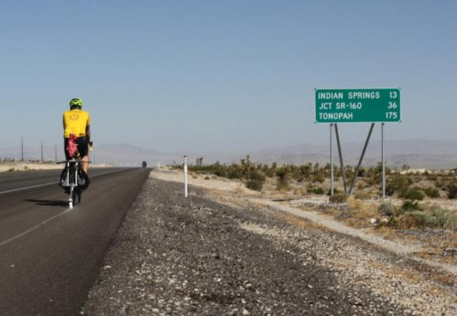
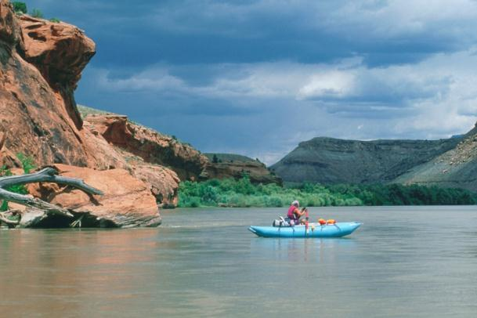
Managing Scenic Values and Viewsheds
. . . benefiting those experiencing the public landscape.
. . . in the planning for the human visual experience

Slide 7
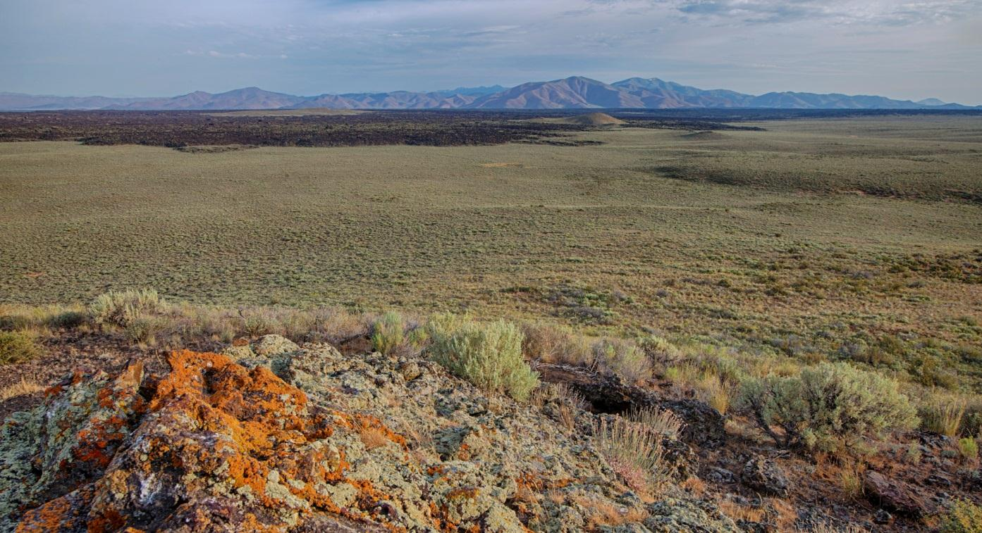
Managing Scenic Values and Viewsheds
Making those difficult decisions on what to preserve and ...

Slide 8
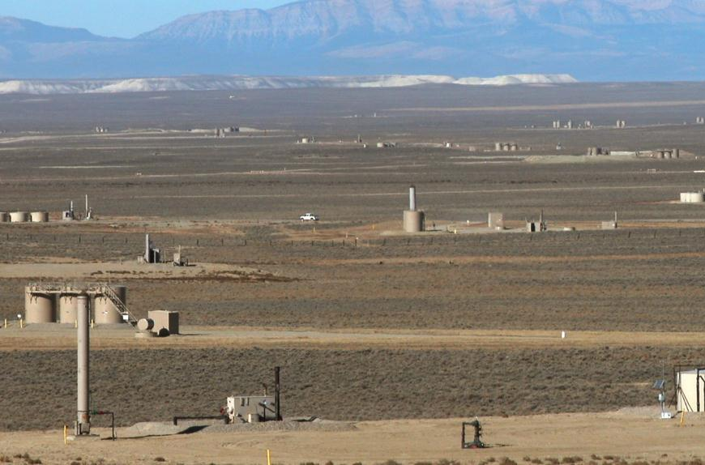
Managing Scenic Values and Viewsheds
what will change and the nature and scale of change.

Slide 9
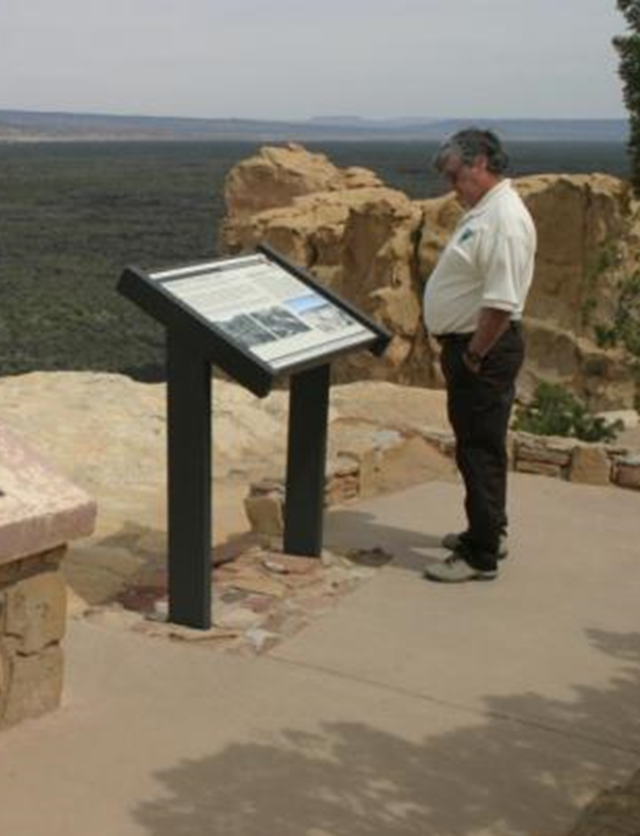
Managing Scenic Values and Viewsheds
These decisions can be challenging and should not been taken lightly.
Notes:
Work on this

Slide 10
Insights based on WO Reviews
What I’m looking for:
Evidence that the VRI was indeed considered in the LUP process:
VRI is the primary source of information when developing alternatives and is properly represented.
Describes an adequate trend analysis
VRM Alternatives cross check with other resource concerns, activities, and allocations.
Impact to VRI factors are adequately disclosed
A rationale is presented for each alternatives VRM Class objective.

Slide 11
Land Use Planning Process
Notes:
Need new image – maybe a lattice tower example instead that it less dominating and set back from the road a little further

Slide 12
RMP Planning Policy Directives
VRM Manual Section 8400
Visual resource management objectives established within the RMP in conformance with the land use allocations.
Handbook H-8410-1:
Consider visual values throughout the land use planning process and when assigning VRM class objectives
Management decisions in the RMP must reflect the value of visual resources.
VRM Class boundaries are adjusted to reflect the resource allocations decisions made with the RMPs.
Notes:
Start with VRM manual (1984/ 1987) which over time now contradicts the LUP policy (2006). New revision of 8400 in surnaming.

Slide 13
RMP Planning Policy Directives
Planning Decision Hierarchy
Desired Outcomes: goals and objectives of the plan
Goals: broad statements of desired conditions
Objectives: specific desired conditions for resources
Allowable Uses: activities and foreseeable development that are allowed, restricted, or excluded for all or part of the planning area, based on desired future conditions.
Management Actions: (to achieve desired outcomes) actions anticipated to achieve desired outcomes, including actions to maintain, restore, or improve land health.
Notes:
Planning 2.0 – objectives, allowable uses, designations

Slide 14
Objectives
Visual Resource Management Classes
A concise statement of desired resource conditions developed to guide progress toward one or more goals.
An objective is:
specific,
Measurable (contrast rating, cumulative effects),
has established time-frames for achievement,
identify standards to mitigate undesirable effects to resource condition,
should provide integrated consideration of resource, environmental, ecological, social, and economic factors.
Notes:
Talking Points
Changes:
Objectives are resource conditions, they describe outcomes not outputs.
Requirement for specific and measurable objectives.
Under planning 2.0 the objectives are the key element that guides future management and drive the resource management plan.

Slide 15
VRM Class Objectives
Inventory to Management Classes
Directs the management of visual resource factors
The VRM class objectives are binding land use plan decisions
Land use authorizations under the RMP’s implementation must conform to the land use plan VRM Class Objectives.
Notes:
Talking Points
Changes:
Objectives are resource conditions, they describe outcomes not outputs.
Requirement for specific and measurable objectives.
Under planning 2.0 the objectives are the key element that guides future management and drive the resource management plan.

Slide 16
RMP Planning Policy Directives
Land Use Planning Handbook H-1601-1 Appendix C:
Land Use Plan Decisions:
Manage visual resource values in accordance with visual resource management objectives
Designate VRM management classes for all areas of BLM land, based on an inventory of visual resources and management considerations for other land uses.
VRM classes may differ from VRI classes, based on management priorities for land uses.

Slide 17
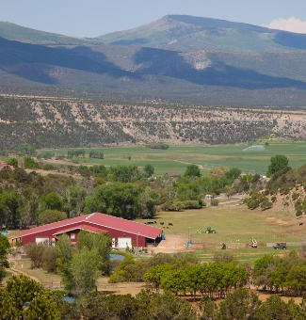
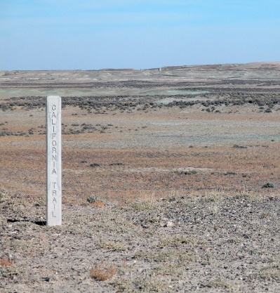
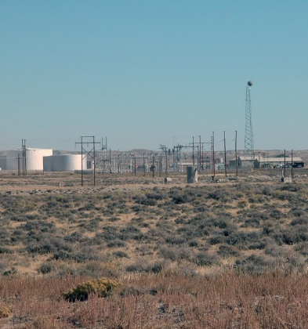
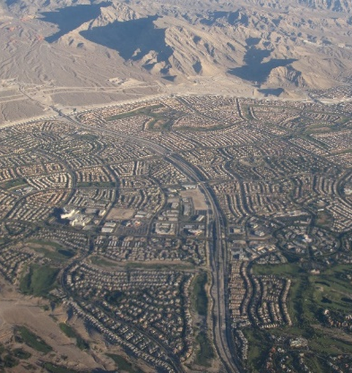
Visual Resource Management Classes
Guides the Transition of the Characteristic Landscape Manage to protect the quality of…
Describing the landscape character at the larger scale
Decisions on the extent the BLM will allow the landscape to move away from its natural scenic value
Types of Characteristic Landscapes: natural, rural agricultural, rural industrial, rural residential, commercial, urban, suburban, urban, urban industrial.
Natural
Naturalistic
Rural Industrial
Rural Industrial
Suburban
Notes:
Talking Points

Slide 18
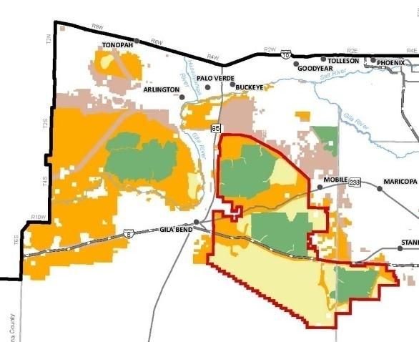
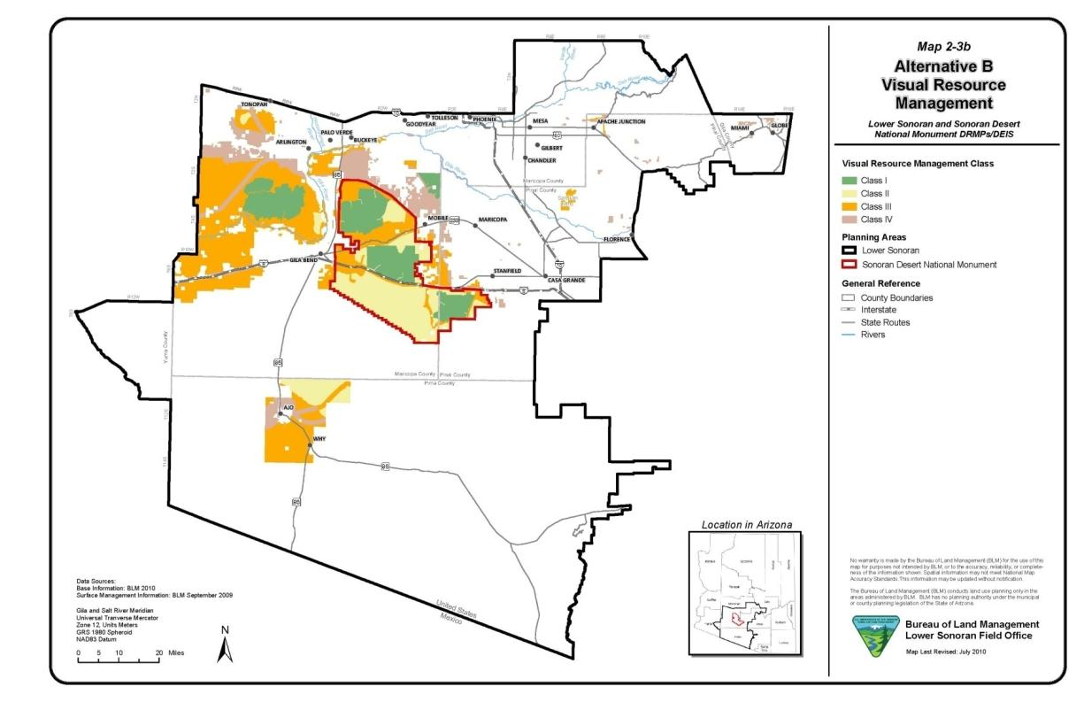
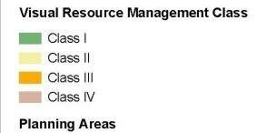
Inventory to Management Classes
VRM Class Objectives – Defined spatially delineated units

Slide 19
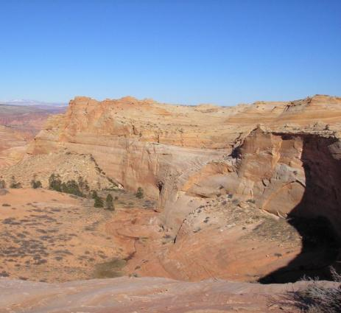
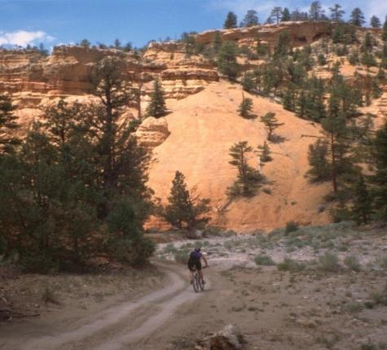
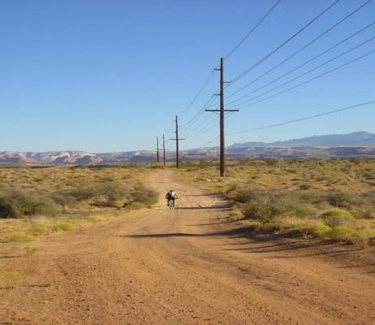
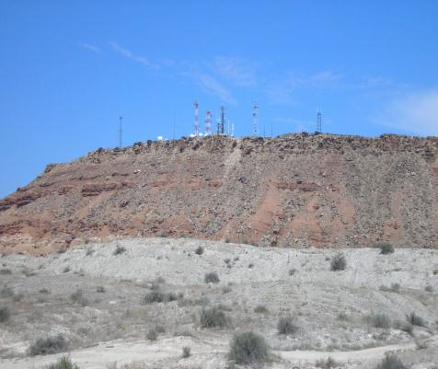
Defining Management Classes

Slide 20
Defining Management Classes – Class I
Class I Objective:
To preserve the existing landscape character.

Slide 21
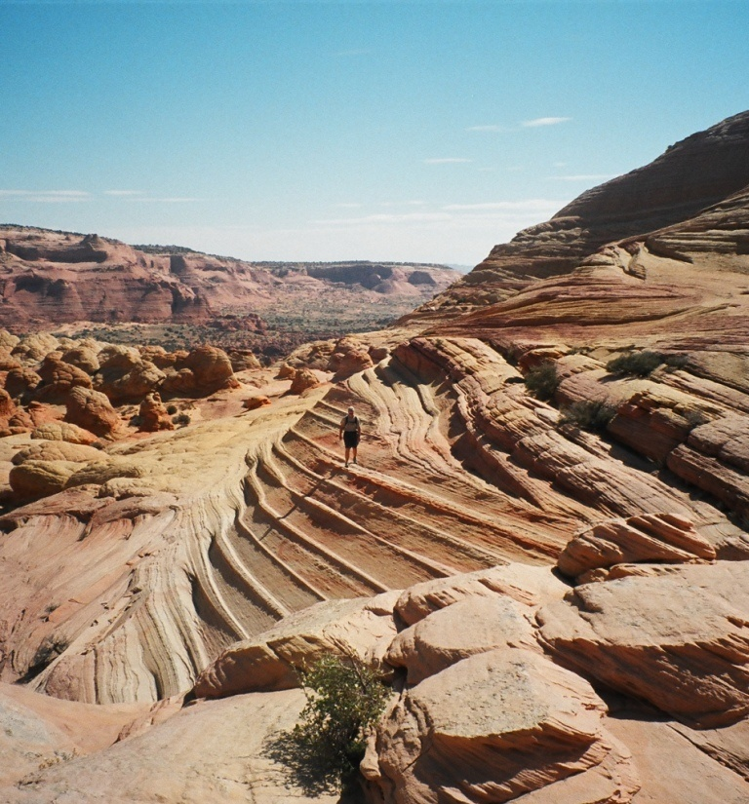
Defining Management Classes – Class I
Level of change to the characteristic landscape should be very low; and must not attract attention.

Slide 22
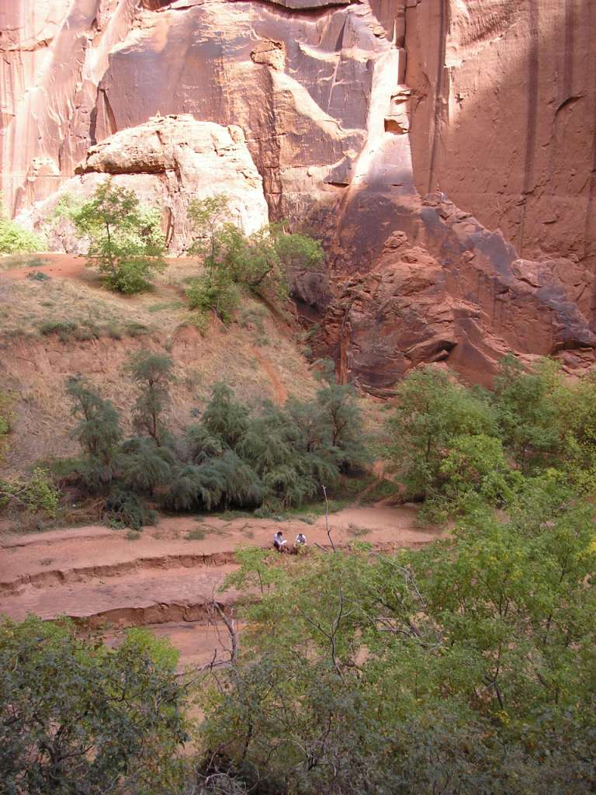
Defining Management Classes – Class I
Provides for natural ecological change
Notes:
Replace with fire example

Slide 23
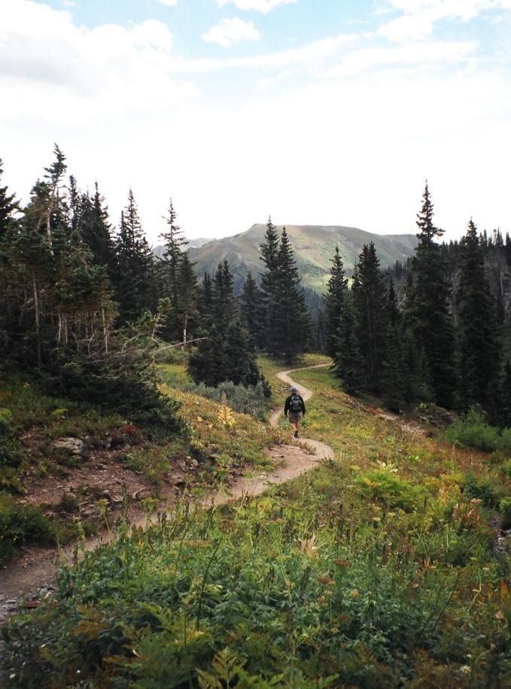
Defining Management Classes – Class I
Provides for limited management activity
Notes:
Replace with fire example

Slide 24
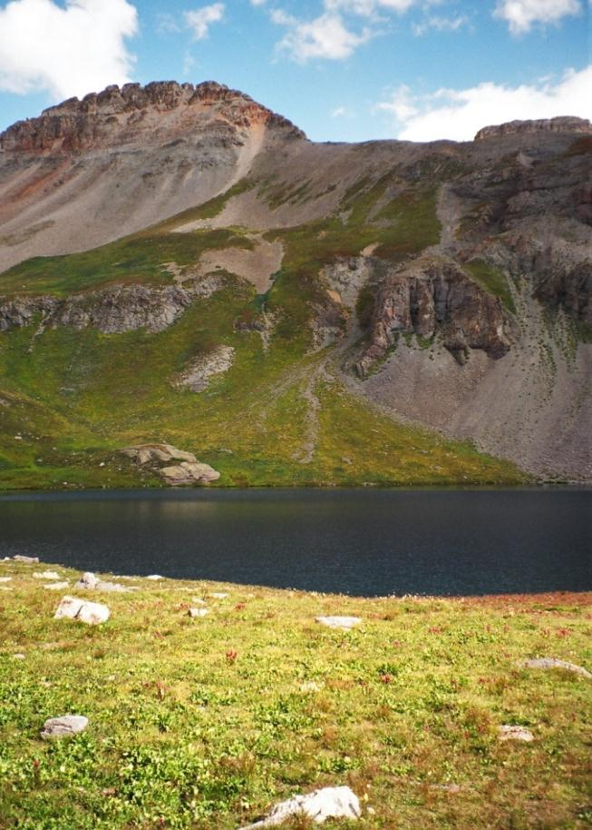
Defining Management Classes – Class I
Examples:
Designated Wilderness
Wilderness Study Areas (WSA)
Scenic ACEC
Wild Sections of Wild and Scenic Rivers

Slide 25
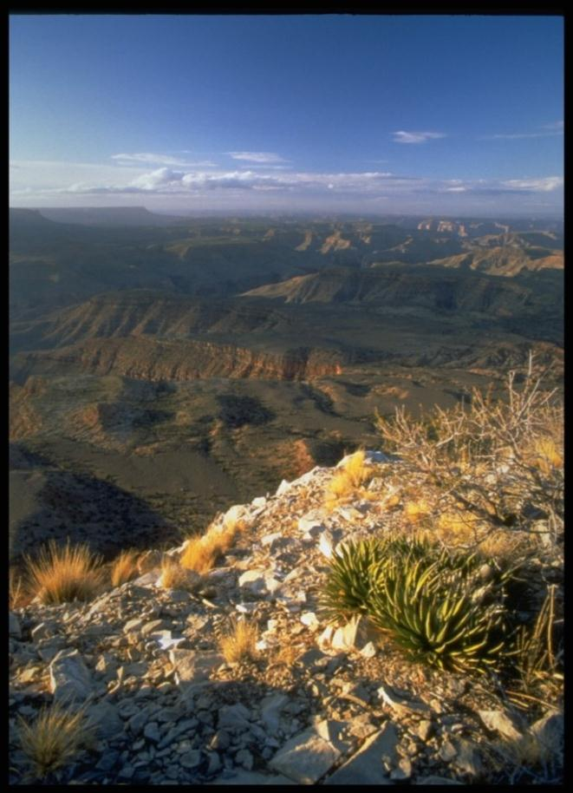
Defining Management Classes – Class II
Class II Objective:
To retain the existing character of the landscape.

Slide 26
Defining Management Classes – Class II
Level of change to the characteristic landscape should be low

Slide 27
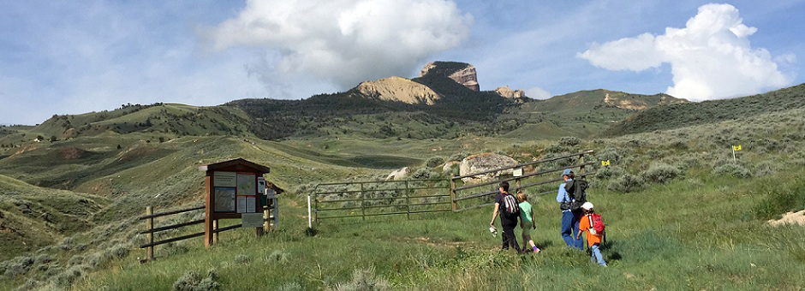
Defining Management Classes – Class II
Changes should repeat the basic elements found in the natural features of the landscape – form, line, color, & texture
Notes:
Get toilet image from the color research file.

Slide 28
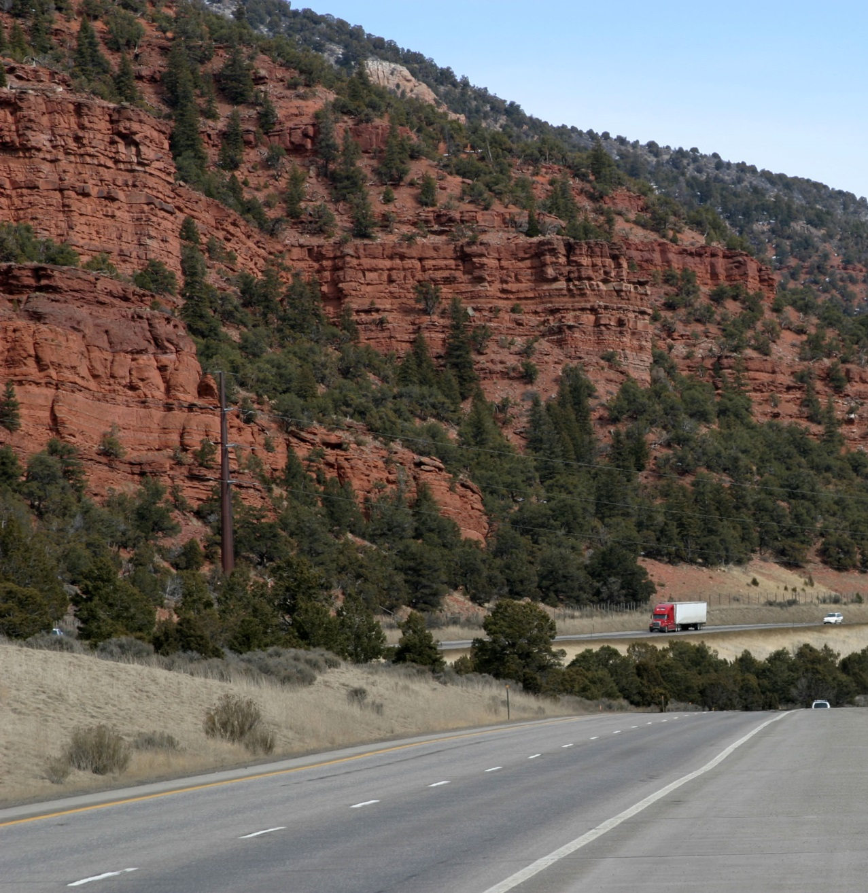
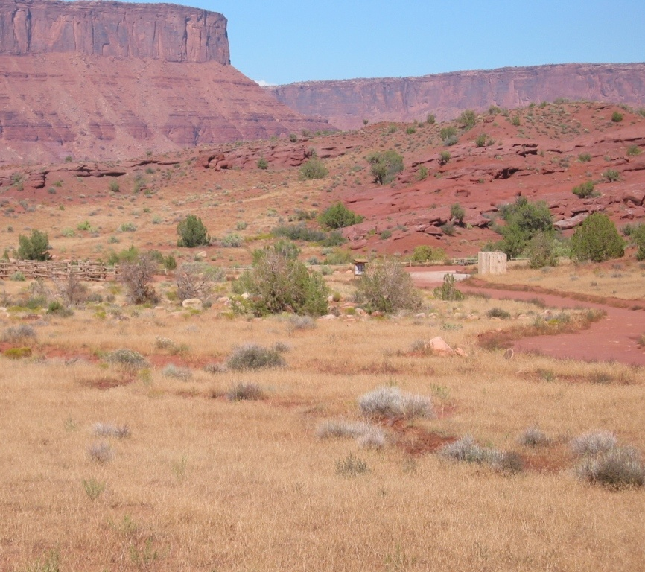
Defining Management Classes – Class II
Management activities may be seen but should not attract attention of the observer

Slide 29
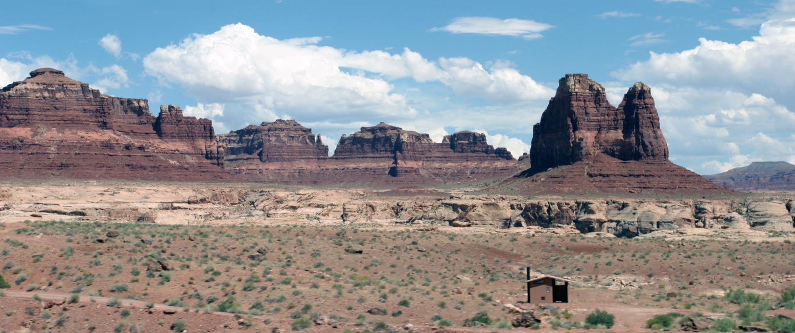
Defining Management Classes – Class III
Class III Objective:
To partially retain the existing character of the landscape
Notes:
Need new image

Slide 30
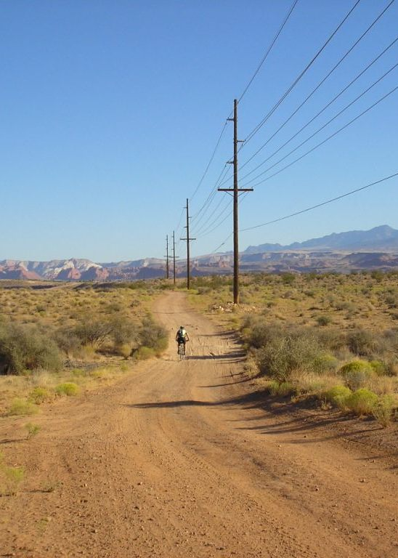
Defining Management Classes – Class III
Level of change to the characteristic landscape can be moderate
Notes:
Need new image – maybe a lattice tower example instead that it less dominating and set back from the road a little further

Slide 31
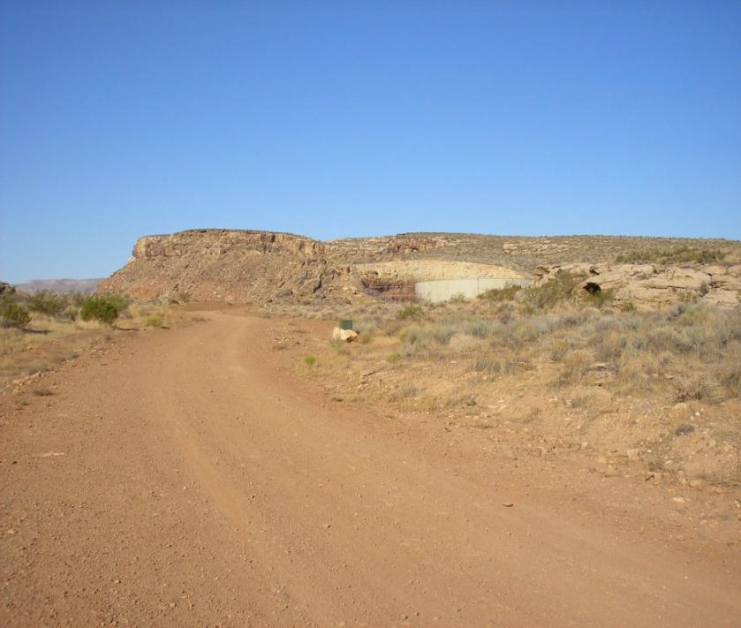
Defining Management Classes – Class III
Management activities may attract attention, but should not dominate the view of the casual observer
Notes:
Need new image – maybe a lattice tower example instead that it less dominating and set back from the road a little further

Slide 32
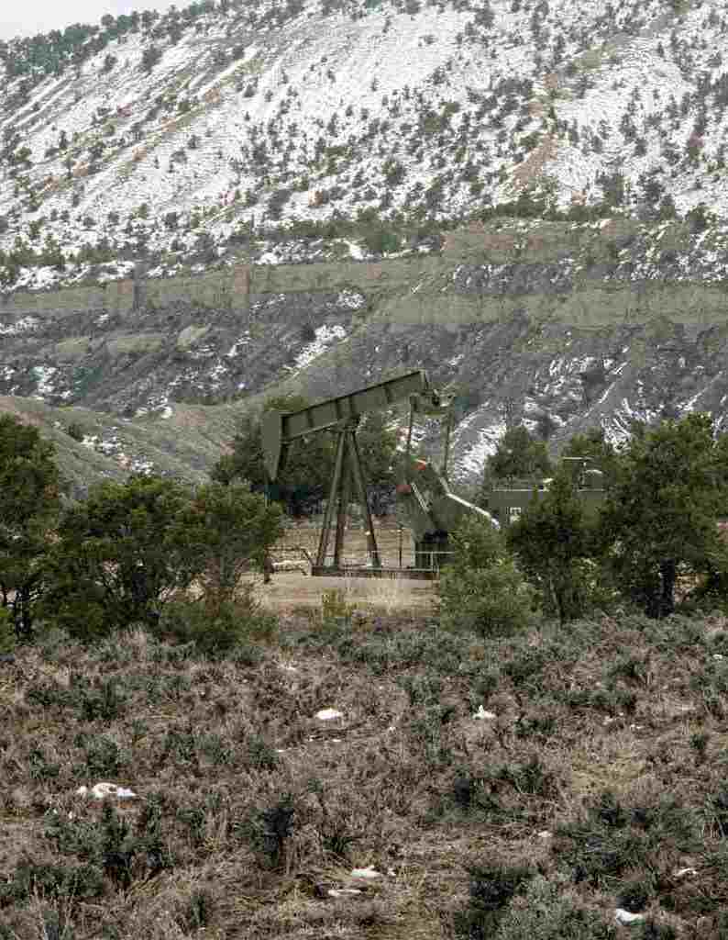
Defining Management Classes – Class III
Change should repeat the basic elements found in the natural landscape – form, line, color, & texture
Notes:
Need new image – maybe a lattice tower example instead that it less dominating and set back from the road a little further

Slide 33
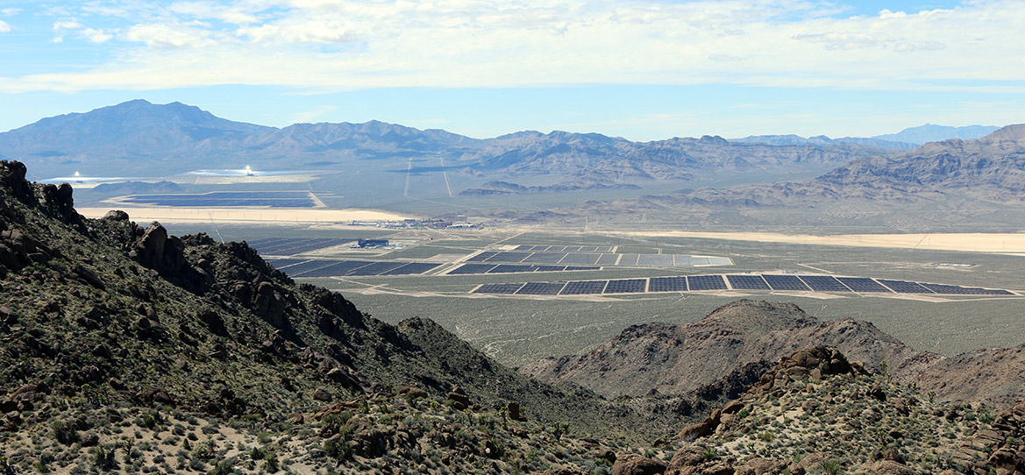
Defining Management Classes – Class IV
Class IV Objective:
To provide for activities that require major modification of the landscape
Notes:
Get updated image from overlook

Slide 34
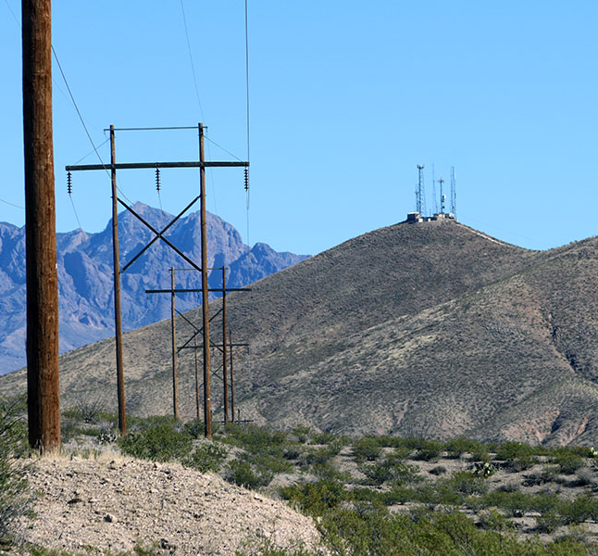
Defining Management Classes – Class IV
Level of change to the landscape can be high
Notes:
Need new image – maybe a lattice tower example instead that it less dominating and set back from the road a little further

Slide 35
Defining Management Classes – Class IV
Management activities may dominate the view and be the major focus of attention
Notes:
Need new image – maybe a lattice tower example instead that it less dominating and set back from the road a little further

Slide 36
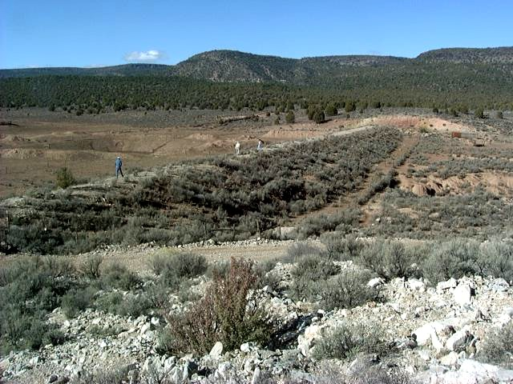
Defining Management Classes – Class IV
Still minimize impacts through location and design by repeating form, line, color, and texture
Notes:
WHERE DO YOU SPEND YOUR TIME
Need new image – maybe a lattice tower example instead that it less dominating and set back from the road a little further

Slide 37
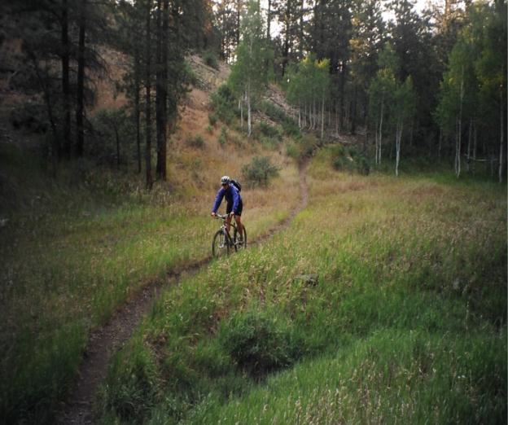
Inventory to Management Classes
Final decisions on Visual Resource Management Classes may or may not be commensurate with Visual Resource Inventory Classes
Notes:
Commensurate – the level of management may not be proportional to the visual resource value
WHERE DO YOU SPEND YOUR TIME?

Slide 38
Land Use Planning Process
Notes:
WHERE DOES THE INVENTORY COME INTO PLAY?

Slide 39
Preparation Plan
Serves as the foundation for the entire land use planning process.
Identify the preliminary issues and list planning questions
Planning team skills needed to address the issues
Opinion on the preliminary budget requirements
Preliminary planning criteria
Data need and requirements – VRI, other data sets
Basis for the Statement of Work (if using a contractor)
Notes:
Consider breaking the bullet points out into individual slide headings

Slide 40
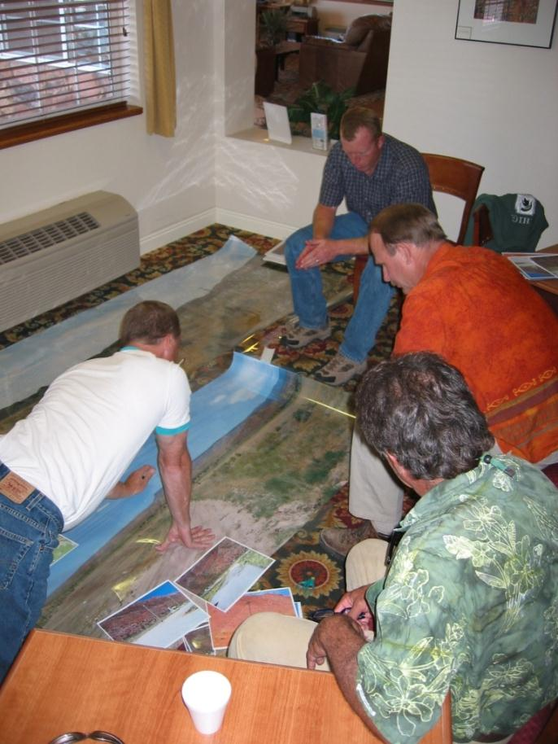
Preparation Plan
Planning Team
Recreation usually represents the values of visual resources on the planning team.
Should others participate with VRM?
Notes:
Need new image – maybe a lattice tower example instead that it less dominating and set back from the road a little further

Slide 41
Preparation Plan
VRM Data Needs - Determine status of the visual resource inventory
Is there one?
How old is it?
Do you still have the background support data?
Is it paper (mylar) or electronic?
If electronic then is it updated to current 2011 inventory data standard and entered into the geodatabase?
Notes:
Need new image – maybe a lattice tower example instead that it less dominating and set back from the road a little further

Slide 42
Preparation Plan
If you need to refresh or conduct a new inventory:
Who will do it?
Internal BLM personnel or by a Contractor?
Combination of internal personnel and contractors?
What’s your budget?
Notes:
Need new image – maybe a lattice tower example instead that it less dominating and set back from the road a little further

Slide 43
Preparation Plan: ID preliminary issues
VRM planning issues and questions to consider:
How can the BLM manage public lands for visual qualities? (Wyoming)
What are current and potential conflicts with managing VRM values and how can they be mitigated? (Eastern States)
Is the visual resources inventory current? (Idaho)
Where are the different visual resource values within the planning area and to what degree should they be protected? (Idaho)
Are the current visual resource management classes appropriate? (Idaho)
How can VRM classes be managed in a manner consistent with resource and social concerns? (CA)
How should VRM classes be established for lands within the decision area that will protect scenic values and/or restore reduced scenic values while accommodating multiple use management and sustained yield?
Notes:
Need to work a list into the class as an exercise.

Slide 44
Preparation Plan: ID preliminary issues
VRM planning issues and questions to consider:
Were the VRM classes under the current RMP adhered to and enforced?
How much of the planning areas has been visually modified (the condition of the visual resource)?
What are the trends in the management of visual resources?
How should scarce visual values be managed?
In what areas do visual values contribute to positive human outcomes the most?
What are important viewsheds associated with adjacent land uses and land management jurisdictions?
Where are lands dependent, or designated as places to preserve natural unaffected scenic values?
Where are the development pressures and what are the visual values in these proximities?
Notes:
Need to work a list into the class as an exercise.

Slide 45
Land Use Planning Process
Notes:
Need new image – maybe a lattice tower example instead that it less dominating and set back from the road a little further

Slide 46
Analyze the Management Situation (AMS)
Analysis of the Management Situation (AMS)
H-1601 Appendix F-3
Should describe the current conditions and trends of the resources and the uses/activities in the planning area in sufficient detail to create a framework from which to resolve the planning issues through the development of alternatives.

Slide 47
Analyze the Management Situation (AMS)
Analysis of the Management Situation (AMS)
H-1601 Appendix F-3
Ten Chapters:
Introduction
Area Profile
Current Management Direction
Management Opportunities
Consistency/ Coordination with Other Plans (Fed/State/County/City)
Specific Mandates and Authority
Scoping Report or Summary thereof
List of Prepares
Glossary
References

Slide 48
Analyze the Management Situation (AMS)
Analysis of the Management Situation (AMS)
H-1601 Appendix F-3
Ten Chapters:
Introduction
Area Profile
Current Management Direction
Management Opportunities
Consistency/ Coordination with Other Plans (Fed/State/County/City)
Specific Mandates and Authority
Scoping Report or Summary thereof
List of Prepares
Glossary
References

Slide 49
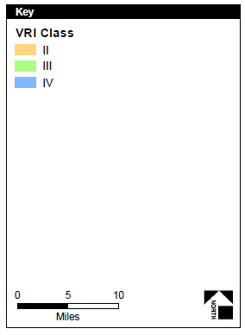
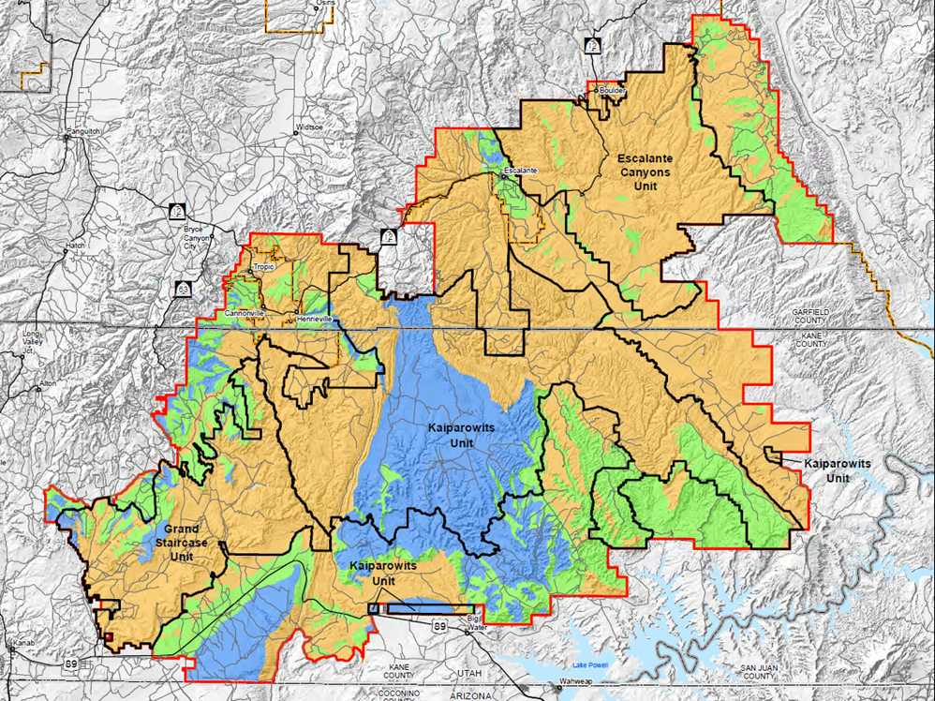
Analyze the Management Situation (AMS)
What is our VRM planning area?

Slide 50
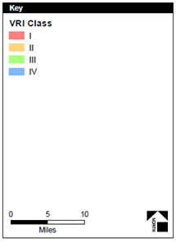
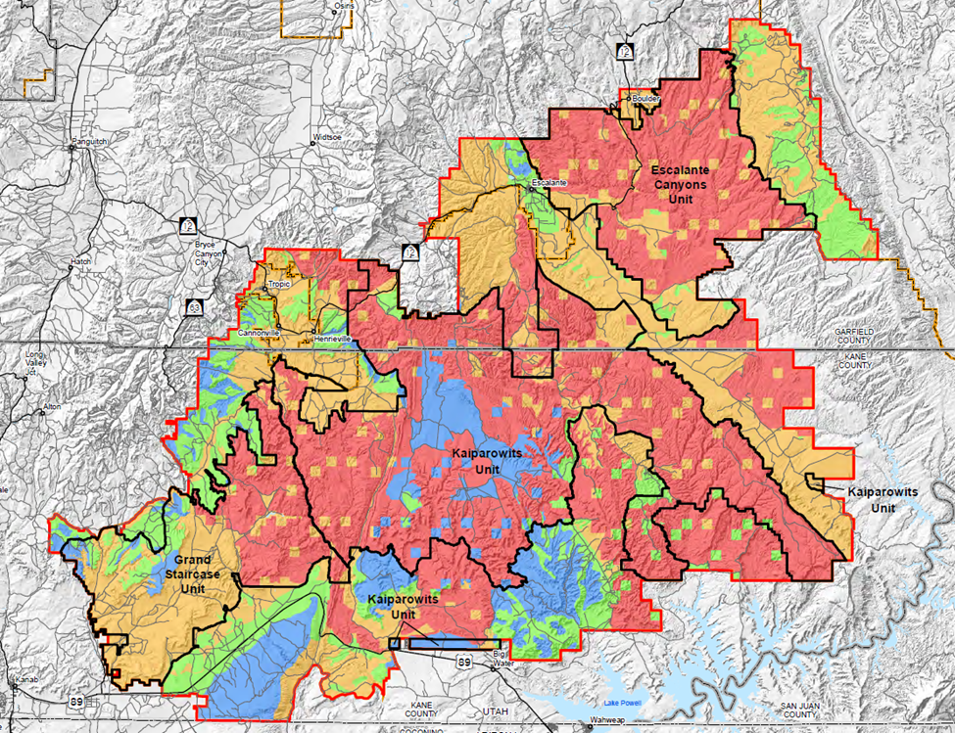
Analyze the Management Situation (AMS)
What is our VRM planning area?

Slide 51
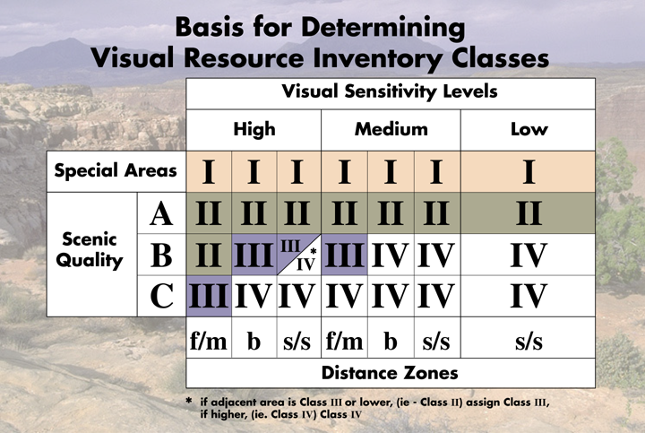
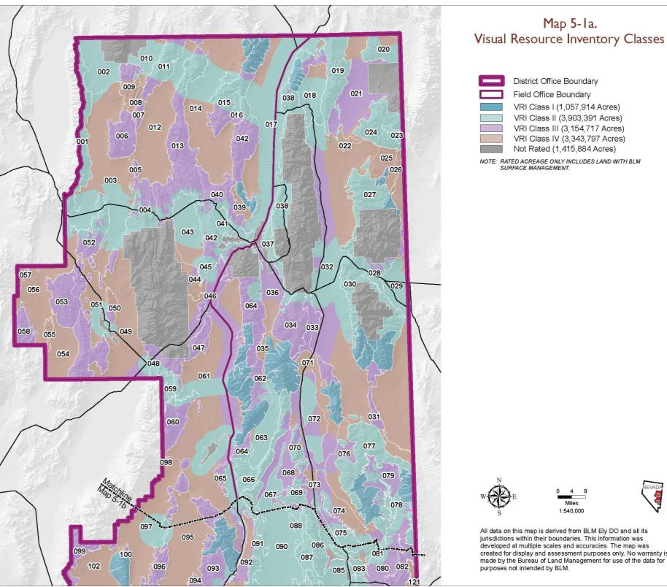
Analyze the Management Situation (AMS)
21 to 27 unique Interrelationships between VRI values
Class I *
Class II
Class III
Class IV
Notes:
Need to know your resource. Don’t limit yourself to VRI Classes alone

Slide 52
VRI Classes .
Class I 7,032,363 (8%)
Class II 18,951,779 (21%)
Class III 23,813,554 (26%)
Class IV 40,826,781 (45%)
Scenic Quality Rating .
A 7,332,472 (9%)
B 38,435,868 (48%)
C 34,914,502 (43%)
Sensitivity Level Rating .
High 34,674,733 (43%)
Medium 24,698,345 (31%)
Low 20,455,318 (26%)
Distance Zones .
FGrnd/MGrnd 55,783,643 (67%)
Background 9,170,500 (11%)
Seldom Seen 18,644,208 (22%)

Slide 53
Analyze the Management Situation (AMS)
VRI Classes
Class I 7,032,363 (8%)
Class II 18,951,779 (21%)
Class III 23,813,554 (26%)
Class IV 40,826,781 (45%)
Scenic Quality Rating
A 7,332,472 (9%)
B 38,435,868 (48%)
C 34,914,502 (43%)
Sensitivity Level Rating
High 34,674,733 (43%)
Medium 24,698,345 (31%)
Low 20,455,318 (26%)
Distance Zones
FGrnd/MGrnd 55,783,643 (67%)
Background 9,170,500 (11%)
Seldom Seen 18,644,208 (22%)

Slide 54
Analyze the Management Situation (AMS)
VRI Classes
Class I 7,032,363 (8%)
Class II 18,951,779 (21%)
Class III 23,813,554 (26%)
Class IV 40,826,781 (45%)
Scenic Quality Rating
A 7,332,472 (9%)
B 38,435,868 (48%)
C 34,914,502 (43%)
Sensitivity Level Rating
High 34,674,733 (43%)
Medium 24,698,345 (31%)
Low 20,455,318 (26%)
Distance Zones
FGrnd/MGrnd 55,783,643 (67%)
Background 9,170,500 (11%)
Seldom Seen 18,644,208 (22%)

Slide 55
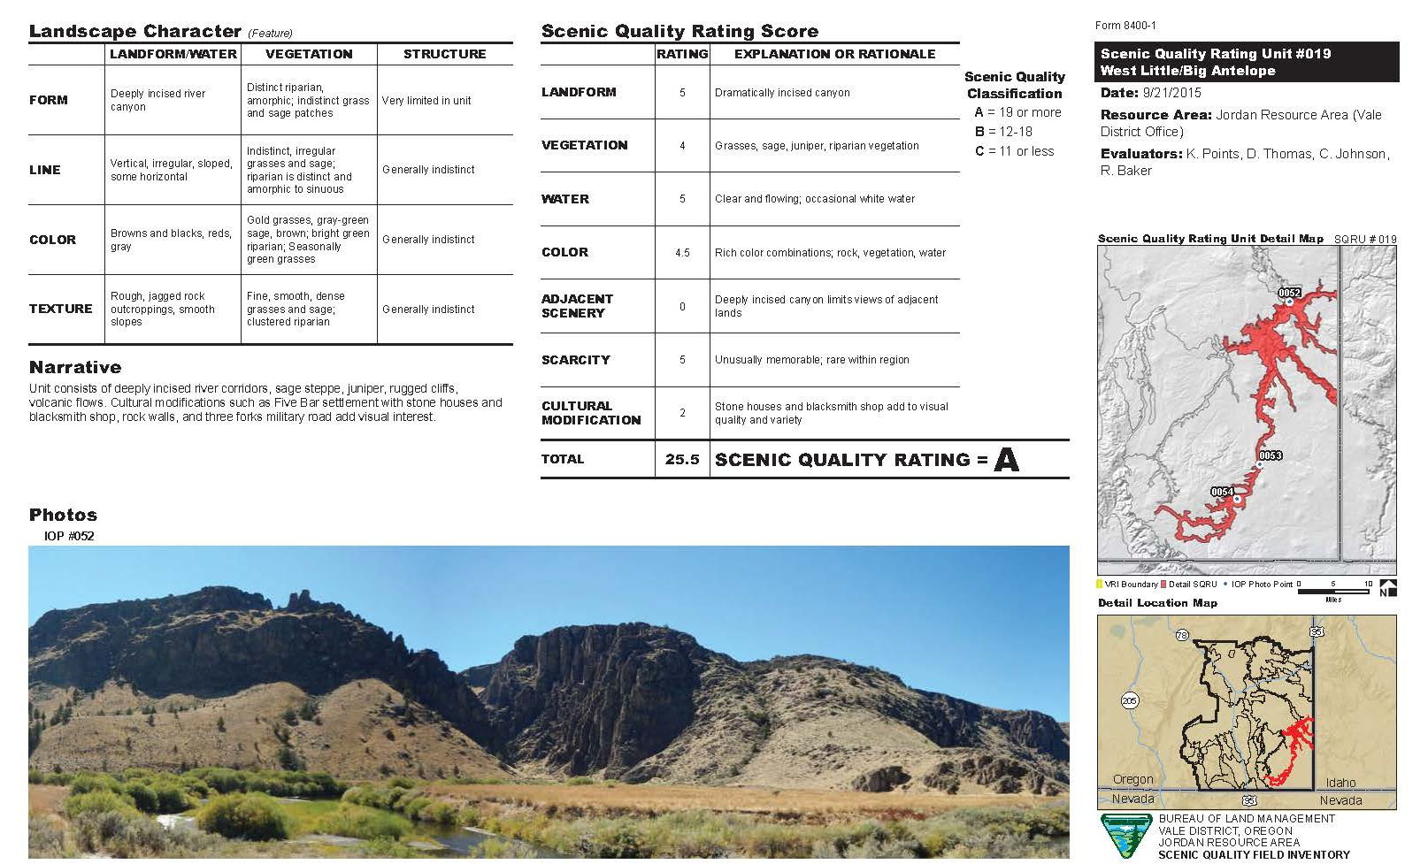
Analyze the Management Situation (AMS)
Analyzing the Existing Management Situation
Understanding the visual resource data
ENTER IN MAPS – JORDAN – High SQRU Score
High sensitivity
ADJACENT SCENERY

Slide 56
Analyze the Management Situation (AMS)
Analyzing the Existing Management Situation
Chapter 2 Area Profile: A.2 Resource-specific information
Indicators: Factors that describe resource condition (e.g., ambient pollutant level)
Current Condition: Location, extent, and current condition of the resource in the planning area.
Trends: Degree and direction of change between the present and some point in the past. Is it moving away or toward the current desired condition based on indicators (stable, declining, improving).
Forecast: Predict changes in the resource condition given the current management and describe the drivers or change agents.
Key Features: geographic location, distribution, areas or types of resource features that should guide land use allocation or management decisions.
Notes:
Indicators: Cultural Modification Score within the SQRU
Current Condition: Where and degree of the Cultural Modifications are located and their relevance to land use and populations (Cult. Mod. Map)
Trends: Are these changes under the current RMP consistent with the VRM class objectives? ID those that are outside the VRM objective, remain unchanged, and those areas that are consistent – reference the scoring adjustment in the SQRU.
Forecast: What’s on the horizon – where are the current applications for development being concentrated and for what type of development, what EO and SO and PEIS works underway e.g. 368 corridors.
Key Features: Where are the high scenic values – WHAT ARE THEY? E.G. SQ-A, High Sensitivity no matter the SQ,- Visibility of landscape.
Compared to resource allocations, special designations, other uses. – Where are the lower SQ areas and have lower levels of sensitivity.
ID the associated uses that benefit from the region’s visual values – Resource uses – example poils and gas – Outdoor Recreation (be specific)

Slide 57
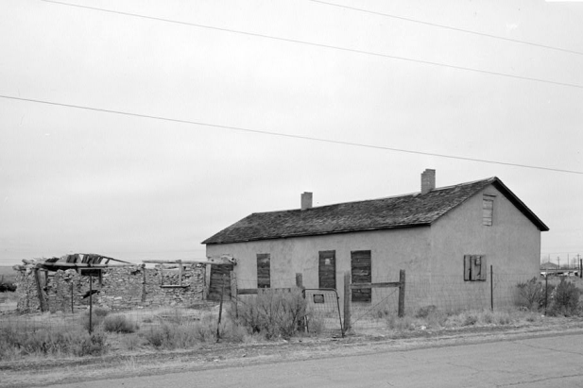
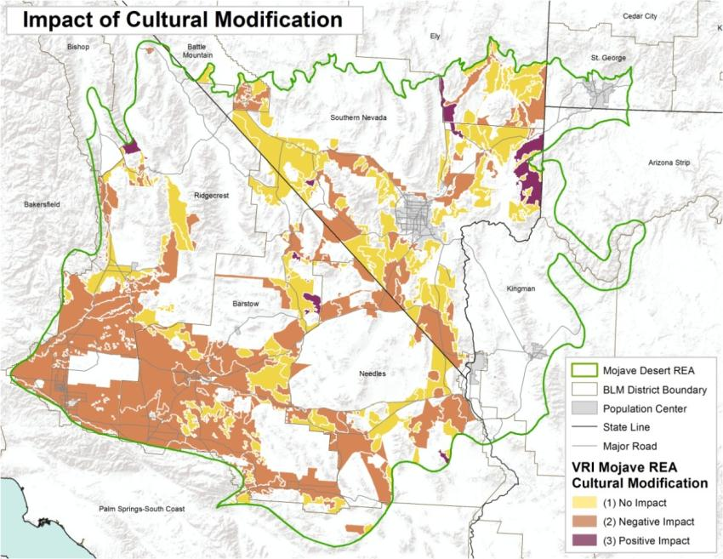
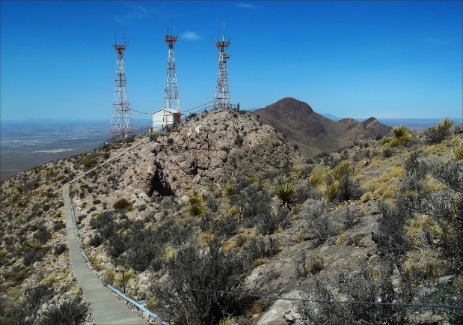
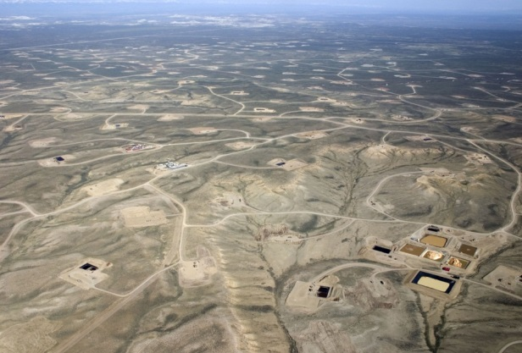
Analyze the Management Situation
Indicator of Condition
Condition of the Visual Resource
Trend of the Visual Resource (stabilized, increasing, decreasing)
Identifying cultural modifications worthy of visual protection not necessarily within areas of high scenic quality.
Delineating areas in need of visual rehabilitation
Notes:
It’s really important to accurately define areas of cultural modifications.

Slide 58
Analyze the Management Situation
Trends in the condition of the Visual Resource
Stable , increasing, decreasing and character of those changes.
Identifying cultural modifications worthy of visual protection not necessarily within areas of high scenic quality.
Delineating areas in need of visual rehabilitation
Notes:
REWORK THIS SLIDE

Slide 59
Analyze the Management Situation (AMS)
Analyzing the Existing Management Situation (H-1601 Appendix F)
Resource Uses – Orientation to the visual values
Special Designations - Orientation to the visual values
Social & Economic Features - Orientation to the visual values
Notes:
We don’t sell or lease or otherwise “use” Visual Resources. We don’t permit Visual Resources. We issue Special Recreation permits where the uses benefit from and sometimes alter the quality of setting,
We authorize land use development and grant Rights-of-Ways that change the landscape’s character which affects visual resources.
So marry up VRI information up with current uses and foreseeable needs – collaborate with the other program disciplines.

Slide 60
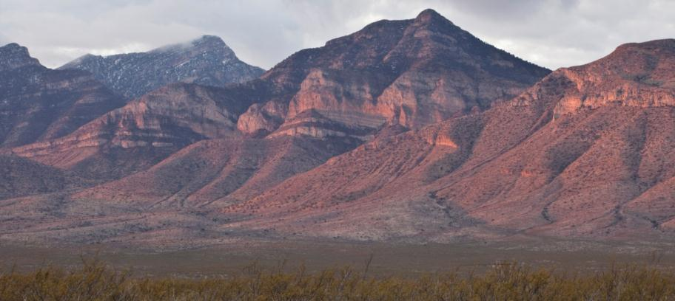
Analyze the Management Situation
Proximity to and enhanced viewshed sensitivities from:
National Monuments and National Conservation designations
Eligible Wild and Scenic Rivers
Wilderness Areas and Wilderness Study Areas
Other special management designations (e.g., National Parks, etc.)

Slide 61
Analyze the Management Situation
areas of increased levels of recreational use under current plan:
Visually sensitive ACECs
National, State or BLM Backcountry Byways
Trail corridors
Special Recreation Management Areas
Off Road Vehicle areas

Slide 62
Formulate Alternatives
Recreation planning interface
Recreation Settings Characteristics
Outcome Experiences
Notes:
Settings characteristics – match up with the VRI values

Slide 63
Analyze the Management Situation
Opportunities for Scenic ACEC
Unique/ scarce high quality scenery
If the importance of the setting’s scenery and/ or viewshed supersedes other resource considerations, a Visual ACEC can be considered

Slide 64
Analyze the Management Situation
Forecasting of high potential resource demand:
Rights-of-way (368 Energy Transmission Corridors, roads, communication systems)
Fluid minerals (oil & gas/ CO2),
Solid minerals,
Precious metals,
Renewable energy development

Slide 65
Analyze the Management Situation
Abandoned Mine Land:
Undesignated Travel Routes:
Impaired Historic settings (e.g., NSHT):
“Ugly Hill”
Middle Knob ACEC
“Nellies Nip”
Jawbone-Butterbredt ACEC

Slide 66
Analyze the Management Situation (AMS)
Analyzing the Existing Management Situation (H-1601 Appendix F)
Chapter 3: Current Management Direction
Relevant plan amendments
Current management decisions
Chapter 4: Management opportunities
Changes in management worthy of consideration
Chapter 5: Consistency and Coordination with other plans
County/ city plans
State plans: wildlife conservation, outdoor recreation plans, etc.
Other Federal agencies
Notes:
Maybe break these apart into their own slides and incorporated images:
Ch 3 – Plan Amendment Doc
Chapter 4 – Think about it
Ch. 5 – Garfield County scenic overlay

Slide 67
Analyze the Management Situation
Identify potential sources of land use conflict:
Consistency with other BLM land use plans
Other federal agencies’ land use plans : National Park Service, US Forest Service, US Fish & Wildlife, etc.
State, County, and Municipal comprehensive master plans

Slide 68
Analyze the Management Situation
Identify potential sources of land use conflict:
State, County, and Municipal comprehensive master plans

Slide 69
Analyze the Management Situation
Acknowledge and address the sensitivity of Adjacent Private Landowners (adjacent land uses in the VRI)

Slide 70
Analyze the Management Situation
AMS Report should cover the following for VRM:
Adherence to the VRM class objectives under current RMP
Distribution of the VRI Classes and inventory factors
Scarcity present within the range of visual values
Condition of the visual resource values
Scenic integrity of the landscape’s intact natural character
Sensitive viewsheds of adjacent land uses
Trends in protection or alteration of the landscape character
Overlay with other data to identify compatibility and conflicts
Concerns/ issues regarding protecting/ modifying the natural landscape character related to other land uses.
Notes:
TURN INTO ON SCREEN EXERCISE

Slide 71
Analyze the Management Situation
VRM Classes and other Management Objectives
VRM Class I, II, III, IV
ACEC
Land tenure zones
ROW Avoidance/Exclusions Areas
Recommended mineral withdrawal
Leasing with standard or special stipulations
Closed to Leasable Minerals or No Surface Occupancy
Renewable energy areas of emphasis
Congressional (non-discretionary) designations
OHV Open, Closed, Limited
SRMA/ERMA
Notes:
Leasing Stip exemptions

Slide 72
Analyze the Management Situation
Public Scoping and AMS
Opportunity to validate VRI
Share insights developed and other issues and conflicts identified
The public’s take on the insights, issues, and conflicts
Public input on thoughts regarding possible VRM alternatives
Notes:
Need new image – maybe a lattice tower example instead that it less dominating and set back from the road a little further

Slide 73
Formulate Alternatives
Bringing the AMS information forward into Alternatives:
Generate a report on the finding,
Is the basis for formulating reasonable alternatives
Alternatives must meet the purpose and need
Each alternative needs to have a rationale
Notes:
Need new image – maybe a lattice tower example instead that it less dominating and set back from the road a little further

Slide 74
Land Use Planning Process
Notes:
Need new image – maybe a lattice tower example instead that it less dominating and set back from the road a little further

Slide 75
Formulate Alternatives
VRI is the primary source of information to build alternatives, but visual values coexist with other resource values and land use allocations.
Other legislative mandates, or other program directives that require, protective visual management of sensitive resource values (designations).
Compatibility between VRM class objectives and land use allocations (e.g., oil and gas, minerals, coal, renewable energy, rights-of-way, etc.).
Prioritizing visual values over other resource values and land use allocations by designating Areas of Critical Environmental Concern (ACEC) based on scenic value and/or VRM Class I.

Slide 76
Formulate Alternatives
Common approach:
Current management direction (No Action)
Conservation emphasis
Resource Use – emphasis on constraint reduction
Balanced management – increased conservation balanced against moderate levels of resource use
Notes:
Need new image – maybe a lattice tower example instead that it less dominating and set back from the road a little further

Slide 77
Formulate Alternatives
VRI Classes to VRM Classes
Classes | Inventory (Pre-planning) VRI Classes |  | Management (Land Use Planning) VRM Classes
I | Special Designation (Congressional or administrative ) |  | Preservation
II | High Visual Values |  | Low levels of change
III | Medium Visual Values |  | Moderate levels of change
IV | Low Visual Values |  | Major levels of change

Slide 78
Formulate Alternatives
VRI Classes to VRM Classes

Slide 79
Formulate Alternatives
VRI Classes to VRM Classes
Classes | Inventory (Pre-planning) VRI Classes |  | Management (Land Use Planning) VRM Classes
I | Special Designation (Congressional or administrative ) |  | Preservation
II | High Visual Values |  | Low levels of change
III | Medium Visual Values |  | Moderate levels of change
IV | Low Visual Values |  | Major levels of change

Slide 80
Formulate Alternatives
FLPMA Directs that:
inventory of all public lands and their resources (including, but not limited to outdoor recreation and scenic values),
maintain on a continuing basis, and
use during the land use planning process.
These land use decisions are binding.
Notes:
VRM Class objectives is the number one reason RMPs are amended.
IS THIS THE RIGHT PLACE – OR SHOULD I MOVE THE TABLE DOWN UNDER ALTERNATIVES DEVELOPMENT?

Slide 81
Formulate Alternatives
VRM Class Objectives
VRM Class alternatives need to be carefully thought through and truly explore the range of alternatives using the VRI.
Notes:
1. A: Talk about the remanding Rawlins
1. B: VRM Class objectives is the number one reason RMPs are amended.
No Act: 2,381,133
Alt. A: 2,783,605 (7% of area)
Alt. B: 2,783,480
Alt. C: 2,792,608
Alt. D: 2,792,635 (difference between the most ac and least ac = 0.3%
VRM IV – 2% between the most and least
VRM III – 9% between most and least in VRM III
VRM II – 10% between most and least in VRM II 2% difference between A & B)
VRM Class objectives is the number one reason RMPs are amended.
After they included VRI Factor maps, discussed the VRI Factors and reported out how they’ll be affected, I found that much of the VRM II is covering areas of B and C scenery of Mod and low sensitivity.
The reported out that Scenic Quality A is managed under VRM III and IV.
IS THIS THE RIGHT PLACE – OR SHOULD I MOVE THE TABLE DOWN UNDER ALTERNATIVES DEVELOPMENT?

Slide 82
Formulate Alternatives
VRM Class Objectives
VRM Class alternatives need to be carefully thought through and truly explore the range of alternatives using the VRI.
VRM Class | No Action Acres | Alt. A Acres | Alt. B Acres | Alt. C Acres | Alt. D Acres
I | 7,058 | 37,764 | 42,102 | 16,222 | 16,222
II | 43,613 | 235,946 | 315,700 | 60,791 | 41,092
III | 402,725 | 367,295 | 294,177 | 549,329 | 546,2005
IV | 2,330,462 | 2,142,600 | 2,131,501 | 2,166,266 | 2,189,116
Notes:
1. A: Talk about the remanding Rawlins
1. B: VRM Class objectives is the number one reason RMPs are amended.
No Act: 2,381,133
Alt. A: 2,783,605 (7% of area)
Alt. B: 2,783,480
Alt. C: 2,792,608
Alt. D: 2,792,635 (difference between the most ac and least ac = 0.3%
VRM IV – 2% between the most and least
VRM III – 9% between most and least in VRM III
VRM II – 10% between most and least in VRM II 2% difference between A & B)
VRM Class objectives is the number one reason RMPs are amended.
After they included VRI Factor maps, discussed the VRI Factors and reported out how they’ll be affected, I found that much of the VRM II is covering areas of B and C scenery of Mod and low sensitivity.
The reported out that Scenic Quality A is managed under VRM III and IV.
IS THIS THE RIGHT PLACE – OR SHOULD I MOVE THE TABLE DOWN UNDER ALTERNATIVES DEVELOPMENT?

Slide 83
Formulate Alternatives
Visual Absorption Capability (USFS) – reading the landscape’s visual variety that will visually absorb built facilities

Slide 84
Formulate Alternatives
Visibility Study/ viewshed modeling

Slide 85
Formulate Alternatives
Visibility Study/ viewshed modeling
VRI Class IV
VRI Class II
VRI Class III

Slide 86
Formulate Alternatives
Factor in the visual value and evaluate the landscape’s potential for absorbing the types of anticipated land use:

Slide 87
.
Formulate Alternatives
Photo by Bob Wick

Slide 88
Formulate Alternatives

Slide 89
Formulate Alternatives

Slide 90
Formulate Alternatives

Slide 91
Formulate Alternatives
Rationale behind the VRM class objectives - for the range of alternatives and as carried forward in the ROD.
Need to know the why behind the how
Helps with the plan’s implementation especially for those tasked with implementation without the benefit of being a part of the plan’s development.
Defending the plan decisions against a non-conforming use.

Slide 92
Formulate Alternatives
The minimum required:
At a minimum, all plans should delineate the standards and objectives for protecting scenic resources by designating BLM lands as Class I, II, III, or IV.
Supplemental management protections:
The RMP process allows further standards and management actions for visual resources to be described.
Other Management Tools
ROW Exclusion and Avoidance Areas
No Surface Occupancy (NSO)
Controlled Surface Use (CSU)

Slide 93
Formulate Alternatives
Lands with Wilderness Characteristics
Can wilderness characteristics be managed as VRM Class I or should they be VRM Class II, III or IV?

Slide 94
Formulate Alternatives
What about the inverse? Exemptions?
Exception under VRM Class II stipulation-Alternatives B and C:
The level of change to the landscape should be low; management activities may be seen, but should not attract attention of the casual observer.
Any change to the landscape must repeat the basic elements of form, line, color, and texture found in the predominant natural features of the characteristic landscape.
Also, recognized utility corridors are exempt only for utility projects which would be managed according to VRM III objectives.

Slide 95
Land Use Planning Process
Notes:
Need new image – maybe a lattice tower example instead that it less dominating and set back from the road a little further

Slide 96
Analyze Effects of the Alternatives
Chapter 3: Describing the Affected Environment
Description of VRM policy and procedures
Current VRM Classes and changed conditions or circumstances in the planning area
General description of the landscape character
Visual condition and trends
VRI classes and values (Scenic Quality, Sensitivity, Distance Zones) for whole planning area
VRI Class map and VRI values (SQ, SL, DZ) maps and
View-shed values of adjacent lands – public and private

Slide 97
Analyze Effects of the Alternatives
Chapter 4: Environmental Impact Analysis
Each VRM class objective within each alternative shall be evaluated for potential impacts on existing VRI classes and VRI factors (scenic quality, sensitivity, distance zones).
Quantification of potential impacts in accordance with BLM National Environmental Policy Handbook H-1790-1.
Identify and describe the anticipated types of land uses that would potentially alter the VRI factors under plan implementation.

Slide 98
Analyze Effects of the Alternatives
What are the shifts in VRM Class Designation between the No Action and other alternatives?
“Alternative C is less protective than A, B and D”

Slide 99
Analyze Effects of the Alternatives
What are the shifts in VRM Class Designation between the No Action and other alternatives?
“X acres of VRM Class III will now be managed at VRM Class IV and will affect Scenic Quality B within Fg/Mg Distance Zone with High Sensitivity inventoried as VRI Class II. Under this alternative 17% VRI Class II will be managed as VRM Class III”

Slide 100
Analyze Effects of the Alternatives
Which lands are under higher levels of visual protection and why?
Protection of scenic quality
National Historic Trails – recent policy shift
Prioritized views from National Parks within the planning area
New residential areas within the BLM land interface
And quantify – acres, percent of planning area . . .

Slide 101
Analyze Effects of the Alternatives
Which lands are under lesser levels of visual protection and why?
Fluid mineral leasing
Coal leasing
Renewable energy development
Transmission Rights-of-Way

Slide 102
Analyze Effects of the Alternatives
98%
<1%
33%
24%
43%
<1%
65%
25%
10%
Notes:
Discussion on the types of allowable uses and their impact potential in form, line, color, texture, scale

Slide 103
Analyze Effects of the Alternatives
Notes:
Discussion on the types of allowable uses and their impact potential in form, line, color, texture, scale

Slide 104
Management Measures (Actions)
Rehabilitation/ Restoration Areas (part of SQRU Cultural Modifications)
Flag areas needing rehab during the inventory and build a list of needs.
Level of rehab will be determined by the visual objectives assigned in the RMP.
Set goals that are achievable.
Work with the other programs in identifying priority areas.
Step down plans
Integrate into the Regional Mitigation strategy

Slide 105
Visual Restoration Management Actions
Abandoned Mine Land:
Undesignated Travel Routes:
Impaired Historic settings (e.g., NSHT):

Slide 106
Amending the RMP VRM Class Objective
Land Use Plan Amendments
What if there is a scenario that you didn’t foresee?
Three options
Deny
Mitigate
Amend the Plan

Slide 107
Non-conforming action/ LUP Amendment
Contemplating a land use plan amendment: An amendment shall be initiated by the need to consider the following criteria (43 CFR 1610.5-5):
New or revised policy.
New data.
A change in circumstances.
Findings from monitoring and evaluation.
A proposed action that may result in a change in scope of resource uses.
A change in the terms, conditions, and decisions of the approved land use
plan.

Slide 108
Non-conforming action/ LUP Amendment
Contemplating a land use plan amendment: Also carefully consider and evaluate before making the final decision to amend the VRM class objectives:
Existing land use plan’s rationale for the current VRM class objective.
If the public benefits associated with the proposed action’s purpose and need outweigh the public benefits associated with the purpose and protection level of the current VRM class objective.
Effects on other resource values and land use plan decisions that may result from modifying the level of visual resource protection.
The need to compensate for any loss of or reduction to visual resource value

Slide 109
Non-conforming action/ LUP Amendment
Contemplating a land use plan amendment: Also carefully consider and evaluate before making the final decision to amend the VRM class objectives:
The BLM shall disclose the impacts to visual resources and explain the tradeoffs and benefits of amending the land use plan.
In circumstances in which a land use plan amendment allows a proposed action to move forward, conditions of approval shall include mitigation of adverse visual resource impact and evaluation of the opportunities for compensatory mitigation for recovering lost or reduced value to the VRI factors. (list of restoration areas)

Slide 110
Other Considerations
Renewable Energy and VRM
West-wide Energy Corridor Programmatic EIS –
IOPs
Wind Energy PEIS
15 Amendments
Geothermal PEIS
Comprehensive list of BMPs
Solar PEIS
17 Solar Energy Zones
BMPs
Notes:
No change to VRM classes

Slide 111
Interim VRM Classes
What do you do when you have no VRM objectives for an area of public land?
Develop interim classes using guidelines from H-8410-1.
A surrogate process to bring non-compliant land use plans into interim compliance with VRM policy.
Interim management classes should reflect existing decisions within the RMP.
A plan amendment is not required unless the project driving the VRM evaluation requires one.
The conclusion of the appropriate interim management should be the result of a NEPA analysis
Is a VRI needed?
Notes:
This should be under project planning

Slide 112
Emerging Issues
Night Sky

Slide 113
Land Use Plan Checklist
Build a robust AMS
VRM Goals, objectives, issues
Inventory – VRI Classes, Scenic Quality, Sensitivity, Distance Zones – Acres and percent area
Description of landscape
Current management classes
How the management of visual values shifts under the alternatives
Impact analysis – VRM Class impact on VRI values
What are the allowable uses within the VRM Class designations creating visual change
Explanation behind why certain VRM Classes were designated – especially when VRM Classes are not commensurate with VRI values

