Slide 1
National Priorities & Recreation
Supporting Text

Slide 2
Changes in Washington Office
Changes to WO-200
Andy’s detail
Cory’s departure
Katelyn’s old and new details
Cameron’s internship

Slide 3
Week’s Recreation Highlights
Great Outdoors Month
Exemption of outfitters & guides from EO 13658
New Recreation Trails
Partners Outdoors

Slide 4
BEA Report on Economic Impact of Outdoor Recreation
2% of GDP in 2016
4.4 annual growth
673 billion gross output
4.3 million jobs

Slide 5
Secretary’s Ten Priorities
Create a conservation stewardship legacy
Sustainably develop our energy & natural resources
Restore trust & be a good neighbor
Ensure tribal sovereignty means something
Increase revenues to support & Department and nation

Slide 6
Secretary’s Ten Priorities
Protect our people & the border
Strike a regulatory balance
Modernize our infrastructure
Reorganize the Department for the next 100 years
Achieve our goals and lead our team forward

Slide 7
Secretary’s Recreation Priorities
Access
Infrastructure
Metrics
Organization

Slide 8
BLM Recreation Priorities
Secretarial Orders
SRP Streamlining
TTM Handbook
Rec.gov implementation

Slide 9
Strategic Plan 2018-2022
Mission Area 3: Expanding Outdoor Recreation & Access
Goal #1: Expand hunting, fishing, & other recreation access on DOI lands and waters
Strategy #1: Promote hunting, fishing, & other recreation on DOI lands and waters
BLM: Number legal public access transactions completed that facilitate open access to recreation opportunities: 20

Slide 10
Strategic Plan 2018-2022:
Mission Area 3: Expanding Outdoor Recreation & Access
Goal #2: Enhance public satisfaction
Strategy: #1: Enhance enjoyment and appreciation of natural and cultural heritage
BLM target:
% visitors satisfied with experience: 95%
% visitors satisfied with facilitated programs: 94%

Slide 11
Other Metrics
Deliverables under the SOs
% developed recreational facilities/areas listed on rec.gov
# facilities/areas reservable on rec.gov
# Individuals participating in different recreational activities
% Visitor satisfaction

Slide 12
Other On-Going Work
Infrastructure opportunities
Data Standards
Internet Applications
Assistance Agreements/MOUs
Shooting Sports Policy
VRM Handbook
CXs
Reporting Tools

Slide 13
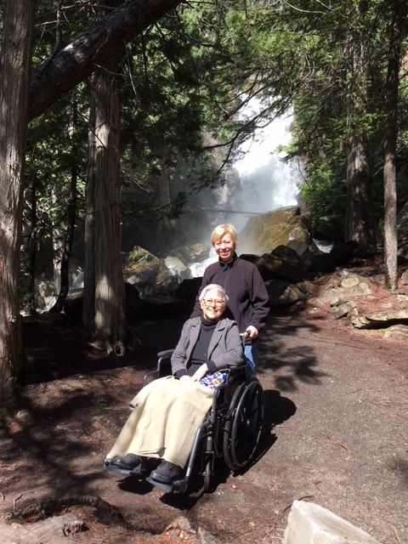
Questions?

Slide 14
Contact Information
Robin Hawks
rhawks@blm.gov
Office: 202-812-7094
Cell: 202-713-8141

