Slide 1
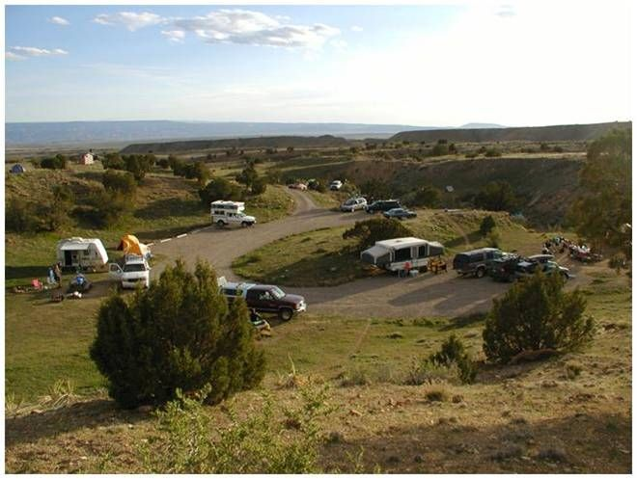
Overnight Visitor Use Formulas
Notes:
North Fruita campground
Adding overnight visitation does make how you think about you average visit more complex. Can anyone think of a reason why? Possible answers: people camp for more than one night so the number of hours they stay are longer. They may leave the site and come back (sometimes several times) and how do you account for that time? I like to think of a visit as the time a visitor arrives on Public land until they are leaving public land for the last time (i.e. going home). This is important because this is how our economist put value on recreation is by visit (local vs tourist and overnigth vs day use). It is also why we calculate recreation visitor days (12 worth of activity)

Slide 2
Overnight Visitor Use Formula Worksheet
Site Name: North Fruita Desert Campground
Formula Name: NFD Campground
Average visitor stay: 22 hours
Visitor Activity Average Hours Percentage Average stay
Camping 12 100% 720 minutes
Picnicking 1 70% 42 minutes
Social Gathering 8 50% 240 minutes
Mountain biking 6 85% 306 minutes
Total 1308 minutes
(1308 min/60 min per hour = 21.8 hours)
Notes:
Stress the average visitor stay!

Slide 3
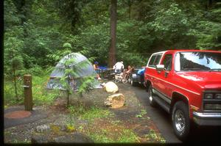
Let’s go camping somewhere else
Notes:
Read this or have someone from the class ready this scenario:
We have a large campground located on Loon Lake. Visitors typically show up about noon, they spend two nights and they leave the third day at noon, for a total of about 48 total hours. They usually participate in several water-related activities (water play, fish and swim), they walk around the camp, hike and explore, they spend time socializing with other campers, they eat their meals sometimes by the lakeshore, and they sleep.

Slide 4
Use might look like this
Total Camping is about 30 hours and everyone participates
Picnicking about five hours total and everyone does that.
Swimming for two hours, but only a quarter of them participate.
Fishing, which is a much longer use at the site, might be 10 hours, but only half the people do that.
Hiking around the area exploring, might be eight hours during their stay, but only half of them do that.
General playing in the water, although a high percentage do that, they only do it for about four hours.
Notes:
Hiker on the newly constructed Mule Ridge Trail in Shasta County, CA - BLM.
Sign into BASS and build this formula.
How do we use these formulas in recreation planning?
Our simple formula says that all the people that visit this trail hike for half an hour and as a recreation planner, it’s our job to estimate the amount of use. If you have a trail counter or go and count cars and the people in them at the trail head you might estimate that 2,320 people visit this trail over the course a year. You can enter the number of visits into your journal or onto a spread sheet but the BLM being a forward thinking organization created the Recreation Management Information System (RMIS) back in 1984 for just this sort of information. The RMIS Program lets you set up sites, create visitor formulas and will store the number of visits and calculates the number of visitor hours and keep that information safe, forever.

Slide 5
Overnight Visitor Use Formula Worksheet
Site Name: Loon Lake Campground
Formula Name: Loon Lake Campground
Average visitor stay: 48 hours
Visitor Activity Average Hours Percentage Average stay
Camping 30 100% 1800 minutes
Picnicking 5 100% 300 minutes
Swimming 2 25% 30 minutes
Fishing 10 50% 300 minutes
Hiking 8 50% 240 minutes
Water Play 4 100% 240 minutes
Total 2,910 minutes
(2910 min / 60 min per hour = 48.5 hours)
Notes:
Stress the average visitor stay!

