Slide 1
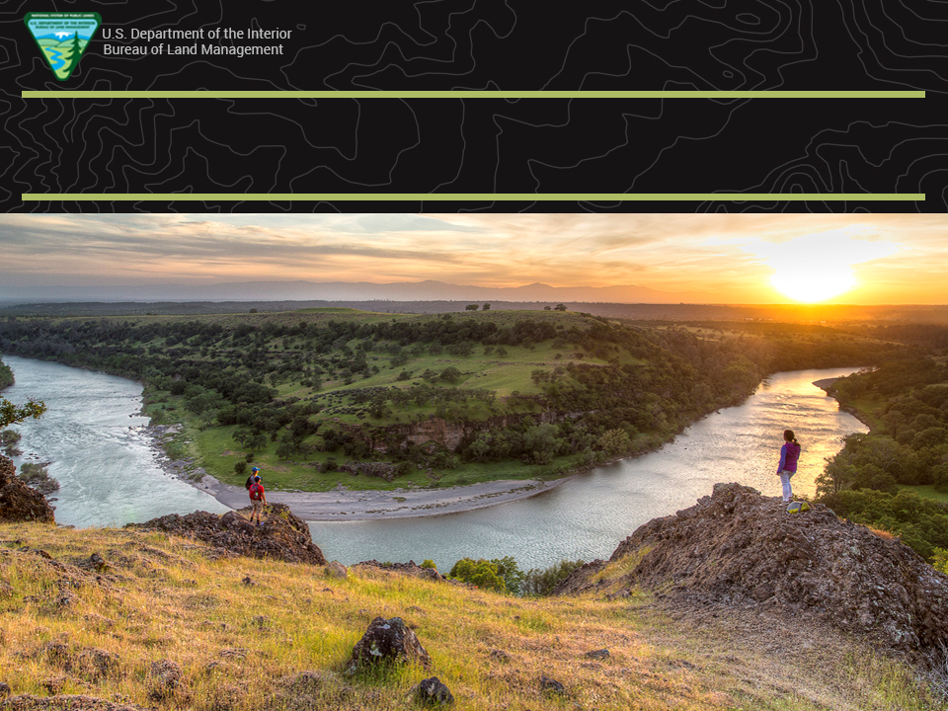
Visitor Use Formulas

Slide 2
Visitor Use Formulas
Not as hard as they look
$$f\left(x\right)=a_{0}+\sum_{n=1}^{∞}{\left(a_{n}\cos{\frac{nπx}{L}}+b_{n}\sin{\frac{nπx}{L}}\right)}+\sin{α}±\sin{β}=2\sin{\frac{1}{2}\left(α±β\right)}\cos{\frac{1}{2}\left(α∓β\right)}$$

Slide 3
Visitor Use Formulas
Not as hard as they look
$$f\left(x\right)=a_{0}+\sum_{n=1}^{∞}{\left(a_{n}\cos{\frac{nπx}{L}}+b_{n}\sin{\frac{nπx}{L}}\right)}+\sin{α}±\sin{β}=2\sin{\frac{1}{2}\left(α±β\right)}\cos{\frac{1}{2}\left(α∓β\right)}$$
?
?

Slide 4
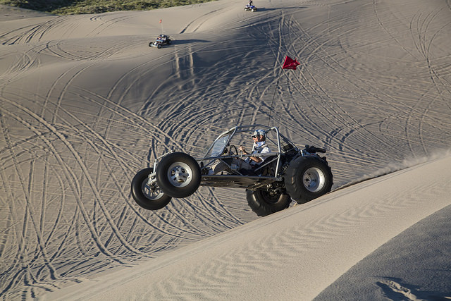
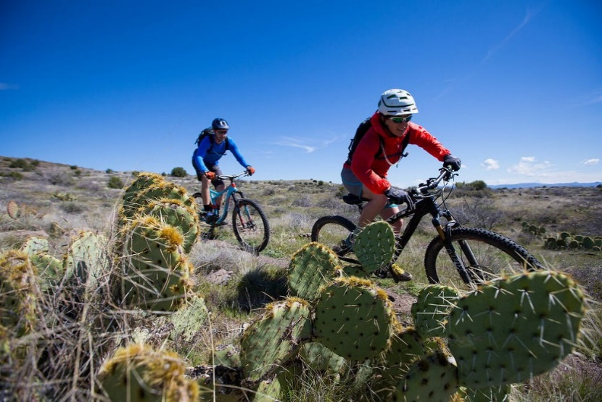
Objective
Understand and be able to explain:
  What we should know about the recreating public,
  Why we collect visitor use information,
  What information is needed to develop a visitor use formula,
  How to determine if your formula makes sense,
  How to create a formula in RMIS,
  How to view visits added in the RMIS database

Slide 5
Example
Given a recreation site description and visitor use data, create and test a visitor use formula that includes;
  average length of a site visit,
  activities to be tracked,
  percent of participation each activity represents during a visit, and
  average length of time of participation in each activity.

Slide 6
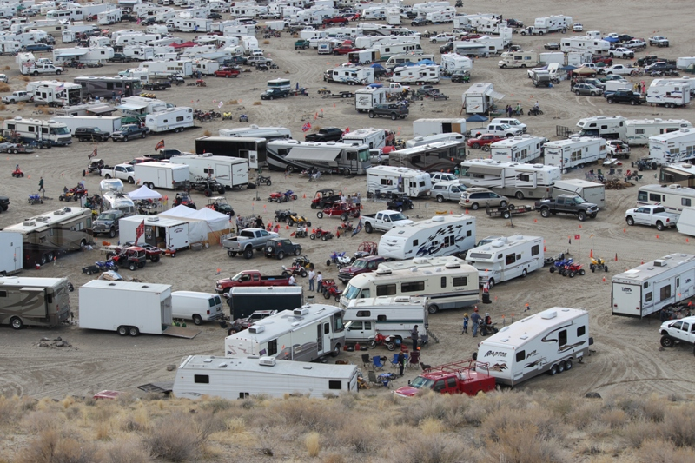
What is important to know about the people recreating at your site?

Slide 7
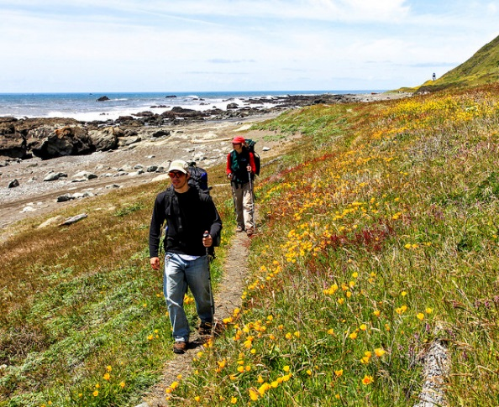
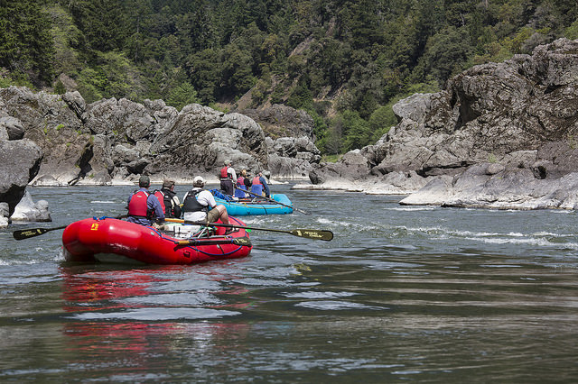
What is important to know about the people recreating at your site?
At a minimum, managers like to know
  how many people use sites and areas,
  when they are used, and
  what activities take place.

Slide 8
What is important to know about the people recreating at your site?
Knowing our customers helps balance supply and demand for recreation with other resources,
Enables us to meet visitor’s expectations.
Demand for recreation opportunities is often measured by number of visitors.

Slide 9
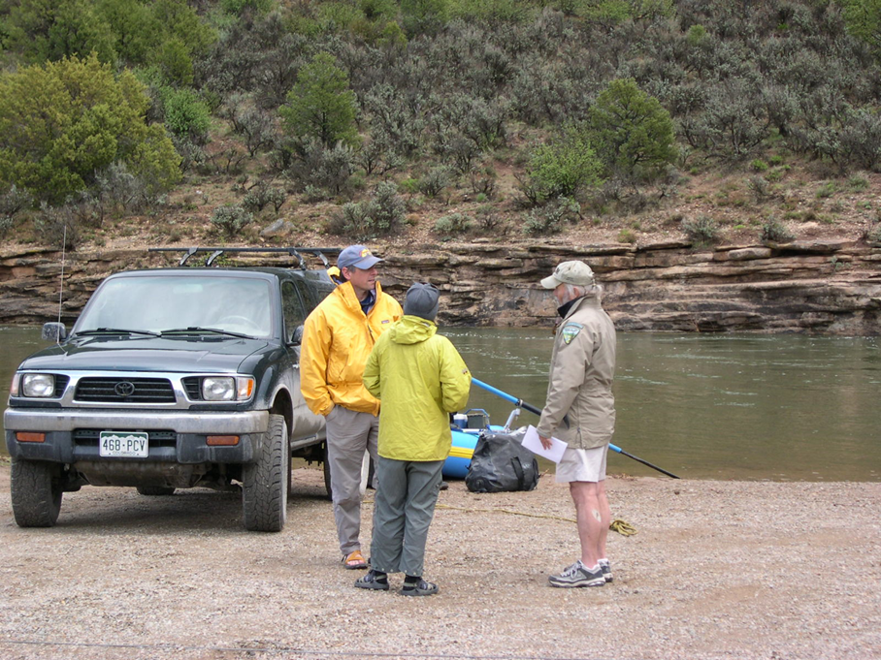
Why do we collect visitor information?

Slide 10
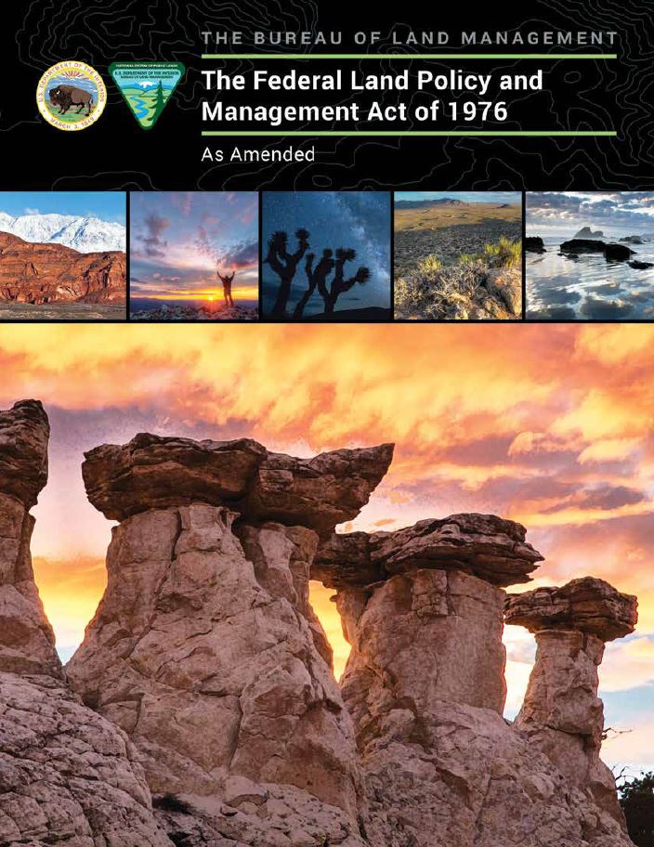
Why do we collect visitor information?
FLPMA – Sec. 201 (a)
The Secretary shall prepare and maintain on a continuing basis an inventory of all public lands and their resource and other values (including, but not limited to, outdoor recreation and scenic values).

Slide 11
Why do we collect visitor information?
Visitor use is baseline information that allows us to;
  track trends,
  link recreation use to resource changes,
  allocate/prioritize resources,
  analyze administrative decisions, and
  allows us to estimate the amount, type, and distribution of visitor use.
This information is needed for revisions to management plans and to help make resource decisions.

Slide 12
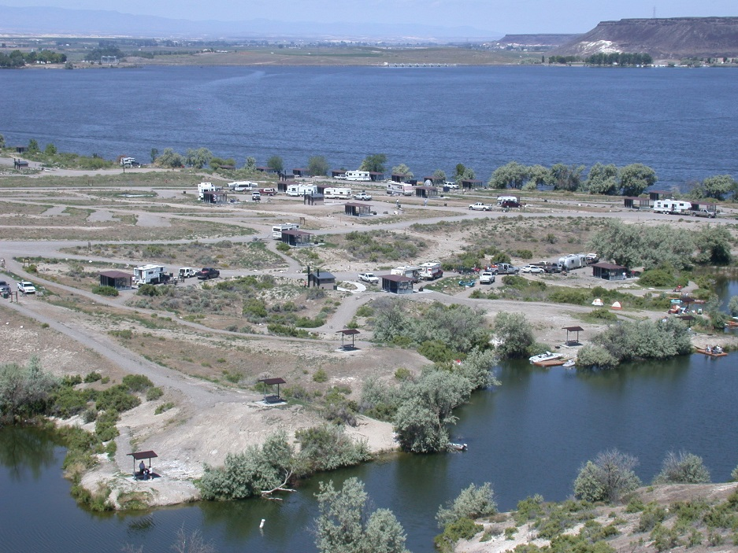
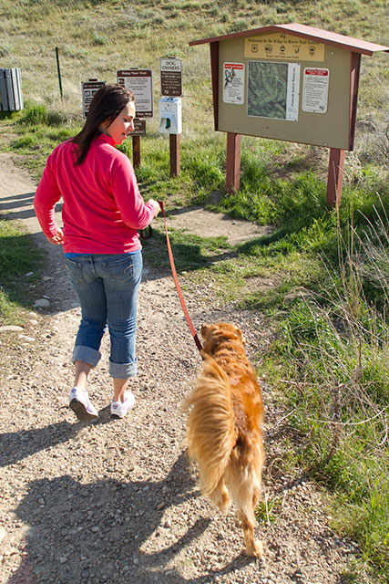
Where do we collect this information?
It all starts with selecting a place to track visitor use.
This can be a day use site, a campground, a river corridor, a fairly large area with multiple rec. sites, or an area where people visit but there are no recreation facilities.

Slide 13
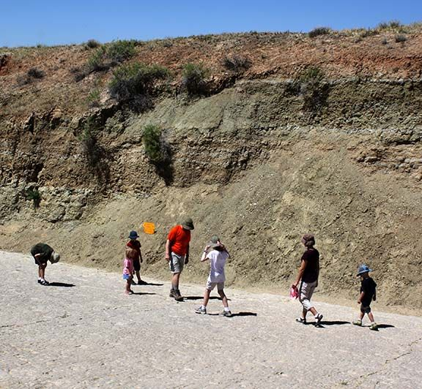
Why do we need formulas?

Slide 14
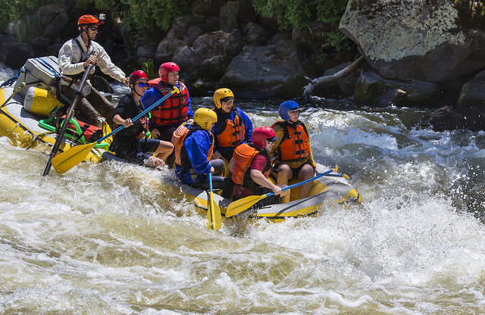
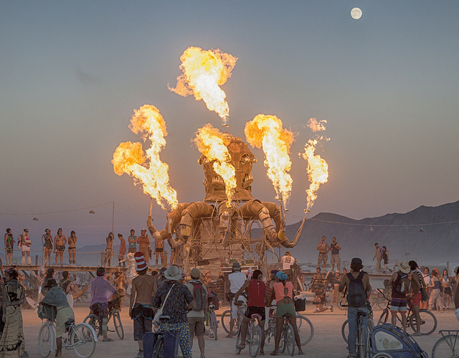
Why do we need formulas?
It helps tell the story of what visitors are doing on BLM lands without having to know what every visitor is doing.

Slide 15
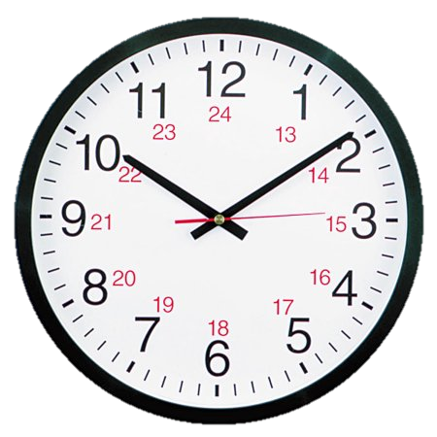

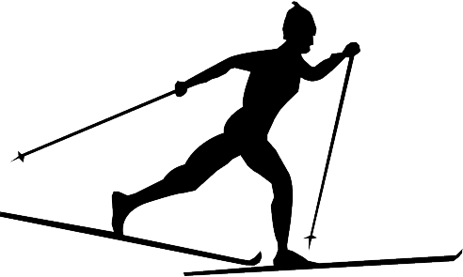
Visitor Use Formulas – Easy as:
Activities
Average amount of time spent doing each activity
Average percent of time visitors participate in each activity

Slide 16
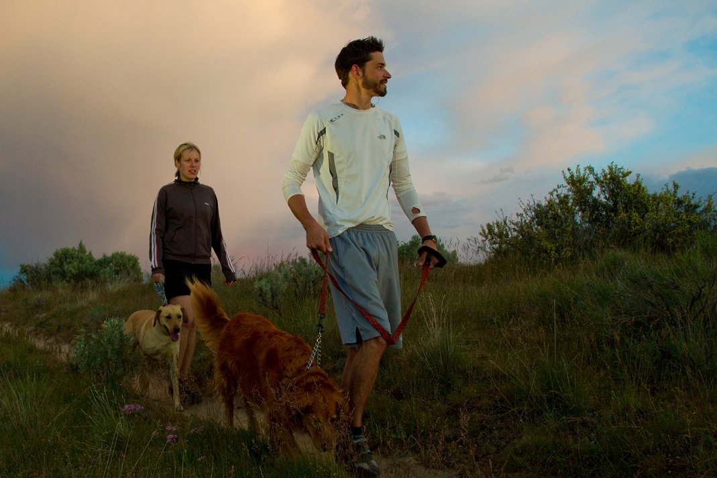
Example – Simple Formula
Our site is a hiking trail, where the average visit is 30 minutes, and everyone who visits hikes the trail.
Activity: Hiking
Average time: 0.5 hour (30 minutes)
Percent Participation: 100 %

Slide 17
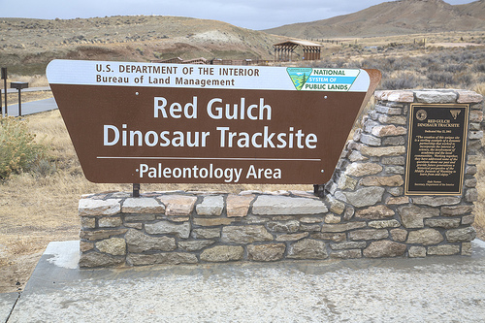
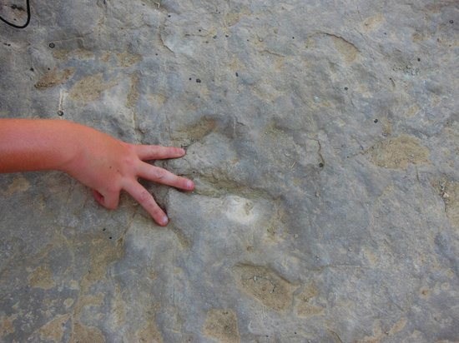

Formula – Red Gulch Dinosaur Tracksite
Visitors are staying at the Tracksite for an hour (observations)
100% participate in viewing the interpretive exhibits and going to see the dinosaur tracks. That takes them about 45 minutes
30% have snacks or a meal that takes them an hour to enjoy.
15% go geocaching and that takes about 15 minutes to locate and log the cache.

Slide 18
Formula – Red Gulch Dinosaur Tracksite
Let’s build a visitor formula which should:
  include the main activities that we want or need to track and
  Should reflect the type and proportion of use that occurs.
The total number of visitor hours for the formula should be about the same as the average length of stay.

Slide 19
Formula – Red Gulch Dinosaur Tracksite
Let’s build a visitor formula which should:
  include the main activities that we want or need to track and
  Should reflect the type and proportion of use that occurs.
The total number of visitor hours for the formula should be about the same as the average length of stay.
The total number of visitor hours for the formula should be about the same as the average length of stay.

Slide 20
Formula – Red Gulch Dinosaur Tracksite
If we add the average time for each activity, we get two hours which is twice as long as the average length of stay.
Activity Average Hours
Viewing 0.75
Picnicking 1.00
Geocaching 0.25
Total 2.00

Slide 21
Formula – Red Gulch Dinosaur Tracksite
But if we look at the visitor hours per user – which is the hours (x) times percent participation, we get a total of 65 minutes as our length of stay – which is about what we want.
Activity Average Hours x Percent = Average Stay
Viewing 0.75 100% 45 minutes
Picnicking 1.00 30% 18 minutes
Geocaching 0.25 15% 2 minutes
Total 65 minutes

Slide 22
Visitor Use Formula Worksheet
Site Name: Red Gulch Dinosaur Tracksite
Formula Name: Red Gulch Summer Use
Average visitor stay: 1 hour
Activity Average Hours x Percent = Average Stay
Viewing 0.75 100% 45 minutes
Picnicking 1.00 30% 18 minutes
Geocaching 0.25 15% 2 minutes
Total 65 minutes

Slide 23
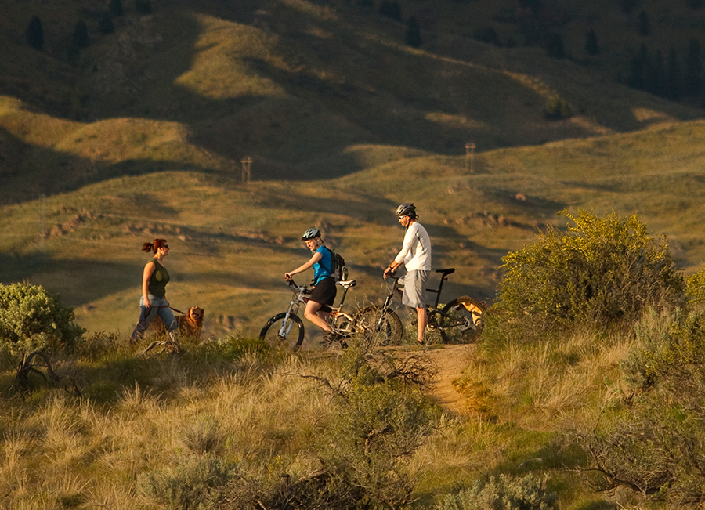
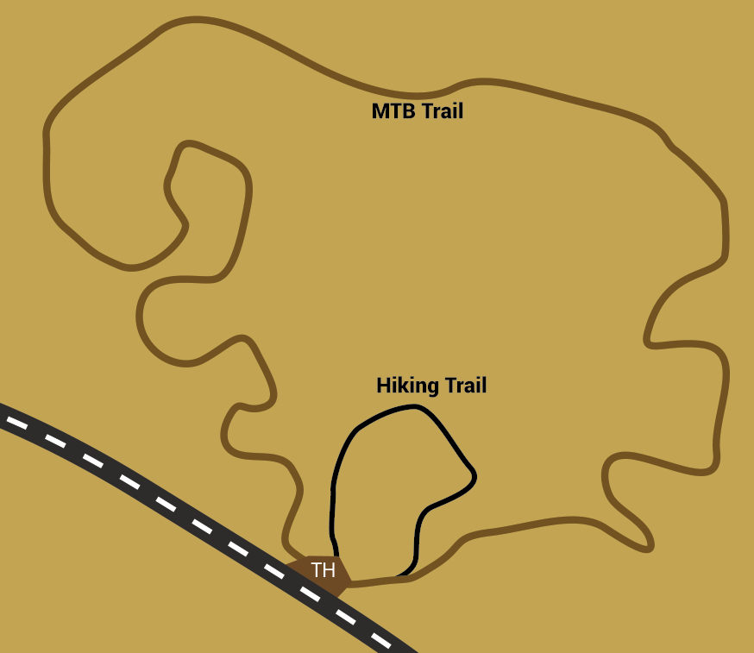
Try building a formula in RMIS
Our Trailhead has two trails; a hiking trail and a mountain bike trail. Half the users hike and half the users ride mountain bikes. Each user stays an average of one hour.

Slide 24
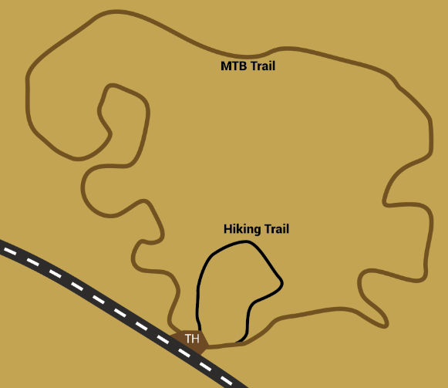

What does the formula look like?
Hiking; average one hour; 50 percent participation.
Mountain biking; one hour; 50 percent participation.
Visitor Activity Average Hours x Percentage = Average stay
Hiking 1.0 50% 30 minutes
Picnicking 1.0 50% 30 minutes
Total 60 minutes

Slide 25
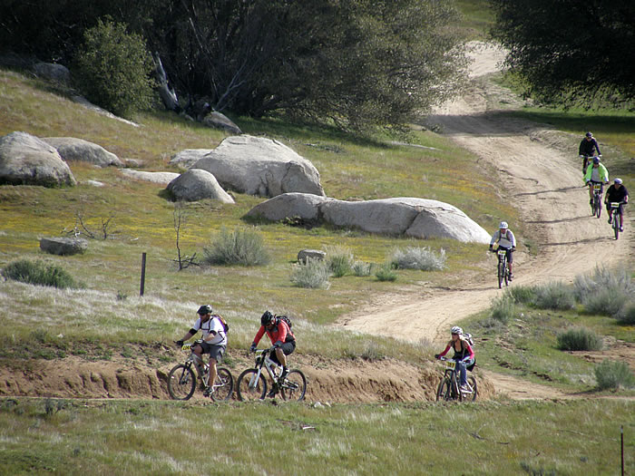
Let’s Add Some Visits to the Site
In RMIS – Add 100 visits to the trailhead site.

Slide 26
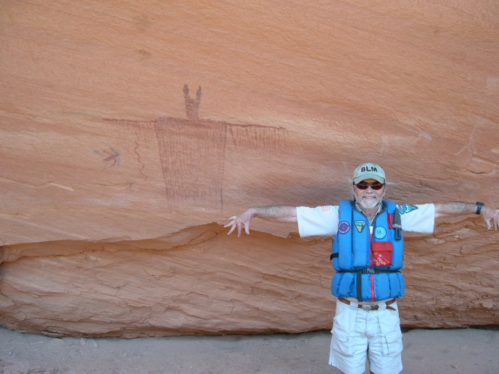
Summary
We know why we need visitor use information
We know what a visitor use formula is and what it consist of.
We have created a Visitor Use Formula in RMIS, added data, and checked our work.

Slide 27
Conclusion
For a given recreation site with visitor use data, you can now create and test a visitor use formula that will includes;
average visit stay,
activities to be tracked,
percent of participation for each selected activity, and
average length of time each activity is participated in.

Slide 28
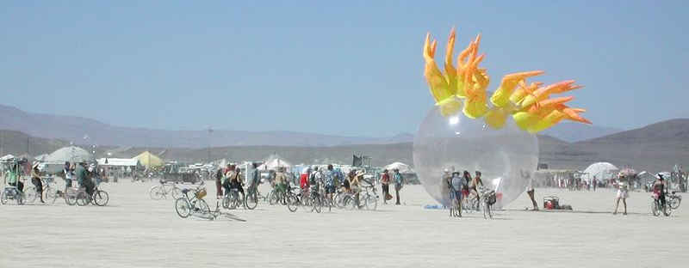
Understanding our Visitors
As Outdoor Recreation Planner we need to understand our visitor so that we can make good decisions about what they expect about the activities in which they are participating.

Slide 29
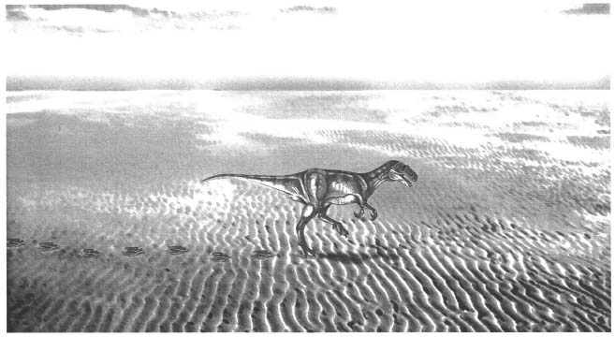
Understanding our Visitors
We know people will head to Wyoming and drive 5 miles down a dirt road to visit the spot where dinosaurs walked on a beach 163 million years ago.

Slide 30

Questions?

