Slide 1
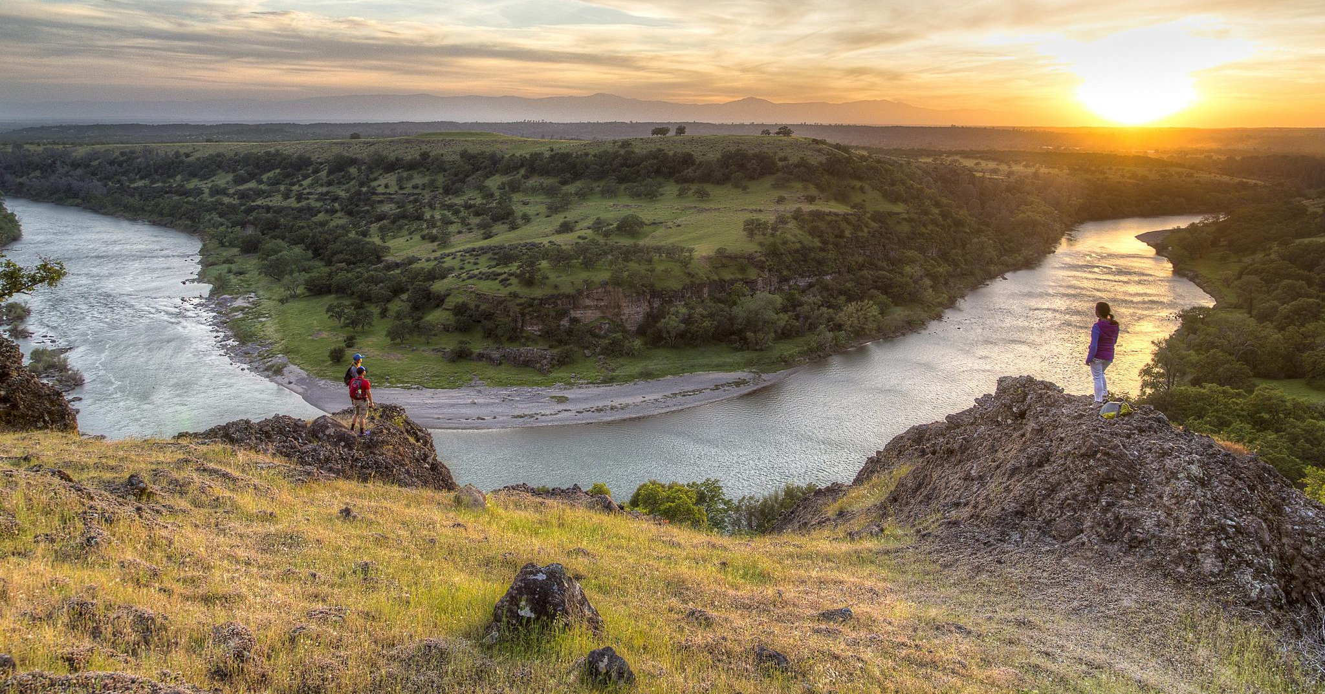
BLM National Recreation and TTM Training for Program Managers – June 5-7, 2018
Supporting Text

Slide 2
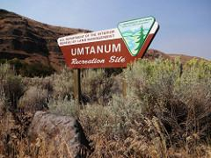
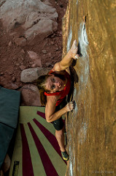
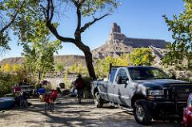
BUSINESS PLANS DEMYSTIFIED
Peggi Brooks
David Ballenger
WO-250
Recreation Permits and Fees Program
Notes:
Overview of session: BLM Business Plans: what are they? What is the “mystical” process to get them approved? This presentation will go over some basic information for those not familiar with BLM’s fee proposal process, talk about some common misconceptions and provide a few tips and tricks to make the approval process just a little bit less mysterious.
Note: This slide deck can be used by anyone here to give presentations or training to field staff. This and the handout are meant as tools for you to use, and will be available on the new Permits and Fees WO-250 Sharepoint Site.

Slide 3
What is a “Business Plan” and Why Do We Need Them?
What are they?
busi·ness plan, noun:
“a document setting out a business’ future objectives and strategies for achieving them”
Why do we need them?
Demonstrates a business need and a public benefit to charge or change fees
Meets the requirements stemming from FLREA (Sec. 6802(b)(1-6) & Sec. 2(c))
Notes:
Handbook pg 2-4 requires that: BLM fee proposals include a comprehensive business and communication plan that thoroughly discusses and explains how fees are consistent with the criteria set forth in the REA, Section 3(b)(1-6), Basis for Recreation Fees, and Section 3(c), Special Considerations.
Quote by Dave: “Creating a business plan is one of the most important steps you will take because the plan serves as your road map. The business plan projects 3-5 years ahead and outlines the route you intend to take to reach its yearly milestones, including revenue projections and budgeting for expenses. A well-thought out plan also helps you to step back and think objectively about the key elements of managing your recreation site(s) and informs your decision-making on a regular basis.”
So a business plan can be much more than just a fee proposal: it can be a road map for successful management of your recreation program as well.

Slide 4
What is a Business Plan and Why Do We Need Them?
Opportunity for public input on recreation fee proposals
Determine the appropriate level of recreation fees
Identify and guide priorities for future expenditures
Consider impacts to underserved communities and the local economy
Provide public transparency on agency’s use of recreation fees
Notes:
Draft business plans: provide the BLM with the opportunity to determine the appropriate level of recreation fees, identify priorities for future expenditures, and consider impacts to underserved communities and the local economy. Most importantly, they provide the BLM with the opportunity to receive stakeholder input on recreation fee proposals and be accountable to the public regarding the agency’s use of their collected recreation fees.

Slide 5
Components of FLREA Business Plans
Executive Summary
Introduction
Background
Project description
Business rationale and justification
Compliance with FLREA
Financial analysis
Market assessment of similar sites in region
Socio-economic & resource impacts from implementing/not implementing plan
Documentation of public participation including RRAC, FRN etc.
States how the public will be kept informed of the uses of fee revenues
Notes:
Here’s a short checklist showing the basic elements of a business plan. This doesn’t have to be an elaborate, 30-page document; you should tailor the plan and include enough info. to address the complexity of the site and how you intend to manage a fee program there. A concise plan can be done in 10 pages, with supplemental materials like graphs and charts placed in exhibits.

Slide 6
Common Mistakes and Some TIPs:
Executive Summary is the most important part – people read this if nothing else!
Don’t “bury the lead”.
Include the where, what, when and why of the fee proposal.
Write for the intended audience: public, stakeholders, RACs, agency leadership, watchdog groups.
Be clear about the kind of amenity fee or ISRP fee proposed for the rec site, and how it meets the criteria in FLREA.
Notes:
Common mistakes and some tips:
Don’t “bury the lead”: this is a business plan containing a fee proposal. Put both the current and proposed fees front and center.
Do include a short executive summary about the plan: The where, what, when and why of the document.
Write for the intended audience: public, stakeholders, R/RACs, agency leadership, watchdog groups.
Be clear about the kind of amenity fee or ISRP fee that is being proposed for the rec site, and why it meets the criteria in FLREA. If in doubt, contact WO-250.

Slide 7
Common Mistakes and Some TIPs:
Don’t try to use a Business Plan as a land use planning document: planning and NEPA must come first.
Permits/fees are a method of implementing the plan and achieving its goals.
Keep the timeframe short:
only include fees for facilities that exist now or will be built in the immediate future (1-3 years)...
...not 5-10 years down the road.
Notes:
Common Mistakes and Some TIPs continued:

Slide 8
Common Mistakes and Some TIPs:
Avoid vague statements and undocumented claims:
“We could not determine the estimated revenue due to lack of information”
Vague: if you can’t show a profit-loss statement, you can’t have a business plan.
Undocumented claims: if we can collect fees, we can pay for all of our expenses, deferred maintenance and capital improvements.
Maybe, but you have to be able to demonstrate this is true through your analysis.
Notes:
Common Mistakes and Some TIPs continued:

Slide 9
Step by Step Process
1. Draft Business Plan
Demonstrates the ‘business rationale’ for charging fees:
Document past and projected future expenses and revenues
Identify the need for future expenditures and shortfalls in traditional funding sources
Discuss fees charged for comparable facilities and services in the area
Notes:
Provide Handout. The next several slides go over the steps needed to build a business plan, and to get it approved. We won’t go thru them all here, but the slides and handout could be good tools for training field staff or informing the public at community or RRAC meetings.
The main emphasis of the fee proposal should be to “Demonstrate the ‘business rationale’ for charging fees”. Do this by showing in words and numbers the need for future expenditures (annual O&M money and funding for enhancements) and shortfalls in traditional funding sources.
Show the proposed fees are warranted based on fees being charged for comparable facilities and services in the area.

Slide 10
Step by Step Process
1. Draft Business Plan, cont’d
Discuss fee collection methods and efficiency
Explore whether and how a fee program can benefit both visitors and BLM management and resource stewardship
Determine the appropriate level of recreation fees
Notes:
Discuss fee collection methods and efficiency (revenues vs. costs of collection).
Establish whether and how a fee program can benefit both visitors and BLM management and resource stewardship. Factor in any management objectives that can be achieved via a fee program; not always just about net proceeds.
Determine the appropriate level of recreation fees and be able to show how this was determined.

Slide 11
Step by Step Process
1. Draft Business Plan, cont’d
Description of new recreation fee area or proposed fee change
Identify the public involvement process employed: site postings, public meetings, outreach efforts, website
Identify RAC/RRAC briefings, field trips, etc.
Demonstrate that fees are just one funding component

Slide 12
Step by Step Process
1. Draft Business Plan, cont’d
Financial analysis of site costs and expected collections
Analysis of existing private and public facilities or services, including fees charged
Consider impacts to underserved communities and the local economy
Demonstrate how fee dollars will be spent, and how the public will be informed of expenditures on an annual basis
Notes:
Emphasize these points

Slide 13
Step by Step Process
2. Review/Approval
Authorized Officer reviews and approves
State Recreation Lead reviews
Washington Office (WO 250) reviews (2-3 weeks)
3. Public review and comment (30+ days)
Outreach
Press Releases, website, social media, onsite postings
Public workshops, contact stakeholder & community groups
Notes:
Outreach: very important to do early and often throughout the planning process!
Press Release
BLM website (https://www.blm.gov/programs/recreation/permits-and-fees/business-plans) and ePlanning
Post notices at local recreation sites
Social media, news articles/stories
Notify identifiable user groups (such as river runners, mountain bikers, ATV riders, cavers, etc.,) and other stakeholders
Review and categorize/summarize comments
Modify business plan, based on public comments, as appropriate

Slide 14
Step by Step Process
Schedule Recreation Resource Advisory Council (R/RAC) presentation - for proposals to establish/modify/or eliminate RUPs and Special Area fees.
5. Prepare Federal Register Notice package – for new fees only. Publish 6 months in advance of charging fees.
6. Prepare and post the Final Business Plan
7. Implement new/modified fees after final plan is signed and posted online.
Notes:
4. Schedule Recreation Resource Advisory Council (R/RAC) presentation - for proposals to establish/modify/or eliminate RUPs and Special Area fees.
Ensure Federal Register Notice is published at least 30 days in advance of the meeting, and indicates recreation fees will be discussed.
Provide RAC with draft business plan and documentation of “general public support” in advance of the meeting.
Deliver RAC presentation. RAC will either recommend to implement the fee, request that the BLM modify the proposal or disapprove entirely.
5. For New Fees only: Prepare Federal Register Notice package - must be published six months in advance of any new Recreation Fee implementation. See IM-2018-028 for FRN packaging and surnaming requirements.
6. Prepare and post the Final Business Plan. Include:
A summary of all public outreach efforts conducted for draft business plan;
A summary of public comments received;
A summary of the RAC’s recommendation on the fee proposal; and
The authorized officer’s signature approving the implementation of the business plan on a specific date.
Final business plans must remain available on the appropriate BLM websites for public viewing: https://www.blm.gov/programs/recreation/permits-and-fees/business-plans and ePlanning
7. Implement new/modified fees as soon as the final business plan is signed and posted (or 6 months after FRN is published if applicable). Don’t forget to set up a new Commodity Subject Action (Form 1310-20) in CBS for depositing funds.

Slide 15
TIPS:
Do: Document the uses of fee revenues; take before and after photos to show enhancements made to benefit the public!
Do: Collect public comments on fee envelopes etc. regarding value for fees paid - useful for next business plan update!
Don’t: Wait too long before updating your business plan and adjusting prices to reflect comparables and rising operating costs!
Notes:
Things to do after the new fees are implemented: Reference the need for documentation for: compliance with REA, Triennial Report to Congress, to address budget office concerns about spending carryover balances etc.

Slide 16
What’s in YOUR
State Business Plan Portfolio?
Which states are working on updating or crafting new plans?
See and post templates and related tools on Sharepoint at https://doiportal.doi.net/blm/WO200/250/Permitting/Pages/Overview.aspx
Post online at BLM.gov Permits and Fees webpage
https://www.blm.gov/programs/recreation/permits-and-fees/business-plans
Recent examples of R/RAC approved business plans:
Guffy Gorge, Red Rock Canyon
5 UT Business Plans
What are the needs for training/guidance documents/process improvements?
Notes:
See and post Business Plan templates and related tools on the new WO-250 Sharepoint site (under development) at:
Https://doiportal.doi.net/blm/WO200/250/Permitting/Pages/Overview.aspx
Discuss UT workshop, show agenda, lessons learned/BMP’s
UT held a weeklong bus. plan workshop in Dec. 2017. F.O.’s were tasked with homework to do in advance: State Office assisted by prepping financial/budget info., providing cost estimation for facilities and services like building a new accessible campsite, buying and installing a vault toilet, improving a boat ramp, installing new signage etc. Participants were given presentations on each of the major components of a bus. plan by SME’s, then asked to work on that chapter of their own bus. plan then and there. The goal was, by the end of the week, to have draft bus. plans with something written for most of the major headings. Lots of resources were on hand to assist with analyzing and writing the plans. WO-250 committed to quickly reviewing the plans once submitted.
Was it a success? It wasn’t easy to do, but the end result is that 5 new or updated bus. plans were crafted, reviewed, put out for public review, presented to the RRAC, and approved by late May 2018. So in less than 6 months UT now has approved fees for 5 field offices! Another 5 bus. plans are in the works.

Slide 17
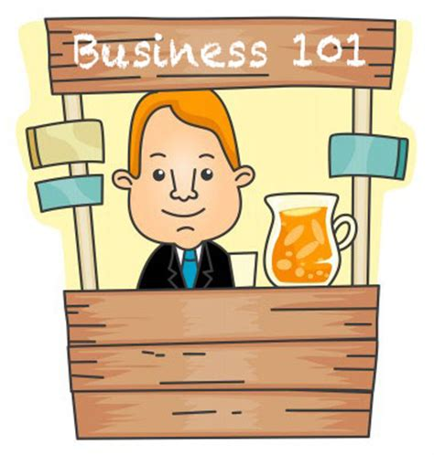
Common Misconceptions
I’m an ORP, not an MBA – how can I write a Business Plan?
Basic Questions:
What’s the cost to run it?
How much can I earn?
Is it worth the effort?
Notes:
Demystifying Common Misconceptions
’m an ORP, not an MBA – how can I write a Business Plan?
a business degree is not needed; keep it simple, write in layman’s terms, focus on demonstrating a logical rationale for charging or changing fees. E.g. If you were going to open a lemonade stand, what would it cost you to run it, how much could you earn and would it be worth the effort?

Slide 18
Misconceptions
ATB passes take away a lot of our revenue…
Do they? [include in financial analysis to know for sure]
Passes can also be a good source of revenue
Non-monetary benefits: expand access, grow stewardship etc.
Nobody reads these plans, why should I bother?
Public/stakeholder groups want to know the info.
Helps leadership to support and defend BLM’s fee program
Post on BLM.gov as part of FRN and transparency
Notes:
Demystifying Common Misconceptions
ATB passes take away a lot of our revenue: do they? Have you accounted for this in your financial analysis? Passes can also be a good source of revenue (over $1 mil in just senior pass sales in 2017!). Non-monetary benefits of the pass program include expanding access to youth, veterans, disadvantaged visitors; encouraging repeat visitors with a stewardship ethic, possible source of volunteers, bringing friends and family along at full price etc.
Think of passes as a way to expand access and grow program support.
Nobody reads these plans, why should I bother? Not true! The public/stakeholder groups want to know the info. contained in the plans. Requirement to post on BLM.gov as part of FRN and transparency. Helps leadership to support and defend BLM’s fee program.

Slide 19
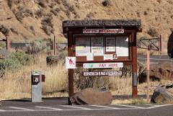
Misconceptions:
Fee collection isn’t worth the effort; we don’t have staff to run it and people will just steal the iron rangers anyway.
Notes:
Demystifying Common Misconceptions
Fee collection isn’t worth the effort; we don’t have staff to run it and people will just steal the iron rangers anyway - stat’s on fee revenues by state as a percentage of 1220 recreation budget shows that rec fees are becoming increasingly important to a field office or district’s overall funding strategy. Using Rec.gov, e-commerce, check scanners can help reduce labor costs.

Slide 20
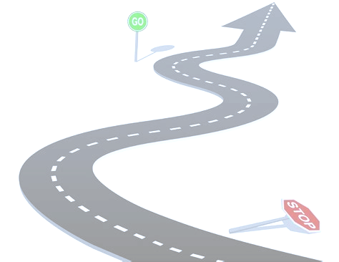
Business Plan Bottom Line:
Fee collection CAN BE worth the effort…
but only a comprehensive Business Plan will tell us for sure, and
provide the roadmap to get us there
Collecting fees is only half the story…spending the money (and telling the story) is the other half
Notes:
Bottom line (summary)
Fee collection CAN BE worth the effort…
but only a comprehensive Business Plan will tell us for sure, and
provide the roadmap to get us there
Collecting fees is only half the story...spending the money (and communicating to the public) is the other half; BLM does the first part well (fee collection), needs improvement on the 2nd part. Call to action? Dave Ballenger has some additional information on the importance of spending fee revenues and tracking expenditures…..

Slide 21
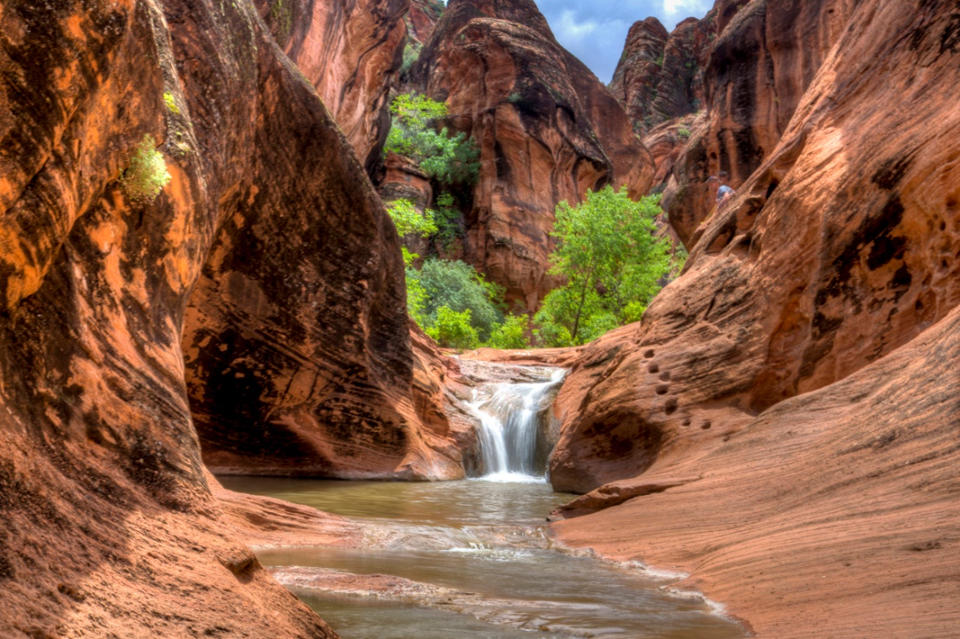
Questions?
Notes:
Any questions on this part of the presentation?

