Slide 1
1232 Fees
Carryover, Expenditures, National & Public reporting
Supporting Text

Slide 2
Trends since 2008 for:
Collections
Expenditures
Carryover

Slide 3
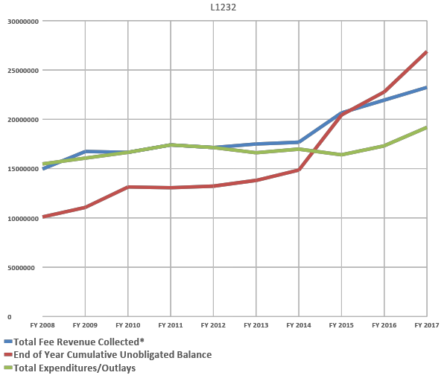

Slide 4
Tableau Reports
Demo
https://doiportal.doi.net/blm/WO200/Budget/SitePages/BLM%20Budget%20Site.aspx
Explore the 2018 Cost Analysis Report and
the 2018 Consumable Budget Report.

Slide 5
Reporting
Goals:
1232 Funds expended according to REA
Business Plan direction – follow through (accountability)
Monitoring of spending plans
Reducing carryover balances
Easy public reporting – template creation
Your ideas!

Slide 7
