Slide 1
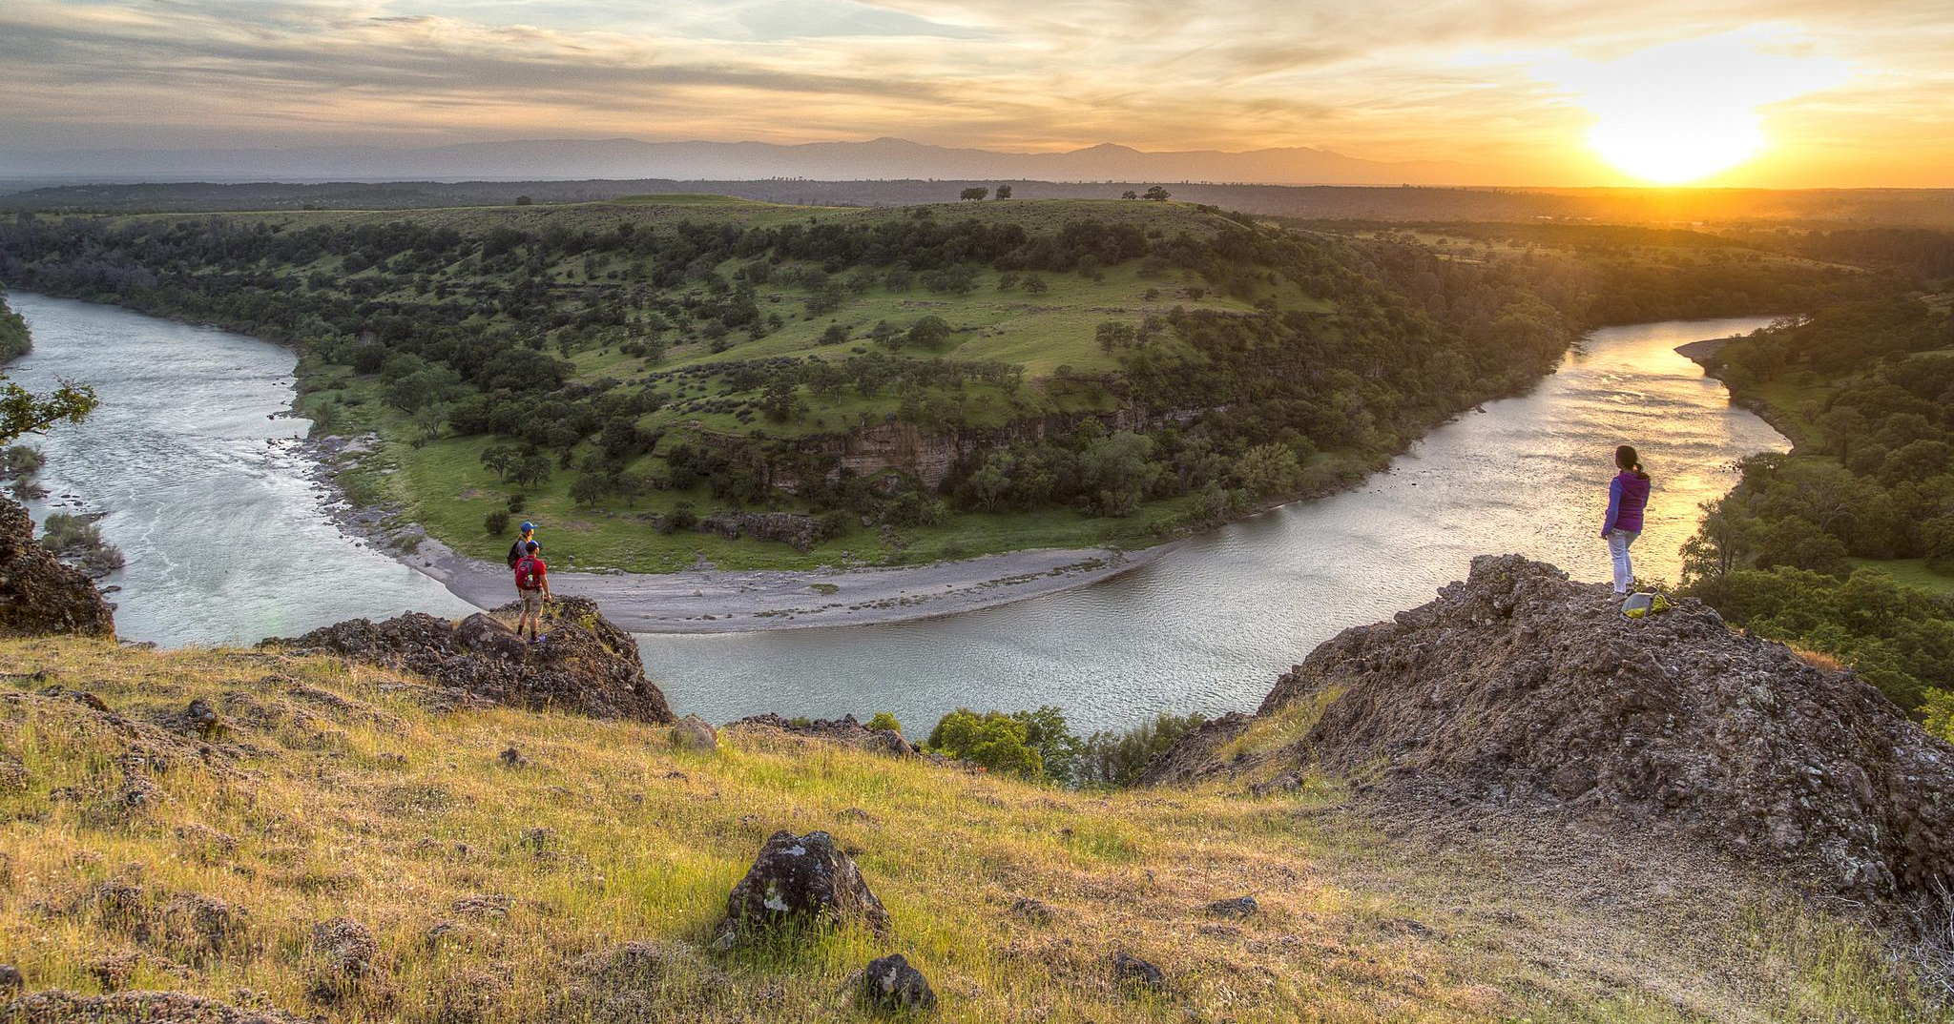
Mobile Payment Opportunities
E-commerce solutions for BLM Field Sites
Supporting Text
Notes:
The BLM’s recreation sites have varying infrastructure in terms of wireless connectivity, high speed internet, employee presence and internal business rules.
These variables mean there is (currently) no one-size-fits-all digital solution to make online reservations, apply for permits and lotteries, and enable payment of recreation fees by credit card, as well as redeeming permits and passes on mobile devices.
But we’re getting there….soon!

Slide 2
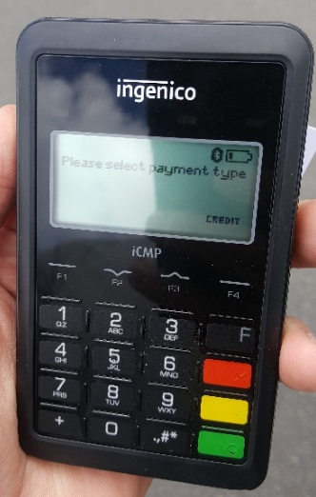
E-Commerce Solutions
We will discuss three options:
Treasury Public App
Treasury Mobile Point of Sale
Your Pass Now (NIC)
Notes:
While we can only touch briefly here about some of the different options being explored, know that the WO, NOC and state and field offices are working on several fronts to develop a toolbox of new e-commerce solutions for the field to use.
Here are a few of several being explored (name from list)

Slide 3
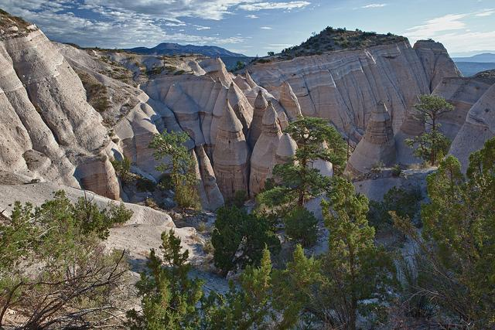
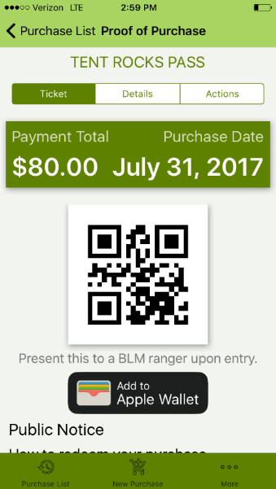
Treasury Public App
A mobile app that visitors download onto their phones to pre-pay fees
Can reduce the handling of cash at recreation sites, save employee labor, and provide the public with a convenient electronic payment platform
Notes:
The first option is the Treasury Public App
This solution depends on the public downloading and using the app to pre-pay fees
Use of this app will reduce the handling of cash at recreation sites, save employee labor inputting payments into CBS, provide added security to financial transactions, and provide the public with a convenient 24 hour electronic payment platform.
Currently live on your app store and available for Kasha-Katuwe

Slide 4
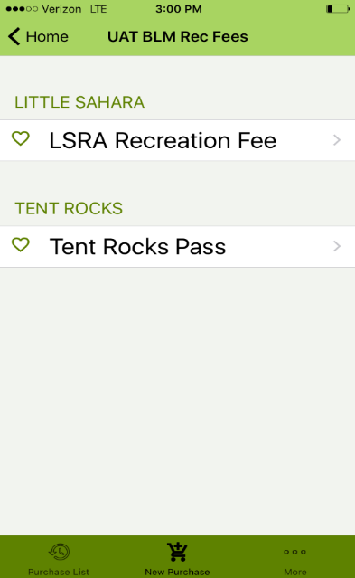
Treasury Public App
How does it work?
Customer downloads the app and uses a credit card to pre-pay their recreation fee
App is customized for each of BLM’s recreation sites
The agency fee collector uses a cell phone to scan the QR code, validating the purchase.
Notes:
The customer downloads the app from their respective app store and using a credit card can then pre-pay (purchase their recreation fee before arriving at the site
The customer receives an email confirmation and presents a generated QR code with the app as proof of purchase when arriving at the site (may alternatively print the email)
The agency fee collector uses a cell phone to scan the QR code, validating the purchase.
If desired the site can issue a hang-tag or other proof of purchase to the vehicle

Slide 5
Mobile Point of Sale
A mobile payment system that connects to pay.gov and CBS through a secure hotspot or cell phone signal
Enables BLM staff to take a credit card payment in the field using a handheld credit card reader
Notes:
Treasury Mobile Point of Sale (POS)
Customers credit card is inserted into the Ingenico terminal (credit card reader) and connects via Bluetooth to the agency cell phone (held by the fee collector).
The Agency cell phone connects to Treasury’s pay.gov; Payments are processed through pay.gov and CBS then pulls the transactions from pay.gov and creates a paid order in CBS to reflect the deposit into the recreation site account.
Customer receives an emailed receipt
Fee collector provides a hangtag, fee envelope or other site specific proof of purchase.
Not useable for unstaffed sites or those without reliable cell phone signal or WIFI.

Slide 6
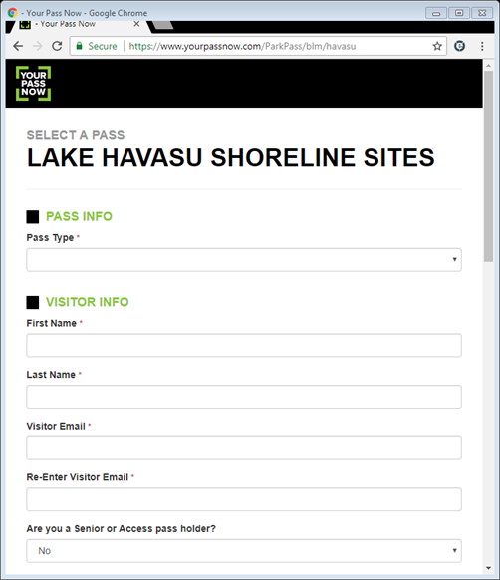
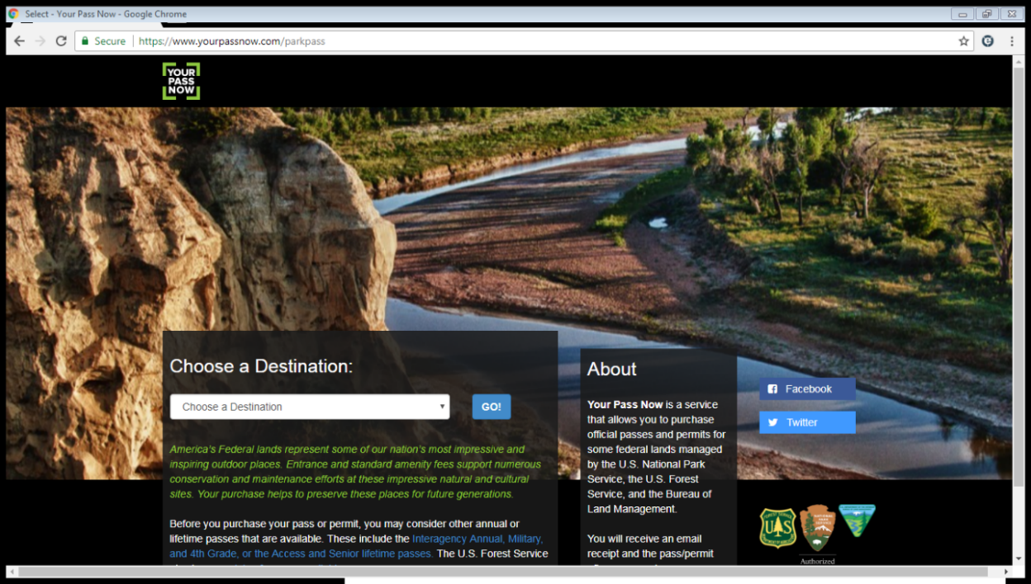
NIC: Your Pass Now
A digital platform for the sale of passes including entrance fees, single, multi-day, and seasonal passes and permits
Notes:
Your Pass Now (via NIC):
Is a digital platform for the sale of passes and permits that includes mobile phones, tablets and desktop computers.
Can provide an alternative fee collection method at sites without staffed fee booths and that do only spot-checks for fee compliance.
User visits Your Pass Now website and purchases the pass/permit, pays the recreation fee (either at home or onsite from mobile device). User receives an email with a QR code. The email and QR code are printed and displayed in the visitor’s vehicle window when visiting the site. Agency staff use a smartphone to scan and validate the QR code through the window.
Currently piloting at National Parks, USFS, and 2 BLM units. Unlike the Treasury options, this does charge a transaction fee to the customer or agency.
Will become the standard digital payment service by Rec.gov’s new contractor, since NIC company is a sub to Booz Allen Hamilton

Slide 7
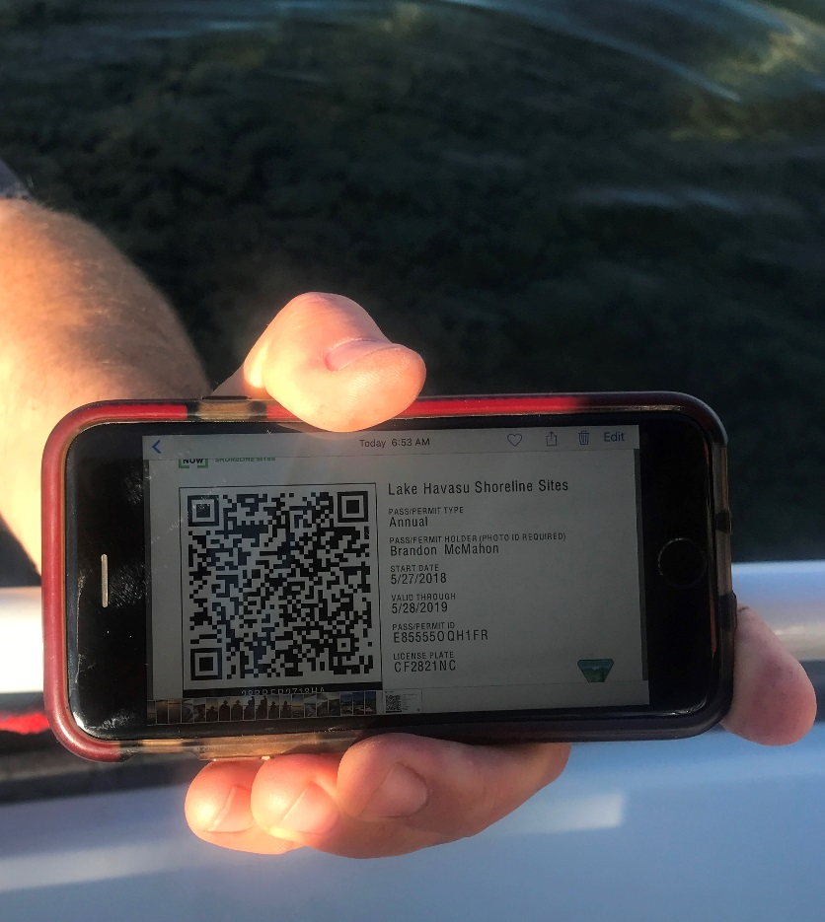
NIC: Your Pass Now
Visitors enter their details on a website to pre-purchase a pass - NIC charges 10% of the fee cost, which is passed on to the user
Can be used at both staffed and not-staffed entry stations and fee booths
Reduce labor costs, increase fee compliance, and provides improved internal reporting
Notes:
Your Pass Now (via NIC):
Is a digital platform for the sale of passes and permits that includes mobile phones, tablets and desktop computers.
Can provide an alternative fee collection method at sites without staffed fee booths and that do only spot-checks for fee compliance.
User visits Your Pass Now website and purchases the pass/permit, pays the recreation fee (either at home or onsite from mobile device). User receives an email with a QR code. The email and QR code are printed and displayed in the visitor’s vehicle window when visiting the site. Agency staff use a smartphone to scan and validate the QR code through the window.
Currently piloting at National Parks, USFS, and 2 BLM units. Unlike the Treasury options, this does charge a transaction fee to the customer or agency.
Will become the standard digital payment service by Rec.gov’s new contractor, since NIC company is a sub to Booz Allen Hamilton

Slide 8
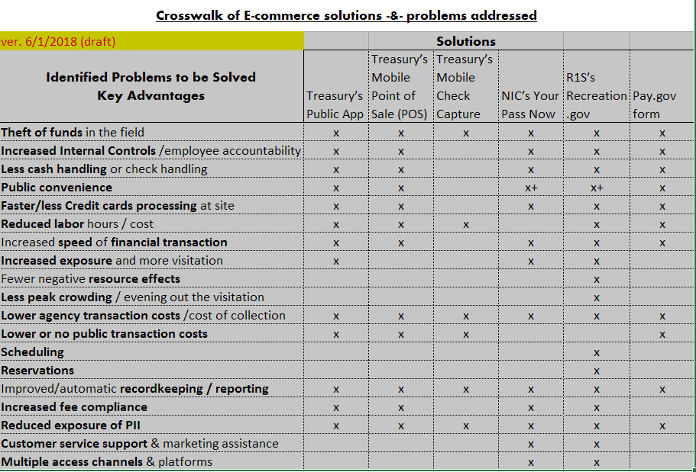
Notes:
Every site is different – before jumping on a solution, evaluate your needs, what each service can offer and what would work best for you!

Slide 9
Questions?
Notes:
While we can only touch briefly here about some of the different options being explored, know that the WO, NOC and state and field offices are working on several fronts to develop a toolbox of new e-commerce solutions for the field to use.
Here are a few of several being explored (name from list)

Slide 10
How to get on board
Commitment:
Commitment from FM & AFM
State Rec lead participation
Dedicated local office Point of Contact
Day lighted Process
Correct CBS coding?
Updated RMIS site info?
Recent Business Plan?
Public summary of Fees and Expenditures?
Updated Rec.gov description and photos
Proper use of the America The Beautiful Pass series

