Slide 1
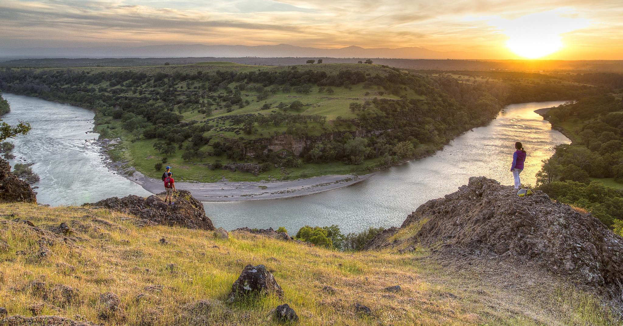
IM#___ Sec. Orders 3356, 3366
Streamlining the SRP process
Supporting Text

Slide 2
Pre-application consultation
Recommended! Every time, every place, everywhere.
Help identify the best way to facilitate appropriate recreational uses and to streamline the SRP process.
Attachment 1:
Appendix B-2 Decision Tree for Special Recreation Permitting (H-2930-1)

Slide 3
Decision Tree For SRPs (appendix B2)
Determine land use plan conformance
Determine if an SRP is required
Is it commercial?
Is it competitive?
Is a vending permit necessary and appropriate?
Is an ISRP appropriate?
Is an organized group permit required?
See - Matrix for evaluating proposed Organized Group activity

Slide 4
SRP processing moratoriums
Secretarial Order 3356, calls on the BLM to “…enhance and expand public access to lands and waters administered by the Department-lands and waters owned by all Americans-for hunting, fishing, recreational shooting, and other forms of outdoor recreation.”
“SRPs are a fundamental use authorization allowing the public to use their public lands.”
SRP processing moratoriums have to be communicated to Division Chief of RVS through State Directors.

Slide 5
SRP Alternatives
Waivers and Letters of Authorization
43 CFR 2932.5 (Definitions)
43 CFR 2932.11 (When do I need an SRP?)
43 CFR 2932.12 (Waiving requirement for SRPs)
43 CFR 2932.34 (Waiving SRP fees)
Letter of Agreement
Documents no permit is required
Outlines parameters and expectations

Slide 6
SRP Streamlining Implementation
Provide adequate staffing and training for… processing, administration, and monitoring of SRPs
Prioritize hiring and training of Park Rangers and Outdoor Recreation Planners involved with administering recreation permits.
WO-250 & NTC will provide Course # 8300-14 Recreation Permits on Public Lands, a minimum of three times per year.
Local Officials will make this training a high priority for staff and managers dealing with SRP administration, and, support subject matter experts to provide the training.

Slide 7
SRP Streamlining Implementation
B. Emphasize use of programmatic NEPA for SRPs and increase use of the SRP categorical exclusion (CX).
1. Existing & Adequate NEPA documentation = DNA
2. Programmatic EAs may be prepared for a geographic area to cover similar uses
3. SRP CX amended analysis report. CX use is not prohibited in 43 CFR 2932.5 (1) and (3) areas.
Only for establishing management controls described in (2) - ISRP requirement

Slide 8
SRP Streamlining Implementation
43 CFR 2932.5 Definitions:
Special area means:
(1) An area officially designated by statute, or by Presidential or Secretarial order;
(2) An area for which BLM determines that the resources require special management and control measures for their protection; or
(3) An area covered by joint agreement between BLM and a State under Title II of the Sikes Act (16 U.S.C. 670a et seq.)

Slide 9
SRP Streamlining Implementation
C. 2930-001 Electronic Form, now available in fillable PDF document format.
https://www.blm.gov/services/electronic-forms

Slide 10
SRP Streamlining Implementation
D. Electronic document submittal
Offices are directed to accept electronic submissions of SRP applications, post use reports, and other required materials, subject to compliance with the Privacy Act (5 U.S.C. § 552a) and compatibility with BLM computer programs.

Slide 11
SRP Streamlining Implementation
E. Use multiyear permits (up to 10 years) whenever an established permittee has demonstrated satisfactory performance. H-2930-1 Chapter 1, page 16, Permit Duration.
1. Demonstrated ability to meet permit terms & stipulations
BLM ensured terms and stipulations are appropriate
Must be validated annually (completed: post-use reports, pre-paid annual fees, bonds, insurance, licenses, acceptable annual performance rating)
AOs can modify a multiyear permit at any time
Permittee can request changes to a multiyear permit by submitting an updated operating plan or other material.

Slide 12
SRP Streamlining Implementation
F. Pilot program in Nevada and Wyoming – multi office/district permits
1. Establishing common best management practices in conjunction with the state agencies,
2. Establishing guidelines for determining the lead Authorized Officer and delegation of control for multi-office SRPs,
3. Creating new standard permit stipulations for increased consistency across office and District boundaries,
4. Establishing guidelines and standard operating procedures for the authorization of multi-Office permits.

Slide 13
SRP Streamlining Implementation
Figure 1. STEPS FOR ISSUING COMMERCIAL, COMPETITIVE, AND ORGANIZED GROUP SPECIAL RECREATION PERMITS
Step | Responsible Person | Schedule | Action
1 | Authorized Officer | As appropriate. | Provides information and pre-application consultation with affected users about permit requirements.
2 | Authorized Officer | 180 days or more before the desired use date. | Provides SRP applications, other information (maps, pamphlets, stipulations), and requirements for operating plans and other supplemental information, on request.
3 | Applicant | At least 180 days before the desired use date, unless a shorter period is approved or a longer period is required. | Contacts local BLM office regarding requirement for and availability of permits before making use of the public lands and related waters. Submits completed application and required supplemental information to the appropriate BLM office.
4 | Authorized Officer | Within 30 days of receipt of application. | Reviews application. Determines completeness, consistency with planning, level of monitoring required, past performance, or bills due. May involve interdisciplinary team. May reject the application at this stage or require additional materials.
5 | Authorized Officer | Within 30 days of receipt of all required application materials. | Notifies applicant if substantial processing work is involved owing to extensive NEPA consultation, monitoring, or other requirements, and if cost recovery charges will apply.
6 | Authorized Officer and Applicant | As appropriate. | Coordinate on any problems with the application, discuss monitoring strategy, and discuss permittee coordination with other landowners and managers. Agency conducts environmental analysis, tribal consultation, and public involvement as necessary.
7 | Authorized Officer | Upon completion of permit processing, or at least 31 days before desired use date. | Provides written notification of approval/ disapproval, requests additional documents, such as certificate of insurance or performance bond, and requests full or partial payment of estimated fees.
8 | Applicant | At least 10 business days before desired use date. | Provides policy or certificate of insurance (as appropriate), bond (if required), other requested information, and full or partial payment of fees.
9 | Authorized Officer | As appropriate before desired use date. | Issues the approved permit with any special stipulations; also issues the required reporting forms (daily trip logs and post-use report).
10 | Permittee | As established in permit stipulations (generally within 30 days after use). | Provides post-use report.
11 | Authorized Officer | No later than 90 days after operating season, or at end of permit term. | Calculates total fees due and provides a final billing statement, as applicable. Provides written performance evaluation to permittee.
G. Applicant/Permittee Outreach
Communicate the Process
Figure 1, Page 1-13, Chapter 1, H-2930-1
“Steps for Issuing Commercial, Competitive, and Organized Group SRPs”
(attachment 2)

Slide 14
SRP Streamlining Implementation
G. Applicant & Permittee Outreach
2. Conduct outreach activities
Outfitters & Guides
Prospective permittees
Veterans and Youth
Utilize and customize the tools provided in the share point
SRP Power Point
Talking points

Slide 15
SRP Streamlining Implementation
G. Applicant & Permittee Outreach
3. Quarterly reports via the Education share point reporting tool
Record outreach, meetings, trainings on the share point form
See item #8 – Permitting Workshops Given

Slide 16
SRP Outreach

Slide 17
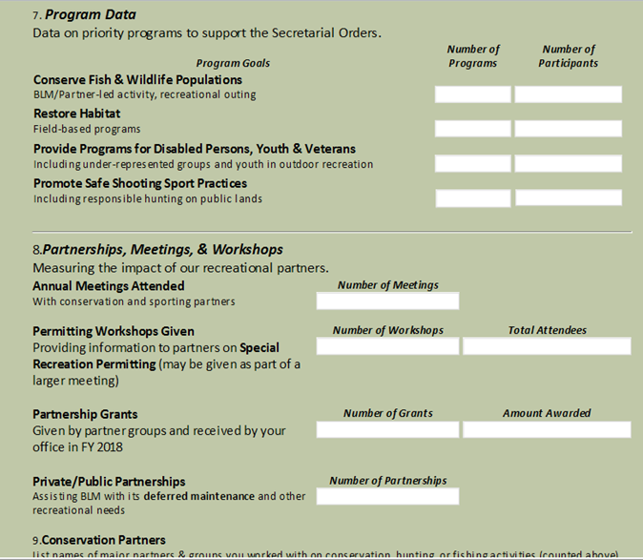
SRP Outreach

Slide 18
SRP Outreach
http://teamspace/sites-wo/wo170nlc/WO172/FY_2018_Data/Hunting_Fishing_Access_Data/Forms/AllItems.aspx

Slide 19
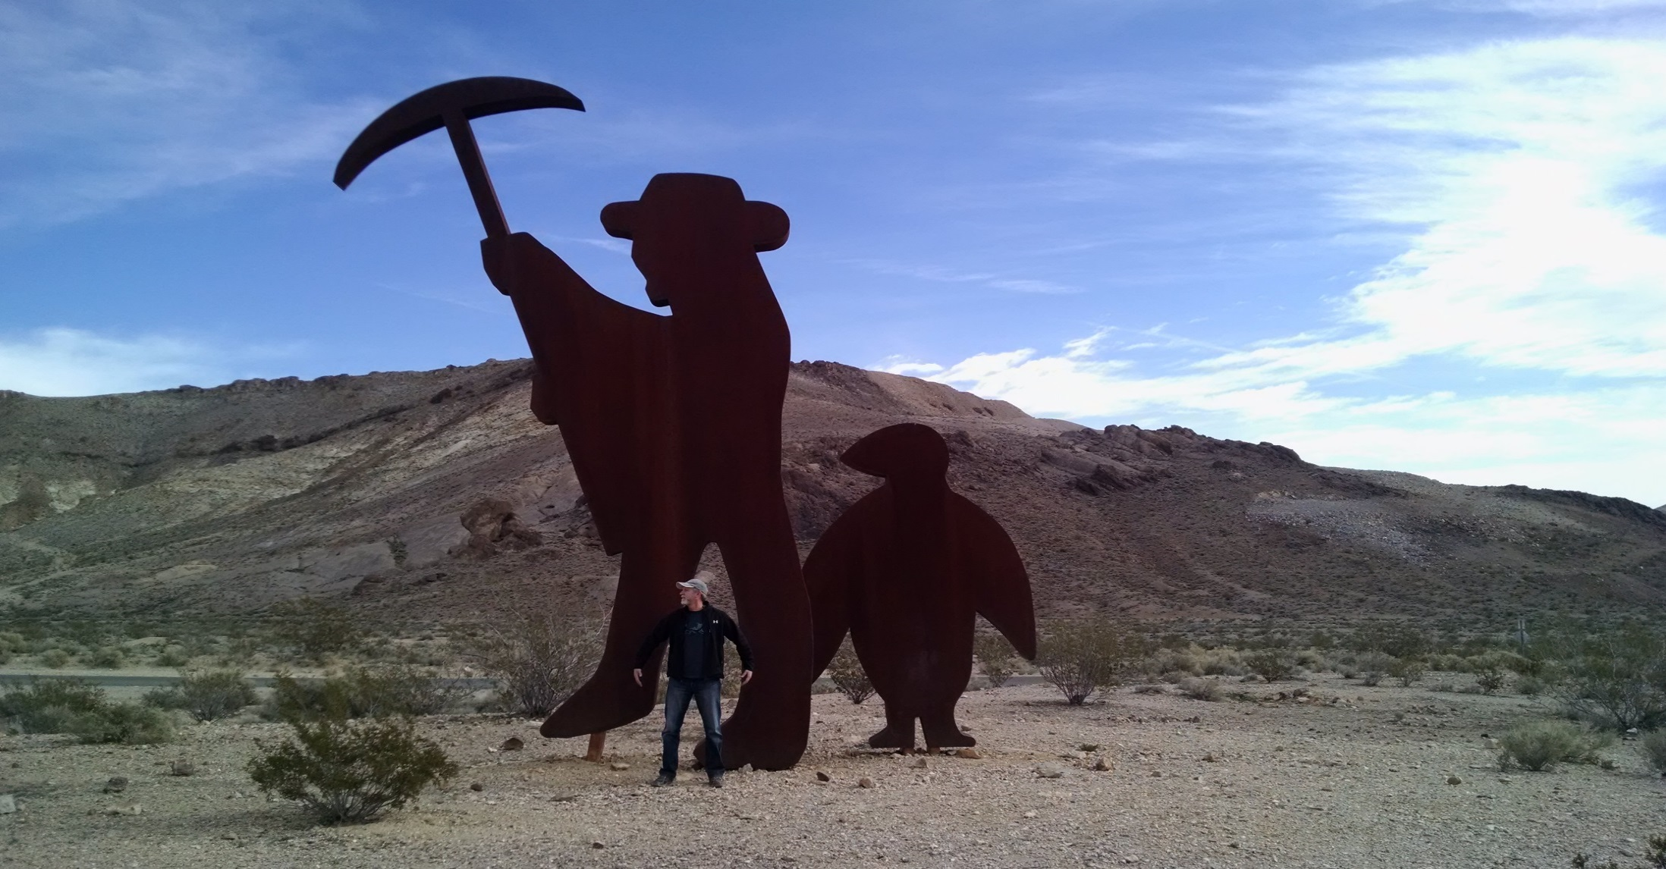
Questions???
Supporting Text

