Slide 1
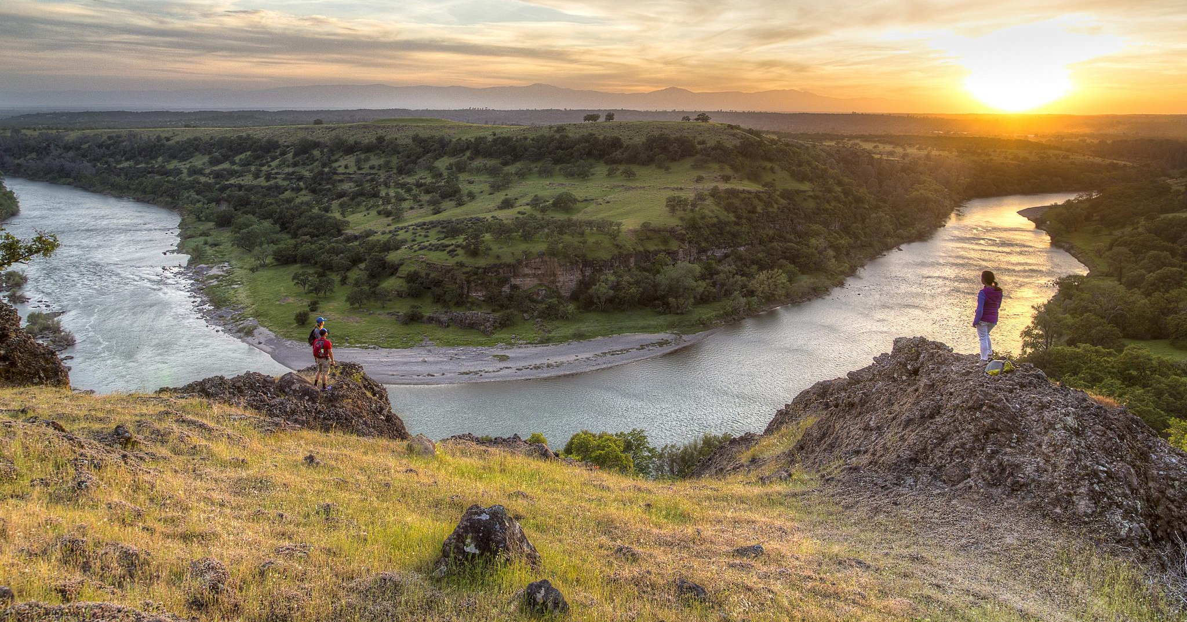
The Gig economy
What do the sharing apps mean for managing SRPs?
Supporting Text

Slide 2
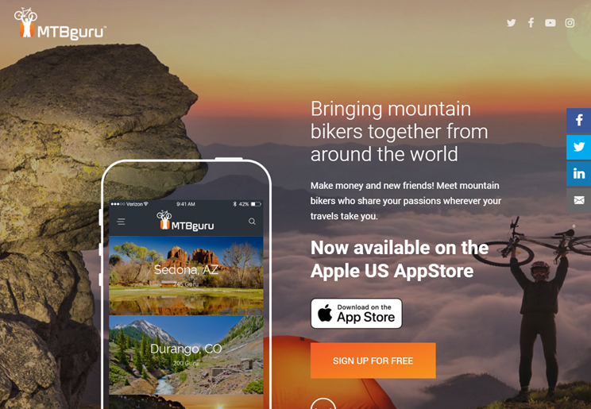
What are they?

Slide 3
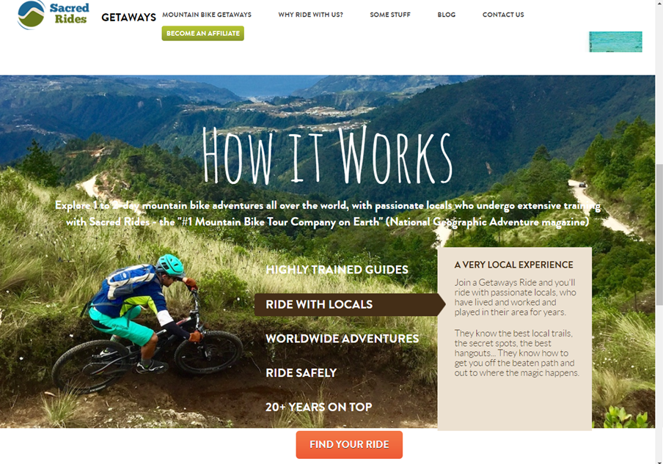
What are they?

Slide 4
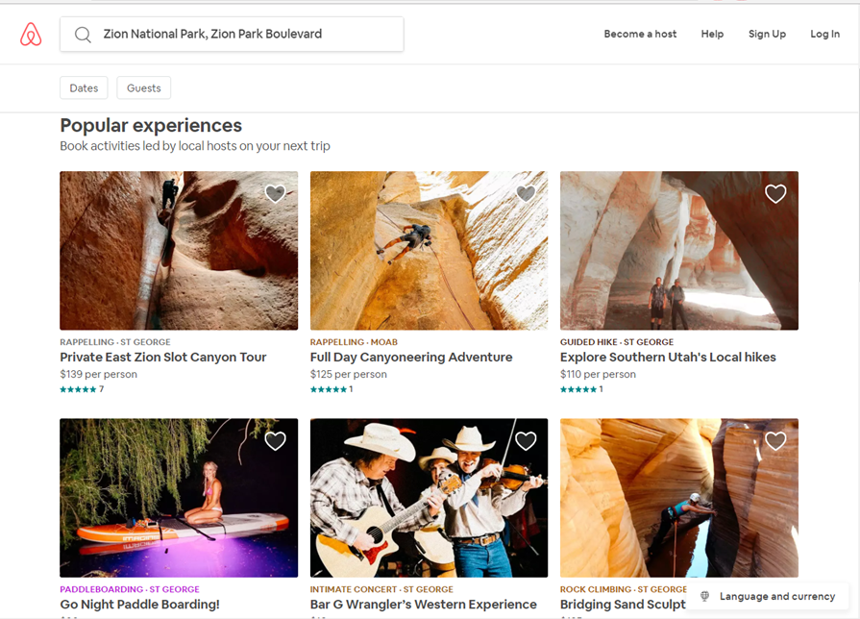
What are they?

Slide 5
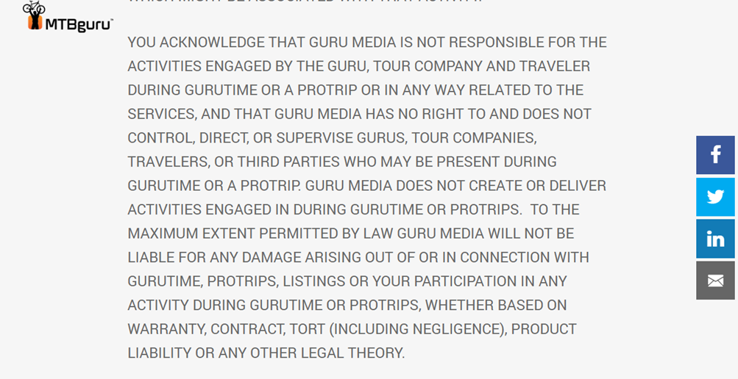
Who’s responsible?

Slide 6
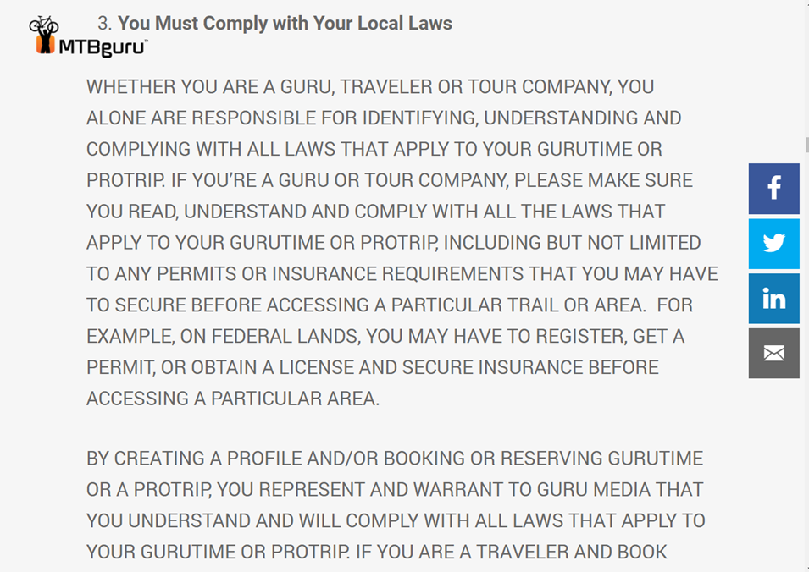
Who’s responsible?

Slide 7
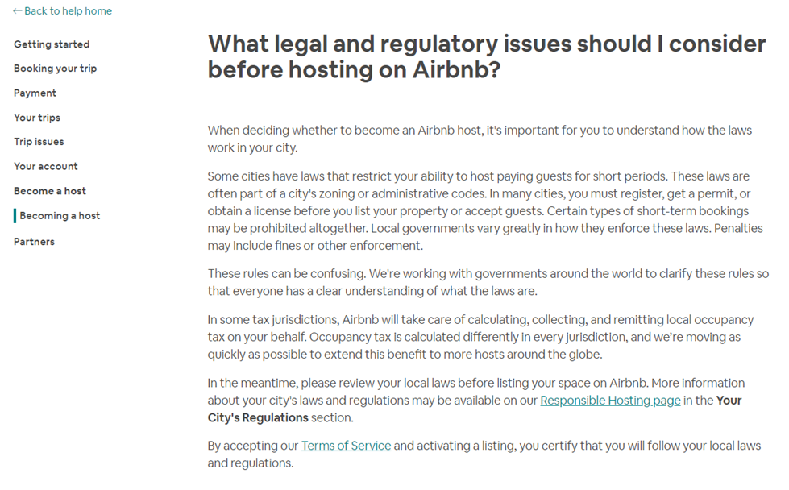
Who’s responsible?

Slide 8
What to do… What to do... What to do…
Find the activity
Word of mouth, online resources, other permittees.
2. Determine if this is recreation related
Lands & Realty? Filming?
3. Is this is something you would issue and SRP for?
Casual use?
Notes:
charges a fee, posting/ advertising, liability waivers, insurance coverage?

Slide 9
Now a word from our Sponsor
Why do we issue SRPs?
Support recreation planning goals.
Manage visitor use.
Provide for public health and safety.
Reduce user conflicts.
Reduce resource conflicts and damage.
Educate/communicate with the public.
Manage BLM workload.
Get a return for the commercial use of public land.

Slide 10
Now a word from our Sponsor
What are the…
Physical
Social
Operational
…setting characteristics?
How does the activity fit the current plan?

Slide 11
Our Sponsor says…
Have a plan - Execute the plan
Planning
SRPs are not a separate activity. They are a means to implement recreation goals and objectives.
Permits must serve the public interest.
Make allocation decisions in LUP process, not one application at a time.

Slide 12
What to do… What to do... What to do…
SRP’s should support the LUP or RAMP
Is the activity supporting your recreation planning goals?
No? Yes? (what recreation planning goals?)
Does it support the outcomes and experiences?
This question defines the next move
NEPA completed for the activity type or use?
No - Should you consider a programmatic approach?
Yes – What are the stipulations and parameters needed?
Notes:
Build a house, pick your specialty

Slide 13
What to do… What to do... What to do…
Case Study:
St. George FO – Zion Tiny Homes LLC
Dispersed camping
Limited to 14 days in any one location
SRP came before the plan

Slide 14
Feedback
1) BLM is undercutting similar operations on private property. 3% of gross is overly cheap and uncompetitive.
2) Public doesn’t want to see commercial rentals when out mountain biking, ATV riding, trail running, camping, etc..
3) The lodging rental is taking away dispersed camping opportunities that the public depends on.
4) Public lands have been annexed by a municipality are particularly against this type of operation.
5) Local and State municipalities are more equipped to regulate these operations, and may depend on fees and tax revenue (particularly in gateway communities).
6) Local and State municipalities may be the end recipients of associated waste water/ sewage/ trash disposal.
Notes:
Contrast - Moab example in designated campgrounds

Slide 15
Consider all factors
Competition with private landowners
Competition with local governments
Complete NEPA 1st… then… consider SRP 2nd
14 day stay limit, or Land & Realty 2920 permit
1 year permits to start
Effects on:
Visual Resources
Recreation Setting Characteristics

