Slide 1
On-line SRPs
Applications, Communications, Approval, Management and Reporting
Supporting Text

Slide 2
What’s in a name?
SPATS –
Science Permit & Application Tracking System
GeoAPS –
Geospatial Authorization and Permit System

Slide 3
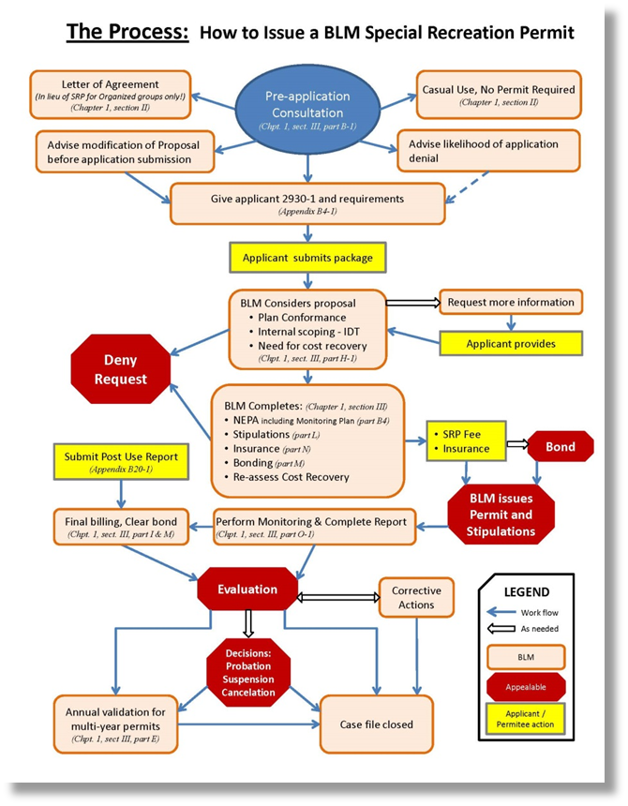

Slide 4
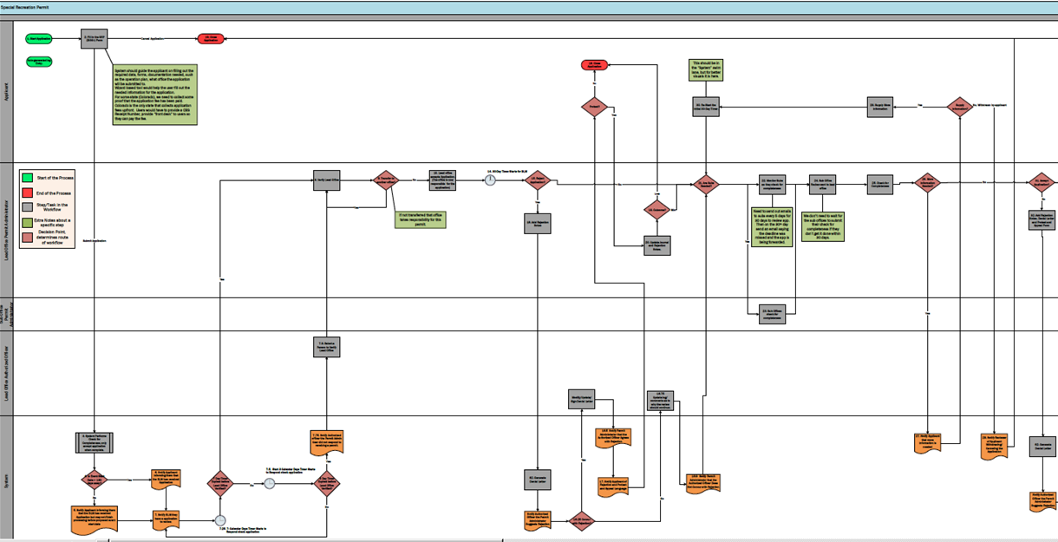
Workflow 1/3

Slide 5
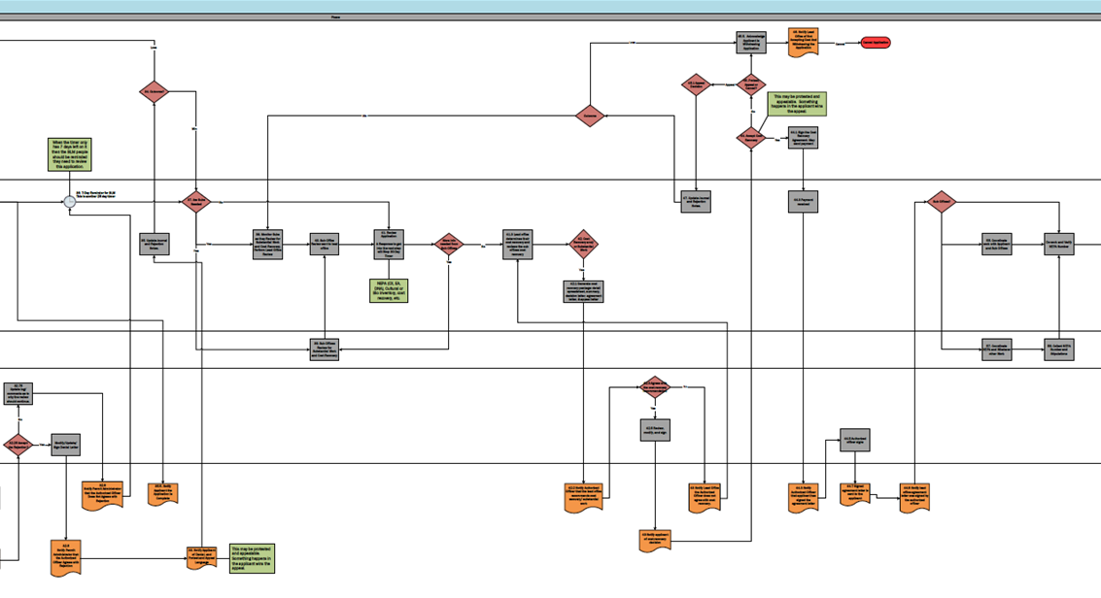
Workflow 2/3

Slide 6
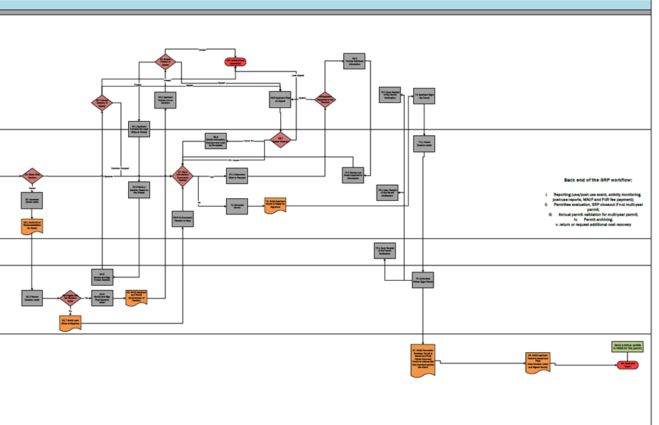
Workflow 3/3

Slide 7
Special Recreation Permit
2. Fill in the SRP
2930-1 Form
19. Close Application
Phase
45.5. Acknowledge Applicant is Withdrawing Application
46. Notify Lead Office of Not
1. Start Application
Cancel Application
Loss
Loss
Accepting Cost And
Withdrawing the Cancel ^{Cancel Application}
Auto-generated log Entry.
System should guide the applicant on filling out the required data, forms, documentation needed, such as the operation plan, what office the application will be submitted to.
Wizard based tool would help the user fill out the
needed information for the application.
For some state (Colorado), we need to collect some proof that the application fee has been paid.
Colorado is the only state that collects application
fees upfront. Users would have to provide a CBS Receipt Number, provide “front desk” to users so they can pay the fee.
19. Close Application
This should be in the “System” swim lane, but for better visuals it is here.
45.1 Appeal Decision
45. Protest,
Appeal Appeal or Cancel?
Application
64. Accept, Protest, or
Appeal
Accept
65. Cancel/Close Application
69.3
Provide Additional Information
Applicant
No
30. Re-Start the Initial 30-Day Timer.
28. Supply More Information
Yes
Supply No, Withdrawn by applicant
34. Outcome?
Win
Outcome
No
This may be protested and appealable. Something happens in the applicant wins the appeal.
Accept
Appeal
Lose Appeal
Protest?
Yes
Information?
Win
44.1 Sign the Cost
44. Accept Cost Recovery
64.7 Accept Decision or
Appeal
Protest
63.1 Applicant Follows Link to
Decision
Appeal
69.5 Applicant Files Appeal
69 Applicant Responds to the Request
75.1 Upon Receipt of the Permit Notification
74. Applicant Signs the Permit
14. 30-Day Timer Starts for BLM
When the timer only has 7 days left on it then the BLM people should be reminded they need to review this application.
Recovery
Yes Agreement. May send payment
64.1 Applicant Contacts the Lead Office to Protest
69.9
Modify information that was over ruled by the appeal
an Appeal
Start of the Process
End of the Process Step/Task in the
Workflow
Extra Notes about a specific step
Decision Point, determines route of workflow
8. Verify Lead Office
9. Transfer to another office?
No
10. Lead office accepts Application. (The office is now responsible for the
application)
15. Reject Application?
No
Loss
21. Are Subs Needed?
22. Monitor Subs as they check for
completeness
24. Sub Office Review sent to lead
office
25. Check for Completeness
26. More Information Needed?
No
31. Accept Application?
36. 7-Day Reminder for BLM This is another 25 day timer
37. Are Subs Needed
No
47. Update Journal and Rejection
Notes.
44.3 Payment received
Sub Offices?
Partial Win
69.7
Appeal Outcome
74.1 Create Decision Letter
Yes
Yes
^{18. Outcome?} Win
Need to send out emails to subs every 5 days for 30 days to review app. Then on the 30th day send an email saying the deadline was
No
38. Monitor Subs as they Review for Substantial Work and Cost Recovery, Perform Lead Office
Review
40. Sub Office Review sent to lead
office
41. Review Application
A Response to get into the next step will Stop 30-Day Timer
41.3 Lead office determines their cost recovery and reviews the sub
offices cost recovery
55. Coordinate work with Applicant
and Sub Offices
Decision Dropped
Win Appeal
70.2 Review and Accept Applicant’s
Information
Lead Office Permit Administrator
If not transferred that office takes responsibility for this permit.
16. Add Rejection Notes
We don’t need to wait for the sub offices to submit their check for completeness if they don’t get it done within 30 days.
32. Add Rejection Notes, Denial Letter
and Protest and Appeal Form
35. Update Journal and Rejection
Notes.
Yes
Yes
More info ^{needed from} No
Sub Offices
42. Cost Recovery and/ or Substantial
Work
Do work and Verify NEPA Number
61. Make Final Decision
Approve
64.3 Make a
67. More Information/ Documents
Needed
Yes
67.1 Determine What to Request
75.1 Upon Receipt of the Permit Notification
Back end of the SRP workflow:
Submit Application
20. Update Journal and Rejection
Notes.
missed and the app is
Yes
Denial
Decision Based on the Protest
Yes being forwarded.
Yes
62. Generate Denial Letter
i. Reporting (use/post use event, activity monitoring,
Yes
NEPA (CX, EA,
DNA), Cultural or Bio inventory, cost recovery, etc.
42.1 Generate cost recovery package: detail spreadsheet, summary, decision letter, agreement
letter, & appeal letter
62.1 Notify AO of
62.9 Un-Document Decision to Deny
No
72. Generate Permit
73. Notify Applicant Permit is Ready for
Signature
post-use reports, MAUF and PUR fee payment);
Permittee evaluation, SRP closeout if not multi-year permit;
Annual permit validation for multi-year permit;
Permit archiving.
return or request additional cost recovery
Recommendation
23. Sub Offices check for
completeness
Yes
39. Sub Offices Review for
Substantial Work
57. Coordinate NEPA and Whatever
other Work
56. Collect NEPA
for Denial
75.1 Upon Receipt of the Permit Notification
Number and
Sub Office
Lead Office Authorized Officer Permit Administrator
7.9. Select a Person to Verify
Lead Office
32.75
Update log/ comments as to why the review should continue.
and Cost Recovery
42.3 Agrees with the cost recovery recommendation
No
Stipulations
64.5
Review and Sign Protest Decision
75. Authorized Officer Signs Permit
No
Yes
62.3 Review Decision Letter
62.5 Agree with
the Decision Yes Letter
62.6
Modify and Sign Final Decision Letter
63. Notify Applicant and Permit
Administrator of Decision
Modify/Update/ Sign Denial Letter
16.75
Update log/ comments as to why the review should continue.
42.5 Review, modify, and sign
44.5 Authorized officer signs
No
^{32.25 Accept} Yes ^{Modify/Update/}
62.7 Notify Lead Office of Rejection
3. System Performs Check for
Completeness, only accept application when complete.
7.75. Notify Authorized officer the Permit Admin User did not respond to
receiving a permit.
16.5 Notify Permit Administrator that the
Authorized Officer Agrees with Rejection
27. Notify Applicant that more
information is needed
29. Notify Reviewer of Applicant Withdrawing/
62. Generate Denial Letter
the Rejection?
Sign Denial Letter
32.9
Notify Permit Administrator that the Authorized Officer Does Not Agrees with Rejection
35.5. Notify Applicant the Application is
42.2 Notify Authorized Officer that the lead office
recommends cost recovery/ substantial work
43 Notify Lead Office the Authorized Officer does not agree with cost recovery.
44.3 Notify Authorized Officer that applicant has
signed the agreement letter
44.7 Signed agreement letter is
sent to the applicant
44.9 Notify lead office agreement
letter was signed by the authorized
87. Notify Recreation Reviewer Permit is Issued and Final Upload Approved
88. Notify Applicant
Send a status update to RMIS for this permit.
Canceling the Application
Complete
Permit is Issued and
4. Is Event Start Date > 180 days away?
6. Notify Applicant informing them that the BLM has received
Application
7.5. Start 3 Calendar Days Timer Starts to Respond check application
Yes
62. Generate Denial Letter
Yes
16.9 Notify Permit Administrator that the Authorized Officer Does Not Concur with Rejection
officer
Permit to Internal Site that important parties can check.
Final
(Gets Decision Letter and Signed Permit)
89. Close and Track?
Yes
7 Day Timer 3 Day Timer
17. Notify Applicant of Rejection and Protest and Appeal Language
43 Notify applicant of cost recovery decision
System
Expired before Expired before
No
Lead Office No
Verified?
Lead Office Verified?
No
Notify Authorized Officer the Permit Administrator Suggests Rejection
32.5
Notify Permit Administrator that the Authorized Officer Agrees with
33. Notify Applicant of Denial, and
Protest and Appeal Language
This may be protested and appealable.
Something happens in
the applicant wins the appeal.
5. Notify Applicant informing them
^{that the BLM has received} 7. Notify BLM they
No
Notify Authorized Officer the Permit Administrator Suggests Rejection
Rejection
^{Application but may not finish} have a application processing before proposed event to review.
start date
7.25. 7- Calendar Days Timer Starts to Respond check application
16.25 Concur with Rejection?

Slide 8
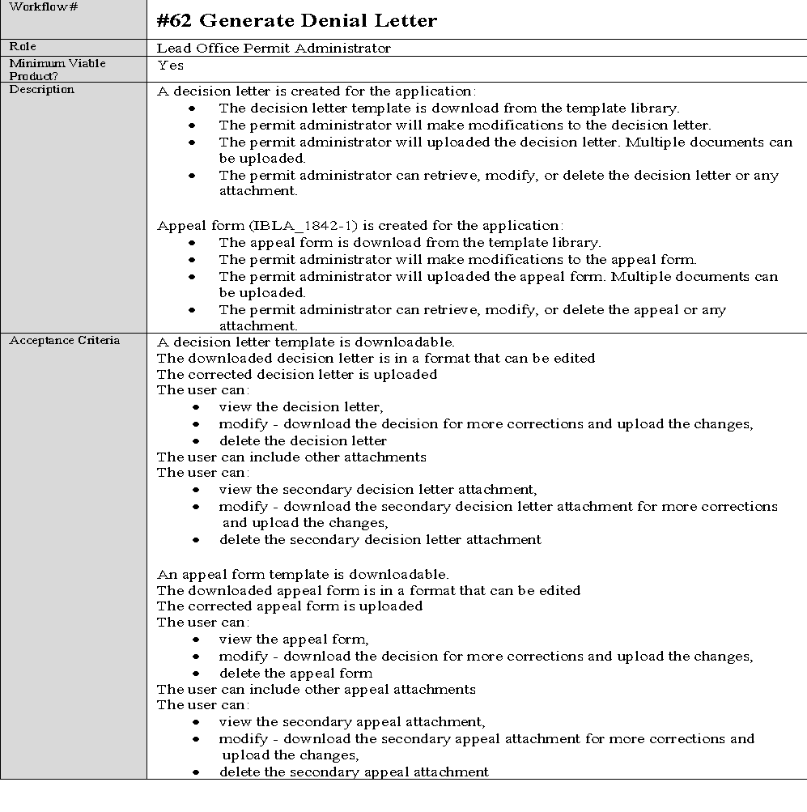

Slide 9
Key components
Implements SRP streamlining (SO 3356/3366)
Geospatially enabled
Forces pre-consultation meetings
User Friendly (internal & external)
Status Table: know where you are & what’s next
Customizable system generated emails
E-signature
National database (reports)
Templates: customizable but standardized

Slide 10
Minimum Viable Product -MVP
Learn about SRPs
How to apply (use the system)
Submit an application
Manage an application, communicate, issue or deny a permit.
Manage a permit throughout it’s life
Interface with Pay.gov & CBS
API with: RMIS and other systems

Slide 11
Where are we now?
Contract was cancelled
Two potential NOC contractors
May propose new solutions/software
Re-use of previous software/code
Incorporate USFS code/solution

