Slide 1
Recreation One Stop (R1S) BLM Recreation Managers
June 2018

Slide 2
Today’s Agenda
Background
Vision for Recreation.gov
Overview of Platform
Demonstration
Q&A

Slide 3
A brief history of Recreation.gov
1995 NRRS
2003 E-Gov Initiative
2007 Recreation.gov launched
2016 10-Year Contract Expired
2017 New Contract Awarded
Notes:
Site started as campsite reservations but has grown into much more. Growing pains over the last decade have helped clarify how to improve the underlying system and how users interact with it. Ready for a new platform that can accommodate evolving requirements and new programs. Contract reflects those goals.

Slide 4
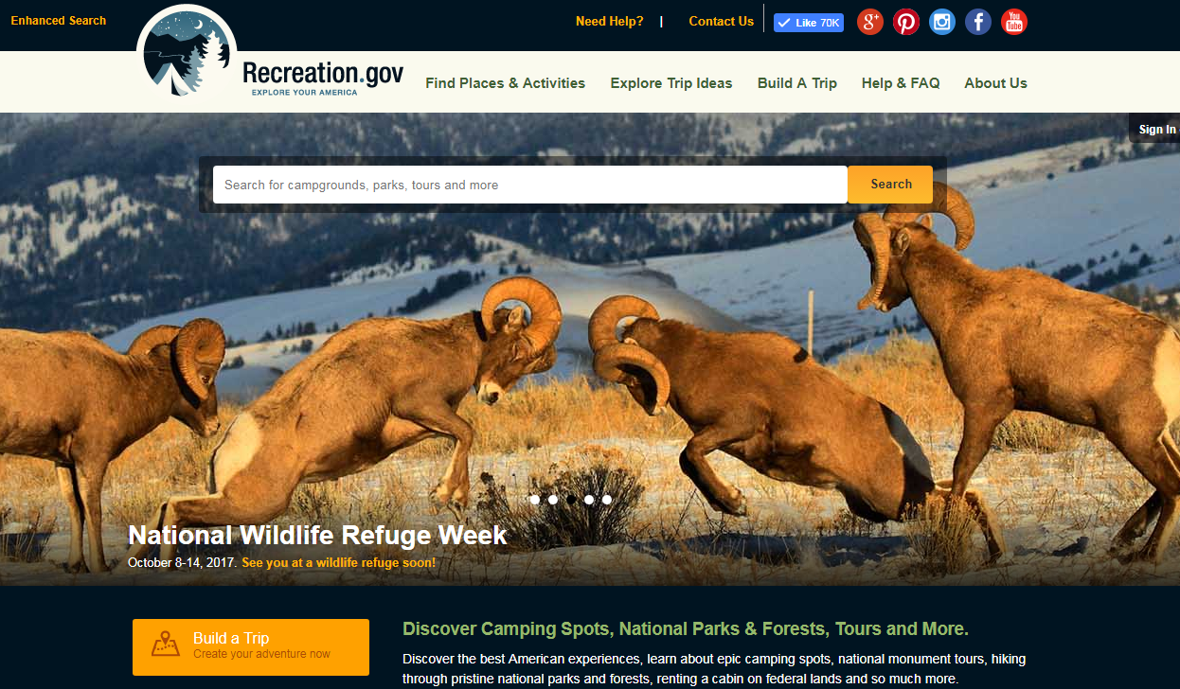
Recreation.gov today
Trip planning and reservation service for all federal land & waters
37 million sessions in 2017
4.8 million transactions
344 million page views in 2017%
> 3,400 sites and activities
19 million users in 2017
10 million accounts
> 90,000 individual reservable sites
12 partner agencies
Notes:
With 19 million users and 4.5 million transactions in 2017, the site functions as the first interaction many of our visitors will have with their public lands and waters.

Slide 5
Our Purpose
Notes:
Shouldn’t just be a transactional software package. Should reflect the mission of our agencies.

Slide 6
Our Promise
Notes:
This brand promise reflects what we expect the site to do. We are transforming the digital experience at every level. We know more than half of our users will be accessing Recreation.gov on mobile, so they will be able to access via the mobile responsive website or the dedicated mobile app. We’ve transformed the site into an intuitive, simple, reliable, and personalized experience. We’ve built in new tools and functions to allow last minute reservations, promote underused locations, and utilize digital passes.

Slide 7
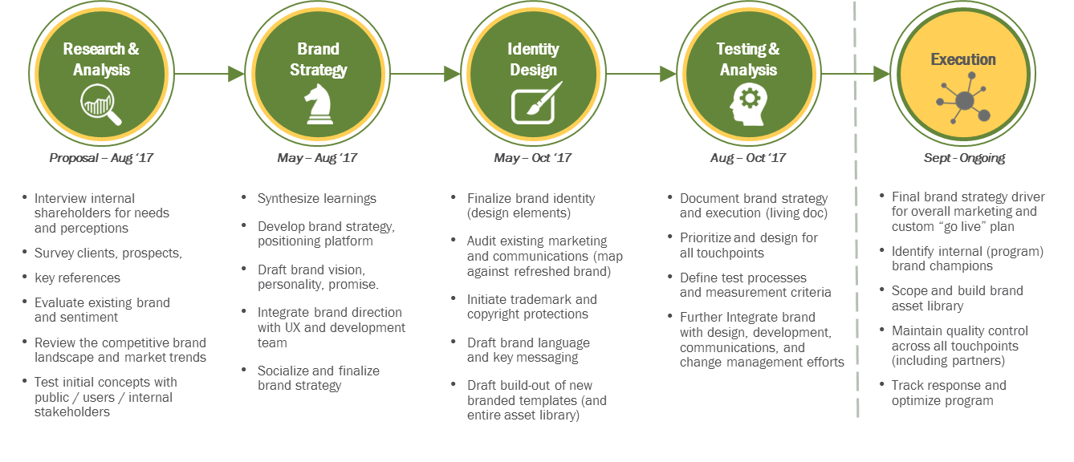
Our Branding Process
Notes:
Wanted a brand that made connection between citizens and public lands. And to keep coming back.
We followed a process similar to the development which included research, design, and testing. Applied Industry and marketing best practices.

Slide 8
Final Four
Notes:
Worked with government partners, RMC committee. Research, thought, logo. Narrowed down to four. Extensive field testing. Monuments, grocery stores, NP, few hundred people to give feedback. Unveiling when we go live.

Slide 9
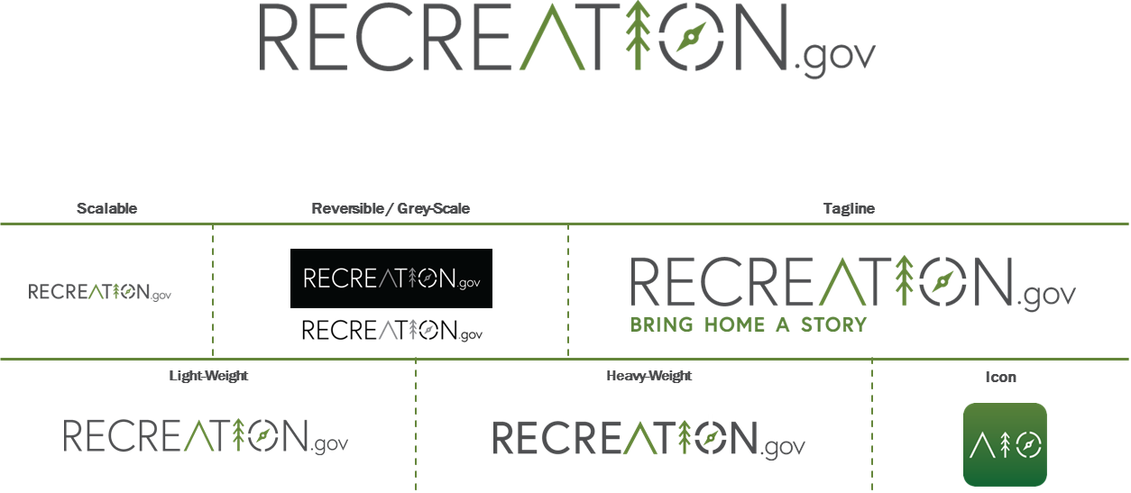
Final Logo

Slide 10
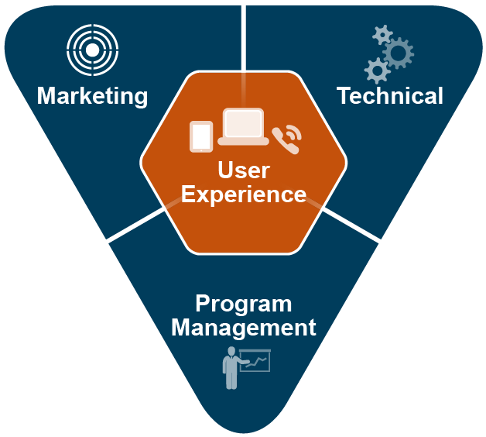
Integrated Solution
Web, Mobile, Call Center
Inventory and Business Rules
Third Party Integration
1
2
Strategy
Brand
Communications
Content
3
Architecture
Agile (Development)
Help Desk
Telecommunications
4
PMO
Analytics/Enterprise Reporting
Financial Management
Getting to Go-Live
Notes:
The re-imagined and modern platform is the product of a multi-year effort founded on extensive user research and feedback from our visitors and field staff. How are we doing it? Our integrated solution differs from traditional practices because each piece builds on its counterparts. The holistic approach means we don’t under-resource critical areas like change management. We know IT projects most often fail due to a lack of change management, so we’ve had it in mind from the beginning. The whole is greater than the sum of its parts.

Slide 11
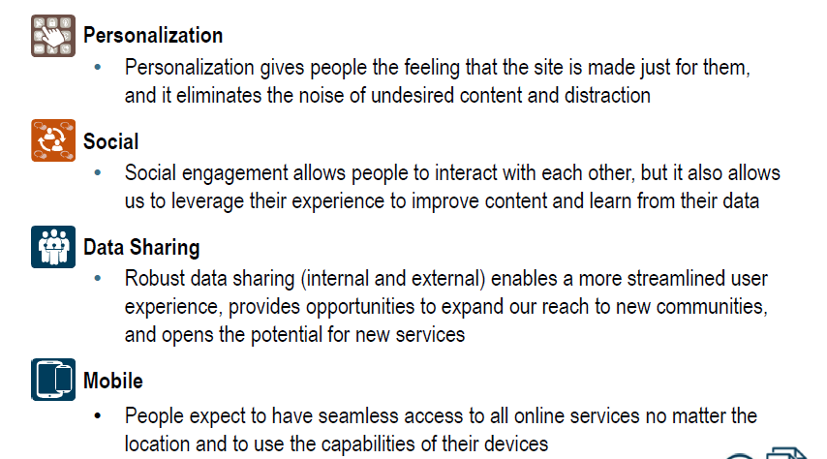
User experience is the priority
Notes:
From the beginning, this effort was driven by the needs and expectations of our users. Our users span many groups – the public, the government, businesses, and an existing group we call “power users” to name a few. We wanted to know how the needs differed from a family out for a picnic to a seasoned adventurer getting a river rafting permit to field staff at the Forest Service processing reports for the day. We listened to all these users to hear what was right, wrong, and critical for the next iteration of Recreation.gov. That’s our foundation, and we developed our requirements and scope with the end-users in mind. Our user research underscored by four components which we’ve woven into the design and architecture.

Slide 12
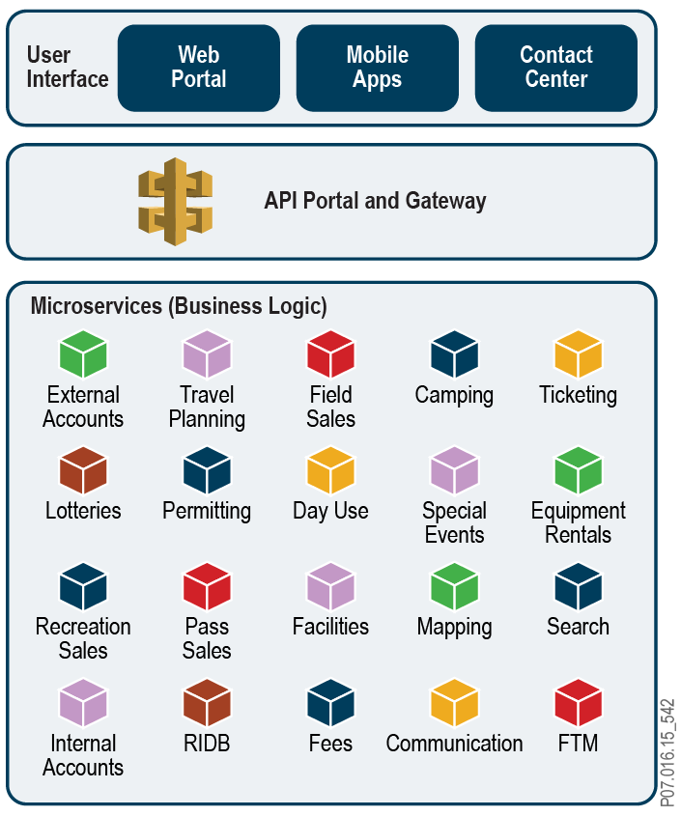
Architecture - Microservices and APIs
Features
Single underlying solution provides the foundation for all reservation services
Modular solution supports product evolution through changes to microservices
APIs provide connectivity between applications, allowing for natural information sharing across microservices
Benefits
User can access R1S services anywhere, anytime, with any device
User has a consistent experience across web, mobile, and call center
System enhancements can be made quickly with no impact on users
Notes:
We’re building the platform incrementally on a microservice and API architecture. The independent nature of microservices means we can make system enhancements quickly and with no impact to the other microservices. It also means the users have a seamless experience no matter what devices they are using. In addition, our architecture prepares us for the future. Five years ago there was no Apple watch. We don’t know what visitors will be using in five years, so we’ve built the site to prepare for advancing technology.

Slide 13
Data Sharing
Our architecture and microservice design allow for greater data availability:
Ad hoc and On-demand daily reporting for feds/field staff/internal users
APIs for ongoing data feeds
Application and impacts to VUM, facility maintenance, capacity management, impacts to local economies, targeted marketing to new visitor populations
ACCESS
USES
Federal & state agencies,
local associations, business partners, promotional partners, academics & others
DATA CONSUMERS
Notes:
One of the benefits of the architecture and microservice design is the ability to share data.

Slide 14
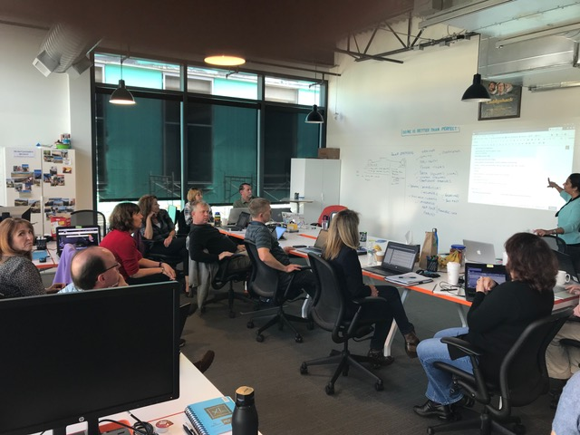
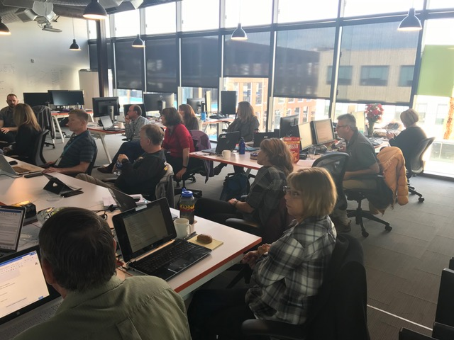
Agile in Action
Notes:
We’re able to pull off this rapid development schedule due to the agile approach and continuous communication between contractors and the government. It was the only way we could effectively respond to the regular feedback we requested -- and received. This model gave the team the ability to experiment, iterate, and develop solutions while testing and learning along the way. Government and Booz Allen staff share workspace, physically working side by side toward a shared vision and facilitating consistent communication. Co-location ensures we are able to address problems quickly.

Slide 15
Demonstration

Slide 16
High-level Timeline
”Phase In” = 16 Months
Operate = 10 Years
6 Months
6 Months
3 Months
Base Period = 5 Years
Five 1-year Optional Award Terms
Start
MVP
Review
Go-Live
Build
Deploy
Operate & Enhance
Market
Manage
Jul 1
2017
Jan 1
2018
July 1
2018
Oct 1
2018
Oct 1
2023
Oct 1
2028
Notes:
Accomplishing on a very short timeframe. Able to do it because of true partnership with clients and commitment of Booz Allen resources. We have a true public-private partnership.

Slide 17
Need for Change Management
Successful adoption of the new Recreation.gov requires users who are ready, willing, and able to use the new site.
Beyond the technology, the Recreation.gov team must prepare both internal and external users for the change. Otherwise we risk users adopting unapproved workarounds, resisting, and damaging our credibility.
IT projects most often fail due to a lack of change management.
Agile approach and constant user input significantly reduces this risk
Broader user engagement before Go Live is required
Field operations staff will need dedicated training to ensure a seamless transition
This document is confidential and intended solely for the client to whom it is addressed.
Notes:
Your support is critical to its effective implementation. It is essential that users see accurate and current information about locations to ensure proper planning and safe recreation. Trained and prepared staff are also a significant component.

Slide 18
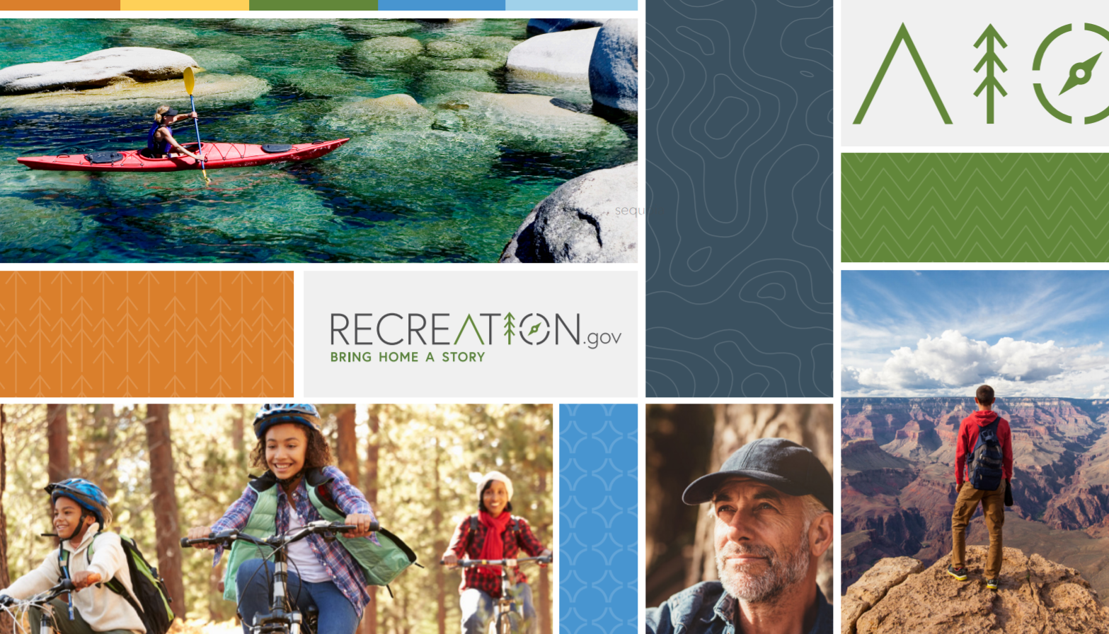
THANK YOU

