Slide 1
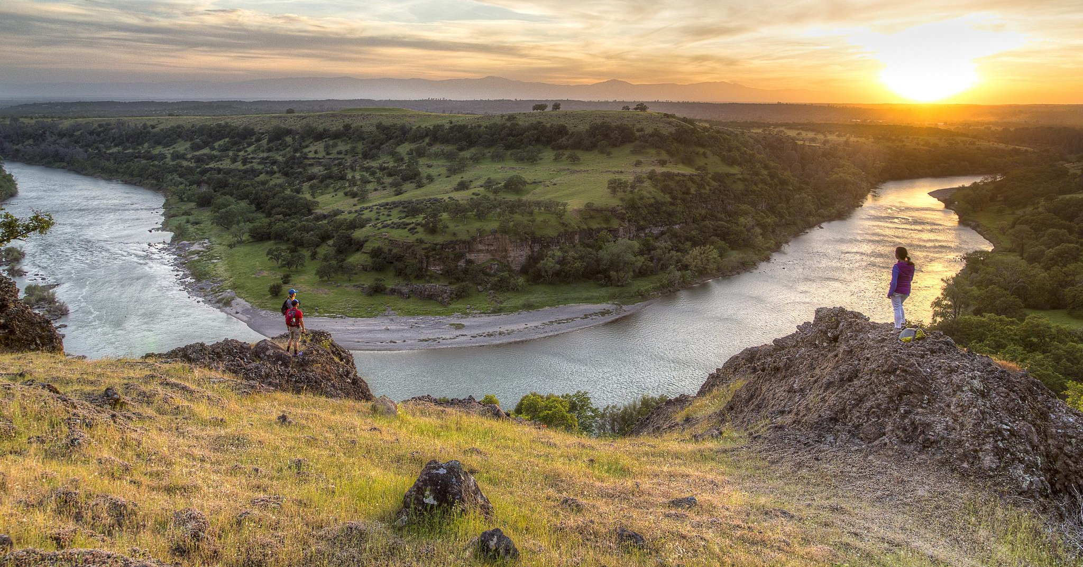
Hunting, Fishing, Shooting, and SO 3356
Jeff McCusker
Supporting Text

Slide 2
Hunting, Fishing and Shooting Access: SOs 3347 and SO 3356
Outdoor Recreation: SOs 3365 and 3366

Slide 3
Presentation Goals
Able to explain background: SOs 3347, 3356, 3365, 3366
Able to explain key parts of our response strategy
Able to describe main BLM responses, responsibilities for field

Slide 4
Background
Hunters and Anglers are longtime conservationists to protect wildlife resources
Active in politics and policy making
Funding to state agencies through taxes on firearms, equipment and ammunition, boat fuel, license fees

Slide 5
SO 3356
Secretarial Order 3347
Focused on reporting
on EO 13443 (2007)
Notes:
Secretarial Order 3347 focused on reporting accomplishments related to implementing EO 13443 on Conservation Stwardship

Slide 6
3347 response
30 days to complete response lead was recreation, working closely with wildlife
60 page report
Over 242 projects, events, activities listed either in process or planned in support of order

Slide 7
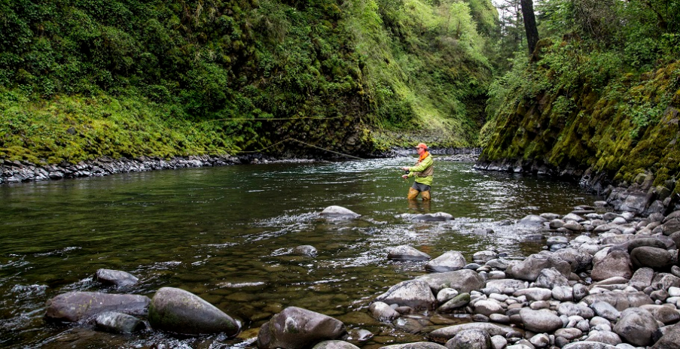
SO 3356
Secretarial Order 3356
26 Directives Covering Access, Habitat, 3Rs, Planning and Analysis, Cooperation with States and Tribes
Notes:
Secretarial Order 3356: Enhance enhancing conservation stewardship, increase outdoor recreation for all Americans, and improve the management of game species and their habitat “for this generation and beyond.” This order stems from the ideology of President Theodore Roosevelt, via executive order 13443 which embodies “The Facilitation of Hunting Heritage and Wildlife Conservation.” Roosevelt’s legacy as an outdoorsman is echoed through SO 3356, in that hunting and fishing are still to be carefully considered on public lands.

Slide 8
3356 responses
4 reports:
30 day-SRP streamlining
60 day: access-legal and programmatic
120 day: detailed implementation plan for SO 3347, collaboration with states and tribes
180 day: analysis, consistency of planning with SO

Slide 9
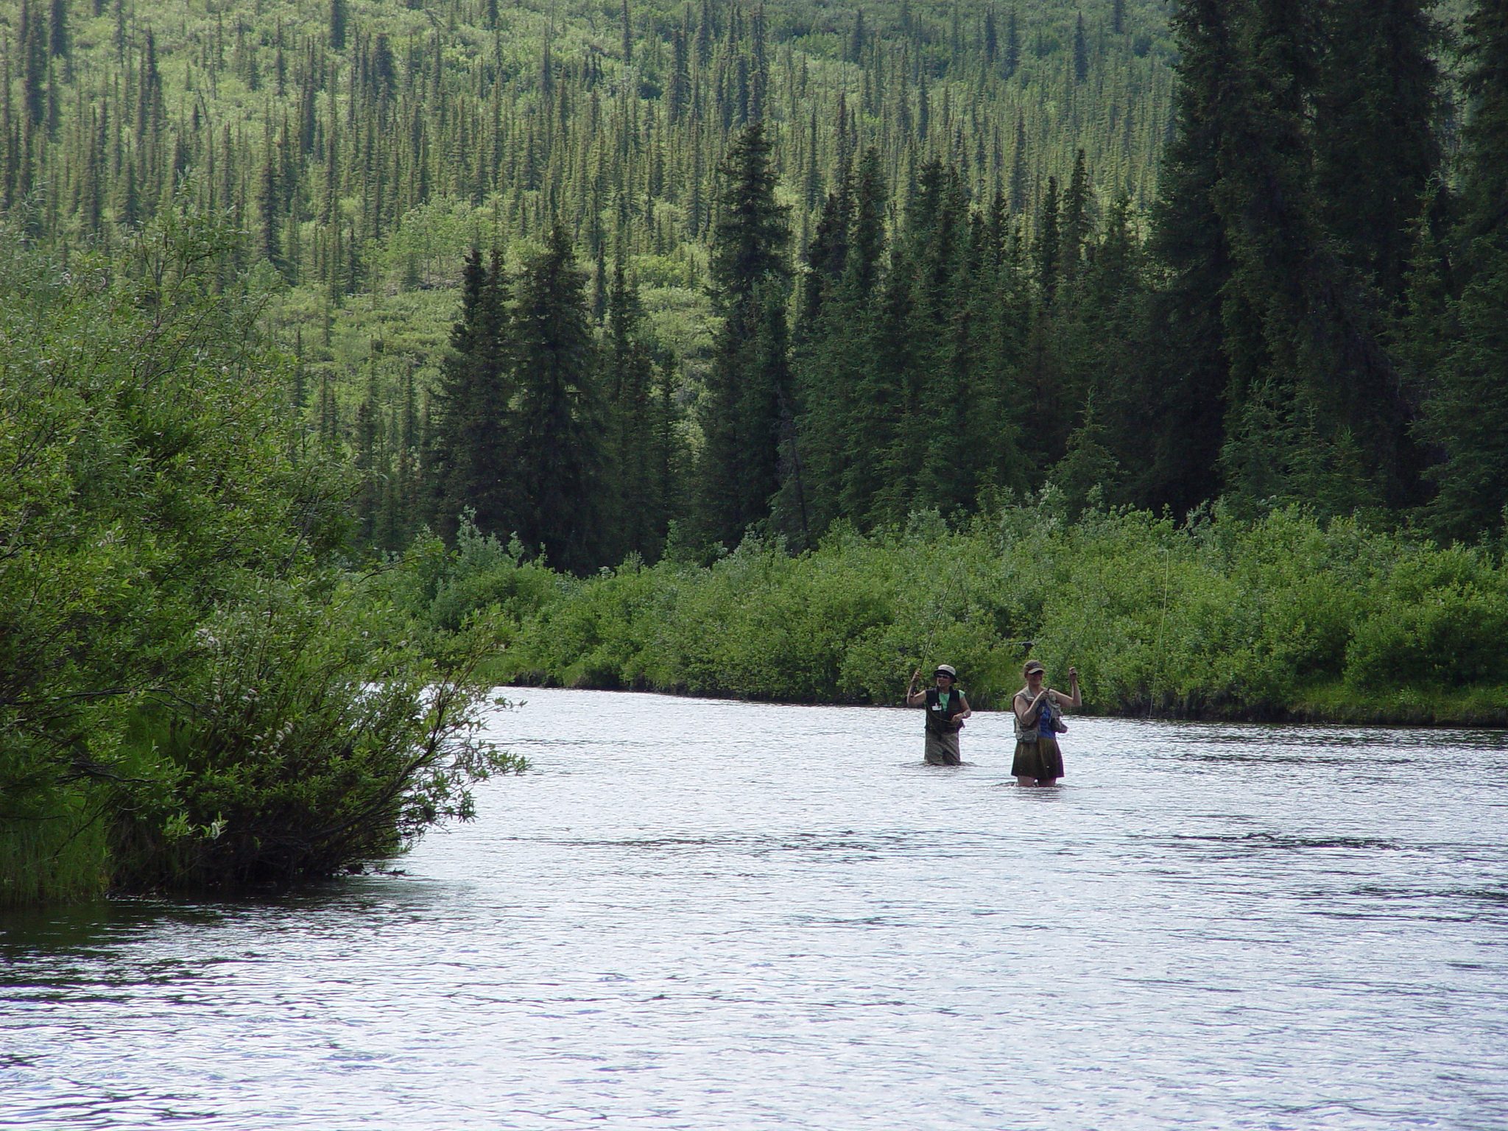
SO 3356
Secretarial Order 3356
Reports resulted in 90 milestones
Notes:
However, this process will not be successful as a top down directive only. This directive needs to be driven by the local level of BLM in order to be successful. For our organization to succeed in the implementation of this order, we need to show how we are implementing these guidelines. We need to demonstrate that we do, on a consistent basis conduct outreach programs to increase hunting and fishing, that we are streamlining permitting, that we do attain access to lands through easements and acquisitions.

Slide 10
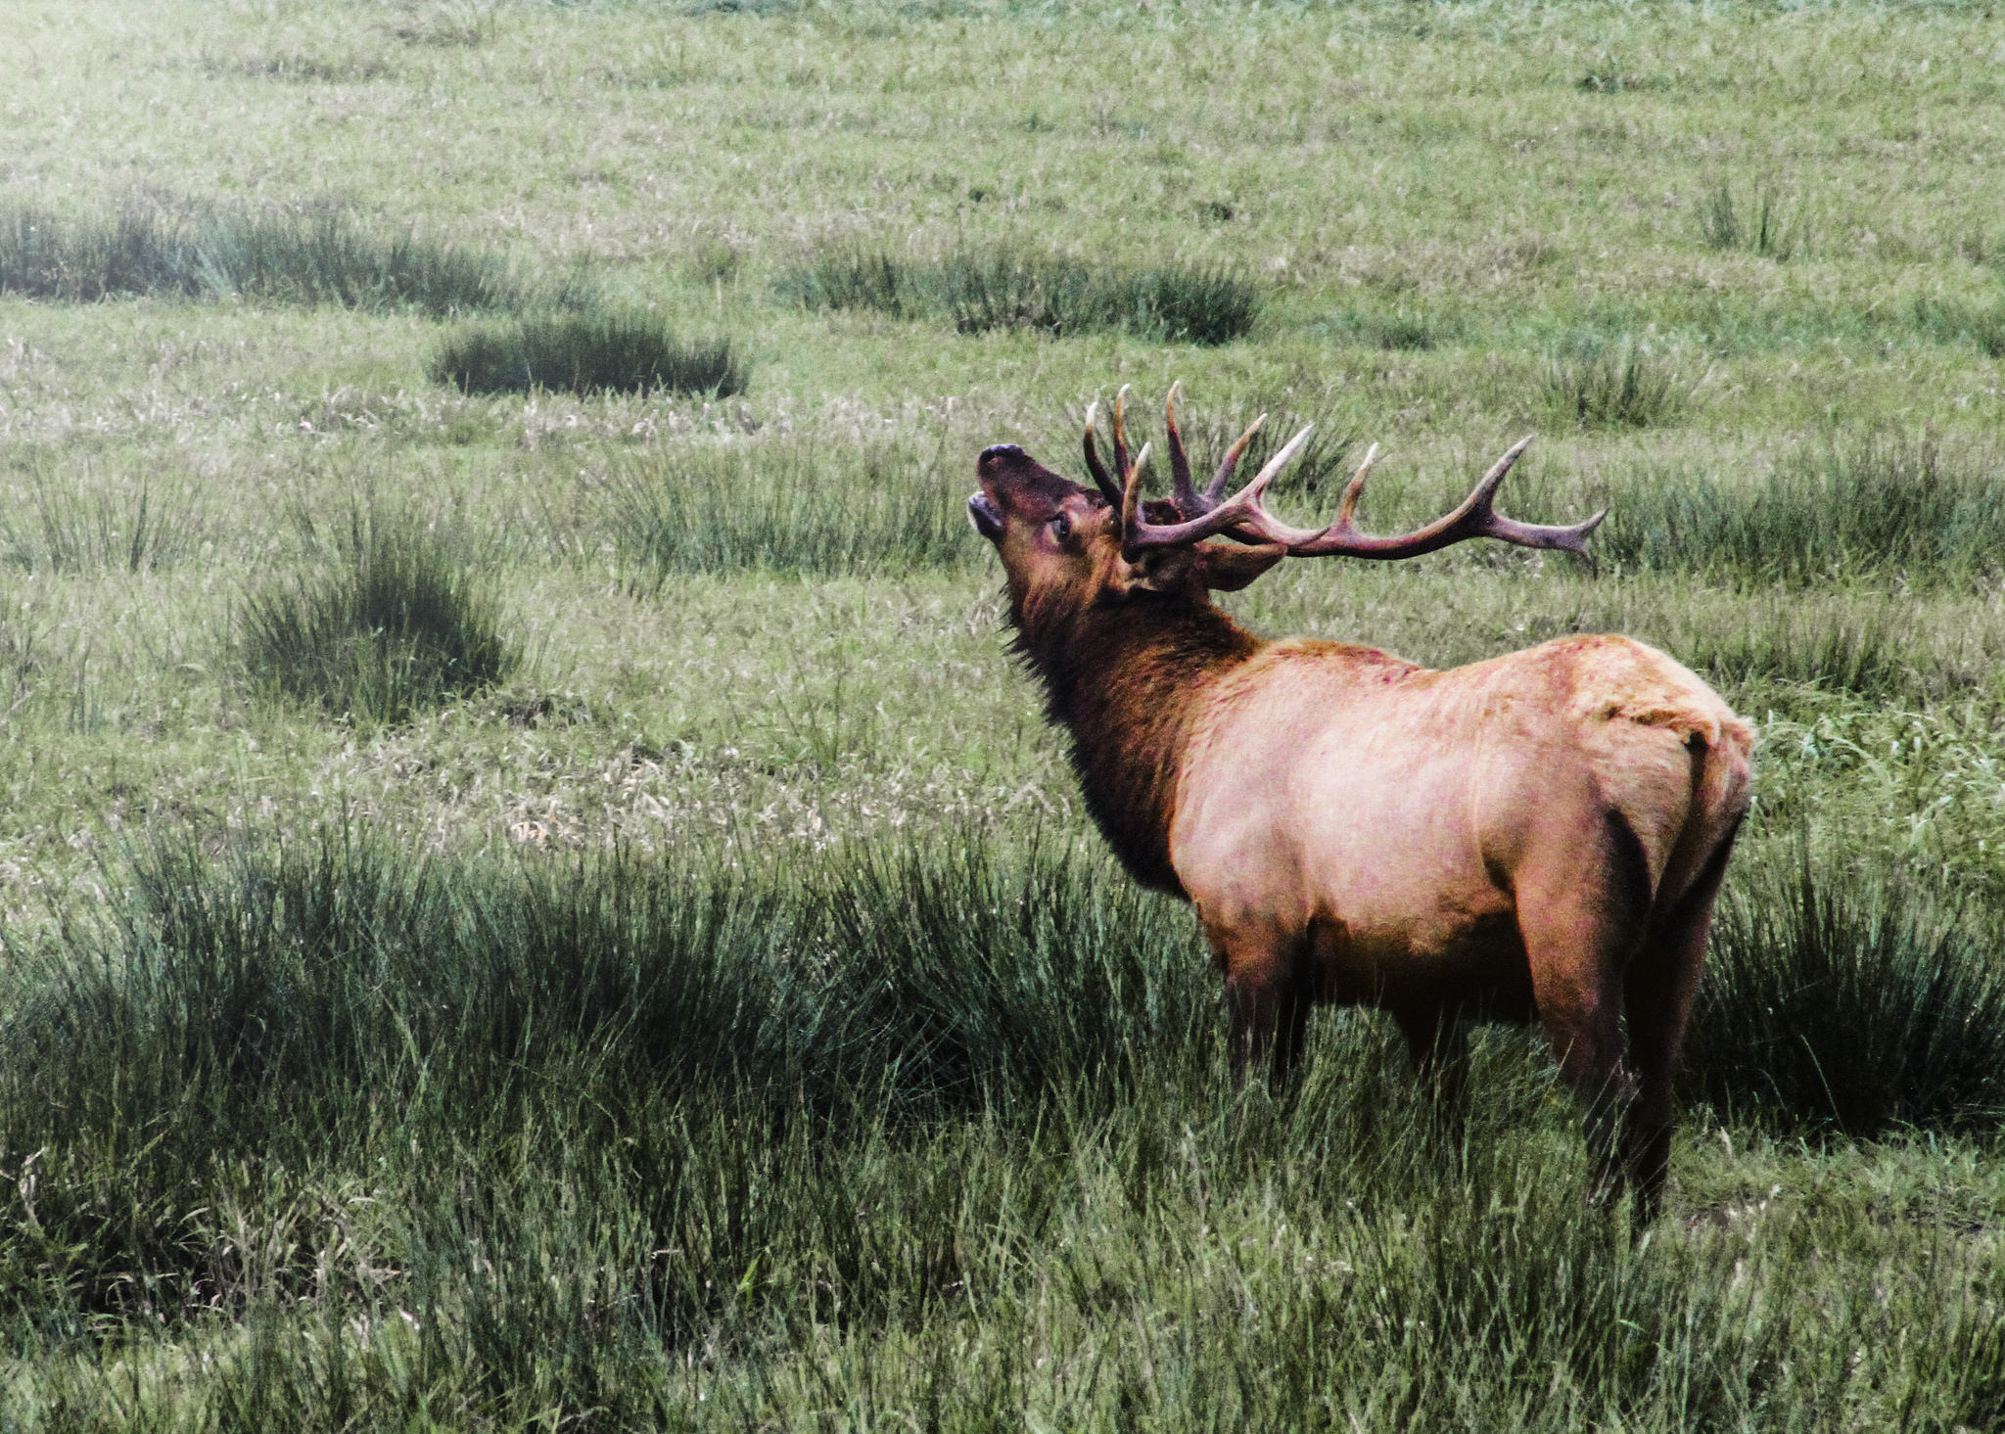
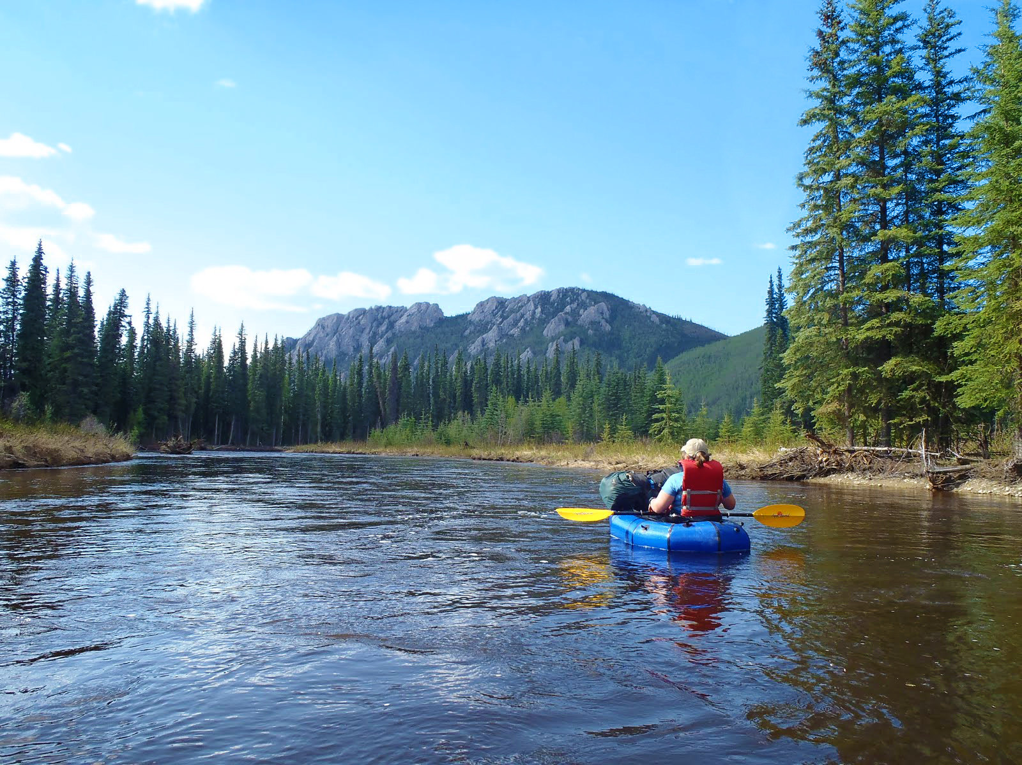
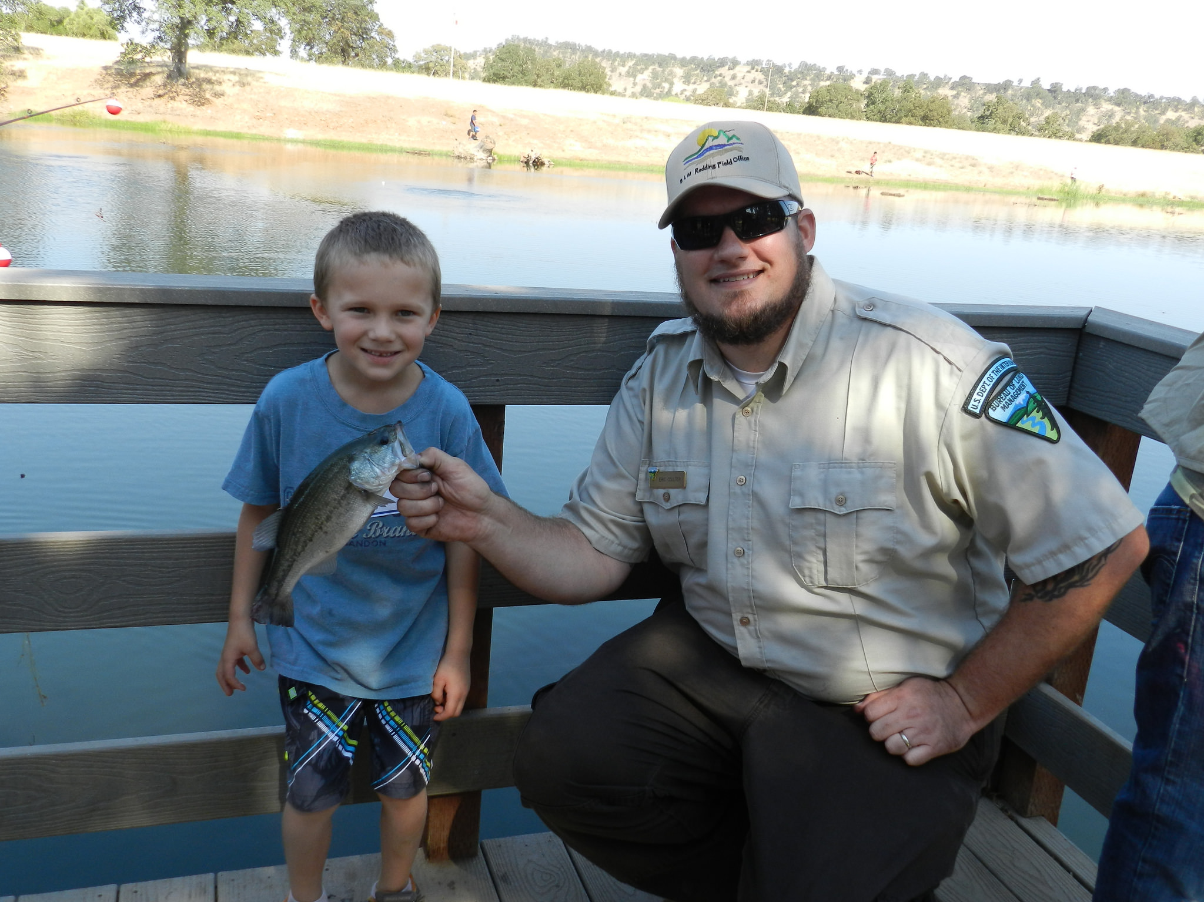
SO 3356
Secretarial Order 3356
Notes:
Coordinated by Recreation and Visitor Services (WO-250), a cross-directorate team has identified 90 milestones toward the BLM realizing SO 3347, and is working to design a similar track toward realizing SO 3356. So far, the BLM has produced 4 reports aimed at SO 3356: a 30 day report on streamlining the SRP process, a 60 day report which is based on the expansion of accessible lands and programs, a 120 day report with a detailed implementation plan, and a 180 day report to cover the regulatory review process. This is where the data you are collecting comes into play. In order to track our progress toward accessing lands and utilizing the space for programs, we need to know what has been done. We will talk about reporting slightly later on.

Slide 11
SO 3356
Projects that are spinning off of SO 3356
Reporting tool
Landlocked Parcel Project
CXs-Habitat Restoration, SRPs in Special Area clarification, travel management: Route redesignation, route marking and signage and
TRAIL CONSTRUCTION

Slide 12
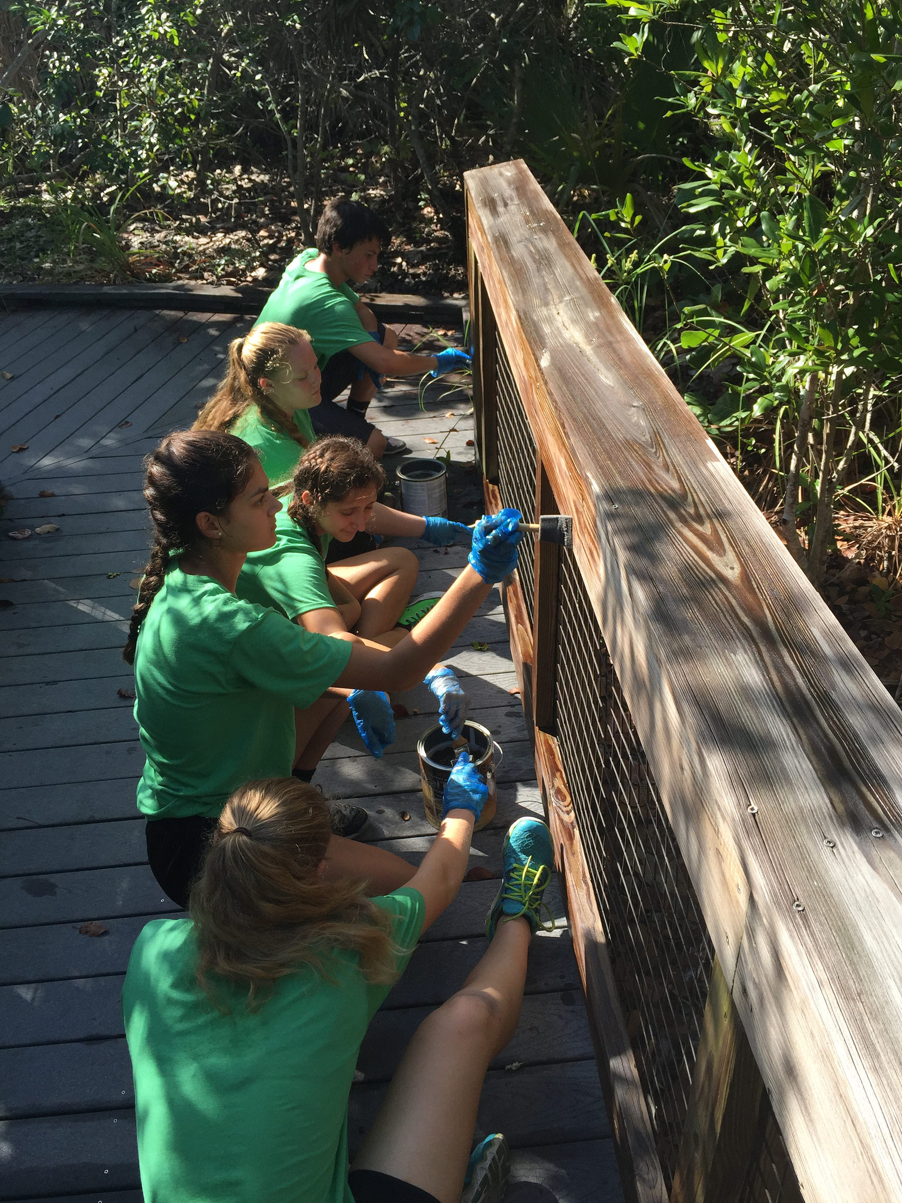
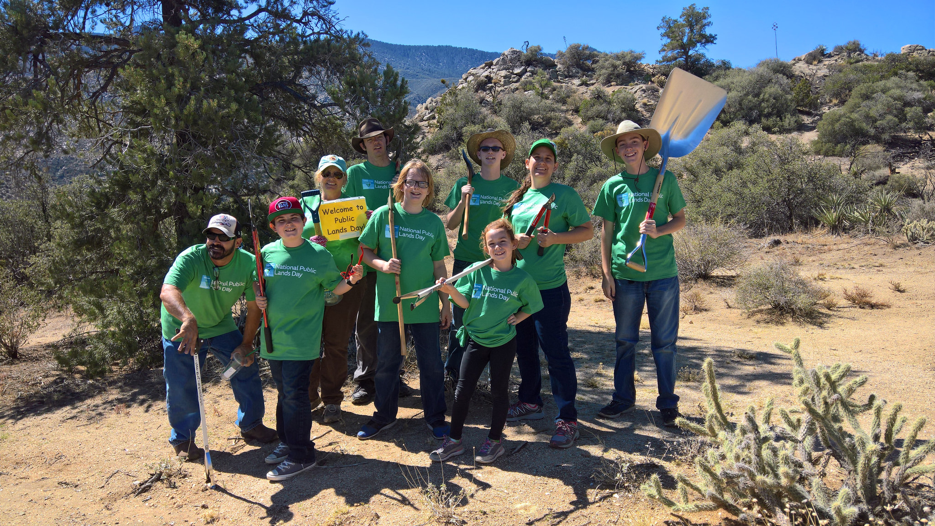
Data Reporting
Fiscal Year 2018 Data Reporting
IM No. 2018- gives directions on what we are to reporting, and who is to report it.
The deadline to report is November 30, 2018, but we’d like items to be entered as they happen for SO 3356

Slide 13
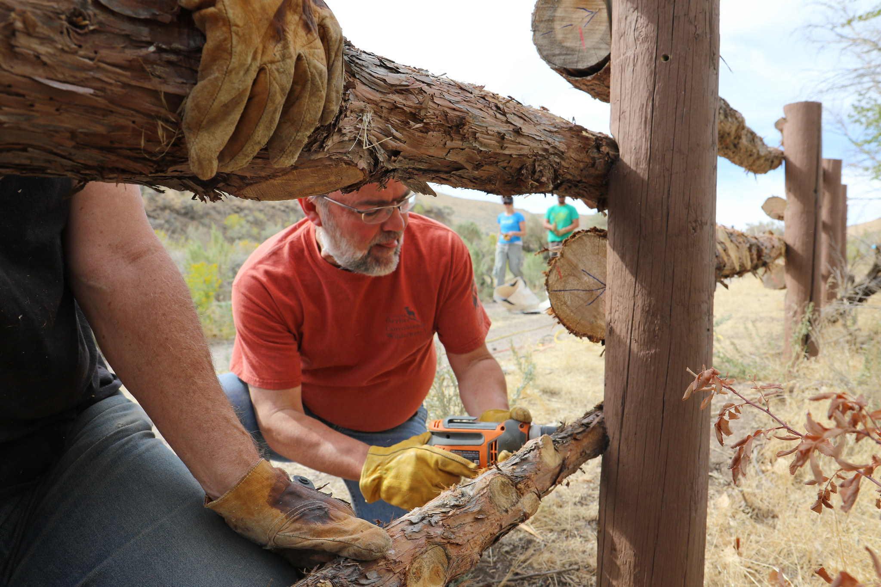
Data Reporting
Fiscal Year 2018 Data Reporting
Using the WO-420 Data Center reporting system to gather up Access and hunting, fishing, and recreational shooting projects, programs and events.
Also the traditional education and youth engagement activities across the BLM.

Slide 14
Data Reporting
Partner Supported Work and Training Opportunities
Traditional Reports:
Opportunities for individuals age 35 and under that are 80 hours or more in length for a given fiscal year.
Conservation corps or other partners, resource assistant internships, student volunteer internships,
A summary of what was done.
Notes:
Note: Partner-Supported Work and Training Opportunities will not be collected quarterly anymore.

Slide 15
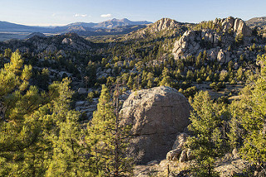
Data Reporting
Activities related to S.O. 3356 and 3366
Reports should include:
Projects to provide legal public access to Public Lands via land or easement acquisition.
Physical access to public lands through the opening or repairing of culverts and bridges.
Events and Programs that enhance hunting, fishing, or recreational shooting.
The recruitment, retention, and reactivation of hunters, anglers, and other forms of outdoor recreation.
Notes:
These reports are simplified down to a single form which will only take a few minutes to complete. The deadline for these forms is November 30, 2018.

Slide 16
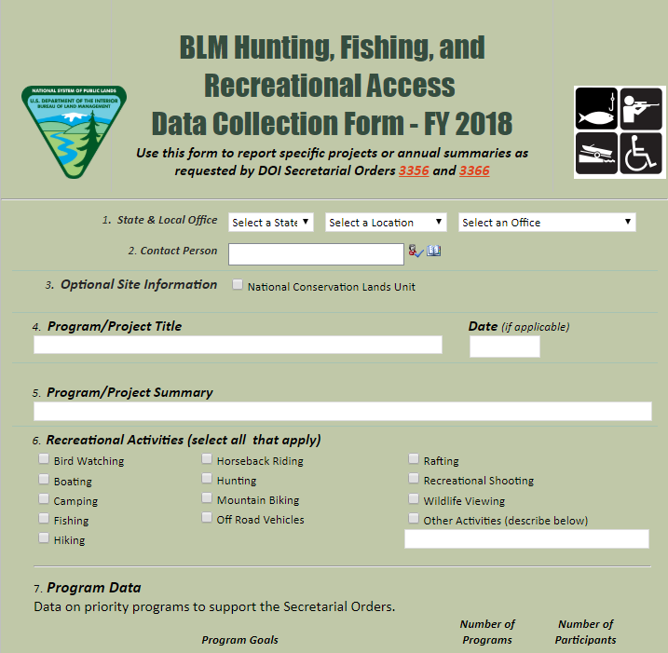
Data Reporting
SharePoint Form

Slide 17
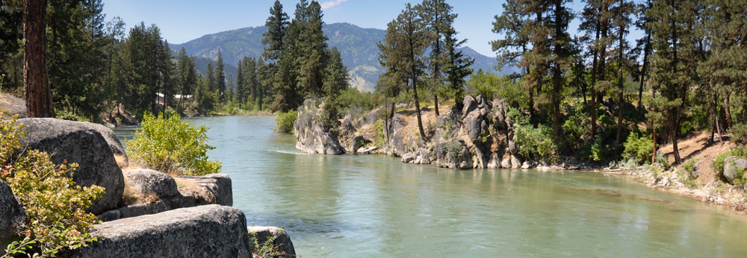
Data Reporting
Data Collection and Form Submission
The form consists of 6 sections and approximately 25 items, which do not all have to be filled out in order to complete.
Notes:
*Note: Please do not send this form by email or fax.

Slide 18
Data Reporting
SharePoint
We are using the WO-420 Data Center reporting program to complete this form. Request Kevin Flynn in WO-420 to get permissions
To complete this form, open it in either Internet Explorer or Chrome.
Once Submitted, the system will automatically store the data.
Notes:
*Note: Please do not send this form by email or fax.

Slide 19
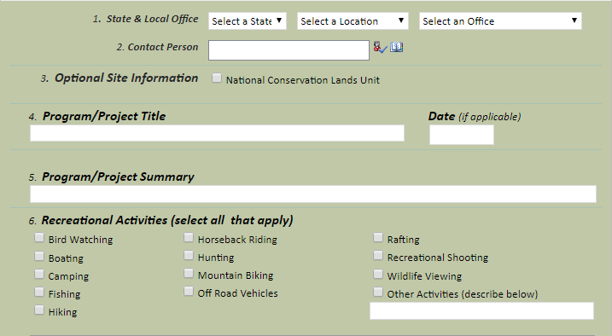
Data Reporting
Section 1
Notes:
Pretty straight forward, simple questions about the project. Each piece of information in this section is fairly important, so make sure it is filled out correctly. Very Important: To fill in the contact person, do not type in their name. Instead, search for them in the directory and select the name from there (directory is located directly to the right of the box). You can also type their BLM email into the box and search that way.

Slide 20
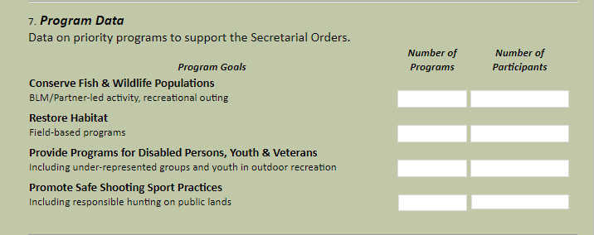
Data Reporting
Section 2
Supporting Text
Notes:
This section tracks the number of events carried out while working toward each of our program goals; conserving fish and wildlife populations, restoring habitat, providing programs for disabled persons, youth, and veterans, as well as promoting safe shooting sport practices. Again this is fairly straight forward, just be sure to log the number of total participants at the event as well as the number of times these events were carried out.

Slide 21
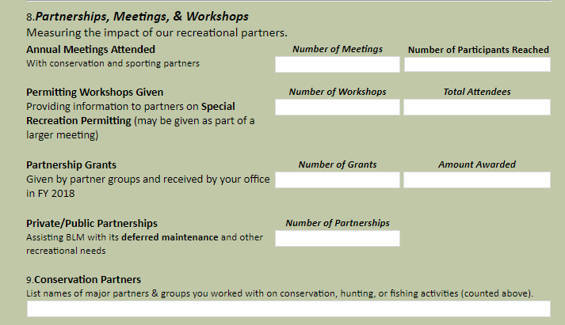
Data Reporting
Section 3
Supporting Text
Notes:
This section focuses upon the general statistics of the events. The top row tracks totals for both the number of events held and the number of participants reached. The next few lines are fairly specific, tracking partnership information specifically.

Slide 22
Data Reporting
Section 4
Supporting Text
Notes:
Section 4 tracks progress towards easing the access to public lands.

Slide 23
Data Reporting
Section 5
Supporting Text
Notes:
Section 5 tracks specific stories that come from these experiences– whether they come from within the BLM or from the outside.

Slide 24
Data Reporting
Section 6
Supporting Text
Only press submit the first time you submit the form. If you are editing the form, PRESS SAVE, and all the added information will still be there. Resubmitting the form simply creates a duplicate form- rather than updating the original.
Notes:
Section 6 is a space to attach documents and submit the form. Once a form is submitted, it does not need to be resubmitted to make changes– as this would generate duplicates of the same form. Instead, after the form has been submitted once, save the changes and back out of the page. All the added information will still be there if the document is saved.

